Slide 1
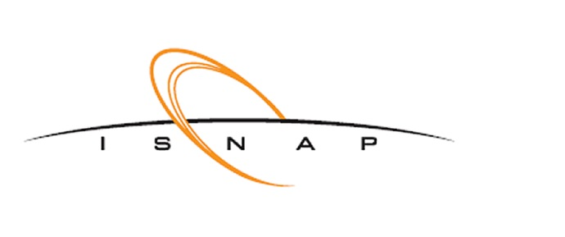

Low-lying
Vibrational Excitations in Nuclei?
Ani Aprahamian
University of Notre Dame
ZAKOPANE
CONFERENCE
on Nuclear Physics
Extremes of the Nuclear Landscape
2026
Notes:
Hello…it is a pleasure to be here…for the first time every at the lake Zakopane nuclear physics conference!
my title is vibrational excitation in Nuclei….specifically the low-lying vibrational excitation in nuclei
There has been a lot of discussions in our field in the past two decades or so…about the possiblility that there are no low-lying vibrational excitations in nuclei
I hope to show you that it is not the case…they exist and I. hope to share with you how you can tell the difference…..

Slide 2
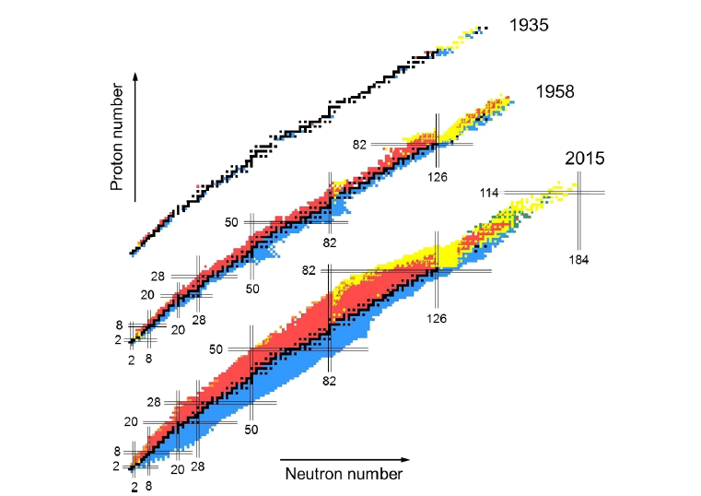
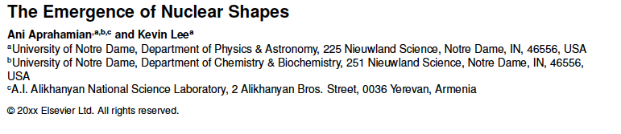
M. Thoennessen
Notes:
Dynamics of nuclei…in rotations and vibrations…

Slide 3
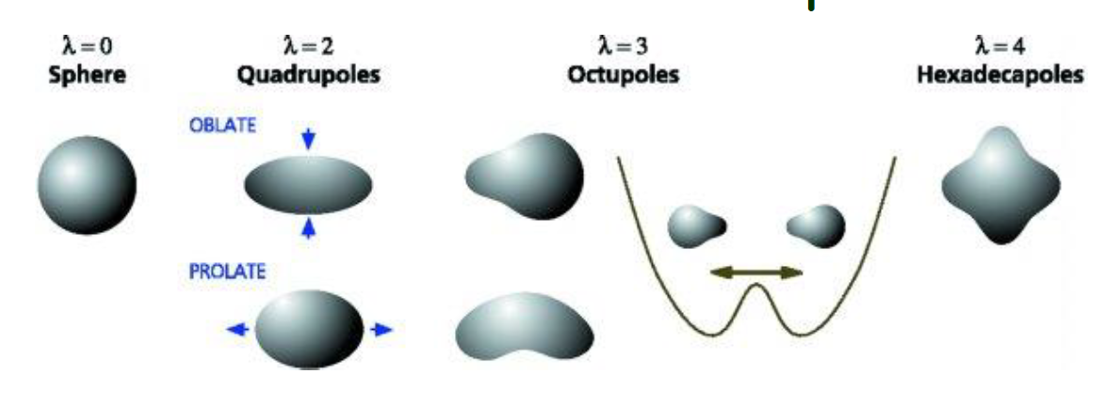
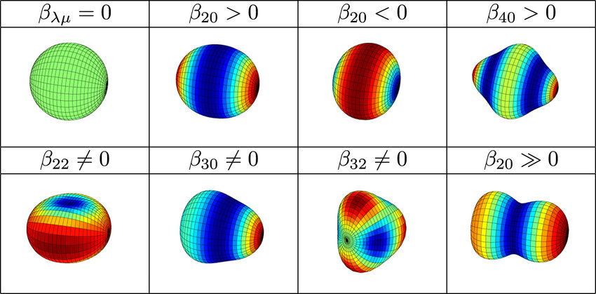
oblate
prolate
Quadrupole
Notes:
No solid shapes…n-p interactions that yield a pattern of low-lying excited states from which we extract the idea of a shape…

Slide 4
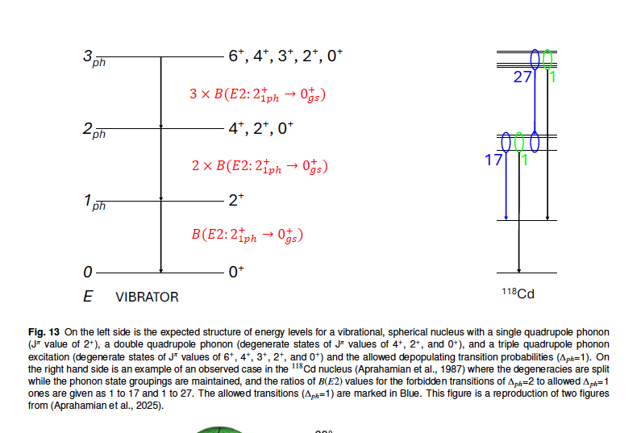

Slide 5
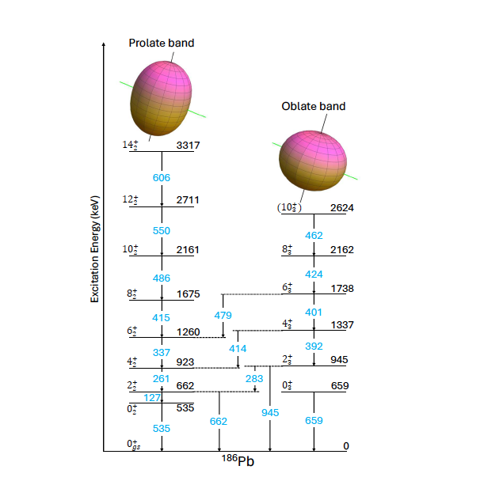
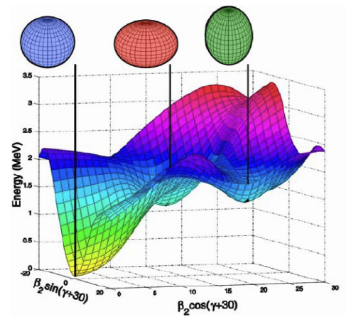
¹⁸⁶Pb

Slide 6
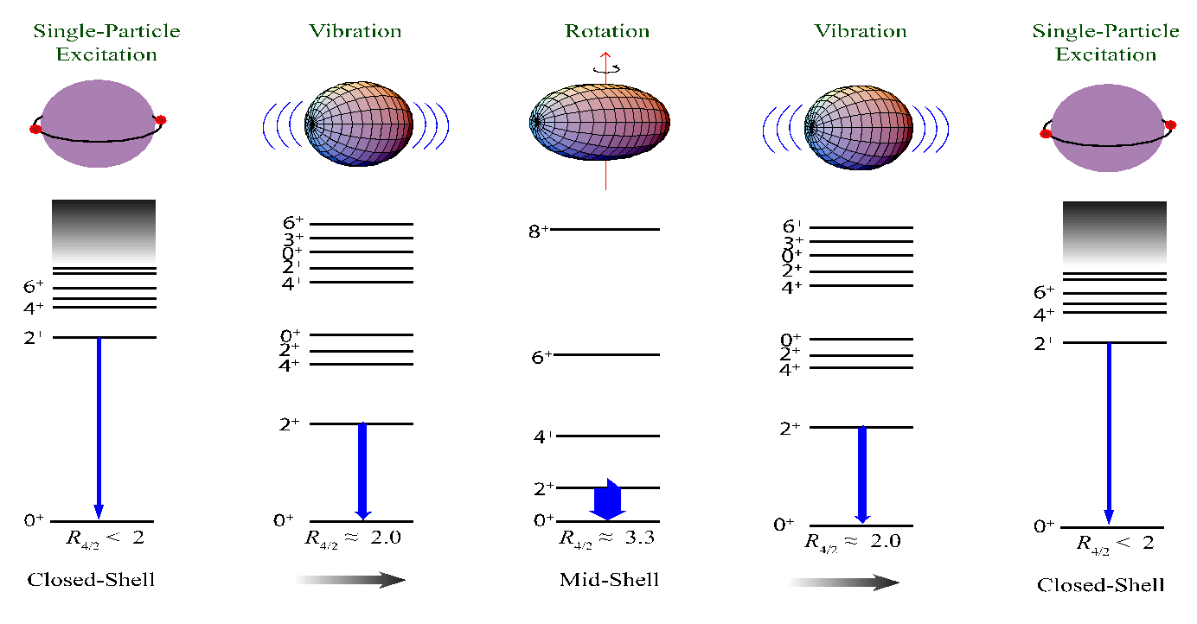
Evolution of Nuclear Structure
Transition rates - collectivity
¹⁴²Nd
¹⁴⁶Nd
¹⁵⁶Nd
1576 keV
E₄₊/E₂₊
454 keV
67.2 keV
1.33
2.30
3.31
3.2
< 2
Near closed shell
~ midshell
Notes:
Vibrational excitations took much longer than rotational ones to be accepted….

Slide 7
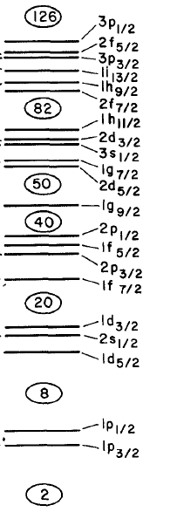
Shape Coexistence:
Near closed shells
and
subshells
O, Ca, Ni
Zr, Mo
Cd, Sn
Hg,Pb
28
28
Gaute Hagen: ab initio calculations
s-wave “contact” for the onset of deformation
Notes:
Gaute Hagen’s s-wave contact to cause deformation….

Slide 8
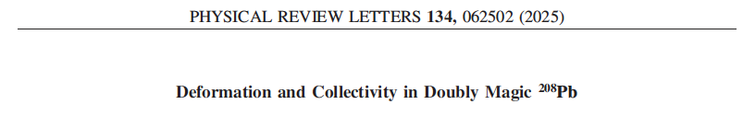
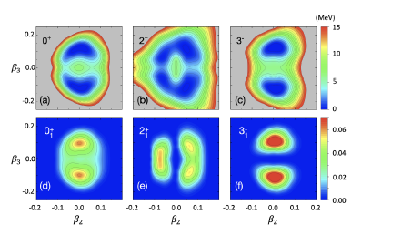
J. Henderson et al.

Slide 9
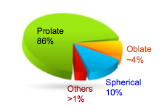
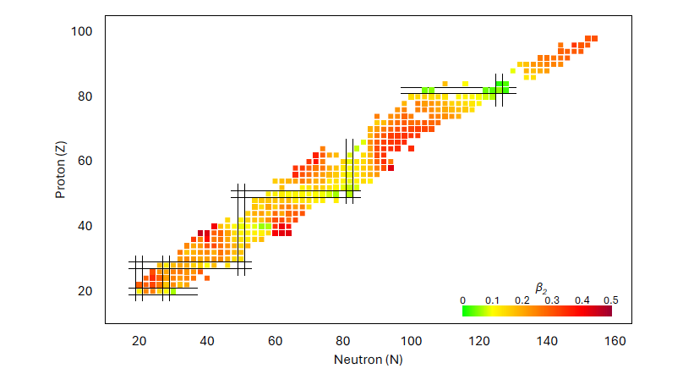
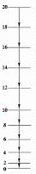
Vibrational Excitations built on a deformed ground state?
How can you differentiate between coexistence and β vibration?

Slide 10
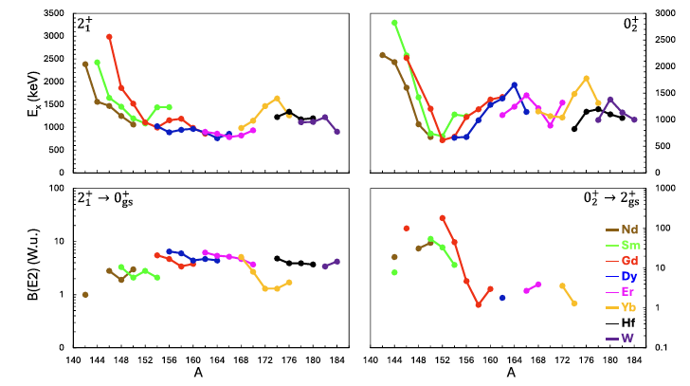
K=2⁺
K=0⁺

Slide 11
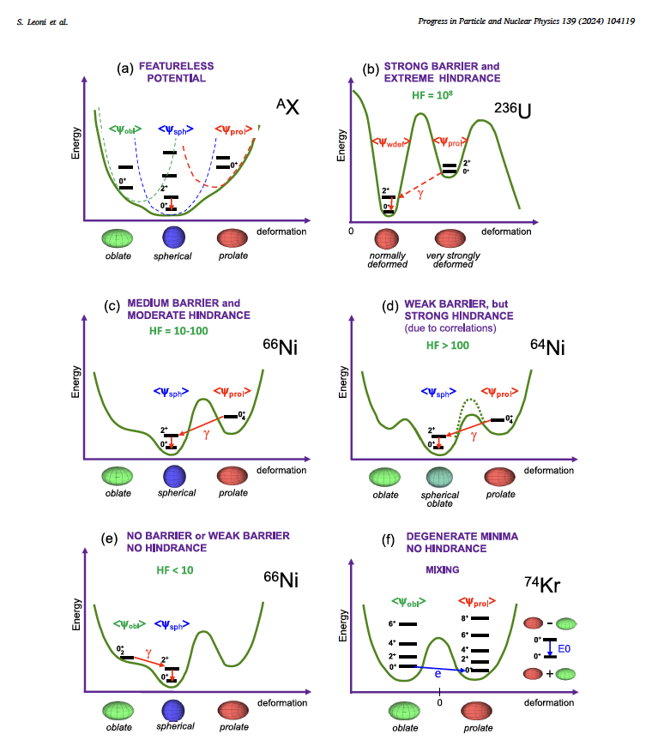
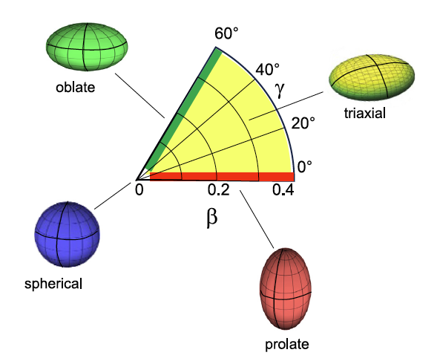
Oscillations on top of deformation?
S. Leoni et al. PPNP 139, 104119 (2024)
Multifaceted character of shape coexistence phenomena in atomic nuclei
P. Garrett, M. Zielinska, Emmanuel Clement, PPNP 124, 103931 (2022)
An experimental view on shape coexistence in nuclei
,
Notes:
Of course if nuclei do not have oscillations …would be an odd quantum mechanical system…

Slide 12
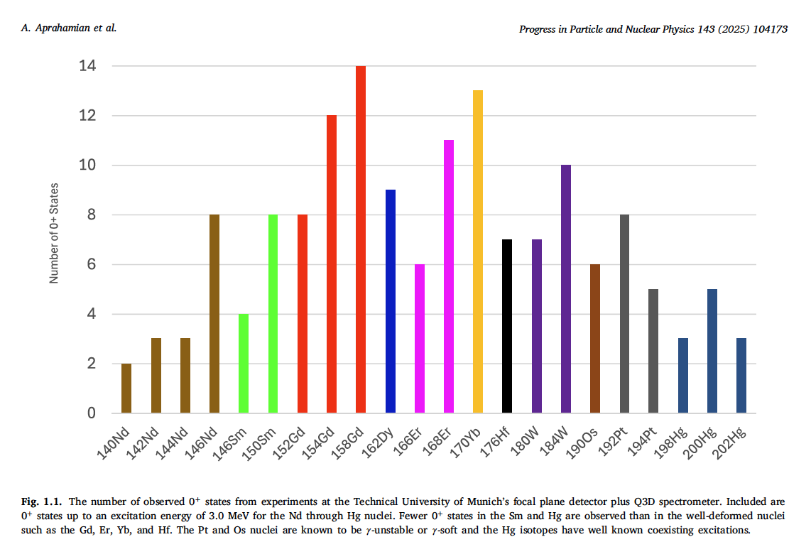
Observations of large numbers of 0⁺ states
Are any of them vibrational excitations built on a deformed ground state?
How can you differentiate between coexistence and β vibration?
Notes:
Typically difficult to observe experimentally….
What is the nature of these 0+ states?

Slide 13
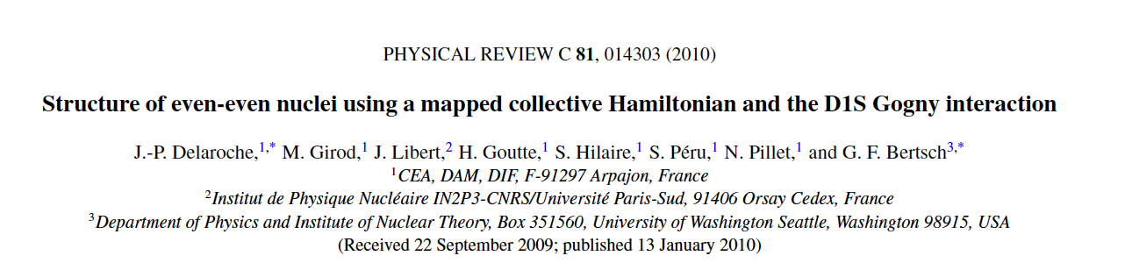
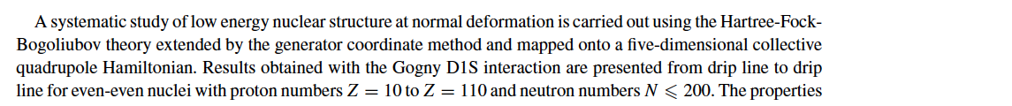
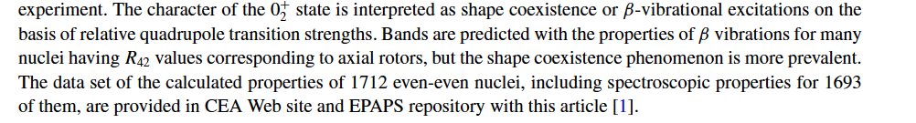
Quad transition strengths
Same deformation
Notes:
What does the nuclear landscape tell us?
Global calculations using HFB theory extended by the generator coordinate method and mapped onto a five-dimensional collective quadrupole Hamiltonian
Same deformation as the ground state with a larger dispersion….

Slide 14
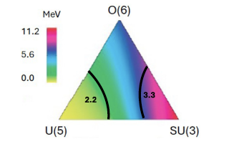
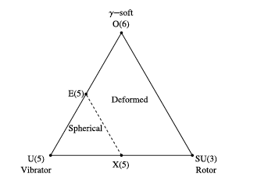
Nature of 0⁺ states in Deformed Nuclei
IBA
IBA with partial dynamical symmetries
Proxy-SU(3)…coexistence for nuclei with R_{4/2} <3.05
Pseudo-SU(3) Shell model
Monte Carlo Shell Model
Quantum Phase Transitions
E5
X5
What is the nature of the 0⁺ states?
What is a β vibration?
How can you differentiate between coexistence (min of deformed shape) and β vibration?
Notes:
Theoretical framework is broad and spans from the shell model and extensions to the onset of collectivity with microscopic/macroscopic foundations of geometric and algebrai models…

Slide 15
What can we expect to see? Deformed Ground State
Two phonon
K=4⁺_{γγ}
K=0⁺_{γγ}
K=0⁺_{ββ}
K=2⁺_{βγ}
One phonon
K=2⁺
K=0⁺
B(E2:4+_{γγ}→2+_{γ})
K=0⁺
= 2.78
B(E2:2+_{γ}→0+_{gs})
B(E2:0+_{γγ}→2+_{γ})
= 5.0
B(E2:2+_{γ}→0+_{gs})
Quadrupole oscillations
B(E2:2+_{ββ}→0+_{gs})
= 2.0
B(E2:2+_{β}→0+_{gs})

Slide 16
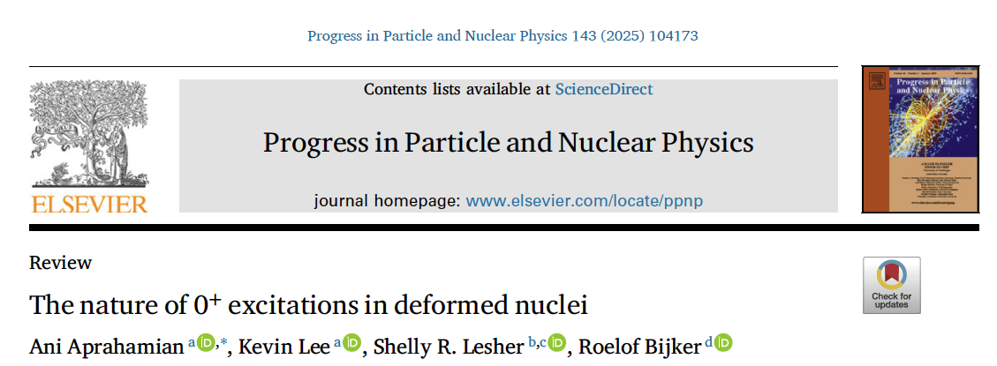
Transfer Reactions (Q3D at U of Munich + others over 6 decades) → Lifetime measurements: DSAM, GRID
Transition probabilities, Quadrupole moments
Dynamic moments of inertia
Mikhailov plots …mixing
Examples: ^{154,156,158}Gd, ¹⁶²Dy, ¹⁶⁸Er, ¹⁶⁸Yb ¹⁷⁸Hf, ^{182,184}W

Slide 17
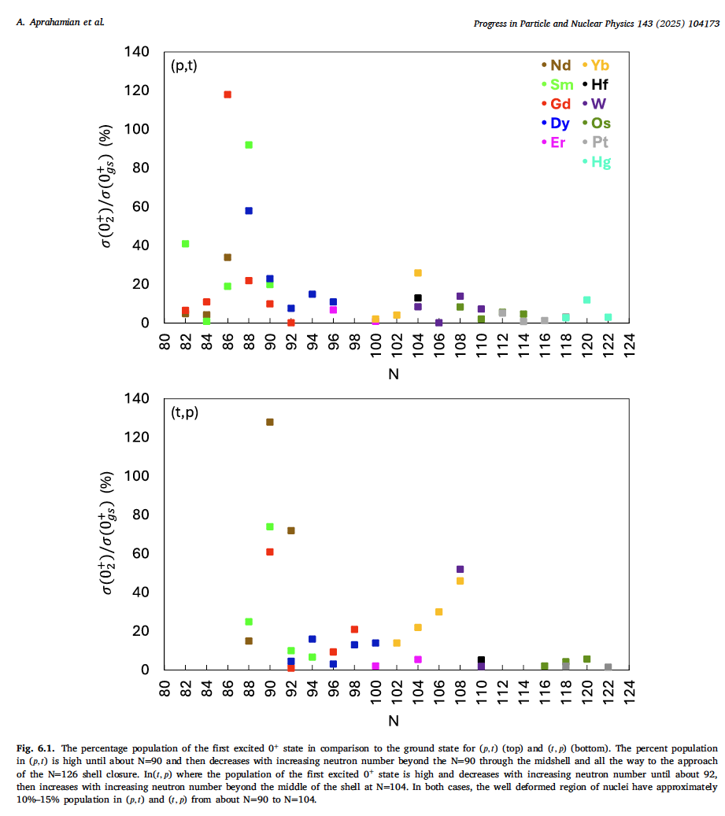
Transfer Reactions: (t,p) and (p,t)

Slide 18


Quadrupole Moments
Notes:
Fo

Slide 19
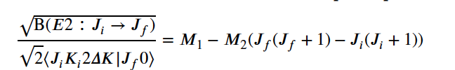
Mikhailov Plots
Notes:
Fo

Slide 20
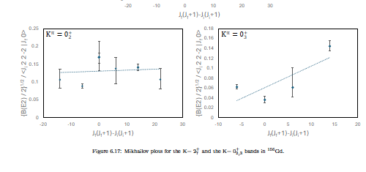

Slide 21
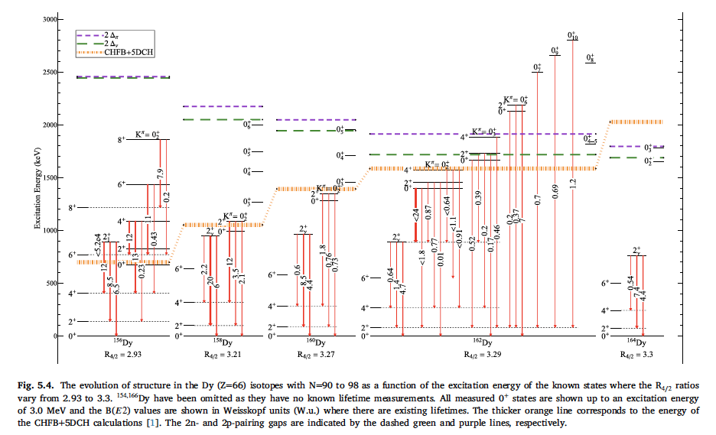
Example 1

Slide 22
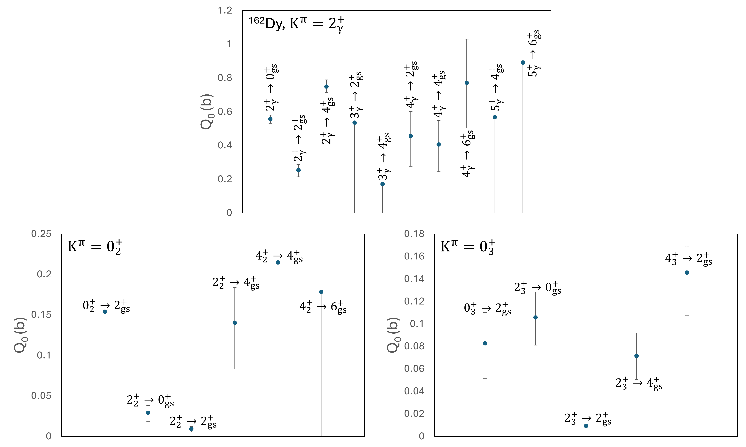
Quadrupole Moments

Slide 23
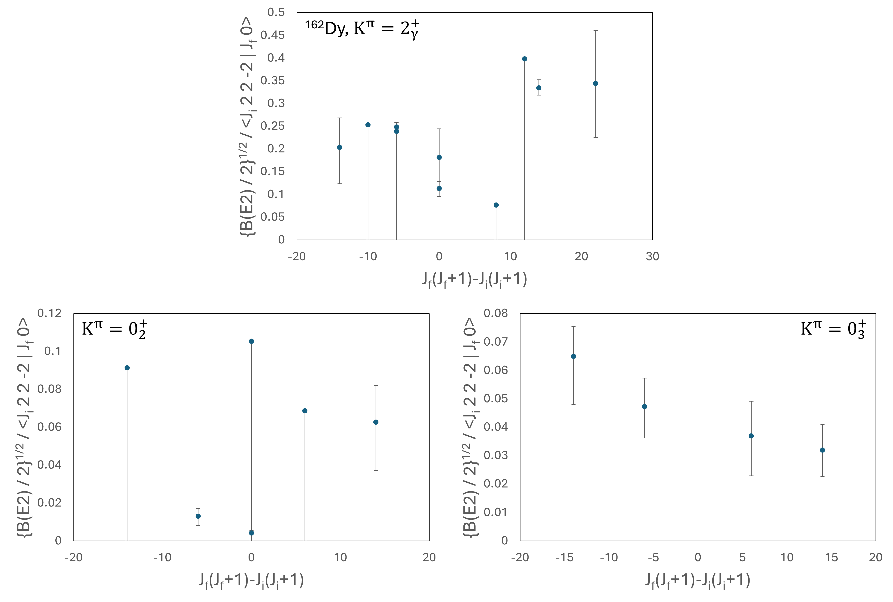
Mikailov Plots

Slide 24
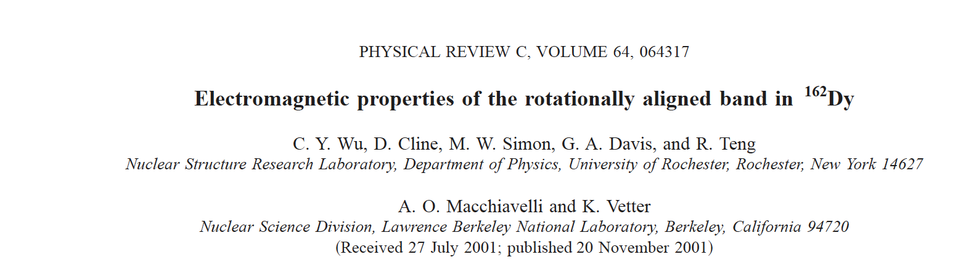
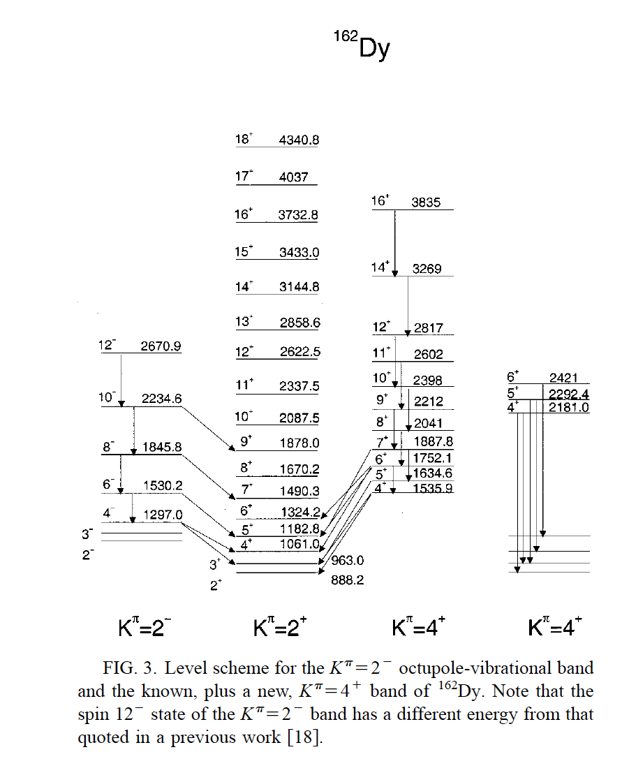
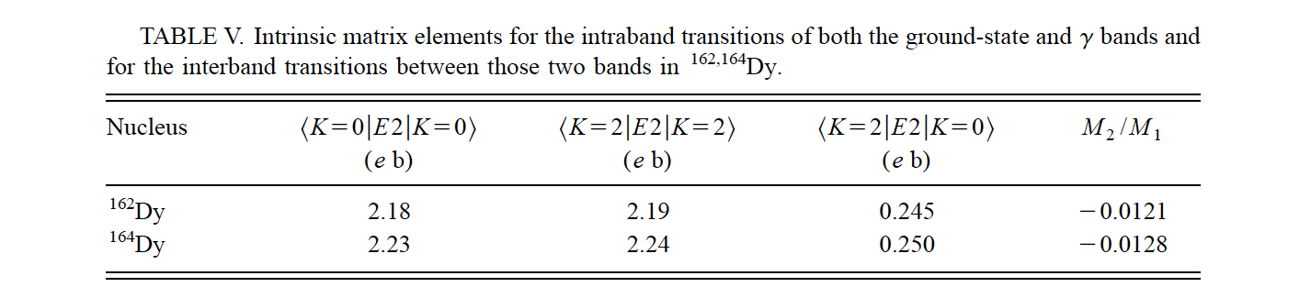
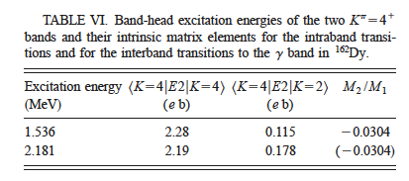
K=4⁺/K=2⁺ = 1.73
GAMMASPHERE + CHICO
K=4⁺/K=2⁺ = 2.46

Slide 25
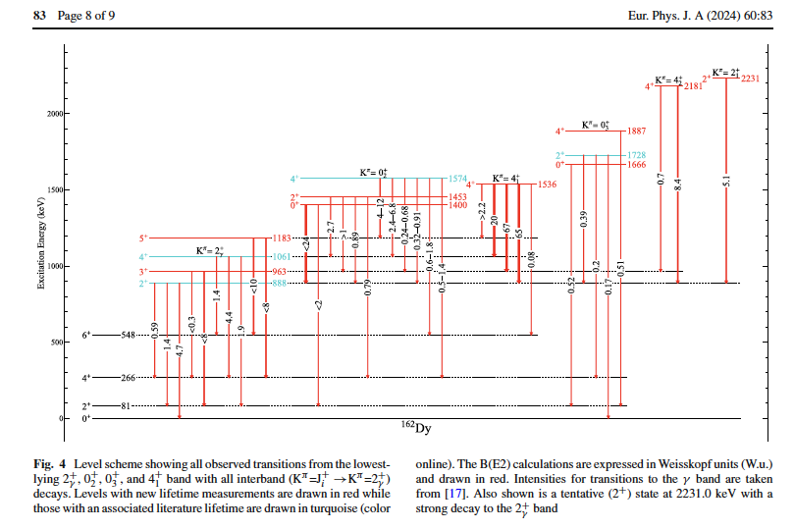
Two-phonon Vibrational Excitations?
K=4⁺/K=2⁺ = 2.46
K=4⁺/K=2⁺ = 1.73

Slide 26
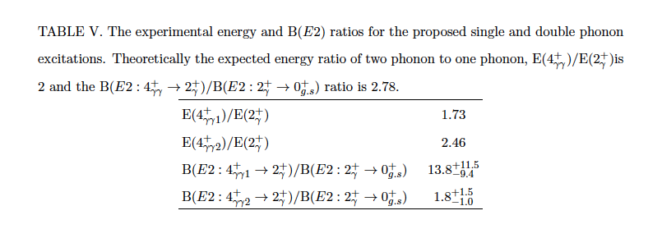
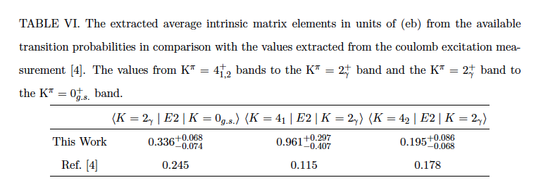
2.0
2.78

Slide 27
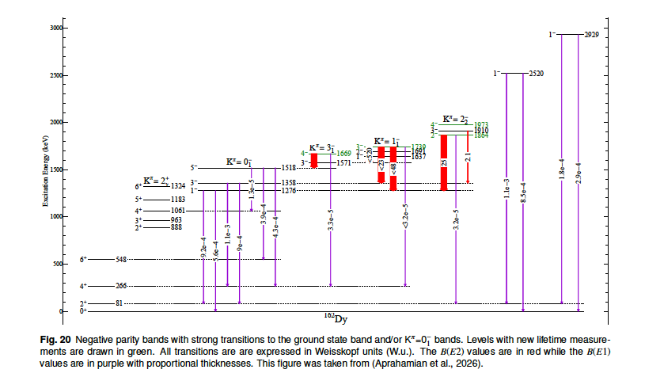
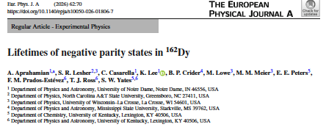
Octupole vibrational States on a deformed ground state:
K=3⁻, 2⁻, 1⁻, 0⁻

Slide 28

Institute for Structure
And Nuclear Astrophysics
GRID (n,n’γ) Theory
ILL Grenoble H. Boerner Univ of Kentucky R. Bijker
B.P. Crider G. Bertsch
M. Jentschel M. Lowe R.F. Casten
E. E. Peters D. Bonatsos
F.M. Prados-Estevez
T. J. Ross
Z. Tully
Univ. of Brighton A.M. Bruce S.W. Yates
__________________________________________________________ (p,t) TU Munich
Univ. of Wisconsin-LaCrosse S.R. Lesher
Notre Dame C. Casarella R. C. de Haan
A. Stratman
K. Lee

