Slide 1


Isospin Mixing via GDR Decay: An Overview and Recent Results
A. Giaz
INFN Sezione di Milano

Slide 2
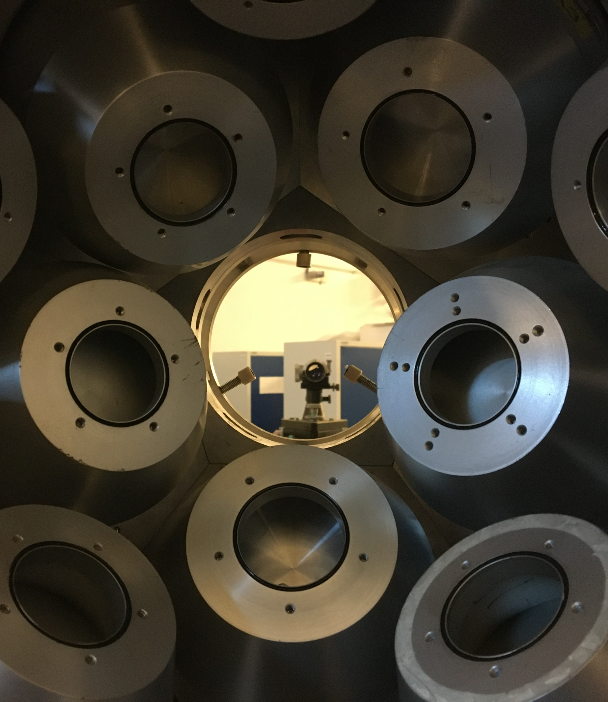

OUTLINE
Motivations
  Isospin mixing
  Isospin mixing via GDR
  Why ⁷²Kr?
Experimental Technique & Setup
Results
  The isospin mixing value $α^{2}$ and the correction term $δ_{c}$
Summary & Prespectives

Slide 3
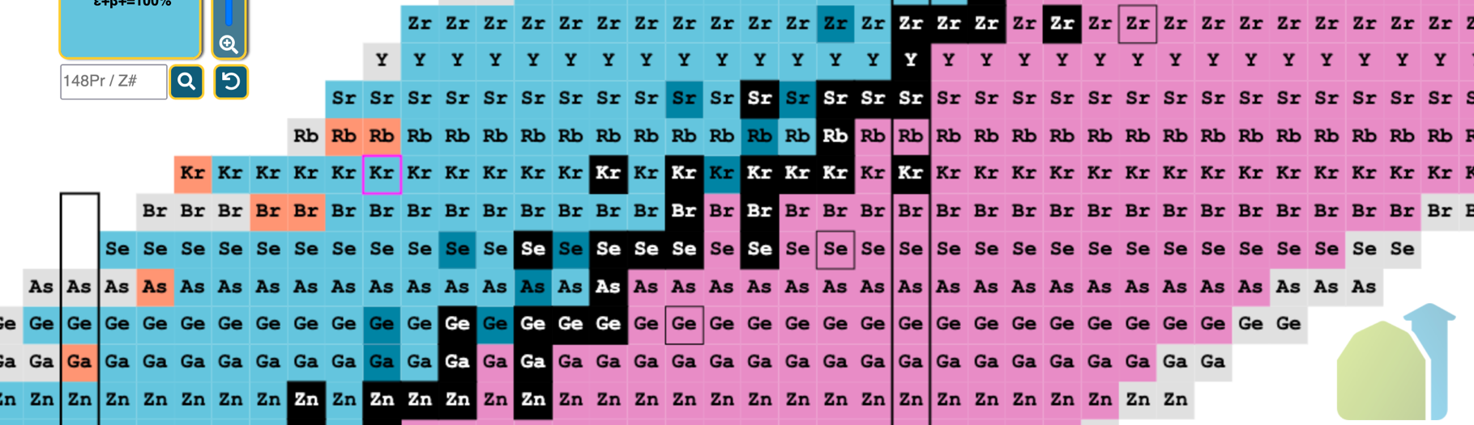
Motivations
⁷²Kr at lowest possible temperature

Slide 4
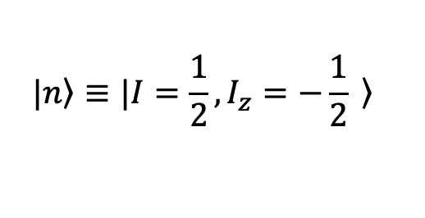
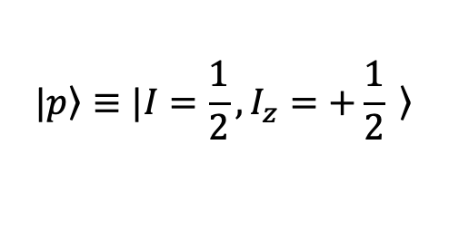
Isospin Symmetry & ISOSPIN MIXING
Isospin symmetry plays a key role in nuclear structure and nuclear nuclear reaction.
$$|\left.p\right\rangle ≡|I=\frac{1}{2}, I_{z}=+\frac{1}{2}\left. \right\rangle$$
$$|\left.n\right\rangle ≡|I=\frac{1}{2}, I_{z}=−\frac{1}{2}\left. \right\rangle$$

Slide 5
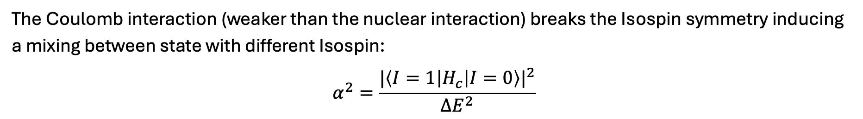
Isospin Symmetry & ISOSPIN MIXING
Isospin symmetry plays a key role in nuclear structure and nuclear nuclear reaction.
$$|\left.p\right\rangle ≡|I=\frac{1}{2}, I_{z}=+\frac{1}{2}\left. \right\rangle$$
$$|\left.n\right\rangle ≡|I=\frac{1}{2}, I_{z}=−\frac{1}{2}\left. \right\rangle$$
The Coulomb interaction (weaker than the nuclear interaction) breaks the Isospin symmetry inducing a mixing between state with different Isospin:
$$α^{2}=\frac{|\left\langle I=1 | H_{c} | I=0\right\rangle |^{2}}{∆E^{2}}$$
Mixing Probability in the g.s.

Slide 6
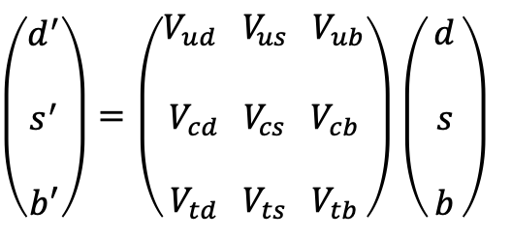
Isospin Symmetry & ISOSPIN MIXING
Isospin symmetry plays a key role in nuclear structure and nuclear nuclear reaction.
$$|\left.p\right\rangle ≡|I=\frac{1}{2}, I_{z}=+\frac{1}{2}\left. \right\rangle$$
$$|\left.n\right\rangle ≡|I=\frac{1}{2}, I_{z}=−\frac{1}{2}\left. \right\rangle$$
The Coulomb interaction (weaker than the nuclear interaction) breaks the Isospin symmetry inducing a mixing between state with different Isospin:
$$α^{2}=\frac{|\left\langle I=1 | H_{c} | I=0\right\rangle |^{2}}{∆E^{2}}$$
Mixing Probability in the g.s.
Isospin mixing beyond nuclear structure: The CKM matrix
$\left(\begin{aligned}d^{′} \\ \\ s^{′} \\ \\ b′\end{aligned}\right)=\left(\begin{aligned}\begin{aligned}V_{ud} V_{us} { V}_{ub} \\ \\ V_{cd} V_{cs} { V}_{cb} \\ \end{aligned} \\ V_{td} V_{ts} V_{tb}\end{aligned}\right)$ $\left(\begin{aligned}d \\ \\ s \\ \\ b\end{aligned}\right)$

Slide 7
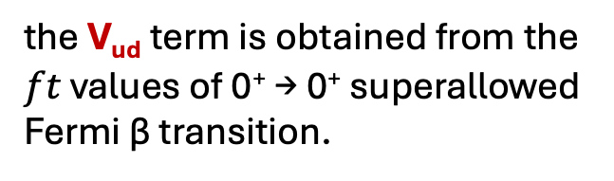
Isospin Symmetry & ISOSPIN MIXING
Isospin symmetry plays a key role in nuclear structure and nuclear nuclear reaction.
$$|\left.p\right\rangle ≡|I=\frac{1}{2}, I_{z}=+\frac{1}{2}\left. \right\rangle$$
$$|\left.n\right\rangle ≡|I=\frac{1}{2}, I_{z}=−\frac{1}{2}\left. \right\rangle$$
The Coulomb interaction (weaker than the nuclear interaction) breaks the Isospin symmetry inducing a mixing between state with different Isospin:
$$α^{2}=\frac{|\left\langle I=1 | H_{c} | I=0\right\rangle |^{2}}{∆E^{2}}$$
Mixing Probability in the g.s.
the V_{ud} term is obtained from the $ft$ values of 0⁺ → 0⁺ superallowed Fermi β transition.
Isospin mixing beyond nuclear structure: The CKM matrix
$\left(\begin{aligned}d^{′} \\ \\ s^{′} \\ \\ b′\end{aligned}\right)=\left(\begin{aligned}\begin{aligned}V_{ud} V_{us} { V}_{ub} \\ \\ V_{cd} V_{cs} { V}_{cb} \\ \end{aligned} \\ V_{td} V_{ts} V_{tb}\end{aligned}\right)$ $\left(\begin{aligned}d \\ \\ s \\ \\ b\end{aligned}\right)$

Slide 8
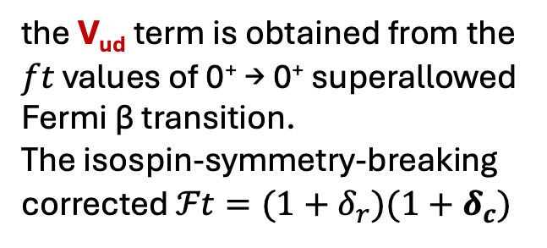
Isospin Symmetry & ISOSPIN MIXING
Isospin symmetry plays a key role in nuclear structure and nuclear nuclear reaction.
$$|\left.p\right\rangle ≡|I=\frac{1}{2}, I_{z}=+\frac{1}{2}\left. \right\rangle$$
$$|\left.n\right\rangle ≡|I=\frac{1}{2}, I_{z}=−\frac{1}{2}\left. \right\rangle$$
The Coulomb interaction (weaker than the nuclear interaction) breaks the Isospin symmetry inducing a mixing between state with different Isospin:
$$α^{2}=\frac{|\left\langle I=1 | H_{c} | I=0\right\rangle |^{2}}{∆E^{2}}$$
Mixing Probability in the g.s.
the V_{ud} term is obtained from the $ft$ values of 0⁺ → 0⁺ superallowed Fermi β transition.
The isospin-symmetry-breaking corrected $ℱt=(1+δ_{r})(1+δ_{c})$
Isospin mixing beyond nuclear structure: The CKM matrix
$\left(\begin{aligned}d^{′} \\ \\ s^{′} \\ \\ b′\end{aligned}\right)=\left(\begin{aligned}\begin{aligned}V_{ud} V_{us} { V}_{ub} \\ \\ V_{cd} V_{cs} { V}_{cb} \\ \end{aligned} \\ V_{td} V_{ts} V_{tb}\end{aligned}\right)$ $\left(\begin{aligned}d \\ \\ s \\ \\ b\end{aligned}\right)$

Slide 9
How we can measure Isospin mixing?
Measuring transition strictly forbidden by isospin conservation.

Slide 10
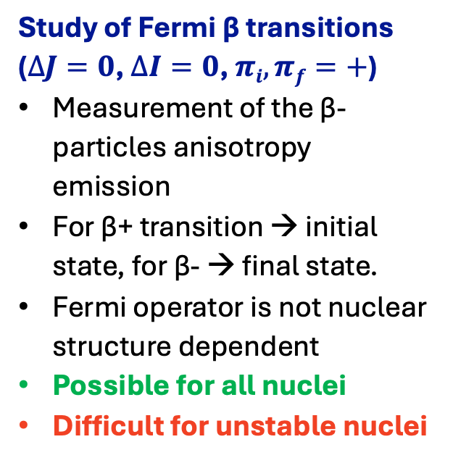
How we can measure Isospin mixing?
Measuring transition strictly forbidden by isospin conservation.
Study of Fermi β transitions
($∆J=0$, $∆I=0$, $πi, πf=+$)
Measurement of the β-particles anisotropy emission
For β+ transition → initial state, for β- → final state.
Fermi operator is not nuclear structure dependent
Possible for all nuclei
Difficult for unstable nuclei

Slide 11
How we can measure Isospin mixing?
Measuring transition strictly forbidden by isospin conservation.
Study of a forbidden E1 decay
(polarization & angular distribution)
Possible only in N=Z nuclei
Unstable nuclei
It cannot discern if the mixing occur in the initial or final state
Study of Fermi β transitions
($∆J=0$, $∆I=0$, $πi, πf=+$)
Measurement of the β-particles anisotropy emission
For β+ transition → initial state, for β- → final state.
Fermi operator is not nuclear structure dependent
Possible for all nuclei
Difficult for unstable nuclei
⁶⁴Ge
⁷²Kr
5⁻
3⁻
5⁻
1665 keV
1339 keV
1334 keV
4⁺
2⁺
4⁺
E. Farnea et al., PLB, 551, (2003), 56-62
A. Ertoprak, et al., proposal for AGATA @ LNL

Slide 12
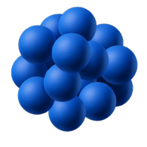
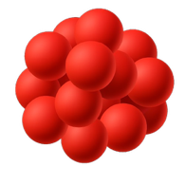
How we can measure Isospin mixing?
Measuring transition strictly forbidden by isospin conservation.
Study of a forbidden E1 decay
(polarization & angular distribution)
Possible only in N=Z nuclei
Unstable nuclei
It cannot discern if the mixing occur in the initial or final state
Study of Fermi β transitions
($∆J=0$, $∆I=0$, $πi, πf=+$)
Measurement of the β-particles anisotropy emission
For β+ transition → initial state, for β- → final state.
Fermi operator is not nuclear structure dependent
Possible for all nuclei
Difficult for unstable nuclei
Study of E1 Giant Dipole Resonance Strength
Possible only in N=Z nuclei
Unstable nuclei
It cannot discern if the mixing occur in the initial or final state
⁶⁴Ge
⁷²Kr
5⁻
3⁻
5⁻
1665 keV
1339 keV
1334 keV
4⁺
2⁺
4⁺
E. Farnea et al., PLB, 551, (2003), 56-62
A. Ertoprak, et al., proposal for AGATA @ LNL
⁷²Kr this work

Slide 13
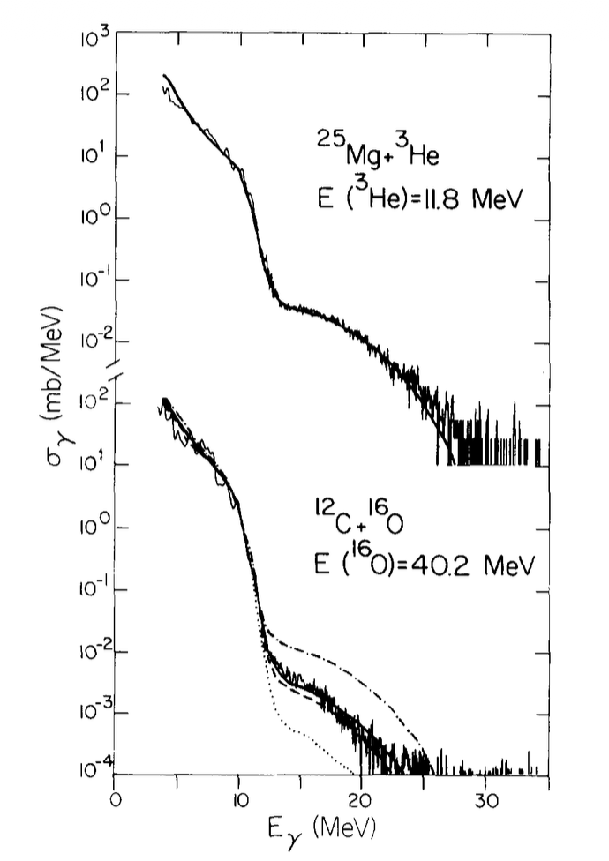
Previous experiments based on GDR TECNIQUE (I)
Previous measurements in light nuclei
First investigation of the role of isospin mixing in GDR decay
²⁴Mg
M. Harakeh, et al., Phys. Lett. B 176 (1986) 297

Slide 14
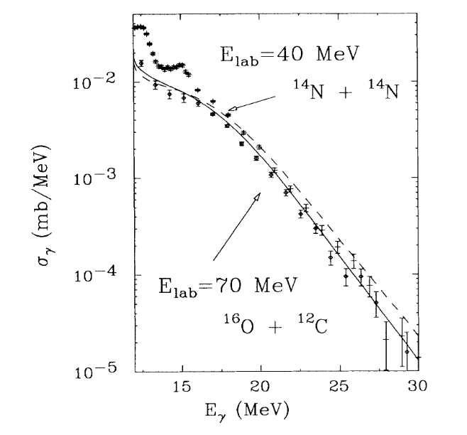
Previous experiments based on GDR TECNIQUE (I)
Previous measurements in light nuclei
First investigation of the role of isospin mixing in GDR decay
Isospin mixing in ²⁸Si and ³⁰Si
²⁴Mg
M. Harakeh, et al., Phys. Lett. B 176 (1986) 297
J. Behr, et al., Phys. Rev. Lett. 70 (1993) 3201.

Slide 15
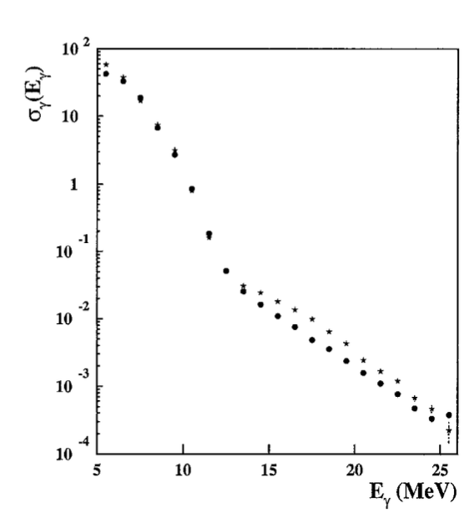
Previous experiments based on GDR TECNIQUE (I)
Previous measurements in light nuclei
First investigation of the role of isospin mixing in GDR decay
Isospin mixing in ²⁸Si and ³⁰Si
Isospin mixing in ³²S
²⁴Mg
M. Kicińska-Habior, et al.,
Nucl. Phys. A 731 (2004) 138.
M. Harakeh, et al., Phys. Lett. B 176 (1986) 297
J. Behr, et al., Phys. Rev. Lett. 70 (1993) 3201.

Slide 16
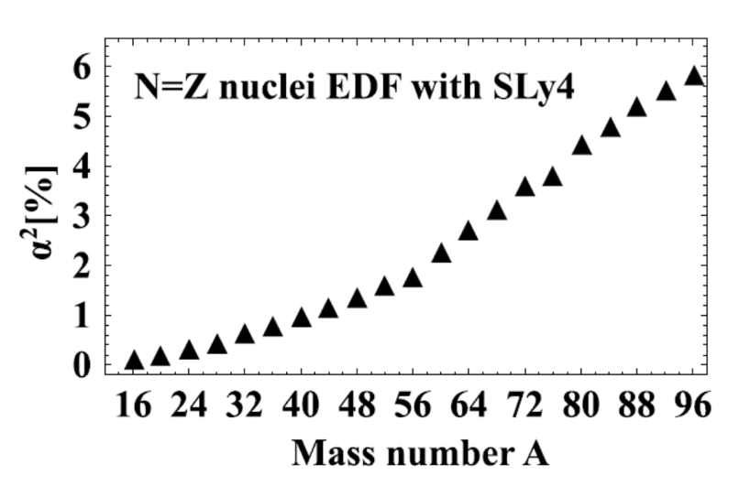
Previous experiments BASED on GDR TECNIQUE (II)
W. Satula, et al., Phys. Rev. Lett., 103,(2009) 012502
[1] A. Corsi et al., PRC 84, 041304(R) (2011)
[2] S. Ceruti et al., PRL 115, 222502 (2015)
[3] G. Gosta et al., PRC 103, L041302 (2021)

Slide 17
Previous experiments BASED on GDR TECNIQUE (II)
Nucleus | Temperature | Setup
⁸⁰Zr | 2.8 MeV | HECTOR – GARFIELD [1]
⁸⁰Zr | 1.8 MeV | AGATA –HECTOR⁺ [2]
⁶⁰Zn | 2.0 MeV | GALILEO – 3’’x3’’ LaBr₃:Ce [3]
⁶⁰Zn | 2.4 MeV | GALILEO – 3’’x3’’ LaBr₃:Ce [3]
⁸⁰Zr [1-2]
⁶⁰Zn [3]
W. Satula, et al., Phys. Rev. Lett., 103,(2009) 012502
[1] A. Corsi et al., PRC 84, 041304(R) (2011)
[2] S. Ceruti et al., PRL 115, 222502 (2015)
[3] G. Gosta et al., PRC 103, L041302 (2021)

Slide 18
Previous experiments BASED on GDR TECNIQUE (II)
Nucleus | Temperature | Setup
⁸⁰Zr | 2.8 MeV | HECTOR – GARFIELD [1]
⁸⁰Zr | 1.8 MeV | AGATA –HECTOR⁺ [2]
⁶⁰Zn | 2.0 MeV | GALILEO – 3’’x3’’ LaBr₃:Ce [3]
⁶⁰Zn | 2.4 MeV | GALILEO – 3’’x3’’ LaBr₃:Ce [3]
⁸⁰Zr [1-2]
This work
⁶⁰Zn [3]
W. Satula, et al., Phys. Rev. Lett., 103,(2009) 012502
The new experiment:
Isospin Mixing in ⁷²Kr at the lowest possible temperature at IFIN-HH tandem
[1] A. Corsi et al., PRC 84, 041304(R) (2011)
[2] S. Ceruti et al., PRL 115, 222502 (2015)
[3] G. Gosta et al., PRC 103, L041302 (2021)

Slide 19
Isospin MIXING in ⁷²Kr
⁷²Kr is a N=Z nucleus, produced by fusion-evaporation reactions.
It has an intermediate mass between ⁶⁰Zn and ⁸⁰Zr.
It has a E1 discrete transition so it can be measure with two techniques.

Slide 20
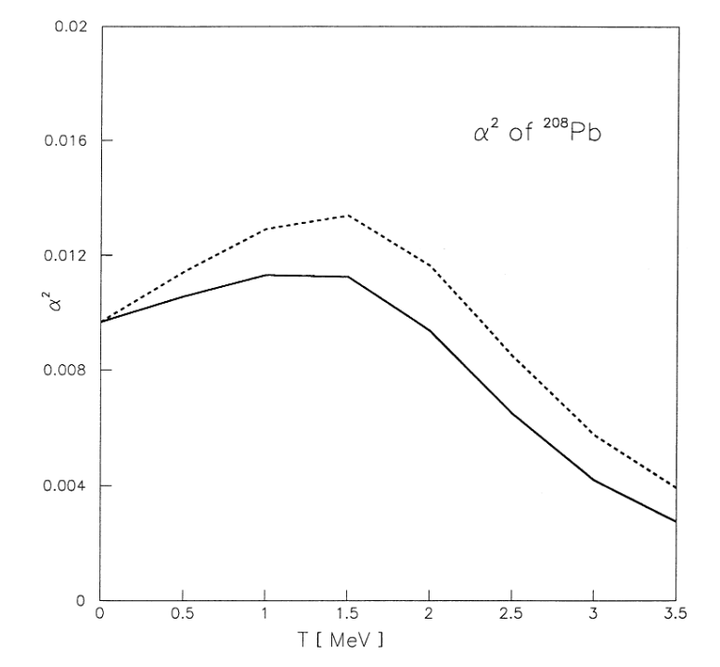
Isospin MIXING in ⁷²Kr
⁷²Kr is a N=Z nucleus, produced by fusion-evaporation reactions.
It has an intermediate mass between ⁶⁰Zn and ⁸⁰Zr.
It has a E1 discrete transition so it can be measure with two techniques.
H. Sagawa et al. Phys. Lett. B, 444, (1998), 1–6

Slide 21
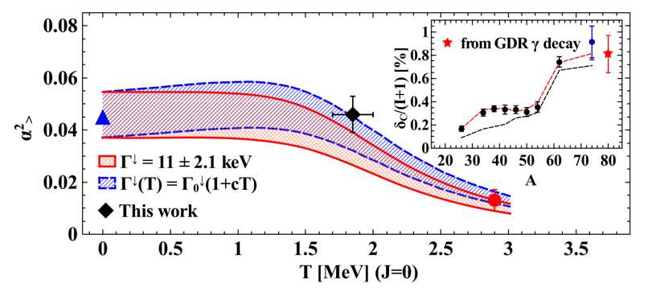
Isospin MIXING in ⁷²Kr
⁷²Kr is a N=Z nucleus, produced by fusion-evaporation reactions.
It has an intermediate mass between ⁶⁰Zn and ⁸⁰Zr.
It has a E1 discrete transition so it can be measure with the two techniques.
H. Sagawa et al. Phys. Lett. B, 444, (1998), 1–6
Add a point in the plateau region
S. Ceruti et al., Phys. Rev. Lett., 115, (2015) 222502

Slide 22
Isospin MIXING in ⁷²Kr
⁷²Kr is a N=Z nucleus, produced by fusion-evaporation reactions.
It has an intermediate mass between ⁶⁰Zn and ⁸⁰Zr.
It has a E1 discrete transition so it can be measure with two techniques.
H. Sagawa et al. Phys. Lett. B, 444, (1998), 1–6
Add a point in the plateau region
S. Ceruti et al., Phys. Rev. Lett., 115, (2015) 222502
ADVATAGE: In the plateau region, only one data point is needed to extract the isospin-mixing value at T=0.

Slide 23

Isospin MIXING in ⁷²Kr
⁷²Kr is a N=Z nucleus, produced by fusion-evaporation reactions.
It has an intermediate mass between ⁶⁰Zn and ⁸⁰Zr.
It has a E1 discrete transition so it can be measure with two techniques.
H. Sagawa et al. Phys. Lett. B, 444, (1998), 1–6
Add a point in the plateau region
S. Ceruti et al., Phys. Rev. Lett., 115, (2015) 222502
ADVATAGE: In the plateau region, only one data point is needed to extract the isospin-mixing value at T=0.

Slide 24
Isospin MIXING in ⁷²Kr
⁷²Kr is a N=Z nucleus, produced by fusion-evaporation reactions.
It has an intermediate mass between ⁶⁰Zn and ⁸⁰Zr.
It has a E1 discrete transition so it can be measure with two techniques.
H. Sagawa et al. Phys. Lett. B, 444, (1998), 1–6
Add a point in the plateau region
S. Ceruti et al., Phys. Rev. Lett., 115, (2015) 222502
ADVATAGE: In the plateau region, only one data point is needed to extract the isospin-mixing value at T=0.
DISADVATAGE: Low reaction cross-section

Slide 25

Isospin MIXING in ⁷²Kr
⁷²Kr is a N=Z nucleus, produced by fusion-evaporation reactions.
It has an intermediate mass between ⁶⁰Zn and ⁸⁰Zr.
It has a E1 discrete transition so it can be measure with two techniques.
H. Sagawa et al. Phys. Lett. B, 444, (1998), 1–6
Add a point in the plateau region
S. Ceruti et al., Phys. Rev. Lett., 115, (2015) 222502
ADVATAGE: In the plateau region, only one data point is needed to extract the isospin-mixing value at T=0.
DISADVATAGE: Low reaction cross-section

Slide 26
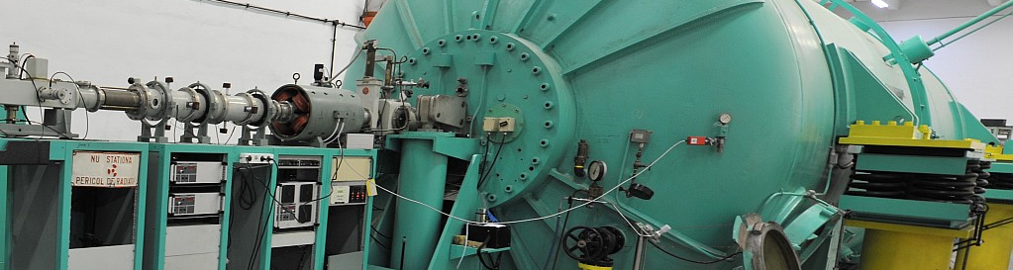
Experimental technique and Setup
Isospin MIXINg VIA GDR

Slide 27
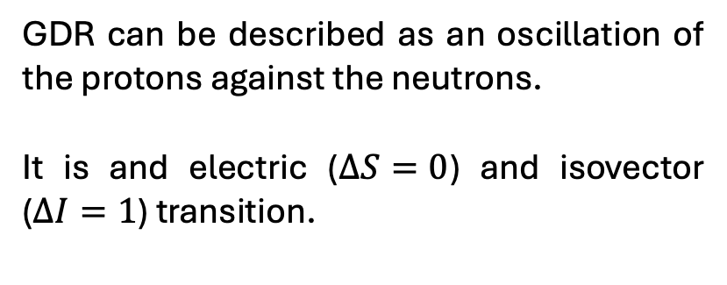
Experimental Technique: GDR (I)
GDR can be described as an oscillation of the protons against the neutrons.
It is and electric ($∆S=0$) and isovector ($∆I=1$) transition.

Slide 28
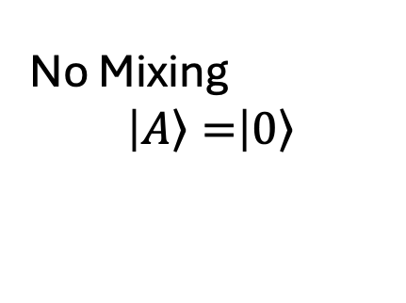
Experimental Technique: GDR (I)
No Mixing
$$\left|\left.A\right\rangle =\right|\left.0\right\rangle$$
I = 0
E1
GDR can be described as an oscillation of the protons against the neutrons.
It is and electric ($∆S=0$) and isovector ($∆I=1$) transition.
I = 0
I =1
(few states)

Slide 29
Experimental Technique: GDR (I)
No Mixing
$$\left|\left.A\right\rangle =\right|\left.0\right\rangle$$
I = 0
E1
GDR can be described as an oscillation of the protons against the neutrons.
It is and electric ($∆S=0$) and isovector ($∆I=1$) transition.
I = 0
I =1
(few states)

Slide 30
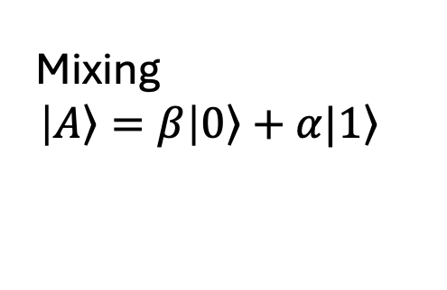
Experimental Technique: GDR (I)
No Mixing
$$\left|\left.A\right\rangle =\right|\left.0\right\rangle$$
I = 0
E1
GDR can be described as an oscillation of the protons against the neutrons.
It is and electric ($∆S=0$) and isovector ($∆I=1$) transition.
I = 0
I =1
(few states)
I = 0
+
I =1
E1
I = 0
Mixing
$$\left|\left.A\right\rangle =β\right|\left.0\right\rangle +α|\left.1\right\rangle$$

Slide 31

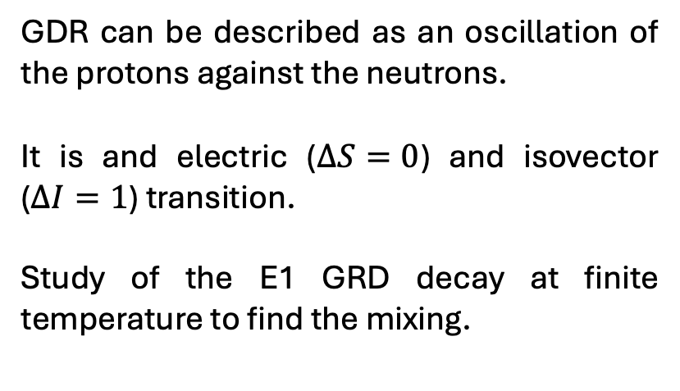
Experimental Technique: GDR (I)
No Mixing
$$\left|\left.A\right\rangle =\right|\left.0\right\rangle$$
I = 0
E1
GDR can be described as an oscillation of the protons against the neutrons.
It is and electric ($∆S=0$) and isovector ($∆I=1$) transition.
Study of the E1 GRD decay at finite temperature to find the mixing.
I = 0
I =1
(few states)
I = 0
+
I =1
E1
I = 0
Mixing
$$\left|\left.A\right\rangle =β\right|\left.0\right\rangle +α|\left.1\right\rangle$$

Slide 32
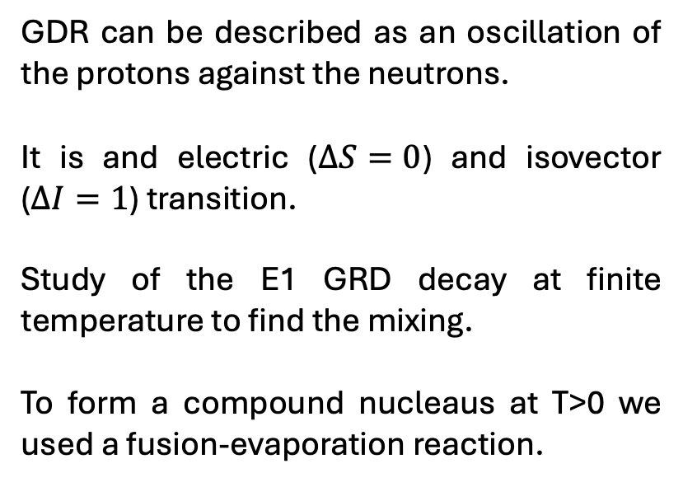
Experimental Technique: GDR (I)
No Mixing
$$\left|\left.A\right\rangle =\right|\left.0\right\rangle$$
I = 0
E1
GDR can be described as an oscillation of the protons against the neutrons.
It is and electric ($∆S=0$) and isovector ($∆I=1$) transition.
Study of the E1 GRD decay at finite temperature to find the mixing.
To form a compound nucleaus at T>0 we used a fusion-evaporation reaction.
I = 0
I =1
(few states)
I = 0
+
I =1
E1
I = 0
Mixing
$$\left|\left.A\right\rangle =β\right|\left.0\right\rangle +α|\left.1\right\rangle$$

Slide 33
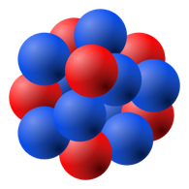

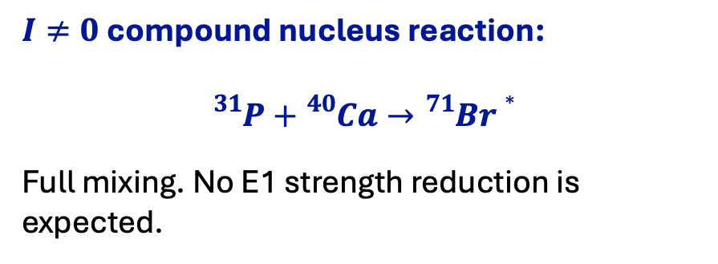
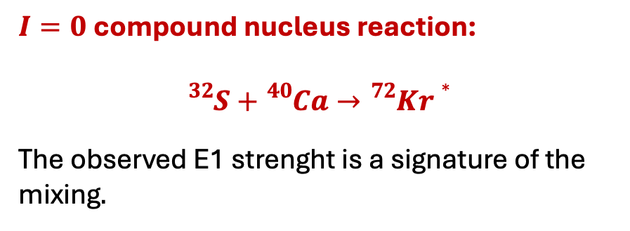
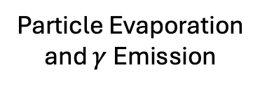
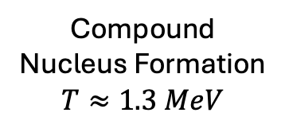
Experimental Technique: GDR (II)
Target: ⁴⁰Ca
Particle Evaporation and $γ$ Emission
Compound Nucleus Formation
$$T≈1.3 MeV$$
Beam: ³²S, ³¹P
$I=0$compound nucleus reaction:
$${}_{}^{32}{S+{}_{}^{40}{Ca}}→{}_{}^{72}{Kr}∗$$
The observed E1 strenght is a signature of the mixing$.$
$I≠0$compound nucleus reaction:
$${}_{}^{31}{P+{}_{}^{40}{Ca}}→{}_{}^{71}{Br}∗$$
Full mixing. No E1 strength reduction is expected.

Slide 34
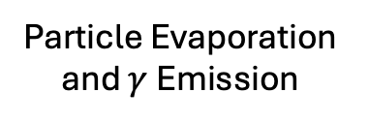
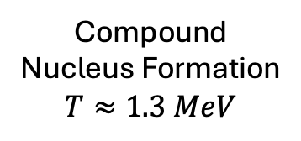
Experimental Technique: GDR (II)
Target: ⁴⁰Ca
Particle Evaporation and $γ$ Emission
Compound Nucleus Formation
$$T≈1.3 MeV$$
Beam: ³²S, ³¹P
$I=0$compound nucleus reaction:
$${}_{}^{32}{S+{}_{}^{40}{Ca}}→{}_{}^{72}{Kr}∗$$
The observed E1 strenght is a signature of the mixing$.$
$I≠0$compound nucleus reaction:
$${}_{}^{31}{P+{}_{}^{40}{Ca}}→{}_{}^{71}{Br}∗$$
Full mixing. No E1 strength reduction is expected.
GDR manifest itself as E1 Strenght → GDR is a probe of the isospin mixing

Slide 35
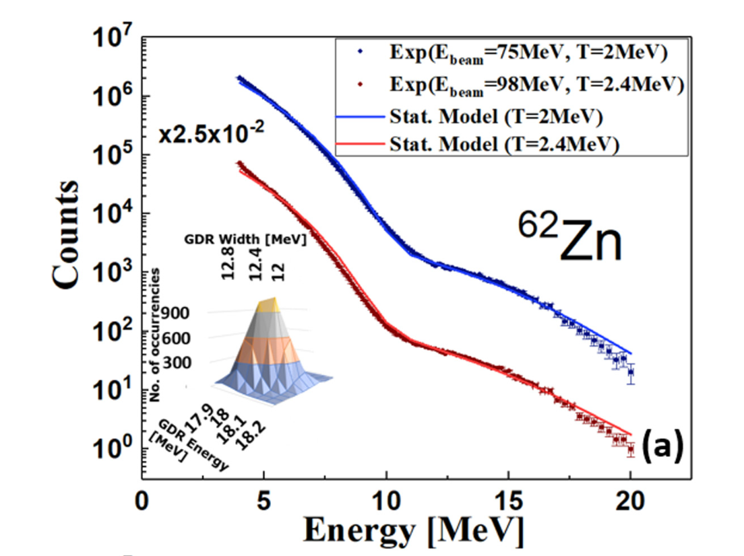

Data analysis tecnique
Reaction with I $≠$ 0, no GDR decay suppression
G. Gosta et al., PRC 103, L041302 (2021)
Statistical model to extract of GDR parameters: centroid, width and strenght

Slide 36
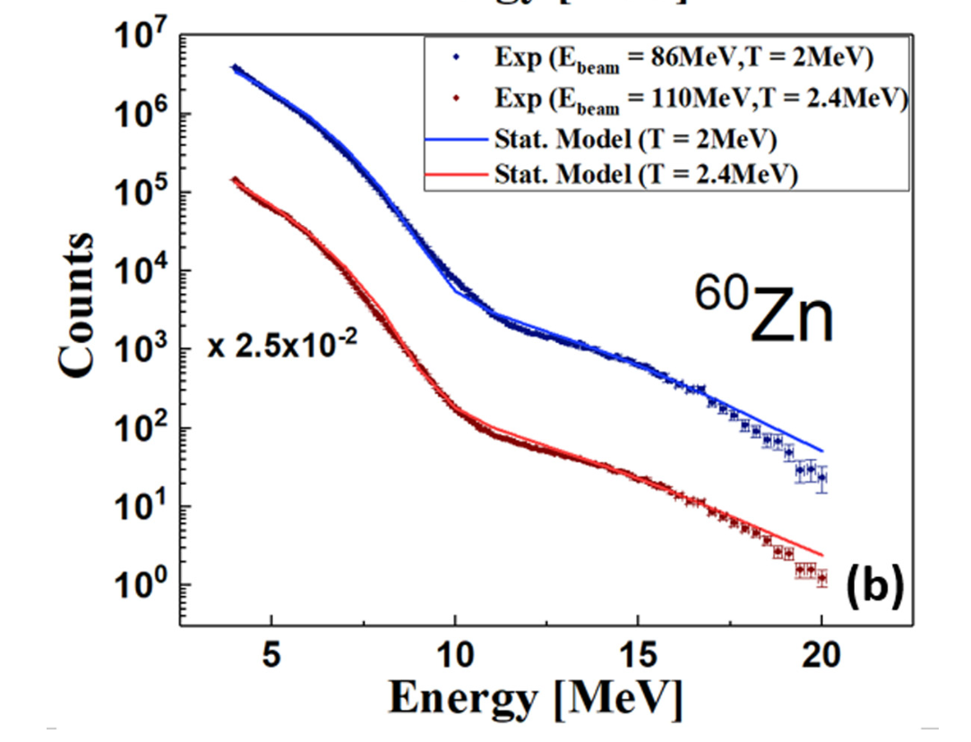


Data analysis tecnique
Reaction with I $≠$ 0, no GDR decay suppression
Reaction with I $=$ 0, GDR decay possible only in case of isospin mixing
G. Gosta et al., PRC 103, L041302 (2021)
G. Gosta et al., PRC 103, L041302 (2021)
Statistical model to extract of GDR parameters: centroid, width and strenght
Statistical model to extract the
Coulomb Spreading Width $Γ_{c}^{↓}$

Slide 37
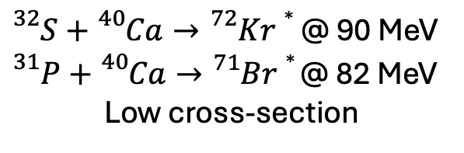
Experimental Setup
${}_{}^{32}{S+{}_{}^{40}{Ca}}→{}_{}^{72}{Kr}∗$ @ 90 MeV
${}_{}^{31}{P+{}_{}^{40}{Ca}}→{}_{}^{71}{Br}∗$ @ 82 MeV
Low cross-section
High efficiency

Slide 38
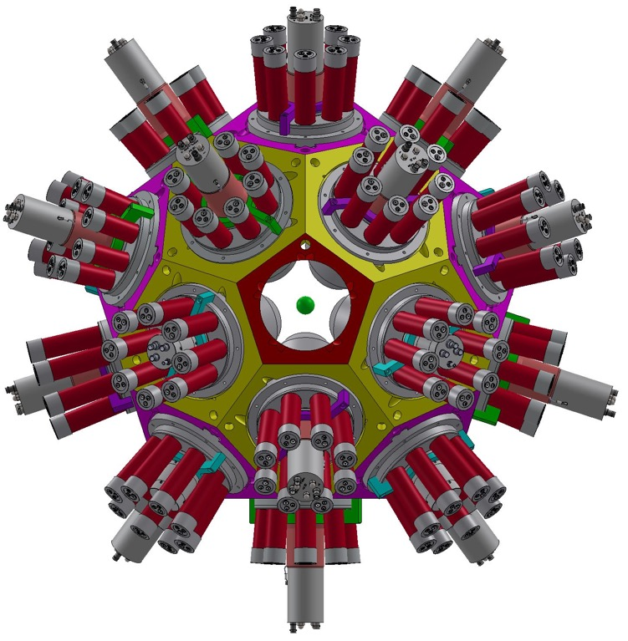

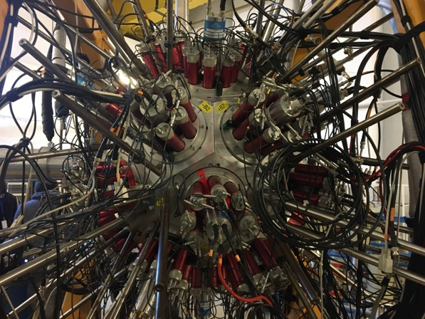


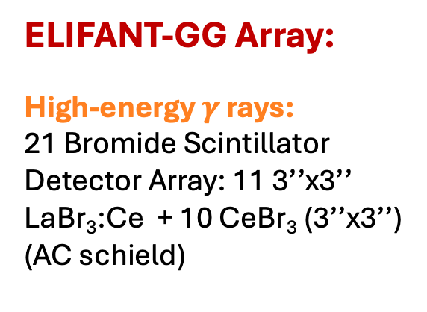
Experimental Setup
ELIFANT-GG Array:
High-energy $γ$ rays:
21 Bromide Scintillator
Detector Array: 11 3’’x3’’ LaBr₃:Ce + 10 CeBr₃ (3’’x3’’)
(AC schield)
${}_{}^{32}{S+{}_{}^{40}{Ca}}→{}_{}^{72}{Kr}∗$ @ 90 MeV
${}_{}^{31}{P+{}_{}^{40}{Ca}}→{}_{}^{71}{Br}∗$ @ 82 MeV
Low cross-section
High efficiency

Slide 39
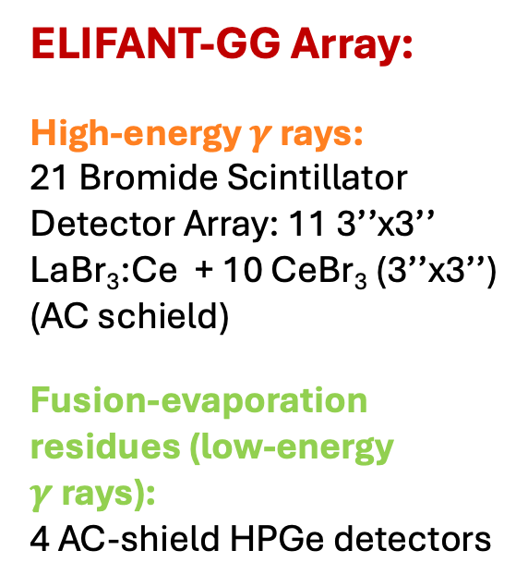
Experimental Setup
ELIFANT-GG Array:
High-energy $γ$ rays:
21 Bromide Scintillator
Detector Array: 11 3’’x3’’ LaBr₃:Ce + 10 CeBr₃ (3’’x3’’)
(AC schield)
Fusion-evaporation residues (low-energy $γ$rays):
4 AC-shield HPGe detectors
${}_{}^{32}{S+{}_{}^{40}{Ca}}→{}_{}^{72}{Kr}∗$ @ 90 MeV
${}_{}^{31}{P+{}_{}^{40}{Ca}}→{}_{}^{71}{Br}∗$ @ 82 MeV
Low cross-section
High efficiency

Slide 40
Results
IsoSPIN MIXING PARAMETRES: $α^{2}$ & $δ_{c}$

Slide 41
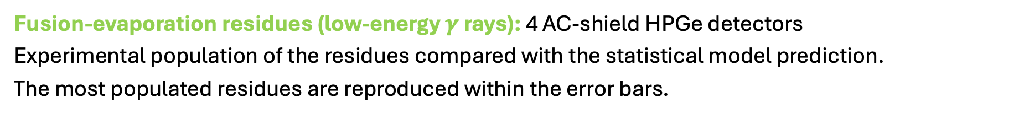


Results: EVAPORATION RESIDUES
Fusion-evaporation residues (low-energy $γ$ rays): 4 AC-shield HPGe detectors
Experimental population of the residues compared with the statistical model prediction.
The most populated residues are reproduced within the error bars.
Reaction with I $≠$ 0
Reaction with I $=$ 0
A. Giaz et al., Phys. Lett. B, 868 (2025) 13965

Slide 42
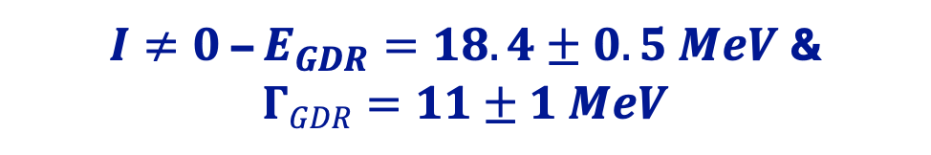
Results: HIGH-ENRGY $γ$-RaY Spectra
$I≠0$– $E_{GDR}=18.4±0.5 MeV$&
$$ΓGDR=11±1 MeV$$
A. Giaz et al., Phys. Lett. B, 868 (2025) 13965

Slide 43



Results: HIGH-ENRGY $γ$-RaY Spectra
$I≠0$– $E_{GDR}=18.4±0.5 MeV$&
$$ΓGDR=11±1 MeV$$
$I=0$– Mixing $Γ_{c}^{↓}=6 keV$
$$Γ_{c}^{↓}$$
$$χ^{2}$$
A. Giaz et al., Phys. Lett. B, 868 (2025) 13965

Slide 44
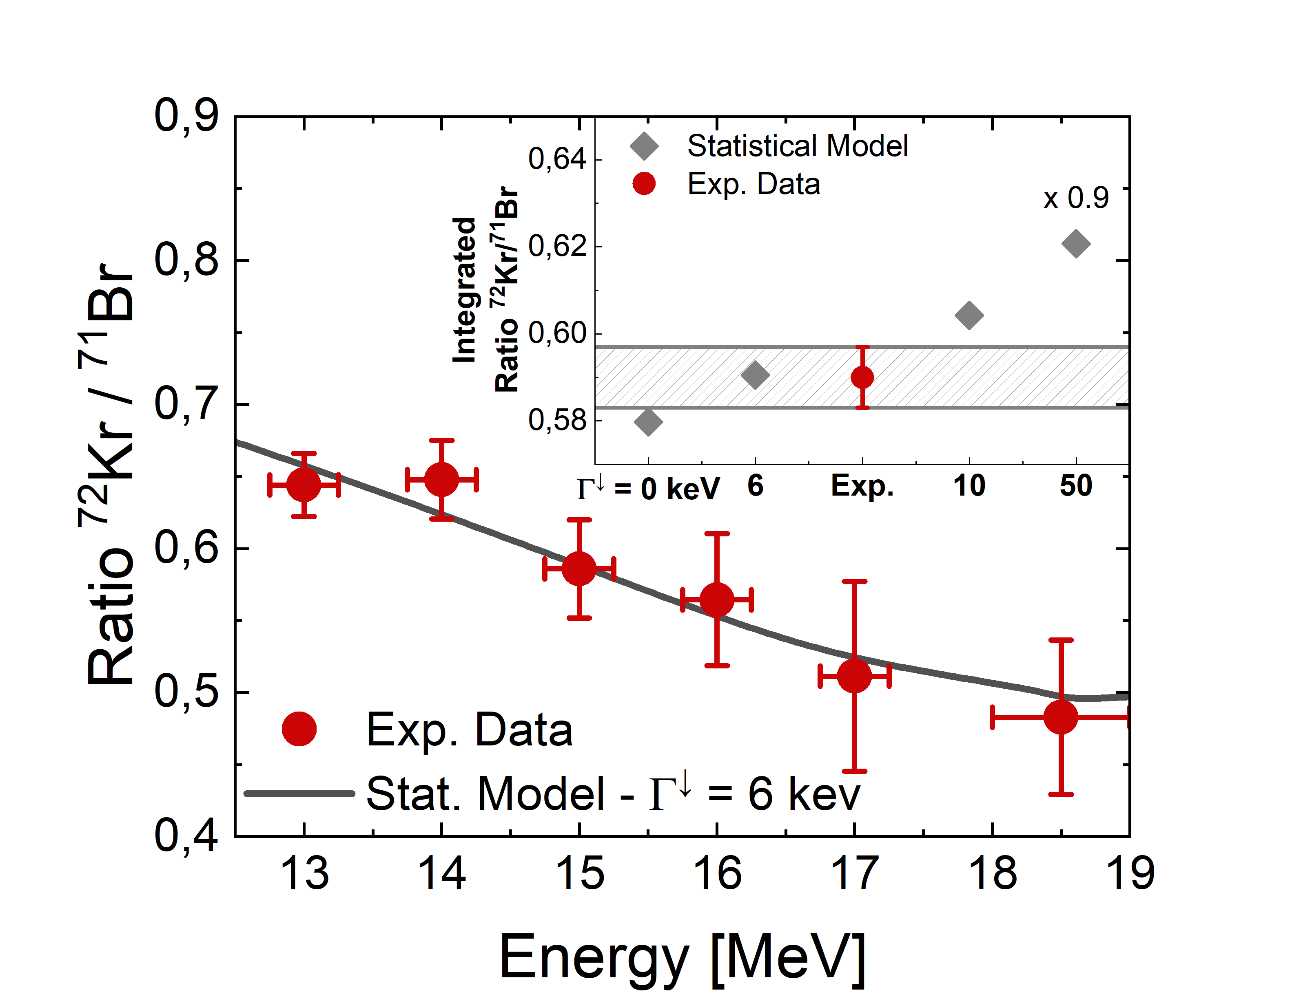
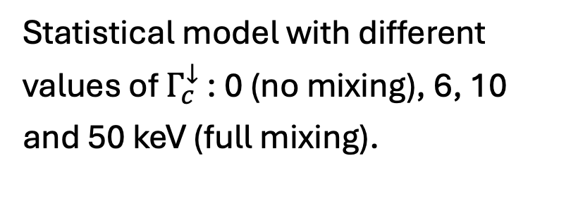
Results: MiXING Estimation
Statistical model with different values of $Γ_{c}^{↓}$ : 0 (no mixing), 6, 10 and 50 keV (full mixing).
A. Giaz et al., Phys. Lett. B, 868 (2025) 13965

Slide 45
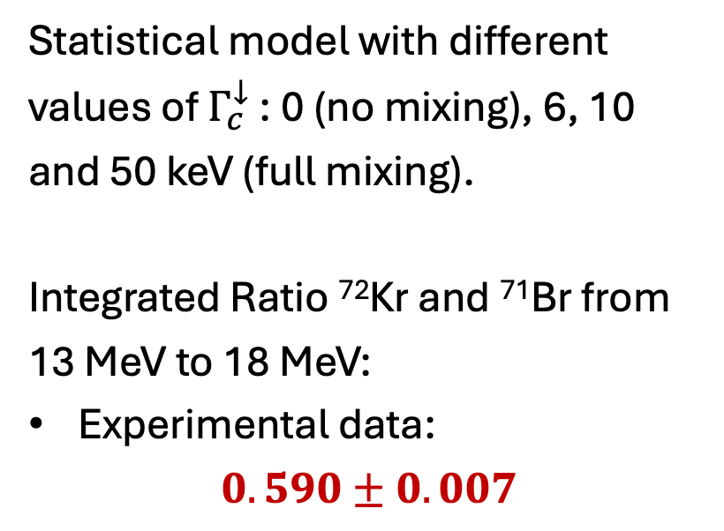
Results: MiXING Estimation
Statistical model with different values of $Γ_{c}^{↓}$ : 0 (no mixing), 6, 10 and 50 keV (full mixing).
Integrated Ratio ⁷²Kr and ⁷¹Br from 13 MeV to 18 MeV:
Experimental data:
$0.590±0.007$
A. Giaz et al., Phys. Lett. B, 868 (2025) 13965

Slide 46
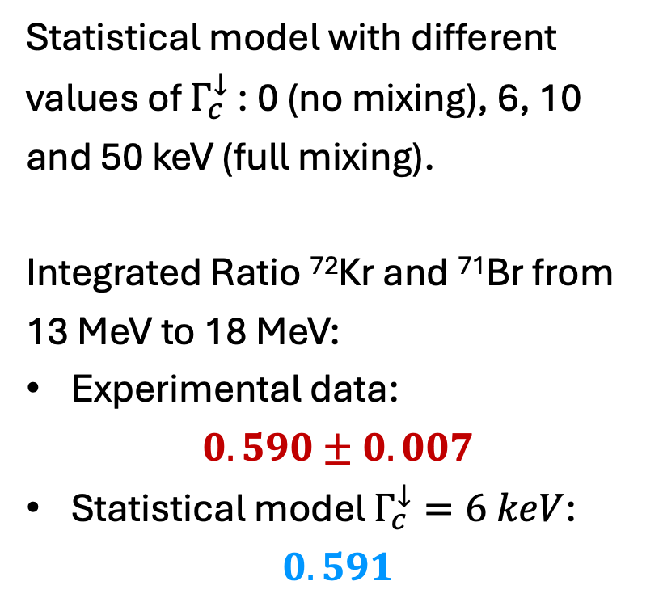
Results: MiXING Estimation
Statistical model with different values of $Γ_{c}^{↓}$ : 0 (no mixing), 6, 10 and 50 keV (full mixing).
Integrated Ratio ⁷²Kr and ⁷¹Br from 13 MeV to 18 MeV:
Experimental data:
$0.590±0.007$
Statistical model $Γ_{c}^{↓}=6 keV$:
$0.591$
A. Giaz et al., Phys. Lett. B, 868 (2025) 13965

Slide 47
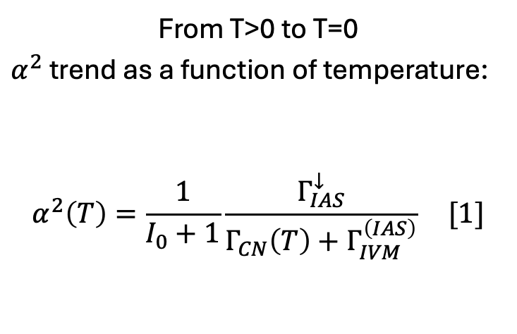
Results: $α^{2}$ MiXING PaRAMETER (I)
From T>0 to T=0
$α^{2}$ trend as a function of temperature:
$$α^{2}\left(T\right)=\frac{1}{I_{0}+1}\frac{Γ_{IAS}^{↓}}{Γ_{CN}\left(T\right)+Γ_{IVM}^{\left(IAS\right)}} [1]$$
[1] G.C.H. Sagawa, P.F. Bortignon, Phys. Lett. B, 444, (1998), 1-6

Slide 48
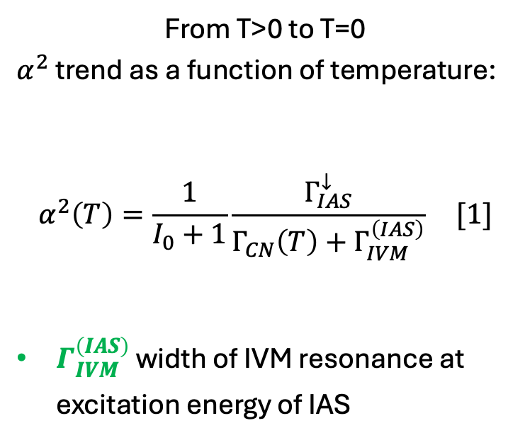

Results: $α^{2}$ MiXING PaRAMETER (I)
From T>0 to T=0
$α^{2}$ trend as a function of temperature:
$$α^{2}\left(T\right)=\frac{1}{I_{0}+1}\frac{Γ_{IAS}^{↓}}{Γ_{CN}\left(T\right)+Γ_{IVM}^{\left(IAS\right)}} [1]$$
$Γ_{IVM}^{\left(IAS\right)}$ width of IVM resonance at excitation energy of IAS
$200 keV$[1]
[1] G.C.H. Sagawa, P.F. Bortignon, Phys. Lett. B, 444, (1998), 1-6

Slide 49
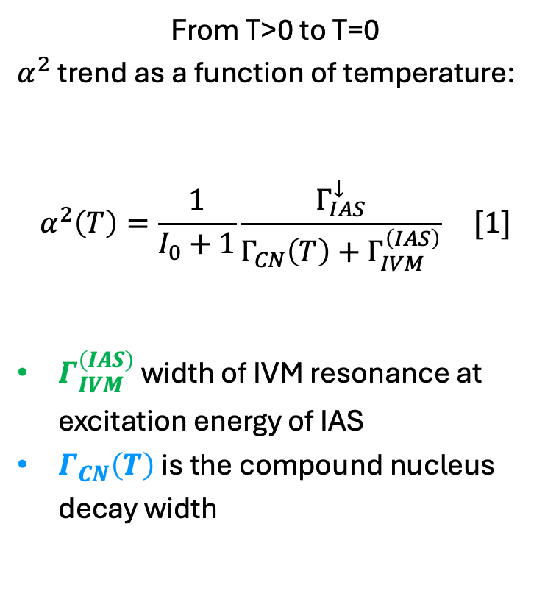
Results: $α^{2}$ MiXING PaRAMETER (I)
From T>0 to T=0
$α^{2}$ trend as a function of temperature:
$$α^{2}\left(T\right)=\frac{1}{I_{0}+1}\frac{Γ_{IAS}^{↓}}{Γ_{CN}\left(T\right)+Γ_{IVM}^{\left(IAS\right)}} [1]$$
$Γ_{IVM}^{\left(IAS\right)}$ width of IVM resonance at excitation energy of IAS
$Γ_{CN}\left(T\right)$ is the compound nucleus decay width
From Stat. Model
$200 keV$[1]
[1] G.C.H. Sagawa, P.F. Bortignon, Phys. Lett. B, 444, (1998), 1-6

Slide 50
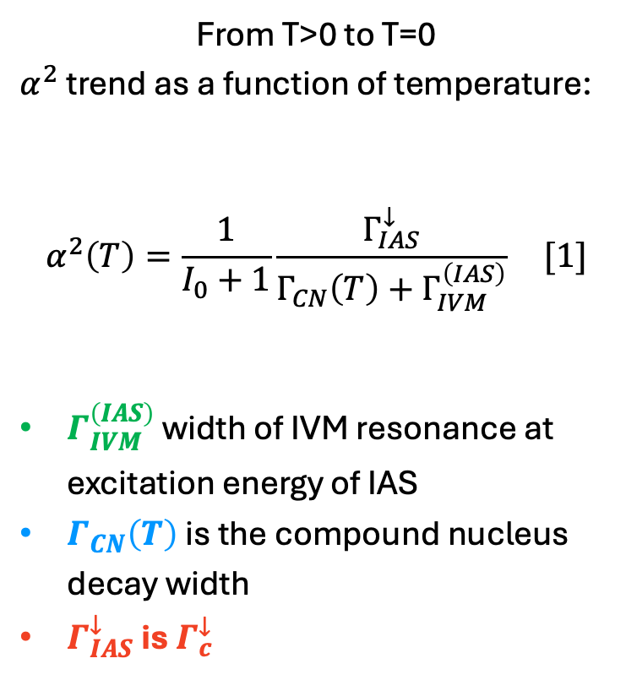

Results: $α^{2}$ MiXING PaRAMETER (I)
From T>0 to T=0
$α^{2}$ trend as a function of temperature:
$$α^{2}\left(T\right)=\frac{1}{I_{0}+1}\frac{Γ_{IAS}^{↓}}{Γ_{CN}\left(T\right)+Γ_{IVM}^{\left(IAS\right)}} [1]$$
$Γ_{IVM}^{\left(IAS\right)}$ width of IVM resonance at excitation energy of IAS
$Γ_{CN}\left(T\right)$ is the compound nucleus decay width
$Γ_{IAS}^{↓}$ is $Γ_{c}^{↓}$
$$6.0±2.0 keV$$
From Stat. Model
$200 keV$[1]
[1] G.C.H. Sagawa, P.F. Bortignon, Phys. Lett. B, 444, (1998), 1-6

Slide 51
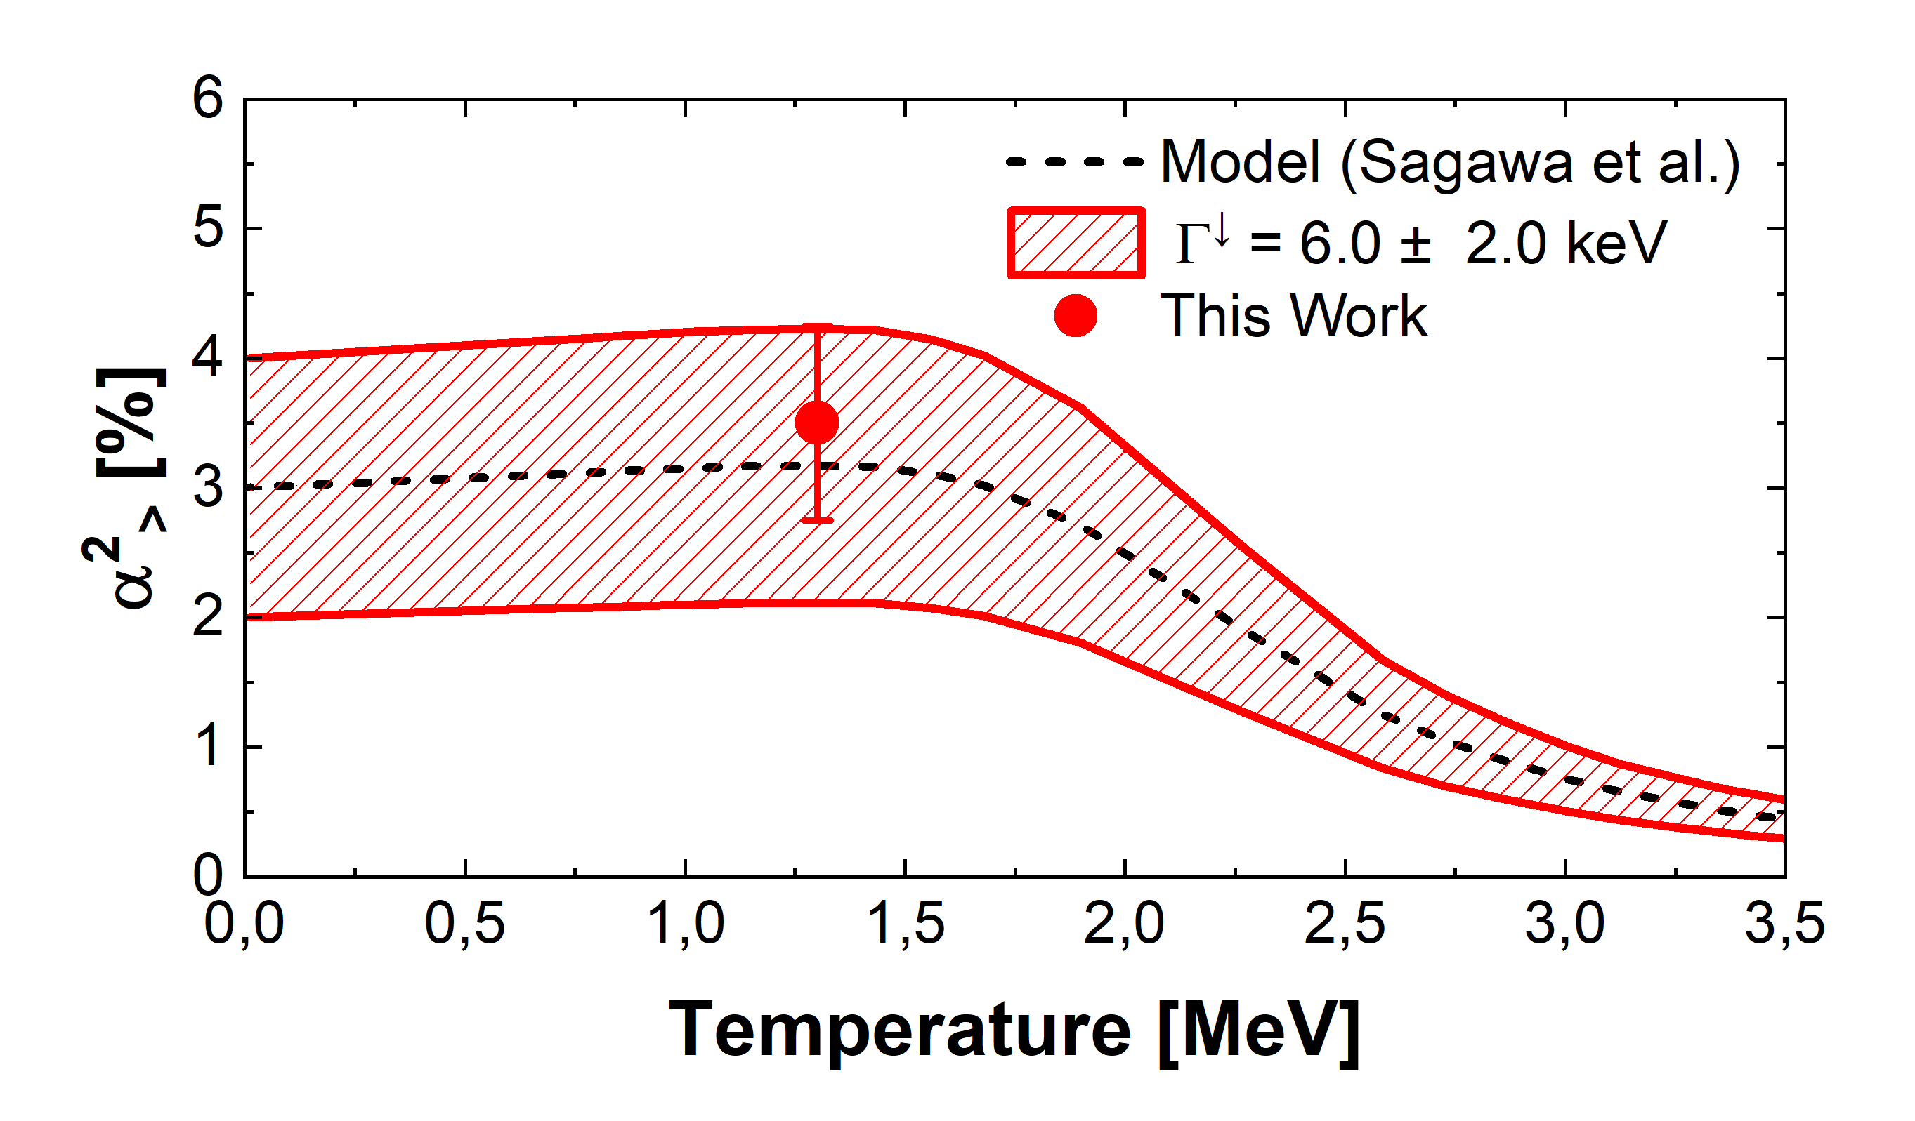
Results: $α^{2}$ MiXING PaRAMETER (I)
From T>0 to T=0
$α^{2}$ trend as a function of temperature:
$$α^{2}\left(T\right)=\frac{1}{I_{0}+1}\frac{Γ_{IAS}^{↓}}{Γ_{CN}\left(T\right)+Γ_{IVM}^{\left(IAS\right)}} [1]$$
$Γ_{IVM}^{\left(IAS\right)}$ width of IVM resonance at excitation energy of IAS
$Γ_{CN}\left(T\right)$ is the compound nucleus decay width
$Γ_{IAS}^{↓}$ is $Γ_{c}^{↓}$
$$6.0±2.0 keV$$
From Stat. Model
$200 keV$[1]
A. Giaz et al., Phys. Lett. B, 868 (2025) 13965
[1] G.C.H. Sagawa, P.F. Bortignon, Phys. Lett. B, 444, (1998), 1-6

Slide 52
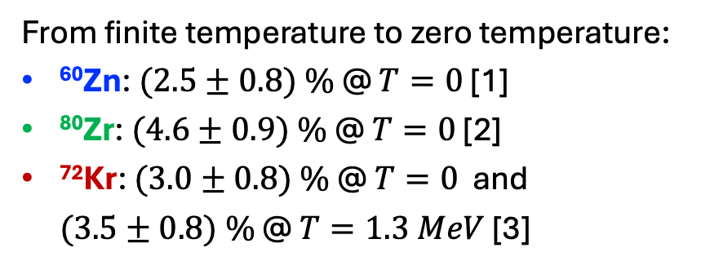
Results: $α^{2}$ MiXING PaRAMETER (II)
From finite temperature to zero temperature:
⁶⁰Zn: $(2.5±0.8) \%$ @ $T=0$ [1]
⁸⁰Zr: $(4.6±0.9) \%$ @ $T=0$ [2]
⁷²Kr: $(3.0±0.8) \%$ @ $T=0$ and
$(3.5±0.8) \%$ @ $T=1.3 MeV$ [3]
[1] G. Gosta et al., Phys. Rev. C 103, (2021) L041302
[2] S. Ceruti et al., Phys. Rev. Lett. 115, (2015) 222502
[3] A. Giaz et al., Phys. Lett. B, 868 (2025) 13965

Slide 53

Results: $α^{2}$ MiXING PaRAMETER (II)
From finite temperature to zero temperature:
⁶⁰Zn: $(2.5±0.8) \%$ @ $T=0$ [1]
⁸⁰Zr: $(4.6±0.9) \%$ @ $T=0$ [2]
⁷²Kr: $(3.0±0.8) \%$ @ $T=0$ and
$(3.5±0.8) \%$ @ $T=1.3 MeV$ [3]
Mixing Probability $α^{2}$ follows the expected trend both as a function of Mass Number (A) and Temperature
[1] G. Gosta et al., Phys. Rev. C 103, (2021) L041302
[2] S. Ceruti et al., Phys. Rev. Lett. 115, (2015) 222502
[3] A. Giaz et al., Phys. Lett. B, 868 (2025) 13965

Slide 54

RESULTS: Correction term $δ_{c}$
From $α^{2}$

Slide 55

RESULTS: Correction term $δ_{c}$
To $δ_{c}=4\left(I+1\right)\frac{V_{1}}{41ξA^{2/3}}α^{2}$ [1]
$$δ_{c}=\left(0.66±0.14\right)\%$$
From $α^{2}$
[1] N. Auerbach, Phys. Rev. C 79, 035502 (2009)

Slide 56

Summary and prespectives
SUMMARY
We measure the isospin mixing via GDR in ⁷²Kr at ELIGANT setup at the IFIN-HH Tandem (Bucharest)
We found $α^{2}=(3.5±0.8)\%$ at T=1.3 MeV and
$α^{2}=(3.0±0.8)\%$ at T=0
We obtained the correction term $δ_{c}$ $=(0.66±0.14)\%$
PRESPECTIVES
Exotic beam to reach N=Z nuclei with A > 80
Measurement of isospin mixing at T=0 via GDR throught inelastic scattering

Slide 57
Summary and prespectives
SUMMARY
We measure the isospin mixing via GDR in ⁷²Kr at ELIGANT setup at the IFIN-HH Tandem (Bucharest)
We found $α^{2}=(3.5±0.8)\%$ at T=1.3 MeV and
$α^{2}=(3.0±0.8)\%$ at T=0
We obtained the correction term $δ_{c}$ $=(0.66±0.14)\%$
PRESPECTIVES
Exotic beam to reach N=Z nuclei with A > 80
Measurement of isospin mixing at T=0 via GDR throught inelastic scattering

Slide 58
Summary and prespectives
SUMMARY
We measure the isospin mixing via GDR in ⁷²Kr at ELIGANT setup at the IFIN-HH Tandem (Bucharest)
We found $α^{2}=(3.5±0.8)\%$ at T=1.3 MeV and
$α^{2}=(3.0±0.8)\%$ at T=0
We obtained the correction term $δ_{c}$ $=(0.66±0.14)\%$
PRESPECTIVES
Exotic beam to reach N=Z nuclei with A > 80
Measurement of isospin mixing at T=0 via GDR throught inelastic scattering
Exotic Beams

Slide 59
Collaborators
Agnese Giazª, Oliver Wielandª, Angela Bracco^{b,a}, Franco Camera^{b,a}, Soichiro Aogaki^{c}, Dimiter L. Balabanskic,
Maria Brezeanu^{c}, Ruxandra Borcea^{d}, Marian Boromiza^{d}, Ion Burducea^{e}, Stefana Calinescu^{d}, Adina Coman^{d}, Paul Constantin^{c},
Cristian Costache^{d}, Michał Ciemała^{f} , Gheorghe Ciocan^{d}, Cristina Clisu^{d}, Fabio C.L. Crespi^{b,a}, Mihai Cuciuc^{c}, Anukul Dhal^{c},
Irina Dinescu^{d}, Nikolay Djourelov^{c}, Nicoleta M. Florea^{d}, Ioana Gheorghe^{d}, Decebal Iancu^{e}, Violeta Iancu^{c}, David M. Kahl^{c},
Maria Kmiecik^{f}, Aslı Kuşoğlu^{c,g}, Razvan Lica^{d}, Adam Maj^{f} , Nicolae M. Mărginean^{d}, Raluca Mărginean^{d}, Constantin Mihai^{d},
Radu E. Mihai^{d,h}, Bénédicte Millionª, Catalin Neacsu^{d}, Dragos Nichita^{c}, Cristina R. Nită^{d}, Haridas Pai^{c}, Alfio D. Pappalardo^{c}, Teodora Petruse^{c}, Adrian Rotaru^{c}, Andreea B. Serban^{c}, Pär-Anders Söderström^{c}, Cristophe O. Sotty^{d}, Anamaria Spătaru^{c},
Lucian Stan^{d}, Alexandru N. State^{c}, Alexandru Stoica^{d}, Dmitry A. Testov^{c}, Sebastian Toma^{d}, Tatiana Tozar^{c}, Andrei Turturică^{d}, Gabriel V. Turturică^{c}, Sorin Ujeniuc^{d}, Vlad Vasilca^{c}, Yi Xu^{c}, Fan Zhu^{c}
ªINFN, sezione di Milano, Via Celoria, 16, Milano, 20133, MI, Italy
^{b}Università degli studi di Milano and INFN, sezione di Milano, Via Celoria, 16, Milano, 20133, MI, Italy
^{c} Extreme Light Infrastructure-Nuclear Physics, Str. Reactorului 30, Bucharest-Măgurele 077125, Romania
^{d}Department of Nuclear Physics, Str. Reactorului 30, Bucharest-Măgurele, 077125, Romania
^{e}Applied Nuclear Physics Department, Str. Reactorului 30, Bucharest-Măgurele, 077125, Romania
^{f}The Henryk Niewodniczanski Institute of Nuclear Physics, Polish Academy of Sciences, ul. Radzikowskiego 152, Krakow, 31-342, Poland
^{g}Department of Physics, Faculty of Science, Istanbul University, Vezneciler/Fatih, Istanbul, 34134, Turkey
^{h}Institute of Experimental and Applied Physics, Czech Technical University in Prague, Husova 240/5, Prague, 110 00, Czech Republic

Slide 60

Thank you for the attention!

