Slide 1


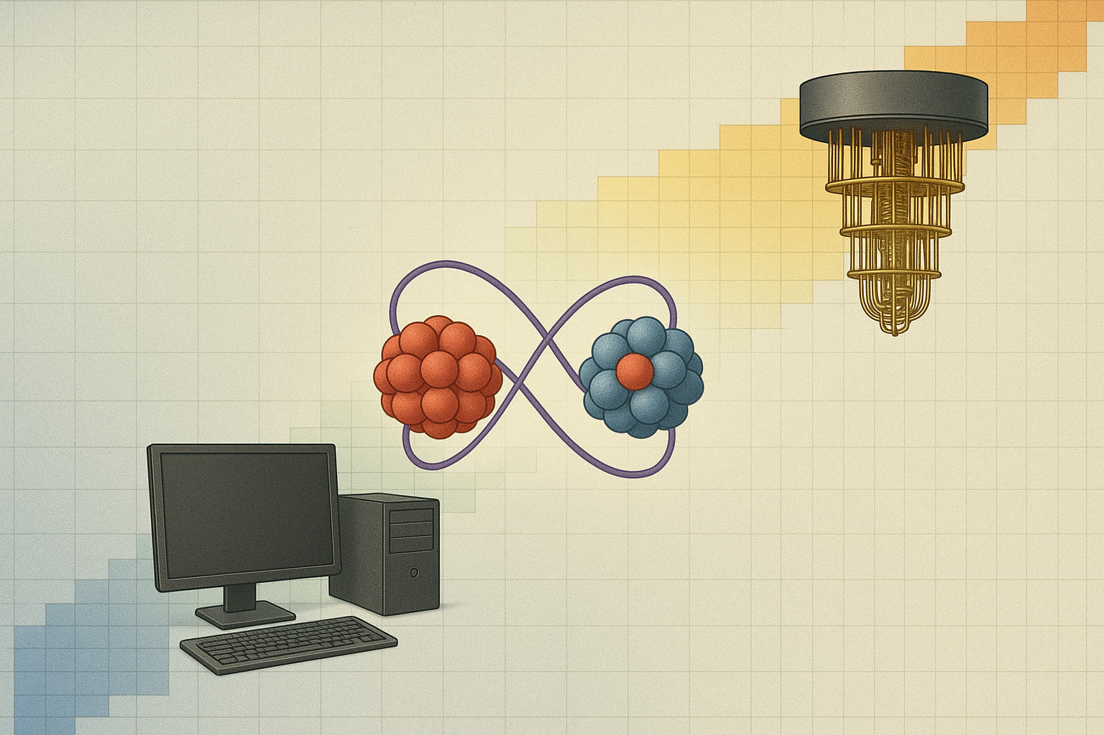


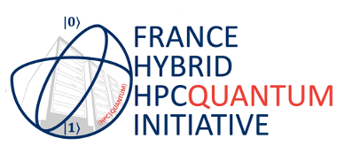
Using quantum computers
for nuclear structure studies
Denis Lacroix
Many-body physics and QC - T. Ayral, P. Besserve, D. Lacroix, and E.A. Ruiz Guzman , Quantum computing with and for many-body physics, EPJA 59 (2023)
Symmetry and QC – D. Lacroix, A. Ruiz Guzman and P. Siwach, Symmetry breaking/symmetry preserving circuits and symmetry restoration on quantum computers, EPJA 59 (2023)
CERN Quantum Initiative – Di Meglio et al., Quantum Computing for High-Energy Physics: State of the Art and Challenges, PRX Quantum 5, 037001 (2024)

Slide 2
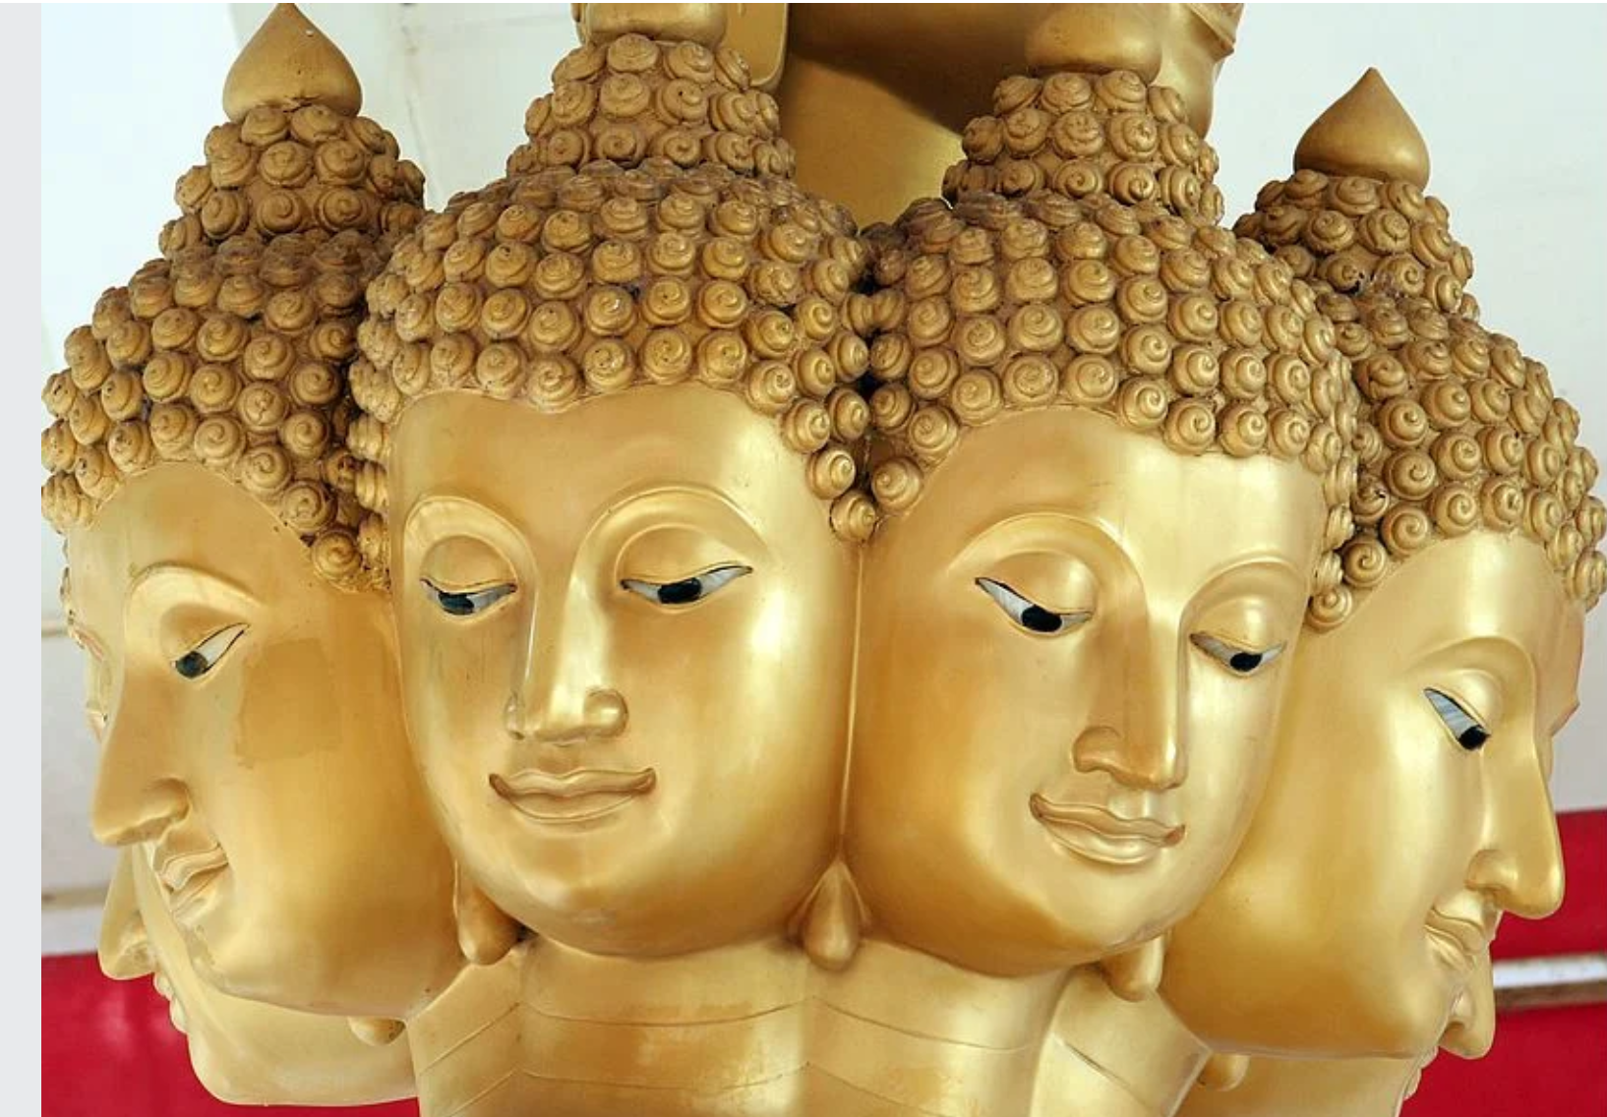
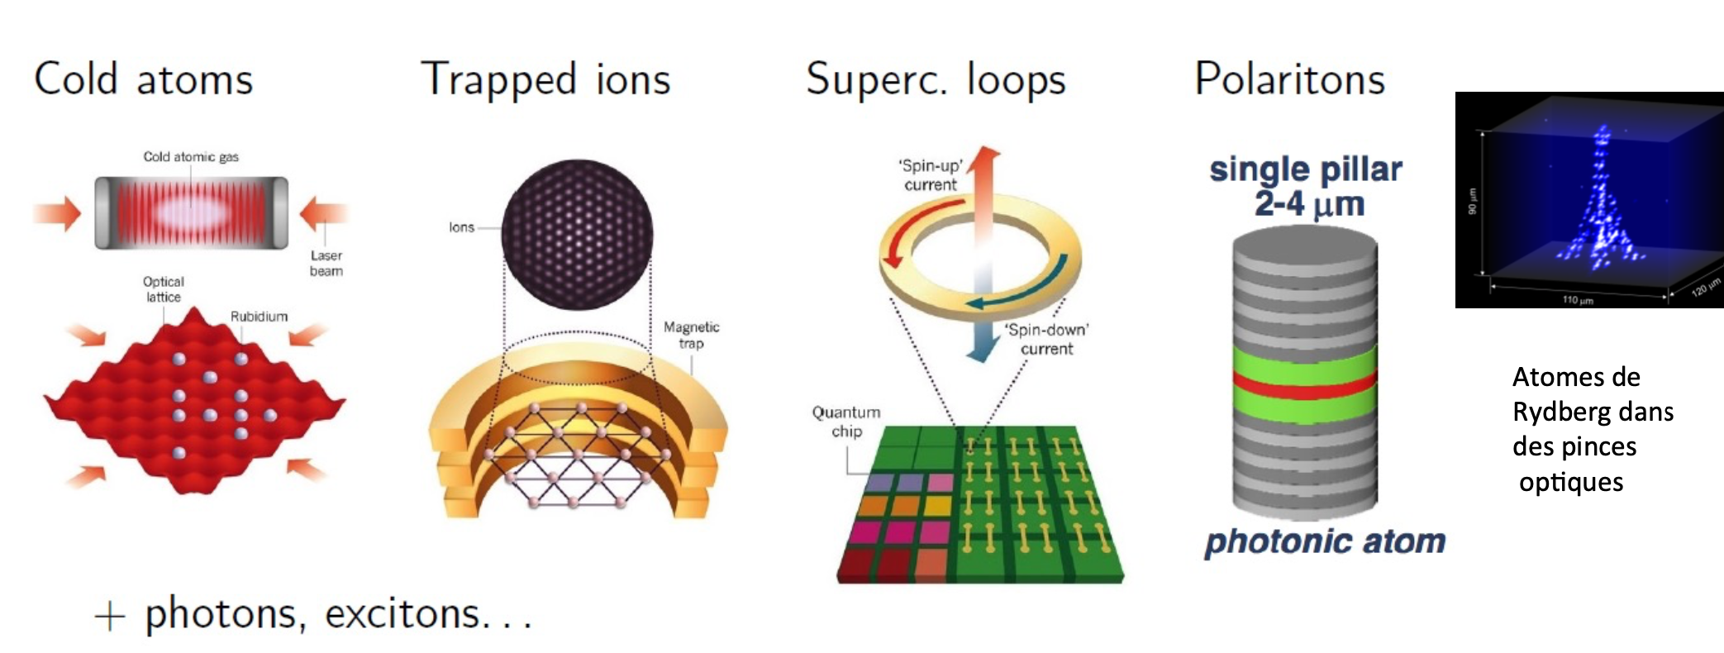
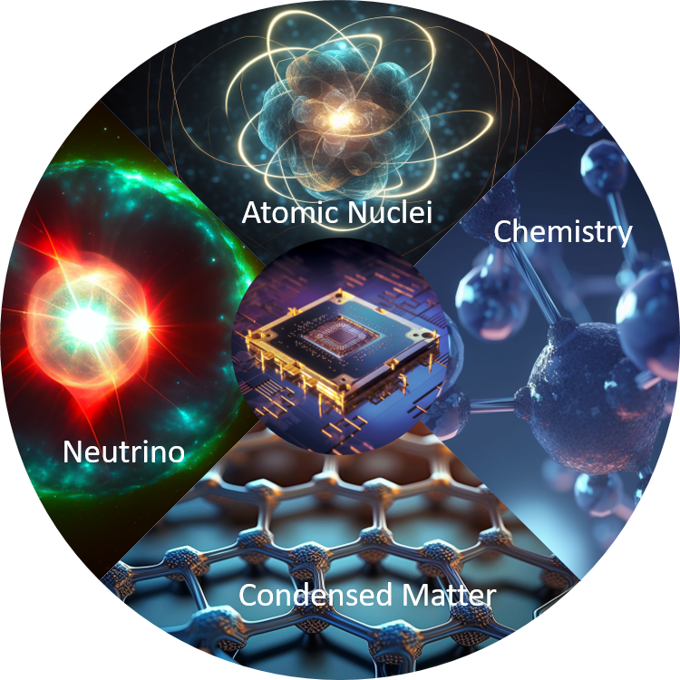
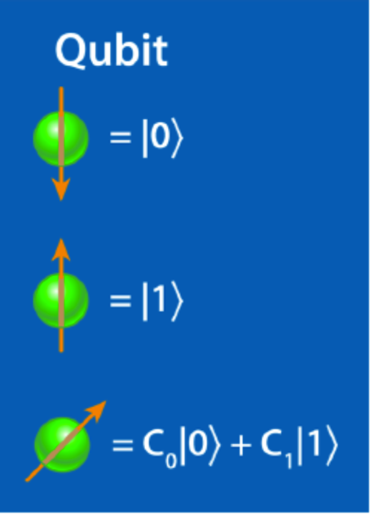
What means quantum devices today?
There are many types of quantum computers: analog versus digital quantum computers
There are now many quantum objects one can manipulate
Quantum machines are often themselves
many-body systems
Analog quantum simulator
Digital quantum simulator
Analog
Systems
Physical problem 1
Physical problem 2
Complex problem
that cannot or hardly
be simulated on
classical computers
Analog problem to 1
that could be tested
in laboratory
Non-universal
Universal Quantum simulation

Slide 3
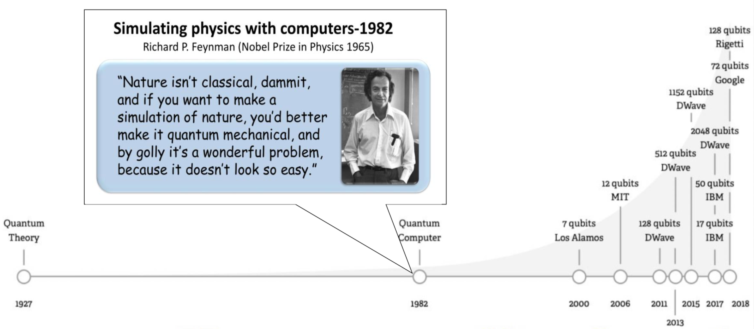
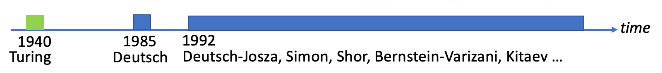
Why quantum computing is becoming mature now ?
Quantum technologies/devices
Quantum
Computing
Cloud
General Quantum mechanics
General Quantum algorithmic
faster than classical ones.
Quantum computing
is democratizing

Slide 4
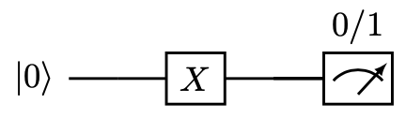
What can be done on a perfect digital quantum computer?
We can essentially solve the Schroedinger equation
Practical solution on a classical computer
In a basis
Formal solution
Schroedinger Eq. is a Linear algebra problems
time
Having information on the w.f. means measuring it.
Preparation
Manipulation
Measurement
Quantum Circuit
Arrow of time
Digital
Quantum Circuit

Slide 5
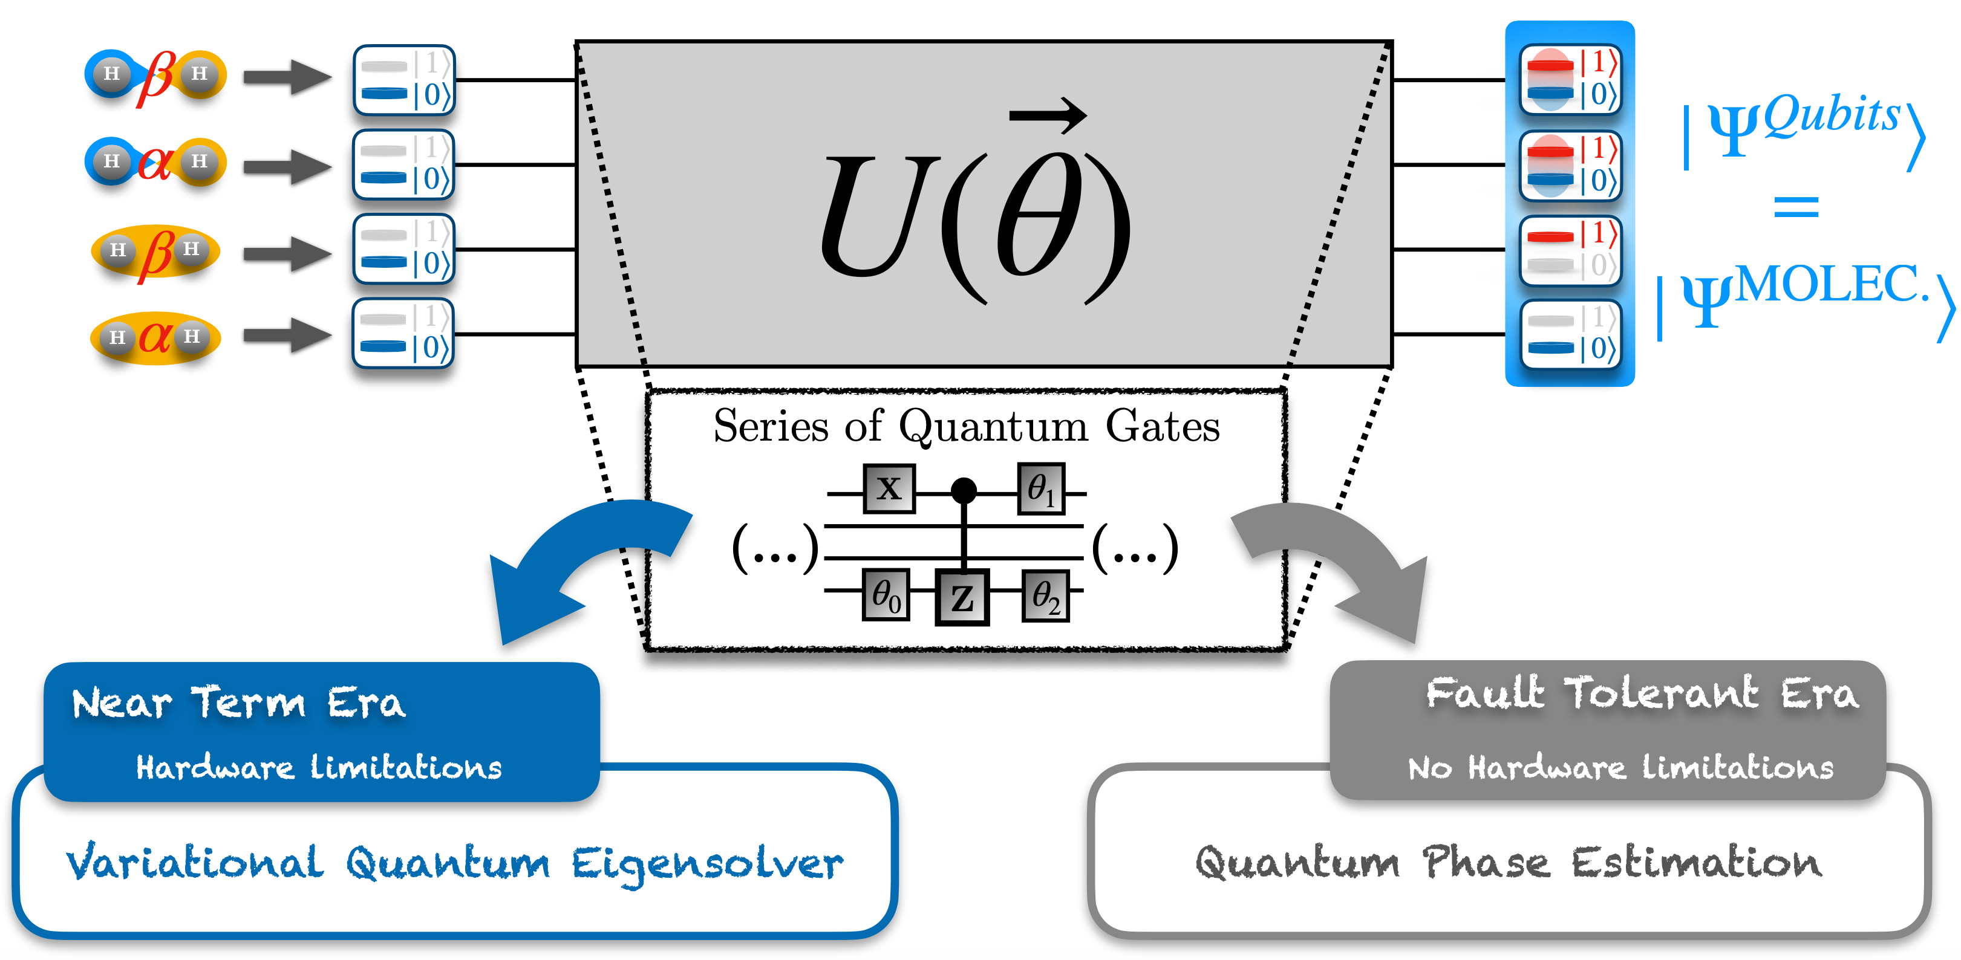
Preparation
Manipulation
Measurement
Arrow of time
Ideal circuit
State preparation and manipulation are replaced by
elementary quantum gates on one and two qubits
(credit: Y. Saad)

Slide 6
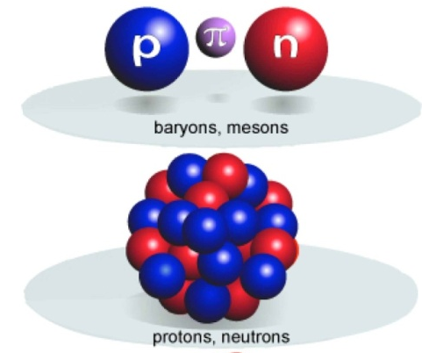
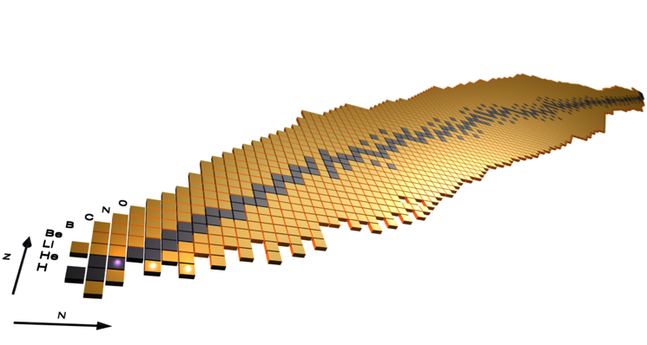
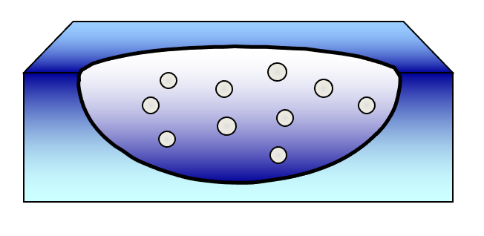
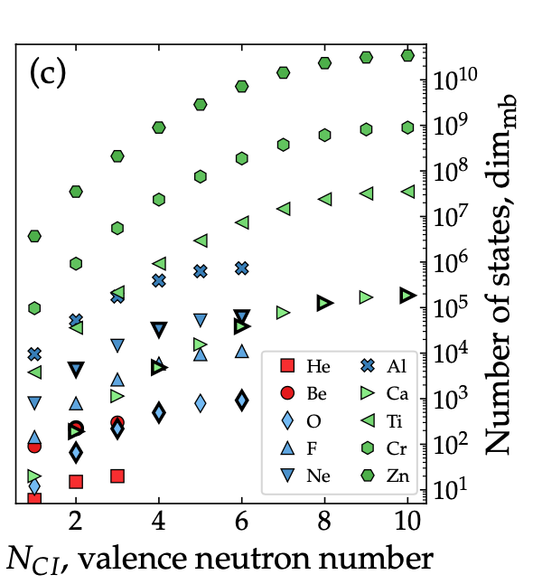
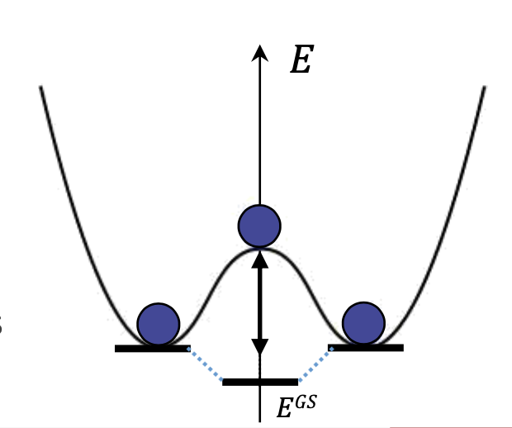
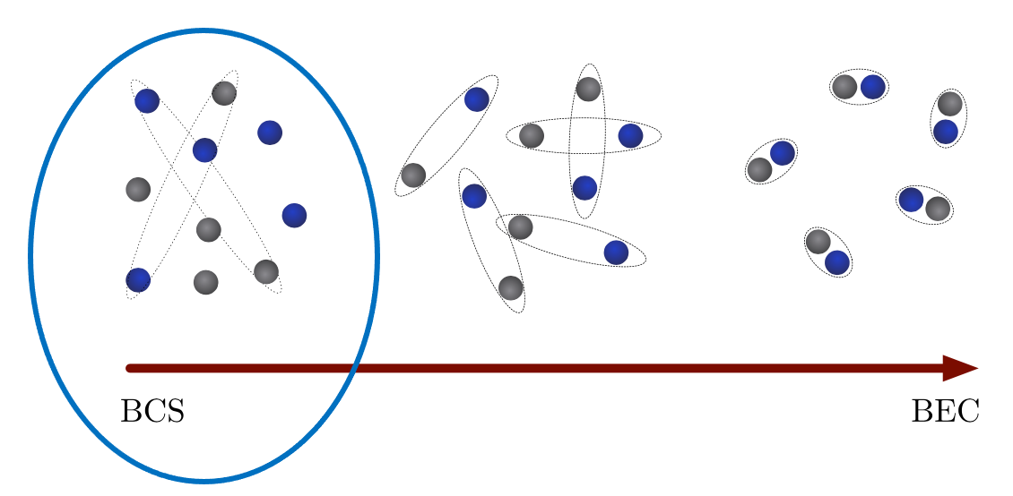
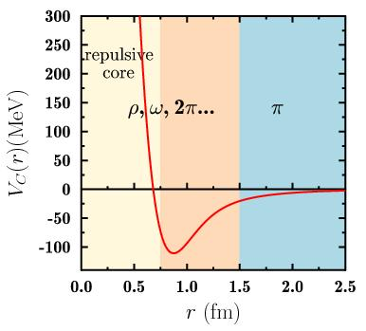
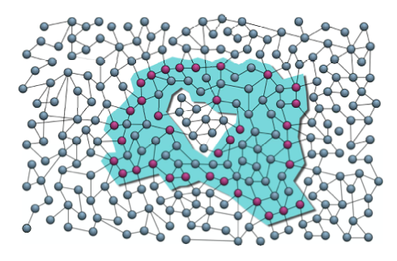
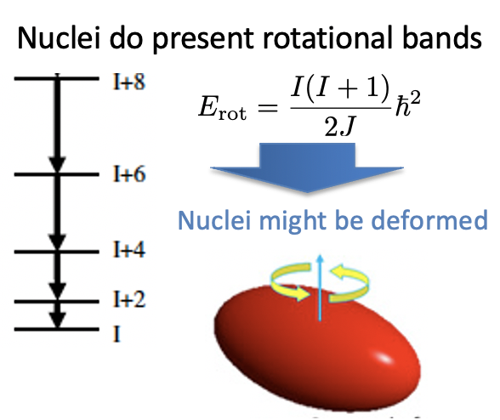
Quantum computing for the description
of static and dynamical properties of atomic nuclei
Problematic and challenges
Finding eigenstates
Nuclei are self-bound quantum
mesoscopic systems
Nb of particles
Matrix dimension to diagonalize
Spontaneous
Broken symmetries (SB)
Number of single-particle states
Small superfluid
Symmetries /Entanglement
Global symmetries induce
All-to-all entanglement
Interaction
(particle number SB)
Deformation can happen
The problem is highly
non-perturbative
Nuclei are subject to entanglement volume law
(bad candidate for Tensor Network)
(rotational invariance SB)
…

Slide 7
Pairing
Deformation
Developing variational approaches based on
symmetry-breaking (SB)/symmetry restoration (SR)
after J. Yang
1
Preparation of SB states on QC
D. Lacroix, A. Ruiz Guzman and P. Siwach,
Symmetry breaking/symmetry preserving circuits
and symmetry restoration on quantum computers
EPJA 59 (2023)
Variational optimization
2
Symmetry restoration on QC
Further
Quantum
or hybrid
Quantum-Classical
Post-processing
3
Post-processing for
Improved ground state or excited
States (QPE, Quantum Krylov, …)
3
1
Symmetry
Breaking (SB)
state
Many-Body
Which symmetries ?
Particle Number
Parity
Total Spin
2
Symmetry Restored
(SR) state (multi-reference)

Slide 8
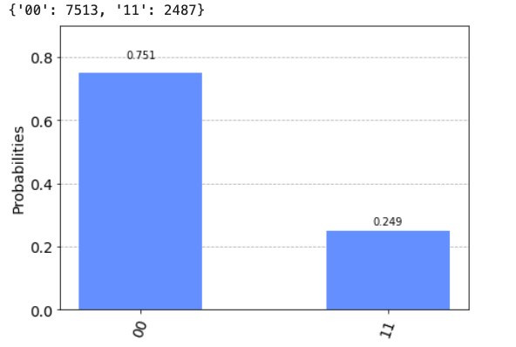
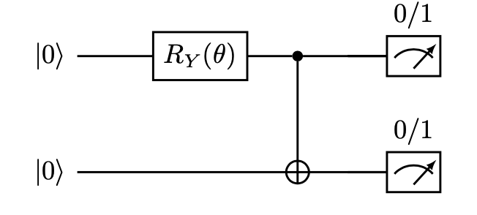

Illustration with the pairing Hamiltonian
Example
Mixes states with 0, 2, 4, … particles
BCS states are generalized Bell states
Here I created a Bell state

Slide 9
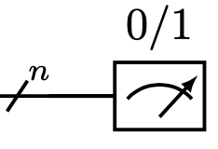
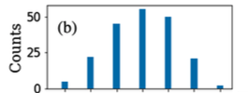

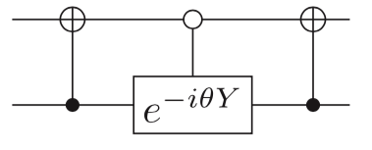
Quantum computing for atomic nuclei
Illustration for small superfluids
Example of mixing for 12 qubits
BCS circuit
0
2
4
6
8
10
12
Restoring symmetries on a quantum computer?
Symmetry
Preserving HF state
Pairing
Deformation
after J. Yang
Symmetry Breaking
(SB) state
…
Symmetry Restored
(SR) state (multi-reference)
D. Lacroix, A. Ruiz Guzman and P. Siwach,
Symmetry breaking/symmetry preserving circuits
and symmetry restoration on quantum computers
EPJA 59 (2023)

Slide 10
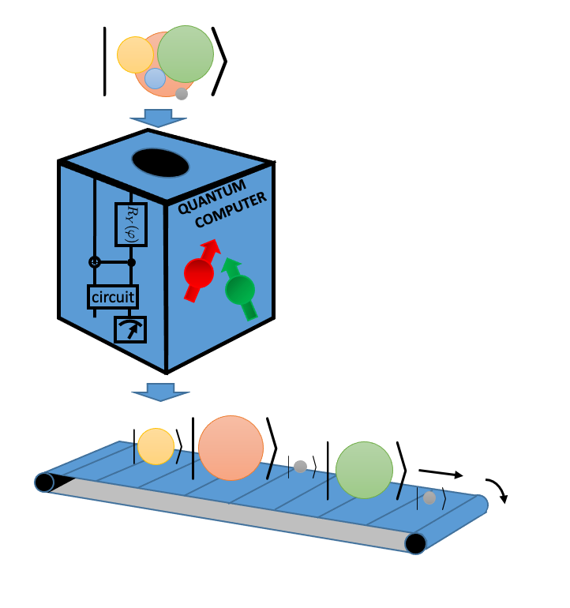
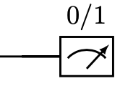
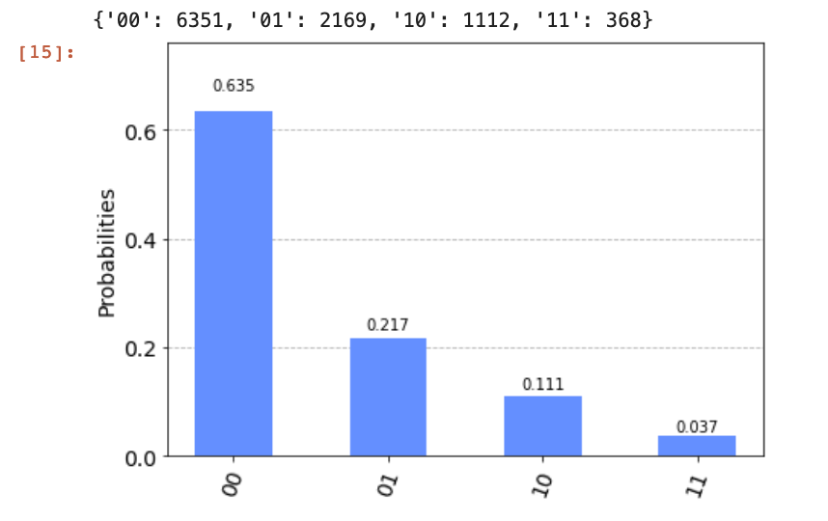
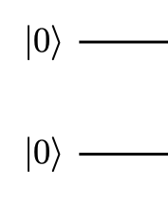
A brief overview of the symmetry restoration problem
and its solution
The particle number case
Use it for evolution,
Energy minimization, …
For 2 qubits
Difficulty – wave-function collapse
D. Lacroix, “Symmetry-Assisted Preparation of Entangled Many-Body States on a Quantum Computer”, PRL 125 (2020).

Slide 11
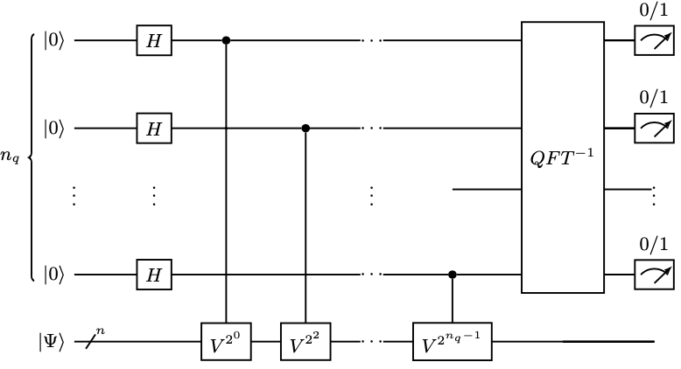
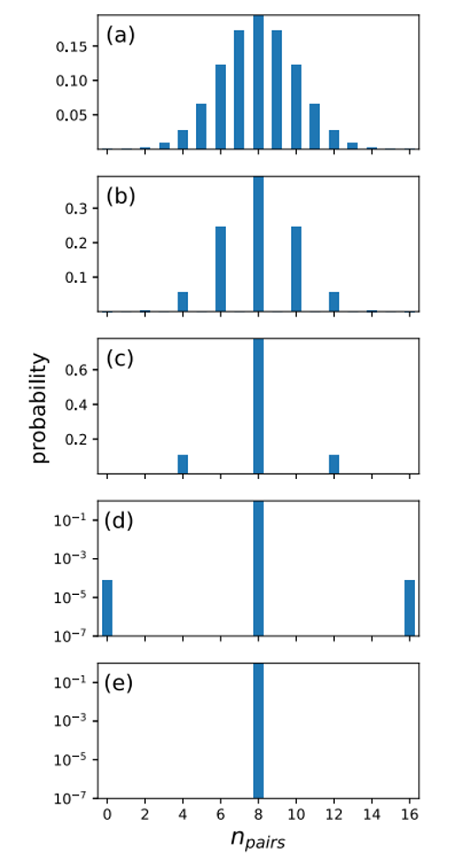
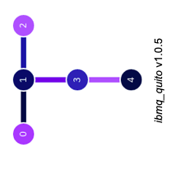
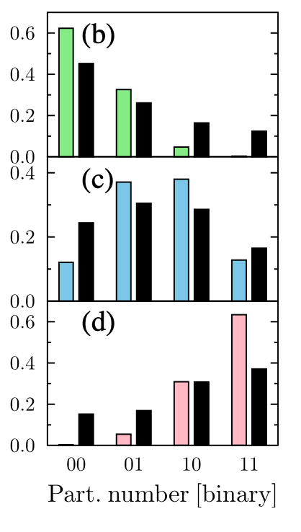
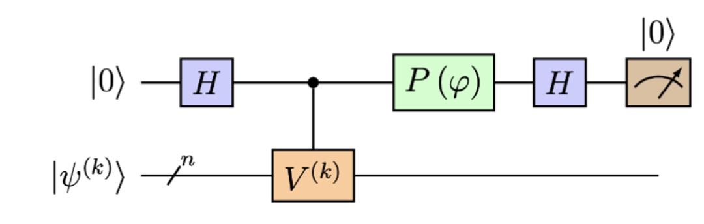
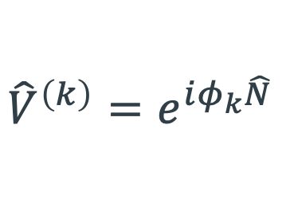
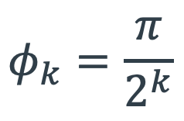
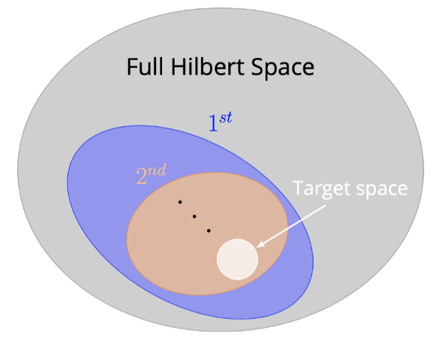

Systematic of Symmetry filtering methods
Standard Quantum Phase estimation
16 qubits, N$=8$
Send information
Test on real devices
Introduce ancillary
qubits
Make indirect
measurement
IBM Q5
(5 qubits)
Iterative Quantum Phase estimation
D. Lacroix, Phys. Rev. Lett. 125 (2020).

Slide 12
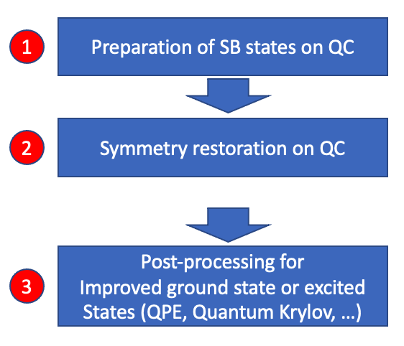
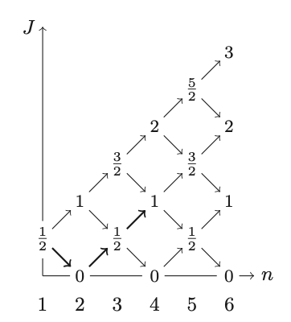

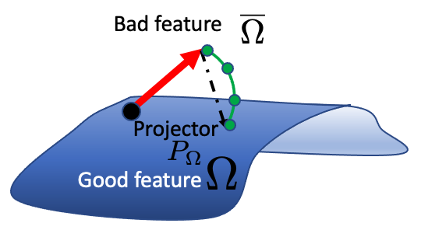
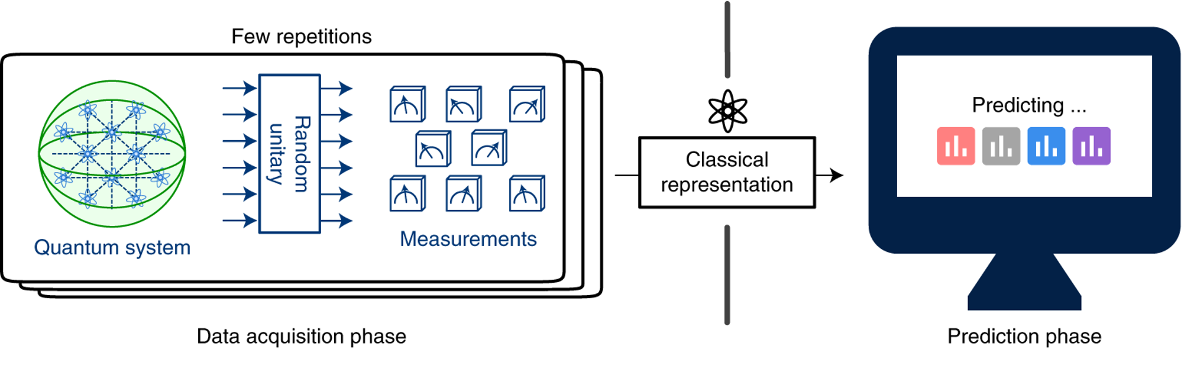
Summary of achieved work on symmetry restoration
Total spin
symmetry
P. Siwach and DL, Phys. Rev. A 104, (2021)
Ruiz Guzman, DL, Eur. J. Phys. A 60 (2024)
J. Zhang, PhD thesis Paris-Saclay Univ. (2025)
Various methods being developed
2
Restoring symmetries
-With phase-estimation
D. Lacroix, PRL 125, 230502 (2020).
-Using quantum Oracles
Ruiz Guzman, Lacroix, PRC 107 (2023)
-Using classical
post-processing
(shadows)
Ruiz Guzman, Lacroix, Eur. J. Phys. A 60 (2024)

Slide 13
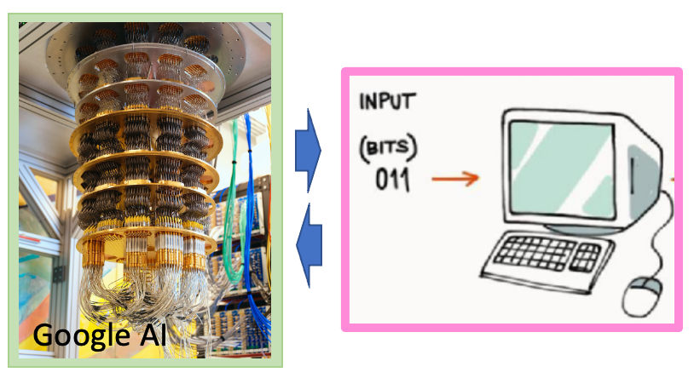
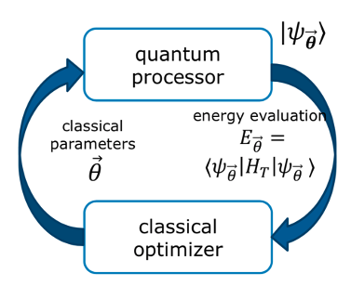
Classical optimization
Coming back to our superconducting problem
Combining projection with variational method
Symmetry
Preserving
(HF)
Quantum-Classical optimizers
SB state
Standard BCS theory
BCS
Q-PAV
Q-VAP
Project after optimization
Q-PAV: Quantum Projection
After Variation
SB state
projection
By QPE
8 particles on 8 equidistant levels
SB+projection
By QPE
Percentage of error
superfluid
The optimization is made on the
Symmetry restored state.
Q-VAP: Quantum Variation
After Projection
normal
Ruiz Guzman and Lacroix, PRC 105 (2022)

Slide 14
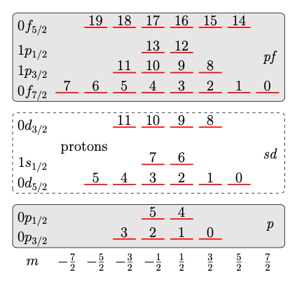
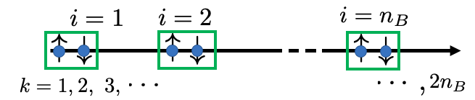
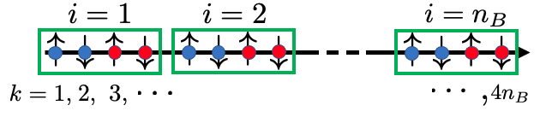
Getting closer to realistic problems
Is the breaking of symmetries always a good idea?
Most tests up to know were made on
Particles with spins (s).
But nuclei have both spin (s) and isospin (t) (neutron/proton)
This increases the number of qubits
This increases the number of symmetries that could be broken
Symmetry-breaking states become extremely hard to control
Symmetry restoration becomes very demanding
J. Zhang, PhD thesis Paris-Saclay Univ. (2025).

Slide 15
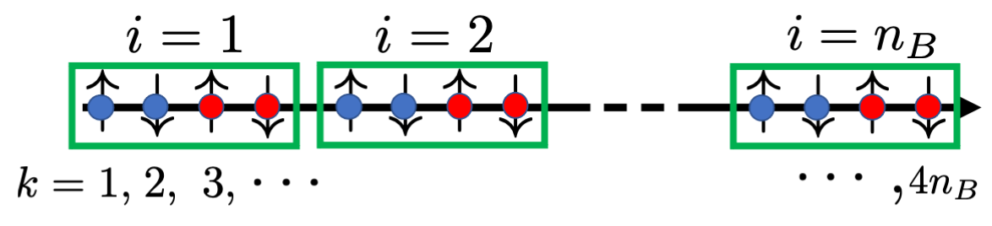
Going beyond traditional nuclear physics methods: Use of adaptative methods
Iterative construction of the ansatz
ADAPT-VQE applied to the
Superfluid problems: only spins
Grimsley, et al, Nat. Commun. 10 (2019)
Start from a state
Built iteratively the ansatz such as:
Such that
is maximum
ADAPT-VQE w/o SB
J. Zhang, D. Lacroix, and Y. Beaujeault-Taudière, PRC (2025)
Extension to
spin and isospin
0
1
2
3
4
5
6

Slide 16
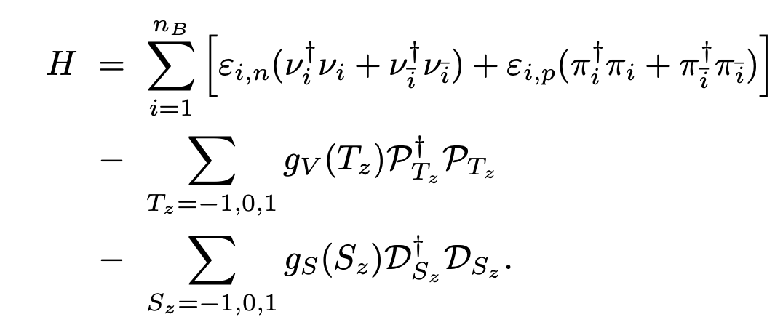
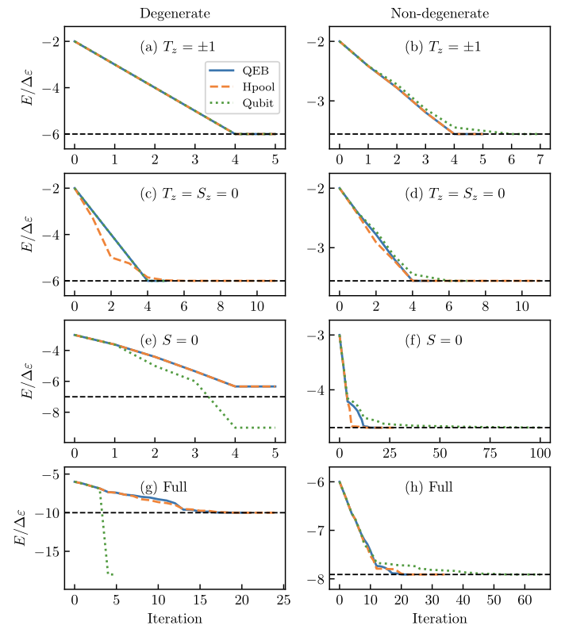
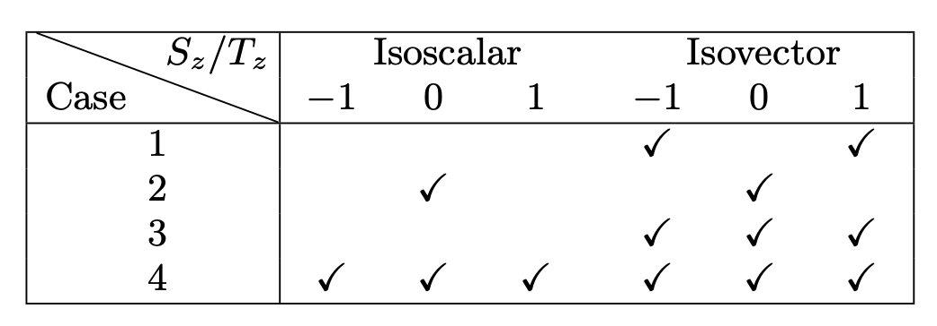
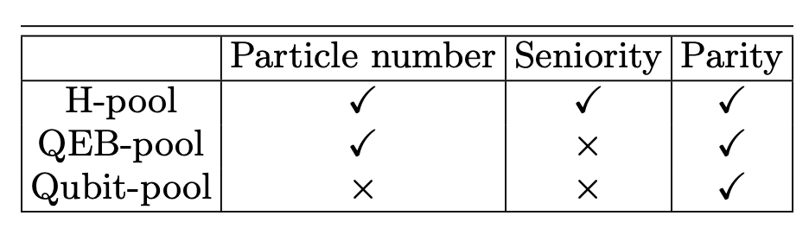
Is breaking symmetries always a good idea?
Extension to the proton-neutron pairing Hamiltonian problem
4 particles on 12 qubits
Different Hamiltonian limit
Different operator pool in ADAPT-VQE breaking or not symmetries
J. Zhang, D. Lacroix, and Y. Beaujeault-Taudière, PRC 110 (2024)

Slide 17



Specific methods to improving convergence
Going closer to nuclei: adding isospin
Embedding
Fictitious
set of qubits
Initial condition
Randomization
Initial random
entangler
J. Zhang, D. Lacroix and Y. Beaujeault-Taudière, PRC 110 (2024)

Slide 18



From ground state only to excited states
The states generated during the convergence
contain information on excited states
We used these states in a Quantum Subspace
Diagonalization method (QSD)
…
2nd excited
1st excited
GS
molecule dissociation
Applications
J. Zhang, D. Lacroix, Phys. Lett. B 869 (2025)
Neutron-proton pairing
H
H
H
H
H
H
H
H

Slide 19





Green’s function estimated with a quantum computer
Green’s function matrix elements
Lehman representation
Illustration with the pairing Hamiltonian
S. Aychet Claisse, D. Lacroix, V. Somà, Phys. Rev. C 113 (2026)

Slide 20



Ongoing work- Quantum simulation of nuclei on lattices
lattice
Number of single-particle states:
(here )
Pionless EFT Hamiltonian
[Bedaque, van Kolck 2002]
Kinetic-non local
Two-body local
Three-body local
Preliminary
Gu, Heinz, Kiss, Papenbrock, Phys. Rev. C 113 (2026)
A. Singh, D. Lacroix, (in preparation )

Slide 21










Discussion and summary
The field of quantum algorithms for many-body systems is evolving rapidly.
Experimental quantum computing platforms are improving constantly.
Symmetry problem
Traditional shell-model
Lattice pionless EFT

Slide 22




































Special Thanks to
PhD students/postdocs
E. A. Ruiz Guzman
Y. Beaujeault-Taudiere
J. Zhang
S. Aychet Claisse
C. de Correc
R. Bocquet
A.Singh
Collaborators
M. Mangin Brinet
B. Balantekin
A. Roggero
O. Kiss
F. Tavernelli
F. Tacchino
Vittorio Somà
P. Siwach
T. Ayral
P. Besserve
C. Bertrand
F. Jamet
B. Senjean
Jesus pascual Casado
Laura Oliveira Atencio
S. Baid

Slide 23
Additional discussions
(applications to real quantum computers)

Slide 24






Today’s applications
Simplified Shell Model applications on real quantum computers
Hard-core Boson mapping
Wave preparation
After optimal
solution
Is found
+ Observable
Energy gradients
Optimization
Build the
Approximate GS
Compute observable
RIKEN-Quantinuum’s
Reimei device
(trapped Ion)
Sota Yoshida, Takeshi Sato, Takumi Ogata, Masaaki Kimura, Phys. Rev. Res. (2026)

Slide 25







Beam 1
A focus on neutrino oscillation physics simulated
on quantum computers
Illustration of the Hamiltonian (2 flavor approx)
Beam 2
Beam 3
Oscillation
Coupling
12 neutrinos
Quantinuum’s H1-1
20 qubit trapped-ion
12 neutrinos / qutrits
H1-1 & ibm_torino
4 & 8 neutrinos
HQD-H1
Trapped Ion device
4 neutrinos
IBM-Vigo QPU
Illa et al, PRL 130 (2023)
Turro et al,
PRD D 111 (2025)
Amitrano,et al, PRD 107, (2023)
Hall et al, PRD 104 (2021)

Slide 26




A focus on neutrino oscillation physics simulated
on quantum computers
Phase-Space approach
Matrix Product State
Lacroix et al, Phys Rev. D106 (2022),
Phys Rev D110 (2024).
200 qubits
Mangin Brinet, DL,
Phys. Rev. D 113 (2026)
300 qutrits
De Correc et al,
APS Open science 1, (2026)
2000 qubits
>100 neutrinos
IBM machines
12 neutrinos / qutrits
H1-1 & ibm_torino
12 neutrinos
Quantinuum’s H1-1
4 & 8 neutrinos
HQD-H1
Trapped Ion device
Neutrino thermalization time
4 neutrinos
IBM-Vigo QPU
(IBM hardware)
Turro, PRD 111 (2025)
Illa, PRL 130 (2023)
Kiss, Tavernelli, Tacchino, Lacroix,
Roggero, nature com., arxiv:2510.24841
Hall, PRD 104 (2021)
Amitrano, PRD 107 (2023)

