Slide 1

59th Zakopane Conference on Nuclear Physics
30 August to 6 September 2026, Zakopane
Microscopic description of multinucleon transfer reactions with relativistic TDDFT:
mass and spin distributions
Dandan Zhang
Institute of Theoretical Physics, Chinese Academy of Sciences
Sep. 1, 2026
Collaborators: B. Li, J. Meng, T. Nikšić, Z. X. Ren, D. Vretenar, P. W. Zhao

Slide 2
Contents
Introduction
Relativistic time-dependent density functional theory
Multinucleon transfer reaction
  Mass distribution
  Angular momentum distribution
Summary and outlook

Slide 3
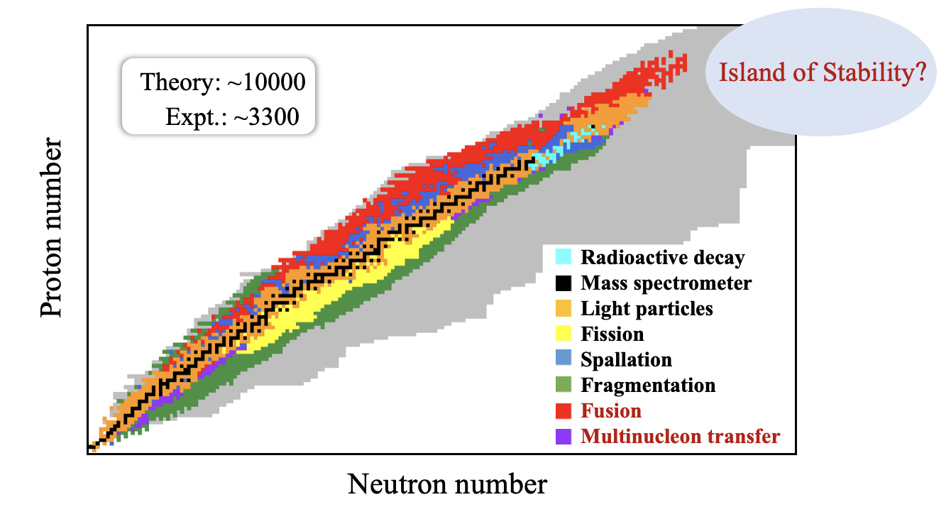

Heavy-ion reactions
Heavy-ion reactions, induced by ions heavier than $α$ particles, are one of the important methods for synthesizing new nuclides.
Fusion: synthesizing superheavy nuclei (SHN).
Multinucleon transfer (MNT) reactions: synthesizing neutron-rich nuclei.
Thoennessen, The Discovery of Isotopes (2016)
Xia et al., ADNDT 121, 1 (2018)
Jiang, DDZ, Zhou. Physics 54, 599 (2025)

Slide 4
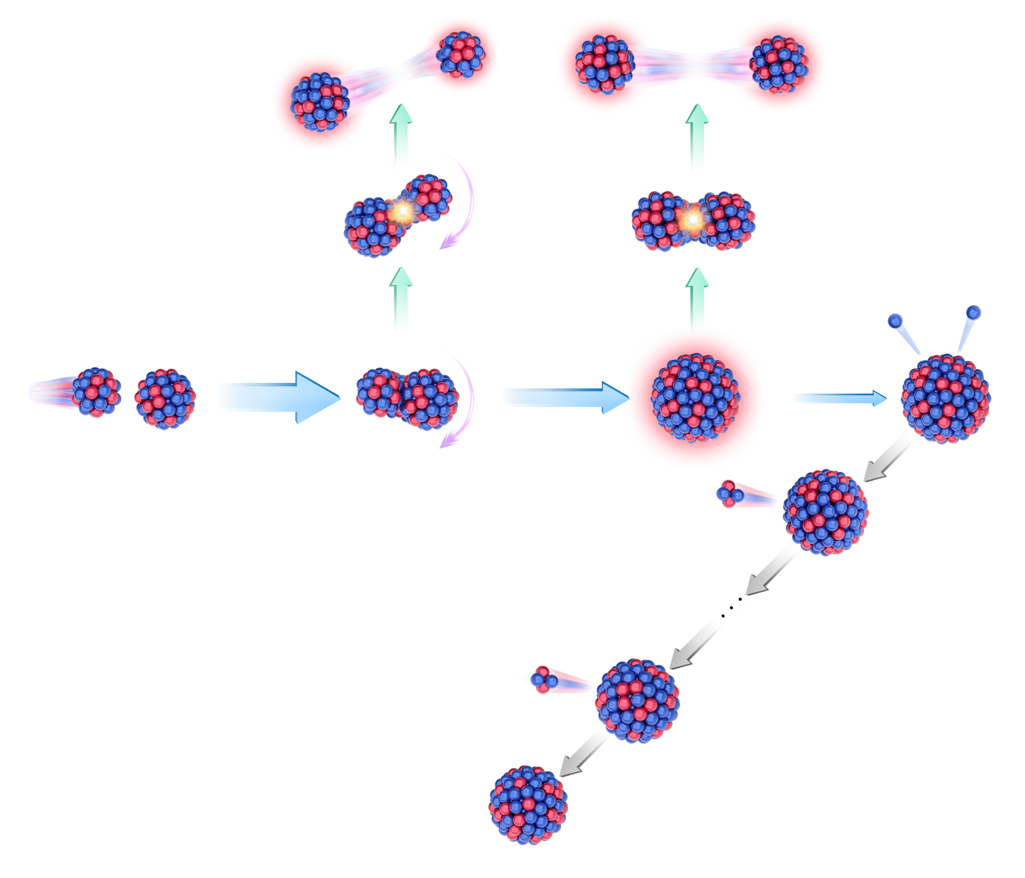
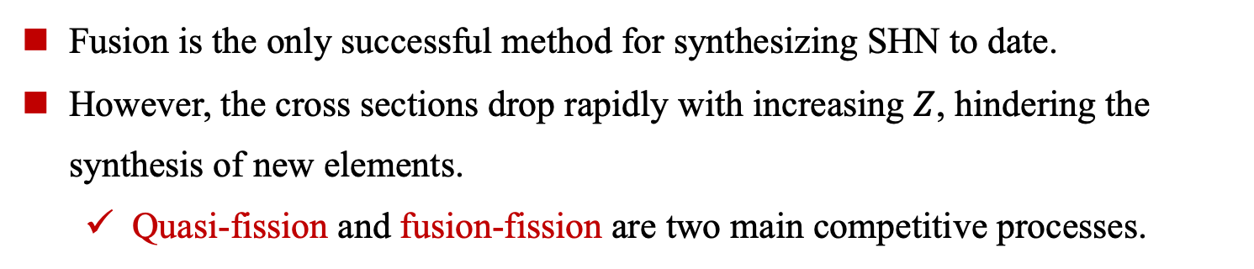
Fusion: Neutron-deficient superheavy nuclei
Fusion is the only successful method for synthesizing SHN to date.
However, the cross sections drop rapidly with increasing $Z$, hindering the synthesis of new elements.
  Quasi-fission and fusion-fission are two main competitive processes.
Münzenberg et al., EPJA 59, 21 (2023)
Oganessian, EPJA 60, 227 (2024)
Zhang et al., NST 36, 204 (2025)
Quasi-fission
Fusion-fission
Jiang, DDZ, Zhou. Physics 54, 599 (2025)

Slide 5
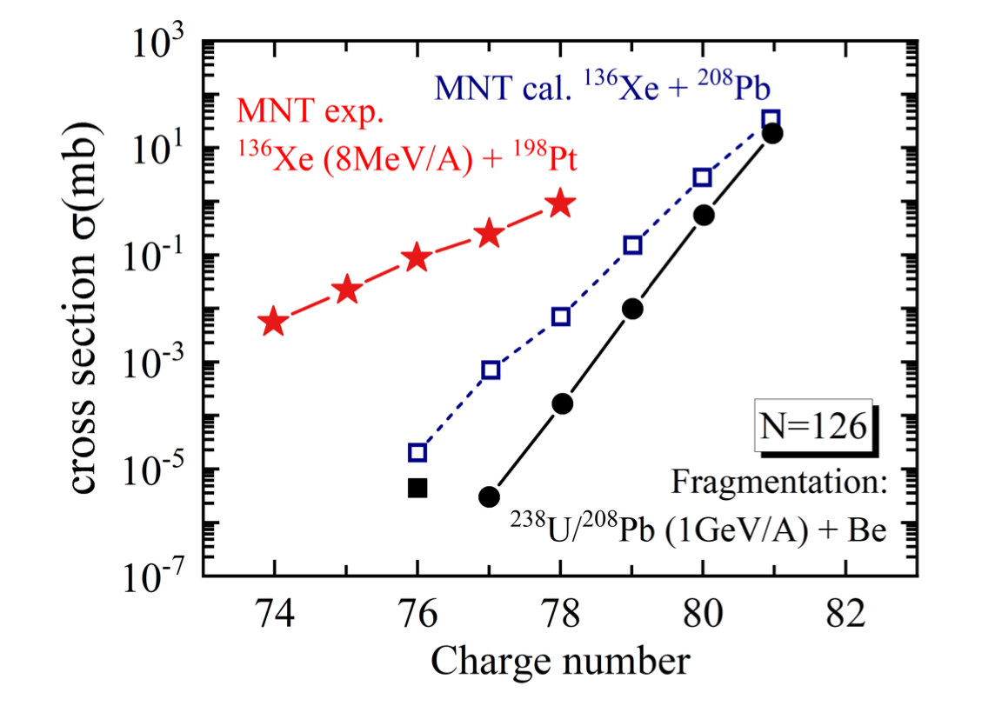
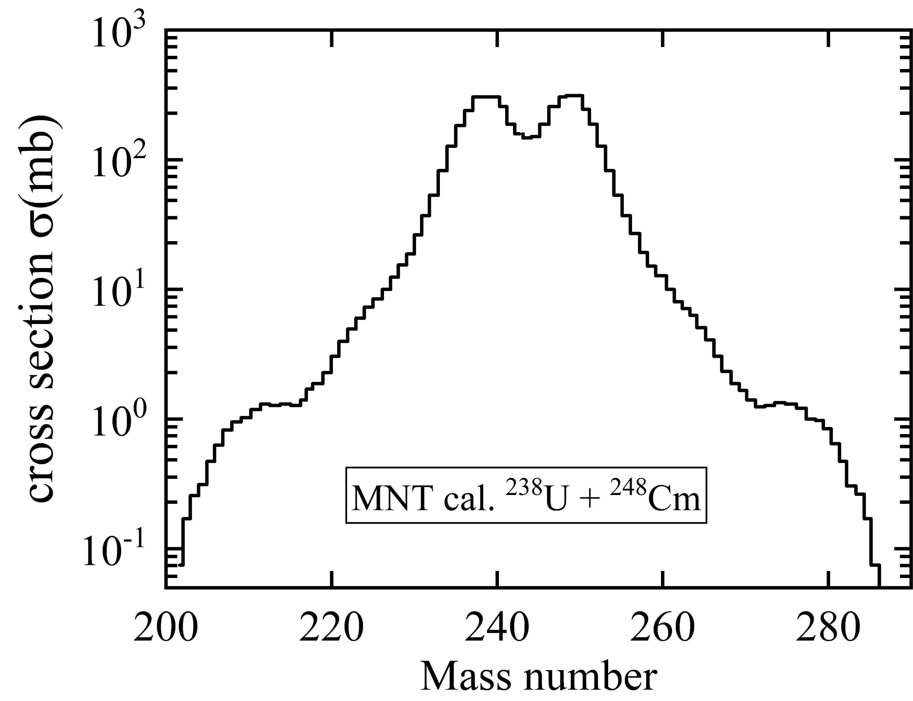
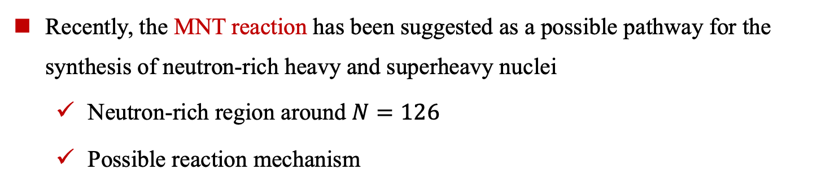
MNT: Neutron-rich nuclei
Recently, the MNT reaction has been suggested as a possible pathway for the synthesis of neutron-rich heavy and superheavy nuclei
  Neutron-rich region around $N=126$
  Possible reaction mechanism
Complex mass and angular distributions!
²³⁸U
²⁴⁸Cm
²⁰⁸Pb
SHE
Shell effect
Zagrebaev and Greiner, PRL 101,122701 (2008)
Watanabe et al., PRL 115,172503 (2015)
Zagrebaev and Greiner, JPG 34, 2265 (2007)
Zagrebaev and Greiner, PRC 87, 034608 (2013)

Slide 6
Theoretical models for MNT reactions
The multinucleon transfer process is a complex quantum many-body dynamical problem. A broad range of theoretical approaches has been developed:
  Coupled channels
  Dinuclear System Model
  GRAZING Model
  Langevin Model
  (Improved) Quantum Molecular Dynamics
  Time-Dependent Density Functional Theory (TDDFT)
  Stochastic Mean-Field / TDRPA
  Other approaches
Thompson, Comput. Phys. Rep. 7, 167 (1988); Scamps & Hagino, PRC 92, 054614 (2015)
…
Adamian, Antonenko, and Scheid, NPA 618, 176 (1997); Adamian et al., NPA 633, 409 (1998)
Adamian et al., PRC 81, 024604 (2010); Feng, PRC 95, 024615 (2017); Zhu et al., JPG 42, 085102 (2015)
…
Winther, NPA 572, 191 (1994); Yanez and Loveland, PRC 91, 044608 (2015);Wen et al., PRC 99, 034606 (2019)
…
Zagrebaev and Greiner, PRL 101, 122701 (2008); Zagrebaev and Greiner, PRC 78, 034610 (2008)
Zhu, PLB 849, 138423 (2024); Dai et al., PRC 109, 024617 (2024)
…
Wang et al., PRC 65, 064608 (2002); Li et al., PRC 93, 014618 (2016); Zhao et al., PRC 92, 024613 (2015)
…
Simenel, PRL 105, 192701 (2010); Sekizawa and Yabana, PRC 88, 014614 (2013)
Zhang et al., PRC 109, 024614 (2024); Li et al., PRC 110, 034611 (2024)
Zhang et al., PLB 869, 139828 (2025)
…
Simenel, PRL 106, 112502 (2011); Ayik et al., PRC 97, 054618 (2018);
Yilmaz et al., PRC 98, 034604 (2018); Sekizawa and Ayik, PRC 102, 014620 (2020);
Gao, Sekizawa, and Zhu, PRC 112, 014602 (2025);…

Slide 7
Contents
Introduction
Relativistic time-dependent density functional theory
Multinucleon transfer reaction
  Mass distribution
  Angular momentum distribution
Summary and outlook

Slide 8
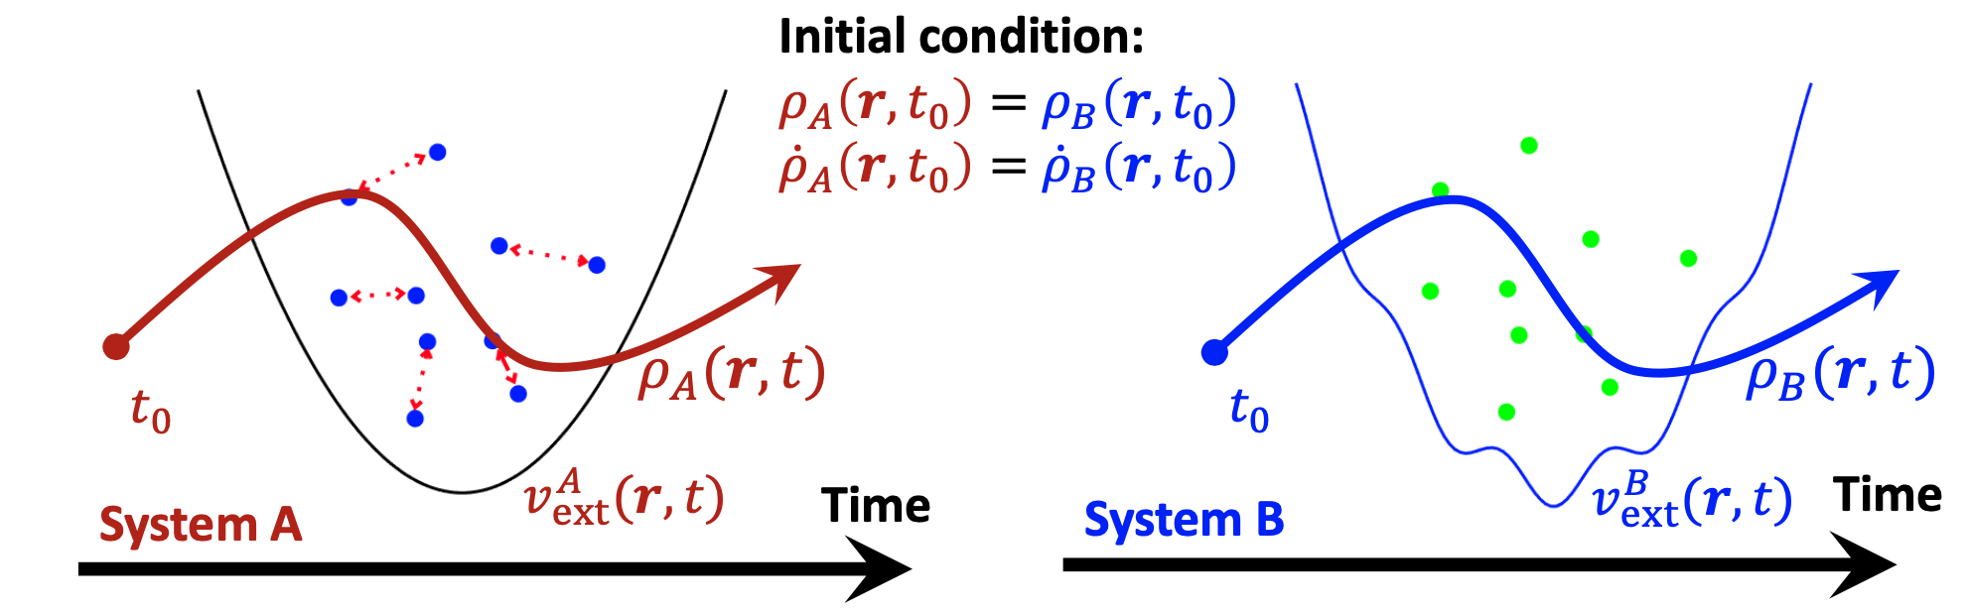
Relativistic TDDFT
Relativistic TDDFT has been developed and applied to a series of nuclear dynamical phenomena.
Idea: Transforming the time-dependent many-body problem to a time-dependent one-body problem.
Li, Vretenar, Ren, Nikšić, Zhao, Zhao, Meng, PRC 107, 014303 (2023)
Li, Vretenar, Nikšić, Zhao, Meng, PRC 110, 034302 (2024)
Li, Zhao, Meng, PLB 856, 138877 (2024)
DDZ, Vretenar, Nikšić, Zhao, Meng, PRC 109, 024614 (2024)
DDZ, Li, Vretenar, Nikšić, Ren, Zhao, Meng, PRC 109, 024316 (2024)
DDZ, Vretenar, Nikšić, Zhao, Meng, PLB 869, 139828 (2025)
DDZ, Li, Vretenar, Nikšić, Ren, Zhao, Meng, PRC 114, 014628 (2026)
Ren, Zhao, and Meng, PRC 102, 044603 (2020)
Ren, Zhao, and Meng, PLB 801, 135194 (2020)
Ren, Zhao, and Meng, PRC 105, L011301 (2022)
Ren, Zhao, Vretenar, Nikšić, Zhao, Meng, PRC 105, 044313 (2022)
Ren, Vretenar, Nikšić, Zhao, Zhao, Meng, PRL 128, 172501 (2022)
Runge and Gross, PRL 52, 997(1984)
Leeuwen, PRL 82, 3863(1999)
Time-dependent many-body problem
Time-dependent one-body problem
Figure is taken from Z. X. Ren

Slide 9
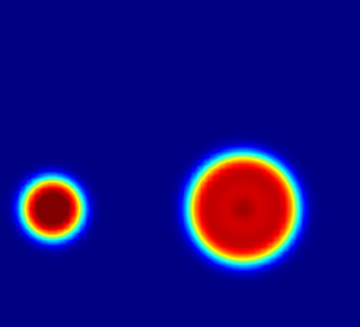
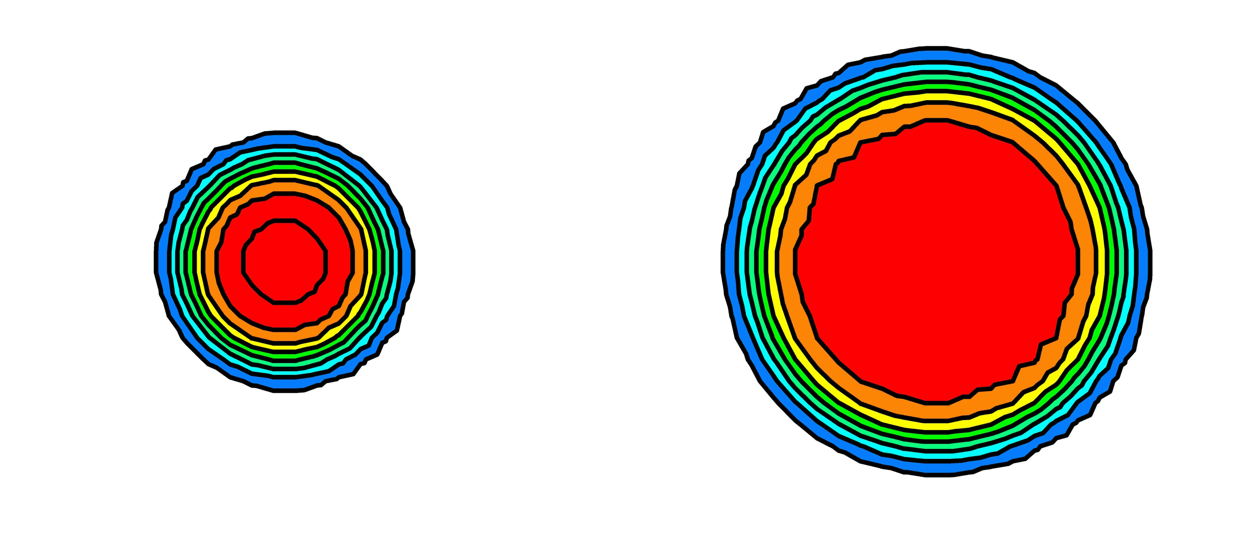



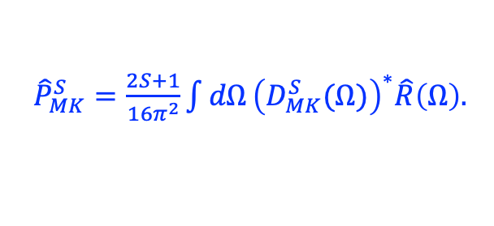
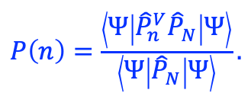
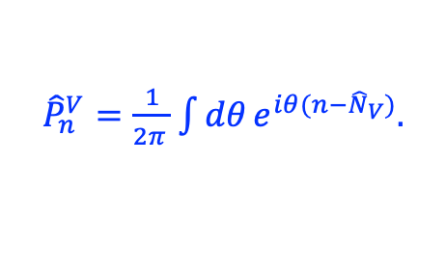
Particle number and angular momentum projection
TDDFT gives the most probable reaction path, and the wavefunction of reaction products typically lacks well-defined quantum numbers (particle number, spin)
We extended relative TDDFT to include particle number projection and angular momentum projection.
DDZ, Vretenar, Nikšić, Zhao, Meng, PRC 109, 024614 (2024)
DDZ, Vretenar, Nikšić, Zhao, Meng, PLB 869, 139828 (2025)
Particle number projection
Angular momentum projection
Particle number projection operator:
Angular momentum projection operator:
${\hat{P}}_{n}^{V}=\frac{1}{2π^{ }}\int{dθ}e^{iθ(n−{\hat{N}}_{V})}.$
${\hat{P}}_{MK}^{S}=\frac{2S+1}{16π^{2}}\int{dΩ}{\left(D_{MK}^{S}(Ω)\right)}^{∗}\hat{R}\left(Ω\right).$
$P\left(n\right)=\frac{\left\langle Ψ | {\hat{P}}_{n}^{V}{\hat{P}}_{N}^{ } | Ψ\right\rangle }{\left\langle Ψ | {\hat{P}}_{N}^{ } | Ψ\right\rangle }.$
$P(n)=\left\langle Ψ | {\hat{P}}_{n}^{V} | Ψ\right\rangle$,
$$P(S,K)=\left\langle Ψ | {({\hat{P}}_{MK}^{S})}^{+}{\hat{P}}_{MK}^{S} | Ψ\right\rangle$$
$=\left\langle Ψ | {\hat{P}}_{KK}^{S} | Ψ\right\rangle$.
Simenel, PRL 105, 192701 (2010); Sekizawa and Yabana, PRC 88,014614 (2013)
Scamps et al., PRC 108, L061602 (2023)

Slide 10
Contents
Introduction
Relativistic time-dependent density functional theory
Multinucleon transfer reaction
  Mass distribution
  Angular momentum distribution
Summary and outlook

Slide 11
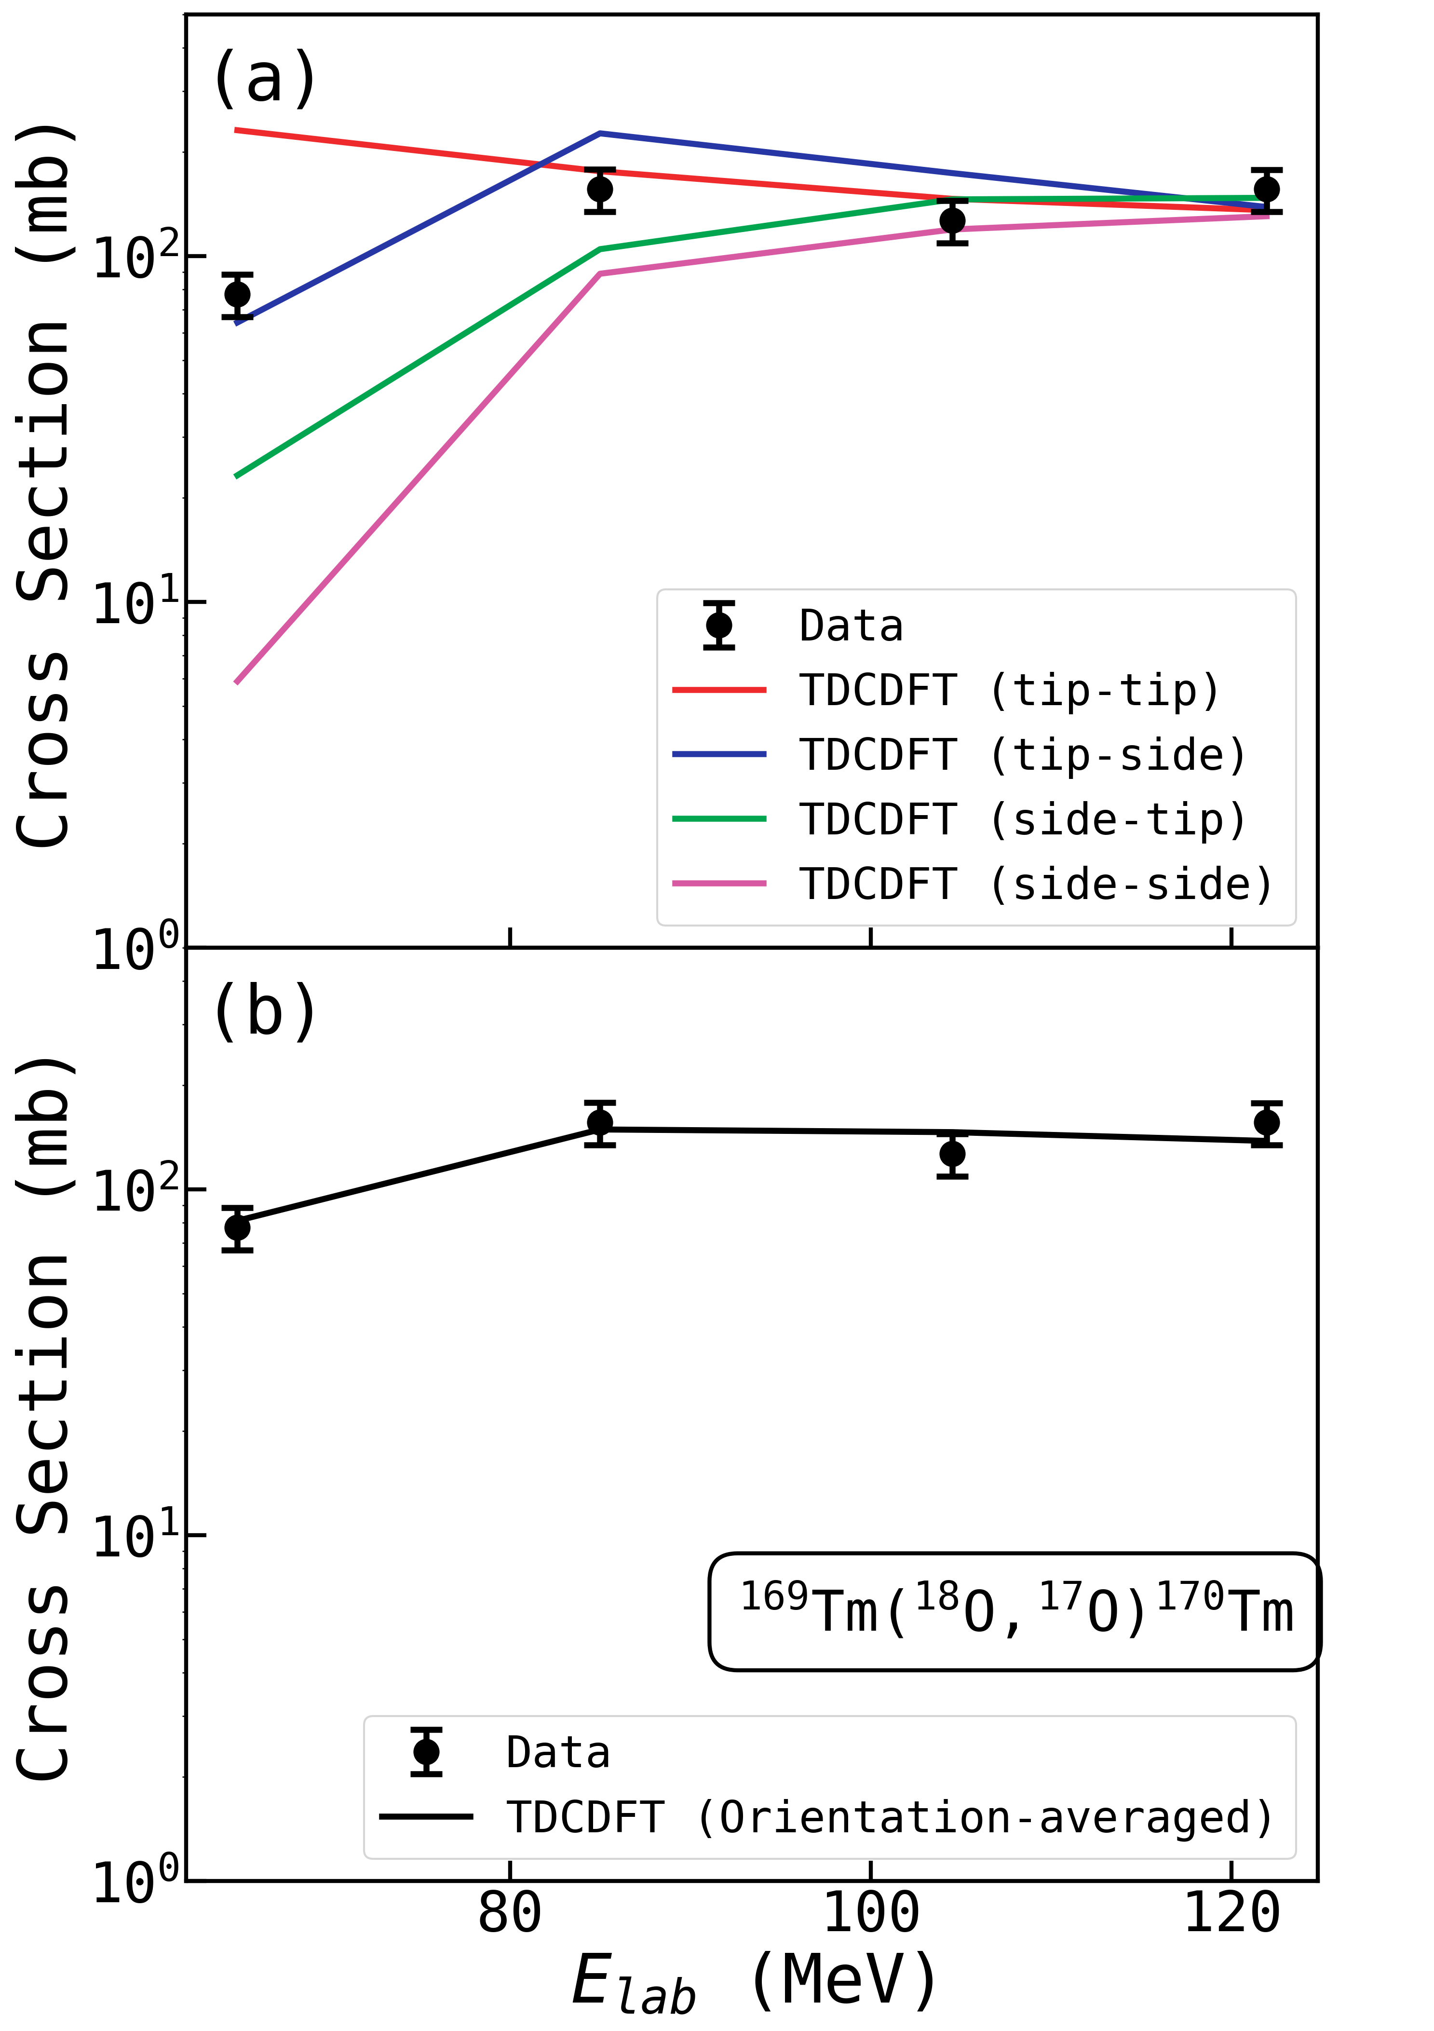
Predictions of one-neutron transfer cross-section
One-neutron transfer cross-section prediction of $^{18}$O +$^{169}$Tm:
Preliminary
tip-tip
side-side
The orientation effects are rather strong below the Coulomb barrier.
Compared with the data, relativistic TDDFT+GEMINI accurately predicts the one-neutron transfer cross-section.
Preliminary
In preparation
Data are measured by G. S. Li’s group (Institute of Modern Physics)

Slide 12
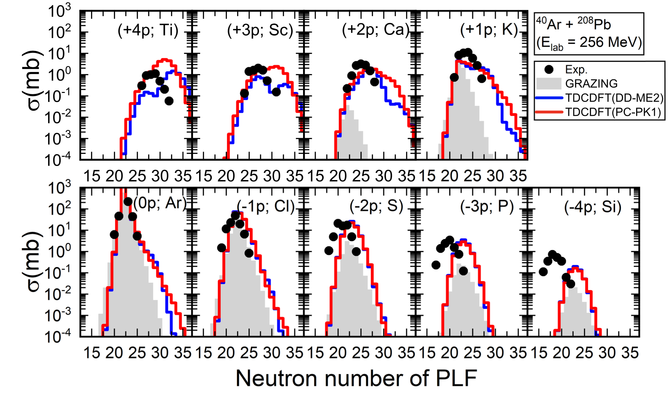




Multinucleon transfer cross-sections
For the MNT reaction$^{40}$Ar +$^{208}$Pb,
(+$x$p) channel
Protons
$$^{40}Ar$$
$^{208}$Pb
Protons
(-$x$p) channel
D. D. Zhang, D. Vretenar, T. Nikšić, P. W. Zhao, and J. Meng, Phys. Rev. C 109, 024614 (2024)
Relativistic TDDFT gives a reasonable description of the cross-section.
The inclusion of the de-excitation process would improve the results.

Slide 13
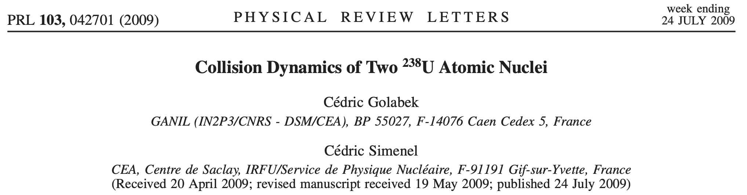
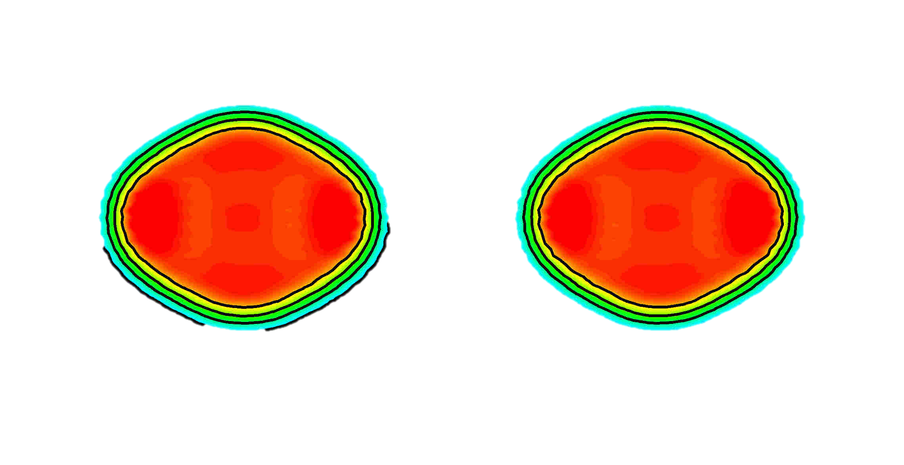
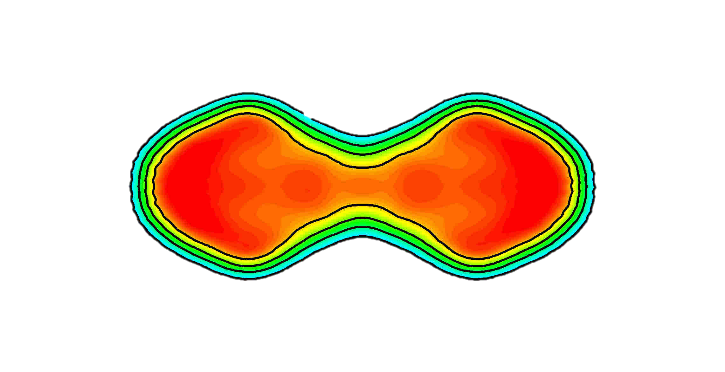
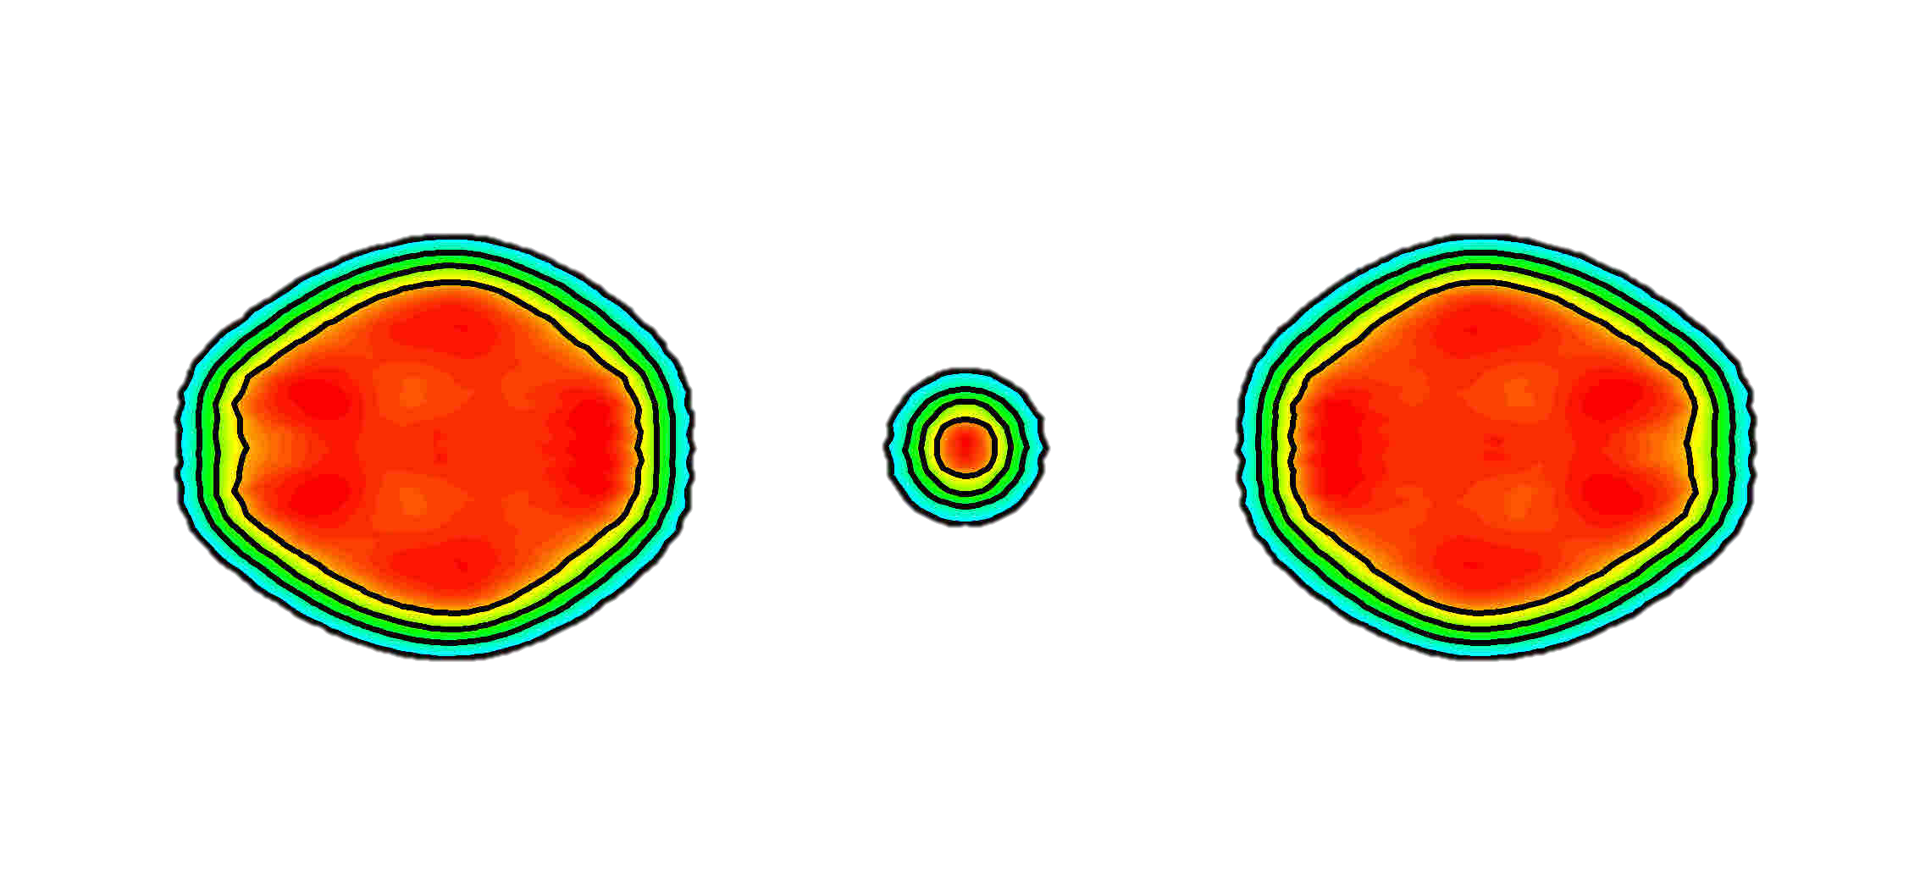
Ternary quasi-fission in ²³⁸U + ²³⁸U collision
“…Surprisingly, we also observe ternary fission due to purely dynamical effects. ”
Time evolution

Slide 14
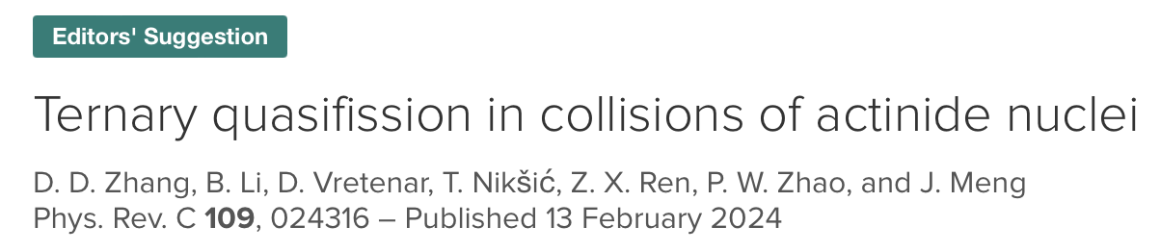
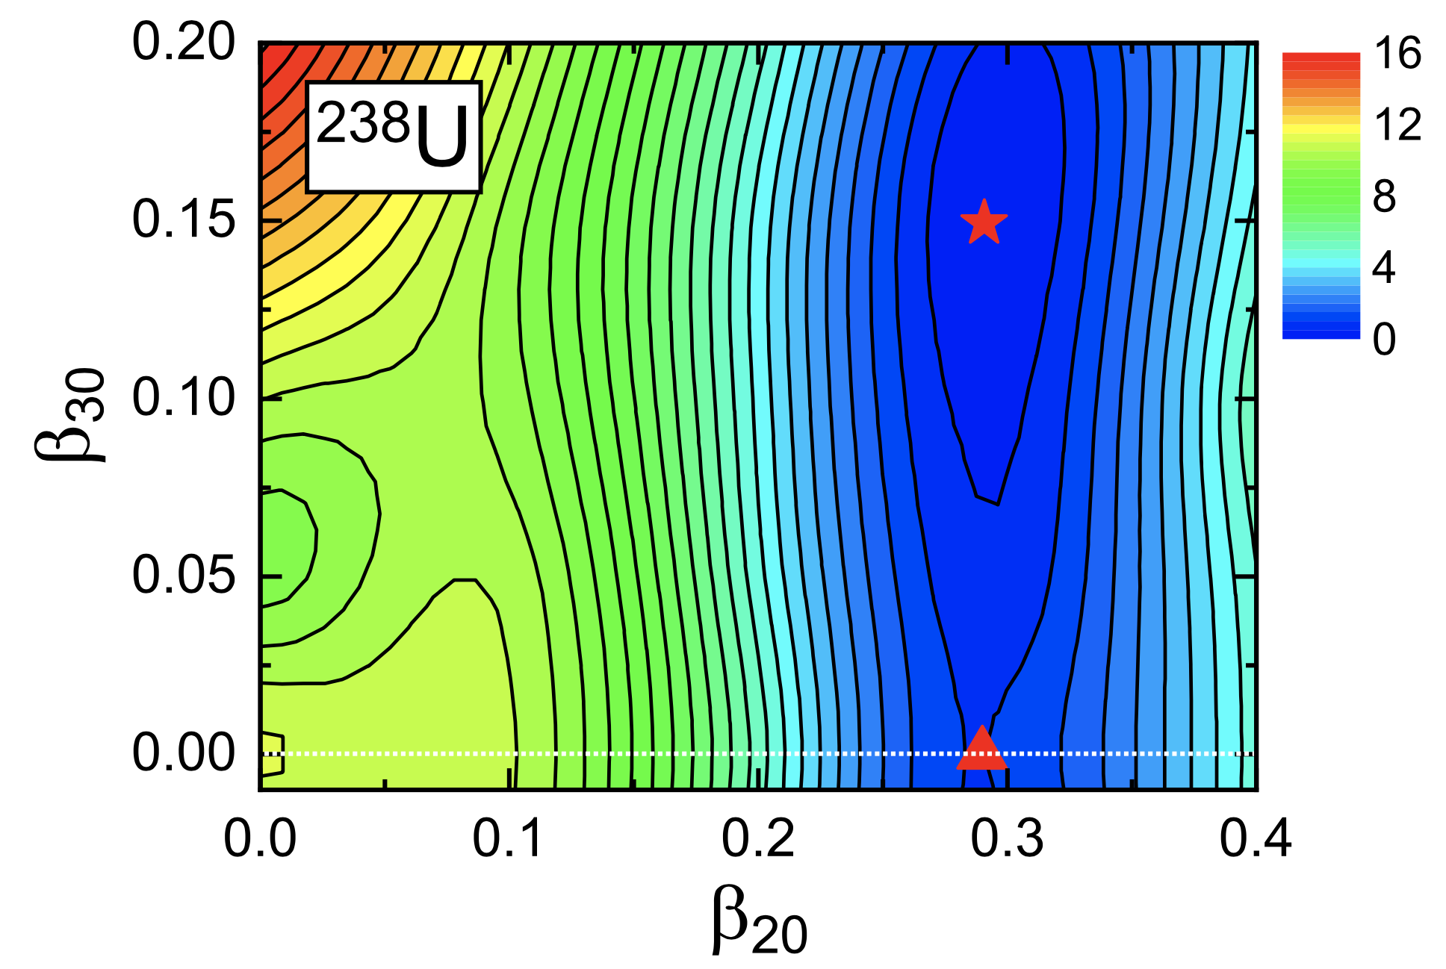
Ternary quasi-fission in collisions of actinide nuclei
The ground state of ²³⁸U is octupole-deformed in the mean-filed level.

Slide 15
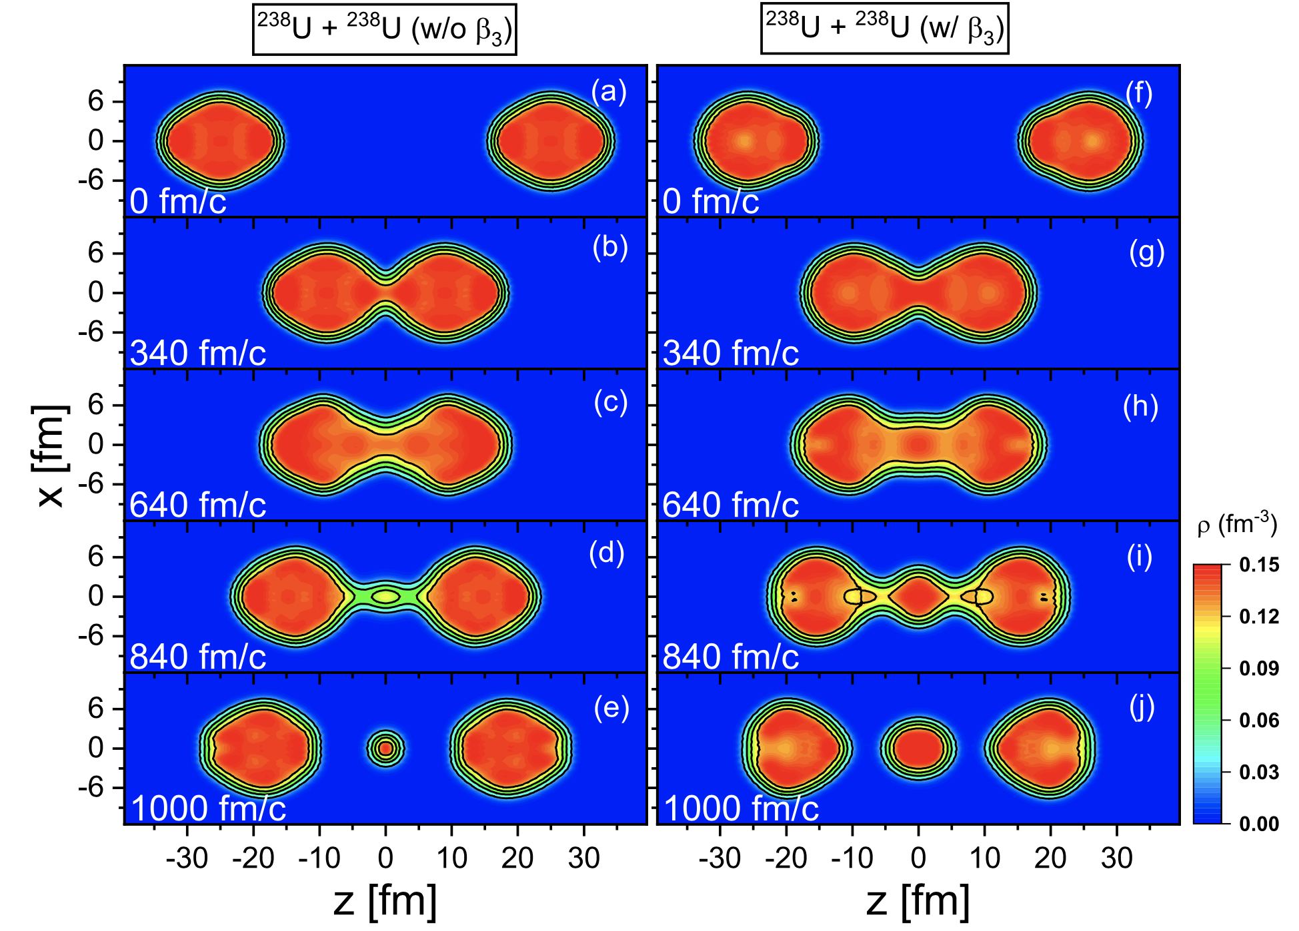


Octupole deformation
without $β_{3}$
with $β_{3}$
The octupole deformation affects the ternary quasi-fission.
D. D. Zhang, B. Li, D. Vretenar, T. Nikšić, Z. X. Ren, P. W. Zhao, and J. Meng, Phys. Rev. C 109, 024316 (2024)

Slide 16
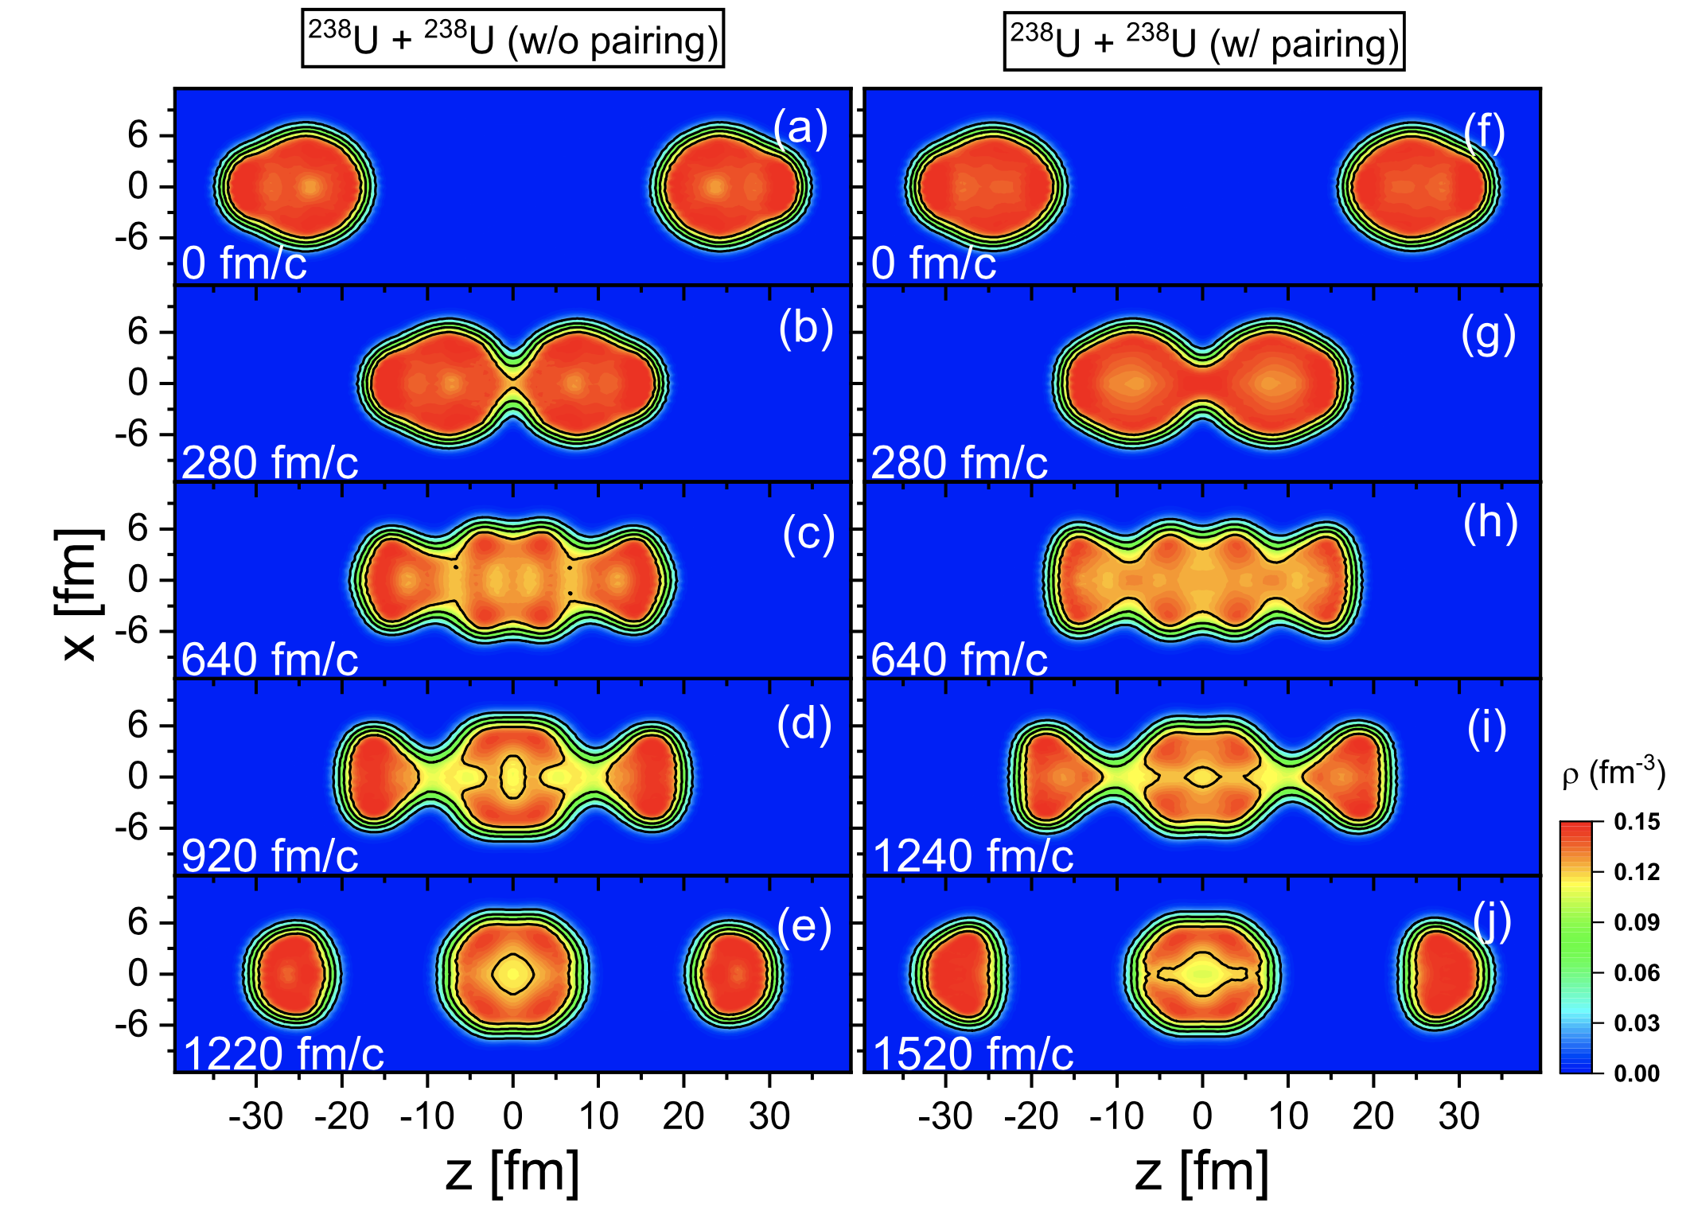
Orientations
without pairing
with pairing
Neutron-rich heavy nuclei around uranium are formed in the middle.
D. D. Zhang, B. Li, D. Vretenar, T. Nikšić, Z. X. Ren, P. W. Zhao, and J. Meng, Phys. Rev. C 109, 024316 (2024)

Slide 17
Contents
Introduction
Relativistic time-dependent density functional theory
Multinucleon transfer reaction
  Mass distribution
  Angular momentum distribution
Summary and outlook

Slide 18
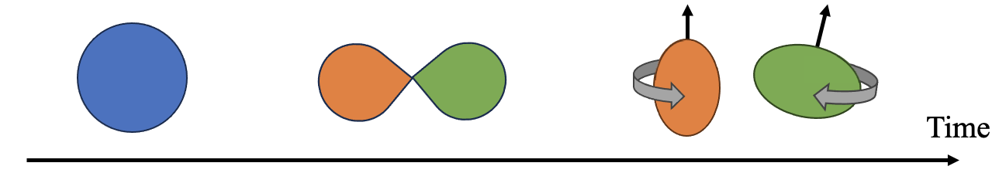




Fragment intrinsic spins and their correlations
In a system that consists of two fragments, the conservation of angular momentum requires
The spontaneous fission of even-even nuclei ($J=0$) is a typical case.
  The fragment intrinsic spins and their correlations in fission have attracted broad interest.
Lack such investigations in reactions (more complex and challenging).
$$J=S^{L}+S^{H}+Λ.$$
$S^{L}, S^{H}:$spins of two fragments.
$Λ:$ orbital angular momentum.
The generation of spins and their correlations.
Wilson et al., Nature 590, 566 (2021)
Bulgac et al., PRL 126, 142502 (2021); Bulgac et al., PRL 128, 022501 (2022); Scamps et al., PRC 108 L061602 (2023)

Slide 19
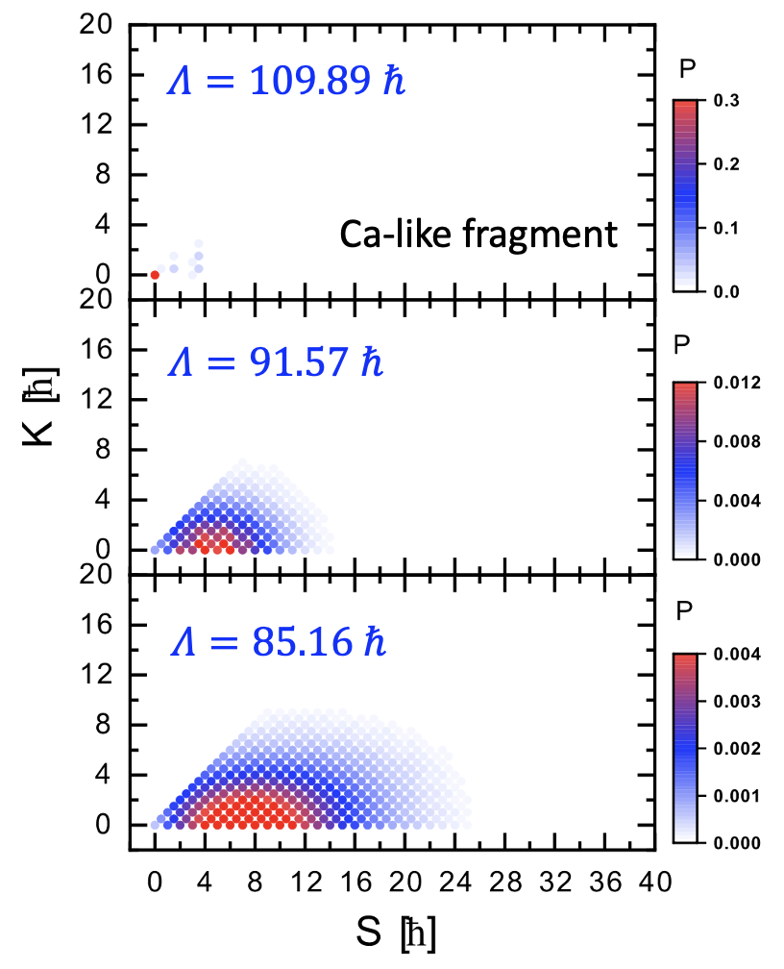







Spin distributions in the MNT reactions ⁴⁰Ca + ²⁰⁸Pb
b=6 fm
$$J=S^{L}+S^{H}+Λ.$$
At the beginning, $J=0+0+Λ$
Almost no nucleon transfer
b=5 fm
The spins are generated.
The orbital angular momentum is converted into intrinsic spin.
b=4.65 fm
Nucleon transfer
$$v_{1}$$
$$Λ=b\sqrt{2μE_{cm}}$$
$$b$$
DDZ, Vretenar, Nikšić, Zhao, Meng, PLB 869, 139828 (2025)
$$v_{2}$$

Slide 20
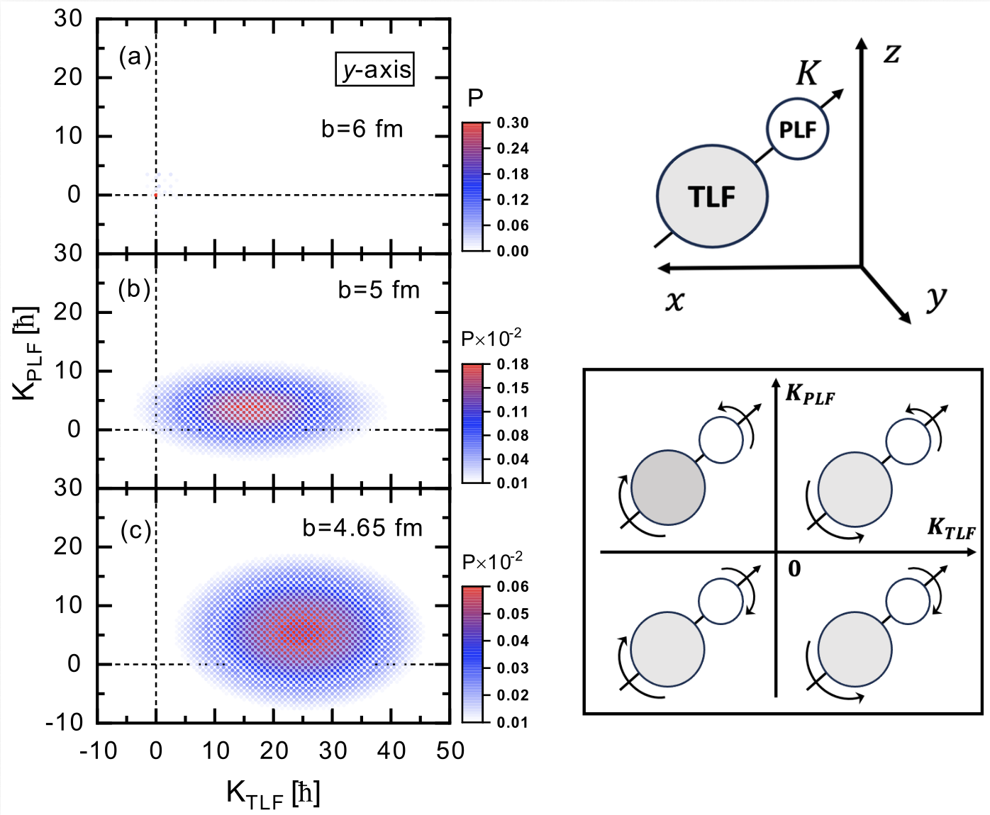






The joint spin distribution of two fragments ($y$-axis)
$$z′$$
Joint spin distribution:
$$P\left(K_{PLF}, K_{TLF}\right)=\left\langle Ψ | {\hat{P}}_{K_{P}}^{ }{\hat{P}}_{K_{T}}^{ } | Ψ\right\rangle .$$
$K_{PLF}K_{TLF}>0$, wriggling
$K_{PLF}K_{TLF}<0$, bending
Various collective rotational modes are revealed.
DDZ, Vretenar, Nikšić, Zhao, Meng, PLB 869, 139828 (2025)
How to quantify the correlations between the two fragments’ spins?

Slide 21
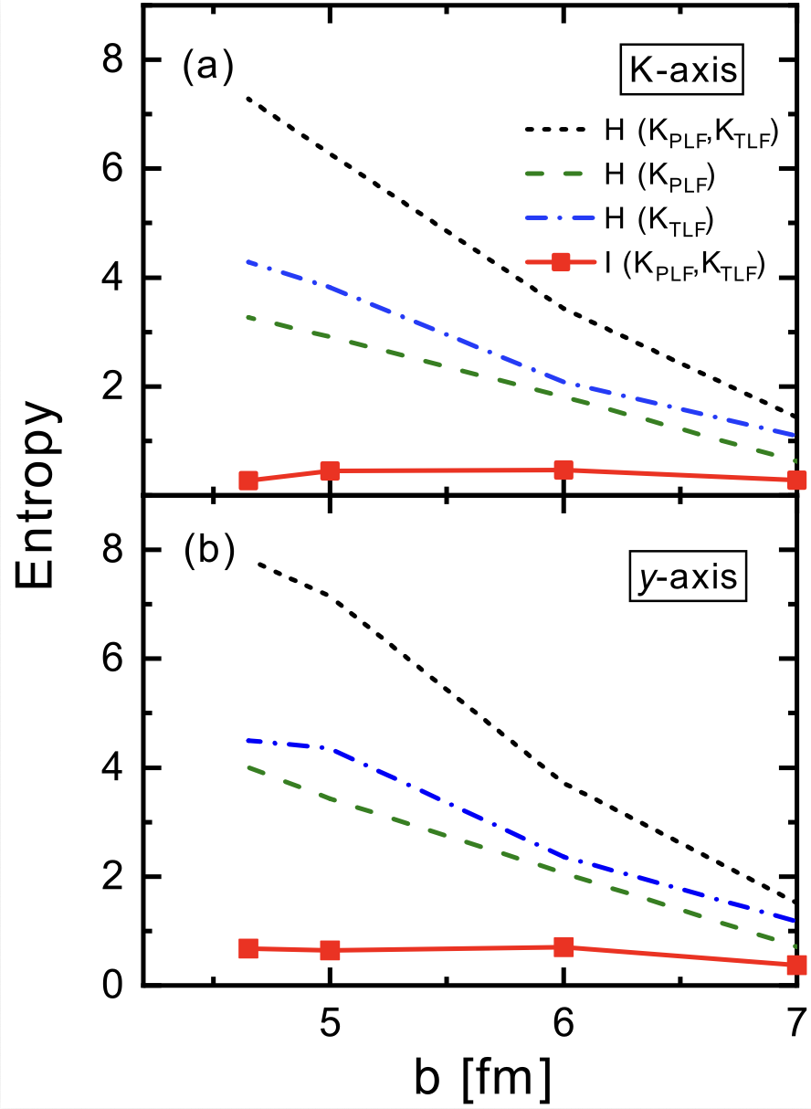

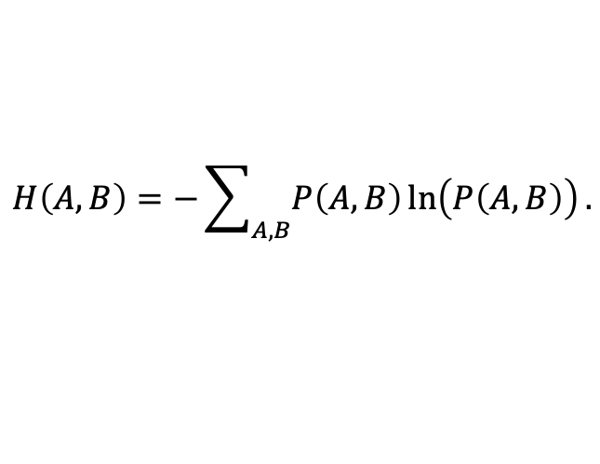
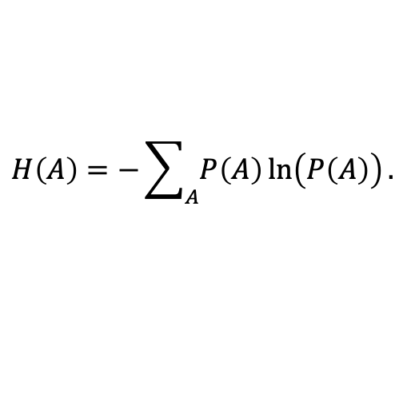
The correlations between two fragments
Entanglement Shannon entropy I(A, B)
$$I\left(A,B\right)=H\left(A\right)+H\left(B\right)−H\left(A,B\right).$$
$$H\left(A\right)=−\sum_{A}{P\left(A\right)\ln\left(P\left(A\right)\right)}.$$
$$H\left(A,B\right)=−\sum_{A,B}{P\left(A,B\right)\ln\left(P\left(A,B\right)\right)}.$$
The smaller entanglement Shannon entropy indicates fewer correlations.
The spins of the two fragments are correlated, but the correlations are rather weak.
DDZ, Vretenar, Nikšić, Zhao, Meng, PLB 869, 139828 (2025)

Slide 22
Contents
Introduction
Relativistic time-dependent density functional theory
Multinucleon transfer reaction
  Mass distribution
  Angular momentum distribution
Summary and outlook

Slide 23
Summary and outlook
Relativistic TDDFT is extended to incorporate particle number projection and angular momentum projection, and then applied to the MNT reaction.
  Mass distribution
  Spin distribution
MNT reaction: What’s the candidate reaction condition for the synthesis of new superheavy nuclei and neutron-rich nuclei (U+U, U+Cm, U+Bi, …).
DDZ, Vretenar, Niksic, Zhao, Meng PRC 109, 024614 (2024)
DDZ, Li, Vretenar, Niksic, Zhao, Meng, PRC 109, 024316 (2024)
DDZ, Li, Vretenar, Niksic, Zhao, Meng, PRC 114, 014628 (2026)
Yang, DDZ, Vretenar, Li, Niksic, Zhao, Meng, PRC 113, 044626 (2026)
DDZ, Vretenar, Niksic, Zhao, Meng, PLB 869, 139828 (2025)
Li, DDZ, Vretenar, Niksic, Zhao, Meng, PRL 136, 252502 (2026)
Thanks for your attention！

