Slide 1
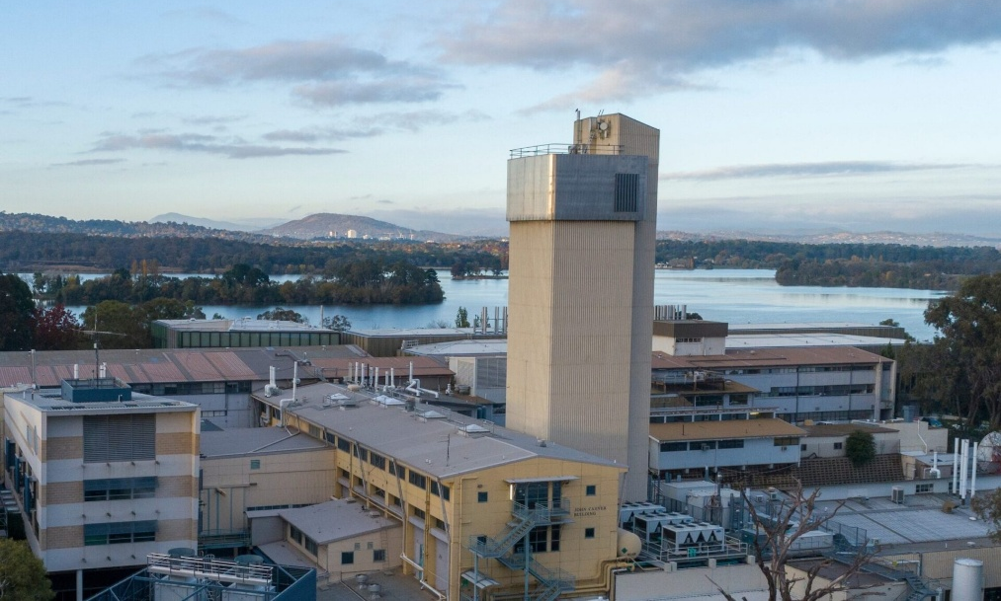

Investigating two-phonon γ-vibrational states in ¹⁶²Dy through Coulomb excitation
By Tom Perissinotto
PhD Candidate
Department of Nuclear Physics and Accelerator Applications
Australian National University

Slide 2
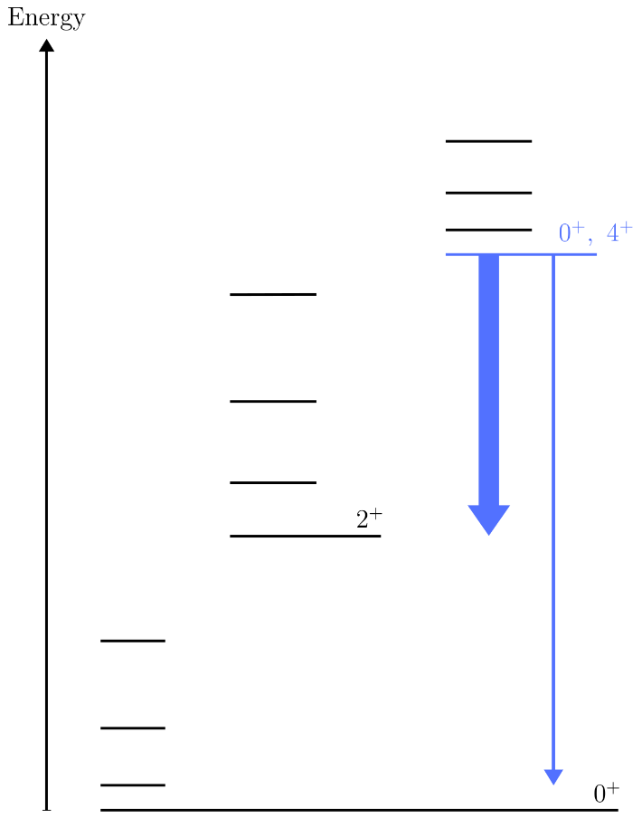
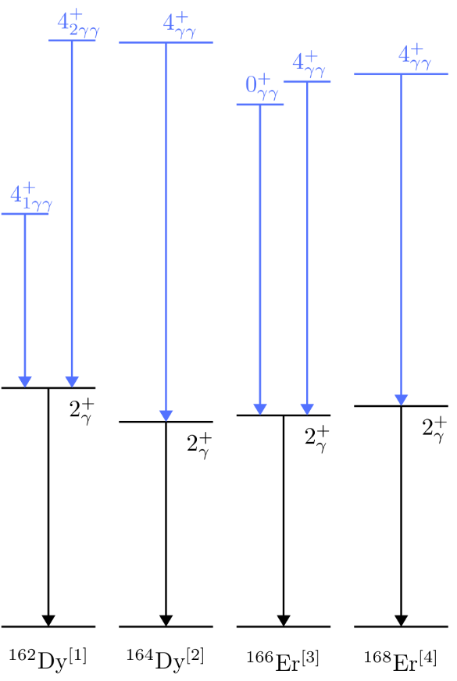
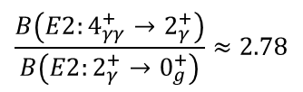
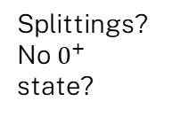

What We Expect…
What We See…
Spin-parities arise from different coupling configurations.
Strong transitions to single-phonon state.
$$\frac{B\left(E2:4_{γγ}^{+}→2_{γ}^{+}\right)}{B\left(E2:2_{γ}^{+}→0_{g}^{+}\right)}≈2.78$$
Single $γ$-phonon vibrational band
Splittings?
No $0^{+}$ state?
[1] C. Y. Wu et al., Phys. Rev. C, vol. 64, no. 6, 2001.
[2] F. Corminboeuf et al., Phys. Rev. C, vol. 56, no. 3, 1997.
[3] C. Fahlander et al., Phys. Lett.B, vol. 388, no. 3, 1996.
[4] H. G. Borner et al., Phys. Rev. Lett., vol. 66, 1991.

Slide 3
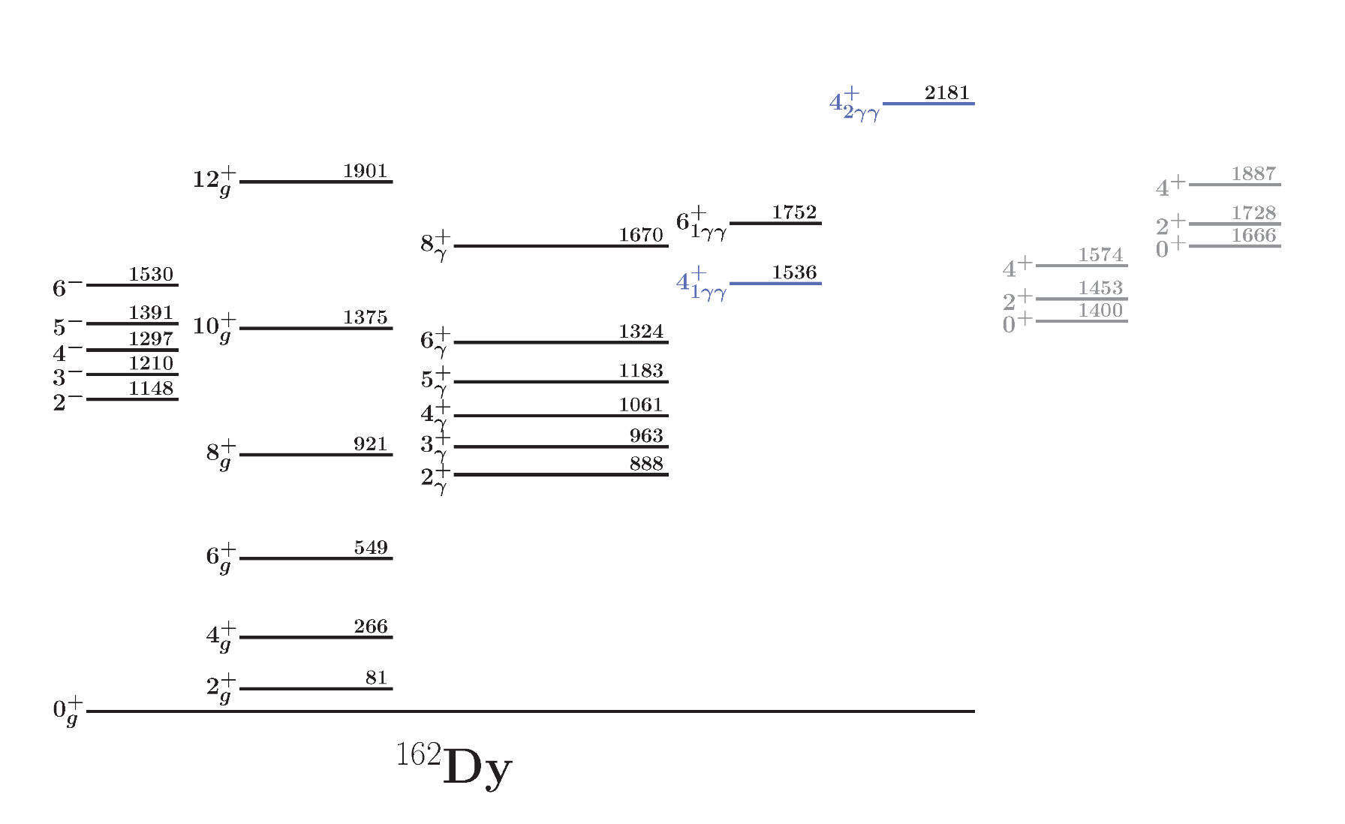

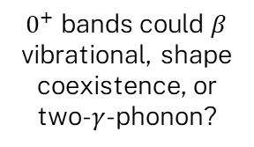

Known level scheme of ¹⁶²Dy [1]
Two-$γ$-phonon bands? [2]
Negative-parity band, octupole vibration [3]?
$0^{+}$ bands could $β$ vibrational, shape coexistence, or two-$γ$-phonon?
Single-$γ$-phonon band [2]
[1] N. Nica, Nuclear Data Sheets, vol. 195, 2024
[2] C. Y. Wu et al., Phys. Rev. C, 2001.
[3] A. Aprahamian et al., Phys. Rev. C, 2017

Slide 4
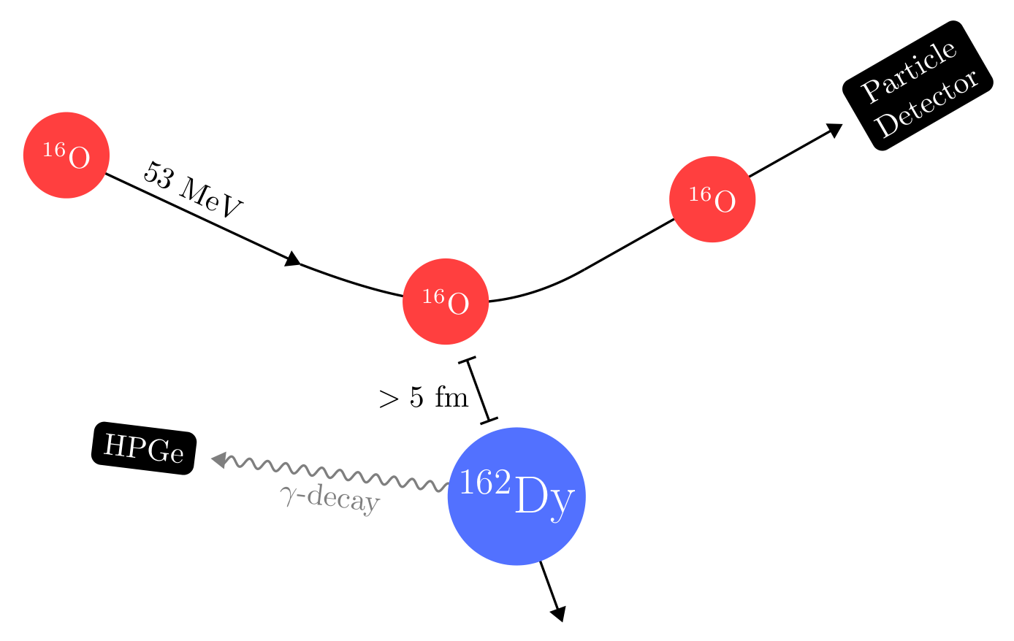

Coulomb-excitation experiment
“Safe” beam energy allows us to neglect strong force effects
Recreate kinematics + reduce background.
Populate along $E2$ transitions.
Self-supporting 1.5 mg/cm² target, enriched to 96% ¹⁶²Dy

Slide 5
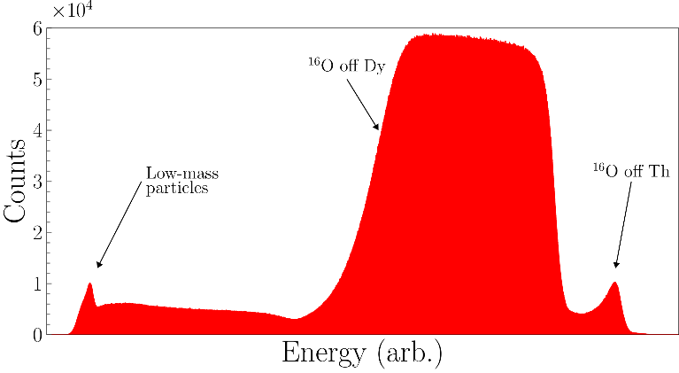
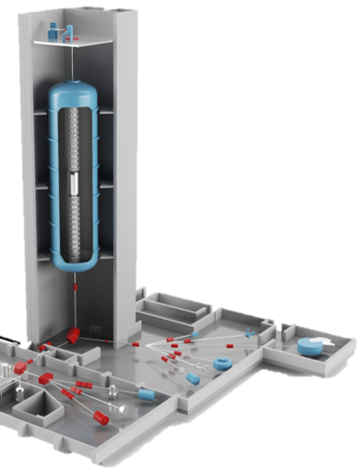
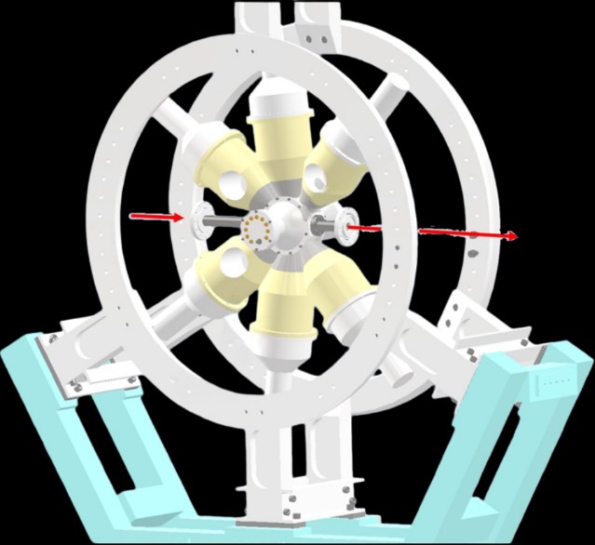
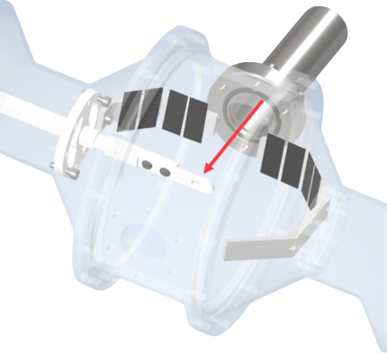
Experimental Set-up

Slide 6
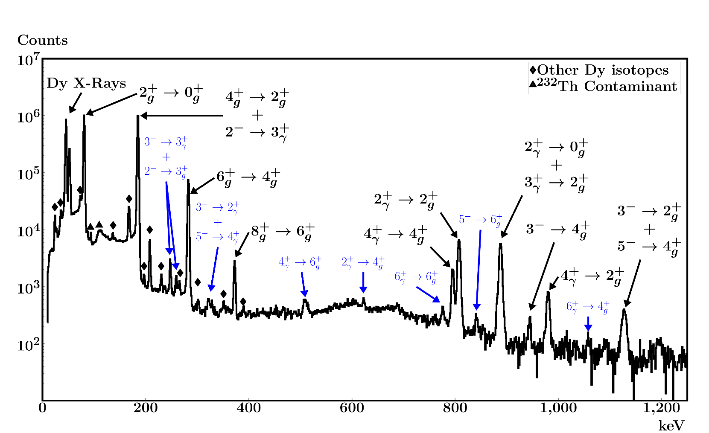
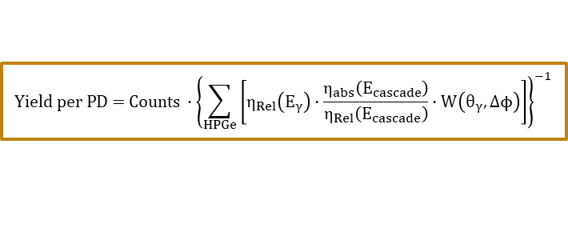
Particle-gated $γ$-ray energy spectrum
$$\text{Yield per PD = C}ounts ⋅{\left\{\sum_{HPGe}{\left[η_{Rel}\left(E_{γ}\right)⋅\frac{η_{abs}\left(E_{cascade}\right)}{η_{Rel}\left(E_{cascade}\right)}⋅W\left(θ_{γ},Δϕ\right)\right]}\right\}}^{−1 }$$

Slide 7
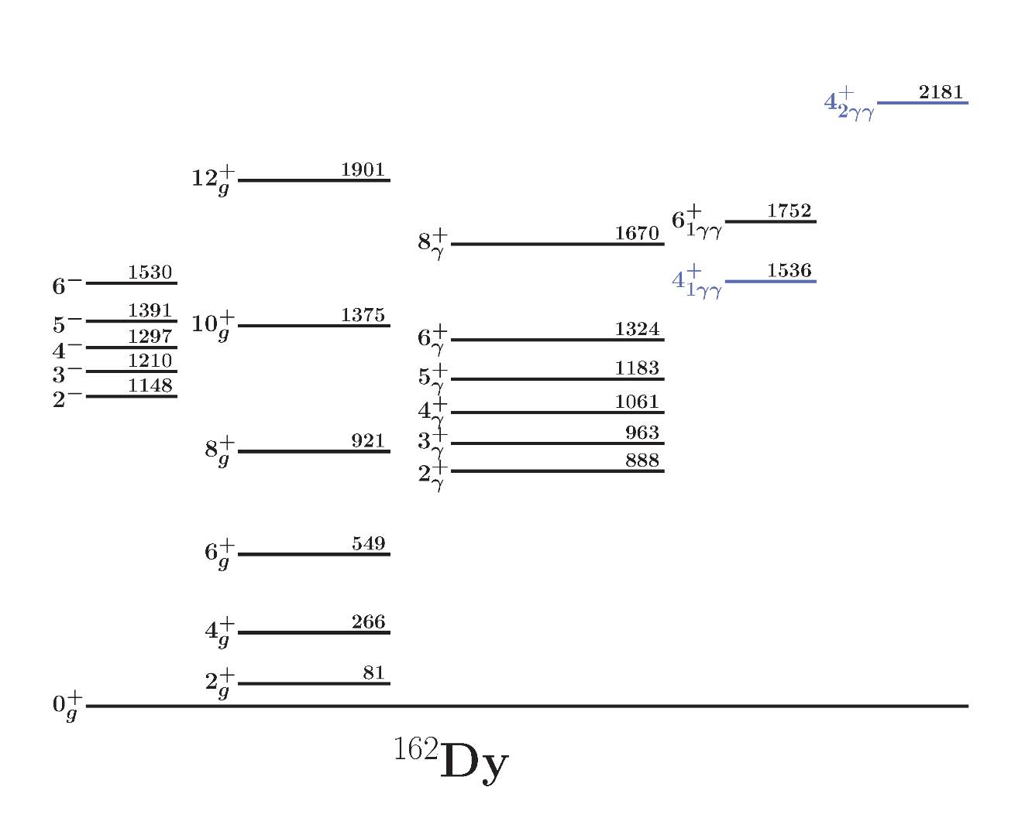
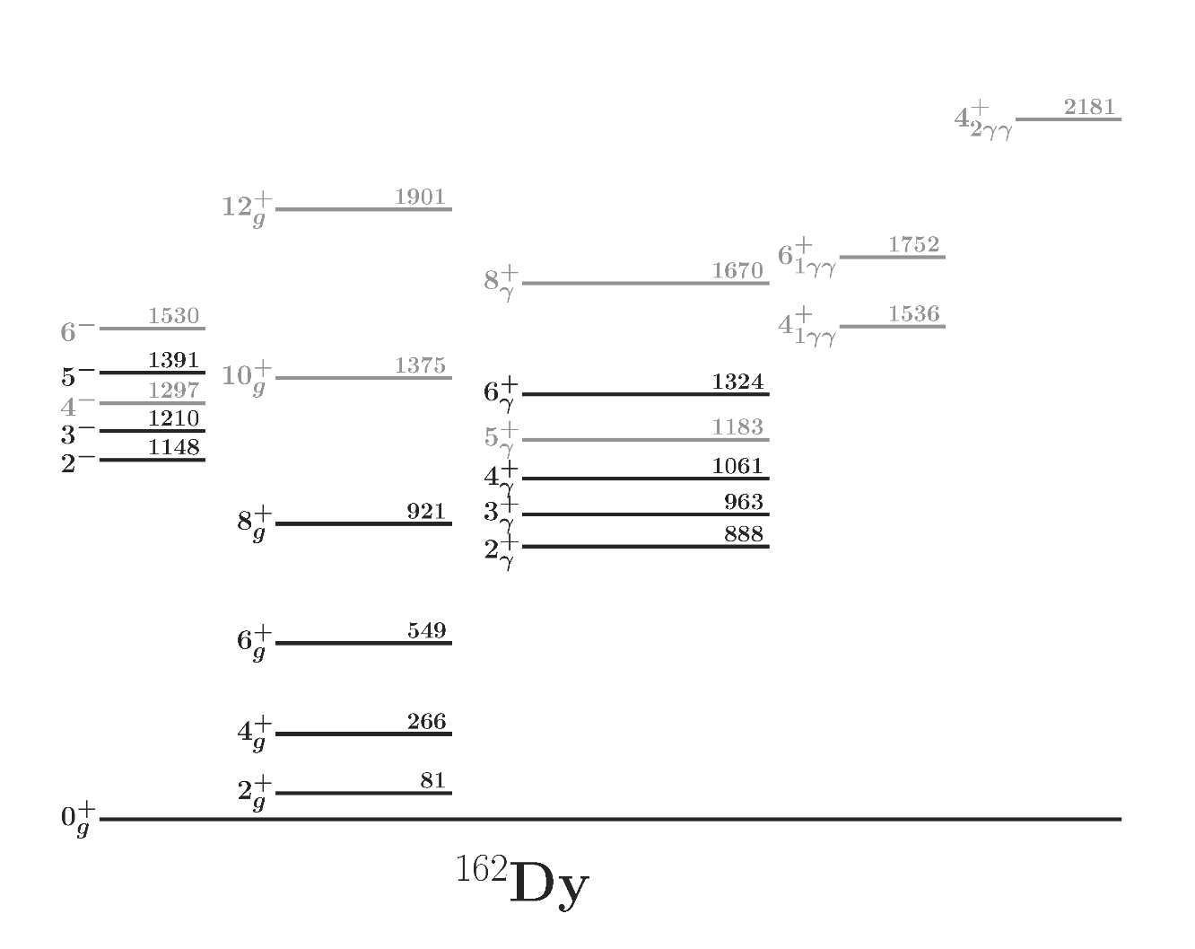
Observed and “buffer” states

Slide 8
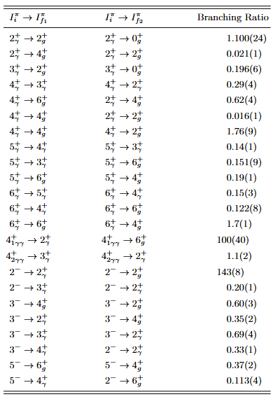
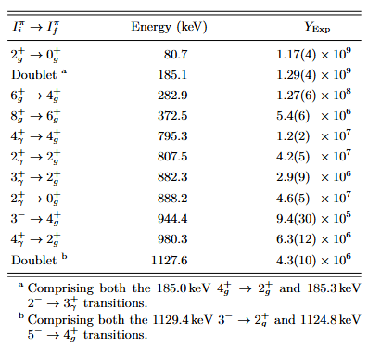
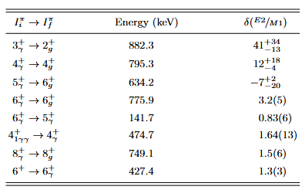



Experimental Yields + Literature Values [1] = GOSIA Minimisation
$$+$$
$$+$$
No lifetimes! We wanted independent measurement where possible
$$×0.5$$
[1] N. Nica, Nuclear Data Sheets, vol. 195, 2024
Notes:
Crop tables of literature results?

Slide 9
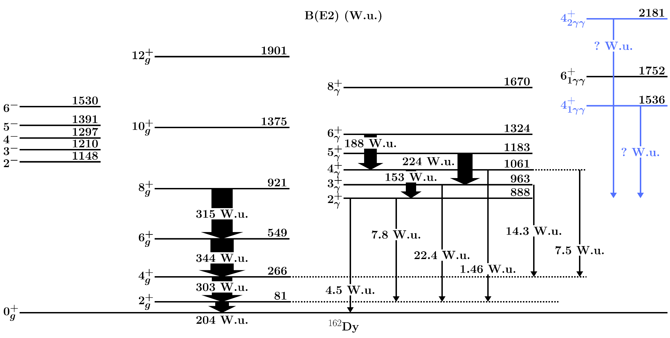

Measured Transition Strengths
$≈12.5$ W.u

Slide 10
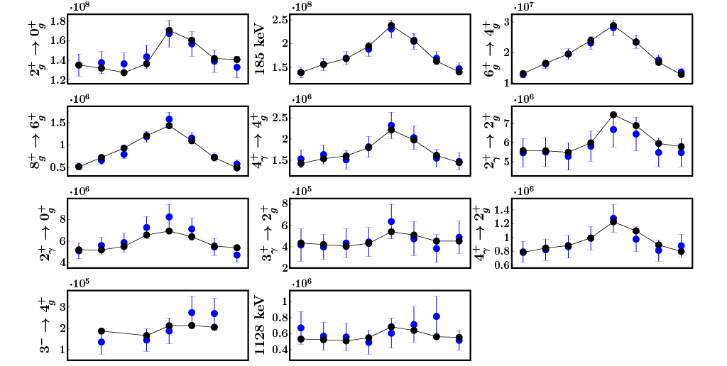
How do the GOSIA minimisations compare to experimental results?

Slide 11
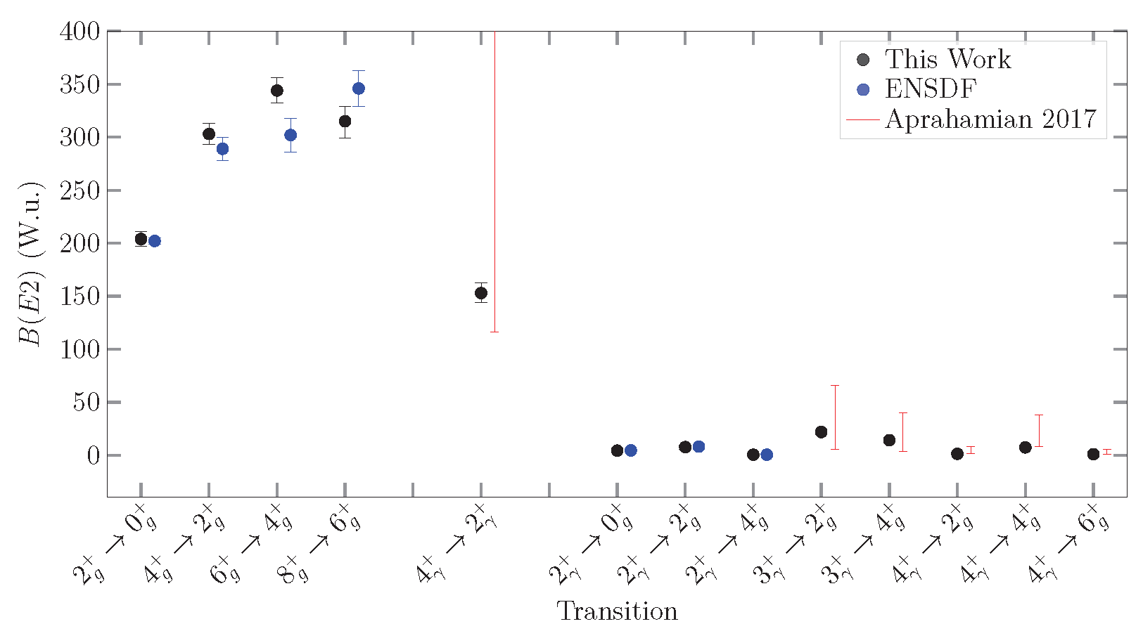
How do these results compare to previous measurements?
Notes:
Create figure (can steal from Honours as template). Otherwise just paste table and crop

Slide 12
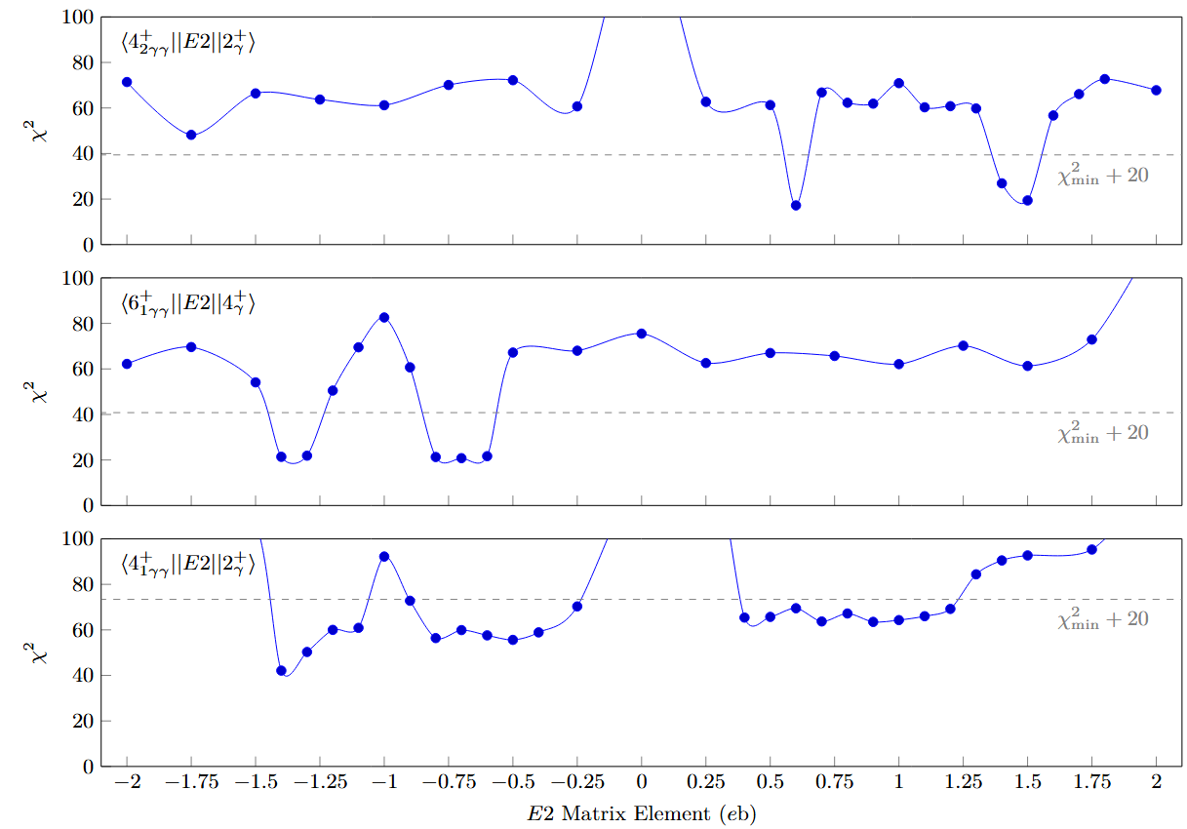

Suspected two-phonon states: What can we say?
Two-$γ$-phonon predictions
Wu et al., 2001
Notes:
MEASUREMENT BY WU IS NOT A LIFETIME MEASUREMENT!!!! CHANGE PAPER. Check placement of Wu lines here as well.

Slide 13
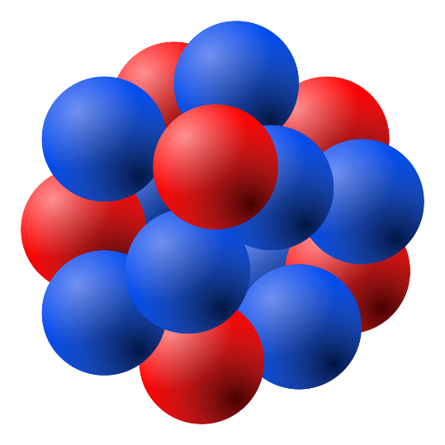
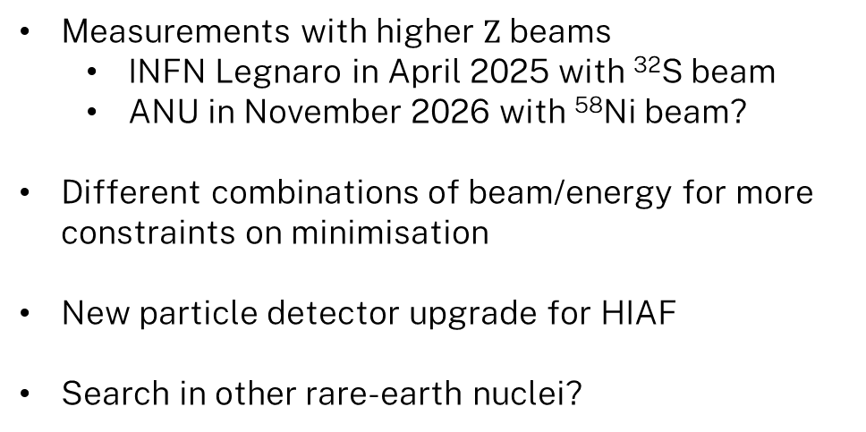
What’s next?
Measurements with higher $Z$ beams
  INFN Legnaro in April 2025 with ³²S beam
  ANU in November 2026 with ⁵⁸Ni beam?
Different combinations of beam/energy for more constraints on minimisation
New particle detector upgrade for HIAF
Search in other rare-earth nuclei?

Slide 14
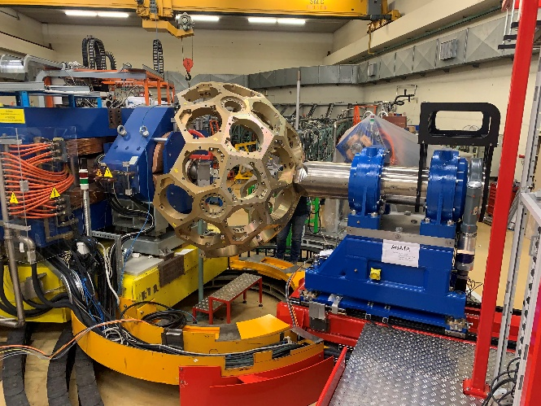
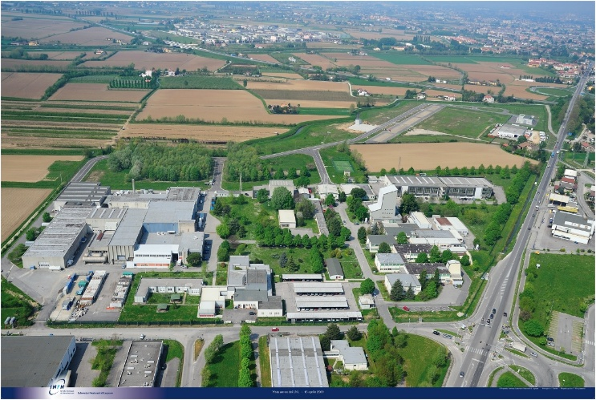
³²S beam at Legnaro, 2025
AGATA Array
³²S beam at 120MeV delivered by the XTU tandem accelerator in at INFN Legnaro
Same target as ANU experiment
AGATA + Spider used for detection
  Much higher statistics, on top of higher beam
Analysis performed by Prof. Claes Fahlander and Rickard du Reitz from Lund University, Sweden
Eventual goal is to combine data-sets for maximum constraints on matrix elements
INFN Legnaro, Italy

Slide 15
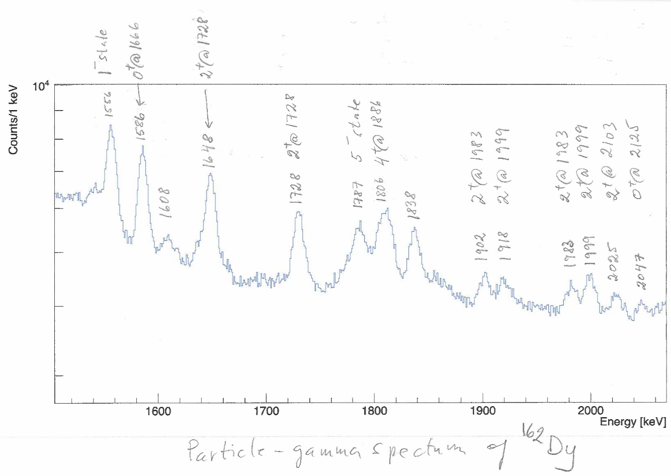

Preliminary results
Population of states up to 2.1 MeV
$0^{+}$ band at 1666 keV strongly populated

Slide 16
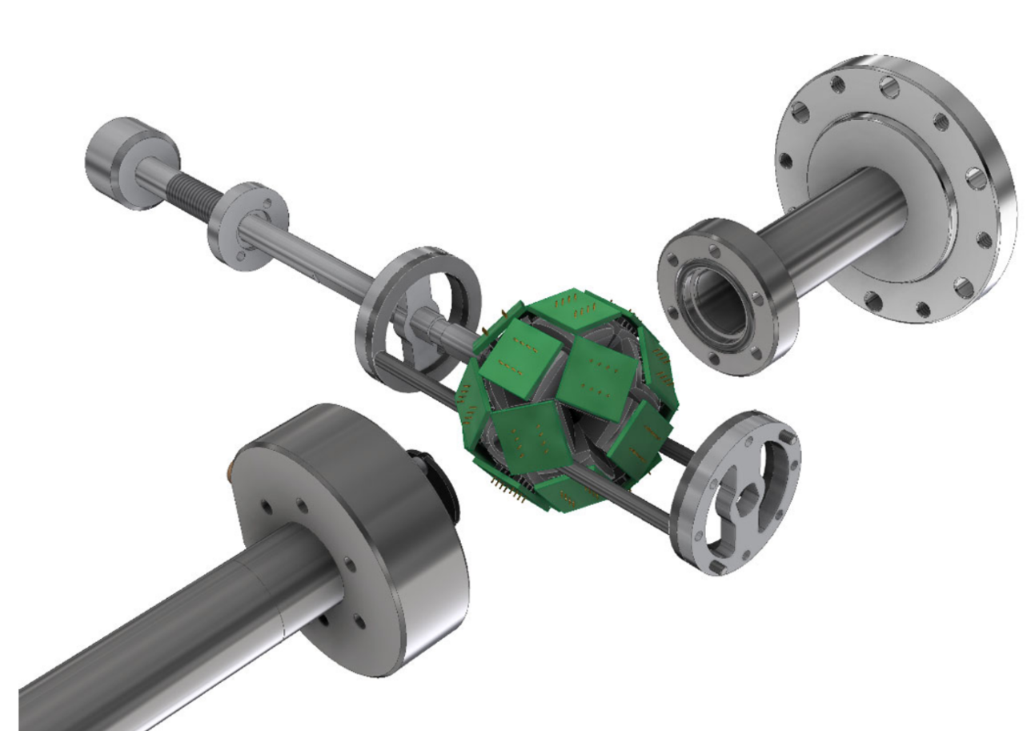
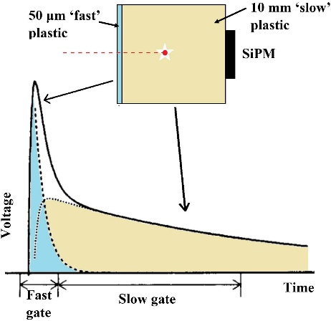
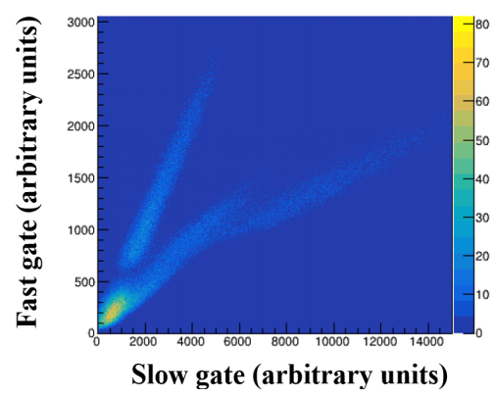
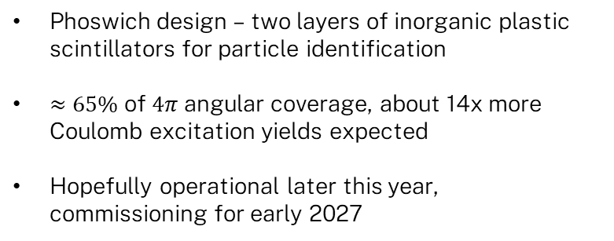
New Particle Detector – “Death Star”
Phoswich design – two layers of inorganic plastic scintillators for particle identification
$≈65\%$ of $4π$ angular coverage, about 14x more Coulomb excitation yields expected
Hopefully operational later this year, commissioning for early 2027
M. Reece, “Challenging Nuclear Vibrations with Particle-Gamma Spectroscopy,” Australian National University, 2022.
Notes:
Steal better picture of deathstar from poster

Slide 17
THANK YOU
Australian National University
AJ Mitchell, Ben Coombes, Jack Woodside, Rikako Kono, Lachlan McKie, Andrew Stuchbery, Gregory Lane, Aditya Babu, Victoria Bashu, Ferdos Dastgiri
Lund University
Claes Fahlander
Northern Border University
Hanaa Alshamnari

Slide 18
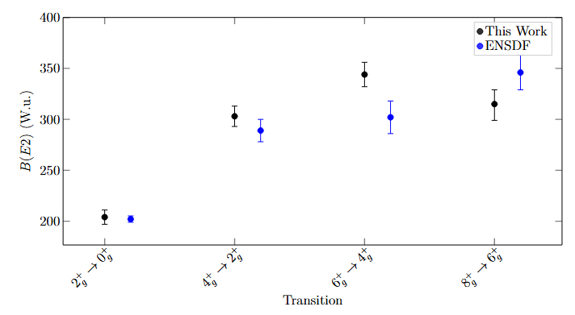
How do these results compare to previous measurements?
Notes:
Create figure (can steal from Honours as template). Otherwise just paste table and crop

Slide 19
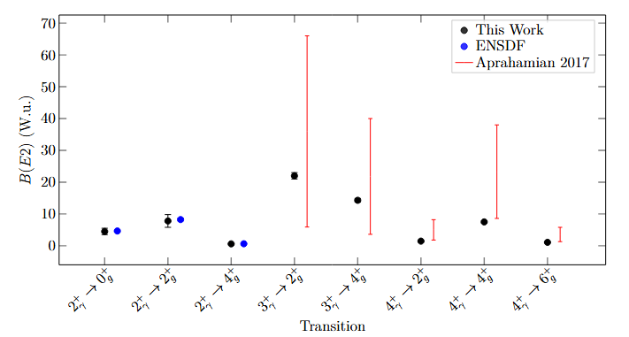
How do these results compare to previous measurements?
Notes:
Create figure (can steal from Honours as template). Otherwise just paste table and crop

Slide 20
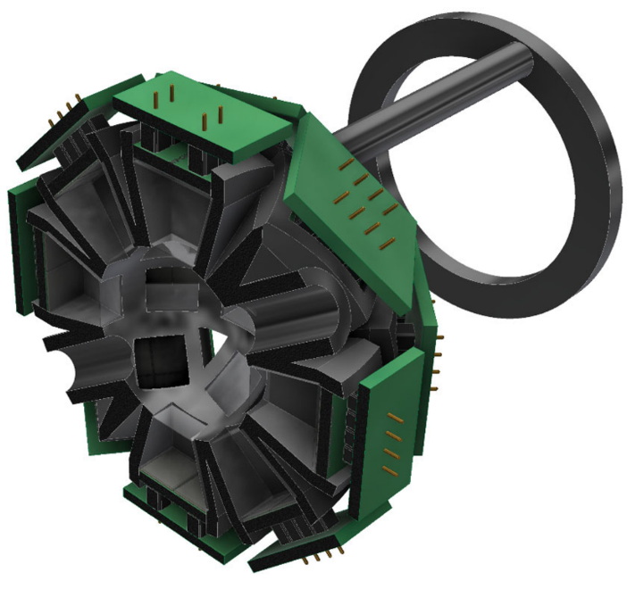
New Particle Detector – “Death Star”
Notes:
Create figure (can steal from Honours as template). Otherwise just paste table and crop

