Slide 1







Dynamical deformation of the ¹³⁶Xe + ²³⁸U system in sub-barrier multi-nucleon transfer reactions
Jonathan Bequet (GANIL)
Barbara Sulignano (CEA), Iulian Stefan (IJCLab), The #1930 ANL experiment collaboration
Zakopane 2026

Slide 2
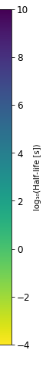
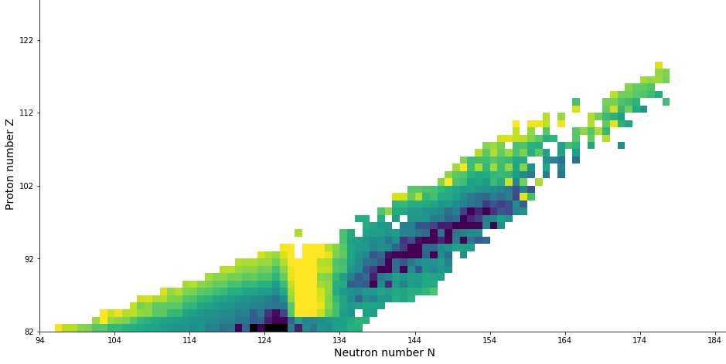
Motivation : the island of stability
Motivation : the island of stability
Short term motivation :
  synthesis of new isotopes
Long term motivation :
  Island of stability
?
Island of stability
126
184
?
120
172
?
114
184
²³⁸U
Rf
²⁰⁸Pb
Notes:
Advance -> ILOT -> synthese plein noyaux fusion ->leur synthese

Slide 3
Motivation : the island of stability
Motivation : the island of stability
Historical method for synthesis of SHI
Limit : low cross-sections
?
Island of stability
126
184
?
120
Fusion-Evaporation
172
?
114
184
²³⁸U
Rf
²⁰⁸Pb
Notes:
Advance -> ILOT -> synthese plein noyaux fusion ->leur synthese

Slide 4
MNT : a complementary mechanism
Motivation : the island of stability
Historical method for synthesis of SHI
Limit : low cross-sections
New neutron-rich isotopes
Promising theoretical cross-sections
Langevin equations model : Heavy beam & target combinations are favored
?
Island of stability
126
184
?
120
Fusion-Evaporation
172
?
114
184
²³⁸U
Rf
²⁰⁸Pb
Multi-Nucleon
Transfer (MNT)
Notes:
But then, how does this mechanism works?

Slide 5
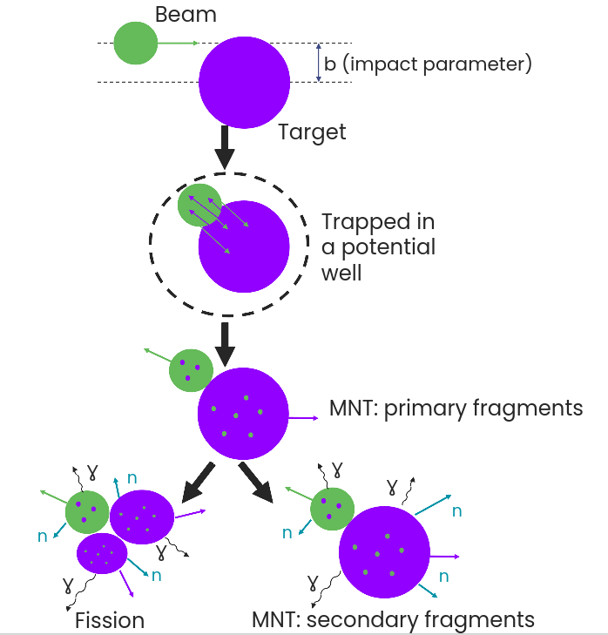
MNT : principles
Di-nuclear system
Beam-like
Target-like
Notes:
This process is usually depicted as a three steps proces which includes …
Then, we aim at using this mechanism as a mean of production so we should look for the optimal parameters to do so
evaporating mostly neutrons and gammas

Slide 6
Physics case
¹³⁶Xe+²³⁸U : « heavy » partners
Reaction around the interaction barrier
Detection of products emitted along the beam axis
Measurement of known actinides around ²³⁸U
Rf
²⁰⁸Pb
²³⁸U
Notes:
But then, how does this mechanism works?

Slide 7
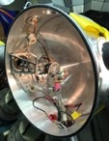

The experimental setup: ¹³⁶Xe+²³⁸U
Beam: ¹³⁶Xe at 5.15 and 5.89 MeV/u
Target: ²³⁸U (U 350 µg/cm² + C 45 µg/cm²)
¹³⁶Xe beam produced by ATLAS
²³⁸U
Target
Analyzed data:
→ 5.15 MeV/u
→ 11 h
→ 11 pnA
→ B⍴ = 1.65 T.m
→ P_{AGFA} = 4 Torr
→ 72 HPGe in Gammasphere
Target chamber
Q_{v}
D_{m}
Target wheel

Slide 8
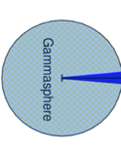
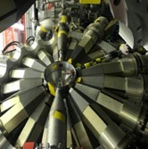

The experimental setup: ¹³⁶Xe+²³⁸U
Beam: ¹³⁶Xe at 5.15 and 5.89 MeV/u
Target: ²³⁸U (U 350 µg/cm² + C 45 µg/cm²)
¹³⁶Xe beam produced by ATLAS
$γ$, X-rays
²³⁸U
Target
Analyzed data:
→ 5.15 MeV/u
→ 11 h
→ 11 pnA
→ B⍴ = 1.65 T.m
→ P_{AGFA} = 4 Torr
→ 72 HPGe in Gammasphere
Target chamber
Q_{v}
D_{m}
Target wheel

Slide 9
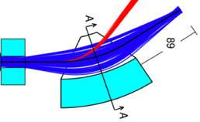
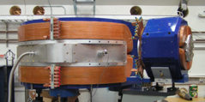
The experimental setup: ¹³⁶Xe+²³⁸U
Beam: ¹³⁶Xe at 5.15 and 5.89 MeV/u
Target: ²³⁸U (U 350 µg/cm² + C 45 µg/cm²)
Unreacted
beam
MNT products
¹³⁶Xe beam produced by ATLAS
$γ$, X-rays
²³⁸U
Target
Focal plane
Q_{v}
D_{m}
Analyzed data:
→ 5.15 MeV/u
→ 11 h
→ 11 pnA
→ B⍴ = 1.65 T.m
→ P_{AGFA} = 4 Torr
→ 72 HPGe in Gammasphere
Target chamber
Q_{v}
D_{m}
Target wheel
Gas-filled separator AGFA

Slide 10
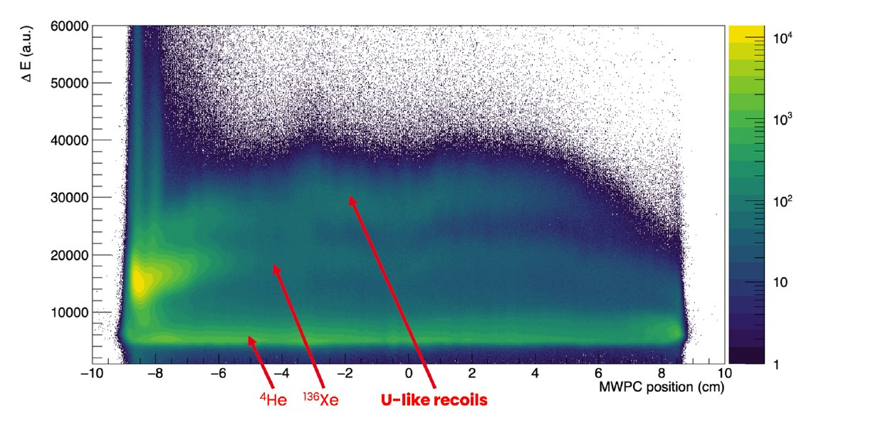
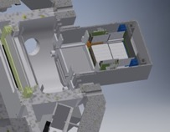
The experimental setup: ¹³⁶Xe+²³⁸U
Beam: ¹³⁶Xe at 5.15 and 5.89 MeV/u
Target: ²³⁸U (U 350 µg/cm² + C 45 µg/cm²)
Unreacted
beam
MNT products
¹³⁶Xe beam produced by ATLAS
$γ$, X-rays
²³⁸U
Target
Focal plane
Q_{v}
DSSD
D_{m}
Analyzed data:
→ 5.15 MeV/u
→ 11 h
→ 11 pnA
→ B⍴ = 1.65 T.m
→ P_{AGFA} = 4 Torr
→ 72 HPGe in Gammasphere
Target chamber
MWPC
Q_{v}
D_{m}
Target wheel
Focal plane
Gas-filled separator AGFA

Slide 11
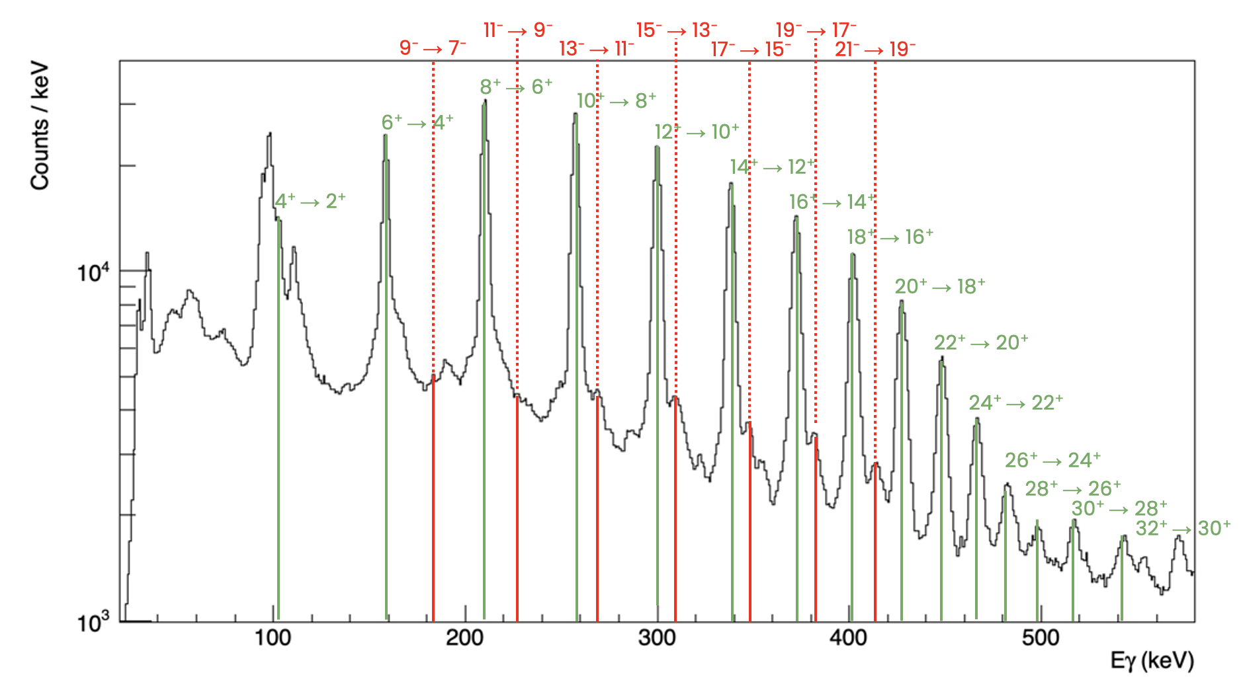
The experimental setup: ¹³⁶Xe+²³⁸U
Beam: ¹³⁶Xe at 5.15 and 5.89 MeV/u
Target: ²³⁸U (U 350 µg/cm² + C 45 µg/cm²)
Unreacted
beam
MNT products
¹³⁶Xe beam produced by ATLAS
$γ$, X-rays
²³⁸U
Target
Focal plane
Q_{v}
DSSD
D_{m}
Analyzed data:
→ 5.15 MeV/u
→ 11 h
→ 11 pnA
→ B⍴ = 1.65 T.m
→ P_{AGFA} = 4 Torr
→ 72 HPGe in Gammasphere
Target chamber
MWPC
Q_{v}
D_{m}
Target wheel
Focal plane
Prompt spectroscopy
Gas-filled separator AGFA

Slide 12
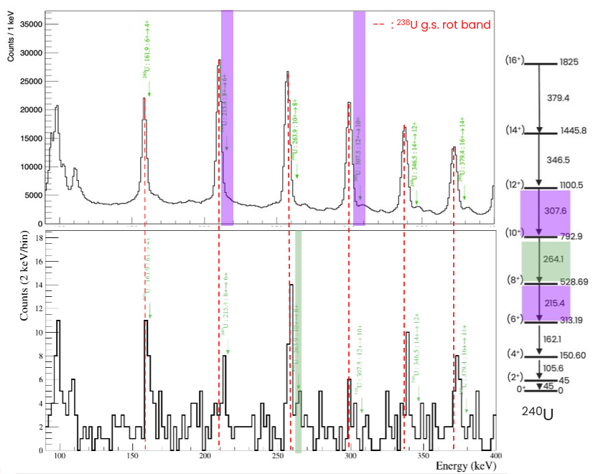
²⁴⁰U : From identification to measurement
Poisson statistics :
Probability that the peak is not completely made of background :
99,93%
True number of counts in a 95% confidence interval using a Bayesian approach* :
[2.78 , 13.22]
*: obtained distribution propagated through the calculation with MC simulations

Slide 13
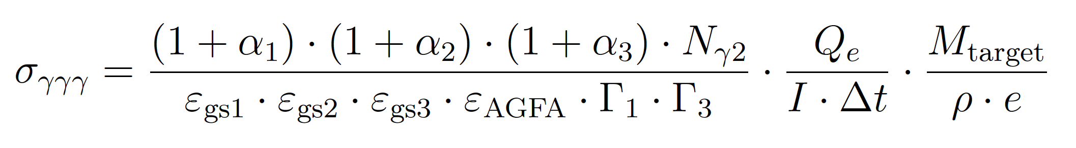
Cross-sections extraction
N_{produced} :
  Integral of the measured transition
  Conversion coefficients of the three transitions
  Absolute efficiency at the energy of the three transitions
  Transmission through the separator
  Gating ratio
N_{beam} :
  Beam intensity (pnA)
  Electron Charge
  Integrated beam time
N_{target} :
  Target thickness
  Target mass (²³⁸U)

Slide 14
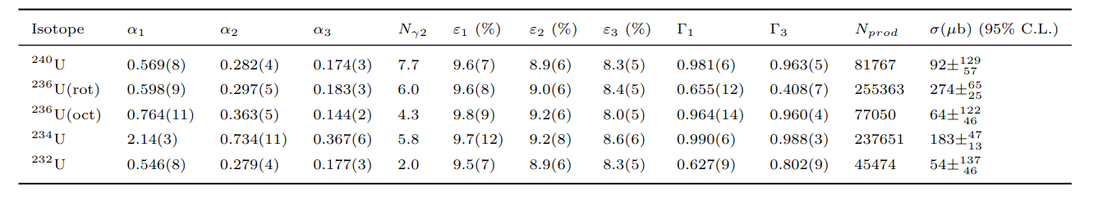
Cross-sections extraction

Slide 15
Cross-sections : Uranium isotopes at 5.15 MeV/u
R.J. Charity, IAEA, Vienna, 2008, Report INDC(DNC)-530.
L. Tassan-Got and C. Stéphan, NPA 524 (1991) 121
DIT & GEMINI++ :
Langevin equations model:
A. V. Karpov; V. Saiko, private communication

Slide 16
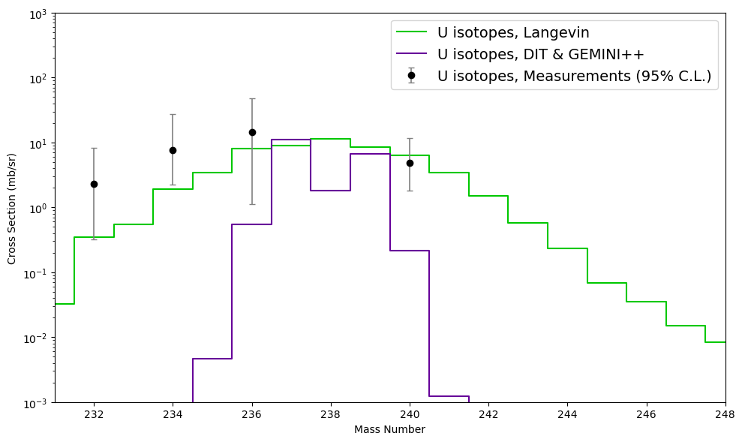
Cross-sections : Uranium isotopes at 5.15 MeV/u
R.J. Charity, IAEA, Vienna, 2008, Report INDC(DNC)-530.
L. Tassan-Got and C. Stéphan, NPA 524 (1991) 121
DIT & GEMINI++ :
Langevin equations model:
A. V. Karpov; V. Saiko, private communication

Slide 17
Cross-sections : Uranium isotopes at 5.15 MeV/u
R.J. Charity, IAEA, Vienna, 2008, Report INDC(DNC)-530.
L. Tassan-Got and C. Stéphan, NPA 524 (1991) 121
DIT & GEMINI++ :
completely fails for this physics case
Langevin equations model:
overall agreement with measurements
A. V. Karpov; V. Saiko, private communication

Slide 18
Cross-sections : Uranium isotopes at 5.15 MeV/u
DIT & GEMINI++ :
Purely spherical nuclei
    → B_{C} = 5.29 MeV/u
Langevin equations model :
Deformations & relative orientations accounted for
    → B_{C} ∈ [5.28, 5.68] MeV/u
E
E
B_{c}
B_{c}
E_{beam} = 5.15 MeV/u
E_{beam} = 5.15 MeV/u
R.J. Charity, IAEA, Vienna, 2008, Report INDC(DNC)-530.
L. Tassan-Got and C. Stéphan, NPA 524 (1991) 121
A. V. Karpov; V. Saiko, private communication

Slide 19
Cross-sections : Uranium isotopes at 5.15 MeV/u
DIT & GEMINI++ :
Purely spherical nuclei
    → B_{C} = 5.29 MeV/u
Statical nuclear properties during the interaction
Langevin equations model :
Deformations & relative orientations accounted for
    → B_{C} ∈ [5.28, 5.68] MeV/u
Dynamical deformation of nuclei while approaching
E
E
B_{c}
B_{c}
E_{beam} = 5.15 MeV/u
E_{beam} = 5.15 MeV/u
R.J. Charity, IAEA, Vienna, 2008, Report INDC(DNC)-530.
L. Tassan-Got and C. Stéphan, NPA 524 (1991) 121
A. V. Karpov; V. Saiko, private communication

Slide 20
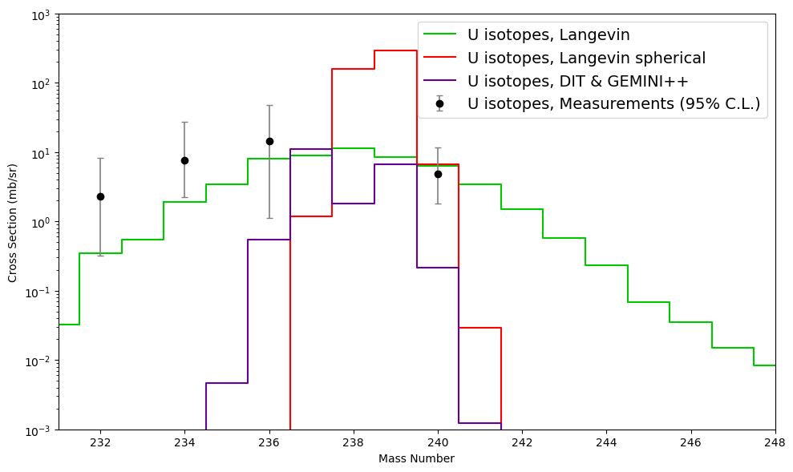
Cross-sections : Uranium isotopes at 5.15 MeV/u
DIT & GEMINI++ :
completely fails for this physics case
Langevin equations model:
overall agreement with measurements
Signature of the dynamical deformation of nuclei

Slide 21
Conclusion
Successes :
MNT neutron-transfer channels observed using ¹³⁶Xe + ²³⁸U
Extracted cross-sections confirm Langevin equations model predictions
Dynamical deformation of the nuclei indirectly observed
Notes:
"degrade sensitivity"

Slide 22
Conclusion
Successes :
MNT neutron-transfer channels observed using ¹³⁶Xe + ²³⁸U
Extracted cross-sections confirm Langevin equations model
predictions
Dynamical deformation of the nuclei indirectly observed
Limitations :
No mass selection → High CoulEx background
Symmetry limit for studies with gas-filled separators
Notes:
"degrade sensitivity"

Slide 23
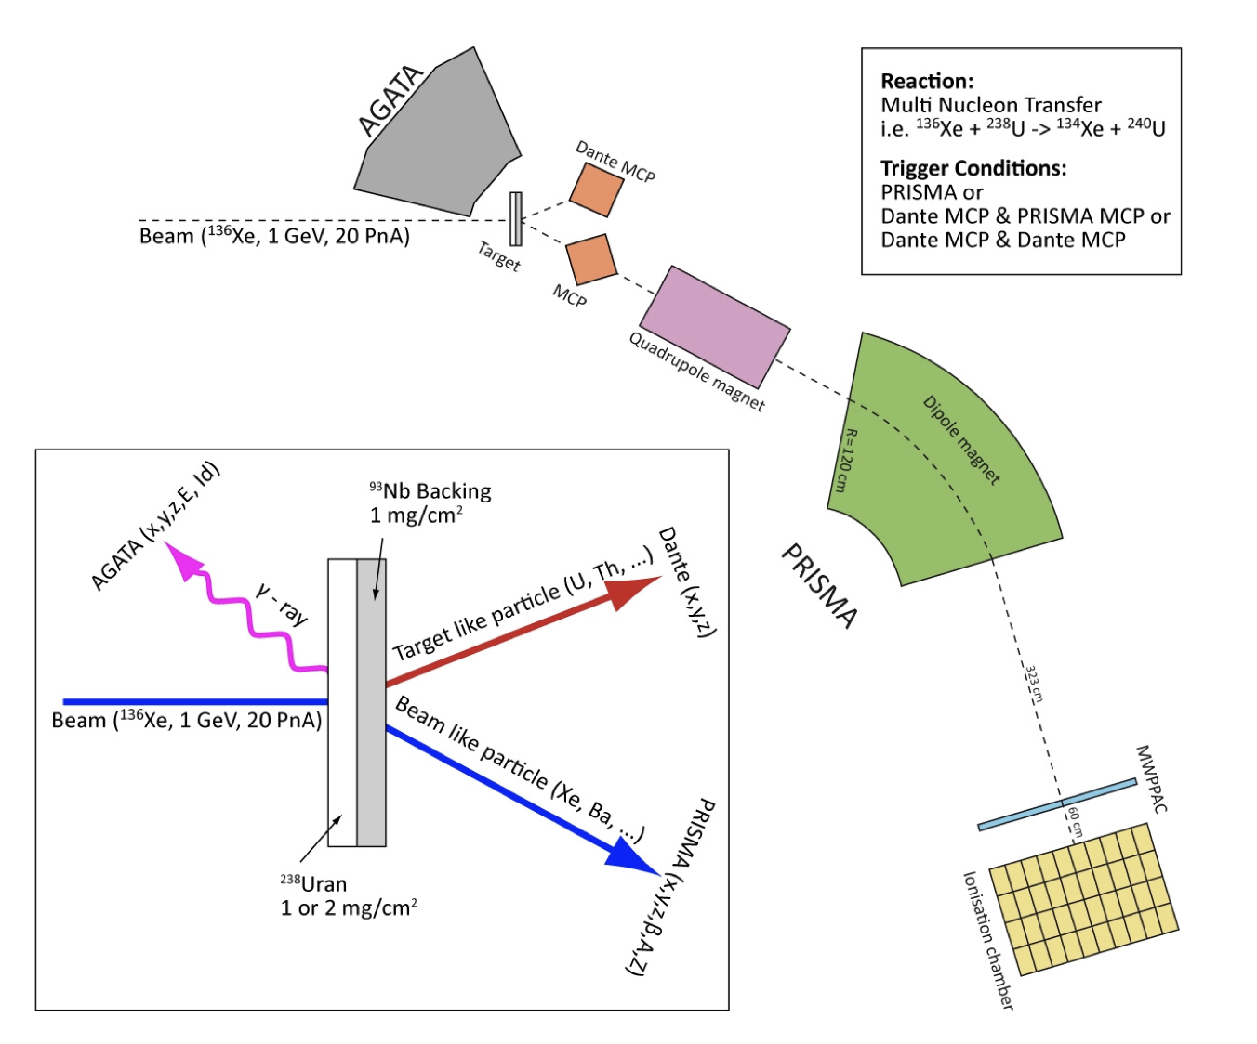
Outlooks : next experiments
²³⁸U + ¹²⁴Sn at 6.2 MeV/u with AGATA at LNL (July 2026) :
Isotopic identification of Sn-like in Prisma
Correlated U-like partner in NOSE
γ spectroscopy of both with AGATA
²³²Th + ⁹⁶Zr at 6 MeV/u with VAMOS at GANIL (Spring 2027) :
Same principle
Focus on the deep-inelastic part of the reaction
NOSE
M. Coguic & L. Busak
²³⁸U
⁶⁴Ni
124Sn

Slide 24
Thank you for your attention

Slide 25
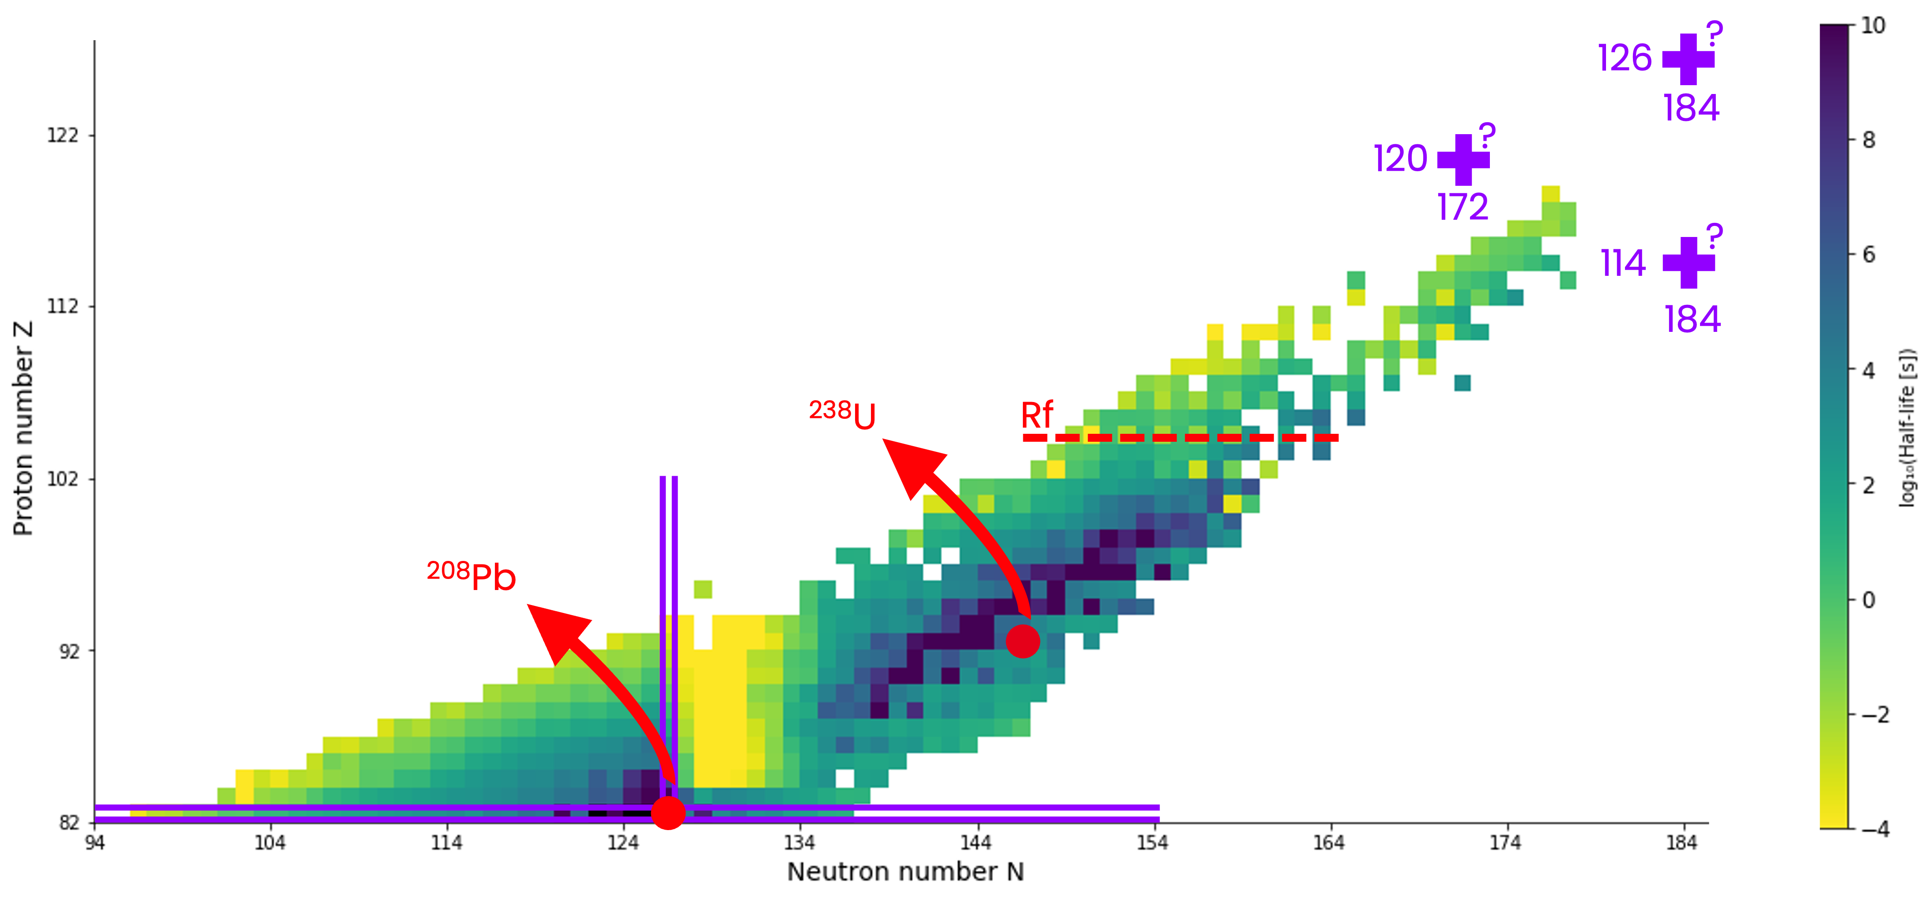
Island of stability
Island of stability
RMF
RMF : relativistic mean field
SHF : Skyrme Hartree-Fock
MM : Microscopic-Macroscopic
SHF
MM

Slide 26
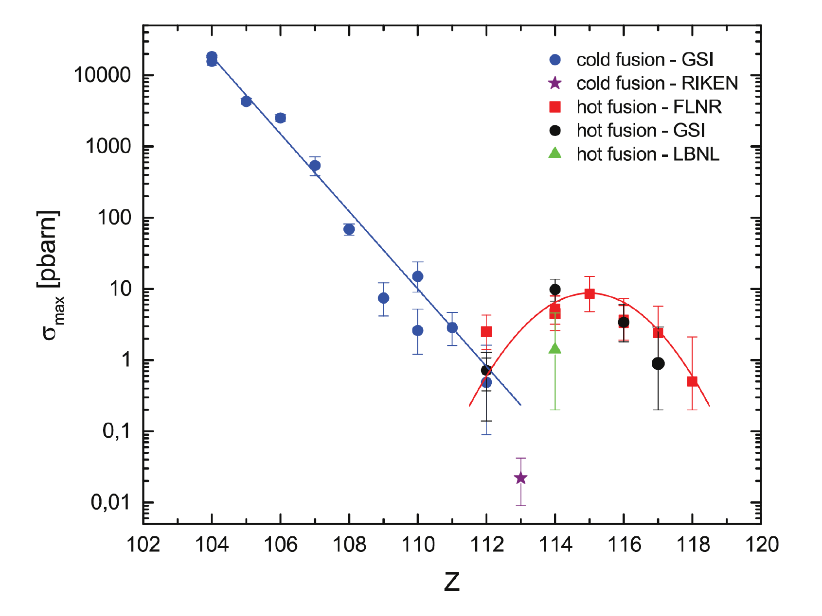
Hot vs Cold fusion
Hot & cold fusion
Cold Fusion
Hot Fusion
Complementary + ²⁰⁸Pb
⁴⁸Ca + Complementary:
Doubly magic
Doubly magic
→ E* ∼ 10 MeV
→ E* ∼ 30 MeV
→ Higher fusion probability
D. Ackermann & Ch. Theisen; PS (2017)

Slide 27
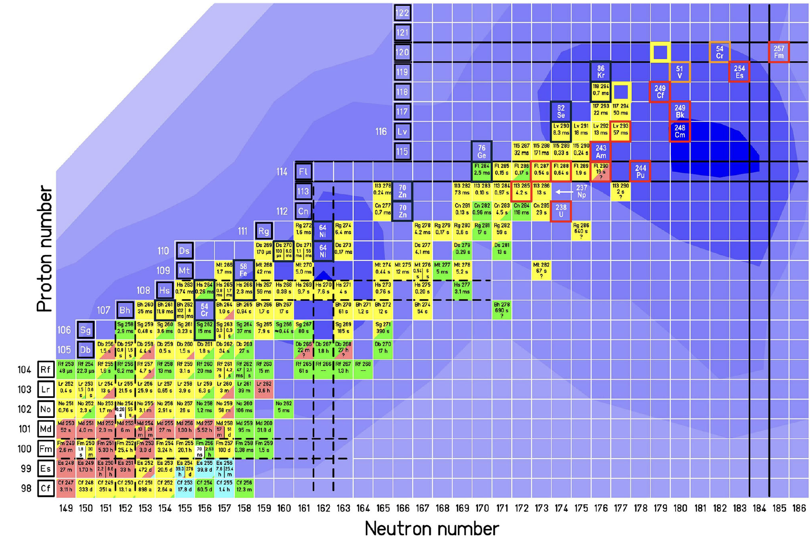
Future discoveries with fusion
Next steps with fusion
t_{1/2} (²⁵⁷Fm) = 100 days
t_{1/2} (²⁵⁴Es) = 256 days
S. Hofmann et. al.; EPJA (2016)

Slide 28
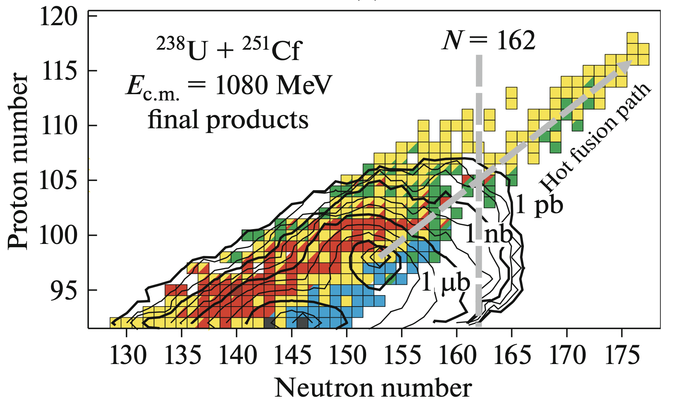
Predictions : SHE
MNT predictions for SHI
A. Karpov, V. Saiko; PPNL (2019)

Slide 29
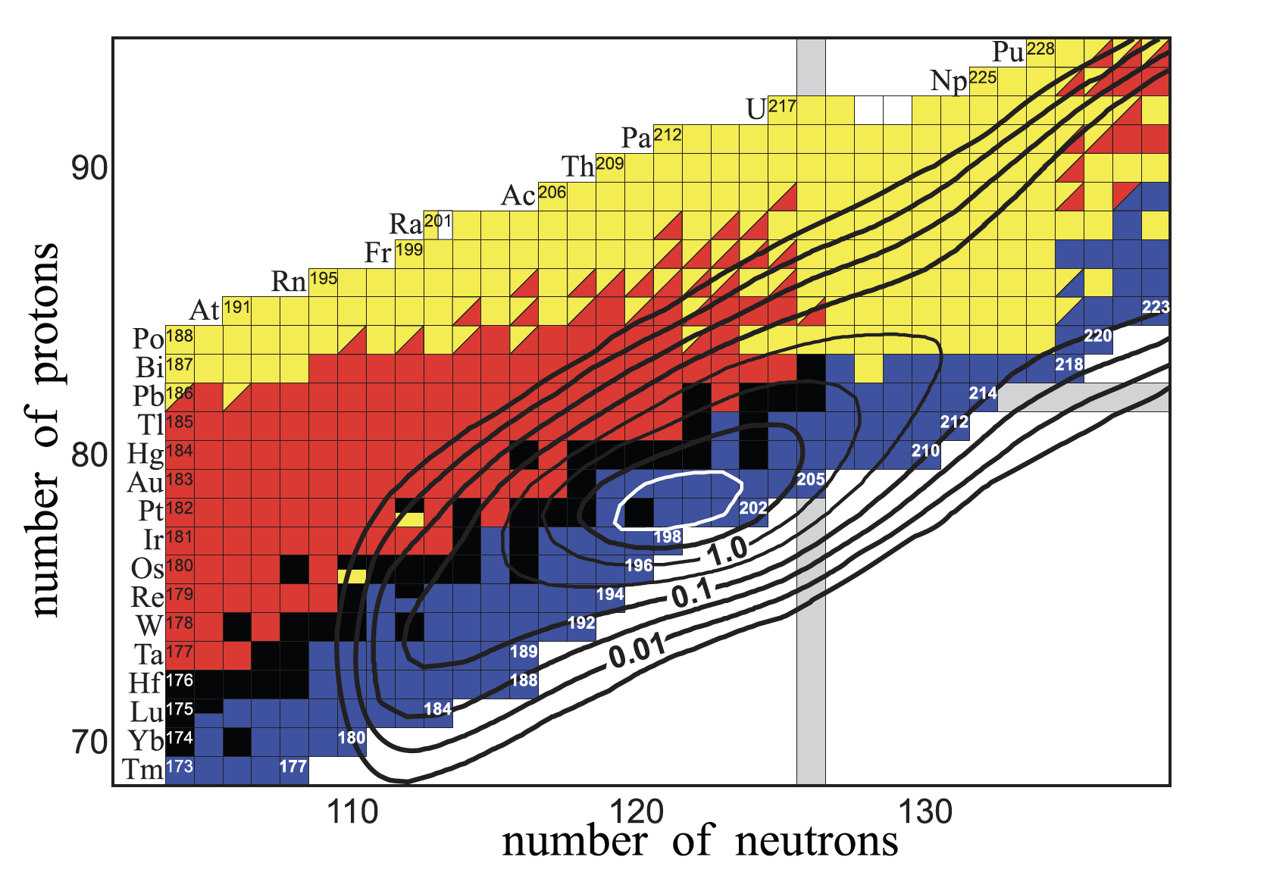
Predictions : N=126
MNT predictions for N = 126
²³⁸U + ¹⁹⁸Pt : 6.55 MeV/u
9.3 % above the barrier
V.I. Zagrebaev, W. Greiner; PRC 87 (2013)

Slide 30
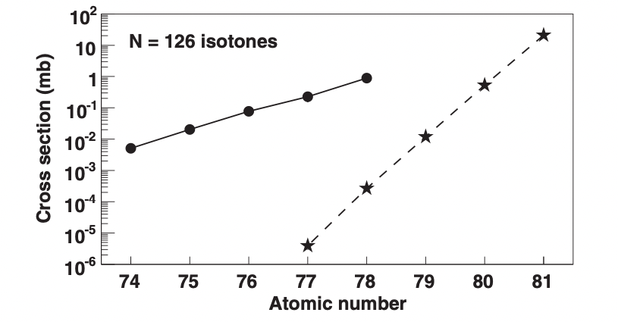
MNT vs Fragmentation
MNT vs fragmentation
MNT :
¹³⁶Xe + ¹⁹⁸Pt
∼ 8 MeV / u
59 % above barrier
Fragmentation : ²⁰⁸Pb + ⁹Be
1 GeV/u
Y. X. Watanabe et. al. ; PRL 115, 172503 (2015)

Slide 31
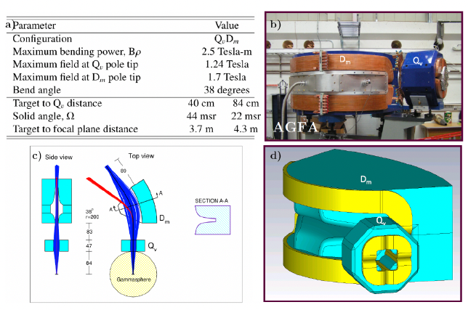
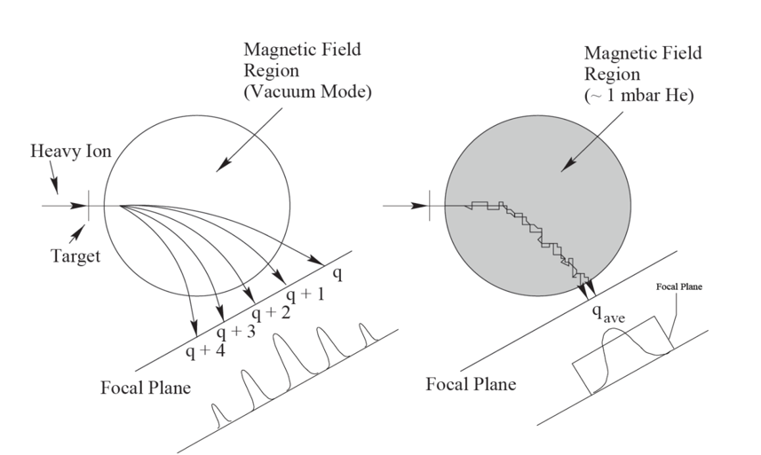
AGFA GFS
AGFA GFS
Greenlees, P; PhD thesis (University of Liverpool, 1999).

Slide 32
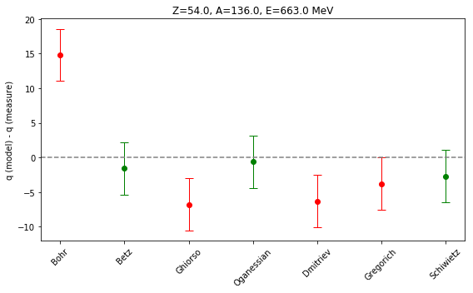
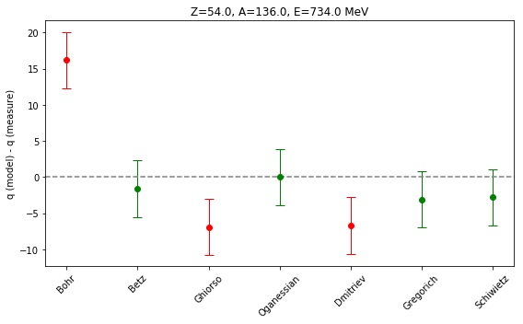
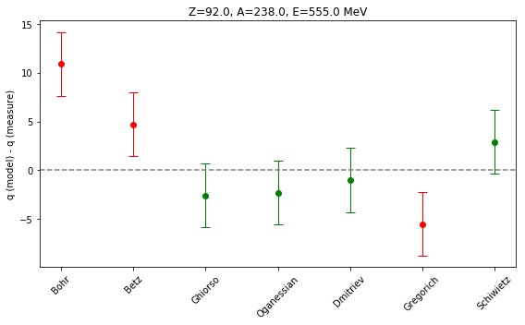
Magnetic rigidity : models
Magnetic rigidity : models

Slide 33
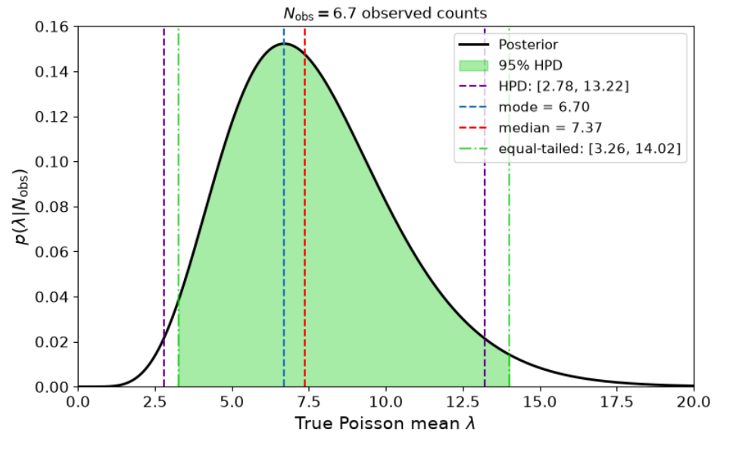
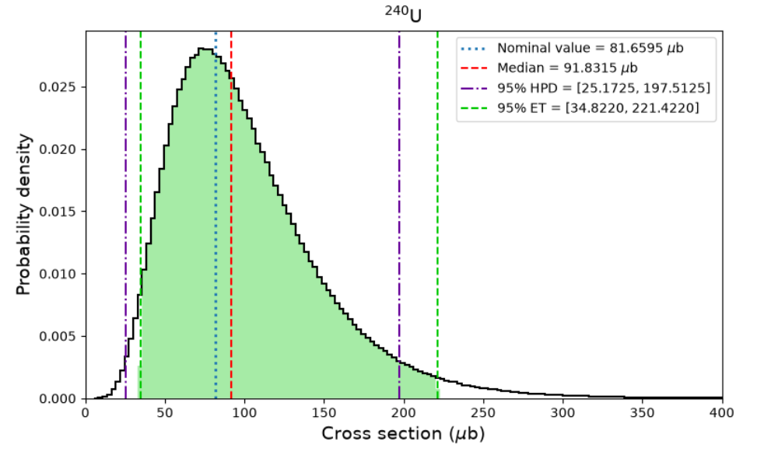
Poisson distribution
Poisson statistics

Slide 34
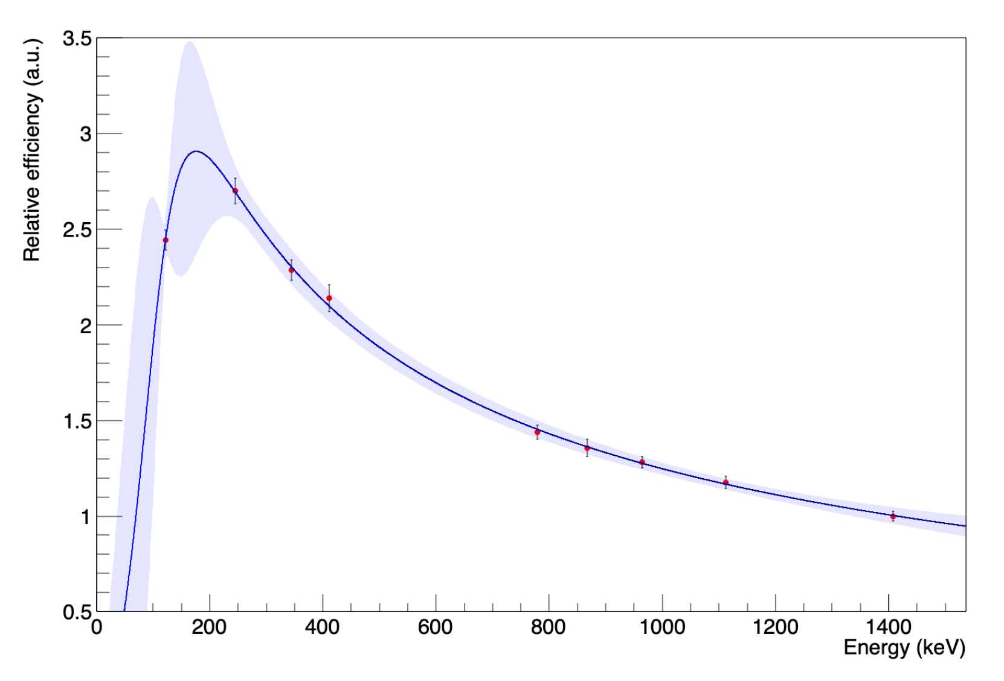
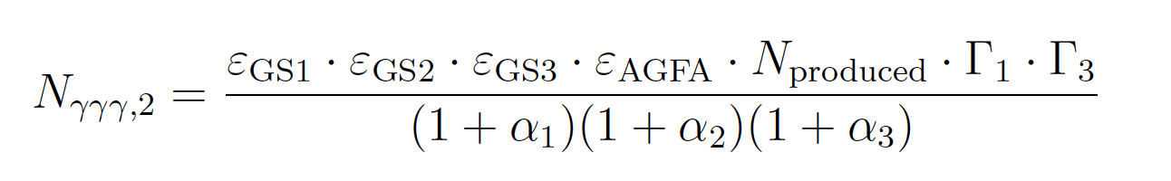
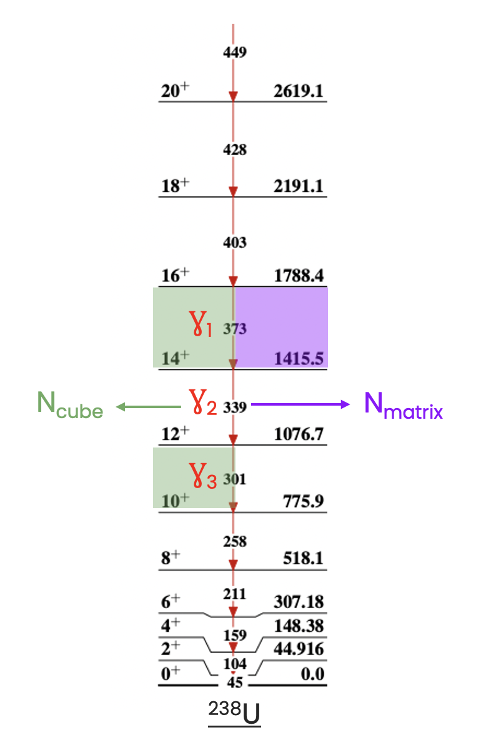
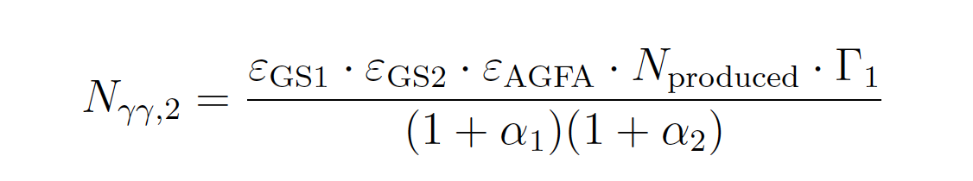
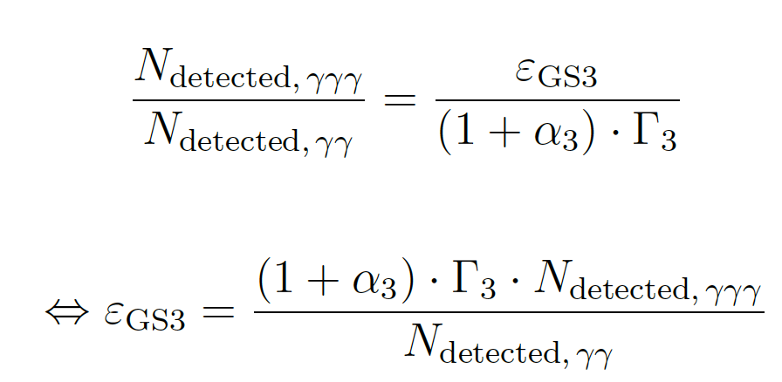
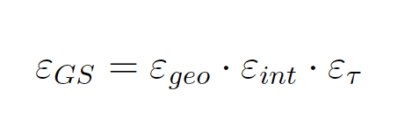
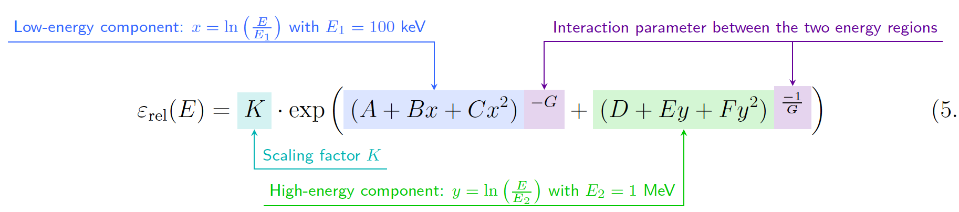
GS : efficiency
Gammasphere : efficiency
9.25 % (1408 KeV)

Slide 35
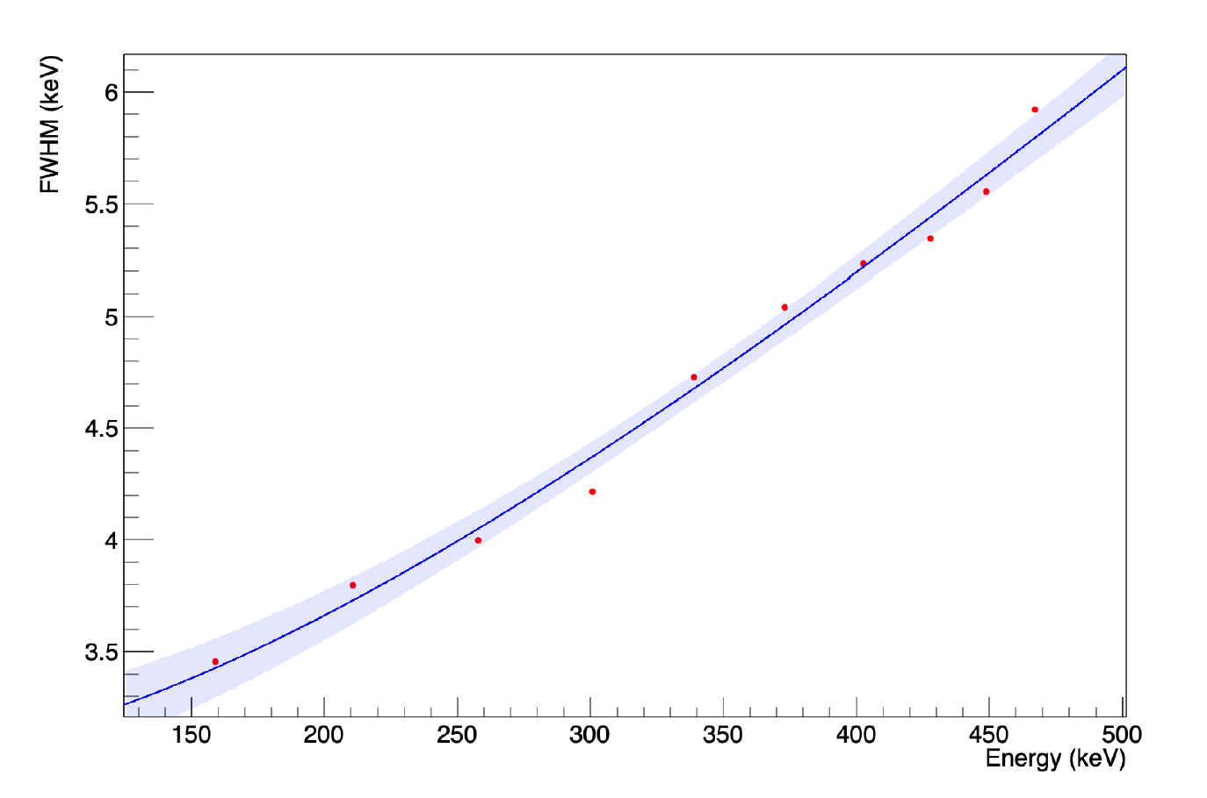
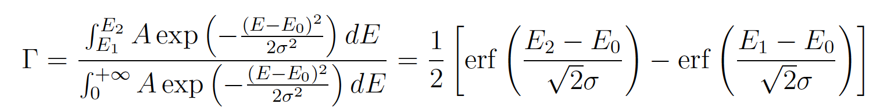
Gating efficiency
Gating efficiency

Slide 36
AGFA : Transmission
AGFA : transmission
AGFA
Known FP distributions
Known beam & fragments properties
E ?
Q ?
Adiabatic assumption → (E_{start},Q_{start}) = (E_{f},Q_{f}) → Set parameters to retrieve the final distribution

Slide 37
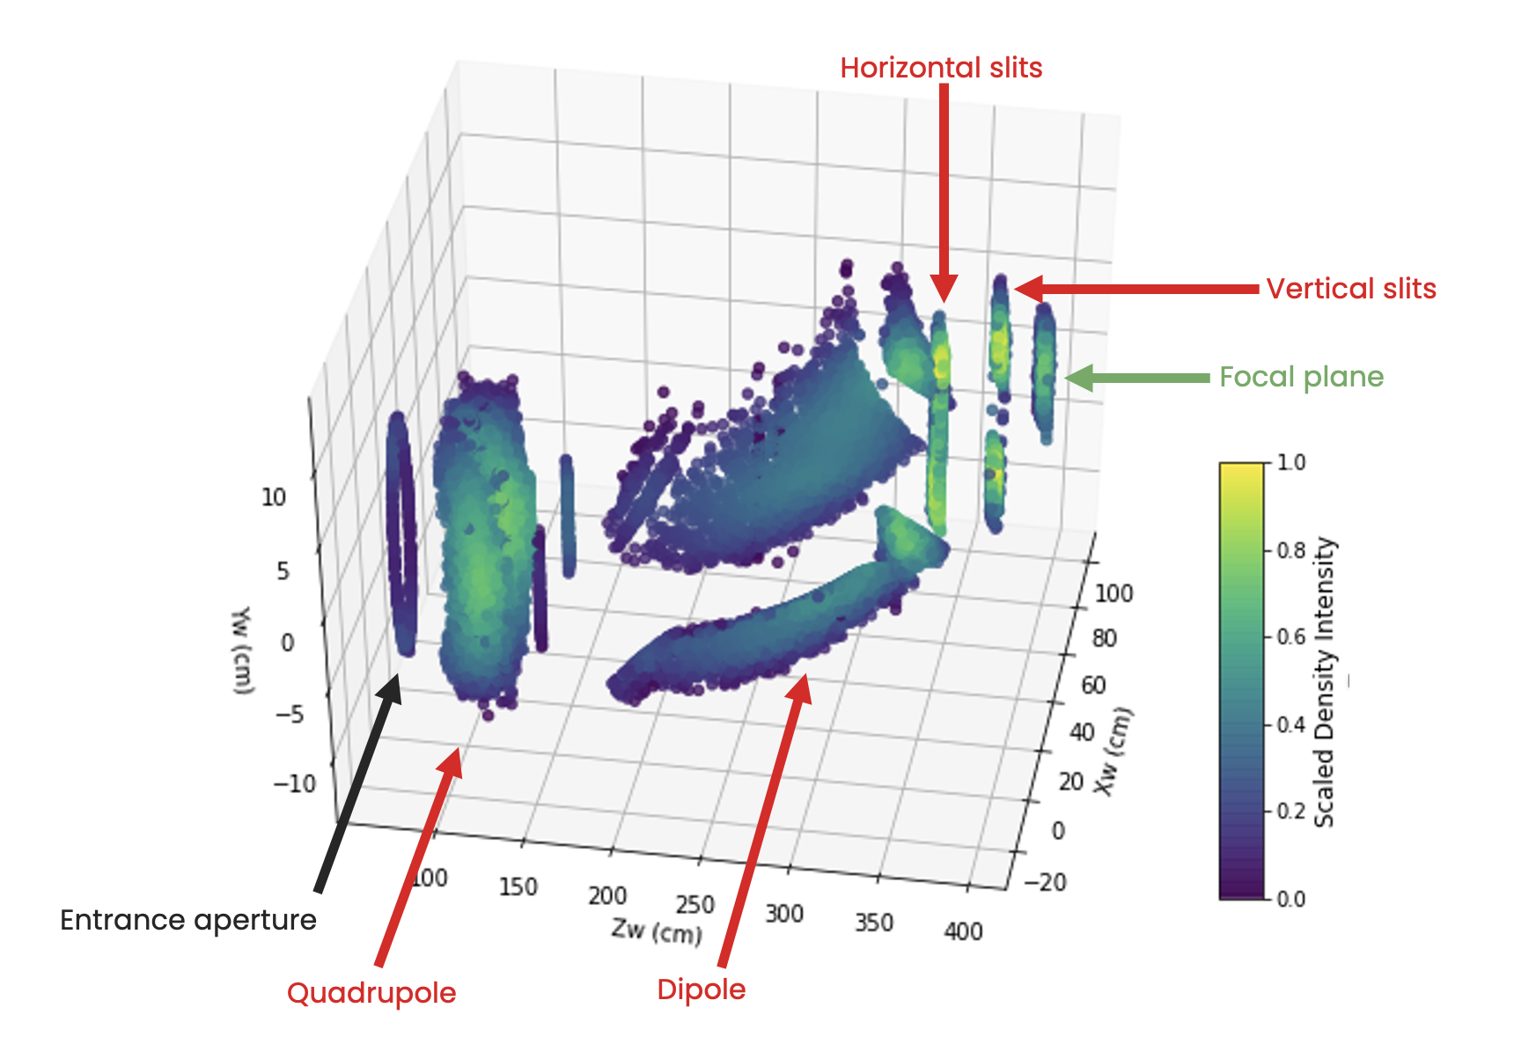
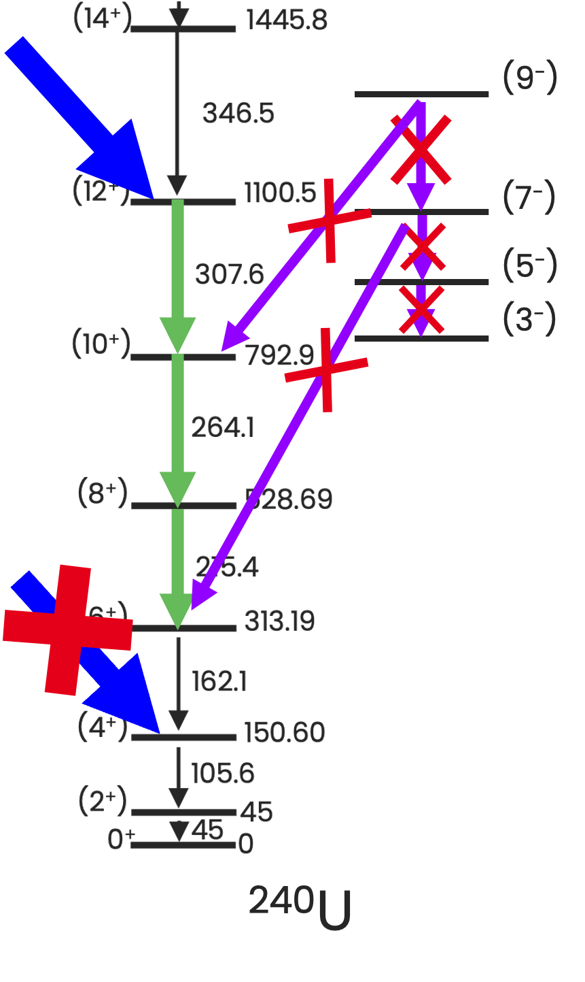
Assumptions :
Assumptions
All transitions not in the g.s. rotational band are neglected
All products are at least excited up to the highest considered state in the triplet
Transmission evaluated with simulations

Slide 38

U-like nuclei selection
5 observables for this study:
Energy loss in the PPAC
Horizontal Position of nuclei in the PPAC (X)
Implantation energy in the DSSD
Nuclei selection
E_{dssd}
ΔE
DSSD
MNT products
X
AGFA
MWPC

Slide 39
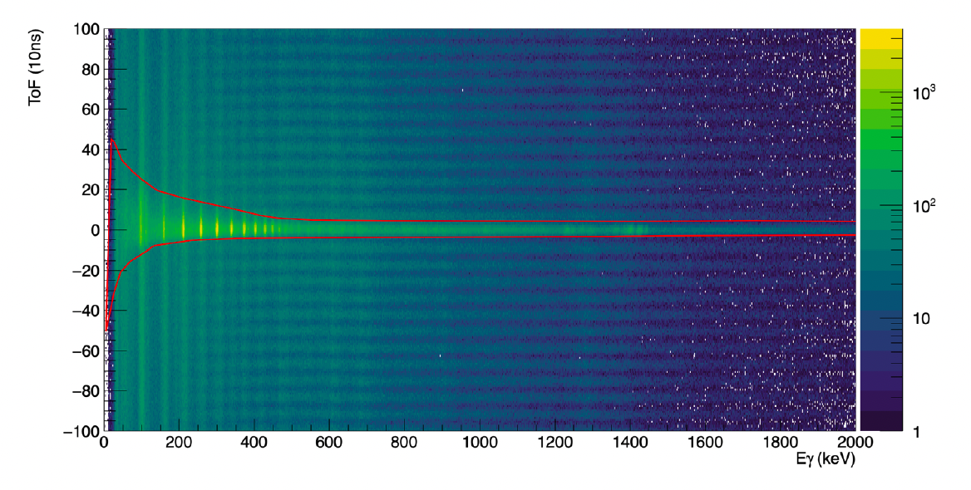
U-like nuclei selection
U-like nuclei selection
5 observables for this study:
Energy loss in the PPAC
Horizontal Position of nuclei in the PPAC (X)
Implantation energy in the DSSD
Time of flight (ToF) between nuclei entering the PPAC and the Ɣ-rays they emitted in Gammasphere
Ɣ-rays selection
HPGe (Gammasphere)
E_{dssd}
Ɣ
DSSD
X
ΔE
MNT products
AGFA
MWPC
Time of Flight
Notes:
Prompt Gamma-rays in coincidence with the nuclei they emmited

Slide 40
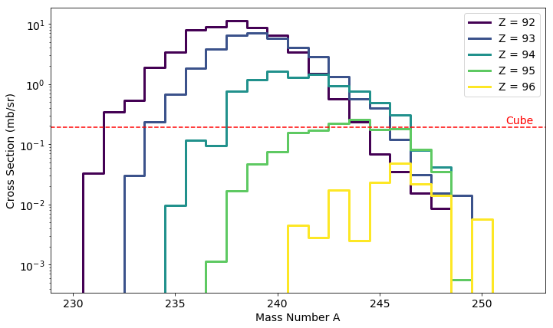
Cross-sections : Uranium isotopes at 5.15 MeV/u
Langevin equations model predictions
Optimal sensitivity limit with cube
∼ 1 µb
Exploratory experiment with heavy partners, near-barrier & forward angle :
massive transfers out of reach here

Slide 41
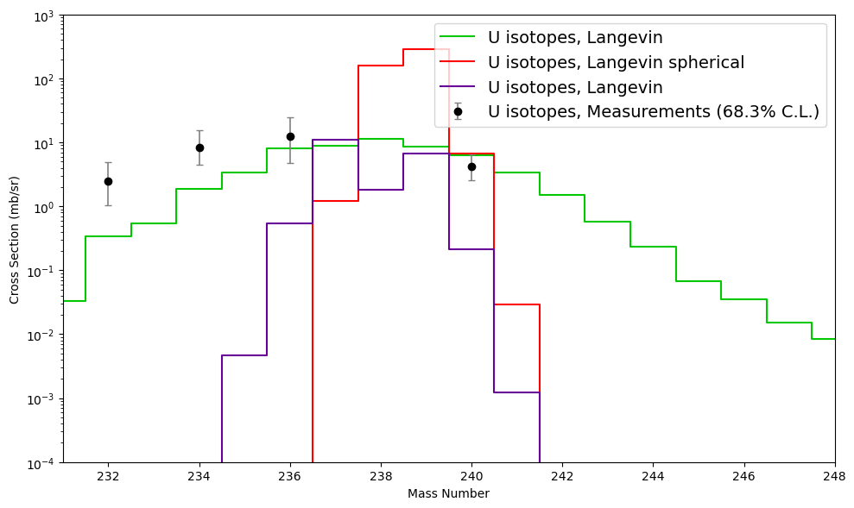
Cross-section : « 1σ » error-bars

Slide 42
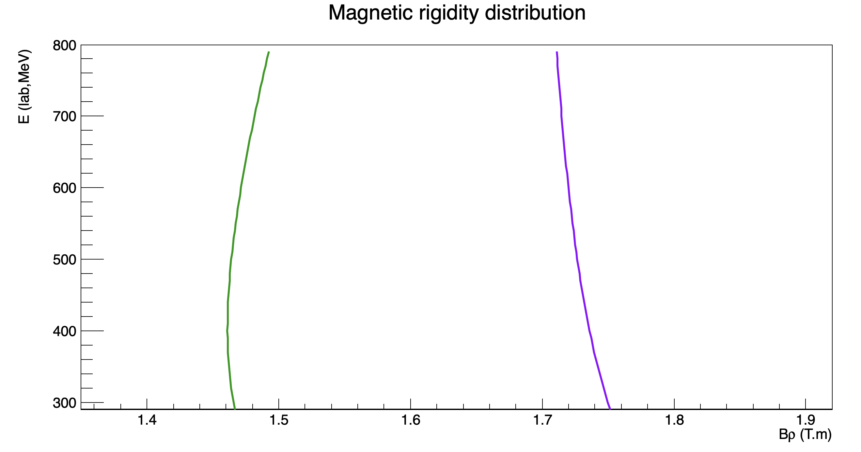
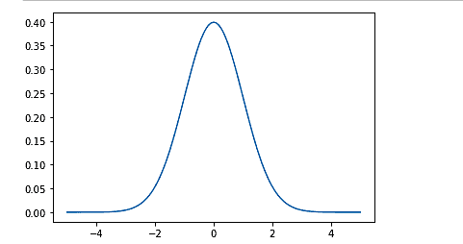
No MNT at 5.88 MeV/u
Schiewietz
B⍴ scan
No U-like identified ( no CoulEx)
Simulations : -30% CoulEx expected w.r.t 5.15 MeV/u data
Oganessian
M. Zielinska; private communication
5.15 MeV/u
B⍴ = 1.65 T.m
Trigger : Focal plane
DSSD
5.88 MeV/u
B⍴_{min} = 1.7 T.m
Trigger : DSSD

Slide 43
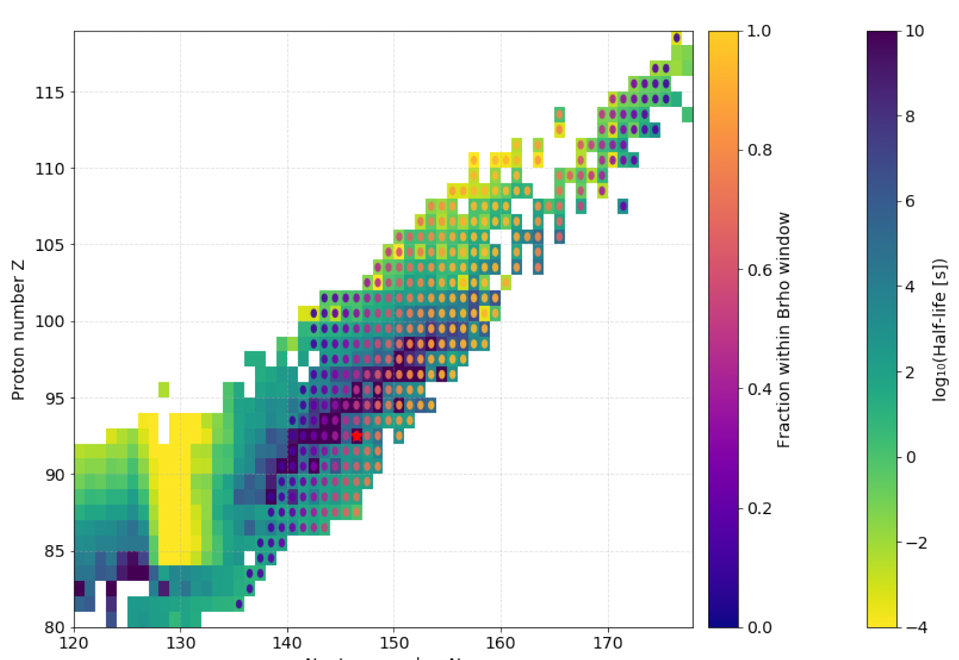
Decay spectroscopy ?

Slide 44
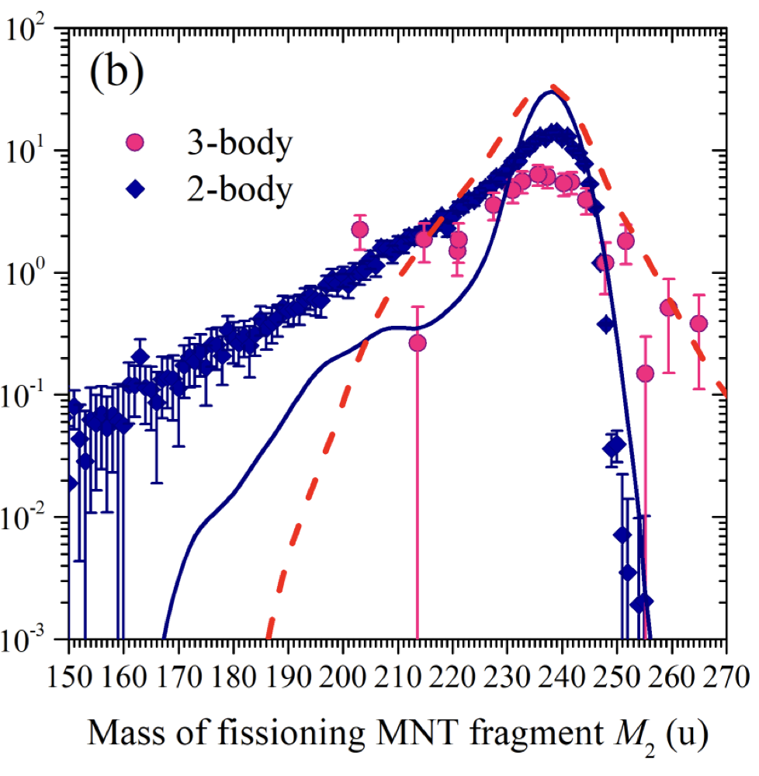
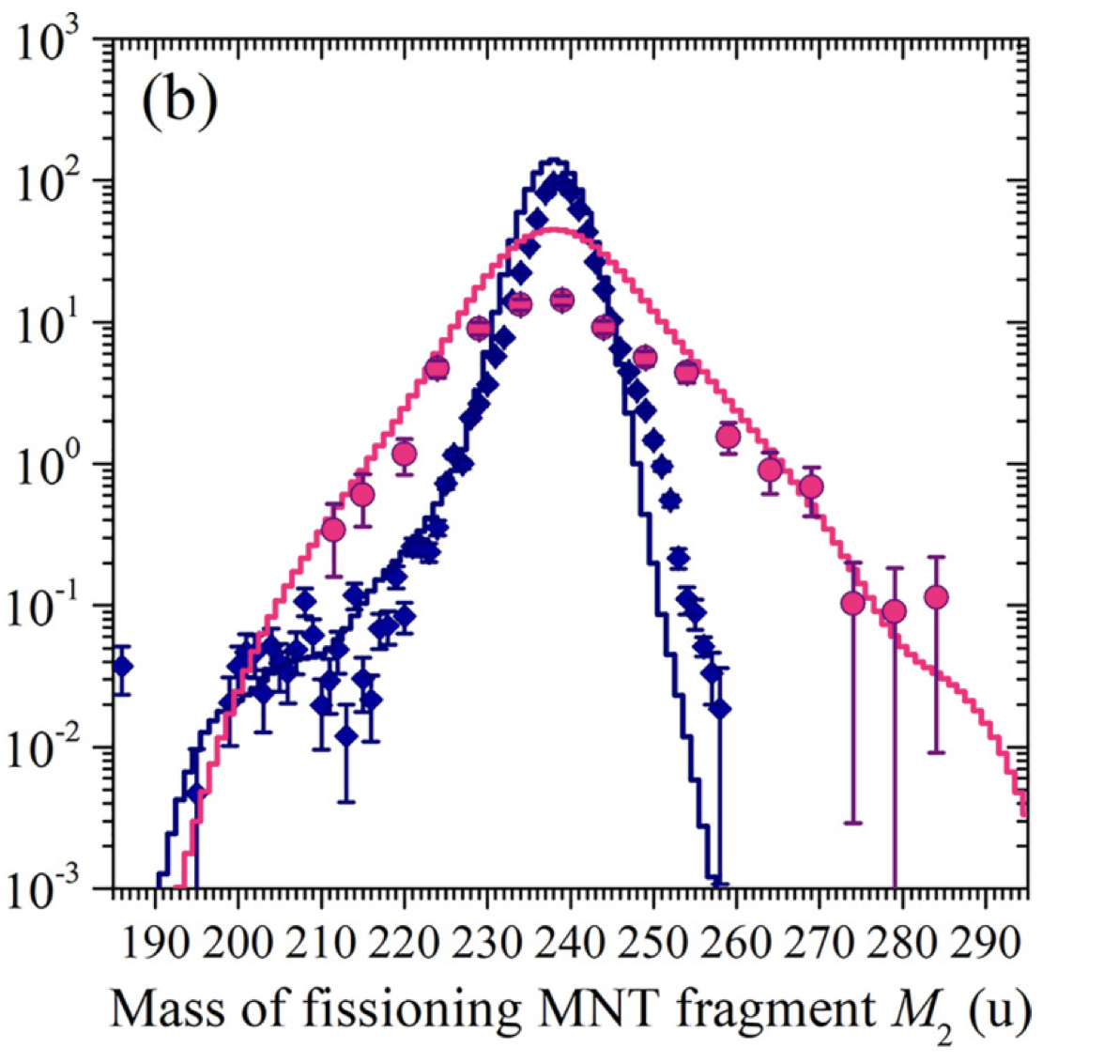
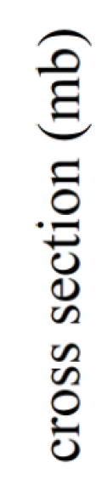
MNT with CORSET
MNT at CORSET
¹³⁶Xe + ²³⁸U : 8.16 MeV/u (51.6 % above barrier)
²⁰⁹Bi + ²³⁸U : 8.85 MeV/u (45.6 % above barrier)
E. M. Kozulin et. al.; PRC 109 (2024)
I. V. Vorobiev et. al.; PRC 112 (2025)

Slide 45

MNT at KISS
MNT with KISS
²³⁸U + ¹⁹⁸Pt : 10.75 MeV/u
T. Niwase et. al.; PRL 130 (2023)
81 % above barrier
Gas-cell (KISS)
Low efficiency setup

Slide 46


MNT : discovering neutron-rich isotopes
²⁶⁰No
²⁶⁰Md
²⁵⁴Es
(mostly) neutron-rich discoveries all along the chart
Adamian, G. G. et al. “How to extend the chart of nuclides?” ; Eur. Phys. J. A 56.2 (2020)

Slide 47


Beam & target : theoretical predictions
Adamian et al. describe such reactions as the evolution of a di-nuclear system, using the diffusion master equation and diabatic internuclear potential.
Light beams are favored: shell effect increases the survival probability of primary products.
Zagrebaev & Greiner, then Karpov & Saiko, developped a model using multidimensional Langevin equations and an adiabatic internuclear potential to describe MNT.
Heavier beams are favoured: large amount of available neutrons increase the probability to transfer enough to synthesise new neutron-rich isotopes.
⁴⁸Ca+^{244,246,248}Cm (E_{c.m.} ≈ 205 MeV)
G. G. Adamian , PRC 71, 034603 (2005)
102
104
106
108
Z
V. Zagrebaev,W. Greiner, NPA 944 (2015)
Both models predict « reasonable » cross-sections for the production of superheavy nuclei for different reaction partners.

Slide 48


Beam & target : validation
¹³⁶Xe+²⁰⁸Pb 5.8 MeV/u with Gammasphere at ANL : beam stopped in a thick target
J.S. Barrett et al. Phys. Rev. C 91, 064615 (2015)
117 Pb-like products identified from Yb (Z=70) to Ra (Z=88)
The cross-section distribution follows the trend predicted by Zagrebaev
But result integrated over all angles and beam energies → first step !

Slide 49

Near barrier reactions
Near barrier reactions
?
Interaction barrier
(+4p)
No Di-nuclear system
(+5p)
Products lost above a given energy
Optimal cross-section to find above the barrier
(+6p)
V. F. Comas, S. Heinz; EPJA i2013-13112-x (2013)

Slide 50


Angular distribution
Angular distribution
Maximum of the cross-section
²³⁸U + ²⁴⁸Cm
6.1 MeV/u
V. Zagrebaev, W. Greiner; PRC 83 (2011)
⁴⁰Ar + ²³²Th
9.7 MeV/u
Cm-like fragments with A>270
Beam
θ_{grazing}
J. Wilczynski; PLB 47 (6), 1973.
Near-barrier → Central collisions
b (impact parameter)
Target
Notes:
Montrer ce plot expliquer tout puis à la fin flasher le resultat théorique pour dire voilà on à des predictins.

Slide 51
Models for comparison:
Models comparison
DIT & GEMINI++ :
Semi-classical approach of the nucleus
Simple mean field potential
Nuclei exchange independant nucleons in a potential well with given probabilities
Statistical de-excitation and evaporation with GEMINI++
Purely spherical nuclei
Statical nuclear properties during the interaction
Langevin equations model :
Microscopic-Macroscopic approach for nuclear properties
Adiabatic (+diabatic component) mean field potential
Evolution of equipotential surfaces through the multi-dimensional Langevin equations
Evaporation calculated within the model
Deformations & relative orientations accounted for
Dynamical deformation of nuclei while approaching
R.J. Charity, IAEA, Vienna, 2008, Report INDC(DNC)-530.
L. Tassan-Got and C. Stéphan, NPA 524 (1991) 121
A. V. Karpov; V. Saiko, private communication

