Slide 1
Exploring ¹³Be resonances with two-neutron transfer in inverse kinematics
Sebastián Gómez García for the IS690 collaboration
59th Zakopane Conference on Nuclear Physics 2026
Extremes of the Nuclear Landscape

Slide 2
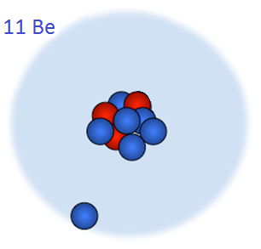
Light nuclei: a laboratory of quantum mechanics
Many different behaviours in a very small region.
Jumping from stable to bound to weakly bound to unbound by just adding or removing one nucleons.
Halo nuclei
Neutron Skin
⁹Be
¹⁰Be
¹¹Be
¹²Be
¹³Be
¹⁴Be
⁶Li
⁷Li
⁸Li
⁹Li
¹⁰Li
¹¹Li
³He
⁴He
⁵He
⁶He
⁷He
⁸He
¹H
²H
³H
n
Light nuclei: a laboratory of quantum mechanics
Peculiar structures in ground states of light nuclei: nuclear skins and/or nuclear halos, nuclear clusters, nuclear molecules, gas condensate ….
Theoretical understanding of the structure and the reaction dynamics of light drip-line nuclei are challenging

Slide 3
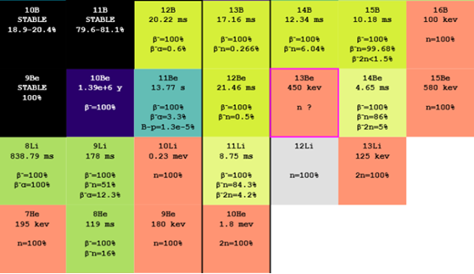
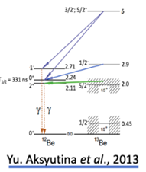
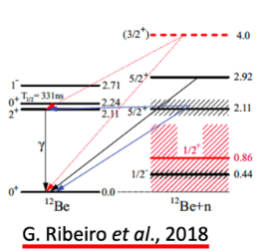
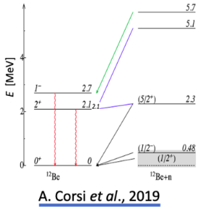
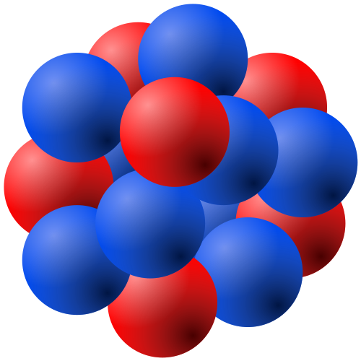
The case of ¹³Be
Unbound nucleus at the edge of nuclear existance.
It is crutial to establish the ¹²Be-n interaction.¹⁴Be is a 2-neutron halo nucleus.
Understand the n-n interaction.
The ordering for the lowest resonances is not resolved.
The 1/2⁻ resonance appears at a surprisingly low energy compared with its isotone in ¹⁵C (¹⁴C+n).
The poblation of the excited states of ¹²Be is not clear.
¹²Be core
n
n
¹⁴Be

Slide 4



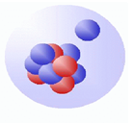
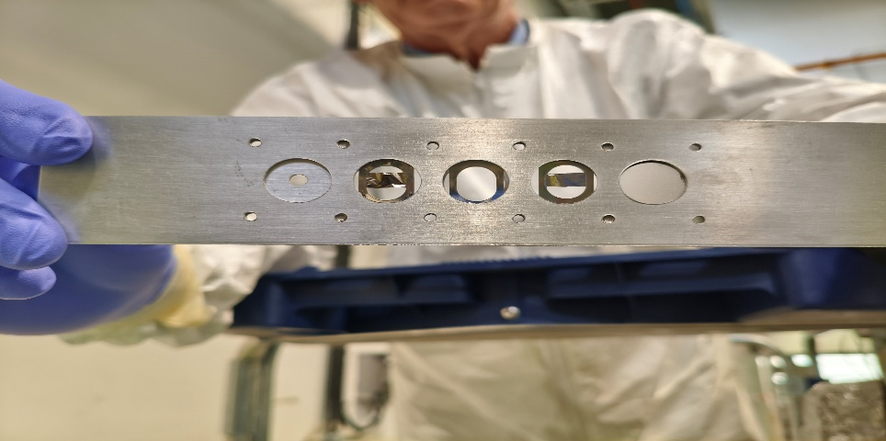
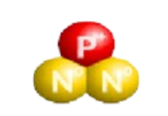
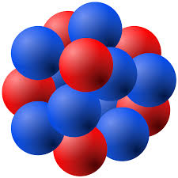

IS690-Experiment
We proposed a new approach by transferring 2 neutrons from ¹¹Be to ¹³Be.
The experiment was carried out Oct 25
The main target consists of a 12 x 5 mm, 1 µm-thick Ti foil loaded with tritium (³H/Ti ≈ 0.4). (Produced by SODERN)
The activity of the source was 3,38 GBq (3 years ago, when it was produced).
5,4 MeV/u
P
n
¹¹Be
ɣ
³H/Ti foil
¹³Be
¹²Be
IS690 Experimental targets

Slide 5
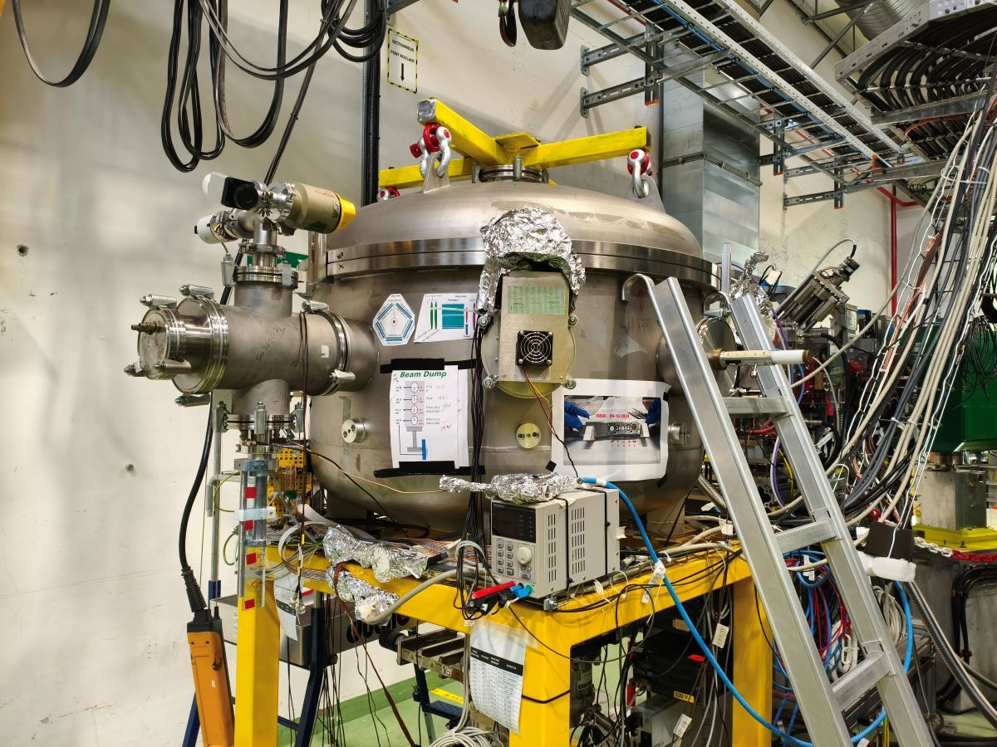
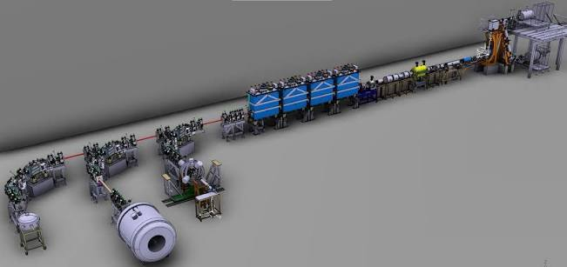
The Scattering Experiment Chamber
The Scattering Experiment Chamber (SEC) is one of the three main experimental stations at HIE-ISOLDE.
Situated at the XT03 beamline.
Cylindric reaction chamber with an internal radius of 50 cm and an internal height of 50 cm, with 8 connections ports.
SEC
Miniball
Scattering Experiment Chamber (SEC) at ISOLDE (CERN)
ISS
HIE-ISOLDE Representation

Slide 6
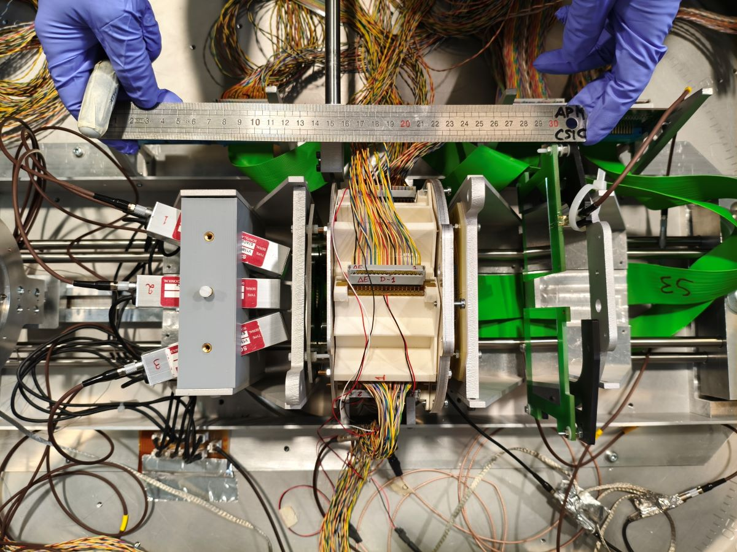
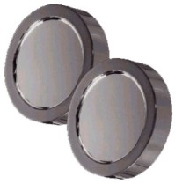
IS690 Experimental Setup @ SEC
Target
Beam
BeamDump
Telescope
IS690 experimental Setup
Two PIPS of 30 and 300 µm

Slide 7
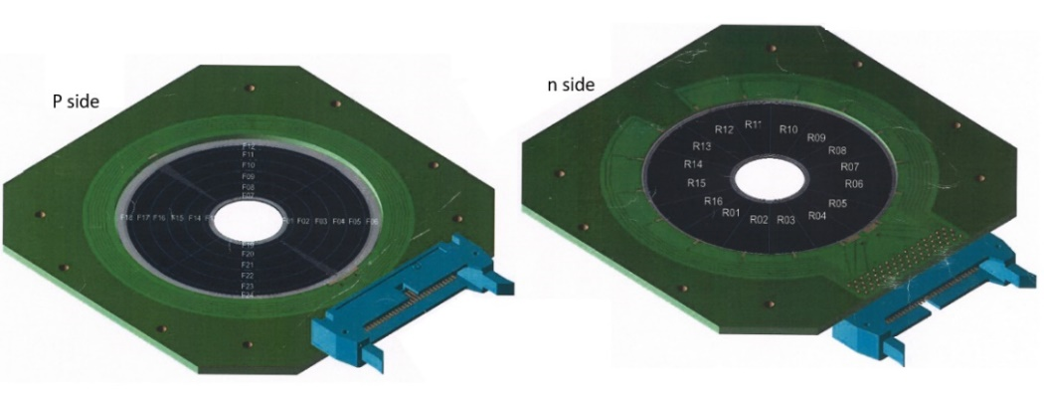
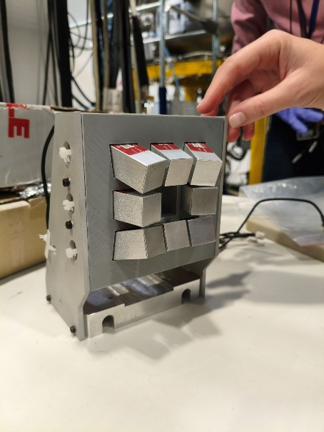
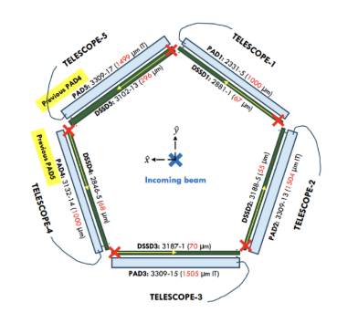
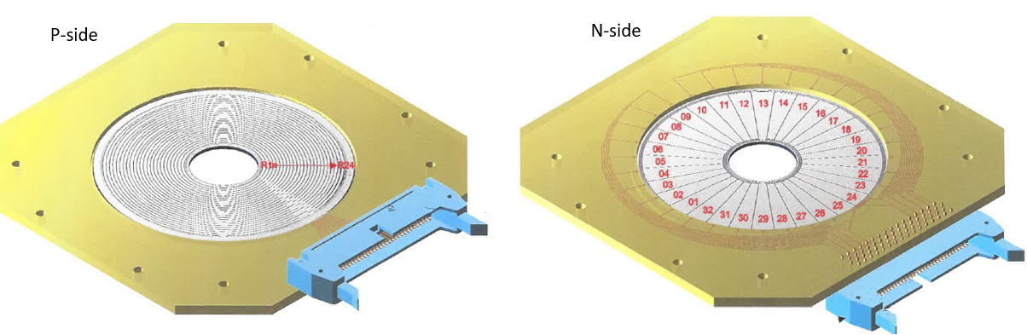
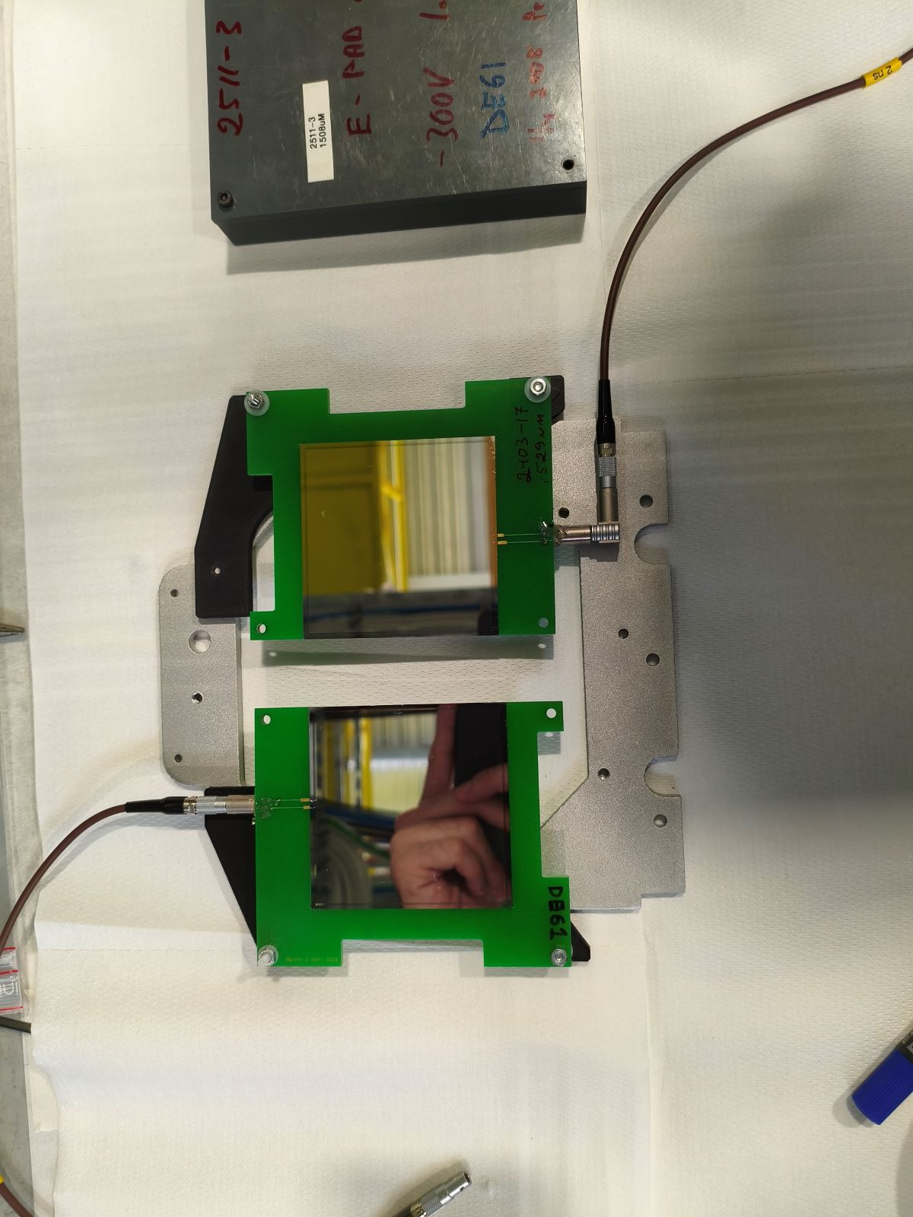
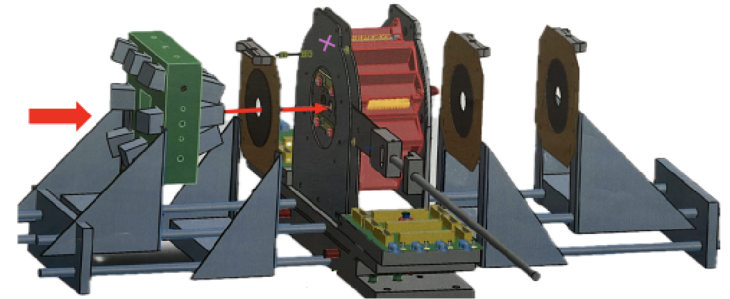
IS690 Experimental Setup @ SEC
X2
³H/Ti foil
GAGGs Scintillators
15x15x30 mm
S5 Detector 300µm
θ ≈ 110°->140°
Telescopes of W1 DSSD
and MSX25 PADs
θ ≈ 36°->76°
S3 Detectors 1 mm
θ ≈ 7°->25°
2 MSX40 1500 µm
v
Beam
Beam

Slide 8
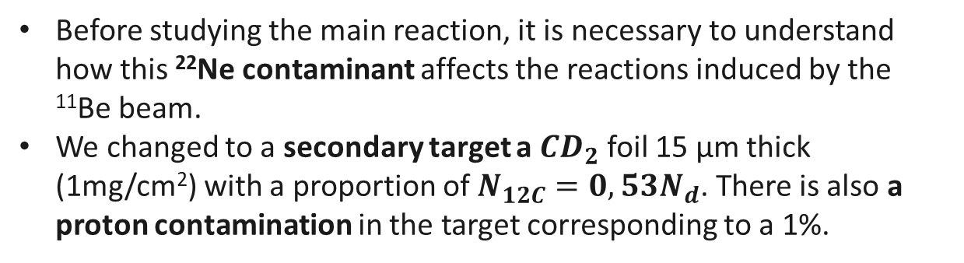
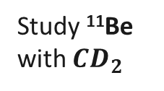
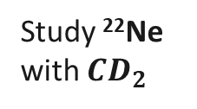
IS690 Preliminaries
Ti Contamination in the ³H/Ti foil ?? Use a new Ti foil as a target.
We used ²²Ne as a buffer gas
²²Ne⁸⁺ is also accelerated to the experimental chamber (2-10% contamination).
Before studying the main reaction, it is necessary to understand how this ²²Ne contaminant affects the reactions induced by the ¹¹Be beam.
We changed to a secondary target a $CD_{2}$ foil 15 μm thick (1mg/cm²) with a proportion of $N_{12C}=0,53N_{d}$. There is also a proton contamination in the target corresponding to a 1%.
Low Statistics
Ti Contribution
Ti Contribution
Study ¹¹Be
with Ti
Study ¹¹Be
with $CD_{2}$
Hard with the 3H target, will need a lot of statistics
Big Statistics
²²Ne Contamination
Study ¹¹Be with ³H
Study ²²Ne
with ³H
Ti Contribution
Study ²²Ne
with Ti
Study ²²Ne
with $CD_{2}$
Ne Contribution

Slide 9
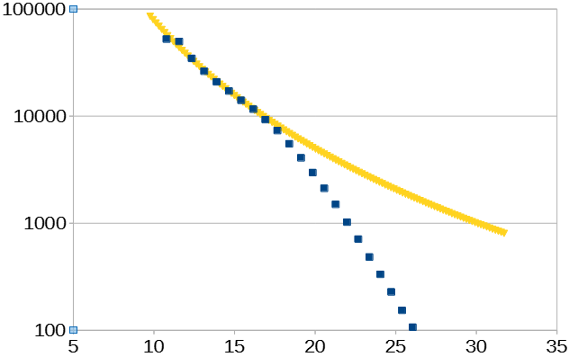
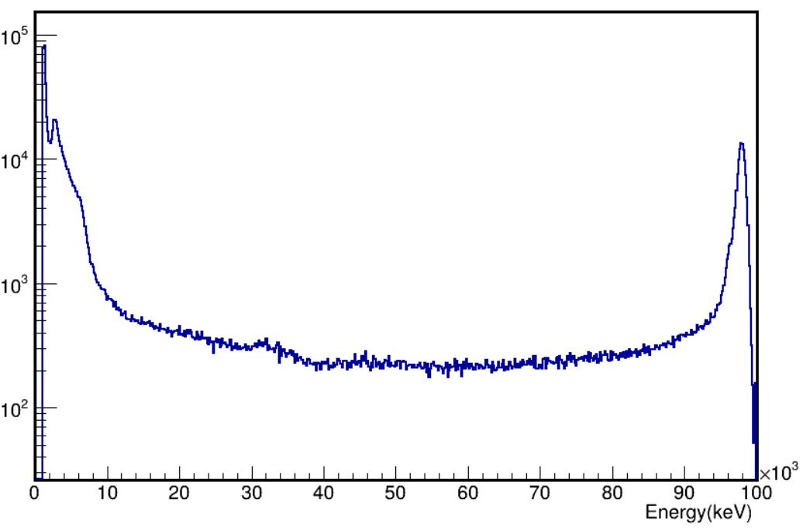
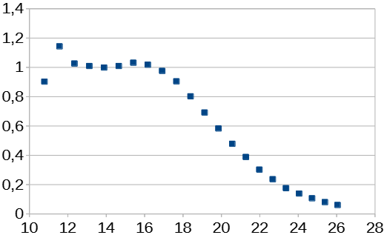
²²Ne elastic scattering on ⁴⁸Ti
Idea: Use the stable beam to optimize the S3 angles by studying the ²²Ne -> ⁴⁸Ti elastic scattering.
Grazing angle = 19º
(dσ/dΩ) mb/sr
²²Ne ->⁴⁸Ti
Rutherford
Experimental Points
Counts / 80 keV
Θ (lab)
Ring θ ≈ 11,5° S3-dE Spectrum
(dσ/dΩ)/(dσ/dΩ)_{Ruth}
Θ (lab)

Slide 10
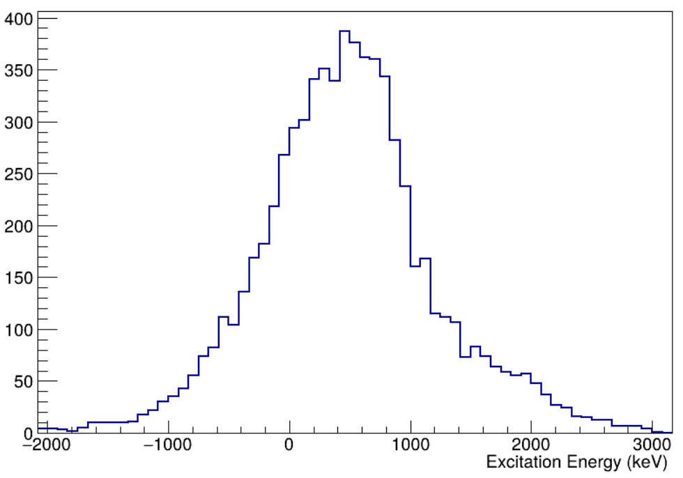
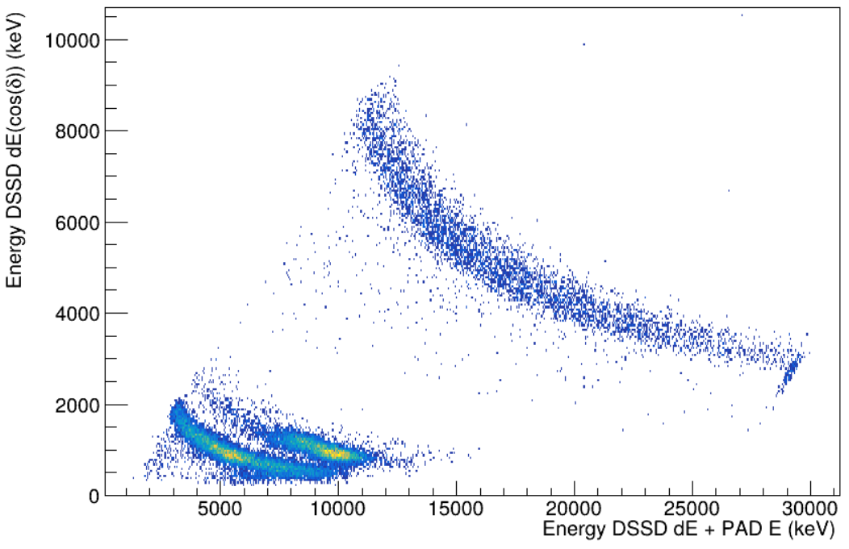

Improving Pentagon geometry: ²²Ne(d,d)²²Ne*
Clearly not centered
Idea: Use the stable beam to improve the setup properties. Now we will be interested in reactions in the Pentagon. The CD₂ target is perfect for the thickness and deuteron.
Excitation Energy
Counts / 50 keV
α
Excitation Energy Deuteron θ ≈ 58º Telescope 1
d
a = ²²Ne, X = d, Y = ²²Ne , b = d
p
Banana Strip P6 θ ≈ 58º Telescope 1
²²Ne(d,d)²²Ne

Slide 11
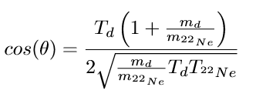
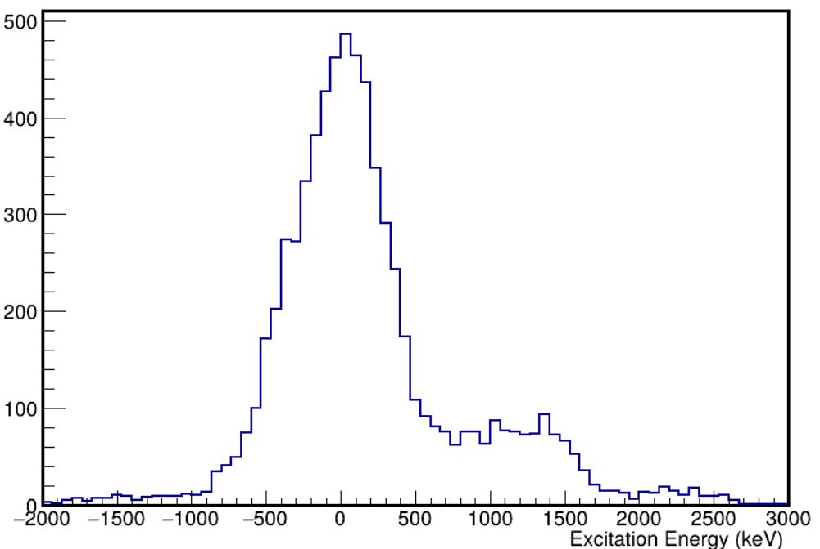
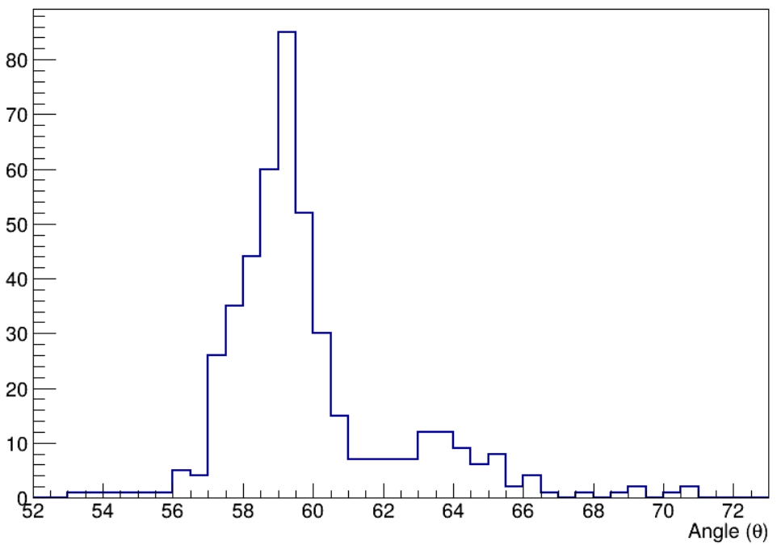
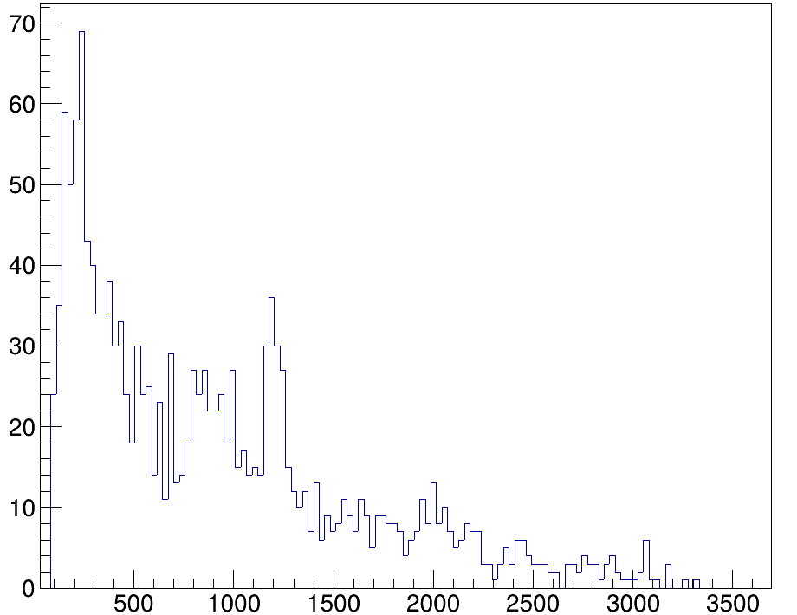
Improving Pentagon geometry: ²²Ne(d,d)²²Ne*
We now see the g.s & 1º excited state
Counts / 66 keV
3181
4456
1099
4456
2+
²²Ne Excited Spectrum “θ ≈ 58º” Telescope 1
Counts/ 0.5 º
4+
2082
3357
Gamma Spectrum Doppler corrected in coincidence with d
Corrected angle for one pixel
of P6 θ ≈ 58º Telescope 1
1274
Counts/25 keV
²²Ne*(1274 keV)
2+
1274
²²Ne*(3357 keV) -> ²²Ne*(1274 keV)
0+
²²Ne excited states
Energy (keV)

Slide 12
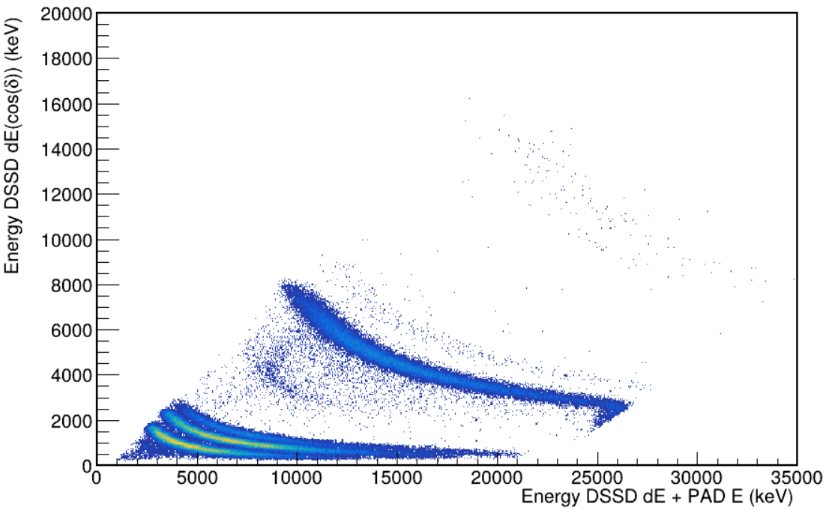
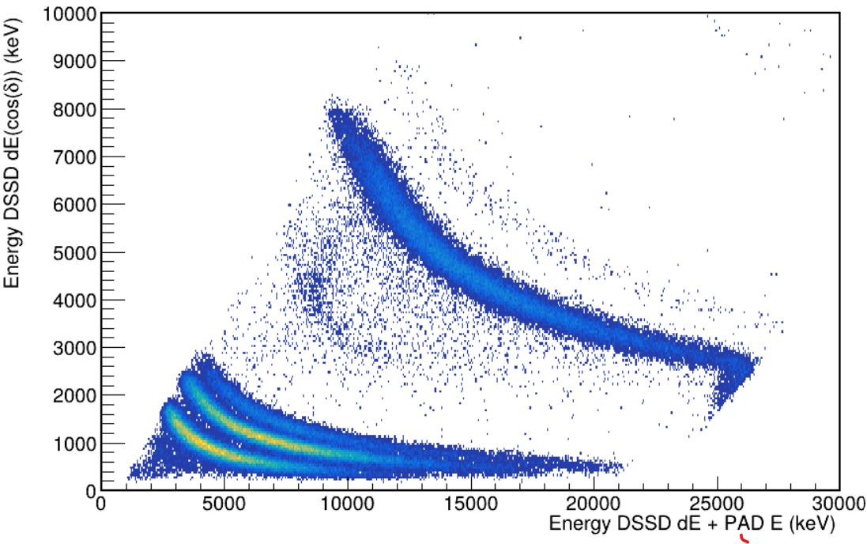
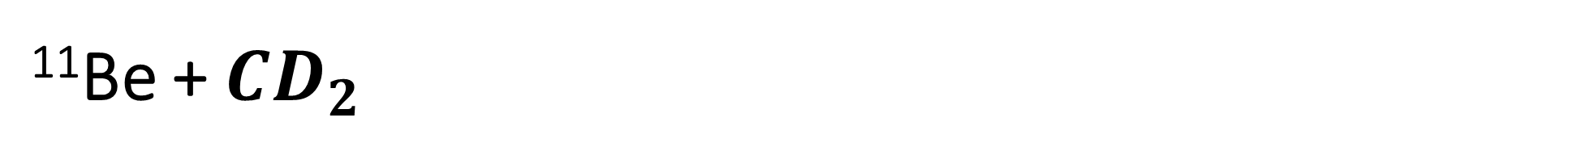
¹¹Be + $CD_{2}$
Li
⁶He
⁴He
⁶He
⁴He
³H
²H
H
¹H
Bananas Telescope 1 Pentagon
Bananas Telescope 1 Pentagon

Slide 13
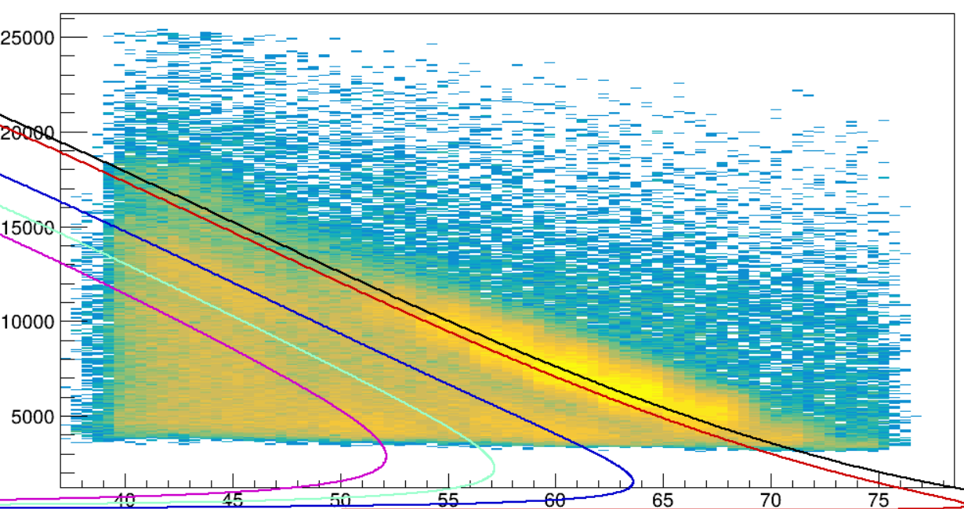
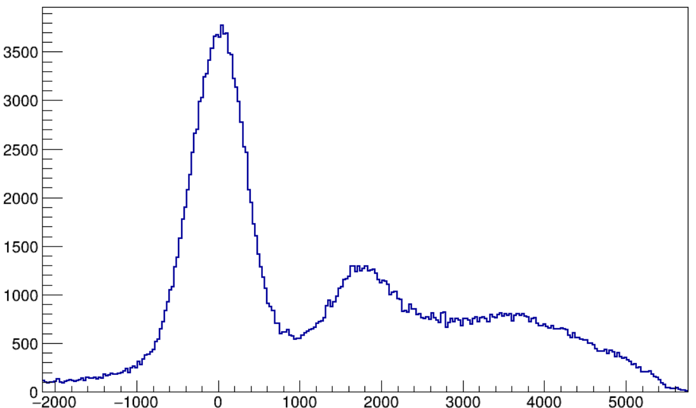
¹¹Be(d,d)¹¹Be*
3/2-
3400
3/2-
2654
5/2+
1783
320
Sn = 501
Deuteron Total Energy (keV)
1/2-
320
1/2+
¹¹Be excited states
g.s & 320
Deuteron θ (deg)
Counts/40 keV
¹¹Be* 1783
¹¹Be* 3400
¹¹Be Excited Spectrum from all the d of the ⬠ (keV)

Slide 14
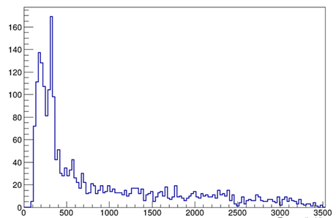
¹¹Be(d,d)¹¹Be*
¹¹Be* 320 (keV)
g.s & 320
Counts/40 keV
Counts/33 keV
¹¹Be* 1783
¹¹Be* 3400
¹¹Be Excited Spectrum from all the d of the ⬠ (keV)
Gamma Spectrum Doppler Corrected
in coincidence with d form pentagon (keV)

Slide 15
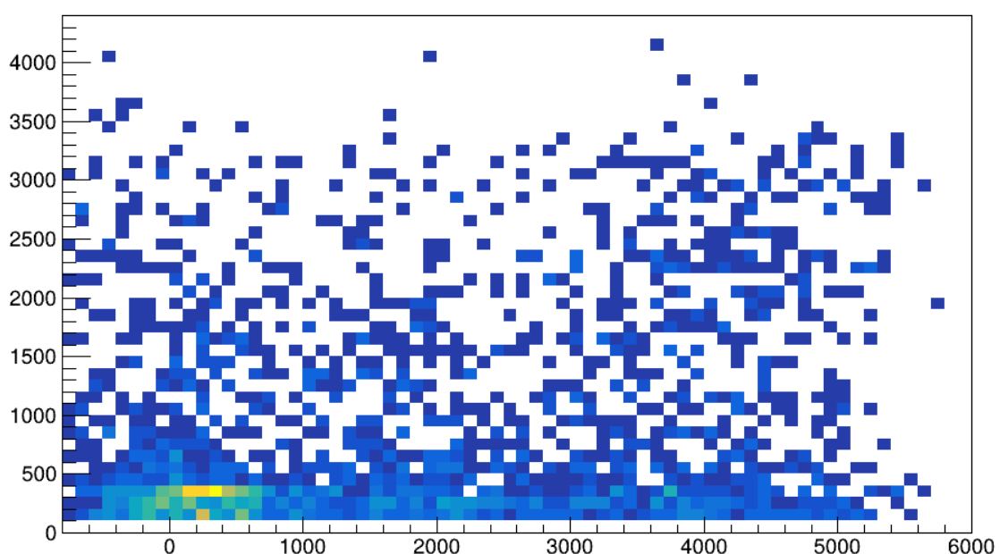
¹¹Be(d,d)¹¹Be*
¹¹Be* 320 (keV)
Gamma Energy (keV)
Counts/33 keV
Gamma Spectrum Doppler Corrected
in coincidence with d form pentagon (keV)
Excited Spectrum (keV)

Slide 16
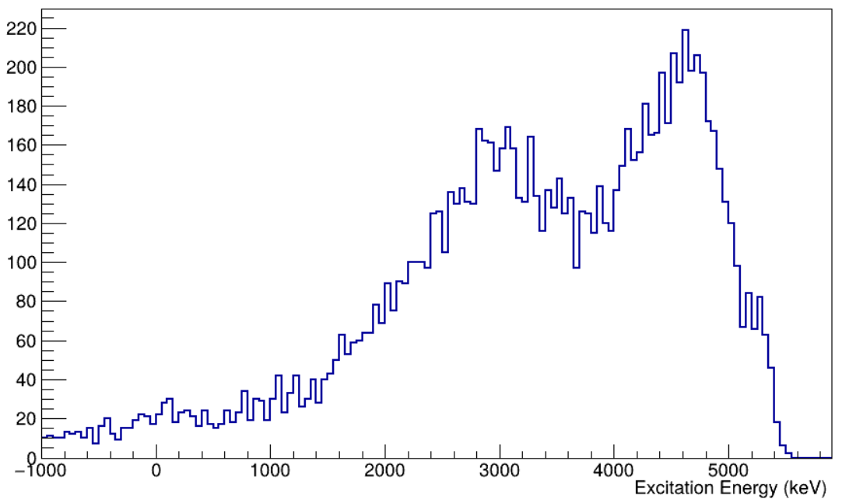
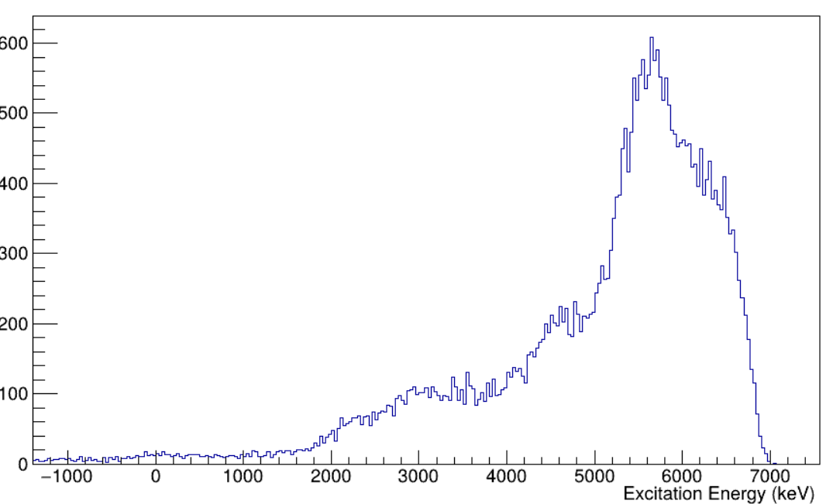
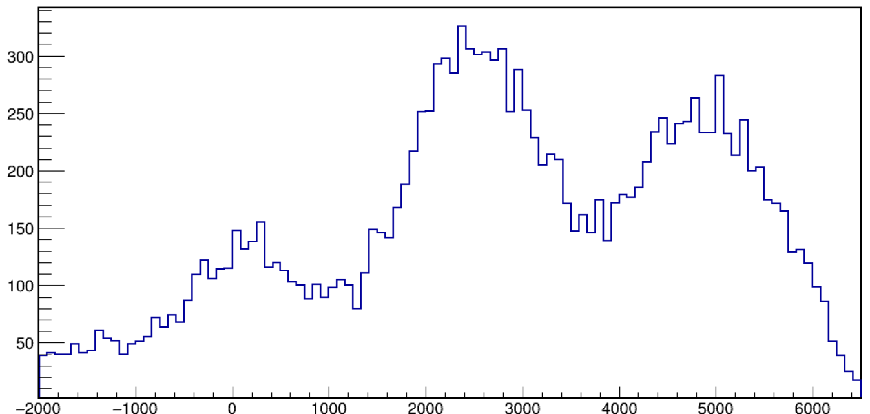
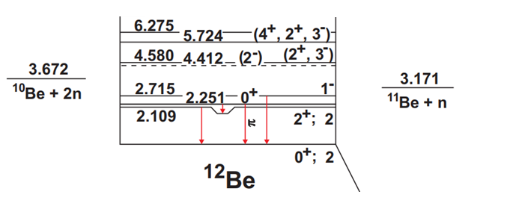
¹¹Be(d,p)¹²Be*
¹²Be* 4.5 MeV
¹²Be* 2 MeV
¹²Be* 5-6 MeV ??
(p,p) ??
¹²Be* 5-6 MeV
¹²Be* 2 MeV
Difference
¹²Be* 2 MeV
Counts/50 keV
Counts/80 keV
¹²Be g.s
Counts/20 keV
2.715 MeV
¹²Be* 4.5 MeV
2.1-2,2 MeV
¹²Be g.s
¹²Be g.s
¹²Be Excited Spectrum at 70-75 º (keV)
¹²Be Excited Spectrum at 55-60 º (keV)
¹²Be Excited Spectrum Telescope 5 (keV)
Level Scheme

Slide 17
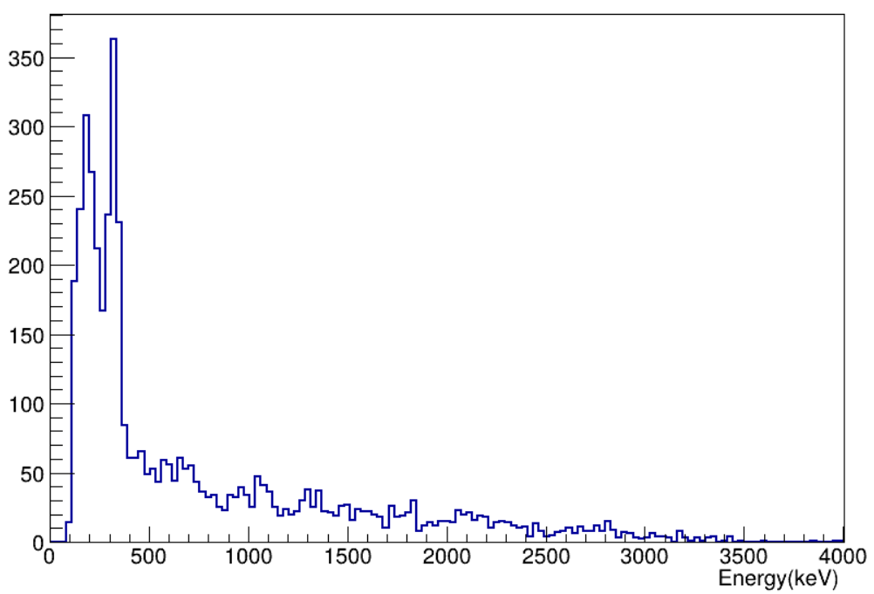
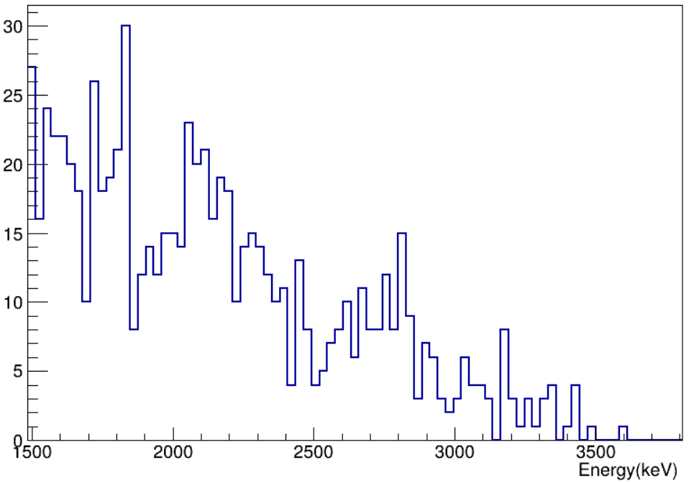
¹¹Be(d,p)¹²Be*
¹¹Be 320 keV
¹²Be* 2109 (keV)
¹²Be* 5-6 MeV ??
(p,p) ??
Difference
¹²Be* 2 MeV
¹²Be* 2715 (keV)
Counts/20 keV
2.715 MeV
¹²Be* 4.5 MeV
Counts/25 keV
2.1-2,2 MeV
¹²Be g.s
Gamma Spectrum Doppler Corrected coincidence with p from ⬠ (keV)
¹²Be Excited Spectrum at 55-60 º (keV)
Level Scheme

Slide 18

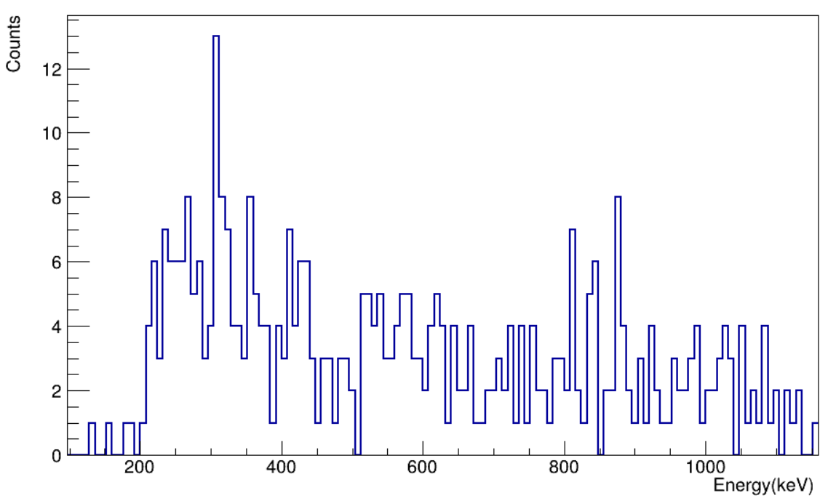
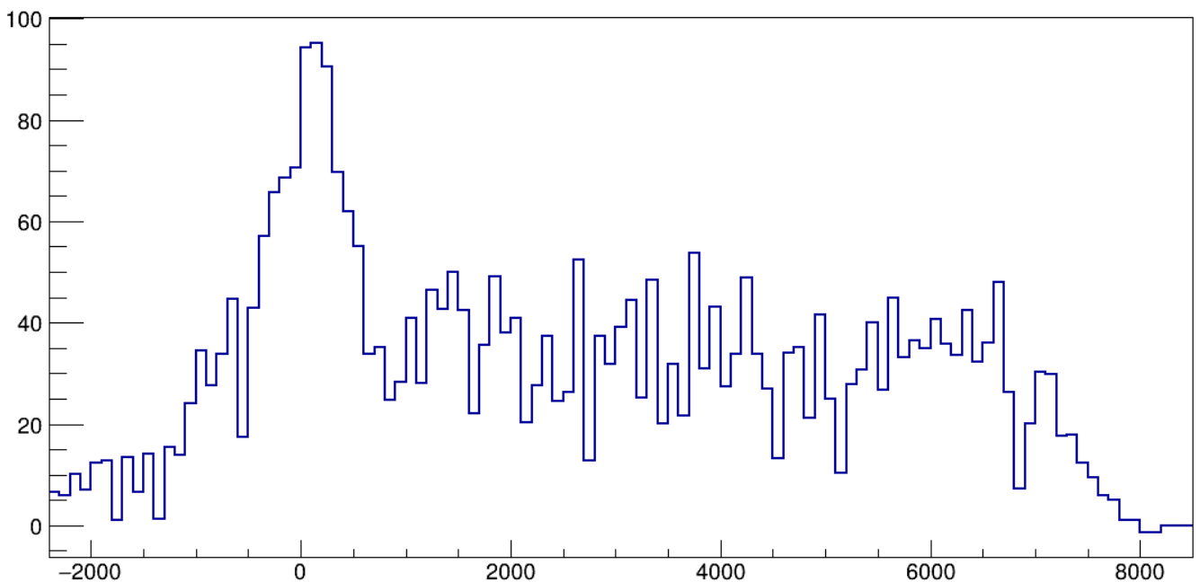
¹¹Be(t,t)¹¹Be*
We substract the Ti according to the ¹¹Be in the BeamDump
¹¹Be g.s & 320 keV
¹¹Be* (320)
¹¹Be* 1783
Counts / 25 keV
Counts/100 keV
¹¹Be Excited Spectrum (keV)
Gamma Spectrum Doppler Corrected (keV)

Slide 19
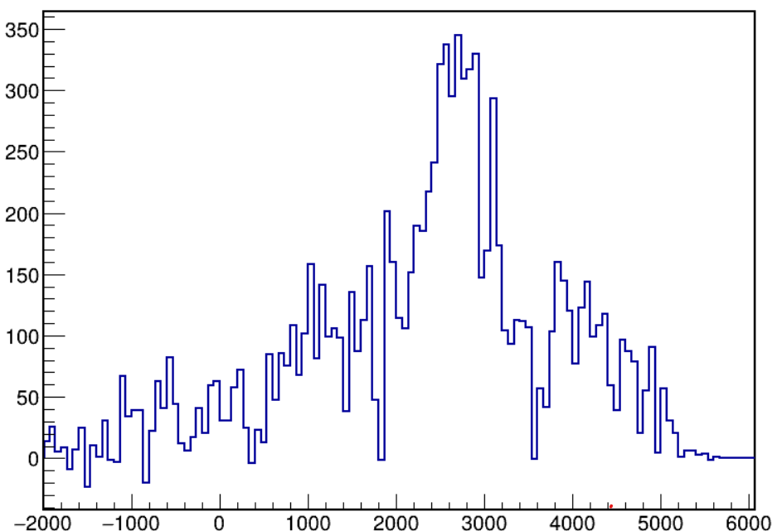
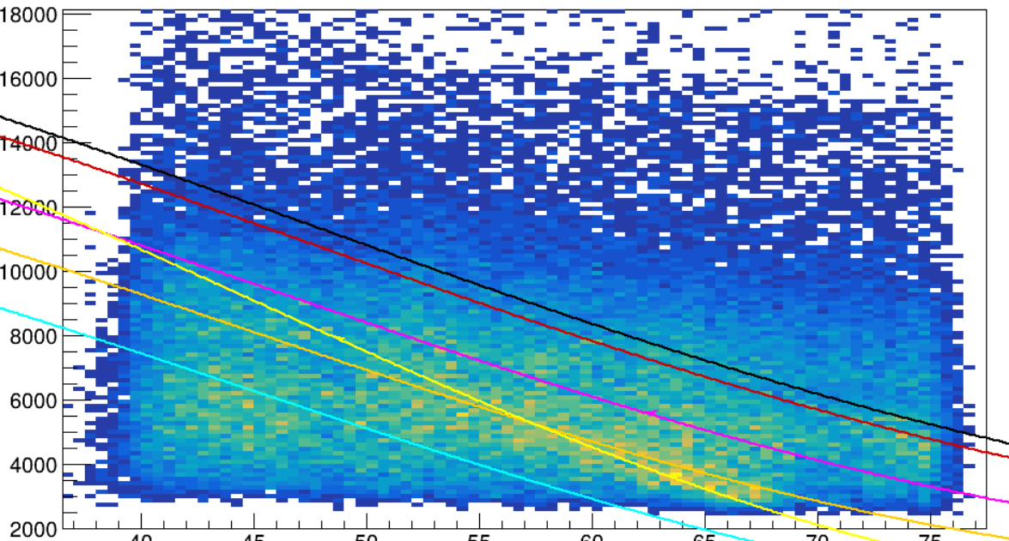
¹¹Be(t,p) ¹³Be*
¹³Be*2530
Or (p,p) contamination
(3/2+)
3550
(5/2+)
2530
¿?
5/2+
Counts/66 keV
Proton Total Energy (keV)
1610
¹³Be g.s & 390
1/2+
390
1/2-
Sn = -450
¹³Be Level Scheme
¹³Be Excited Spectrum (keV)
Proton θ (deg)
¹¹Be(t,p)¹³Be
¹¹Be(t,p)¹³Be* (2530)
¹¹Be(t,p)¹³Be* (390)
¹¹Be(p,p)¹¹Be
¹¹Be(t,p)¹³Be* (1610)
¹¹Be(t,p)¹³Be*(3550)

Slide 20
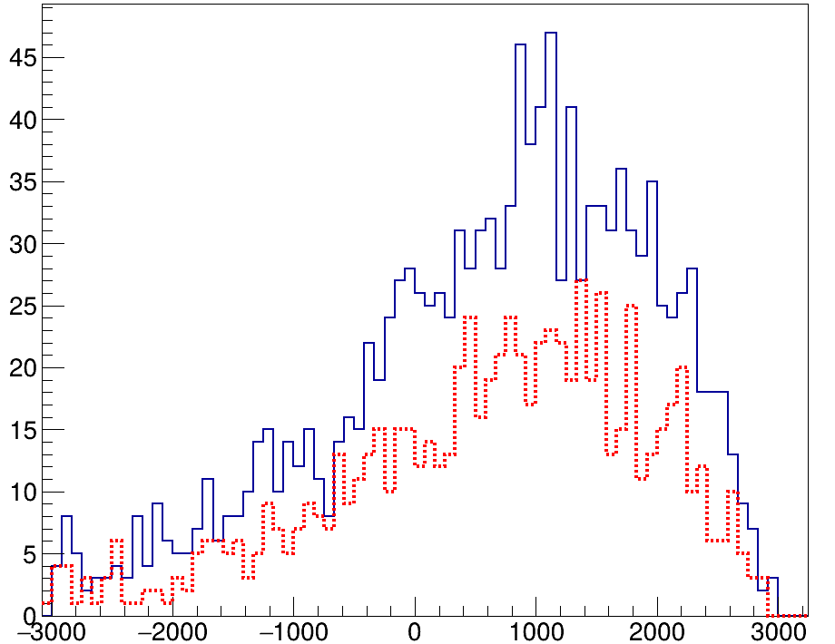
¹¹Be(t,p) ¹³Be*
?????????
(3/2+)
3550
13Be* (1610 keV)
(5/2+)
2530
13Be g.s & 390
5/2+
Counts/83 keV
Proton Total Energy (keV)
1610
1/2+
390
1/2-
Sn = -450
¹³Be Level Scheme
Proton θ (deg)
¹³Be Excited Spectrum @ 70-73º (keV)
¹¹Be(t,p)¹³Be
¹¹Be(t,p)¹³Be* (2530)
¹¹Be(t,p)¹³Be* (390)
¹¹Be(p,p)¹¹Be
Tritium Target
¹¹Be(t,p)¹³Be* (1610)
¹¹Be(t,p)¹³Be*(3550)
Titanium Target

Slide 21

Summary & Outlooks
The Scattering Experiment Chamber (SEC) has proved to be a versatile enough chamber to study a vast part of the nuclear chart.
Thanks to SEC it was possible to combine small scintillators with small Si detectors and get competitive results in a reduced space.
The $CD_{2}$ target gave the perfect data to fully optimize the setup and to test the methodology.
The analysis of the experiment is still on-going, first results are appearing and they look promising but more work needs to be done. Specially to be sure of a new 1 MeV state in ¹³Be.
This work was financially supported by the Spanish project: AEI PID2022-140162NB-100 Experimental Studies of Exotic Nuclei
Dziękuję!!!!

