Slide 1

(SHEXI) PSA
Why do I need Pulse Shape Analysis ?
  Recap on a typical detection set-up for SHE
  Physics example
electron / alpha discrimination set up
Results
  template method
  “simple” features → Neural Network
Conclusions
Zakopane 2024: D-SHEXI
T. Musaev M2 ERASMUS
(LASCALA)
KH, M. Chabot, E. Raully
IJCLab
D-SHEXI: ANR-25-CE31-0057-01
Notes:
So, why the title ?
At the last meeting I prersented a concept for improving the detection systems we use in the heavy element experriments

Slide 2
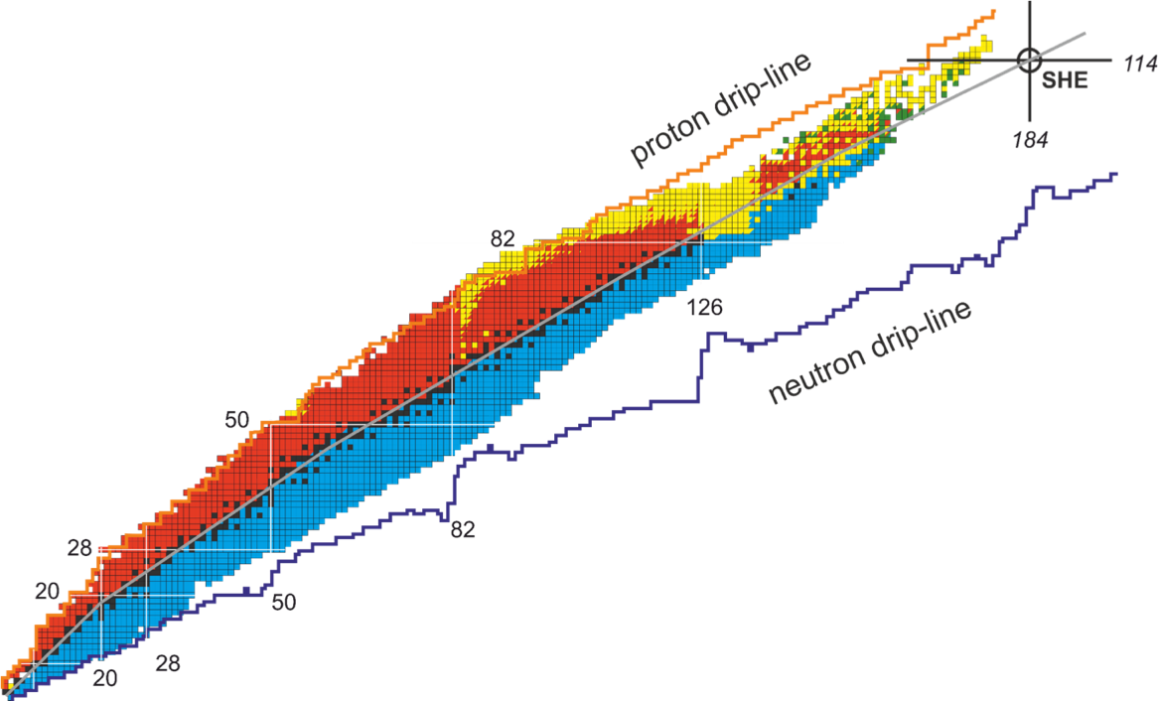
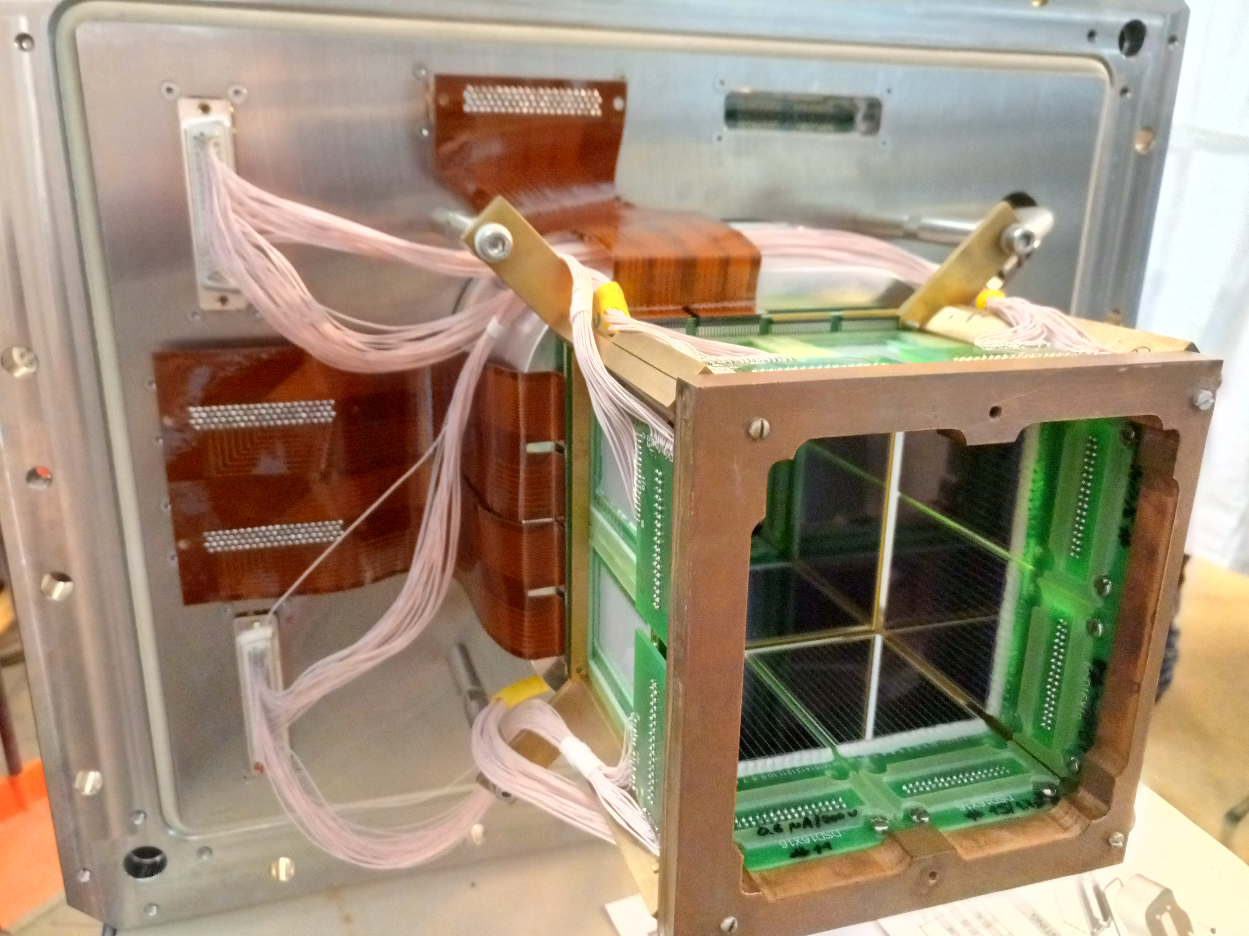
Number of protons
Number of neutrons
Intense heavy-ion beam
fission
1
3
fusion
4
2
fission
γ
γ
Filter
α
e⁻
e-
α
5
target
evaporation
Focal plane
Zakopane 2026
2

Slide 3
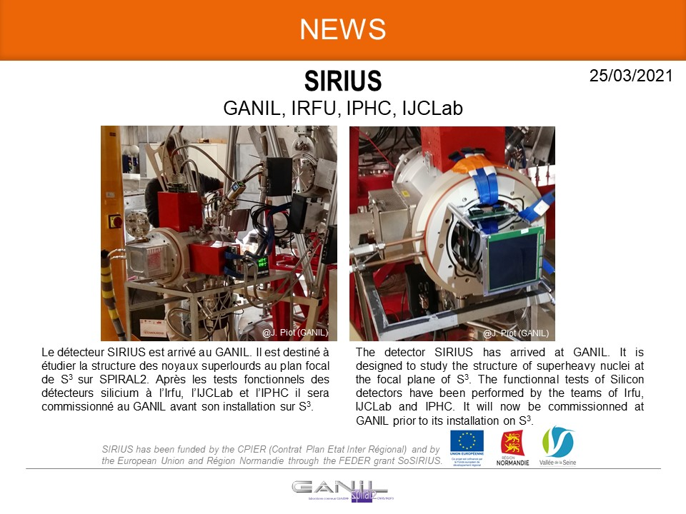
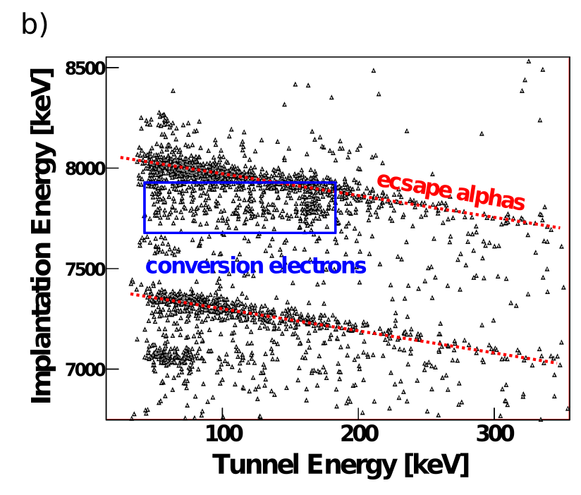
Why PSA ?
²⁰⁸Pb(⁴⁸Ca,2n)²⁵⁴No
²⁵⁴No gs
E_{T}
1
3
4
2
E_{I}
α
γ
²⁵⁴No implanted
E_{I}
²⁵⁵No
²⁵⁰Fm gs
E_{T}
e⁻
²⁰⁸Pb(⁴⁸Ca,1n)²⁵⁵No
²⁵⁵No
²⁵⁴No α
α
5
α
²⁵⁵No α
ICE
²⁵¹Fm
How do we remove these escape alphas ??
Zakopane 2026
Notes:
Reminder of the set-up: evaportion residues are implanted into a DSSD detector.
In this example 254No and 255No are produced in the same reaction.
We are interested in the excited states populated bu the fine structure 255No decay → conversion electrons detected in the tunnel in prompt coincicence with alpha in the implantation detector
254No alpha decay creates a prompt coincidence background.
Alpha particles escaping the implantation detector and impinging on a tunnel leave energy in both detectors. This can mask real alpha – ICE coincidences.
Can PSA be used to reduced the contamination ?

Slide 4
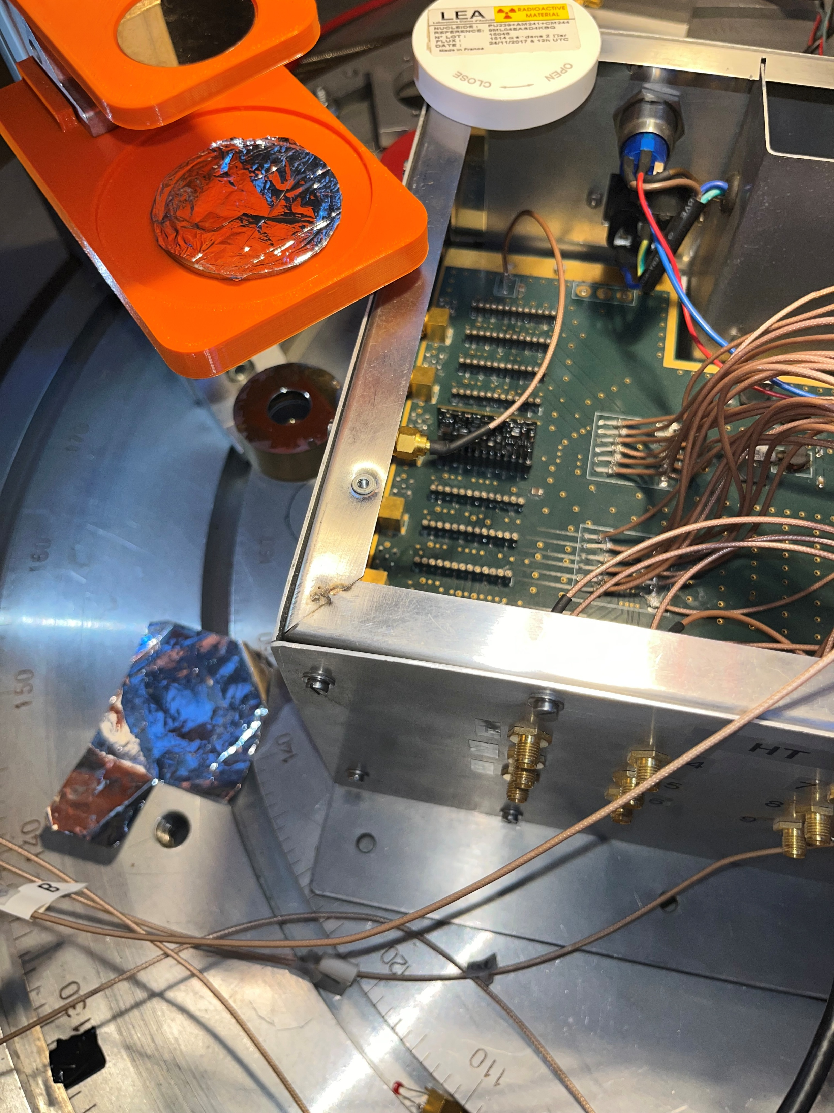
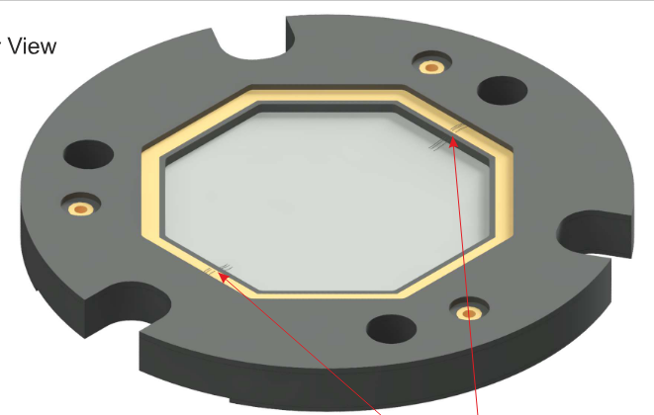
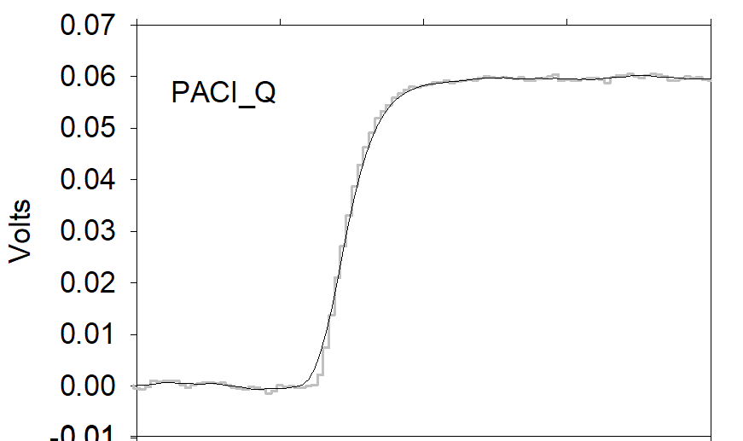
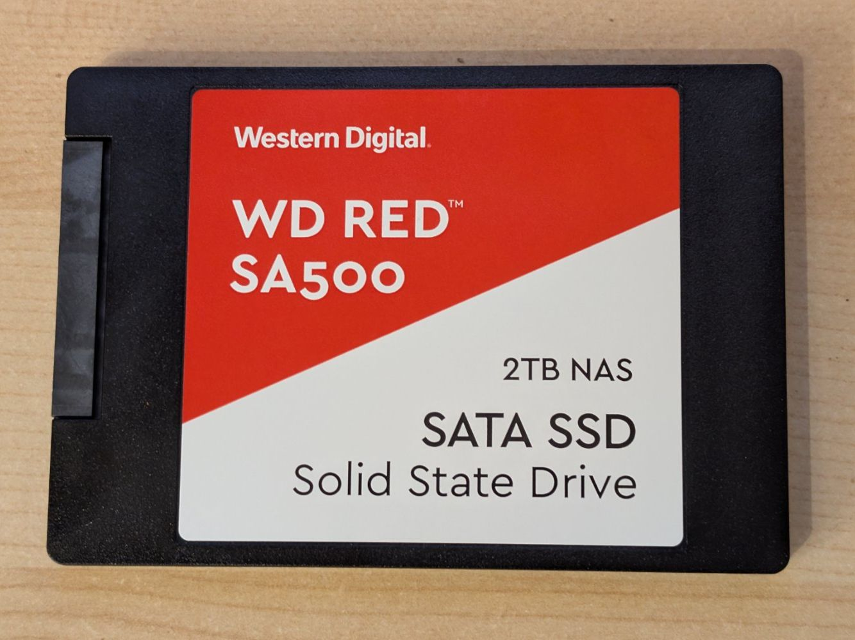
Tests using a GRIT prototype
{²³⁹Pu, ²⁴¹Am,²⁴⁴Cm}, ¹³³Ba, ²⁰⁷Bi
(energy degrader for alphas)
Ohmic
NTD, 500µm, 5.7kΩ/cm, dead-layer ~0.5µm
(successfully used to distinguish p,t,d with E >3 MeV)
Junction
[HV]
PACI (#10) Q & I
CREMAT Q
PARC05_50MHz I
PA
digitise
- 250MHz (NI)
- 1GHz (Lecroy)
M. Chabot, et al., NIM B 197 (2002) 155
J.A.Duenas et al, NIM A 676 (2012) 70
B. Genolini et al., NIM A 732 (2013) 87
M. Assié et al. ,EPJA 51 (2015) 51
J.-J. Dormand et al., NIM A (2021) 165641
C.A.J. Ammerlaan, et al., Nucl. Instr. and Meth. 22 (1963) 189
M. Mutterer, et al., IEEE Trans. Nucl. Sci. 47 (2000) 756.
Zakopane 2026
Notes:
Marin needed a 133Ba source for some tests for a concept radiation monitor for space applications – protons vs electrons
and Karl was interested in a similar separation of low energy (degraded) alphas vs internal electrons
So we performed some tests using the sources indicated which irradiated an NTD GRIT prototype detector and took digitised preamplifier data
This is a set-up that has been successfully used to distinguish different particles but at energies in the MeV to tens of MeV region.
Our interest is in conversion electron of sub MeV.

Slide 5
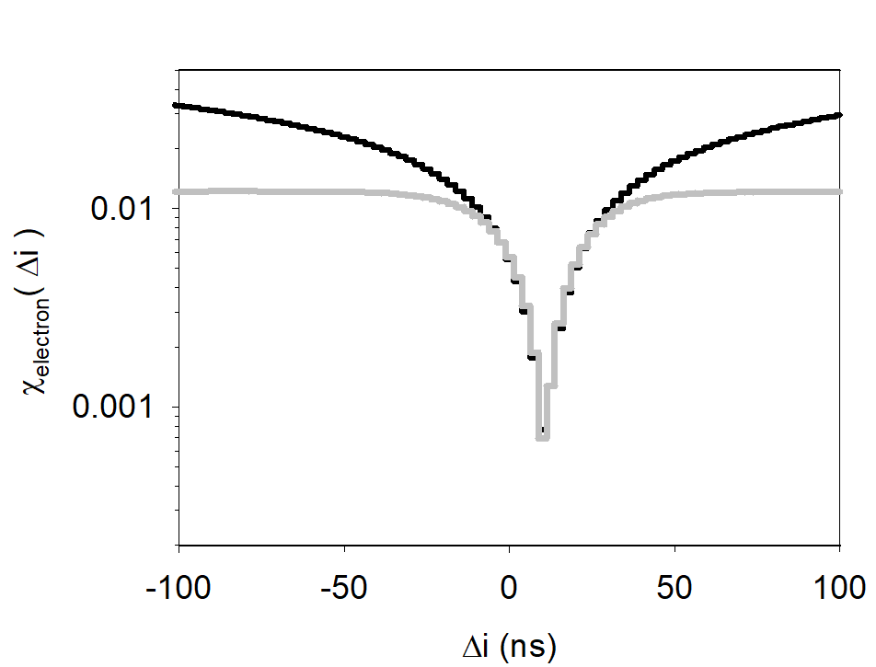
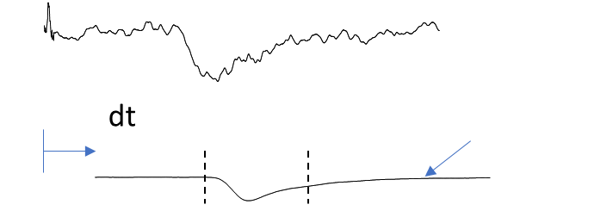
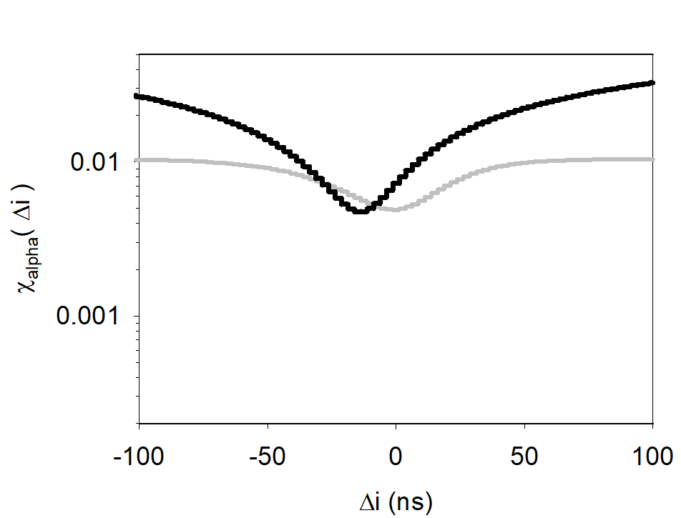
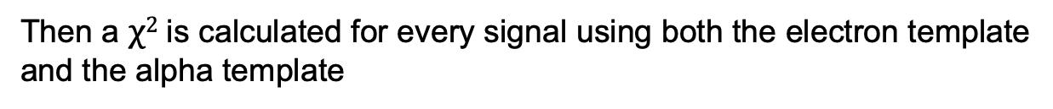
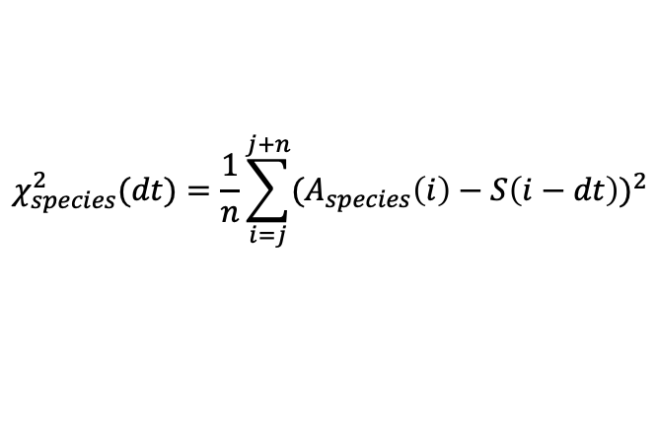
“template” matching → particle discrimination
PACI_Q
For a given energy (bin) the average signal is calculated for both electrons and alphas.
Signal, S(t)
PACI_I
rms
A(t), Average of signals
of a given particle type
e-@320 keV 130V
Courtesy of M. Chabot
Then a $χ2$is calculated for every signal using both the electron template
and the alpha template
$$χ_{species}^{2}(dt)=\frac{1}{n}\sum_{i=j}^{j+n}{{(A_{species}\left(i\right)−S\left(i−dt\right))}^{2}}$$
M. Chabot, et al., NIM B 197 (2002) 155
e-@320 keV 130V
Excellent separation, works on both charge and current signals, (online?)
Zakopane 2026
Notes:
Best separation is obtained using the template matching method which basically means an averaged signal for each particlke type is used as a template and
each individual signal is compared to the electron and the alpha template by calculating the Chi^2. The two figures show the difference when a 320 keV
electron is compared to the electron and alpha master signals.
Excellent separation is obtained when using either the Charge or Current signals…. But it’s not exactly an online calculation (yet)

Slide 6
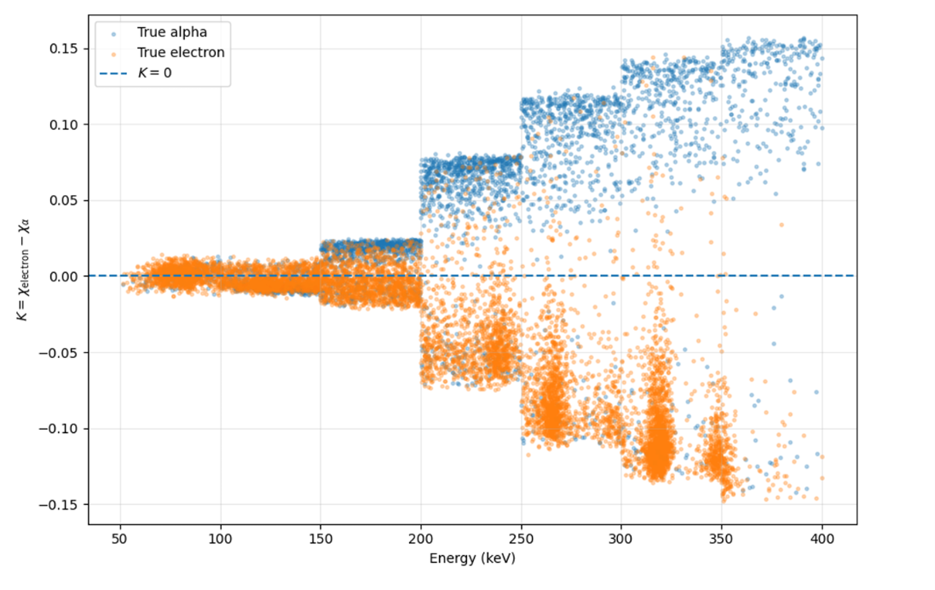
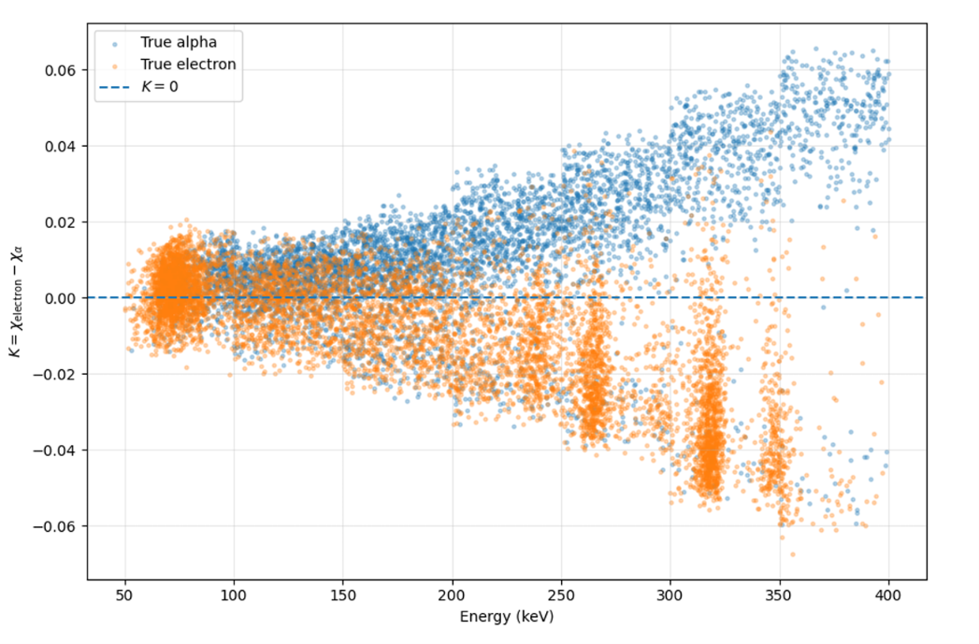
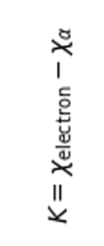

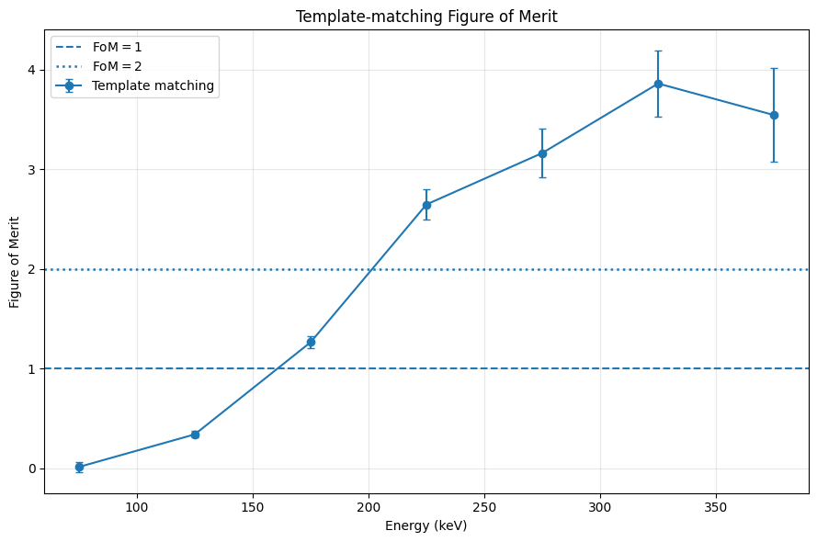
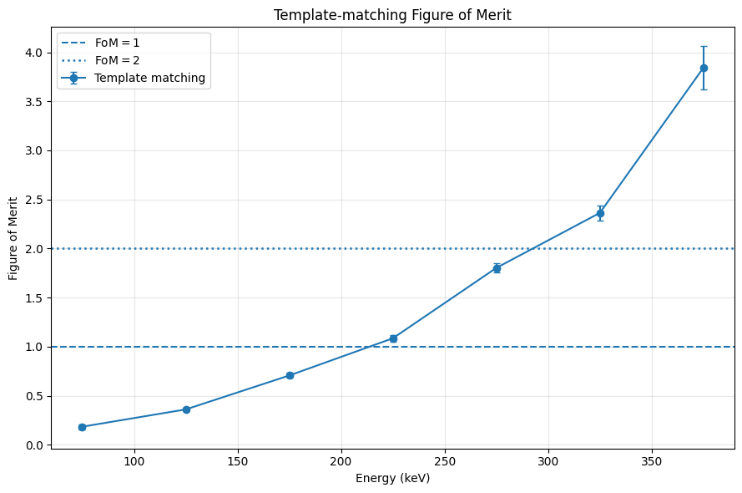
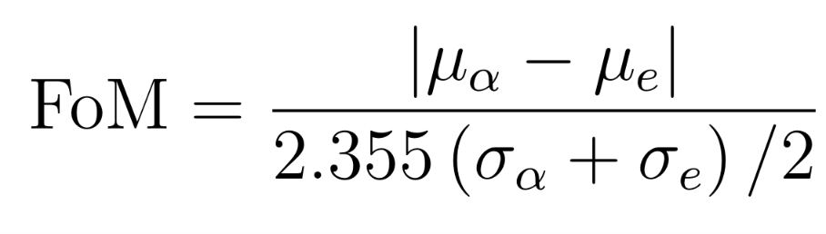

Results from M2 intern Tohirbek MUSAEV
Université Paris-Saclay | 2026
130 V
140 V
80 % Electron, 77 % Alpha
66 % Electron, 81 % Alpha
Excellent separation,
single parameter,
works on both Q and I signal
BUT…
Zakopane 2026
6

Slide 7

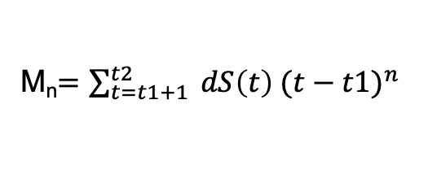
Simple parameters
Time-over threshold
dS/dT
Δt
(optimum 20 / 80 %)
Imax
t1
t2
e-@320 keV 130V
e-@320 keV 130V
Signal rise-time
Maximum current
Current duration
Moments of the trigger (pseudo I) signal ?
M_{n}$=\sum_{t=t1+1}^{t2}{{ dS\left(t\right) (t−t1)}^{n}}$
Zakopane 2026
7
Notes:
So – where does AI come in ?
We will starrt looking at some simple parameters, like rise-time, ttime-over-threshold, maximum current, moments and see if networks can be trained tto distinguish the particles.
In theory the network weights could be implemented in an FPGA and could provide probabilities that an event is electron or alpha.

Slide 8
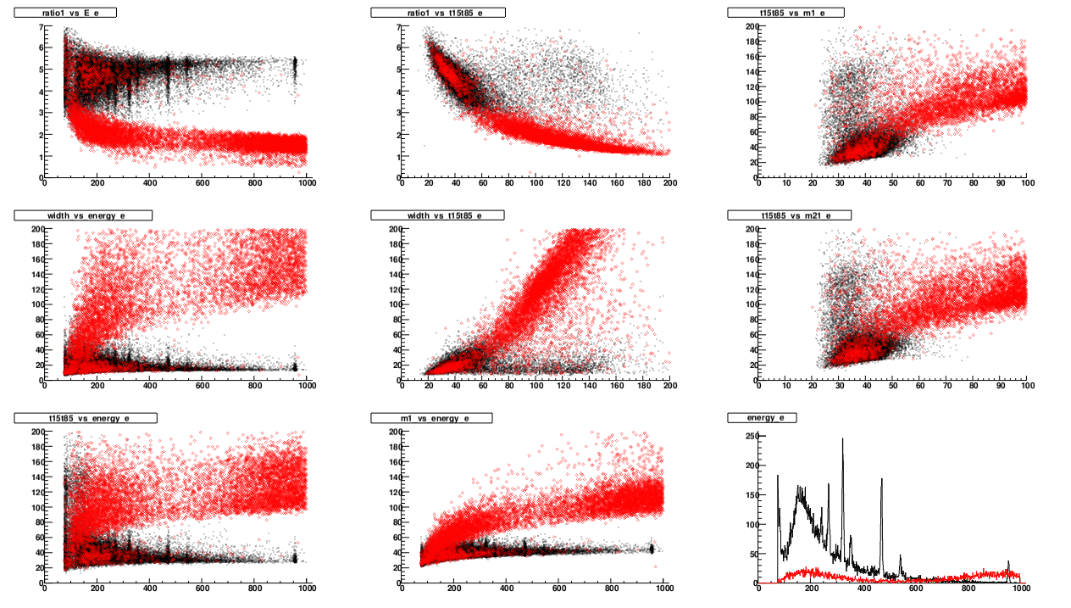
Simple parameters plotted against one another
I_{max}/E
FWHM(e-) ~ 7keV [FS ~17 MeV]
energy
energy
What can a Neural Network bring to the party beyond simple cuts ?
Zakopane 2026
8
Notes:
So – where does AI come in ?
We will starrt looking at some simple parameters, like rise-time, ttime-over-threshold, maximum current, moments and see if networks can be trained tto distinguish the particles.
In theory the network weights could be implemented in an FPGA and could provide probabilities that an event is electron or alpha.

Slide 9
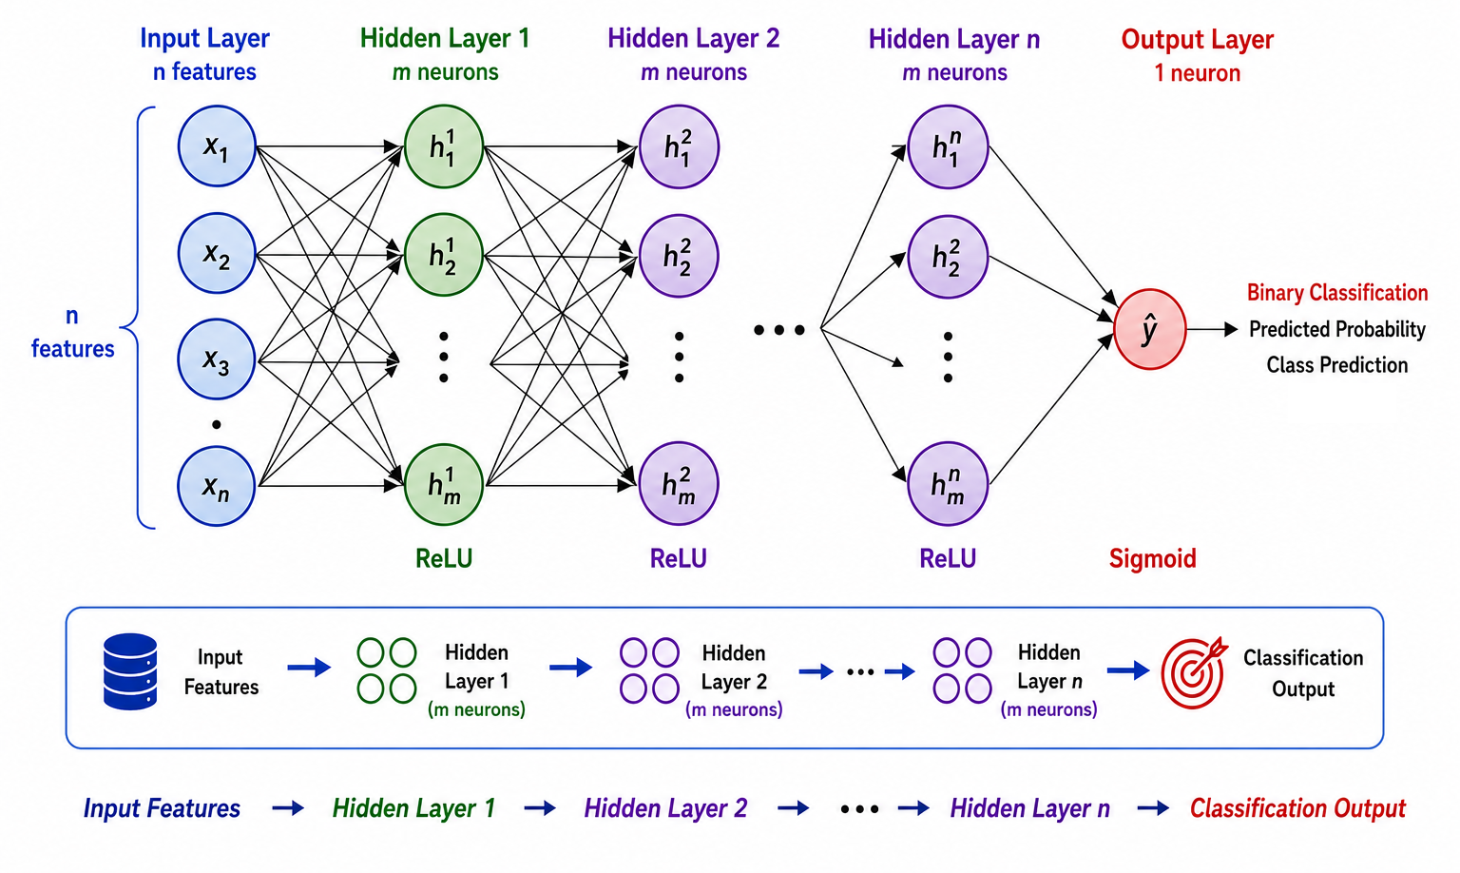
Binary classifier Network architecture
  KH: TMultiLayerPerceptron (ROOT ): [4I, 4H, 1O]
  TM: Multi Layer Perceptron and Keras Sequential API Model: [4I, 4H, 4H, 1O]
Imax/Energy
ToT (Width)
Energy
0 = alpha
1 = electron
Rise time
Zakopane 2026
9
Notes:
So – where does AI come in ?
We will starrt looking at some simple parameters, like rise-time, ttime-over-threshold, maximum current, moments and see if networks can be trained tto distinguish the particles.
In theory the network weights could be implemented in an FPGA and could provide probabilities that an event is electron or alpha.

Slide 10
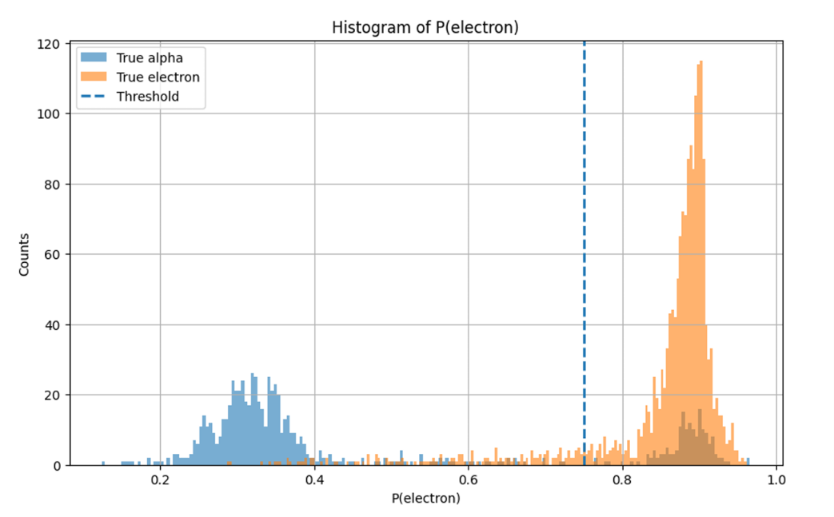
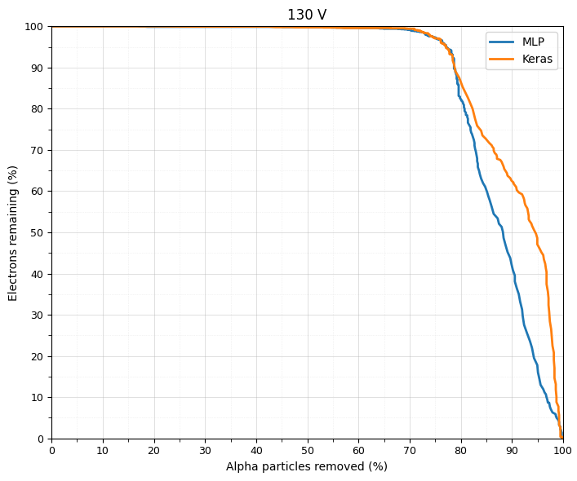

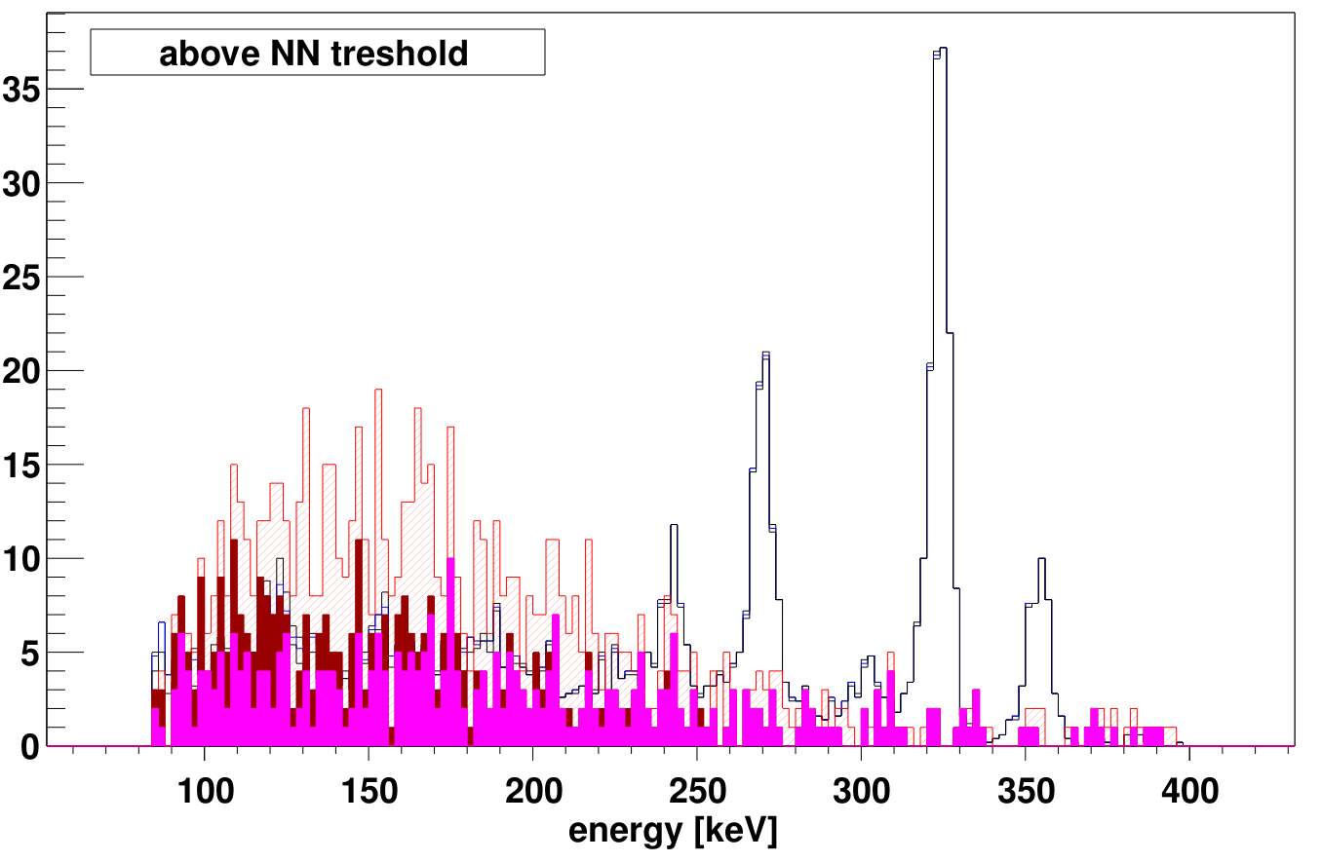

Non-destructive thresholding → cleanliness vs statistics
130 V
M. Tohirbek
M. Tohirbek
Place this cut on NN output
→ ~90% electrons kept
→ almost ~80% α removed
Zakopane 2026
10

Slide 11
  Conclusions
  Successful alpha-electron discrimination using simple NN
  90% electrons kept, 80% alpha removed
  Perspectives
  More degraded alpha data
  Triple alpha source has fine structure decay
  → Pure alpha source (eg. 148Gd )
  New undamaged detector, cooling
    → improve discrimination %
    → lower energy threshold
  Apply Network to an FPGA
Zakopane 2026
11

Slide 12


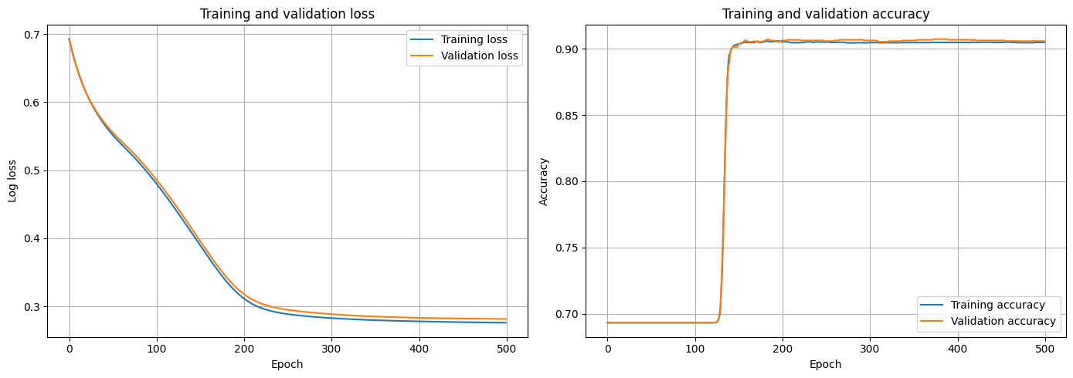
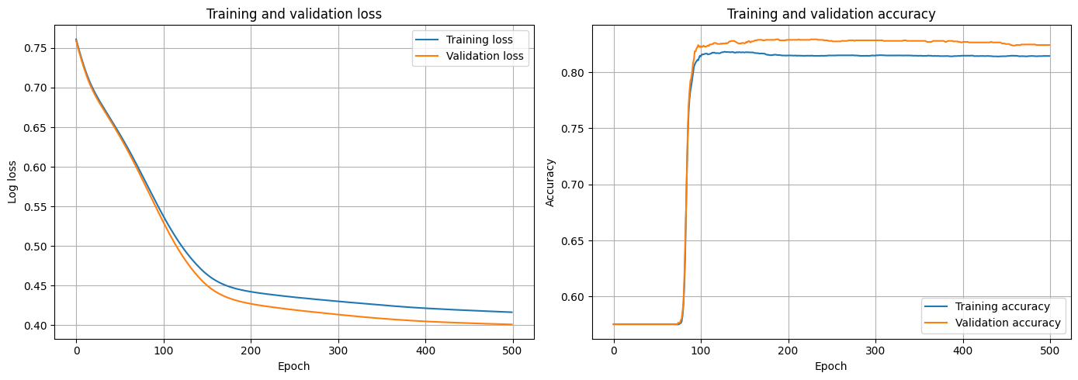

Presented by: Tohirbek Musaev
Université Paris-Saclay | 2026
Neural Network: Validation
130 V
140 V

Slide 13
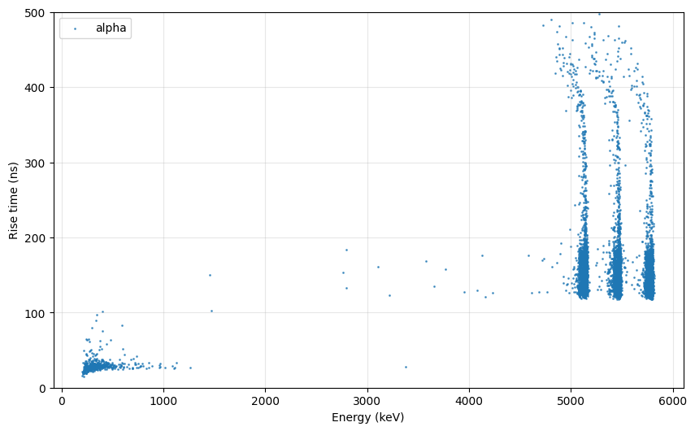
Presented by: Tohirbek Musaev
Université Paris-Saclay | 2026
Rise time of the Triple alpha source

