Slide 1


Multiphysics simulation of the Heavy Ion Detector of the upgraded Recoil Filter Detector using Geant4 and SIMION
C. Hiver, M. Matejska-Minda, D. Duda, P. Bednarczyk, P. Kulessa, P. J. Napiorkowski, B. Sowicki
SONATA BIS, NCN grant No. 2023/50/E/ST2/00621

Slide 2
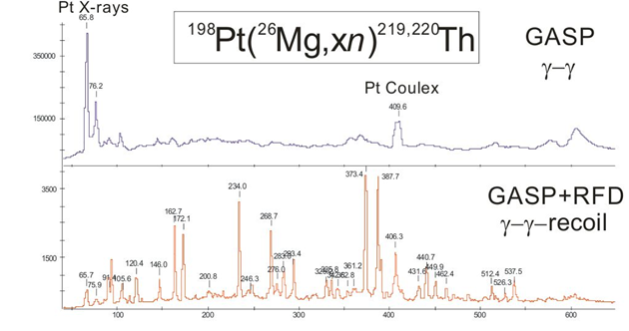
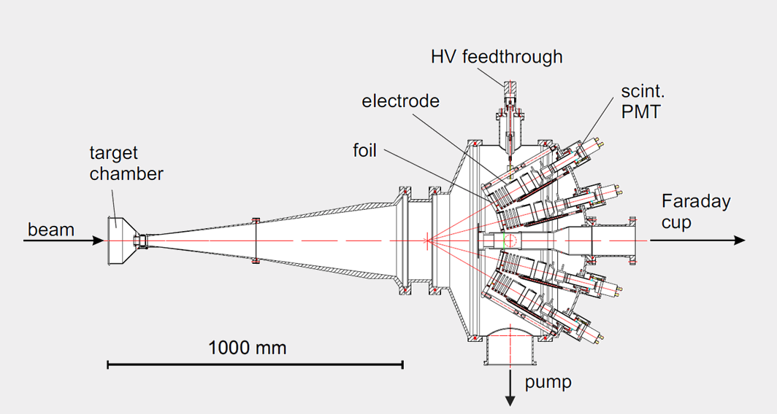
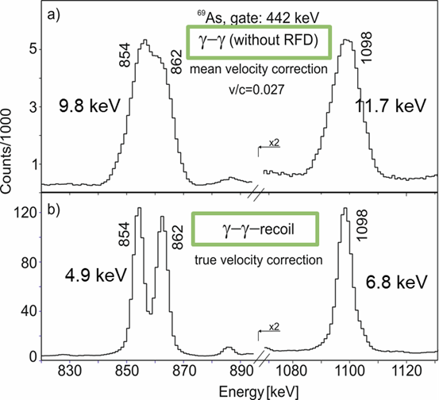
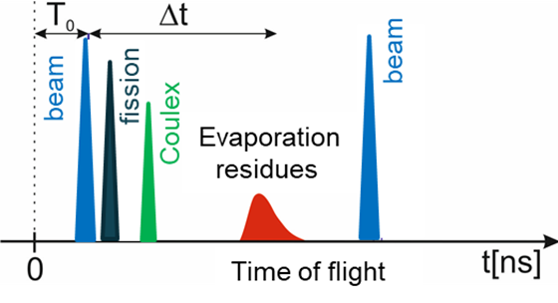


1. The RFD detector
Ge array
$$γ$$
$$γ$$
Ge array

Slide 3
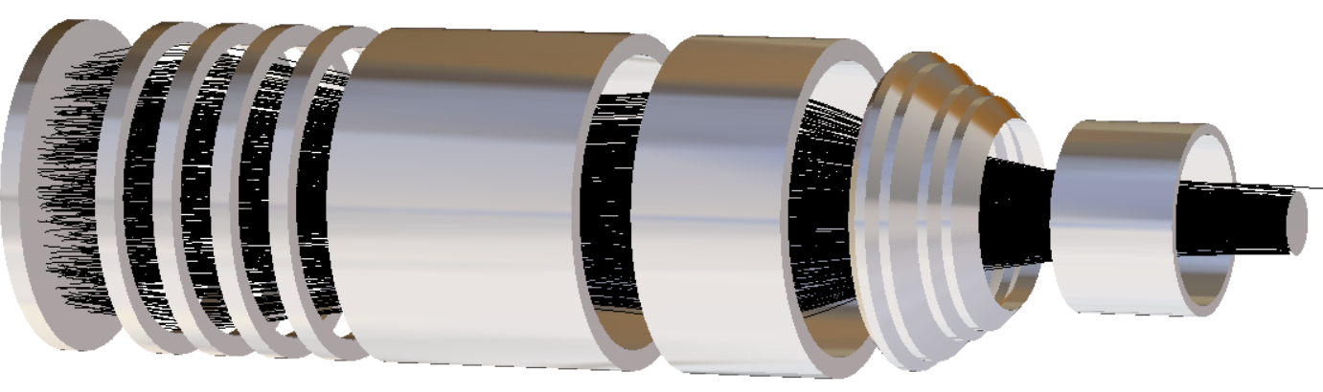
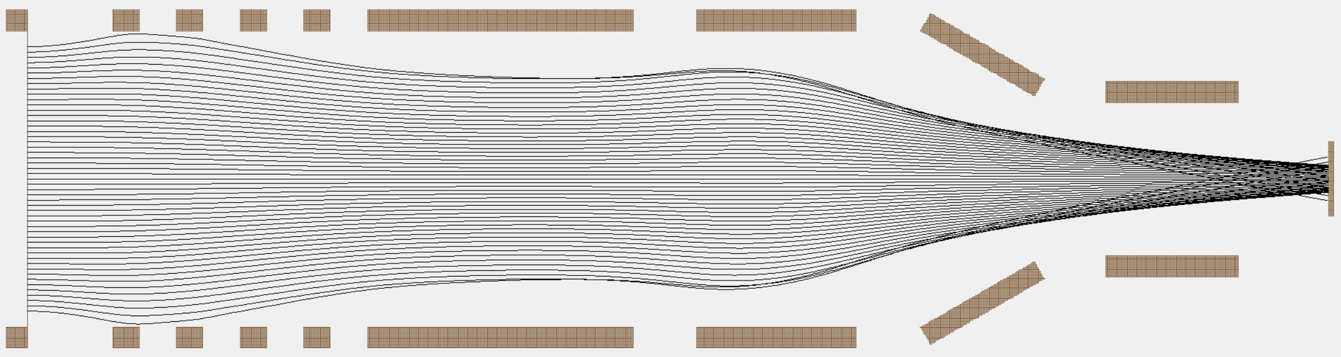
1. The RFD detector
Electrodes
V [kV]:
-20
-18
-16
-12
-7
0
-15
-2
0
Heavy ions
Scintillator+PMT
Aluminized Mylar foil

Slide 4
2. Upgrade
The original setup showed several limitations:
  Limited counting rate (scattered beam in inner detectors)
  Limited fluence (regular pauses needed)
The update consists in replacing the PMT by a SiPM array
  Intrisic segmentation
  Increased counting rate
  Decreased fluence per cell
Integration at Heavy Ion Laboratory in Warsaw for experimental campaign in 2027-2028 with EAGLE and DIAMANT

Slide 5
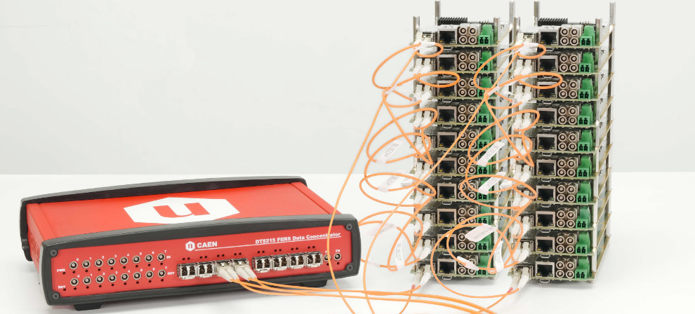
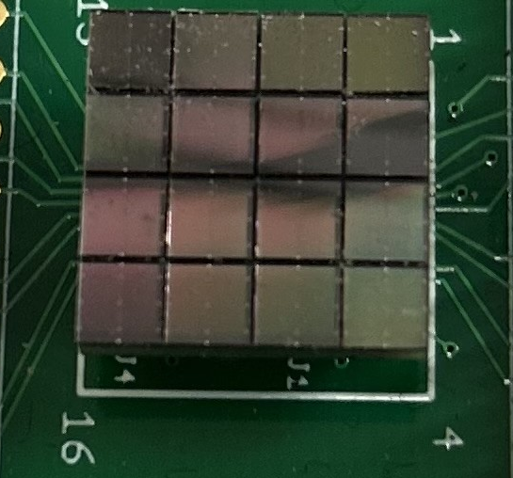
2. Upgrade
FERS-5200
MICROFJ-30035-TSV-TR from onsemi
New electronics from CAEN
Dedicated ASIC for SiPM
Can handle the 16x18 = 288 channels
SiPM array of 16 cells
3x3 mm each

Slide 6
2. Upgrade
Main question: will segmentation work as intended ?
Two probable problems:
  Light sharing between cells
  Dispersion of electron bunches after acceleration
Geant4 simulation for light propagation
SIMION simulation for electron bunches focusing

Slide 7
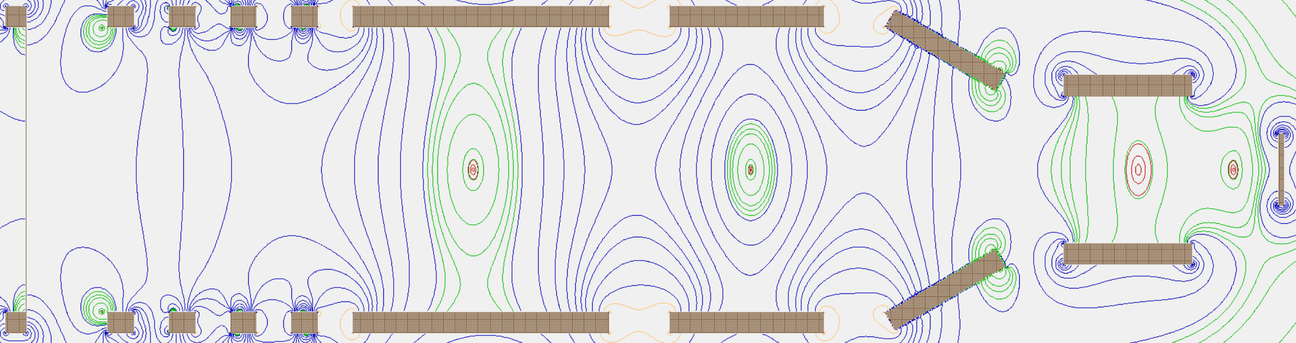
3. SIMION simulation
V [kV]:
-20
-18
-16
-12
-7
0
-15
-2
0
SiPM
Mylar foil

Slide 8
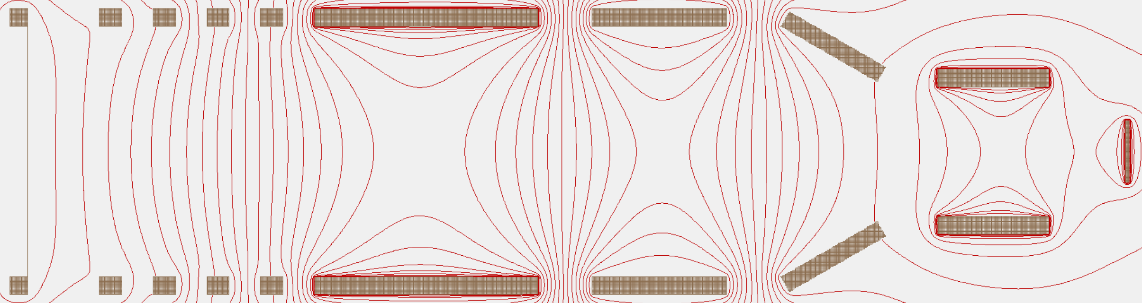
3. SIMION simulation
V [kV]:
-20
-18
-16
-12
-7
0
-15
-2
0
SiPM
Mylar foil

Slide 9
3. SIMION simulation
V [kV]:
-20
-18
-16
-12
-7
0
-15
-2
0
e⁻
Heavy Ion
SiPM
Mylar foil

Slide 10
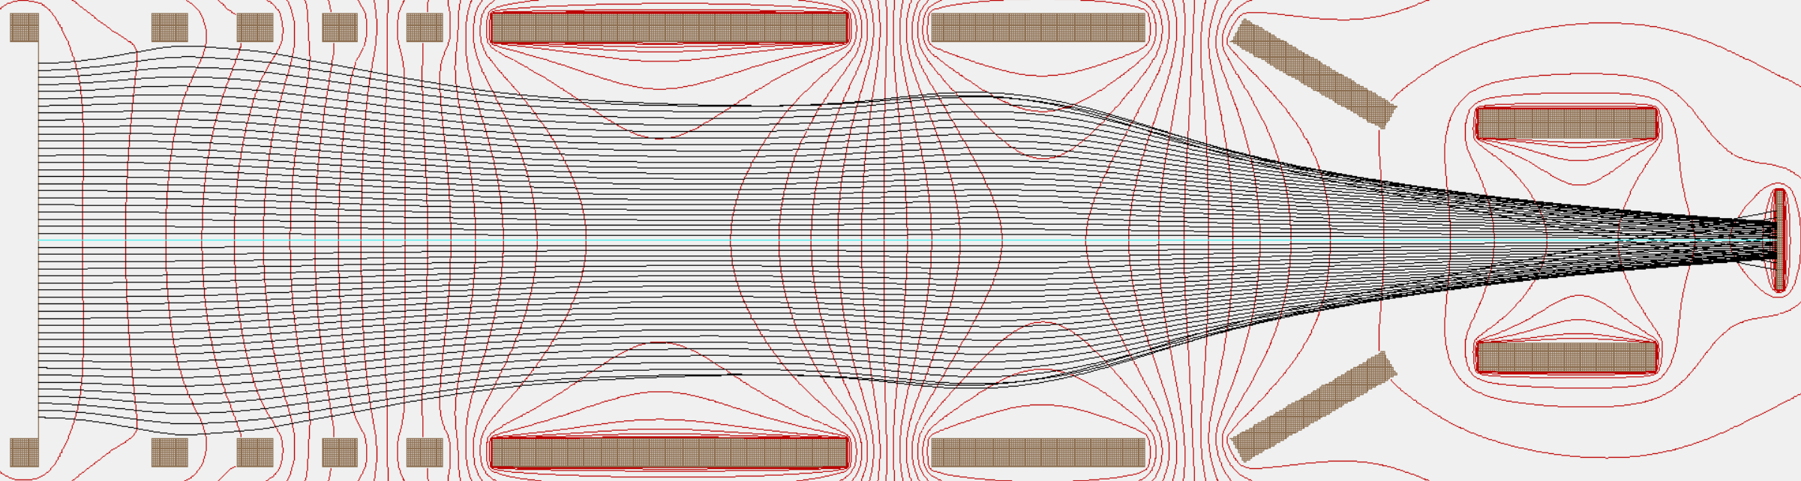
3. SIMION simulation
V [kV]:
-20
-18
-16
-12
-7
0
-15
-2
0
Heavy Ion
SiPM
Mylar foil

Slide 11
3. SIMION simulation
V [kV]:
-20
-18
-16
-12
-7
0
-15
-2
0
Heavy Ion
SiPM
Mylar foil
Electrons emitted with 0 eV !

Slide 12
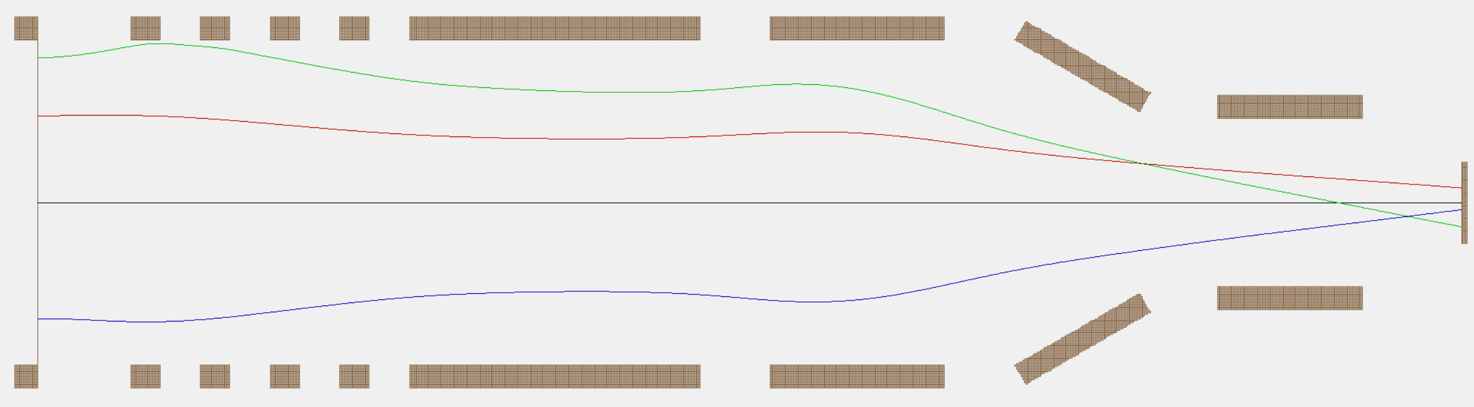
3. SIMION Simulation
Let’s study the impact of the initial energy on the distribution of 4 typical bunches
Lambertian emission + 0 eV:

Slide 13
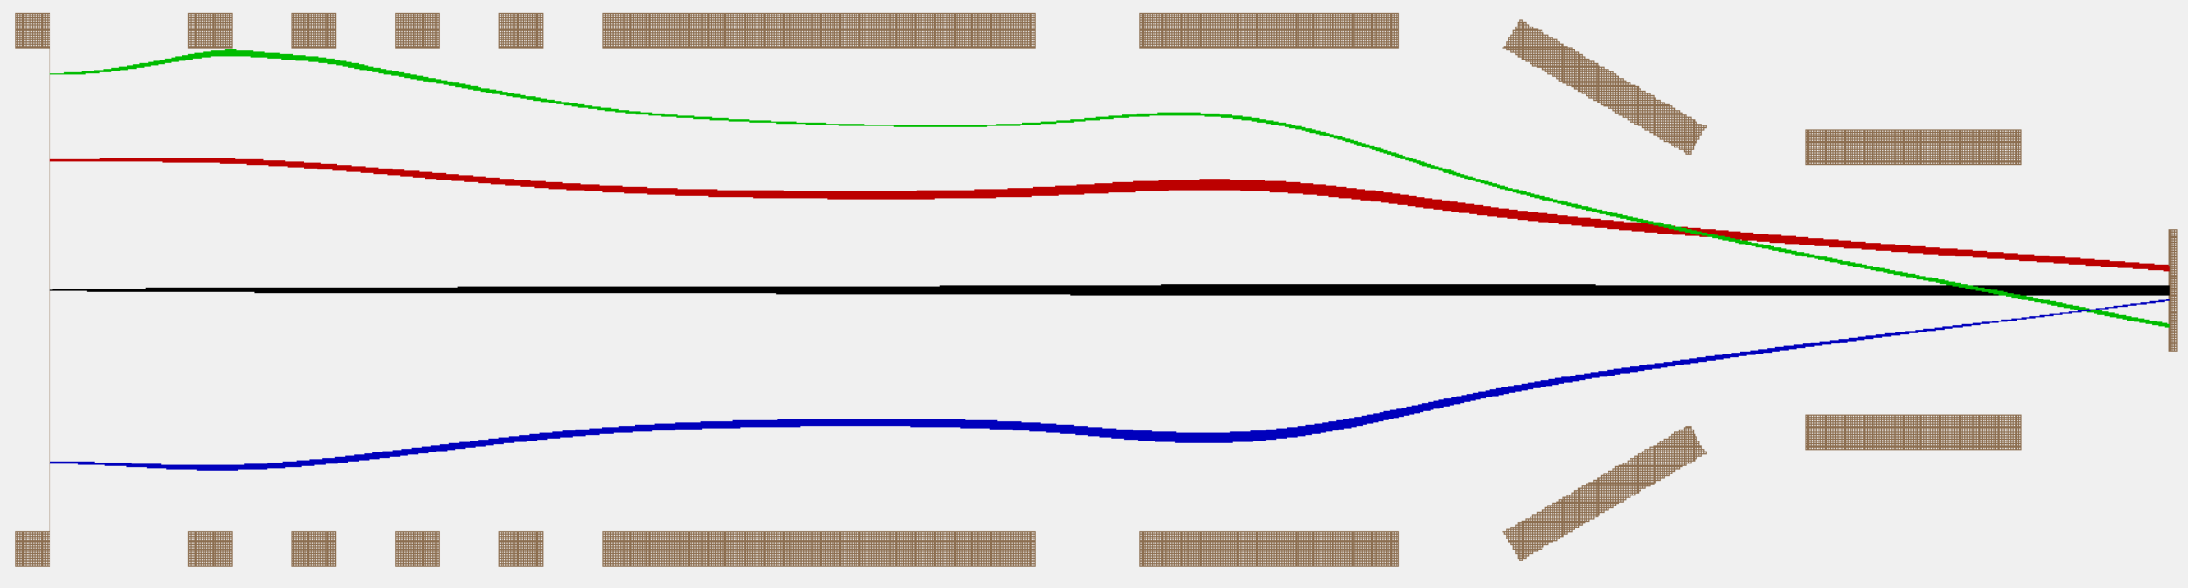
3. SIMION Simulation
Let’s study the impact of the initial energy on the distribution of 4 typical bunches
Lambertian emission + 0.1 eV:

Slide 14
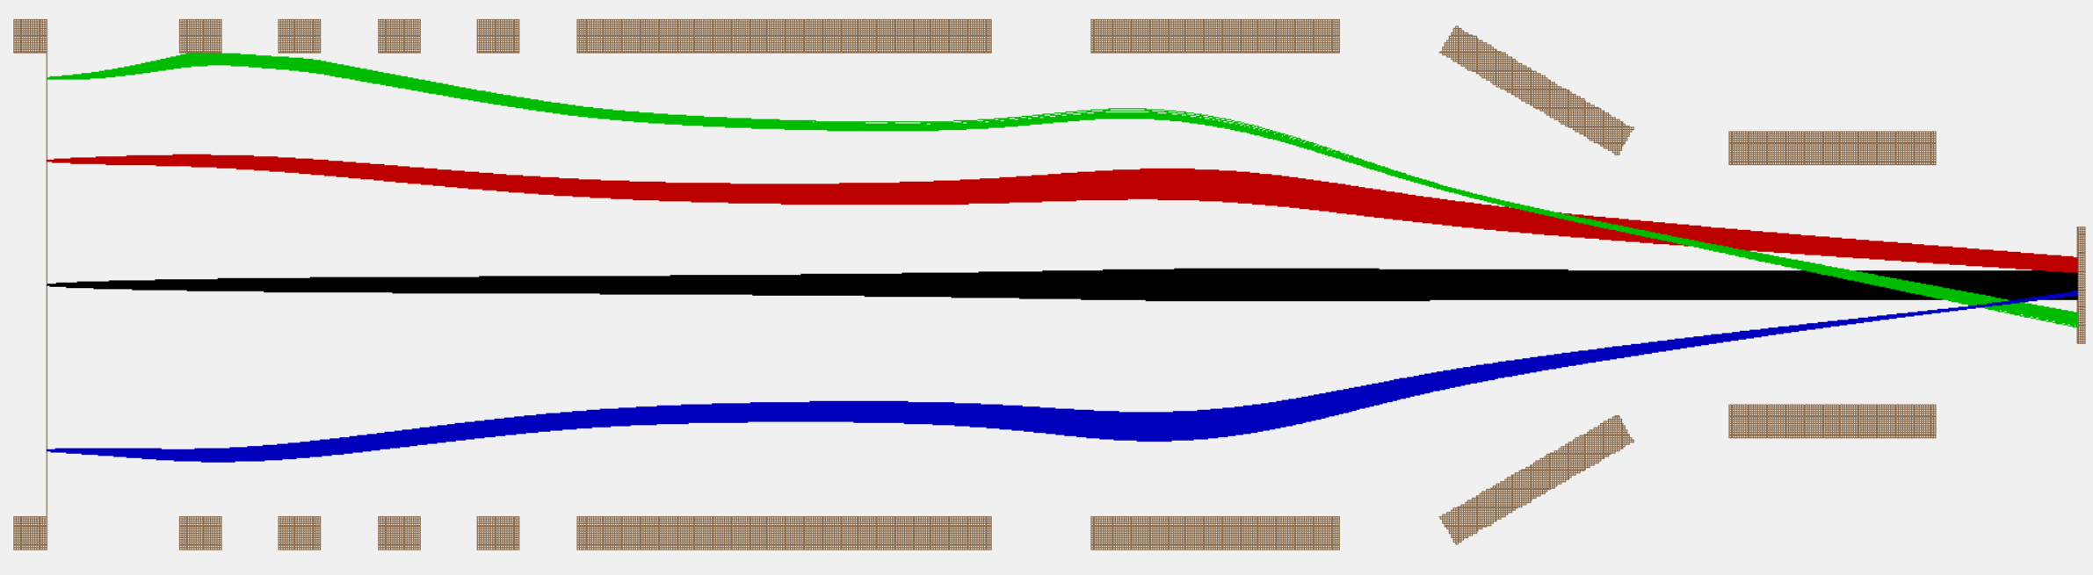
3. SIMION Simulation
Let’s study the impact of the initial energy on the distribution of 4 typical bunches
Lambertian emission + 1 eV:

Slide 15
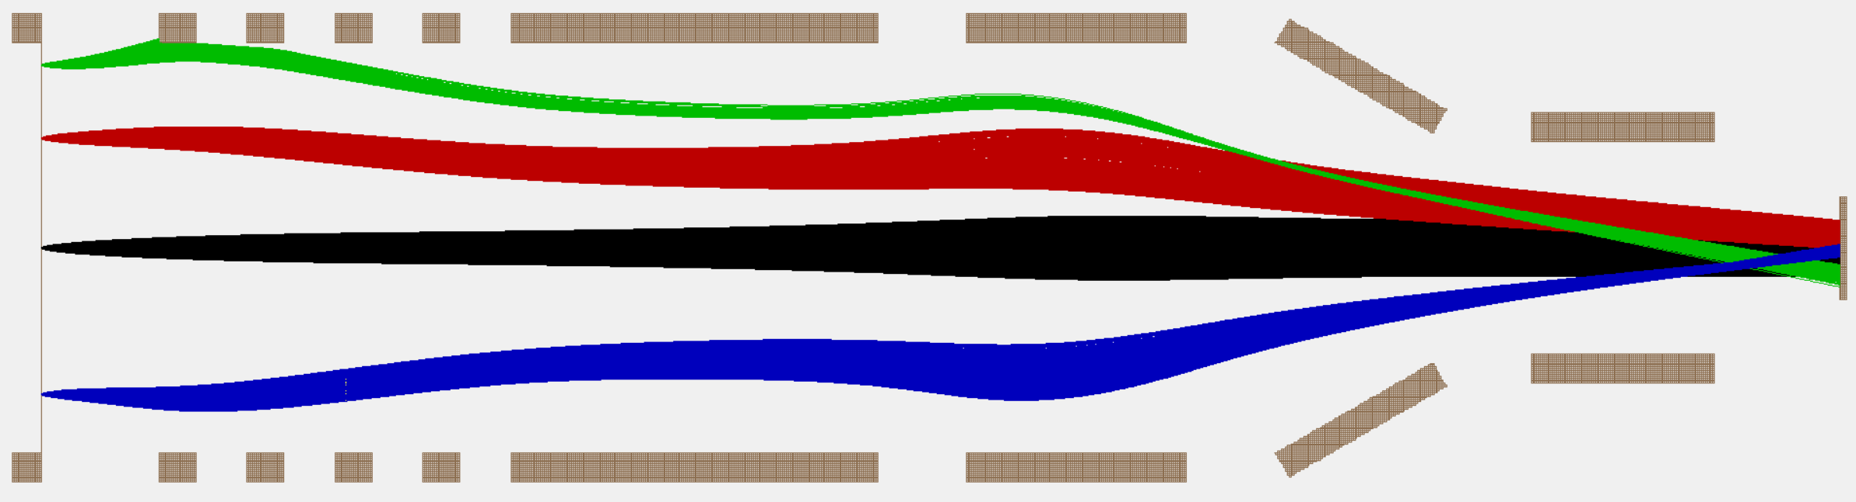
3. SIMION Simulation
Let’s study the impact of the initial energy on the distribution of 4 typical bunches
Lambertian emission + 5 eV:

Slide 16
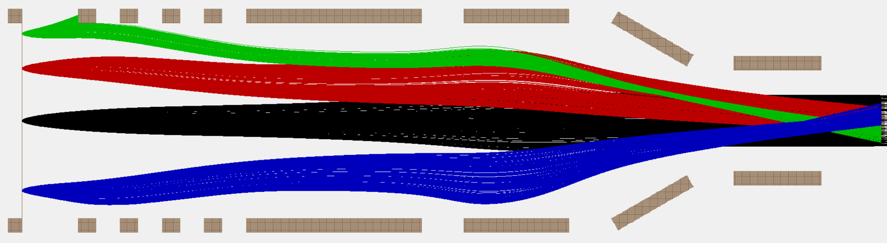
3. SIMION Simulation
Let’s study the impact of the initial energy on the distribution of 4 typical bunches
Lambertian emission + 20 eV:

Slide 17
3. SIMION Simulation
Let’s study the impact of the initial energy on the distribution of 4 typical bunches
Lambertian emission + 20 eV:
Correct modelisation of the kinetic energy emission needed !

Slide 18
4. Kinetic electron emission in Mylar
How many electrons are generated in Mylar ?

Slide 19
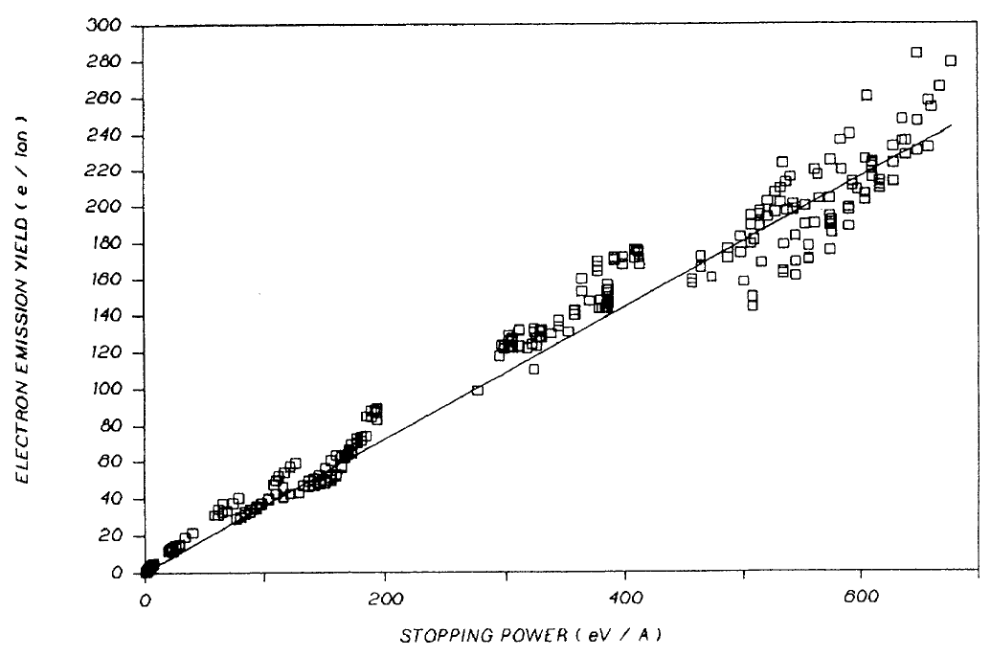

4. Kinetic electron emission in Mylar
How many electrons are generated in Mylar ?
Sternglass proportionality theory :
$$N_{e^{−}}∝stopping power$$
Clouvas, A., et al. Physical Review B 48.10 (1993): 6832

Slide 20
4. Kinetic electron emission in Mylar
How many electrons are generated in Mylar ?
What energy spectrum have these electrons ?

Slide 21
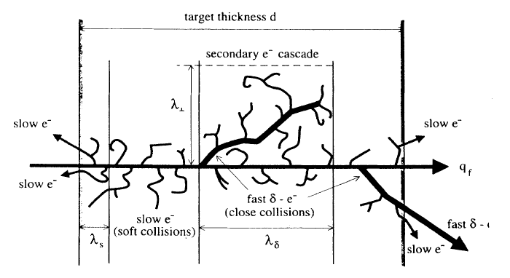
4. Kinetic electron emission in Mylar
How many electrons are generated in Mylar ?
What energy spectrum have these electrons ?
Spectrum with 2 components: fast $δ$ electrons + slow electrons (<100 eV)
Rothard, Hermann, et al. Physical Review A 51.4 (1995): 3066.

Slide 22
4. Kinetic electron emission in Mylar
How many electrons are generated in Mylar ?
What energy spectrum have these electrons ?
Delta electrons:
1-10 per event
High energy -> not focused by the lense
Directional emission and ions not in direction of the SiPM
Low geometrical efficiency

Slide 23
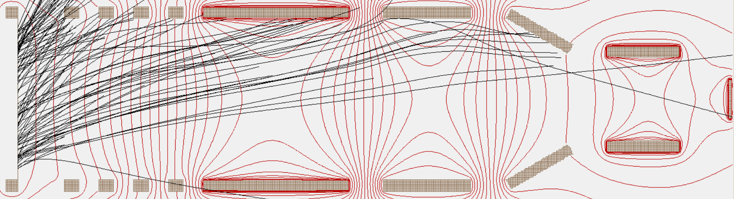
4. Kinetic electron emission in Mylar
How many electrons are generated in Mylar ?
What energy spectrum have these electrons ?
Delta electrons:
1-10 per event
High energy -> not focused by the lense
Directional emission and ions not in direction of the SiPM
Low geometrical efficiency
Neglected in the simulation

Slide 24
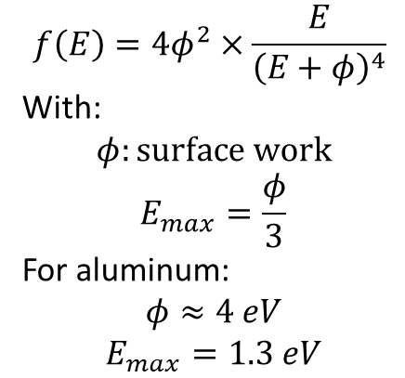
4. Kinetic electron emission in Mylar
How many electrons are generated in Mylar ?
What energy spectrum have these electrons ?
Low-energy electrons:
Chung–Everhart equation:
$$f\left(E\right)=4φ^{2}×\frac{E}{{\left(E+φ\right)}^{4}}$$
With:
$$φ:surface work$$
$$E_{max}=\frac{φ}{3}$$
For aluminum:
$$φ≈4 eV$$
$$E_{max}=1.3 eV$$

Slide 25
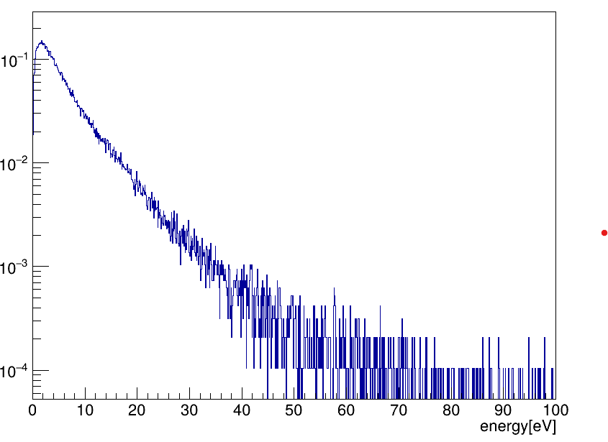

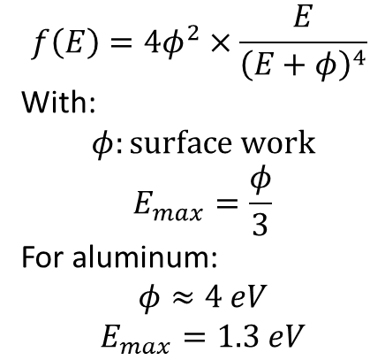
4. Kinetic electron emission in Mylar
How many electrons are generated in Mylar ?
What energy spectrum have these electrons ?
Low-energy electrons:
Chung–Everhart equation:
$$E_{max}=1,3 eV$$
$$f\left(E\right)=4φ^{2}×\frac{E}{{\left(E+φ\right)}^{4}}$$
With:
$$φ:surface work$$
$$E_{max}=\frac{φ}{3}$$
For aluminum:
$$φ≈4 eV$$
$$E_{max}=1.3 eV$$

Slide 26
4. Kinetic electron emission in Mylar
Profile of electron emission after ion interaction:
  Source considered as point-like
  Following a Chung-Everhart distribution
  Isotropical generation -> Lambertian emission
  Typical bunches of 200 electrons

Slide 27
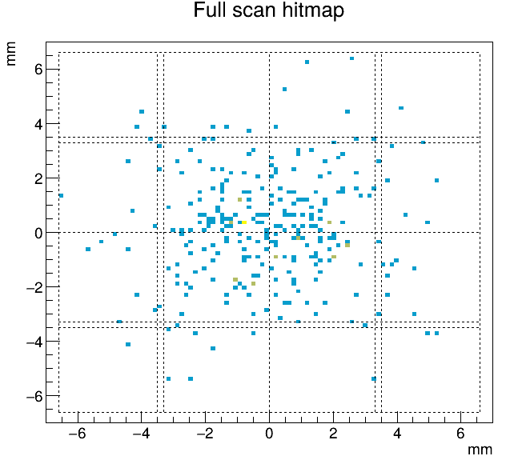
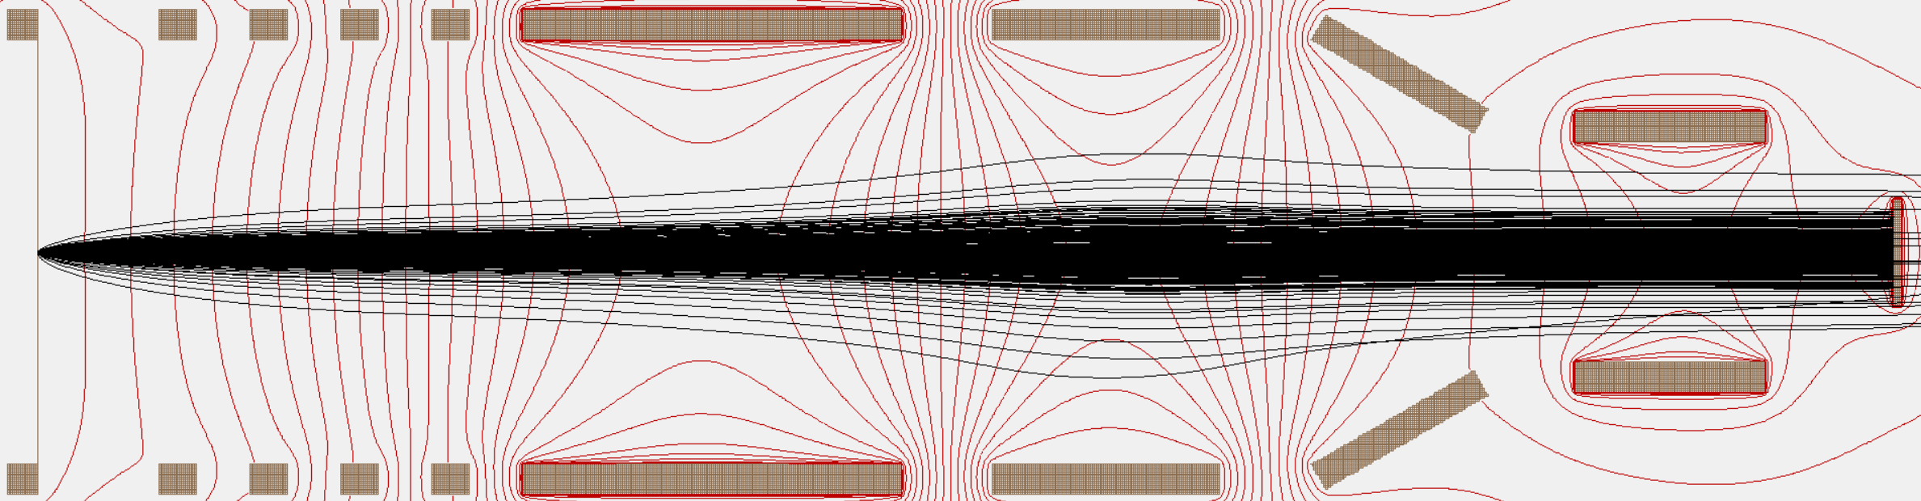
5. Realistic SIMION simulation
Electron
hitmap
x
Chung-Everhard and Lambertian distributions, Ion interacting in the center
y
Heavy Ion

Slide 28
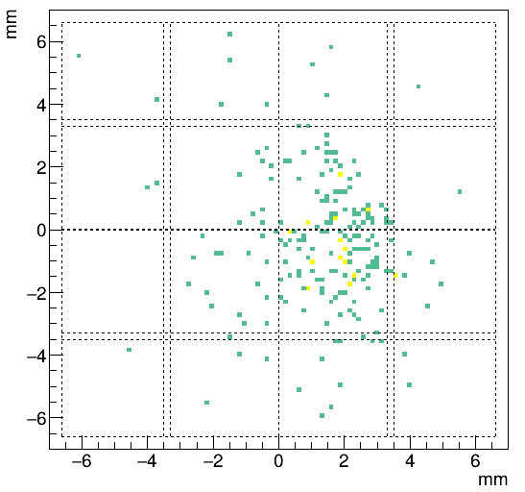
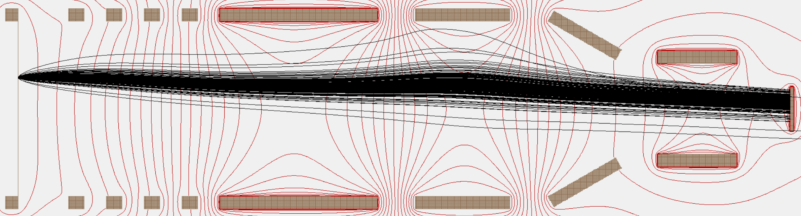
5. Realistic SIMION simulation
Electron
hitmap
x
Chung-Everhard and Lambertian distributions, Ion interacting at (10;0)
y
Heavy Ion

Slide 29
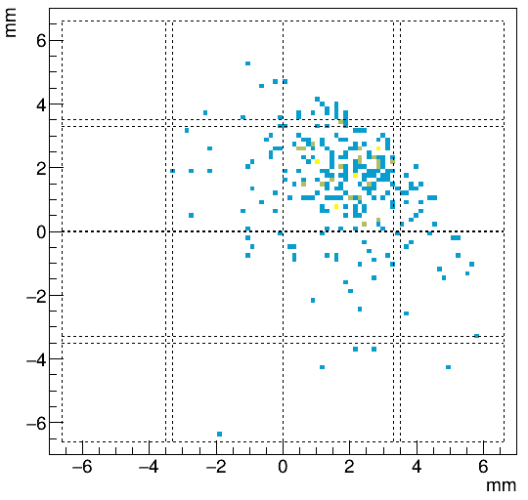
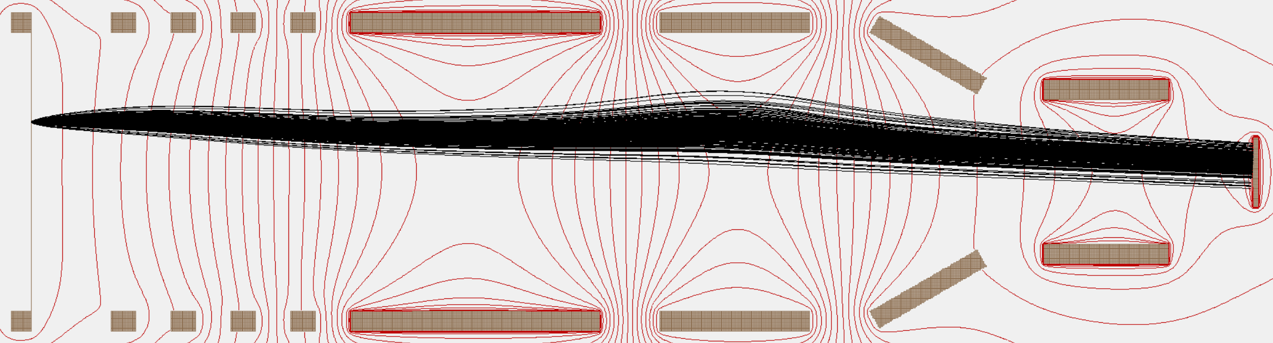
5. Realistic SIMION simulation
Electron
hitmap
x
Chung-Everhard and Lambertian distributions, Ion interacting at (10;10)
y
Heavy Ion

Slide 30
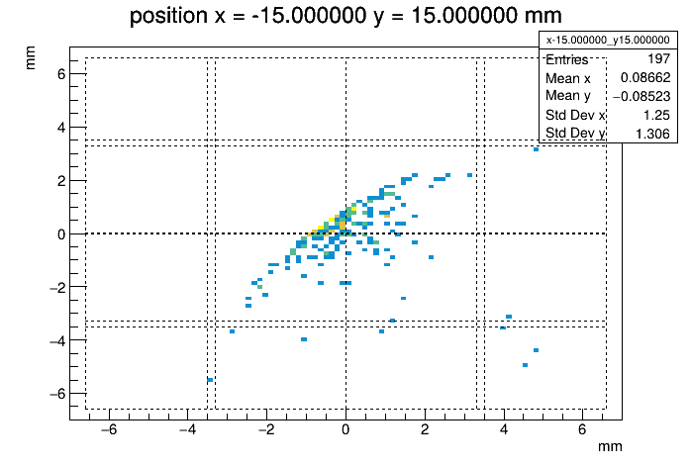
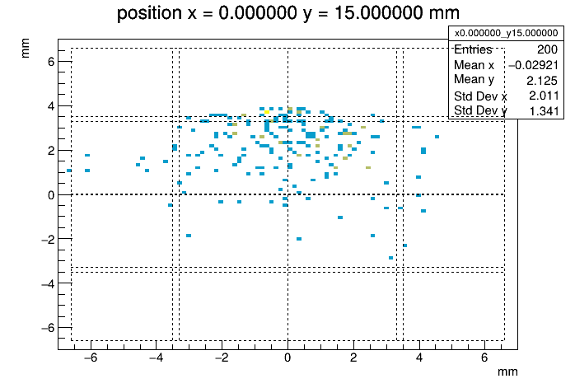
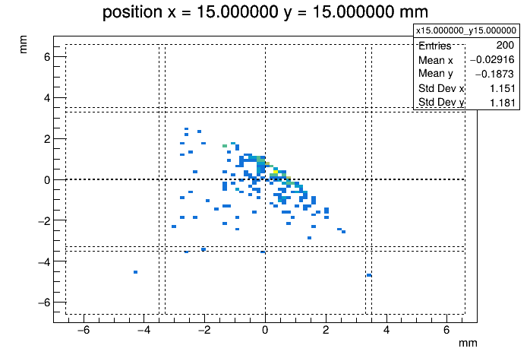
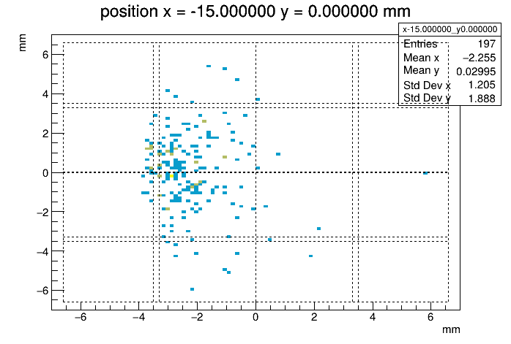
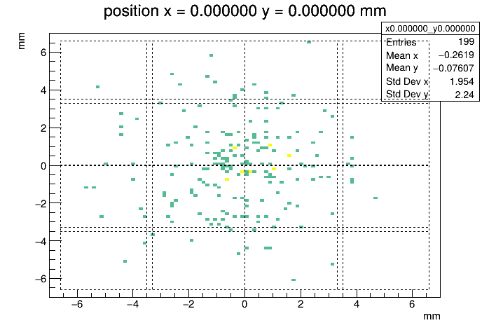
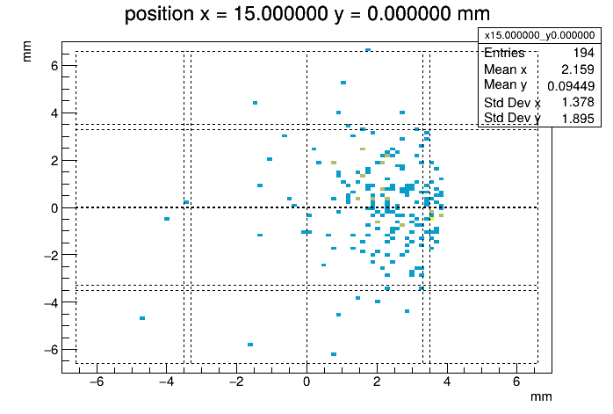
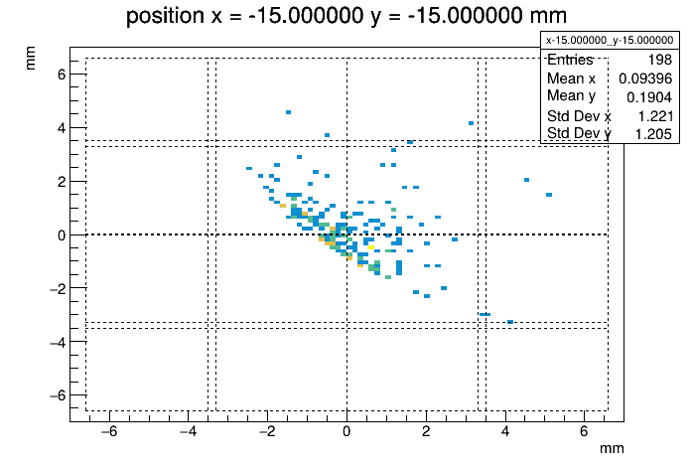
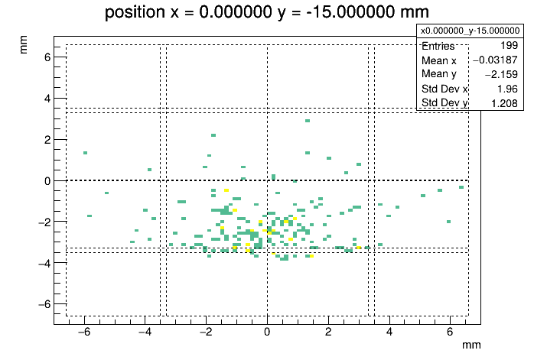
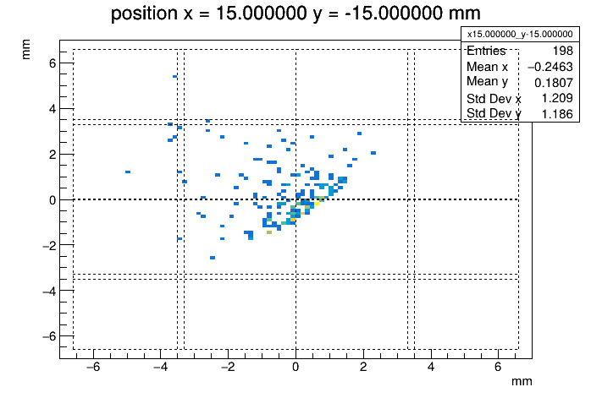
5. Realistic SIMION simulation
Mylar foil
-15; 15
0; 15
15; 15
Focus
-15; 0
0; 0
15; 0
-15; -15
0; -15
15; -15

Slide 31
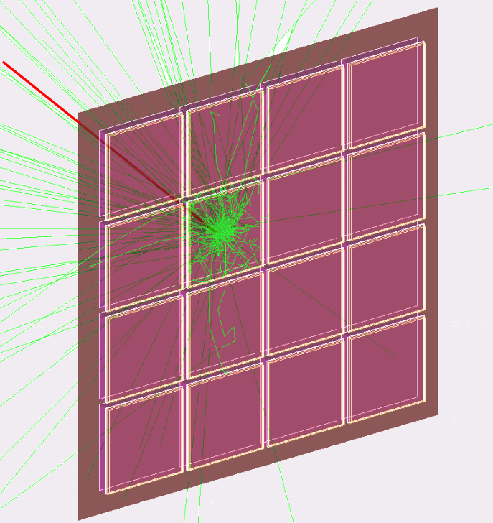
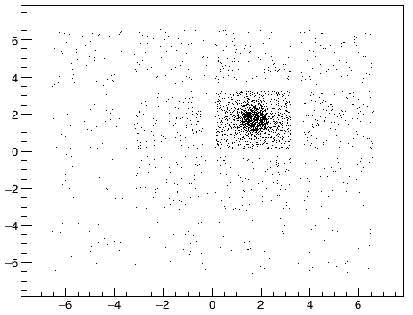
6. Geant4 simulation
y
Scintillation hitmap on SiPM
for 200 electrons interacting at the same point:
x
Beam
Beam
y
x

Slide 32
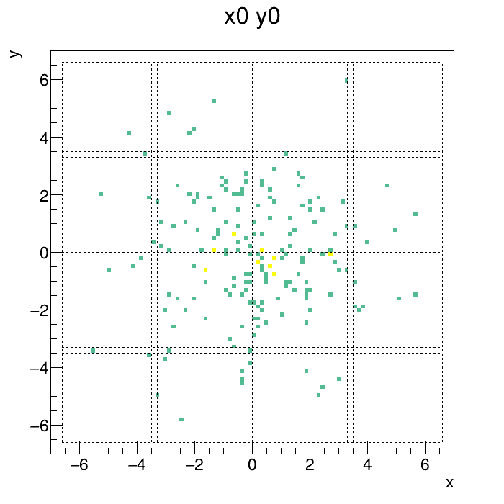
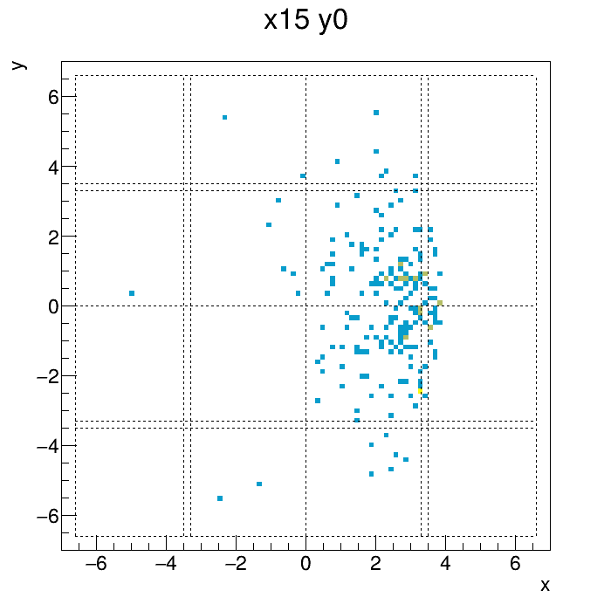
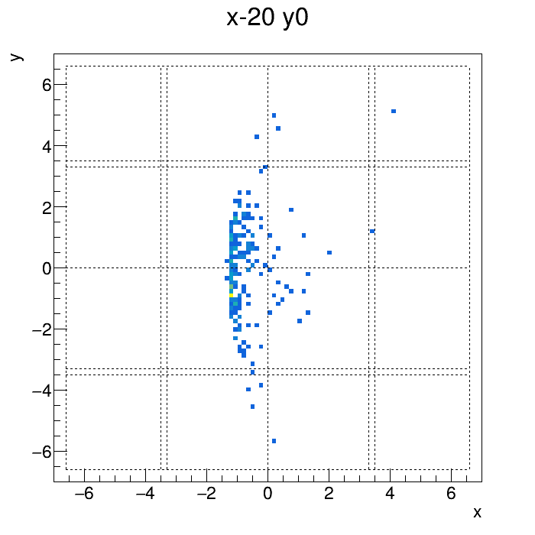
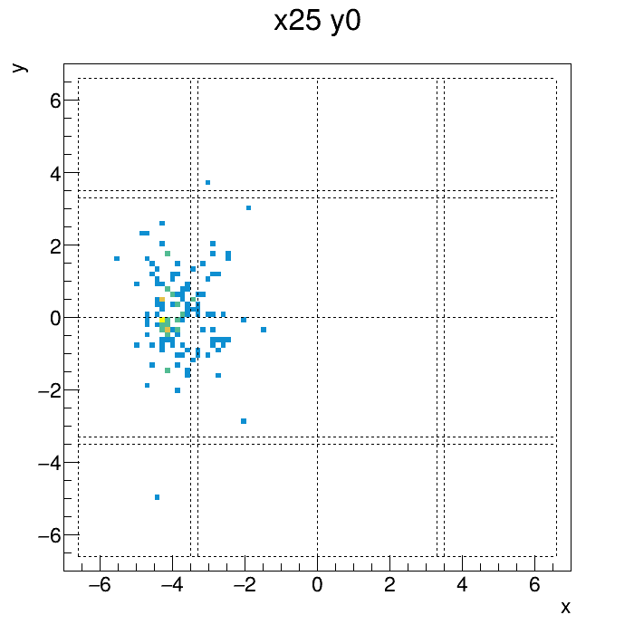
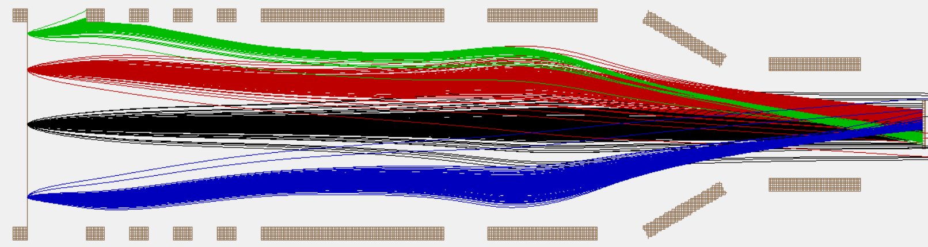
6. Geant4 simulation
Electron hitmap of a bunch in the scintillator
x
y

Slide 33
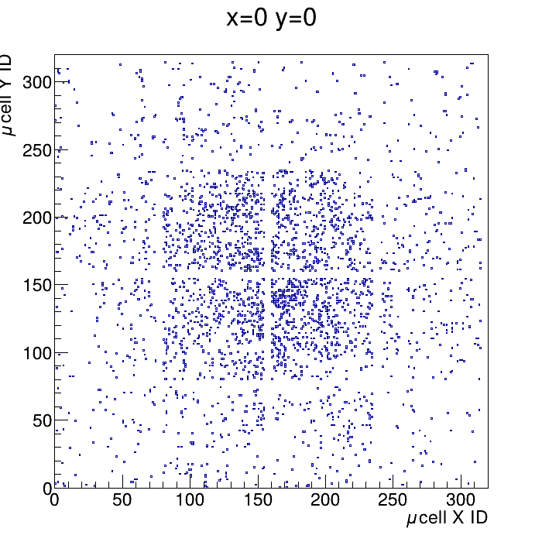
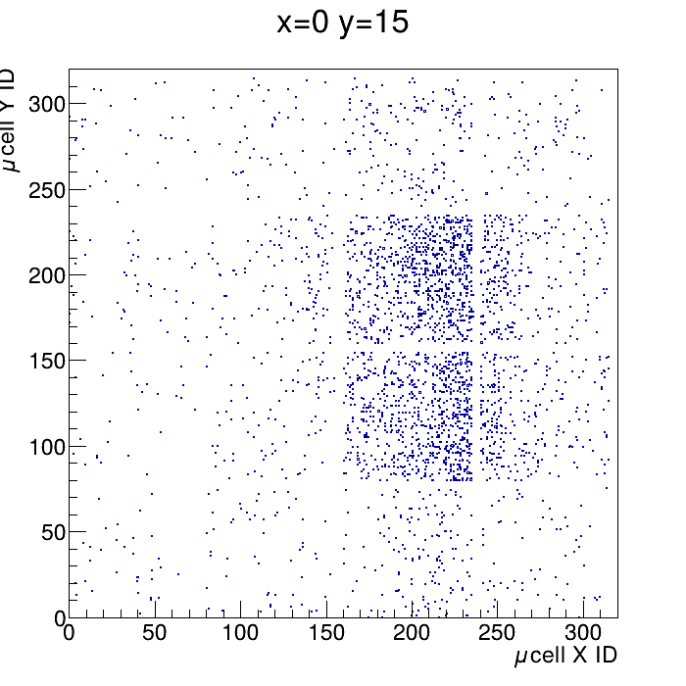
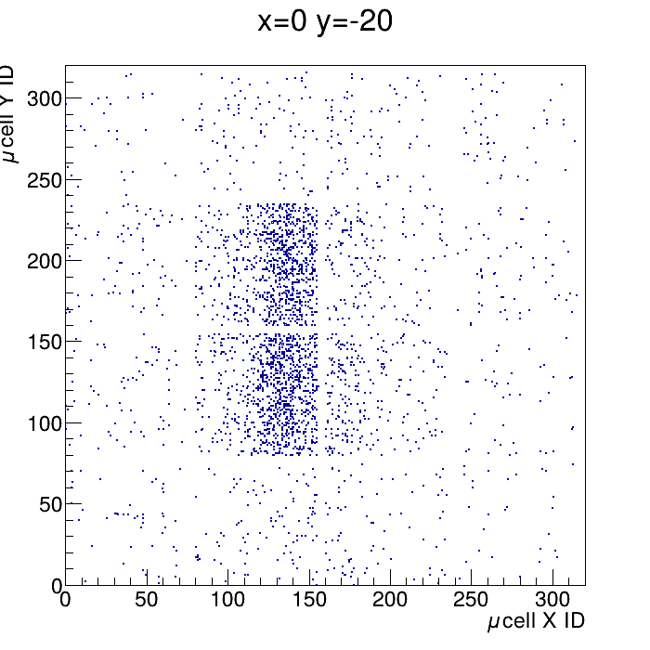
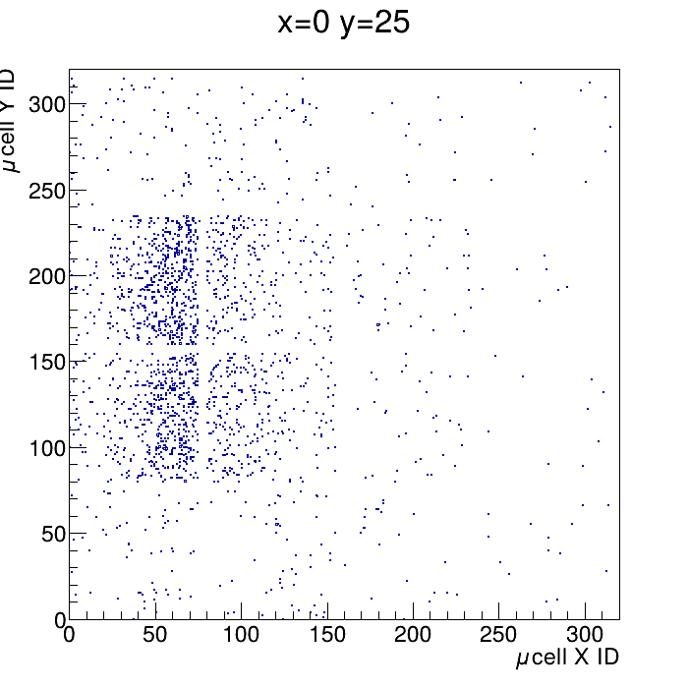
6. Geant4 simulation
Scintillation photon in the SiPM
x
y

Slide 34
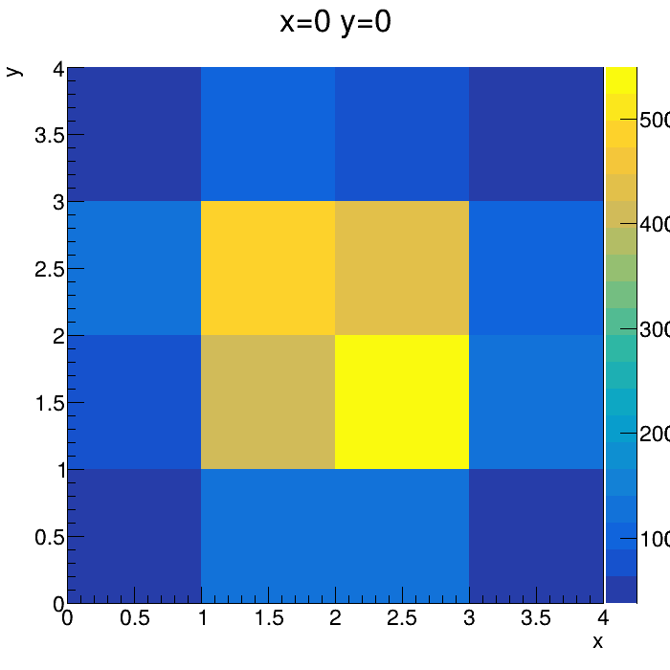
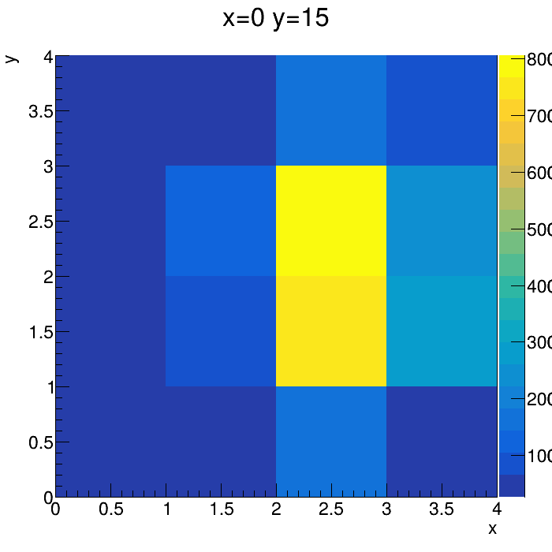


6. Geant4 simulation
x
y

Slide 35









6. Geant4 simulation
Mylar foil
-15; 15
0; 15
15; 15
Focus
-15; 0
0; 0
15; 0
-15; -15
0; -15
15; -15

Slide 36









6. Geant4 simulation
Mylar foil
-15; 15
0; 15
15; 15
Focus
-15; 0
0; 0
15; 0
-15; -15
0; -15
15; -15

Slide 37
Conclusion
Simulations help understanding the detector’s behavior
Segmentation not as performant as forseen, but could be used for other purpose (background rejection, scattered beam rejection, ….)
Simulations allow future investigations for optimisation: SiPM cell size, number, focusing…

Slide 38
Conclusion
Next steps:
Investigate focusing lens :
  Potential field optimisation
  Geometrical optimisation
All-in-one Geant4 simulation:
  Include focusing lens response function (Neural Network? Potentials?)
  Include the full-scale detector
Compare the detector with real-life data
Integration at Heavy Ion Laboratory for experimental campaign in 2027-2028 with EAGLE and DIAMANT

Slide 41


Slide 42









5 eV
Chung-Everhar

Slide 43


4. Kinetic electron emission in Mylar
How many electrons are generated in Mylar ?
What energy spectrum have these electrons ?
δ electrons:
Low-energy electrons:
Chung–Everhart equation:
$$f\left(E\right)=4φ^{2}×\frac{E}{{\left(E+φ\right)}^{4}}$$
With:
$$φ:surface work$$
$$E_{max}=\frac{φ}{3}$$
For aluminum:
$$φ≈4 eV$$
$$E_{max}=\frac{φ}{3}$$
1
5
12
21
34
ELECTRON ENERGY [keV]
Adapted from:
Rothard, Hermann, et al. Physical Review A 51.4 (1995): 3066.

Slide 44

4. Kinetic electron emission in Mylar
V [kV]:
-20
-18
-16
-7
0
-15
-2
0
-12
e⁻
Heavy Ion
Mylar foil
SiPM
Only 1-10 $δ_{e^{−}}$, poorly focused
$δ_{e^{−}}$ not taken into account !

Slide 45

4. Kinetic electron emission in Mylar
How many electrons are generated in Mylar ?
What energy spectrum have these electrons ?
Where are they created ?
Vast majority of electrons created within 10-100 nm around the point of interaction.
Rothard, Hermann, et al. Physical Review A 51.4 (1995): 3066.

