Slide 1


In-beam ɣ-ray Spectroscopy of low-lying Excited States of ¹²⁹In and ¹²⁸Cd
Michał Mikołajczuk
Supervisor: dr hab. Agnieszka Korgul, prof. UW
Co-Supervisor: dr Magdalena Górska-Ott (GSI)

Slide 2


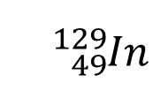


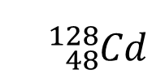









Motivation
Data from isomer decay spectroscopy
¹³²Sn
68
2714
(10⁺) 3.56 (6) μs
2646
(8⁺)
Z = 50
N = 82
538
450
2195
(6⁺)
$$d_{3/2}$$
2108
238
(7⁻) 12 (2) ns
$$g_{9/2}$$
$$h_{11/2}$$
1871
765
(5⁻) 270 (7) ns
$$p_{1/2}$$
$$s_{1/2}$$
411
$$p_{3/2}$$
$$d_{5/2}$$
1430
4⁺
$$f_{5/2}$$
$$f_{7/2}$$
$$π$$
$$ν$$
784
$${}_{}^{}{{}_{48}^{128}{Cd}}$$
$${πg}_{9/2}^{−2} × υh_{11/2}^{−2}$$
$${}_{}^{}{{}_{49}^{129}{In}}$$
$${πg}_{9/2}^{−1} × υh_{11/2}^{−2}$$
646
2⁺
^{Selected reaction chanels}
¹³⁰In(⁹Be,n) ¹²⁹In
¹²⁹Cd(⁹Be,n) ¹²⁸Cd
¹³²Sn(⁹Be,p) ¹³¹In (method validation)
646
0⁺
¹²⁸Cd
L. Cáceres et al..Phys. Rev. C 79, 011301 (2009)

Slide 3
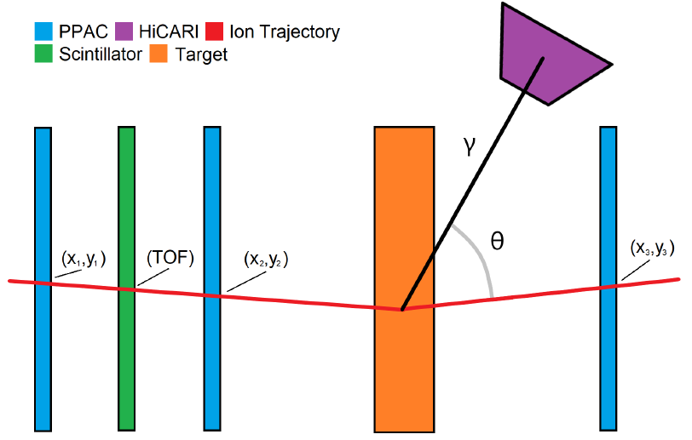
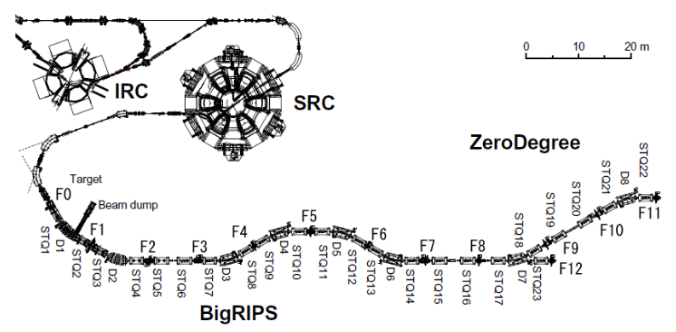
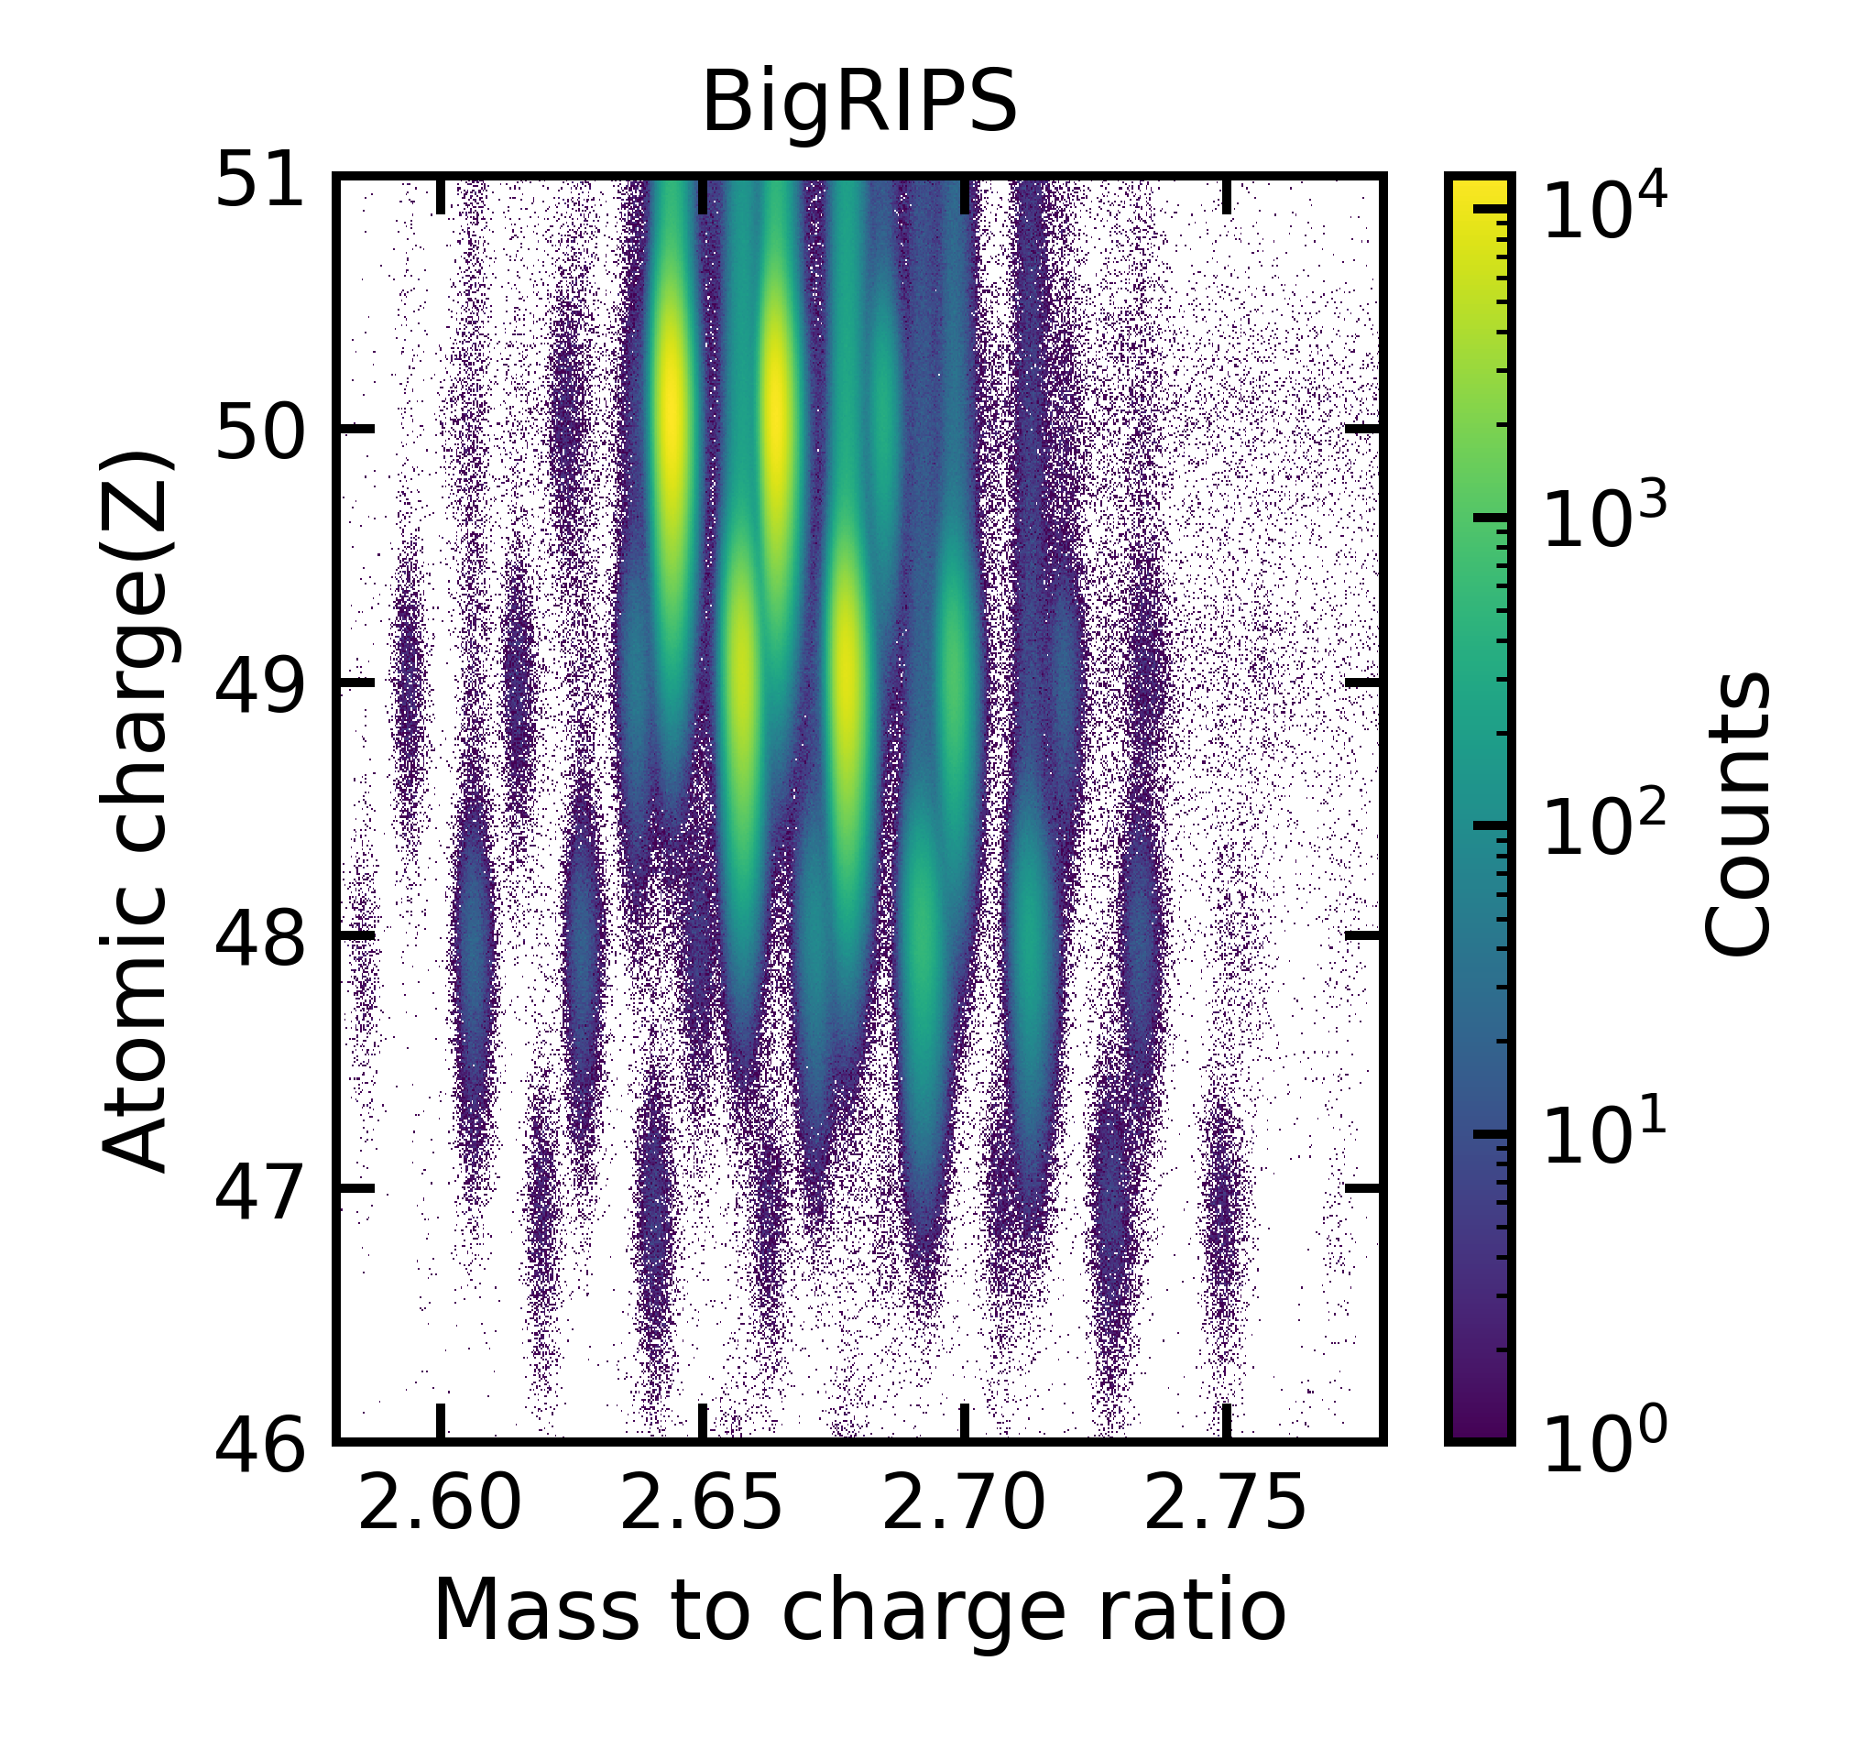
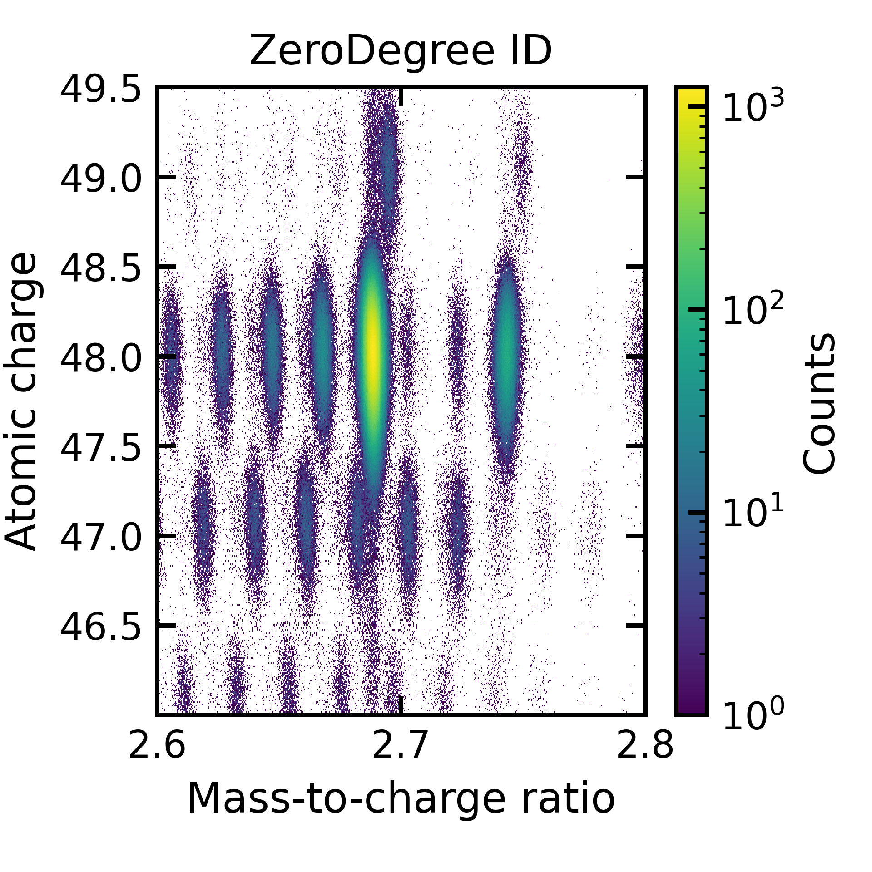
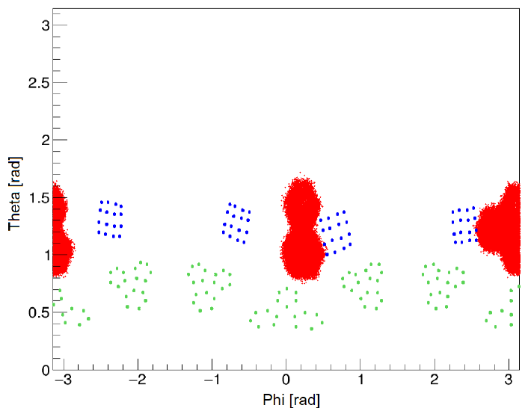
Experiment
BigRIPS PID
ZeroDegree PID
¹²⁸Cd
HPGe ɣ radiation detectors
Miniball
Superclover
Tracking
¹²⁹Cd

Slide 4
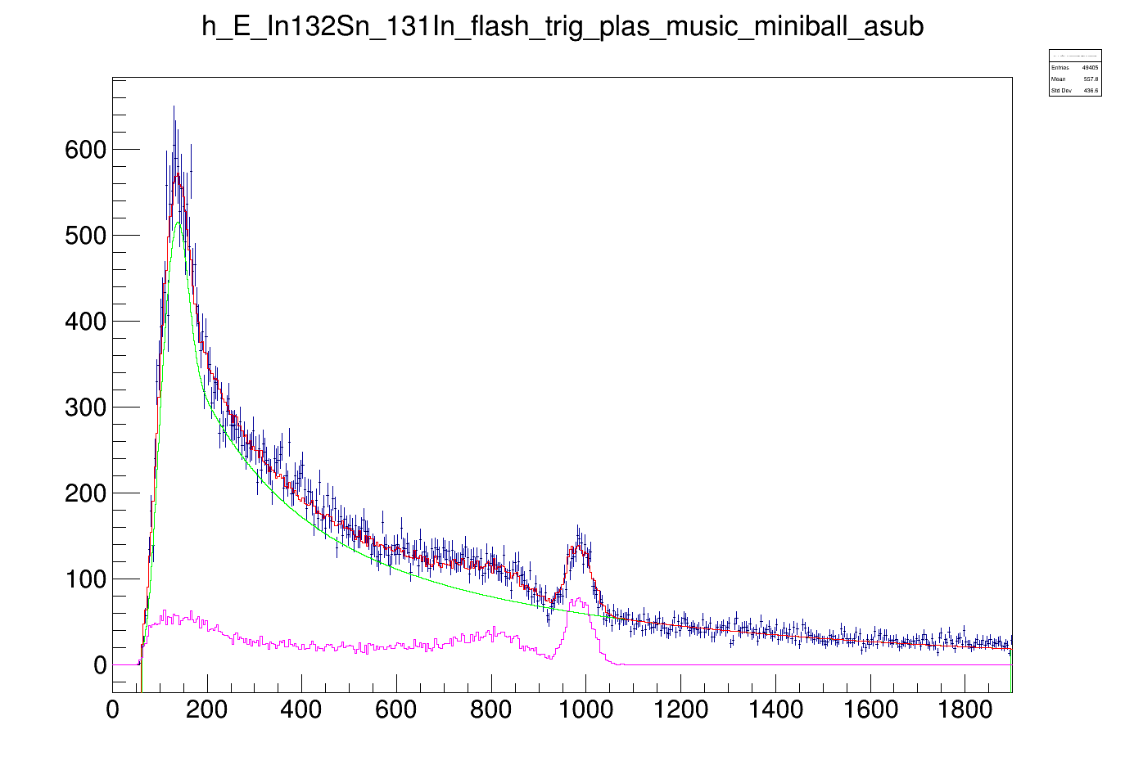
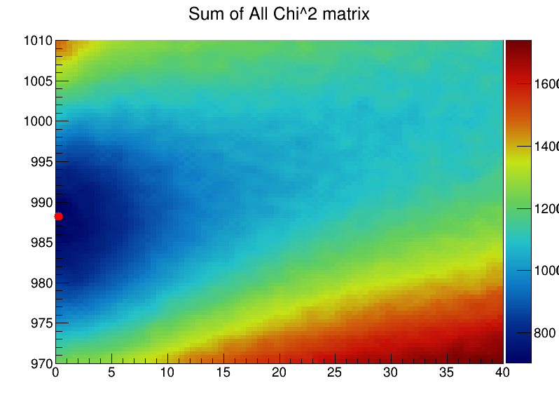



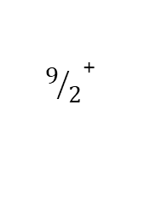
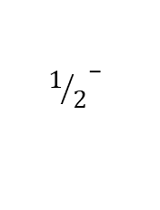

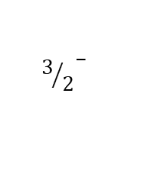

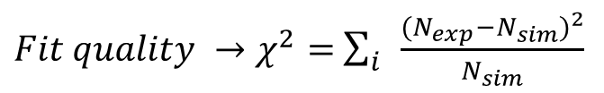
Transition energy and a state half-life extraction method
$Fit quality →χ^{2}=$ $\sum_{i}{\frac{({N_{exp}−N_{sim})}^{2}}{N_{sim}}}$
Sum of all $χ^{2}$ matrices
$${3/2}^{−}$$
Response function (transition)
988 keV
Atomic background
$${1/2}^{−}$$
$$β$$
Total fit
Experimental data
$${9/2}^{+}$$
$${}_{49}^{131}{In}$$
Energy (keV)
Counts per 4 keV
$$T_{1/2}<3ps$$
$$E_{γ}=988 keV$$
Half-life(ps)
Energy (keV)

Slide 5
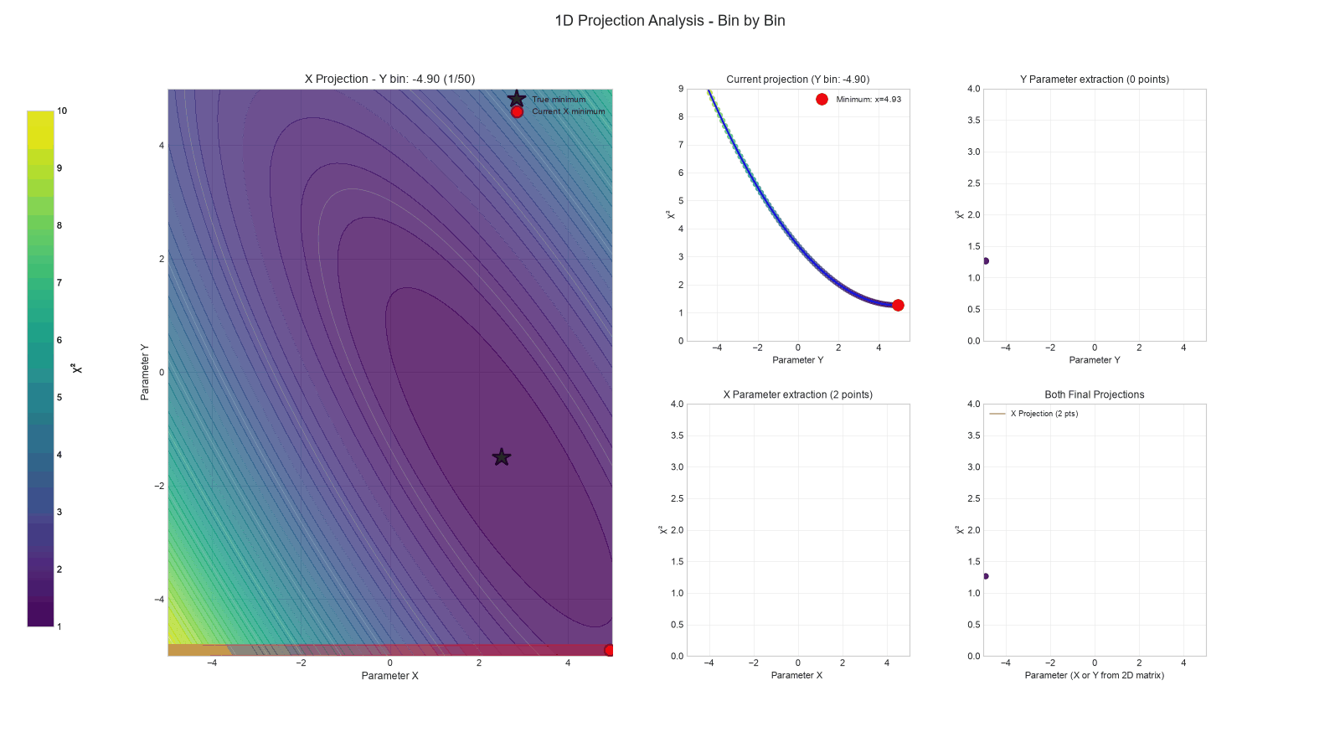
Transition Energy and a state half-life extraction method

Slide 6
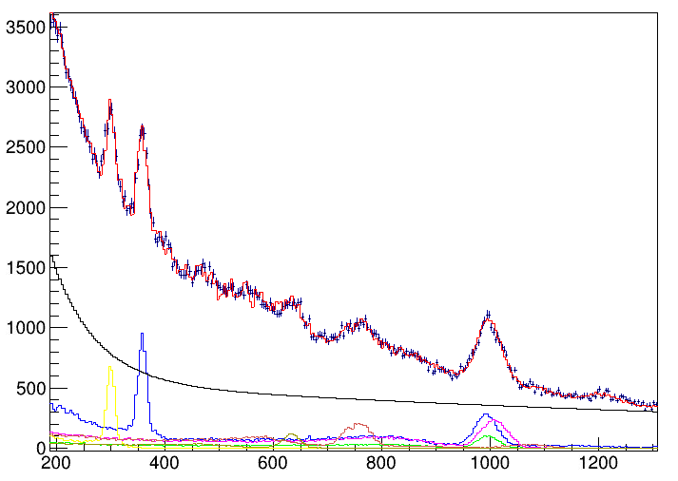
Results: ¹²⁹In
New data
Known isomer
2015
1989
(15/2⁺) < 8 ps
302 (2) keV
1688
17/2⁻ 10.8 (1) μs
(15/2⁺ )-> 17/2⁻
13/2⁺ -> 11/2⁺
1020 (6) keV
1354
13/2⁺ < 10 ps
1219
(5/2⁻) 16 (5) ps
360 (2) keV
Counts per 4 keV
1082
995
(3/2⁻) < 10 ps
(3/2⁻ )-> 1/2⁻
11/2⁺ < 8 ps
(5/2⁻ -> 1/2⁻ )
11/2⁺ -> 9/2⁺
767 (4) keV
635 (4) keV
997 (3) keV
1/2⁻
1.23 (3) s
451
Energy (keV)
0
9/2⁺
¹²⁹In

Slide 7
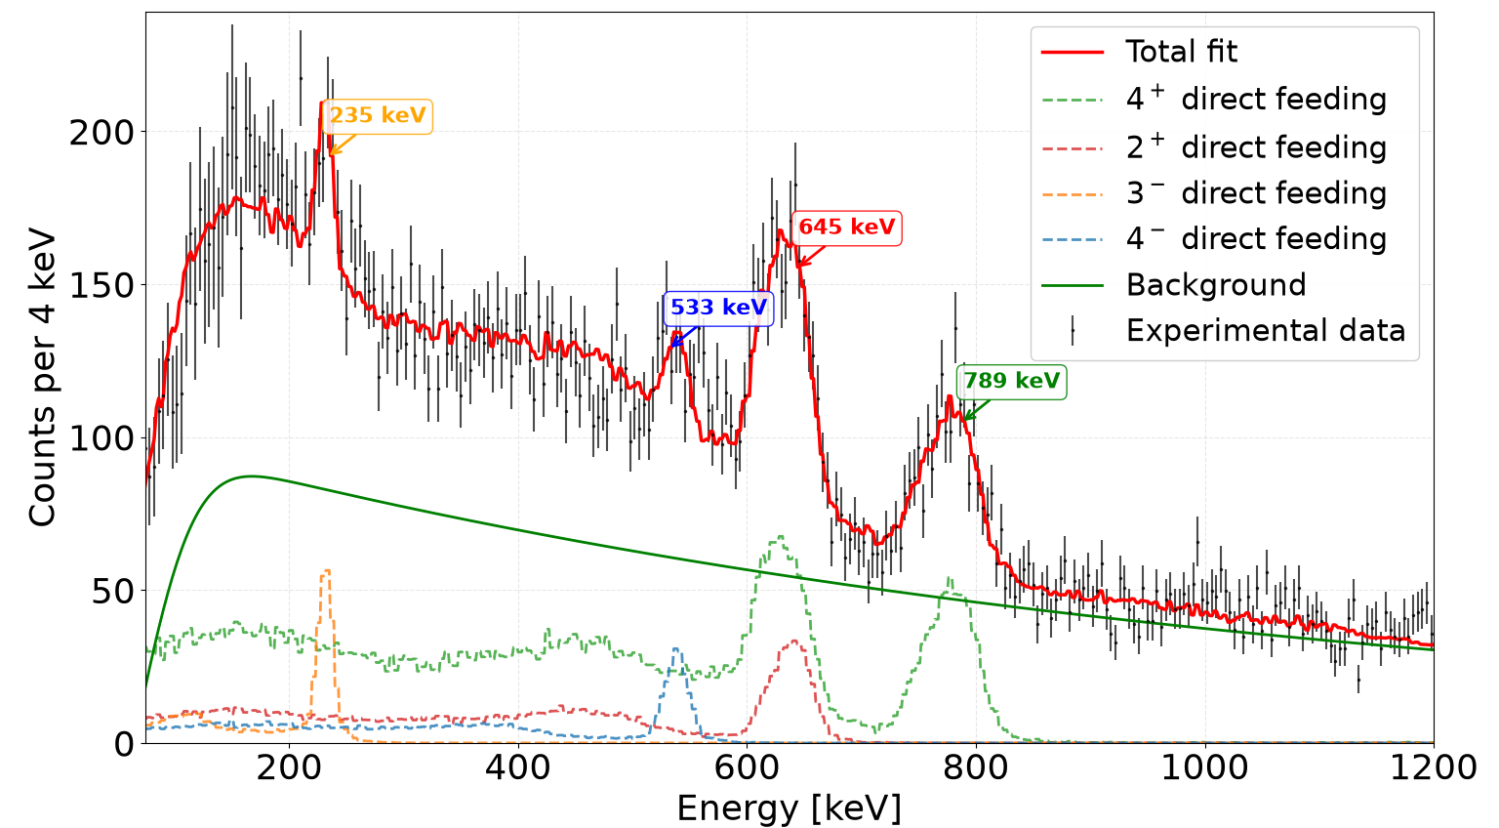
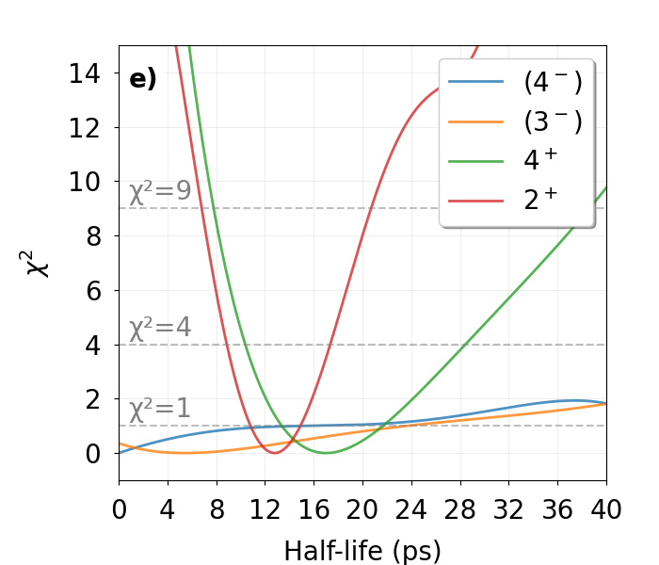
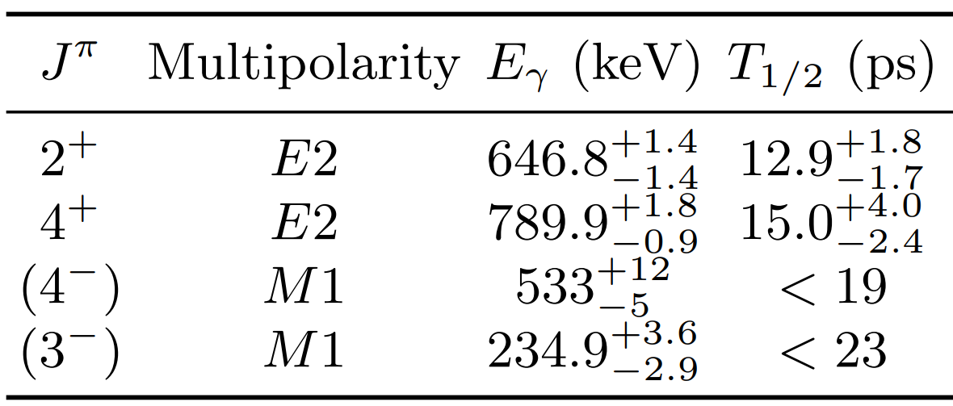
Results: ¹²⁸Cd

Slide 8
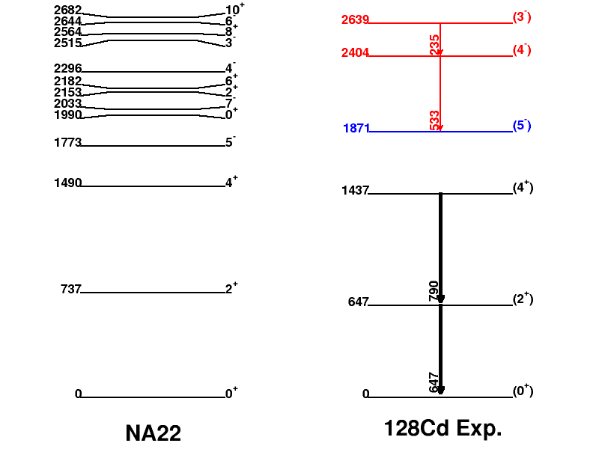
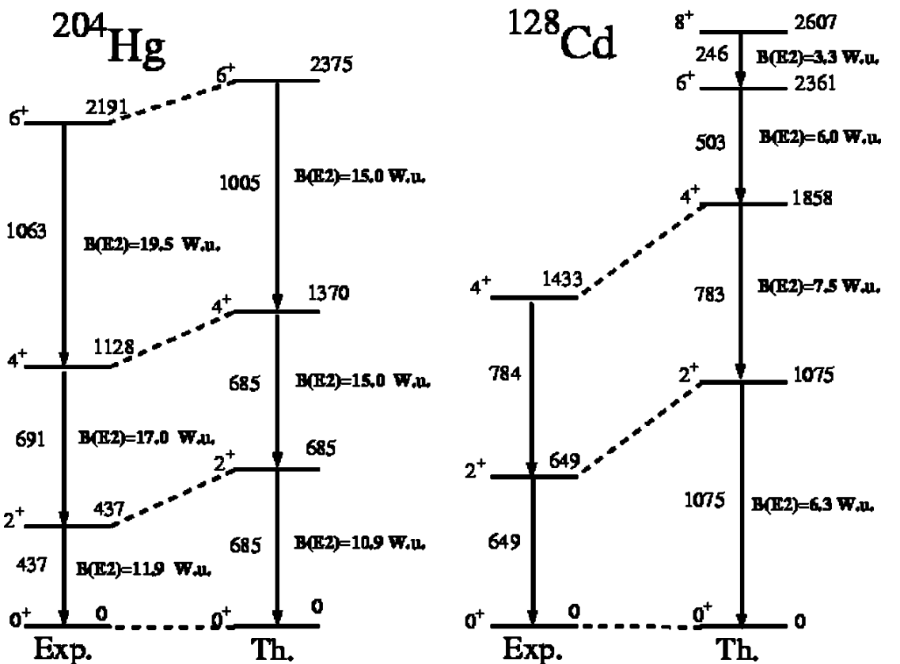
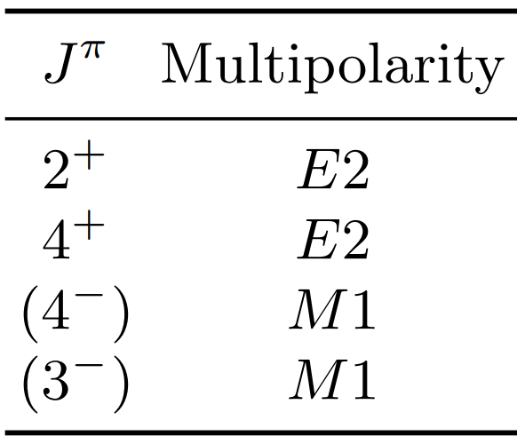
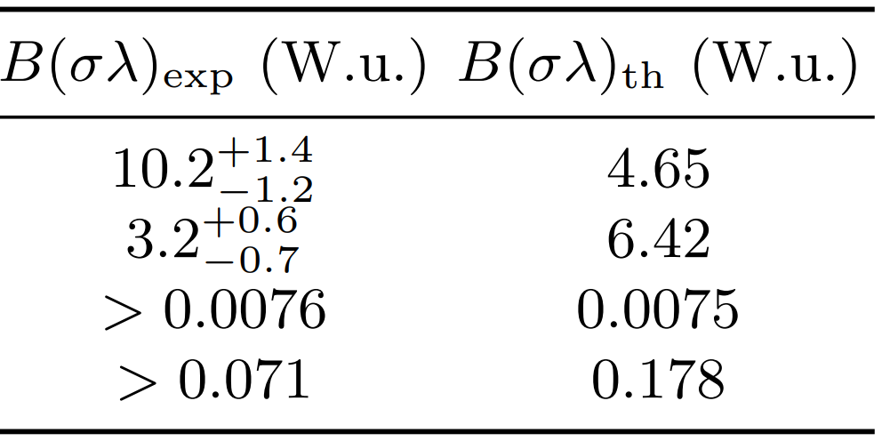
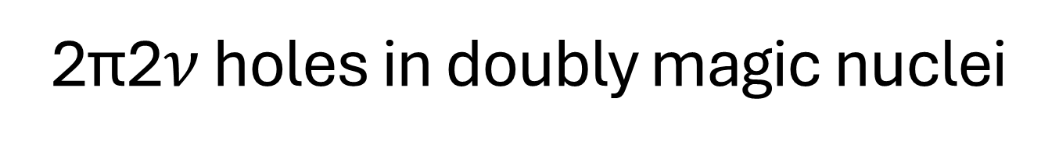


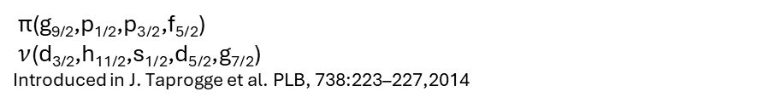
2ϖ2$ν$ holes in doubly magic nuclei
Direct population from knock-out reaction
$${{}_{80}^{204}{Hg}}_{124}$$
$${{}_{48}^{128}{Cd}}_{80}$$
270 (7) ns
NA22
¹²⁸Cd
ϖ(g_{9/2},p_{1/2},p_{3/2},f_{5/2})
$ν$(d_{3/2},h_{11/2},s_{1/2},d_{5/2},g_{7/2})
Introduced in J. Taprogge et al. PLB, 738:223–227,2014
A. Scherillo et al. Phys. Rev. C,70:054318, Nov 2004

Slide 9
Summary
In-beam data from HiCARI campaign in RIKEN
Nucleon removal reactions to populate prompt states
One new transition and 5 half-lives of excited states measured in ¹²⁹In
Two new states tentatively assigned to 3⁻ and 4⁻ and their half-life limits measured in ¹²⁸Cd.
Half-life of 4+ and 2+ states in ¹²⁸Cd were measured for the first time inferring lack of collectivity as compared to ²⁰⁴Hg.

Slide 10
Backup slides

Slide 11
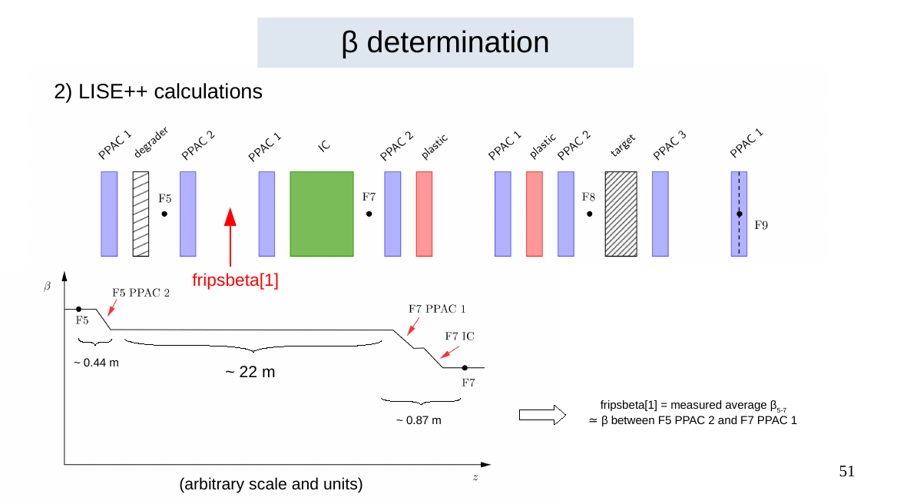
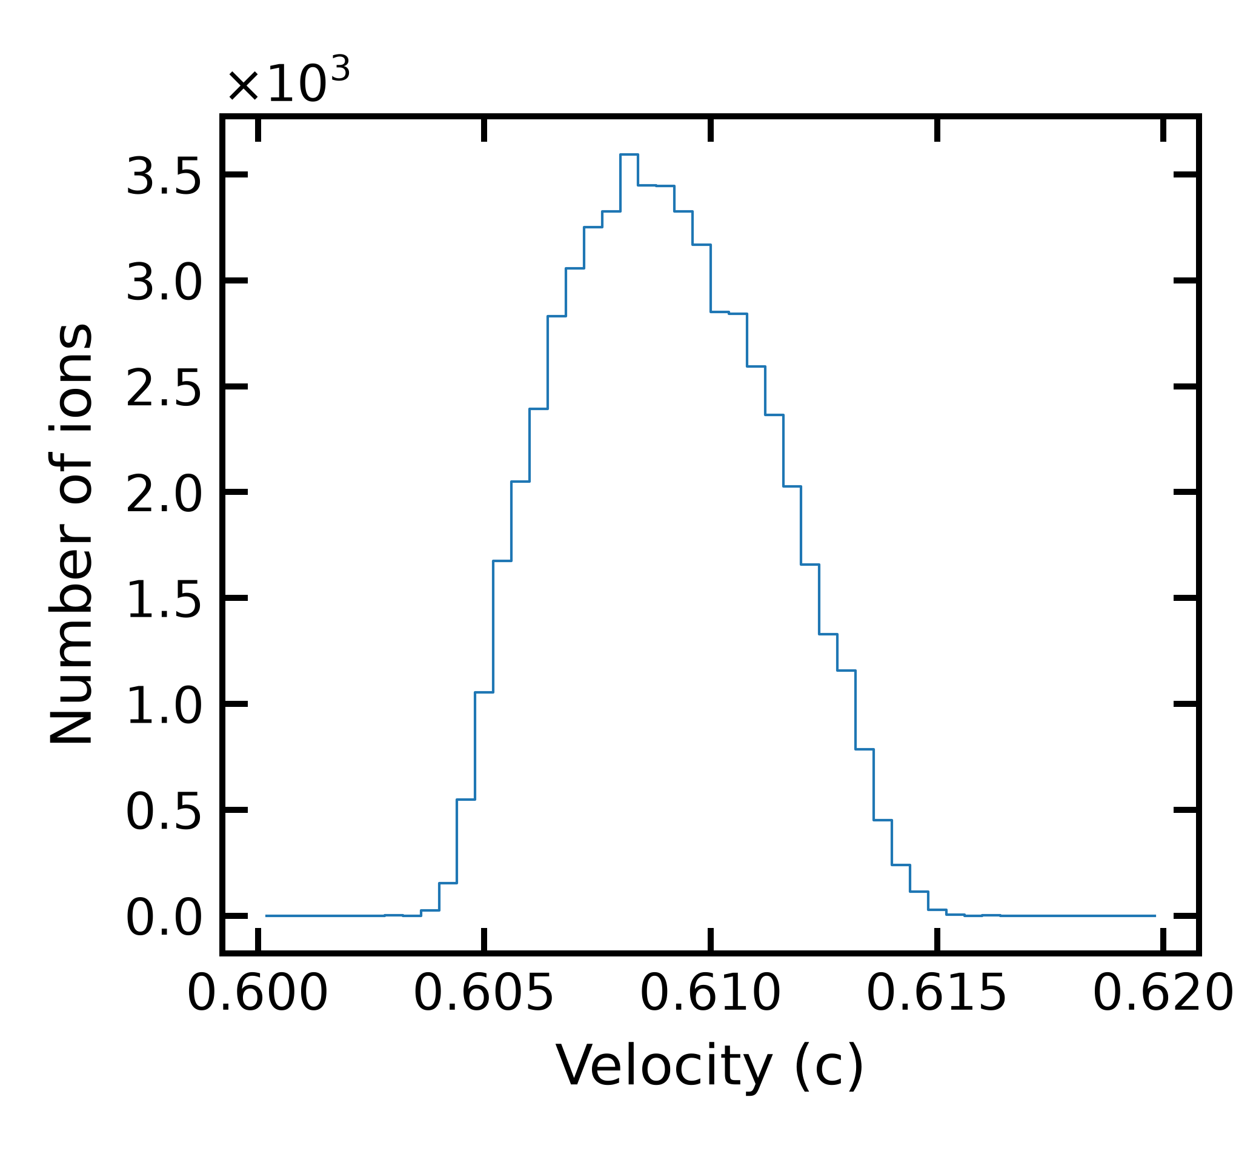
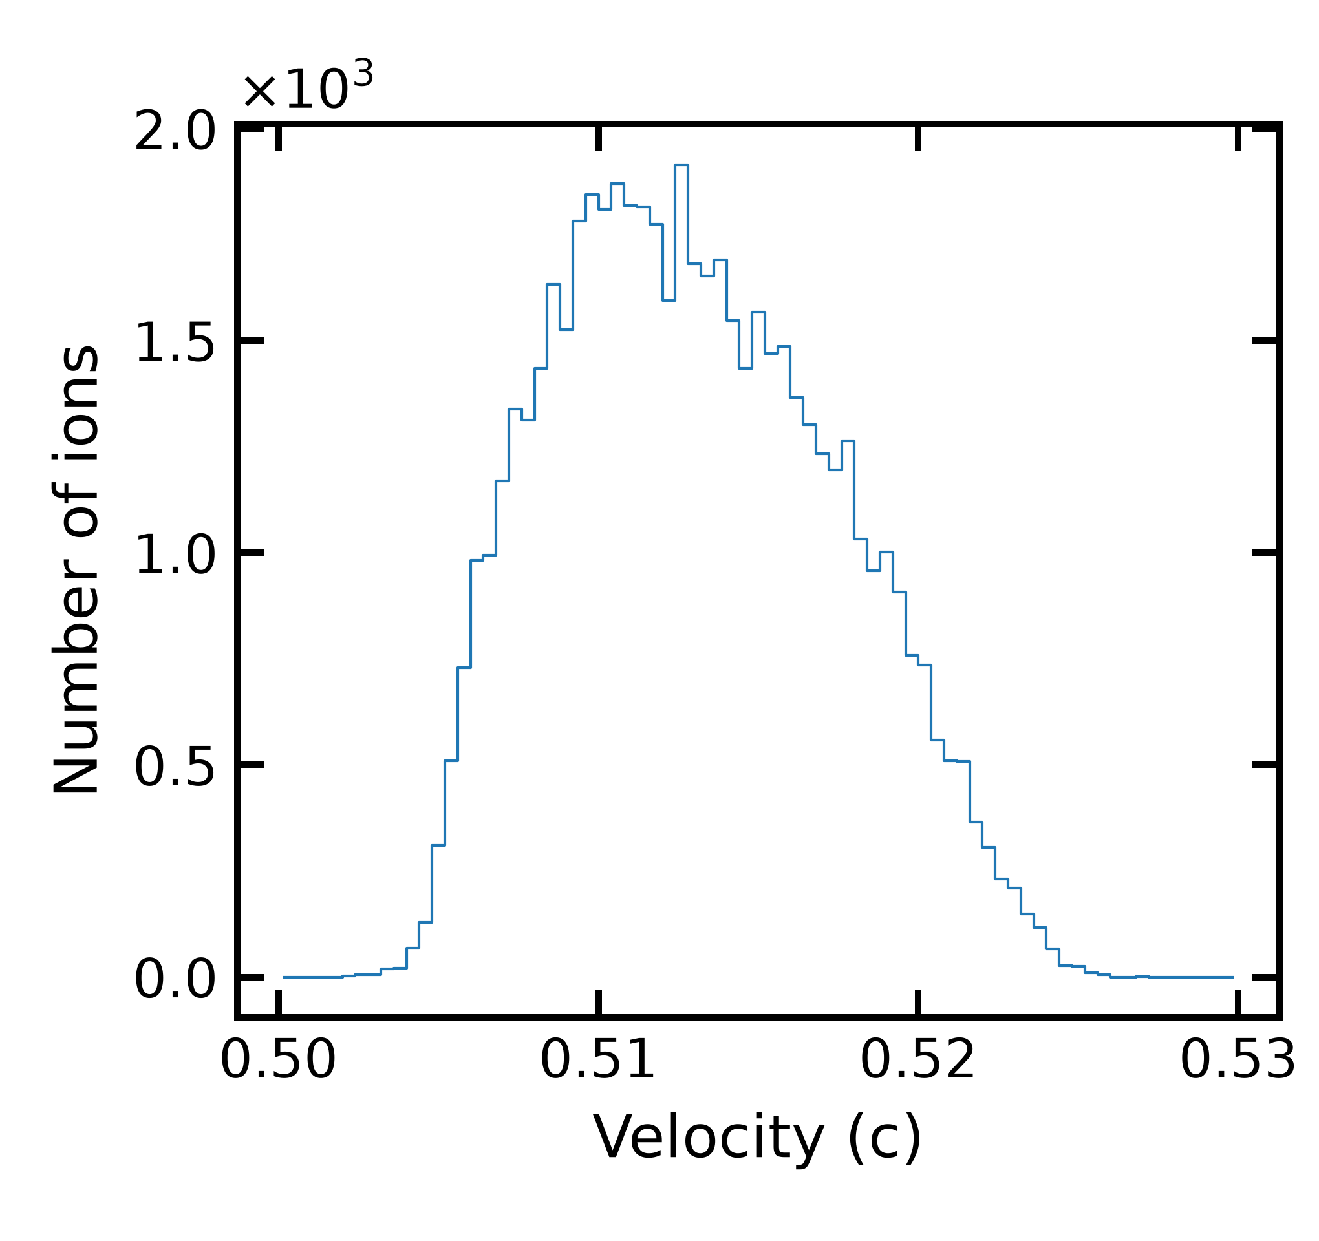
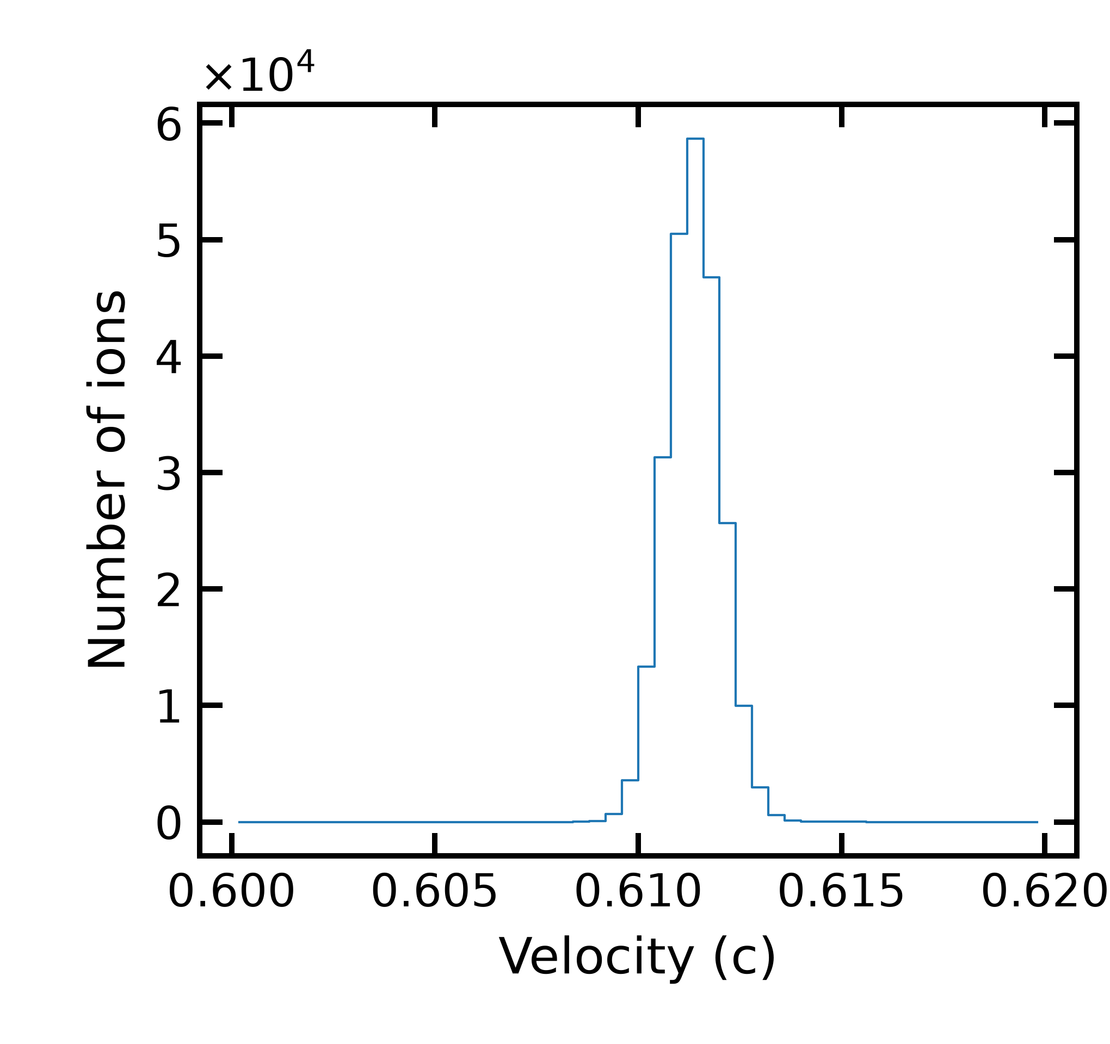
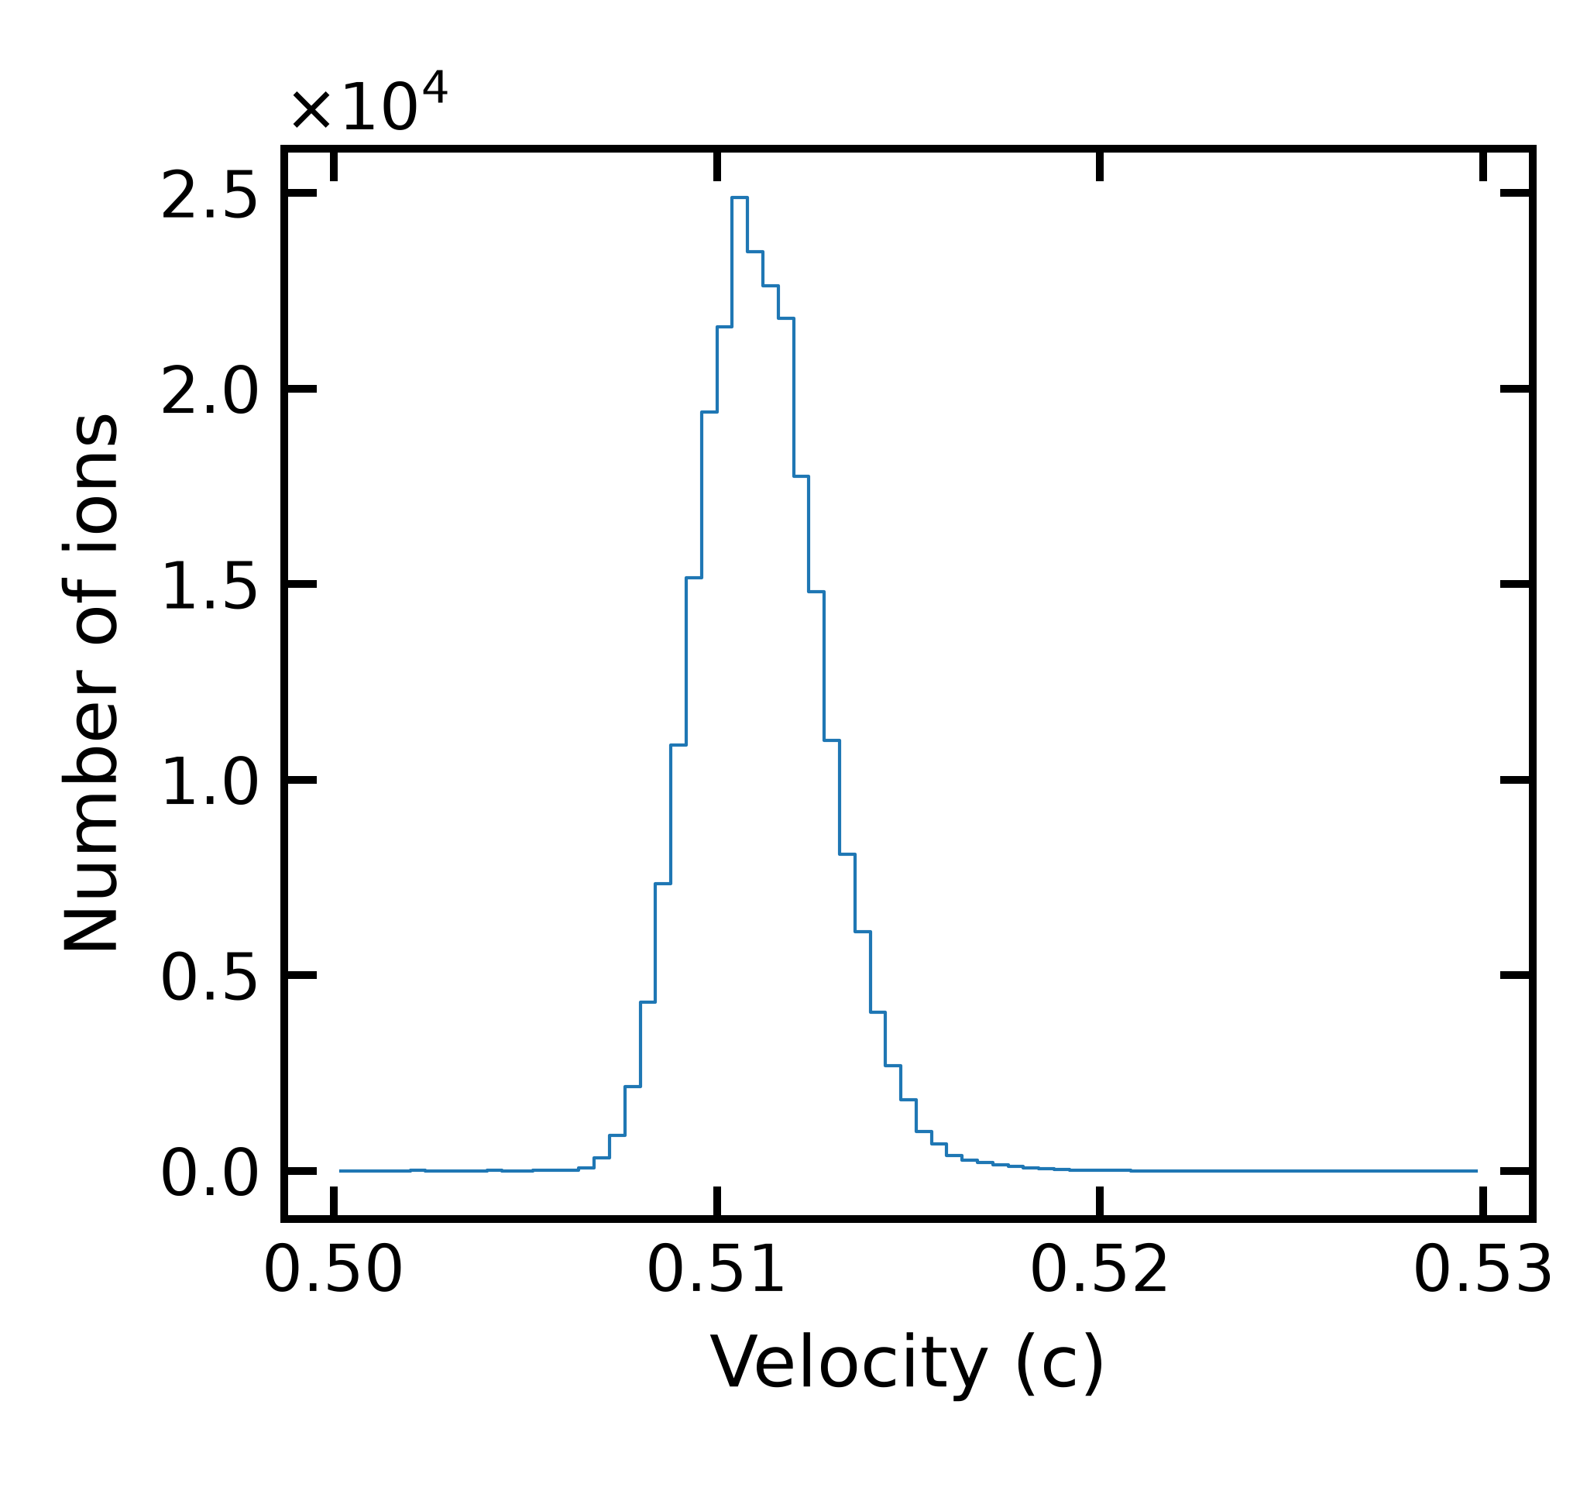
Ion velocity reconstruction
Before the target
After the target
¹²⁹Cd
¹²⁸Cd
ꞵ
ꞵ_{bef}
ꞵ_{aft}
LISE++ Calculations
¹³⁰In
¹³⁰In
Beamline

Slide 12
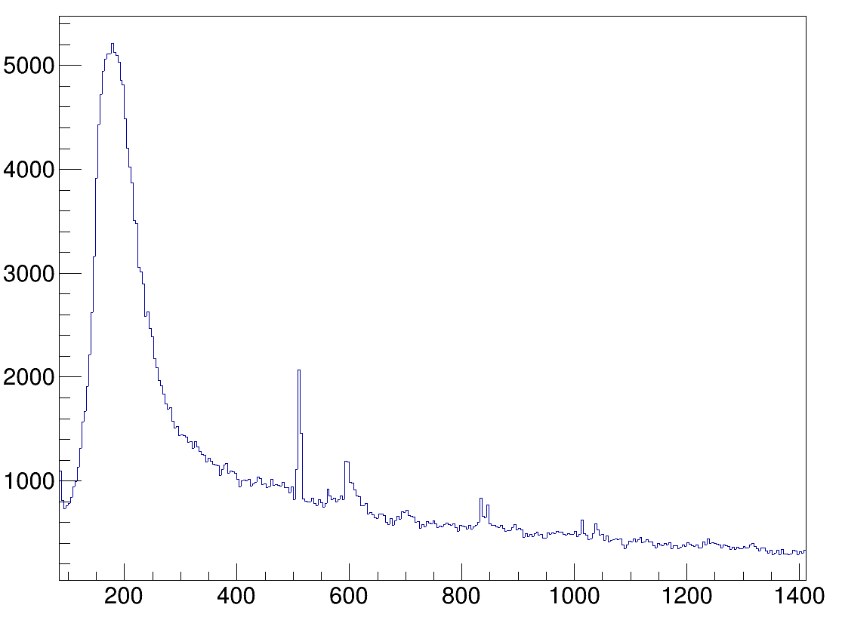
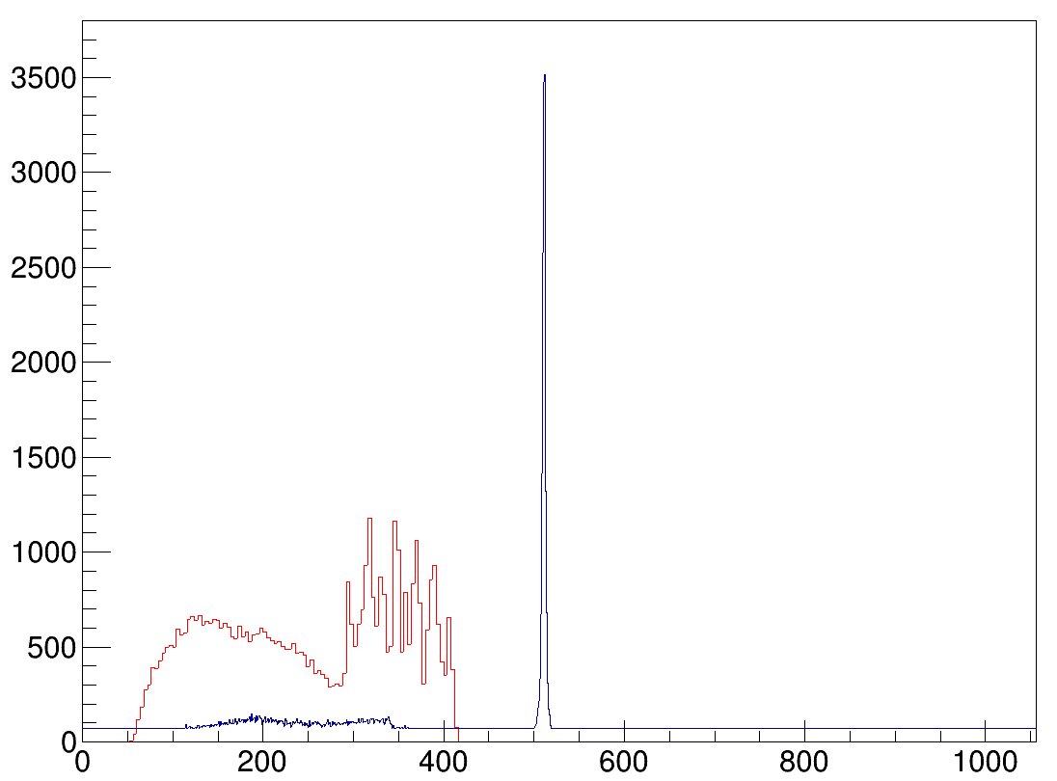
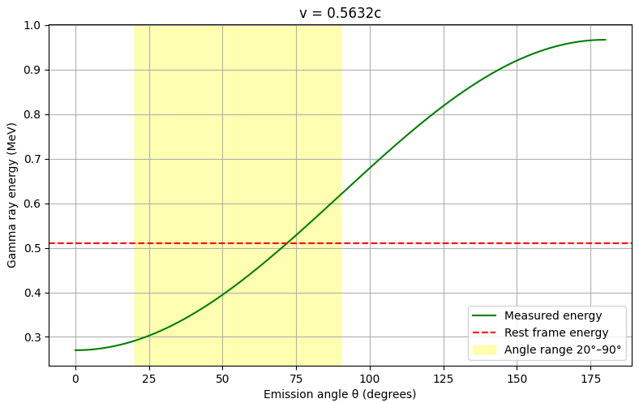
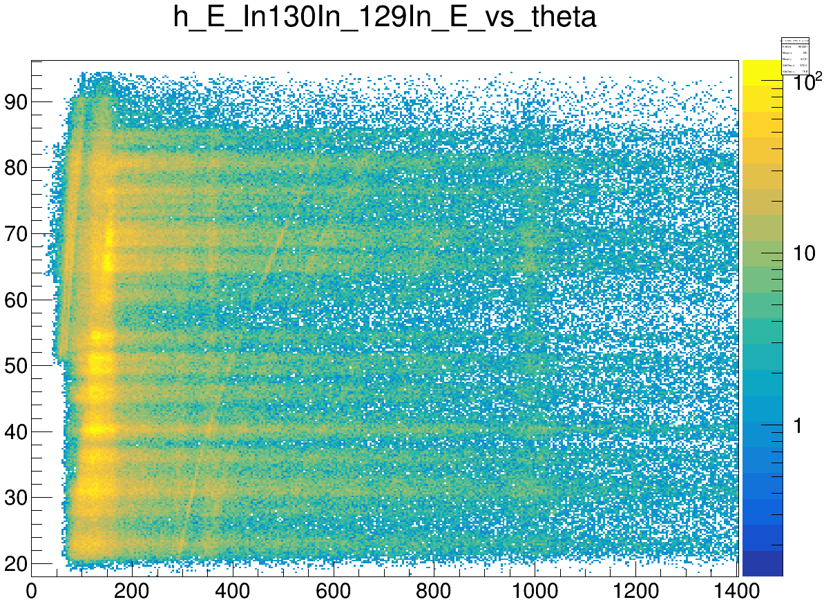
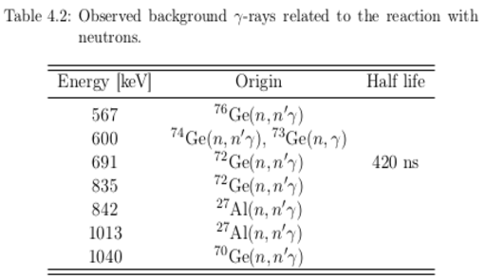
Doppler correctinon (DC) for contaminants
HPGe ɣ radiation detectors
Miniball
Superclover
Tracking
DC 511keV
511keV
Miniball 44 - 58˚
Counts/4keV
Counts per 4keV
Energy [keV]
Energy [keV]
Emission angle (deg)
Energy [keV]

