Slide 1


Ab-initio Renormalized Random Phase Approximation for closed-shells nuclear systems
František Knapp, Radek Folprecht

Slide 2
Outline
newly developed framework for HF + renormalized RPA (RRPA) calculations
with modern chiral-based NN+NNN interactions
calculations of selected closed shell nuclei with chiral NN+NNN potentials
(g.s energies, low-lying spectra, dipole response)
nature of low-lying dipole excitations

Slide 3
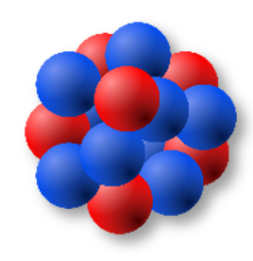


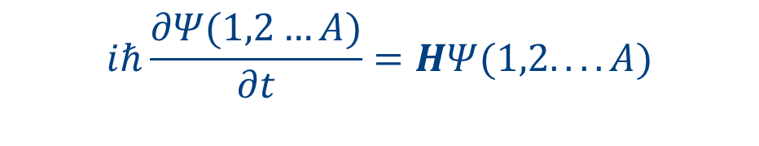
“Ab-initio” in nuclear theory
nuclear structure → many-body Schrödinger equation
→ approximations
$$iℏ\frac{∂Ψ(1,2…A)}{∂t}=HΨ(1,2....A)$$
$$H=\sum_{i=1}^{A}{\frac{p_{i}^{2}}{2m}} + \sum_{i<j}^{A}{V(i,j)}+ \sum_{i<j<k}^{A}{V(i,j,k)}$$
NN and NNN interactions from
chiral effective field theory phenomenological interactions
→ ab initio methods DFT, SM
interaction models
?

Slide 4
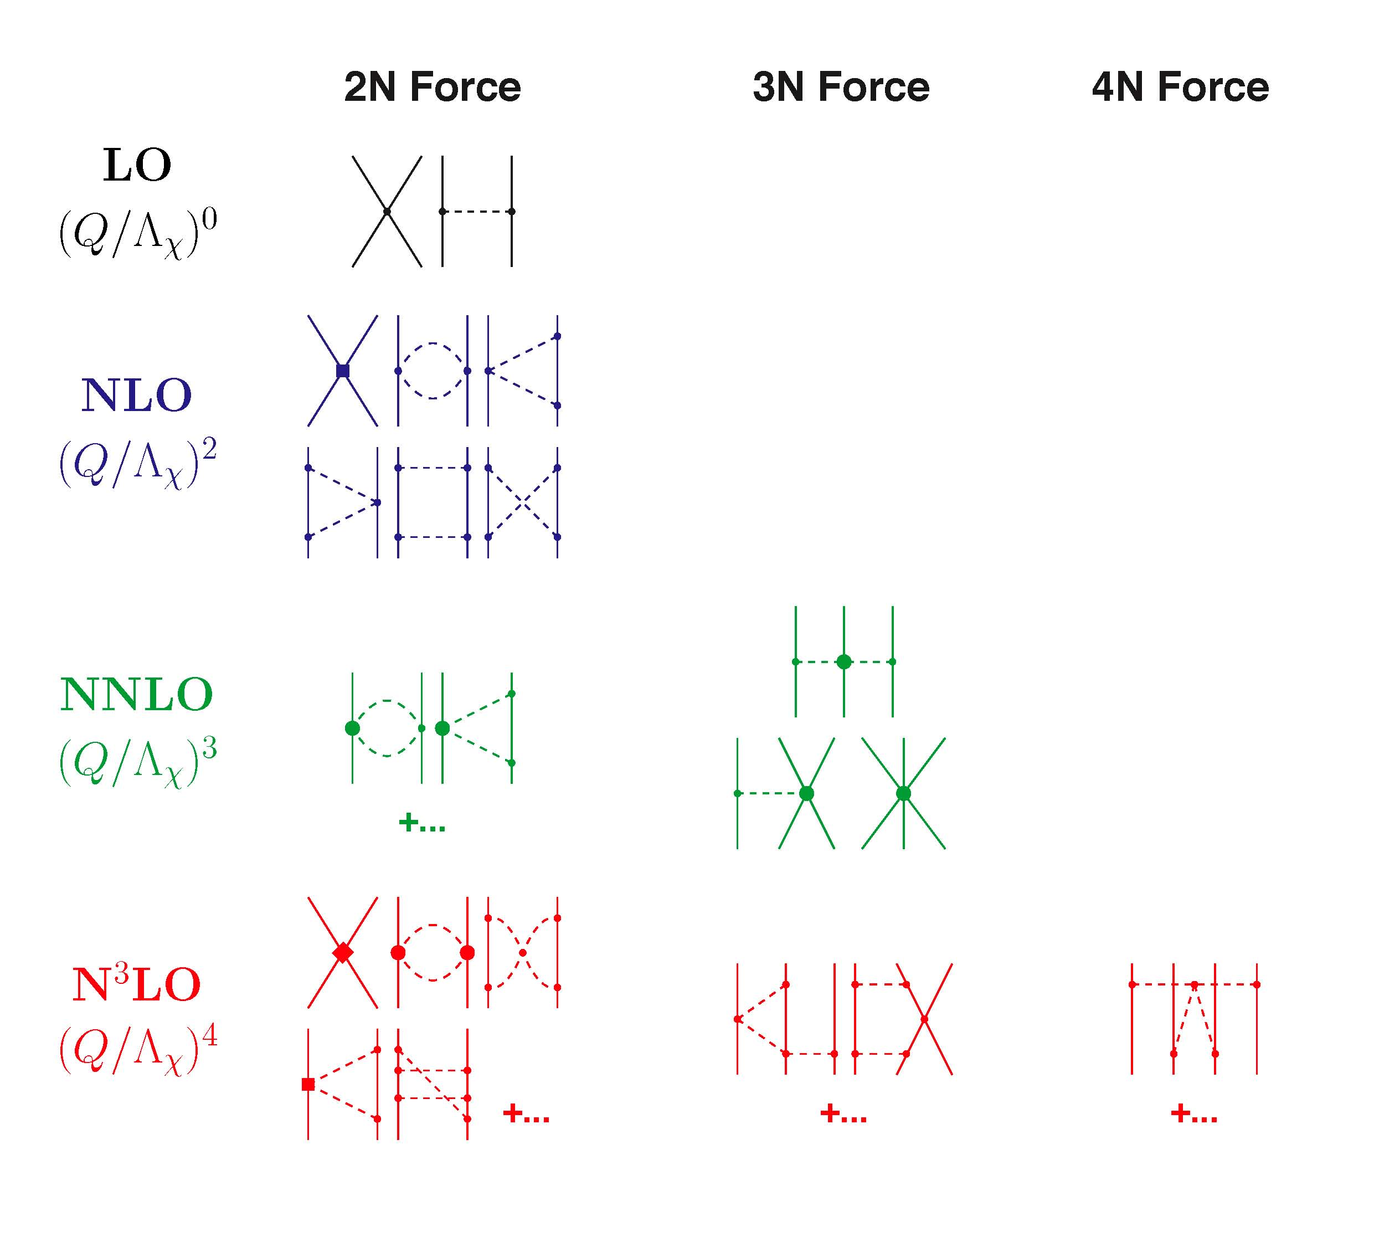
Chiral EFT interactions
Chiral perturbation theory (ChpT)
hierarchy of nuclear forces
systematic improvements
many-body forces
several fitting strategies
N²LO_{sat}
Ekström A. et al., Phys. Rev C 91, 051301 (2015)
∆ -full nuclear interactions
(Gothenburg–Oak Ridge)
∆N²LOGO(394), ∆N²LOGO(450)
Jiang W. G. et al., Phys. Rev C102,054301(2020)
N³LO_{texas}
Hu B. S. et al., arxiv:2512.11723 (2025)
→ different predictions for many-body
systems
LEC‘s have to be fitted to selected set of experimental data

Slide 5
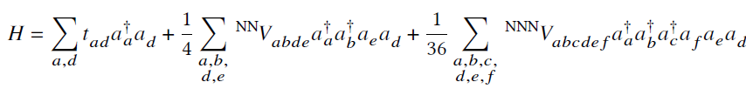
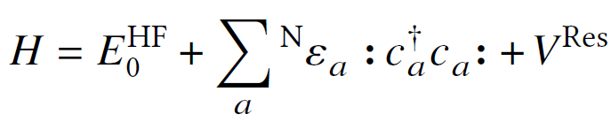
Mean-field and beyond …
intrinsic Hamiltonian with NN+NNN interactions
reference state → Hartree-Fock approximation (HF)
residual interaction → correlations
ground state properties → many-body Perturbation Theory (MBTP), Coupled cluster, Greens-function methods,
In Medium Similarity Renormalisation Group (IMSRG)
excited states and response functions, GRs → Greens function methods, LIT-Coupled cluster
Renormalized Random Phase Approximation (RRPA)

Slide 6

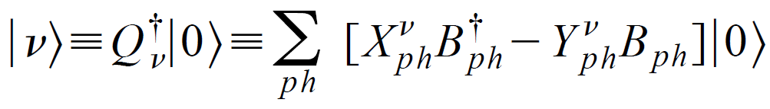
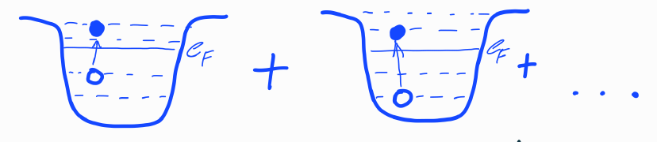


Random Phase Approximation (RPA)
Equation of motion:
Quasiboson approximation : valid if correlations are small
What if correlations are strong? → correlated g.s. → fully self-consistent RPA (SCRPA)
D. J. Rowe, Rev. Mod. Phys 40, 153 (1968), P. Schuck et al., Physics Reports 929, 1-84 (2021)

Slide 7
Renormalized Random Phase Approximation (RRPA)
Renormalized RPA - simplified version of SCRPA
different names in literature: Improved RPA (IRPA), or Extended RPA (ERPA)
metallic clusters
Catara F., Piccito G., Sambataro M. and Van Giai N., Phys. Rev. B 54, 17536 (1996)
Catara F. et al. , Phys. Rev. B 58, 16070 (1998)
Voronov V. et al., Phys. Part. Nucl. 31, 904 (2000)
with UCOM potential
P. Papakonstantinou, R. Roth, and N. Paar, Phys. Rev. C 75, 014310 (2007)
application with chiral NN+NNN potentials
R. Folprecht, F.K. et al., Phys. Rev. C 113, L041302 (2026)

Slide 8
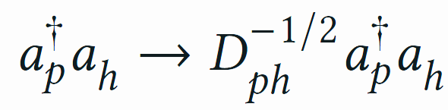
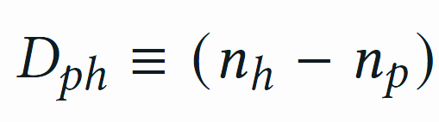

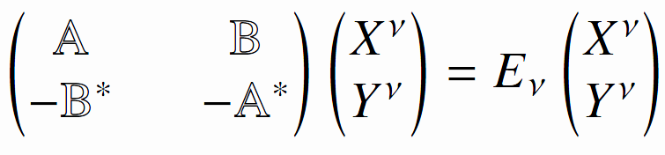
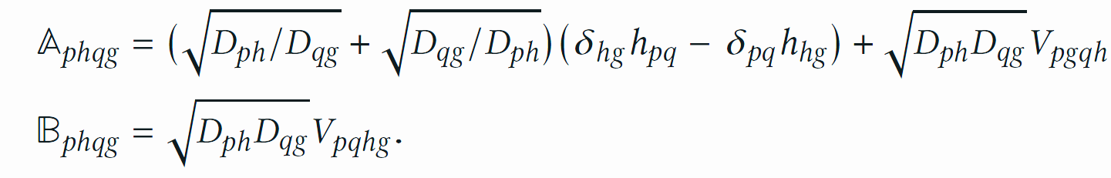
Renormalized Random Phase Approximation (RRPA)
introduction of “renormalized” ph operators → expansion of one-body densities in terms of Y amplitudes
RPA-like eigenvalue problem with “renormalized” interaction

Slide 9
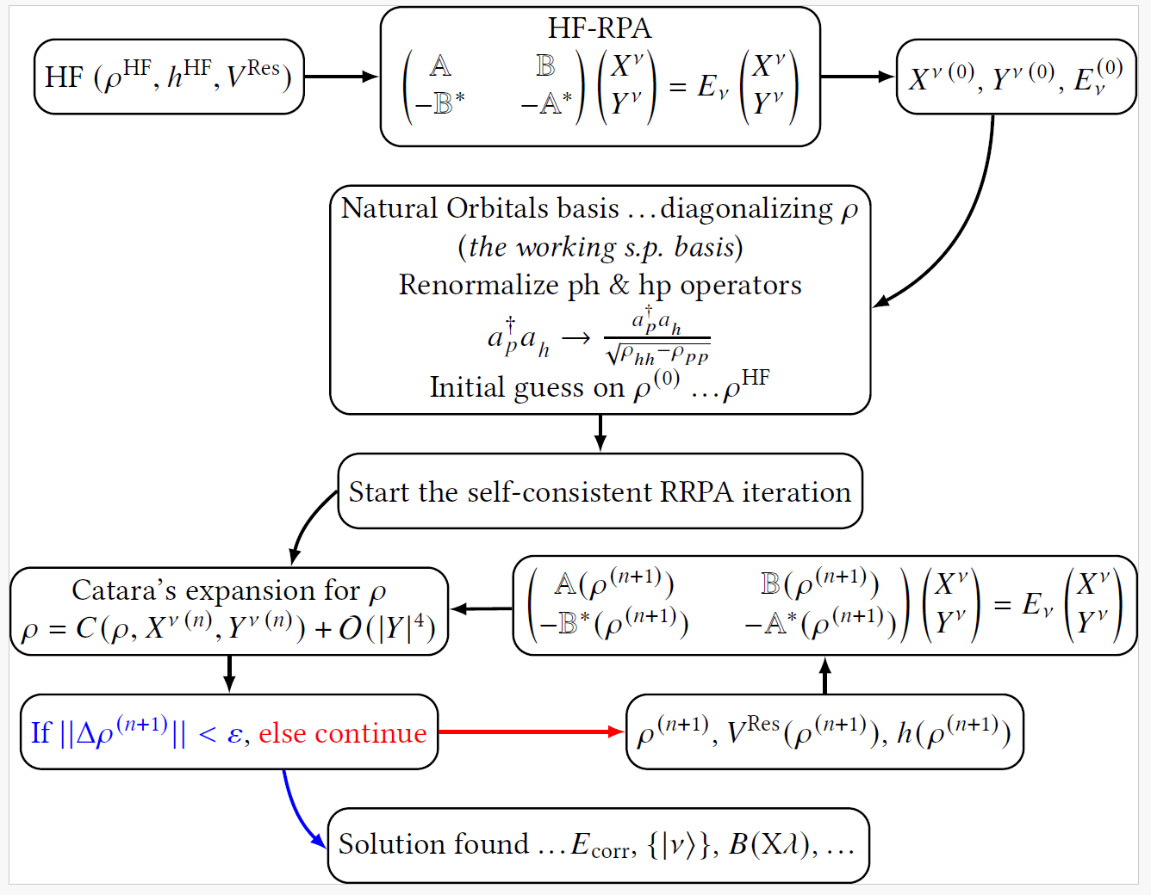
Renormalized Random Phase Approximation (RRPA)

Slide 10

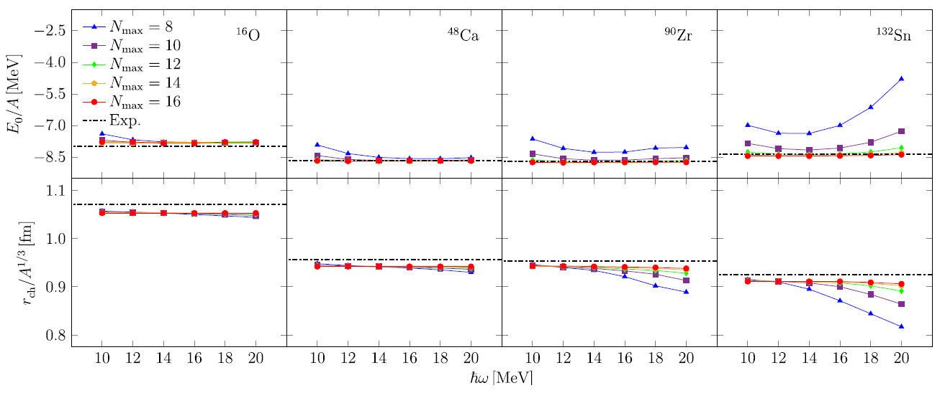
Binding energies and radii
convergence of RRPA results with increasing model space
R. Folprecht, F.K. et al., Phys. Rev. C 113, L041302 (2026)

Slide 11
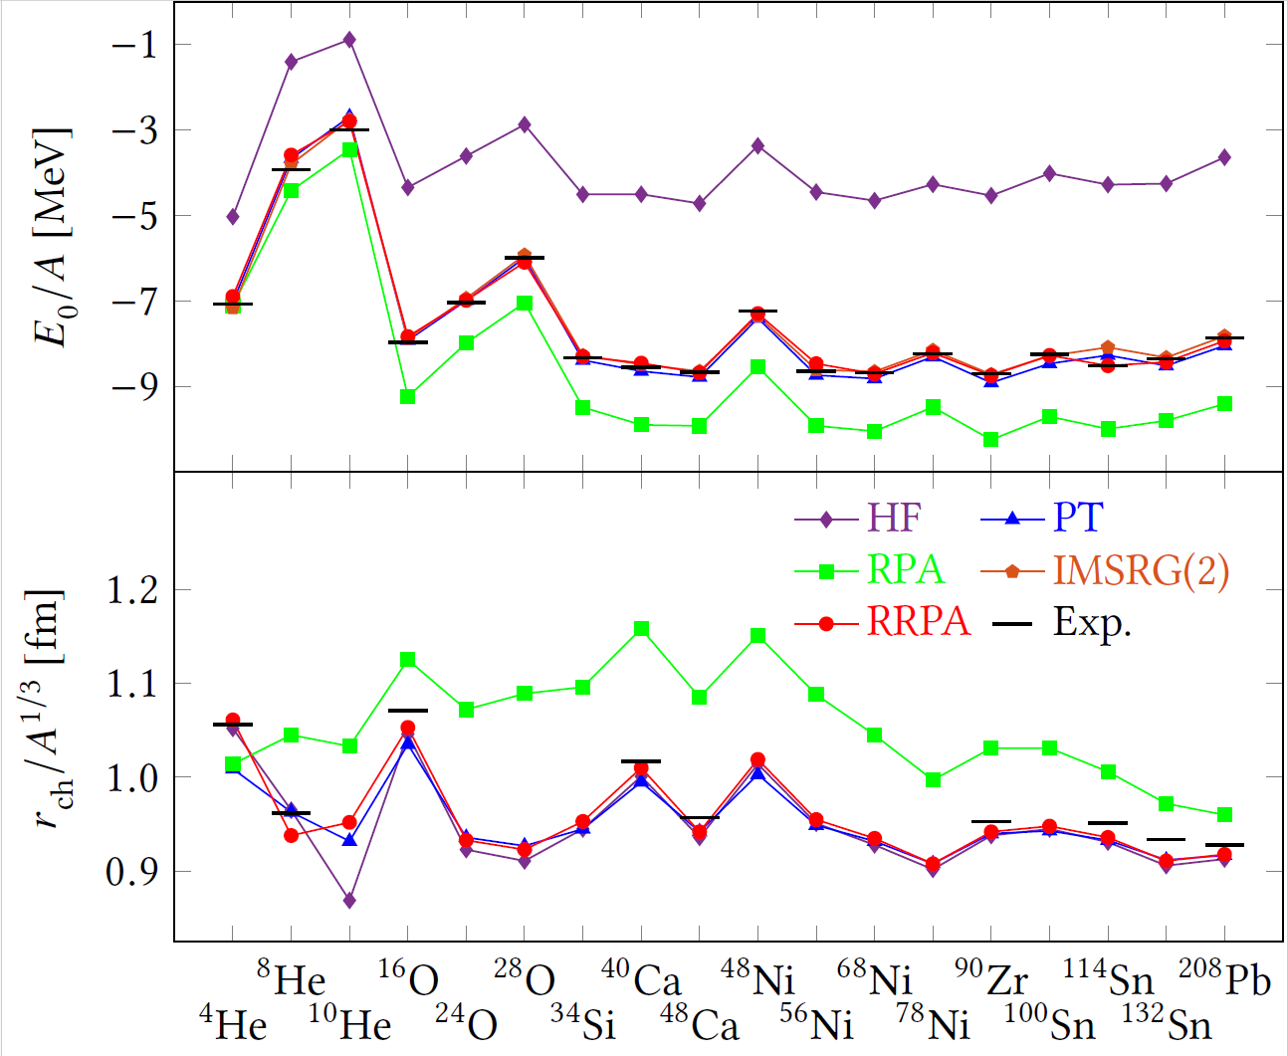

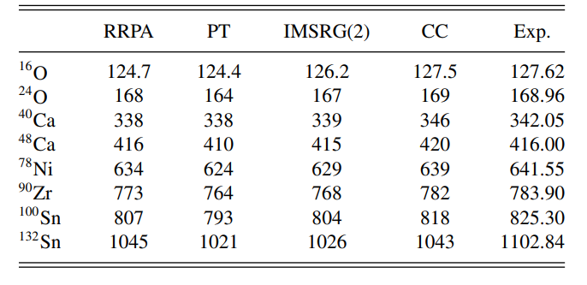
Binding energies and radii
N_{max}=14, N_{3max}=28
ℏω=12 MeV
RRPA results for binding energies and radii
comparable to IMSRG(2) and PT calculations
R. Folprecht, F.K. et al., Phys. Rev. C 113, L041302 (2026)

Slide 12
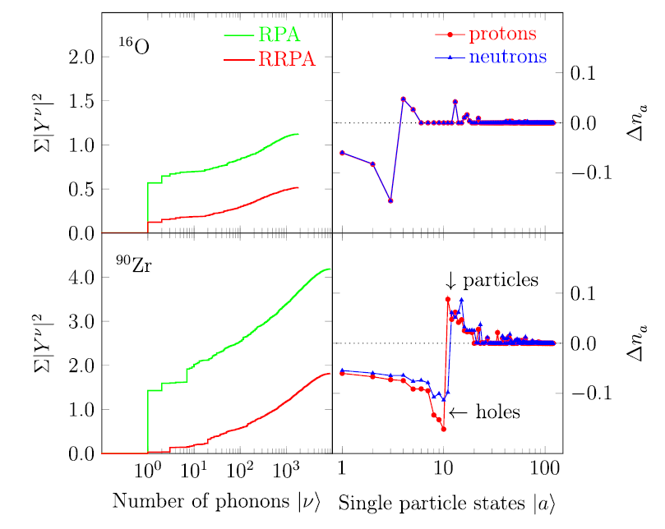

Single-particle occupations
depletion of single-particle occupations
renormalization of phonon amplitudes
R. Folprecht, F.K. et al., Phys. Rev. C 113, L041302 (2026)

Slide 13
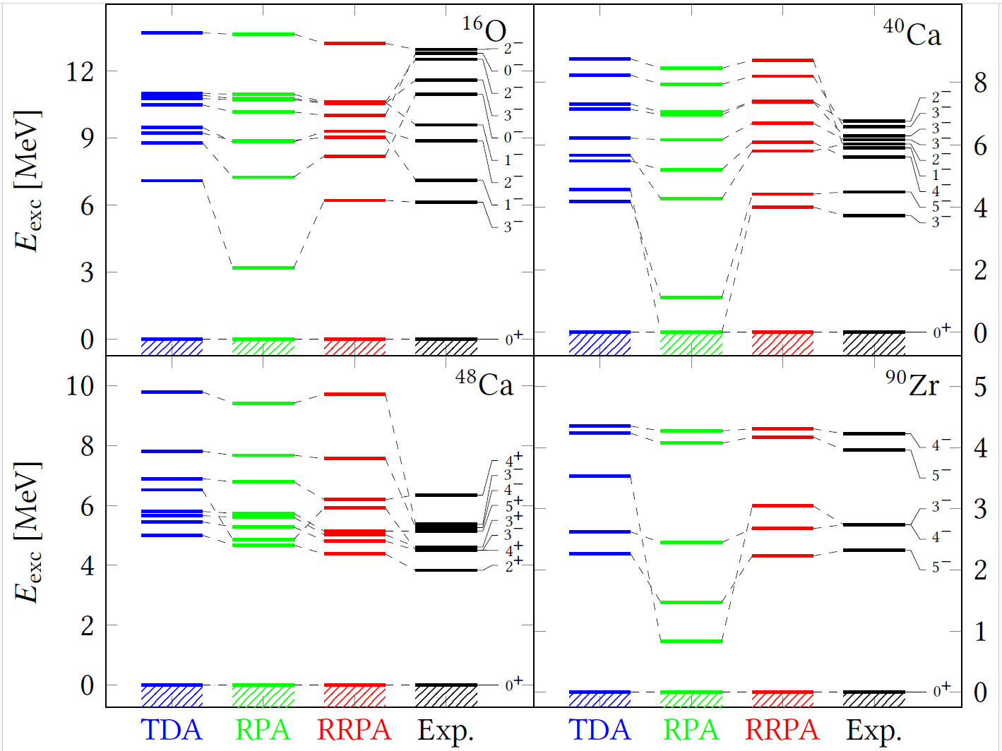
Low-lying levels
collapse of specific levels observed in RPA is cured in RRPA
R. Folprecht, F.K. et al., Phys. Rev. C 113, L041302 (2026)

Slide 14
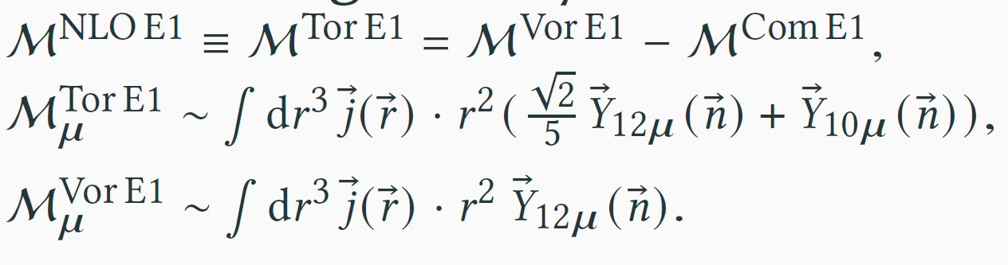
Structure of dipole states
expansion of transition dipole operator
general treatment of vortical, toroidal and compression modes
J.Kvasil et al., Phys. Rev. C 84, 034303 (2011)
toroidal E1 operator can be expressed as combination of vortical and compressional operators

Slide 15
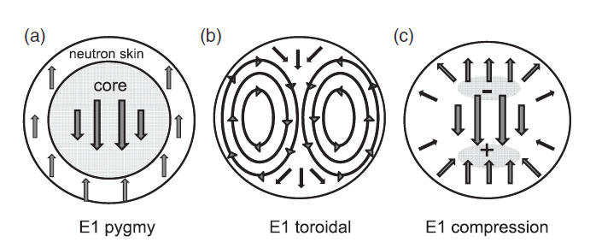
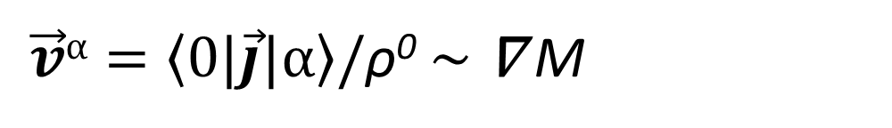
Structure of dipole states
more details about structure we can see from ”velocity fields” (current transition densities)
toroidal (vortical) nature of low-energy E1 mode in ²⁰⁸Pb studied within RPA with Skyrme forces.
A. Repko et al., Phys. Rev. C 87, 024305 (2013)
candidates of toroidal modes in ⁵⁸Ni
P. von Neumann-Cosel et al., Phys. Rev. Lett 133, 232502 (2024)
What we get within RRPA with chiral interactions?
$\vec{v}α=\left\langle 0|\vec{j}|α\right\rangle$/ρ⁰ $∼$ ∇ M

Slide 16
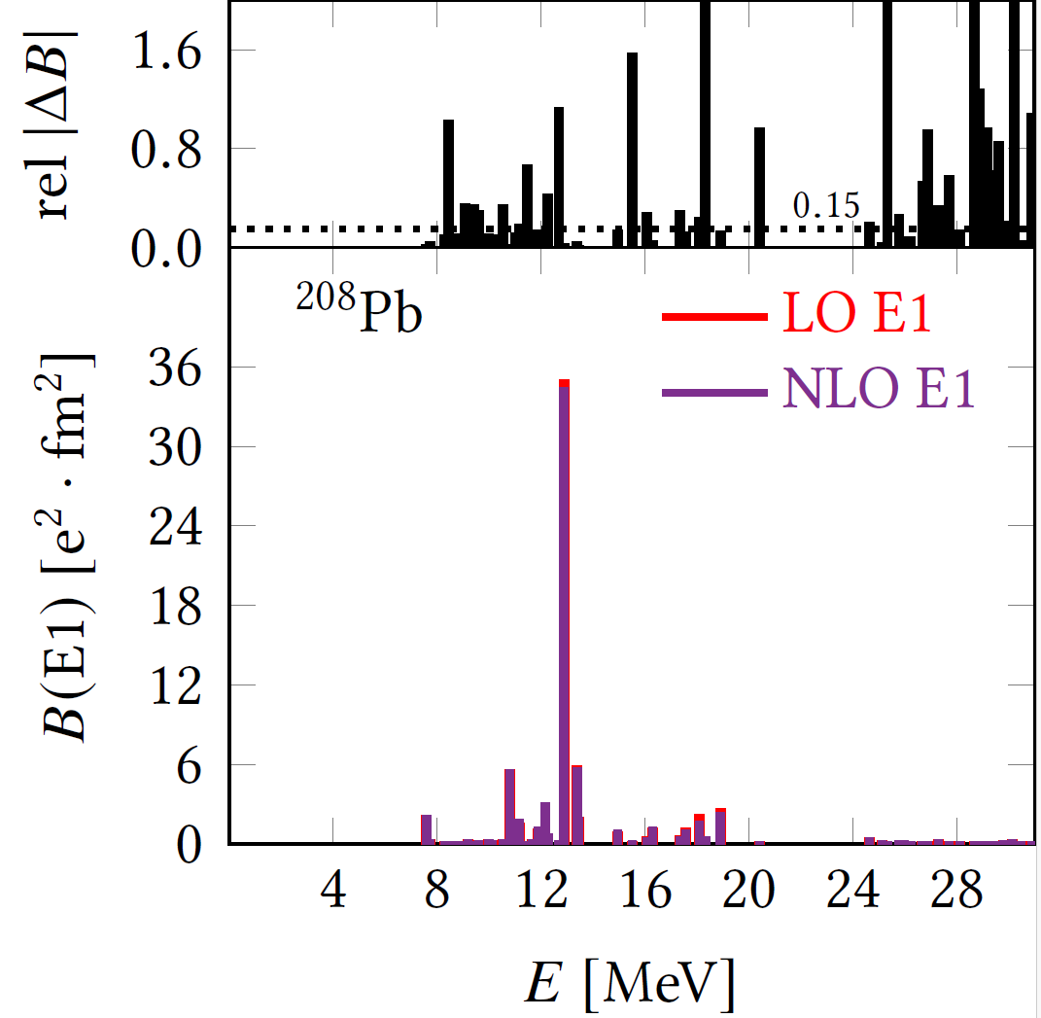
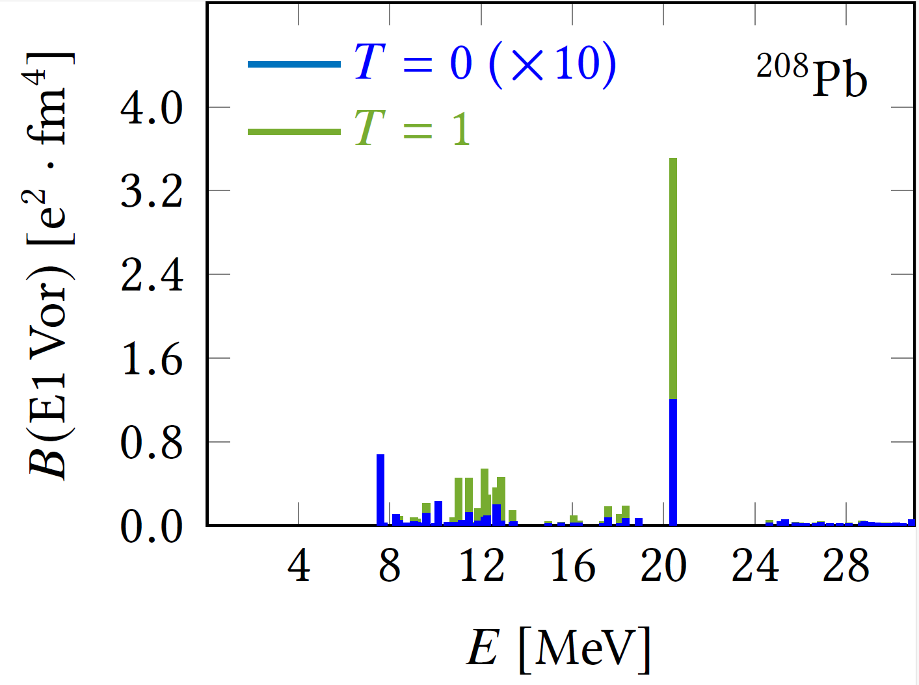
Structure of dipole states

Slide 17
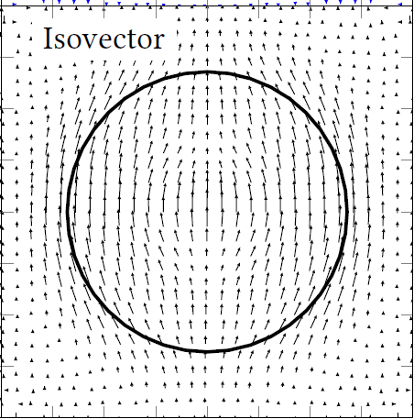
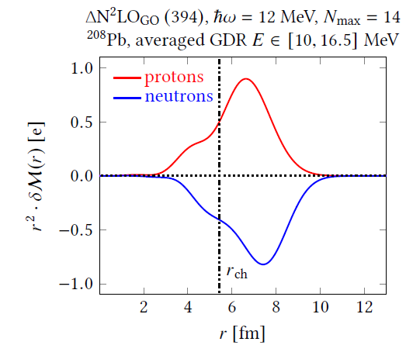
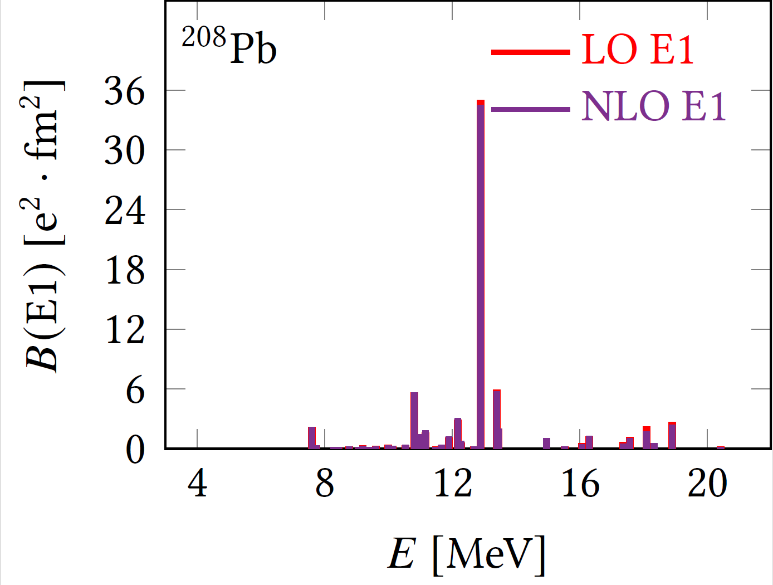
Structure of dipole states

Slide 18
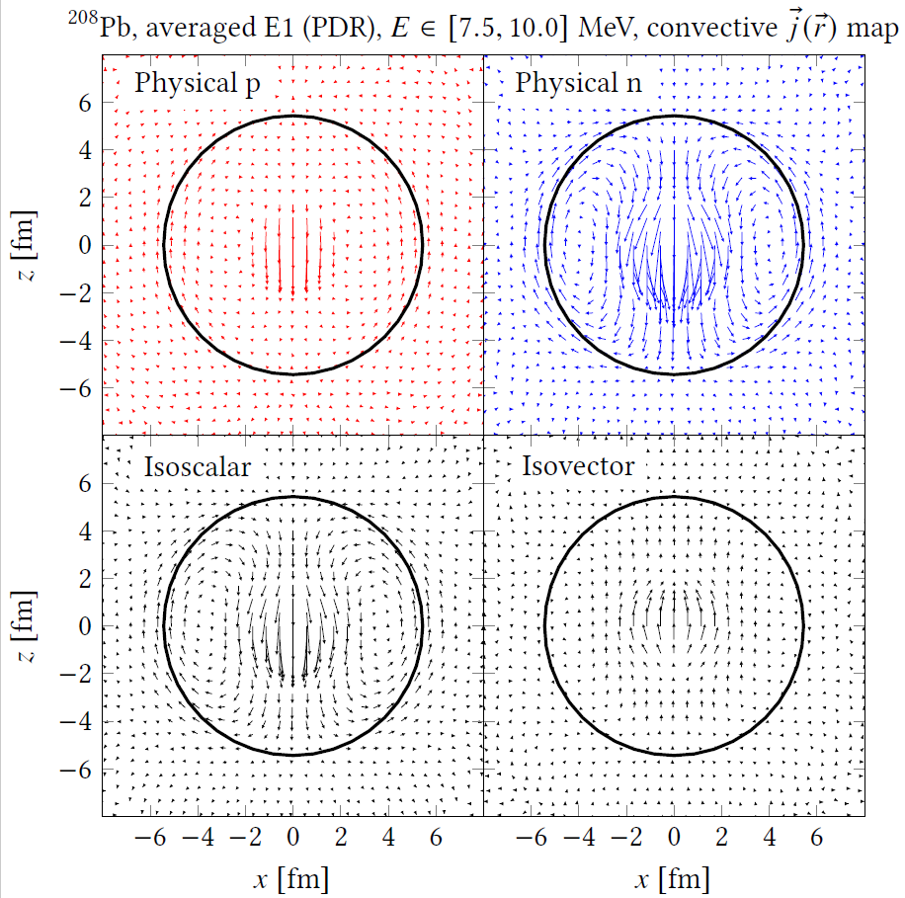
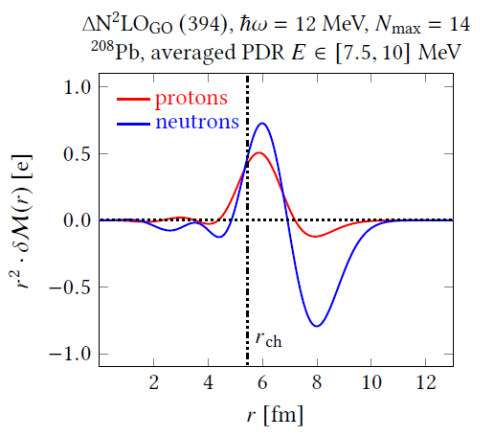
Structure of dipole states

Slide 19
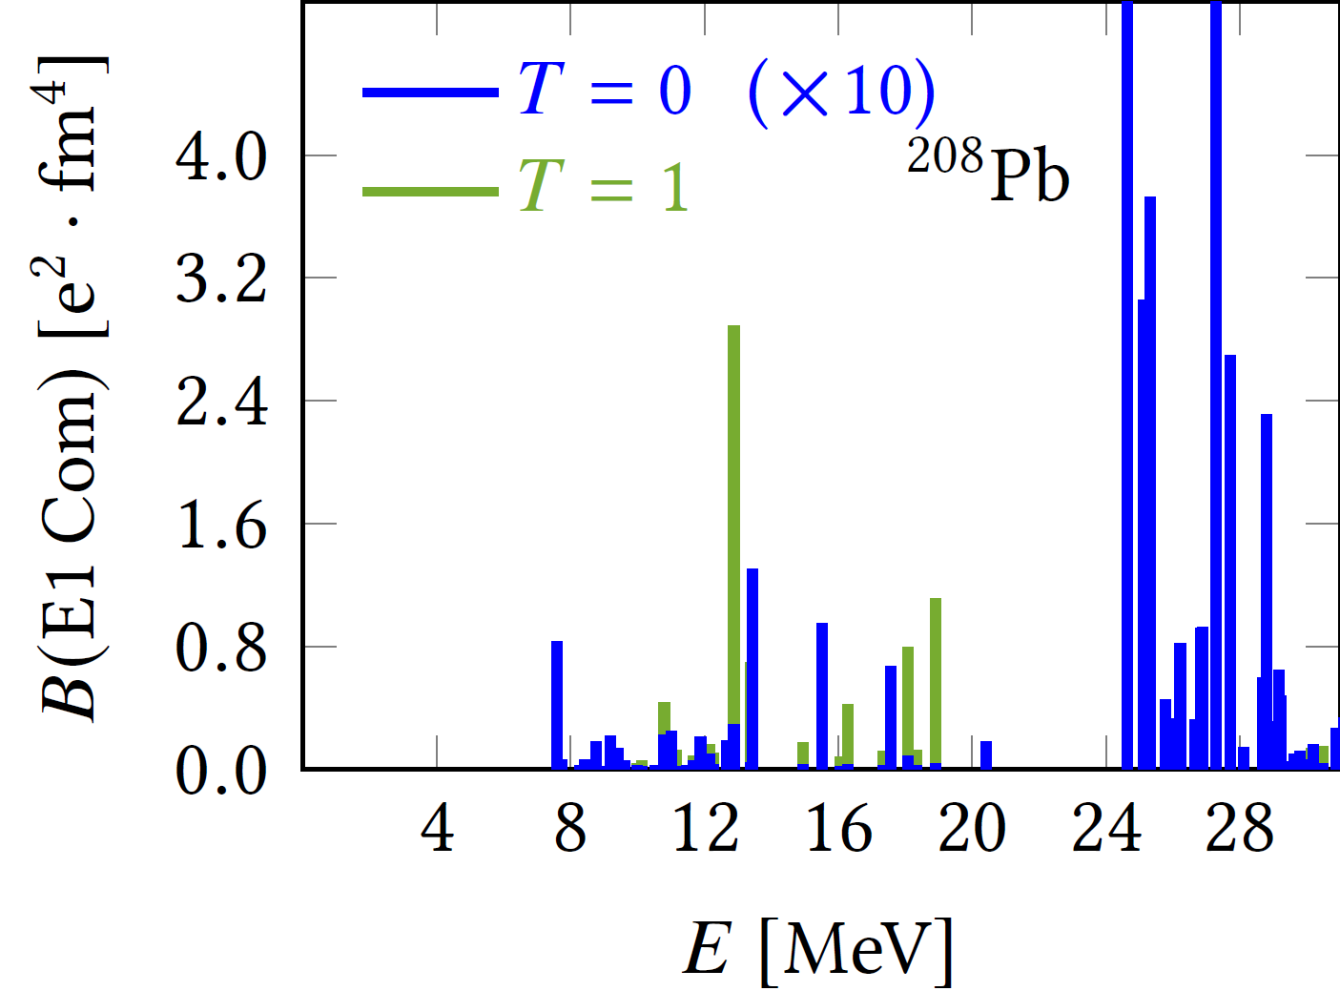
Structure of dipole states
compressional strength distribution

Slide 20
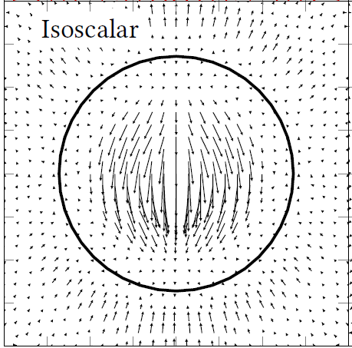
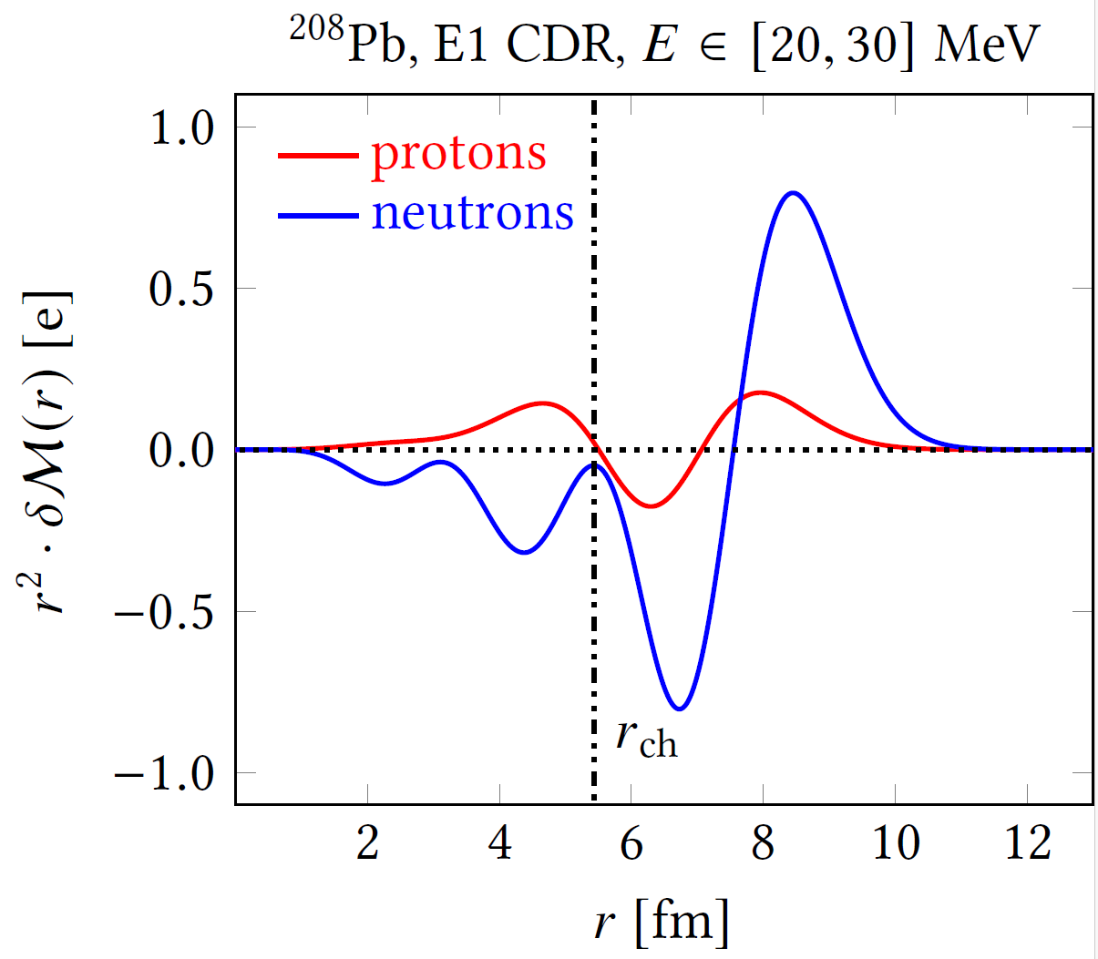
Structure of dipole states

Slide 21
Summary
first implementation of RRPA with NN+NNN chiral potentials
significant improvement with respect to RPA, reasonable description of correlation energies and some low-lying levels and gross properties of GDRs in spherical closed subshell nuclei
toroidal (vortical) character of specific low-lying dipole states
Plans:
systematic calculations with various NN+NNN potentials
quasiparticle extension (see poster of R. Folprecht )
inclusion of “complex” configurations

Slide 22
Collaborators
R. Folprecht
Charles University, Prague, Czechia
G. De Gregorio
INFN & Università degli Studi della Campania "Luigi Vanvitelli„, Italy
N. Lo Iudice
Università di Napoli Federico II, Italy
P. Veselý
Institute of Nuclear Physics, Řež, Czechia

Slide 23
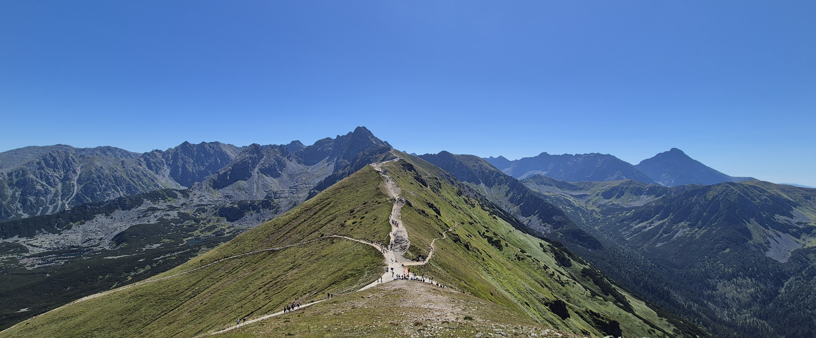
Thank you for you attention!

Slide 24
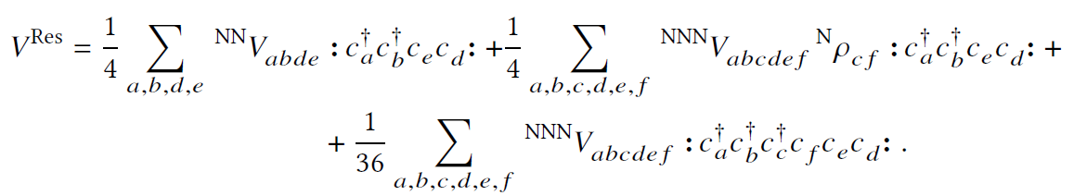
NN and NNN interactions
NuHamil : A numerical code to generate nuclear two- and three-body matrix elements from chiral effective field theory, Miyagi T., Eur. Phys. J. A (2023) 59:150
spherical HO basis – model space given by the HO principal quantum number N_{max} (number of used major shells-1), typically N_{max}=14-16
for practical reasons NNN space must be truncated
normal-ordered 2-body Approximation → clever storage of NNN matrix elements up to N_{3max}=N₁+N₂+N₃ ≤ 28
Miyagi T. , Stroberg S. R., Navrátil P., Hebeler K., and Holt J. D., Phys. Rev. C 105, 014302 (2022).

Slide 25
Backup slides

Slide 26
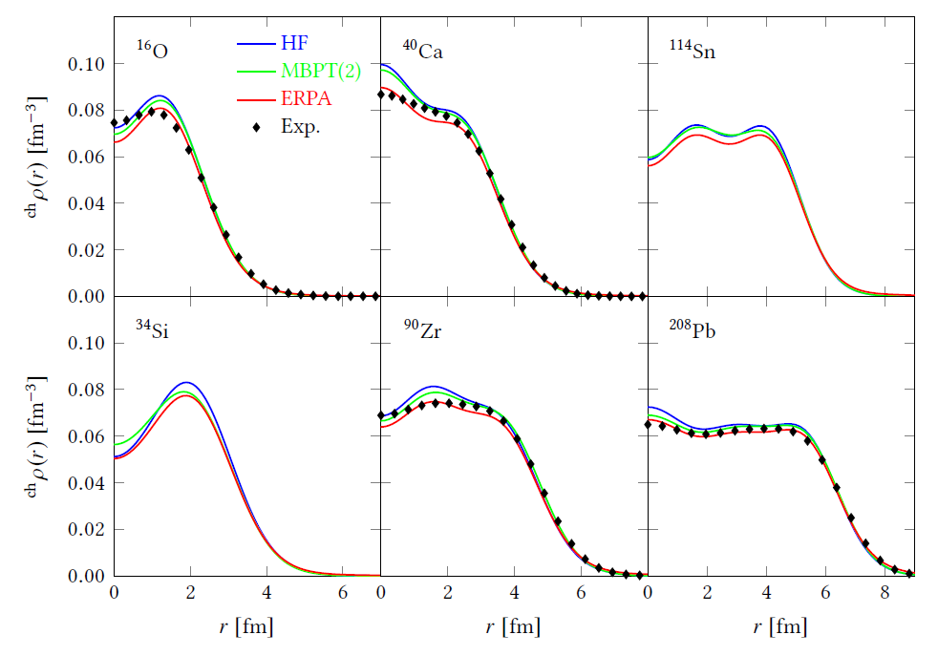

Charged densities
ℏω=12 MeV N_{max}=14, N_{3max}=28

Slide 27
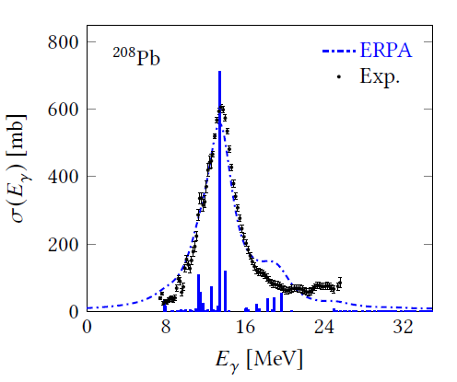


Giant dipole resonance
ℏω=12 MeV N_{max}=14, N_{3max}=28

Slide 28
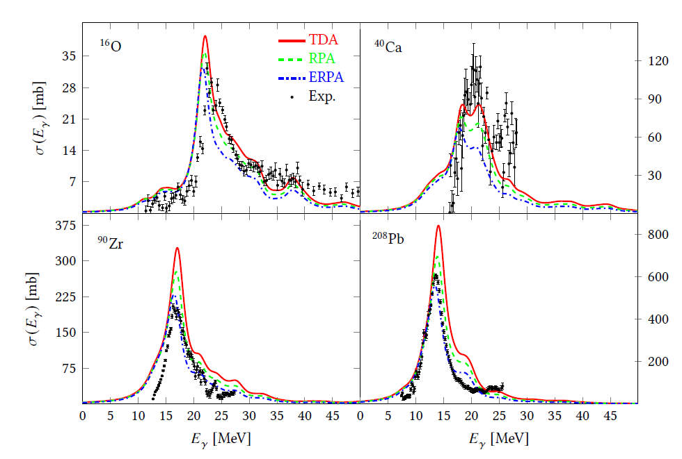
Giant dipole resonance
ℏω=12 MeV N_{max}=14, N_{3max}=28

Slide 29
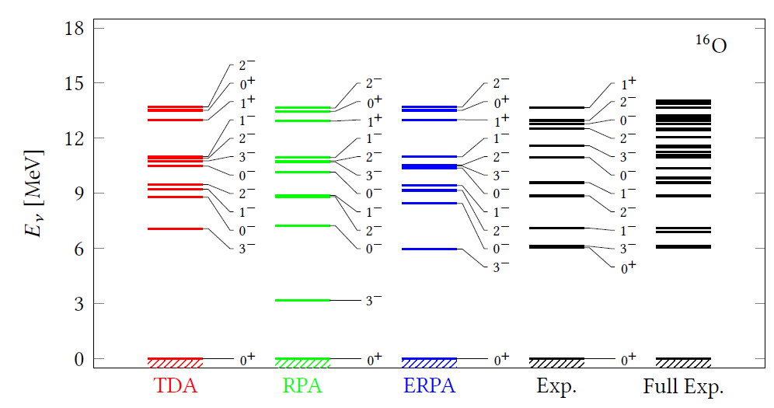
Low-energy spectra

Slide 30
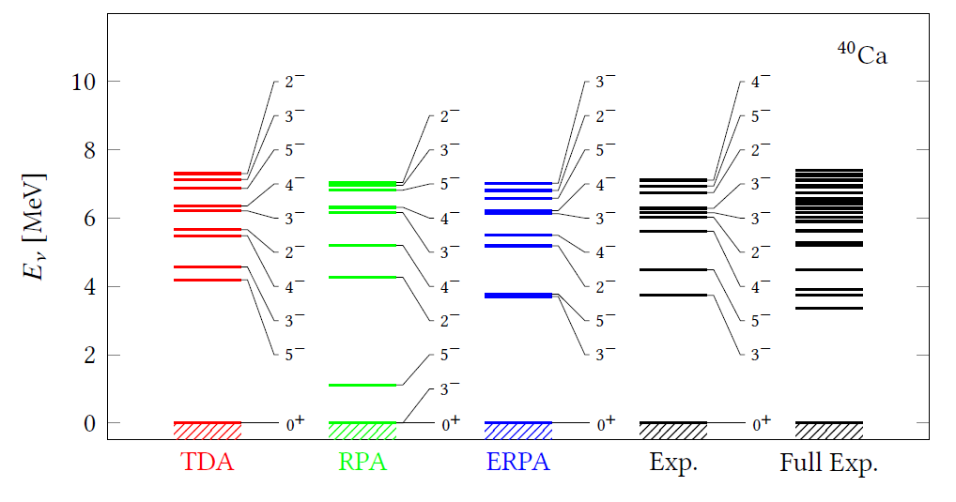
Low-energy spectra

Slide 31
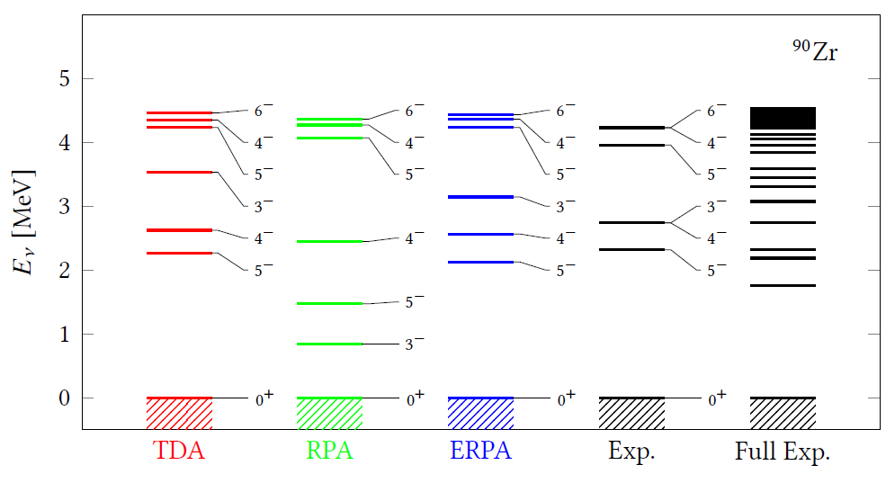
Low-energy spectra

Slide 32
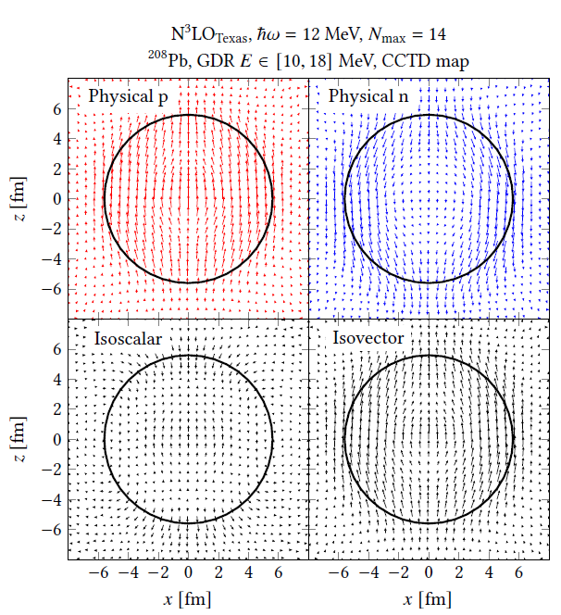
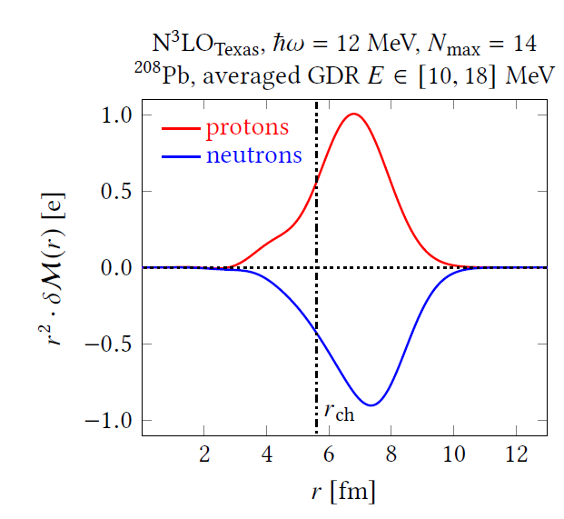
Structure of dipole states

Slide 33
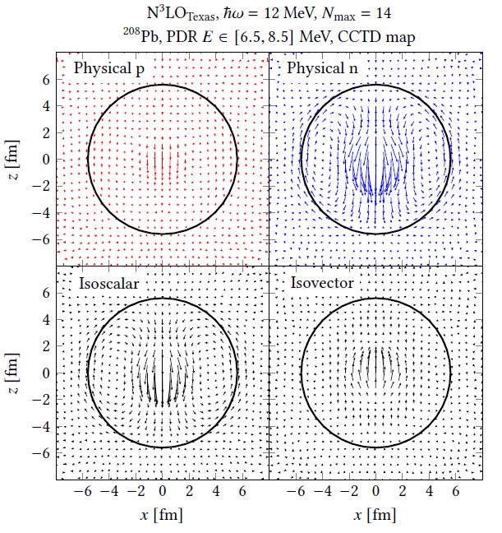
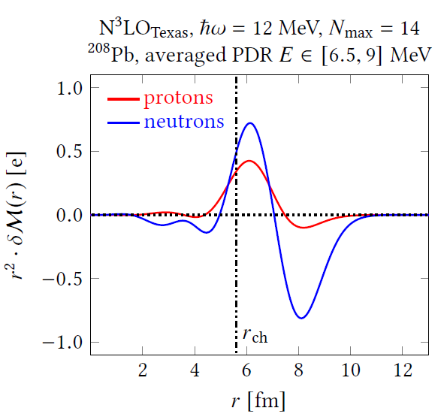
Structure of dipole states

Slide 34
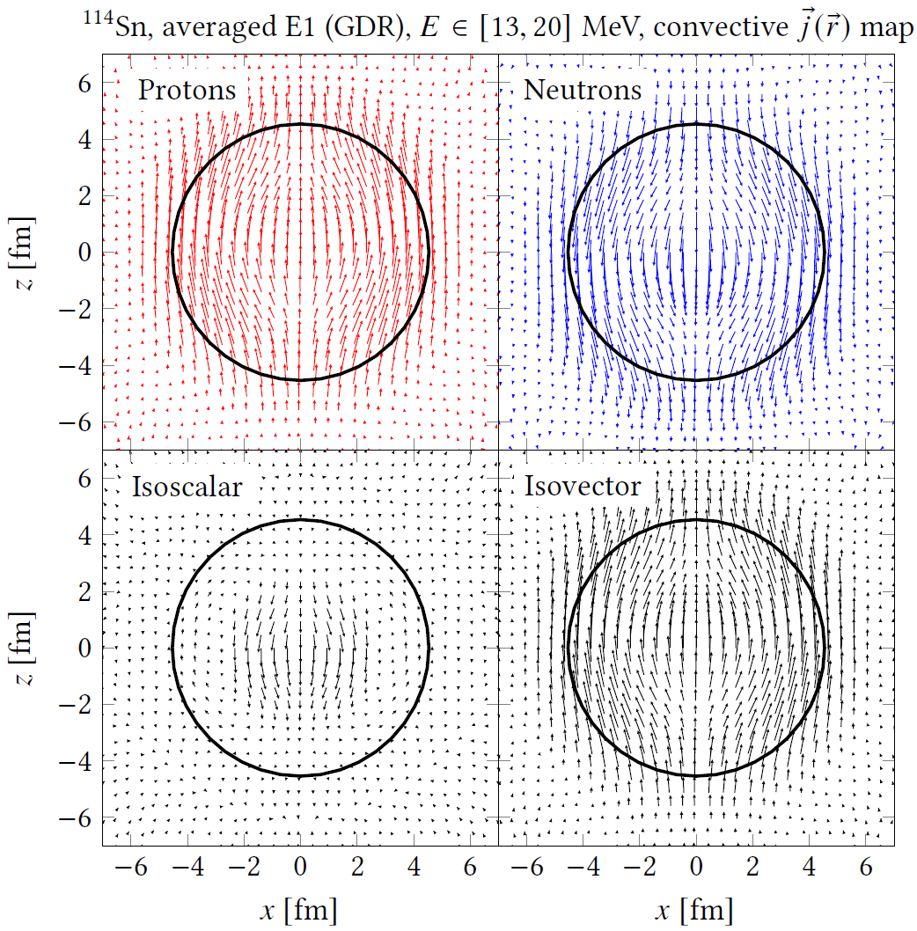
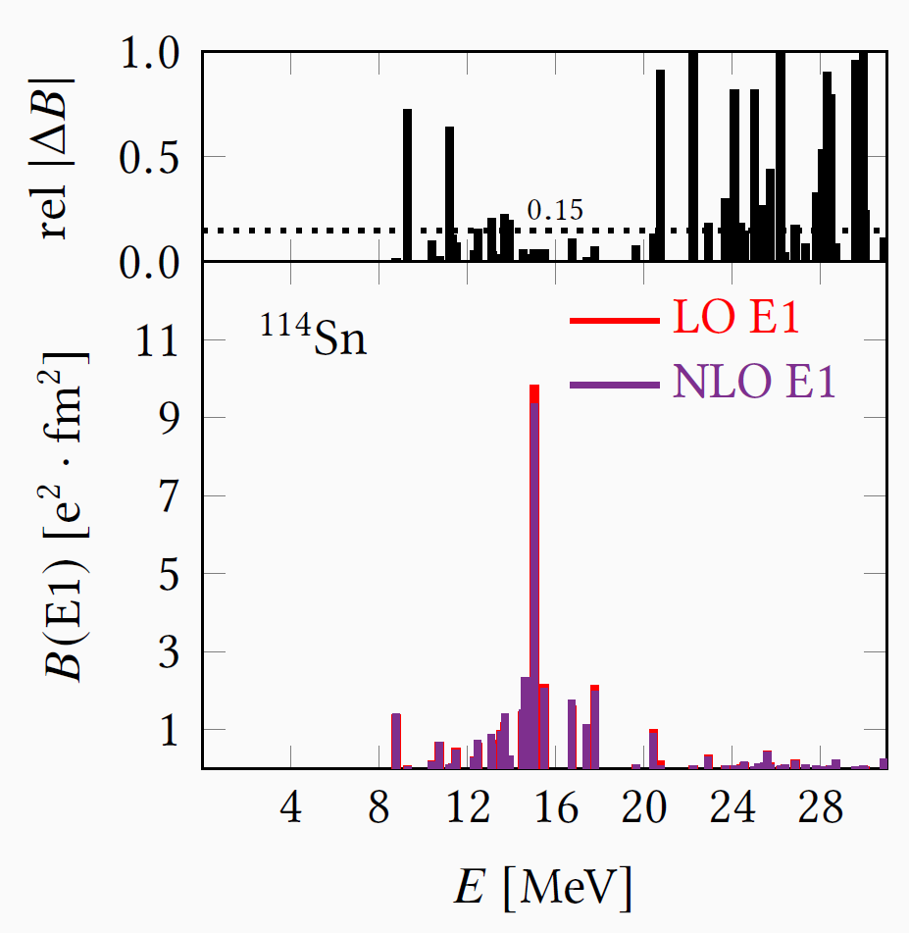
Structure of dipole states

Slide 35
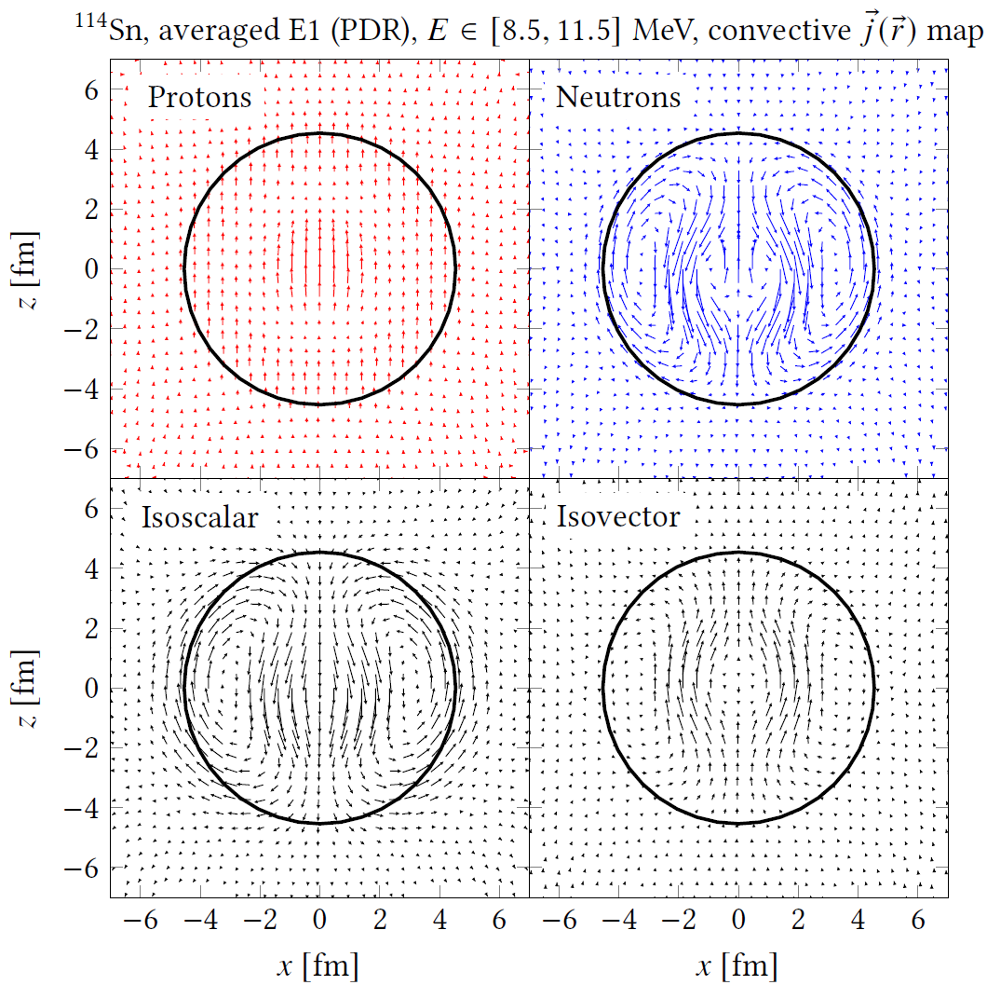
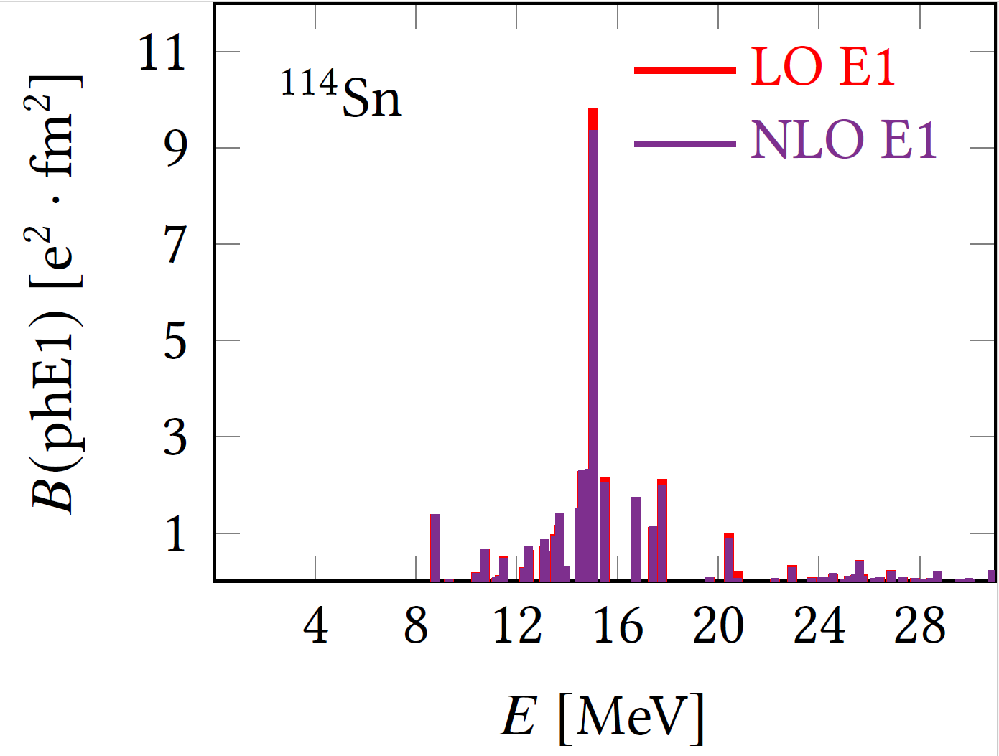
Structure of dipole states

