Slide 1
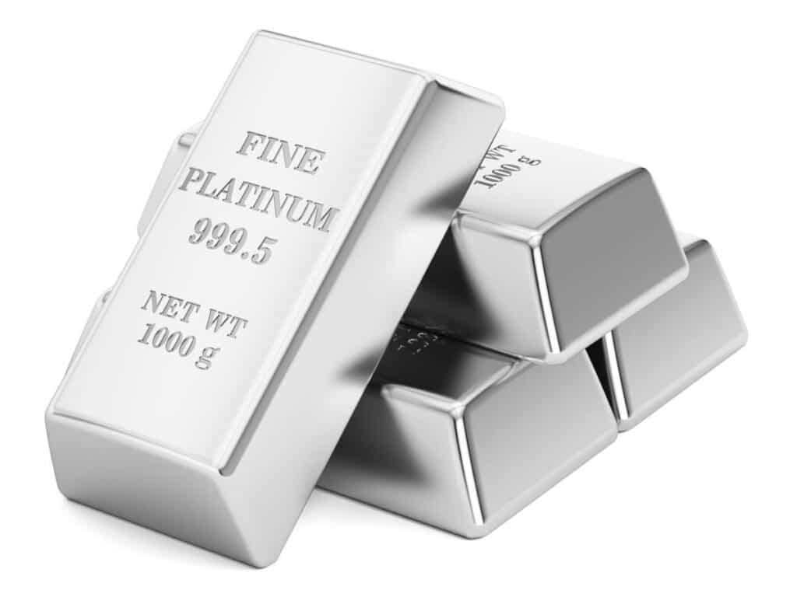

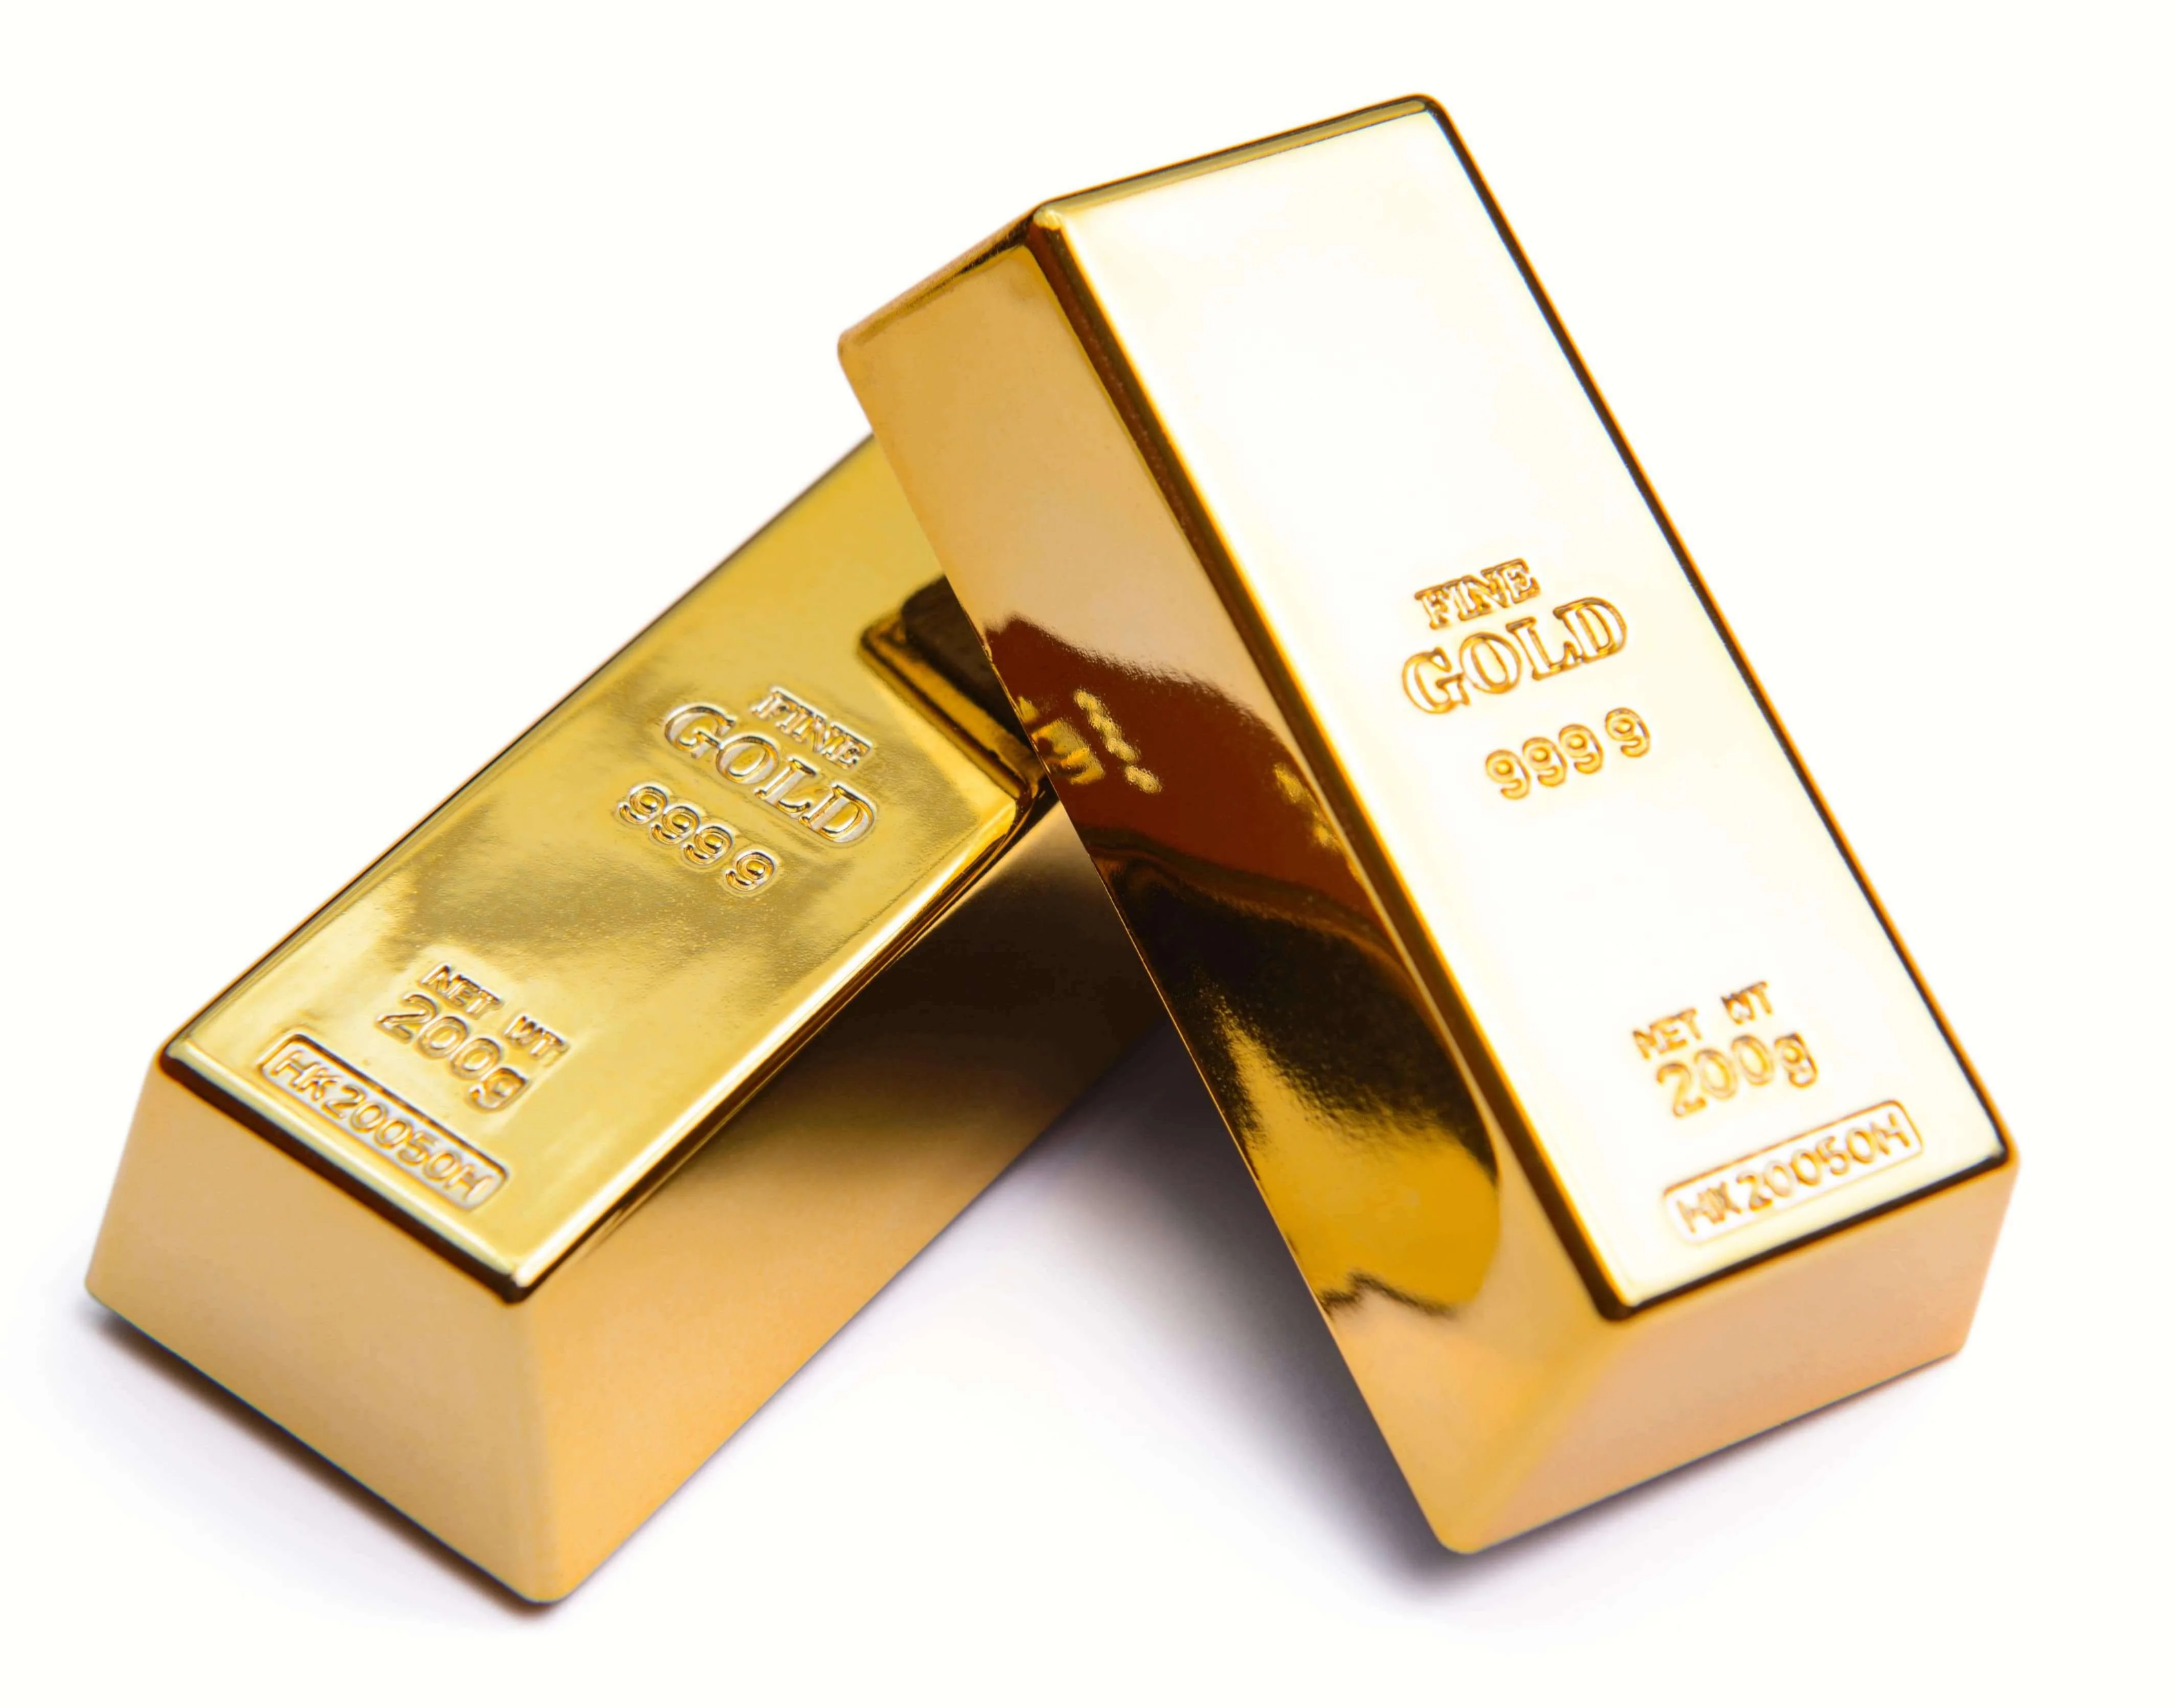
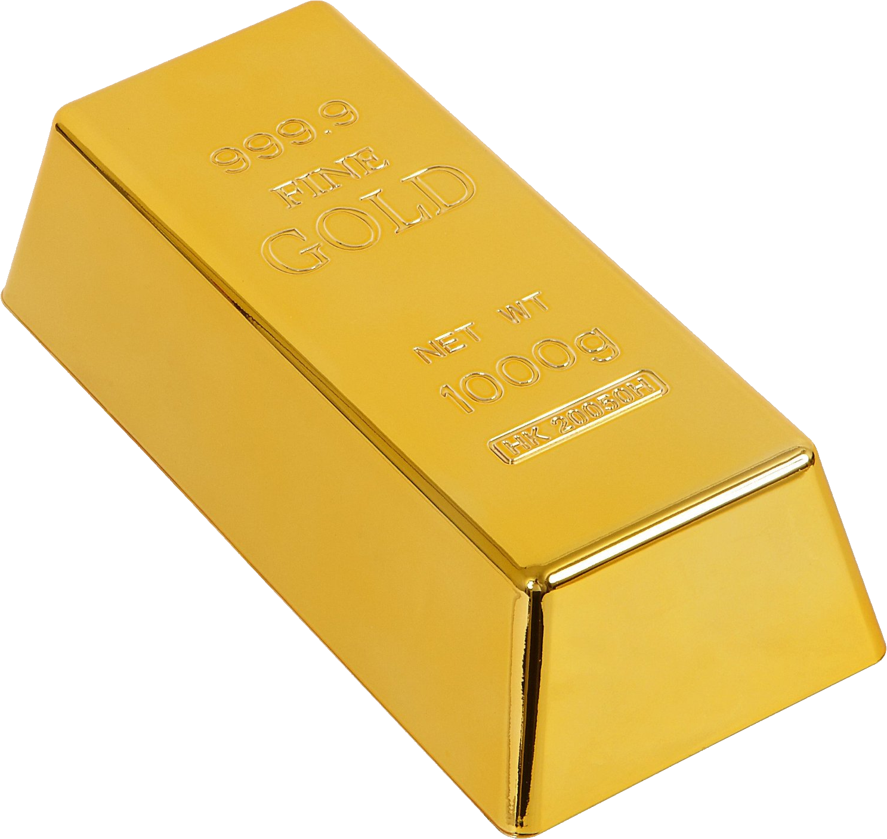



Investigation of coexisting structures in ¹⁸²Pt via detailed $β$-decay studies of ¹⁸²Au
Zakopane Conference on Nuclear Physics 2026
Jozef Mišt
on behalf of the Bratislava-York-KU Leuven, IS665 and IDS collaboration

Slide 2
Introduction
Deformation → key property of atomic nuclei
Shape coexistence
  Competition between different shapes at low excitation energy
  Prominent near shell closures of one nucleon type and mid-shell of another
P. Möller et al., At. Data. Nucl. Data Tables 109, 1 (2016)
with ¹⁸²Au and ¹⁸²Pt
K. Heyde and J. Wood, Rev. Mod. Phys. 83, 1467 (2011)
Notes:
Deformation and shape

Slide 3
Shape coexistence
Possible interpretation via intruder states and particle-hole excitations:
  Excitation of nucleon pair above shell closure – from 0p-4h to 2p-6h for platinum
  Energy lowered by quadrupole proton-neutron interaction
normal-order
oblate
ground states
intruder
prolate
excited states
Switched for ¹⁷⁸⁻¹⁸⁶Pt
P. Gareth et al., Prog. Part. Nucl. Phys. 124, 103931 (2022)
K. Heyde and J. Wood, Rev. Mod. Phys. 83, 1467 (2011)

Slide 4
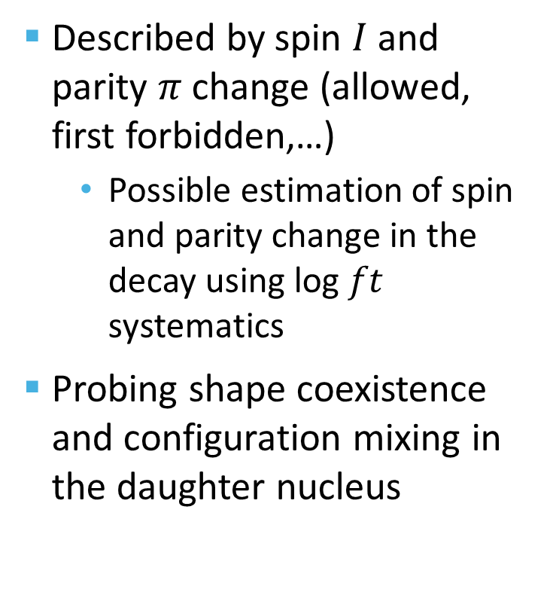
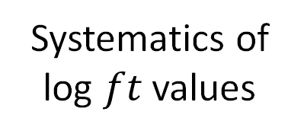
Beta decay
Described by spin $I$ and parity $π$ change (allowed, first forbidden,…)
  Possible estimation of spin and parity change in the decay using log $ft$ systematics
Probing shape coexistence and configuration mixing in the daughter nucleus
Systematics of log $ft$ values
Allowed
1st forbidden
2nd forbidden
S. Turkat et al., At. Data. Nucl. Data Tables 152, 101584 (2023)

Slide 5
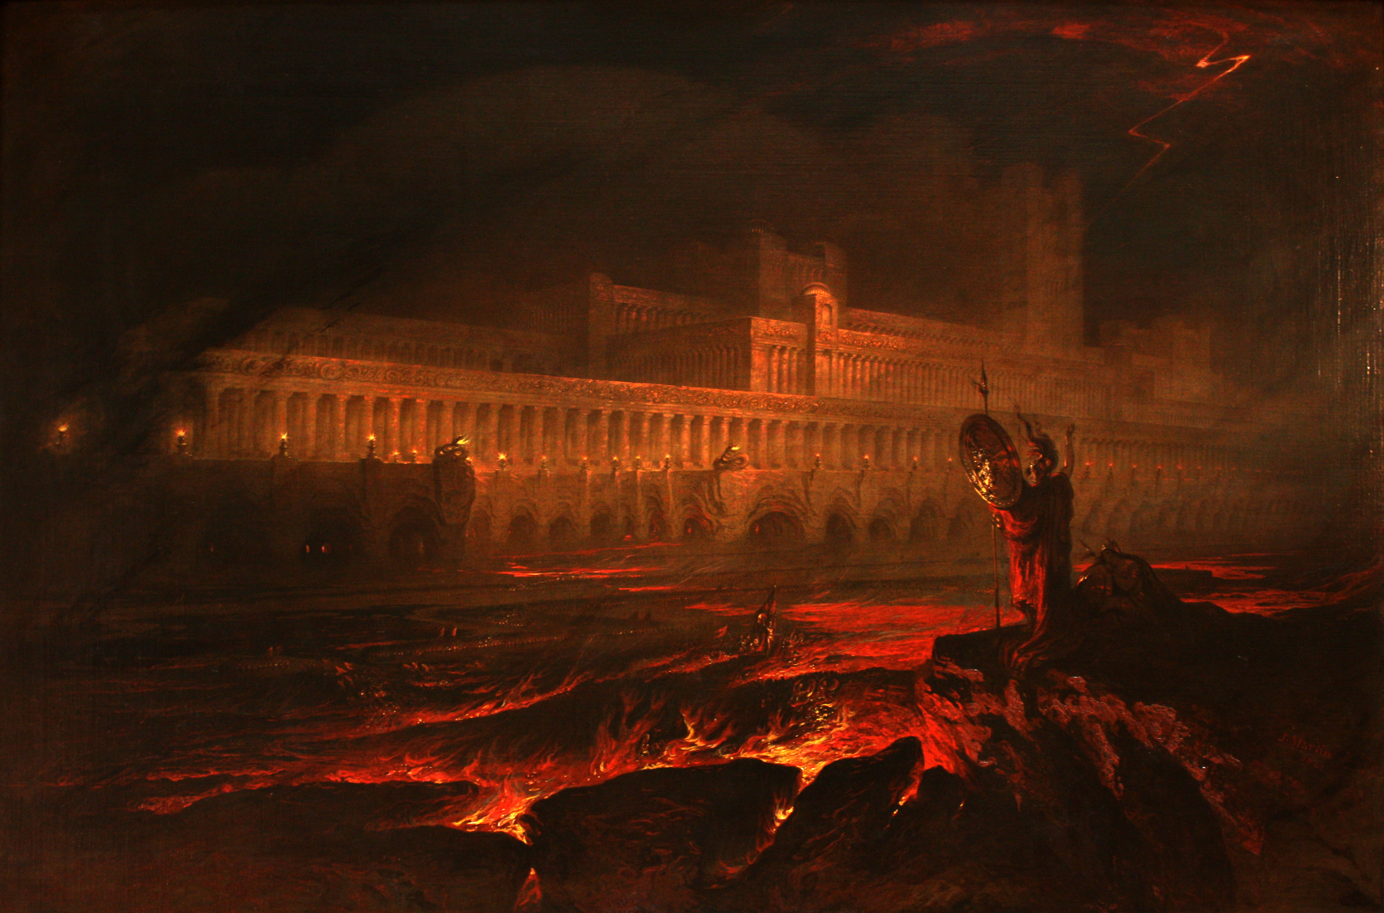
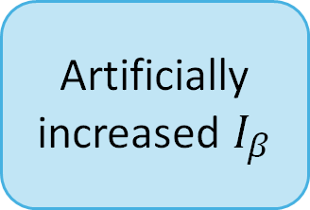
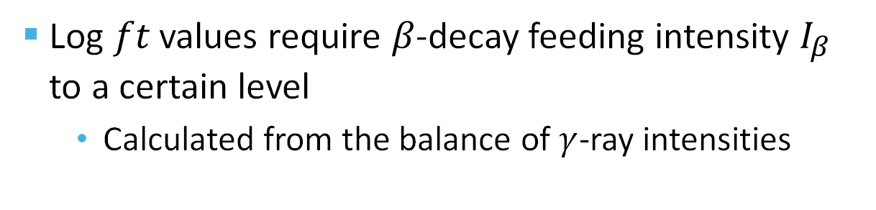
Beta decay and pandemonium effect
Log $ft$ values require $β$-decay feeding intensity $I_{β}$ to a certain level
  Calculated from the balance of $γ$-ray intensities
Influenced by the pandemonium effect
Low detection efficiency at high energy
Unobserved low-intensity transition
Artificially increased $I_{β}$
“A solemn Council forthwith to be held at Pandæmonium, the high Capitol, of Satan and his Peers“
John Milton, Paradise Lost, 1667
John Martin, Pandemonium, 1841
J. C. Hardy et al., Phys. Lett. B 71, 307 (1977)

Slide 6
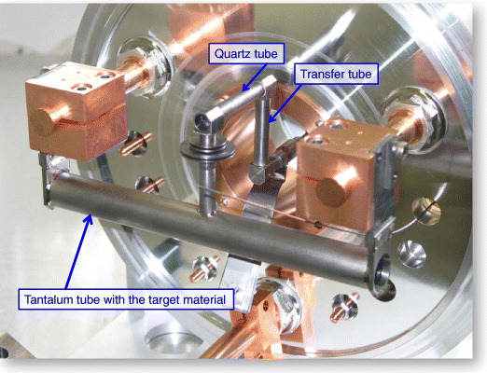
Experiment
The IS665 experiment at ISOLDE (CERN)
E. Bouquerel et al. Eur. Phys. J. Spec. Top. 150, 277 (2007)
Spallation of uranium target by 1.4 GeV protons
Laser ionization by RILIS
    Element selective
Mass separation
High purity ¹⁸²Au sample
S. Rothe et al., Nat. Commun. 4, 1835 (2013) (mod.)
B. A. Marsh et al., Hyperfine Interact. 171, 109 (2006)

Slide 7
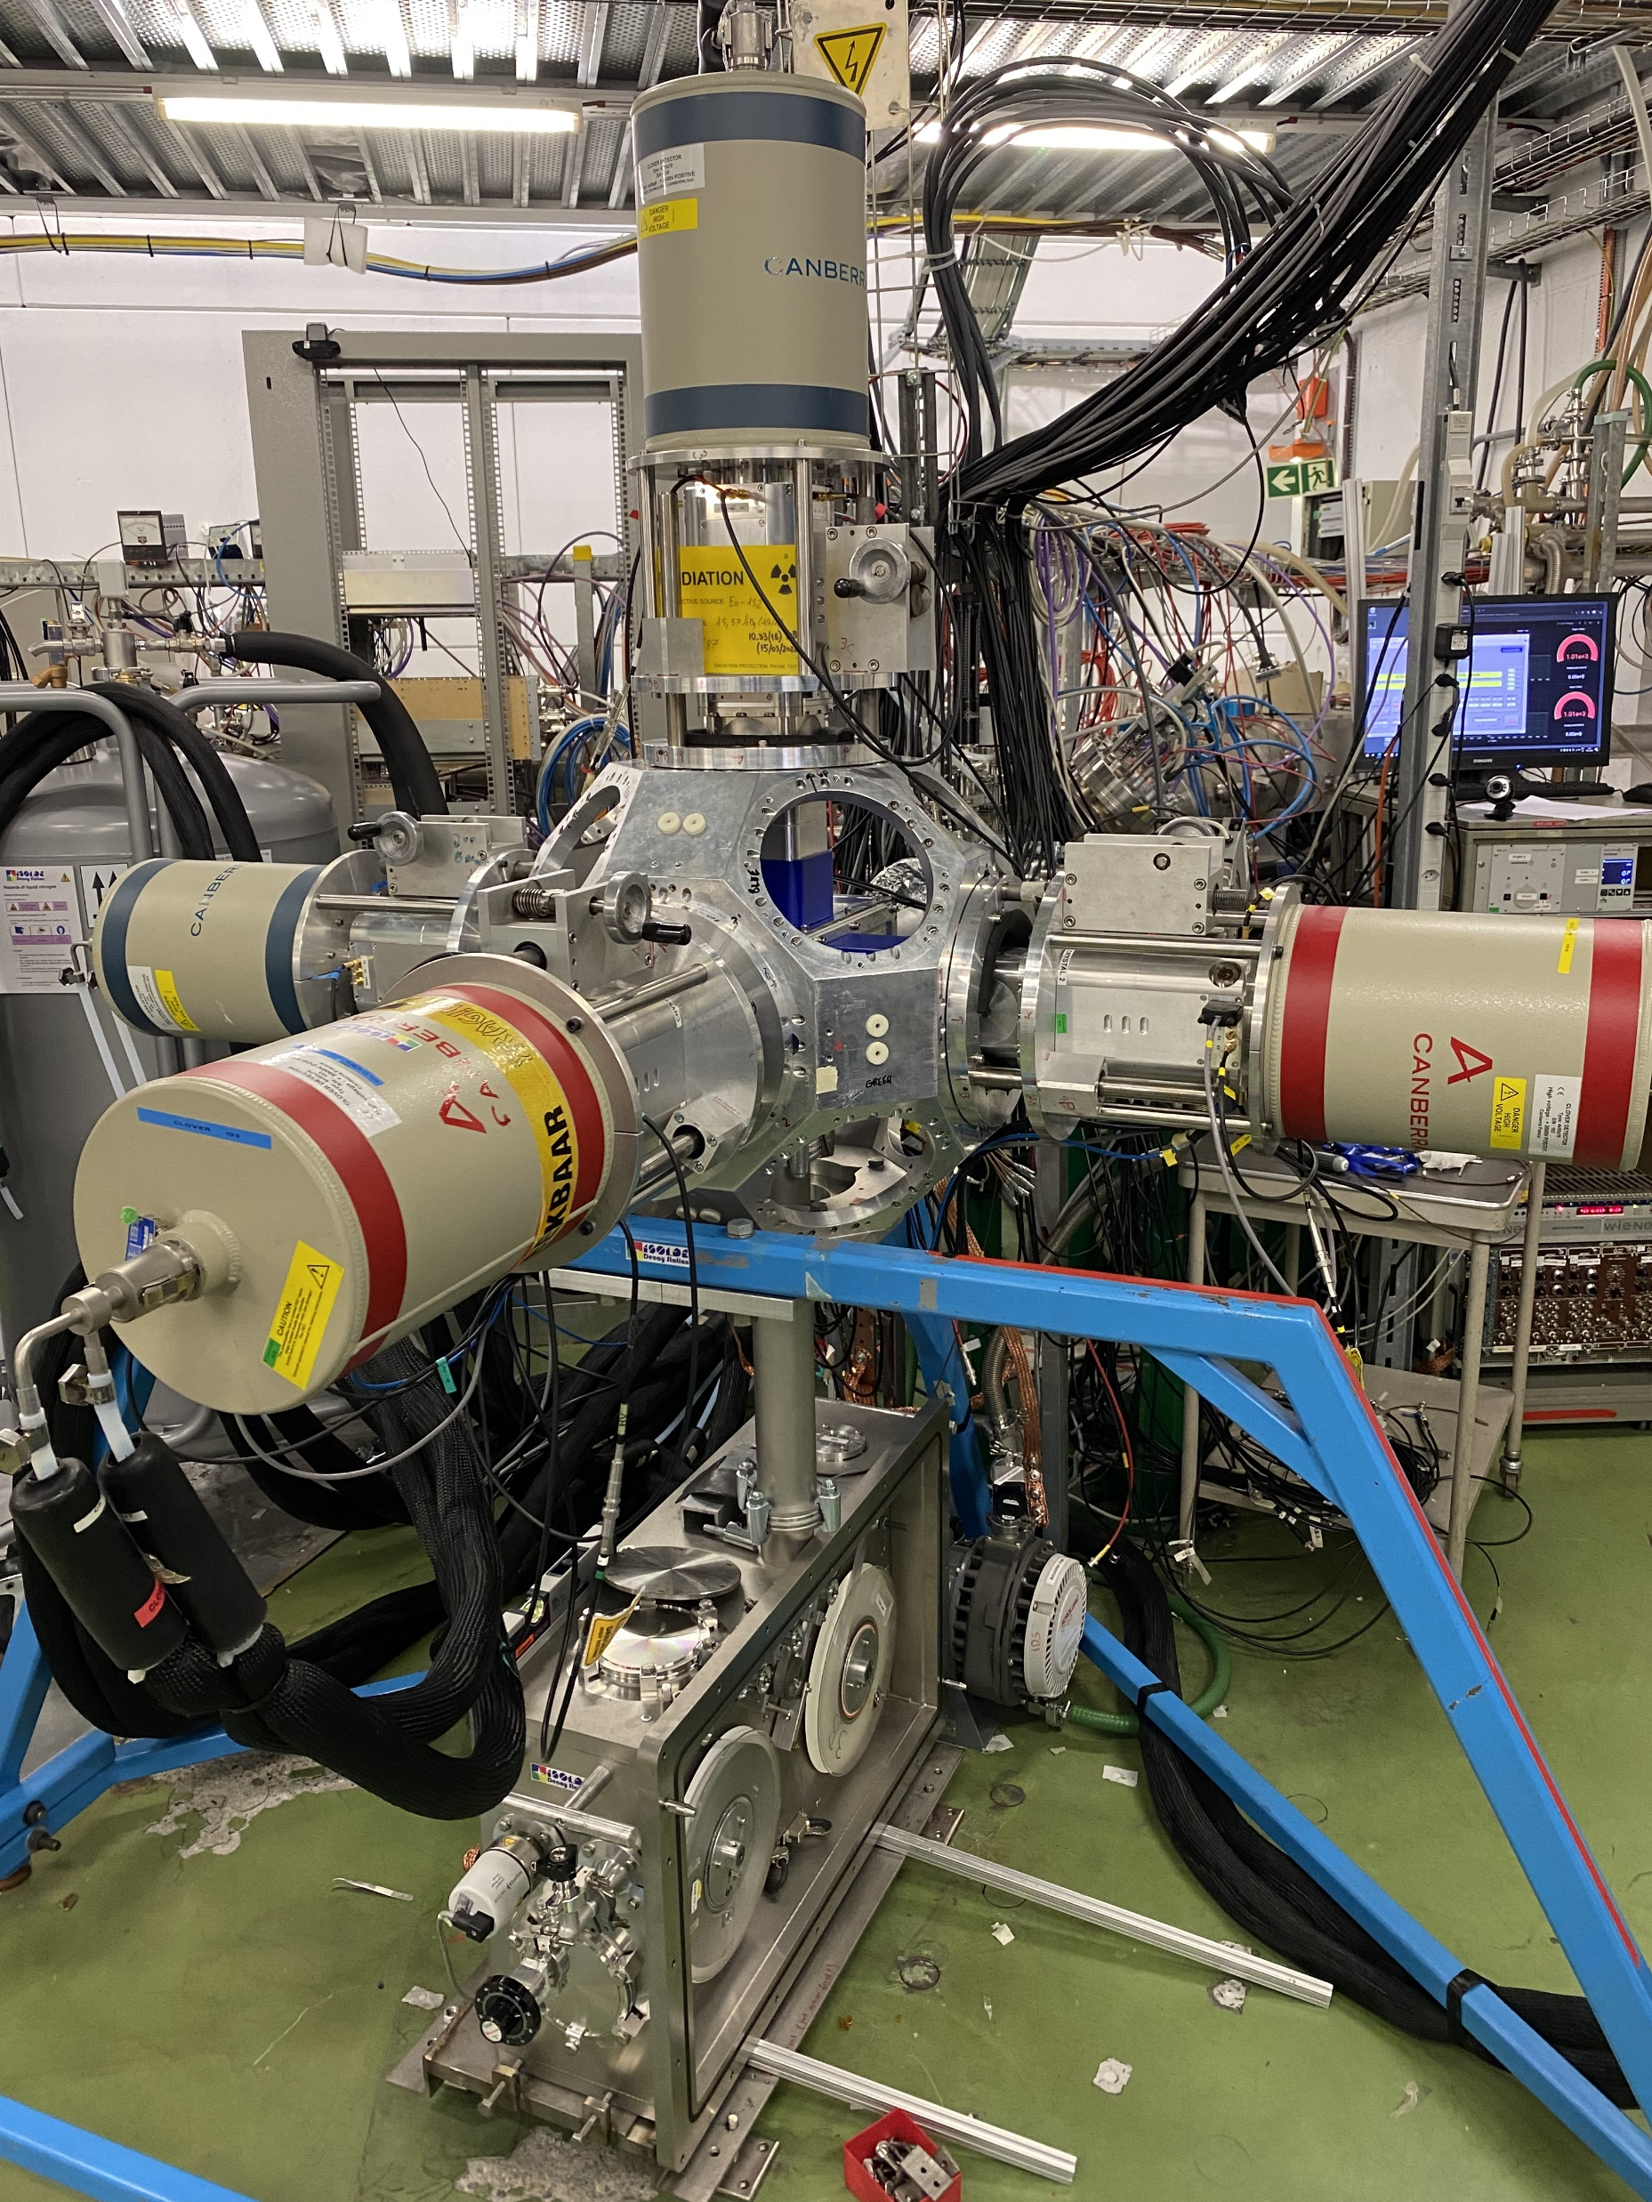
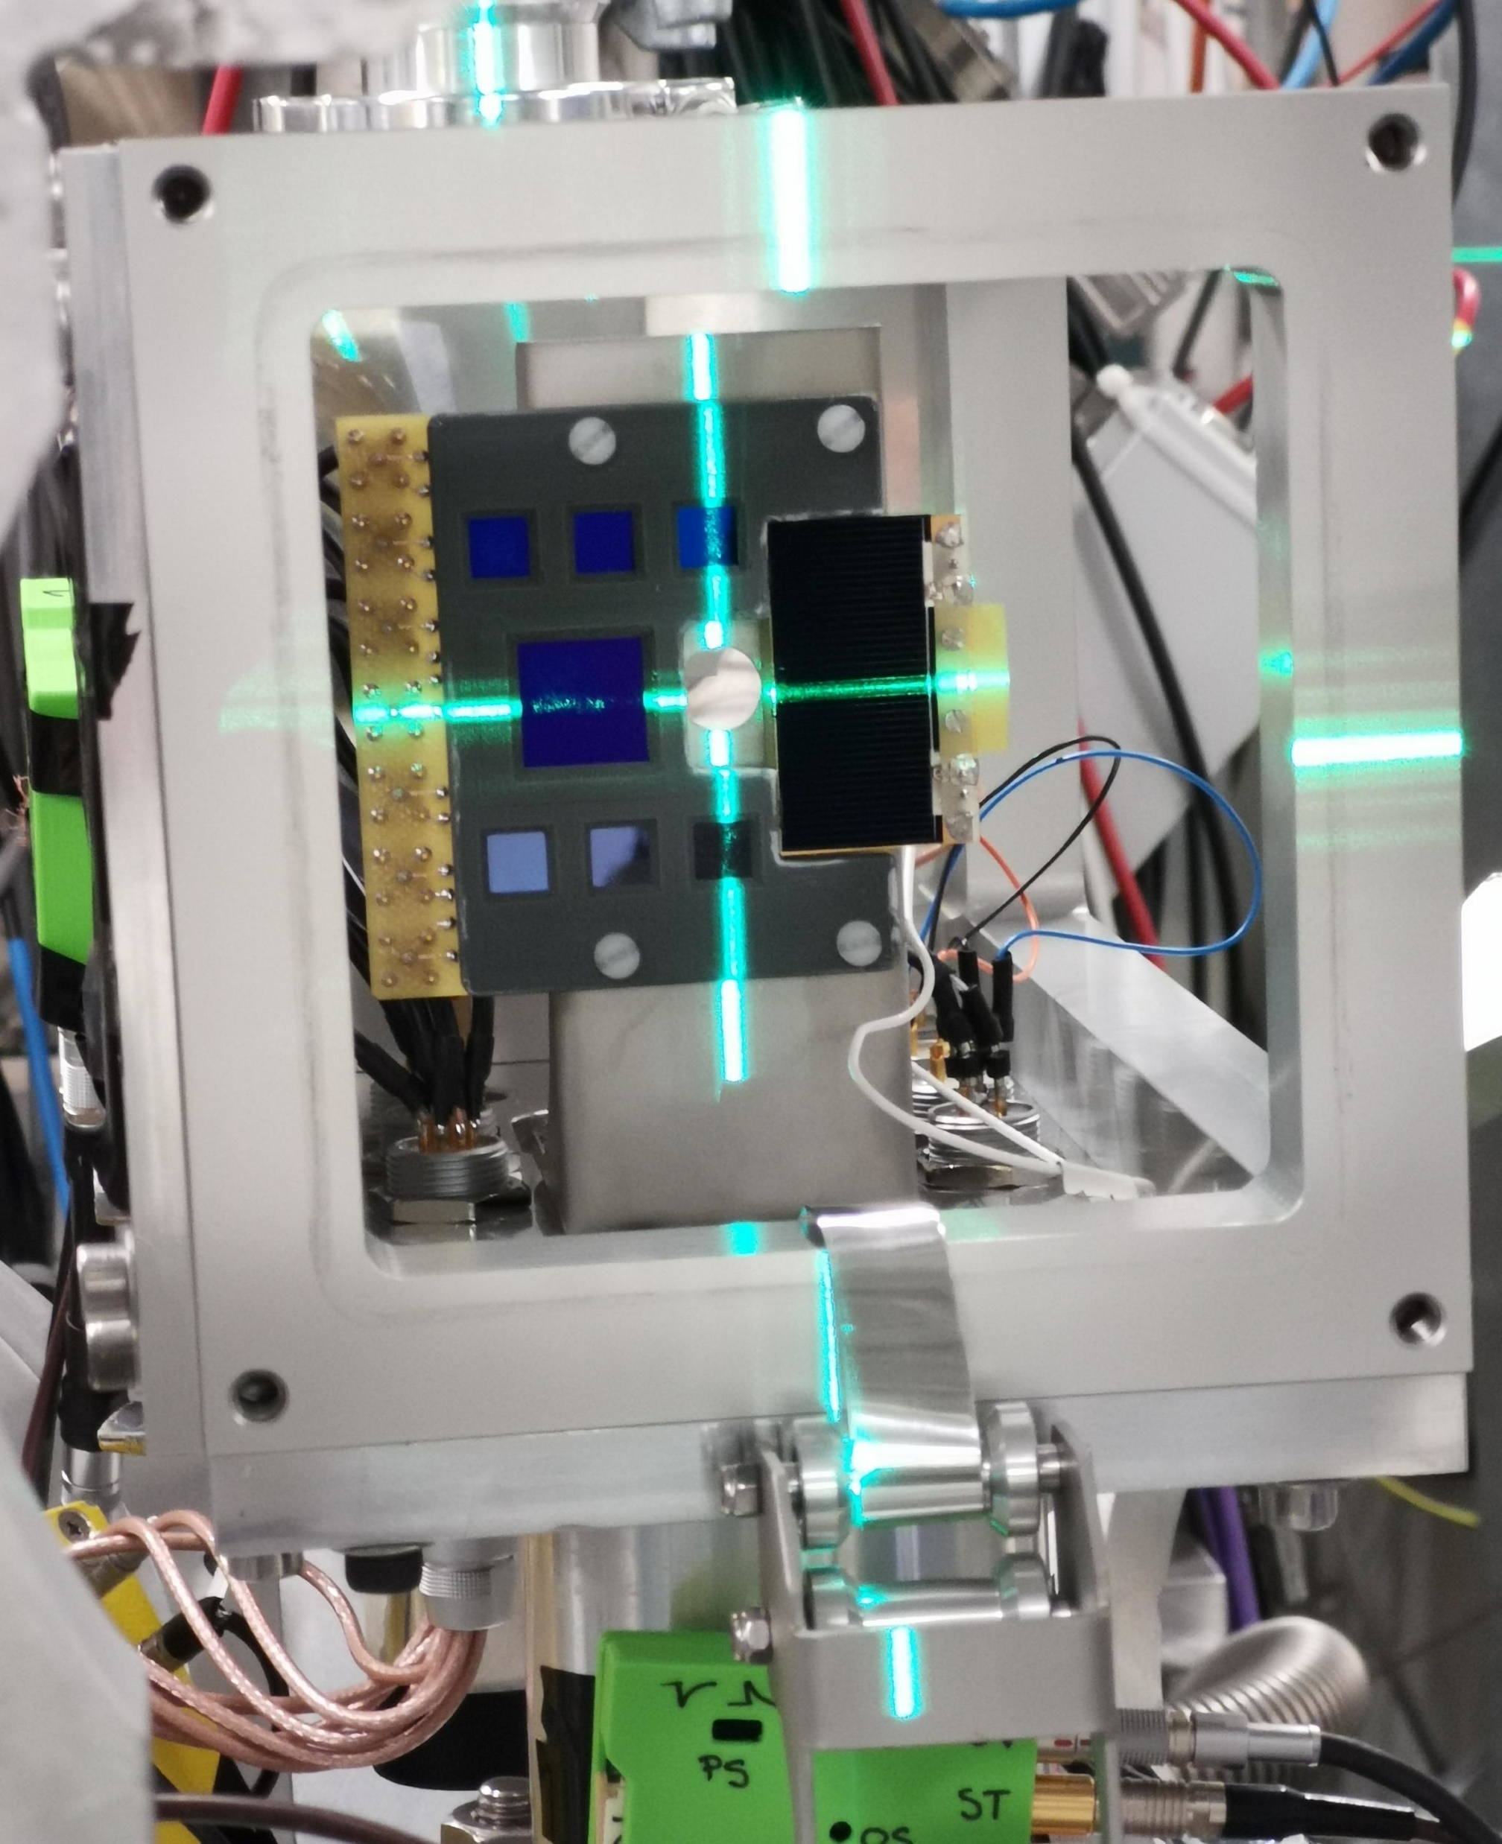

Experiment
¹⁸²Au measured at ISOLDE Decay Station (IDS)
Tape system
4 HPGe Clover detectors (High Purity Germanium)
    4 crystals each
    $γ$- and X-rays
7 silicon PIN diodes
    $α$ particles and conversion electrons
https://isolde-ids.web.cern.ch/

Slide 8
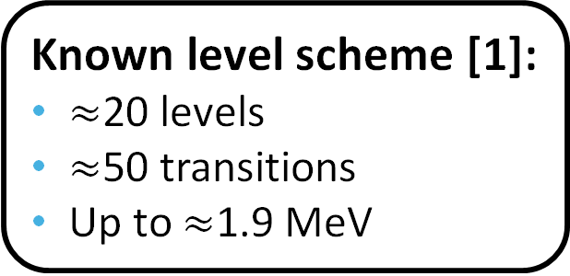
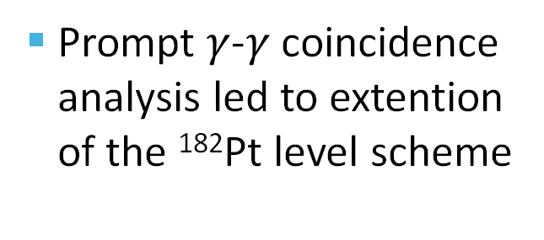
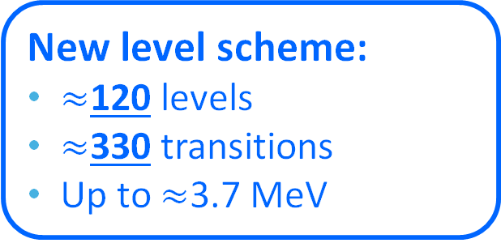
Results - Level scheme of ¹⁸²Pt
Prompt $γ$-$γ$ coincidence analysis led to extention of the ¹⁸²Pt level scheme
Known level scheme [1]:
$≈$20 levels
$≈$50 transitions
Up to $≈$1.9 MeV
New level scheme:
$≈$120 levels
$≈$330 transitions
Up to $≈$3.7 MeV
Partial level scheme of ¹⁸²Pt
[1] P. M. Davidson et al., Nucl. Phys. A 657, 219 (1999)
Notes:
125, 336
3x10e8 decays

Slide 9
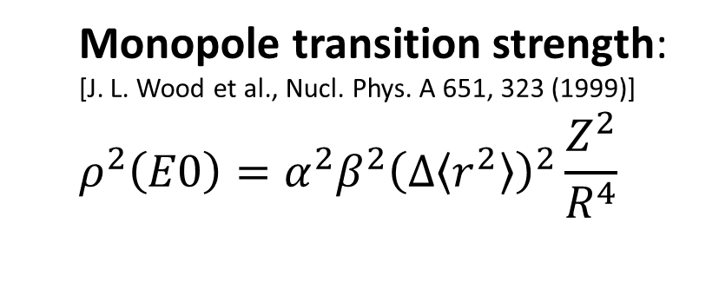
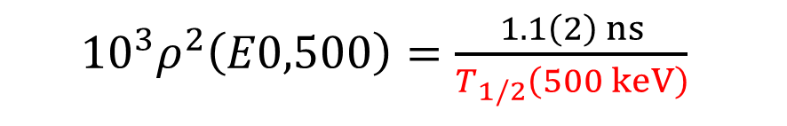

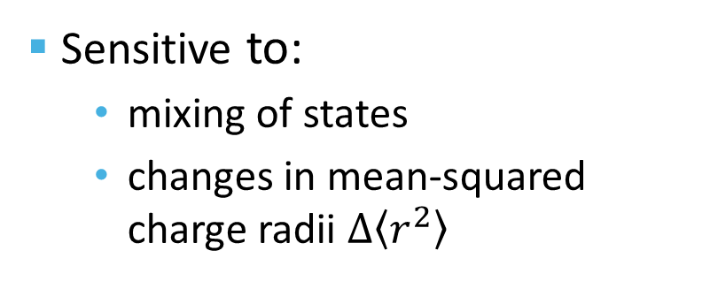
Analysis of E0 transitions
Sensitive to:
  mixing of states
  changes in mean-squared charge radii $∆\left\langle r^{2}\right\rangle$
  Monopole transition strength:
  [J. L. Wood et al., Nucl. Phys. A 651, 323 (1999)]
  $$ρ^{2}\left(E0\right)=α^{2}β^{2}{\left(∆\left\langle r^{2}\right\rangle \right)}^{2}\frac{Z^{2}}{R^{4}}$$
Known mixing amplitudes [1]
500-keV $0_{2}^{+}→0_{1}^{+}$ E0 transition confirmed
  ${10}^{3}ρ^{2}\left(E0,500\right)=\frac{1.1\left(2\right) ns}{T_{1/2}\left(500 keV\right)}$
  Unknown half-life, further fast-timing measurement needed
[1] P. M. Davidson et al., Nucl. Phys. A 657, 219 (1999)
Notes:
Resolution ~10-11keV FWHM

Slide 10
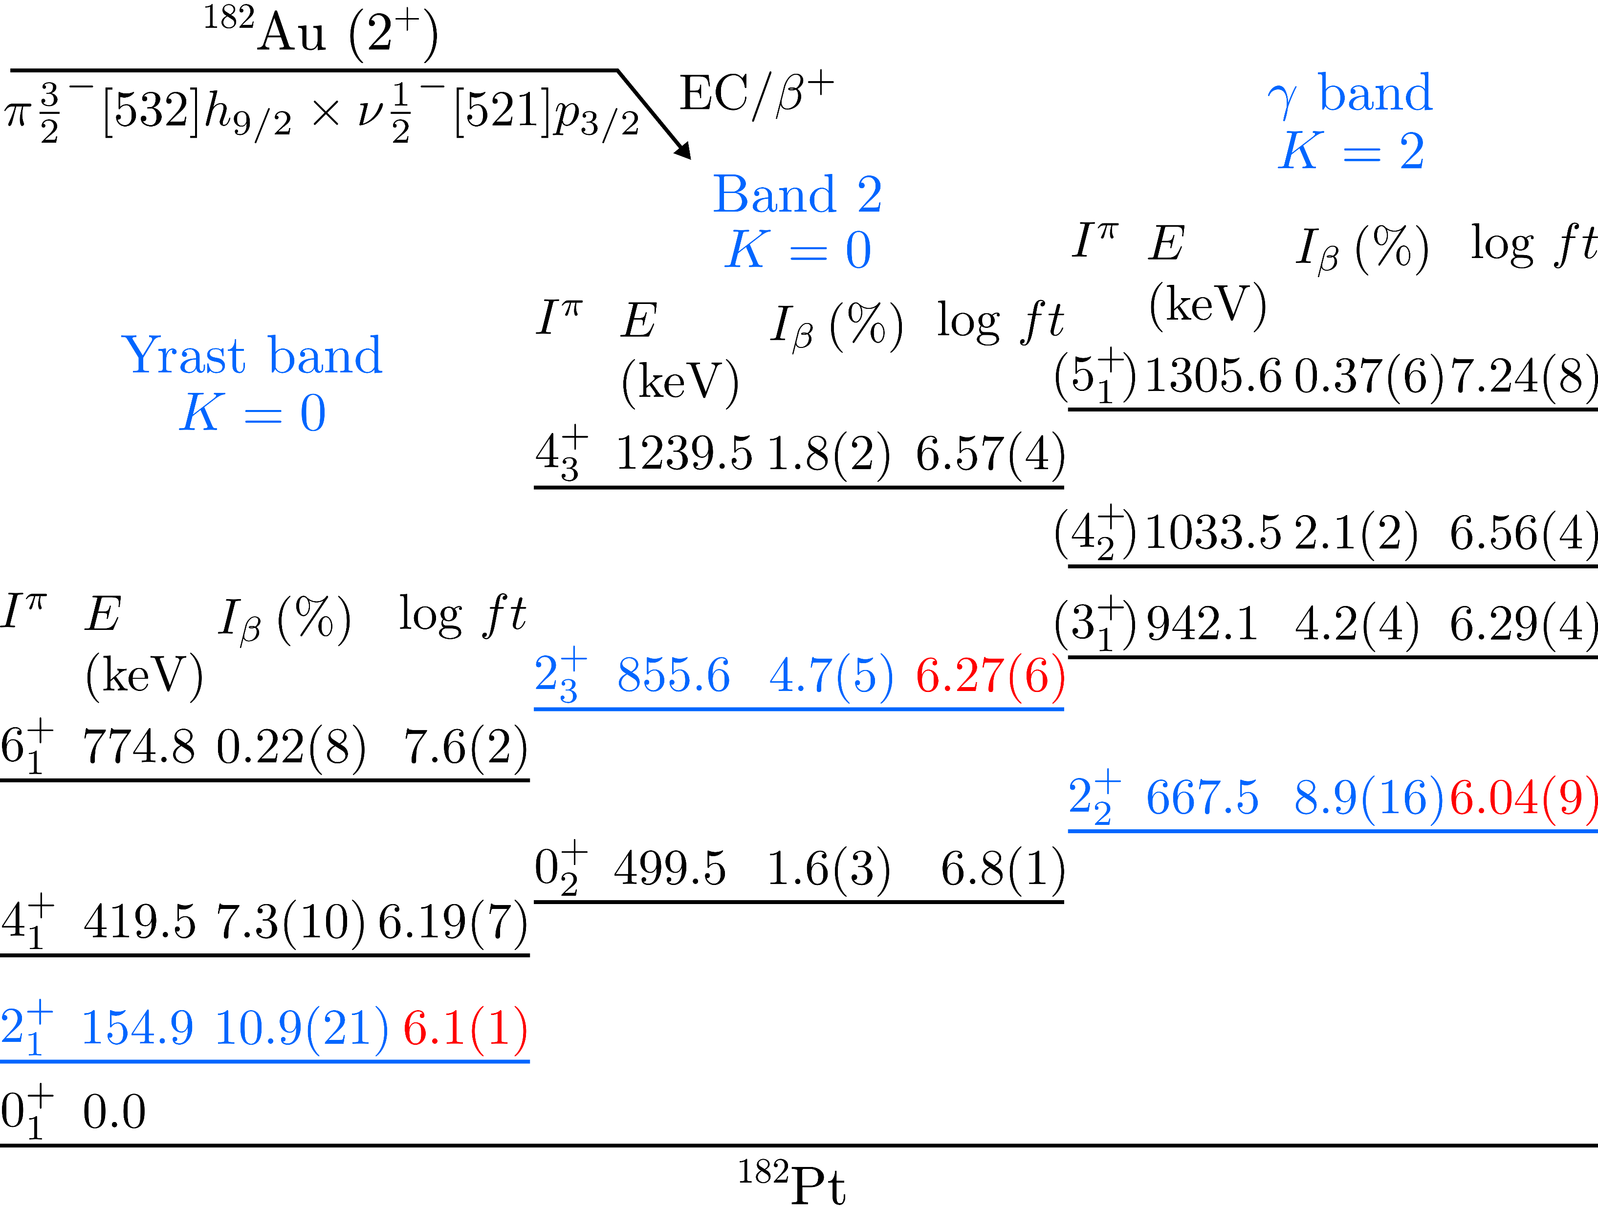
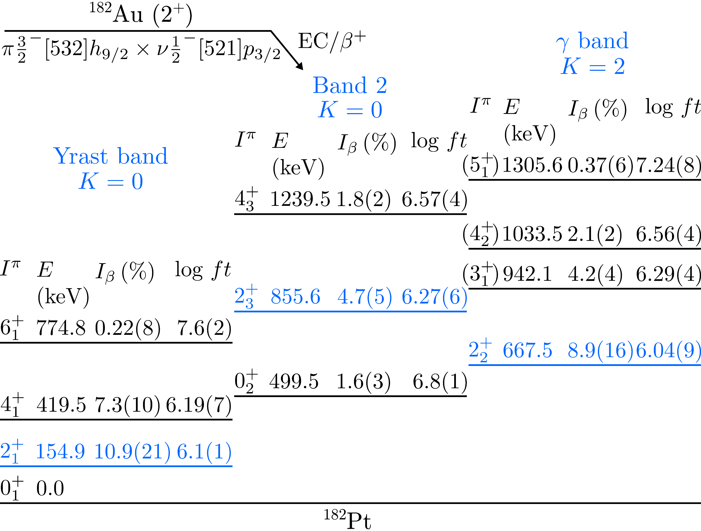
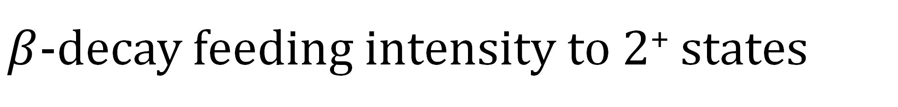
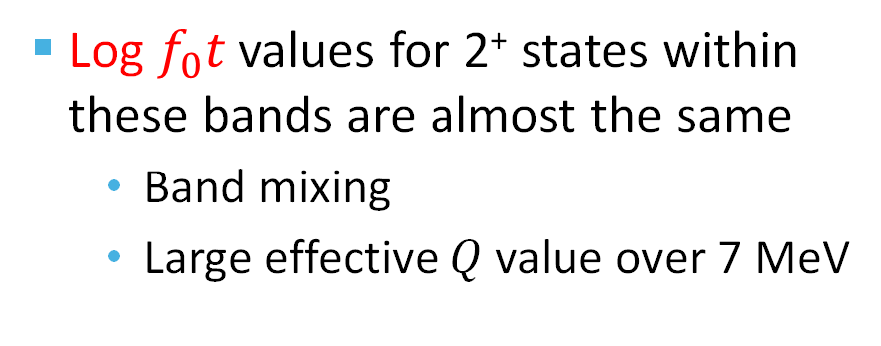
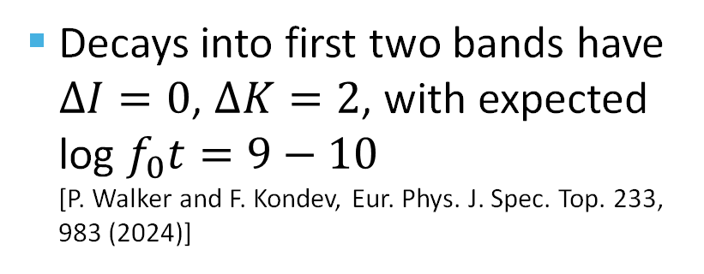
$β$-decay feeding intensity to 2⁺ states
Three bands with 2⁺ states are known in ¹⁸²Pt
Decays into first two bands have $∆I=0$, $∆K=2$, with expected log $f_{0}t=9−10$ [P. Walker and F. Kondev, Eur. Phys. J. Spec. Top. 233, 983 (2024)]
Log $f_{0}t$ values for 2⁺ states within these bands are almost the same
  Band mixing
  Large effective $Q$ value over 7 MeV
P. M. Davidson et al., Nucl. Phys. A 657, 219 (1999)

Slide 11
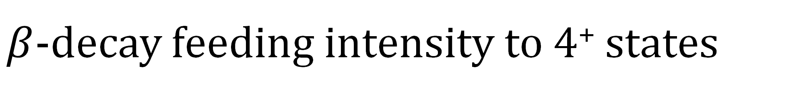
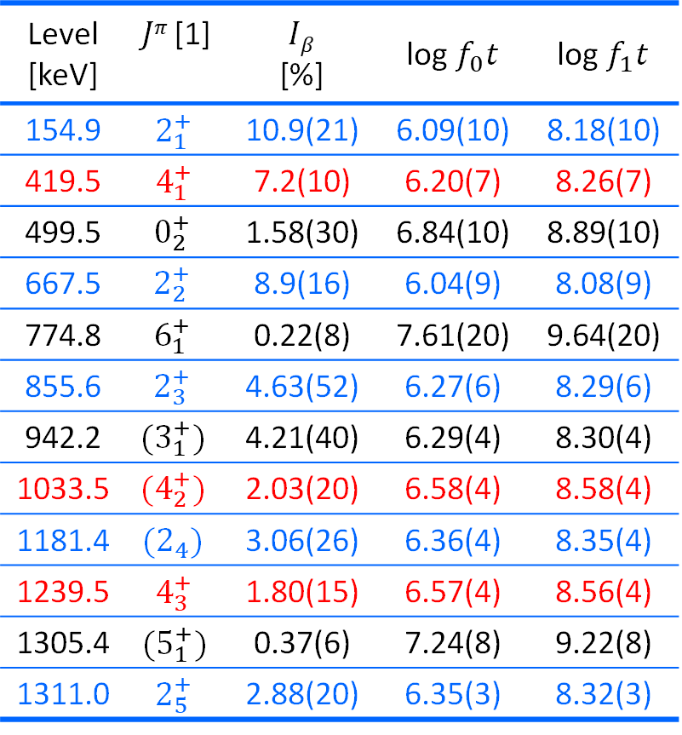
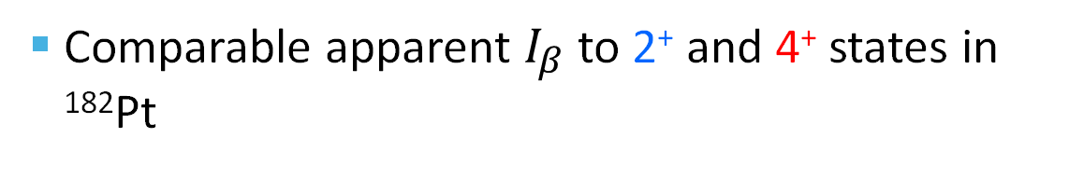
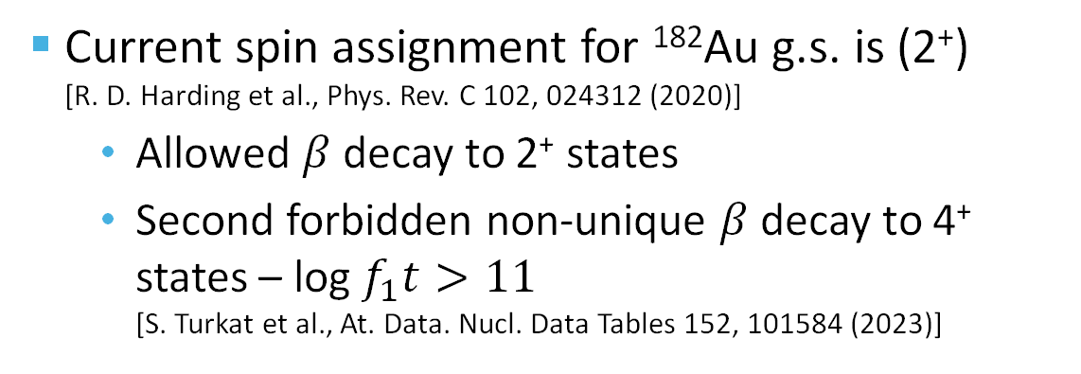
$β$-decay feeding intensity to 4⁺ states
Comparable apparent $I_{β}$ to 2⁺ and 4⁺ states in ¹⁸²Pt
Level [keV] | $Jπ$ [1] | $Iβ$ [%] | log $f_{0}t$ | log $f_{1}t$
154.9 | $$2_{1}^{+}$$ | 10.9(21) | 6.09(10) | 8.18(10)
419.5 | $$4_{1}^{+}$$ | 7.2(10) | 6.20(7) | 8.26(7)
499.5 | $$0_{2}^{+}$$ | 1.58(30) | 6.84(10) | 8.89(10)
667.5 | $$2_{2}^{+}$$ | 8.9(16) | 6.04(9) | 8.08(9)
774.8 | $$6_{1}^{+}$$ | 0.22(8) | 7.61(20) | 9.64(20)
855.6 | $$2_{3}^{+}$$ | 4.63(52) | 6.27(6) | 8.29(6)
942.2 | $${(3}_{1}^{+})$$ | 4.21(40) | 6.29(4) | 8.30(4)
1033.5 | $$(4_{2}^{+})$$ | 2.03(20) | 6.58(4) | 8.58(4)
1181.4 | $$(2_{4})$$ | 3.06(26) | 6.36(4) | 8.35(4)
1239.5 | $$4_{3}^{+}$$ | 1.80(15) | 6.57(4) | 8.56(4)
1305.4 | $$(5_{1}^{+})$$ | 0.37(6) | 7.24(8) | 9.22(8)
1311.0 | $$2_{5}^{+}$$ | 2.88(20) | 6.35(3) | 8.32(3)
Current spin assignment for ¹⁸²Au g.s. is (2⁺) [R. D. Harding et al., Phys. Rev. C 102, 024312 (2020)]
  Allowed $β$ decay to 2⁺ states
  Second forbidden non-unique $β$ decay to 4⁺ states – log $f_{1}t>11$ [S. Turkat et al., At. Data. Nucl. Data Tables 152, 101584 (2023)]
Possible explanations:
3⁺ ground state in ¹⁸²Au
New isomeric state in ¹⁸²Au
Pandemonium effect
[1] P. M. Davidson et al., Nucl. Phys. A 657, 219 (1999)

Slide 12
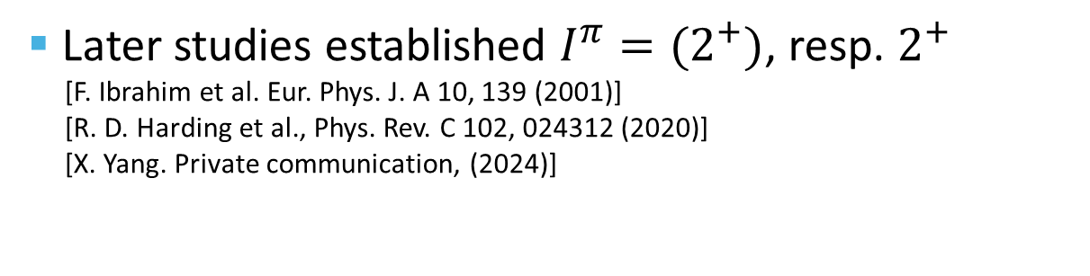

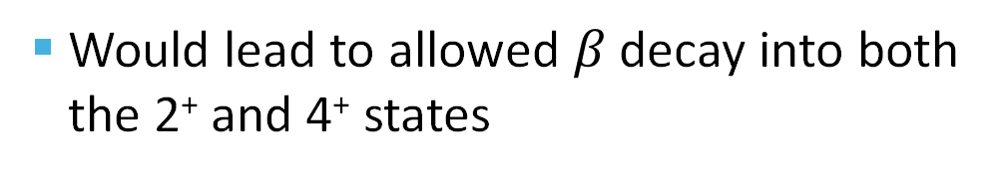
I=3 ground state of ¹⁸²Au?
Would lead to allowed $β$ decay into both the 2⁺ and 4⁺ states
The first spin assignment for ¹⁸²Au g.s. was $I=(2−4)$, with $I=(3)$ as preferred option [I. Romanski et al., Hyperfine Interact. 75, 457 (1992)]
Later studies established $I^{π}=(2^{+})$, resp. $2^{+}$
[F. Ibrahim et al. Eur. Phys. J. A 10, 139 (2001)]
[R. D. Harding et al., Phys. Rev. C 102, 024312 (2020)]
[X. Yang. Private communication, (2024)]
R. D. Harding et al., Phys. Rev. C 102, 024312 (2020)
Yesterday´s talk by O. Ahmad

Slide 13
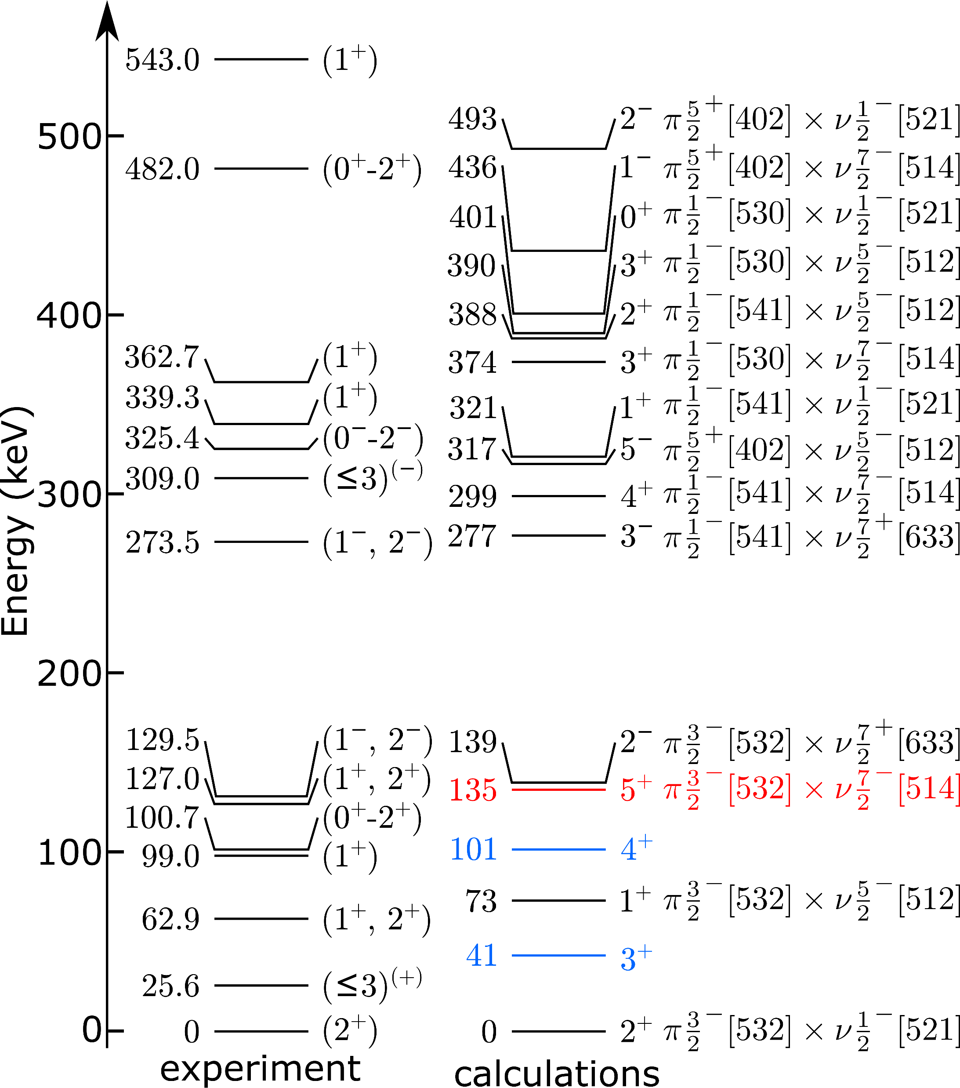
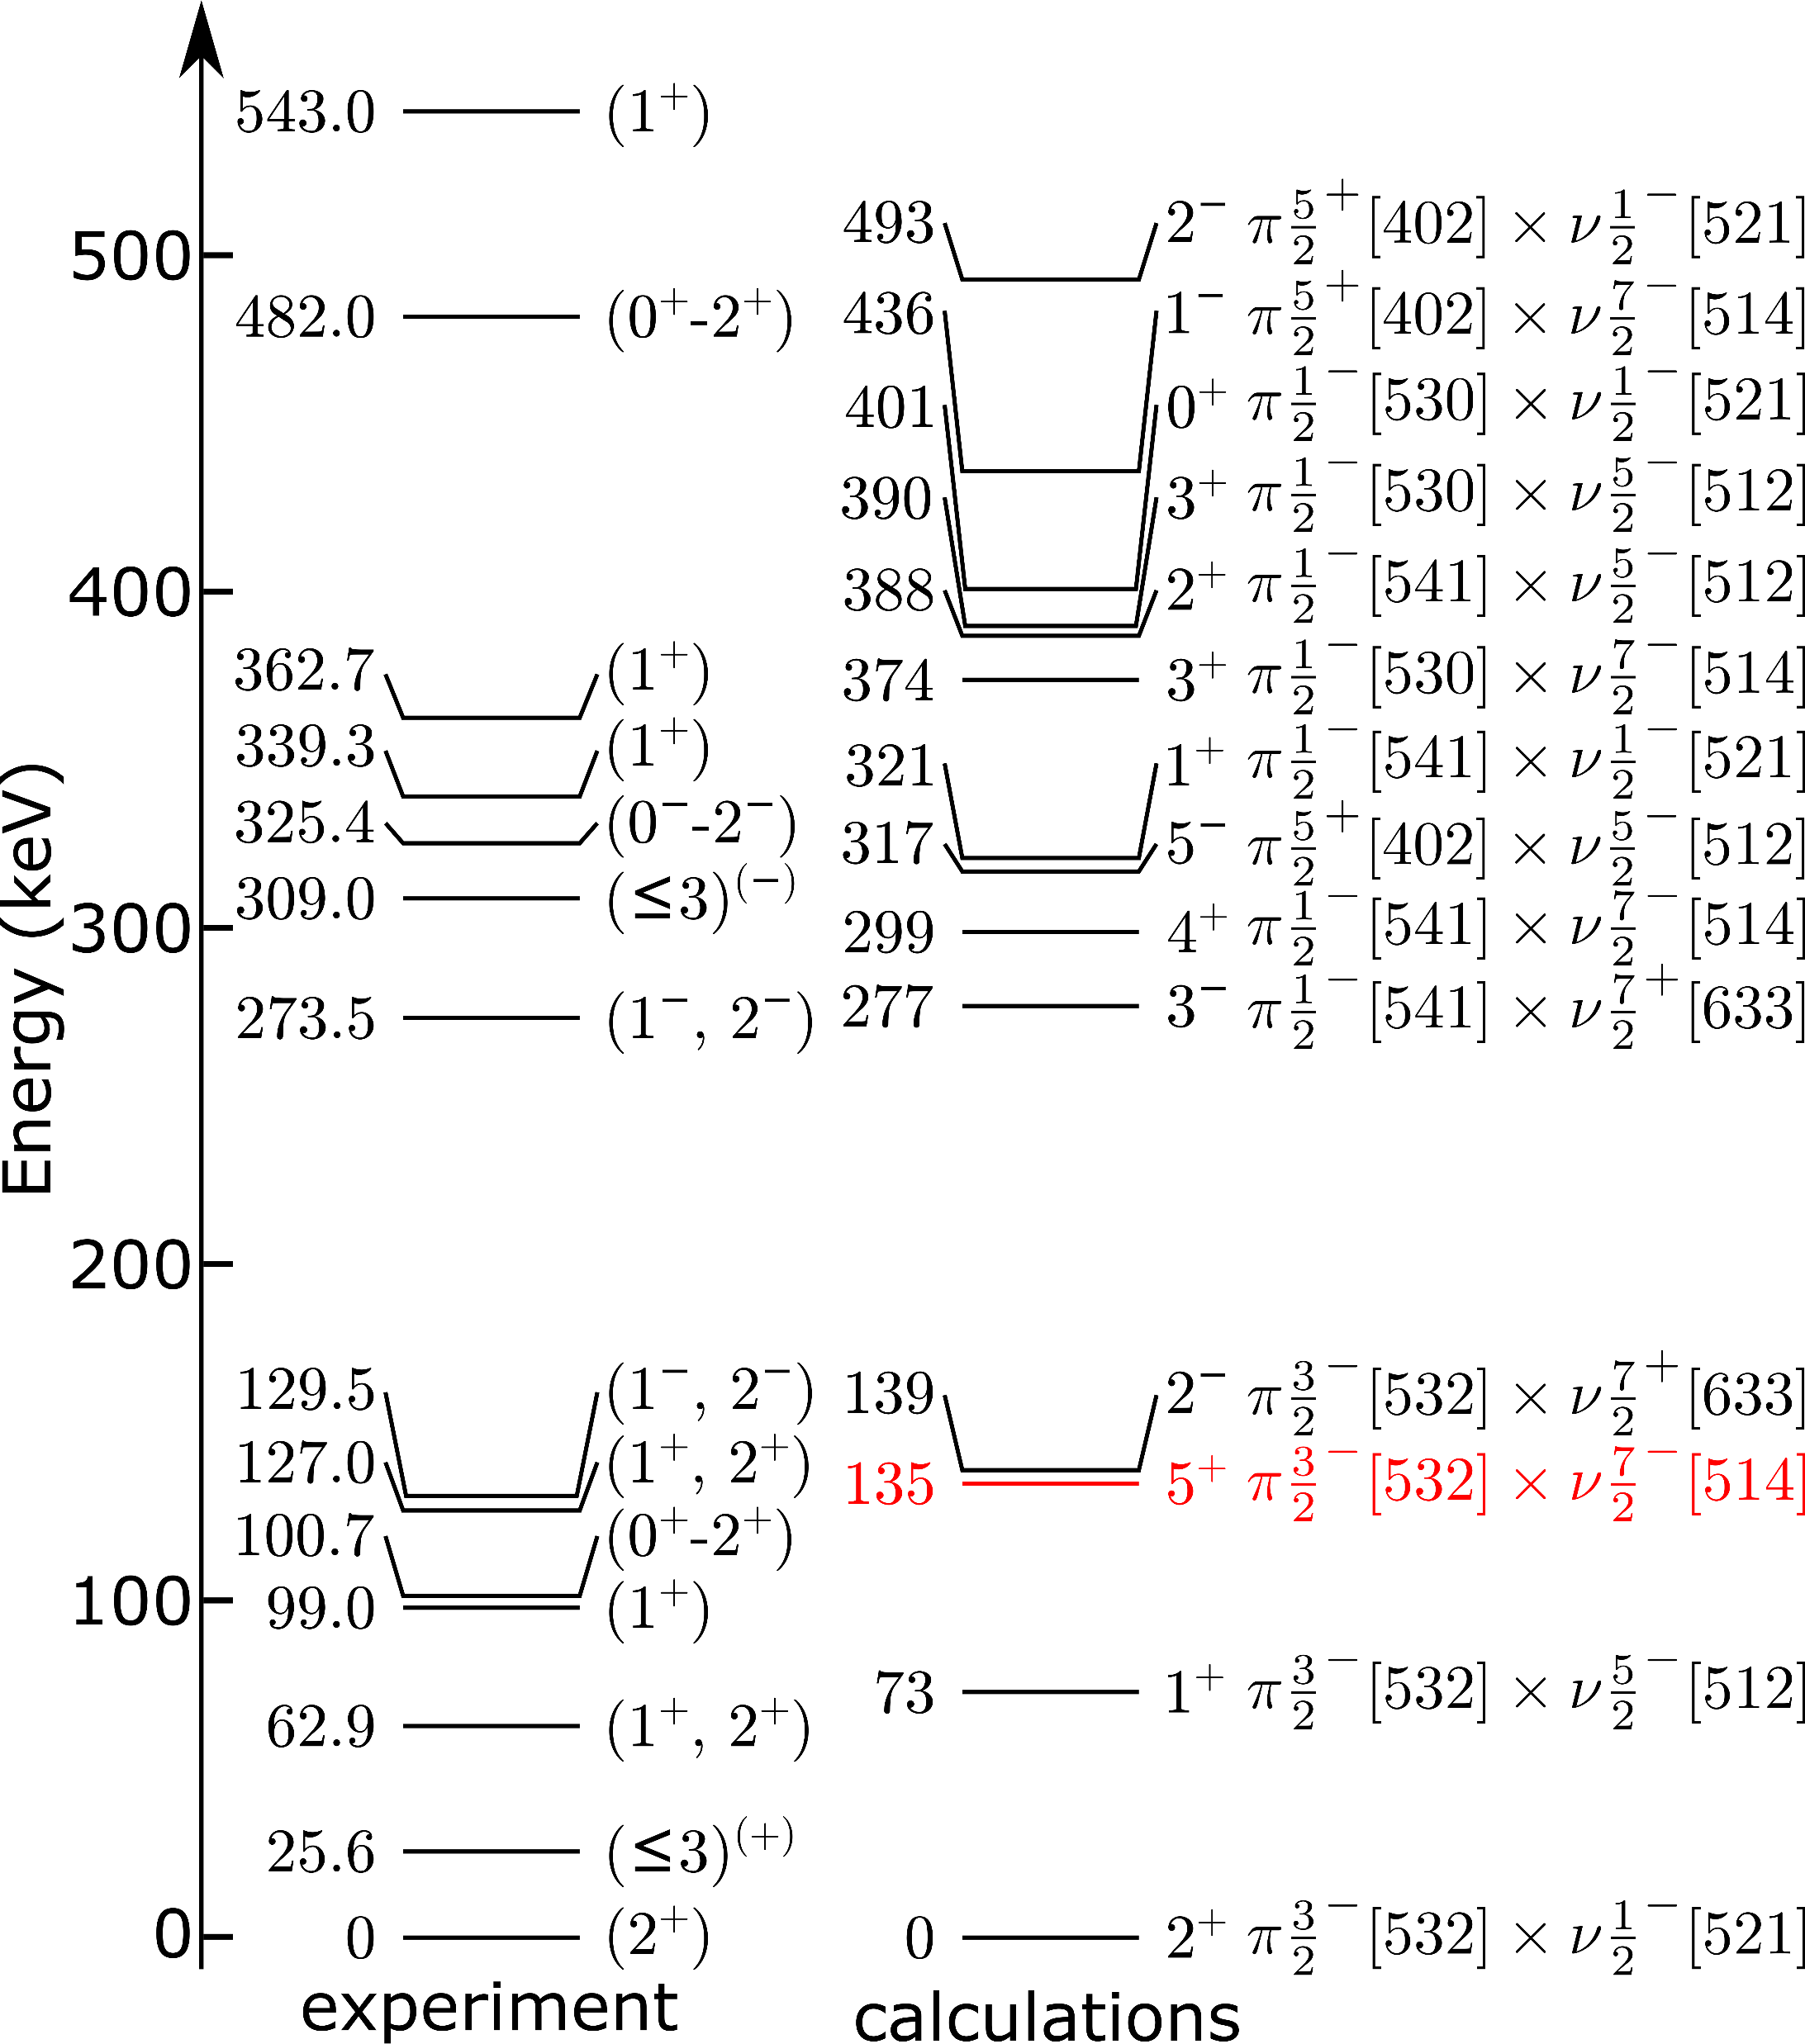
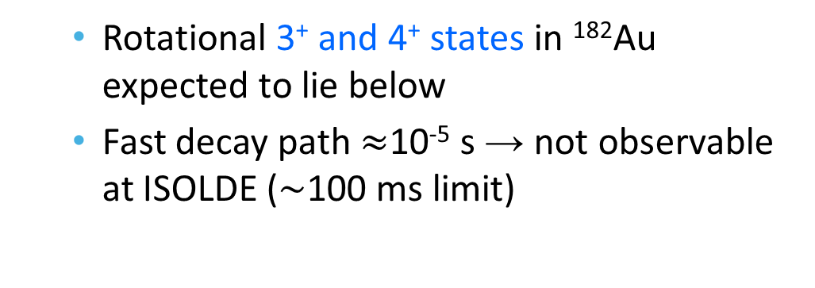
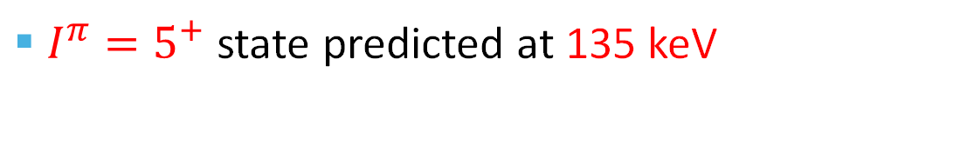
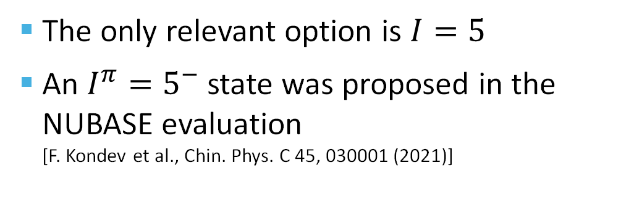
New isomer in ¹⁸²Au?
The only relevant option is $I=5$
An $I^{π}=5^{−}$ state was proposed in the NUBASE evaluation [F. Kondev et al., Chin. Phys. C 45, 030001 (2021)]
$I^{π}=5^{+}$ state predicted at 135 keV
  Rotational 3⁺ and 4⁺ states in ¹⁸²Au expected to lie below
  Fast decay path $≈$10⁻⁵ s → not observable at ISOLDE ($\sim$100 ms limit)
C. F. Jiao, R. Y. Dong, and Z. Liu, Private communication (2024)
J. Mišt et al., Phys. Rev. C 112, 024328 (2025)

Slide 14
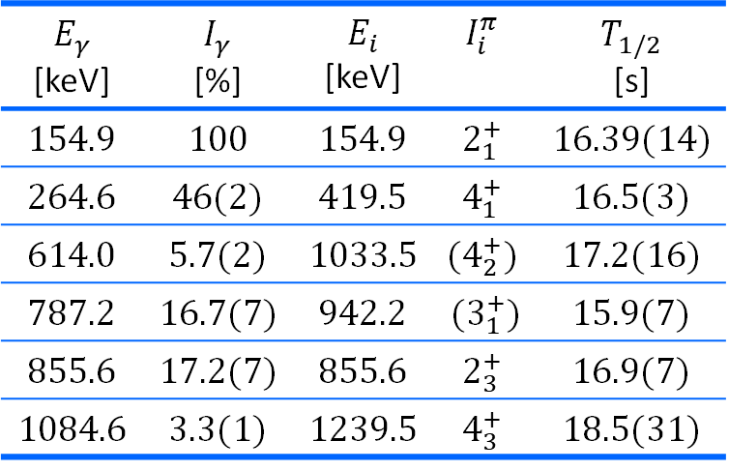
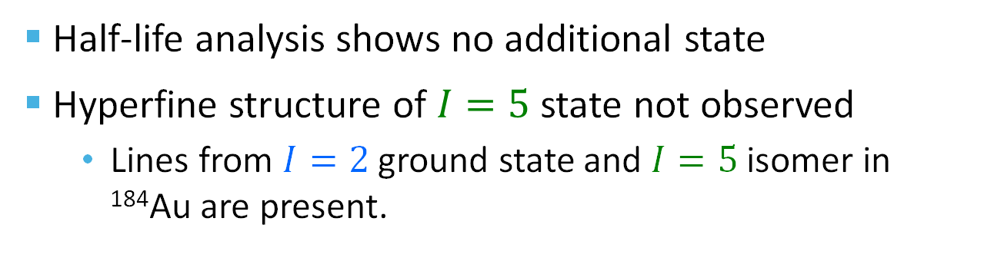
New isomer in ¹⁸²Au?
Half-life analysis shows no additional state
Hyperfine structure of $I=5$ state not observed
  Lines from $I=2$ ground state and $I=5$ isomer in ¹⁸⁴Au are present.
F. Le Blanc et al., Phys. Rev. Lett. 79, 2213 (1997)
$$E_{γ}$$ [keV] | $$I_{γ}$$ [%] | $$E_{i}$$ [keV] | $$I_{i}^{π}$$ | $$T_{1/2}$$ [s]
154.9 | 100 | 154.9 | $$2_{1}^{+}$$ | 16.39(14)
264.6 | 46(2) | 419.5 | $$4_{1}^{+}$$ | 16.5(3)
614.0 | 5.7(2) | 1033.5 | $${(4}_{2}^{+})$$ | 17.2(16)
787.2 | 16.7(7) | 942.2 | ($3_{1}^{+}$) | 15.9(7)
855.6 | 17.2(7) | 855.6 | $$2_{3}^{+}$$ | 16.9(7)
1084.6 | 3.3(1) | 1239.5 | $$4_{3}^{+}$$ | 18.5(31)
Weighted average: 16.43(12) s
S. Kreim (ISOLTRAP Collaboration), A. E. Barzakh, Private communication (2012)

Slide 15
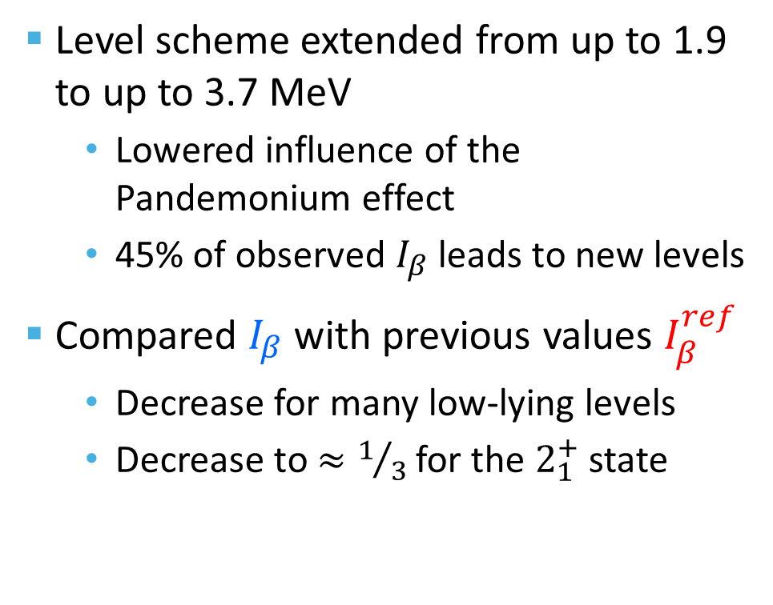
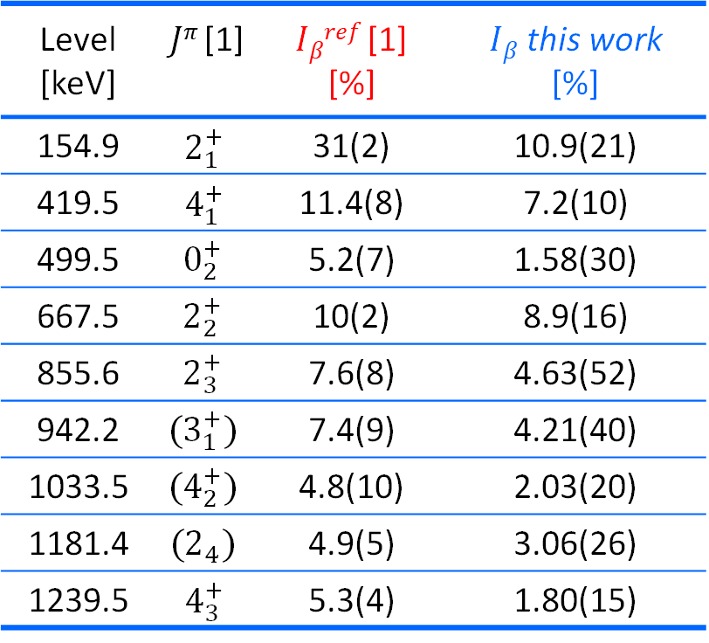
Pandemonium effect
Level scheme extended from up to 1.9 to up to 3.7 MeV
  Lowered influence of the Pandemonium effect
  45% of observed $I_{β}$ leads to new levels
Compared $I_{β}$ with previous values $I_{β}^{ref}$
  Decrease for many low-lying levels
  Decrease to $≈1/3$ for the $2_{1}^{+}$ state
Level [keV] | $Jπ$ [1] | $Iβref$ [1] [%] | $Iβ$ this work [%]
154.9 | $$2_{1}^{+}$$ | 31(2) | 10.9(21)
419.5 | $$4_{1}^{+}$$ | 11.4(8) | 7.2(10)
499.5 | $$0_{2}^{+}$$ | 5.2(7) | 1.58(30)
667.5 | $$2_{2}^{+}$$ | 10(2) | 8.9(16)
855.6 | $$2_{3}^{+}$$ | 7.6(8) | 4.63(52)
942.2 | $${(3}_{1}^{+})$$ | 7.4(9) | 4.21(40)
1033.5 | $$(4_{2}^{+})$$ | 4.8(10) | 2.03(20)
1181.4 | $$(2_{4})$$ | 4.9(5) | 3.06(26)
1239.5 | $$4_{3}^{+}$$ | 5.3(4) | 1.80(15)
[1] P. M. Davidson et al., Nucl. Phys. A 657, 219 (1999)

Slide 16
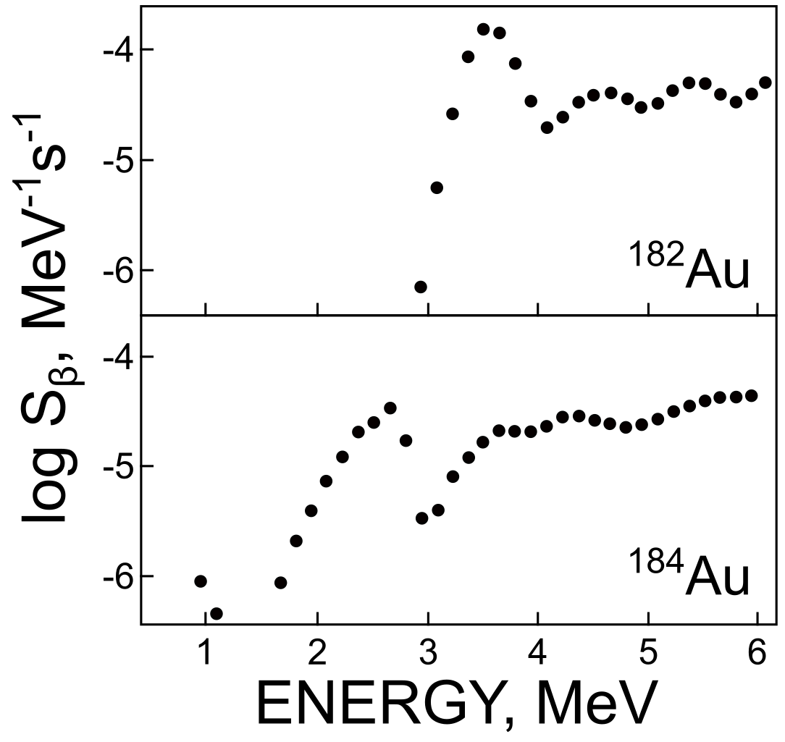
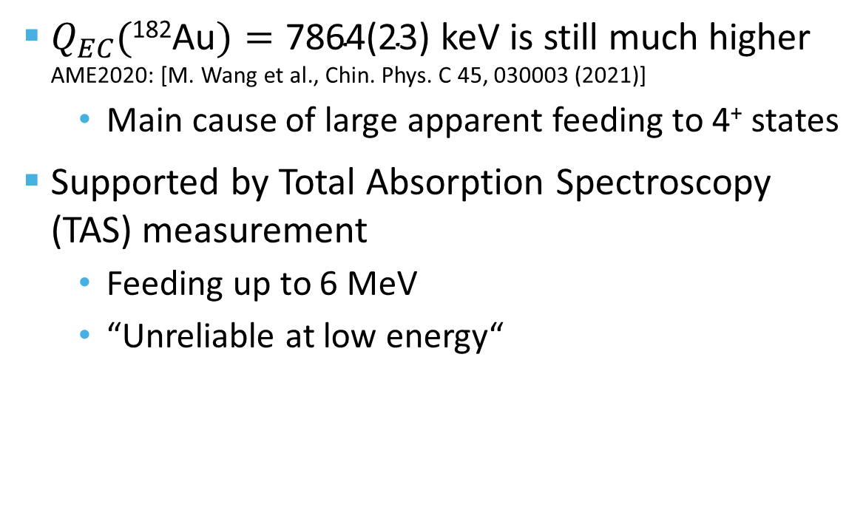
Pandemonium effect
$Q_{EC}(\text{182}\text{Au})=\text{7864(23)}$ keV is still much higher AME2020: [M. Wang et al., Chin. Phys. C 45, 030003 (2021)]
  Main cause of large apparent feeding to 4⁺ states
Supported by Total Absorption Spectroscopy (TAS) measurement
  Feeding up to 6 MeV
  “Unreliable at low energy“
P. Hornshøj et al., Nucl. Phys. A 239, 15 (1975)

Slide 17
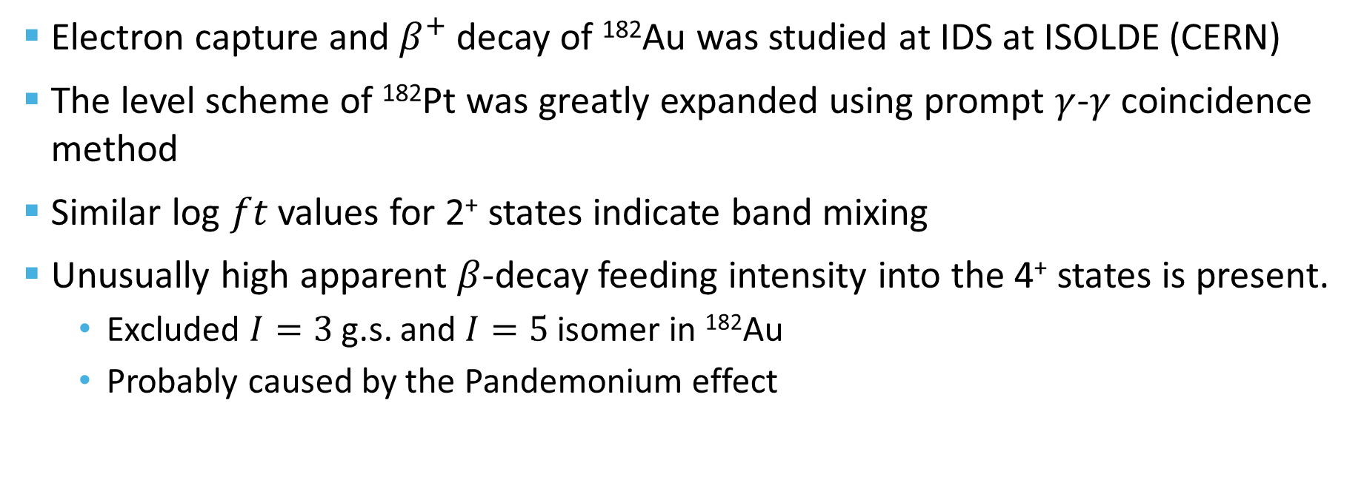
Conclusion
Electron capture and $β^{+}$ decay of ¹⁸²Au was studied at IDS at ISOLDE (CERN)
The level scheme of ¹⁸²Pt was greatly expanded using prompt $γ$-$γ$ coincidence method
Similar log $ft$ values for 2⁺ states indicate band mixing
Unusually high apparent $β$-decay feeding intensity into the 4⁺ states is present.
  Excluded $I=3$ g.s. and $I=5$ isomer in ¹⁸²Au
  Probably caused by the Pandemonium effect
“Long is the way
and hard, that out of Hell leads up to light.”
John Milton, Paradise Lost, 1667

Slide 18















Acknowledgements
Collaborators:
B. Andel , A. N. Andreyev, A. E. Barzakh, J. G. Cubiss, A. Algora, S. Antalic, M. Athanasakis-Kaklamanakis, M. Au, S. Bara, R. A. Bark, M. J. G. Borge, A. Camaiani, K. Chrysalidis, T. E. Cocolios, C. Costache, H. De Witte, R. Y. Dong, D. V. Fedorov, V. N. Fedosseev, L. M. Fraile, H. O. U. Fynbo, R. Grzywacz, R. Heinke, C. F. Jiao, J. Johnson, P. M. Jones, D. S. Judson, D. T. Kattikat Melcom, M. M. Khan, J. Klimo, A. Korgul, M. Labiche, R. Lică, Z. Liu, M. Madurga, N. Marginean, P. Marini, B. A. Marsh, C. Mihai, P. L. Molkanov, E. Nácher, C. Neacsu, J. N. Orce, R. D. Page, J. Pakarinen, P. Papadakis, S. Pascu, A. Perea, M. Piersa-Siłkowska, Zs. Podolyák, M. D. Seliverstov, A. Sitarčík, E. Stamati, A. Stoica, A. Stott, M. Stryjczyk, O. Tengblad, I. Tsekhanovich, A. Turturica, J. M. Udías, P. Van Duppen, N. Warr, A. Youssef

Slide 19
Additional slides

Slide 20
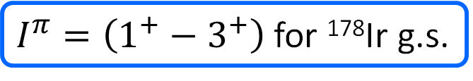
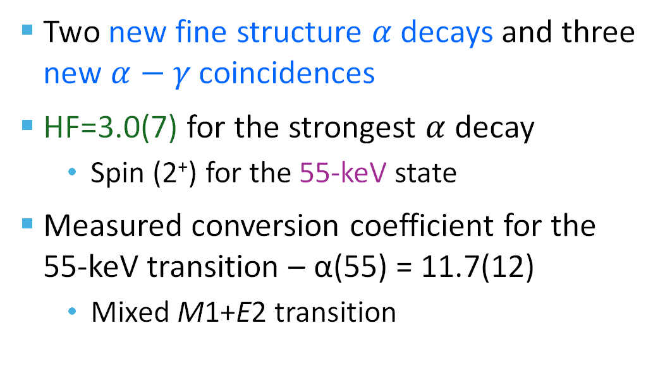
Alpha decay of ¹⁸²Au
Two new fine structure $α$ decays and three new $α−γ$ coincidences
HF=3.0(7) for the strongest $α$ decay
  Spin (2⁺) for the 55-keV state
Measured conversion coefficient for the 55-keV transition – α(55) = 11.7(12)
  Mixed M1+E2 transition
$I^{π}=\left(1^{+}−3^{+}\right)$ for ¹⁷⁸Ir g.s.

