Slide 1
Evolution of changes in mean-square charge radii in californium isotopes
Kenneth van Beek
For the RADRIS collaboration
Technische Universität Darmstadt, Germany
GSI Helmholtzzentrum für Schwerionenforschung GmbH, Darmstadt, Germany

Slide 2
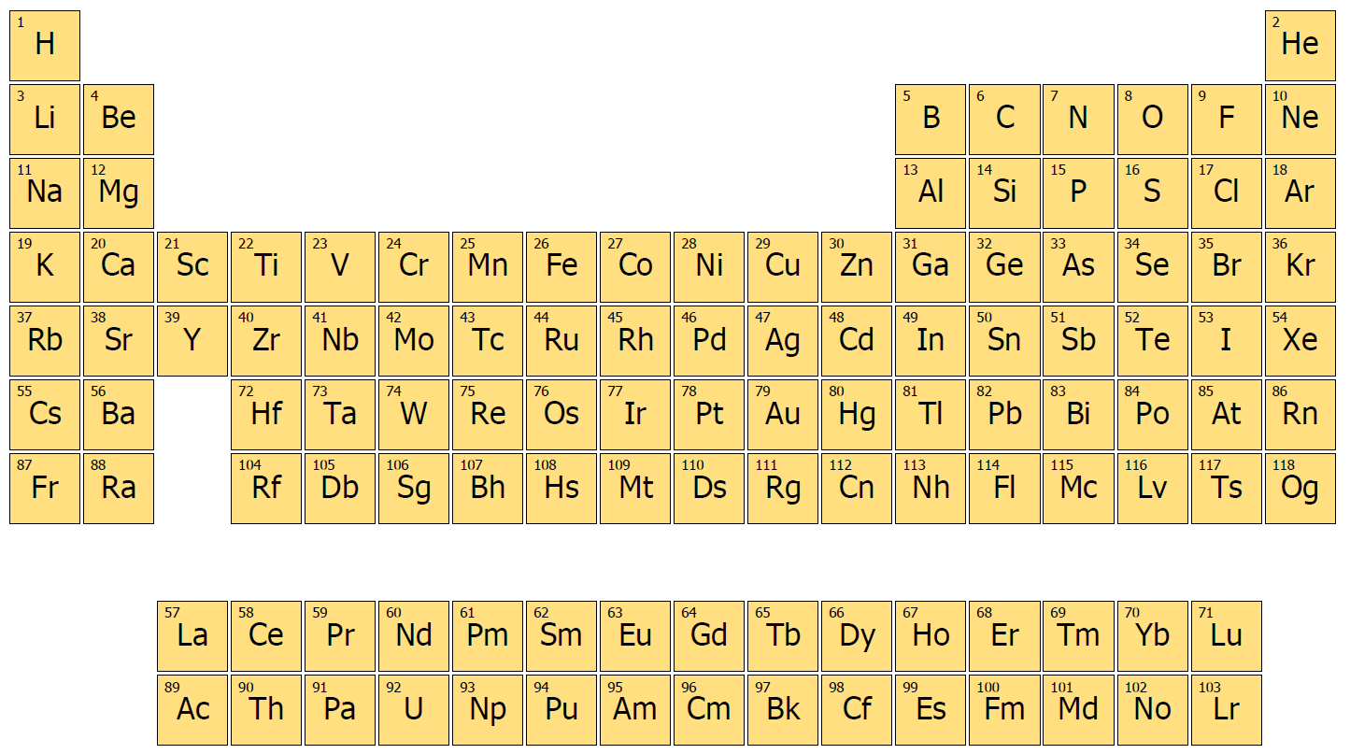
heavy elements: far from stability
Macroscopic instability
Fission barrier diminishes
Microscopic stabilization
Shell effects
Pairing
(Super) heavy elements owe their existence to shell effects
Studying their properties provide stringest tests of nuclear models

Slide 3
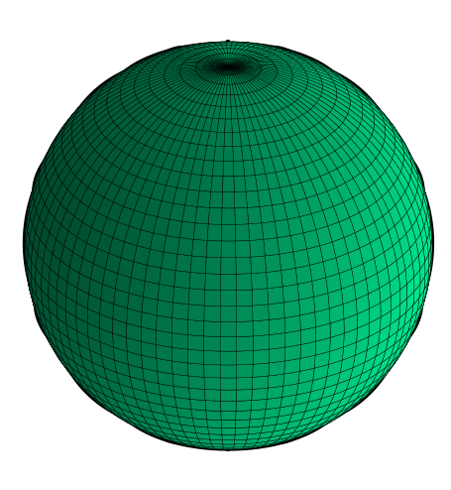
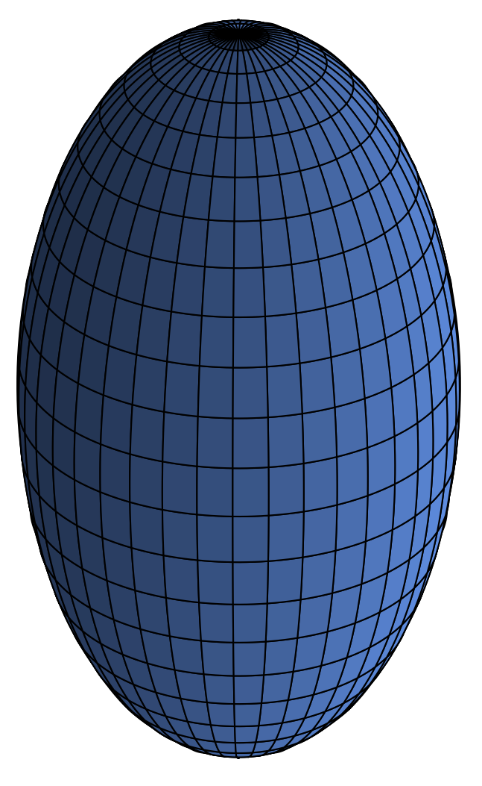
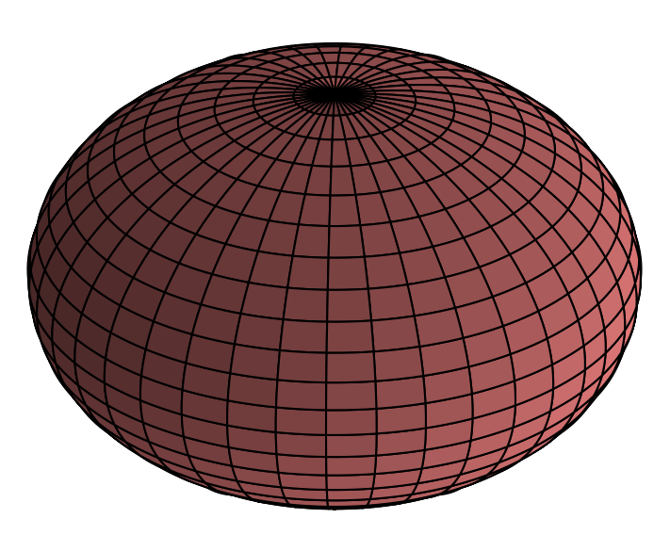
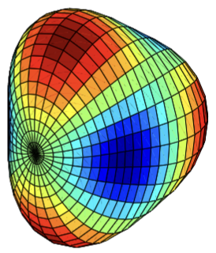
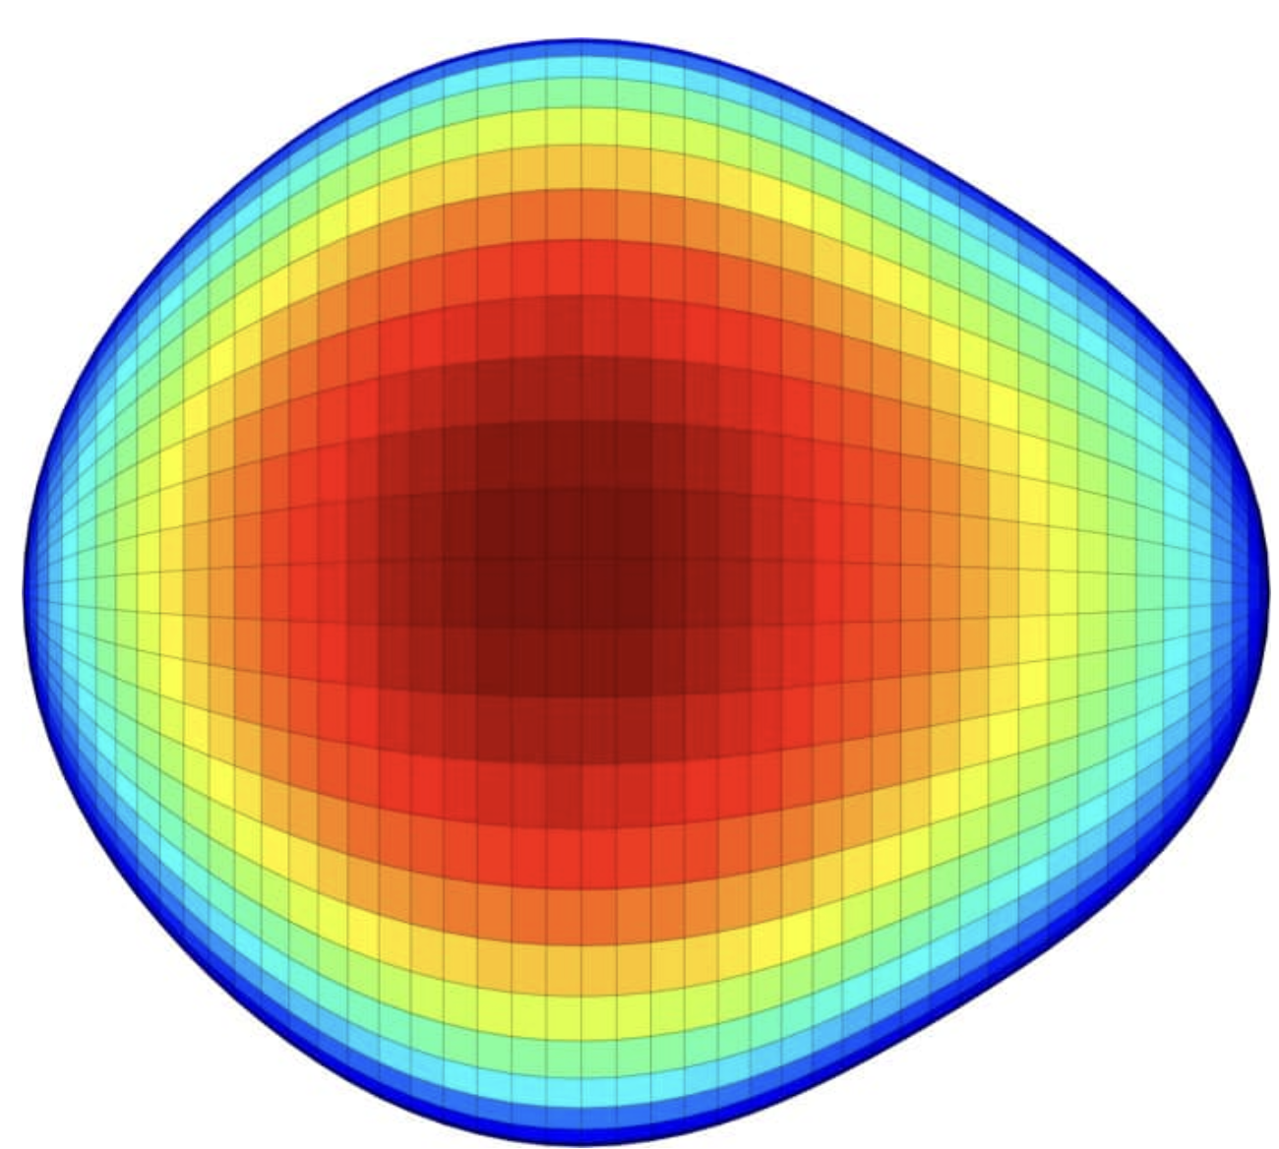
Physics of heavy elements
Nuclear Structure
Rare in heavier systems
Normally found around magic N, Z
Quadrupole Deformation
Prevalent deformation (in heavy actinides)
Often minimizes the nucleus’ total energy
Oblate g.s. more common in lighter nuclei
Often coexists with prolate deformation
Spherical
Oblate
Prolate
Exotic triaxiality (no symmetry axis) can occur
Higher order multipoles (pear shaped Ra-224)

Slide 4
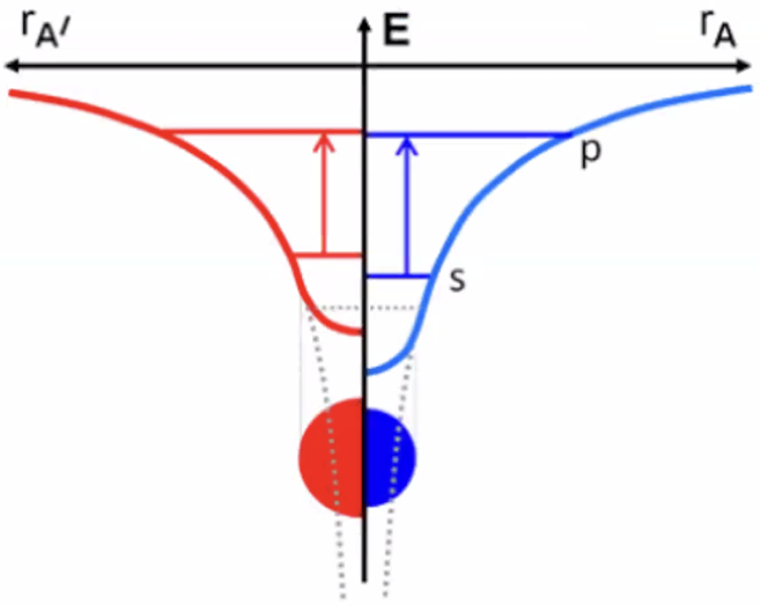
Physics of heavy elements
Isotope Shift
Frequency shift of an electronic transition for different N
Property connects electronic shell with nucleus
COM motion
Not to be confused with the (inverse) of the reduced mass
Field Shift F
Dominant
contribution in heavy systems
Mass Shift K
NMS
+
SMS

Slide 5
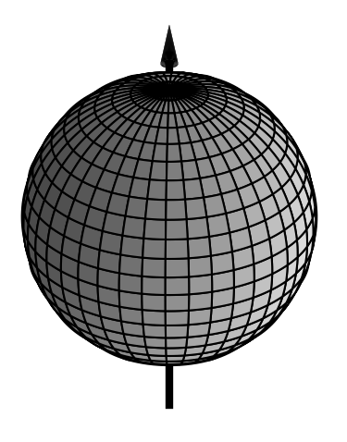
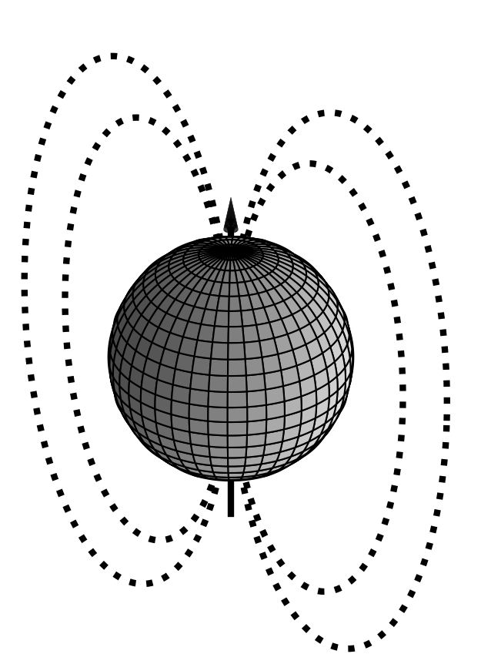
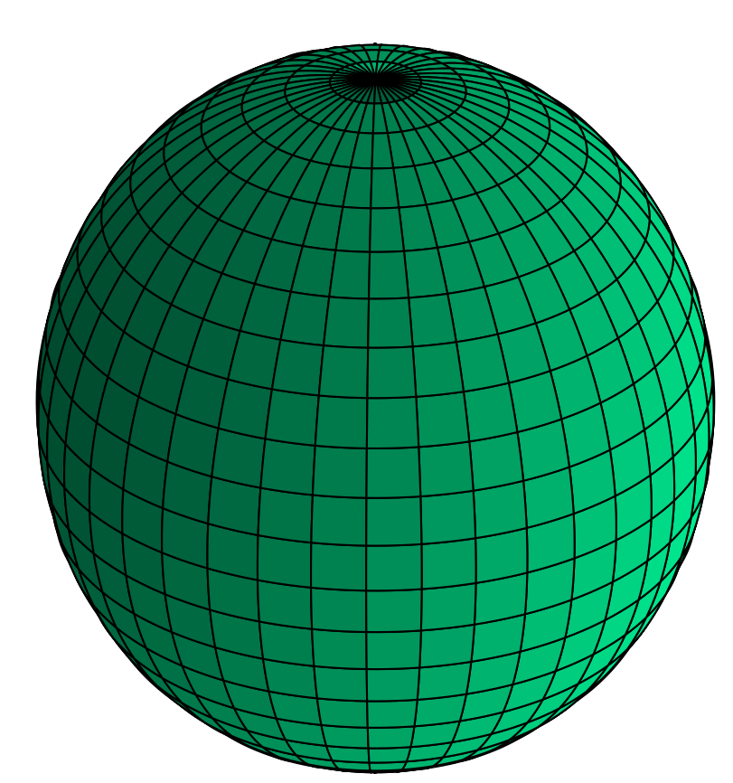
Deriving nuclear properties from laser Spectroscopy
Isotope shift
Size
Hyperfine splitting
x 100.000
Electromagnetic moments can be derived in a nuclear-model-independent way

Slide 6
Resonance ionization spectroscopy
Non resonant: no knowledge about level scheme needed
AI: higher cross section than non-resonant excitation
Rydberg: can be used to determine ionization potential
Laser spectroscopy is a highly selective and efficient technique

Slide 7
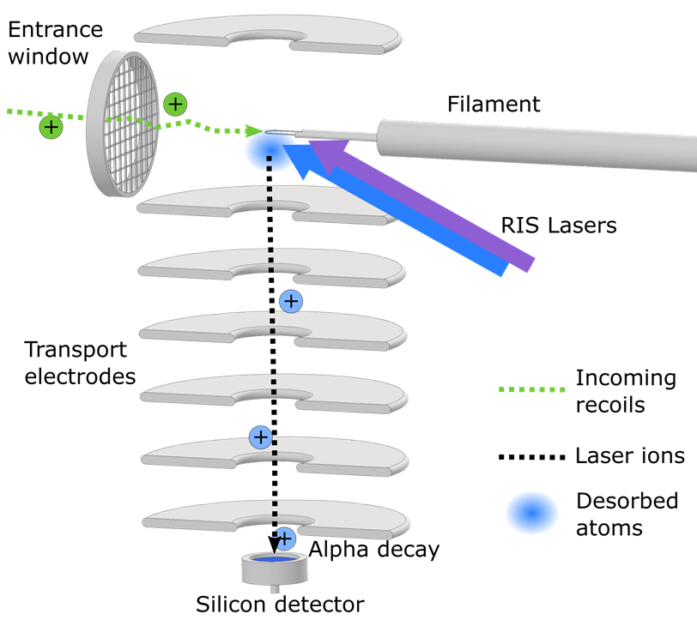
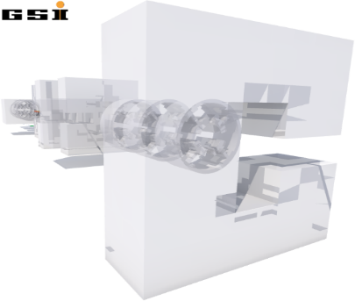
Radiation detected Resonance ionization spectroscopy (RADRIS)
Procedure:
Production and separation
Thermalizing incoming fusion products
Collection and neutralization on filament
Evaporation of neutral atoms
Two-step resonance laser ionization
Subsequent detection by α-decay
85 - 95 mbar
Ar
J. Warbinek et al., Atoms 10, 41 (2022)

Slide 8
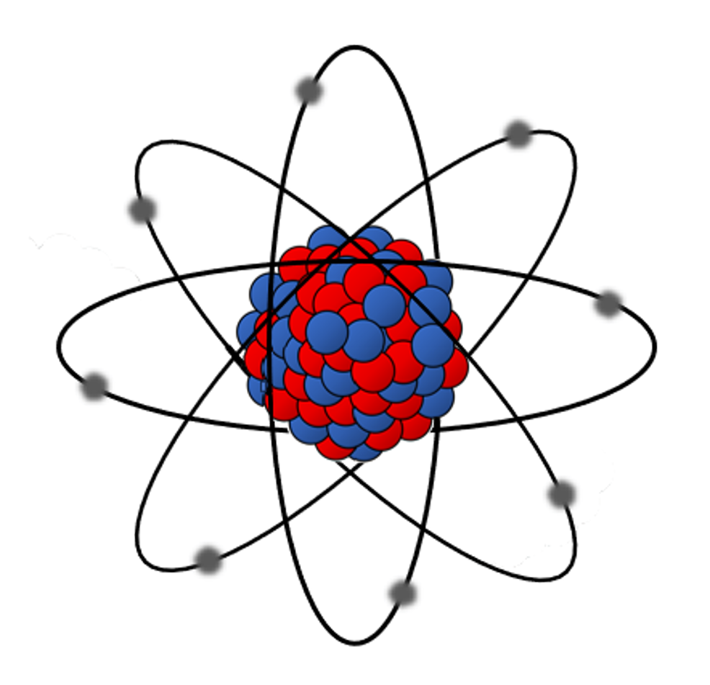
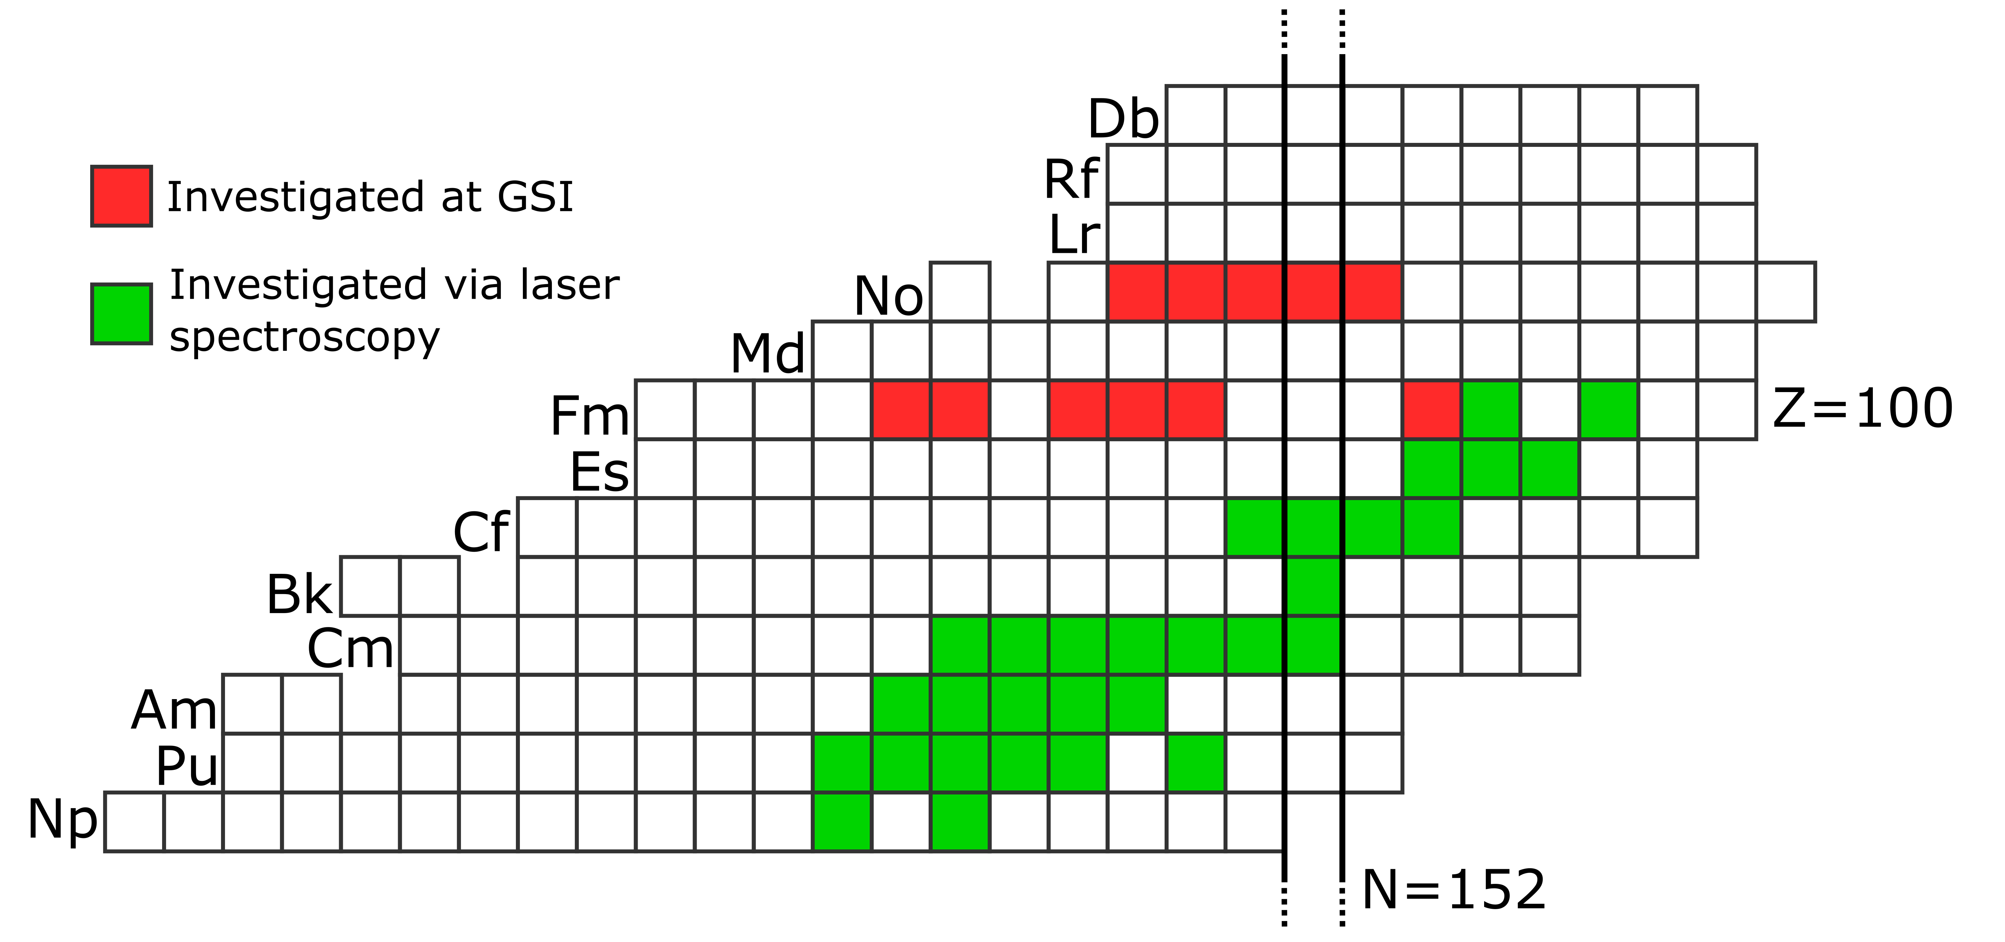
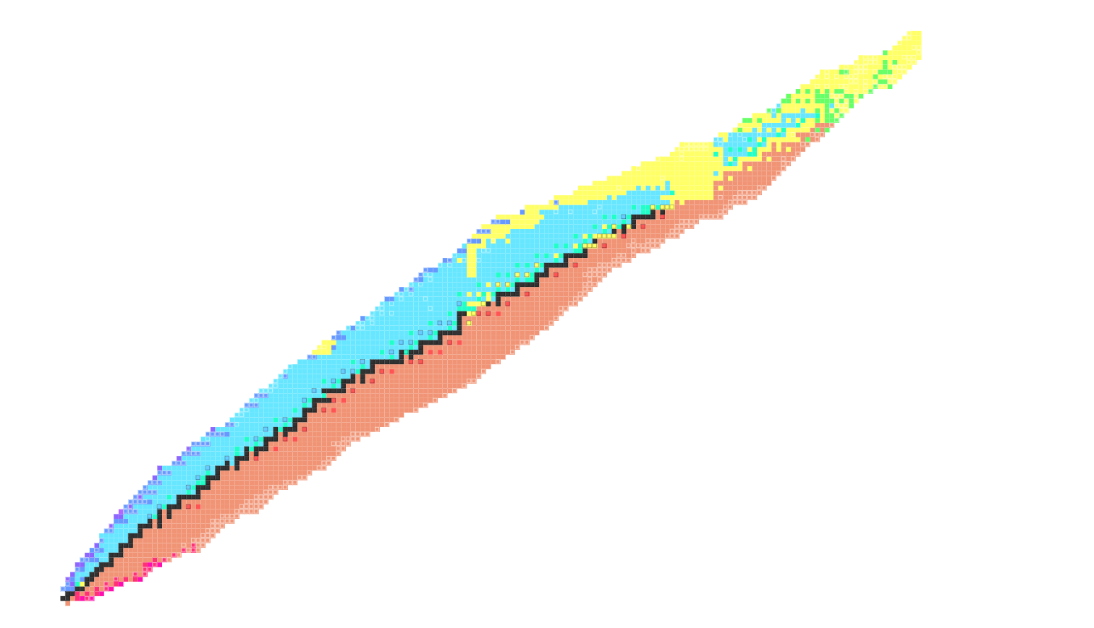









Isotopic chain in californium
$$Z$$
Primary decay mode
Stable
$$β^{−}$$
$${2β}^{−}$$
$$β^{+}$$
$${2β}^{+}$$
$$α$$
$$p/2p$$
Fission
$$n/2n$$
https://people.physics.anu.edu.au/~ecs103/chart/
$$N$$

Slide 9
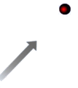
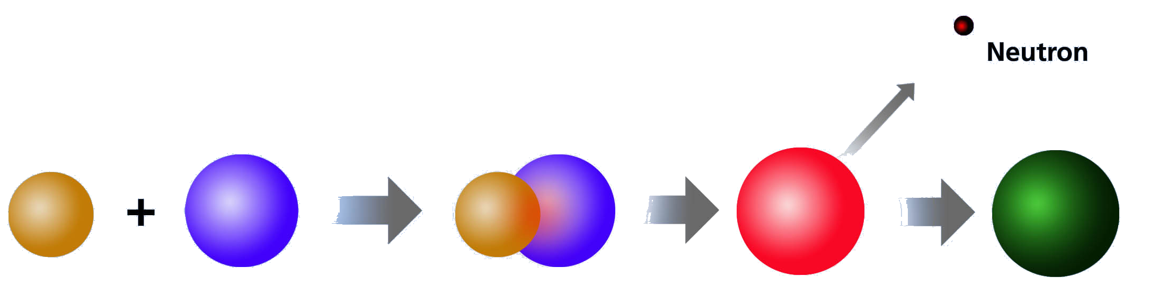







Production of Californium at gsi
Isotope | Half-life | Reaction | Ions per hour
$${}_{ }^{240}{Cf}$$ | $$0.96(15) min⁡$$ | ${}_{ }^{195}{Pt}({}_{ }^{48}{Ca, 3n}$) | $≈$ 1
$${}_{ }^{241}{Cf}$$ | $$3.78(70) min⁡$$ | ${}_{ }^{196}{Pt}$(${}_{ }^{48}{Ca},3n$) | 1 - 1.5
$${}_{ }^{242}{Cf}$$ | $$3.5(2) min⁡$$ | ${}_{ }^{196}{Pt}$(${}_{ }^{48}{Ca},2n$) | 5 - 6
$${}_{ }^{244}{Cf}$$ | $$19.4(6) min⁡$$ | ${}_{ }^{198}{Pt}$(${}_{ }^{48}{Ca},2n$) | 9 - 10
$${}_{ }^{246}{Cf}$$ | $$35.7(5) h$$ | ${}_{ }^{208}{Pb}$(${}_{ }^{48}{Ca},2n$) $${}_{ }^{254}{No} {}_{ }^{246}{Cf}$$ | 18 - 22
$${}_{ }^{48}{Ca}$$
$${}_{ }^{195−198}{Pt}$$
$${}_{ }^{240−246}{Cf}$$
$${}_{ }^{208}{Pb}$$
Direct production of ${}_{ }^{240−244}{Cf}$ with $Pt$
Indirect production via ${}_{ }^{254}{No}$ via subsequent $α$decays
Long half-life challenging for RADRIS method
Notes:
$σ≈2μb$, Usual cross sections in the nb region

Slide 10


Isotope shifts
Reference Isotope
$${}_{ }^{250}{Cf}$$
Preliminary
Weber et al. Atoms 2022, 10(2), 51

Slide 11
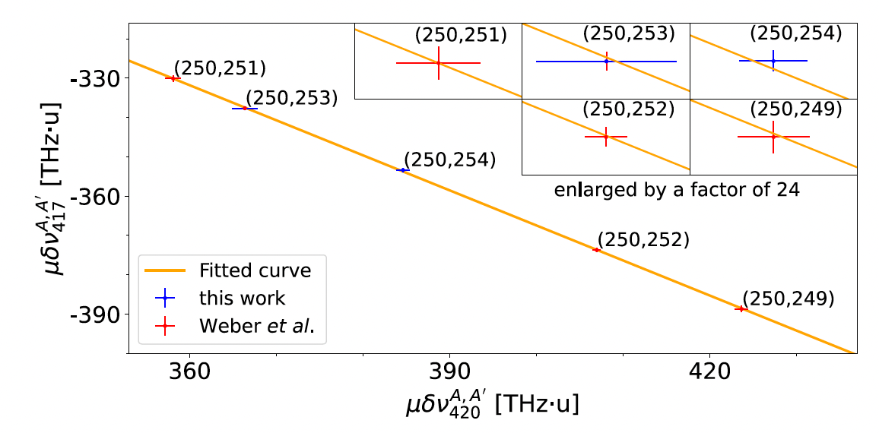

From isotope shift to changes in mean-square charge radii
Weber et al. Atoms 2022, 10(2), 51
$${}_{ }^{250}{Cf}$$
Input from atomic theory
(CI, MCDHF,…)
High uncertainty due to large number if open f-shells in the actinides

Slide 12
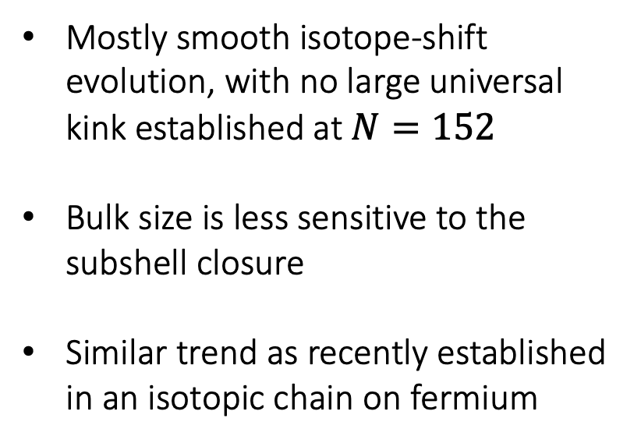
From isotope shift to changes in mean-square charge radii
Mostly smooth isotope-shift evolution, with no large universal kink established at $N=152$
Bulk size is less sensitive to the subshell closure
Similar trend as recently established in an isotopic chain on fermium
Preliminary

Slide 13
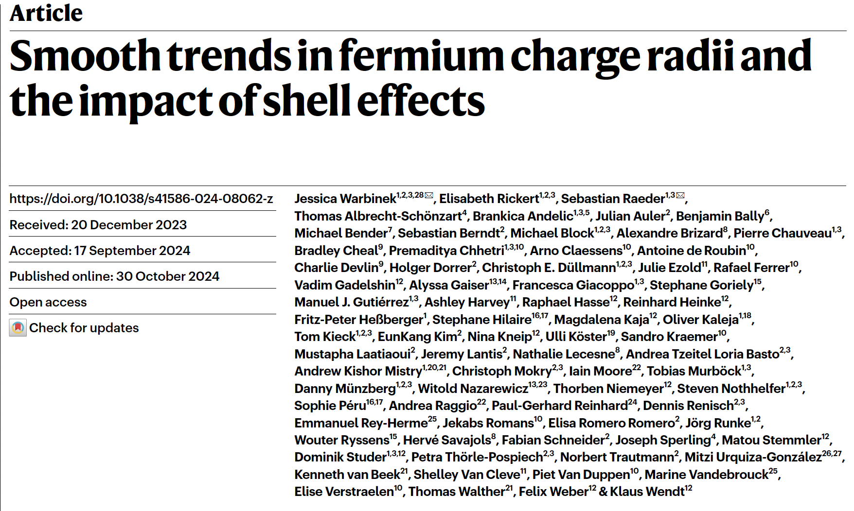
From isotope shift to changes in mean-square charge radii
Mostly smooth isotope-shift evolution, with no large universal kink established at $N=152$
Bulk size is less sensitive to the subshell closure
Similar trend as recently established in an isotopic chain on fermium
Preliminary

Slide 14
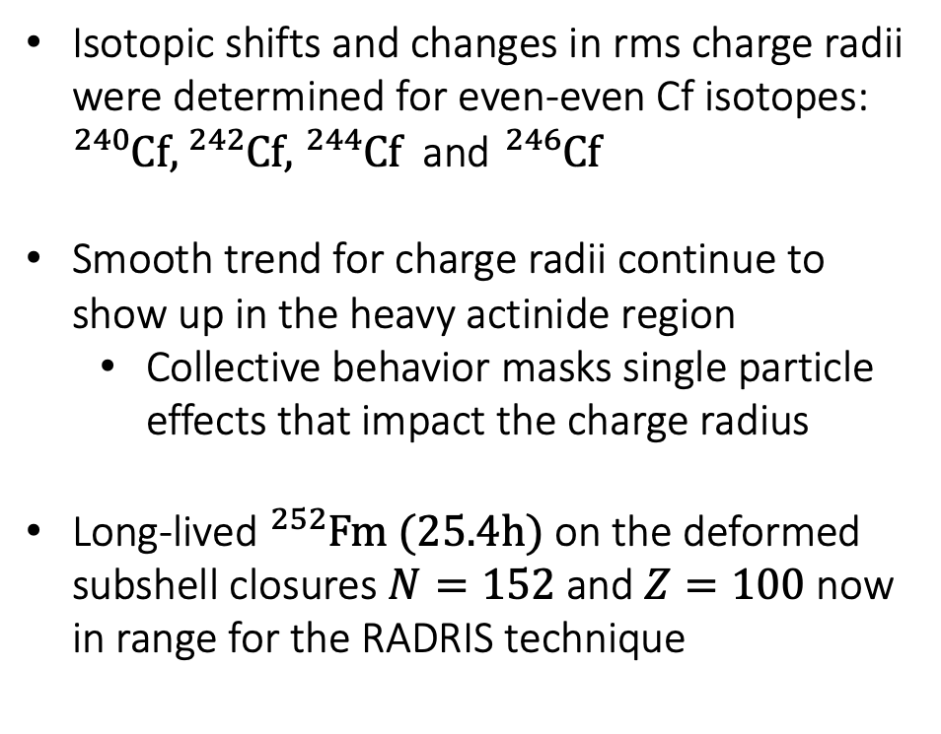
Summary And outlook
Isotopic shifts and changes in rms charge radii were determined for even-even Cf isotopes: ${}_{ }^{240}{Cf},{}_{ }^{242}{Cf},$ ${}_{ }^{244}{Cf}$ and ${}_{ }^{246}{Cf}$
Smooth trend for charge radii continue to show up in the heavy actinide region
  Collective behavior masks single particle effects that impact the charge radius
Long-lived ${}_{ }^{252}{Fm (25.4h)}$ on the deformed subshell closures $N=152$ and $Z=100$ now in range for the RADRIS technique
Preliminary

Slide 15











GSI Darmstadt
M. Block, F. Giacoppo, F.P. Heßberger, A. Mistry, S. Raeder, J. Warbinek, A.Yakushev, B. Hartigan, M. Gutiérrez-Torres,
KU Leuven
A. Claessens, R. Ferrer, S. Kraemer, P. Van Duppen,
F. Ivandikov, Harshithbabu
Universität Mainz
Ch. E. Düllmann, M. Stemmler, K Wendt, S. Berndt, Th. Niemeyer, R. Hasse, P. Chhetri,
TU Darmstadt
Th. Walther, K. van Beek
RUG Groningen
T. Van de Vendel, J. Even
Helmholtz Institut Mainz
D. Münzberg, E. Rickert, T. Kieck, D. Studer, J. Hindermann, J. Weyrich
GANIL / LPC Caen / Orsay
N. Lecesne, A. Lopez, V. Marchant, H. Savajols, V. Manea, A. Brizard, S. Geldhof, A. De Roubin, E. Morin, D. Ackermann, M. Laatiaoui,
TRIUMF Vancouver
P. Kunz
University of Granada
D. Rodriguez
University of Jyväskylä
A. Raggio
Thank you for your attention !
This Marie Sklodowska-Curie Action (MSCA) Innovative Training Network (ITN) receives funding from the European Union H2020 Framework Programme under grant agreement no. 861198.

Slide 16
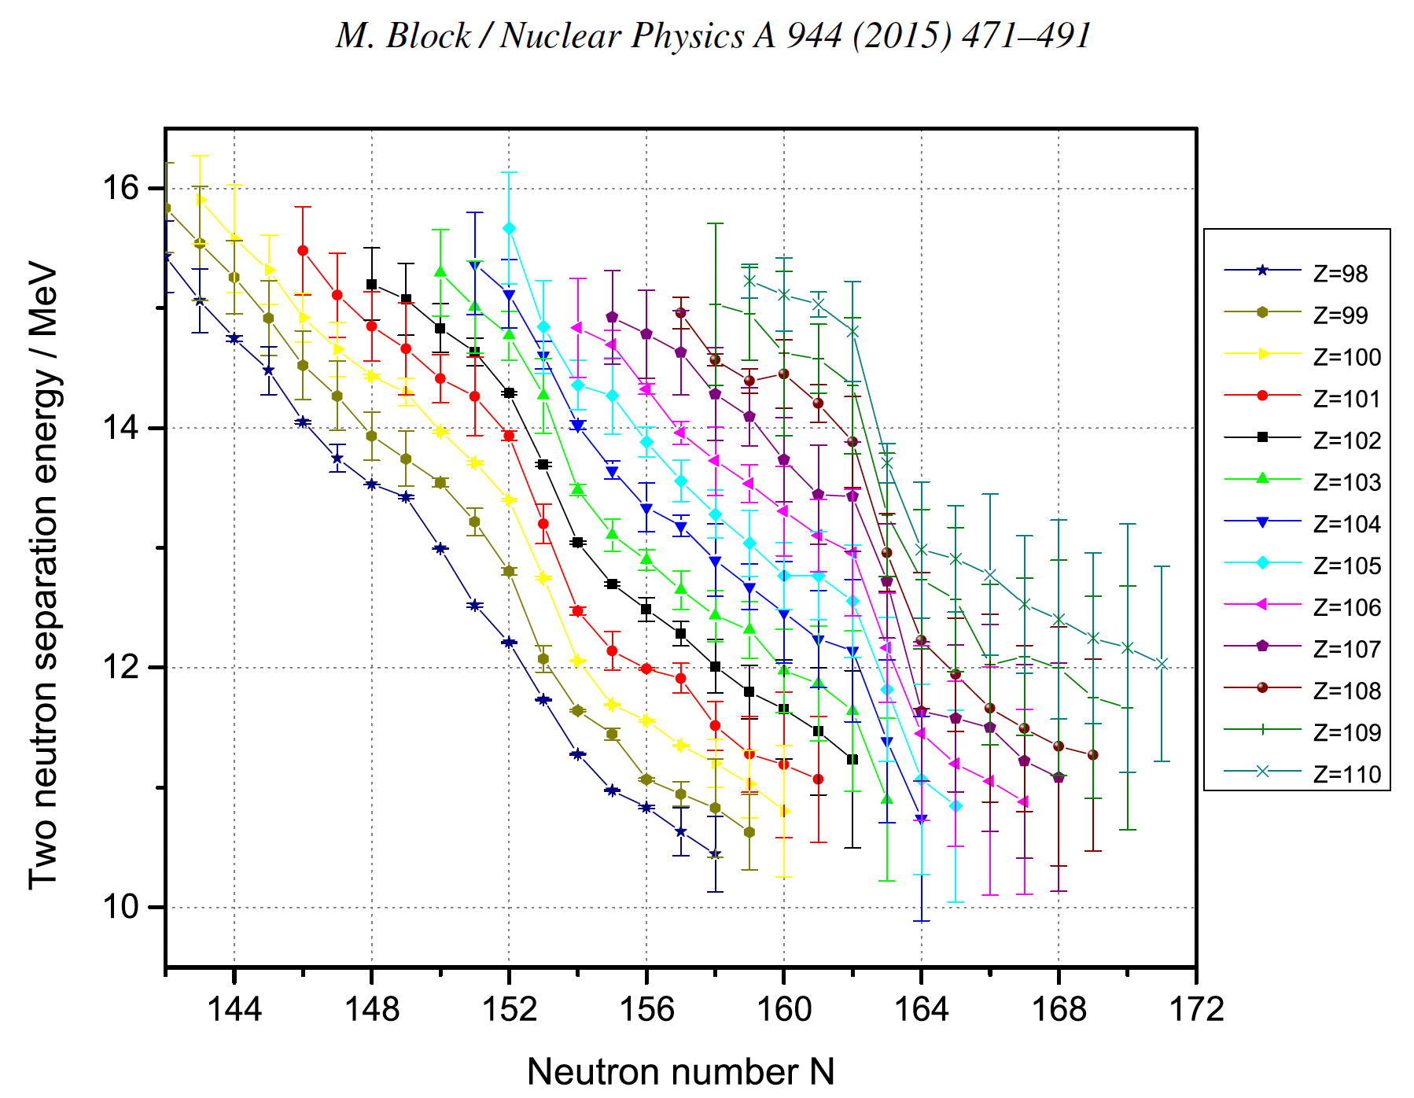
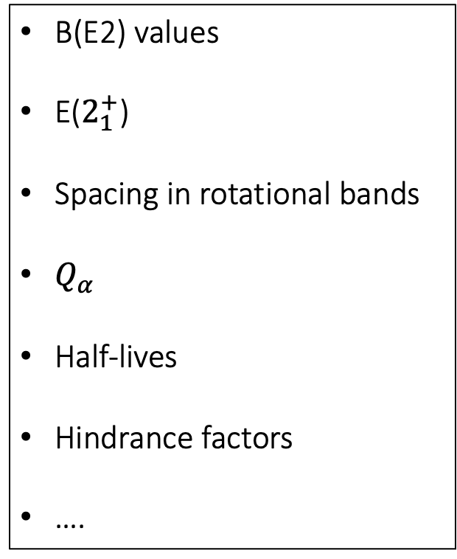
Shell effect sensitive quantities
B(E2) values
E($2_{1}^{+}$)
Spacing in rotational bands
$Q_{α}$
Half-lives
Hindrance factors
….

Slide 17
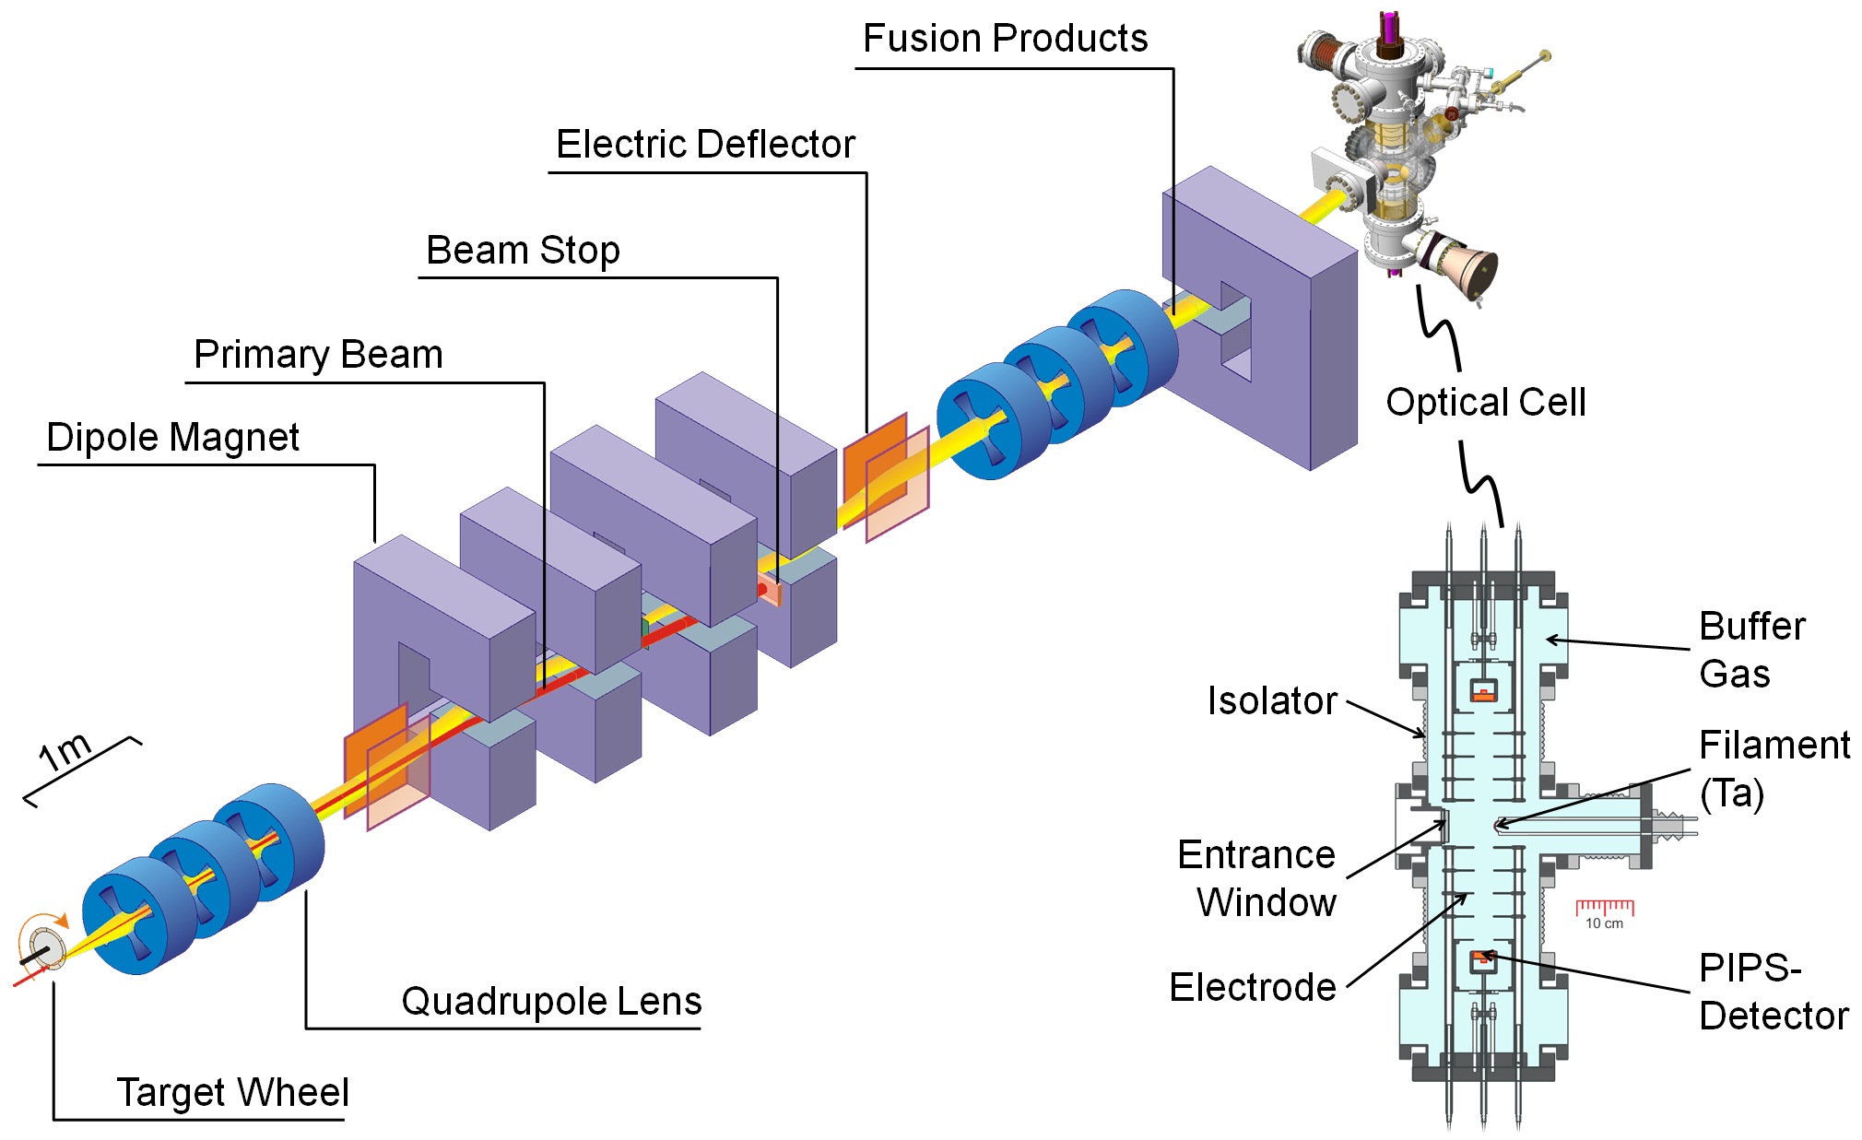
Producing heavy elements
Impinge rotating target wheel with beam
Fusion-evaporation reaction
Separating compound nuclei from primary beam
H. Backe, W. Lauth, M. Block, M. Laatiaoui, , Nuclear Physics A, (2015)
Injection into setup
Notes:
$σ≈2μb$, Usual cross sections in the nb region

Slide 18
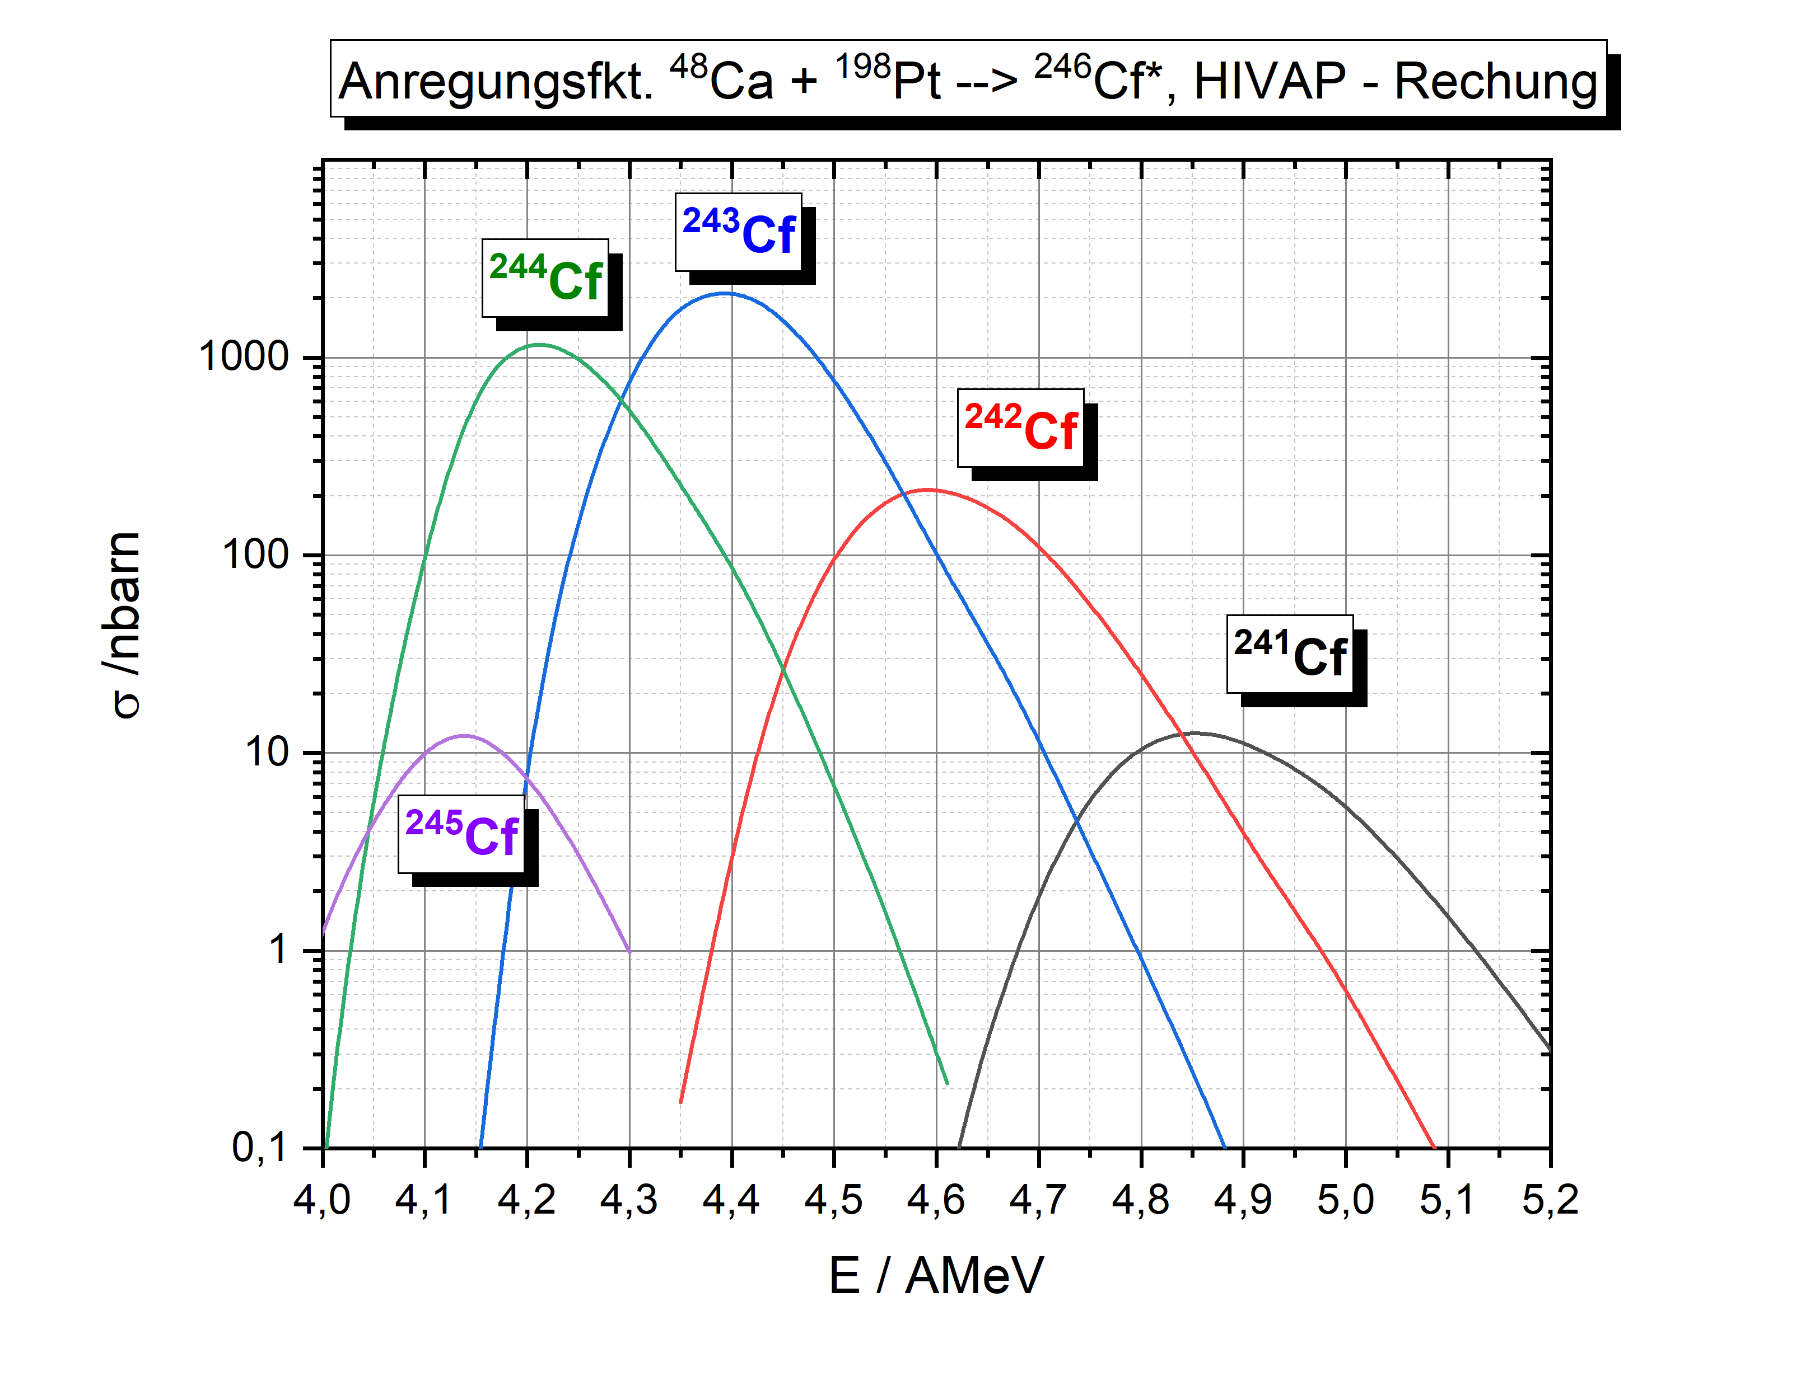
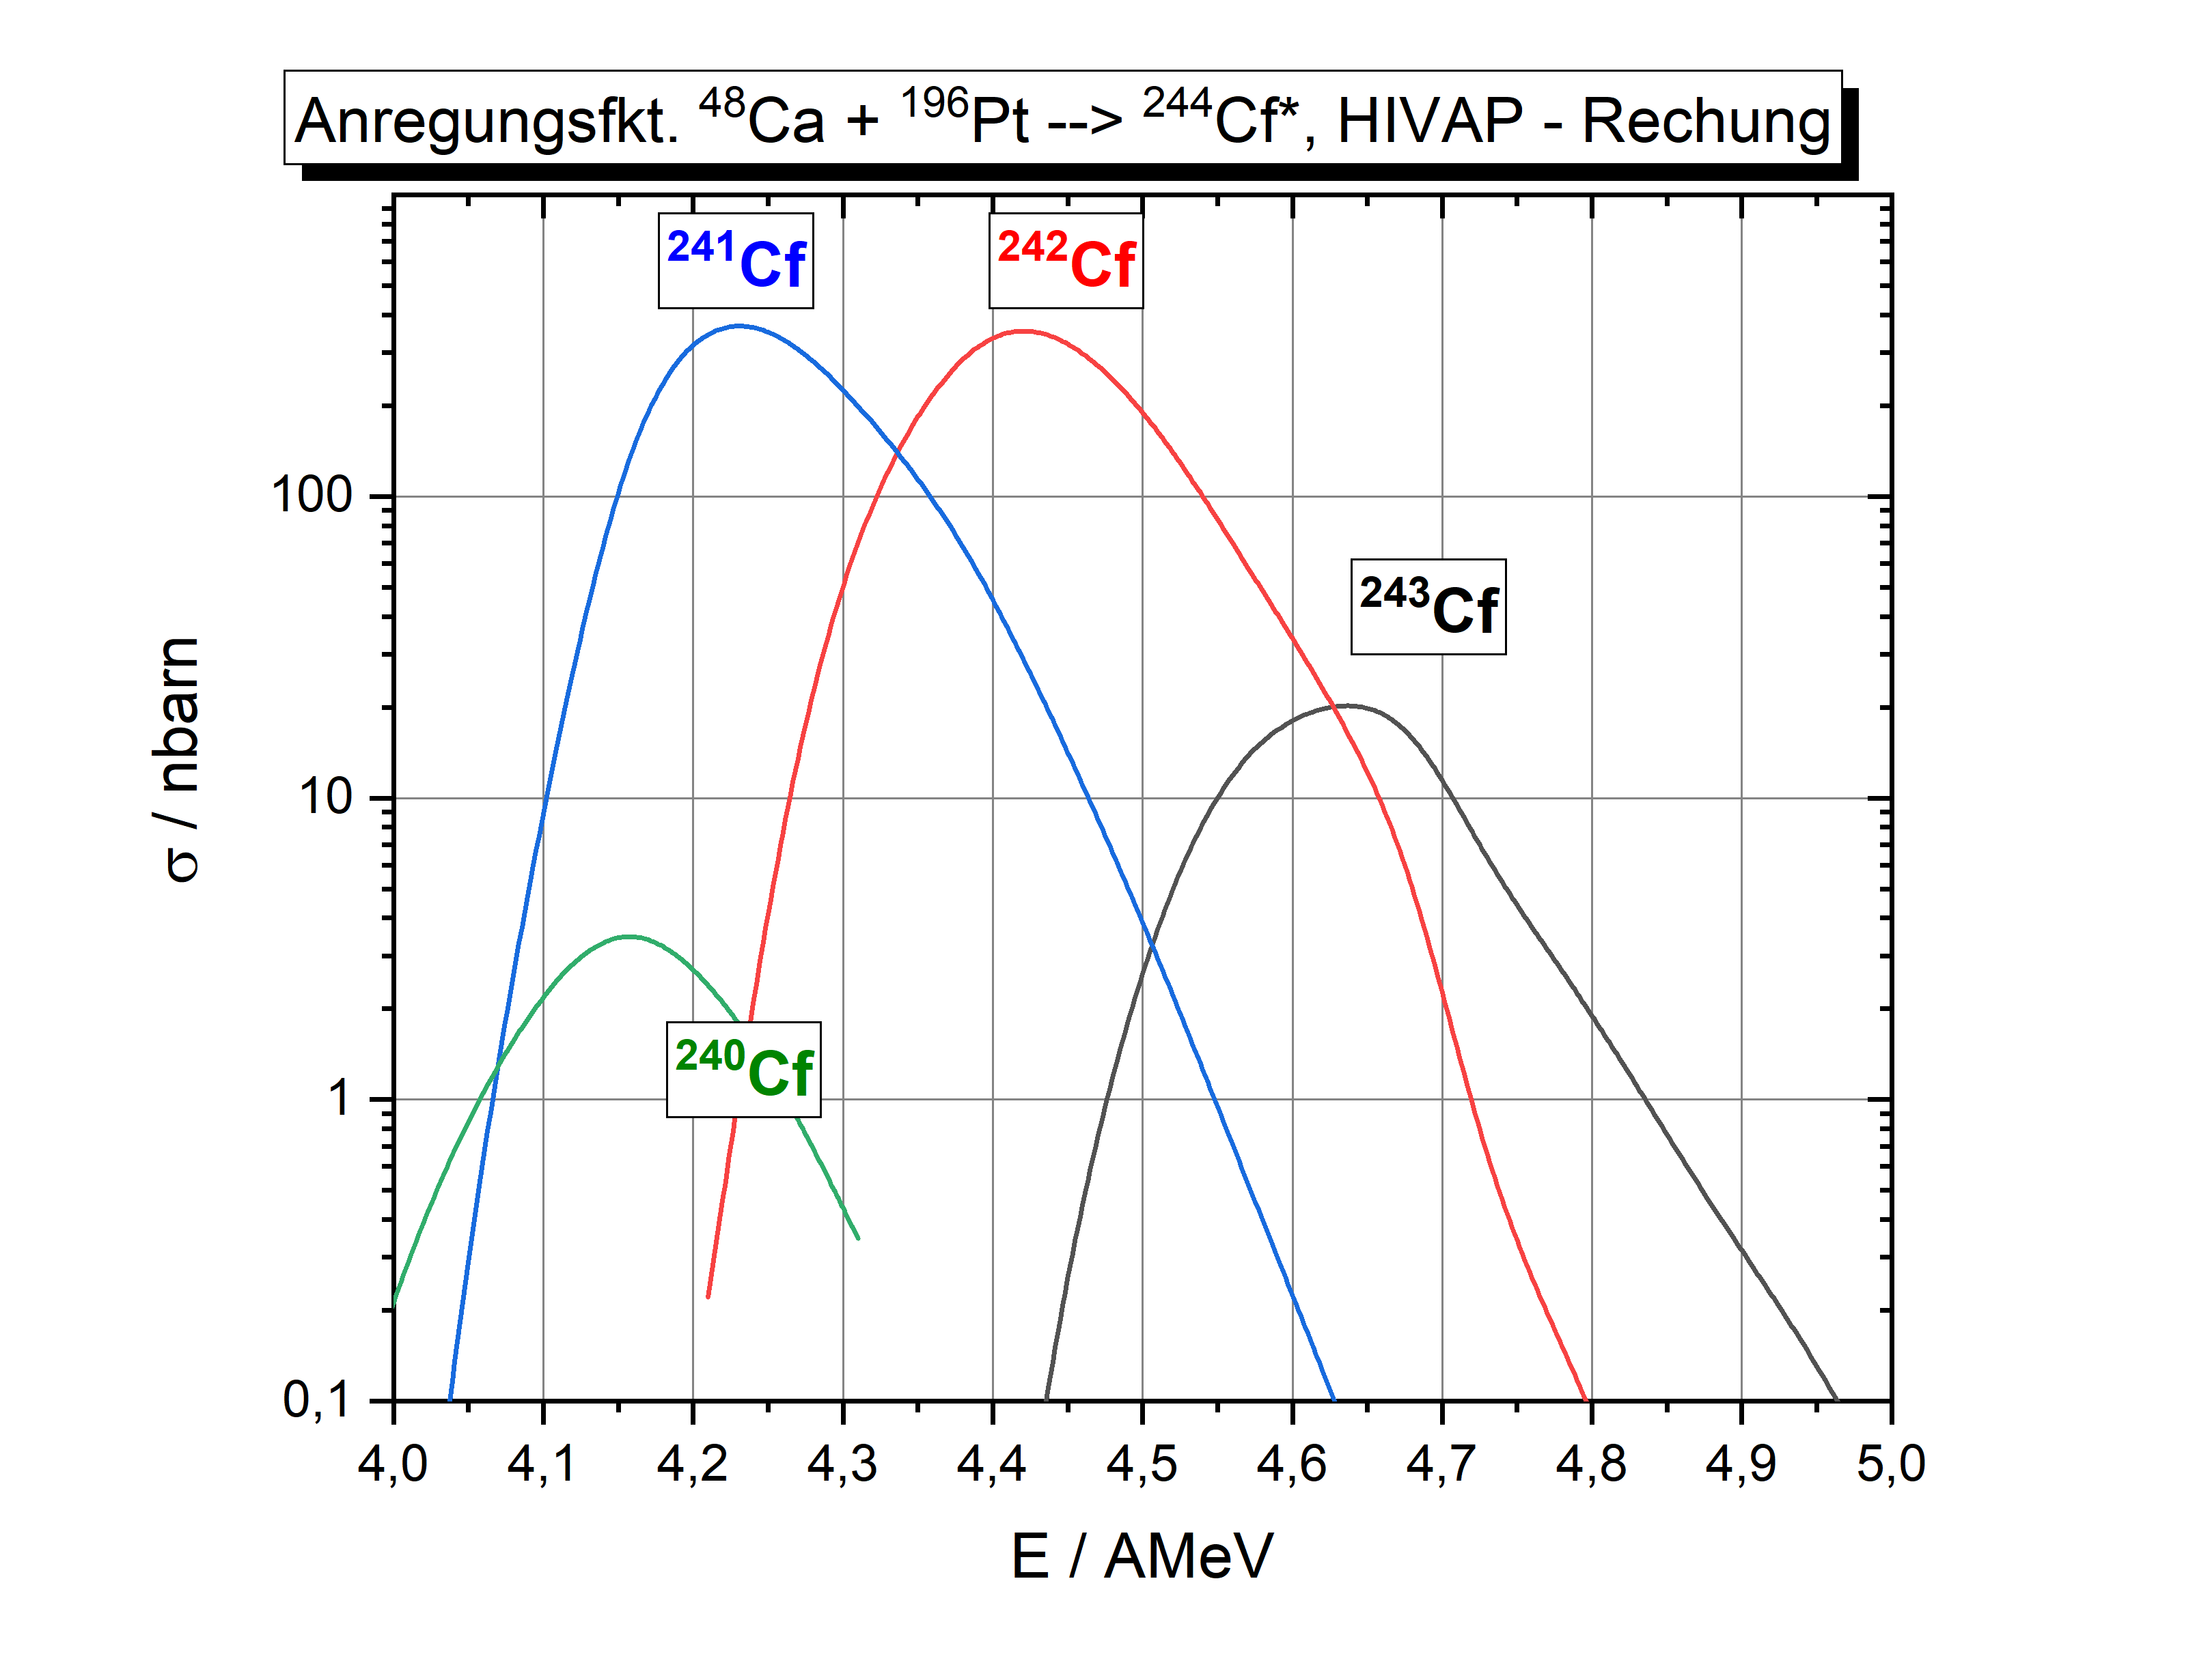

Slide 19
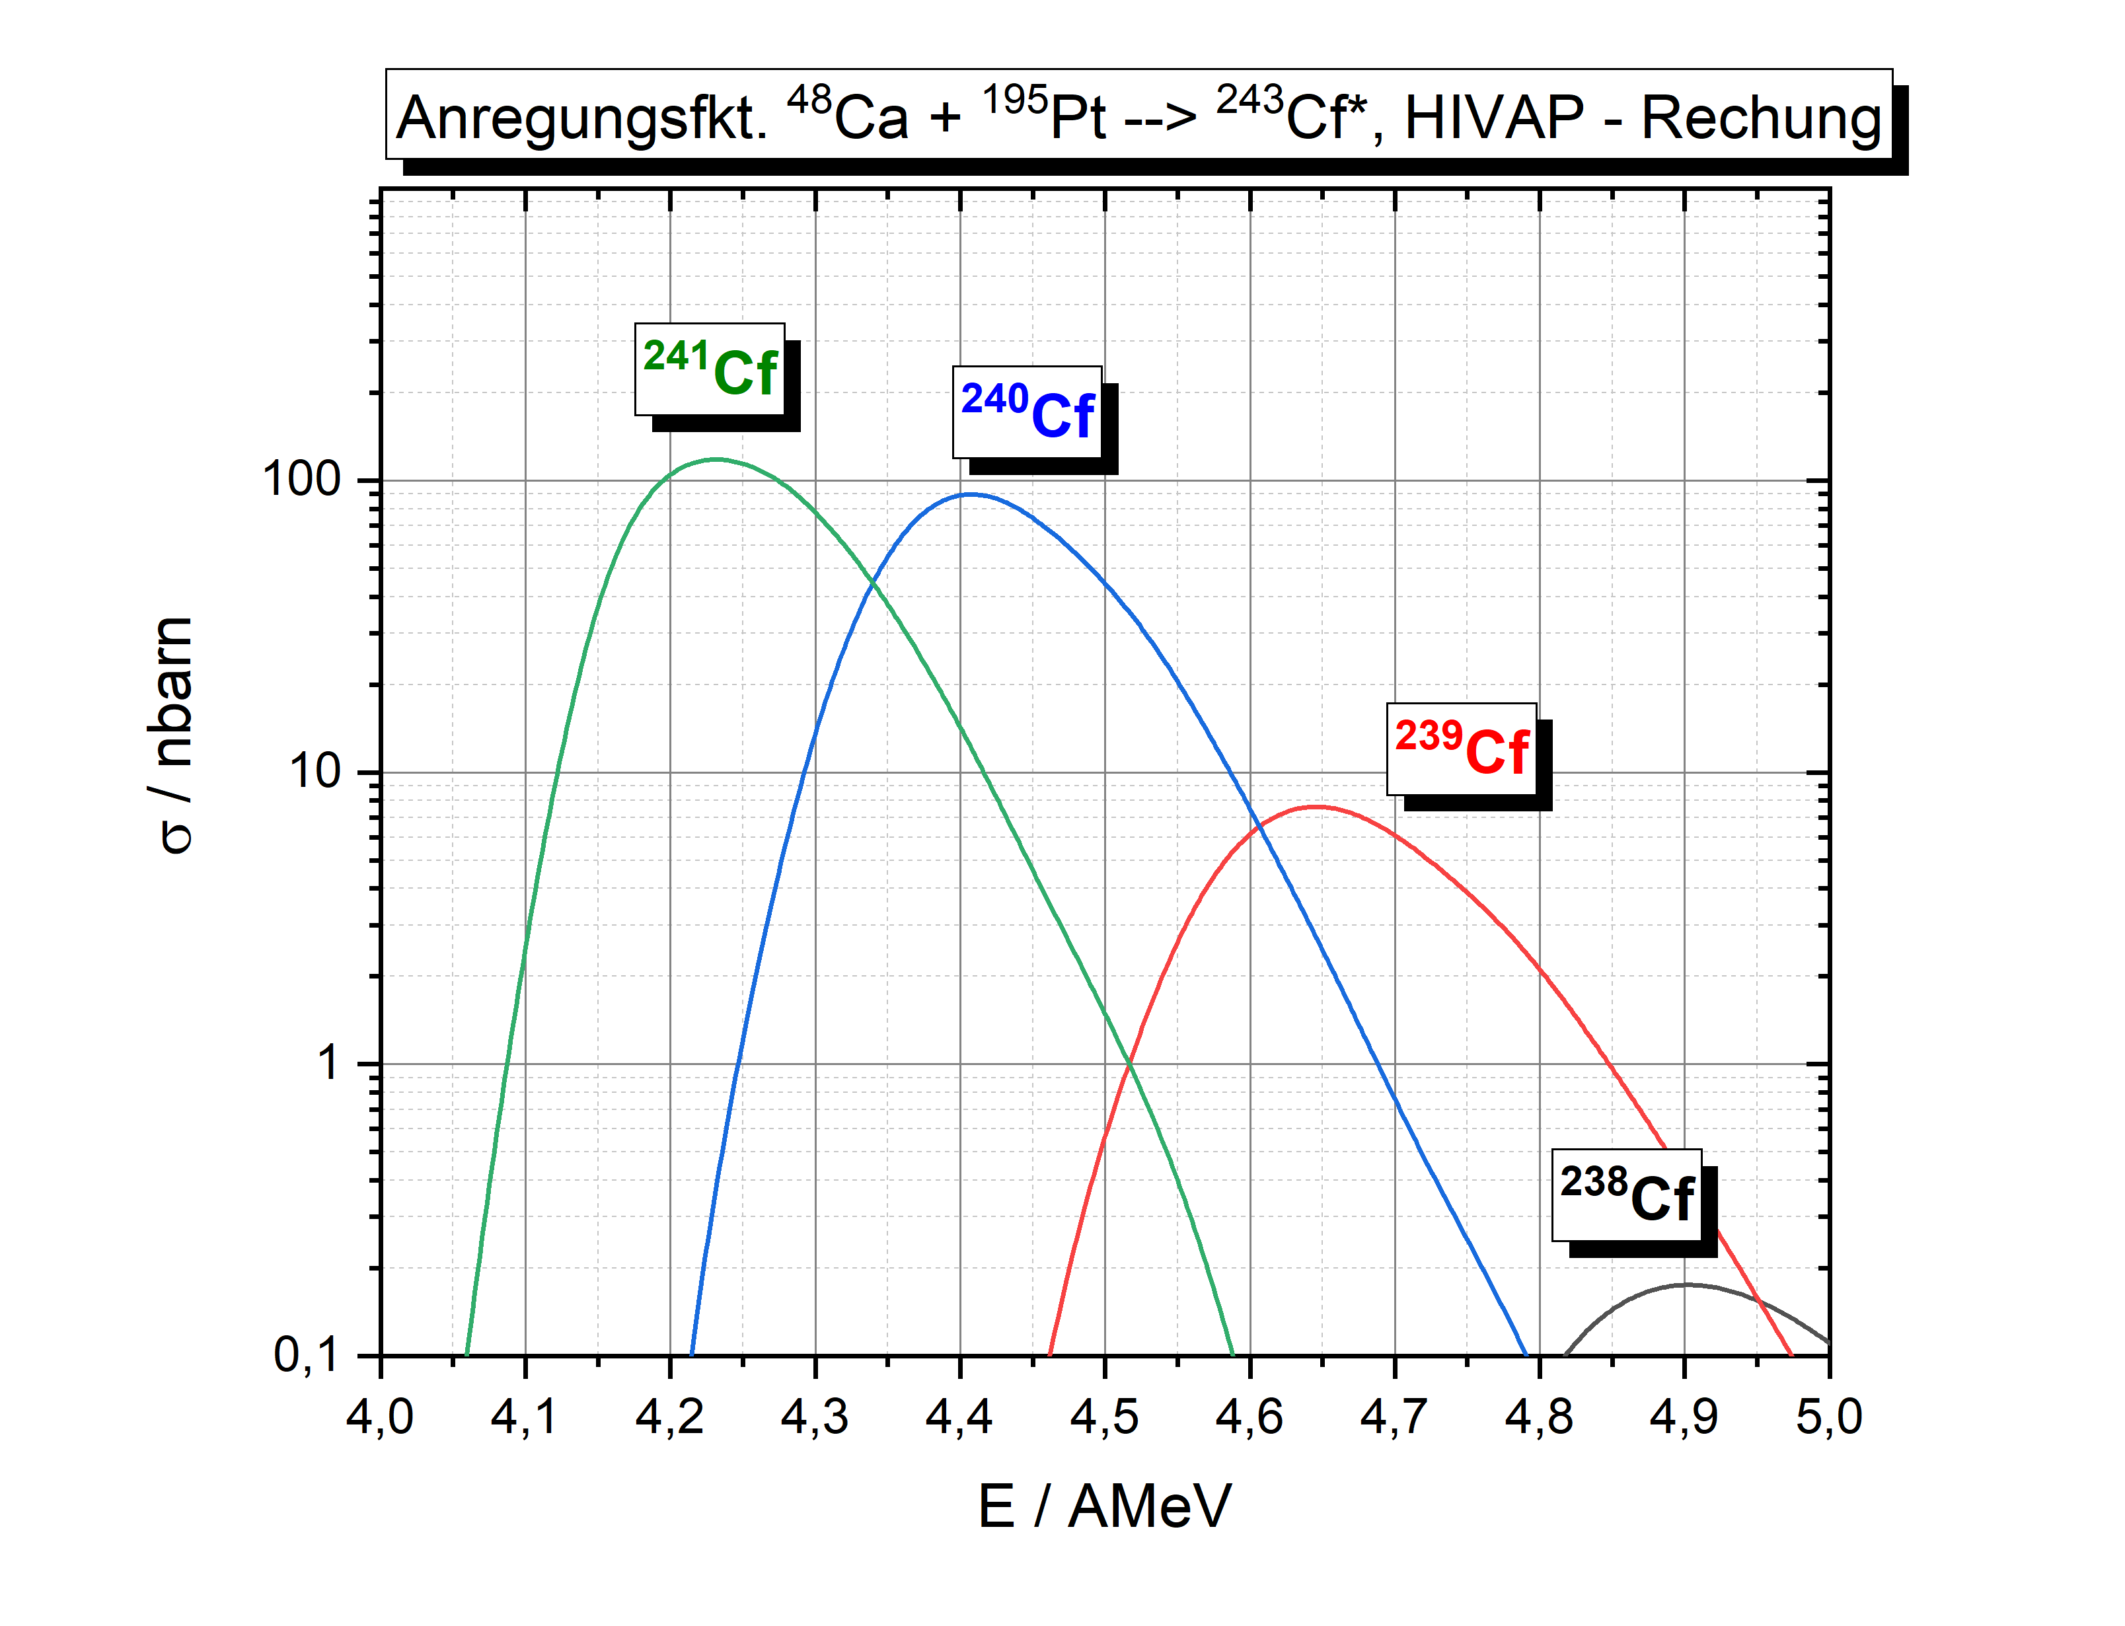
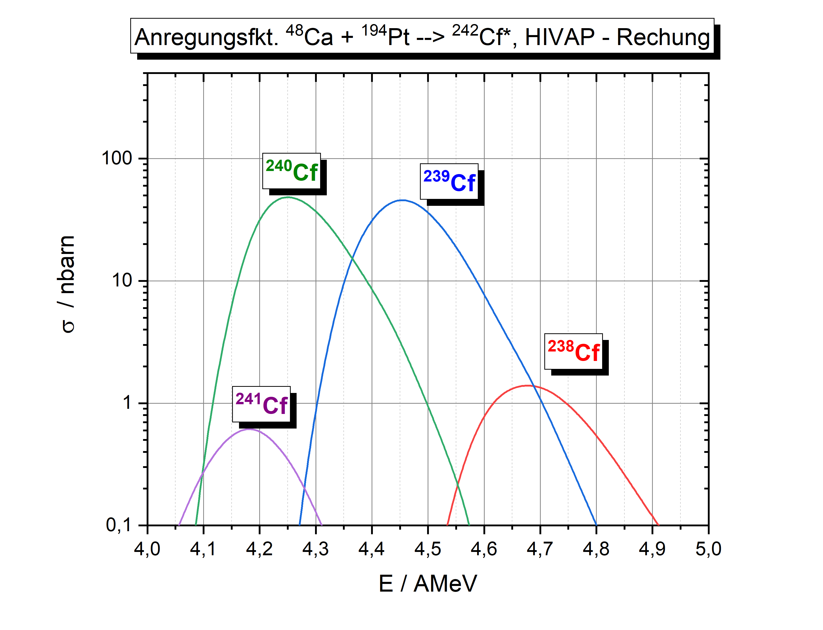

Slide 20
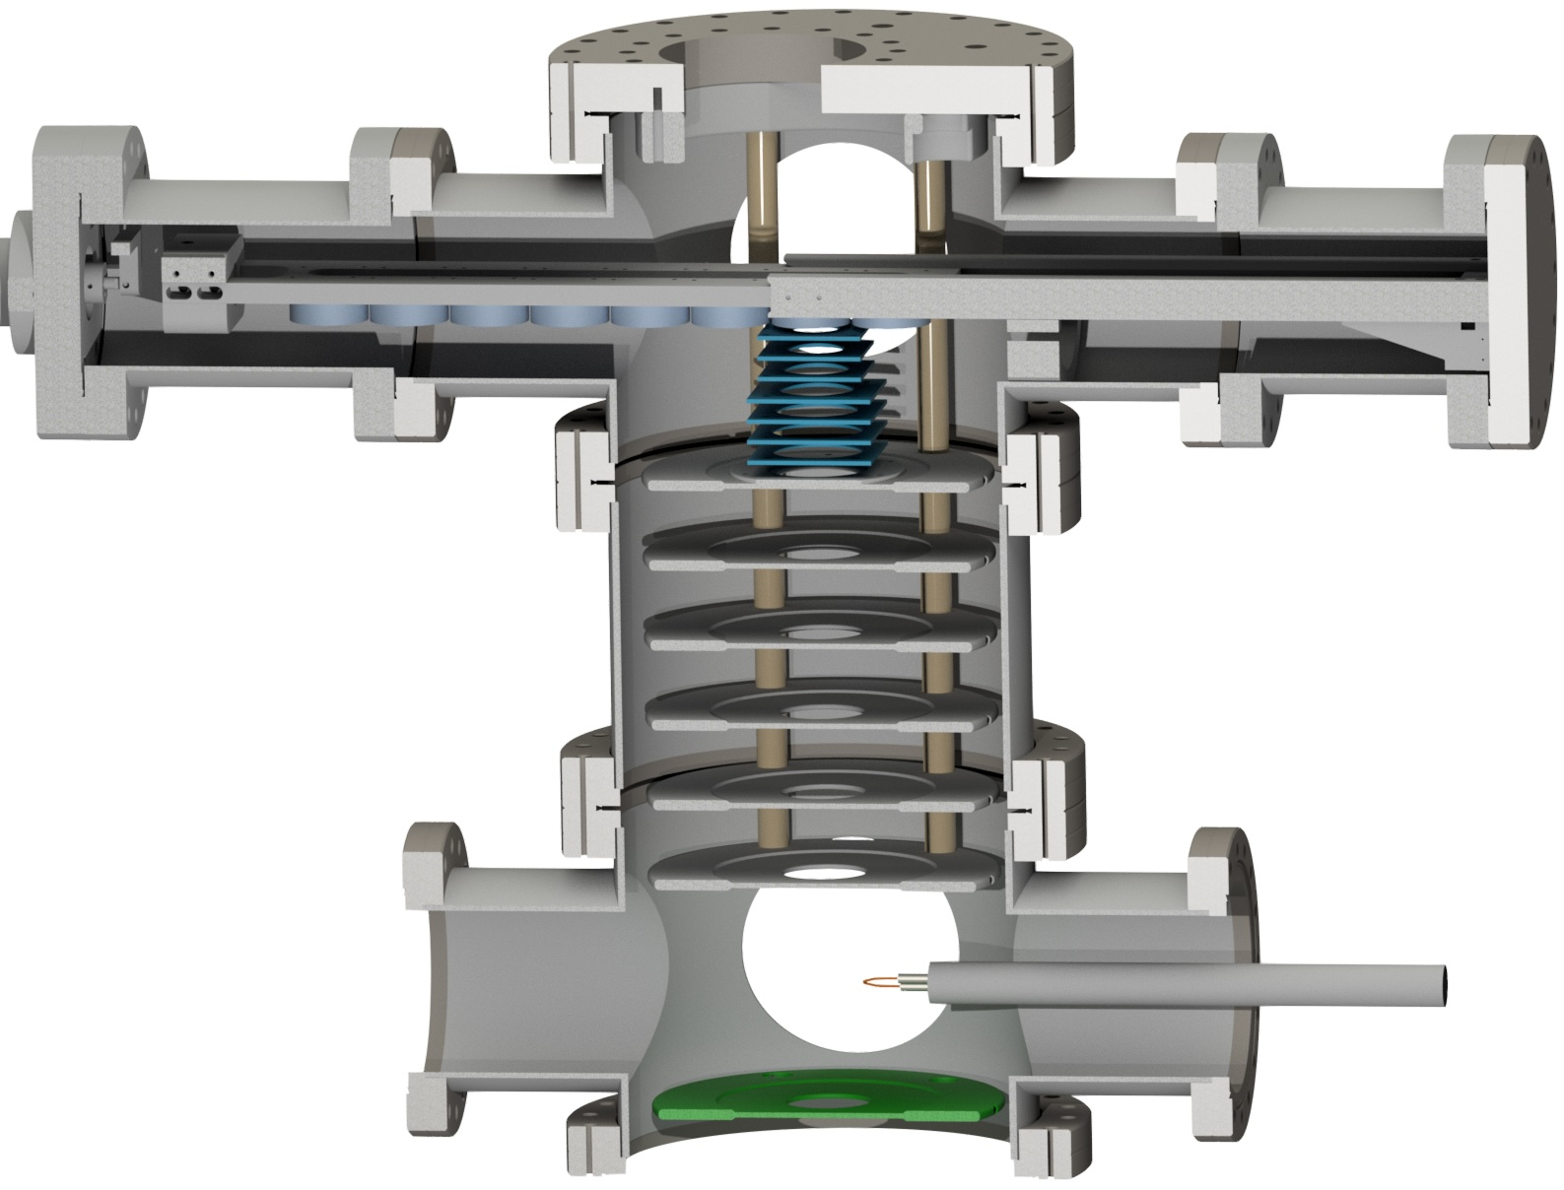
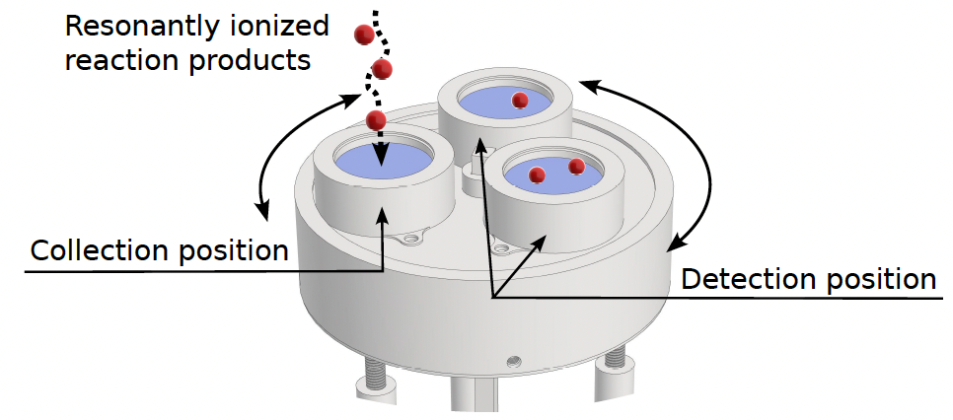




Long half-lives: a challenge for radris
Three rotatable detectors
Array of eight detectors
$${}_{ }^{254}{Fm}$$
$$3.2h$$
$${}_{ }^{246}{Cf}$$
$$35.7h$$
Access to longer-lived nuclei

Slide 21
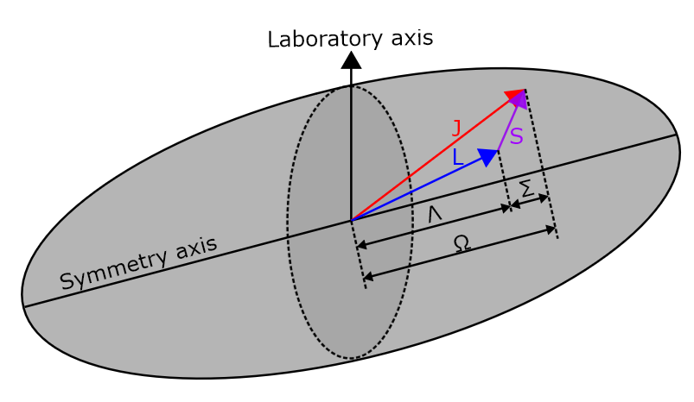
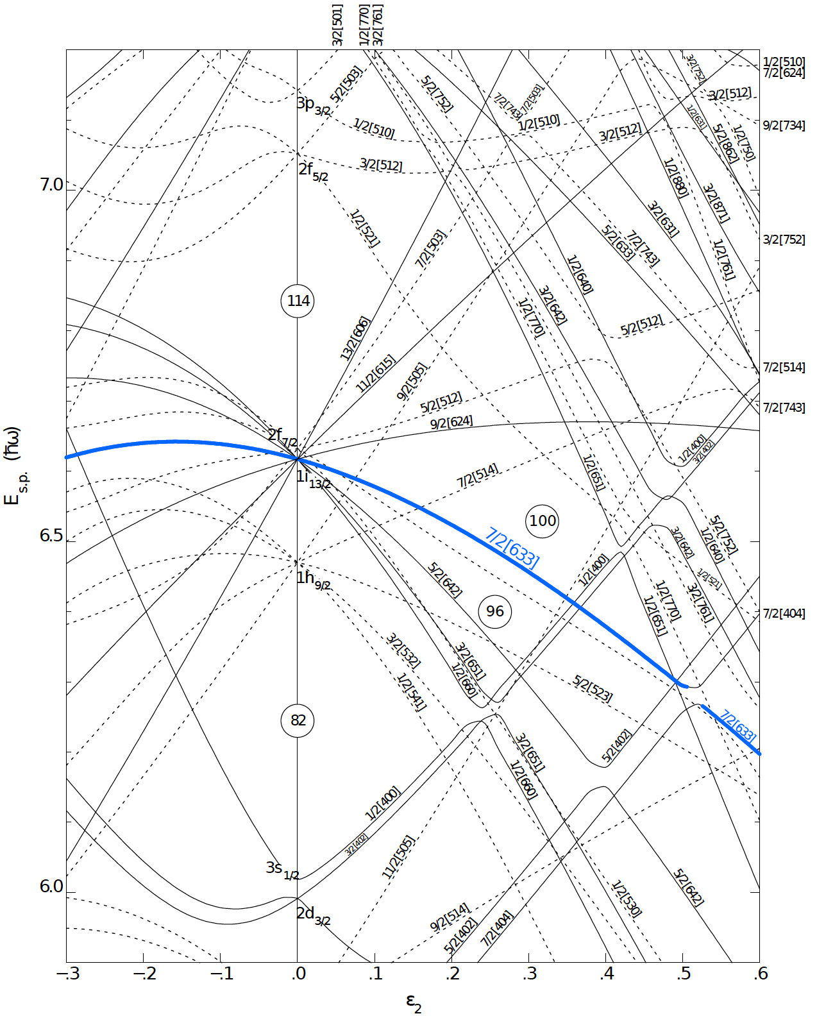
Physics of heavy elements
Nilsson model
Mean-field potential
Quantum Numbers
Nilsson label
States
Deformation
How do orbitals evolve with deformation?

Slide 22




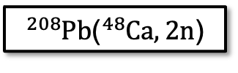






Cycle for californium 246
$${}_{ }^{254}{No}$$
Production
${}_{ }^{208}{Pb}$(${}_{ }^{48}{Ca},2n$)
$$51.2s$$
$$σ≈2 µb$$
$$90\%$$
$${}_{ }^{250}{Fm}$$
Breeding on filament
$$30min$$
$$>90\%$$
$${}_{ }^{246}{Cf}$$
Spectroscopy
$$35.7h$$
Breeding increases Cf yield and decreases possible background from Fm
Prolonging cycle past 75 min doesn’t significantly increase gain
$$100\%$$

Slide 23
Cycle for californium 246
$${}_{ }^{254}{No}$$
Production
${}_{ }^{208}{Pb}$(${}_{ }^{48}{Ca},2n$)
$$51.2s$$
$$σ≈2 µb$$
$$90\%$$
$${}_{ }^{250}{Fm}$$
Breeding on filament
$$30min$$
$$>90\%$$
$${}_{ }^{246}{Cf}$$
Spectroscopy
$$35.7h$$
$$100\%$$
Cycle time optimized based on half-life of nuclide of interest

Slide 24
Cycle for californium 246
$${}_{ }^{254}{No}$$
Production
${}_{ }^{208}{Pb}$(${}_{ }^{48}{Ca},2n$)
$$51.2s$$
$$σ≈2 µb$$
$$90\%$$
$${}_{ }^{250}{Fm}$$
Breeding on filament
$$30min$$
$$>90\%$$
$${}_{ }^{246}{Cf}$$
Spectroscopy
$$35.7h$$
$$100\%$$
Efficiency is given by normalizing abundance over time

Slide 25

Cycle for californium 246
$${}_{ }^{254}{No}$$
Production
${}_{ }^{208}{Pb}$(${}_{ }^{48}{Ca},2n$)
$$51.2s$$
$$σ≈2 µb$$
$$90\%$$
Slow ingrow
$${}_{ }^{250}{Fm}$$
Breeding on filament
$$30min$$
$$>90\%$$
$${}_{ }^{246}{Cf}$$
Spectroscopy
$$35.7h$$
$$100\%$$
Waiting for maximized Cf yield unfeasible $→$ compromise

Slide 26
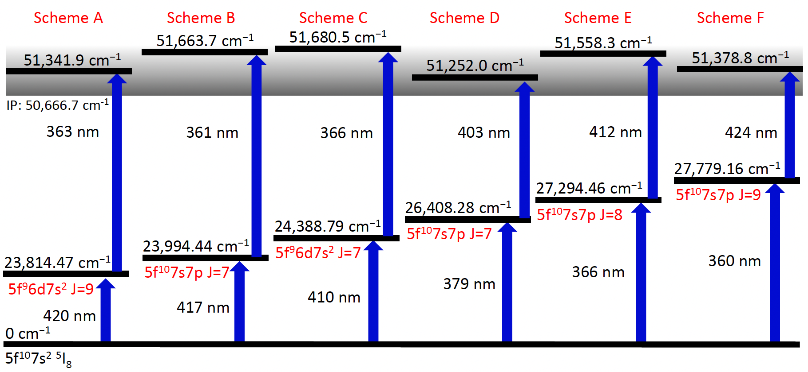
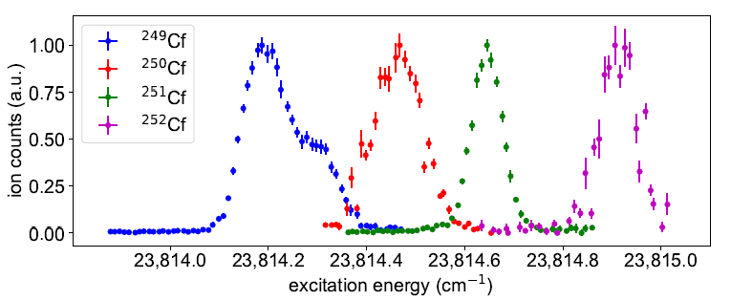
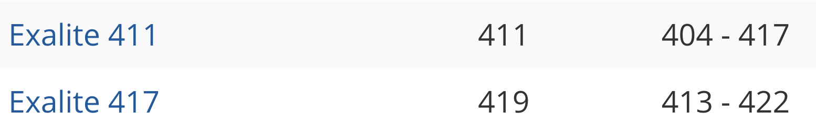
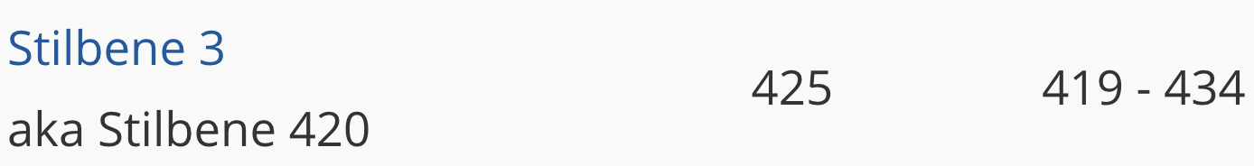

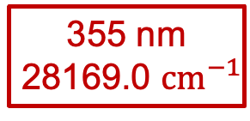
Identified in ${}_{ }^{250}{Cf}$
Non-Resonant
355 nm
28169.0 ${cm}^{−1}$
Resonant (AI)
1st Step

Slide 27
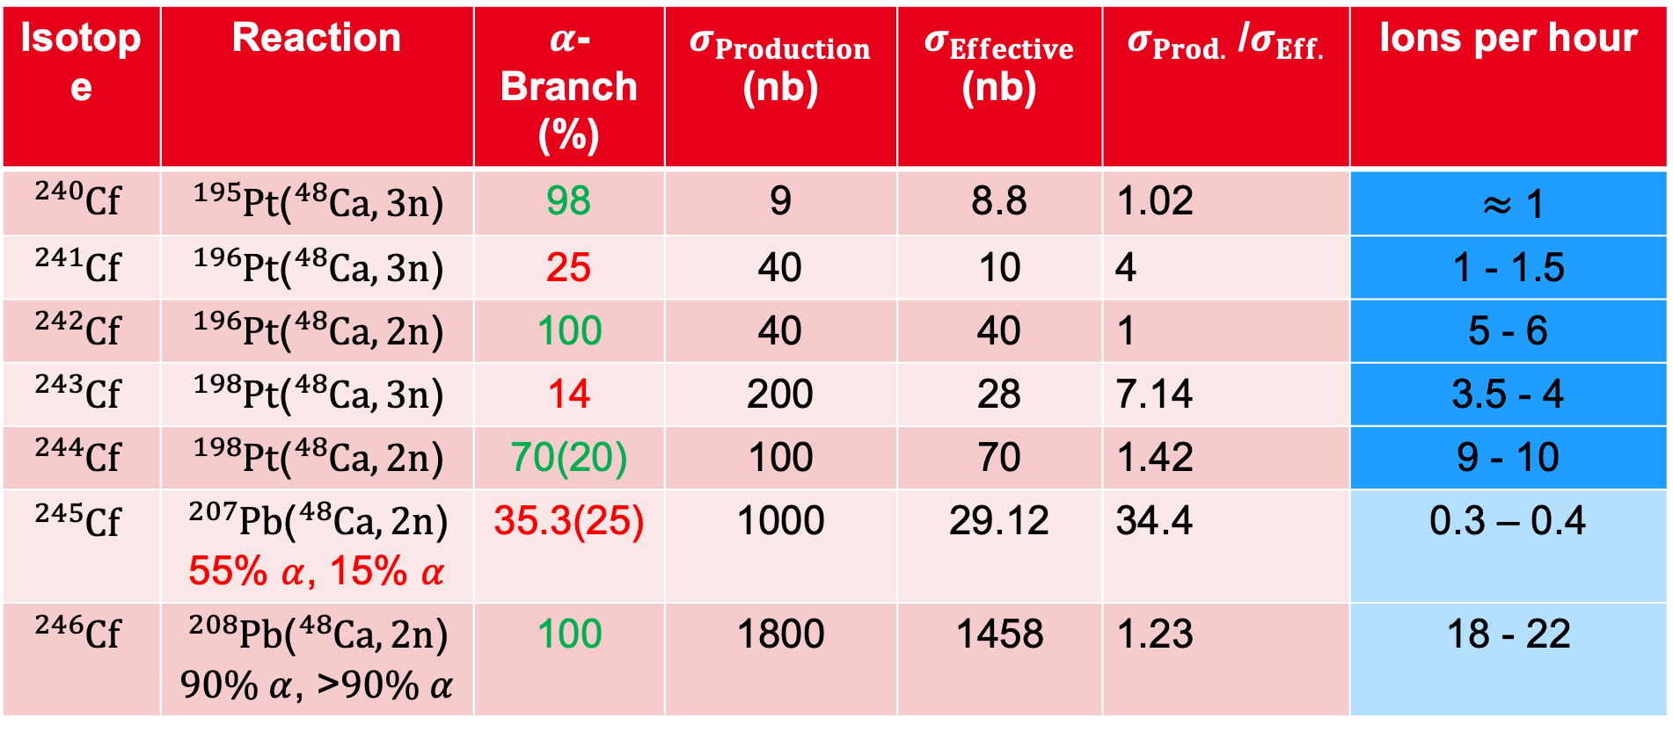
Isotope | Reaction | $α$-Branch (%) | $σ_{Production}$ (nb) | $σ_{Effective}$ (nb) | $σ_{Prod.}$ /$σ_{Eff.}$ | Ions per hour
$${}_{ }^{240}{Cf}$$ | ${}_{ }^{195}{Pt}$(${}_{ }^{48}{Ca, 3n}$) | 98 | 9 | 8.8 | 1.02 | $≈$ 1
$${}_{ }^{241}{Cf}$$ | ${}_{ }^{196}{Pt}$(${}_{ }^{48}{Ca},3n$) | 25 | 40 | 10 | 4 | 1 - 1.5
$${}_{ }^{242}{Cf}$$ | ${}_{ }^{196}{Pt}$(${}_{ }^{48}{Ca},2n$) | 100 | 40 | 40 | 1 | 5 - 6
$${}_{ }^{243}{Cf}$$ | ${}_{ }^{198}{Pt}$(${}_{ }^{48}{Ca},3n$) | 14 | 200 | 28 | 7.14 | 3.5 - 4
$${}_{ }^{244}{Cf}$$ | ${}_{ }^{198}{Pt}$(${}_{ }^{48}{Ca},2n$) | 70(20) | 100 | 70 | 1.42 | 9 - 10
$${}_{ }^{245}{Cf}$$ | ${}_{ }^{207}{Pb}$(${}_{ }^{48}{Ca},2n$) 55% $α$, 15% $α$ | 35.3(25) | 1000 | 29.12 | 34.4 | 0.3 – 0.4
$${}_{ }^{246}{Cf}$$ | ${}_{ }^{208}{Pb}$(${}_{ }^{48}{Ca},2n$) $90\% α$, >$90\% α$ | 100 | 1800 | 1458 | 1.23 | 18 - 22
$$σ_{Effective}=σ_{Production}∗ Π_{i} α_{Branch, i}$$

