Slide 1


PROBING THE STRUCTURAL EVOLUTION IN NEON ISOTOPES APPROACHING THE N = 20 ISLAND OF INVERSION
Davide Genna
University of Milan, INFN Milan
Zakopane Conference on Nuclear Physics 2026 – September 2nd

Slide 2
D. Genna^{[1,2]}, F. Drent^{[3]}, K. Wimmer^{[3]} , S. Bottoni^{[1,2]}, P. Aguilera^{[4]}, G. Benzoni^{[2]},
F. Recchia^{[5,6]}, G. Andreetta^{[5,6]}, F. Angelini^{[3]}, M. Balogh^{[7]}, J. Bardak^{[3,8]}, J. Benito^{[9]},
B. Bles^{[3,8]}, A. Bracco^{[1,2]}, D. Brugnara^{[9]}, S. Carollo^{[5,6]}, Z. Chen^{[3]}, F. Conca^{[1,2]}, L. Corradi^{[9]},
G. Corbari^{[1,2]}, F. C. L. Crespi^{[1,2]}, M. del Fabbro^{[10]}, A. Ertoprak^{[5,6]}, E. Fioretto^{[9]}, F. Galtarossa^{[5]}, A. Giaz^{[2]}, A. Goasduff^{[9]}, B. Gongora Servin^{[9]}, A. Gottardo^{[9]}, Gozzelino^{[9]}, B. Greaves^{[9]},
A. Jungclaus^{[11]}, T. Kröll^{[7]}, G. Kosir^{[12]}, S. Leoni^{[1,2]}, M. Luciani^{[1,2]}, R. Menegazzo^{[6]}, D. Mengoni^{[5,6]}, B. Million^{[2]}, G. Montagnoli^{[6]}, R. Nicolás del Álamo^{[5,6]}, J. Pellumaj^{[5,6]}, R. Pérez-Vidal^{[13]},
S. Pigliapoco^{[14]}, E. Pilotto^{[9]}, W. Poklepa^{[3]}, M. Polettini^{[3,15],} K. Rezynkina^{[5,6]}, M. Rocchini^{[16]},
E. Ronning^{[9]}, M. Sedlak^{[7]}, F. Simioni^{[5,6]}, A. Stefanini^{[6]}, A. Togni^{[5,6]}, J. J. Valiente-Dobón^{[13]},
J. Vesic^{[12]}, L. Zago^{[17]}, I. Zanon^{[18]}.
[1] Dipartimento di Fisica, Università degli Studi di Milano, Italy
[2] INFN Sezione di Milano, Italy
[3] GSI Helmholtzzentrum für Schwerionenforschung GmbH, Germany
[4] Comisión Chilena de Energía Nuclear (CCHEN), Chile
[5] Dipartimento di Fisica, Università degli Studi di Padova, Italy
[6] INFN Sezione di Padova, Italy
[7] Institute of Physics of the Slovak Academy of Sciences, Slovakia
[8] University of Novi Sad, Serbia
[9] Istituto Nazionale di Fisica Nucleare LNL, Legnaro, Italy
[10] Ruđer Bošković Institute, Croatia
[11] CSIC Madrid, Spain
[12] Jožef Stefan Institute, Slovenia
[13] IFIC Universitat de València, Spain
[14] Grand Accélérateur National d'Ions Lourds, France
[15] Facility for Antiproton and Ion Research in Europe GmbH (FAIR GmbH), Germany
[16] INFN Sezione di Firenze, Italy
[17] Institut de Physique des Deux Infinis de Lyon, France
[18] KTH Royal Institute of Technology, Sweden
Zakopane Conference on Nuclear Physics 2026 – September 2nd

Slide 3

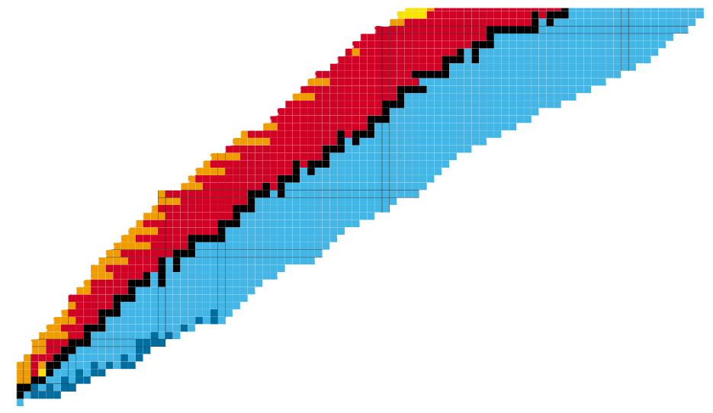
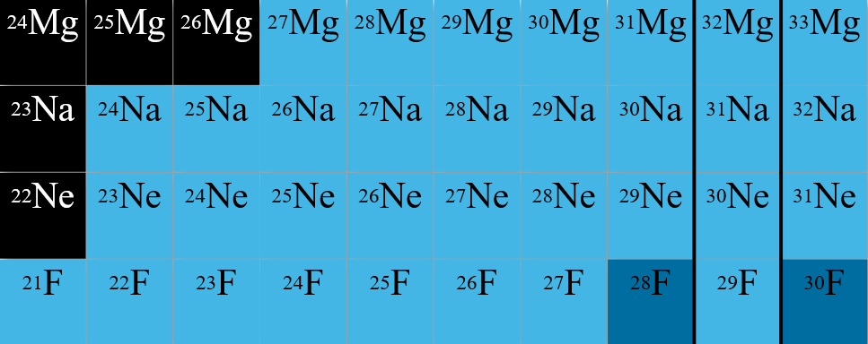
The N = 20 Island of Inversion
rp-process
r-process
Island of
Inversion
Stable nuclei
Big Bang

Slide 4
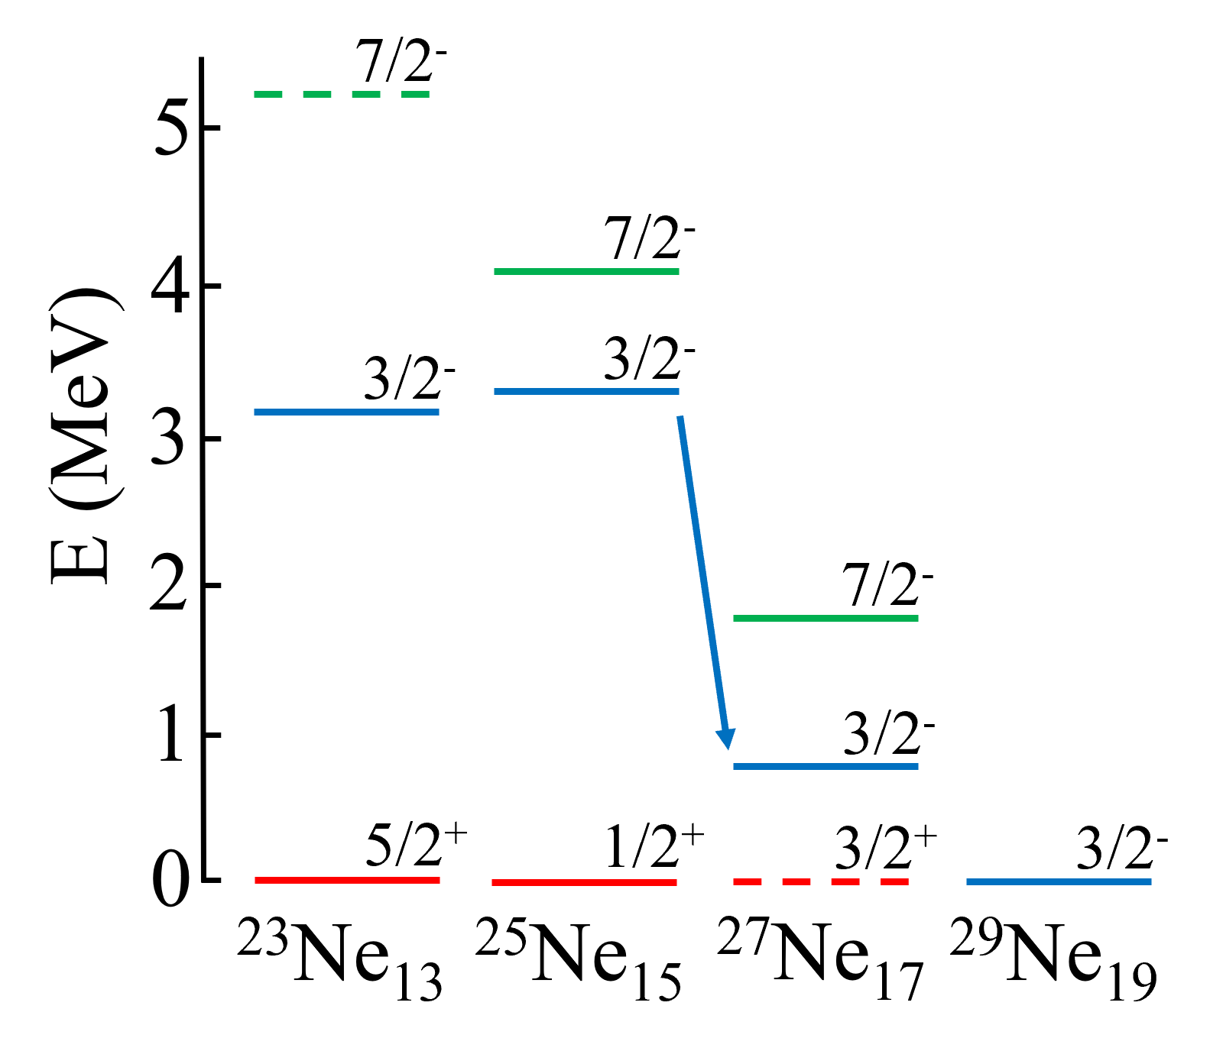
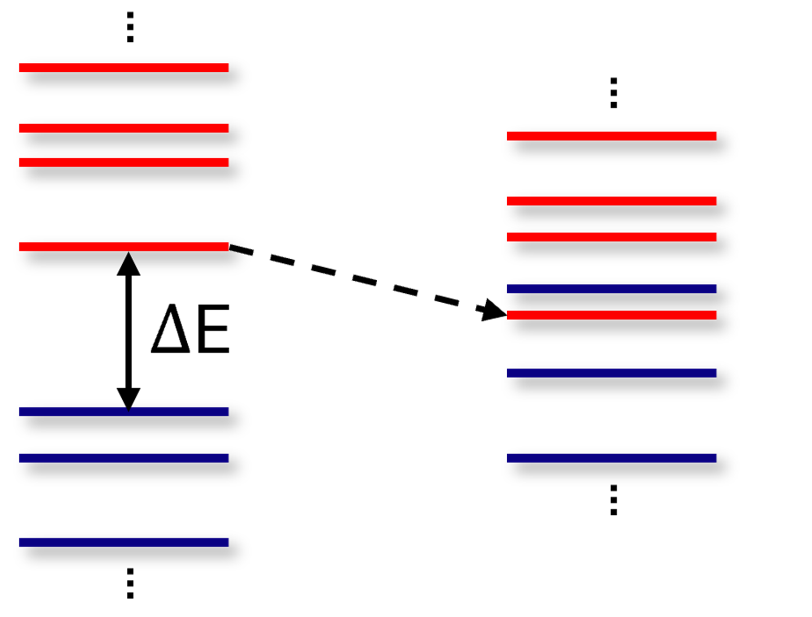

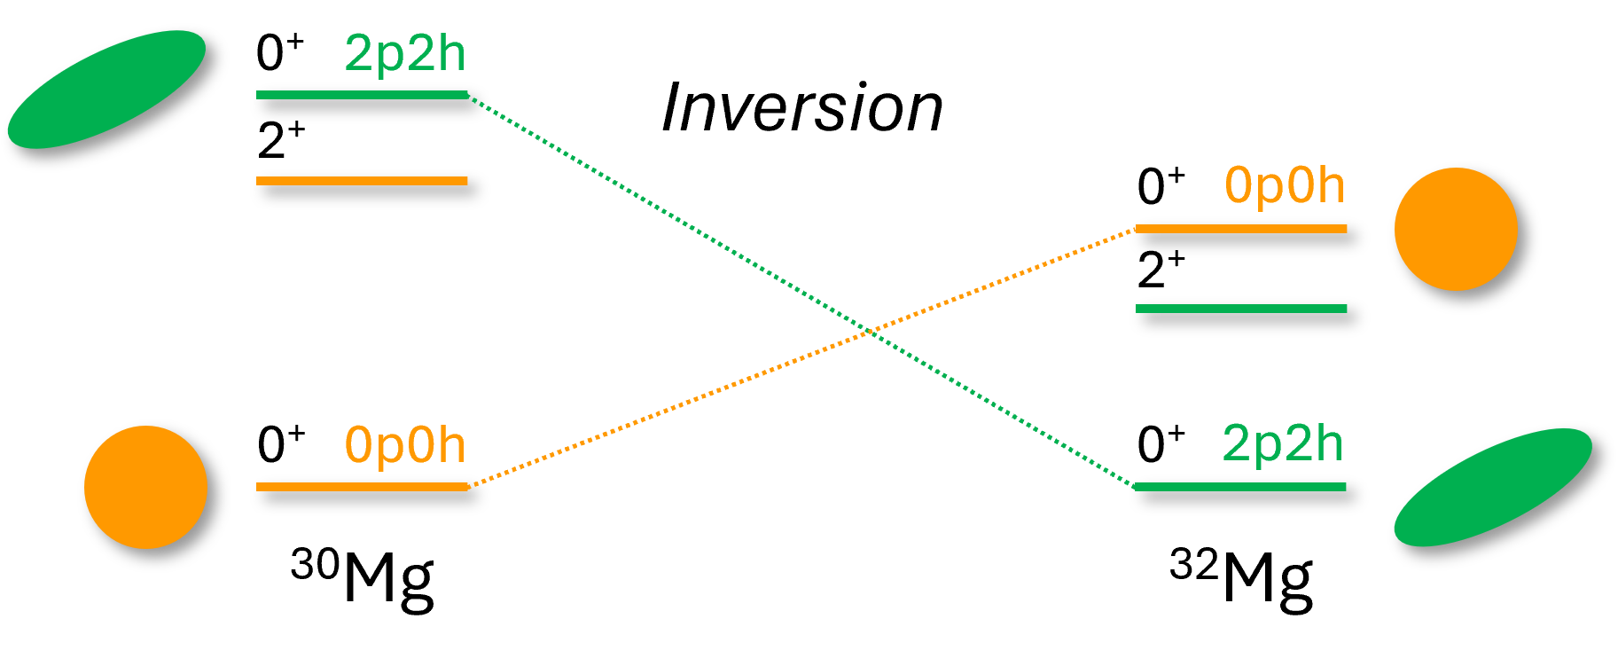




The N = 20 Island of Inversion
Standard
ordering
Intruder configuration
rp-process
$$pf$$
$$π=−1$$
Level Energy
r-process
$$sd$$
$$π=+1$$
Island of
Inversion
Stable nuclei
Big Bang
Adapted from K. Wimmer et al., Phys. Rev. Lett. 105 252501 2010

Slide 5
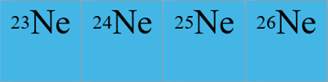
The N = 20 Island of Inversion
Standard
ordering
Intruder configuration
rp-process
$$pf$$
$$π=−1$$
Level Energy
r-process
$$sd$$
$$π=+1$$
Island of
Inversion
Stable nuclei
Big Bang
Adapted from K. Wimmer et al., Phys. Rev. Lett. 105 252501 2010
Spectroscopy and lifetime measurements for n-rich Ne isotopes
Validation for different theoretical models

Slide 6
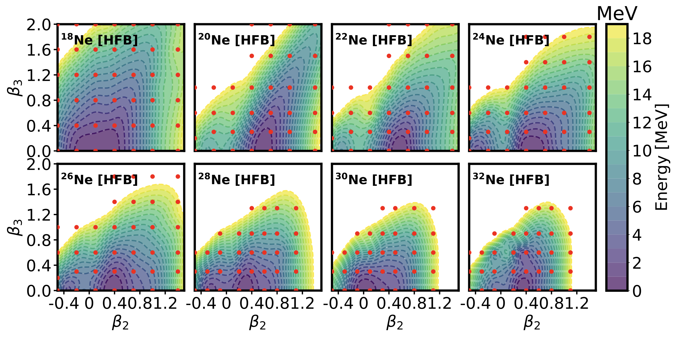
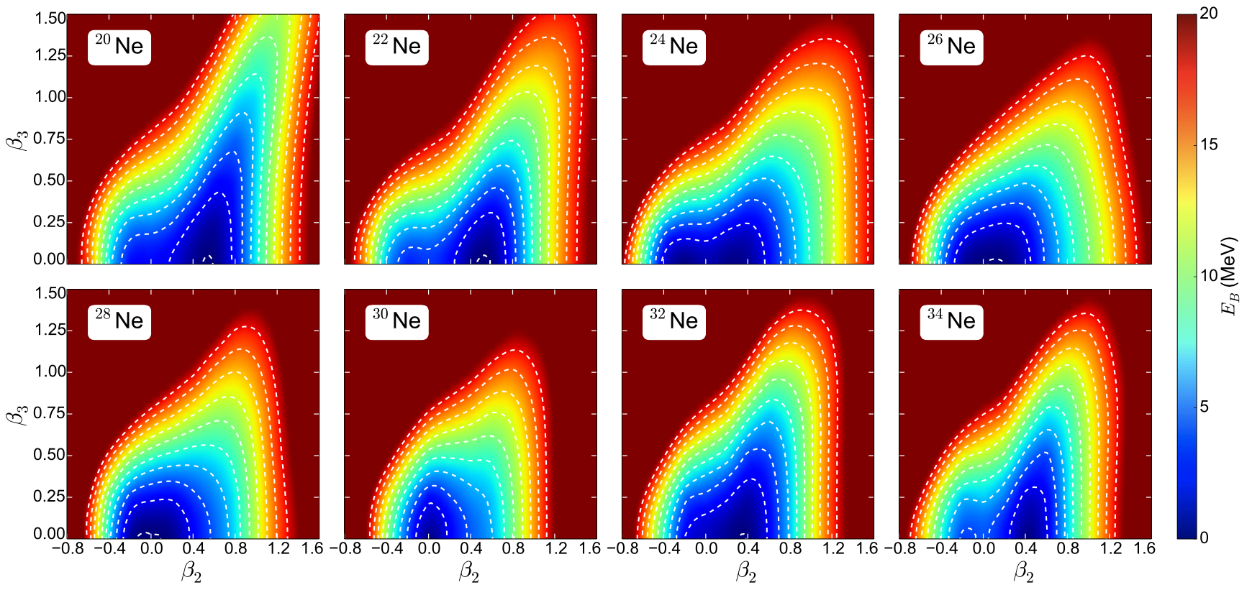
DFT and ab initio calculations
RHB: Physical Review C 97 024334 2018
PGCM, IN-NCSM: The European Physical Journal A 58:63 2022
Relativistic HFB
PGCM & IN-NCSM on χEFT Hamiltonians

Slide 7
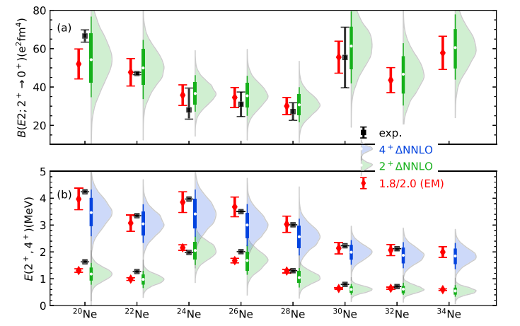
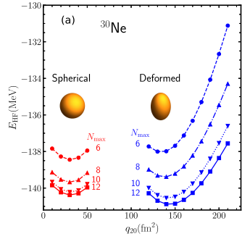
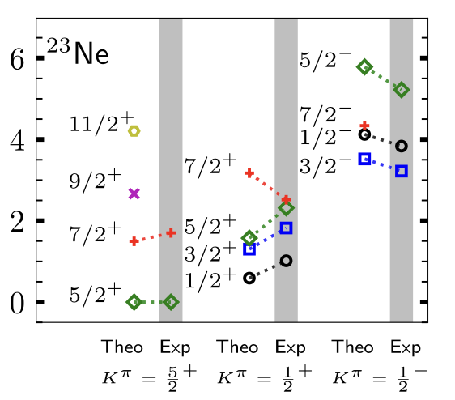
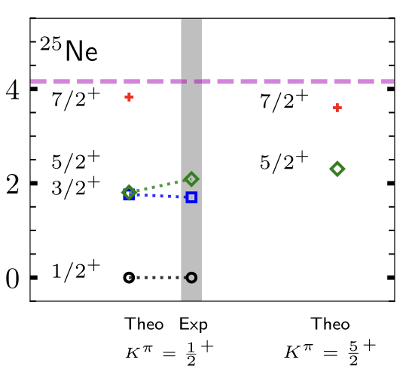

DFT and ab initio calculations
RHB: Physical Review C 97 024334 2018
PGCM, IN-NCSM: The European Physical Journal A 58:63 2022
CC: Physical Review C 111 044304 2025
CC: Physical Review X 15 011028 2025
Relativistic HFB
PGCM & IN-NCSM on χEFT Hamiltonians
Coupled Cluster

Slide 8
DFT and ab initio calculations
RHB: Physical Review C 97 024334 2018
PGCM, IN-NCSM: The European Physical Journal A 58:63 2022
CC: Physical Review C 111 044304 2025
CC: Physical Review X 15 011028 2025
Relativistic HFB
PGCM & IN-NCSM on χEFT Hamiltonians
Data-models discrepancies even in less exotic nuclei
Limited experimental information
²⁴Ne
Couple Cluster
EXP
RHB
PGCM
IN-NCSM
SM

Slide 9



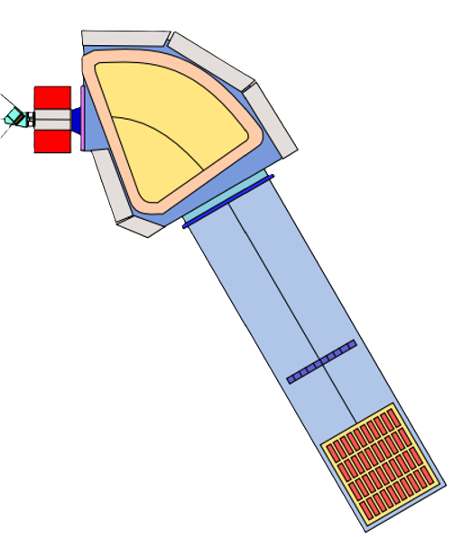
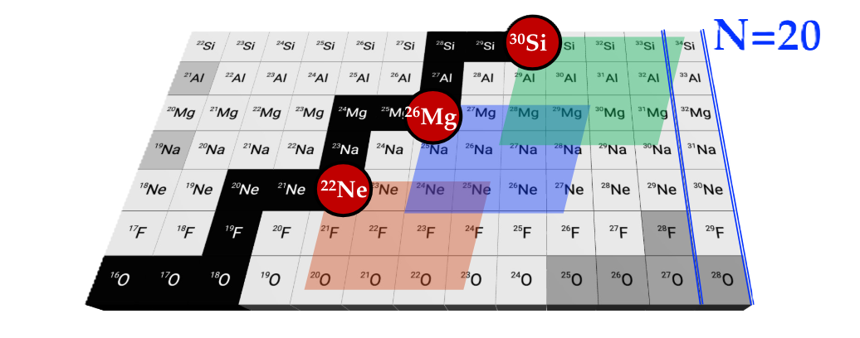
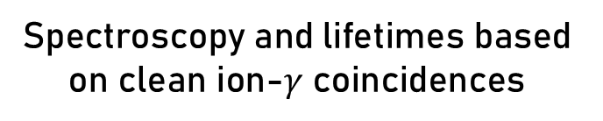
The experimental campaign
Multi-nucleon transfer reactions @LNL
AGATA-PRISMA with ²³⁸U target
AGATA
PRISMA
Dipole
Beam
Quadrupole
European Physical Journal Plus 138:709 2023
Spectroscopy and lifetimes based on clean ion-$γ$ coincidences

Slide 10
The experimental campaign
Multi-nucleon transfer reactions @LNL
AGATA-PRISMA with ²³⁸U target
April 2023: ²²Ne + ²³⁸U
AGATA
Spectroscopy
PRISMA
²²Ne
²³⁸U 1mg/cm²
Dipole
160 MeV
54°
June 2024: ²⁶Mg + ²³⁸U
Beam
Lifetime Measurements
Quadrupole
²⁶Mg
²³⁸U 1mg/cm²+⁹³Nb 5mg/cm²
200 MeV
50°
DSAM
May 2026: ²²Ne + ²³⁸U
Lifetime Measurements
²²Ne
²³⁸U 1mg/cm²+⁹³Nb 5mg/cm²
European Physical Journal Plus 138:709 2023
160 MeV
54°
DSAM
Spectroscopy and lifetimes based on clean ion-$γ$ coincidences

Slide 11
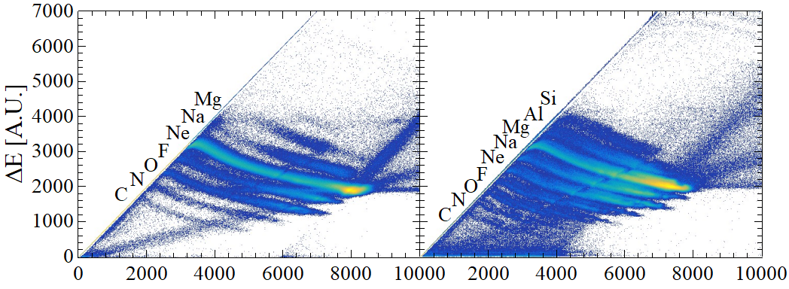
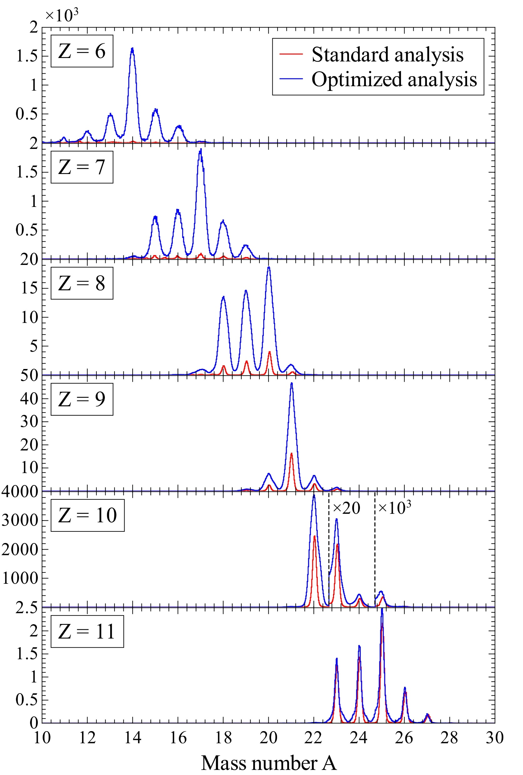
The experimental campaign
Multi-nucleon transfer reactions @LNL
AGATA-PRISMA with ²³⁸U target
April 2023: ²²Ne + ²³⁸U
AGATA
Spectroscopy
PRISMA
²²Ne
²³⁸U 1mg/cm²
Dipole
160 MeV
54°
June 2024: ²⁶Mg + ²³⁸U
Beam
Lifetime Measurements
Quadrupole
²⁶Mg
²³⁸U 1mg/cm²+⁹³Nb 5mg/cm²
200 MeV
50°
DSAM
x 10
May 2026: ²²Ne + ²³⁸U
Counts
Lifetime Measurements
x 4
²²Ne
²³⁸U 1mg/cm²+⁹³Nb 5mg/cm²
European Physical Journal Plus 138:709 2023
160 MeV
54°
Spectroscopy and lifetimes based on clean ion-$γ$ coincidences
x 2.5
DSAM
Mass number A

Slide 12
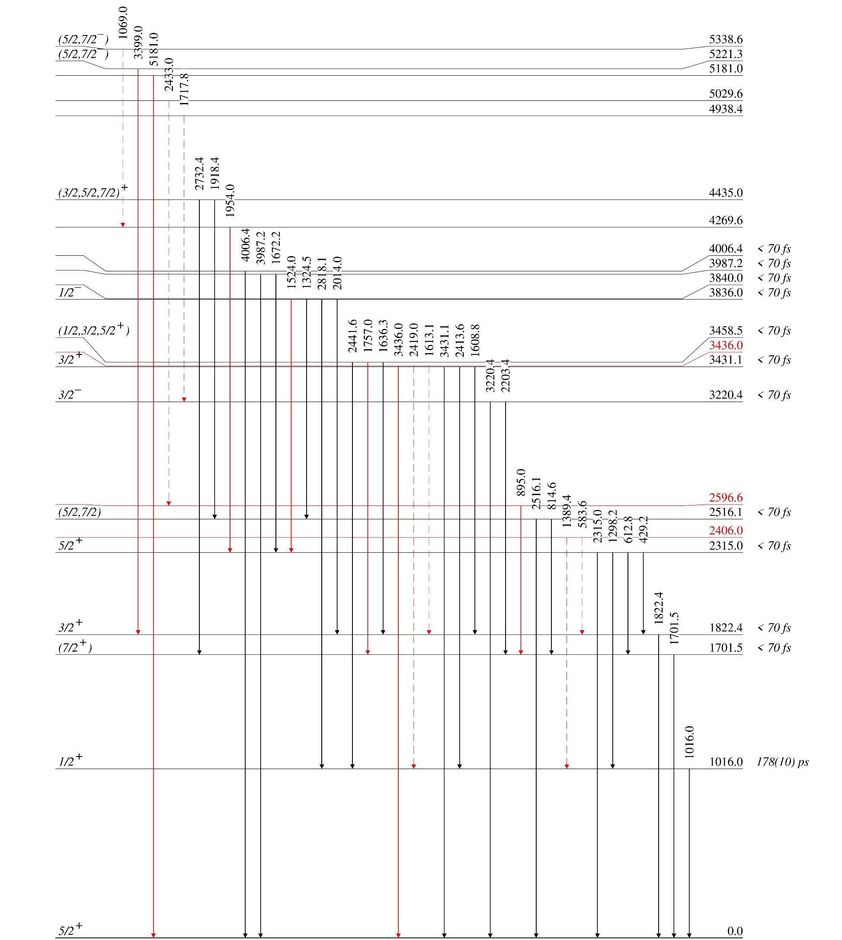
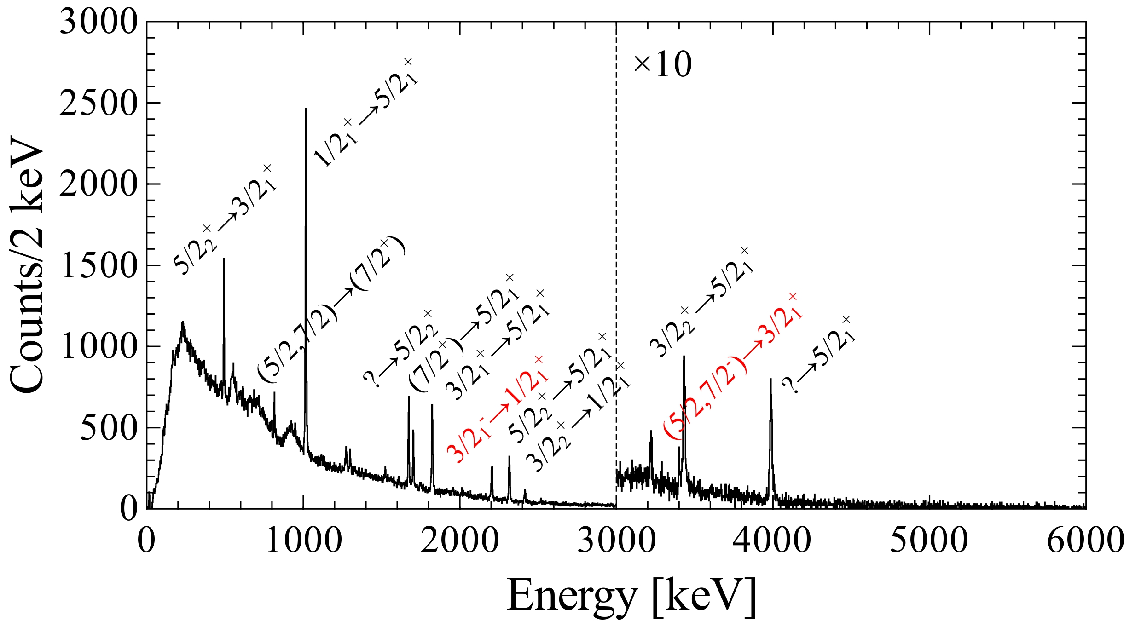
Results: Ne level schemes
Spectroscopy
²³Ne
3 new levels added
7 (+6 uncertain) new observed transitions
First transition candidate originating from (5/2,7/2⁻) state

Slide 13
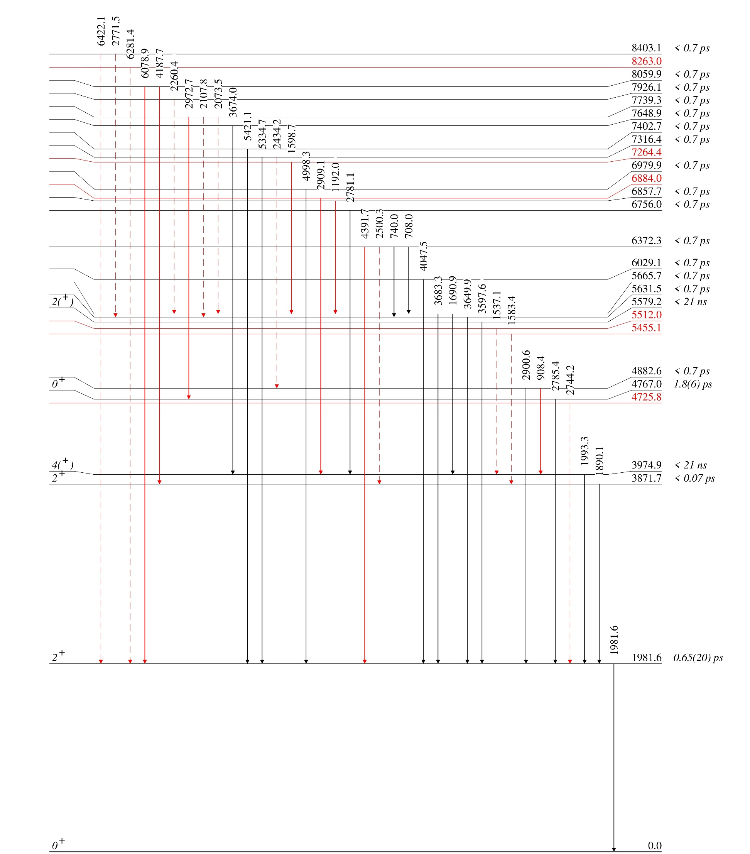
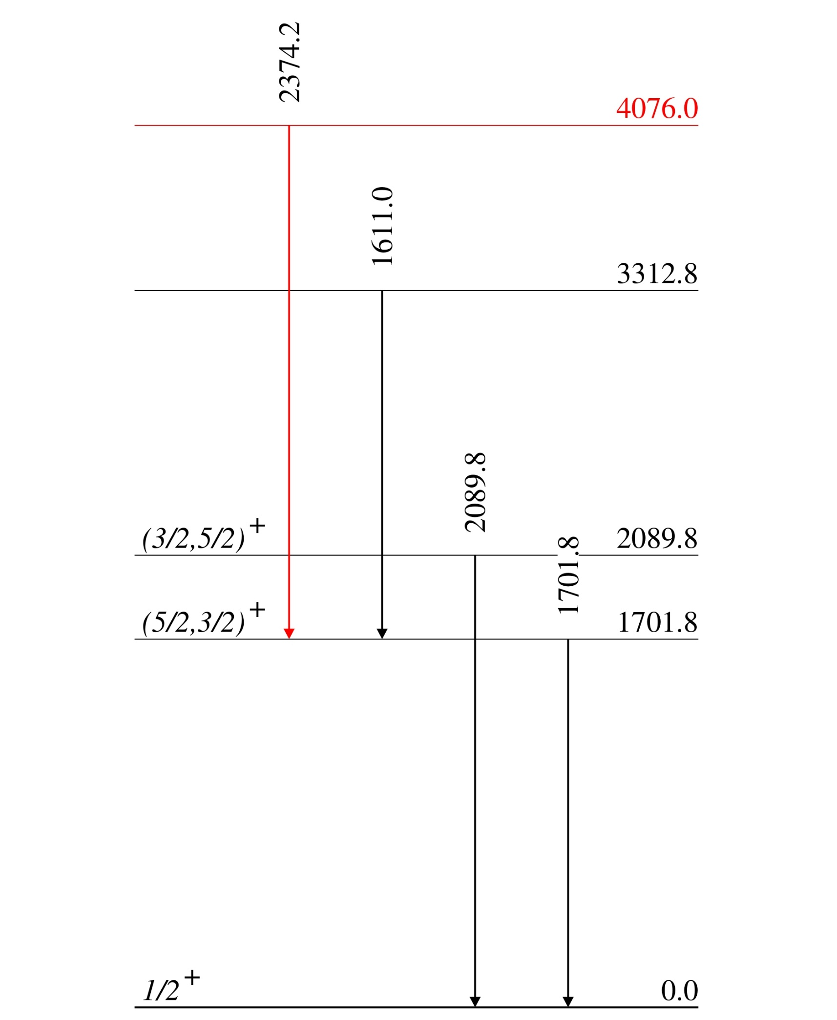
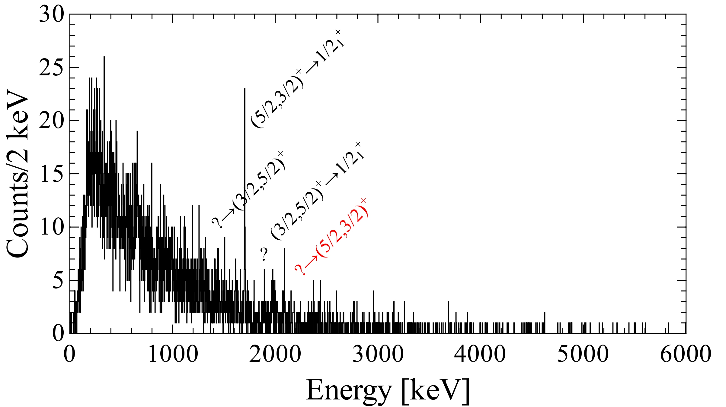
Results: Ne level schemes
Spectroscopy
²⁵Ne
New energy value for (7/2⁻) state
Possible candidate originating from (7/2⁻) state
Phys. Rev. Lett. 104 192501 2010

Slide 14
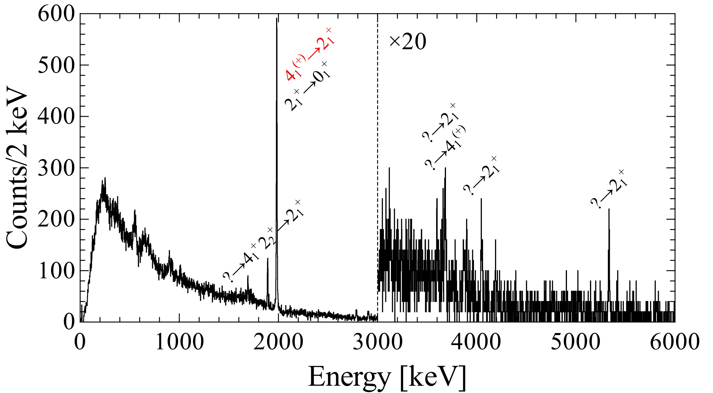
Results: Ne level schemes
Spectroscopy
²⁴Ne
6 new levels added
8 (+11 uncertain) new observed transitions
Focus on low energy doublet structure: 2₁⁺ and 4₁⁺ states
4⁺
?
?
2⁺
1981.6
1981.6
0⁺
0

Slide 15
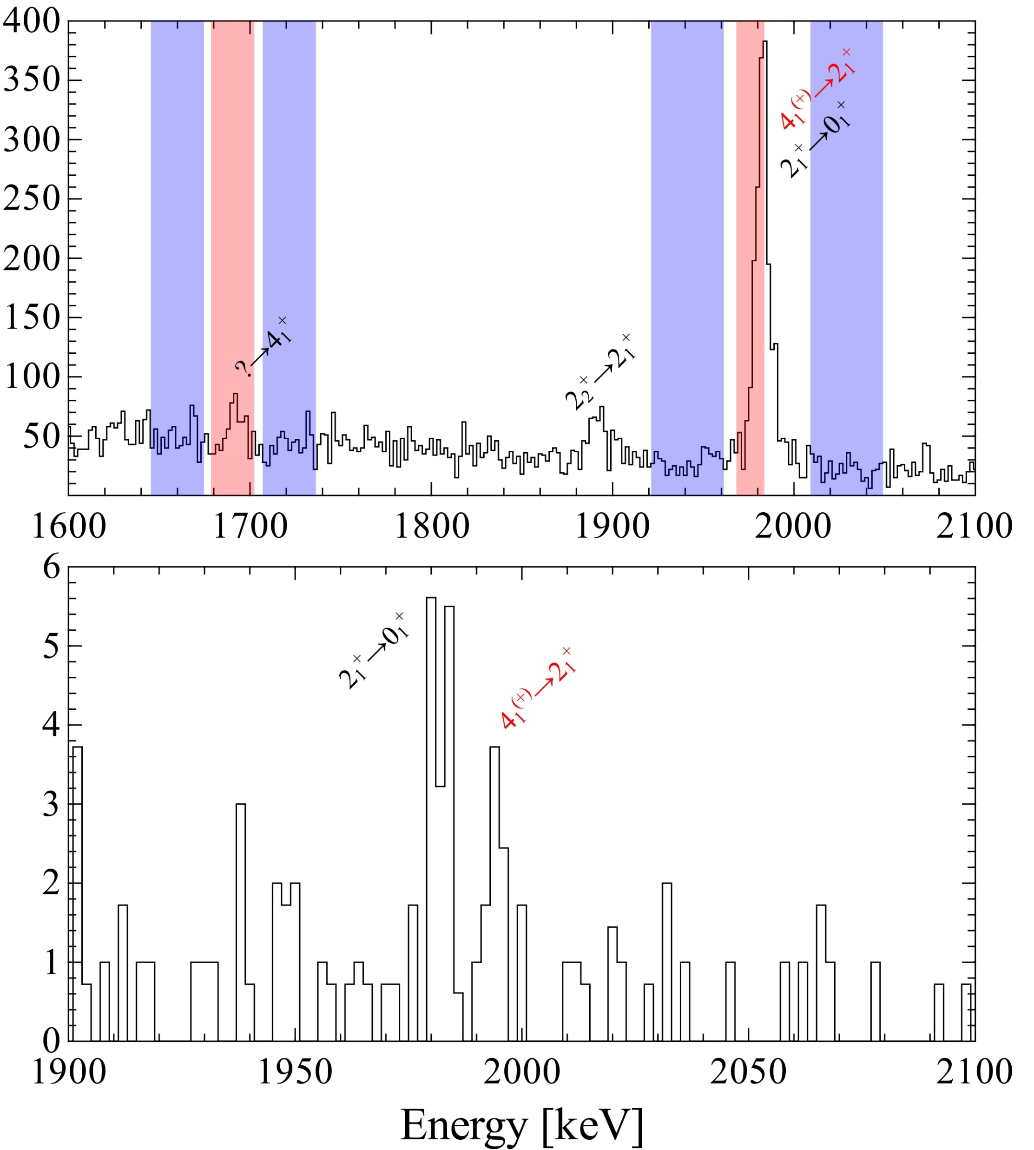

Results: ²⁴Ne energy doublet
Spectroscopy
$γ−γ$Coincidence Matrix
Counts/2 keV
Energy [keV]

Slide 16
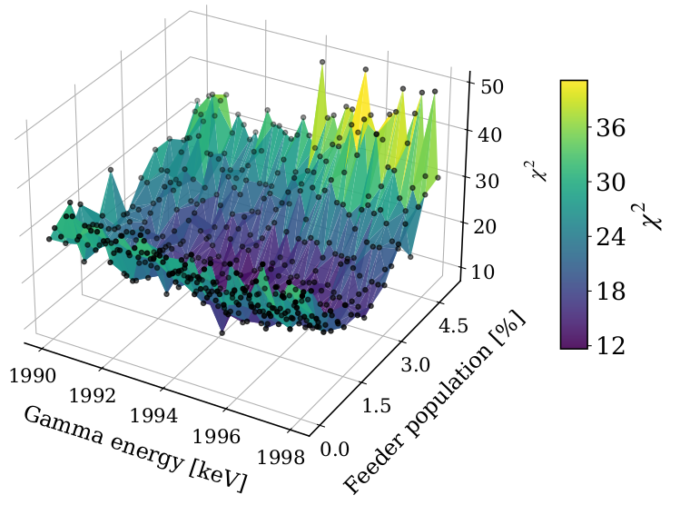
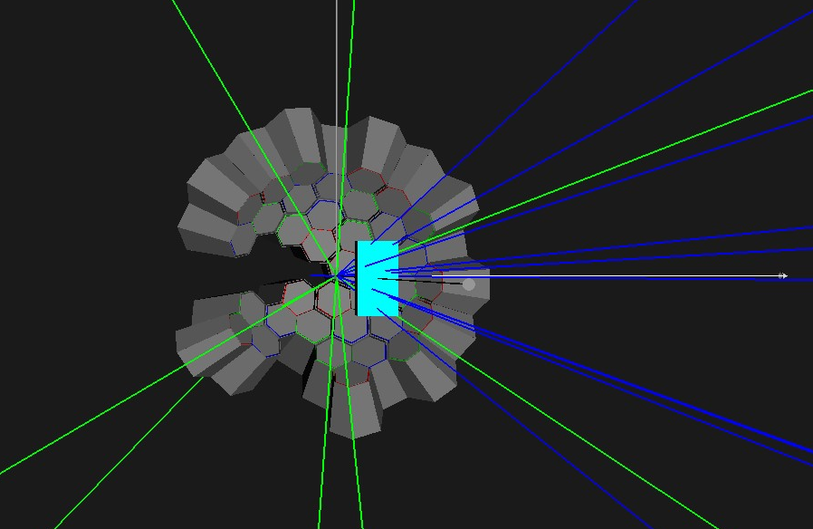
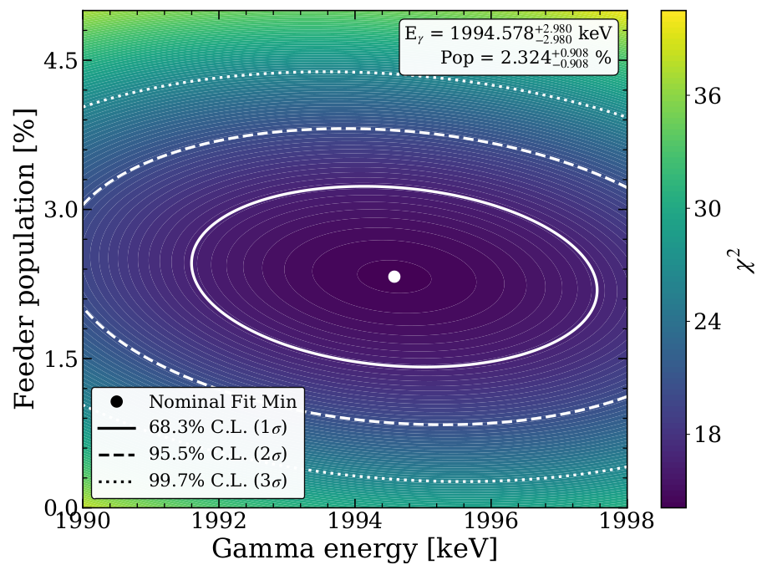
Results: ²⁴Ne energy doublet
Spectroscopy
$γ−γ$Coincidence Matrix
AGATA Simulations (Geant4)
Counts/2 keV
Energy [keV]

Slide 17
Results: ²⁴Ne energy doublet
Spectroscopy
$γ−γ$Coincidence Matrix
AGATA Simulations (Geant4)
Precise energy measurement for future DSAM lifetime extraction
?
4⁺
3974.9
Counts/2 keV
1993.3
0.65 ps
2⁺
1981.6
1981.6
0⁺
0
Energy [keV]

Slide 18
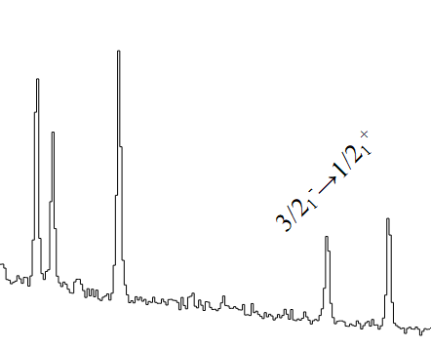
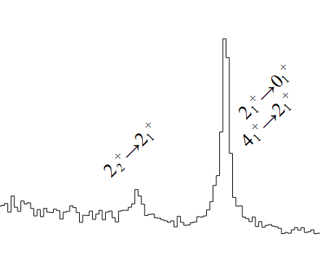
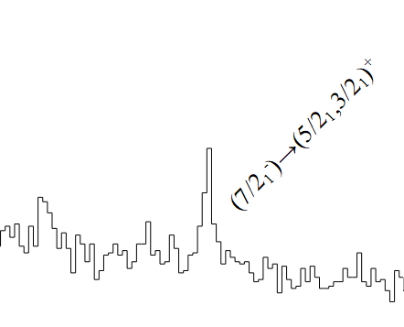
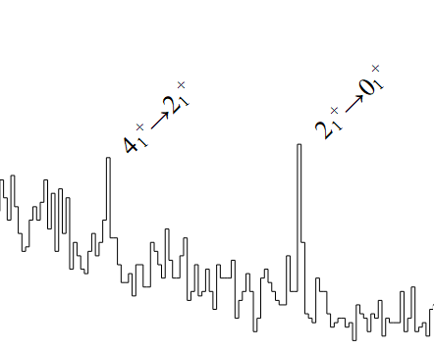
Outlook and perspectives
Rotational band collectivity in ^{24,26}Ne
Intruder states in ^{23,25}Ne
²³Ne
²⁴Ne
²⁵Ne
²⁶Ne
April 2023: ²²Ne + ²³⁸U
Z
June 2024: ²⁶Mg + ²³⁸U
Pre-analysis by F. Drent (GSI)
May 2026: ²²Ne + ²³⁸U
N

Slide 19
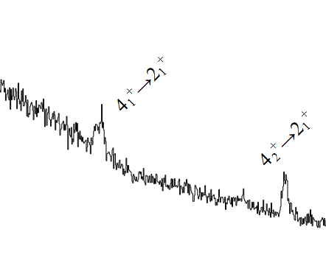
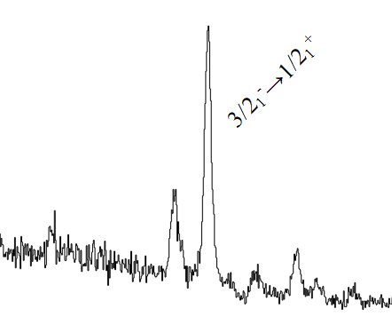
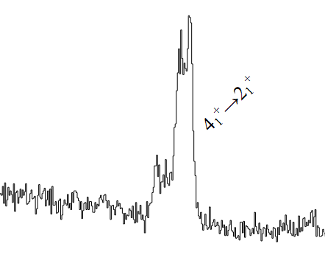
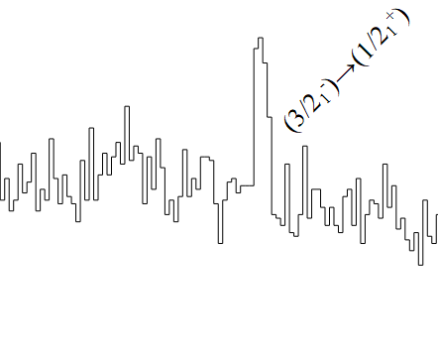
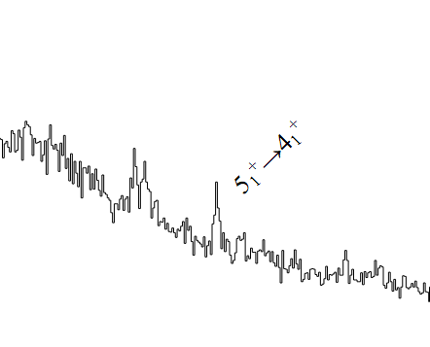
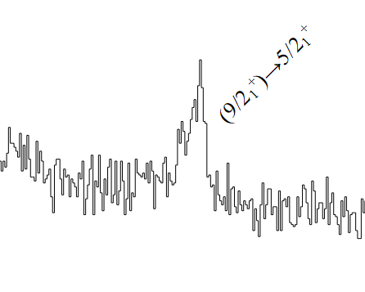
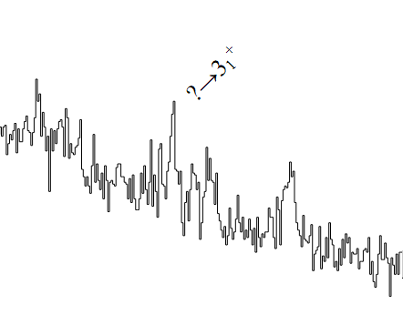
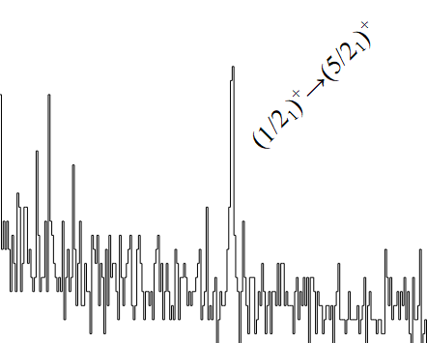
Outlook and perspectives
Rotational band collectivity in ^{24,26}Ne
Intruder states in ^{23,25}Ne
²⁶Mg
²⁷Mg
²⁸Mg
²⁹Mg
²⁴Na
²⁵Na
²⁶Na
Exotic Mg isotopes toward the Island of Inversion
²³Ne
²⁴Ne
²⁵Ne
²⁶Ne
April 2023: ²²Ne + ²³⁸U
Z
June 2024: ²⁶Mg + ²³⁸U
Pre-analysis by F. Drent (GSI)
²³F
Proton contribution to deformation along N = 14
May 2026: ²²Ne + ²³⁸U
N

Slide 20
DSAM Benchmarks on ^{27,28}Mg
Lifetimes
0
²⁷Mg
State: 1698.5 keV
5/2⁻, 7/2⁻
3760.9
0.42 ps
(5/2⁺, 7/2⁺)
3427.4
69 fs
2062.5
1728.9
5/2⁺
1698.5
0.81 ps
1698.5
1/2⁺
0

Slide 21
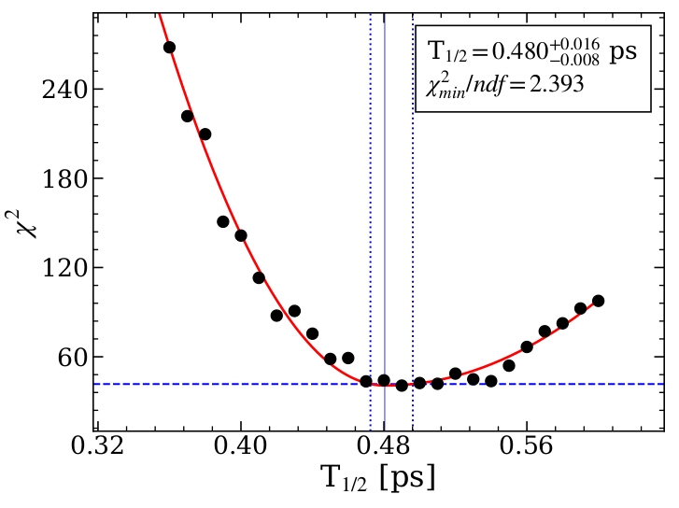
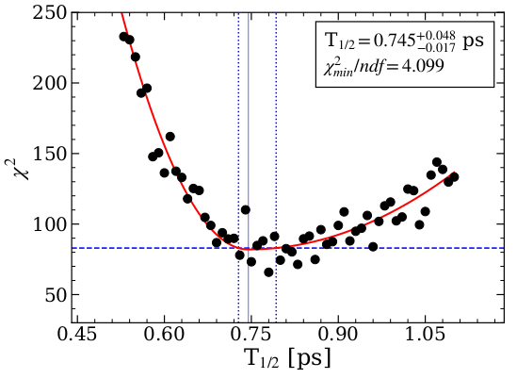
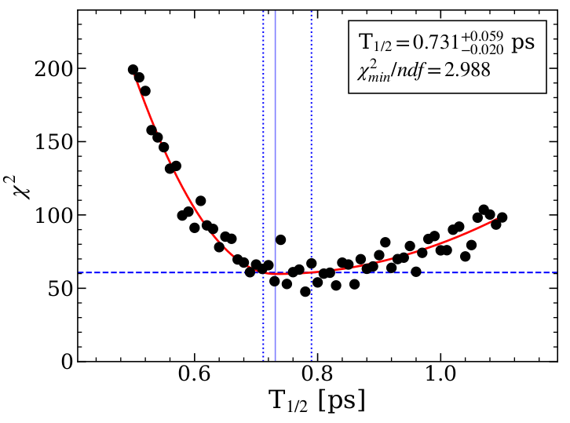
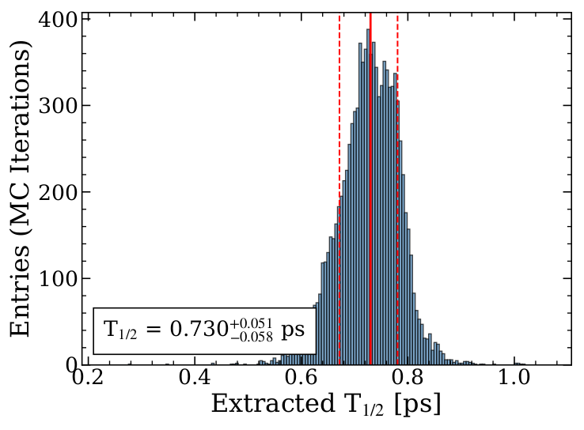
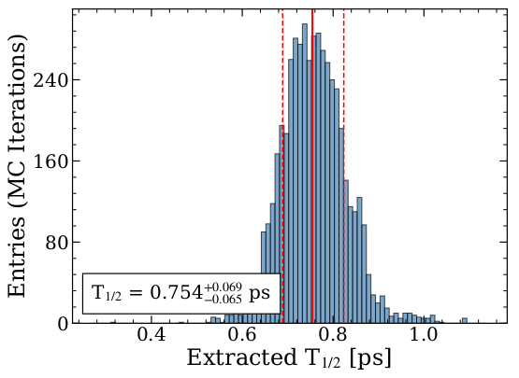
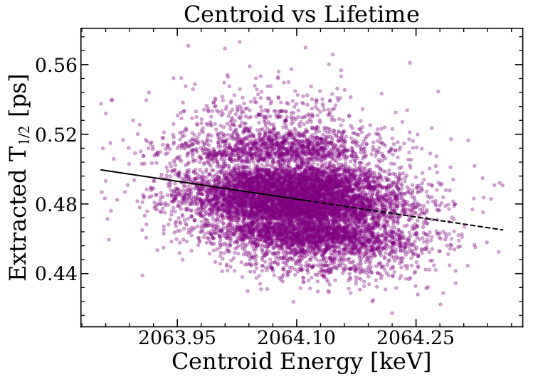
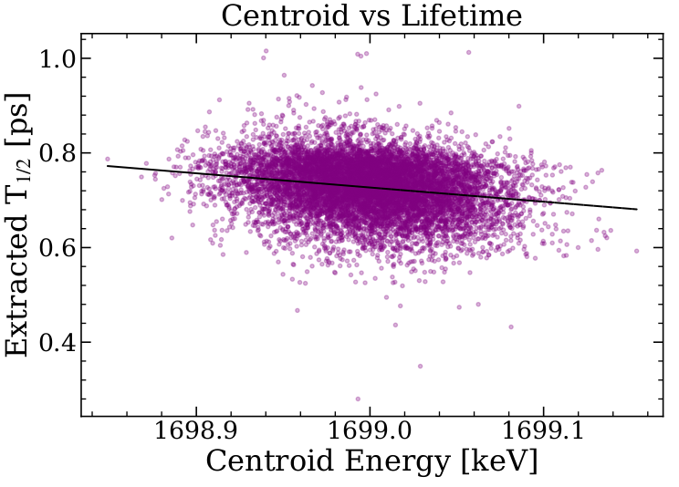
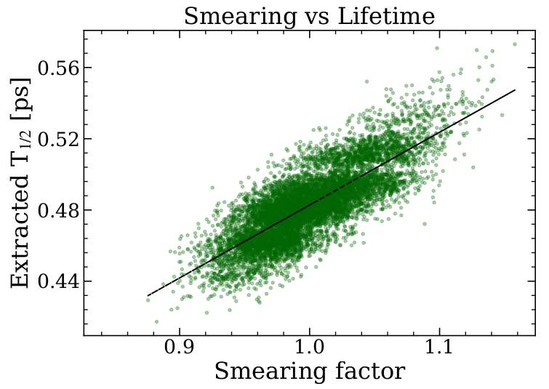
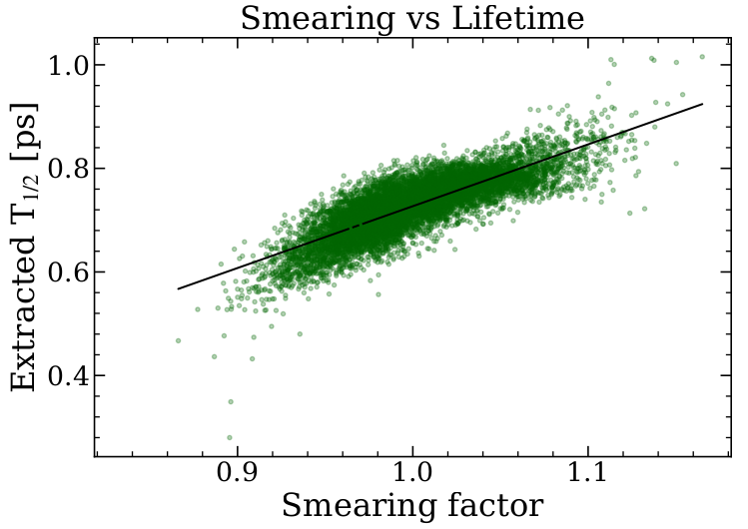
DSAM Benchmarks on ^{27,28}Mg
Lifetimes
0
²⁷Mg
Standard
Standard
Standard
State: 1698.5 keV
5/2⁻, 7/2⁻
3760.9
0.42 ps
(5/2⁺, 7/2⁺)
3427.4
69 fs
2062.5
1728.9
Toy MC
Toy MC
Toy MC
5/2⁺
1698.5
0.81 ps
1698.5
1/2⁺
0

Slide 22
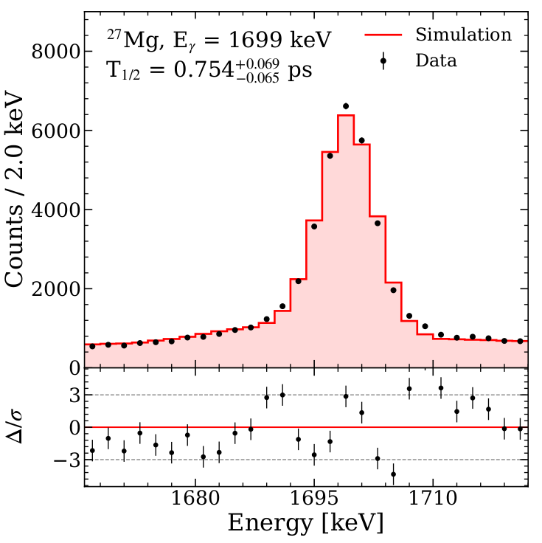
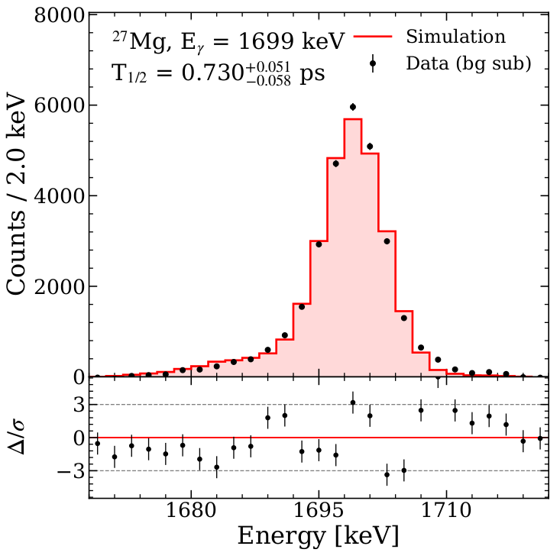


DSAM Benchmarks on ^{27,28}Mg
Lifetimes
0
²⁷Mg
$$T_{1/2}={754}_{−65}^{+69} fs$$
NNDC: $T_{1/2}=810(170) fs$
Standard
State: 1698.5 keV
5/2⁻, 7/2⁻
3760.9
0.42 ps
(5/2⁺, 7/2⁺)
3427.4
69 fs
2062.5
1728.9
Toy MC
5/2⁺
1698.5
0.81 ps
1698.5
1/2⁺
0

Slide 23



DSAM Benchmarks on ^{27,28}Mg
Lifetimes
0
²⁷Mg
$$T_{1/2}={754}_{−65}^{+69} fs$$
NNDC: $T_{1/2}=810(170) fs$
Standard
Almost same cascade structure as 24Ne!
Optimal 2D Benchmark
State: 1698.5 keV
5/2⁻, 7/2⁻
3760.9
0.42 ps
(5/2⁺, 7/2⁺)
3427.4
69 fs
2062.5
1728.9
Toy MC
5/2⁺
1698.5
0.81 ps
1698.5
$$T_{1/2}={740}_{−70}^{+70} fs$$
NNDC: $T_{1/2}=810(170) fs$
1/2⁺
0

Slide 24
Outlook and perspectives
Rotational band collectivity in ^{24,26}Ne
Intruder states in ^{23,25}Ne
²⁶Mg
²⁷Mg
²⁸Mg
²⁹Mg
²⁴Na
²⁵Na
²⁶Na
Exotic Mg isotopes toward the Island of Inversion
²³Ne
²⁴Ne
²⁵Ne
²⁶Ne
April 2023: ²²Ne + ²³⁸U
Z
June 2024: ²⁶Mg + ²³⁸U
Pre-analysis by F. Drent (GSI)
²³F
Proton contribution to deformation along N = 14
May 2026: ²²Ne + ²³⁸U
N

Slide 25

²⁴Ne energy doublet sensitivity
Lifetimes
Low E_{x}
?
4⁺
3974.9
1993.3
2⁺
1981.6
Counts/0.3 MeV
0⁺
1981.6
0
Preliminary
Almost no tail with direct 2₁⁺
(T_{1/2} = 0.65 ps)
Counts/1 keV

Slide 26

²⁴Ne energy doublet sensitivity
Lifetimes
Low E_{x}
?
4⁺
3974.9
High E_{x}
?
4⁺
3974.9
1993.3
1993.3
2⁺
1981.6
2⁺
1981.6
Counts/0.3 MeV
0⁺
1981.6
Counts/0.3 MeV
0⁺
1981.6
0
0
Preliminary
Preliminary
Almost no tail with direct 2₁⁺
(T_{1/2} = 0.65 ps)
Possible tail contribution from 4₁⁺!
Counts/1 keV
Counts/1 keV

Slide 27

The AGATA-PRISMA campaign targeting Ne and Mg nuclei toward the Island of Inversion is now completed.
Decay level scheme were extracted for ^{23,24,25}Ne, including the low energy doublet in ²⁴Ne.
Simulation-based DSAM was successfully benchmarked; lifetimes extraction in progress.
The analysis on ion-$γ$ angular distributions with AGATA is nearing completion.
Zakopane Conference on Nuclear Physics 2026 – September 2nd

Slide 28
D. Genna^{[1,2]}, F. Drent^{[3]}, K. Wimmer^{[3]} , S. Bottoni^{[1,2]}, P. Aguilera^{[4]}, G. Benzoni^{[2]},
F. Recchia^{[5,6]}, G. Andreetta^{[5,6]}, F. Angelini^{[3]}, M. Balogh^{[7]}, J. Bardak^{[3,8]}, J. Benito^{[9]},
B. Bles^{[3,8]}, A. Bracco^{[1,2]}, D. Brugnara^{[9]}, S. Carollo^{[5,6]}, Z. Chen^{[3]}, F. Conca^{[1,2]}, L. Corradi^{[9]},
G. Corbari^{[1,2]}, F. C. L. Crespi^{[1,2]}, M. del Fabbro^{[10]}, A. Ertoprak^{[5,6]}, E. Fioretto^{[9]}, F. Galtarossa^{[5]}, A. Giaz^{[2]}, A. Goasduff^{[9]}, B. Gongora Servin^{[9]}, A. Gottardo^{[9]}, Gozzelino^{[9]}, B. Greaves^{[9]},
A. Jungclaus^{[11]}, T. Kröll^{[7]}, G. Kosir^{[12]}, S. Leoni^{[1,2]}, M. Luciani^{[1,2]}, R. Menegazzo^{[6]}, D. Mengoni^{[5,6]}, B. Million^{[2]}, G. Montagnoli^{[6]}, R. Nicolás del Álamo^{[5,6]}, J. Pellumaj^{[5,6]}, R. Pérez-Vidal^{[13]},
S. Pigliapoco^{[14]}, E. Pilotto^{[9]}, W. Poklepa^{[3]}, M. Polettini^{[3,15],} K. Rezynkina^{[5,6]}, M. Rocchini^{[16]},
E. Ronning^{[9]}, M. Sedlak^{[7]}, F. Simioni^{[5,6]}, A. Stefanini^{[6]}, A. Togni^{[5,6]}, J. J. Valiente-Dobón^{[13]},
J. Vesic^{[12]}, L. Zago^{[17]}, I. Zanon^{[18]}.
[1] Dipartimento di Fisica, Università degli Studi di Milano, Italy
[2] INFN Sezione di Milano, Italy
[3] GSI Helmholtzzentrum für Schwerionenforschung GmbH, Germany
[4] Comisión Chilena de Energía Nuclear (CCHEN), Chile
[5] Dipartimento di Fisica, Università degli Studi di Padova, Italy
[6] INFN Sezione di Padova, Italy
[7] Institute of Physics of the Slovak Academy of Sciences, Slovakia
[8] University of Novi Sad, Serbia
[9] Istituto Nazionale di Fisica Nucleare LNL, Legnaro, Italy
[10] Ruđer Bošković Institute, Croatia
[11] CSIC Madrid, Spain
[12] Jožef Stefan Institute, Slovenia
[13] IFIC Universitat de València, Spain
[14] Grand Accélérateur National d'Ions Lourds, France
[15] Facility for Antiproton and Ion Research in Europe GmbH (FAIR GmbH), Germany
[16] INFN Sezione di Firenze, Italy
[17] Institut de Physique des Deux Infinis de Lyon, France
[18] KTH Royal Institute of Technology, Sweden
Zakopane Conference on Nuclear Physics 2026 – September 2nd

Slide 29



Optimized PRISMA analysis
Recovery of only PPAC cathodes events
Suited for light ions
AGATA
PRISMA
x 50
Dipole
x 20
Beam
x 10
Quadrupole
Counts
x 4
x 2.5
x 1.5
MWPPAC
Mass number A

Slide 30






DSAM Benchmarks on ^{27,28}Mg
Lifetimes
0
²⁷Mg
Standard
$$T_{1/2}={0.482}_{−0.017}^{+0.017} ps$$
NNDC: $T_{1/2}=0.42(9) ps$
Standard
State: 3760.9 keV
3/2⁺
3787.3
<17 fs
5/2⁻, 7/2⁻
3760.9
0.42 ps
2088.7
2062.5
Toy MC
Toy MC
5/2⁺
1698.5
0.81 ps
1698.5
1/2⁺
0

Slide 31








DSAM Benchmarks on ^{27,28}Mg
Lifetimes
0
²⁷Mg
$$T_{1/2}={98}_{−18}^{+16} fs$$
NNDC: $T_{1/2}=69(34) fs$
Standard
Standard
State: 3427.4 keV
(5/2⁺, 9/2⁺)
4398.8
45 fs
4150.4
<7 fs
971.3
(5/2⁺, 7/2⁺)
3427.4
69 fs
2451.8
Toy MC
2442.3
5/2⁺
1698.5
0.81 ps
1698.5
3/2⁺
984.9
0.97 ps
984.9
1/2⁺
0

Slide 32







DSAM Benchmarks on ^{27,28}Mg
Lifetimes
0
²⁸Mg
Standard
$$T_{1/2}={121}_{−13}^{+13} fs$$
NNDC: $T_{1/2}=110 (90) fs$
State: 5171.3 keV
3⁻
5171.3
110 fs
3696.8
Toy MC
2⁺
1473.5
1.2 ps
1473.5
0⁺
0

Slide 33




Ion-$γ$ angular distributions
Spectroscopy
$$A\left(a,b\right)B$$
$$q$$
AGATA
Observed states are prepared once the emitter beam-like fragment is detected in PRISMA
$$p_{f}$$
$$B$$
$φ$ selection
$$p_{i}$$
Quantization axis | Cylindrical symmetry
Beam
Beam-like ($b$)
Recoil-like ($B$)
Normal to reaction plane | (but…)
PRISMA
$$b$$
Reaction plane reconstructed event-by-event
Beam

Slide 34





Ion-$γ$ angular distributions
Spectroscopy
$$A\left(a,b\right)B$$
$$q$$
AGATA
$$p_{f}$$
$$B$$
Preliminary
$$p_{i}$$
²²Ne: 2₁⁺$→$0₁⁺
PRISMA
$$b$$
Cylindrical symmetry
Sub-states population around $m=0$
Preliminary
Beam
²⁴Ne: 2₁⁺$→$0₁⁺

Slide 35






Ion-$γ$ angular distributions
Spectroscopy
$$n$$
$$A\left(a,b\right)B$$
1D analysis
$$q$$
AGATA
$$p_{f}$$
$$B$$
Preliminary
$$p_{i}$$
²²Ne: 2₁⁺$→$0₁⁺
PRISMA
$$b$$
2D analysis
Cylindrical symmetry
Sub-states population around $m=±2$
Preliminary
Need complete $W(θ,φ)$ with mixed
parameters: $A_{22}$, $φ_{22}$
Beam
More statistics is needed when adding mixed parameters…
²²Ne: 2₁⁺$→$0₁⁺

