Slide 1
Hyperfine anomaly studies in Au isotopes at CRIS
Osama Ahmad Supervisor: Prof. dr. Gerda Neyens
Co-supervisor: Dr. Jessica Warbinek
03/08/2026

Slide 2
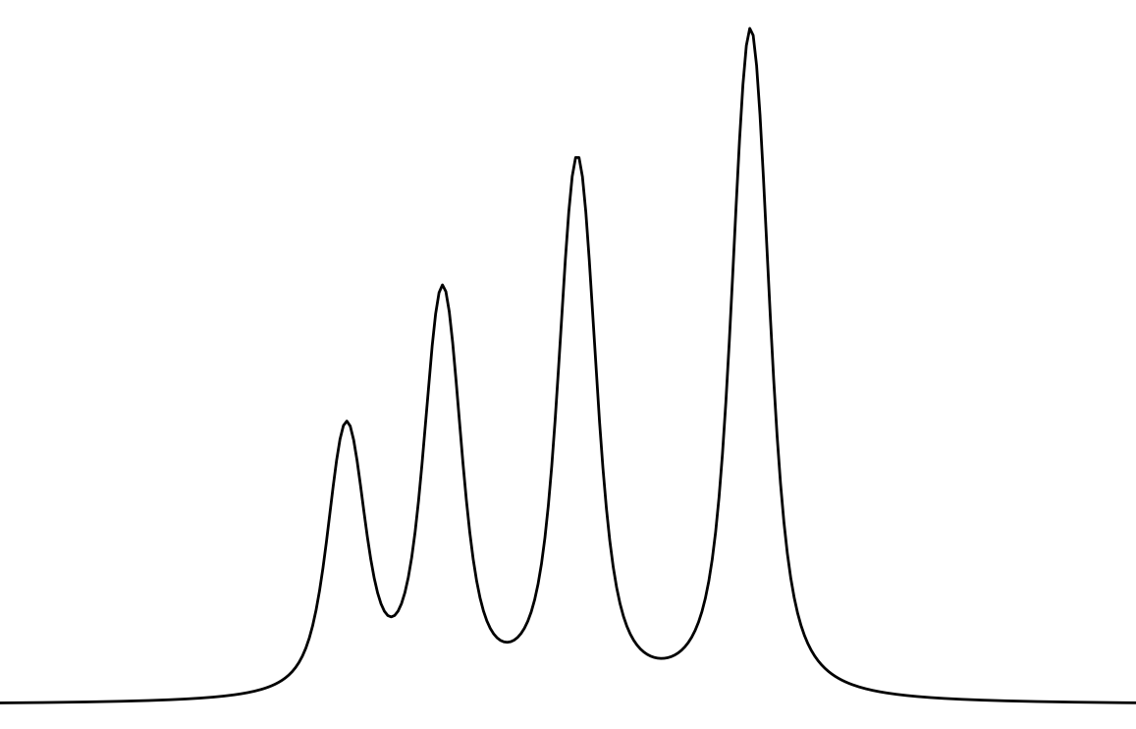
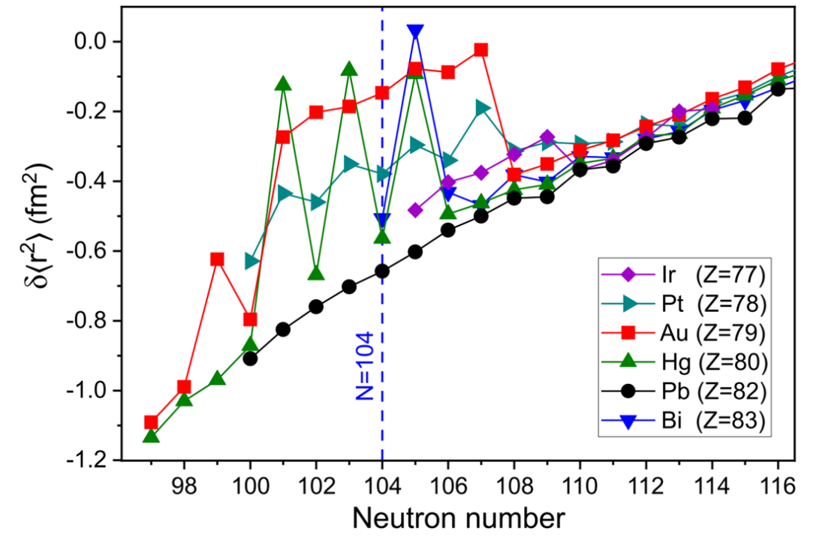
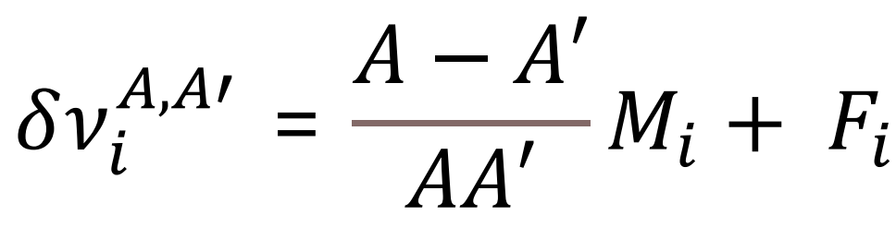
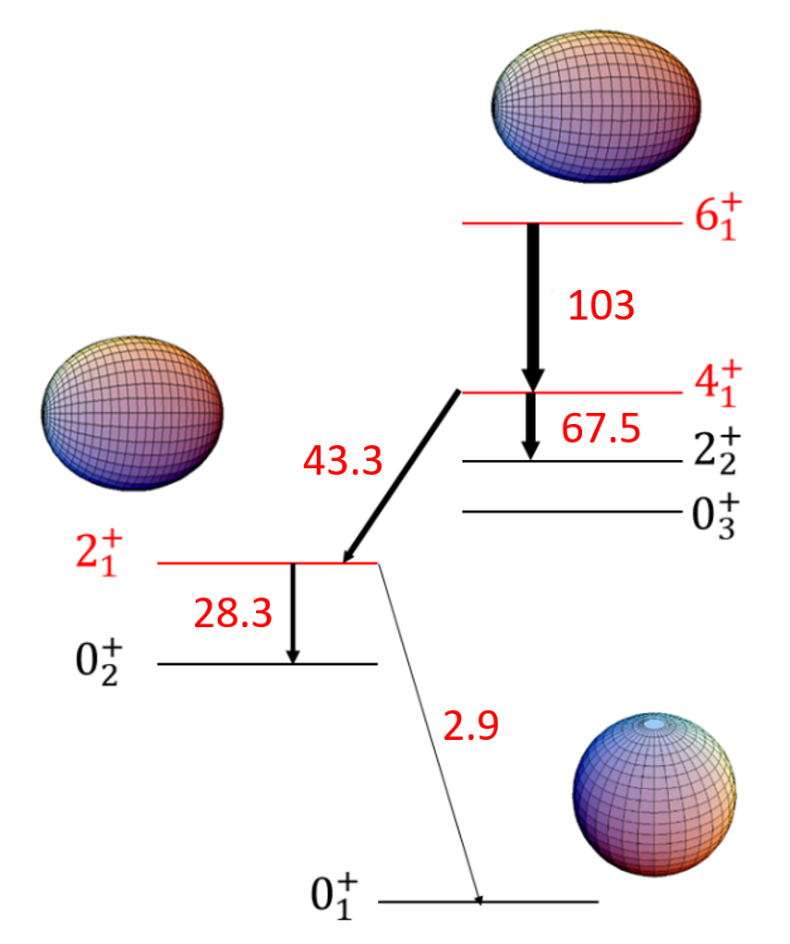
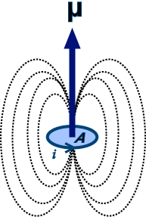
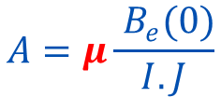



Motivation
Non-res
Hyperfine Structure (HFS) :
AI
79
80
81
82
83
IP
Au
Hg
Tl
Pb
Bi
Rydberg
$$E\left(F\right)=kA+k^{′}B$$
Gold
Mercury
Thallium
Lead
Bismuth
$$A=μ\frac{{ B}_{e}(0)}{I. J}$$
$$B=e Q_{s} V(0)$$
Isotope shift : shift of HFS between two isotopes A and A’
See talk by A. Karadimas
$$δ<r^{2}>$$
Measuring the HFS :
Nuclear Spin (I)
Magnetic dipole moment (μ)
Au: strong increase in charge radii at N = 101-107
→ Proposed “Island of deformation”
Electric Quadrupole moment (Q_{s})
Changes in charge radii δ<r²>
[1] J.G Cubiss et. al ., Phys. Rev. Lett., 131,202501 (2023)

Slide 3
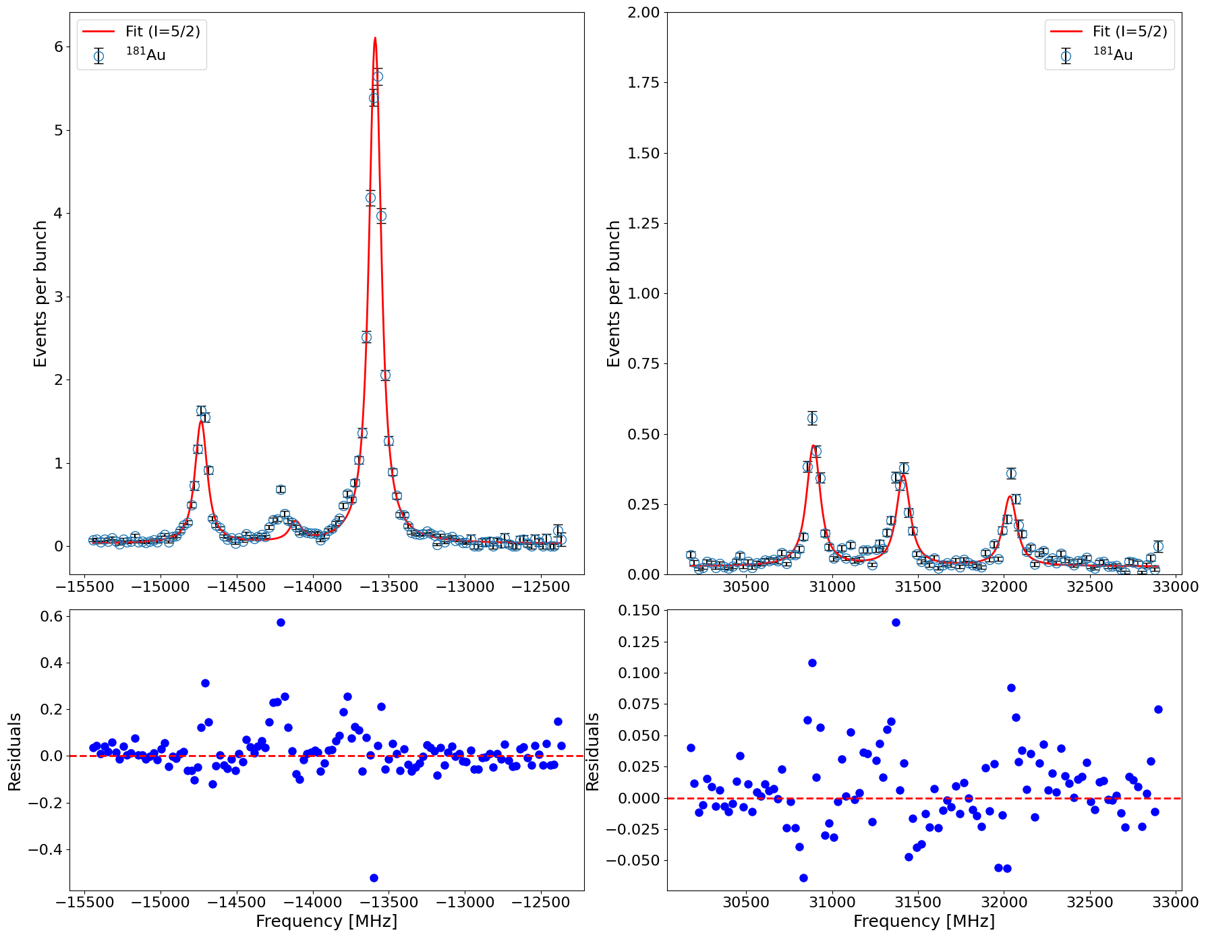
Spin assignment
80
For ¹⁸¹Au, ¹⁸²Au and ¹⁸³Au: Spin assignment is tentative in the literature.
¹⁸¹Au
I = 5/2
Mercury
Thallium
Lead
Bismuth
Isotope | Half-life | I^{π}
¹⁸¹Au₁₀₂ | 13.7 s | (3/2⁻)
¹⁸²Au₁₀₃ | 15.5 s | (2⁺)
¹⁸³Au₁₀₄ | 42.8 s | (5/2⁻)
Possible spins for ¹⁸¹Au & ¹⁸³Au: 3/2, 5/2, 7/2
For ¹⁸²Au: 2,3,4,5
Fit quality

Slide 4
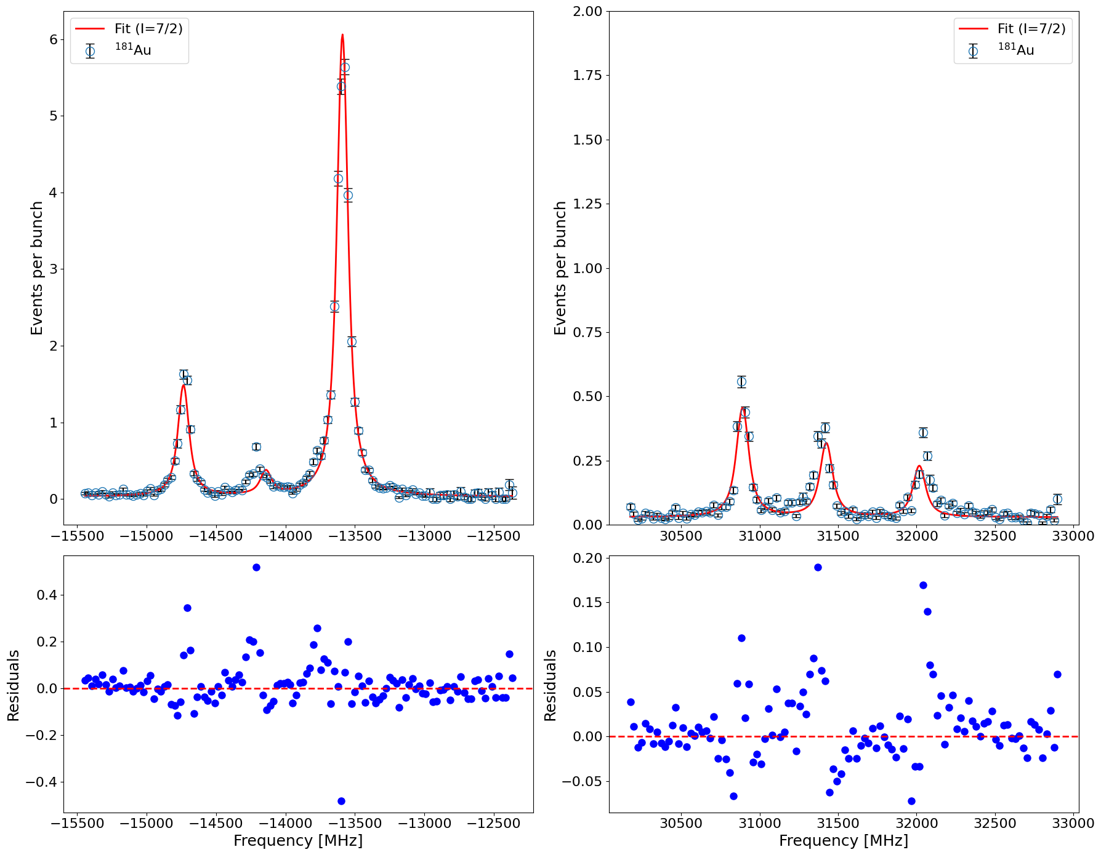
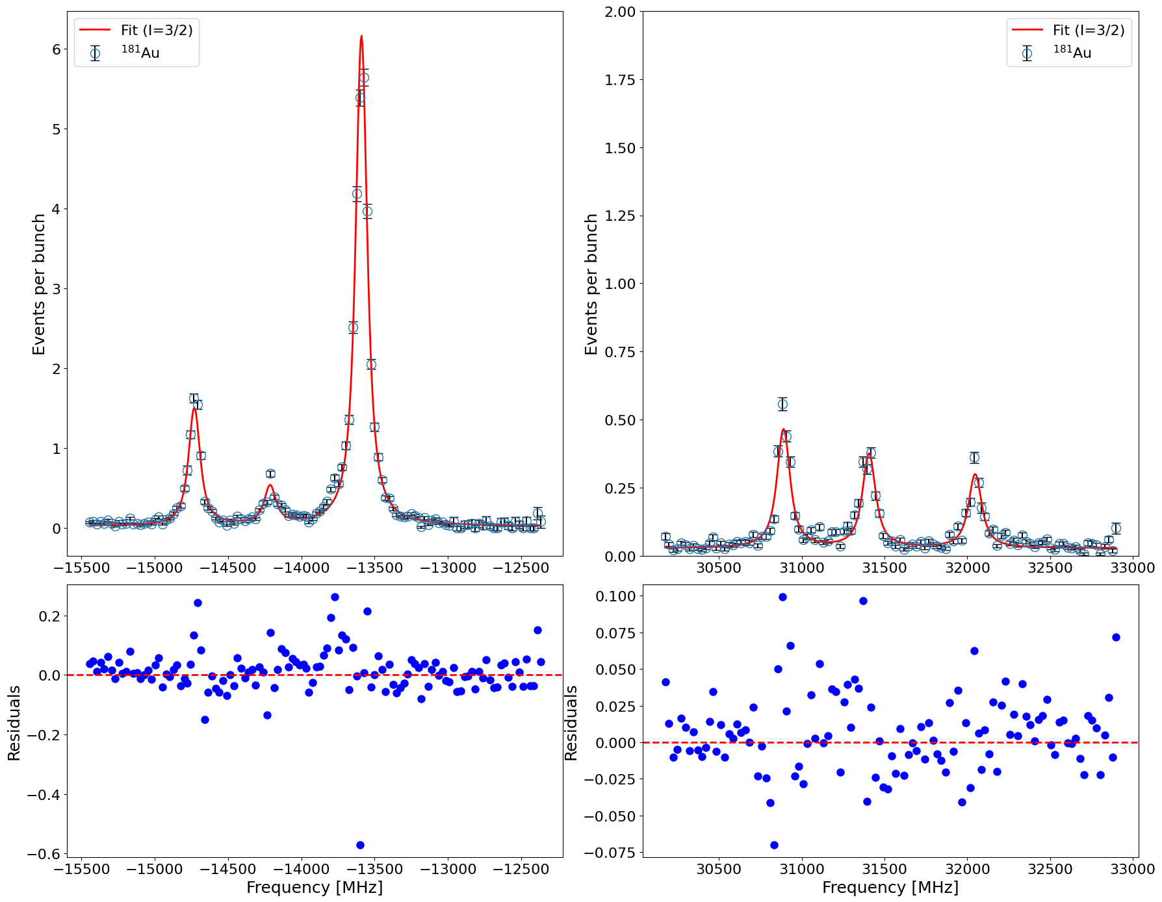
Spin assignment
80
Spins of ¹⁸²Au (I = 2) and ¹⁸³Au (I = 5/2) established in similar way.
Mercury
Thallium
Lead
Bismuth
¹⁸¹Au
I = 7/2
¹⁸¹Au
I = 3/2
Isotope | Spin | A(6s ²S_{1/2}) | A(6p ²P_{3/2}) | B(6p ²P_{3/2}) | Centroid | A_{u}/A_{l} | χ²_{red}
181 | 3/2 | 22809.6(18) | 124.6(7) | 765.8(21) | 3046.09(11) | 0.005 | 6.01
181 | 5/2 | 15382.6(14) | 174.3(5) | -217.7(48) | 5039.9(17) | 0.011 | 8.81
181 | 7/2 | 11539.8(13) | 135.63(43) | -177(6) | 5937.7(19) | 0.012 | 9.64

Slide 5
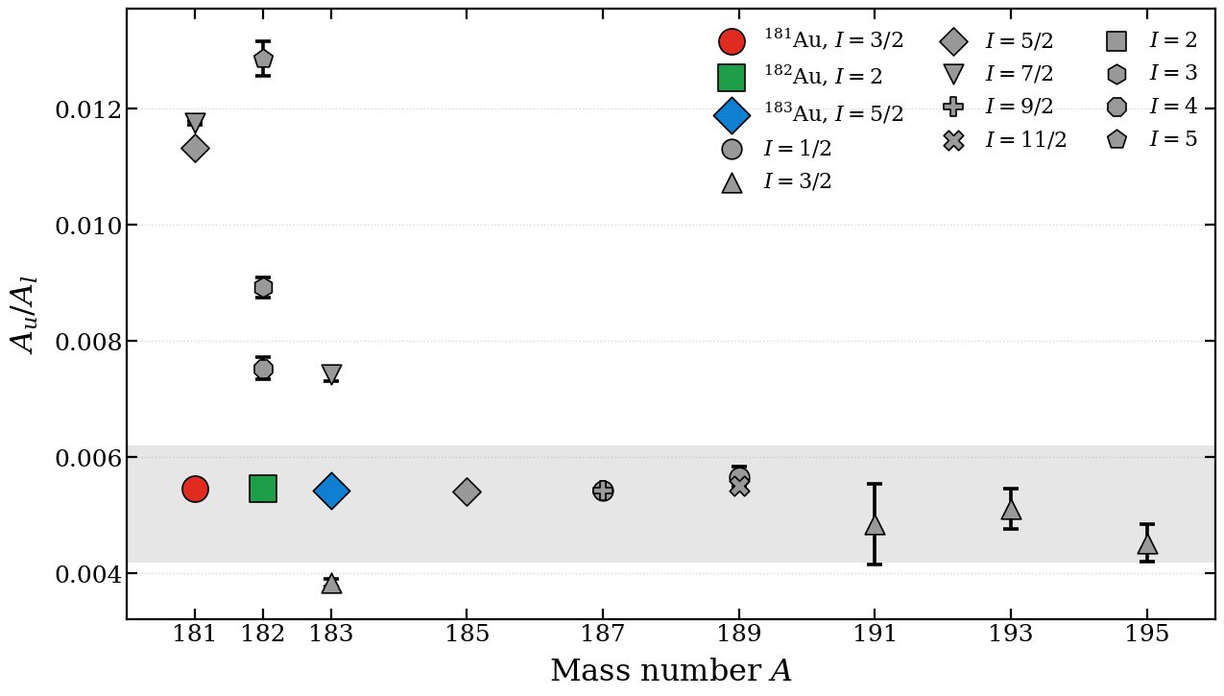

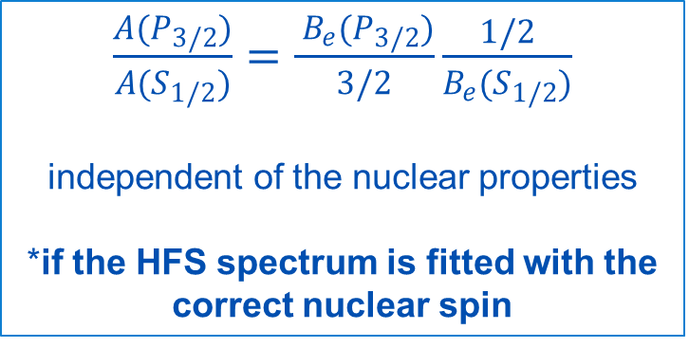

Alternative method: based on A(P_{3/2})/A(S_{1/2})
80
A_{u}/A_{l} ratio: The ratio of magnetic dipole HFS parameters of two atomic states R = A_{u} / A_{l} remains constant across the isotopic chain.
Mercury
Thallium
Lead
Bismuth
6p ²P_{3/2}
$$A_{u}$$
from upper state
First direct spin measurement of ¹⁸¹⁻¹⁸³Au isotopes
6s ²S_{1/2}
$$A_{l}$$
from lower state
$\frac{A(P_{3/2})}{A(S_{1/2})}=\frac{ B_{e}(P_{3/2})}{3/2}\frac{1/2}{B_{e}(S_{1/2})}$
independent of the nuclear properties
*if the HFS spectrum is fitted with the correct nuclear spin
New spin assignments
¹⁸¹Au: I = 3/2
¹⁸²Au: I = 2
¹⁸³Au: I = 5/2

Slide 6
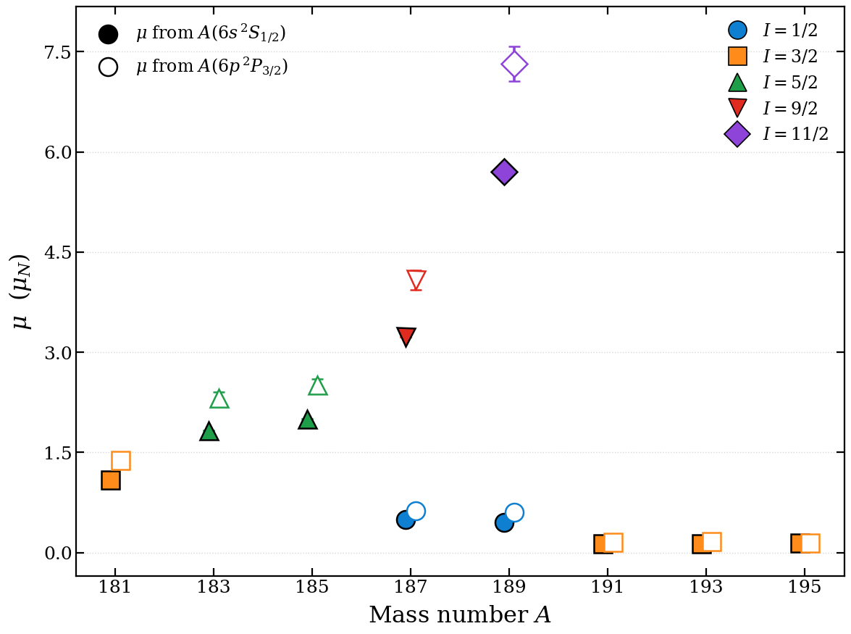


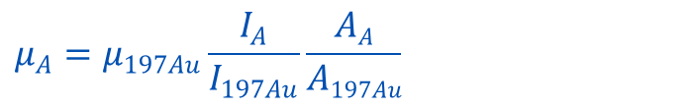




Magnetic dipole moment and Hyperfine Anomaly
$$A=μ\frac{B_{e}(0)}{IJ}$$
from $A$ to $μ$
$$μ_{A}=μ_{197Au}\frac{I_{A}}{I_{197Au}}\frac{AA}{A197Au}$$
$$(1+{197AuΔ}^{A})$$
μ from A(²S_{1/2}) ≠ μ from A(²P_{3/2})
μ from A(²S_{1/2}) = μ from A(²P_{3/2})
Hyperfine Anomaly (HFA): non-uniform distribution of magnetization over the nucleus (BW effect)
6p ²P_{3/2}
$$A$$
from upper state
6p ²P_{1/2}
$$A$$
from another state
Transition probed by RILIS
6s ²S_{1/2}
$$A$$
from lower state
Institute for Nuclear and Radiation Physics (IKS)

Slide 7
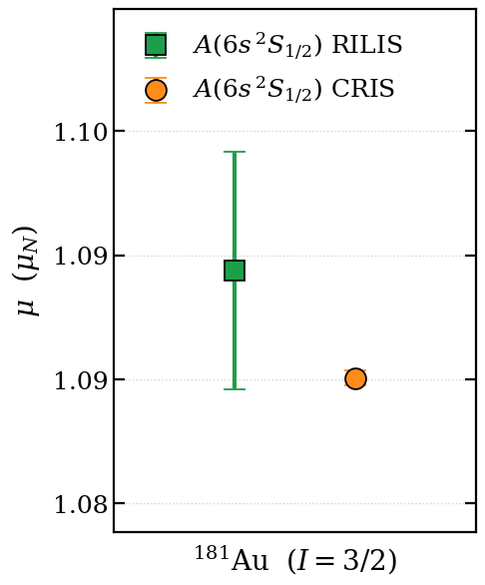
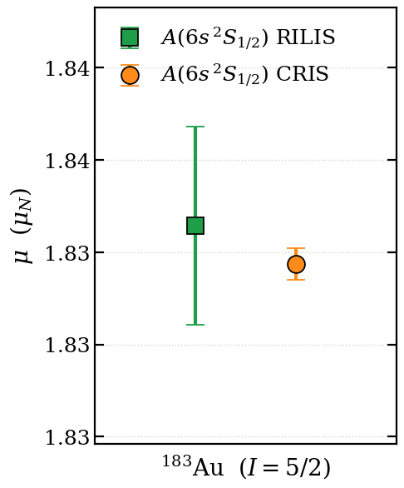
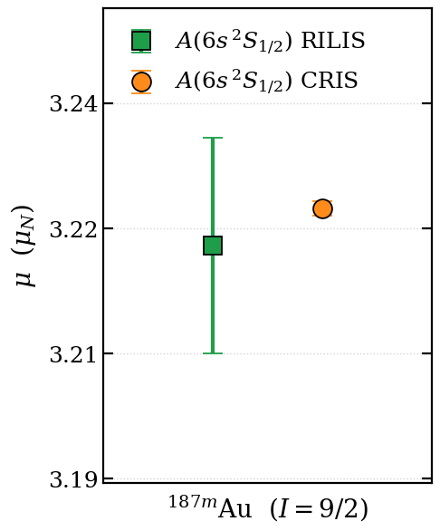
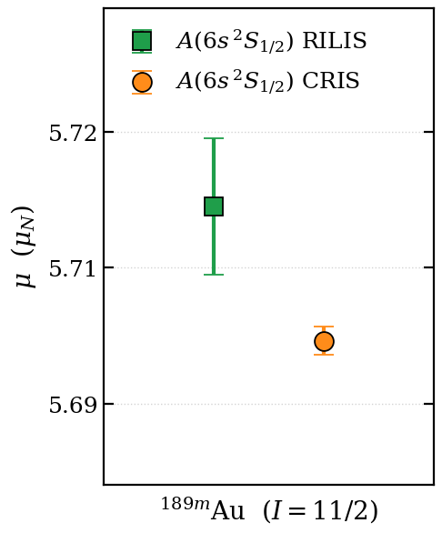
Magnetic dipole moment
80
Mercury
Thallium
Lead
Bismuth
High-resolution CRIS measurement of magnetic moments from 6s ²S_{1/2} compared to RILIS (6s ²S_{1/2})
A(6s ²S_{1/2}) value for ^{189m}Au is debated in literature [1-2].
[1] Wallmeroth et. al, Nucl. Phys. A 493, 224 (1989).
[2] Barzakh et. al, PRC 101, 034308 (2020)
Notes:
5-15 times higher precision on moments from CRIS.

Slide 8
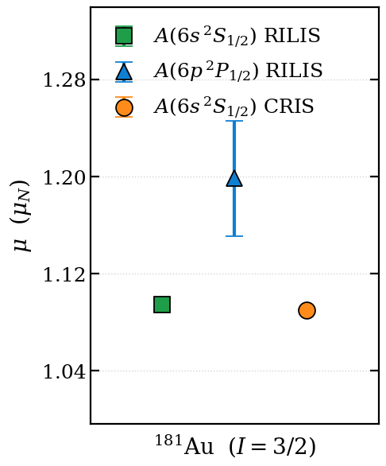
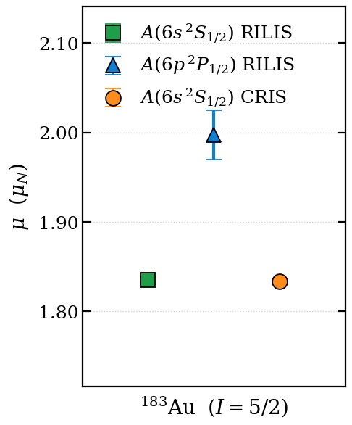
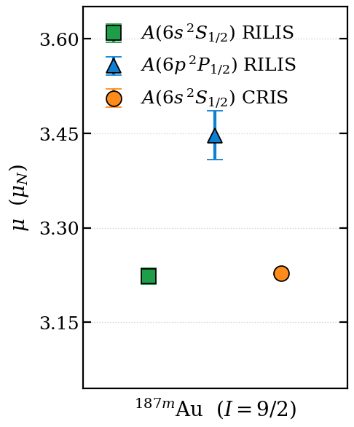
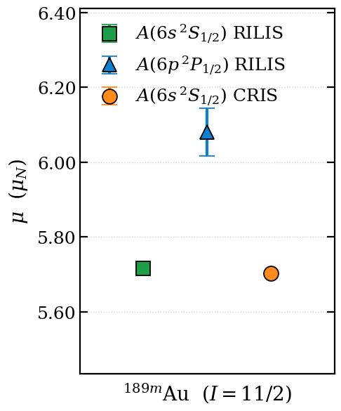
μ from different electronic levels
80
Mercury
Thallium
Lead
Bismuth
A(6p ²P_{1/2}) values from RILIS have precision of 1-4% [1-3]
μ(6s ²S_{1/2}) RILIS don’t agree with μ(6p ²P_{1/2}) RILIS
μ from 6s ²S_{1/2} is different (2σ - 6σ) from μ from 6p ²P_{1/2}
HFA calculations from theory needed!
[1] Cubiss et. al,. PRL 131, 202501 (2023); [2] Barzakh et. al, PRC 101, 064321 (2020)
[3] Barzakh et. al, PRC 101, 034308 (2020)

Slide 9

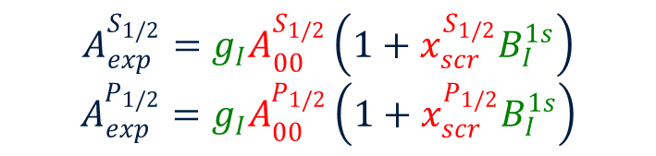




HFA Formalism
The measured magnetic dipole coupling constant, A_{exp} can be expressed as,
$$A_{BW}=g_{I}A_{00}x_{scr}B_{I}^{1s}$$
$$A_{exp}=A_{0}+A_{BW}$$
$A_{exp}=g_{I}A_{00} \left(1+ x_{scr}B_{I}^{1s}\right)$ [1]
$$A_{0}=g_{I}A_{00}$$
Total BW effect (ε)
The parameters highlighted in red are defined only by the electronic wavefunction – calculated.
Those in green only depend on the nuclear wave function – our unknowns.
$$A_{exp}^{S_{1/2}}=g_{I}A_{00}^{S_{1/2}}\left(1+x_{scr}^{S_{1/2}}B_{I}^{1s}\right)$$
$$A_{exp}^{P_{1/2}}=g_{I}A_{00}^{P_{1/2}}\left(1+x_{scr}^{P_{1/2}}B_{I}^{1s}\right)$$
Extraction of the g-factor ($μ$) and BW effect (ε)
Systems of 2 equations and 2 unknowns using A(6s ²S_{1/2}) (CRIS, most precise) and A(6p ²P_{1/2}) (RILIS)
Calculations by J.S.M Ginges and C.J West.
University of Queensland, Australia
[1] B. M. Roberts, J.S.M Ginges et. al, PRA, 105:052802, 2022

Slide 10
Magnetic dipole moment
80
Mercury
Thallium
Lead
Bismuth
[1] Cubiss et. al,. PRL 131, 202501 (2023); [2] Barzakh et. al, PRC 101, 064321 (2020)
[3] Barzakh et. al, PRC 101, 034308 (2020)

Slide 11
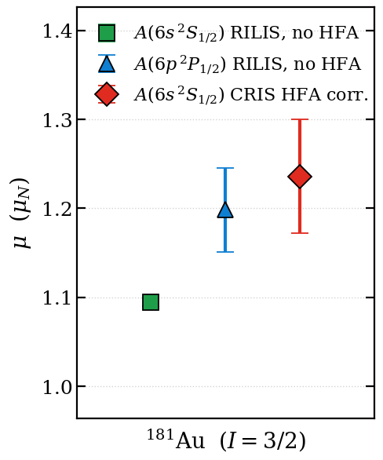
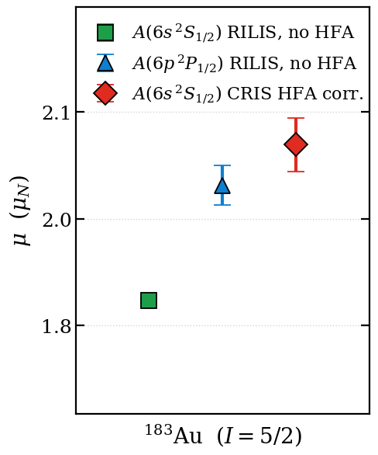
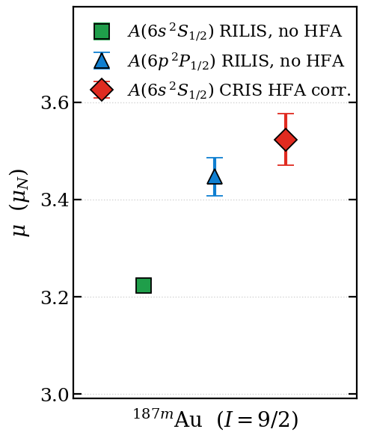
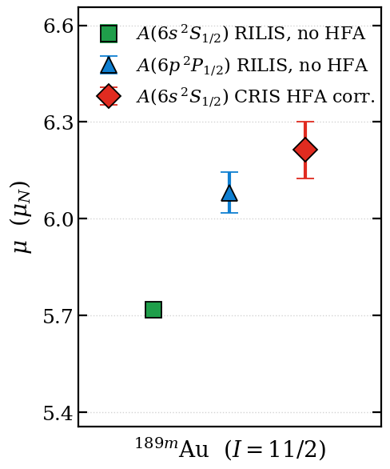
HFA correction (CRIS)
Corrected μ (level independent) value lies higher than the A(6p ²P_{1/2}) and A(6s ²S_{1/2})
Corrected μ precision limited by precision on A(6p ²P_{1/2}) RILIS measurement !! not atomic theory or CRIS A(6s ²S_{1/2})
Absolute BW contribution of around 3-7 % for S_{1/2} and 1-2% in P_{1/2}

Slide 12
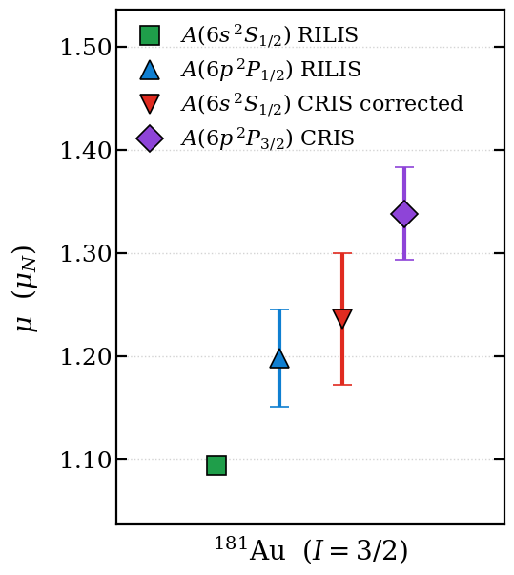
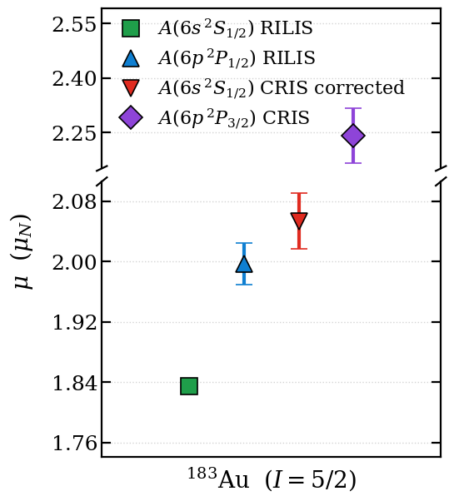
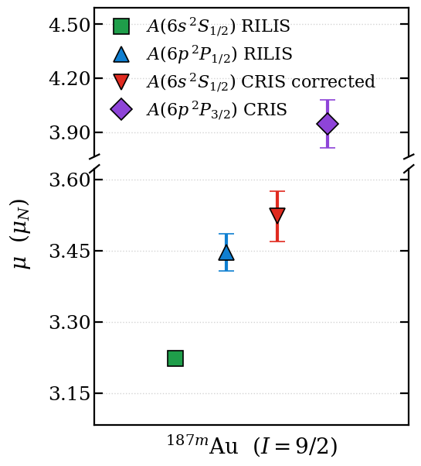
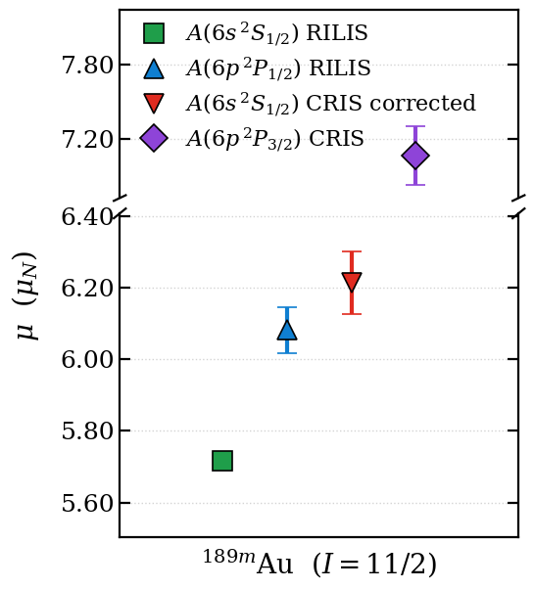
μ from A(6p ²P_{3/2}) CRIS ?
Difference between μ A(6s ²S_{1/2}) CRIS corrected and A(6p ²P_{3/2}) CRIS upto 3.5σ
What about atomic calculations for P_{3/2} ?

Slide 13
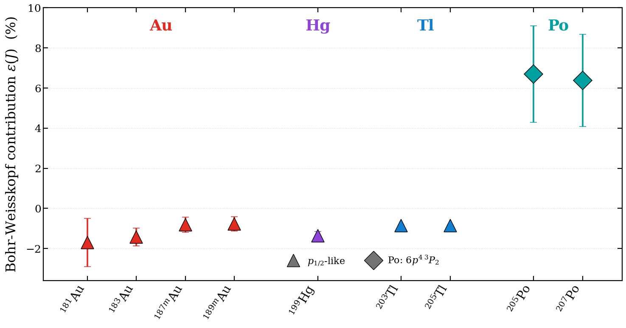
μ from A(6p ²P_{3/2}) CRIS ?
Atomic calculations available for S_{1/2} and P_{1/2} with high-precision (1%)
Atomic theory precision is limited for J >1/2
6p ²P_{3/2} is sensitive to Quadrupole moments, Q_{s} (not P_{1/2} or S_{1/2})!!
Reliable μ extraction using two different transitions in systems with known BW effect
[1] R. J. Reimann and M. N. McDermott, Phys. Rev. C 7, 2065 (1973)
[2] Roberts, Ranclaud & Ginges, PRA 105, 052802 (2022)
[3] L. V. Skripnikov and A. E. Barzakh, Phys. Rev. C 109, 024315 (2024)

Slide 14
Conclusion
New Atomic theory calculations for the S_{1/2} and P_{1/2} can help extract reliable μ.
Magnetic moments for 14 Au isotopes remeasured with high resolution.
Magnetic moments through laser spectroscopy in Pb region (Po, Tl, Hg, Au) need to take into account HFA correction (up to 7%).
In this CRIS experimental campaign, spins of ¹⁸¹⁻¹⁸³Au isotopes have been assigned for the first time.
The Quadrupole moments, Q_{s} for the isotopes in the “island of deformation” (¹⁸¹⁻¹⁸⁶Au) have also been (re)measured (Interpretation in progress, interesting nuclear structure phenomena!!)

Slide 15
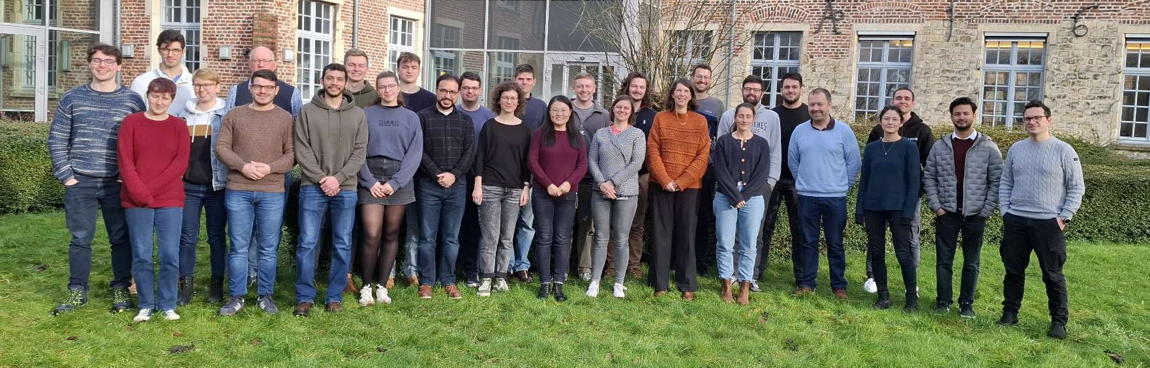








CRIS Collaboration

Slide 16
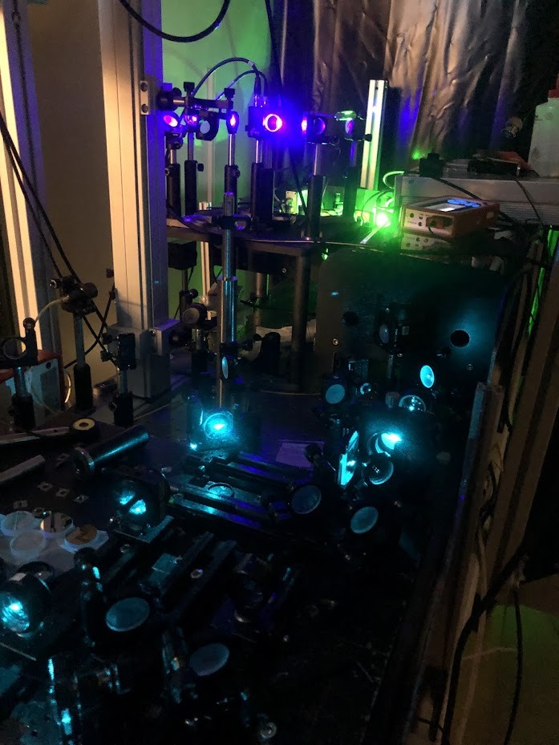
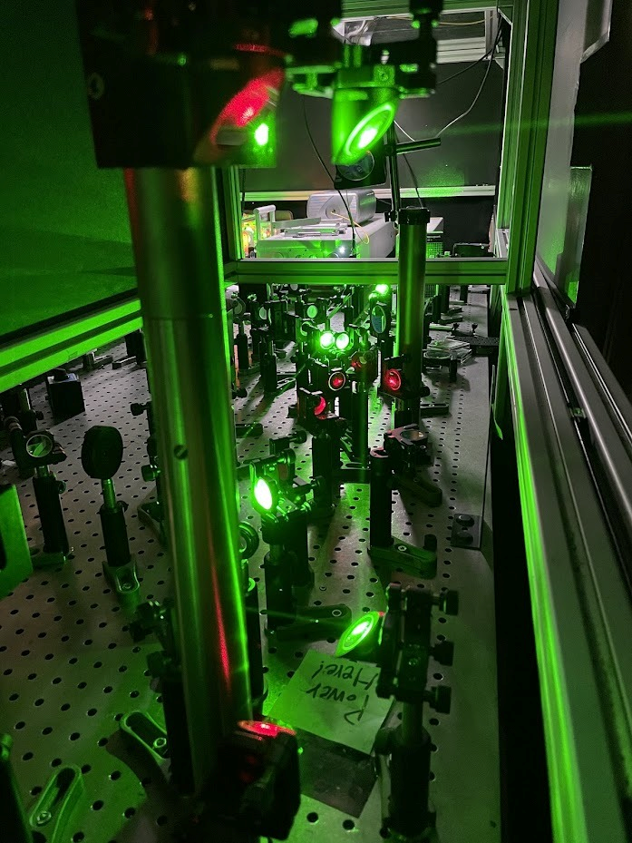
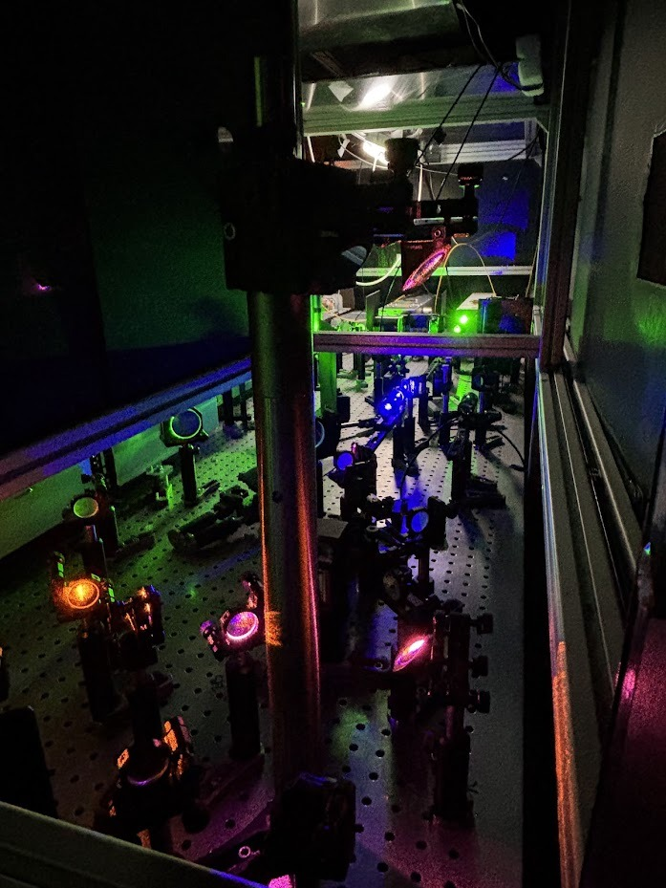
Thank you for your attention

Slide 17
Backup slides

Slide 18
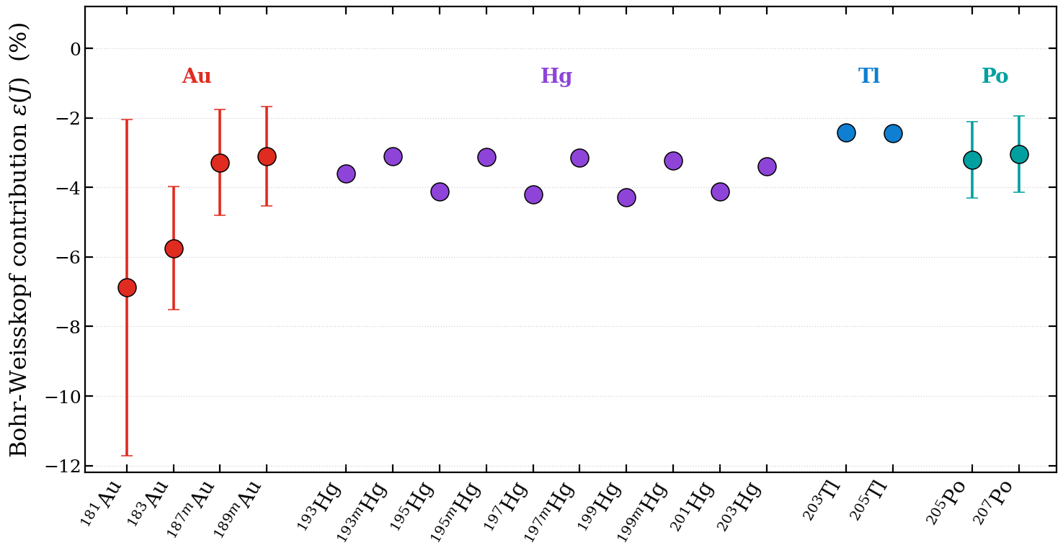
BW contribution in Pb region for S_{1/2}
[1] R. J. Reimann and M. N. McDermott, Phys. Rev. C 7, 2065 (1973)
[2] Prosnyak, Maison & Skripnikov, J. Chem. Phys. 152, 044301 (2020)
[3] L. V. Skripnikov and A. E. Barzakh, Phys. Rev. C 109, 024315 (2024)

Slide 19
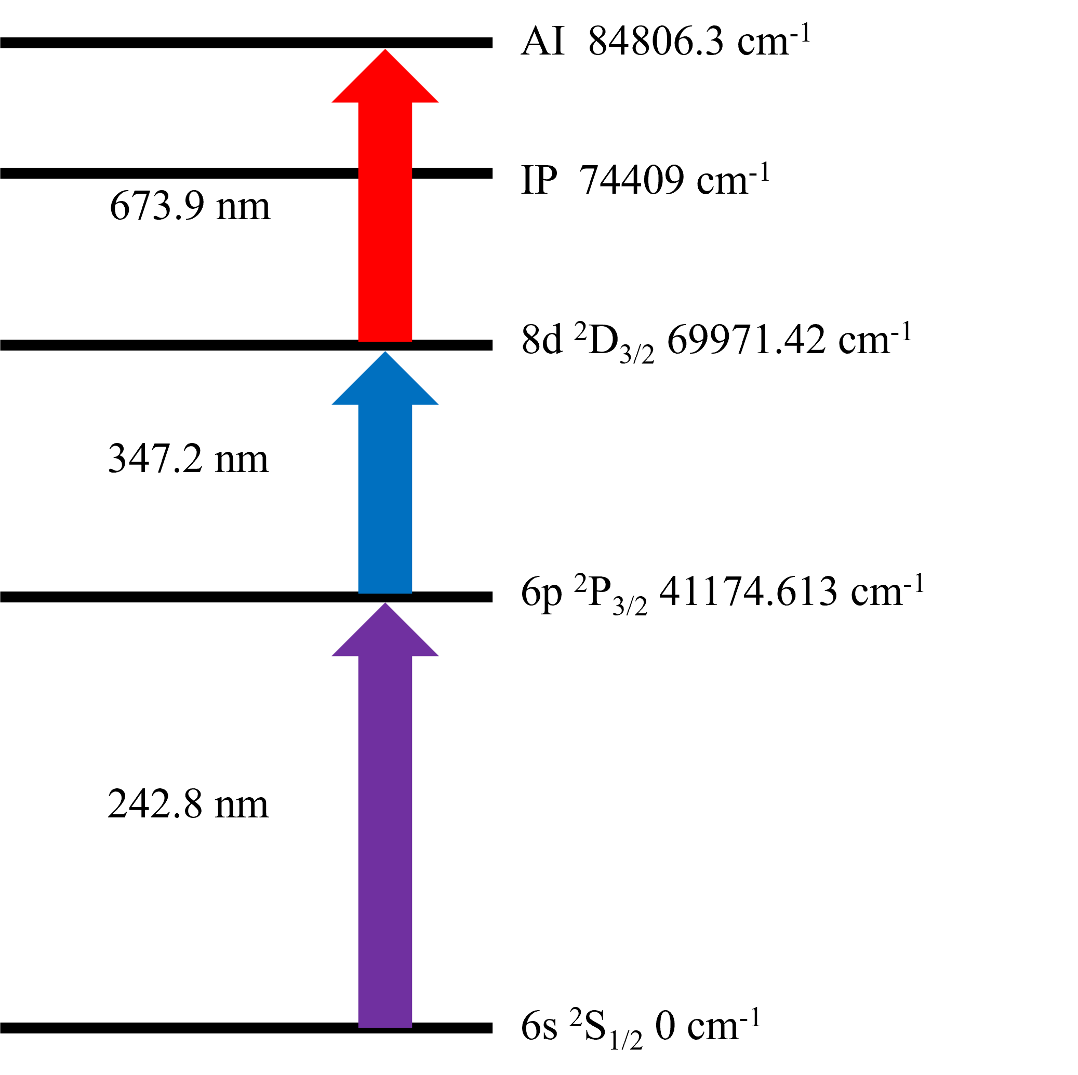
Laser schemes for Au
5d¹⁰ 6p ²P_{3/2}
5d¹⁰ 6p ²P_{1/2}
COLLAPS, 1994
627.8 nm
CRIS
RILIS
242.8 nm
267.6 nm
5d⁹6s² ²D_{3/2}
5d¹⁰6s ²S_{1/2}
RIS scheme for Au (CRIS)
Spectroscopy steps used for Au in literature

Slide 20

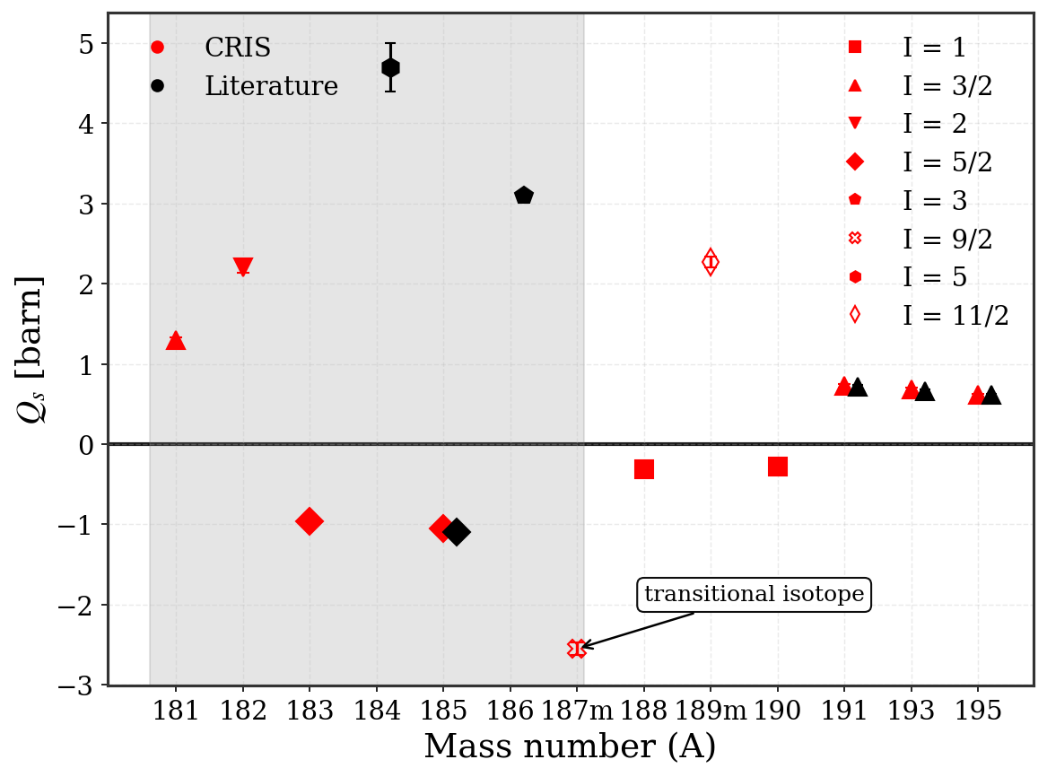
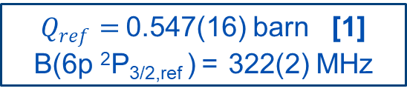
Electric quadrupole moments (Q_{s})
$Q_{ref}=$0.547(16) barn [1]
B(6p ²P_{3/2,ref} ) = 322(2) MHz
Table Q_{s} red ones from CRIS measurements, and the black ones are the literature values.
Isotope | Spin | B(6p ²P_{3/2}) | Q_{s} [b] (this work) | Q_{s} [b] (literature)
181 | 3/2 | 764(5) | 1.274(39)
182 | 2 | 1301(6) | 2.17(7)
183 | 5/2 | -566(3) | - 0.94(3)
184 | 5 |  | - | 4.7(3)
185 | 5/2 | -622(2) | -1.04(3) | -1.1(1)
186 | 3 |  | - | 3.10(6)
187m | 9/2 | -1508(10) | -2.52(8)
188 | 1 | -186(3) | -0.31(1)
189m | 11/2 | 1339(9) | 2.23(7)
190 | 1 | -167(2) | -0.280(9)
191 | 3/2 | 428(5) | 0.71(2) | 0.72(2)
192 | 1 | -130(1) | -0.220(7) | -0.228(8)
193 | 3/2 | 402(3) | 0.67(2) | 0.66(2)
195 | 3/2 | 361(2) | 0.60(2) | 0.61(2)
[1] Powers, R. J., et. al. Muonic ¹⁹⁷Au: A test of the weak-coupling model.
NPA 230 (1997) 413

Slide 21

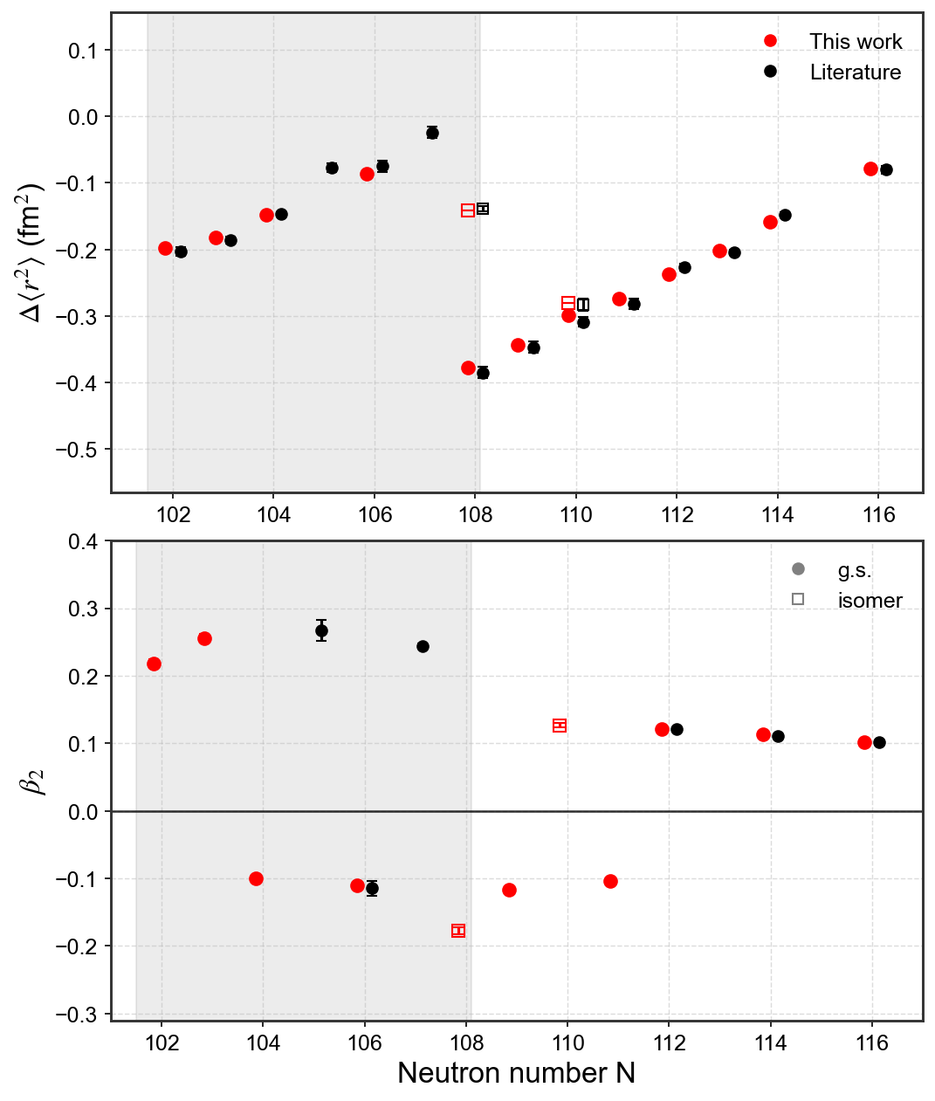

Q_{s} & Island of deformation
Strong coupling (K = I) assumed to extract β₂ (axial deformation)
Positive‑Q (^{181,182}Au, ^{184,186}Au) reaches β₂ ≈ 0.25 (rigid prolate).
Q_{s} > 0
Negative‑Q (^{183,185}Au)
smaller β₂ ≈ -0.10 – -0.11 (moderate oblate) – hints of triaxiality or higher order deformation?
Q_{s} < 0

Slide 22
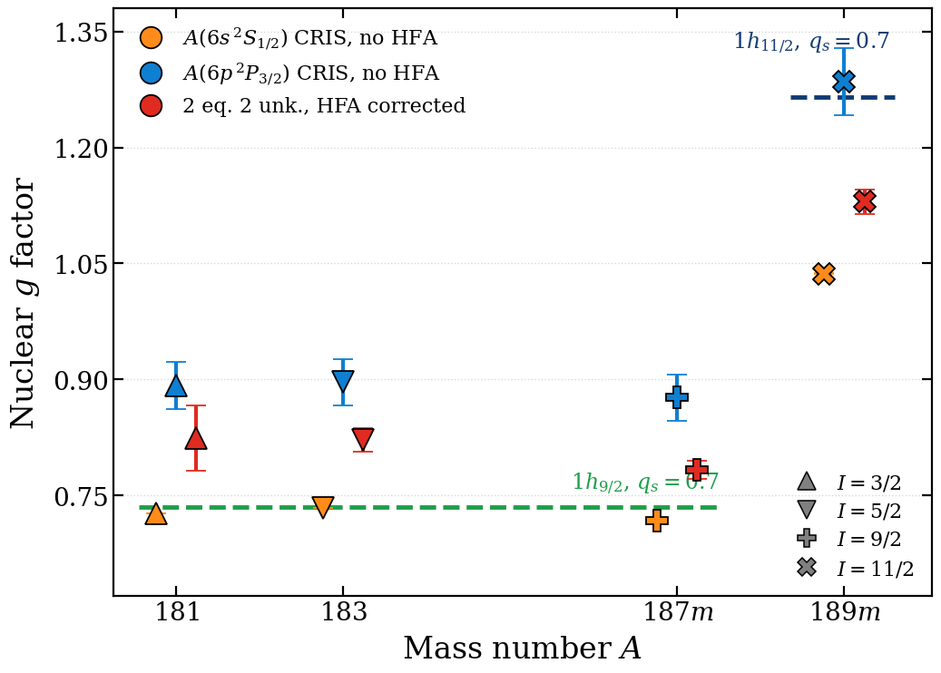
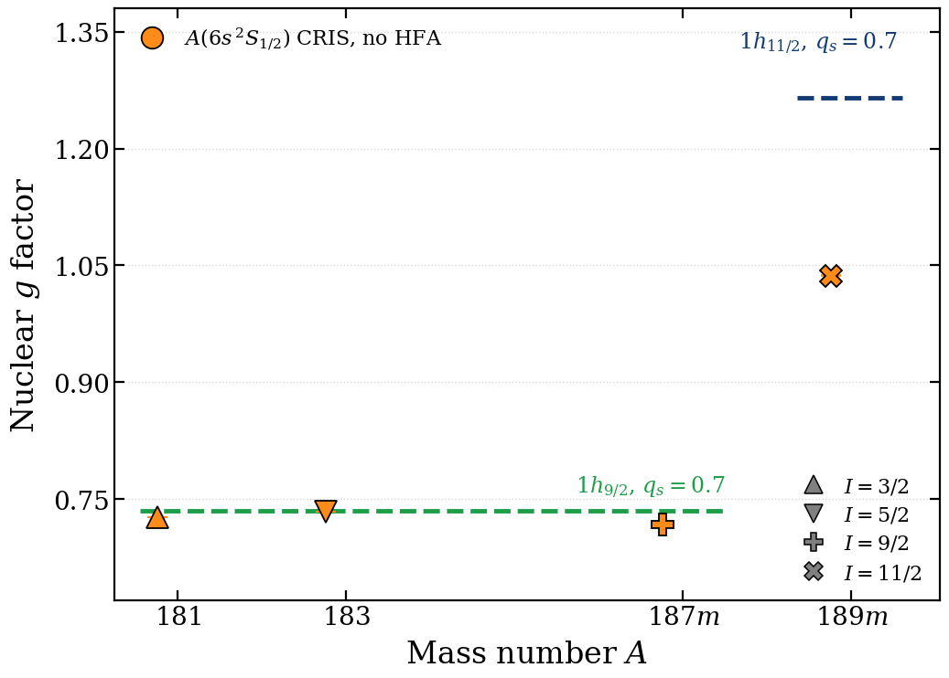
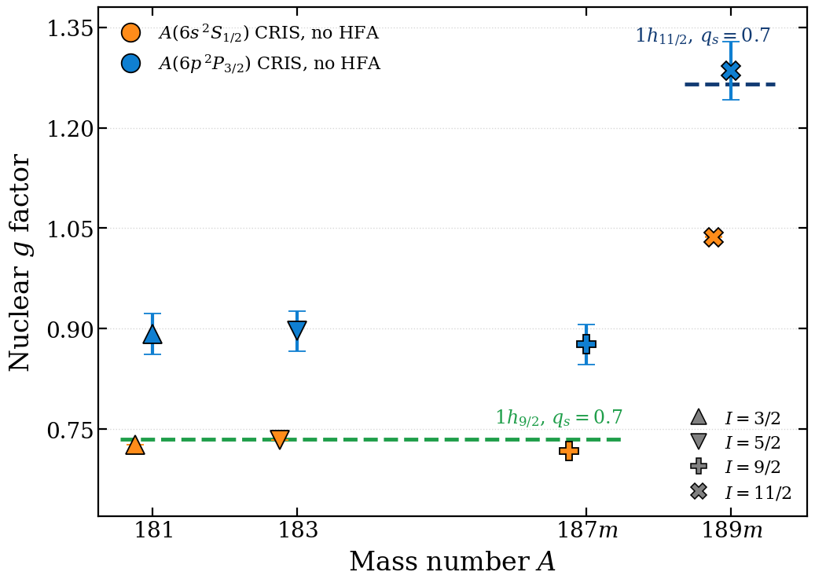
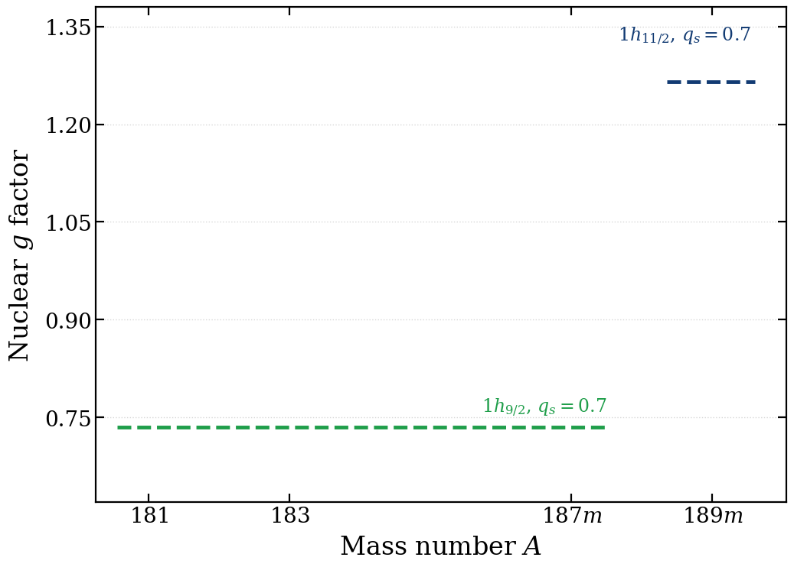
Probing the nuclear configuration

Slide 23
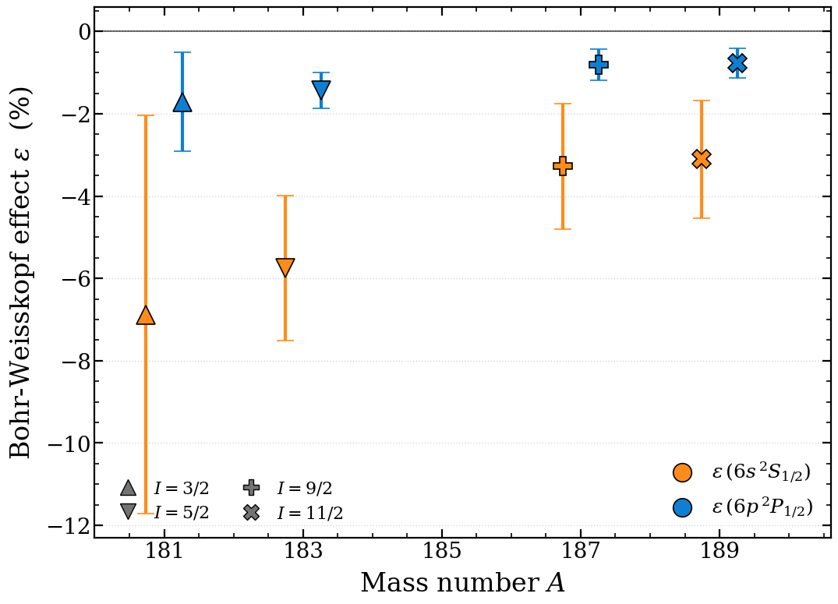
Bohr-Weisskopf contribution in Au isotopes
A | I | ε(6s ²S_{1/2})% | ε(6p ²P_{1/2})%
181 | 3/2 | -6.9(48) | -1.7(12)
183 | 5/2 | -5.8(18) | -1.4 (4)
187m | 9/2 | -3.3(15) | -0.8(4)
189m | 11/2 | -3.1(14) | -0.8(4)
Bohr-Weisskopf contribution from A(6s ²S_{1/2}) and A(6p ²P_{1/2} levels)

Slide 24
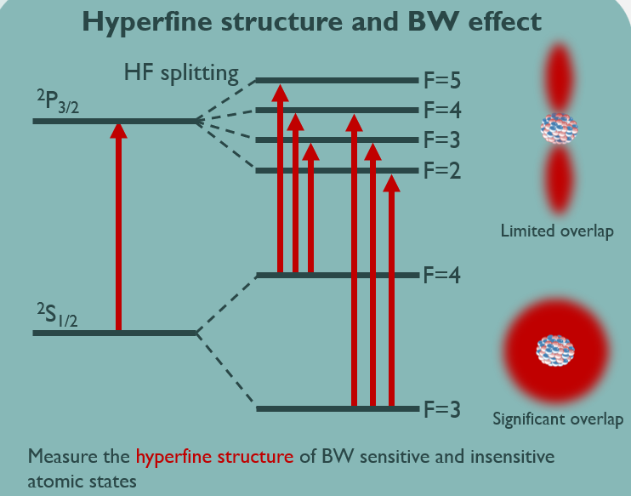
Hyperfine anomaly
80
Mercury
Thallium
Lead
Bismuth

Slide 25
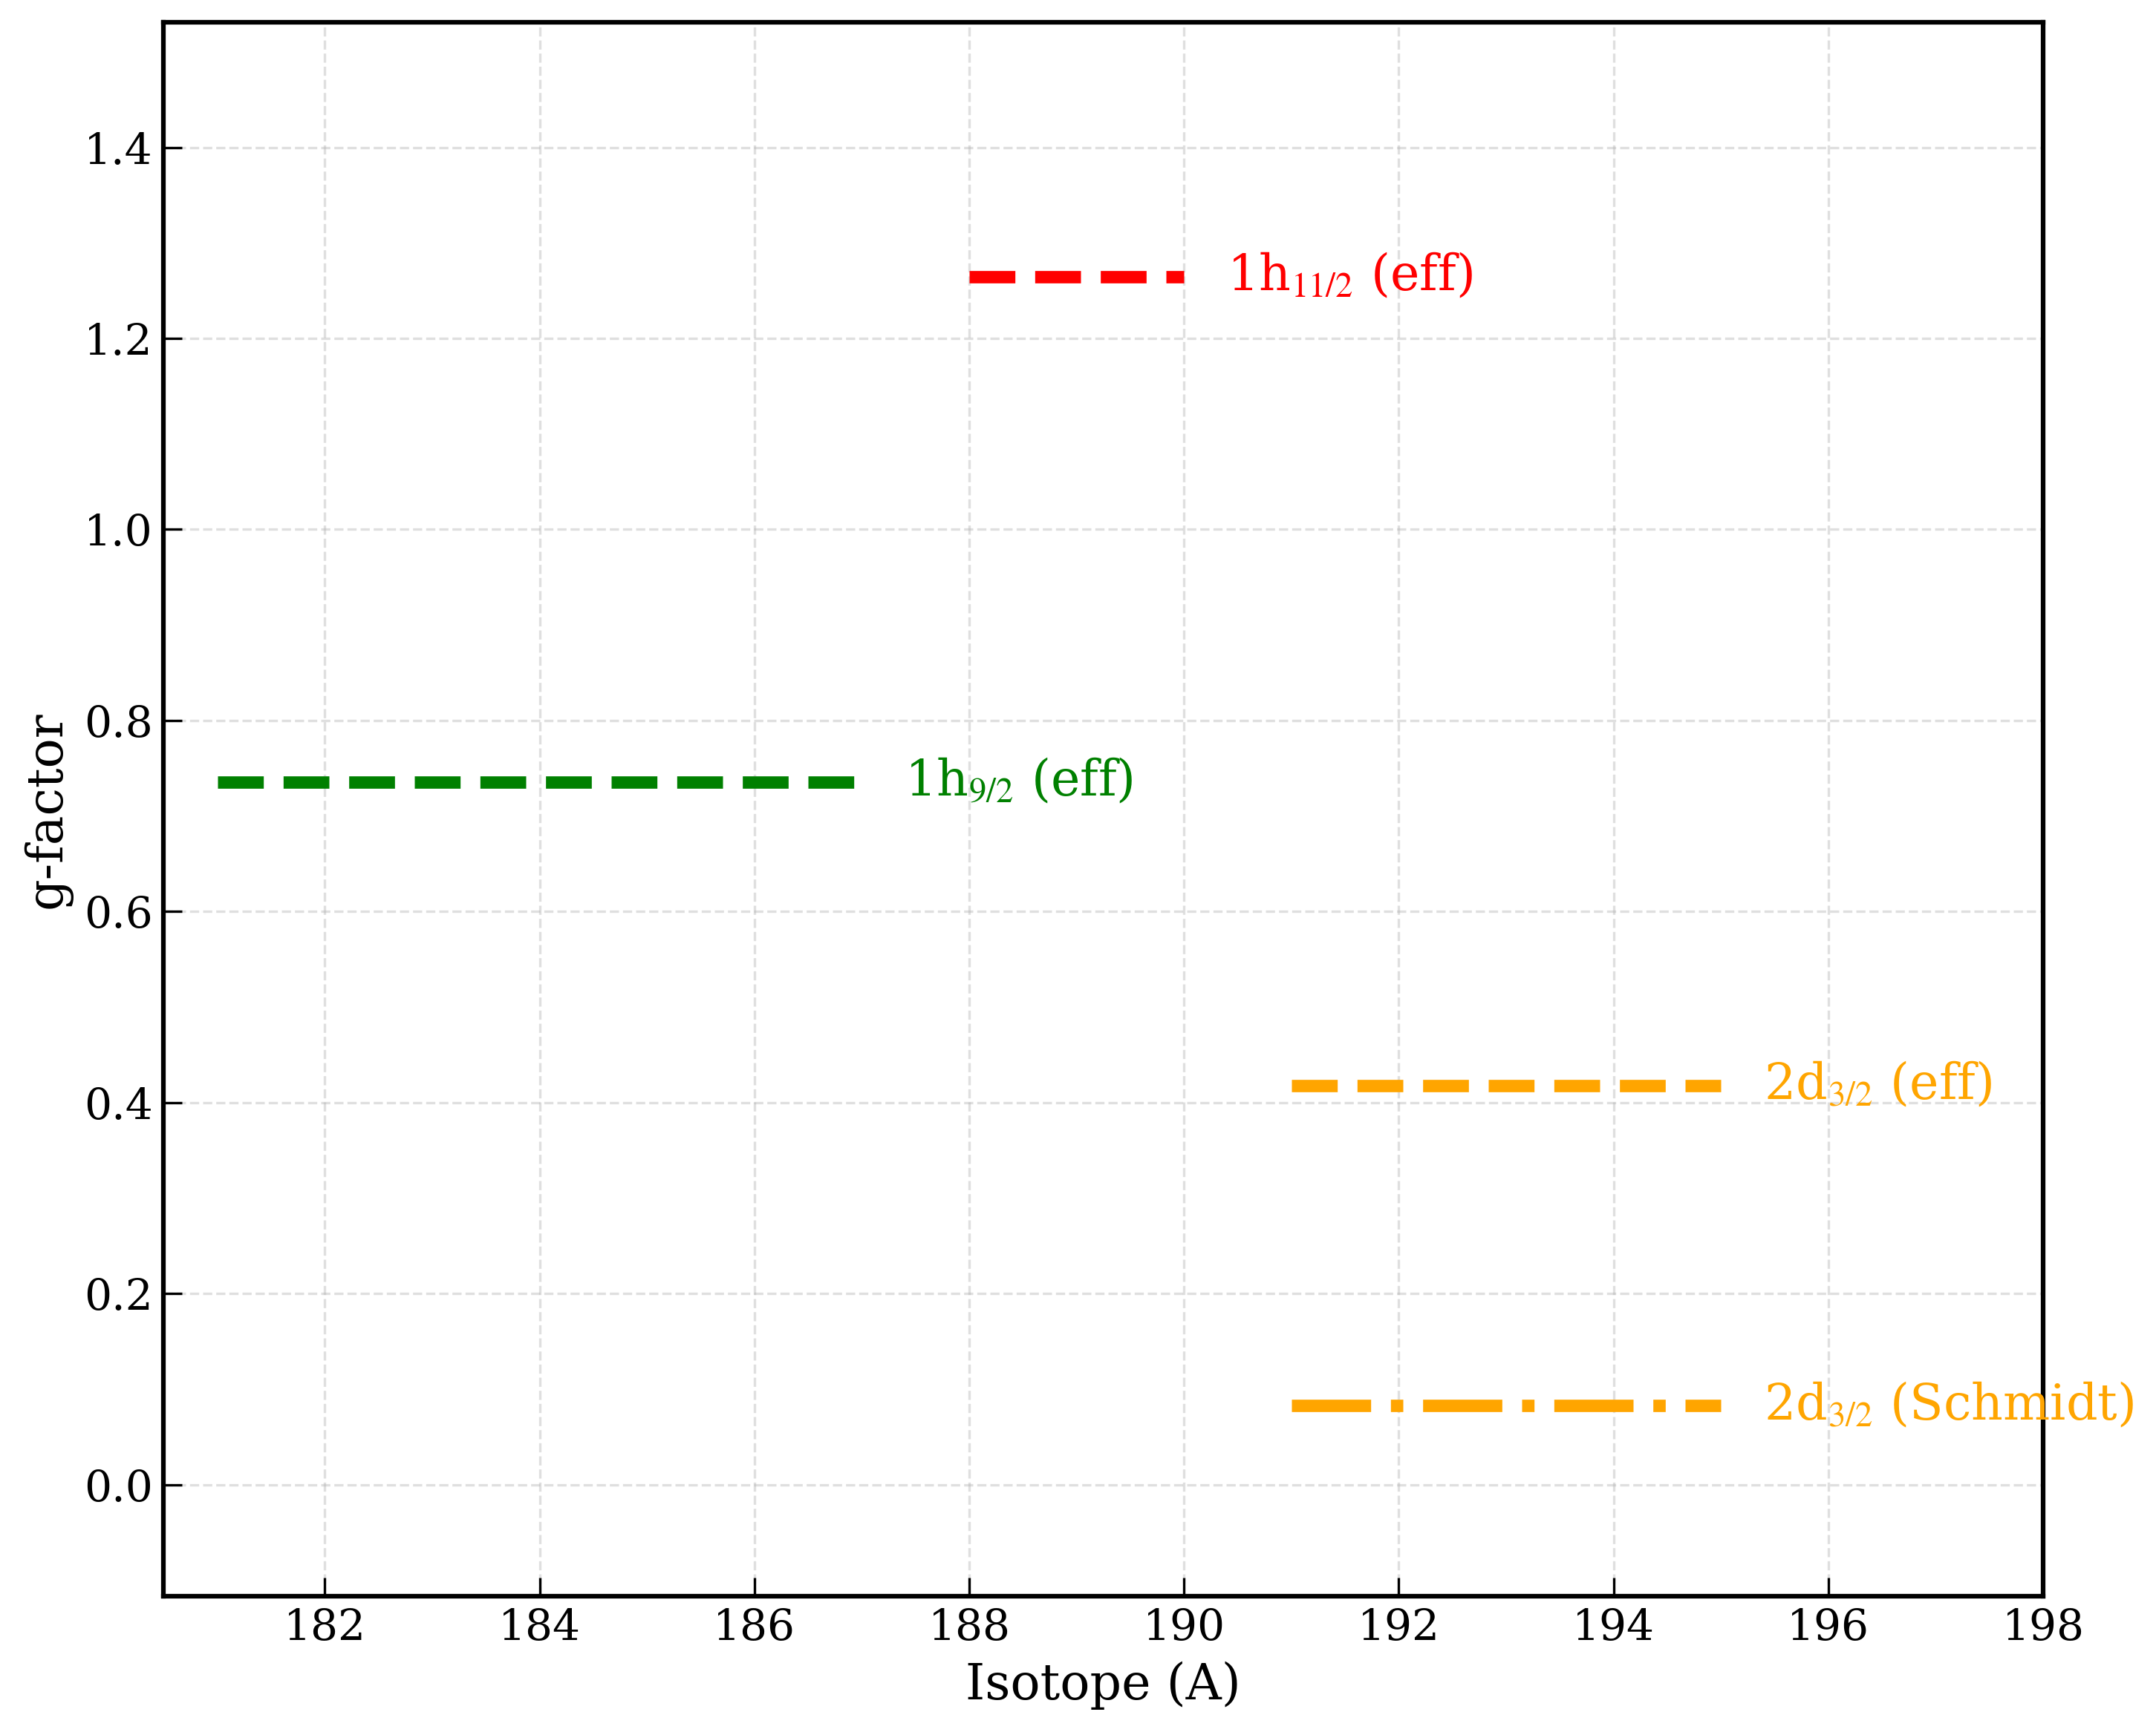
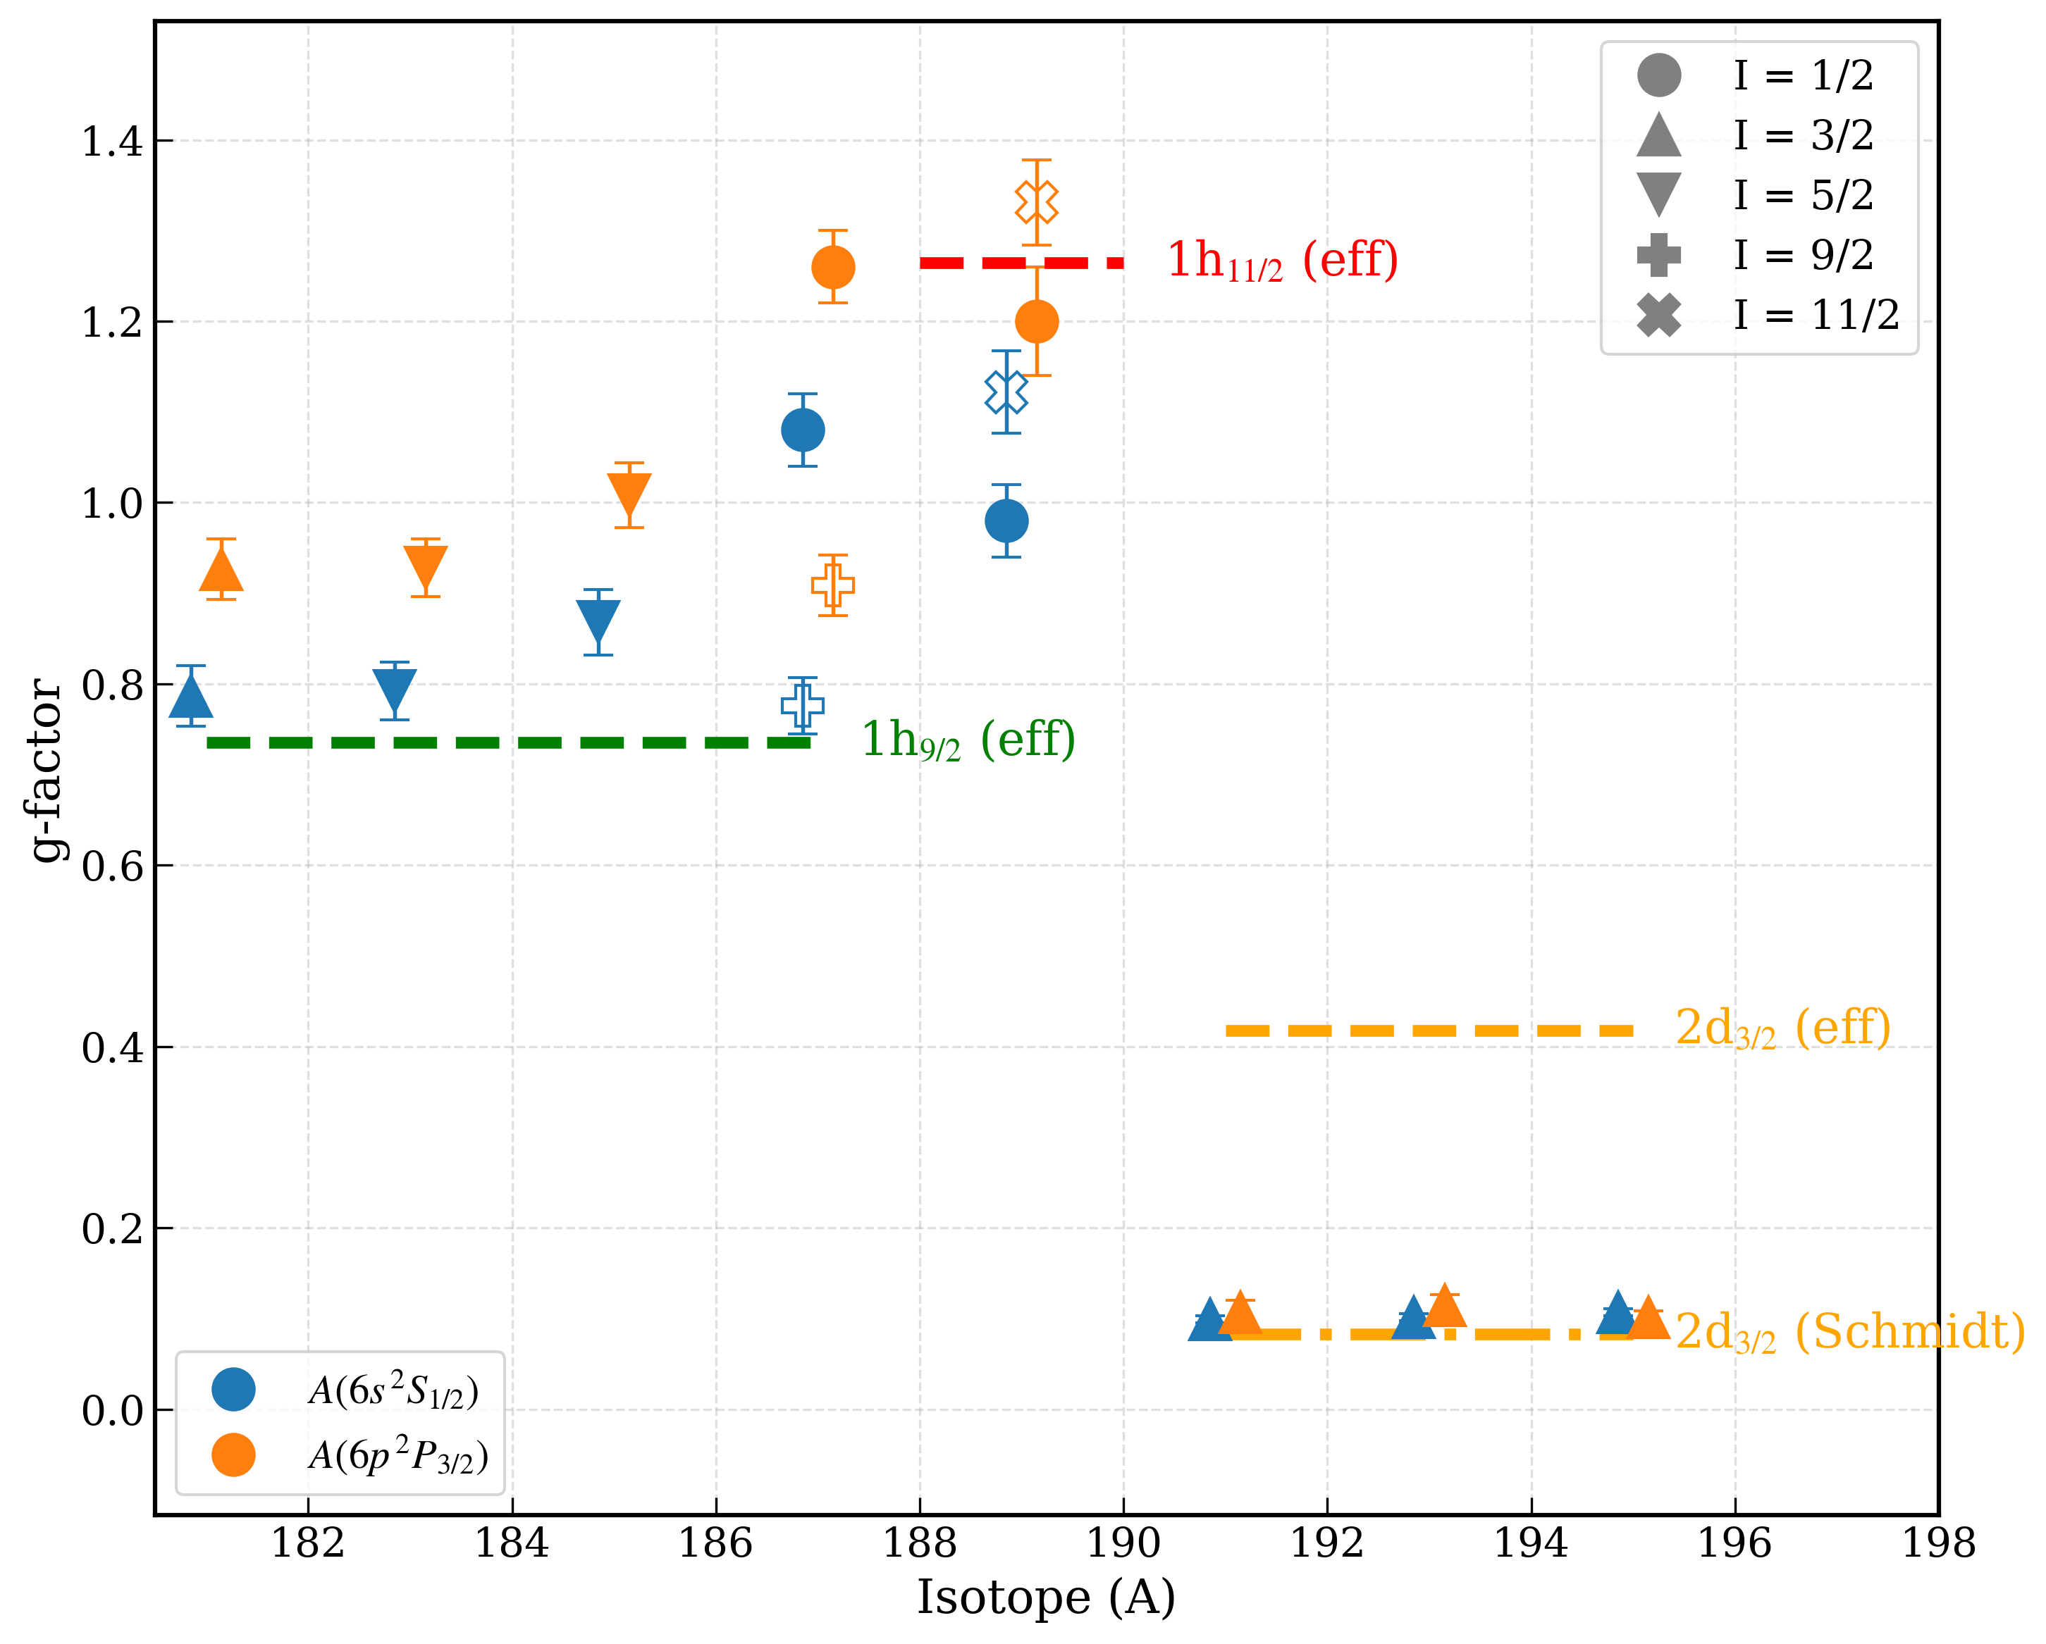
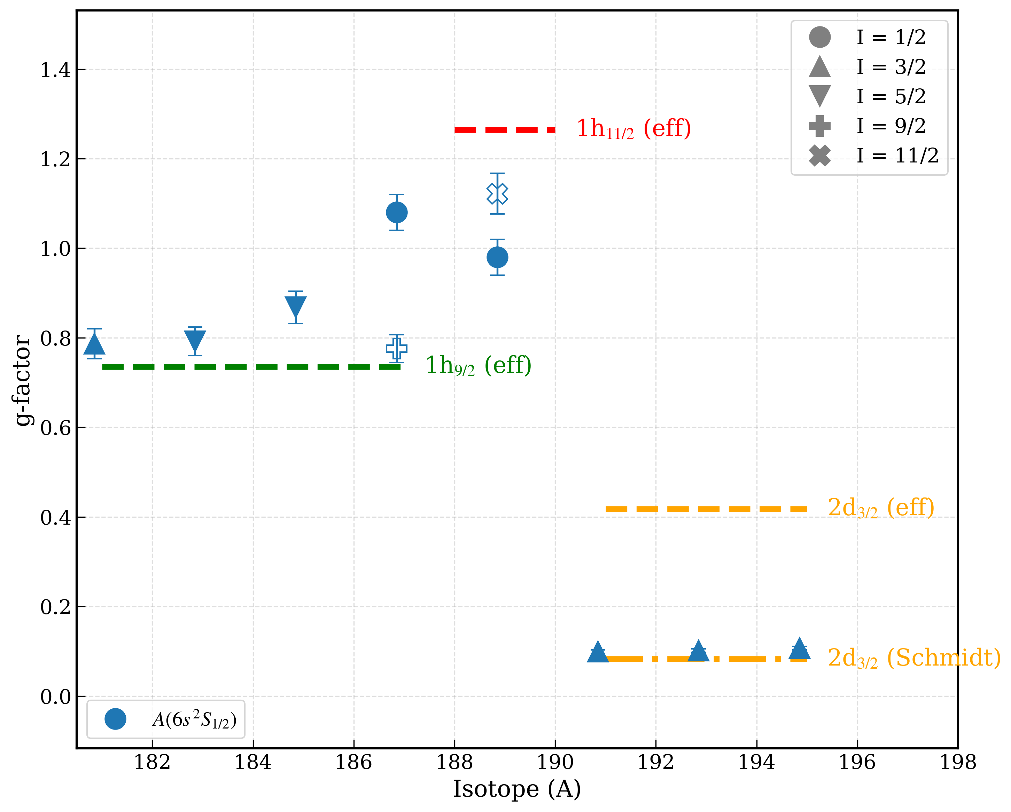
g-factors configuration
Magnetic dipole moments (g-factors) provide key information on the underlying single-particle nature of a nuclear configuration.
1/2
11/2
1/2
11/2
Effective-g factors are calculated with quenching factor of 0.7 for g_{s}
1/2
1/2
9/2
9/2
g-factors extracted from A(6s ²S_{1/2})
3/2
5/2
5/2
3/2
5/2
5/2
g-factors extracted from A(6p ²P_{3/2})
μ (g-factor) changes especially for lighter gold isotopes (bigger μ values).
HFA calculations from theory needed!

