Slide 1



Molecules as probes of nuclear structure: laser spectroscopy of ²²³RaF
Carlos M. Fajardo-Zambrano
CRIS collaboration at ISOLDE-CERN
Zakopane conference on Nuclear physics, 2026

Slide 2
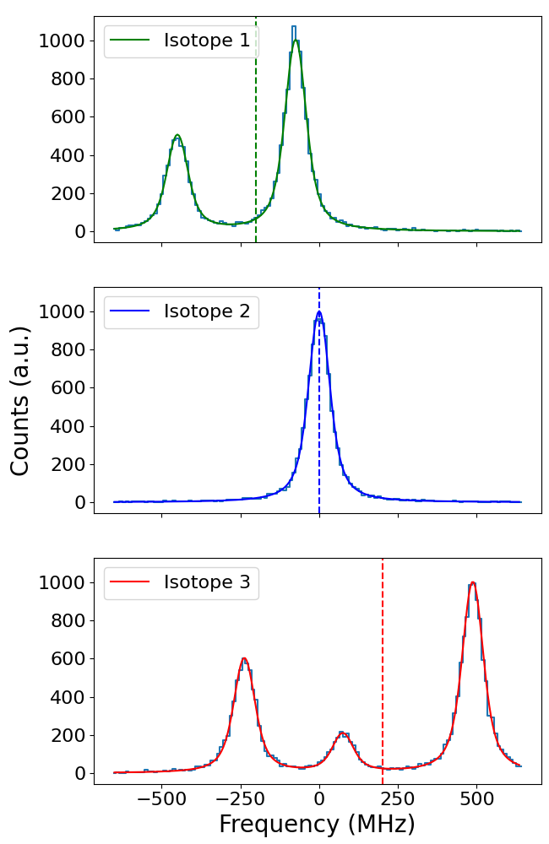




Nuclear structure observables in laser spectroscopy
$$F=5/2$$
¹P₁
Isotope shifts
  Change in rms charge radii (nucleus size).
Hyperfine structure
  Nuclear spin (nuclear shell evolution).
  Magnetic dipole moment (nuclear configuration).
  Electric quadrupole moment (nuclear deformation)
$$F=1/2$$
¹S₀
$$ΔE=f(δν,I,A,eqQ)$$
$$F=3/2$$
Ra
F = |J + I|

Slide 3
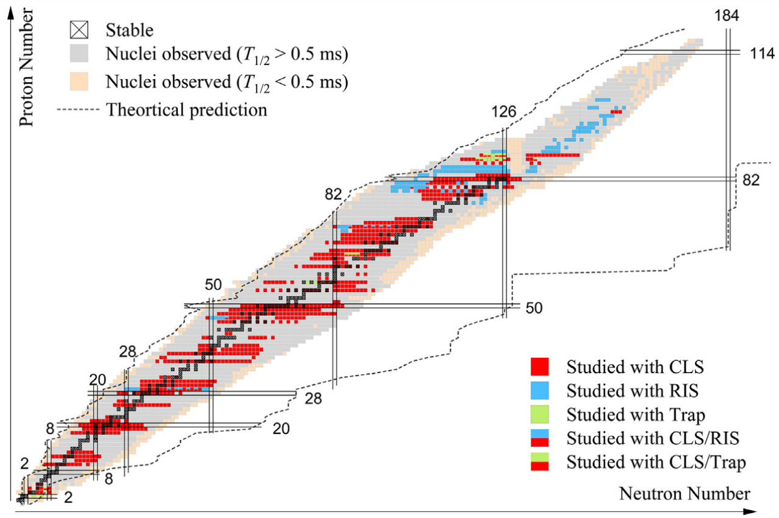
Isotopes studies with laser spectroscopy up to Oct 2022
More than one thousand isotopes and isomers have been measured using laser spectroscopy techniques in atoms/ions.
Several regions of the nuclear chart have not yet been measured ➔ limited by production and sensitivity to nuclear observables.
Refractory atoms
Complex structure
Molecules as an alternative!
Reactive atoms
[1] Yang, X. F., Wang, S. J., Wilkins, S. G., & Ruiz, R. G. (2023). Laser spectroscopy for the study of exotic nuclei. Progress in Particle and Nuclear Physics, 129, 104005.

Slide 4
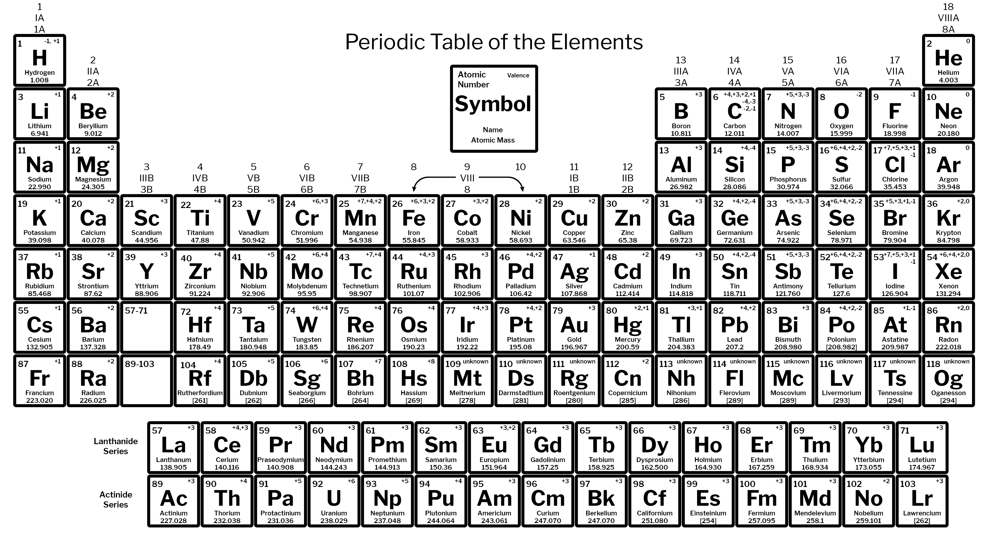
Reference moments from stable molecules (up to Feb 2026)
The measurement of nuclear moments using molecules is not new [Rabi, I. I., Millman, S., Kusch, P., & Zacharias, J. R. (1939)].
Elements highlighted have their current reference moments from molecular measurements.
H
Li
B
C
N
O
F
Na
Al
Si
P
S
Cl
K
Sc
V
Ga
Ge
As
Se
Br
Kr
Rb
Zr
In
Sn
Sb
I
Xe
Cs
Dipole
Quadrupole
Both
[2] Stone, N. (2016). Atomic Data and Nuclear Data Tables, 111:1–28.
[3] Stone, N. (2019). Technical report, International Atomic Energy Agency.

Slide 5
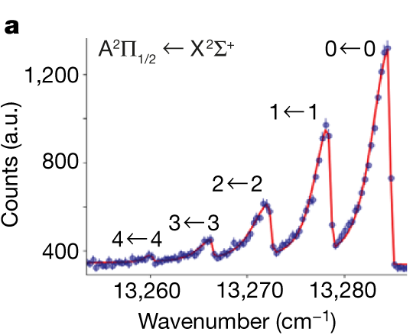
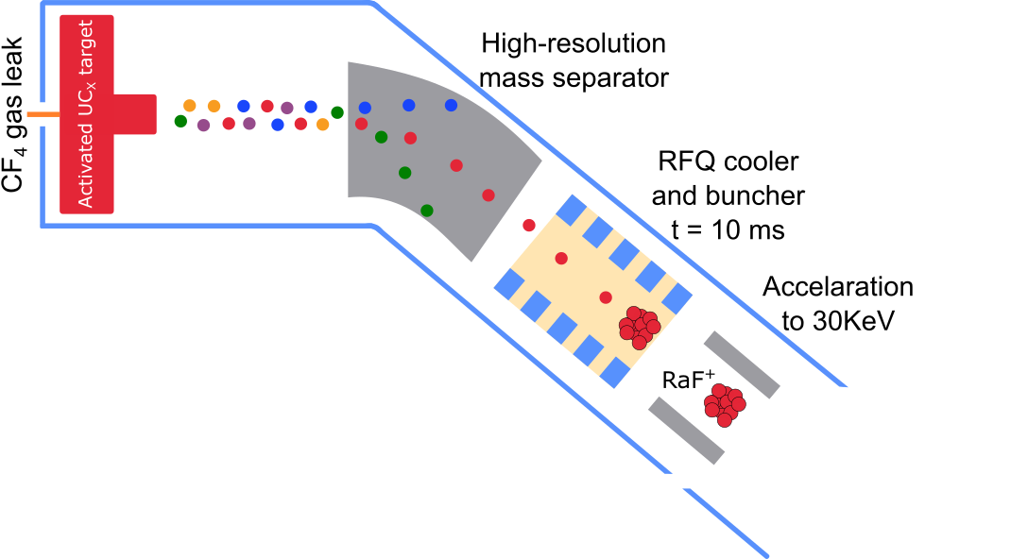
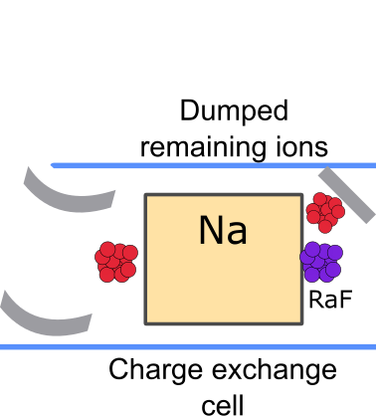
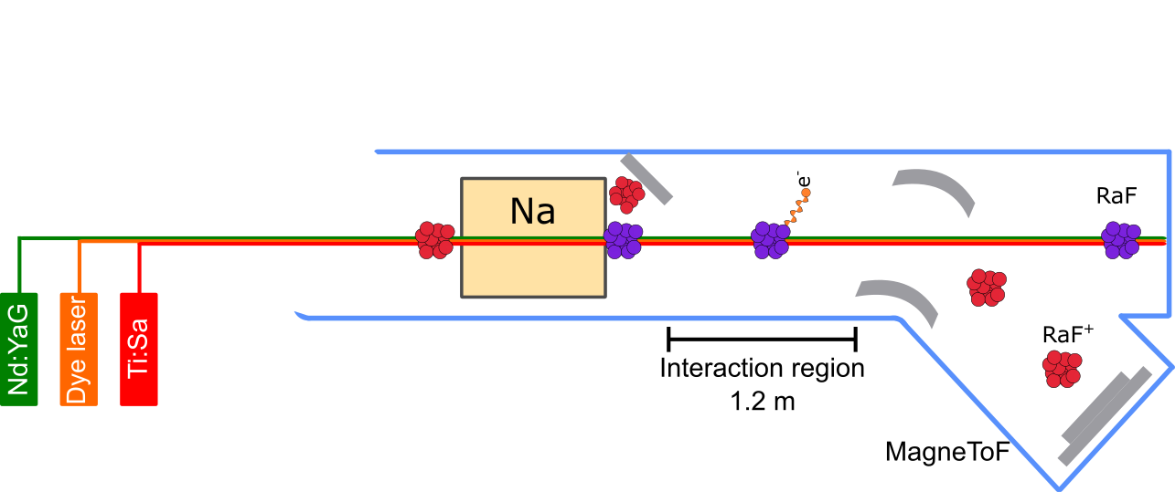
Collinear Resonance Ionization Spectroscopy (CRIS)
Laser beams are overlapped with an accelerated ion beam ➔ reducing doppler broadening.
Very efficient and selective resonance ionization spectroscopy ➔ background reduction.
More of CRIS by Angelos and Osama tomorrow!
[4] Garcia Ruiz, R. F., et al (2020). Spectroscopy of short-lived radioactive molecules. Nature, 581(7809), 396-400.

Slide 6
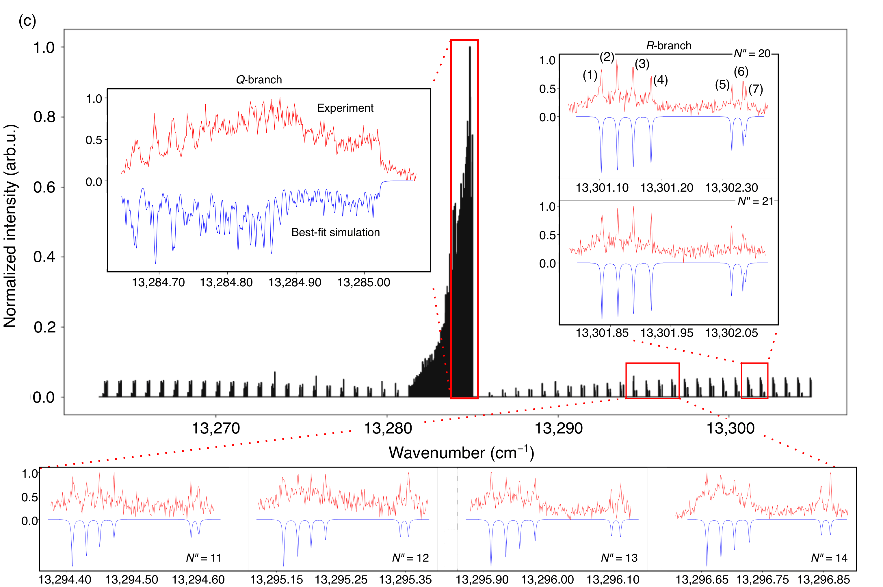
²²³RaF measured spectra
First laser spectroscopy of the electric quadrupole moment in a radioactive molecule ²²³RaF.
Improve resolution with previous experiments (75 MHz) despite the large nuclear spin.
Can be use as a test case for the extraction of nuclear observables with molecules
[8] Udrescu, S. M., et al (2024). Precision spectroscopy and laser-cooling scheme of a radium-containing molecule. Nature Physics, 20(2), 202-207.
[9] Wilkins, S. G., et al. (2025). Observation of the distribution of nuclear magnetization in a molecule. Science, 390(6771), 386-389.

Slide 7
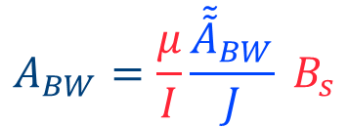
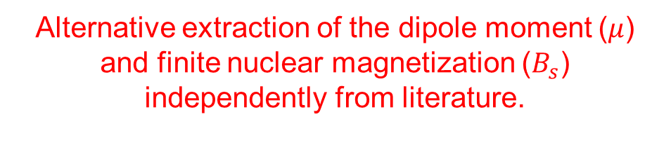

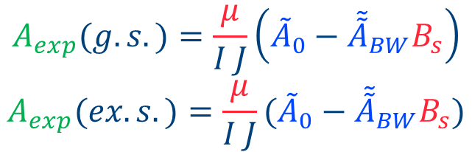
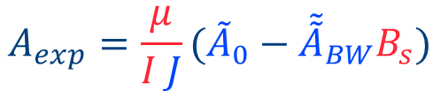
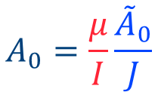
The magnetic dipole moment of ²²³RaF
Even in states with complex electronic structure, the magnetic dipole coupling constant can be divided in terms of the electronic and nuclear components,
$$A_{BW}=\frac{μ}{I}\frac{{\tilde{\tilde{A}}}_{BW}}{J} B_{s}$$
$$A_{exp}=A_{0}−A_{BW}$$
$$A_{exp}=\frac{μ}{I J}({\tilde{A}}_{0}−{\tilde{\tilde{A}}}_{BW}B_{s})$$
$$A_{0}=\frac{μ}{I}\frac{{\tilde{A}}_{0}}{J}$$
The parameters highlighted in blue are defined only by the electronic wavefunction – calculated.
Those in red only depend on the nuclear wave function – our unknowns.
$$A_{exp}(g.s.)=\frac{μ}{I J}\left({\tilde{A}}_{0}−{\tilde{\tilde{A}}}_{BW}B_{s}\right)$$
$$A_{exp}(ex.s.)=\frac{μ}{I J}({\tilde{A}}_{0}−{\tilde{\tilde{A}}}_{BW}B_{s})$$
Alternative extraction of the dipole moment ($μ$) and finite nuclear magnetization ($B_{s}$) independently from literature.
Systems of 2 equations and 2 unknowns
[8] Skripnikov, L. V. (2020). The Journal of Chemical Physics, 153(11).
[9] Skripnikov, L. V., & Barzakh, A. E. (2024). Physical Review C, 109(2), 024315.

Slide 8
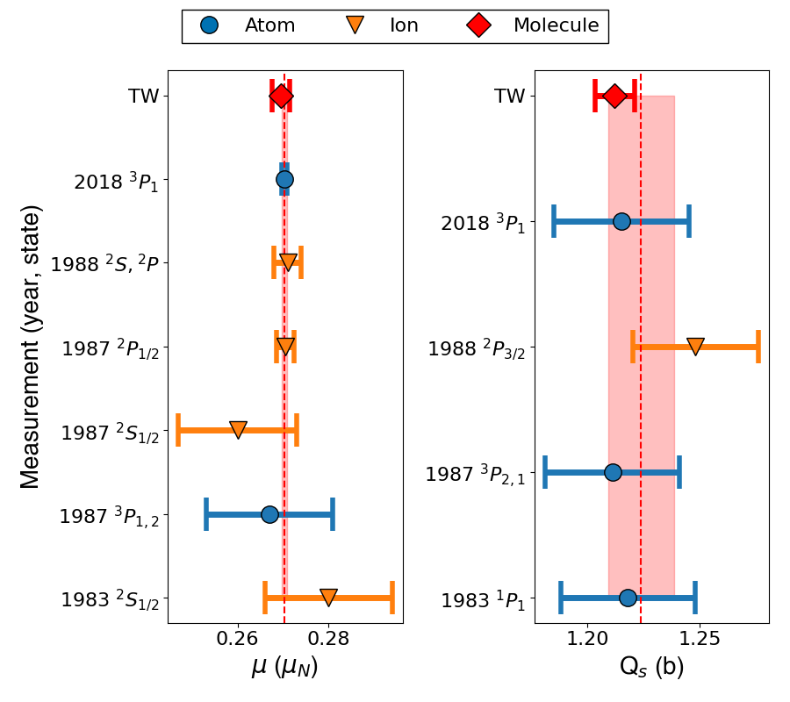
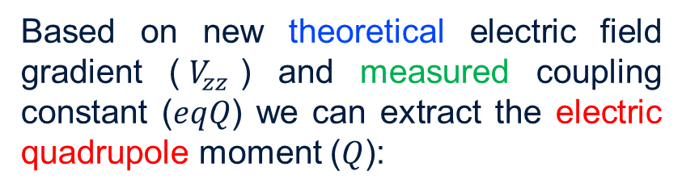
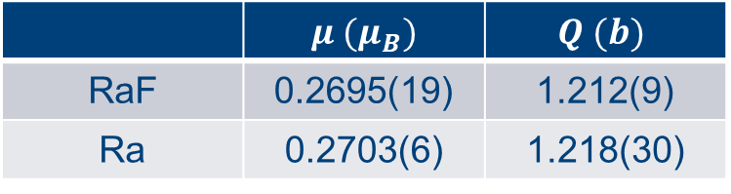
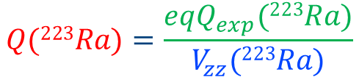
²²³Ra nuclear moments
Based on new theoretical electric field gradient ($V_{zz}$) and measured coupling constant ($eqQ$) we can extract the electric quadrupole moment ($Q$):
$$Q(223Ra)=\frac{eqQ_{exp}(223Ra)}{V_{zz}(223Ra)}$$
Magnetic dipole moment in literature ignores the finite magnetization contribution.
 | $μ (μ_{B})$ | $$Q (b)$$
RaF | 0.2695(19) | 1.212(9)
Ra | 0.2703(6) | 1.218(30)

Slide 9
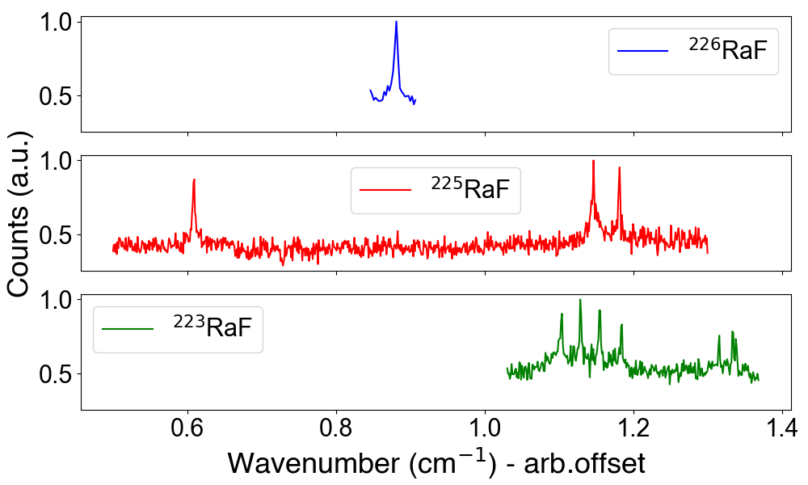
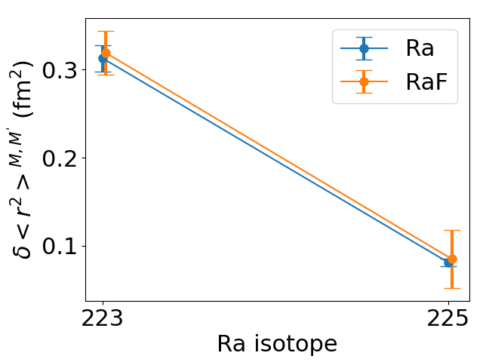
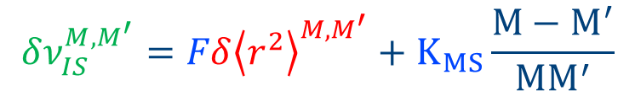
Change in charge radii in Ra using RaF
Like the atomic case, the change in the mean square radii ($δ{\left.\left\langle r^{2}\right.\right\rangle }^{M,M^{′}}$) can be estimated with King plot analysis
$$δν_{IS}^{M,M^{′}}=Fδ{\left.\left\langle r^{2}\right.\right\rangle }^{M,M^{′}}+K_{MS}\frac{M−M^{′}}{{MM}^{′}}$$
Using the isotope shift ($δν_{IS}^{M,226}$) in ^{223,225,226}RaF and predicted Field shift (F) and mass shift (K_{MS}),
[13]
Perfect agreement between atomic/ionic change in charge radii and molecular (due to Ra)!
[12] Athanasakis-Kaklamanakis, M., et al. (2023). King-plot analysis of isotope shifts in simple diatomic molecules. Physical Review X, 13(1), 011015.
[13] Udrescu, S. M., et al (2024). Precision spectroscopy and laser-cooling scheme of a radium-containing molecule. Nature Physics, 20(2), 202-207.

Slide 10
Molecular spectroscopy as an alternative
Laser spectroscopy observables in RaF are in great agreement with their atomic/ionic counterpart (literature independent) ➔ a promising alternative for nuclear structure studies.
Elements with no laser accessible transitions in their atomic/ion⁺ form, such as carbon and nitrogen (< 200 nm).
Highly reactive elements, such as phosphorus, sulfur and the halogens ➔ SeCO⁺ used for decay spectroscopy of ^{67,68}Se (chemically pure and larger beams).
Elements with poor sensitivity to the electric quadrupole (BF, KF ) and magnetic octupole moment (SiO, SF).
Higher sensitivity to CP-violating electromagnetic moments ➔ HfF⁺, ThO, RaF, AcF.

Slide 11
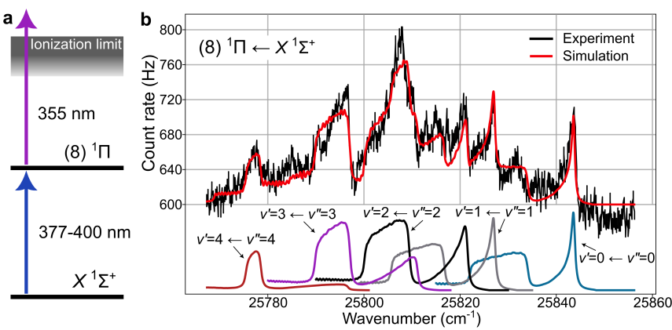
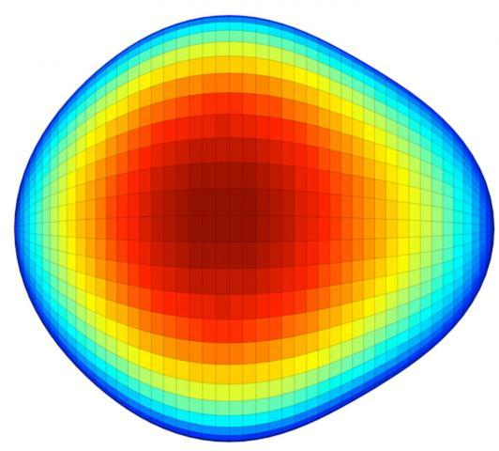

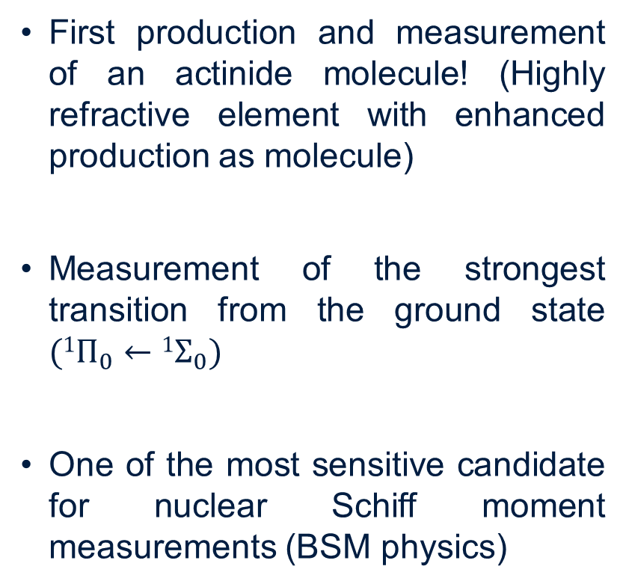
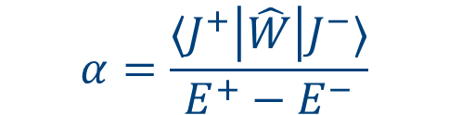
Outlook: molecular spectroscopy of AcF
First production and measurement of an actinide molecule! (Highly refractive element with enhanced production as molecule)
Measurement of the strongest transition from the ground state $(1Π_{0}←1Σ_{0})$
One of the most sensitive candidate for nuclear Schiff moment measurements (BSM physics)
Heavy & deformed nucleus
$$α=\frac{⟨J^{+}\left|\hat{W}\right|J^{−}⟩}{E^{+}−E^{−}}$$
stronger P,T-odd
interaction mixing
[8] Athanasakis-Kaklamanakis, M. et al (2025). Laser spectroscopy and CP-violation sensitivity of actinium monofluoride. Nature, 648(8094), 562-568.
[9] Gaffney, L. P., et al (2013). Studies of pear-shaped nuclei using accelerated radioactive beams. Nature, 497(7448), 199-204.

Slide 12
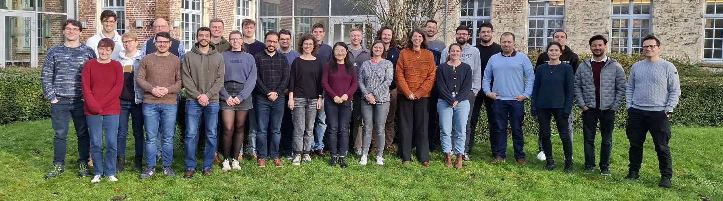








Thanks to the CRIS collaboration

Slide 13
Thanks for your attention

Slide 14
Backup slides

Slide 15
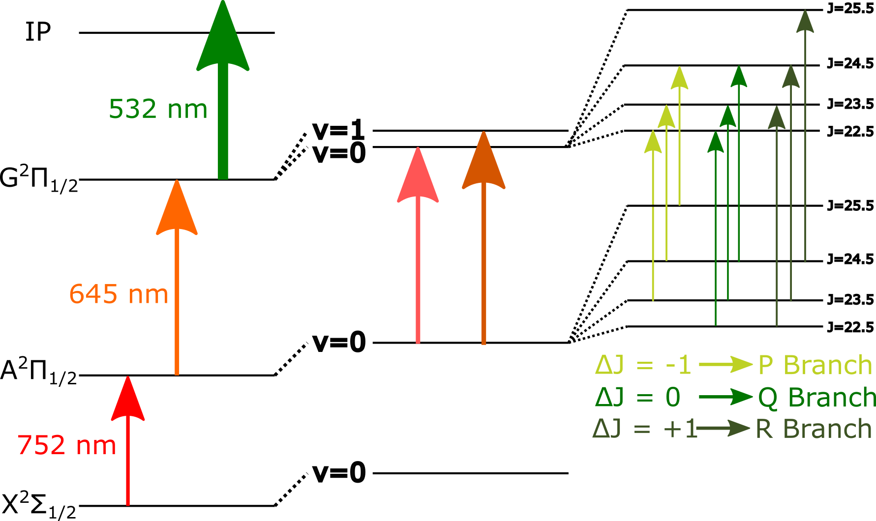
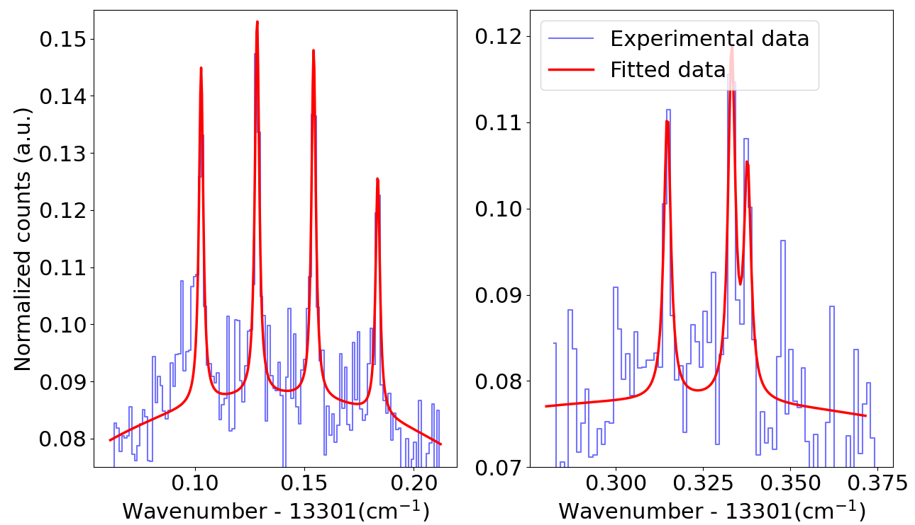



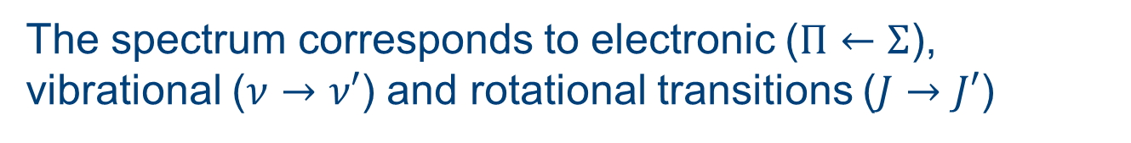
Laser spectroscopy on molecules
The spectrum corresponds to electronic ($Π←Σ$), vibrational ($ν→ν′$) and rotational transitions ($J→J′$)
²²³RaF
$$H_{el}$$
$$H_{vib}$$
$$H_{rot}$$
[5] Athanasakis-Kaklamanakis, M. et al (2025). Nature communications, 16(1), 2139.
[6] Udrescu, S. M., et al. (2024). Precision spectroscopy and laser-cooling scheme of a radium-containing molecule. Nature Physics, 20(2), 202-207.
[7] Wilkins, S. G., et al. (2025). Observation of the distribution of nuclear magnetization in a molecule. Science, 390(6771), 386-389.

Slide 16
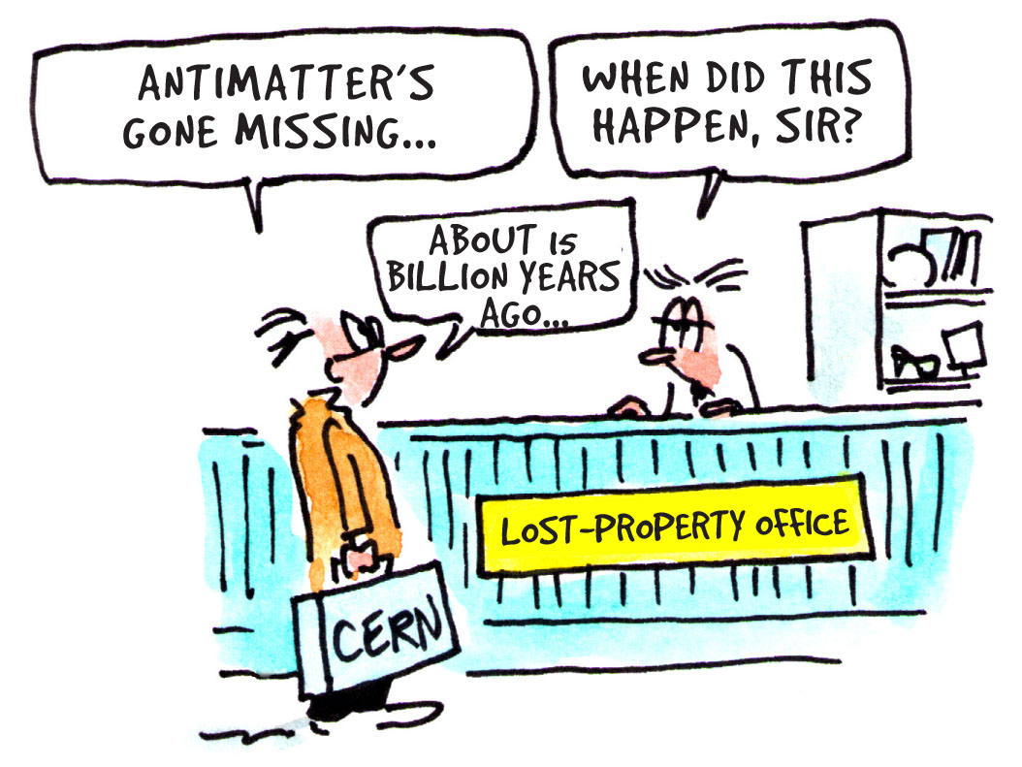
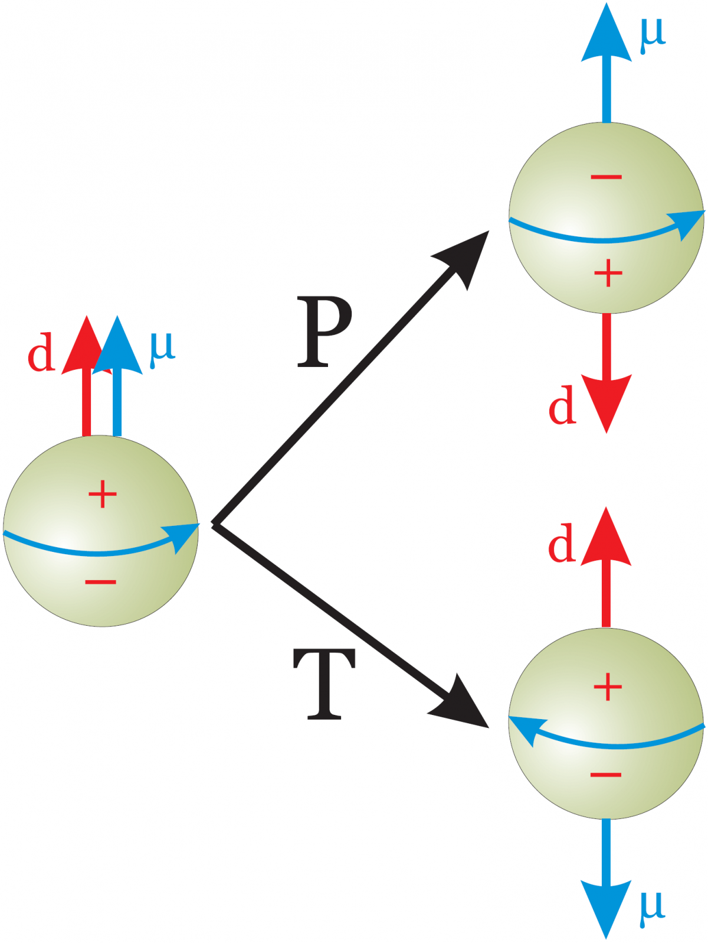
Search for the electric dipole moment (EDM)
Matter/antimatter asymmetry is ~10⁸ larger than expected by the standard model (SM).
Matter imbalance could be explained if charge-parity (CP) symmetry is broken ➔ How can we prove it?
EDM is odd under parity (P) and time-reversal (T) transformation ➔ CP violation.
Its measurement could proof a larger CP violation in the universe.
EDM’s are theoretically predicted to be extremely small (~10⁻³⁵ e cm),
therefore, not yet observed.
[3] Jayich-Lab, EDM-Limits (2024) https://github.com/Jayich-Lab/EDM-Limits

Slide 17
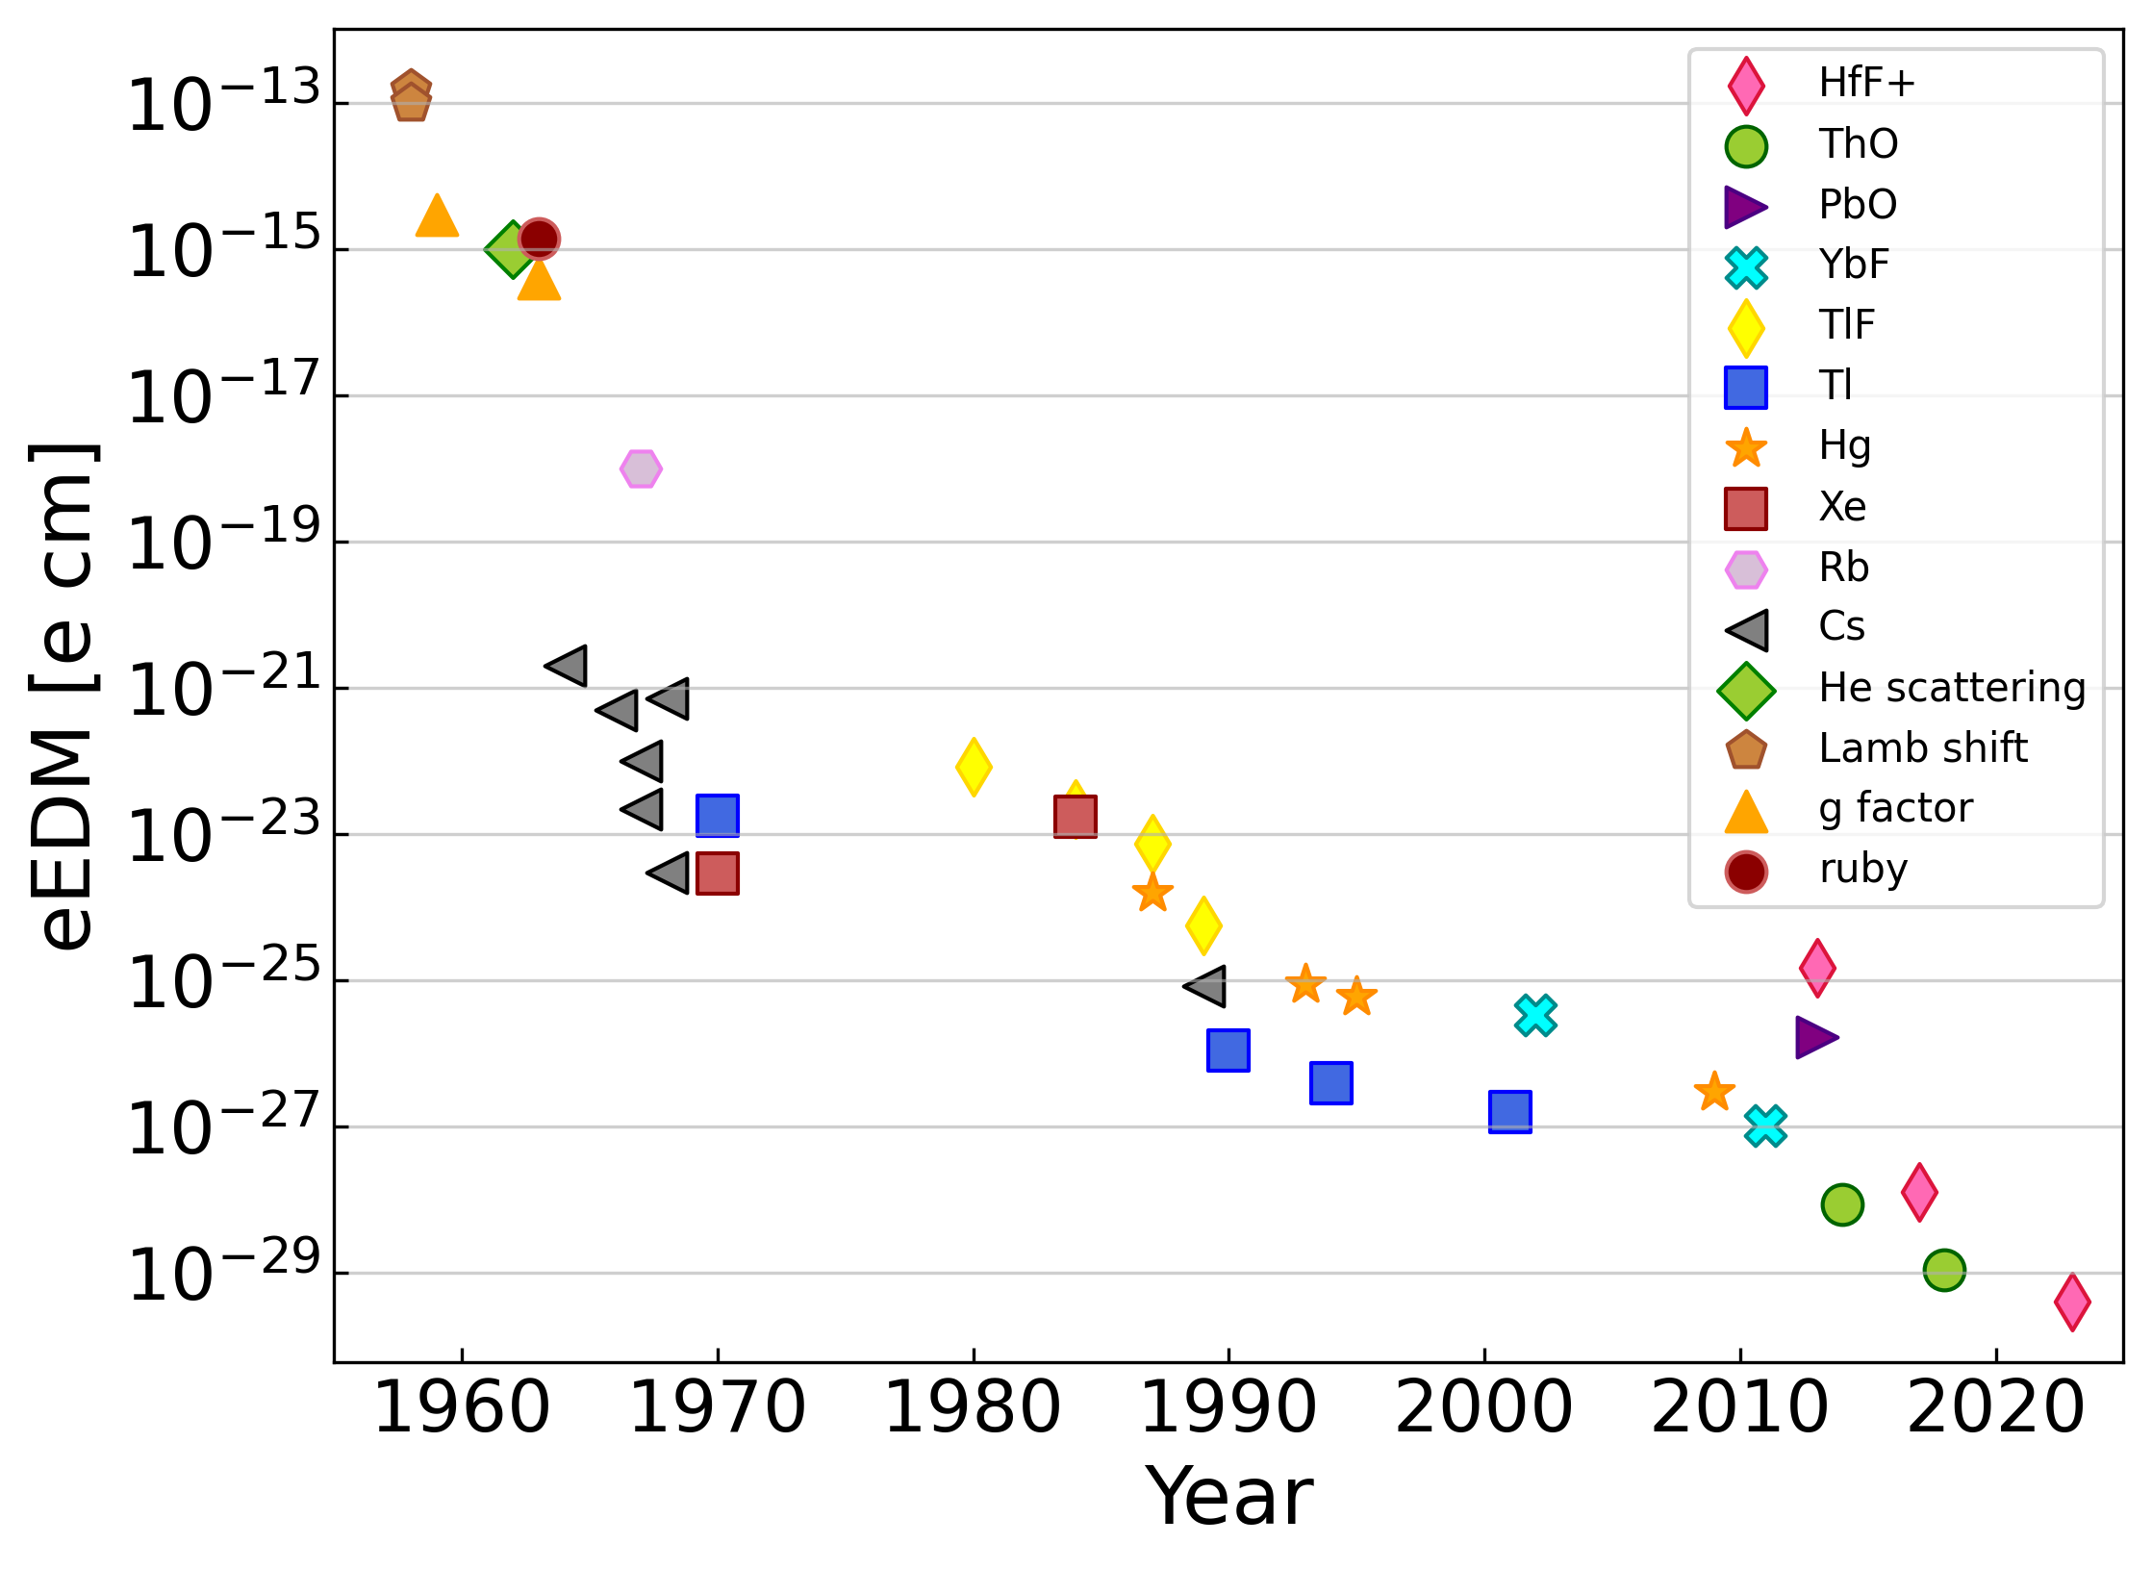
Molecular sensitivity to EDM ~ κ_{EDM}E_{eff}
Polar molecules containing heavy nuclei (larger E_{eff}) have an enhanced sensitivity to EDM sources (~Z³).
Octupole deformed nuclei have an intrinsically larger nuclear EDM (larger κ_{EDM}) ➔ limited to radioactive species such as ^{223,225}Ra and ^{225,227}Ac.
Most sensitive molecular candidates, except Th and U molecules, have a poorly known electronic structure ➔ preliminary molecular spectroscopy studies needed.
Measurements so far only on ‘stable’ species
[3] Jayich-Lab, EDM-Limits (2024) https://github.com/Jayich-Lab/EDM-Limits

Slide 18
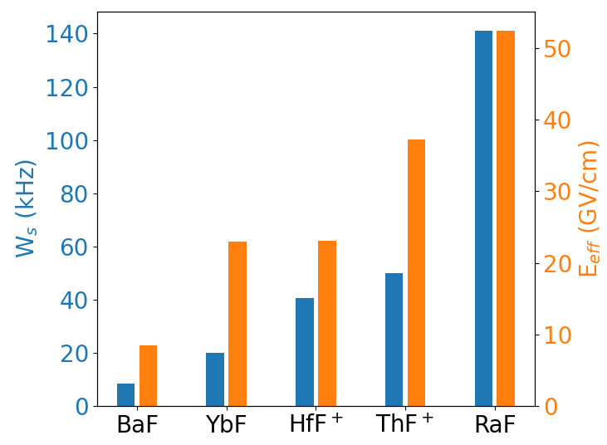
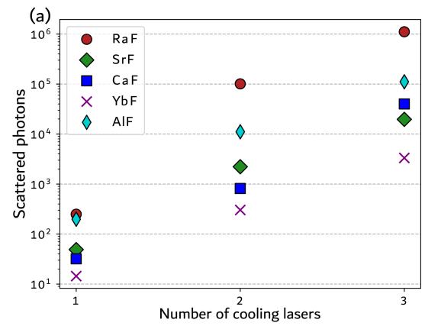
RaF sensitivity to leptonic EDM sources
RaF has a large sensitivity to electron (leptonic) EDM sources
RaF laser coolable structure allows to scatter ~1 millions photons with only three lasers
Intrinsically sensitive system with experimental advantages!
[4] Isaev, T. A., Hoekstra, S., & Berger, R. (2010). Physical Review A—Atomic, Molecular, and Optical Physics, 82(5), 052521.
[5] Athanasakis-Kaklamanakis, M. (2024). Phys.Rev.A, 2024, 110 (1), pp.L010802.

Slide 19
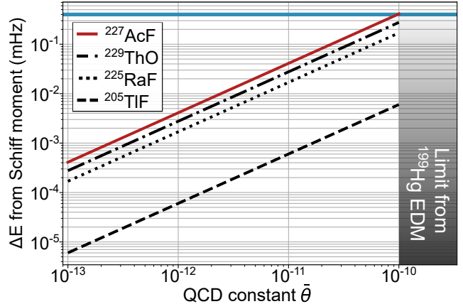
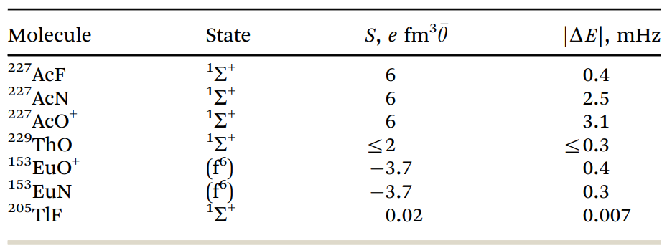
²²⁷AcF as a promising candidate
Electronic + nuclear sensitivity to EDM sources, gives AcF the highest sensitivity to the Schiff moment.
No previously known electronic structure.
Further enhancement is expected for AcN and AcO ➔ highly refractive nature hinders its extraction.
Higher production rates makes AcF a more promising candidate.
Assuming Schiff moment as the only nuclear EDM source
[8] Athanasakis-Kaklamanakis, M. et al (2025). Nature, 648(8094), 562-568.
[11] Skripnikov, L. et al. (2020). Physical Chemistry Chemical Physics, 22(33), 18374-18380.
Notes:
200 cm-1 also scanned using Tisa+PDL+532 nm

Slide 20
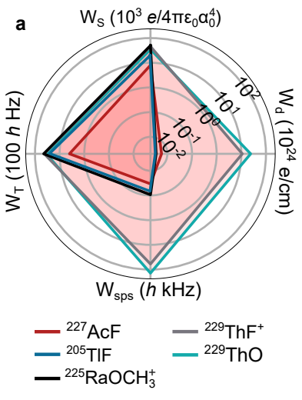

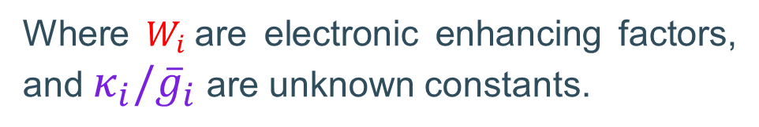
Sources of EDM in atoms/molecules
In a simplistic way, the EDM sources in an atom/molecule can de described as,
$${ΔE}_{atom,mol} ∝ W_{e}κ_{e}+W_{sps}κ_{sps}$$
Leptonic EDM
Nuclear EDM
$$+ W_{m}κ_{m}+W_{p}κ_{p}+W_{T}κ_{T}+W_{S}S({\overline{g}}_{0},{\overline{g}}_{1})+W_{M}M({\overline{g}}_{0},{\overline{g}}_{1})$$
Where $W_{i}$are electronic enhancing factors, and $κ_{i}/{\overline{g}}_{i}$ are unknown constants.
Different systems have different sensitivity to each source ➔ requires complementary experiments to disentangle the EDM sources.
[8] Athanasakis-Kaklamanakis, M. et al (2025). Nature, 648(8094), 562-568.
[10] Gaul, K., & Berger, R. (2024). Journal of High Energy Physics, 2024(8), 1-42.
Notes:
Focus on the fact that there are different sources

Slide 21
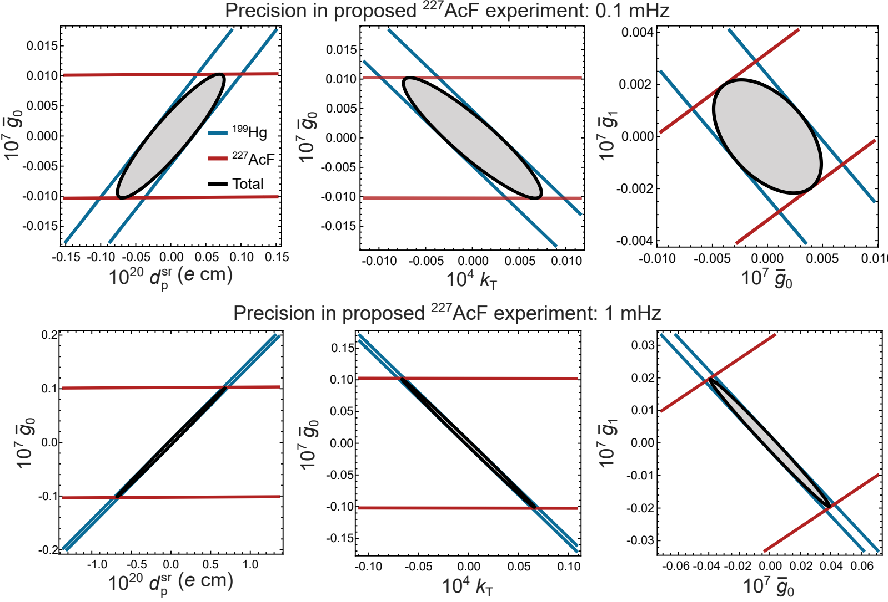
Impact on the CP-violation hyperspace
There are different sources of EDM ➔ requires measurements in different systems.
Global constraints including all EDM experiments plus a fictional ²²⁷AcF.
An experiment in ²²⁷AcF with a precision of 1mHz will improve the constraints on EDM sources by x6000.
TlF, homoelectronic system, have been measured with a precision of 0.1mHz in 1989.
[8] Athanasakis-Kaklamanakis, M. et al (2025). Nature, 648(8094), 562-568.
[12] Cho, D., et al. (1989). Physical review letters, 63(23), 2559.

Slide 22
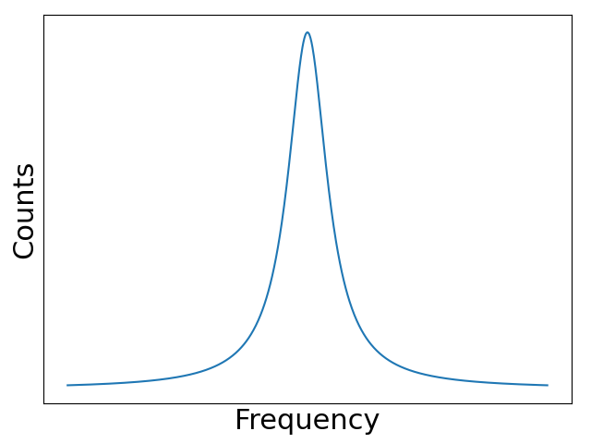
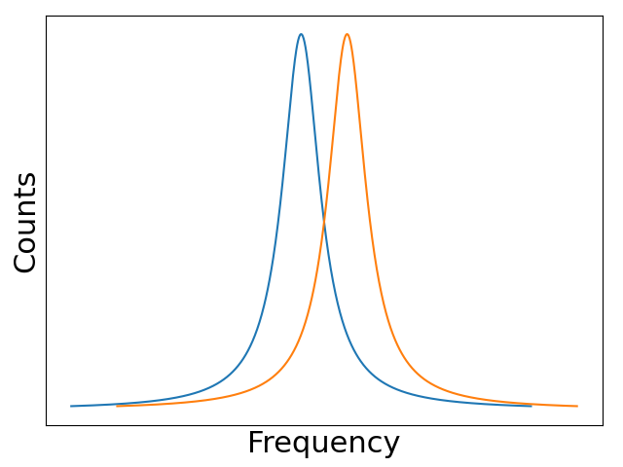
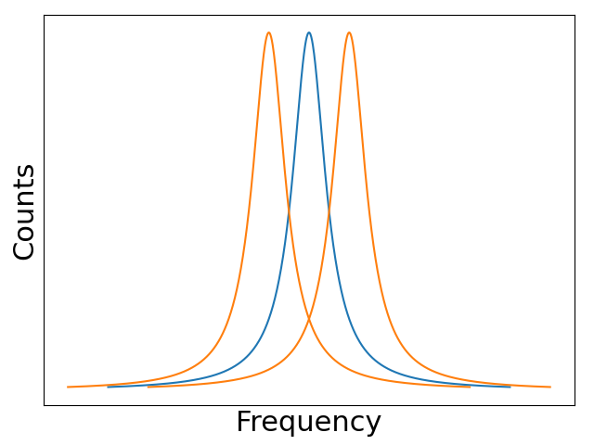






How to measure an EDM d ?
Similar idea to the measurement of a magnetic dipole moment (μ), interacting with a MAGNETIC field B. Measuring an EDM (d) requires interaction with an ELECTRIC field E.
$$2Ed$$
~μ.B
~μ.B + d.E
$$B$$
$$B$$
$$E$$
$$B$$
$$E$$
~μ.B - d.E

Slide 23


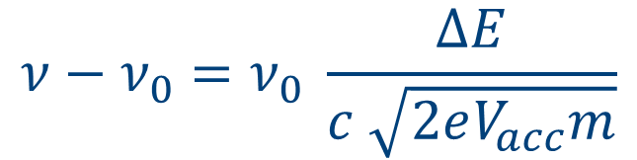



Collinear geometry
Energy
$$E=\frac{1}{2}Mv^{2}$$
Ion beam is accelerated to 30-60 keV, reducing the velocity spread.
Use of a gas-filled radiofrequency cooler-buncher to produce short (μs) bunches.
Overlapped (anti-)collinearly with two or more lasers.
$$ΔE$$
$$ΔE$$
Velocity
$$ν−ν_{0}=ν_{0} \frac{ΔE}{c \sqrt{2eV_{acc}m}}$$
$$Δv_{0}$$
$$Δv$$
Reduction in spectrum broadening from ~GHz to ~MHz!!

