Slide 1
Charge radii of neutron-deficient cobalt isotopes across the N = 28 shell closure
Tobias Christen, KU Leuven
Zakopane Conference on Nuclear Physics 2026

Slide 2
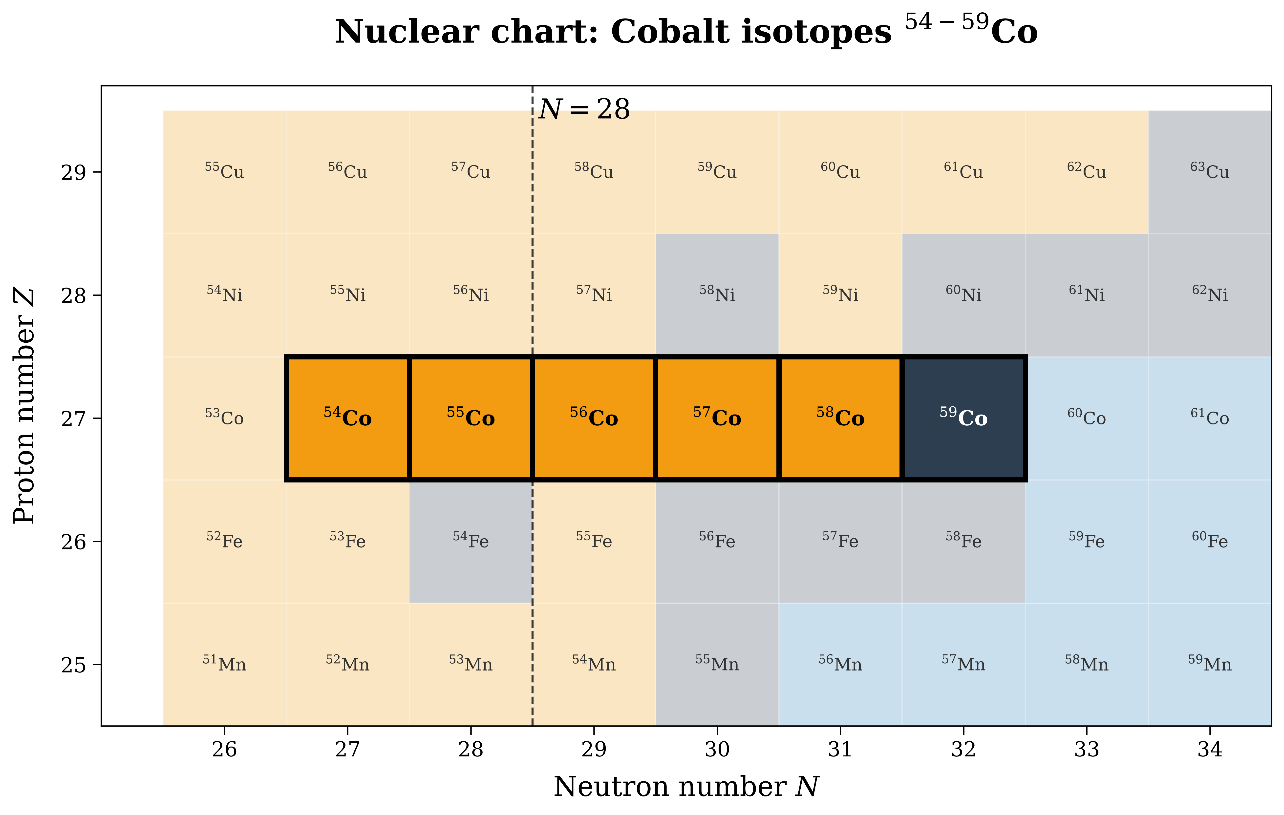
Motivation for probing the doubly-magic nature of ⁵⁶Ni
Co has one proton hole below the
Z = 28 shell closure
Co chain is perfect to study robustness of the Z = 28 shell closure, and around N=28 also the neutron shell closure
⁵⁴Co is a super-allowed β emitter. It’s charge radius is important for determining the unitarity of the CKM matrix. And it has a high-spin isomer
Zakopane Conference on Nuclear Physics 2026

Slide 3
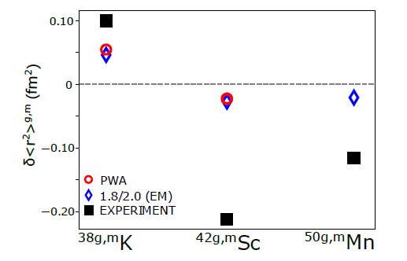
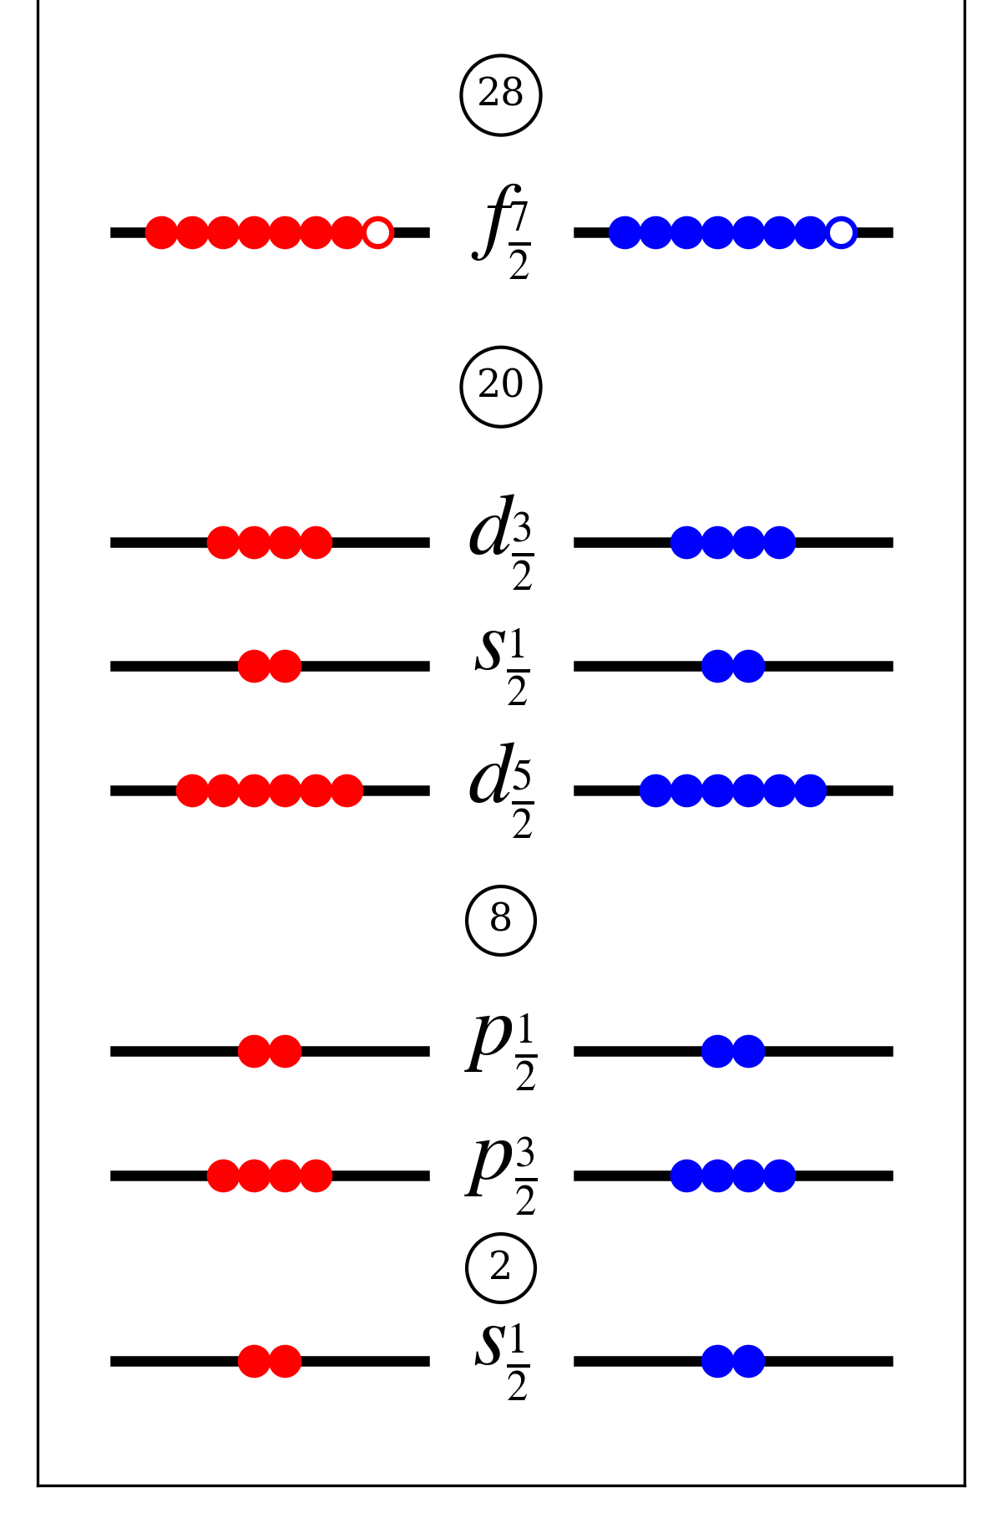
Self-conjugate ⁵⁴Co: a test of π–ν pairing
⁵⁴Co (Z=27, N=27)
In N = Z nuclei, protons and neutrons occupy the same valence orbitals → enhanced π–ν pairing
Within the same nucleus, I = 0, T = 1 state is observed to have a larger charge radius than the
I ≠ 0, T = 0 state
Confirmed in ³⁸K (sd-shell), ⁴²Sc, ⁵⁰Mn (f_{7/2} orbit), but theory underestimates the size of the effect
⁵⁴Co has one proton and neutron hole in the f_{7/2}, coupling parallel (I=0) and antiparallel (I=7 isomer), ideal for constraining the proton–neutron interaction
Á. Koszorús et al., Phys. Lett. B 819, 136439 (2021)
Zakopane Conference on Nuclear Physics 2026

Slide 4
What is known: ⁵⁴⁻⁵⁹Co moments and radii
Isotope | I | μ (μ_{N}) | Rc (fm)
⁵⁴^{g}Co | 0⁺ | — | —
⁵⁴^{m}Co | 7⁺ | — | —
⁵⁵Co | 7/2⁻ | 4.822(3) | —
⁵⁶Co | 4⁺ | 3.850(10) | —
⁵⁷Co | 7/2⁻ | 4.720(10) | —
⁵⁸^{g}Co | 2⁺ | 4.044(8) | —
⁵⁸^{m}Co | 5⁺ | — | —
⁵⁹Co (stable) | 7/2⁻ | 4.627(9) | 3.788(2)
μ: Callaghan et al. (1973) [⁵⁵Co]; Stewart et al., J. Phys. C 10, 3651 (1977) [⁵⁶Co]; Niesen & Huiskamp (1972) [⁵⁷Co]; Walstedt et al., Z. Phys. 233, 477 (1970) [⁵⁸Co]
Zakopane Conference on Nuclear Physics 2026

Slide 5
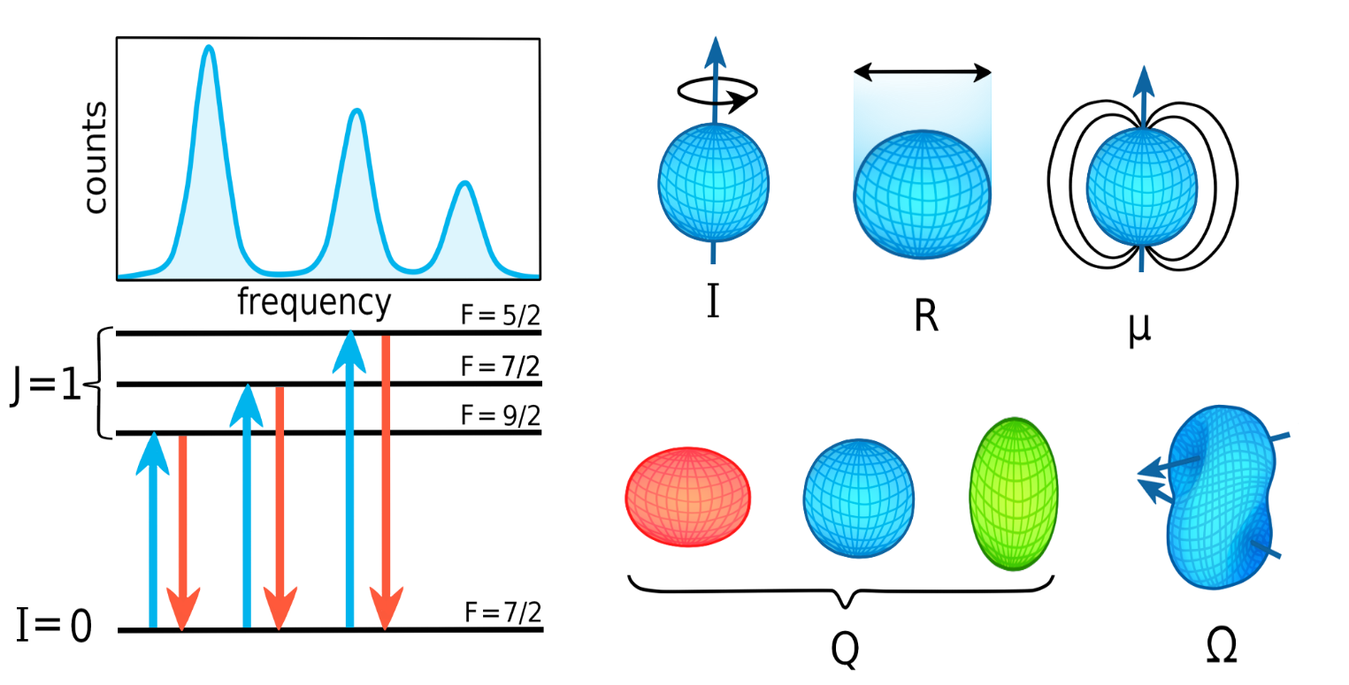
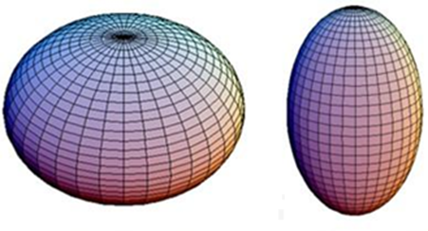
What does Laser Spectroscopy measure?
2. Hyperfine structure
3. Quadrupole correction
1. Fine structure
F = 4
Laser is scanned across the atomic transition; on resonance, scattered photons are counted per hyperfine transition
Result: peak positions and spacings
→ A, B; overall centroid shift → isotope shift
→ δ⟨r²⟩
Model-independent: gives direct access to nuclear moments and charge radii, without relying on nuclear-structure models
J = 1/2
F = 3
F = 4
J = 1/2
F = 3
I = 7/2 (⁵⁹Co)
Electric quadrupole moment (Q)
Magnetic dipole moment (μ)
Zakopane Conference on Nuclear Physics 2026

Slide 6
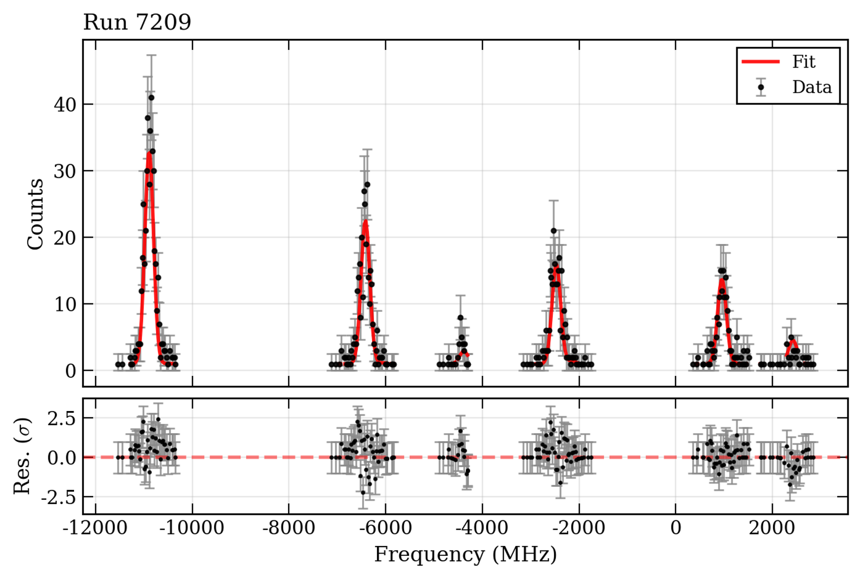
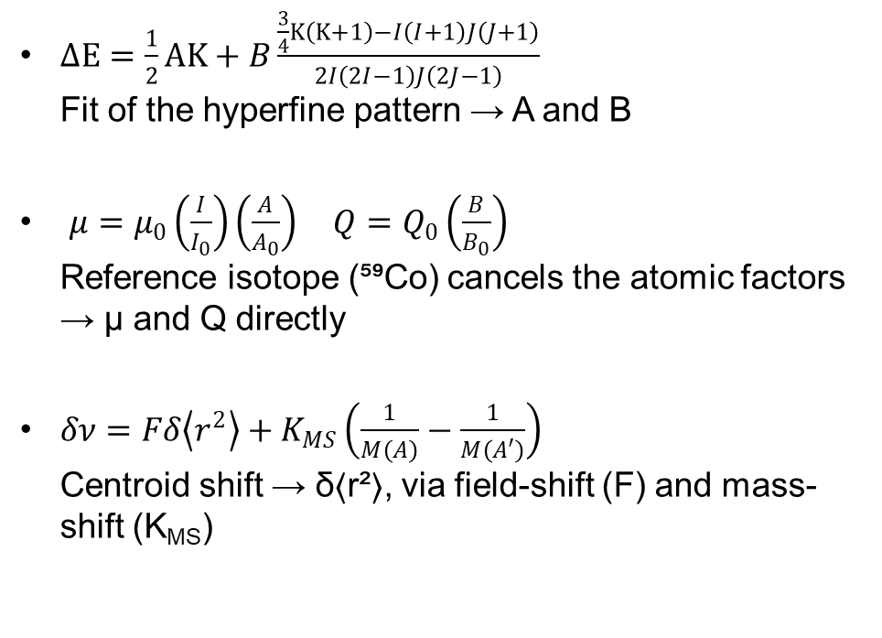
From spectrum to observables
⁵⁶Co example
$ΔE=\frac{1}{2}AK+B\frac{\frac{3}{4}K\left(K+1\right)−I\left(I+1\right)J\left(J+1\right)}{2I\left(2I−1\right)J\left(2J−1\right)}$
Fit of the hyperfine pattern → A and B
$μ=μ_{0}\left(\frac{I}{I_{0}}\right)\left(\frac{A}{A_{0}}\right) Q=Q_{0}\left(\frac{B}{B_{0}}\right)$
Reference isotope (⁵⁹Co) cancels the atomic factors
→ μ and Q directly
$δν=Fδ\left\langle r^{2}\right\rangle +K_{MS}\left(\frac{1}{M\left(A\right)}−\frac{1}{M\left(A′\right)}\right)$
Centroid shift → δ⟨r²⟩, via field-shift (F) and mass-shift (K_{MS})
Zakopane Conference on Nuclear Physics 2026

Slide 7
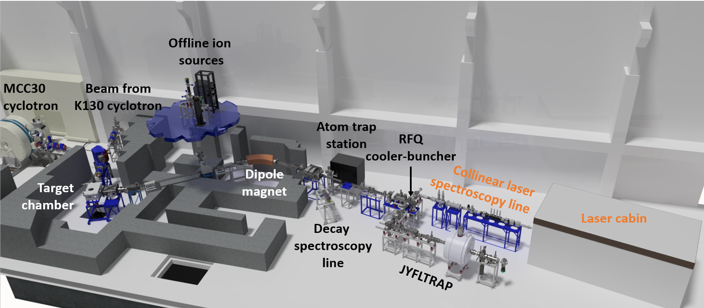
Measurement of Co at IGISOL
Co is a refractory element
→ IGISOL gas cell method needed
RFQ cooler-buncher → 3–4 μs bunches, enabling time-gated photon counting
Ground state has low charge-radius sensitivity → optically pump into a metastable state first
Spectroscopy on the 4s → 4p transition near 229 nm
Deep UV laser light is hard to produce
3d⁷(⁴F)4p
unpaired p-electron
3d⁷(⁴F)4p
unpaired p-electron
Spectroscopy laser
228.6159 nm
Spontaneous
decay
Pumping laser
220.29876 nm
3d⁷(⁴F)4s
unpaired s-electron
3d⁸ ³F₄
unpaired d-electron
S. Geldhof, JYU dissertations (2020)
For more information about CLS, join Saikumar Chinthakayala’s talk
Zakopane Conference on Nuclear Physics 2026

Slide 8
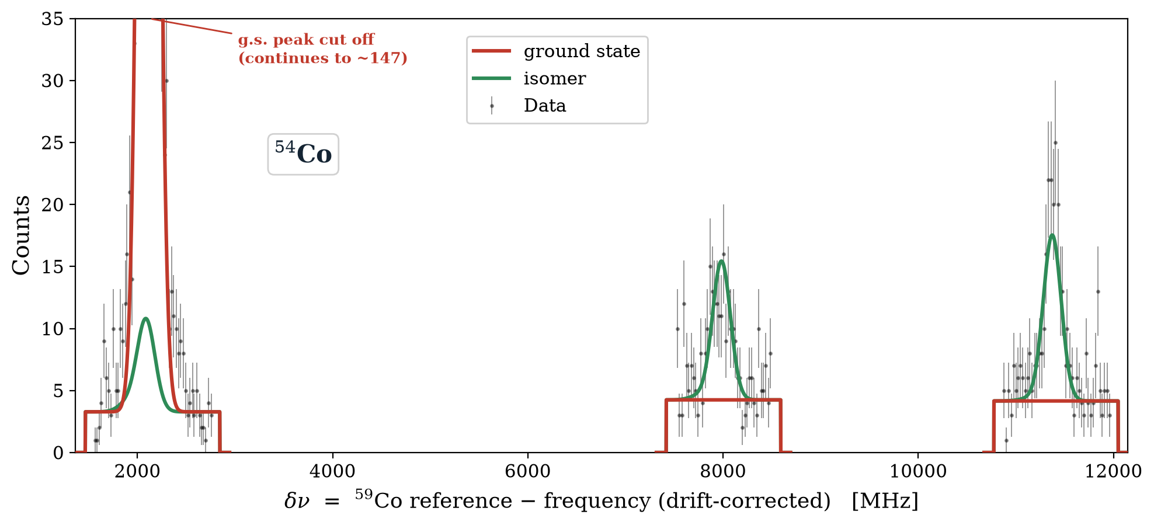
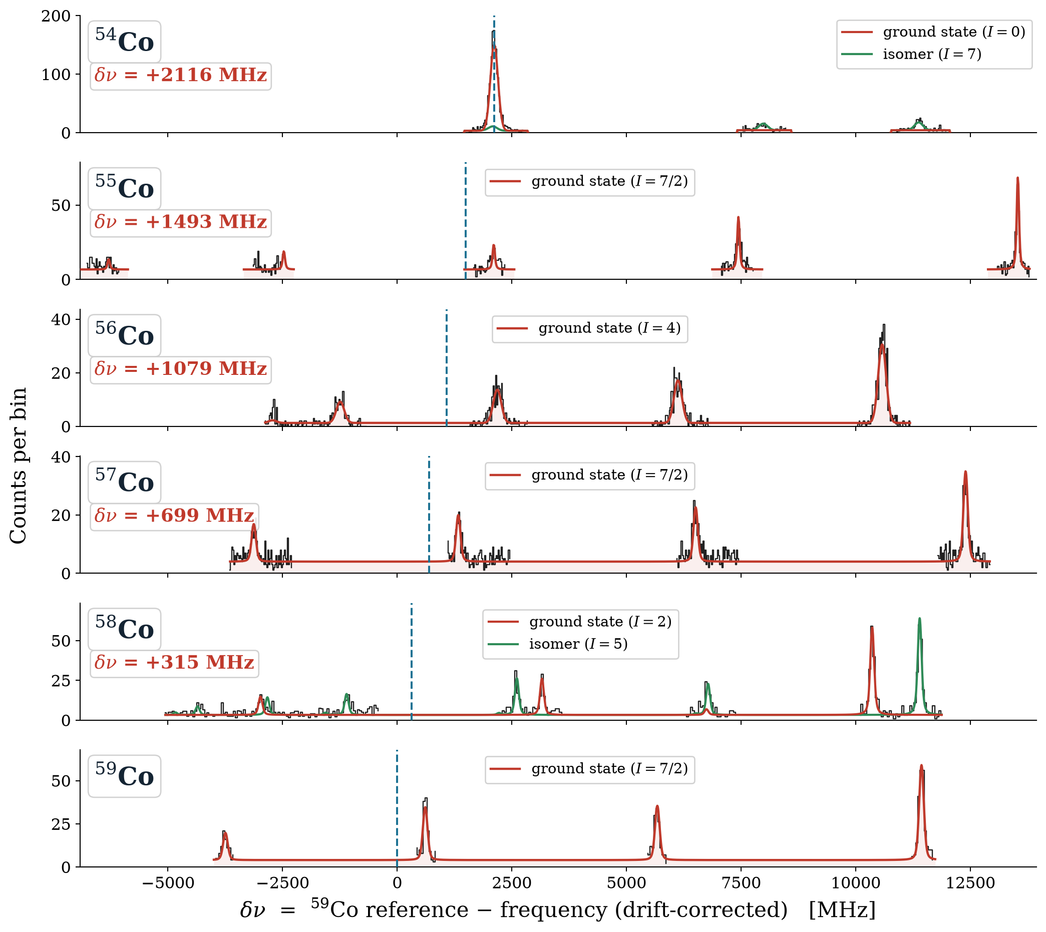
Isotope shifts across ⁵⁴⁻⁵⁹Co
Low production – only a few hundreds ions per second reach the interaction region
Up to 22 hyperfine peaks – only the strongest are measurable
δν = ν(⁵⁹Co) – ν(A), drift-corrected against the ⁵⁹Co reference
Hyperfine spectra spread over several GHz
Zakopane Conference on Nuclear Physics 2026

Slide 9
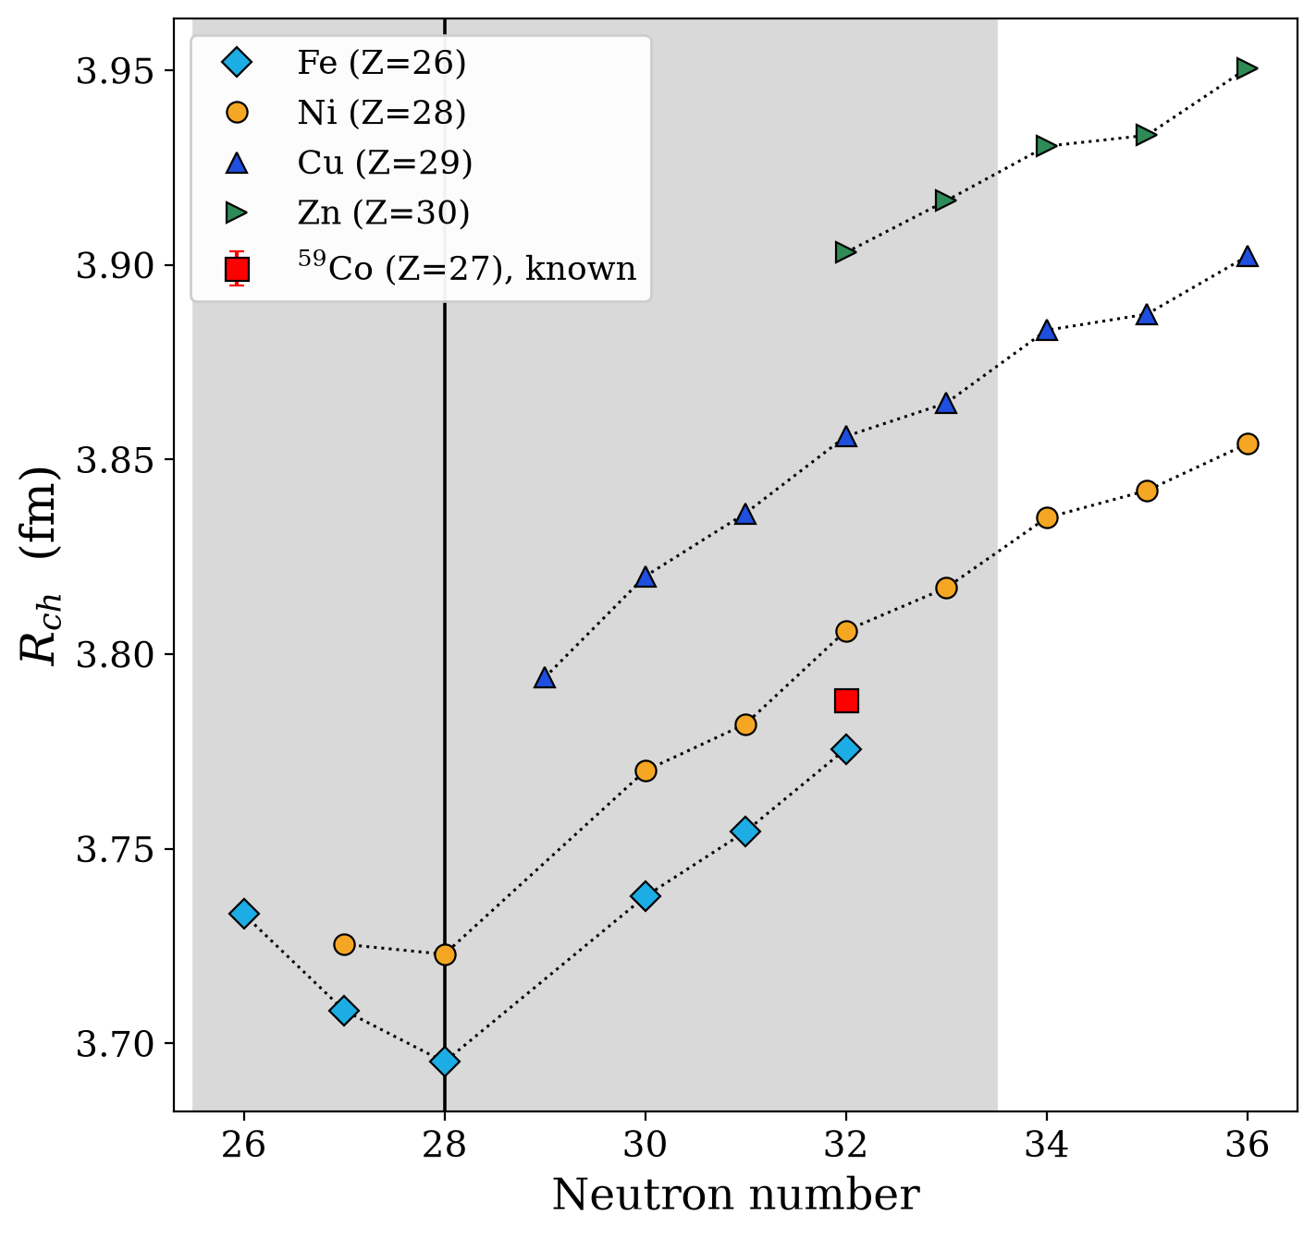

Charge radii of ⁵⁴⁻⁵⁹Co
$$δν^{(A,A_{0})}=M\frac{m_{A0}−m_{A}}{m_{A}m_{A0}}+Fδ{\left\langle r^{2}\right\rangle }^{(A,A_{0})}$$
Converting δν → δ⟨r²⟩ needs the atomic factors F and M – unknown for Co
Standard King-plot calibration needs three known charge radii; Co has only ⁵⁹Co
Solution: fit our isotope shifts against the known Ni charge radii down to N = 28, following the global radii trend in the region
Result: F ≈ 1547.0 ± 369 MHz/fm²,
M ≈ (−1.95 ± 0.17)×10⁶ MHz·u
K. Minamisono et al., Phys. Rev. Lett. 117, 252501 (2016) [Fe]
S. Kaufmann et al., Phys. Rev. Lett. 128, 022502 (2022) [Ni]
F. Sommer et al., Phys. Rev. Lett. 129, 132501 (2022) [Ni]
T. Li, Y. Luo, N. Wang, At. Data Nucl. Data Tables 140, 101440 (2021) [Cu, Zn]
Zakopane Conference on Nuclear Physics 2026

Slide 10
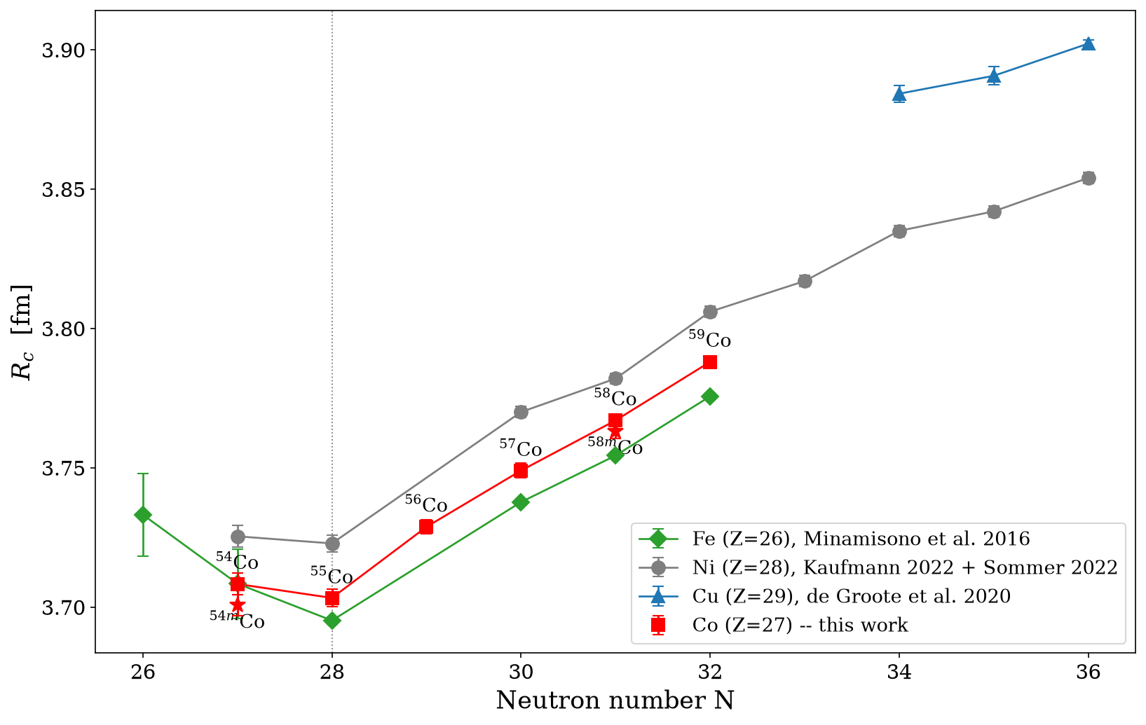
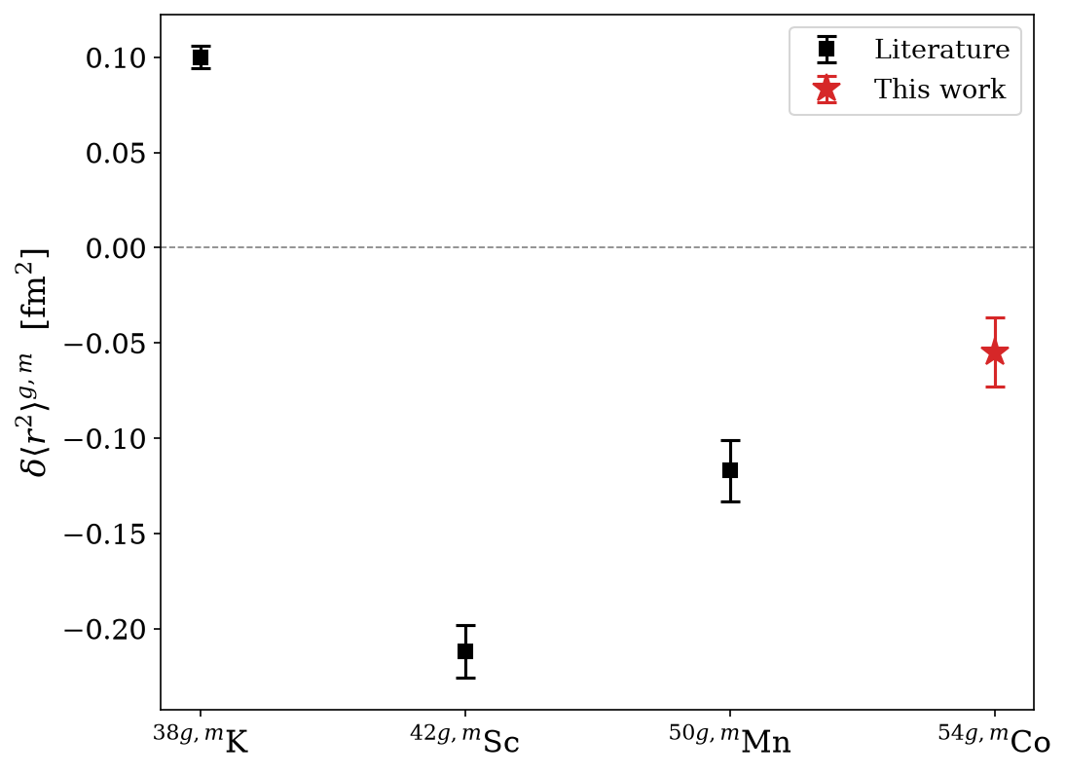
First charge radii of ⁵⁴⁻⁵⁹Co
Charge radii of the Co chain fit nicely between Ni and Fe
Co has a kink at N = 28 shell closure, similar to all other isotopes
δ⟨r²⟩(54ᵐ,54^{g}) = −0.055(18) fm²
T = 0 isomer has the smallest radius – in agreement with the π–ν pairing picture
Complements ³⁸K, ⁴²Sc, ⁵⁰Mn: a 4th self-conjugate case
Linear trend?
Preliminary
Preliminary
Zakopane Conference on Nuclear Physics 2026

Slide 11
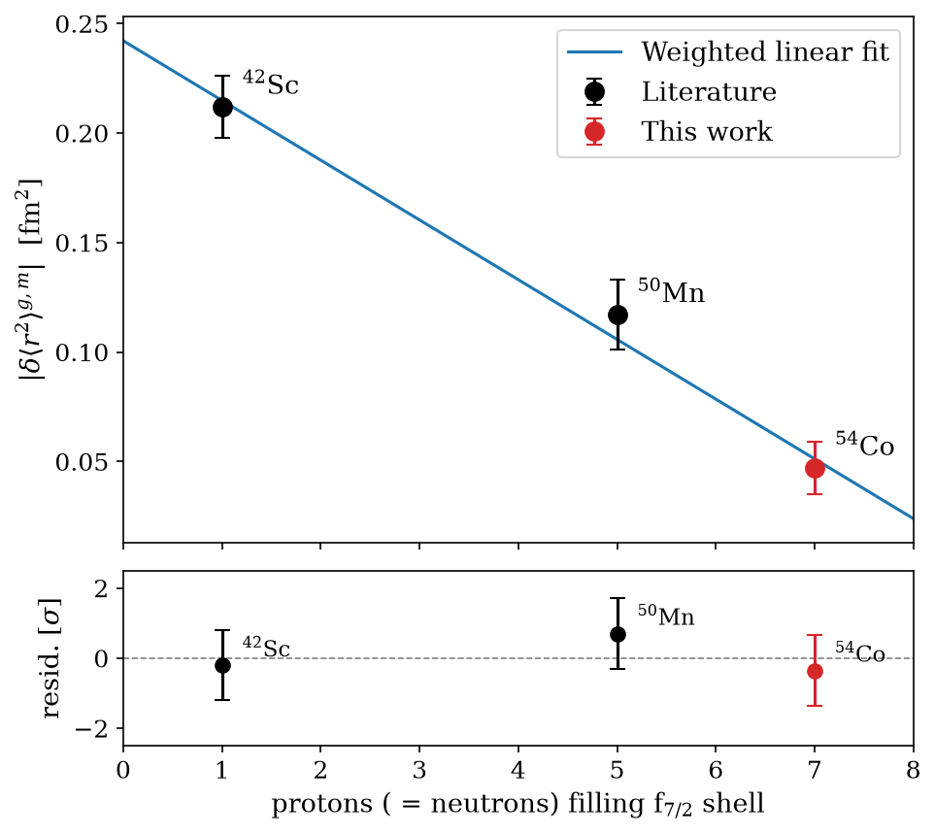
The ⁴²Sc–⁵⁰Mn–⁵⁴Co trend: linear in f₇/₂ filling
|δ⟨r²⟩(g,m)| falls smoothly with f₇/₂ filling:
n = 1, 5, 7 for ⁴²Sc, ⁵⁰Mn, ⁵⁴Co
All three points lie within 1σ of the fitted line
Expected: the pairing-blocking phase space shrinks ∝ remaining f₇/₂ holes (8−n), toward the ⁵⁶Ni closure
³⁸K is excluded: it belongs to a different shell — aligned state 3⁺, not 7⁺ — not part of this f₇/₂ filling sequence
Preliminary
Zakopane Conference on Nuclear Physics 2026

Slide 12
Summary and outlook
⁵⁴⁻⁵⁹Co measured at IGISOL: hyperfine structure and isotope shifts across N = 28
First empirical charge radii for Co below the Z = 28 closure, via Ni-calibrated F and M
δ⟨r²⟩(⁵⁴ᵐ,⁵⁴ᵍ) = −0.055(18) fm² – a 4th self-conjugate test of π–ν pairing
⁴²Sc, ⁵⁰Mn, ⁵⁴Co |δ⟨r²⟩(g,m)| falls linearly with f₇/₂ filling
Outlook
⁵³^{m}Co, the proton-emitting isomer near the proton dripline
Measure ⁴⁶V whether it holds the linear f₇/₂ trend
For more information, join Angelos Karadimas’ talk
Zakopane Conference on Nuclear Physics 2026

Slide 13
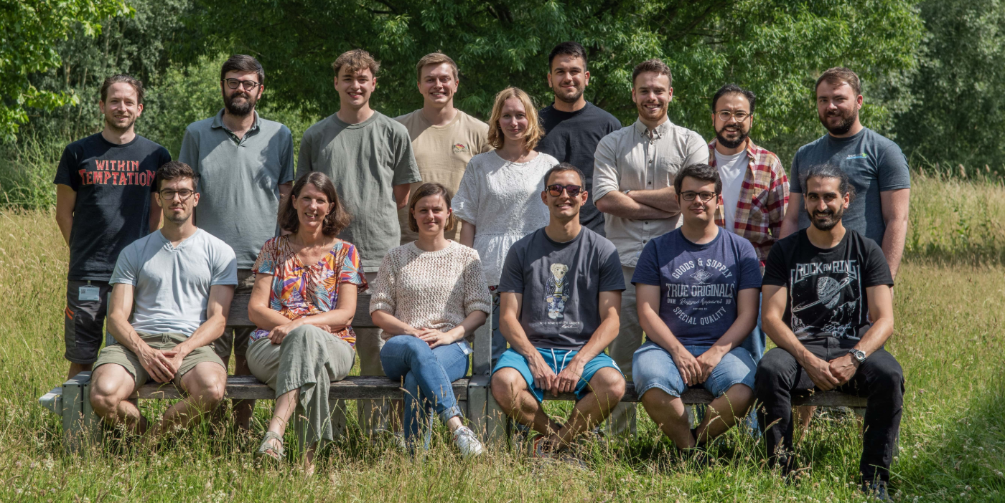
Thanks to the nuclear moments group and the IGISOL collaboration

Slide 14
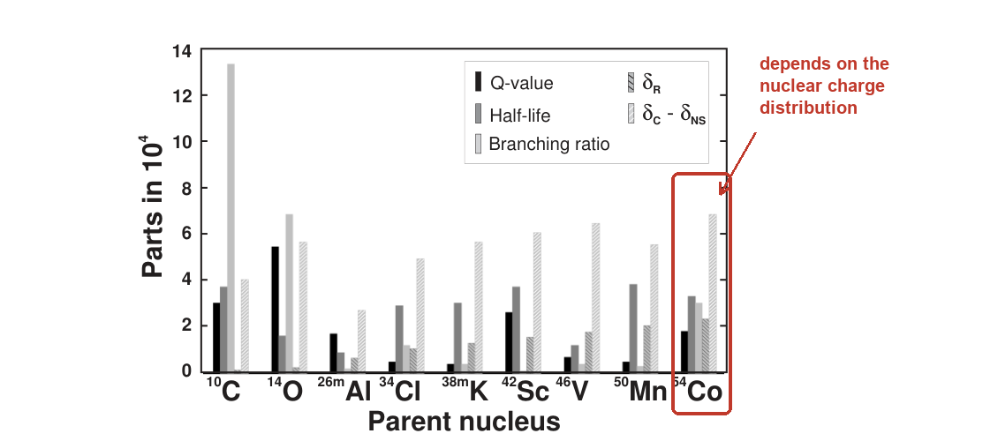
CKM Matrix
⁵⁴Co is one of ~14 superallowed 0⁺ → 0⁺ emitters used to extract V_{ud}, the dominant CKM-unitarity term
That test shows a ~3σ deficit — the “Cabibbo Angle Anomaly” — driven by nuclear structure: the correction δ_{C}
δ_{C} corrects for the radial mismatch between proton and neutron wavefunctions — set by the nuclear charge distribution
Our measured R_{c}(⁵⁴Co) directly constrains δ_{C}, tightening V_{ud}
J.C. Hardy, I.S. Towner, Phys. Rev. C 91, 025501 (2015), Fig. 3
Zakopane Conference on Nuclear Physics 2026

Slide 15
Magnetic moments
Moments from A ratios to the ⁵⁹Co reference (μ = 4.627 μ_{N})
Remeasured moments agree with literature within 1σ
Two new values for dipole moments of ^{54m}Co and ^{58m}Co
Isotope | I | μ this work [μ_{N}] | μ lit. [μ_{N}] | σ
^{⁵⁴ᵐ}Co | 7 | 3.77(7) | — | —
⁵⁵Co | 7/2 | 4.87(5) | 4.822(3) | 0.9
⁵⁶Co | 4 | 3.83(4) | 3.850(10) | 0.4
⁵⁷Co | 7/2 | 4.73(5) | 4.720(10) | 0.1
⁵⁸Co | 2 | 4.04(4) | 4.044(8) | 0.0
^{⁵⁸ᵐ}Co | 5 | 4.52(5) | — | —
⁵⁵Co: Callaghan et al., NMR (1973), ⁵⁶Co, ⁵⁷Co: J. Phys. C 10, 3651 (1977), ⁵⁸Co: Physica 57, 1 (1972)
Zakopane Conference on Nuclear Physics 2026

Slide 16
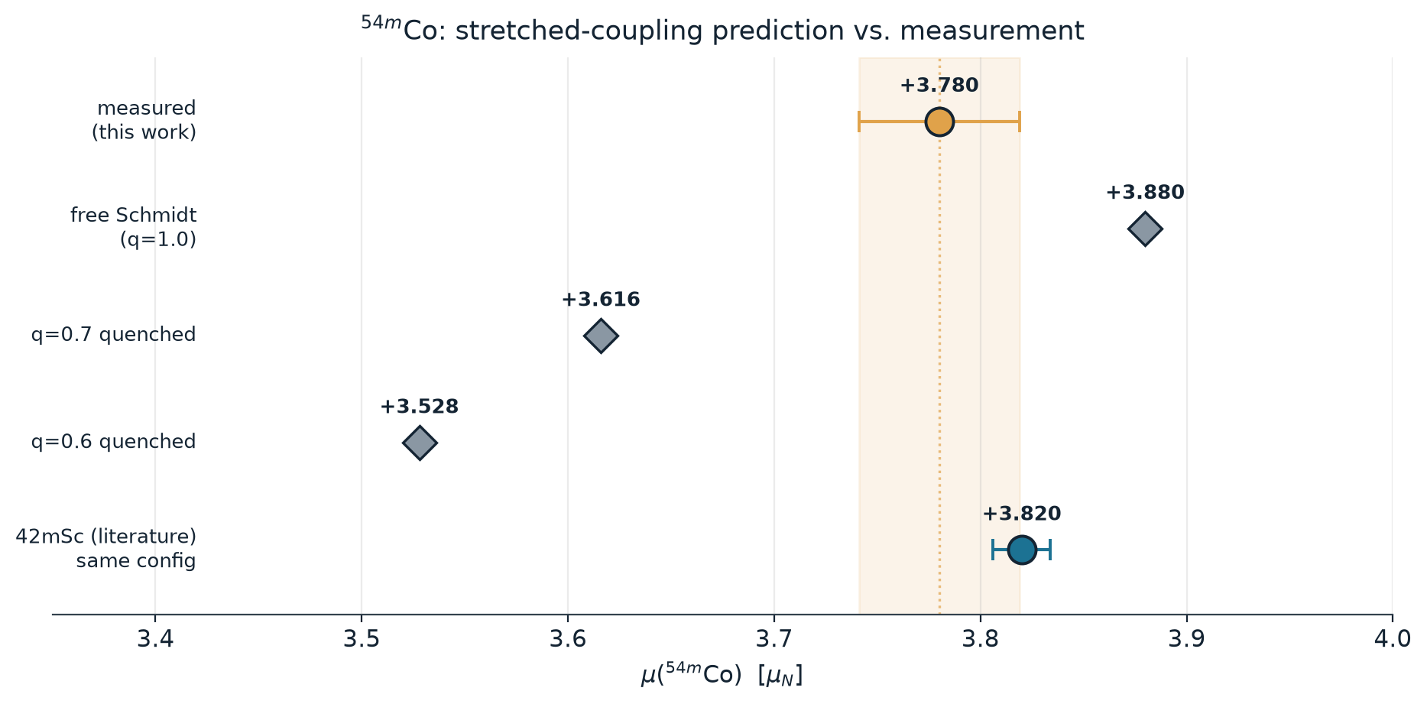
First measurement: μ(⁵⁴ᵐCo)
Measured moment: μ(⁵⁴ᵐCo) = +3.780(39) μ_{N}
Close to free Schmidt and to ⁴²ᵐSc, the same stretched coupling
Required quenching factor: q ≈ 0.89(4) for ⁵⁴ᵐCo and q ≈ 0.93(2) for the literature ⁴²ᵐSc value
Reason: The [πf₇/₂ ⊗ νf₇/₂]_{7⁺} coupling is maximally aligned → little configuration mixing, so little quenching
⁴²ᵐSc: Á. Koszorús et al., Phys. Lett. B 819, 136439 (2021)
Zakopane Conference on Nuclear Physics 2026

Slide 17
Generating the UV light
The 4s → 4p spectroscopy transition lies deep in the UV (228–232 nm) — not directly reachable from a standard tunable laser
Reached by frequency-quadrupling a CW Ti:Sapphire laser (~940 nm) through two SHG cavities in series
frequency-quadrupled overall (940 nm → 235 nm)
Sirah Matisse TS
Ti:Sapphire laser
(CW, ~940 nm)
Wavetrain SHG
cavity #1
→ 470 nm
Wavetrain SHG
cavity #2
→ ~235 nm (UV)
Collinear
beamline
(ion overlap)
laser + 1st SHG cavity purged with N₂
(940 nm overlaps the H₂O absorption band)
0.1–1.5 mW UV
→ 228–232 nm Co II transitions
Zakopane Conference on Nuclear Physics 2026

Slide 18
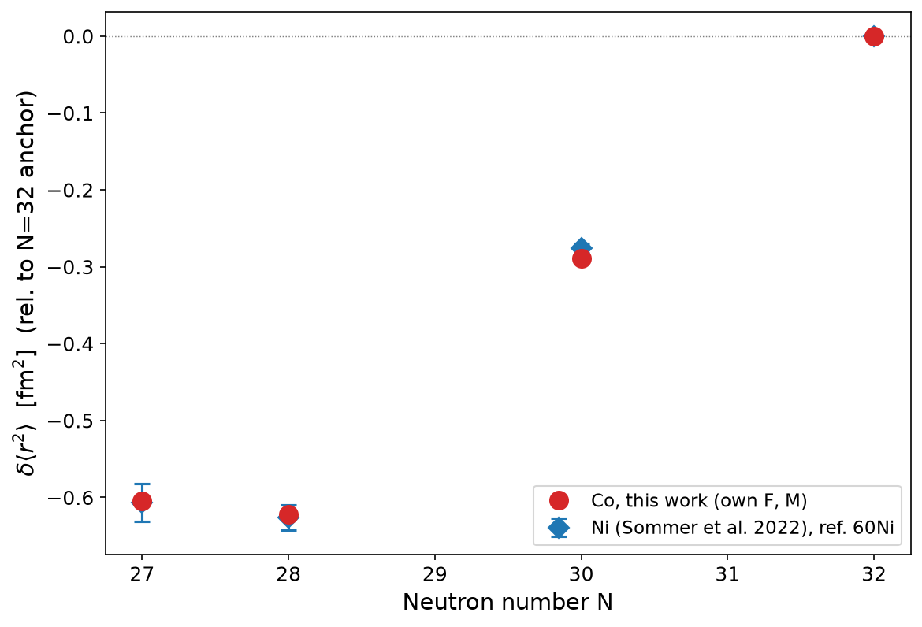
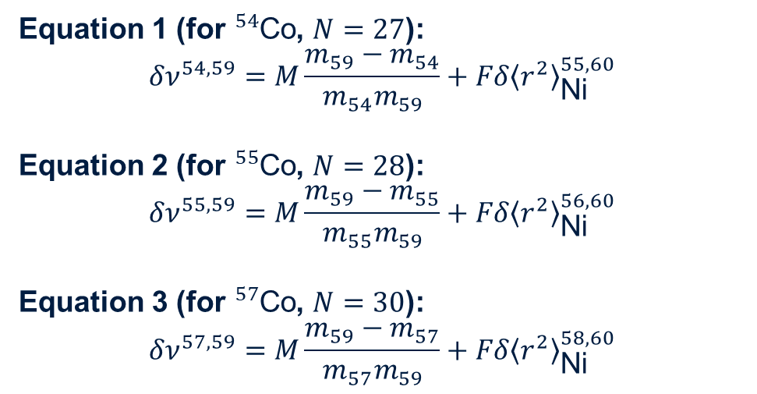
F & M calculation
Nickel charge radii and cobalt mass shift give F and M
Equation 1 (for ${}_{​}^{54}{\text{Co}}$, $N=27$):
$$δν^{54,59}=M\frac{m_{59}−m_{54}}{m_{54}m_{59}}+Fδ{\left\langle r^{2}\right\rangle }_{\text{Ni}}^{55,60}$$
Equation 2 (for ${}_{​}^{55}{\text{Co}}$, $N=28$):
$$δν^{55,59}=M\frac{m_{59}−m_{55}}{m_{55}m_{59}}+Fδ{\left\langle r^{2}\right\rangle }_{\text{Ni}}^{56,60}$$
Equation 3 (for ${}_{​}^{57}{\text{Co}}$, $N=30$):
$$δν^{57,59}=M\frac{m_{59}−m_{57}}{m_{57}m_{59}}+Fδ{\left\langle r^{2}\right\rangle }_{\text{Ni}}^{58,60}$$
Result: F ≈ 1547.0 ± 369 MHz/fm²,
M ≈ (−1.95 ± 0.17)×10⁶ MHz·u
H. Heylen et al., Phys. Rev. C 94, 054321 (2016) (50Mn)
Zakopane Conference on Nuclear Physics 2026

Slide 19
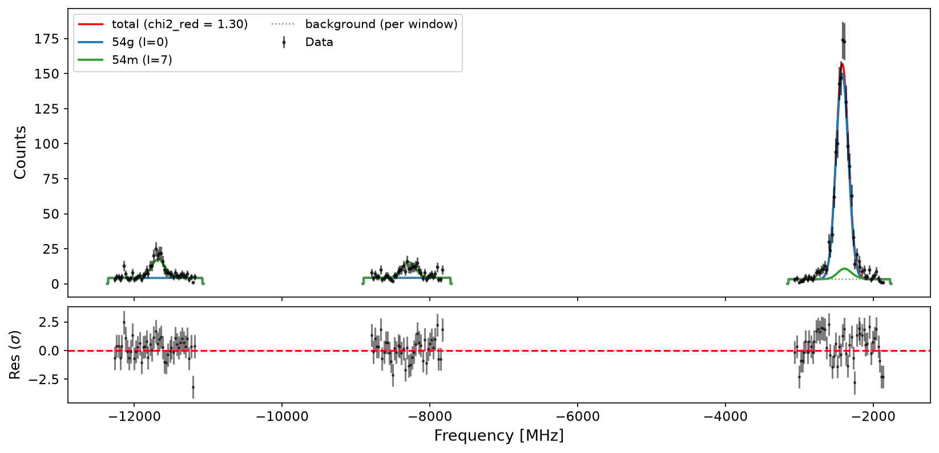
⁵⁴Co: resolving g.s. and isomer, together
Both states populated simultaneously in the same beam
Dual hyperfine model: I = 0 single line (blue) + I = 7 multiplet (green)
First measurement of A(⁵⁴ᵐCo) and μ(⁵⁴ᵐCo)
Zakopane Conference on Nuclear Physics 2026

