Slide 1




New K isomers of the
neutron-rich rare-earth nuclei
Jeroen Peter Bormans
Technical University Darmstadt
Gesellschaft für Schwerionenforschung (GSI) GmbH
Helmholtz Forschungsakademie Hessen für FAIR
for the S100 experiment and
HISPEC/DESPEC collaboration

Slide 2
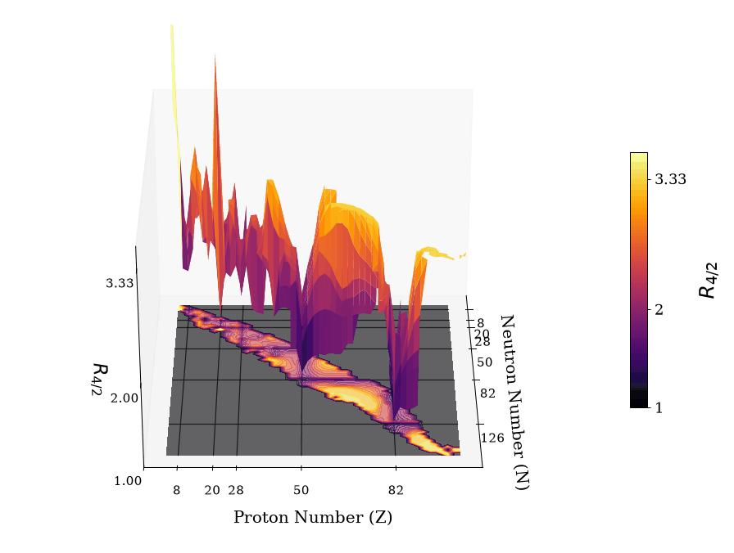
Extremes of the landscape
Mid-shell nuclei far from spherical closures
Study the interplay between collective phenomena and single-particle structures
Data taken from: ENSDF https://www.nndc.bnl.gov/ensdf/
Notes:
R4/2 = indication of the shape in the rigid rotor model and 3.33 → Prolate
The neutron rich ree’s give us the oppo
K-isomers not only provide us insight into the nature single particles involved but also elucidate the level structure below the isomer and give us the ability to measure lifetimes of intermediate states as well

Slide 3
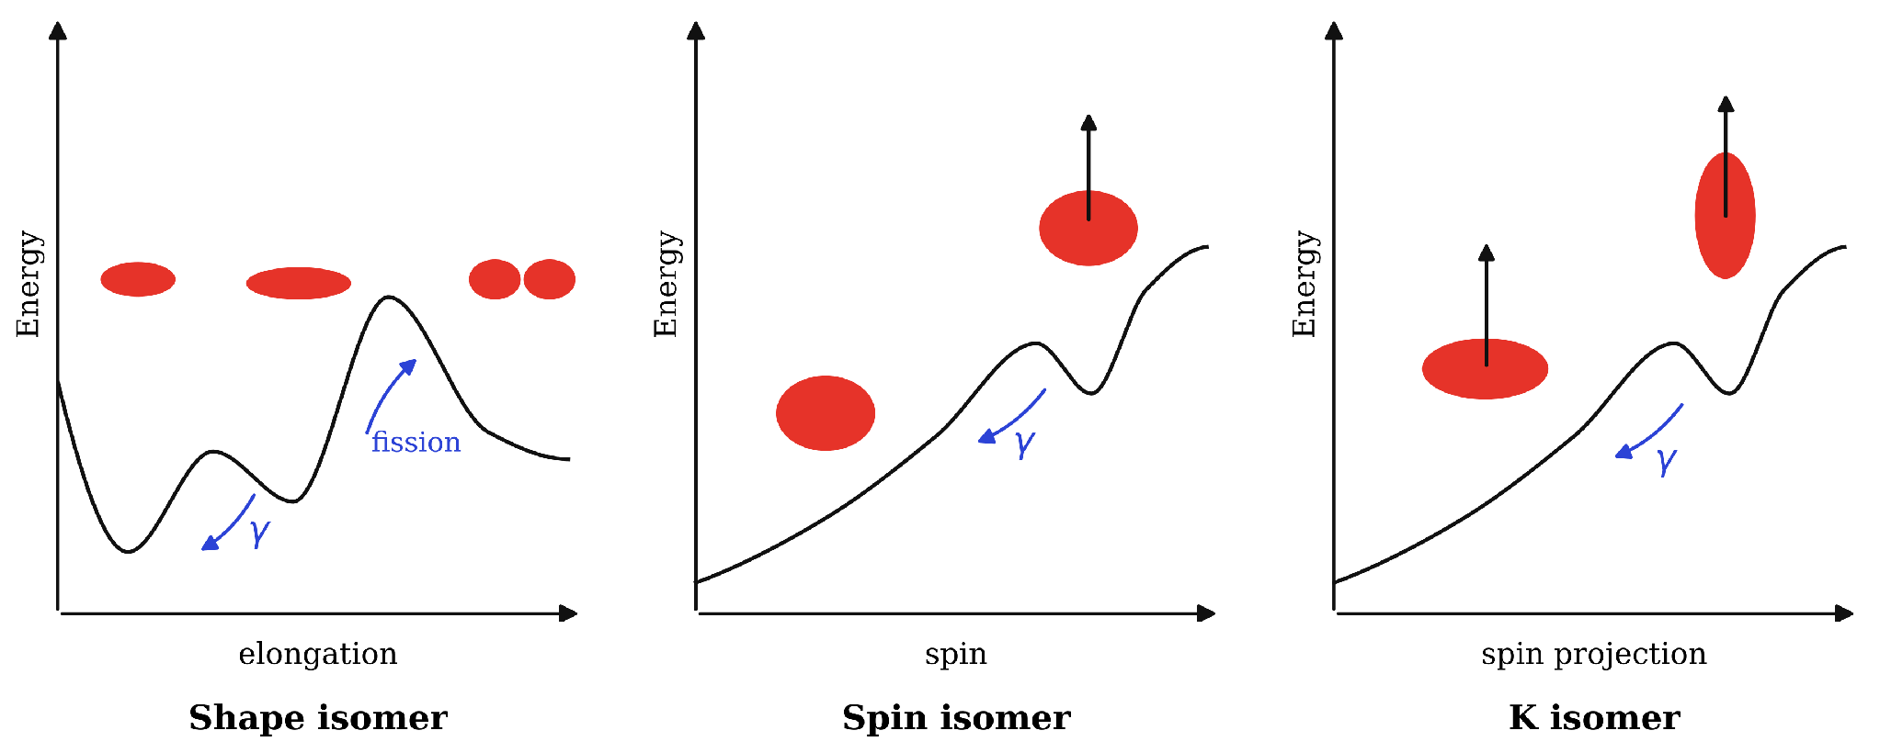
Life at the extremes
※ Isomer = meta-stable state of the nucleus
Adapted from: P. Walker, G.D. Dracoulis, Energy traps in atomic nuclei. Nature 399, 35–40 (1999)

Slide 4
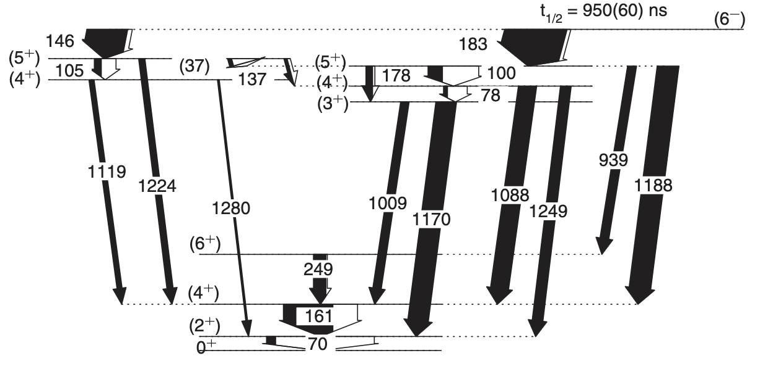

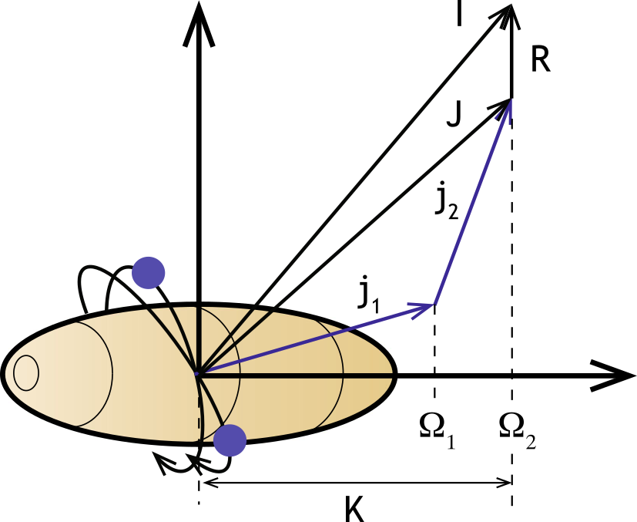
The lone survivors
K = 6
K = 4
K = 3
K = 0
¹⁶⁶Gd
Level scheme taken from: Z. Patel et al., PRL 113, 262502 (2014)
Nuclear structure accessed through
spectroscopic techniques
K
Figure adapted from:
G.D. Dracoulis, P.M. Walker, F.G. Kondev, Rep. Prog. Phys. 79, 076301 (2016)

Slide 5
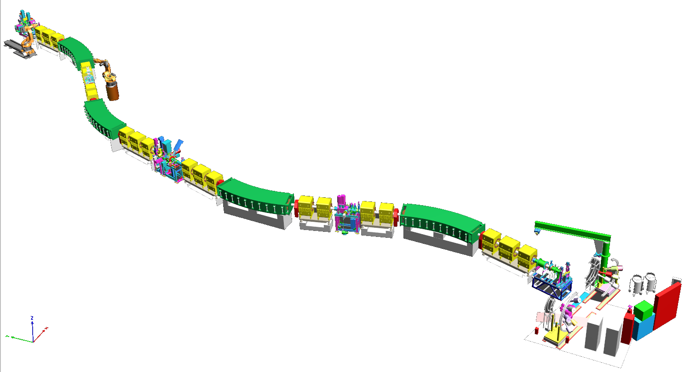
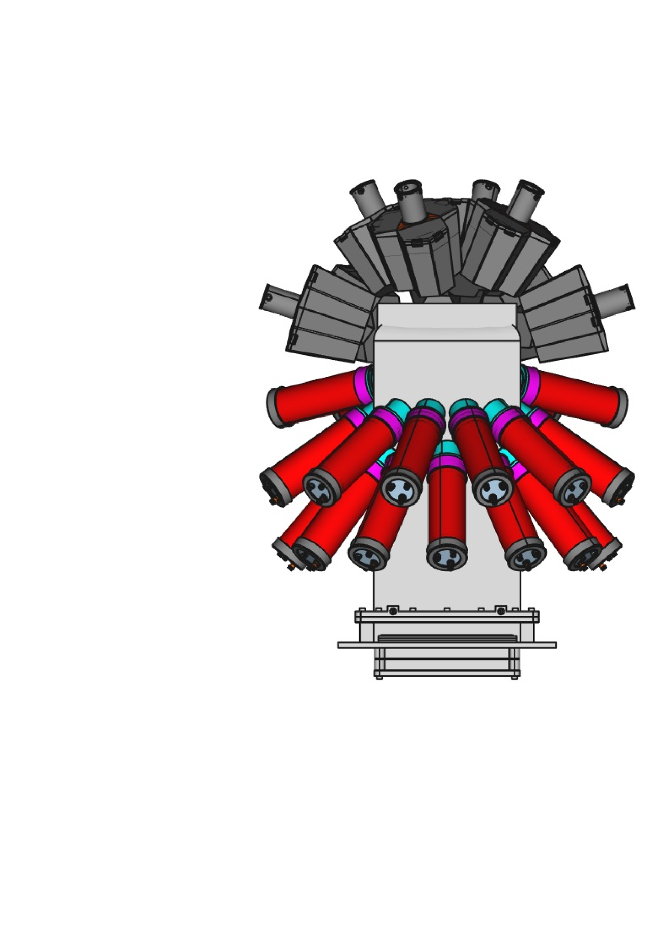
New base camp - ¹⁷⁰Er
Fragments stopped in DEcay SPECtroscopy hybrid 𝛾 ray array
Implantation stack comprising 24x8 cm² AIDA DSSSDs
+ βPlastic scintillators
Hybrid 𝛾 ray array
  12 HPGe triple clusters (DEGAS)
(partially equipped with BGO back-catchers)
  36 LaBr₃(Ce) (FATIMA) detectors
First fragmentation of ¹⁷⁰Er!
¹⁷⁰Er from SIS18 @ 1.08 GeV/u
∆E
Bρ₁
DEGAS
Bρ₂
Beam from FRS
βPlastic
AIDA
Position of the DESPEC setup at the final focal plane
FATIMA
H. Geissel et al., NIM B 70, 286–297. (1992)
※ Two settings focused on ¹⁶⁸Dy and ¹⁶²Eu
Notes:
To study these effects and further understand this picture and experiment was performed at GSI where a beam of 170Er was delivered from the SIS18 ….

Slide 6
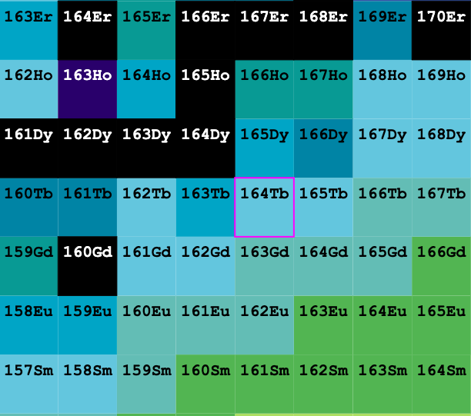
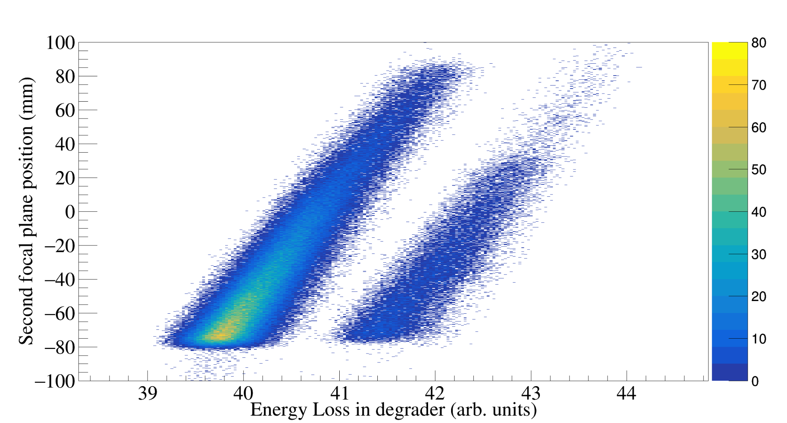
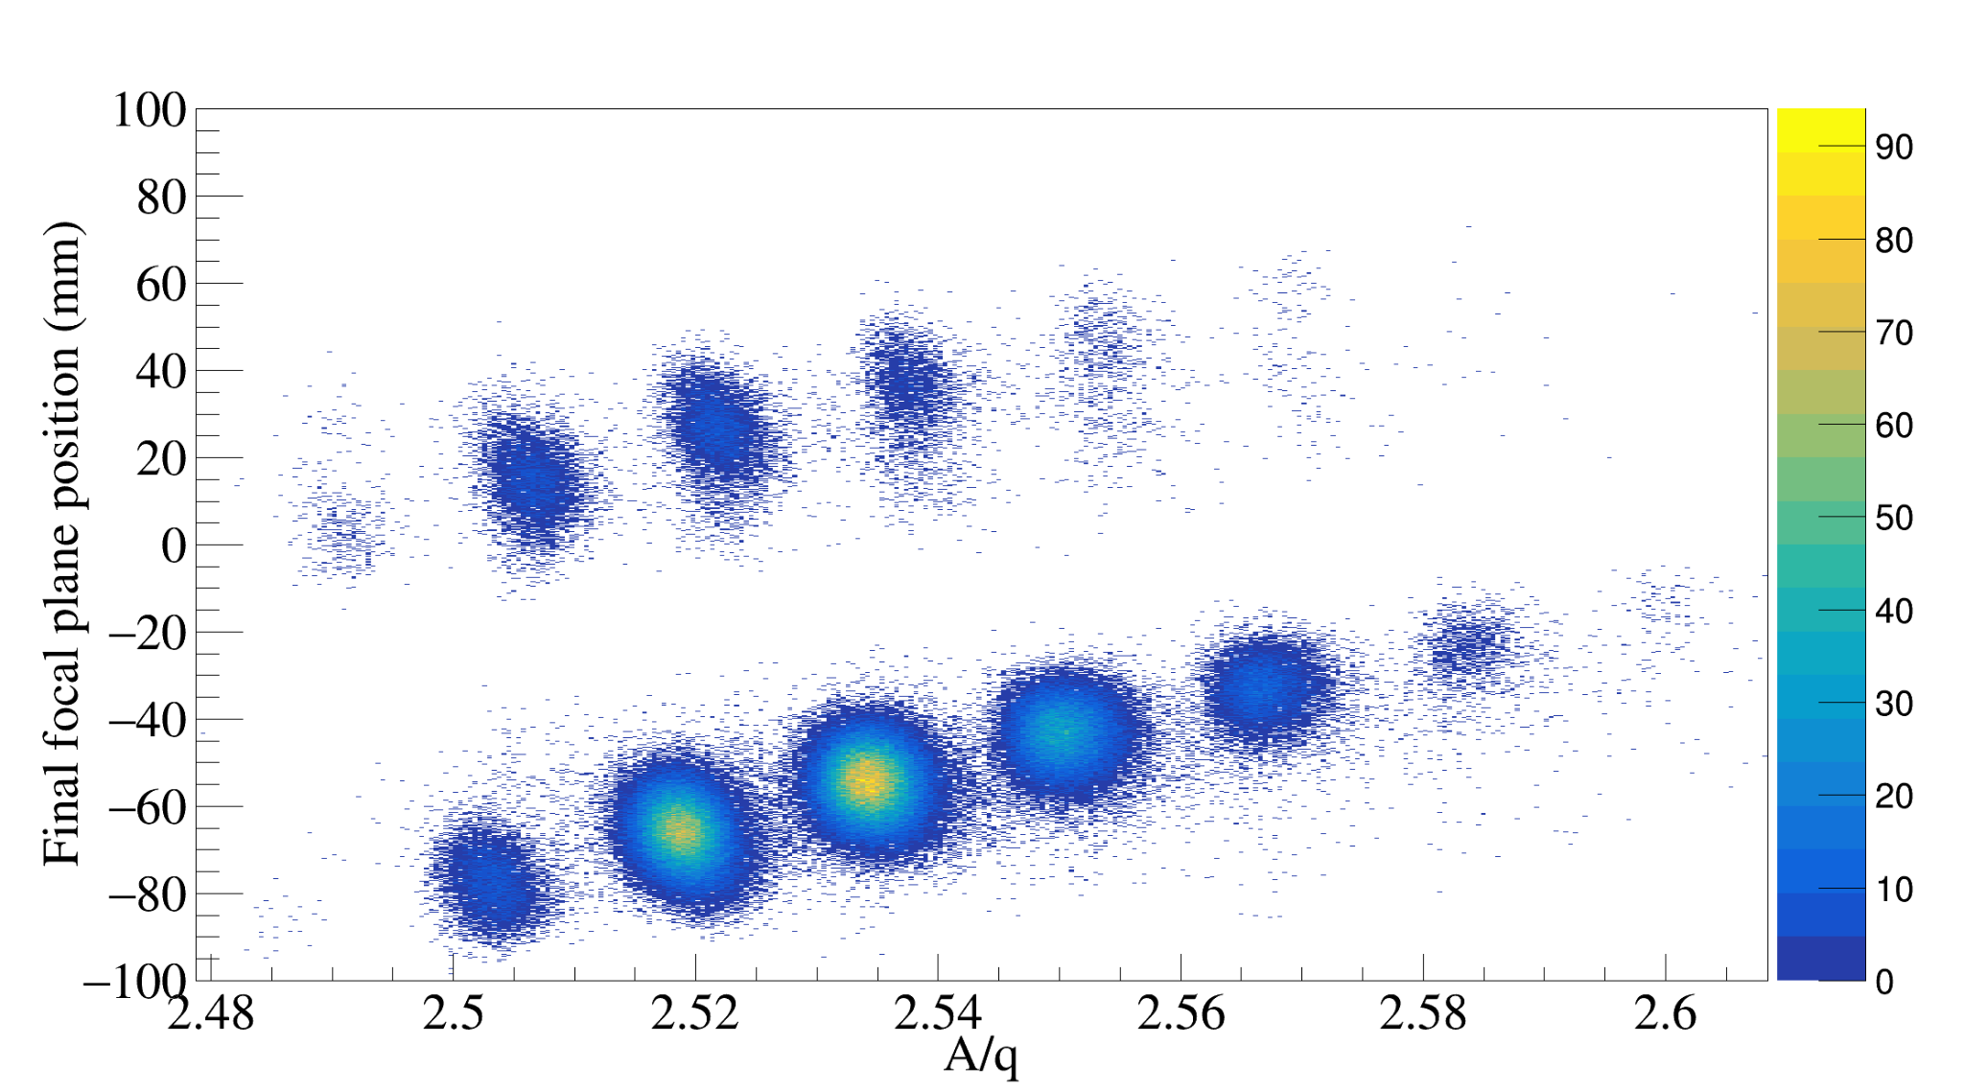
Wayfinding in the wilderness
New isomer and
first gamma-ray spectroscopy
Historically experimentally challenging region
¹⁷⁰Er beam gives us access to competitive yields
High beam energy → Clean charge state separation
New isomer and extended spectroscopy
Charge state separation
Isotope & charge state separation
Fully-stripped
Hydrogen-like
¹⁵⁷Sm fully-stripped
Notes:
The new results of 157Sm are shown here. Here is the delayed gamma rays detected by our germanium array following the arrival of a 157Sm ion.
I want to draw your attention to the level of statistics obtained in particular the height of peaks from the decay of the isomer versus that of beam induced effect such as this peak resulting from the a reaction with the ge crystal.

Slide 7
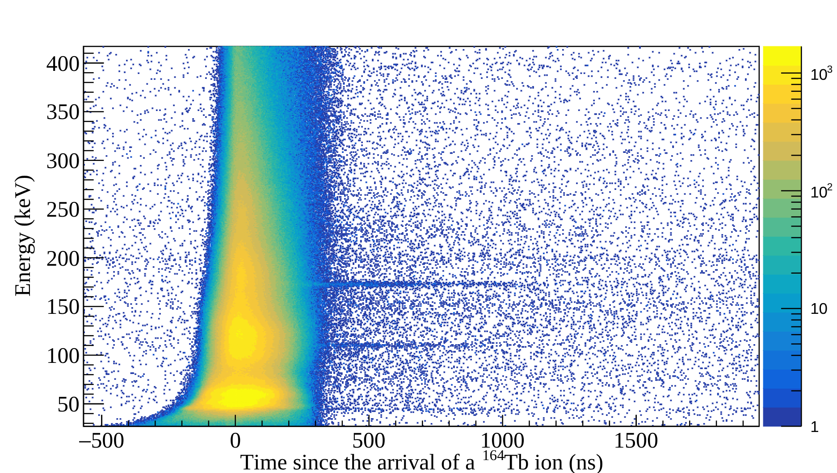
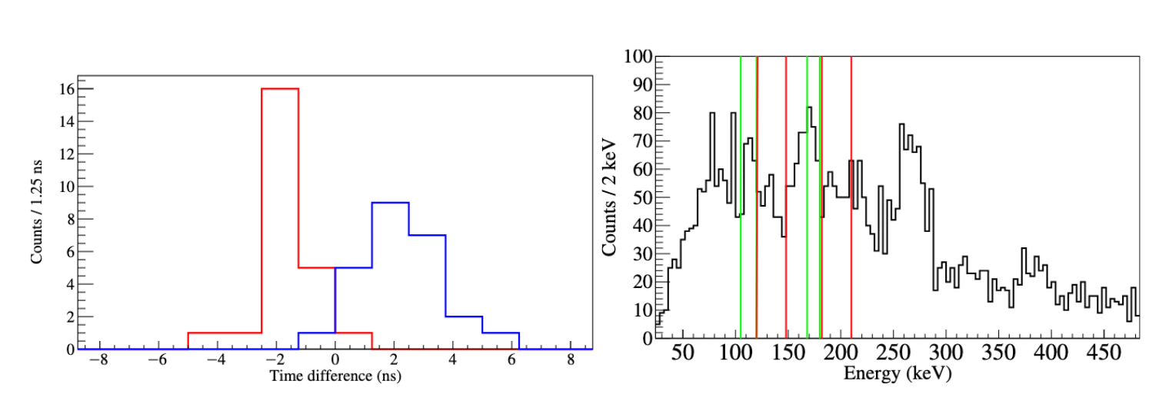
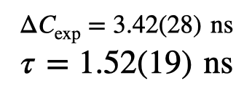
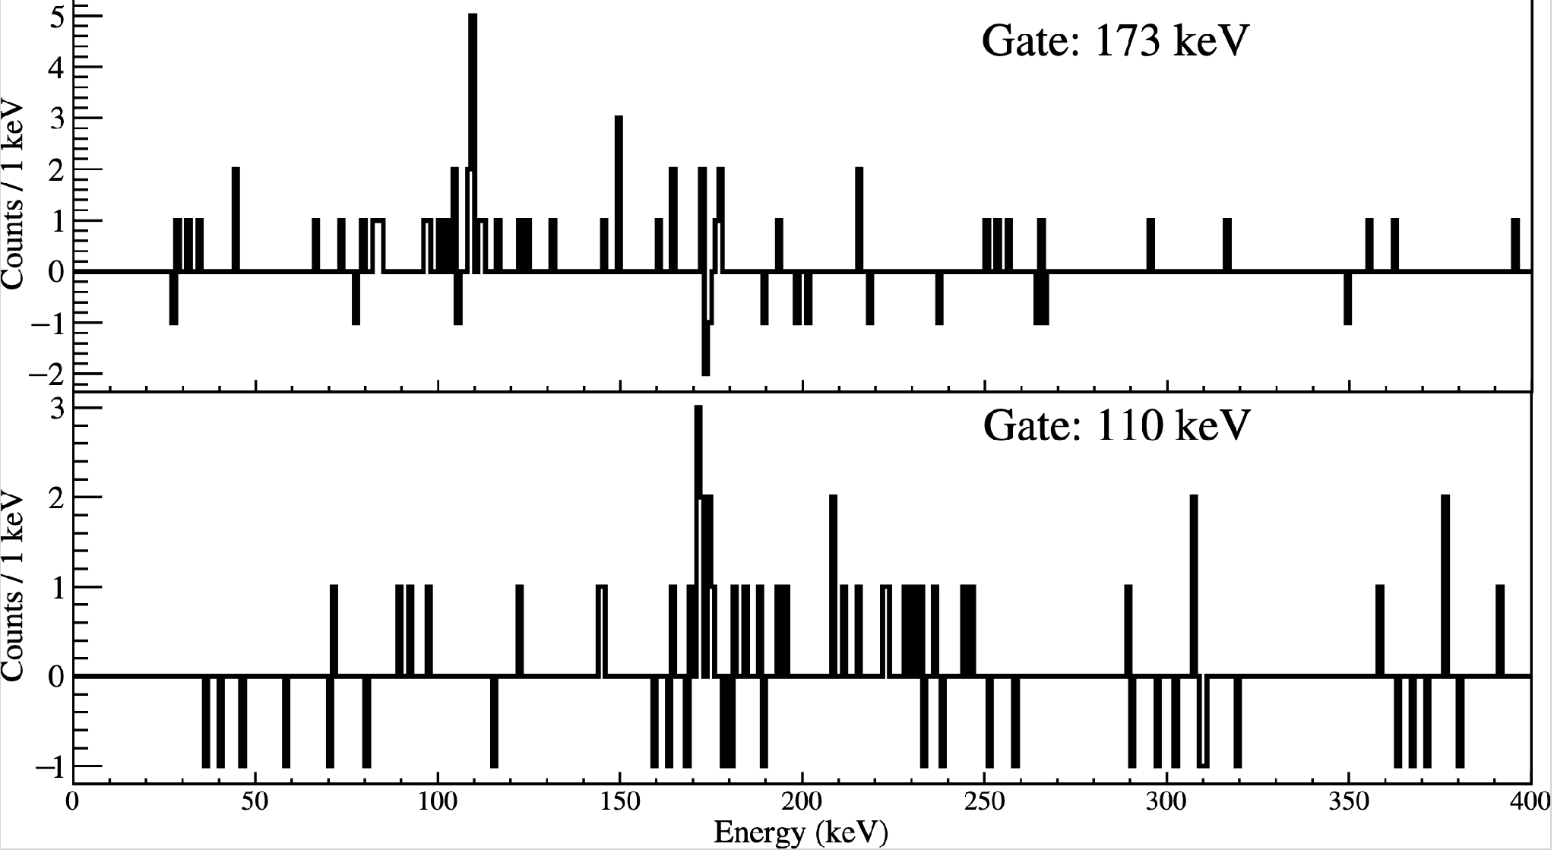
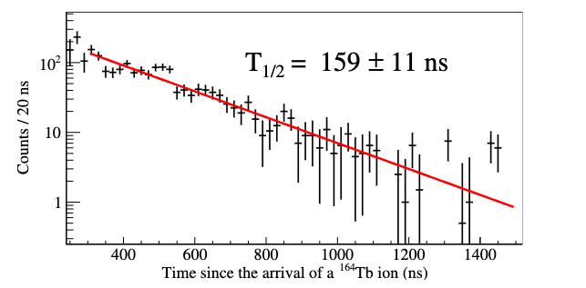
New isomer of ¹⁶⁴Tb
“Beam isomer”
173-110 lifetime with FATIMA
173
110
Anti-delayed
Delayed
Isomer half-life with DEGAS
Notes:
The new results of 157Sm are shown here. Here is the delayed gamma rays detected by our germanium array following the arrival of a 157Sm ion.
I want to draw your attention to the level of statistics obtained in particular the height of peaks from the decay of the isomer versus that of beam induced effect such as this peak resulting from the a reaction with the ge crystal.

Slide 8

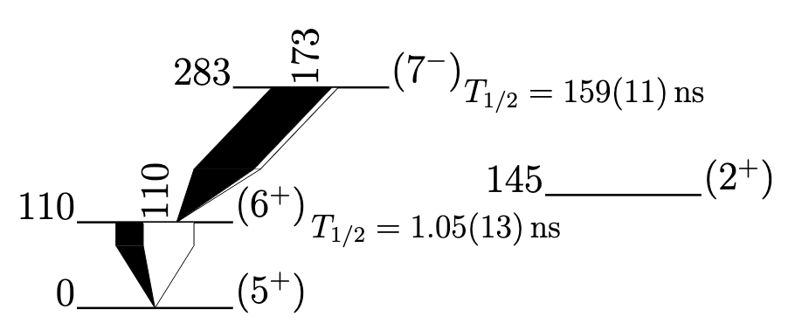
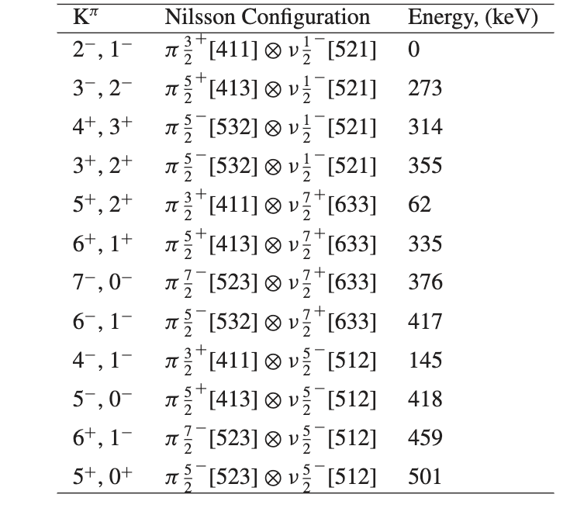



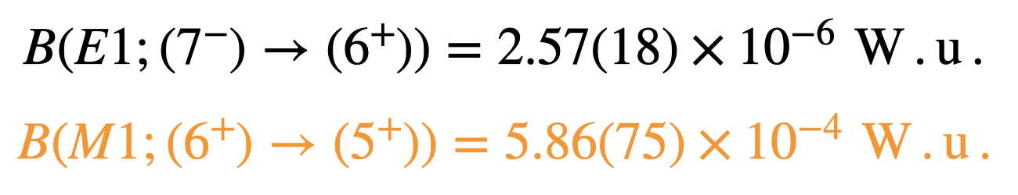
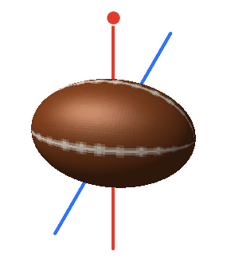
¹⁶⁴Tb level scheme
Blocked BCS calculations done for ¹⁶⁶Tb
R. Orford et al., PRC 102, 011303(R) (2020)
Our results:
L.A. Gurgi, et al., EPJ Web of Conferences 146, 10009 (2017).
Bohr-Mottelson geometrical model:
※ Interpretation: axially deformed core + 2 quasiparticle states is valid
Notes:
The new results of 157Sm are shown here. Here is the delayed gamma rays detected by our germanium array following the arrival of a 157Sm ion.
I want to draw your attention to the level of statistics obtained in particular the height of peaks from the decay of the isomer versus that of beam induced effect such as this peak resulting from the a reaction with the ge crystal.

Slide 9
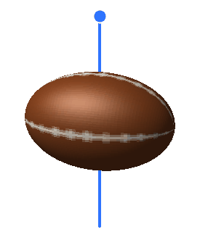
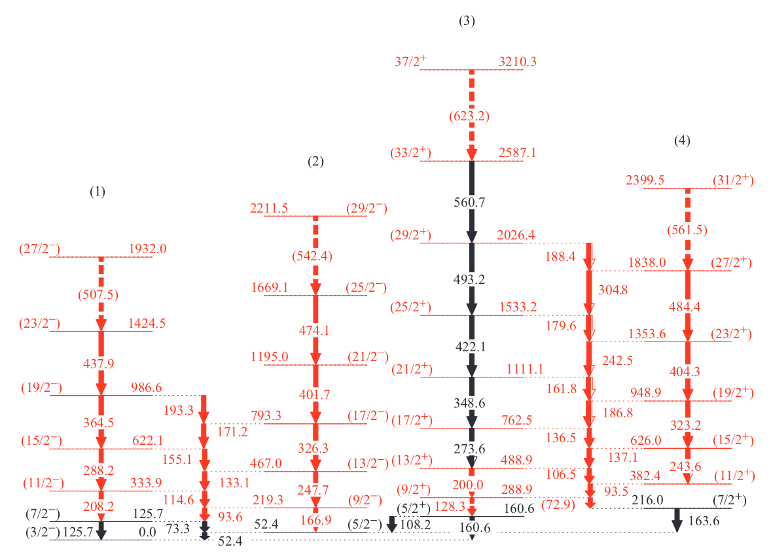
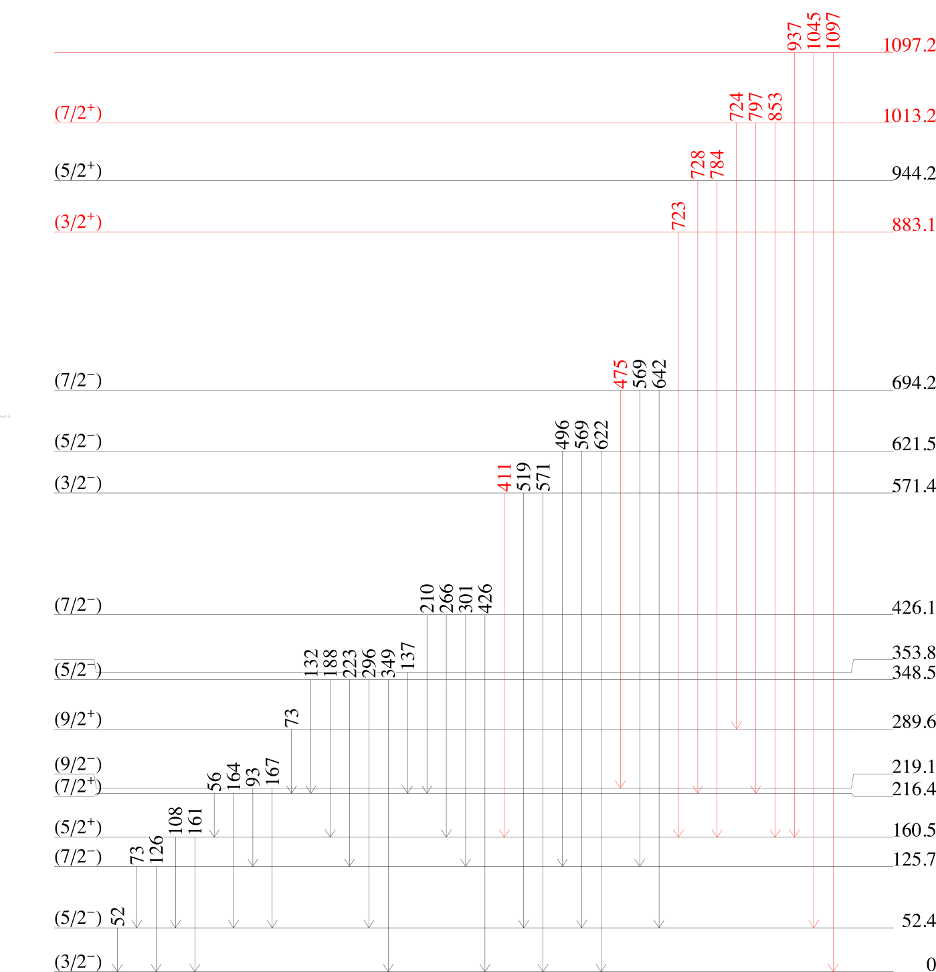
¹⁵⁷Sm in the landscape
Well-deformed nucleus with one unpaired neutron
Immense amount spectroscopic information from prompt spectroscopy
C. Zachary, Ph.D. thesis (unpublished) (2019)
D.J. Hartley et al., PRC 110, 044319 (2024)
Notes:
The new results of 157Sm are shown here. Here is the delayed gamma rays detected by our germanium array following the arrival of a 157Sm ion.
I want to draw your attention to the level of statistics obtained in particular the height of peaks from the decay of the isomer versus that of beam induced effect such as this peak resulting from the a reaction with the ge crystal.

Slide 10
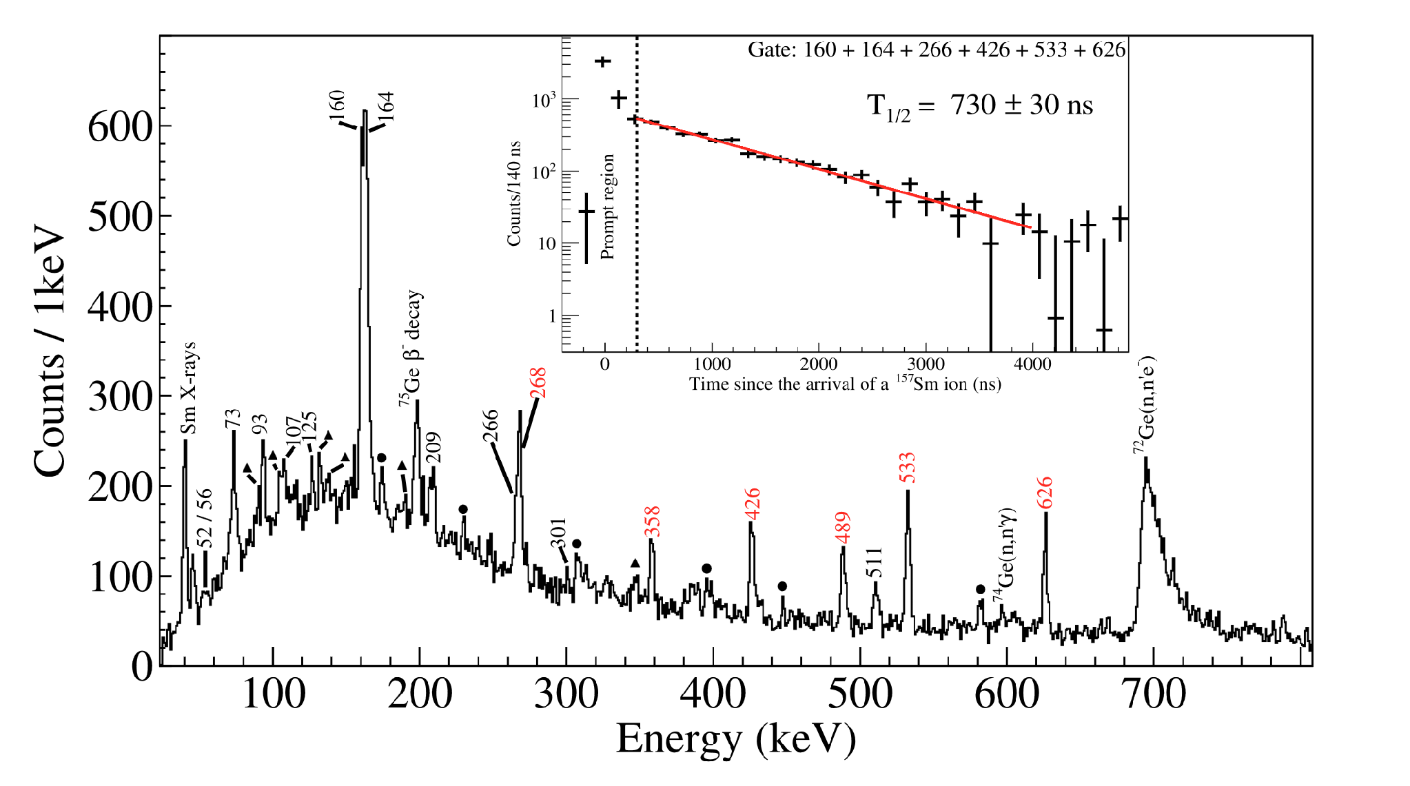
New isomer in ¹⁵⁷Sm
Delayed gamma rays detected with DEGAS following the arrival of a ¹⁵⁷Sm ion
Preliminary
Notes:
The new results of 157Sm are shown here. Here is the delayed gamma rays detected by our germanium array following the arrival of a 157Sm ion.
I want to draw your attention to the level of statistics obtained in particular the height of peaks from the decay of the isomer versus that of beam induced effect such as this peak resulting from the a reaction with the ge crystal.

Slide 11
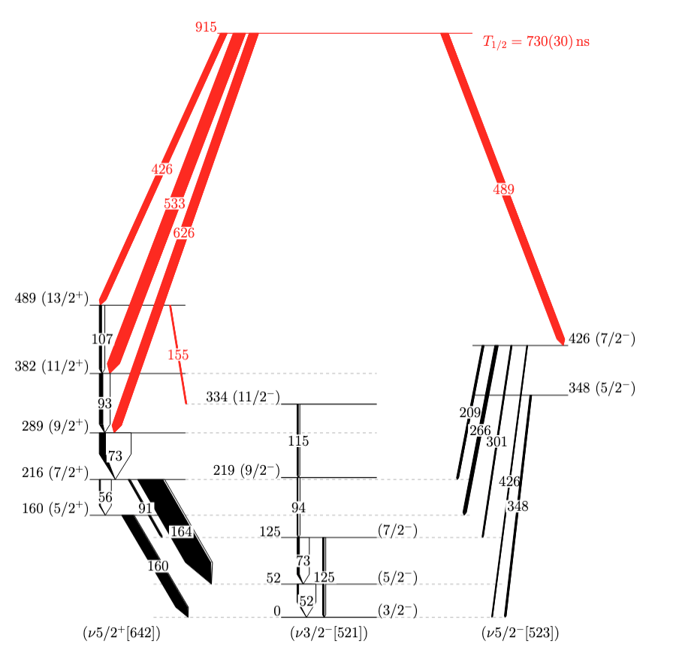
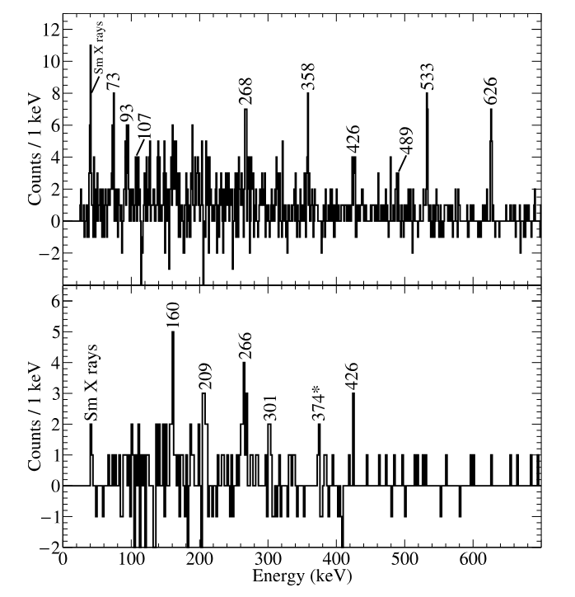
New ¹⁵⁷Sm level scheme
Gate:160
Preliminary
Gate:489
¹⁵⁷Sm
Notes:
The analysis of the singles and coincidence allowed us to develop the following spectrum

Slide 12
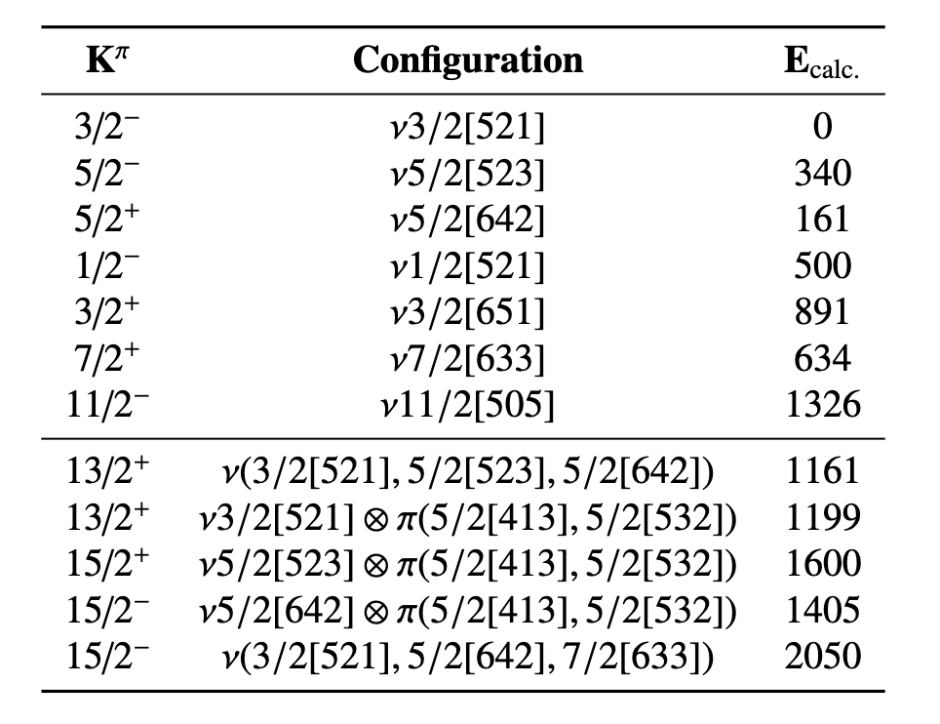


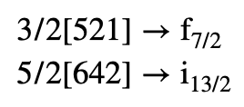
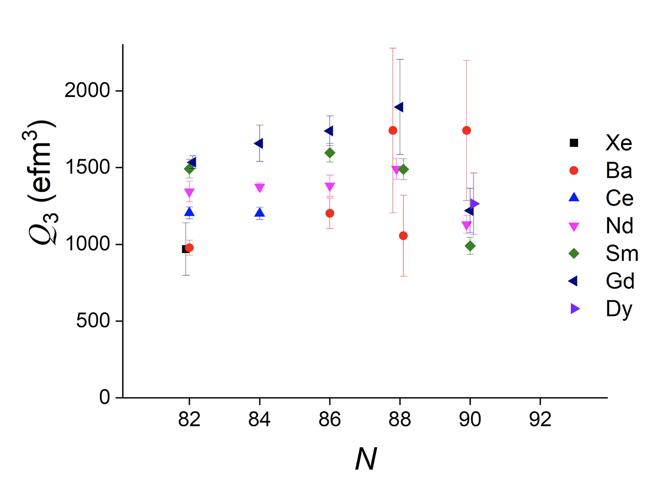
New ¹⁵⁷Sm level scheme
Preliminary
¹⁵⁷Sm
Multi-quasiparticle blocking calculation done by F.G. Kondev (ANL)
Notes:
The analysis of the singles and coincidence allowed us to develop the following spectrum

Slide 13
Summary & Outlook
First fragmentation of ¹⁷⁰Er provides unprecedented access to spectroscopy of neutron-rich rare-earth isotopes.
※ Newly-identified isomeric states of neutron-rich rare-earth nuclei.
※ First gamma-ray spectroscopy of ¹⁶⁴Tb.
    J.P. Bormans et al., EPJ Letters (in press)
A complex isomeric decay pattern of ¹⁵⁷Sm with strongly non-yrast decay pathway.
Isomer of ¹⁵⁷Sm structure still to be clarified and work is being done to develop the level scheme.

Slide 14


With many thanks to...
J.E.L. Larsson, H.M. Albers, M. Górska, M. Polettini, D. Brugnara,
G. Aggez, U. Ahmed, A. Algora, S. Alhomaidhi, M. Armstrong, M. Bajzek, J. Bardak,
G. Bartram, G. Benzoni, D. Bittner, B. Bles, S.N. Singh, C. Chatel, Z. Chen, B. Das, D. Das,
T. Dickel, L.M. Fraile, E.M. Gandolfo, G.G. De Lorenzo, J. Gerl, E. Haettner, P. Herrmann,
C. Hornung, H. Huang, N.J. Hubbard, K.E. Ide, C.E. Jones, A. Jungclaus, G. Kiss, I. Kojouharov,
G. Kosir, G. Kumar, R.K. Prajapat, M. Labiche, G. Li, Zhong Liu, R. Lozeva, X. Ma, H. Mayr,
M. Mikołajczuk, C. Nickel, S. Pascu, C.M. Petrache, A. Pfeil, V. Piau, N. Pietralla, S. Pietri,
Zs. Podolyák, W. Poklepa, D. Prajapati, P. Priyanka, M. Reece, P. Regan, E. Rocco,
H. Schaffner, C. Scheidenberger, S.K. Singh, Y. Tanaka, E. Uusikylä, M. Vencelj,
J. Vesic, K. Wang, V. Werner, K. Wimmer, A. Yaneva, K. Zagar, F. Zeng, J. Zhao, P. Zheng,
R. Zidarova
and the HISPEC/DESPEC collaboration and FRS collaboration

Slide 15
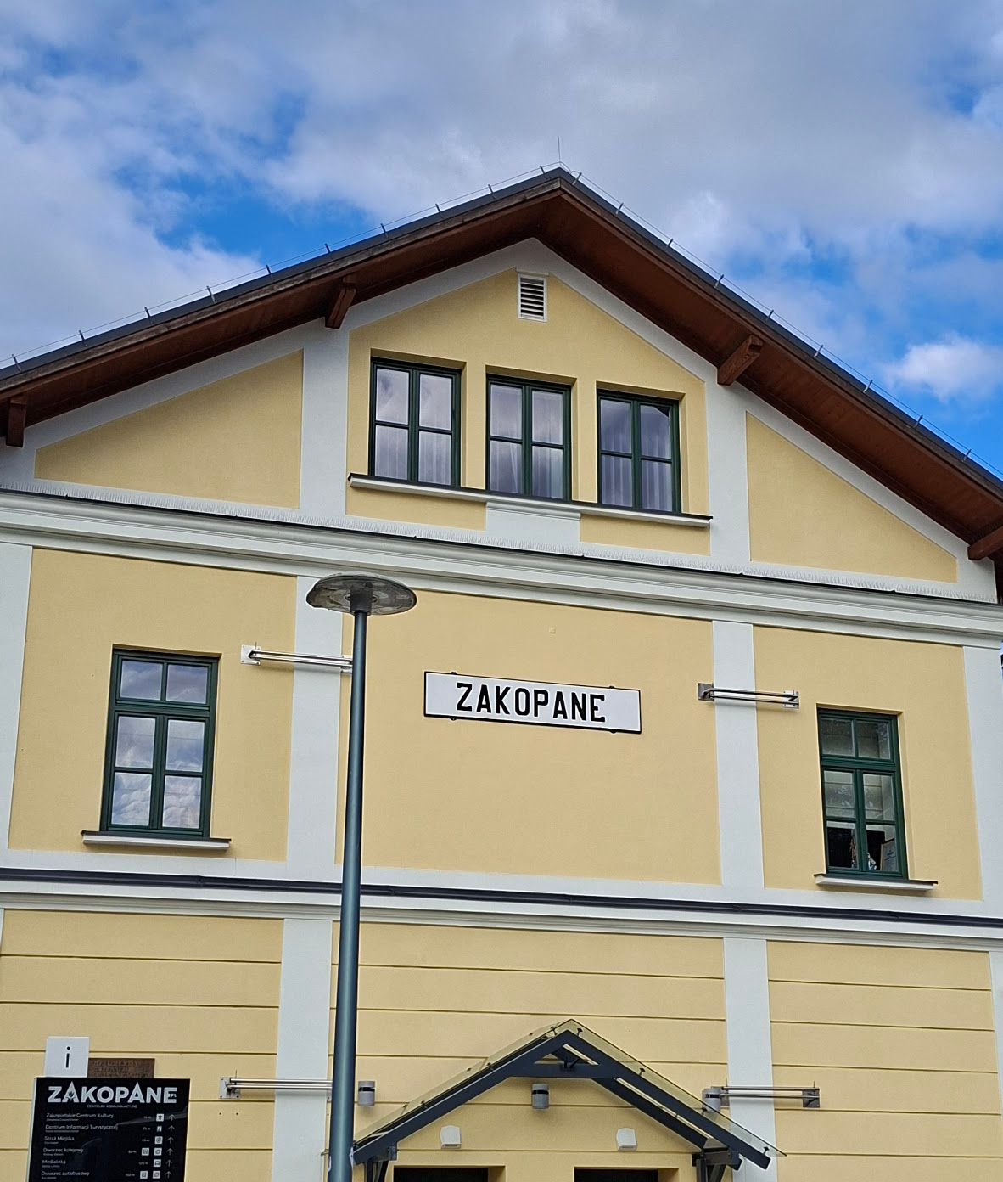
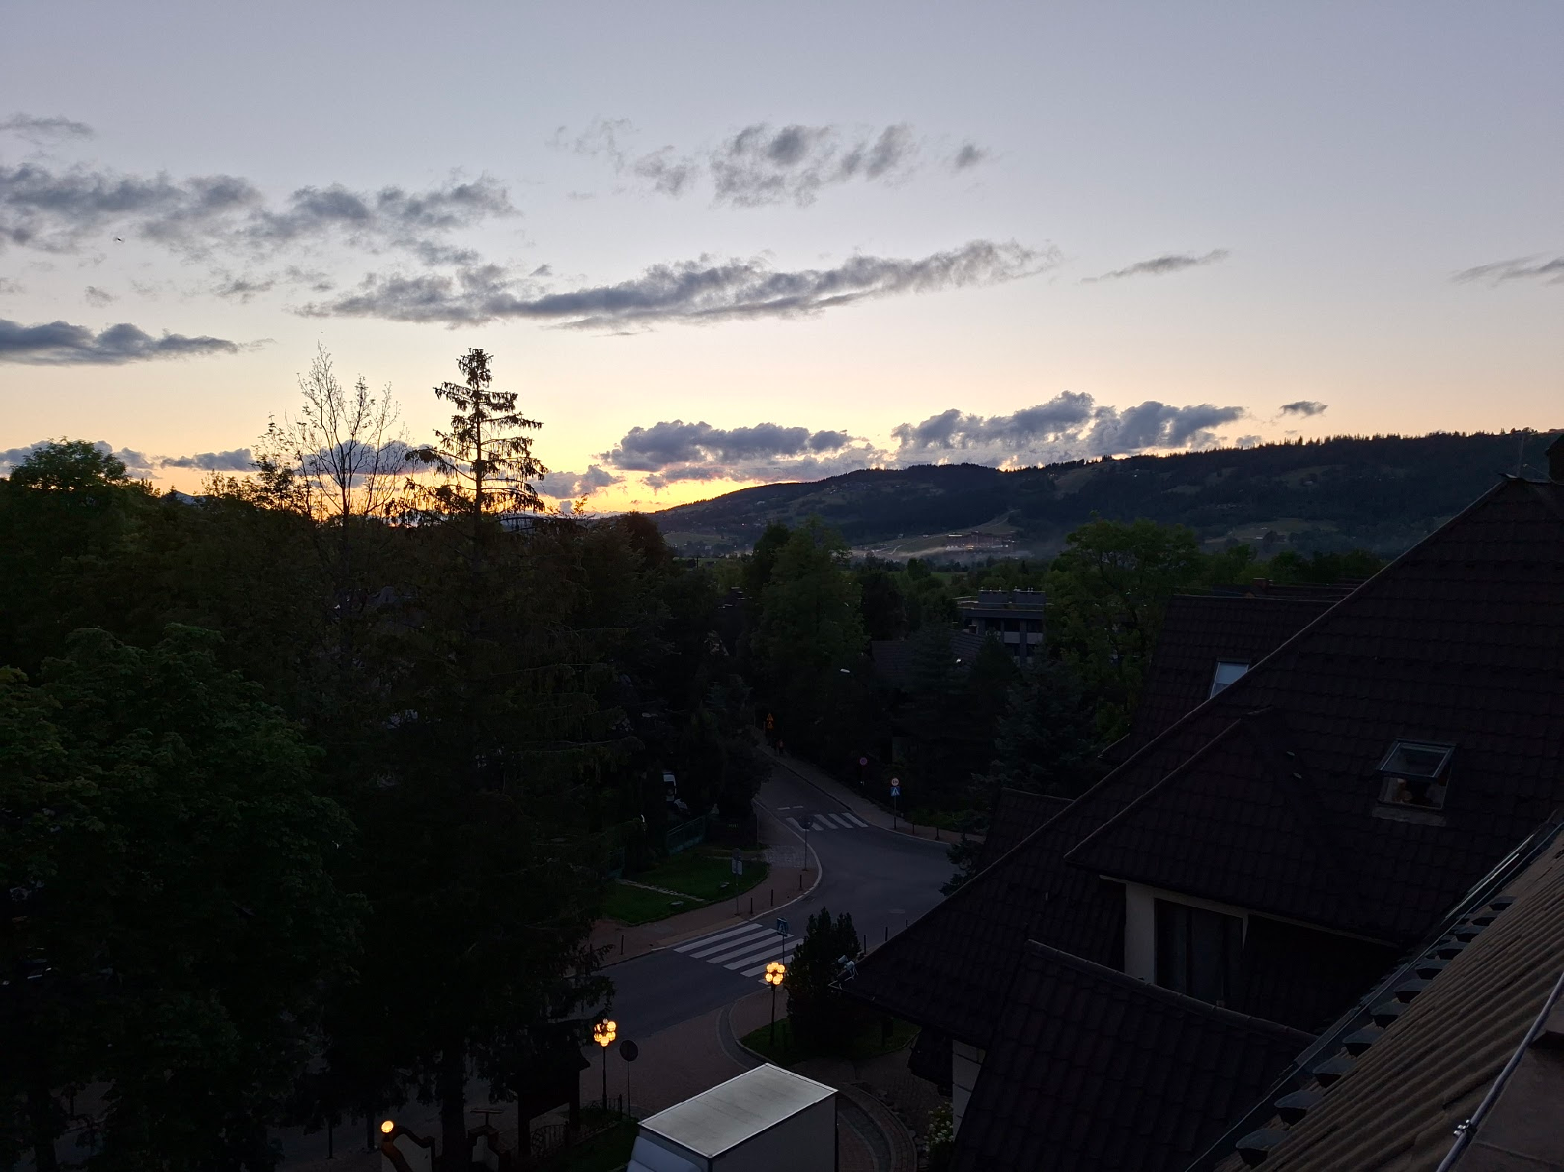
Dziękuję za uwagę!

Slide 16
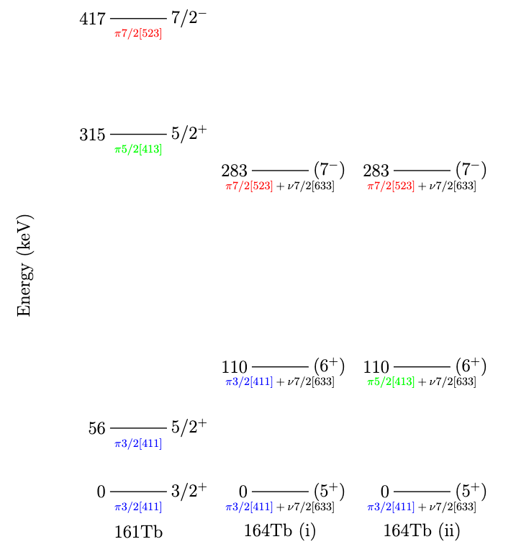
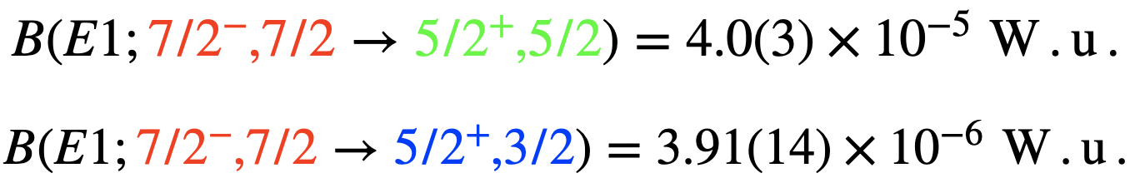
¹⁶⁴Tb level scheme
Blocked BCS calculations done for ¹⁶⁶Tb
In ¹⁶¹Tb:
Our results in ¹⁶⁴Tb:
L.A. Gurgi, P.H. Regan, et al., EPJ Web of Conferences 146, 10009 (2017).
Notes:
The new results of 157Sm are shown here. Here is the delayed gamma rays detected by our germanium array following the arrival of a 157Sm ion.
I want to draw your attention to the level of statistics obtained in particular the height of peaks from the decay of the isomer versus that of beam induced effect such as this peak resulting from the a reaction with the ge crystal.

Slide 17
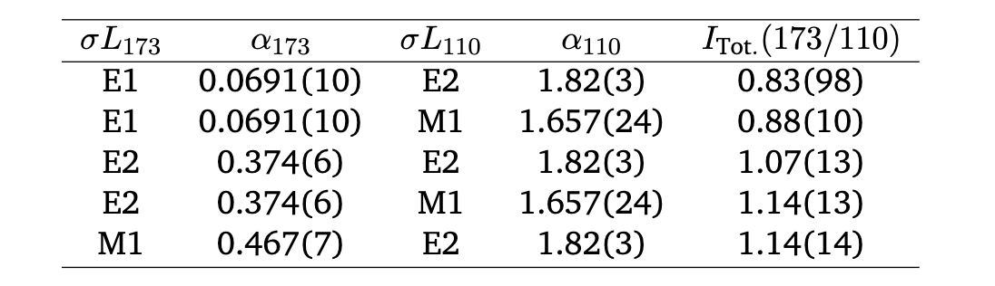
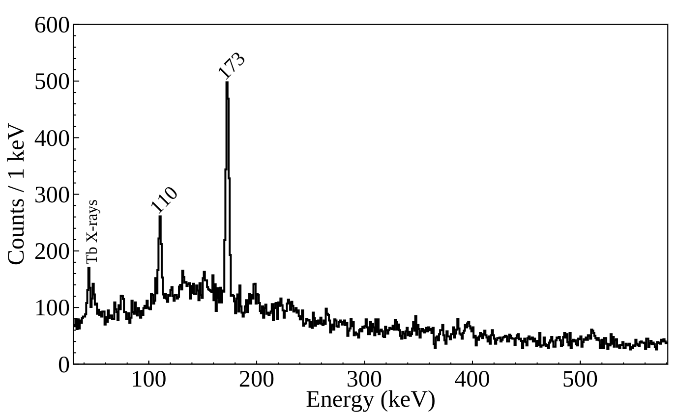
¹⁶⁴Tb DEGAS results
Two gamma rays observed in mutual coincidence
Intensity balance (without mixing) fixes multipolarity
and spin-parity assignments
Assignments should be consistent with the
reduced transition probability
Notes:
The new results of 157Sm are shown here. Here is the delayed gamma rays detected by our germanium array following the arrival of a 157Sm ion.
I want to draw your attention to the level of statistics obtained in particular the height of peaks from the decay of the isomer versus that of beam induced effect such as this peak resulting from the a reaction with the ge crystal.

Slide 18
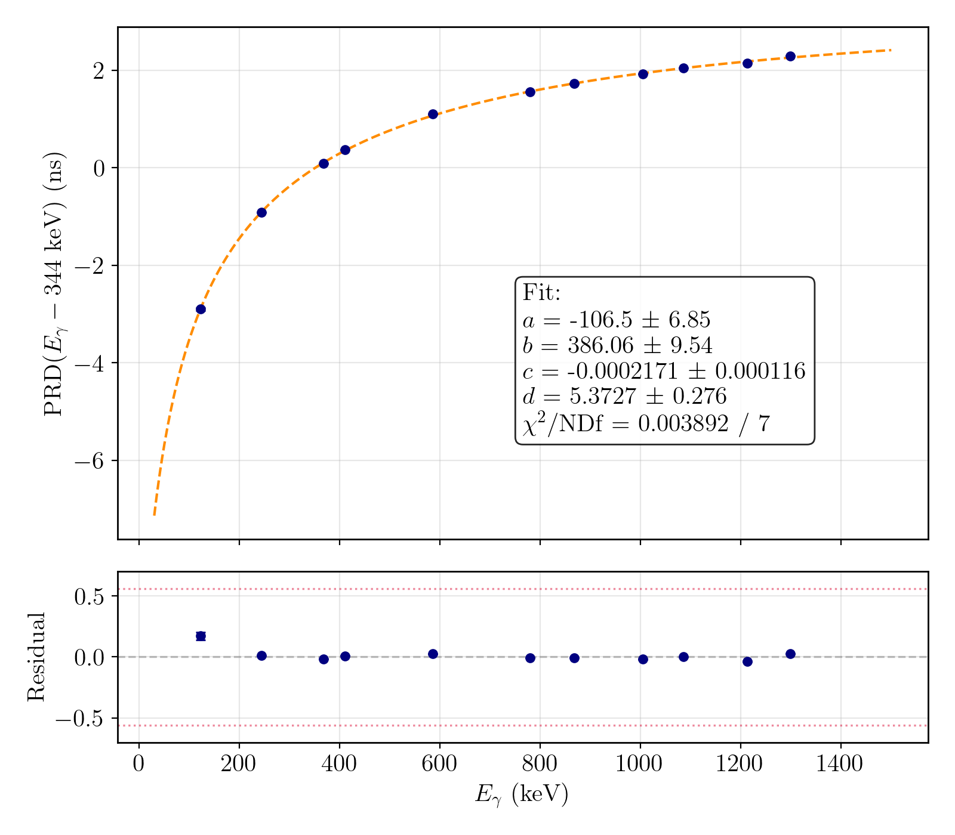
¹⁶⁴Tb FATIMA results
Ordering of gamma rays is fixed, 173 is the feeder.
Anti-delayed
Delayed
Notes:
The new results of 157Sm are shown here. Here is the delayed gamma rays detected by our germanium array following the arrival of a 157Sm ion.
I want to draw your attention to the level of statistics obtained in particular the height of peaks from the decay of the isomer versus that of beam induced effect such as this peak resulting from the a reaction with the ge crystal.

Slide 19
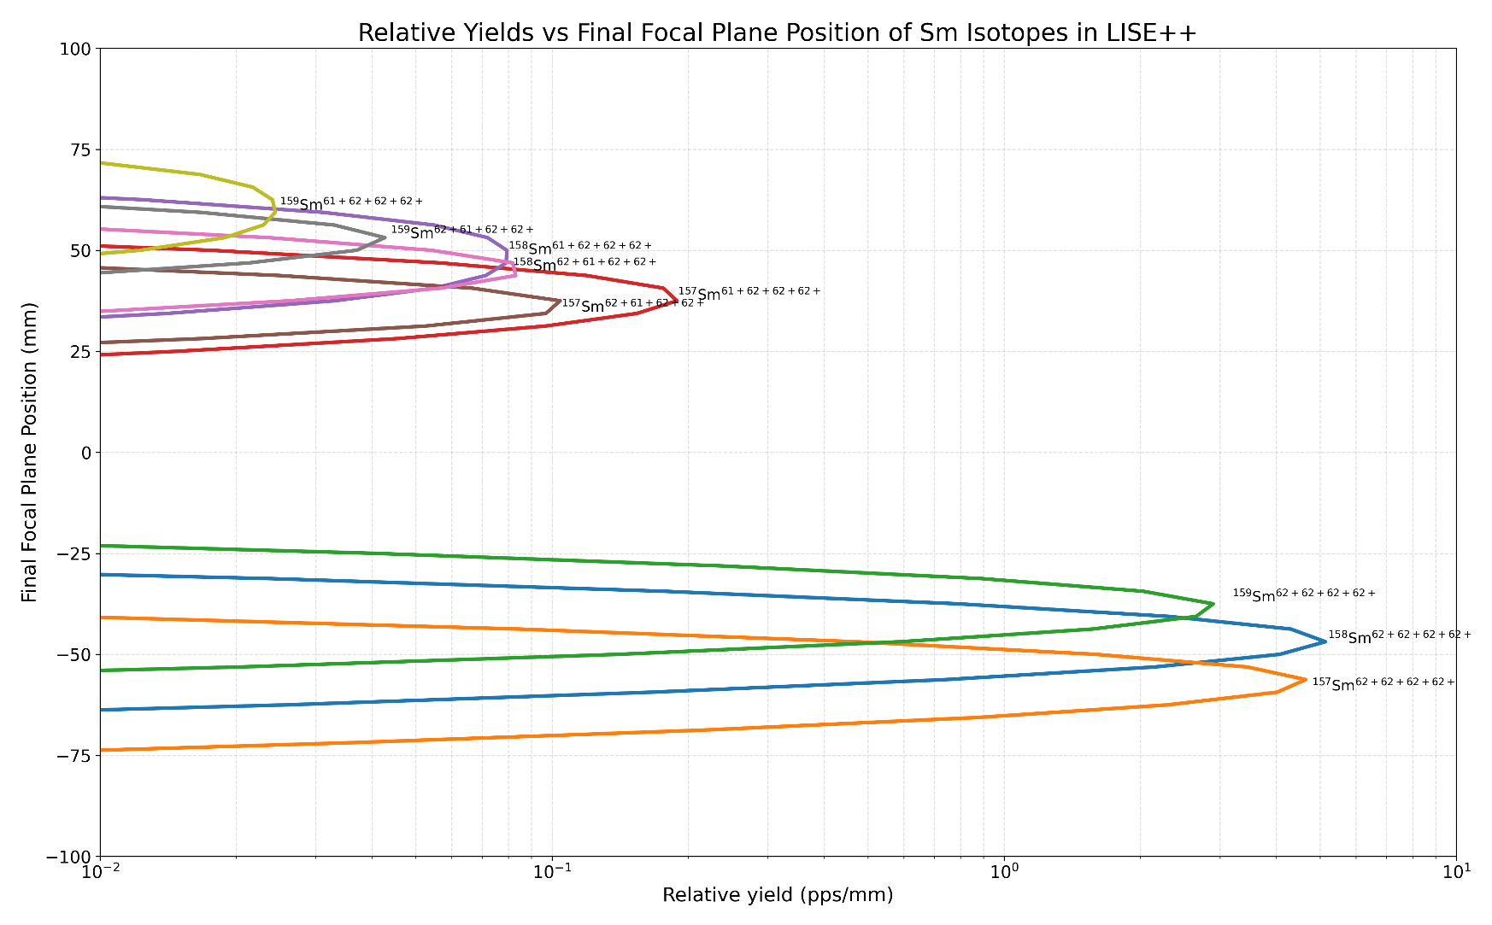
Back up: LISE++ simulations

Slide 20
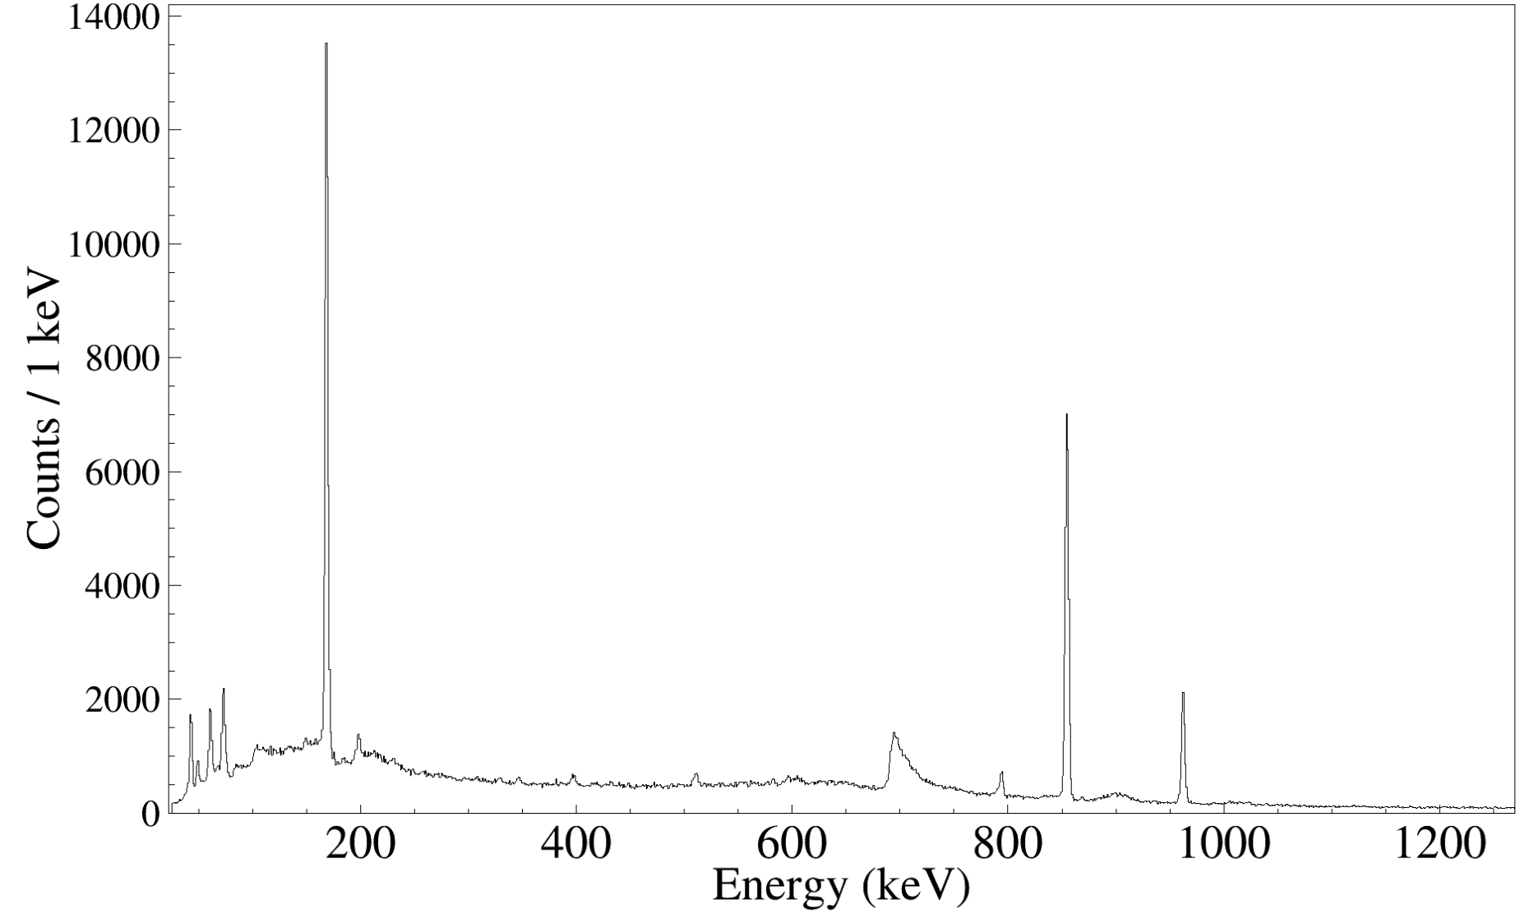
Back up: Isomeric ratio
¹⁶⁴Gd ions identified: 10 M
¹⁵⁷Sm ions identified: 3.95 M
Significantly less background
Preliminary lower bound isomeric ratio for
¹⁵⁷Sm ~ 1 %
¹⁶⁴Gd ~ 12 %

Slide 21
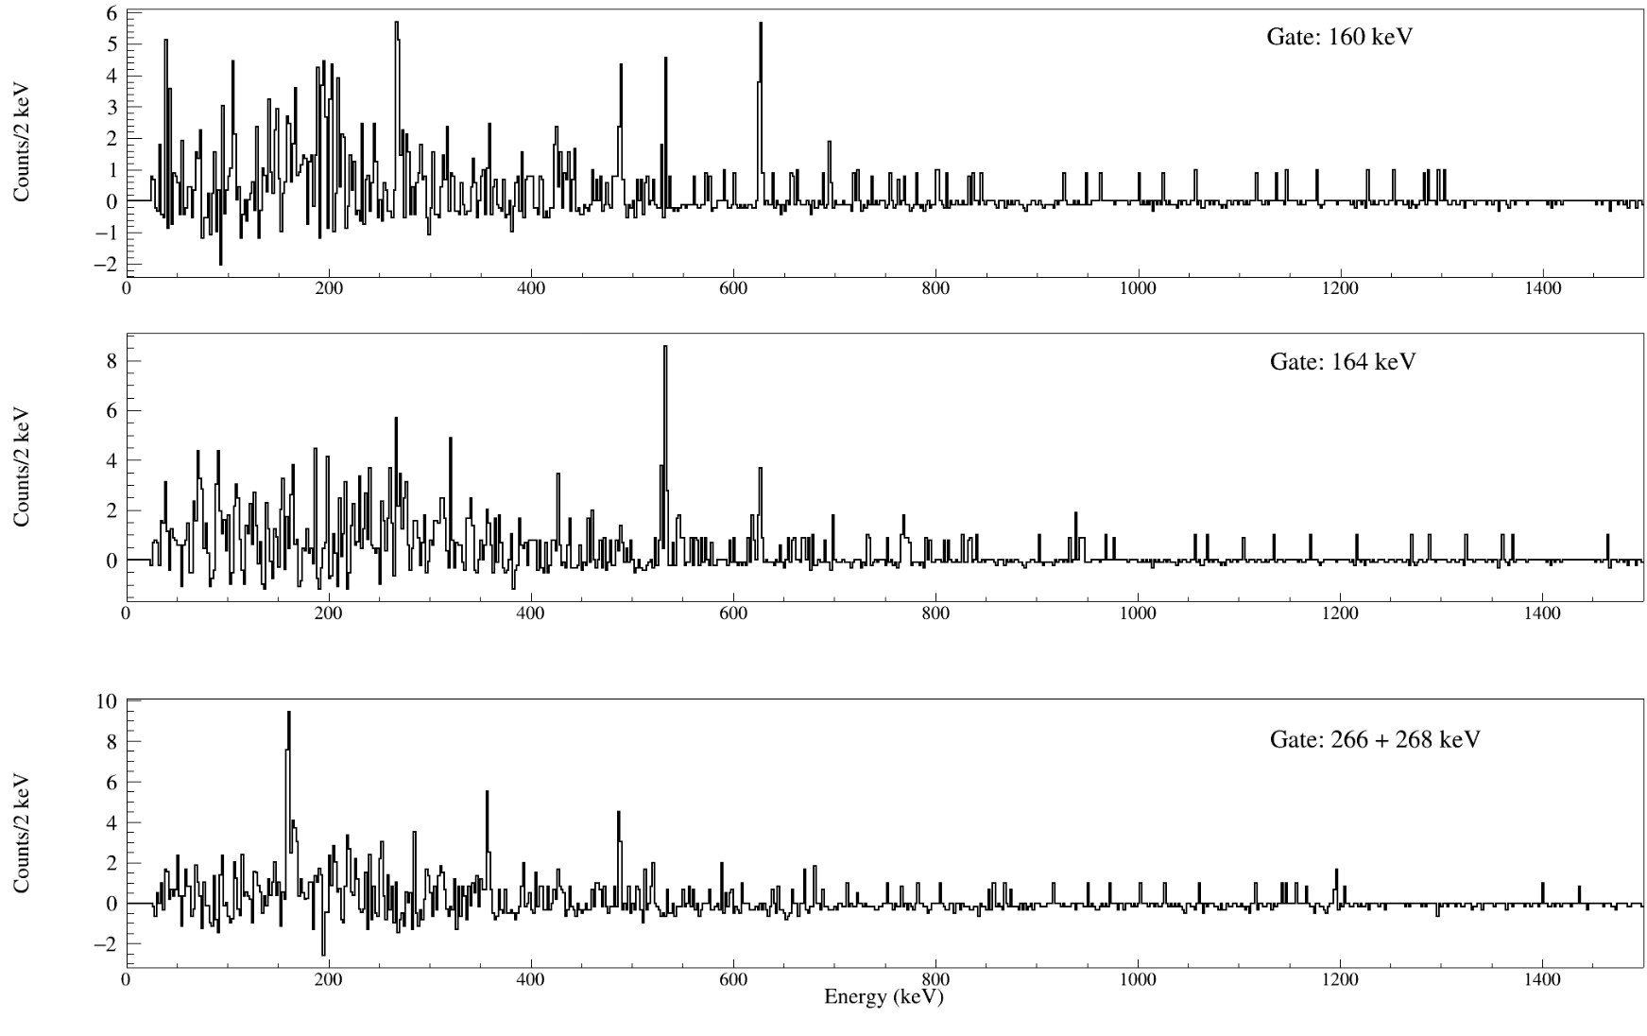
Back up: Coincidences

Slide 22
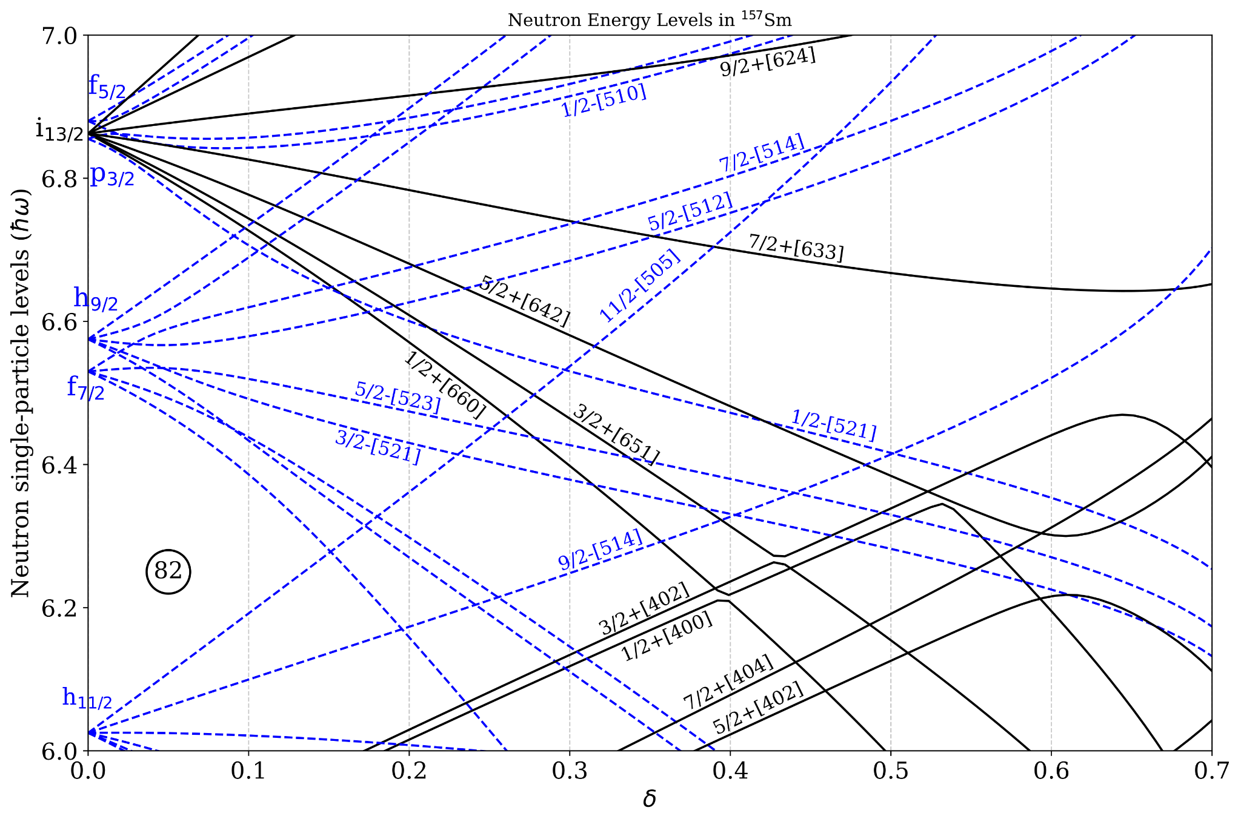
The flying fish orbital
Coined by J. F. Sharpey-Schafer et al. EPJ A 55: 15 (2019)
Nilsson diagram for ¹⁵⁷Sm
A deformation driving mechanism
A neutron in the spherical-driving 11/2⁻[505] extruder orbital, from below the N = 82 gap, drops into the deformation-driving i_{13/2} intruder orbital.
Effect ⇒ increased deformation in the core of the odd-N nucleus
Above mechanism first proposed by Kleinheinz et al. in ¹⁵¹Gd
PRL 32, 68 (1974)
Neutron single-particle level (E/ħω)
Notes:
The the neutron 11/2s was dubbed the flying fish as in the Nilsson picture it rushes up to the Fermi surface from below the N=82 shell gap, crossing the deformation driving i13/2 orbitals before diving back into the Fermi sea with increasing neutron number.
“We draw an analogy between the trajectory of the [505]11/2− neutron orbital, with respect to the Fermi surface, and that of a “flying fish”! The [505]11/2− orbital is chased to the surface by the increasing nuclear deformation as the neutron number is increased. It then flops back into the Fermi sea as orbitals get filled by further increases in the neutron number.”

Slide 23
Back up: Previous results
¹⁵⁷Pm 𝛽⁻ decay study with SATURN tape system. ¹⁵⁷Pm g.s. J^{π} = (3/2⁻) PRC 110, 044319 (2024)
²⁵²Cf spontaneous fission study with Gammasphere.
C. Zachary, Ph.D. thesis (2019)

Slide 24
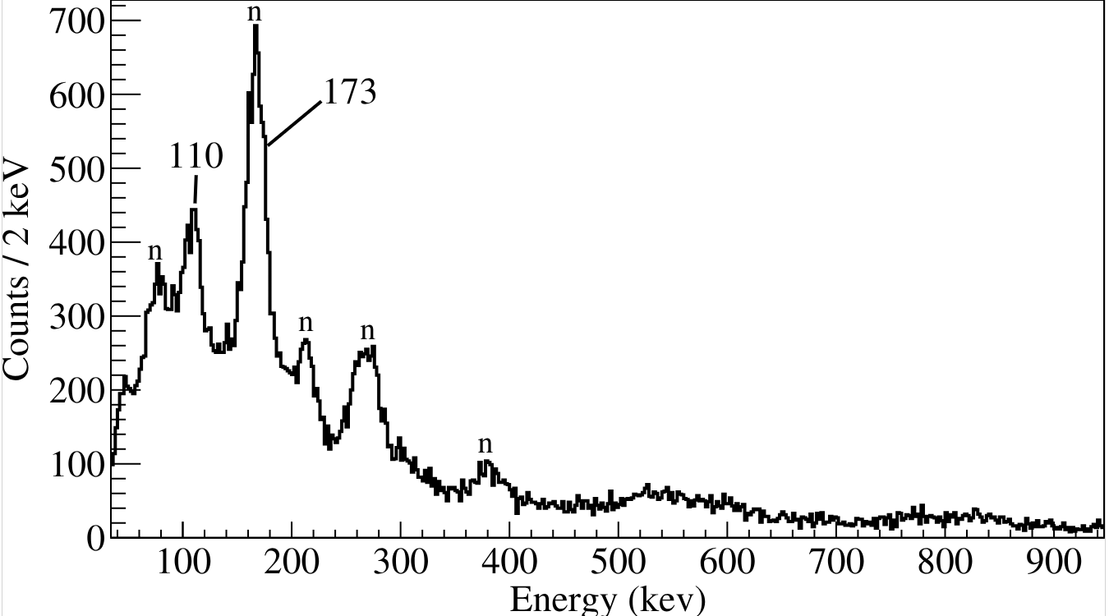
New K-isomer of ¹⁶⁴Tb
Delayed gammas!
HPGe Spectrum
LaBr Spectrum
Notes:
The new results of 157Sm are shown here. Here is the delayed gamma rays detected by our germanium array following the arrival of a 157Sm ion.
I want to draw your attention to the level of statistics obtained in particular the height of peaks from the decay of the isomer versus that of beam induced effect such as this peak resulting from the a reaction with the ge crystal.

Slide 25
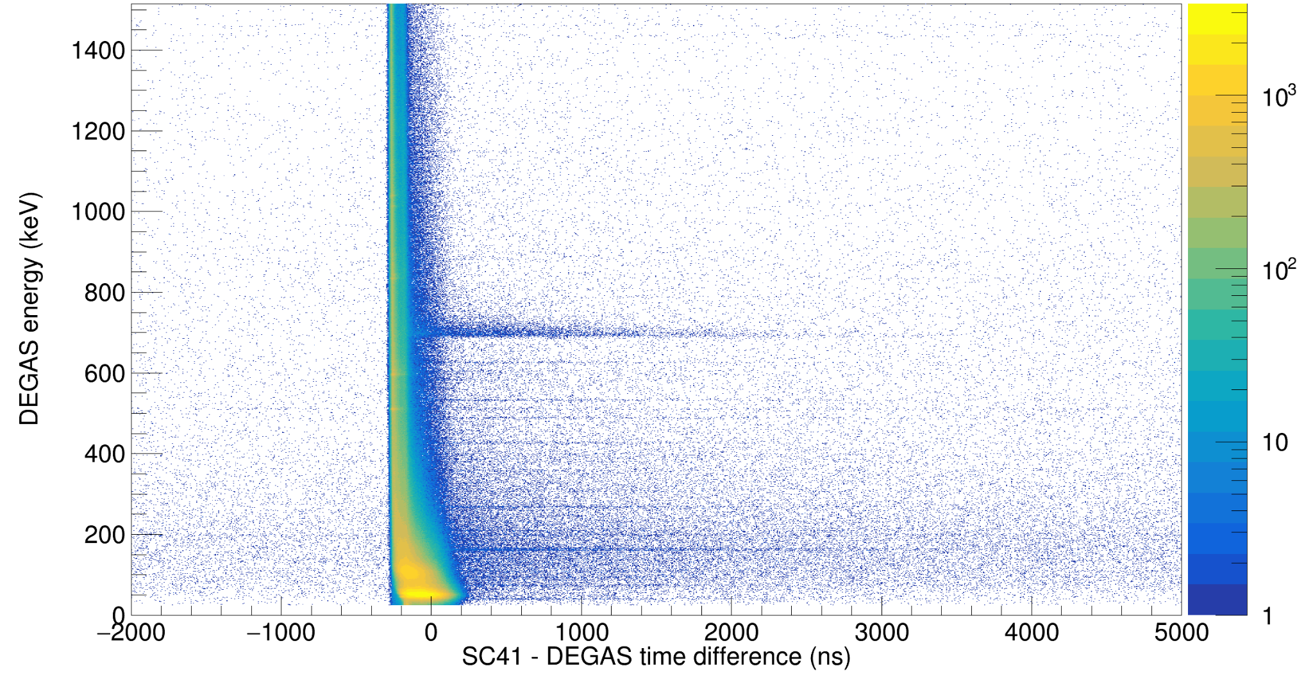
Back up: Waterfall plot

Slide 26
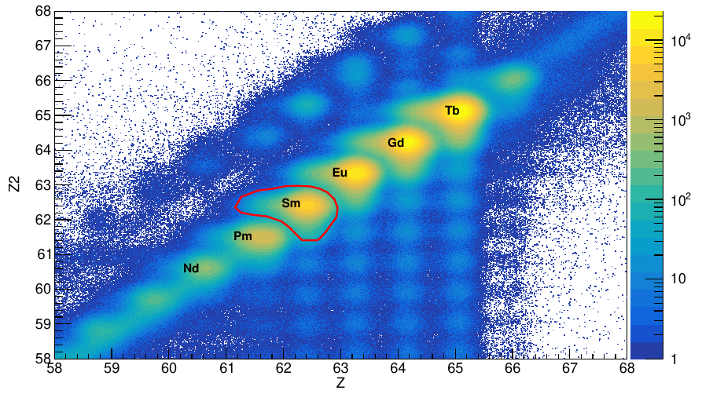
Back up: Z vs. Z2 selection

Slide 27
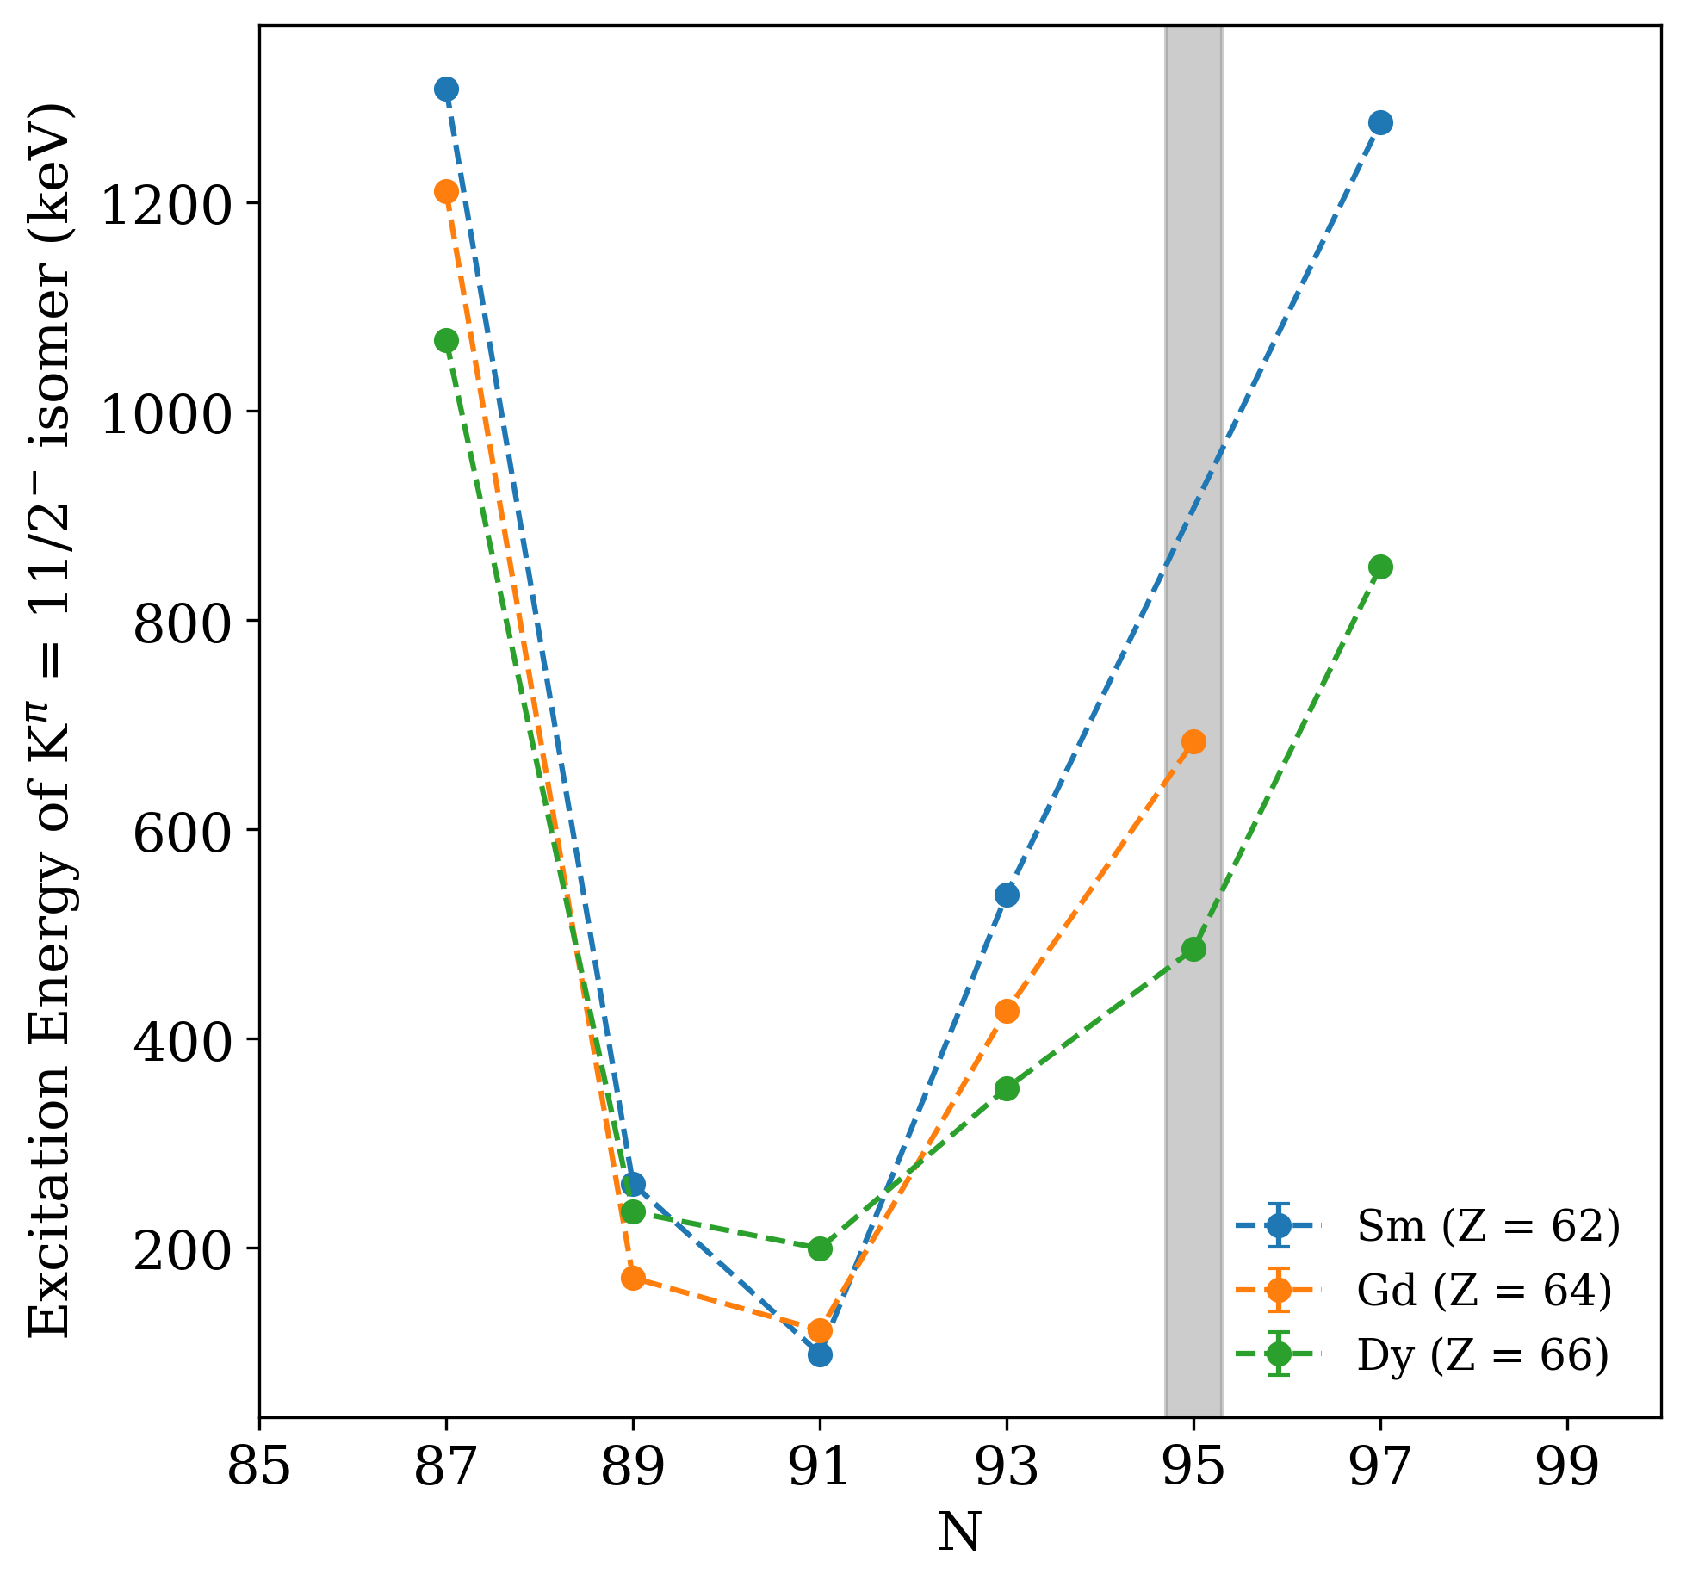
K^{𝜋} = 11/2⁻ isomer
?
K^{𝜋} = 11/2⁻ isomer in odd-even Sm isotopes
¹⁵⁷Sm:
No K^{𝜋} = 11/2⁻ isomer observed,
despite recent spectroscopy.
¹⁵⁹Sm:
K-isomer observed
in two separate studies with
conflicting assignments.
D.J. Hartley et al., PRC 110, 044319 (2024)
C. Zachary, Ph.D. thesis (2019)
K^{𝜋} = (11/2⁻)
Urban et al., PRC 80, 037301 (2009)
K^{𝜋} = (15/2⁺)
Patel et al., PRC 96, 034305 (2017)
Notes:
Situate you in the nuclear chart
Nuclear chart with the ratio of the 4/2+ energy in the even-even nuclei
We are interested in the rare earth region where some of the most prolate deformed nuclei occur across the entire nuclear chart
interested in is to study the ……
if we track on of the Nilsson single particle orbitals (spoiler: neutron 11/2) then we can see a dependence of the excitation energy on the neutron number as shown in the figure on the left. This dip as we move into the rare earths is understood as a shape transition that is also understood for the even-even nuclei.
This interplay can manifest in different ways, but for well deformed systems this is as a K-isomer. In the Samariums ….

Slide 28
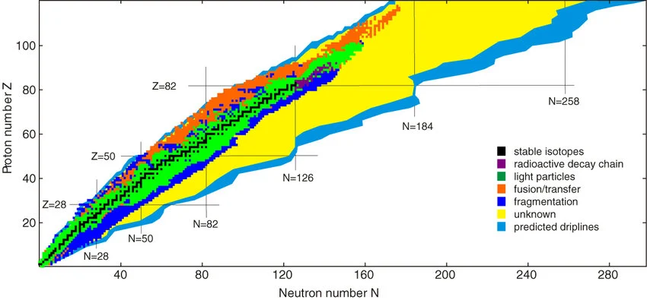
Novel fragmentation of ¹⁷⁰Er
M. Thoennessen, Rep. Prog. Phys. 76 056301 (2013)
Notes:
The the neutron 11/2s was dubbed the flying fish as in the Nilsson picture it rushes up to the Fermi surface from below the N=82 shell gap, crossing the deformation driving i13/2 orbitals before diving back into the Fermi sea with increasing neutron number.
“We draw an analogy between the trajectory of the [505]11/2− neutron orbital, with respect to the Fermi surface, and that of a “flying fish”! The [505]11/2− orbital is chased to the surface by the increasing nuclear deformation as the neutron number is increased. It then flops back into the Fermi sea as orbitals get filled by further increases in the neutron number.”

Slide 29
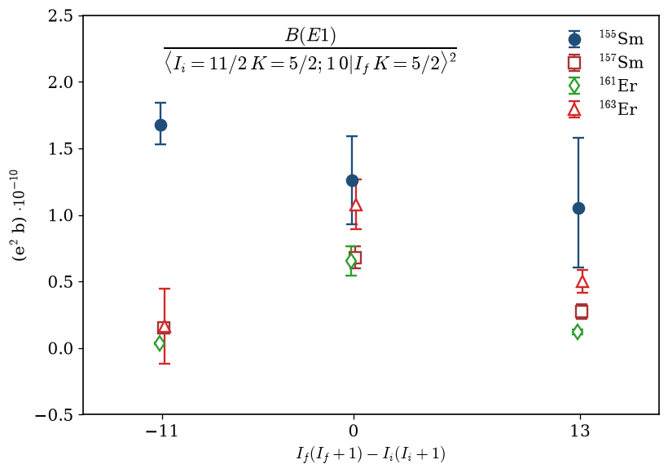
¹⁵⁷Sm: Evidence of Coriolis coupling

Slide 30
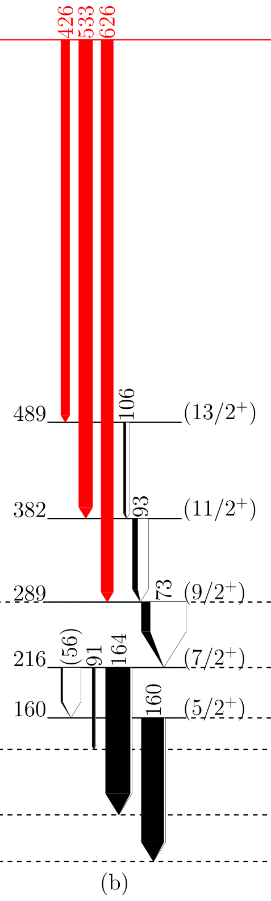
¹⁵⁷Sm: 2-band mixing model
Initial state:
Final state:
Suppose we can model the transition probabilities with 2 single-K matrix elements:
We can show a non-trivial solution exists without explicitly determining the mixing amplitudes
Calculations are being done to determine mixing amplitudes
Plan to submit these results to PLB or PRC

Slide 31
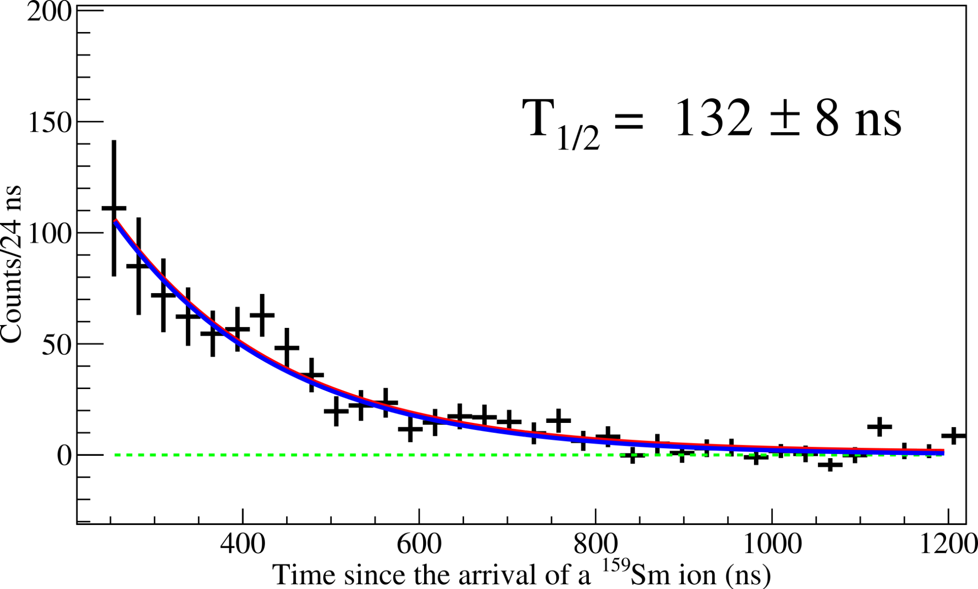
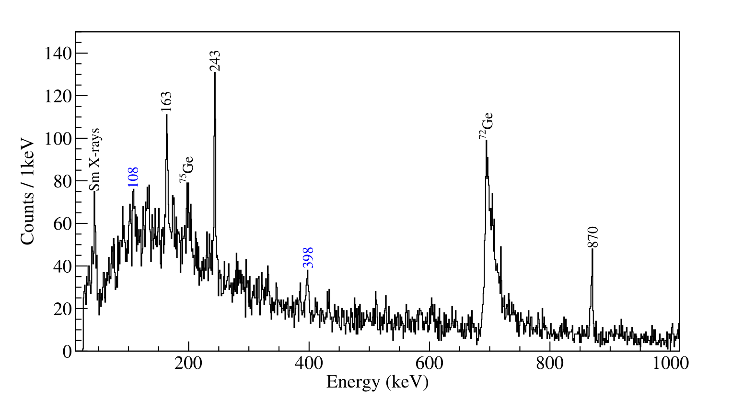
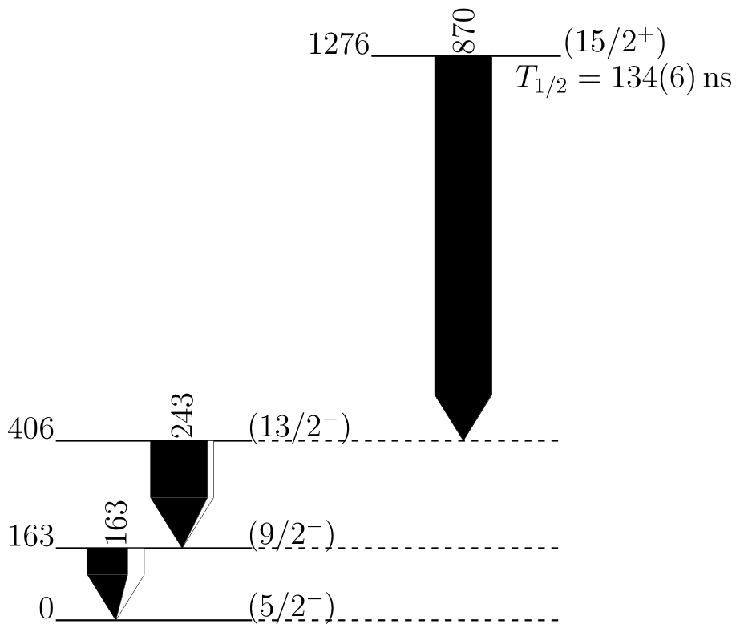
Revisiting ¹⁵⁹Sm
T_{1/2} = 132(8) ns
Can we resolve the nature of the isomer at 1276 keV?
 | T_{1/2} (ns) | Assignment
Urban et al. | 115 (10) | (11/2⁻)
Patel et al. | 50 (17) | (15/2⁺)
This work | 132 (8) | ?

Slide 32
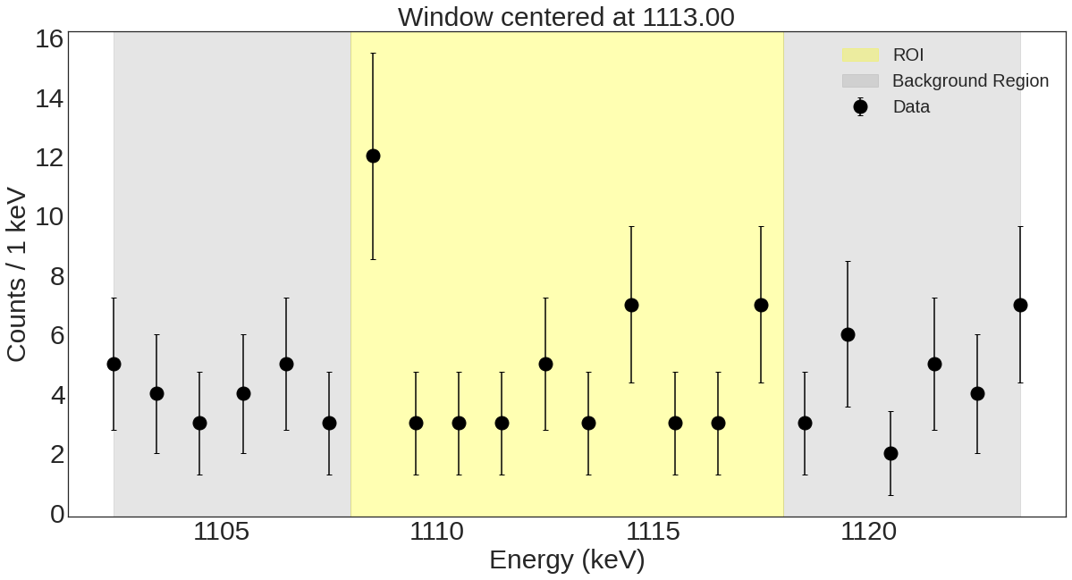
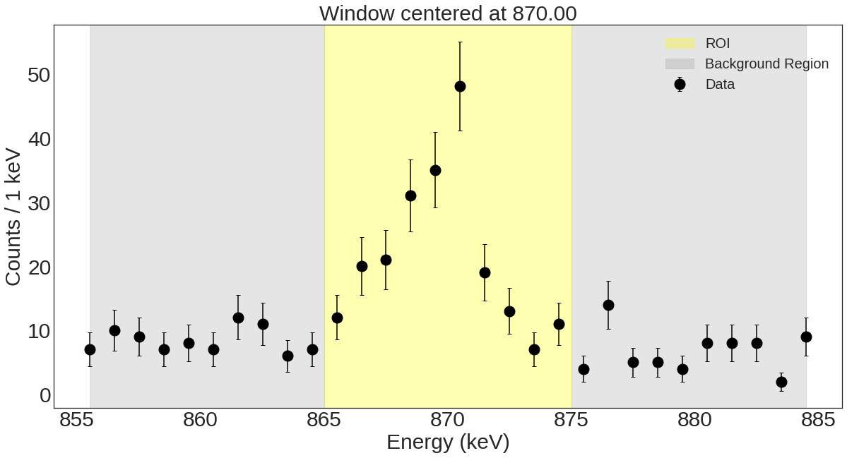
Revisiting ¹⁵⁹Sm
Spectrum analysis to determine peak significance and set an upper bound on the intensity and branching ratio with a given statistical significance (3σ).
G. Gilmore, Practical Gamma Spectroscopy (2008) pp. 114-118
(1113)
T_{1/2} = 132(8) ns
(11/2⁻) case
Energy (keV) | EL; ML | B(EL;ML)(W.u.)
870 | (M1) | < 1.99 x 10⁻⁷
(1113) | (E2) | < 9.66 x 10⁻⁶
(15/2⁺) case
𝜈 5/2⁻ [523] ⊗ 𝜋 5/2⁻ [523] ⊗ 𝜋 5/2⁺[413]
Energy (keV) | EL; ML | B(EL;ML)(W.u.)
870 | (E1) | < 2.08 x 10⁻⁹
(1113) | (E3) | < 0.572

Slide 33





¹⁵⁸Sm with DNO-SM
Adapted from F. Nowacki NUSTAR Seminar
Private communication D.D. Dao, F. Nowacki

Slide 34


Back up: Previous calculations
Previous PSM calculations done for
odd-N ^{153,155,157}Sm isotopes [1].
Reasonable agreement in reproducing band head energies and band spectra observed in high-spin studies with GAMMASPHERE [2].
Predicted K = 11/2 band head starts
~ 0.5 MeV off from our measurement
[1] Pandit et al. Eur. Phys. J. Plus 135, 830 (2020)
[2] C. Zachary, Ph.D. thesis (2019)

Slide 35

Back up: Pair-hopping
Pair hopping model: F. Barranco, G. F. Bertsch, R. A. Broglia, and E. Vigezzi, Nucl. Phys. A 512, 253 (1990).
Urban et. al., PRC 102, 064321 (2020)

