Slide 1



Nuclear structure studies in
the Ca region with
collinear laser spectroscopy
The cases of Ar (Z=18) and V (Z=23)
Speaker: Angelos Karadimas
Supervisors: Agi Koszorus and Gerda Neyens
KU Leuven, Instituut voor Kern- en Stralingsfysica
Zakopane Conference on Nuclear Physics 2026

Slide 2
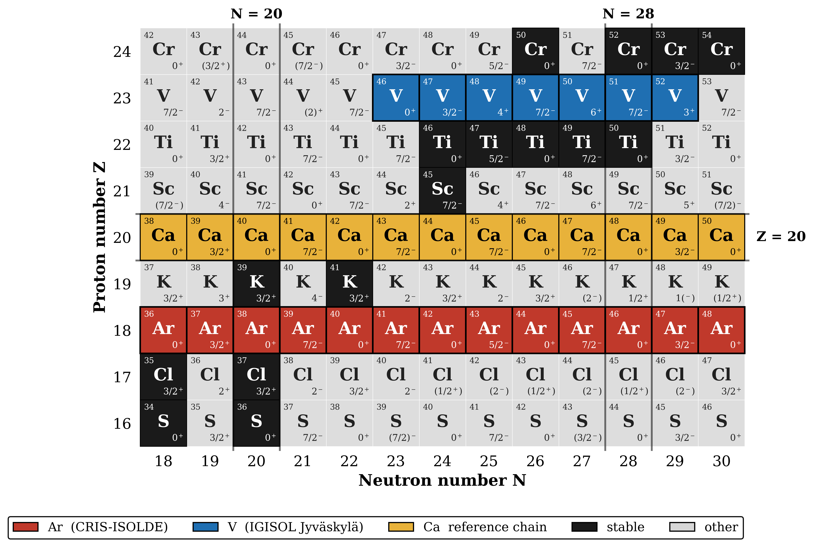
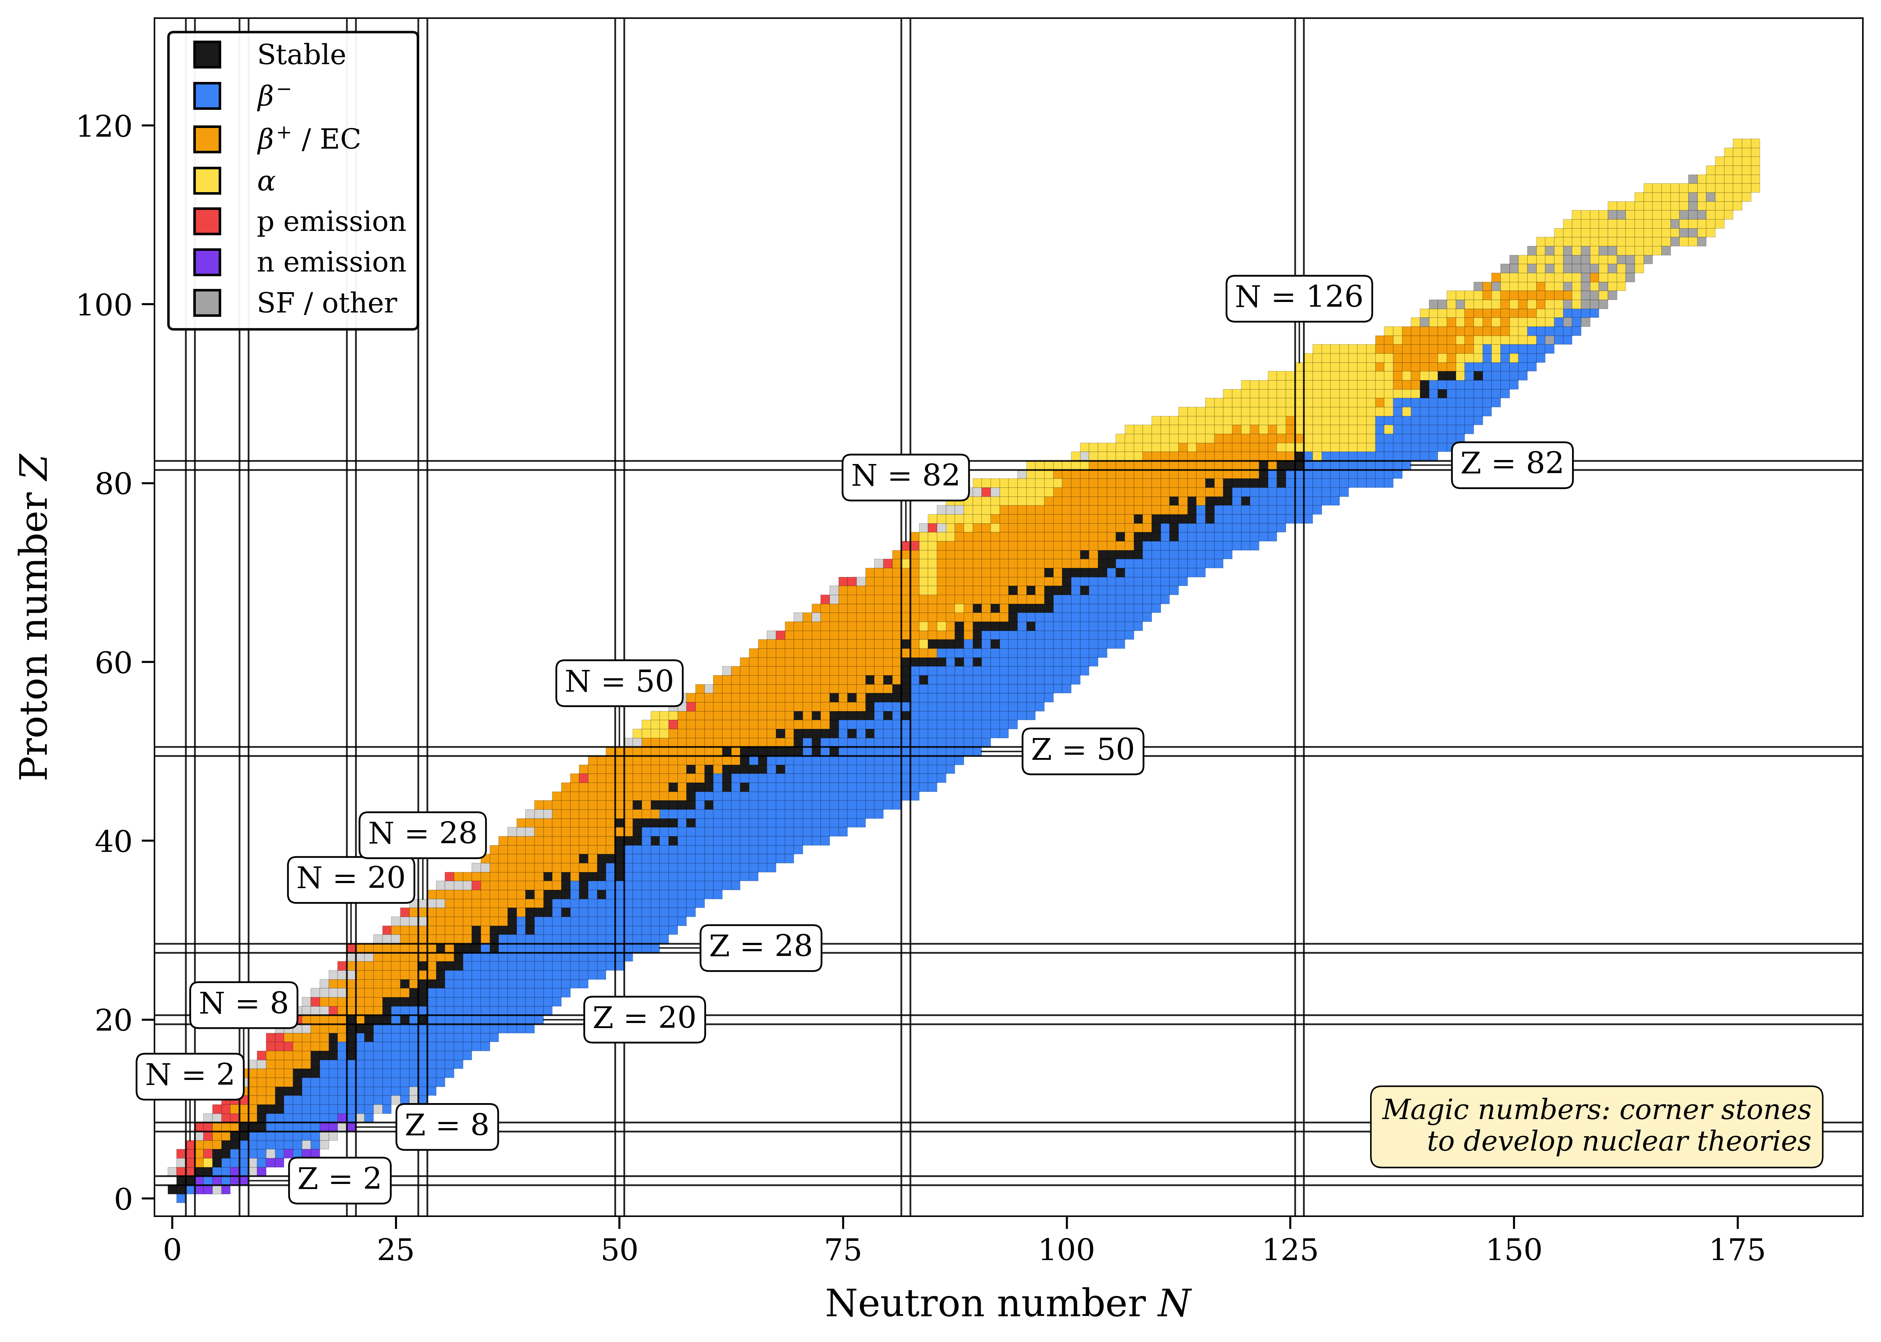
The Ca region — a laboratory for shell evolution
N = 28 shell closure on both sides of a doubly-magic core
▸ Ca (Z = 20) hosts two doubly-magic nuclei: ⁴⁰Ca (N = 20) and ⁴⁸Ca (N = 28)
▸ Rich testbed for shell-model, ab-initio and DFT benchmarked on the Ca chain (Garcia Ruiz 2016)
▸ Open question: how do proton-holes (Ar) and proton-particles (V) reshape the neutron shell structure?
▸ Signatures: magnetic moments μ → single-particle content; quadrupole Qₛ → deformation; δ⟨r²⟩ → charge distribution
▸ Complementary ISOLDE + IGISOL laser-spectroscopy programme covers both sides of Z = 20
Ar chain (this work, CRIS-ISOLDE) · V chain (IGISOL, in analysis)
Angelos Karadimas · KU Leuven — IKS · Zakopane Conference on Nuclear Physics 2026
2 / 12

Slide 3
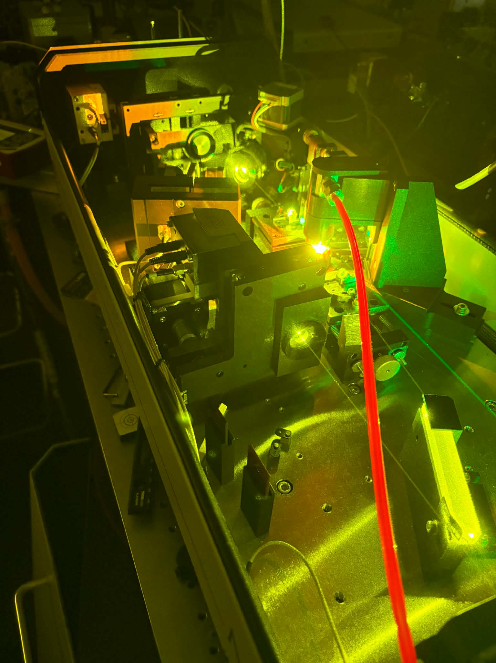
Collinear laser spectroscopy
The hyperfine fingerprint delivers μ, Qₛ and δ⟨r²⟩ model-independently
Two complementary techniques, one goal:
CRIS @ ISOLDE → Ar isotopes
▸ Production via protons on thich target.
▸ Step-wise resonance ionisation, ion detection.
▸ Near-background-free → reach the most exotic isotopes.
CRIS: Collinear Resonance Ionisation Spectroscopy
CLS @ IGISOL → V isotopes
▸ Production on thin target, recoil in gas cell→ ideal for refractory elements.
▸ Fluorescence detection.
▸ Photon background (depending on the ion beam isobaric purity).
CLS: Collinear Laser Spectroscopy
Angelos Karadimas · KU Leuven — IKS · Zakopane Conference on Nuclear Physics 2026
3 / 12

Slide 4
Part I
Argon
CRIS-ISOLDE campaign · ³⁹⁻⁴⁷Ar

Slide 5
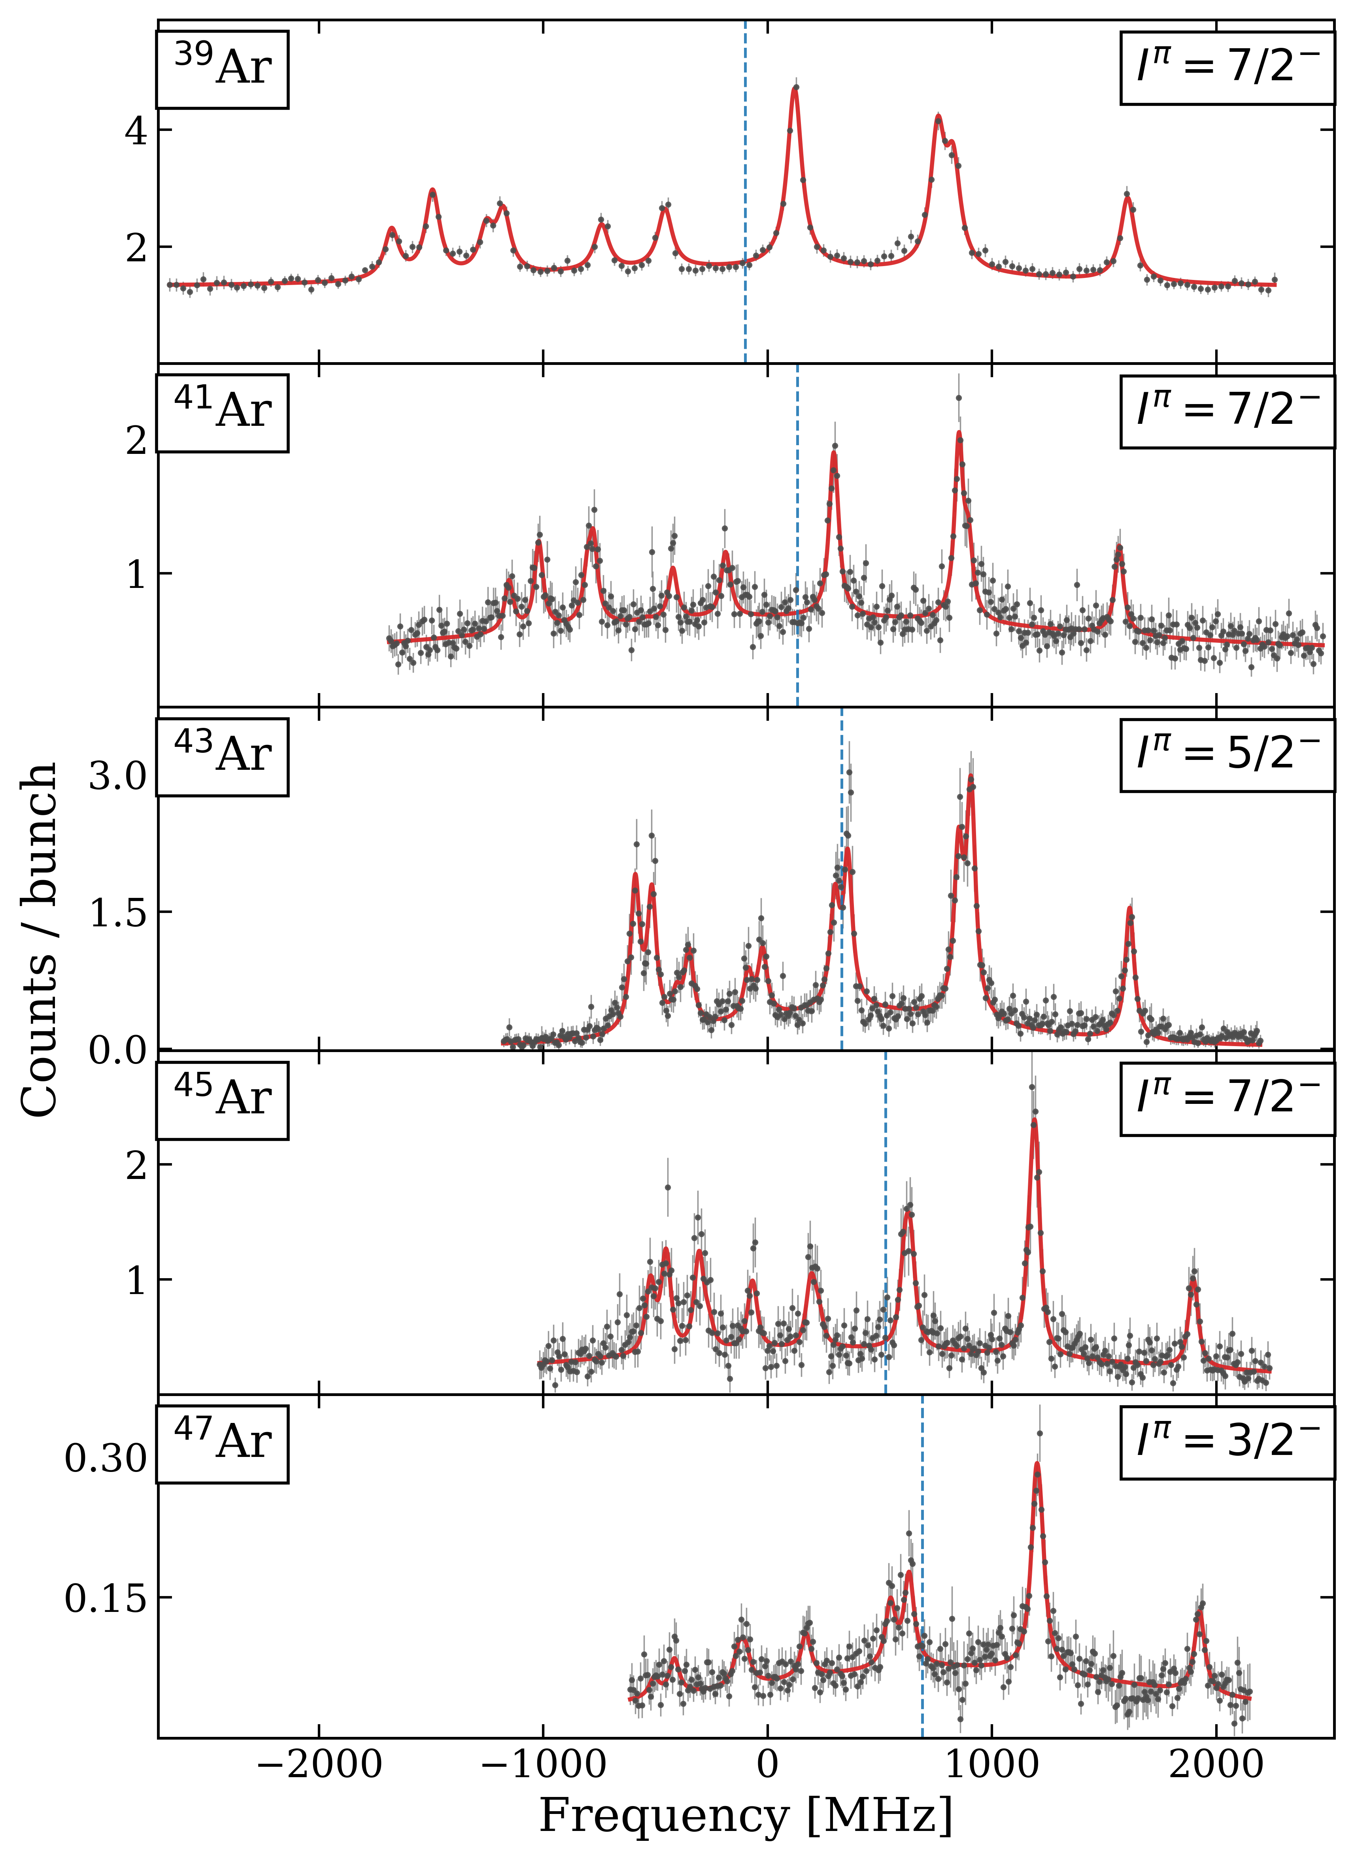
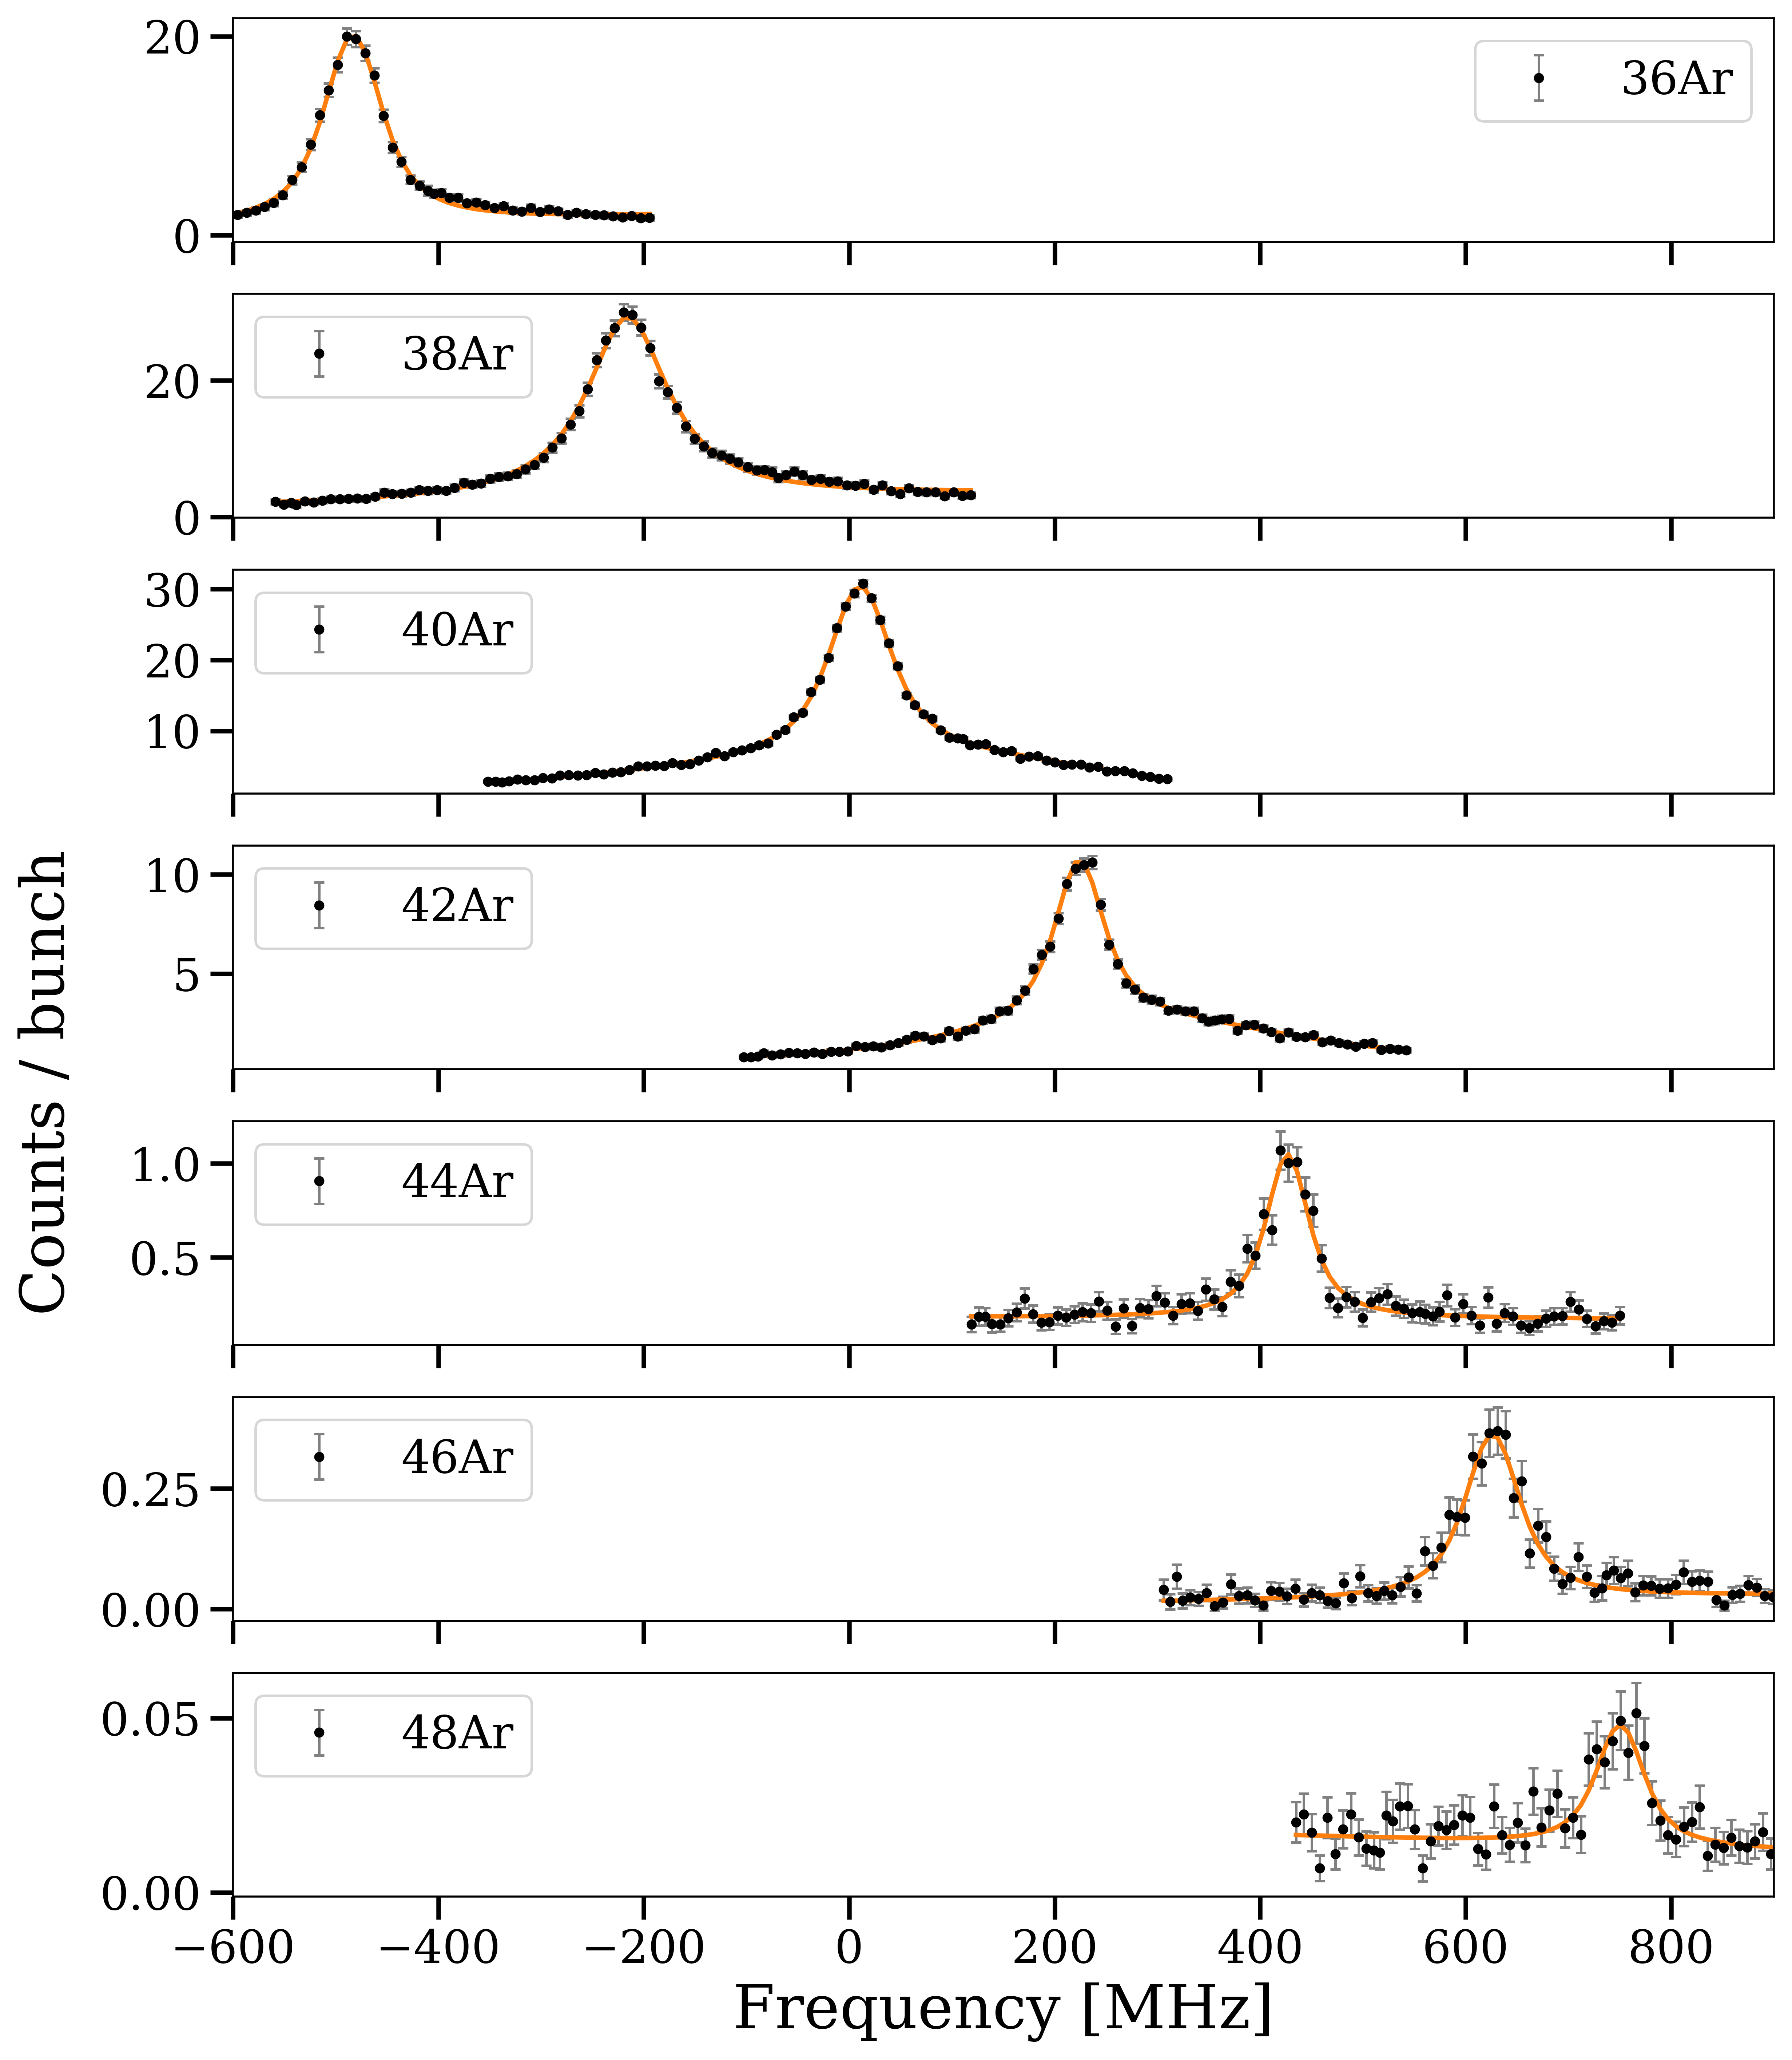
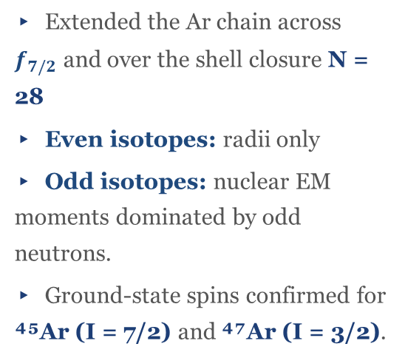
The Ar chain — CRIS campaign at ISOLDE
³⁹⁻⁴⁷Ar hyperfine spectra recorded in the 2025 CRIS run
▸ Extended the Ar chain across $f_{7/2}$ and over the shell closure N = 28
▸ Even isotopes: radii only
▸ Odd isotopes: nuclear EM moments dominated by odd neutrons.
▸ Ground-state spins confirmed for ⁴⁵Ar (I = 7/2) and ⁴⁷Ar (I = 3/2).
▸ In this talk we focus in EM moments.
Even- even Ar isotopes, no hyperfine structure because of I=0
Fitted hyperfine spectra of ³⁹⁻⁴⁷Ar (data · black; total fit · red)
Angelos Karadimas · KU Leuven — IKS · Zakopane Conference on Nuclear Physics 2026
4 / 12

Slide 6
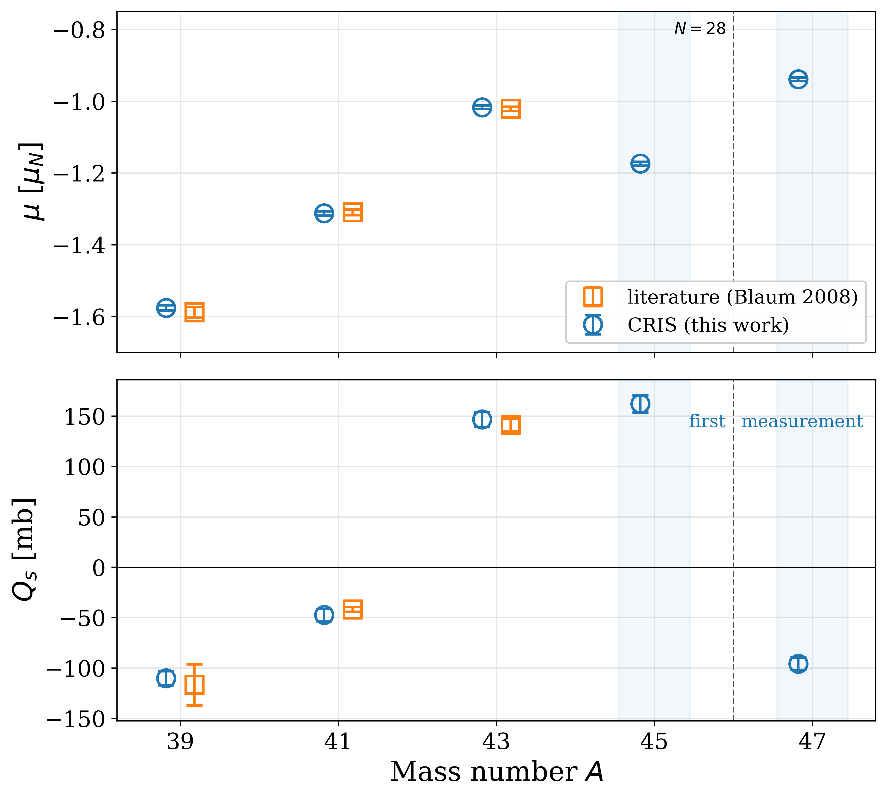
Moments — this work vs literature
CRIS matches the literature precision on ³⁹,⁴¹,⁴³Ar and delivers the first moments of ⁴⁵Ar and ⁴⁷Ar
▸ ³⁹,⁴¹,⁴³Ar: CRIS μ and Qₛ agree with the literature within 1σ.
▸ The two new measurements in the neutron rich isotopes reveal the increased sensitivity of the CRIS technique. ⁴⁷Ar production rate was less than 1000 ions per sec.
▸ What do we actually learn from these 2 new measurements one below and one over the shell closure?
CRIS (blue open circles) vs literature (orange open squares: Blaum 2008)
Angelos Karadimas · KU Leuven — IKS · Zakopane Conference on Nuclear Physics 2026
5 / 12

Slide 7
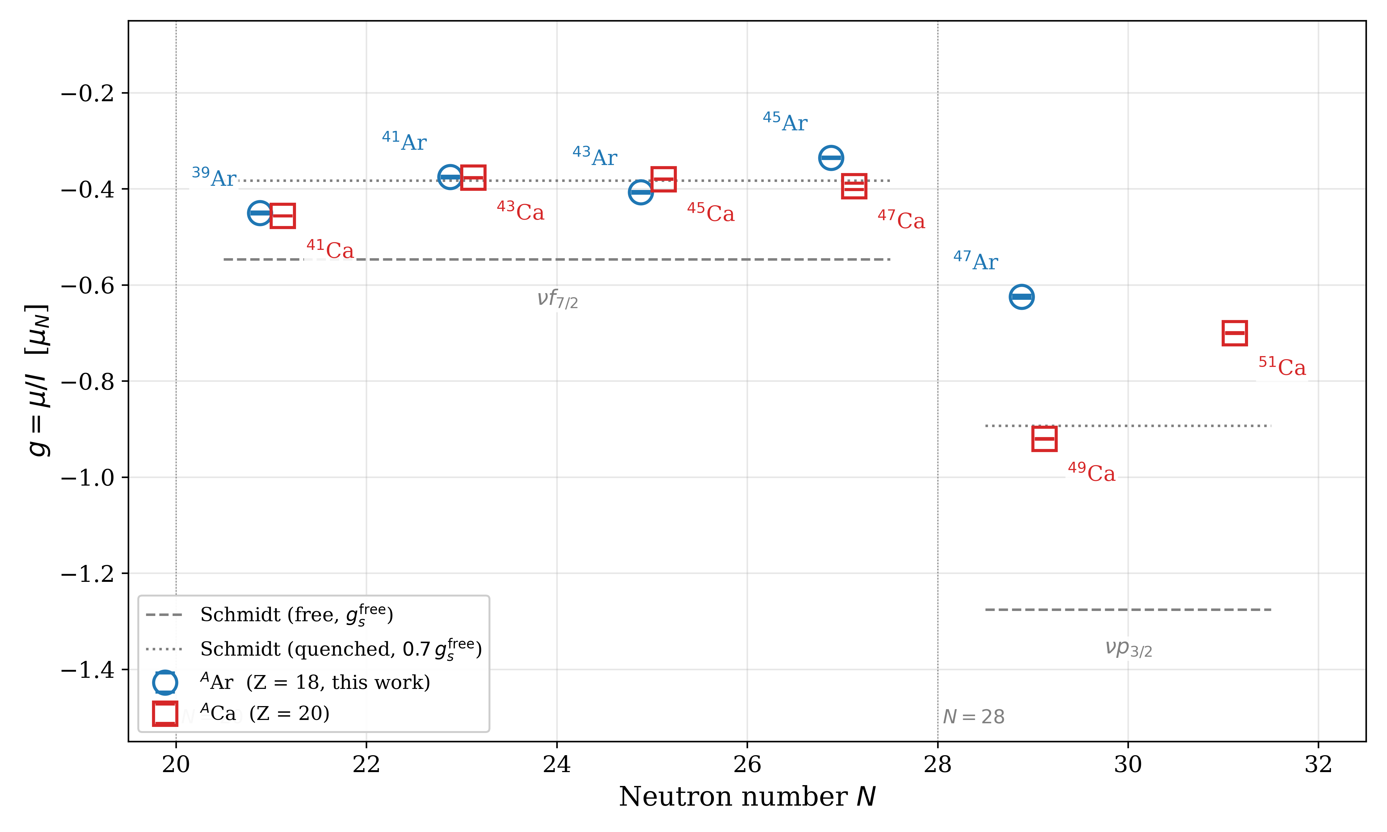
Magnetic dipole moments — g-factor systematics
μ probes the single-particle content of the neutron valence orbits
▸ Isotonic comparison with Ca isolates the effect of the 2 proton holes in the wavefunction.
▸ N = 21, 23: g(Ar) ≈ g(Ca) pure νf₇/₂ single-particle regime
▸ N = 25 (⁴³Ar): Iπ = 5/2⁻, not 7/2⁻ seniority-3 state, 3 unpaired neutrons in the f₇/₂.
▸ N = 27 (⁴⁵Ar): departure begins πd₃/₂-hole polarisation (tensor force weakens)
▸ N = 29 (⁴⁷Ar): largest deviation in the chain strong configuration mixing across N=28
g-factors for Ar (blue) compared with the Ca chain (red)
Angelos Karadimas · KU Leuven — IKS · Zakopane Conference on Nuclear Physics 2026
6 / 12

Slide 8
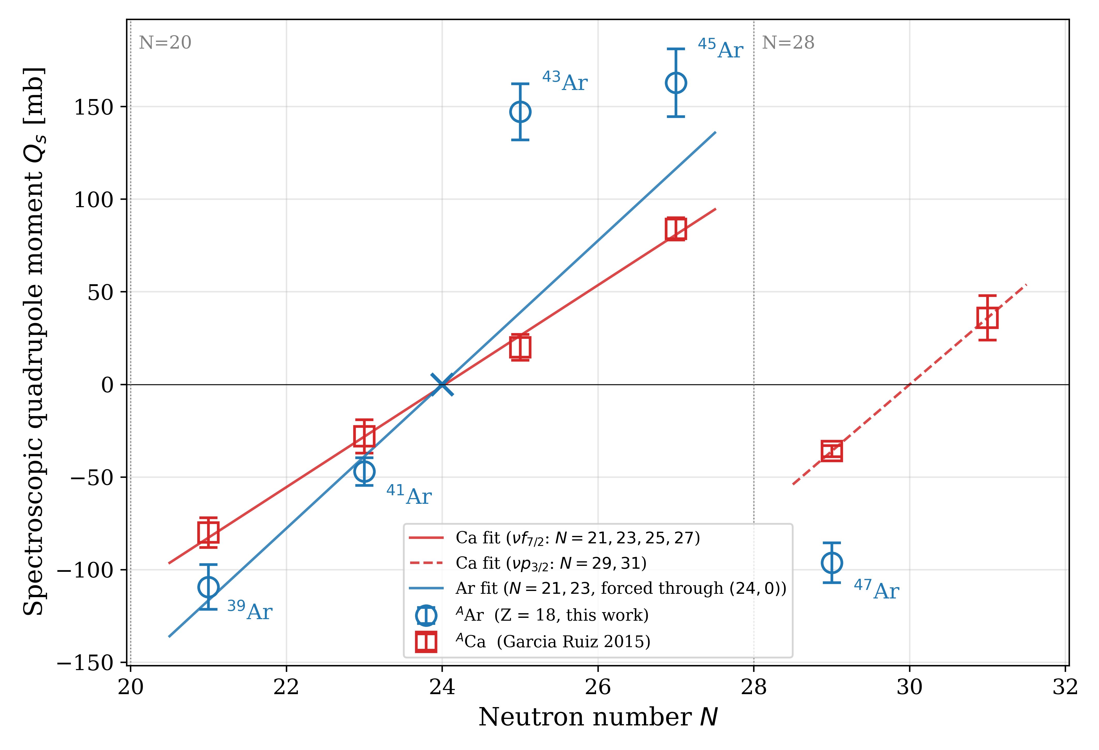
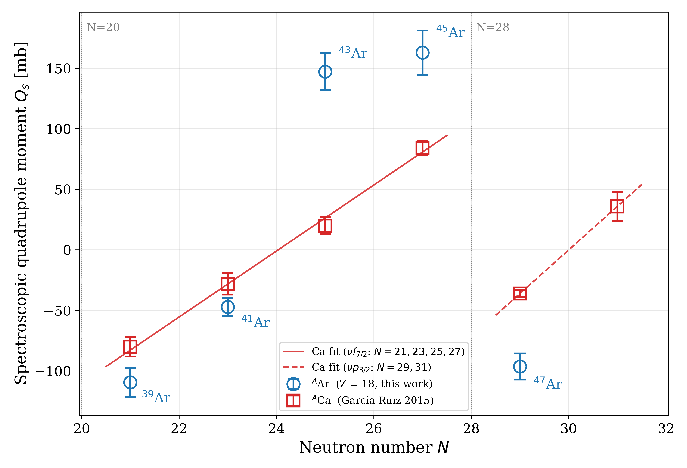
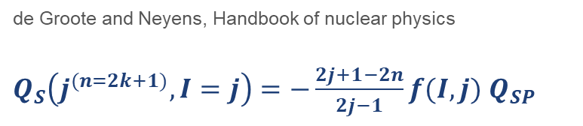
Spectroscopic quadrupole moments
Enhanced mid-shell deformation and the N = 28 sign flip
de Groote and Neyens, Handbook of nuclear physics
$Q_{S}\left(j^{(n=2k+1)},I=j\right)=−\frac{2j+1−2n}{2j−1}f(I,j)$ $Q_{SP}$
▸ Ar slope ≈ 1.4 × Ca slope (≈39 vs ≈27 mb/N, anchored at (24, 0)) → effective neutron charge grows from eₙᵉᶠᶠ ≈ 0.5 e in Ca to ≈ 0.7 e in Ar.
▸ Larger slope = softer proton core: the 2πd₃/₂ in Ar sit at the proton Fermi surface, so every νf₇/₂ neutron induces a bigger core quadrupole than around the rigid Z = 20 core.
▸ Take-home: N = 28 is not rigid at Z = 18, the Ar Qₛ and g factors show that the shell closure starts to collapse.
Qₛ(Ar) [blue] vs Qₛ(Ca) [red, Garcia Ruiz 2015]; fits forced through (N=24, 0)
Angelos Karadimas · KU Leuven — IKS · Zakopane Conference on Nuclear Physics 2026
7 / 12
Notes:
▸ ⁴³Ar mid-shell: I = 5/2 (not 7/2) and collectivity rapidly increases as seniority changes.
▸ ⁴⁷Ar (N = 29) sits below its ⁴⁹Ca isotone → odd p₃/₂ neutron dressed by f₇/₂-hole admixtures
Start with the red line only and another one for the p3/2 orbital.
Then pop out the blue line.
I need to have the equation in there for the single particle quadrupole moment.
.

Slide 9
Part II
Vanadium
IGISOL campaign · ⁴⁶⁻⁵²V

Slide 10
Finding the best spectroscopy transition — offline survey
Stable ⁵¹V⁺ studied offline to pick the most efficient line before the online run
FIRST COLLINEAR LASER SPECTROSCOPY STUDY OF VANADIUM ION
▸ 11 candidate transitions from the 3d³4s → 3d³4p manifold surveyed on stable ⁵¹V⁺.
▸ Figure of merit: spectroscopic efficiency = photons detected per incident ion
▸ Best line selected was T11 and carried into the online run on the exotic isotopes
▸ Offline ⁵¹V A, B constants fix the calibration for the online extraction of μ.
Offline work published: Karadimas et al., Sci. Rep. 16, 13670 (2026)
Angelos Karadimas · KU Leuven — IKS · Zakopane Conference on Nuclear Physics 2026
8 / 12
Notes:
Highlight T11

Slide 11
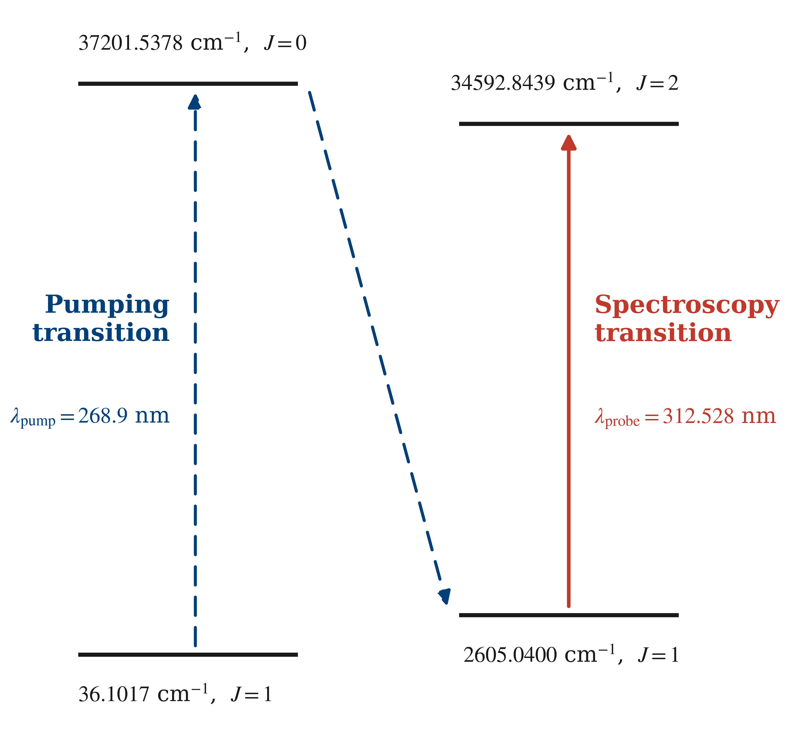
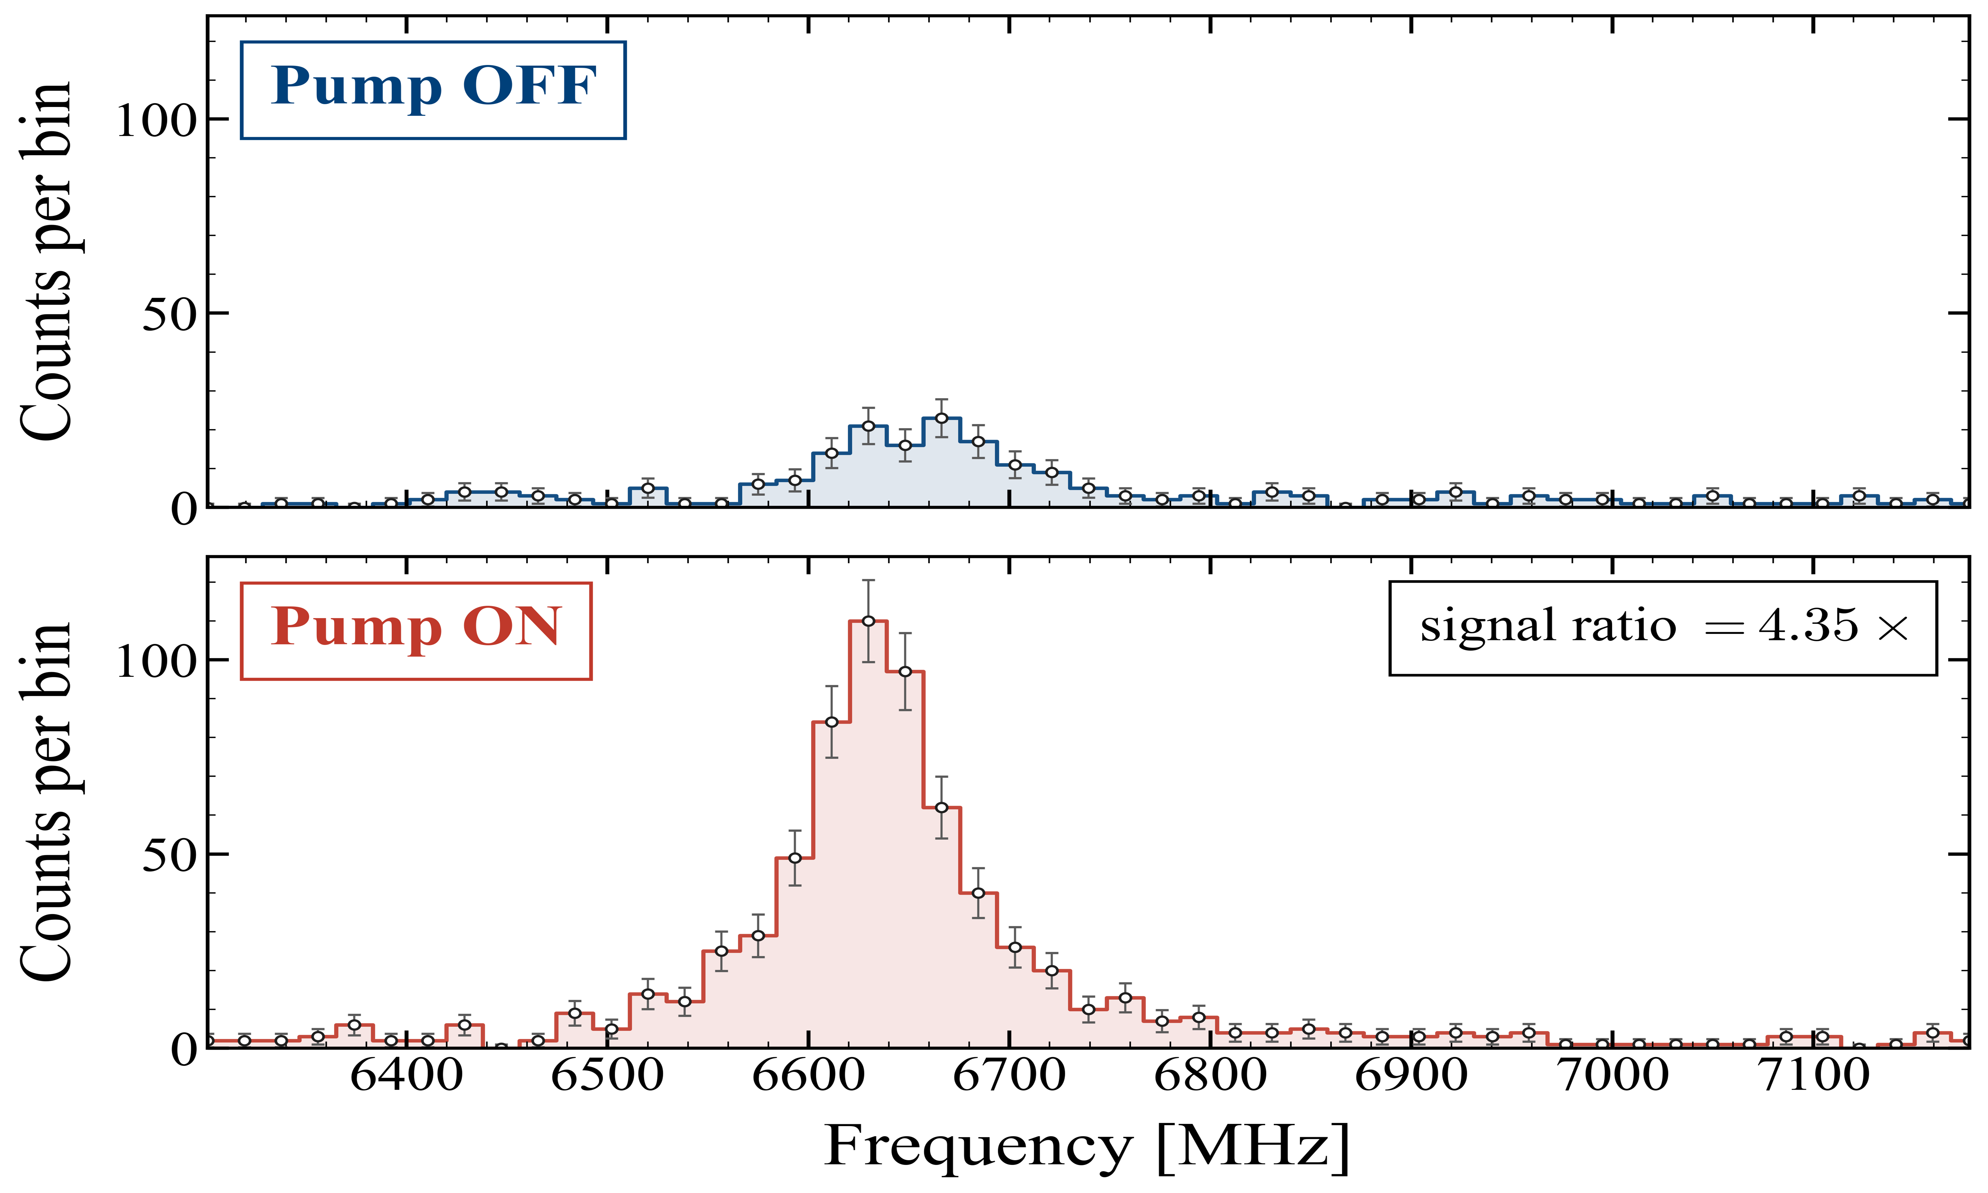
Boosting sensitivity with optical pumping
Populating a metastable level enhances the spectroscopy signal
Signal on the ⁵¹V line without / with the pump laser → ≈ 4× gain
▸ Pump laser at 268.9 nm transfers ions to a long-lived metastable state.
▸ Spectroscopy performed on the 312.5 nm probe transition.
▸ ≈ 4× signal enhancement — essential for the short-lived exotic isotopes.
V⁺ level scheme — pump → metastable, then probe on 312.5 nm
Angelos Karadimas · KU Leuven — IKS · Zakopane Conference on Nuclear Physics 2026
9 / 12

Slide 12
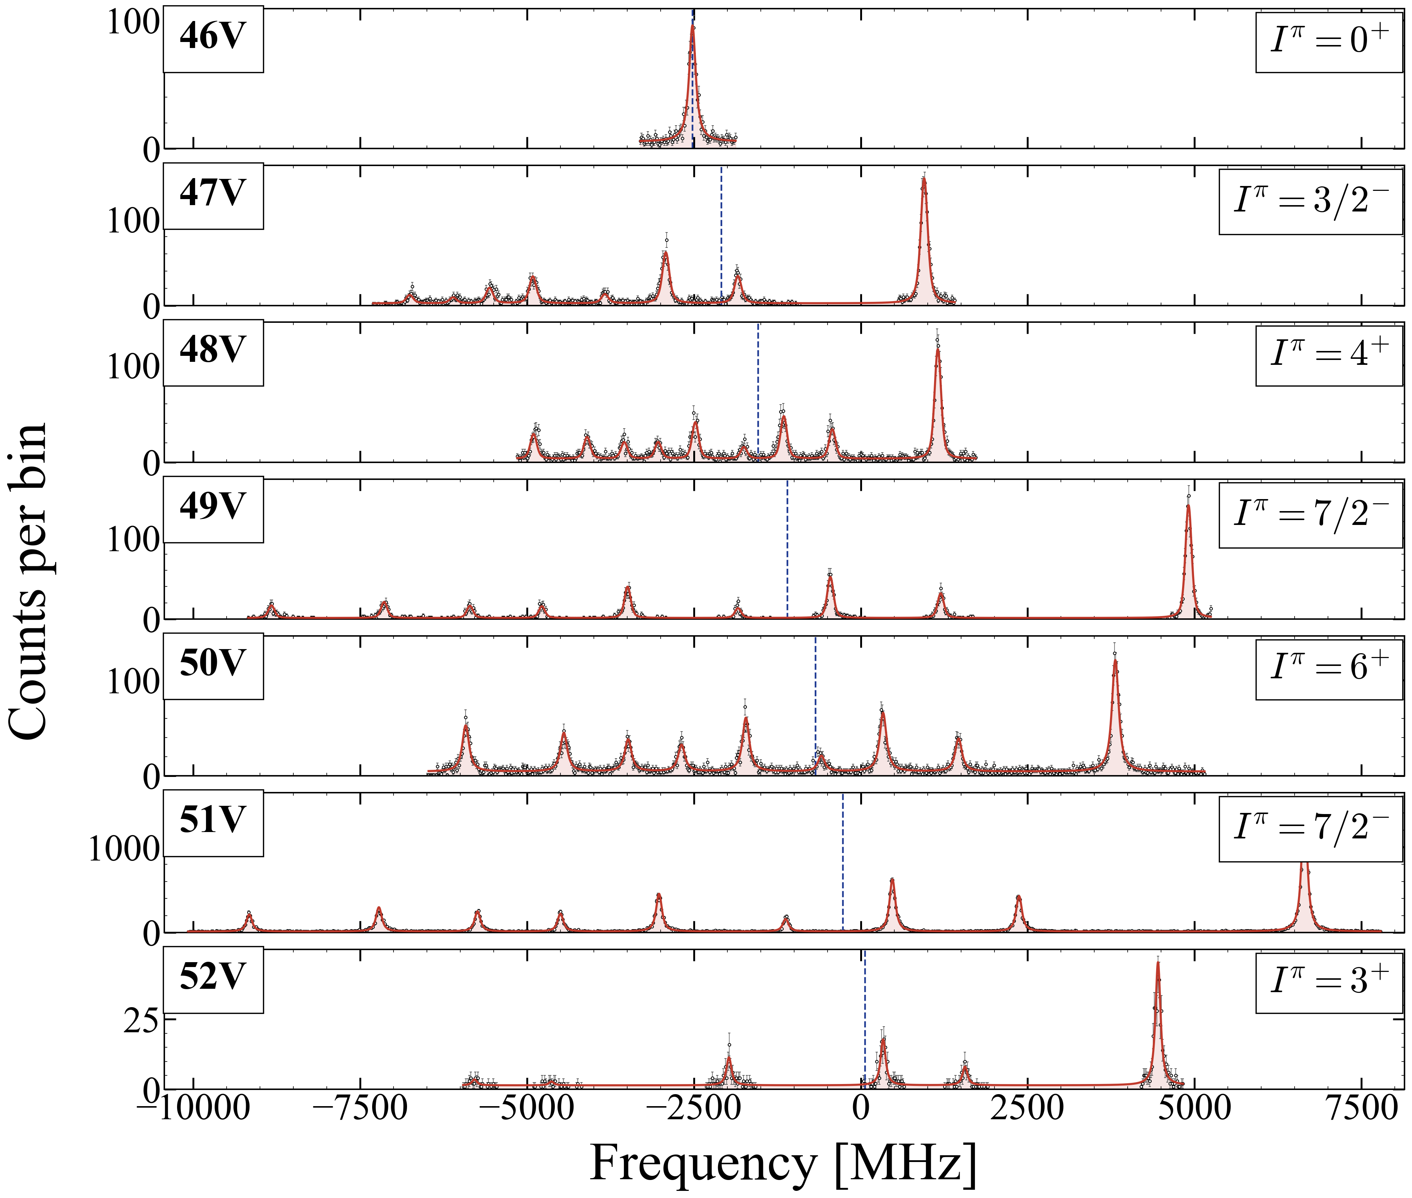
V isotope chain — all proposed isotopes measured
From N = Z to beyond N = 28
▸ All proposed isotopes successfully measured — ⁴⁶V to ⁵²V
▸ Coverage from N = Z (⁴⁶V, N = 23) across the f₇/₂ shell to beyond N = 28 (⁵²V, N = 29)
▸ Laser background only ∼400 photons/s on the PMT ⇒ sensitivity to very weak yield
▸ First direct spin assignment for ⁵²V: first measurement with collinear laser spectroscopy
Merged online scans of ⁴⁶⁻⁵²V⁺; dashed line = fitted centroid
Angelos Karadimas · KU Leuven — IKS · Zakopane Conference on Nuclear Physics 2026
10 / 12
Notes:
Add spins in the graph

Slide 13
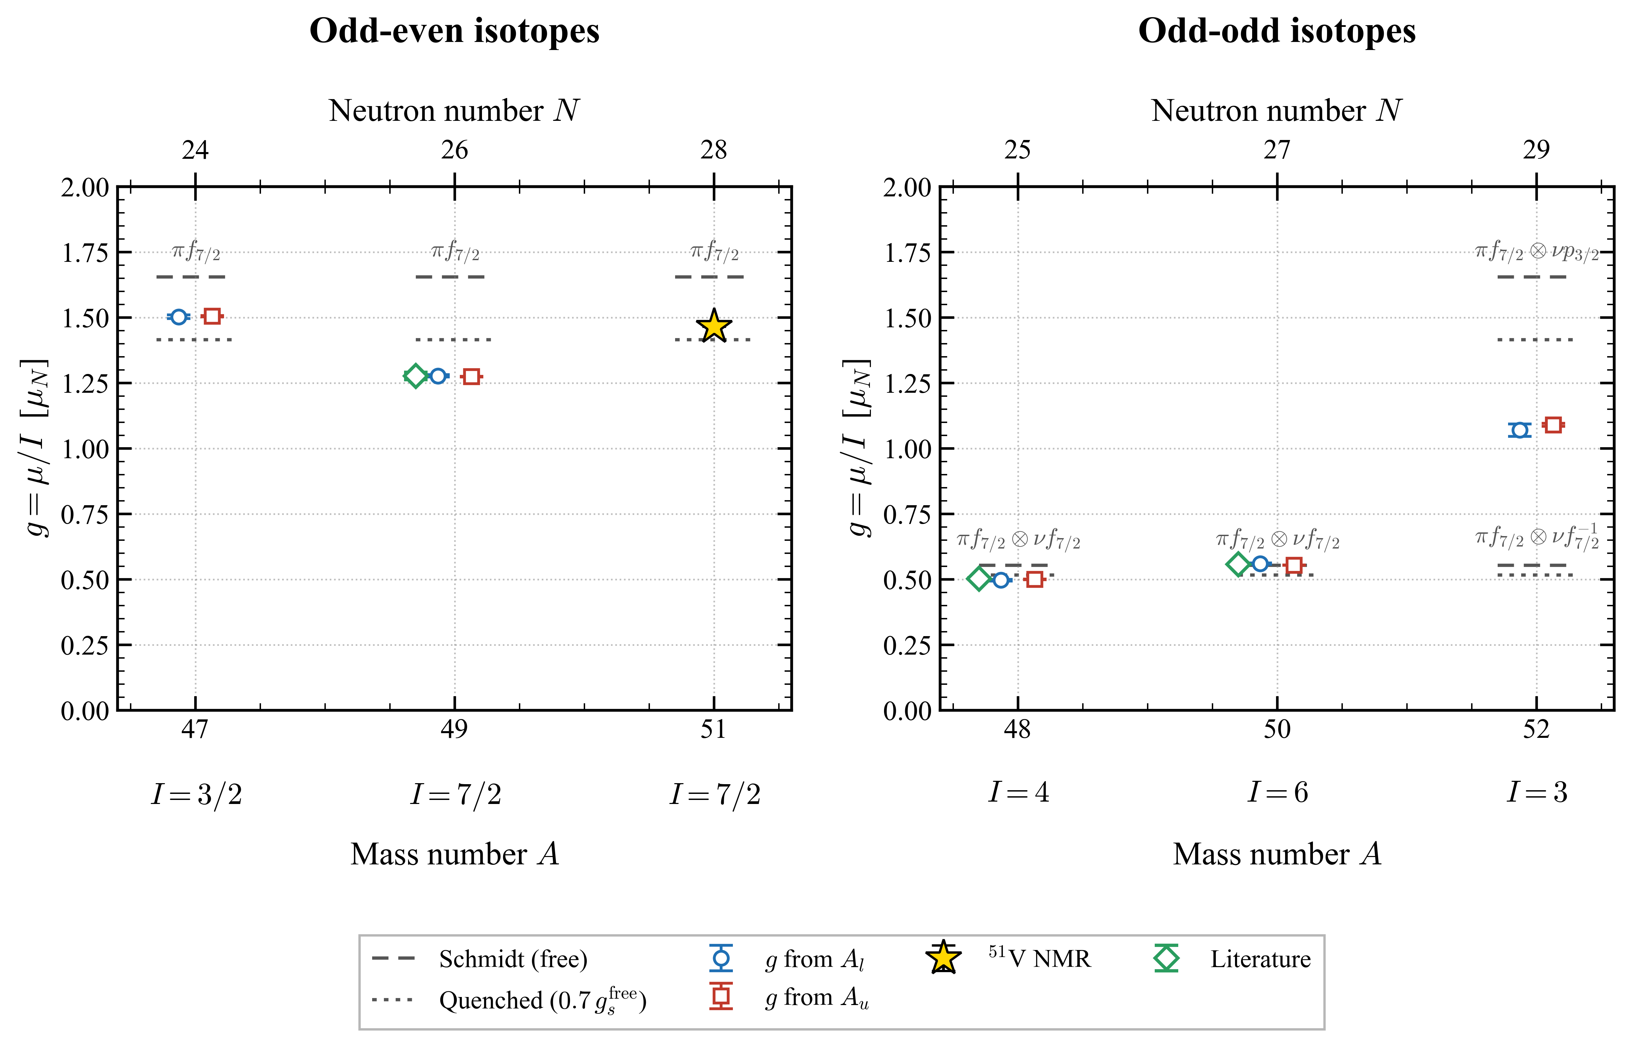
Preliminary magnetic dipole moments
First look at g = μ / I along the V chain
Odd - even
▸ ⁴⁷V (I=3/2, not 7/2) : higher-seniority ground state, same v=3-type mixing seen in ⁴³Ar proton-side analogue
▸ ⁴⁹V: proton g dips below quenched Schmidt hint of mild proton-side mixing approaching N=28.
Odd - odd
▸ ⁴⁸V, ⁵⁰V (πf7/2⊗νf7/2): g factors in agreement with additivity of πf7/2 and νf7/2.
▸ ⁵²V (I=3, πf7/2⊗νp3/2): neutron crosses into p3/2 at N=29 configuration mixing across N=28, same shell-crossing signature as ⁴⁷Ar, now seen from the proton-coupled side.
g-factors from Aₗ (blue) and Aᵤ (red); ⁵¹V NMR reference (gold star)
Angelos Karadimas · KU Leuven — IKS · Zakopane Conference on Nuclear Physics 2026
11 / 12
Notes:
Odd isotopes separately
Keep only the effective Schmidt value
Proton seniority 3 not neutron seniority 3 as Ar

Slide 14
Conclusions and Outlook
▸ Ar and V probe different aspects of nucleon nucleon interaction: Ar (even Z) is neutron-driven with the πd₃/₂ core only polarised; V (odd Z) is proton-driven, with the odd πf₇/₂ proton directly coupled to νf₇/₂ (N ≤ 28) or νp₃/₂ (N ≥ 29).
▸ Theory input still needed → full pf-shell shell model, ab initio, and density functional theory (DFT) to disentangle configuration mixing and constrain the effective interaction.
▸ Charge radii on the way → δ⟨r²⟩ from the same isotope-shift data will map the size evolution across N = 28 and towards N = Z for both chains.
▸ Going lighter, CLS below Ar → Cl, S, P, Si chains are largely unexplored by laser spectroscopy.
Angelos Karadimas · KU Leuven — IKS · Zakopane 2026
12 / 12

Slide 15
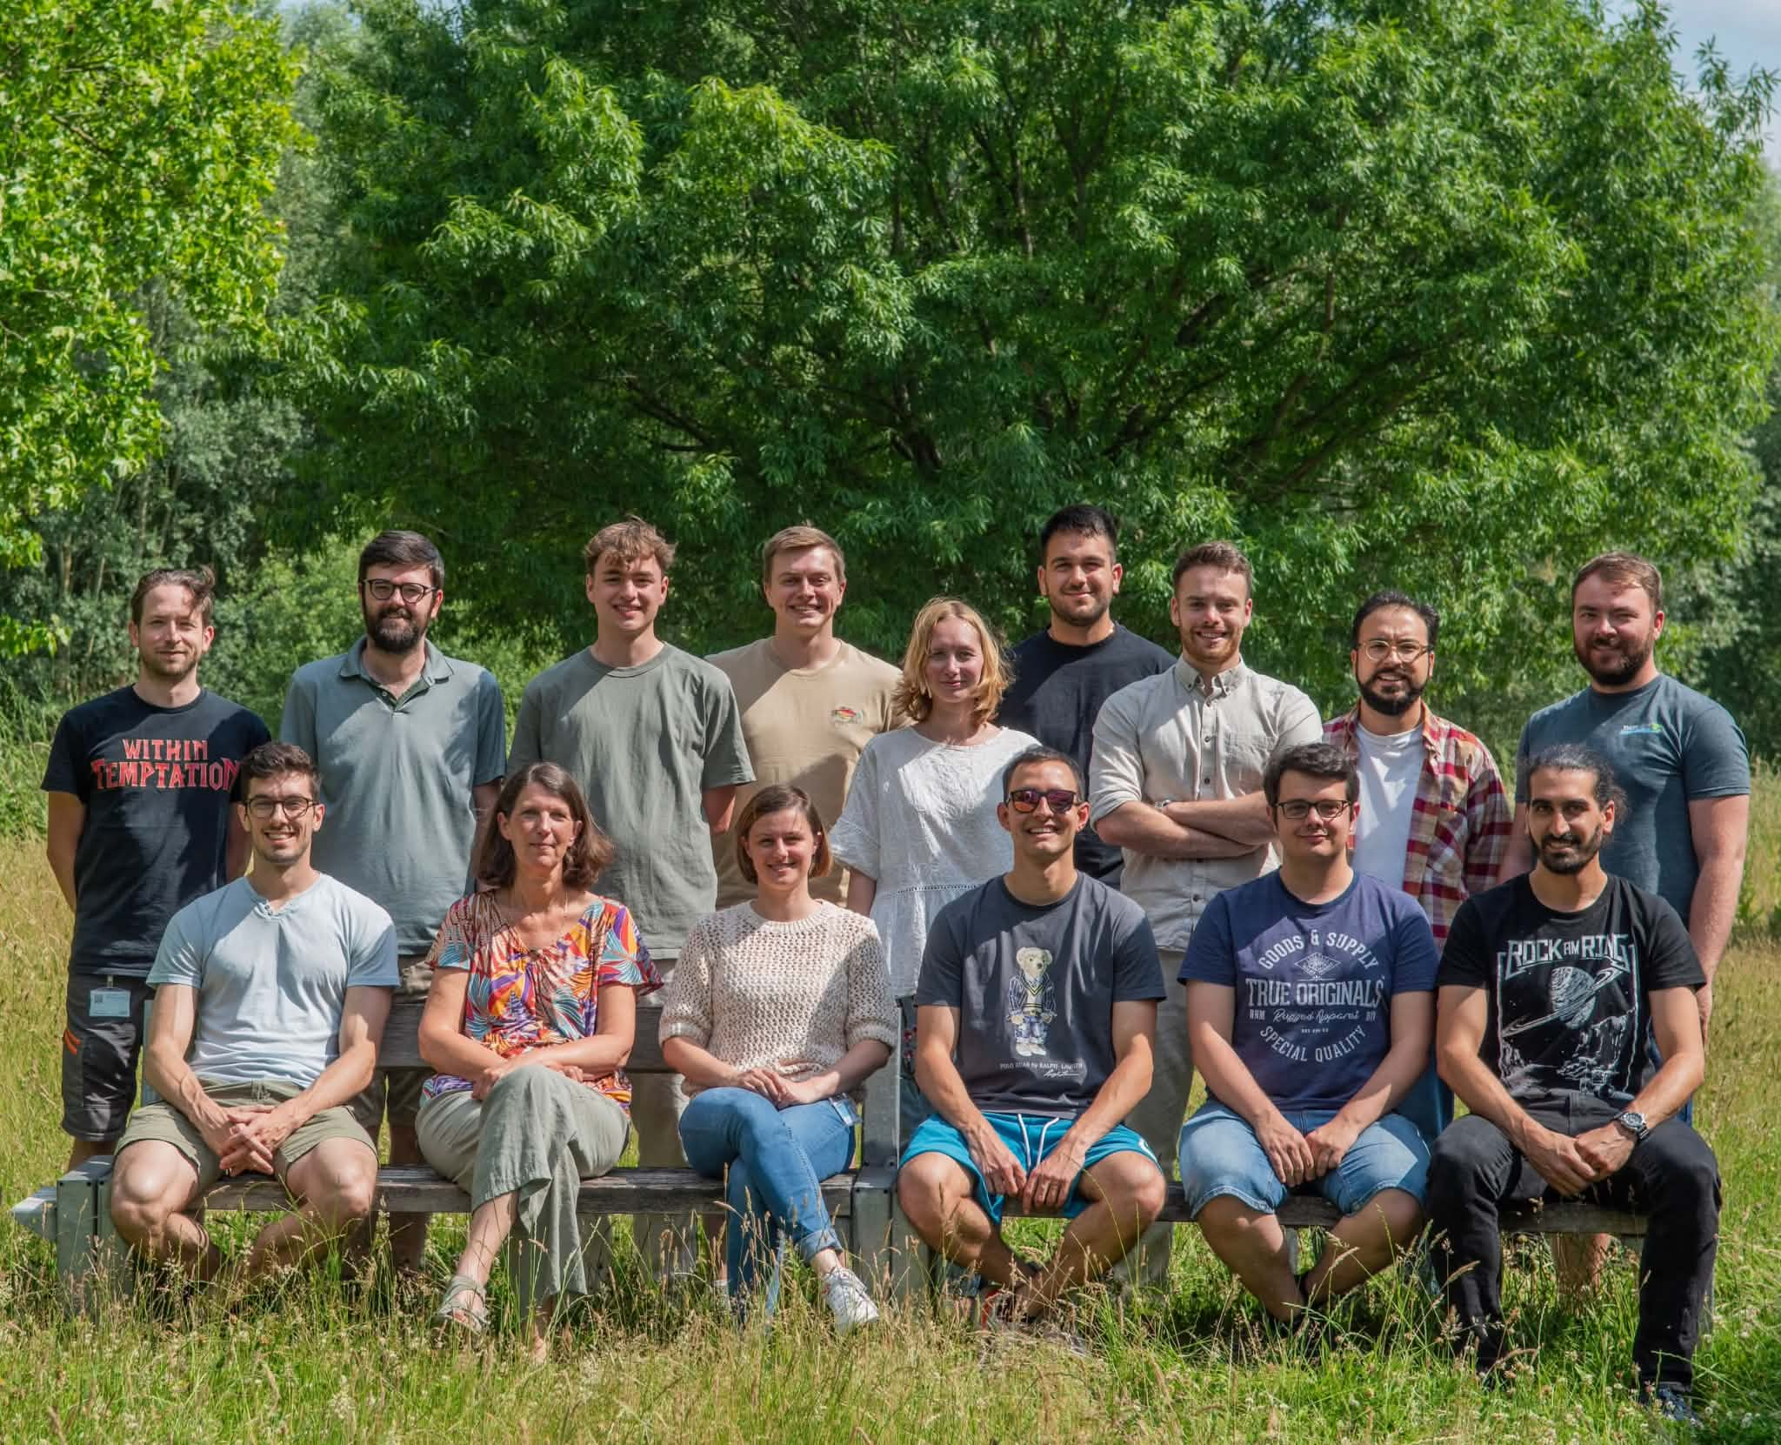
Thank you for your attention!
Special thanks to Nuclear Moments Group, CRIS and IGISOL collaborations.

Slide 16
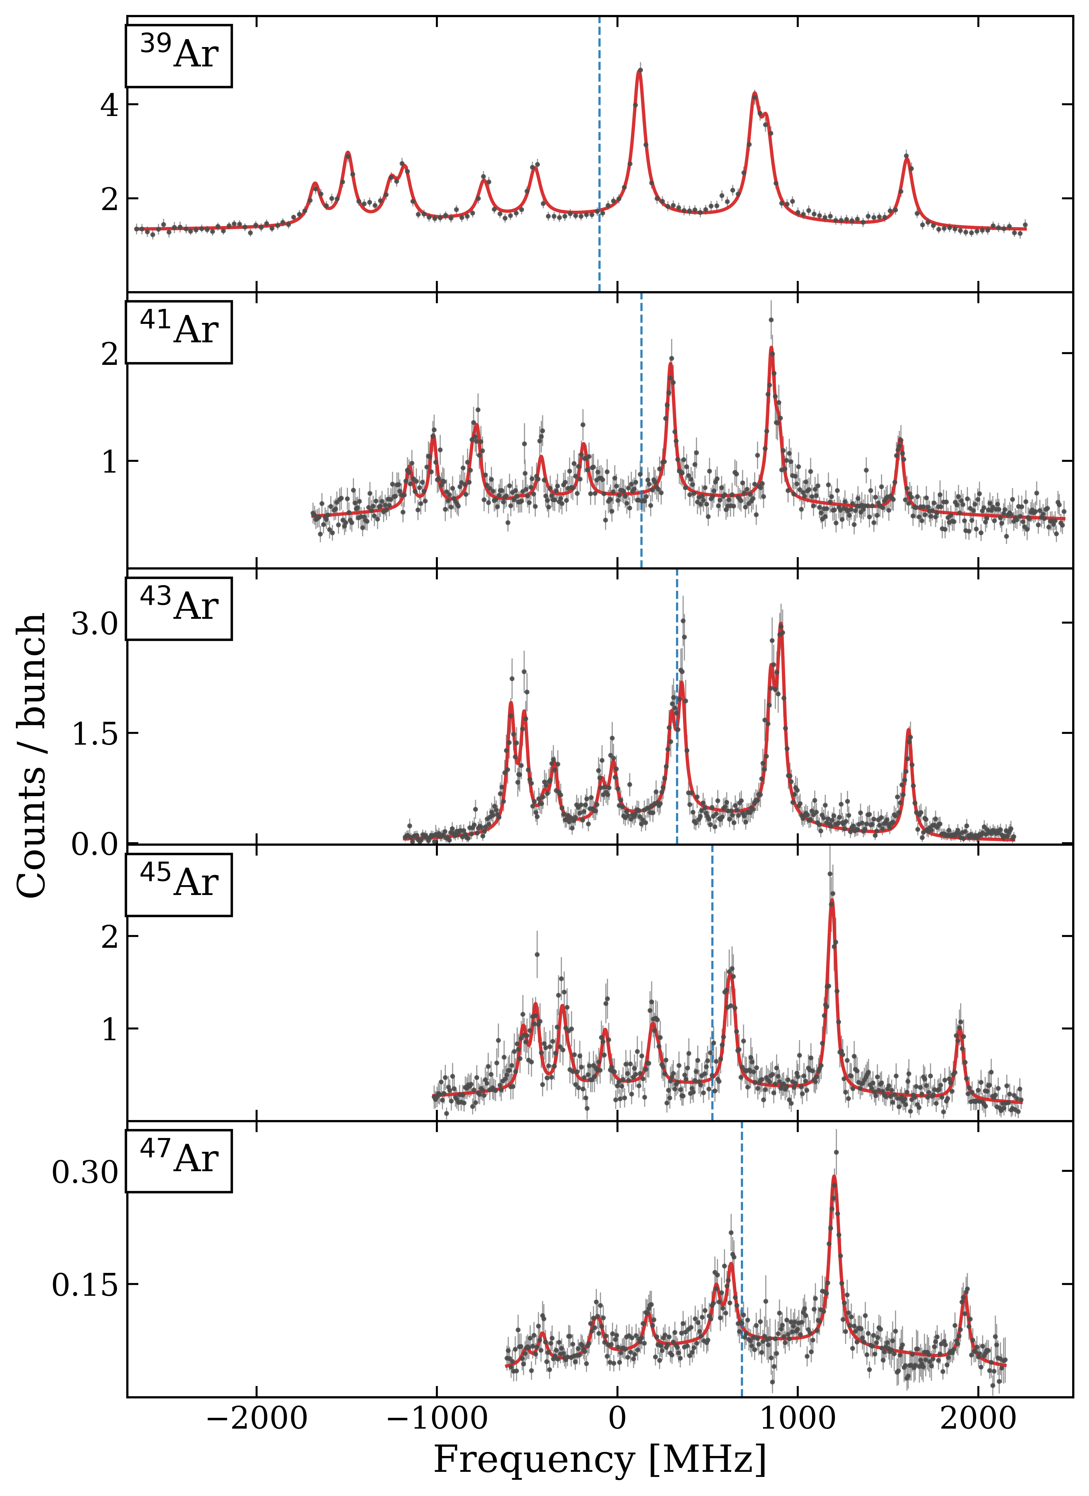
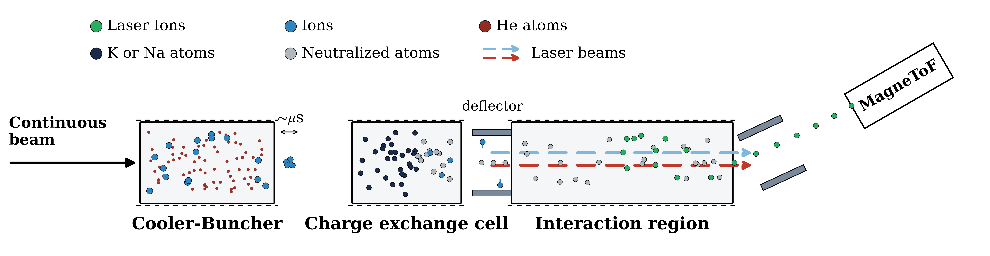
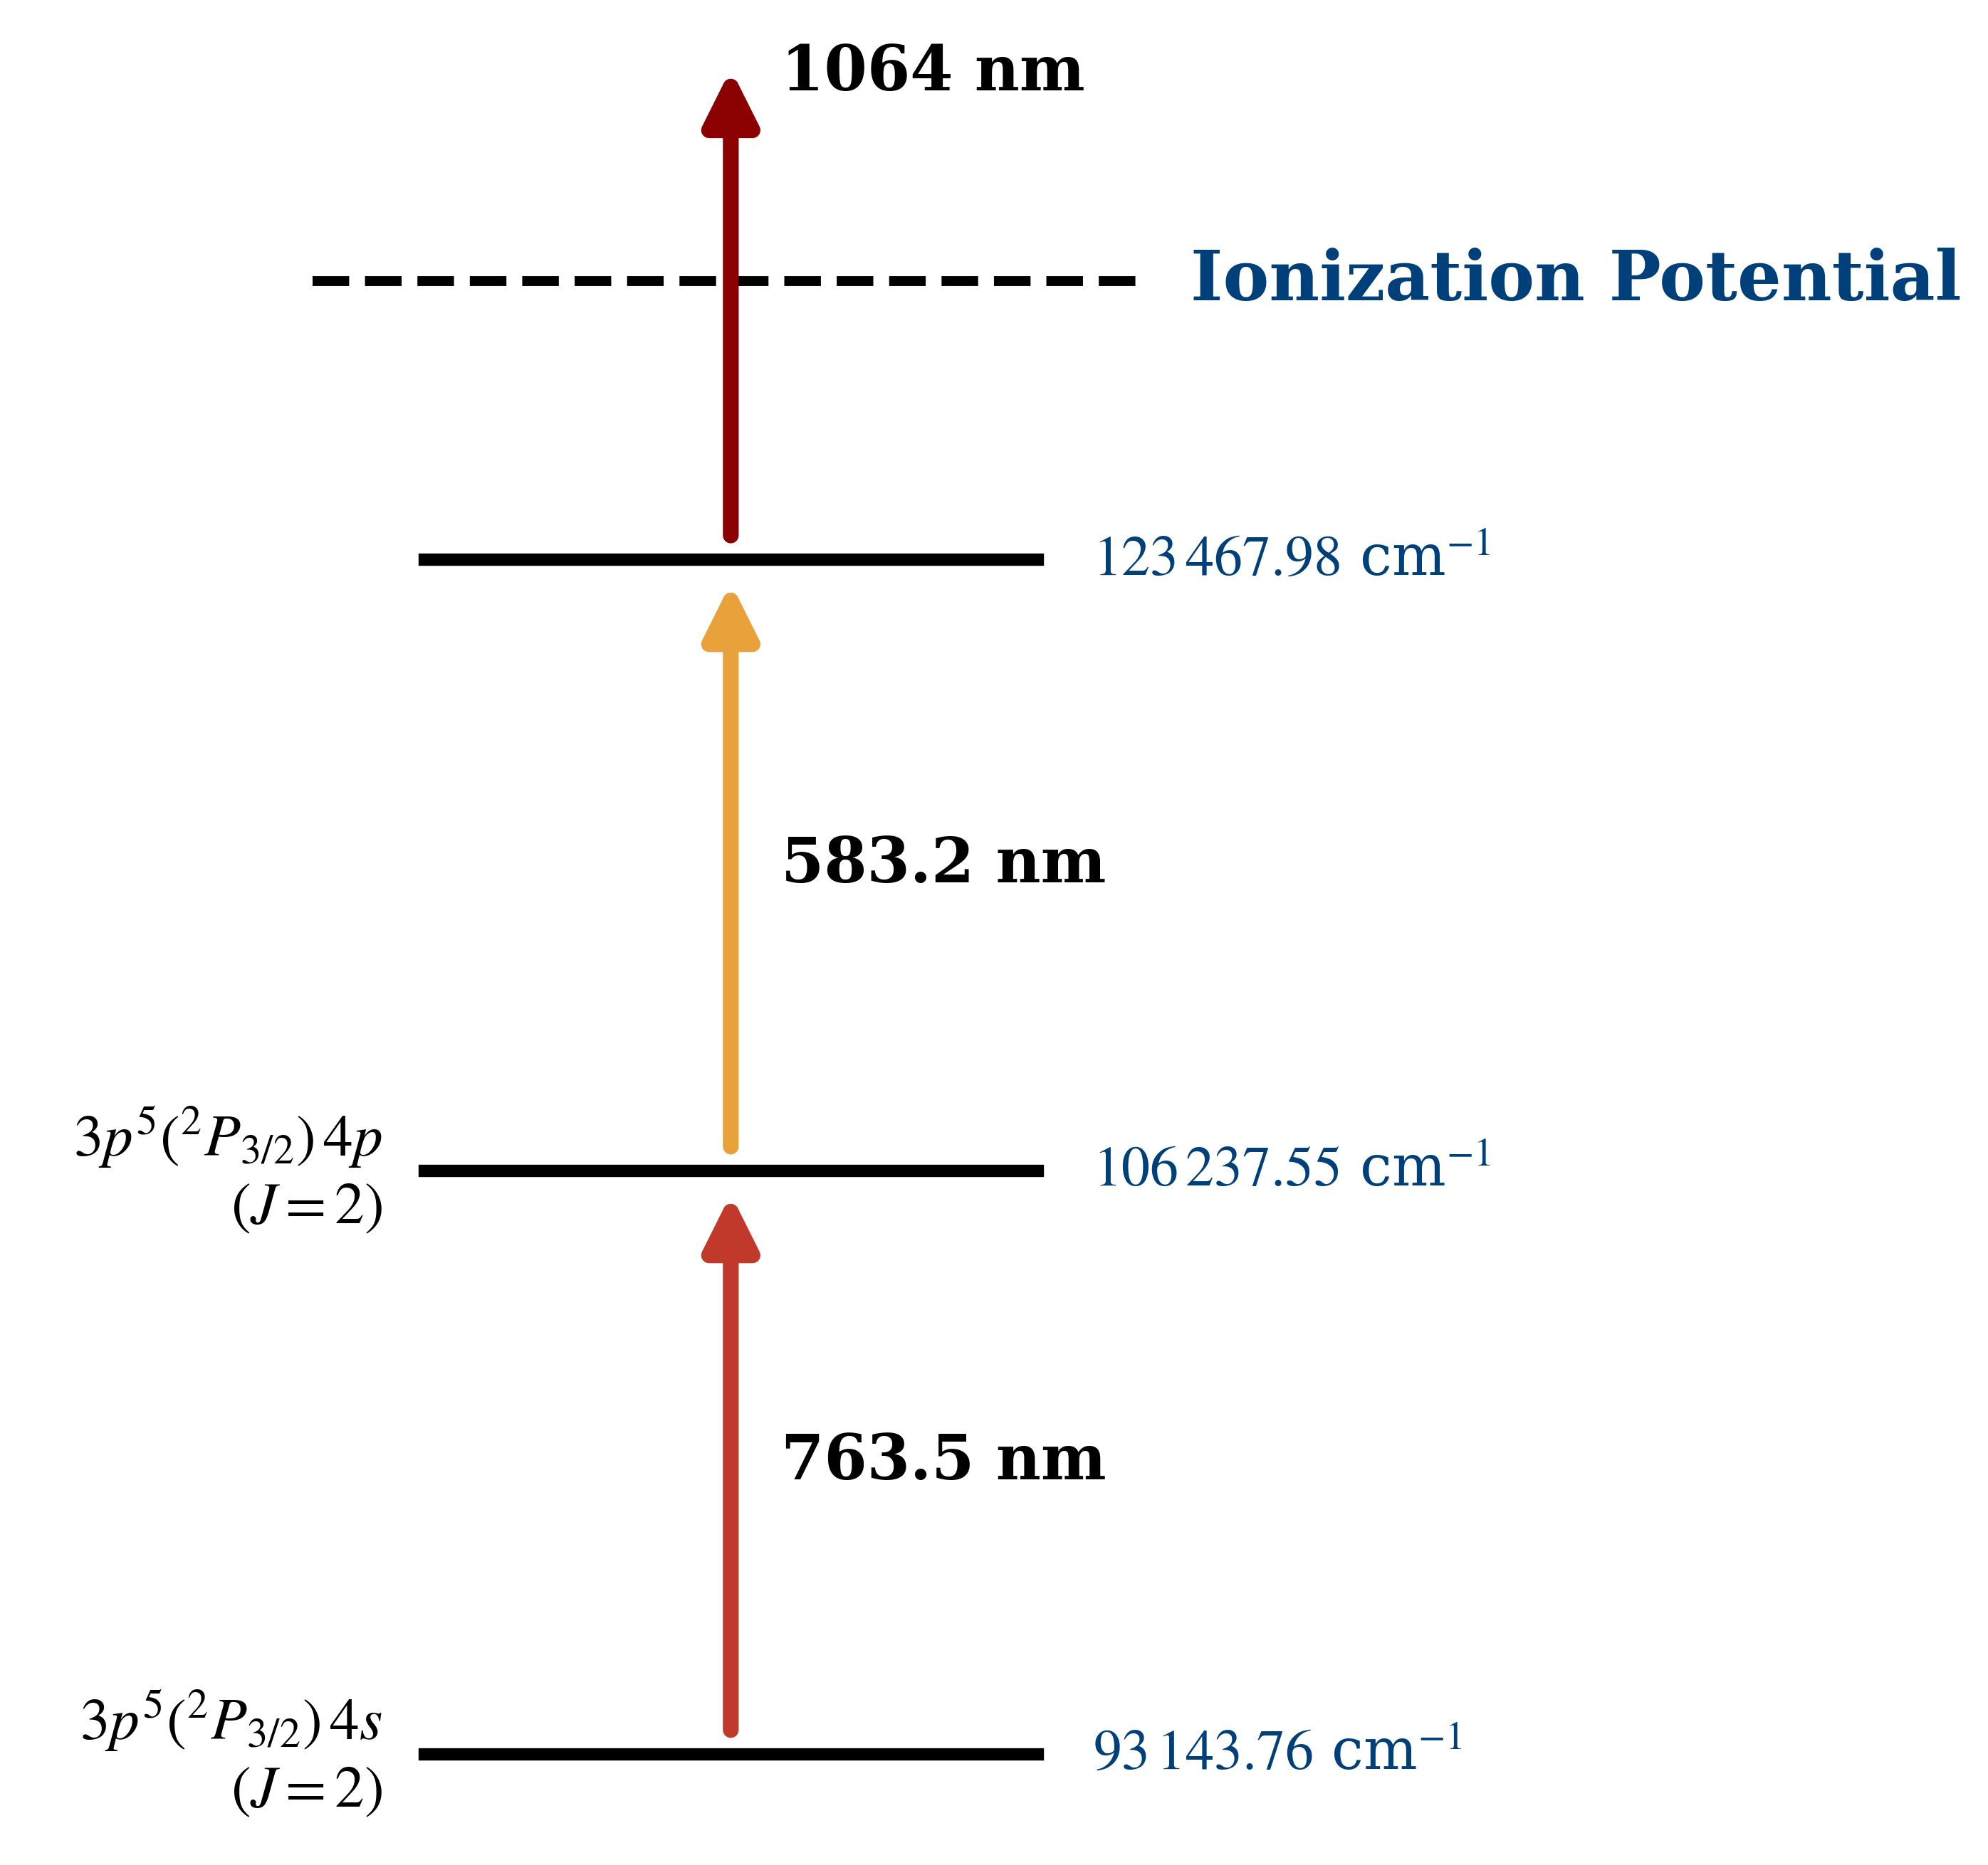
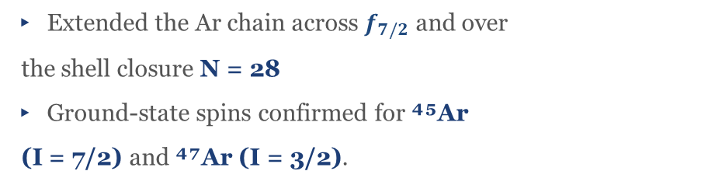
The Ar chain — CRIS campaign at ISOLDE
³⁹⁻⁴⁷Ar hyperfine spectra recorded in the 2025 CRIS run
Ionisation scheme used for Ar I
Scanning the first step resolves the hyperfine pattern. In the end, only atoms that were on resonance with that first step are re-ionized and measured.
▸ Extended the Ar chain across $f_{7/2}$ and over
the shell closure N = 28
▸ Ground-state spins confirmed for ⁴⁵Ar
(I = 7/2) and ⁴⁷Ar (I = 3/2).
Fitted hyperfine spectra of ³⁹⁻⁴⁷Ar (data · black; total fit · red)
Angelos Karadimas · KU Leuven — IKS · Zakopane 2026
4 / 12

Slide 17
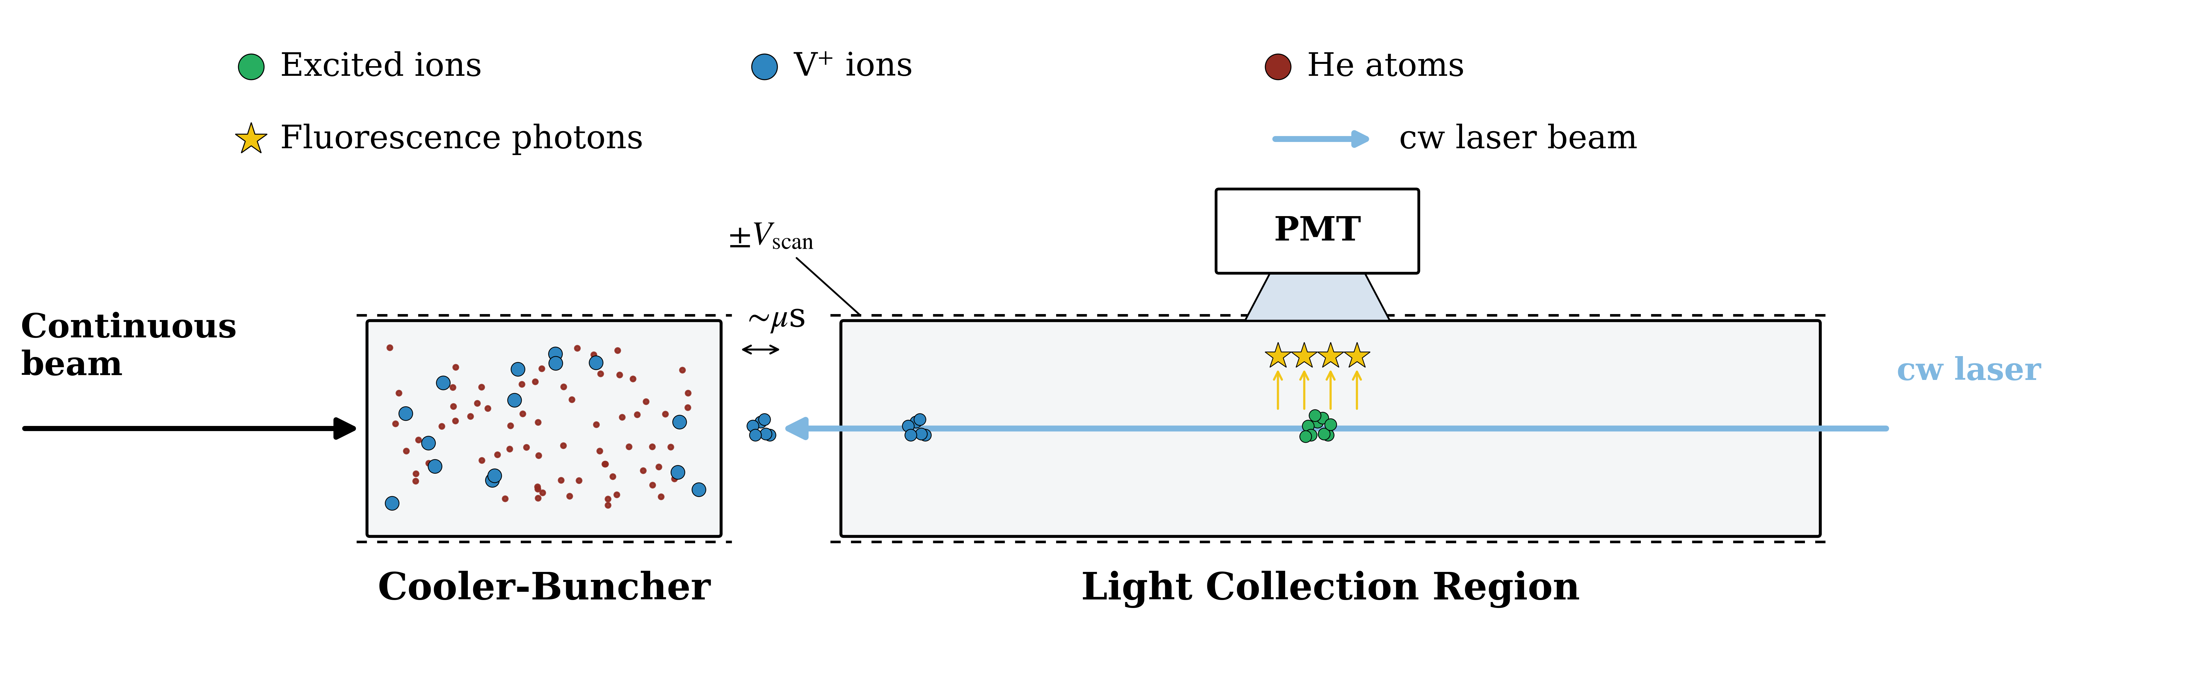
Finding the best spectroscopy transition — offline survey
Stable ⁵¹V⁺ studied offline to pick the most efficient line before the online run
▸ 11 candidate transitions from the 3d³4s → 3d³4p manifold surveyed on stable ⁵¹V⁺.
▸ Figure of merit: spectroscopic efficiency = photons detected per incident ion
▸ Best line selected was T11 and carried into the online run on the exotic isotopes
▸ Offline ⁵¹V A, B constants fix the calibration for the online extraction of μ
11 candidate transitions T01–T11 measured offline on ⁵¹V⁺
Karadimas et al., Sci. Rep. 16, 13670 (2026)
Angelos Karadimas · KU Leuven — IKS · Zakopane 2026
8 / 12
Notes:
Highlight T11

Slide 18
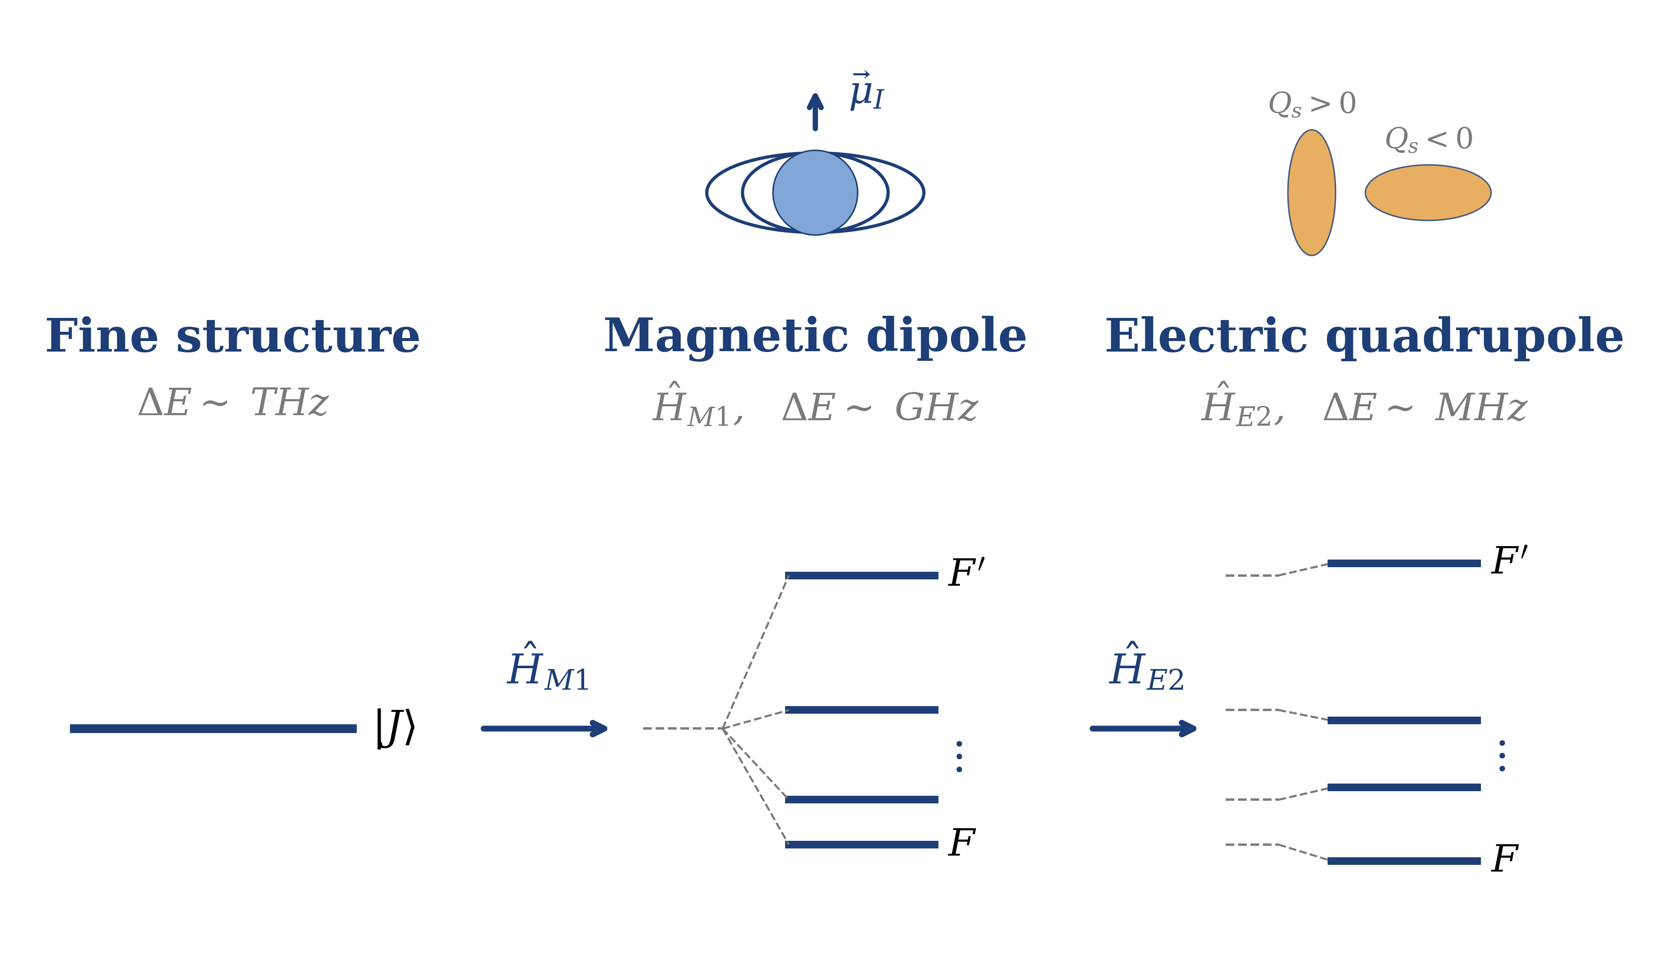
Collinear laser spectroscopy
The hyperfine fingerprint delivers μ, Qₛ and δ⟨r²⟩ model-independently
Two techniques, one goal:
CRIS @ ISOLDE → Ar isotopes
▸ Step-wise resonance ionisation, ion detection
▸ Near-background-free → reach the most exotic isotopes
CRIS: Collinear Resonance Ionisation Spectroscopy
CLS @ IGISOL → V isotopes
▸ Gas-cell stopping ideal for refractory V
▸ Fluorescence detection on a fast ionic beam
CLS: Collinear Laser Spectroscopy
F = I + J · A ↔ μ · B ↔ Qₛ
Angelos Karadimas · KU Leuven — IKS · Zakopane 2026
3 / 12

Slide 19
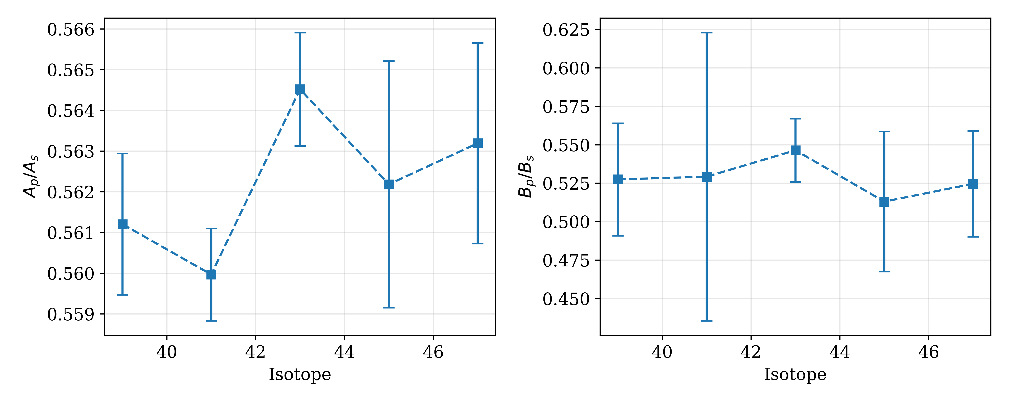
Conservation of hyperfine parameter ratio in Ar
Angelos Karadimas · KU Leuven — IKS · Zakopane 2026
3 / 12

