Slide 1

Zakopane 2026 Conference on Nuclear Physics
August 30-September 6, 2026, Zakopane, Poland
Configuration-interaction time-dependent density
functional theory for nuclear dynamics
Yiping Wang 王一平
School of Physics, Peking University
Collaborators: B. Li, J. Meng, T. Nikšic ́, D. Vretenar, P. W. Zhao

Slide 2
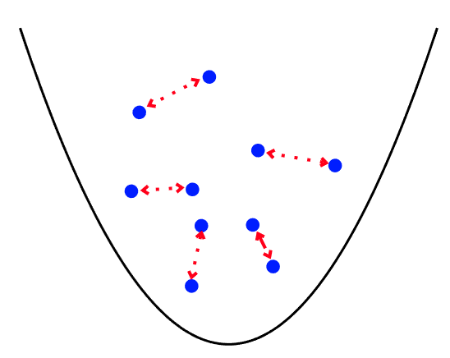
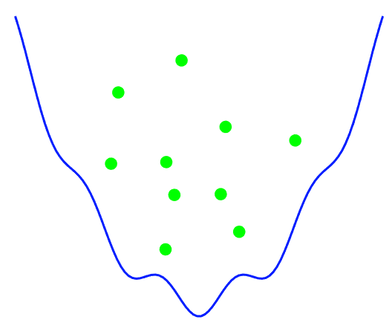




Time-dependent density functional theory
Density functional theory (DFT) is currently the only microscopic theory that can be used to describe almost all nuclei in the nuclear chart.
Bender, Heenen, Reinhard, RMP 75, 121 (2003)
Relativistic Density Functional for Nuclear Structure, edited by J. Meng, 2016
Time-dependent density functional theory (TDDFT) is one of the most important microscopic approaches for describing nuclear dynamics.
$$ρ_{A}(r,t)$$
$$ρ_{B}(r,t)$$
$$v_{ext}^{A}(r,t)$$
System B
$$v_{ext}^{B}(r,t)$$
System A
Time
Time
E. Runge, E. K. U. Gross, PRL 52 (1984) 997; R. van Leeuwen, PRL 82 (1999) 3863
The many-body problem is mapped onto a one-body problem!

Slide 3
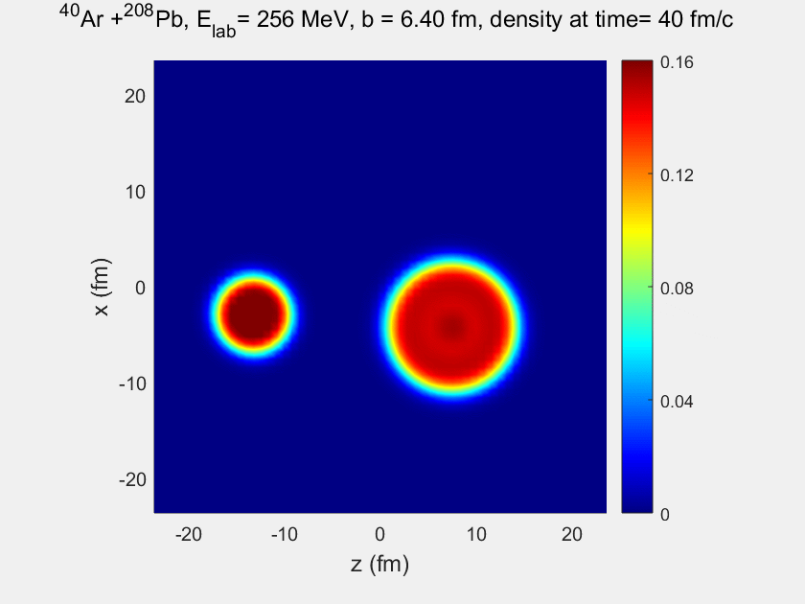
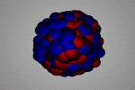
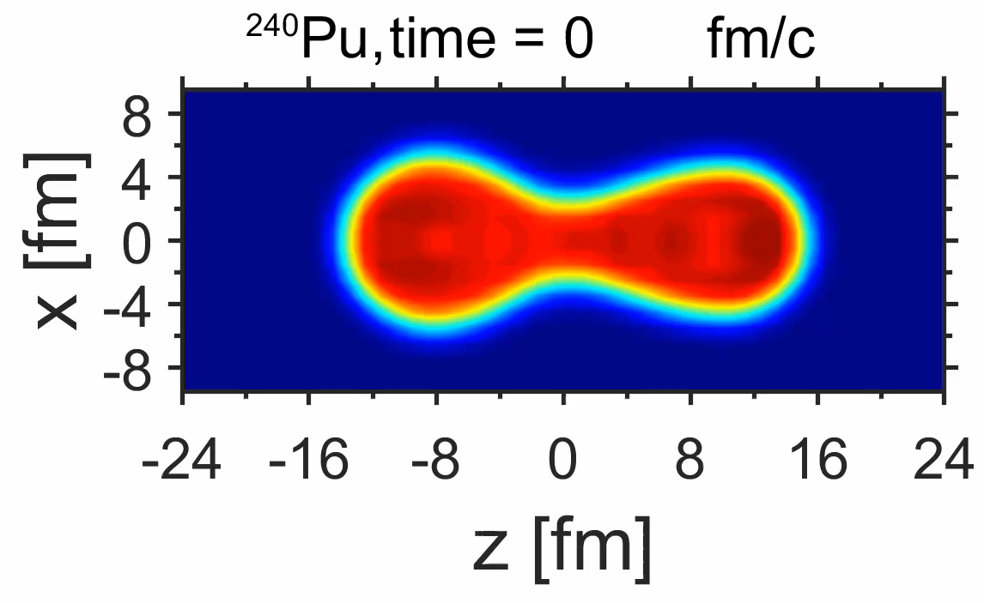
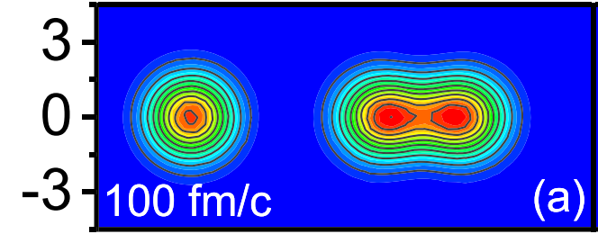
Application of TDDFT
TDDFT has been applied to a variety of nuclear dynamical processes:
✓ Collective vibration
Vretenar, Berghammer, Ring, NPA 581 (1995) 679
Reinhard, Guo, Maruhn, EPJA 32 (2007) 19
  ✓ Dynamics of $α$-chain structure
Umar et al., PRL 104 (2010) 212503
Ren, Zhao, Meng, PLB 801 (2020) 135194
✓ Fission
Bulgac et al., PRL 116 (2016) 122504
Ren et al., PRL 128 (2022) 172501
  ✓ Multinucleon transfer reaction
    Simenel, PRL 105 (2010) 192701
    Wu, Guo, PRC 100 (2019) 014612
Zhang et al., PRC 109 (2024) 024614

Slide 4
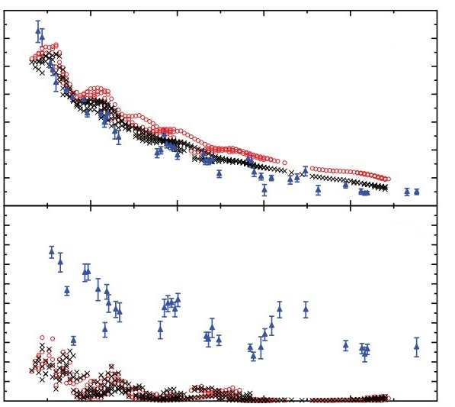
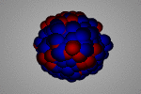






Limitation of TDDFT: Absence of 2p-2h and np-nh Configurations
Strength function
Width $Γ_{total}=ΔΓ+Γ^{↑}+Γ^{↓}$
24
ISGQR
20
E [MeV]
16
$$Γ_{total}$$
Ex (MeV)
12
9
Exp
Sly4
6
SkM*
$Γ_{total}$ [MeV]
3
$$ΔΓ$$
($Landau$)
$$Γ^{↑}$$
($Escape$)
$$Γ^{↓}$$
($Spreading$)
0
0
50
100
150
200
250
A
Harakeh, and van der Woude, Giant resonances (2001)
Scamps, Lacroix, PRC 88, 044310 (2013)
TDDFT does not include 2p-2h and np-nh configurations and therefore systematically underestimates the spreading widths of GRs.

Slide 5
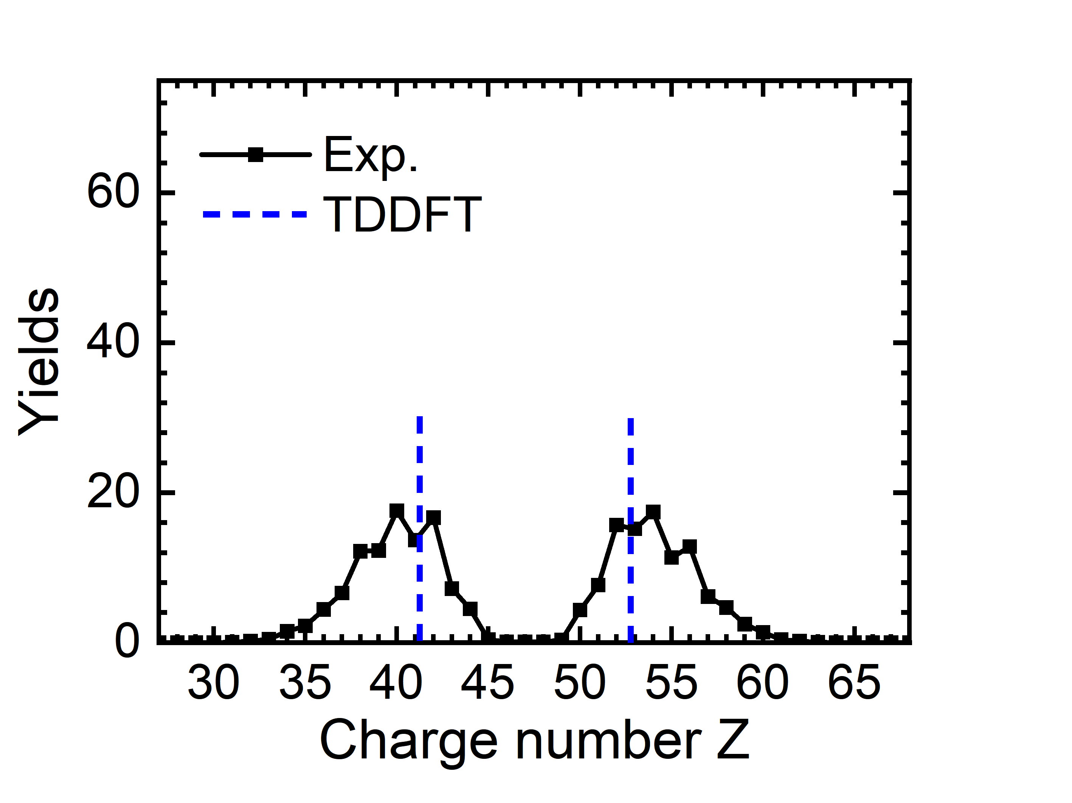
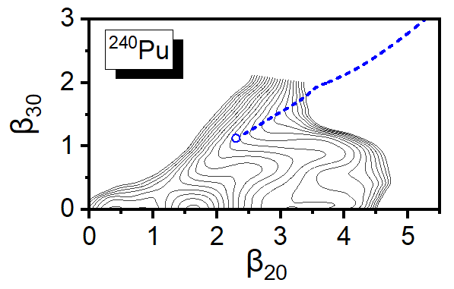
Limitation of TDDFT: Lack of Quantum Fluctuations
Courtesy of B. Li
Z. X. Ren et al., PRC 105, 044313 (2022)
TDDFT lacks quantum fluctuations in the collective space and therefore cannot reproduce the widths of charge or mass distributions.

Slide 6
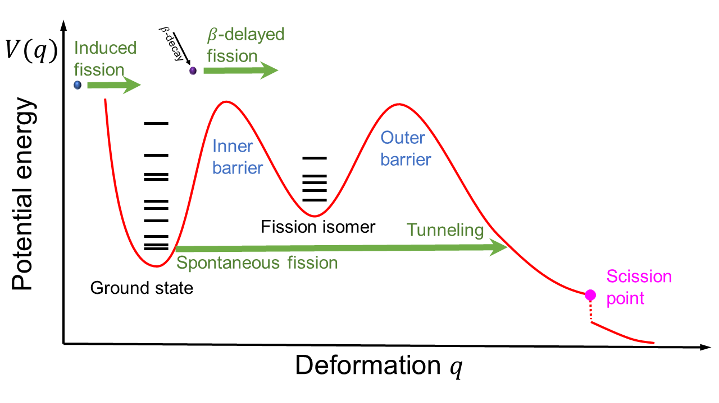
Limitation of TDDFT: Inability to Describe Quantum Tunneling
Courtesy of B. Li
TDDFT cannot describe quantum tunneling and therefore cannot be applied to classically forbidden regions.

Slide 7
Beyond TDDFT methods
Time-dependent density matrix (TDDM) theory and its extensions
Time-dependent random-phase approximation (TDRPA) method
Stochastic time-dependent Hartree-Fock method
Generalized time-dependent generator-coordinate method
Assié and Lacroix, PRL102, 202501 (2009)
Wen, Barton, Rios, Stevenson, PRC 98, 014603 (2018); Tohyama, FP 8, 67 (2020)
Balian and Vénéroni, PRL 47, 1353 (1981)
Simenel, PRL 106, 112502 (2011); Williams et al. PRL 120, 022501 (2018)
Simenel, Godbey, and Umar, PRL 124, 212504 (2020)
Ayik, PLB 658, 174 (2008); Lacroix and Ayik, EPJA 50, 95 (2014)
Tanimura, Lacroix, and Ayik, PRL 118, 152501 (2017)
the wave function is expanded in terms of the time-dependent generator
states initialized from deformation-constrained mean-field calculations
Marević, Regnier, Lacroix, PRC 108, 014620 (2023)
Li, Vretenar, Nikšić, Zhao, Meng, PRC 108, 014321 (2023)

Slide 8
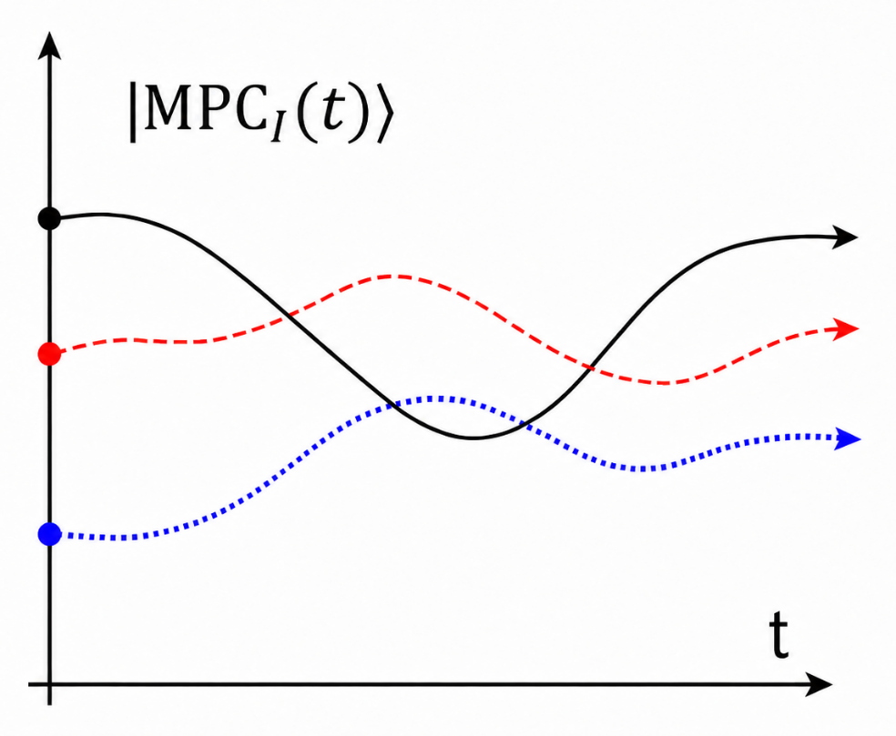

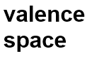


Configuration-interaction TDDFT
$$|Ψ(t)⟩=\sum_{I}{C_{I}}(t)|MPC_{I}(t)⟩$$
Wave function：
$$t$$
WYP, Li, Vretenar, Nikšić, Zhao, Meng, arXiv:2605.21037
provides a quantum framework to include beyond-mean-field correlations
systematically improvable by increasing the number of MPCs
strictly following variational principle
energy and particle-number conservation
Advantages

Slide 9
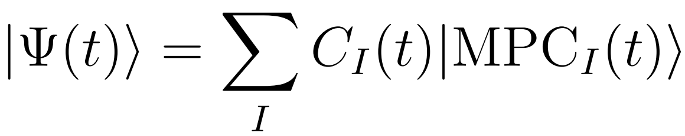

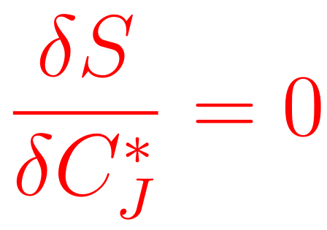
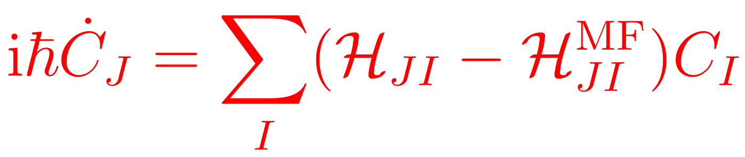

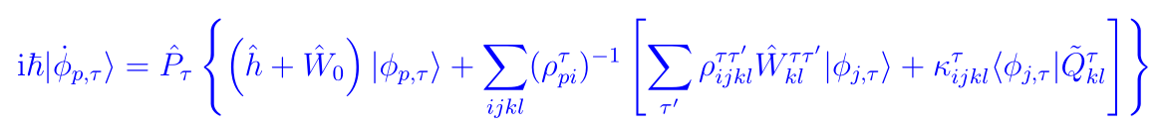
Equations of motion in CI-TDDFT
Correlated wave function:
Hamiltonian:
Action functional:
Equations of motion in CI-TDDFT:
WYP, Li, Vretenar, Nikšić, Zhao, Meng, arXiv:2605.21037

Slide 10
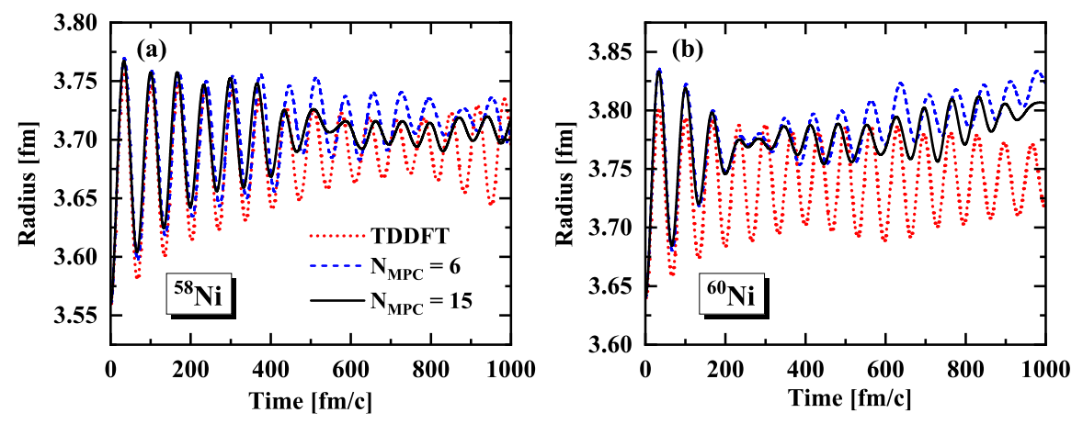
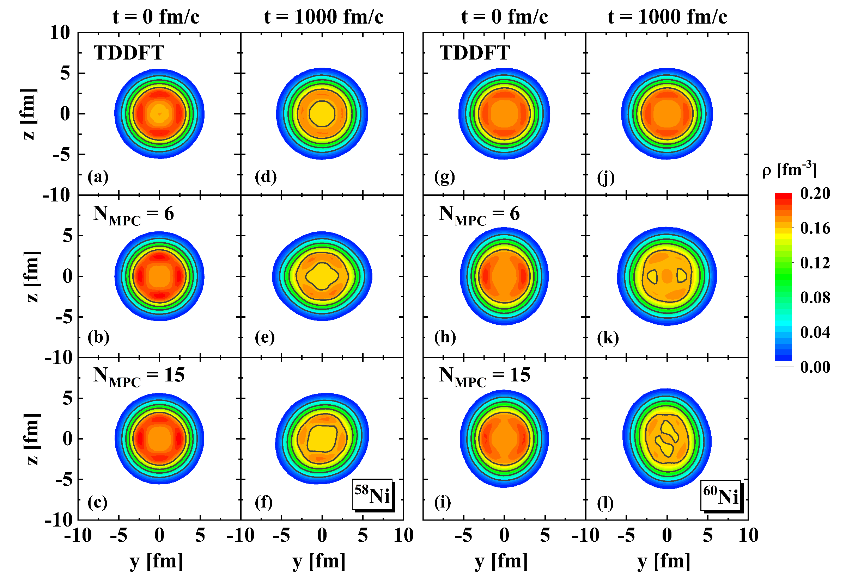
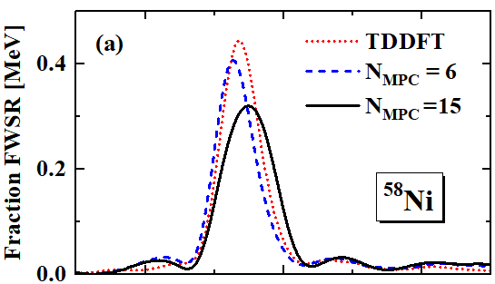

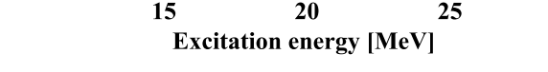
ISGMR strength distributions in Ni
58
CI-TDDFT produces broader strength distributions compared with TDDFT.
WYP, Li, Vretenar, Nikšić, Zhao, Meng, arXiv:2605.21037

Slide 11
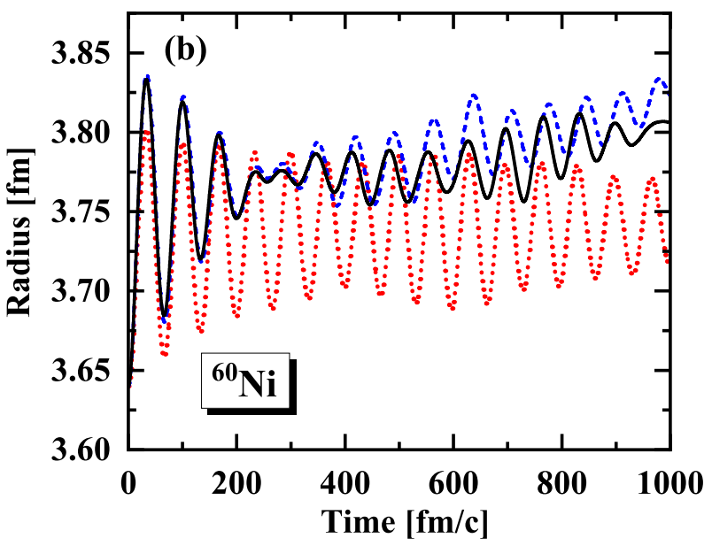
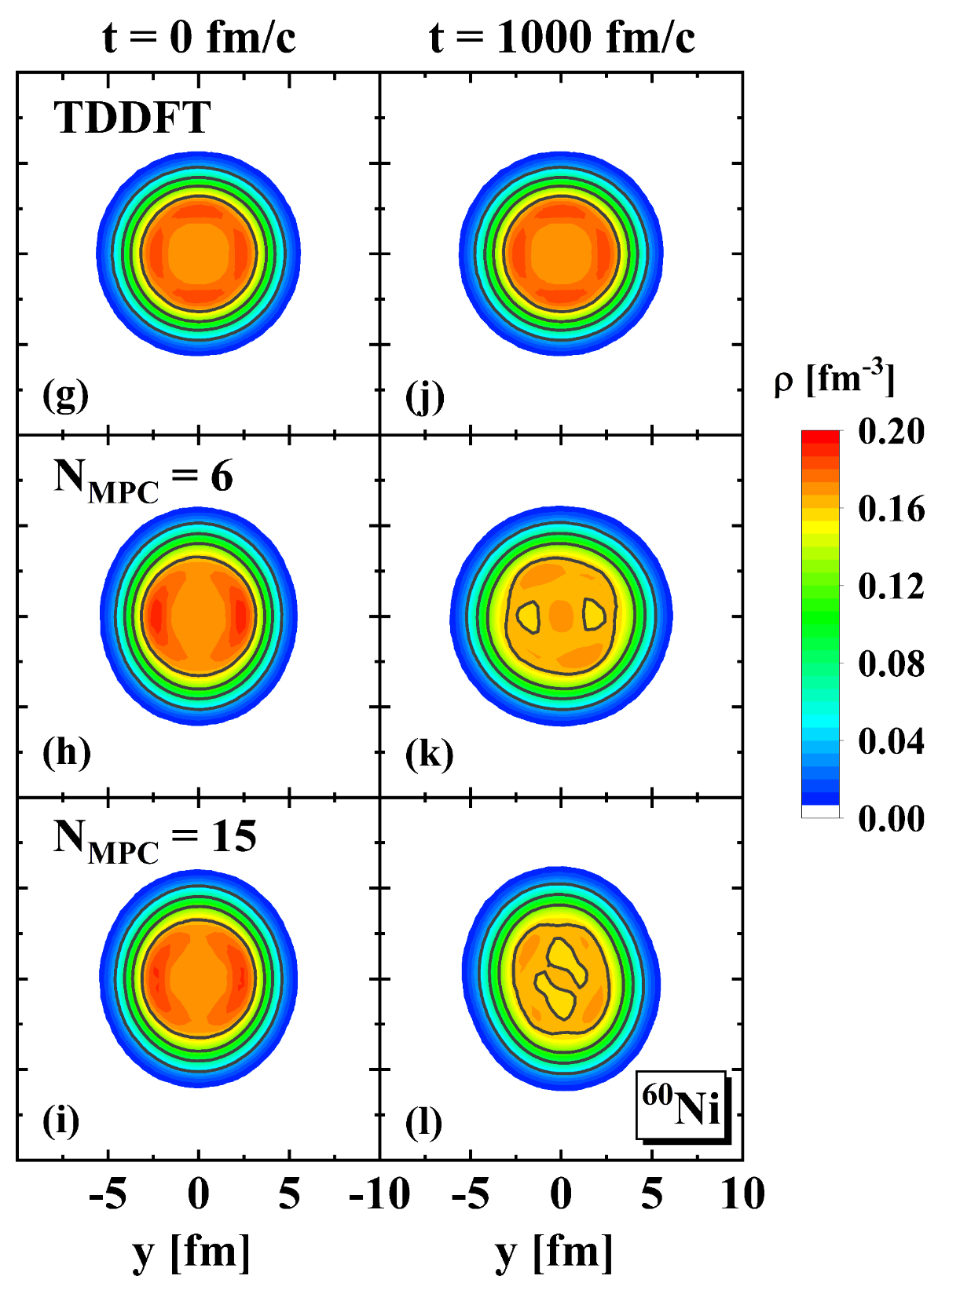
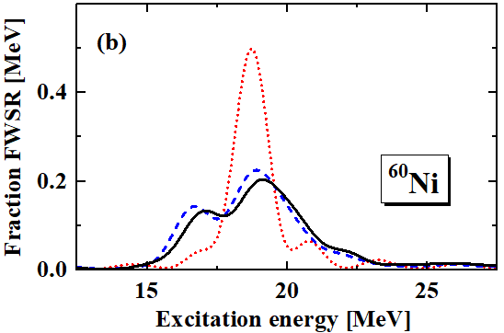
ISGMR strength distributions in Ni
60
60
The effects of configuration mixing are more pronounced in Ni.
WYP, Li, Vretenar, Nikšić, Zhao, Meng, arXiv:2605.21037

Slide 12
Summary and Outlook
Summary
    Configuration-interaction time-dependent density functional theorty (CI-TDDFT) is developed.
    Apply to ISGMR: CI-TDDFT produces broader strength distributions compared with TDDFT.
Outlook
    Fission, Fusion, Multinucleon-transfer reactions…
Thank you!

