Slide 1

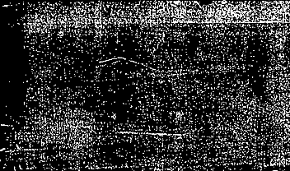

Hadron-in-jet production in (un)polarized pp collisions:
TMD-FF phenomenology
Joint ECFA-NuPECC-APPEC Workshop
“Synergies between the EIC and the LHC”
Umberto D’Alesio
C. Flore & M. Zaccheddu, arXiv:2506.21959
also L. Gamberg, F. Murgia & MZ
PLB 2024

Slide 2
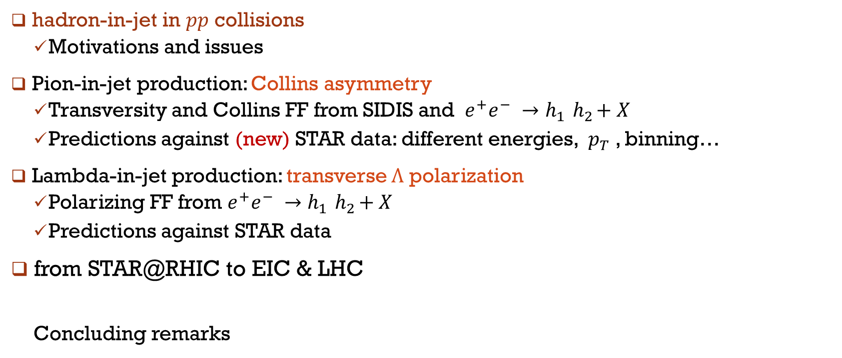
Outline
hadron-in-jet in $pp$ collisions
  Motivations and issues
Pion-in-jet production: Collins asymmetry
  Transversity and Collins FF from SIDIS and $e^{+}e^{−} →h_{1}{ h}_{2}+X$
  Predictions against (new) STAR data: different energies, $p_{T}$, binning…
Lambda-in-jet production: transverse $Λ$ polarization
  Polarizing FF from $e^{+}e^{−} →h_{1}{ h}_{2}+X$
  Predictions against STAR data
from STAR@RHIC to EIC & LHC
  Concluding remarks

Slide 3
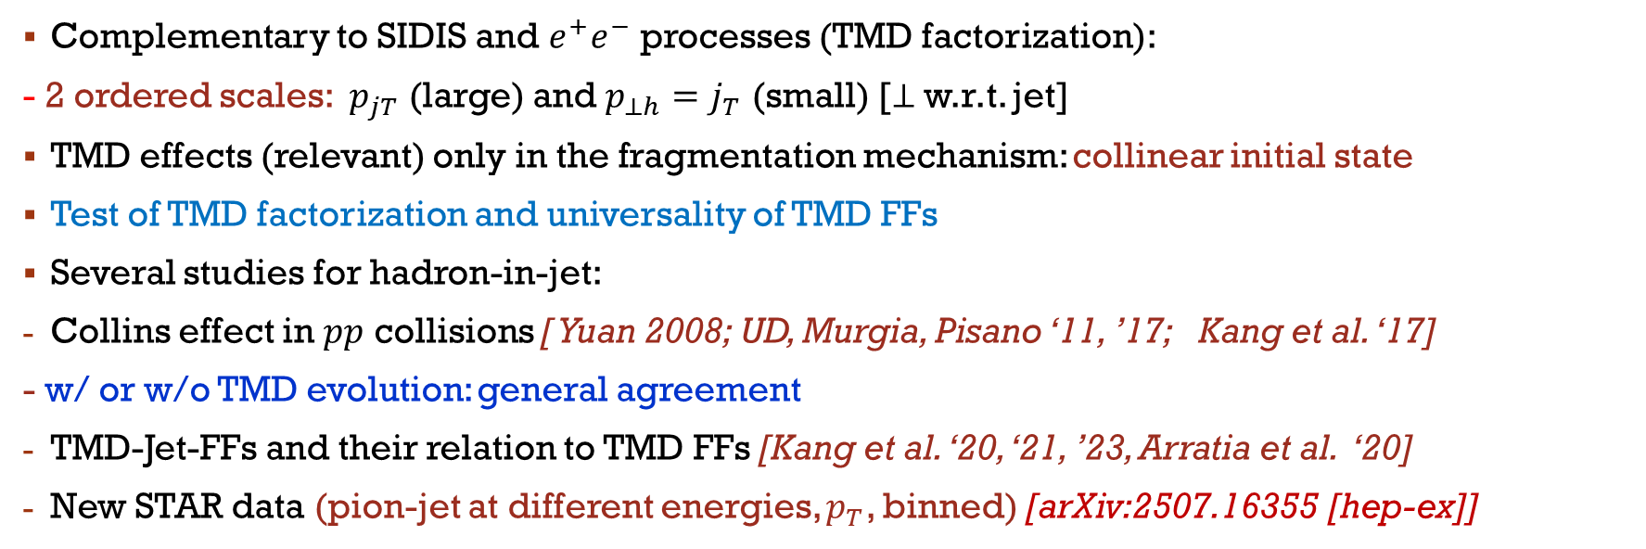
Motivations
Complementary to SIDIS and $e^{+}e^{−}$ processes (TMD factorization):
- 2 ordered scales: $p_{jT}$ (large) and $p_{⊥h}=j_{T}$ (small) [⊥ w.r.t. jet]
TMD effects (relevant) only in the fragmentation mechanism: collinear initial state
Test of TMD factorization and universality of TMD FFs
Several studies for hadron-in-jet:
Collins effect in $pp$ collisions [ Yuan 2008; UD, Murgia, Pisano ‘11, ’17; Kang et al. ‘17]
- w/ or w/o TMD evolution: general agreement
TMD-Jet-FFs and their relation to TMD FFs [Kang et al. ‘20, ‘21, ’23, Arratia et al. ‘20]
New STAR data (pion-jet at different energies, $p_{T}$, binned) [arXiv:2507.16355 [hep-ex]]

Slide 4
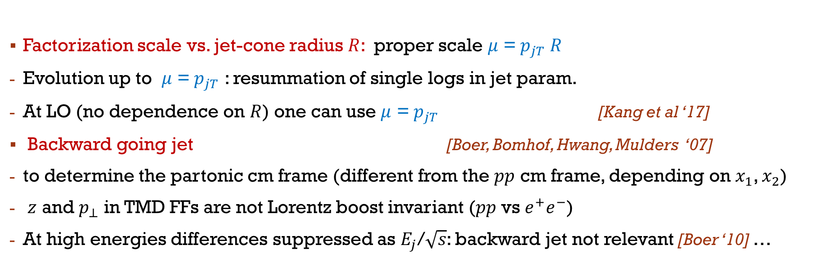
Issues
Factorization scale vs. jet-cone radius $R$: proper scale $μ$ = $p_{jT} R$
Evolution up to $μ$ = $p_{jT}$ : resummation of single logs in jet param.
At LO (no dependence on $R$) one can use $μ$ = $p_{jT}$ [Kang et al ‘17]
Backward going jet [Boer, Bomhof, Hwang, Mulders ‘07]
to determine the partonic cm frame (different from the $pp$ cm frame, depending on $x_{1}$, $x_{2}$)
$z$ and $p_{⊥}$ in TMD FFs are not Lorentz boost invariant ($pp$ vs $e^{+}e^{−}$)
At high energies differences suppressed as $E_{j}$/$\sqrt{s}$: backward jet not relevant [Boer ‘10] …

Slide 5
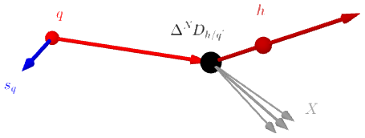
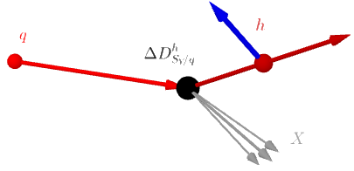
TMD Ffs for spin ½ hadrons
Collins FF
T-odd, chiral-odd
T-odd, chiral-even
polarizing FF

Slide 6


kinematics
Collinear initial state
Figure from Kang, Lee, Zhao 2020

Slide 7
Pion-in-jet: collins asymmetry

Slide 8
Collins asymmetry

Slide 9
parametrizations
MSHT20nlo ‘21
DSSV ‘09
valence
DEHSS ‘15
DGLAP evolution
Boglione, UD, Flore, Gonzalez-Hernandez, Murgia, Prokudin, PLB2024

Slide 10
results

Slide 11
Results [predictions vs. data] I
Collins azimuthal asymmetries vs. $z$ at fixed $p_{jT}$ integrated over $η_{j}$[0:0.9]. Uncertainties at 2$σ$ CL.
STAR data: PRD 2022 (200 GeV) and arXiv:2507.16355 [hep-ex] (510 GeV)

Slide 12
Results [predictions vs. data] II
Collins azimuthal asymmetries vs. $x_{T}=2p_{jT}/\sqrt{s},$integrated over $z$ [0.1:0.8] and over $η_{j}$ [0:0.9].
STAR data: PRD 2022 (200 GeV) and arXiv:2507.16355 [hep-ex] (510 GeV)

Slide 13
Results [predictions vs. data] III
Collins azimuthal asymmetries vs. $z$ integrated over $η_{j}$: [0:0.9], for various $p_{jT}$ bins.
STAR data: SPIN2023 (510 GeV)

Slide 14
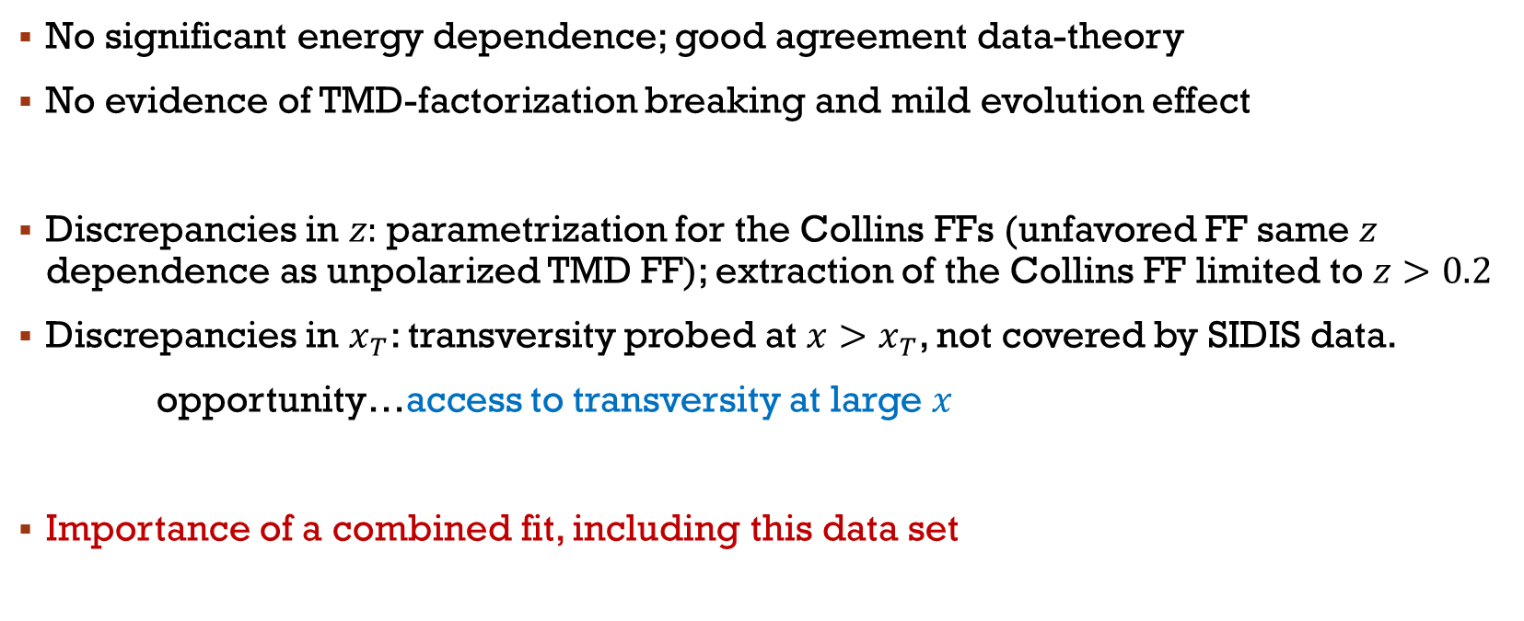
Remarks I
No significant energy dependence; good agreement data-theory
No evidence of TMD-factorization breaking and mild evolution effect
Discrepancies in $z:$parametrization for the Collins FFs (unfavored FF same $z$ dependence as unpolarized TMD FF); extraction of the Collins FF limited to $z>0.2$
Discrepancies in $x_{T}$: transversity probed at $x>x_{T}$, not covered by SIDIS data.
opportunity…access to transversity at large $x$
Importance of a combined fit, including this data set

Slide 15
Results [predictions vs. data] IV
Collins azimuthal asymmetries vs. $j_{T},$integrated over $z$ [0.1:0.8] and over $η_{j}$ [0:0.9], for various $p_{jT}$ bins.
STAR data: SPIN2023 (510 GeV)

Slide 16
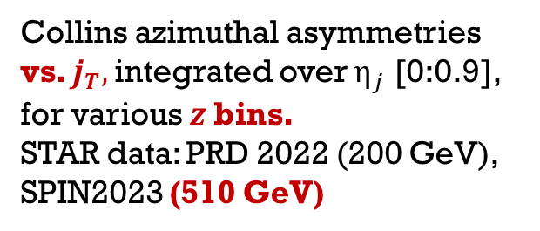
Results [predictions vs. data] IV
Collins azimuthal asymmetries vs. $j_{T},$integrated over $η_{j}$ [0:0.9], for various $z$bins.
STAR data: PRD 2022 (200 GeV), SPIN2023 (510 GeV)

Slide 17
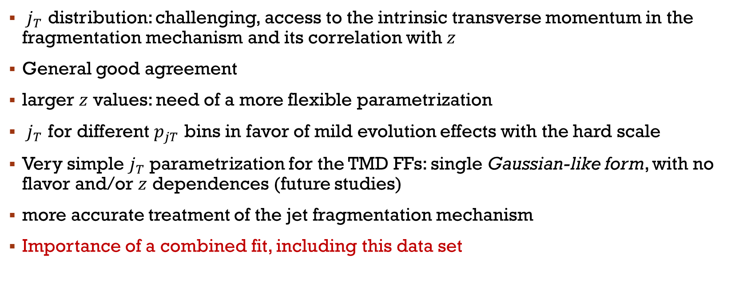
Remarks II
$j_{T}$ distribution: challenging, access to the intrinsic transverse momentum in the fragmentation mechanism and its correlation with $z$
General good agreement
larger $z$ values: need of a more flexible parametrization
$j_{T}$ for different $p_{jT}$ bins in favor of mild evolution effects with the hard scale
Very simple $j_{T}$parametrization for the TMD FFs: single Gaussian-like form, with no flavor and/or $z$ dependences (future studies)
more accurate treatment of the jet fragmentation mechanism
Importance of a combined fit, including this data set

Slide 18

$Λ$-in-jet: transverse $λ$ polarization

Slide 19



UD, Gamberg, Murgia, Zaccheddu ’20, ’24
$$q$$
$$h$$
$$X$$
- Polarization transverse w.r.t. the jet-Λ plane
- Numerator involves the polarizing FF
- similar study/results [Kang, Lee, Zhao ‘20]
- Extraction within CSS framework at NLL accuracy from Belle $e^{+}e^{−} →h_{1}{ h}_{2}+X$ data
[UD, Gamberg, Murgia, Zaccheddu ‘22, ’23]
STAR data [Gao et al. @SPIN2023]

Slide 20

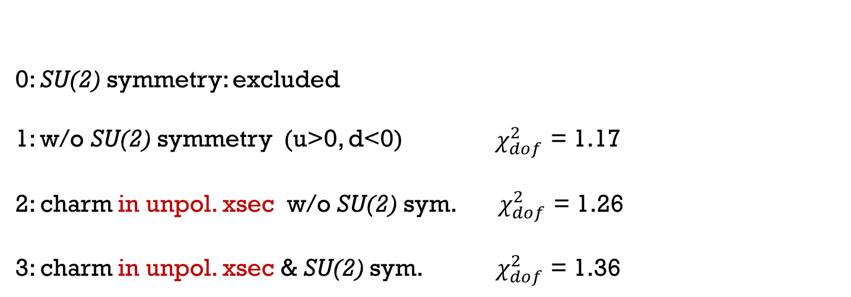
FIT:
$e^{+}e^{−} →$ $h_{1}\left(P_{1}\right){ h}_{2}\left(P_{2}\right)+ X$
Scenarios [pol. FF for u,d,s]
0: SU(2) symmetry: excluded
1: w/o SU(2) symmetry (u>0, d<0) $χ_{dof}^{2}$ = 1.17
2: charm in unpol. xsec w/o SU(2) sym. $χ_{dof}^{2}$ = 1.26
3: charm in unpol. xsec & SU(2) sym. $χ_{dof}^{2}$ = 1.36
SU(2) symmetry: open issue

Slide 21
Results: Λ-in-jet
Transverse Λ polarization vs. $z$(left) $p_{⊥Λ}$ (right) for different scenarios

Slide 22

Results: $\overline{Λ}$-in-jet
Transverse $\overline{Λ}$polarization vs. $z$(left) $p_{⊥Λ}$ (right) for different scenarios

Slide 23
FROM RHIC TO
EIC and LHC

Slide 24
Collins asymmetry at EIC
an example
Arratia, Kang, Prokudin, Ringer 2020

Slide 25
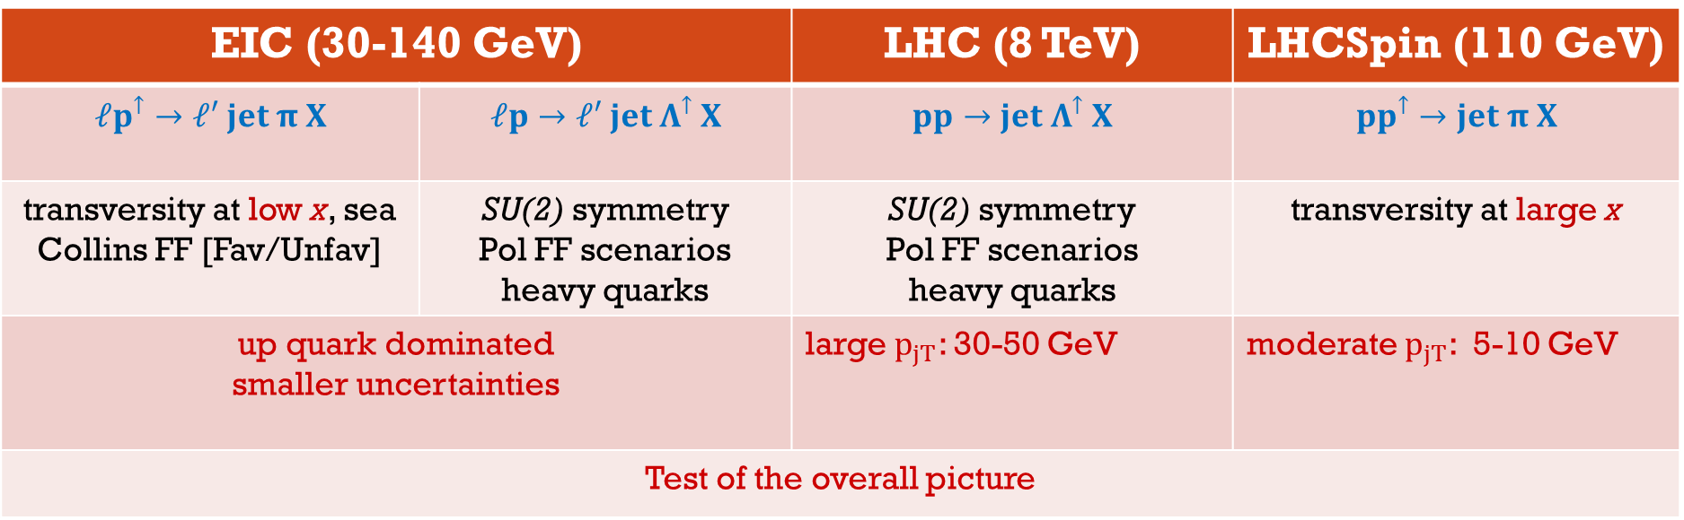
EIC (30-140 GeV) |  | LHC (8 TeV) | LHCSpin (110 GeV)
$$ℓp^{↑}→ℓ′ jet π X$$ | $$ℓp→{ℓ′ jet Λ}^{↑} X$$ | $$pp→jet Λ^{↑} X$$ | $$pp^{↑}→jet π X$$
transversity at low x, sea Collins FF [Fav/Unfav] | SU(2) symmetry Pol FF scenarios heavy quarks | SU(2) symmetry Pol FF scenarios heavy quarks | transversity at large x
up quark dominated smaller uncertainties |  | large $p_{jT}$: 30-50 GeV | moderate $p_{jT}$: 5-10 GeV
Test of the overall picture

Slide 26

Concluding Remarks
$h$-jet in $pp$ collisions:
- Deep insight into the fragmentation mechanism
- test of universality of TMD FFs and TMD factorization…and evolution
TMD effects only in the fragmentation mechanism (two-scale processes)
Collins asymmetry and transverse Λ polarization in $h$-jet : general agreement
Future work:
- jet fragmentation mechanism beyond LO accuracy, TMD FF parametrizations
- Collins asymmetry and transverse Λ polarization in $h$-jet @EIC and @LHC
THANKS for the ATTENTION

Slide 27
Back-up slides

Slide 28
Towards a unified TMD picture?

Slide 29

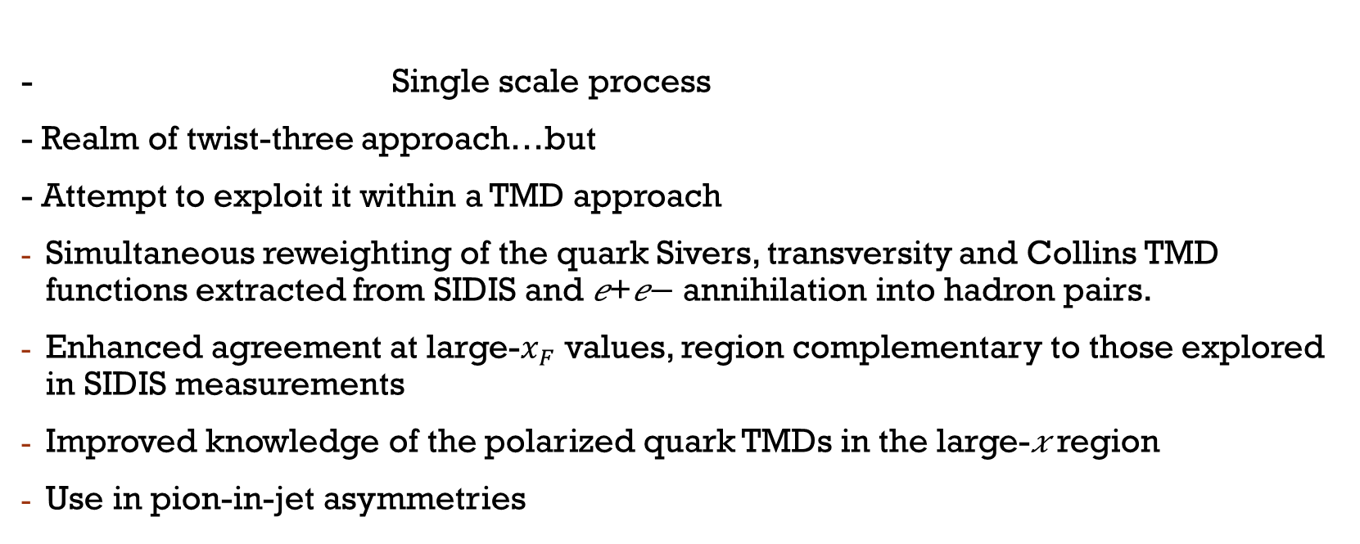
Towards a unified TMD picture?
Boglione, UD, Flore, Gonzalez-Hernandez, Murgia, Prokudin, PLB2024
- Single scale process
- Realm of twist-three approach…but
- Attempt to exploit it within a TMD approach
Simultaneous reweighting of the quark Sivers, transversity and Collins TMD functions extracted from SIDIS and 𝑒+𝑒− annihilation into hadron pairs.
Enhanced agreement at large-$x_{F}$ values, region complementary to those explored in SIDIS measurements
Improved knowledge of the polarized quark TMDs in the large-𝑥 region
Use in pion-in-jet asymmetries

Slide 30
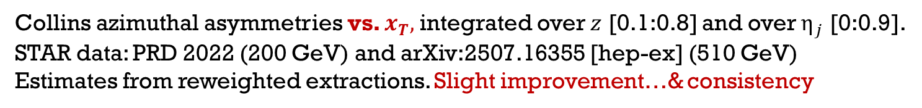
Use of reweighted extractions from SSAs
Collins azimuthal asymmetries vs. $x_{T},$integrated over $z$ [0.1:0.8] and over $η_{j}$ [0:0.9].
STAR data: PRD 2022 (200 GeV) and arXiv:2507.16355 [hep-ex] (510 GeV)
Estimates from reweighted extractions. Slight improvement…& consistency

Slide 31
Results [predictions vs. data]
Collins azimuthal asymmetries vs. $z$ integrated over $η_{j}$: [0:0.9], for various $p_{jT}$ bins.
STAR data: PRD 2022 (200 GeV)

Slide 32
Results [predictions vs. data]
Collins azimuthal asymmetries vs. $j_{T},$integrated over $z$ [0.1:0.8] and over $η_{j}$ [0:0.9], for various $p_{jT}$ bins.
STAR data: PRD 2022 (200 GeV)

Slide 33
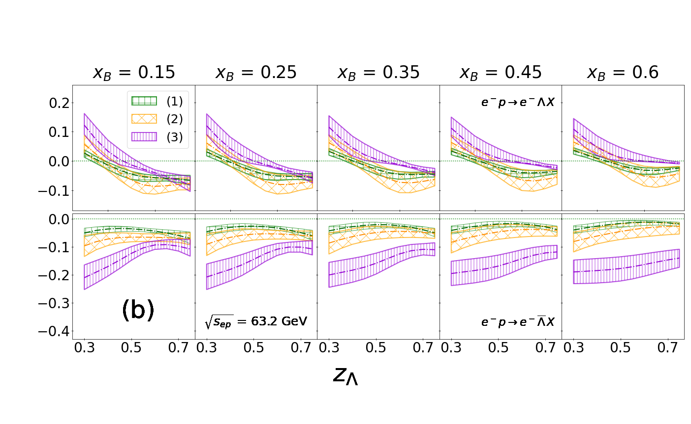

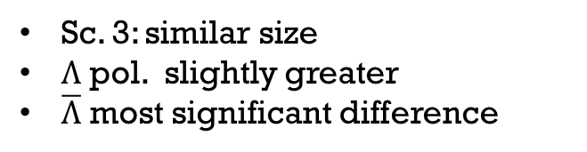
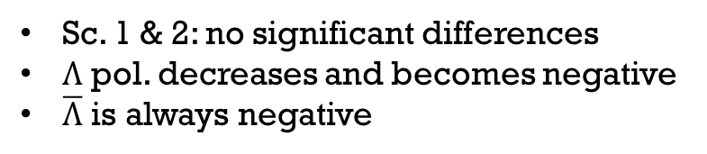
PREdICTIONS FOR EIC
Unpolarized PDFs:
CT14nnlo set
[Dulat et al 2016]
No ch, No SU(2)
ch, No SU(2)
ch & SU(2)
Sc. 1 & 2: no significant differences
$Λ$ pol. decreases and becomes negative
$\overline{Λ}$ is always negative
Sc. 3: similar size
$Λ$ pol. slightly greater
$\overline{Λ}$ most significant difference
Impact study in SIDIS@EIC (Sc 1 at LO) Kang, Terry, Vossen, Xu, Zhang 2022

Slide 35
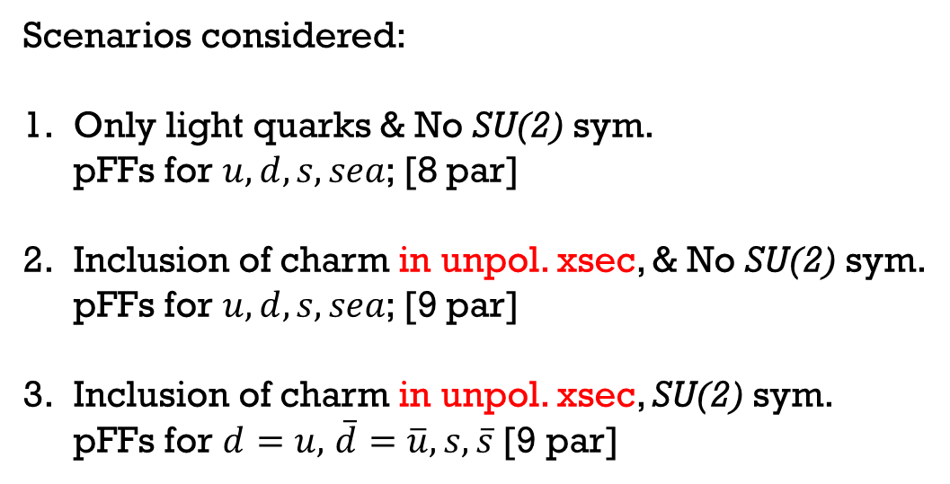
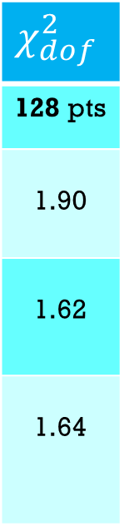
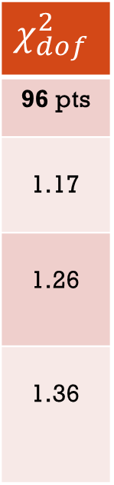
FIT of Belle data [NLL]
Data selection: $Λ+π/K$: $z_{π.K}$[0.5-0.9] bin excluded $→$ 96 data points (128)
$$χ_{dof}^{2}$$
96 pts
1.17
1.26
1.36
$$χ_{dof}^{2}$$
128 pts
1.90
1.62
1.64
Scenarios considered:
Only light quarks & No SU(2) sym.
pFFs for $u, d,s, sea$; [8 par]
Inclusion of charm in unpol. xsec, & No SU(2) sym.
pFFs for $u,d,s, sea$; [9 par]
Inclusion of charm in unpol. xsec, SU(2) sym.
pFFs for $d=u,$ $\overline{d}=\overline{u}, s, \overline{s}$ [9 par]

Slide 36
Transverse $λ$ polarization
Kang, Lee, Zhao 2020

