Slide 1
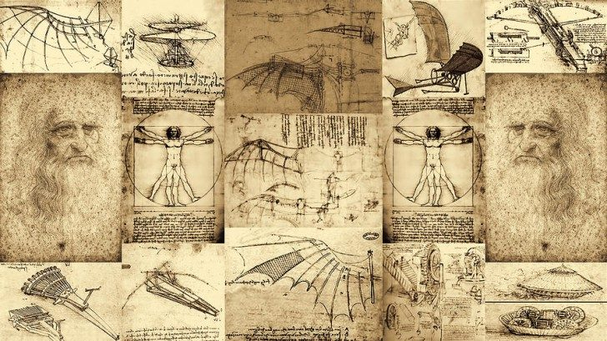
Physics for Radiation Medicine: where do we go?
Paweł Olko
Institute of Nuclear Physics Polish Academy of Sciences
Notes:
Prdicting the futuer is a risky job
fortune telling with tea leaves and cards

Slide 2
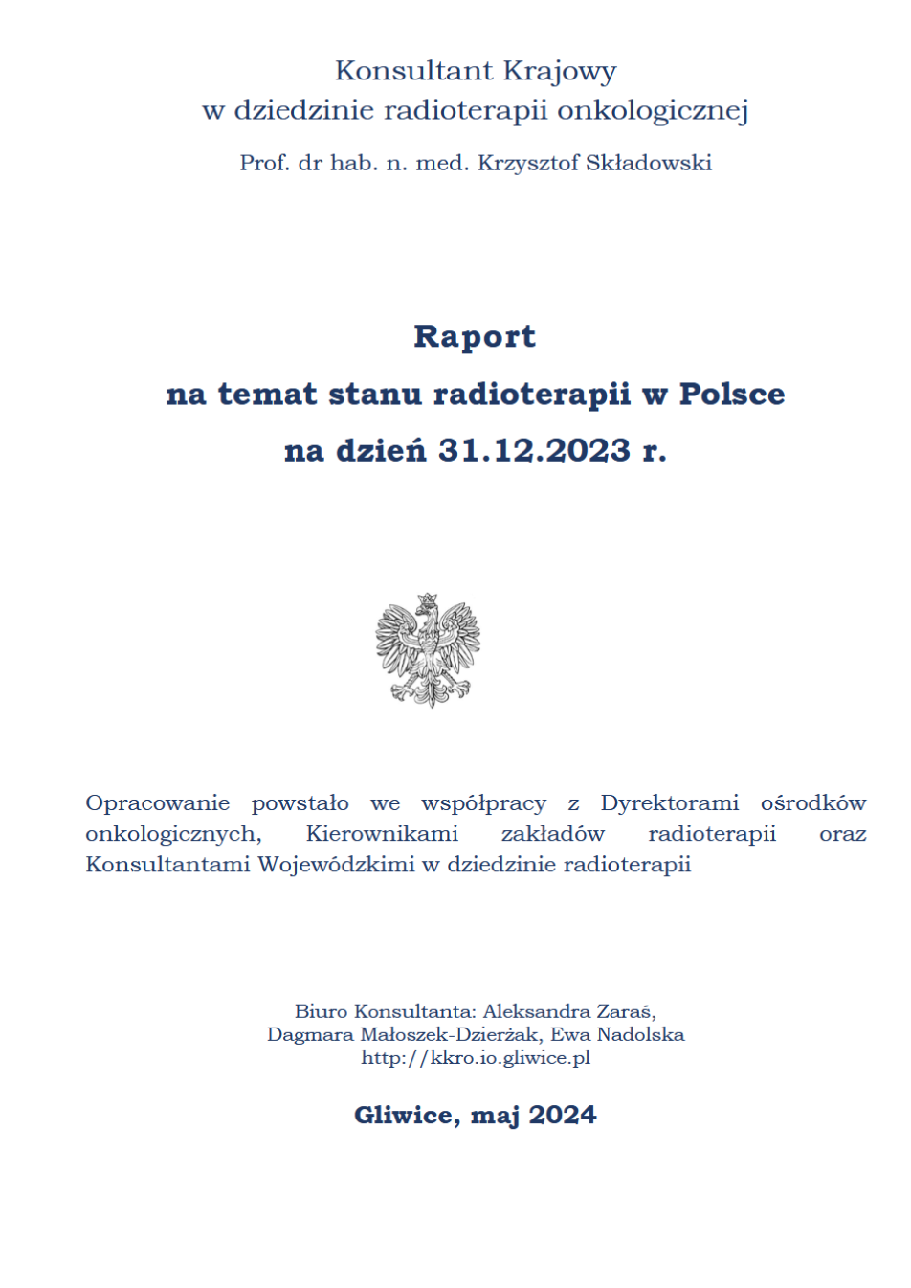
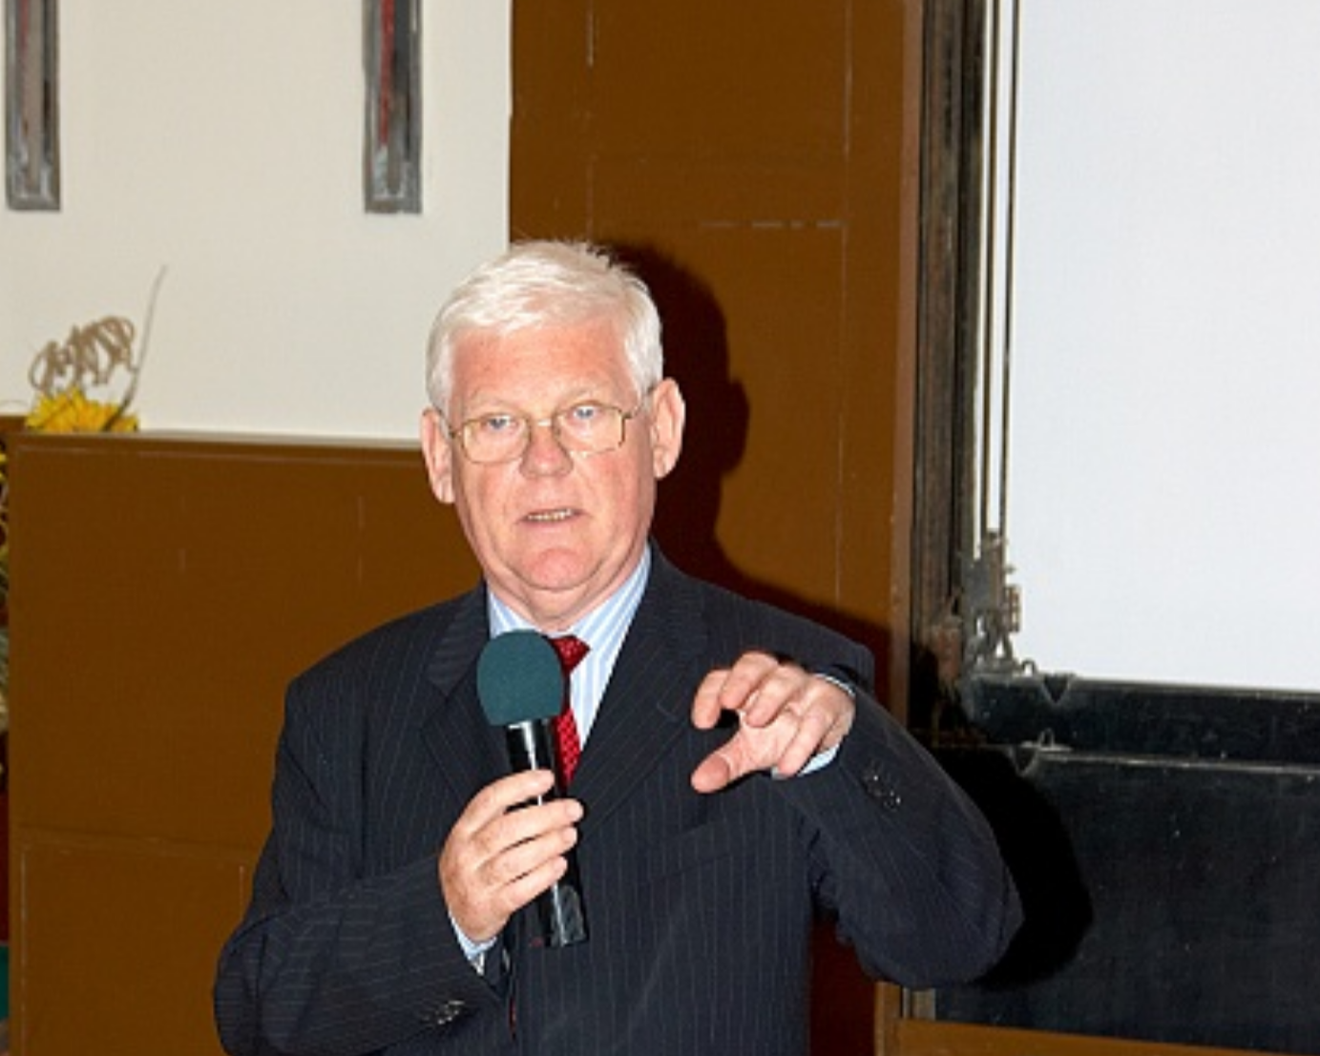
It is difficult to predict future directions …
My younger colleague, in 10 years there will be no more radiotherapy, the progress of gene therapy is so quick ...
Prof. Marian Reinfuss
chief radiation oncologist in Poland in 2004
… in 2023 105 890 patients in Poland underwent radiation therapy

Slide 3
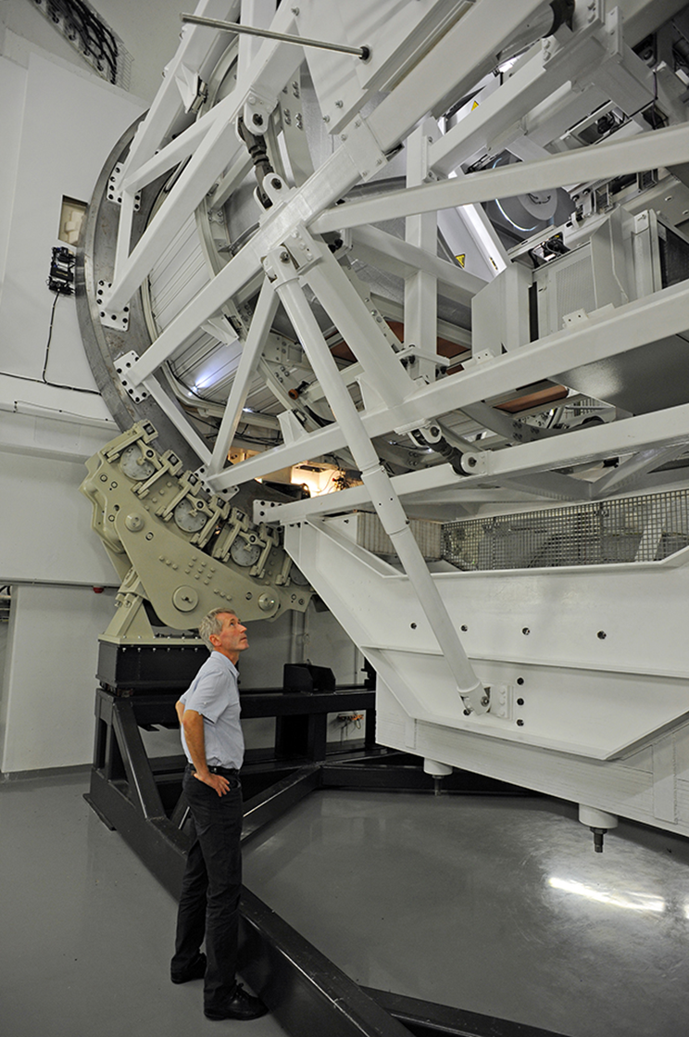
Outlook
1. Physics for radiation medicine: how did I get here?
2. Physics for radiation medicine: where do we go?
- detectors and dosimeters
- accelerators
- isotopes

Slide 4
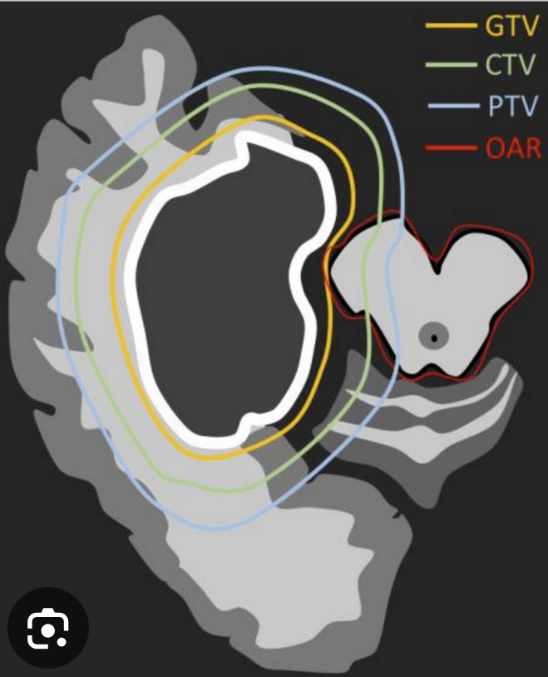
Challenges of radiation therapy
Gross Tumor Volume
Clinical Target Volume
Planning Target Volume
Organ at Risk
What to irradiate?
How to irradiate?
Was the irradiation correct?

Slide 5
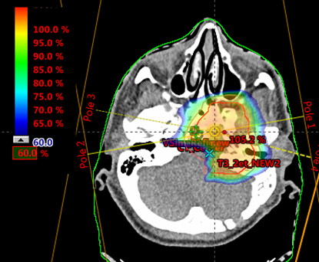
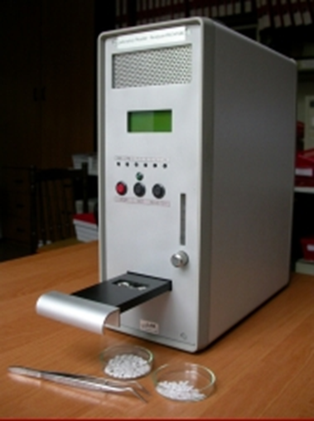
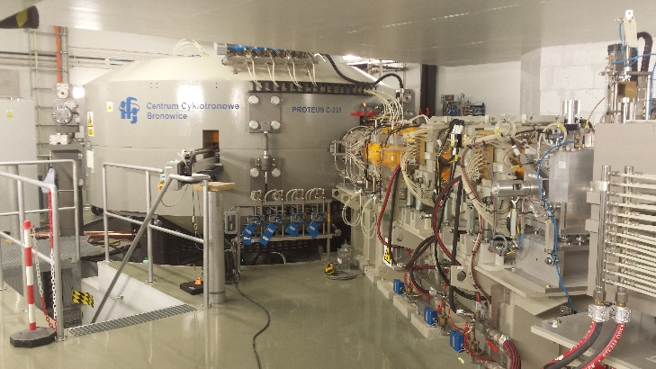
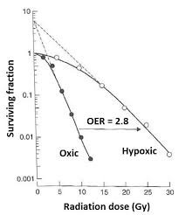
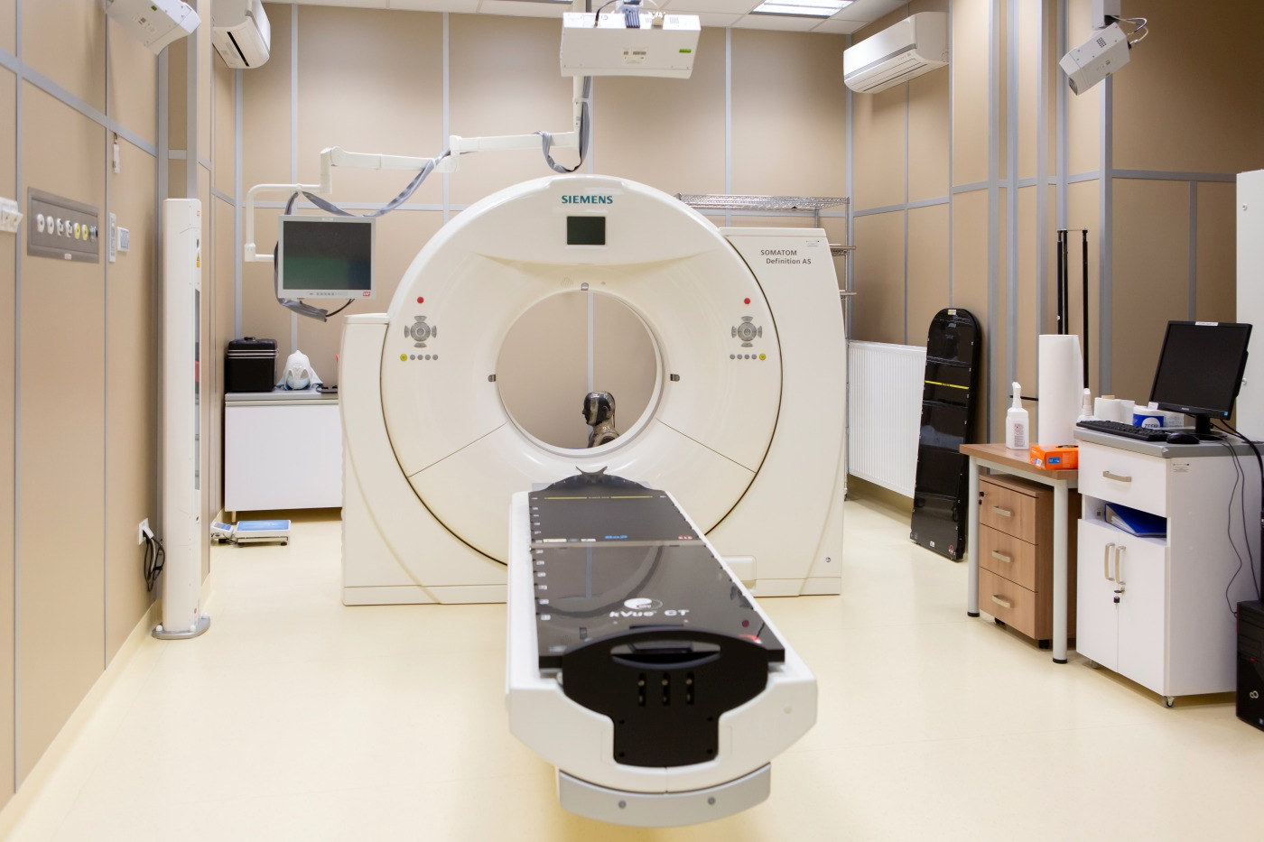
Radiation physics for medicin: how did I get here?
Curt. R. Kopec
radiation sources & accelarators
detectors and dosimeters
diagnostics
models

Slide 6
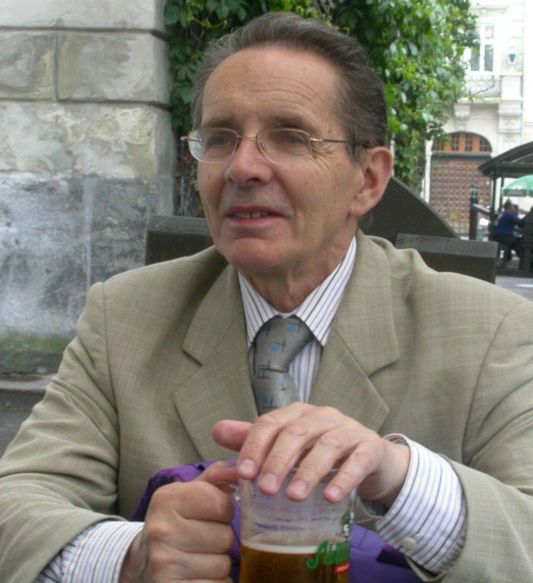
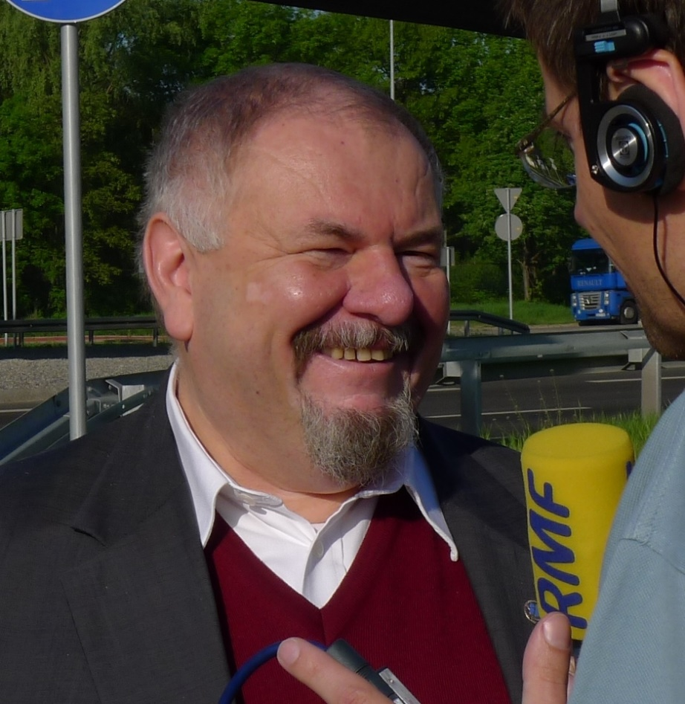
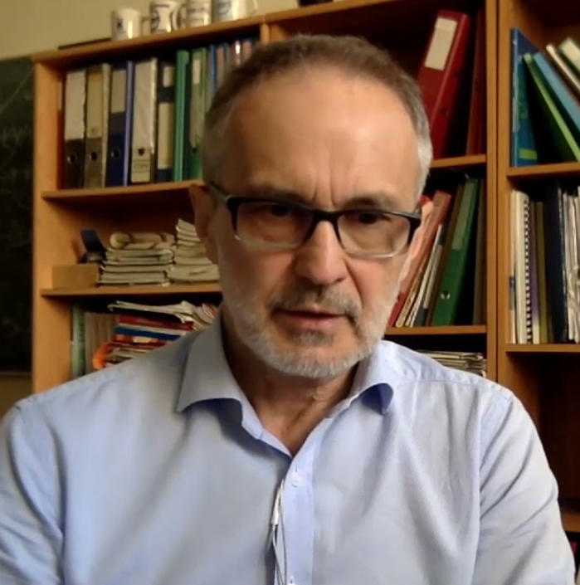
Directors IFJ PAN supported development of cyclotrons at IFJ PAN
prof. A. Budzanowski
Director IFJ PAN 1990 -2004
prof. M. Jeżabek
Director IFJ PAN 2004 -2020
prof. T. Lesiak
Director IFJ PAN from 2020

Slide 7
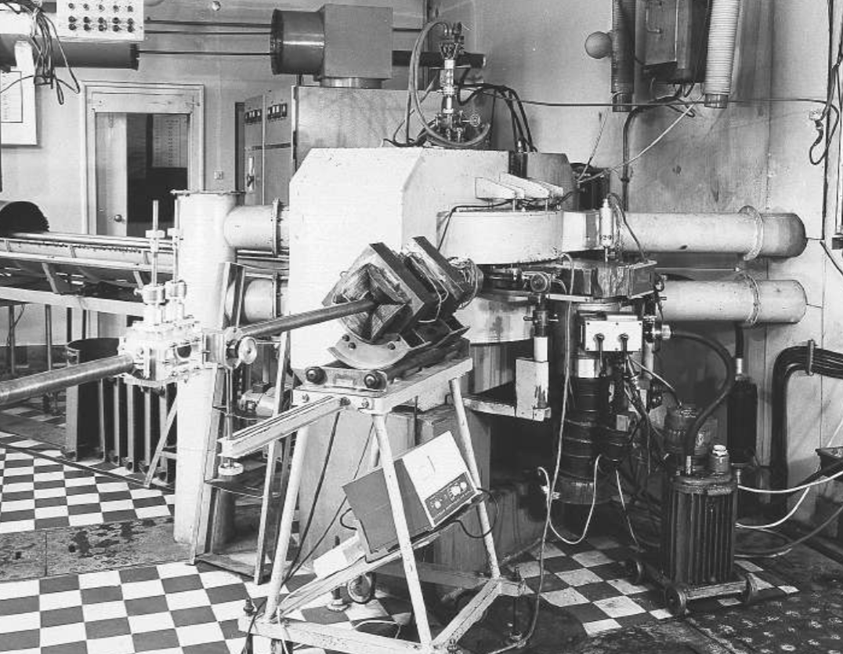
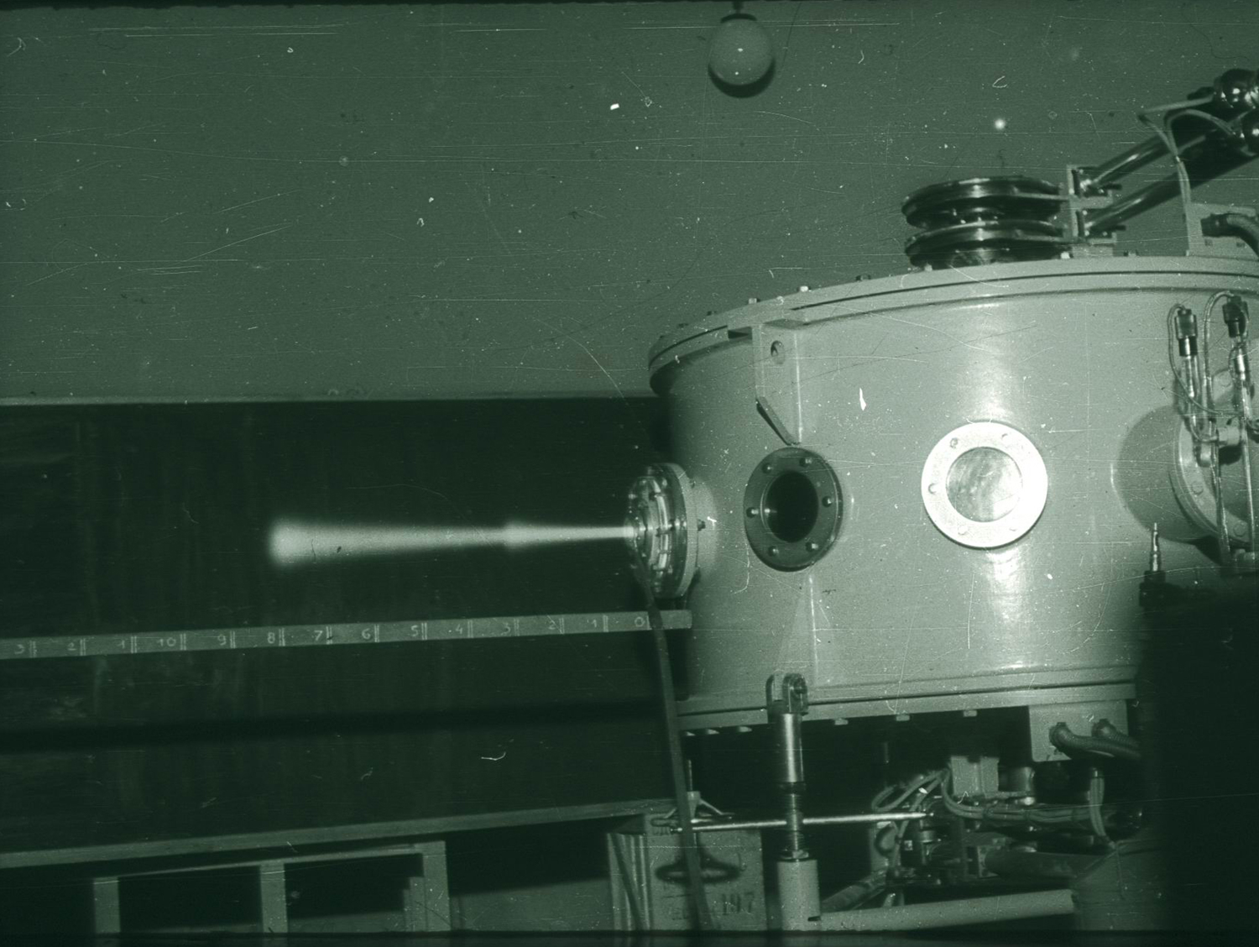

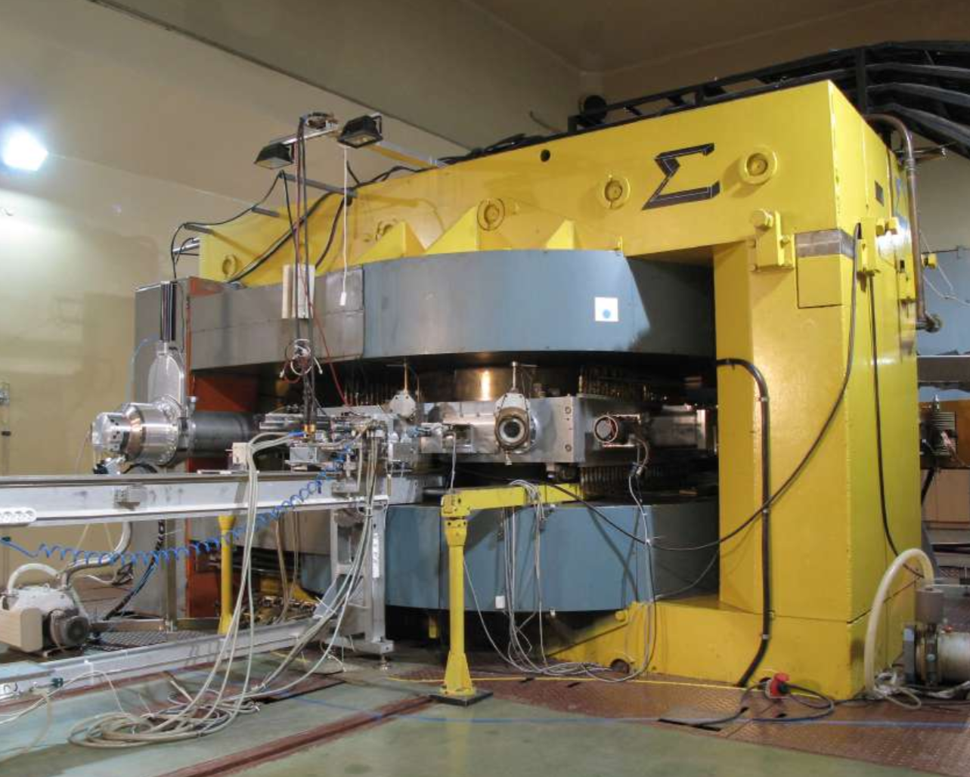
The competences in accelerator techniques was present from the beginning of the institute
C-48
2.5 MeV p
put in operation
28.12.1956
U-120
put in operation
11.1958
AIC-144
60 MeV p
first therapy
02.2011
C-230
228 MeV p
first beam
2013

Slide 8
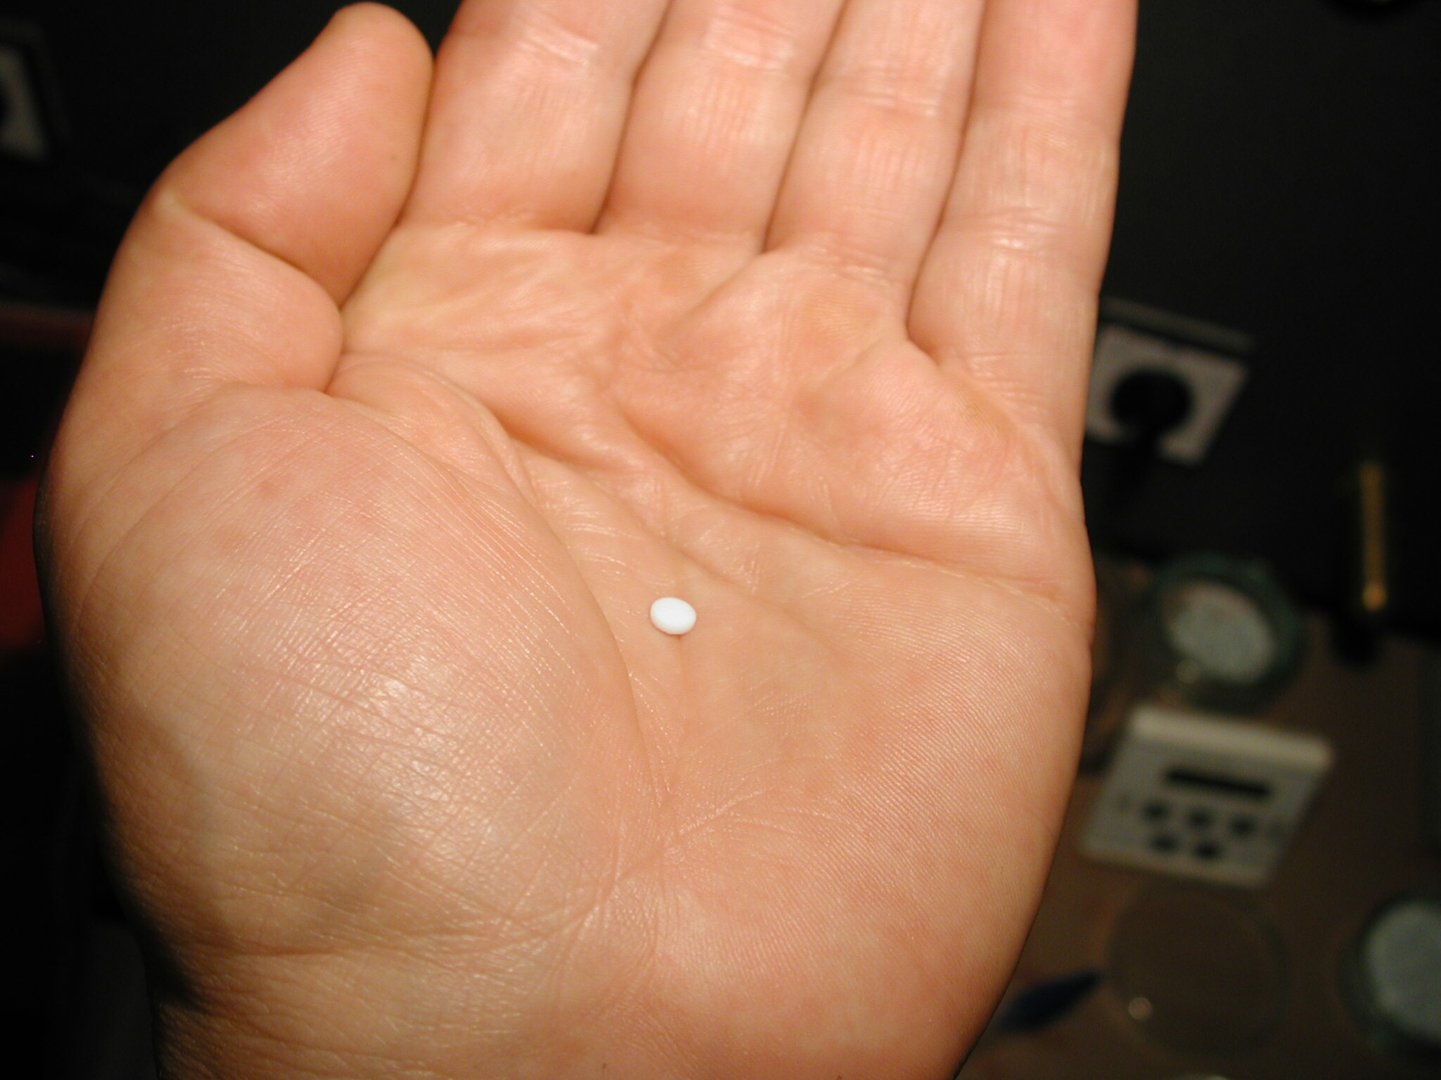
Thermoluminescent detectors
IFJ PAN success story

Slide 9

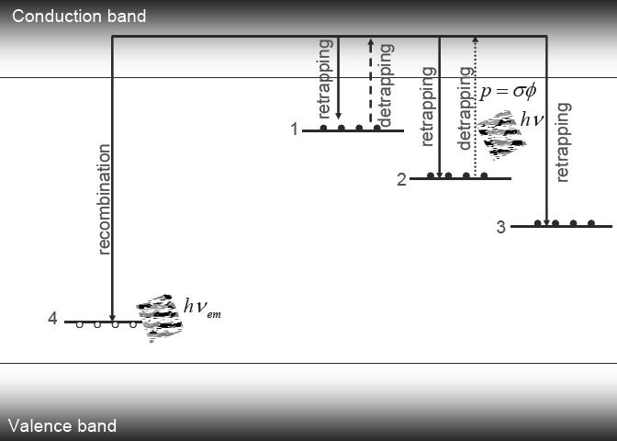
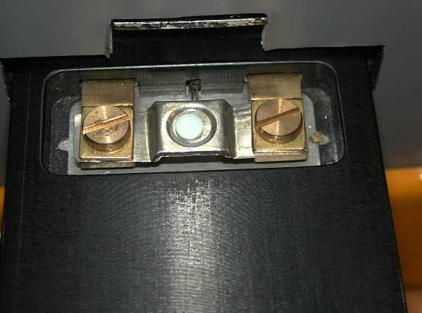
Thermoluminescence and thermoluminescent detectors
2 stages process:
Irradiation
free charge produced by ionizing radiation is trapped
2) Readout
Heating removes charge from trapping centers, recombination with emission of luminescent light
Luminescence
Heating
Yukihara, SSD 15, 2007

Slide 10
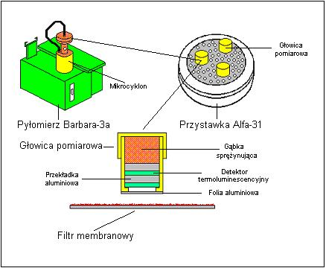
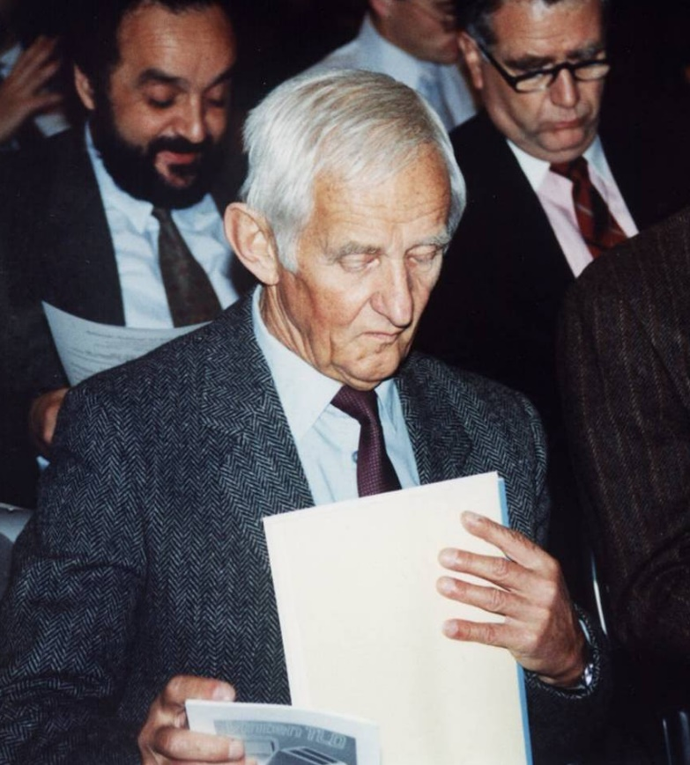
Tadeusz Niewidomski, the father of thermoluminescent dosimetry
1974 he patented LiF:Mg,Ti (MTS-N) thermoluminescence detectors. Today LADIS monitors 50,000 of radiation workers using those detectors,
1983 thin layer CaSO₄:Dy for radon measurements. For the next 30 years radon monitoring in Polish coal mines was based on those detectors
1985 high sensitive MCP-N (LiF:Mg,Cu,P) Break- through in environmental monitoring – it is possible to measure dose after a few hours of environmental exposure
Tadeusz Niewiadomski (1920-1996)
Radon monitoring of miners in Polish coal mines using detctors and device Alfa-31 developed by T. Niewiadomski

Slide 11
Microdosimetry – high doses in small volumes
ionizations
Indirect events
p⁺
Direct events
Tools:
Monte Carlo Track Structure codes
MOCA-8, MOCA-14, TRION
Nowadays: GEANT4 DNA
Results:
Analytical model for calculation of microdos. distributions for protons
Simulation of response of detectors
Biological Response Function

Slide 12
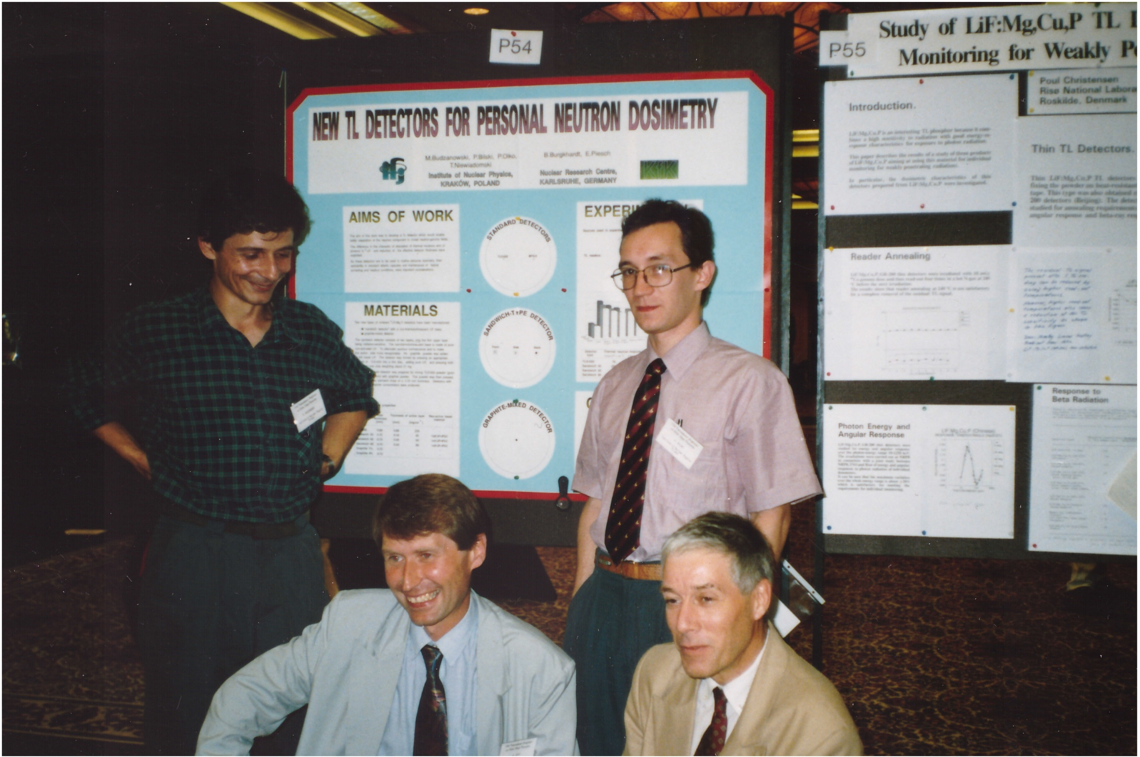
10th Solid State Conference, Washington July 1992
P. Bilski
M. Budzanowski
M. Maligórski

Slide 13
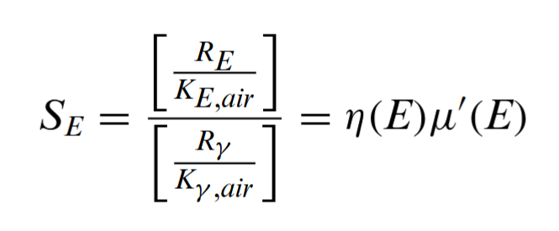
Anomalous photon energy response of MCP-N (LiF:Mg,Cu,P)
Relative energy response S’(E) of MCP-N (LiF:Mg,Cu,P) - does not follow ratio of mass energy absorption coefficients of LiF and air
?

Slide 14
Anomalous photon energy response of MCP-N (LiF:Mg,Cu,P)
Relative energy response S’(E) of MCP-N (LiF:Mg,Cu,P) - does not follow ratio of mass energy absorption coefficients of LiF and air
Microdosimetric effect caused by a reduction of relative efficiency, η, due to local saturation of response
The best oral presentation of 10th Solid State Dosimetry conference, Washington, 1992
Olko, P., Bilski, P., Ryba, E., & Niewiadomski, T. (1993). Microdosimetric interpretation of the anomalous photon energy response of ultra-sensitive lif:mg,cu,p tl dosemeters. Radiation Protection Dosimetry, 47(1-4), 31-35. https://doi.org/10.1093/oxfordjournals.rpd.a081697

Slide 15
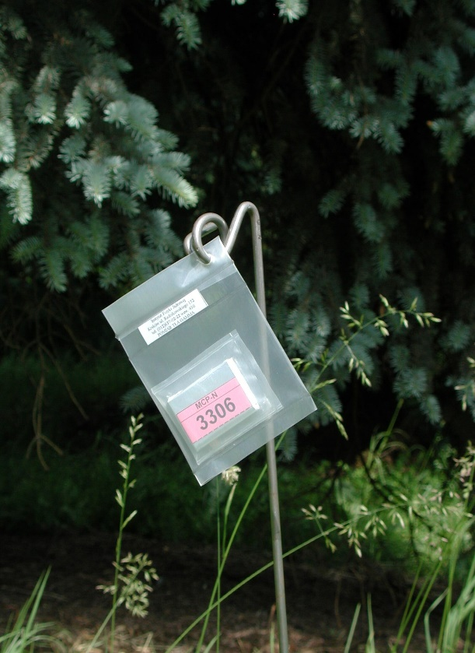
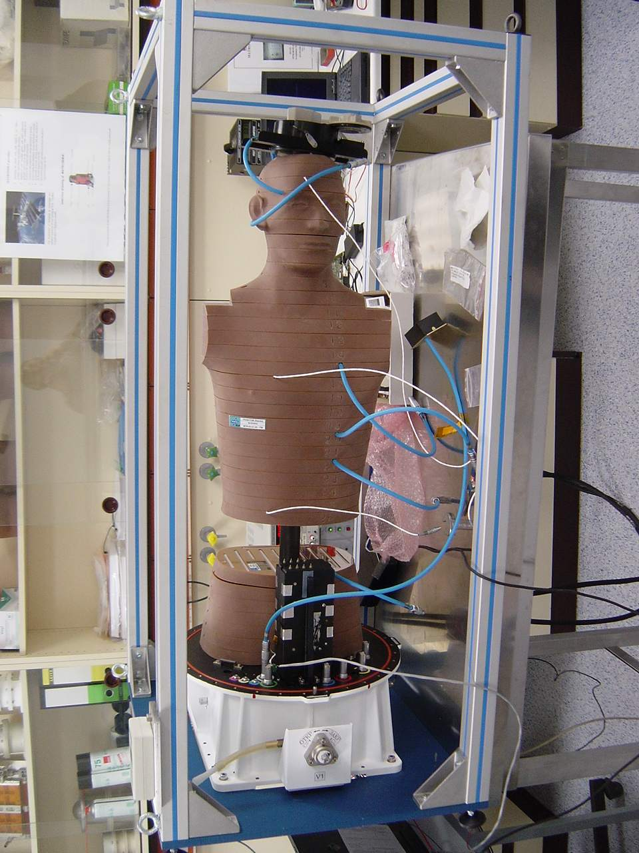
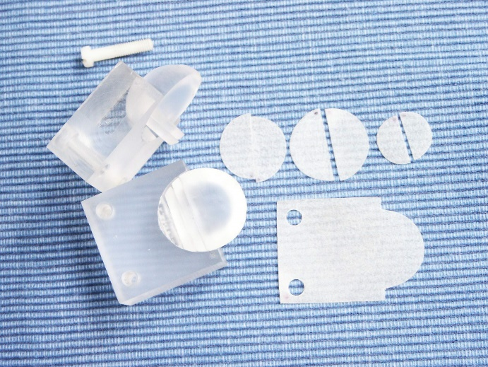
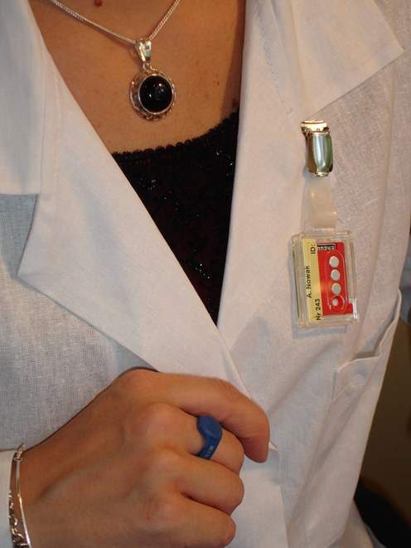
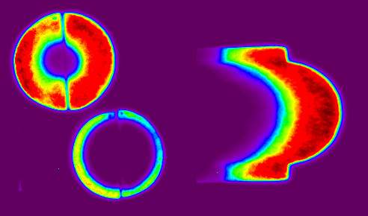
Broad applications of TLDs from IFJ PAN to dosimetry
Environmental measurements
Space flights – Matroshka project
Personal dosimetry
2D- irradiation after proton irradiation
P. Bilski, M. Budzanowski, M. Kłosowski, P. Olko – more than 100 papers published on TLDs

Slide 16

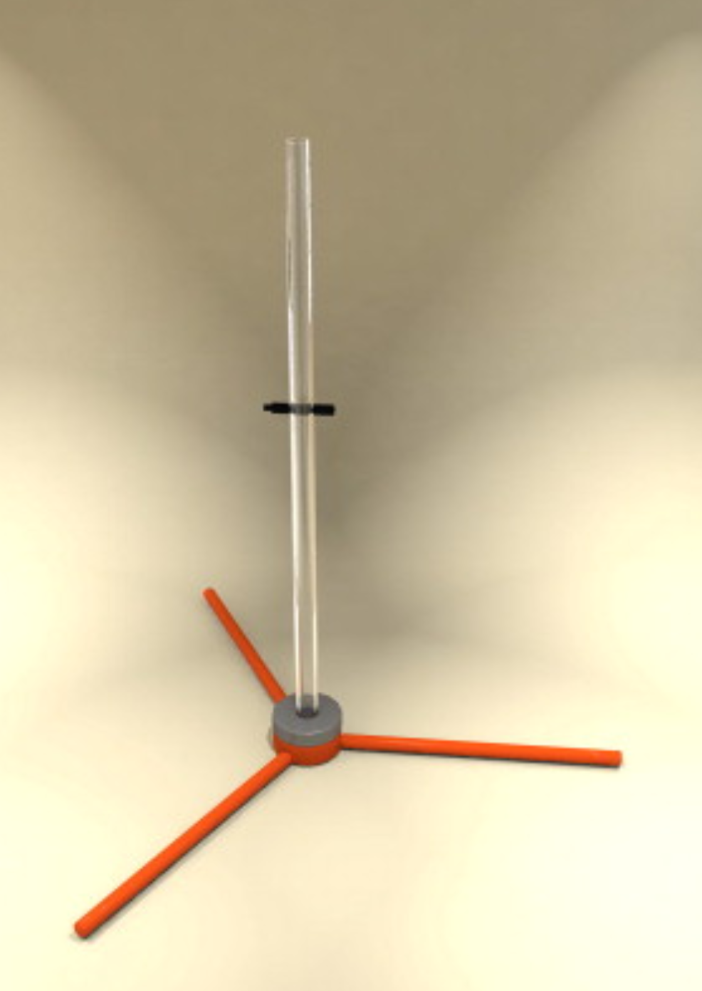
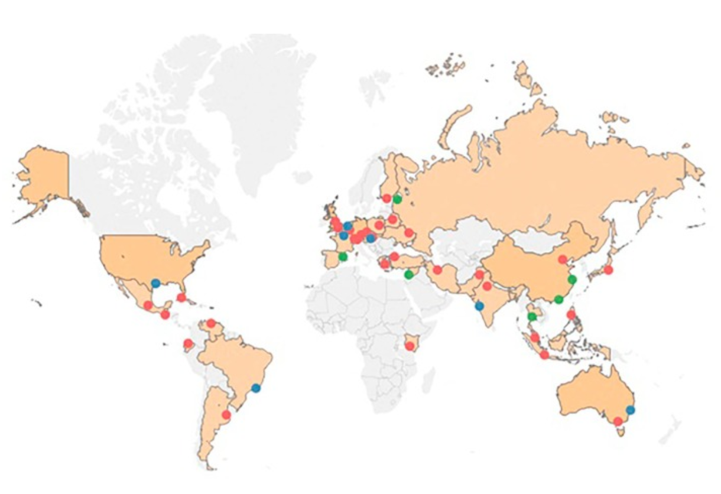
Is the dose to patient treatment correct?
– mailed dosimetric audit of radiotherapy units
Mailed dosimetric audit
TLD detectors distributed to hospitals
Irradiated at each radiotherapy unit
Returned and read-out at IAEA
The result should be within 2-5%
If exceeding 10% - the hospital inspected
Mailed dosimetry network built by IAEA
The system developed by J. Iżewska (IAEA)

Slide 17
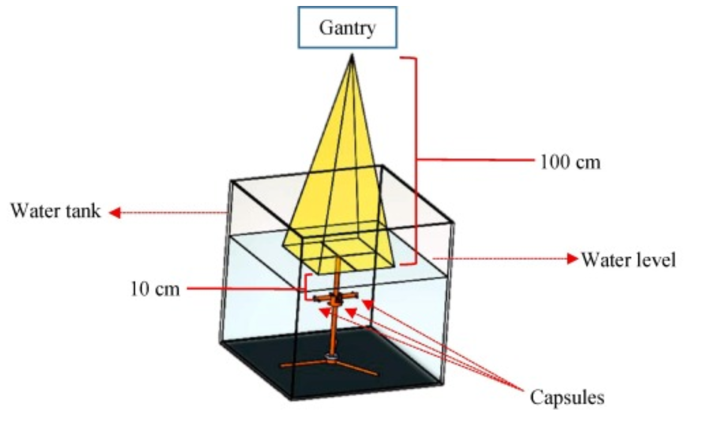
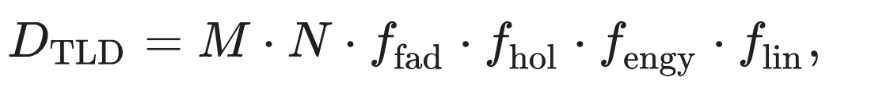

Mailed dosimetric audit of radiotherapy units – method
Detector: thermoluminescent LiF:Mg,Ti
Challenge: accuracy of dose measurements
$\frac{D_{true} −D_{TLD}}{D_{true}}$ < 1 %
Corrections of response on fading (f_{fad}), holder (f_{hol}), energy (f_{engy}) and linearity (f_{lin})
I worked at IAEA to develop and modify the TLD system 1998-1999

Slide 18
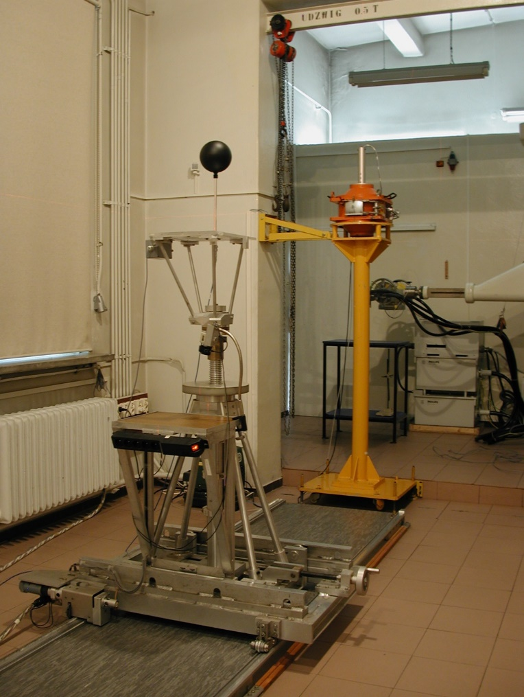
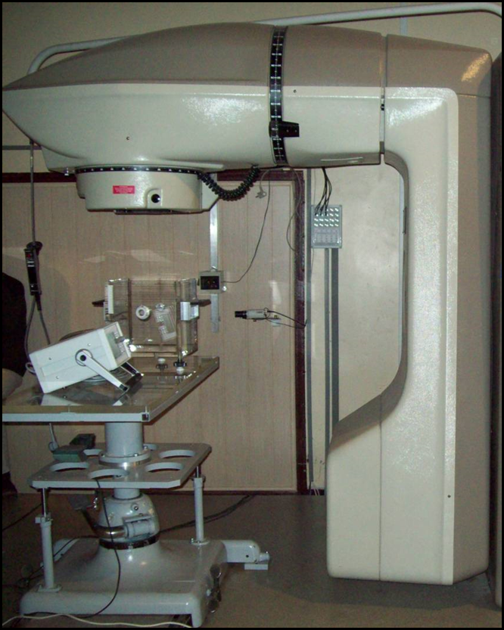
Calibration laboratories - a must for radiation therapy
First dosimetric laboratory in Poland with accreditation od Polish Center of Accreditation (2001)
Calibration for radiotherapy
Theratron 780 with Co-60,
high dose rate ( 1 Gy/min)

Slide 19
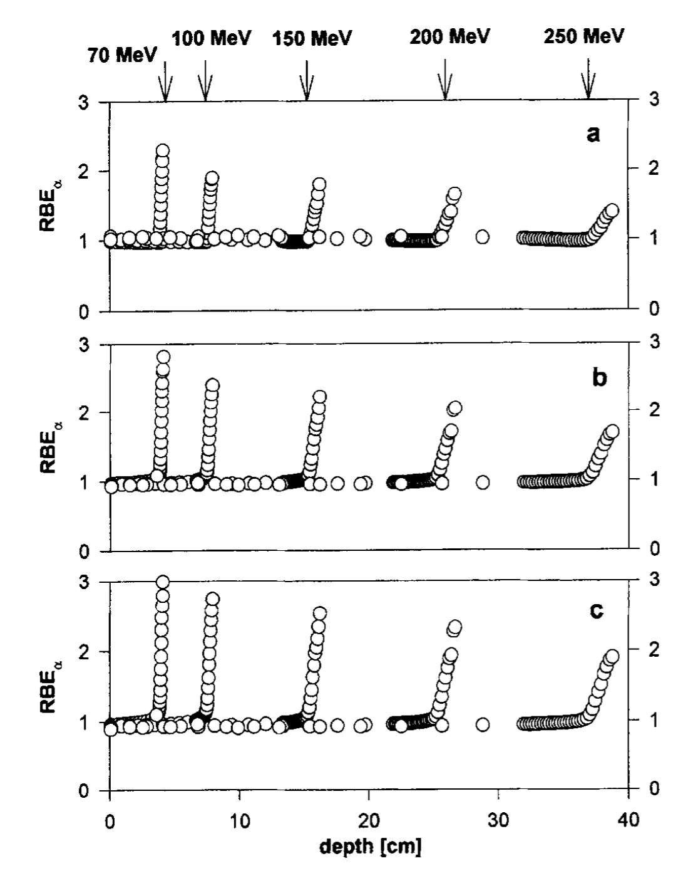
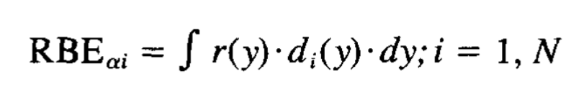
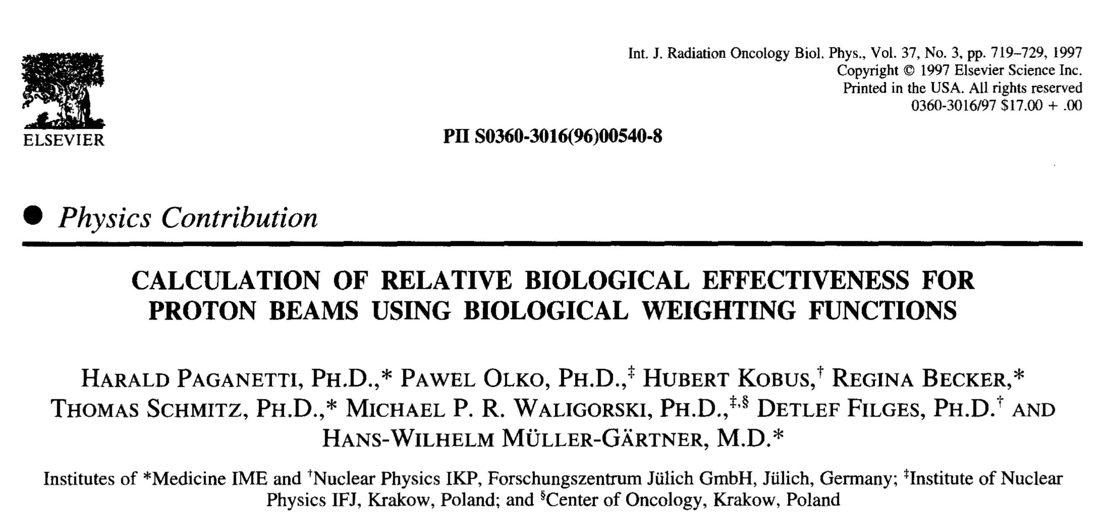
Microdosimetric calculations of relative biological effectivness (RBE) of protons
y = (energy deposited / mean chord lengths of target)
r(y) - biological response function
d_{i}(y) - lineal energy distribution
Conclusions:
- RBE grows at the end of Bragg peak
- depends on dp/p of the initial proton beam

Slide 20
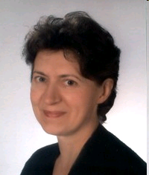
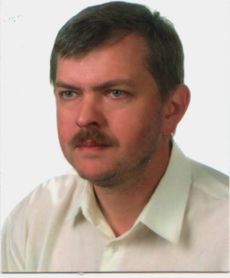
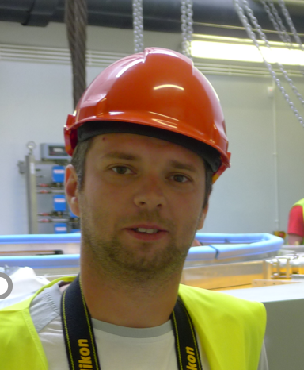
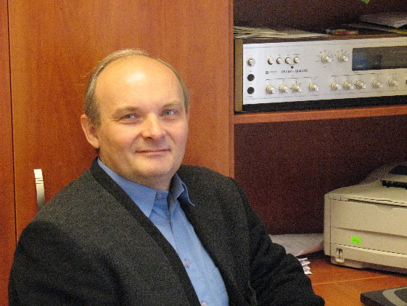
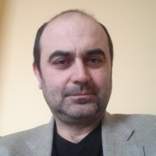
The beginning of proton eye cancer therapy
Bożena Romanowska –Dixon,
The head of Clinic of Ophthalmology and Ophthalmic Oncology, Collegium Medicum UJ Krakow
Jan Swakon the head of Proton Radiotherapy Group (2011) , IFJ PAN
Tomasz Kajdrowicz
developed TPS for eye treatment (2011)
Jacek Sulikowski, the head of AIC-144 cyclotron
Konrad Guguła the head of
C-230 cyclotron

Slide 21
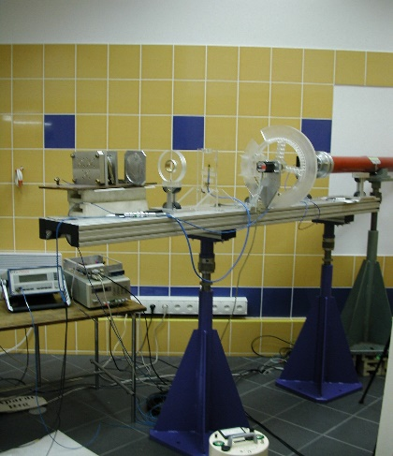
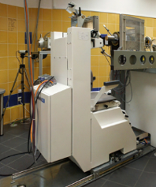
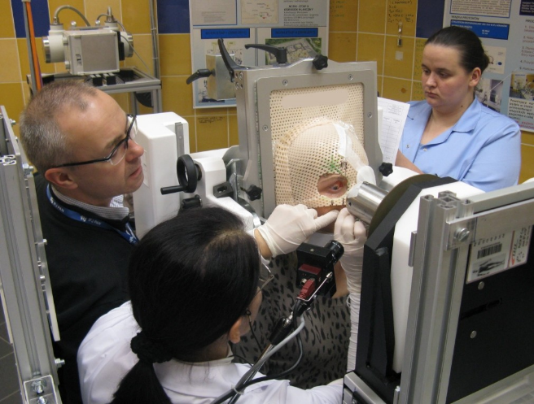
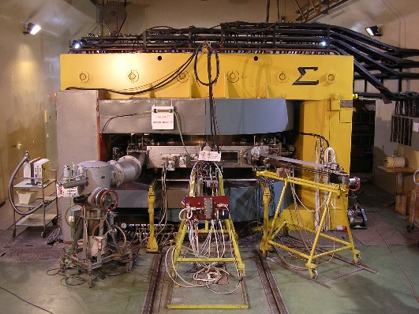
Proton therapy of eye – a long way to the first patient (1994 – 2011)
First internat. workshop
Proposal to KBN – failed
Proposal for offset for F-16
failed
Proposal Isotopes and Accelerators
failed
Funding dosimetry IAEA- 2009
Proposal to D-PL fundation –
failed
Proposal to Min. Health- failed
Norwegian Fund 2010
Funding new HF generator to AIC by Min. Science
Extraction 58 MeV beam from AIC
Funding treatment chair – Min Health - 2006-2007
First treatment of eye at AIC-144 18.02.2011
Funding eye treatment room KBN opening 21.02.2001
Funding by PAA
installation of AIC cyclotron

Slide 22
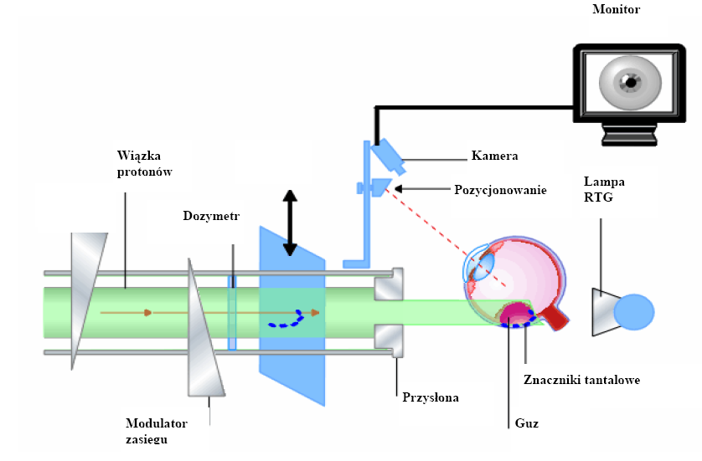
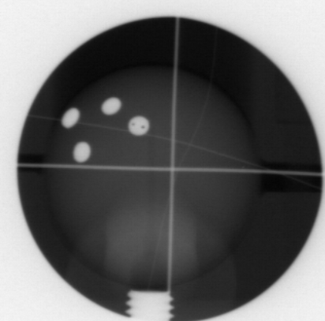
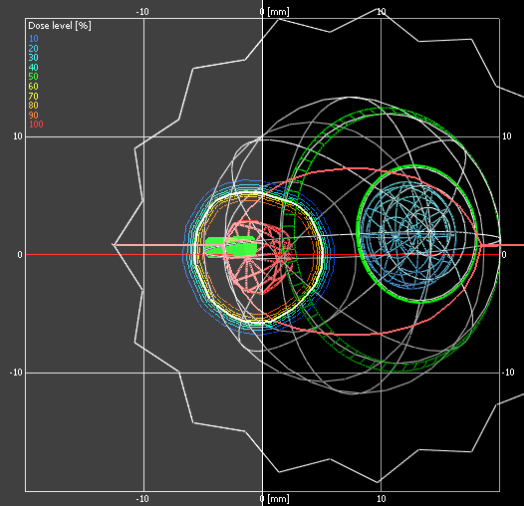
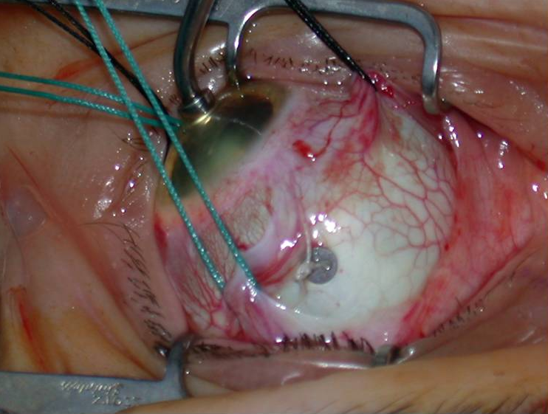
The method of proton therapy of eye cancer
T. Kajdrowicz, M. Bajer
Treatment Planning System Eclipse
To learn more go to Jurek Grębosz web page:
https://www.ifj.edu.pl/private/grebosz/new_look/filmy_ang.html

Slide 23

The first eye treatment completed, February 2011

Slide 24




Cyclotron Centre Bronowice: the teamwork (March 2011)
P. Olko
M. Zydek
M. Jeżabek
A. Maj

Slide 25





Cyclotron Centre Bronowice: from the first proposal to the first patient (2006–2016)
Proposals for CCB and gantry – failed
First proposal to OP IE failed
Gantry 2 operational
Contract with Min. Science for CCB- 1st phase
Contract with Min. Science for gantry
Gantry 1 operational
Poland joint EU
Installation of C-235 cyclotron May 2012
First promise from Min. Science for 25 MEuro
Signing first contract with IBA 08.2010
First patient February 2016
Building completed

Slide 26

Ionizing radiation was used for diagnosis and therapy immediately after discovery
Radiation Therapy
It is impossible nowadays – before a device is to be used to treat patients it must receive a CE Medical or FDA (USA) stamp
: X-rays were used for the first time to treat cancer, in breast cancer patients
1900: Skin cancer patients were treated
with X-rays
1903: The first attempt to treat leukemia
with radiation therapy
Wilhelm Konrad Röntgen discovery of x-rays on 28 Dec 1895
7 Feb 1896 first diagnosis at University Hospital, Kopernika street, Krakow

Slide 27

CE Medical certificate for eye treatment line – 2015
The first patient February 2016

Slide 28











Acknowledgements to my graduates in proton therapy and/or TLDs
Dr. A. Wochnik
Dr. Natalia Mojższek
Dr. J. Baran
Dr. J. Gajewski
Dr. M. Liszka
Dr. M. Kłodowska
Dr. K. Jeleń
Dr. M. Puchalska
Dr. L. Stolarczyk
Dr. Fabio Schirru
Dr hab. R. Kopeć
Dr. M. Garbacz
Dr. B. Obryk

Slide 29


Patient treatment at the Cyclotron Centre Bronowice
> 1800 patients treated with protons
> 100 children
40-50 patients are irradiated every day
dr hab. Renata Kopeć,
Prof. IFJ PAN, head of CCB

Slide 30
Research projects on medical physics
1. HORIZON-EURATOM-2021-NRT-01 ,"Towards safe, optimized and personalized radiology and radiotherapy procedures for pregnant patients" (SONORA) Dawid Krzempek 2024/08/X/NZ7/00625
2. MINIATURA 8 Tytuł: Combination of modern, complex multidrug chemotherapy with radiotherapy (proton or photon) as a new treatment strategy for glioblastoma multiforme, Anna Zając-Grabiec, 11.10.2024 - 10.10.2025, 49 500 zł
3. Science for Society, NdS/544985/2021/2021 Image-guided proton radiotherapy for the treatment of musculoskeletal tumors, Renata Kopeć, : 31.05.2022 - 31.05.2025, 1 715 800 zł
4. Science for Society II, NdS-II/SP/0295/2023/01, The importance of proton radiotherapy in the treatment of patients with central nervous system tumors, Justyna Miszczyk, 21.12.2023 - 20.12.2026, 1 000 000 zł
5. Science for Society NdS-II/SP/0292/2024/01, Optimization of irradiation methods and dosimetric characteristics of the FLASH proton beam, Marzena Rydygier, 29.03.2024 - 28.03.2027, 1 000 000 zł
6. Science for Society 01.01.2025, NdS/544748/2021/2021, Application of computational dosimetry in proton radiotherapy of oncological patients, Antoni Ruciński, 02.09.2022 - 01.01.2025, 1 570 200 zł
7. Weave-UNISONO, Computational and Experimental Nanodosimetry in Proton Radiotherapy, Antoni Ruciński, 3 343 200 zł , 48 months
8. SONATA BIS-14, From Plasmid DNA to FLASH Radiotherapy: Experiments and Computations, Antoni Ruciński, 5 536 200,00 zł
9. Pianoforte: KAYAC+: Knowledge on outcome of adolescent and young adults with cancer – Renata Kopeć (in signature)
10. NCN SONATA 2021/43/D/ST5/03042 3D dosimetry based on optically stimulated luminescence - facilitating the high-resolution proton radiotherapy, Michal Sądel, 2022-2025 (810 000 zł) NZ63

Slide 31
Radiation physics contribution to medicine: where do we go?

Slide 32


Challenges: proton range uncertainty
Because of range uncertainty additional margin M is set:
3.5% of the range + 1–3 mm
For range R= 15 cm -> M = 8.3 mm
The major source of uncertainty (up to 3%) comes from ambiguity of proton Stopping Power Ratio (SPR):
HU(ρ₁,Z₁) = HU (ρ₂, Z₂)
SPR (ρ₁,Z₁) ≠ SPR (ρ₂,Z₂)
Dong, 2012
Haunsfield unit

Slide 33

Proton range uncertainty
Solution: Dual Energy Computed Tomography (DECT)
Combination of H as a combination of HU for low energy (80 kVp) and high energy (140 kVp) X-rays
N. Peters et al. Rad. Oncol. 166 (2022)

Slide 34


Proton range uncertainty
Solution: PET monitoring of proton induced β+ activity in the body
MC simulation of produced and reconstructed activiy from J-PET measurements
J-PET setup at CCB in collaboration with P. Moskal (UJ)
A. Ruciński LIDER/26/0157/L-8/16/NCBR/2017

Slide 35

Carbon ions: how to determine range uncertainties?
Radioactive C-11 beam, β⁺ T_{1/2} = 21.34 min
C-12 and He-4 beams are accelarated simultanously
Measurements with Positron Emission Tomography (PET) allows to determine the stopping ends of C-11 ions
He-4 ions of the same E/amu are passing the patient and their range allows to determine the range of C-12 in patient
D. Boscolo et al., Front. Oncol. 11, (2021), DOI: 10.3389/fonc.2021.737050
L. Volz et al., Phys Med Biol 65, (2020), DOI: 10.1088/1361-6560/ab6e52

Slide 36

FLASH irradiation: the hope or illusion?
at IFJ PAN
Damian Wróbel: PhD Thesis Dosimetry of FLASH protons at AIC-144
supervision of Jan Swakoń
Marzena Rydygier
Dosimetric characterization of the FLASH beam
Science for Society (2024-2026)
Antoni Ruciński
From Plasmid DNA to FLASH Radiotherapy: Experimental and Computational Insights
Sonata Bis (2025-2027)
FLASH radiotherapy (FLASH-RT)
is a cancer treatment that delivers an extremely high dose of radiation to a tumor in a short (< 1 s) time.
FLASH not confirmed clinically (only on a few patients treated)
Worth to investigate: both positive or negative result might be interesting

Slide 37
Attempts to decrease the price of proton and ion therapy
Treatment in the upright position
Volz et al. Phys. Med. Biol. 69 (2024)
- The costs of the rotating gantry is very high
- The scanning beam should have only magnets moving beam vertical

Slide 38

Treatment in the upright position at CCB?
- Potentially , there is a place at CCB for installation of such a treatment chair
- It might increase the patient throughput even by 50%
The place for installation of beam line

Slide 39



Cyclotron Centre Bronowice – a mid life upgrade?
Cone Beam CT for better patient positioning
Next generation true DECT
Line for upright position?
Modern Treatment Planning System (RaySearch)?

Slide 40


Progress to fight metastasis - radioisotopes
Cyclotrons
Reactors
a variable-energy IBA Cyclone® 30 XP,
p(400 μA), d (50 μA), α (50 μA)
from 15 to 30 MeV
30 MW Maria reactor at Świerk by Warsaw
¹¹C, ¹⁵O, ¹⁸F, ⁴⁷Sc, ⁶¹Cu, ⁶⁴Cu, ⁶⁷Cu, ⁶⁷Ga, ⁶⁸Ge, ⁸²Sr, ⁸⁹Zr, ⁹⁹Mo, ¹¹¹In, ¹²³I, ¹²⁴I, ²⁰¹Tl, ²¹¹At, ²²⁵Ac
¹³¹I, ³⁵S, ³²P, ⁹⁹Mo, ¹⁵³Sm, ¹⁶⁹Yb, ⁶⁰Co and ¹⁷⁷Lu
www.technopolis-group.com
Notes:
Select the isotope you want to produce to see which equipment you need.
F18
N13
Zr89
Cu64
Cu61
Tl201
Ga67
Sr82
Ge68
Mo99
At211
Ac225
Cu67
Sc47
Laser-accelerated proton beams have been applied to radioisotope production for medical purposes by several groups.1–4 In 2011, Kimura and Bonasera5 analyzed the feasibility of laser production as an alternative to other methods. Since then, laser technology has greatly improved, and high-repetition lasers in the petawatt regime are available at a cost competitive to accelerator-based systems. These laser systems rely on chirped pulse amplification (CPA)6 to push laser intensities beyond 1018 W/cm2. At such intensities, ions from the target surface irradiated by the laser beam are accelerated to energies of several MeV by the action of the laser in stripping the less strongly bound electrons from the target and thus creating a strong (repulsive) electric field that accelerates the ions. Without going into the details of the mechanism, we will loosely refer to it as target normal sheath acceleration (TNSA),1–5 and we discuss an intuitive scenario which we put to an experimental test in this work. We assume that the stripped electrons leave a positively charged target. Ions or protons on the opposite sides of the target surface feel the repulsive Coulomb field, are accelerated, and leave the target area, thus decreasing the Coulomb repulsion. In particular, the shorter the laser pulse, i.e., the faster the laser energy is released on the target, the more rapidly the positive electric field at the target increases. Thus, we may expect higher proton energies for shorter pulses and thin targets.4 The accelerated ions will move in the direction perpendicular to the target and in both directions (i.e., forward and backward) with respect to the laser direction, possibly with different intensities. With protons reaching 60 MeV and above,7 isotope production becomes possible, and in this context, we will discuss experimental results on the following systems:
63Cu(p,n)63Zn, Q = −4.15 MeV;
70Zn(p,4n)67Ga, Q = −27.68 MeV;
70Zn(p,α)67Cu, Q = 2.62 MeV;
10B(p,α)7Be, Q = 1.14 MeV;
11B(p,n)11C, Q = −2.76 MeV;
18O(p,n)18F, Q = −2.44 MeV.

Slide 41

Accelerators for Alpha Emitters Production – a Chance for IFJ PAN?
Radiolabeled antibodies particularly effective with alpha-emitting radionuclides:
Cyclotrons have too small current for efficient production of Astatine-211 (T_{1/2} = 7.2 h), limited by extraction losses.
²⁰⁹Bi (α, 2n) ²¹¹At
The optimal energy for this reaction: 28 MeV (below the threshold for production of ²¹⁰Po)
Spin-off of low energy section of carbon therapy linacs q/m =1/2
Beam current offered by ion sources designed at CERN: 2 mA!!!!
dr Arshiya Anees Ahmed (NZ64)
IFJ PAN seminar 27-02-2025
Department of Nuclear Physical Chemistry (NZ64) (prof. J.W. Mietelski) has long competences in investigation the process of production of radioisotopes
Notes:
Lutet (177Lu) rozpada się do stabilnego hafnu (177Hf). Rozpadowi towarzyszy emisja cząstek β- o maksymalnej energii 498 keV (średnio 149,2 keV) i emisja kwantów promieniowania gamma o energiach głównie 208 keV (10,4%) i 113 keV (6,2%). Okres półtrwania lutetu (177Lu) wynosi 6,65 dni.
Radiolabbeled antibodies particularly efefctive with alpha-emitting radionuclides
Metasttic
Personalised medicinie
If the isotope is also gamma or beta emiter can be coupled to diagnostc too optimise the dose (theragnostics)

Slide 42
Scientific Advisory Committee of IFJ PAN (2025)
prof. Fulvio Piccinini (Istituto Nazionale di Fisica Nucleare),
dr Maurizio Vretenar (CERN),
prof. Robert Feidenhans’l (European XFEL GmbH),
prof. Marek Lewitowicz (Grand Accélérateur National d’Ions Lourds),
prof. Achille Stocchi (Laboratoire de physique des 2 infinis - Irène Joliot-Curie)
,
prof. Helmut Schober (European Spallation Source).
Someone from applications of physics ?
Someone from a proton therapy center?

Slide 43
Where do we go?
Is the upgrade of CCB a priority?
What with CCB after 2035?
Should we plan any other significant infrastructure at IFJ PAN within next 10 years?
Should it be discussed within the Scientific Council of IFJ PAN?

Slide 44
Where do we go?
ChatGPT ….
Yes, the expansion of Centrum Cyklotronowe Bronowice (CCB) is a strategic priority for the Institute of Nuclear Physics Polish Academy of Sciences (IFJ PAN).
The project is part of Poland's national roadmap for research infrastructures, which includes 70 high-potential scientific facilities.
CCB is listed among these due to its significant contributions to both medical and fundamental research.
In summary, the development of CCB is a central component of IFJ PAN's mission to advance both scientific research and medical applications, aligning with national and international strategic objectives.
Is the upgrade of CCB a priority?
What with CCB after 2035?
Should we plan any other significant infrastructure at IFJ PAN within next 10 years?
Should it be discussed within the Scientific Council of IFJ PAN?

Slide 45
Where do we go?
ChatGPT…
Yes, planning additional significant infrastructure at the Institute of Nuclear Physics Polish Academy of Sciences (IFJ PAN) within the next decade is advisable.
IFJ PAN is actively involved in several strategic projects that align with national and international research priorities. These initiatives are part of the Polish Roadmap for Research Infrastructures, which identifies key facilities contributing to scientific excellence and innovation.​
Currently, IFJ PAN is coordinating the Cyclotron Centre Bronowice (CCB) and the Centre of Engineering of Cryogenic Materials and Research Equipment (…)
Given the dynamic nature of scientific research and technological advancements, it is essential to continually assess and plan for infrastructure development. This ensures that IFJ PAN remains at the forefront of scientific discovery and continues to contribute effectively to both national and international research communities.
Is the upgrade of CCB a priority?
What with CCB after 2035?
Should we plan any other significant infrastructure at IFJ PAN within next 10 years?
Should it be discussed within the Scientific Council of IFJ PAN?

Slide 46
Thank you!
This was only possible because I had the privilege of working at IFJ PAN

