Slide 1
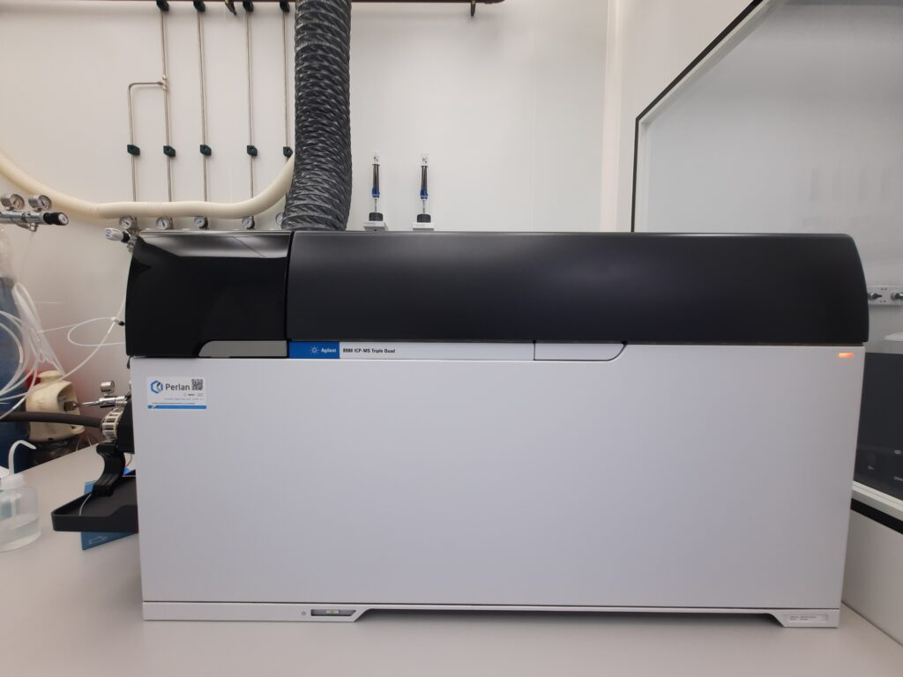
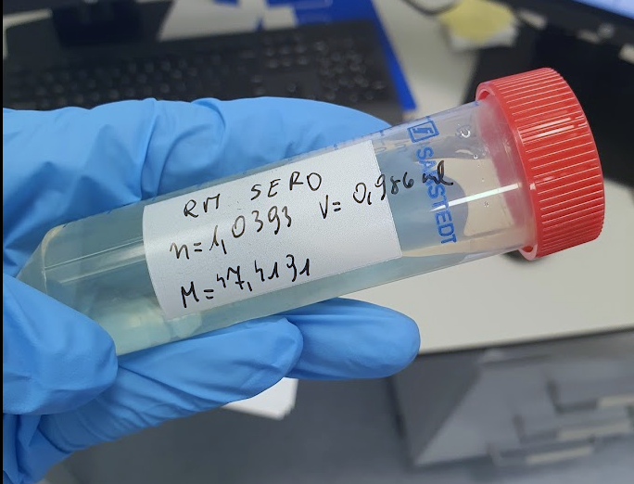
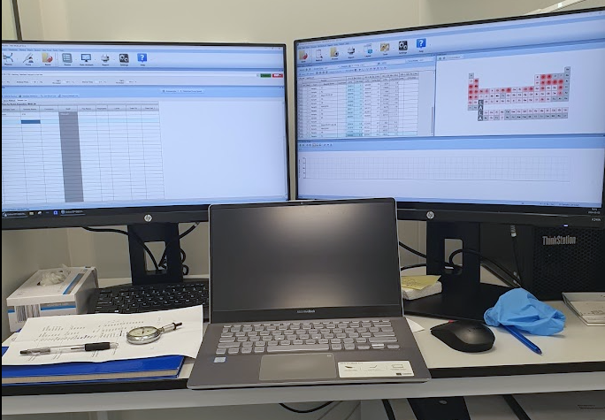
Searching for early biomarkers of Parkinson's disease using mass spectrometry methods
mgr inż. Renata Franczak
Supervisor: dr hab. Kamil Brudecki, prof. IFJ PAN
Co-supervisor: prof. Aleksanda Klimkowicz-Mrowiec

Slide 2
Contents
Parkinson's disease- introduction
The role of metals in Parkinson's disease - a review of current research
Scientific research plan and implemented activities
Methodology - sample preparation and principle of operation of ICP-MS
Experience improving measurement results
Current research results

Slide 3
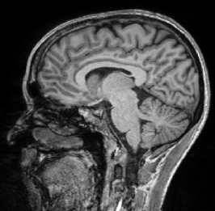
Parkinson's disease
This is a chronic and progressive neurodegenerative disorder, one of the most common neurological diseases in older adults.
Fig 1. Typical symptoms of parkinson's disease

Slide 4
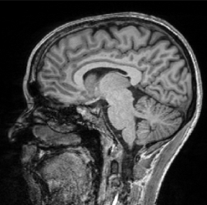
Parkinson's disease
The area in which patients with PD show tissue damage, compared to healthy control individuals.
This is a chronic and progressive neurodegenerative disorder, one of the most common neurological diseases in older adults.
Fig 2. MRI images for detection of microstructural changes in early-stage PD patients.
Fig 1. Typical symptoms of parkinson's disease
[https://alpine-biomedical.ch/en/blog/parkinsons-disease/]

Slide 5
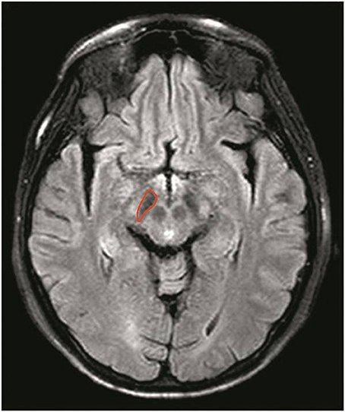
The area in which patients with PD show tissue damage, compared to healthy control individuals.
Substantia nigra
Fig 2. MRI images for detection of microstructural changes in early-stage PD patients.
Fig 3. Example of marked substantia nigra in the brain
The substantia nigra is a structure in the midbrain, part of which produces dopamine and sends it to the striatum, regulating motor control. The degeneration of dopaminergic neurons in this area is one of the main mechanisms of the pathogenesis of Parkinson's disease.

Slide 6
Stage of Parkinson's disease - Hoehn and Yahr Scale
Stage | Description
1 | Symptoms occur on one side (e.g. tremor, stiffness or slowness of movement in one limb), but do not significantly affect daily functioning
1.5 | Symptoms are unilateral with little effect on balance
2 | The symptoms are bilateral, but the patient does not have balance disorders. He is still able to function independently
2.5 | Bilateral symptoms with mild balance disturbance, but patient does not fall
3 | Balance problems and falls occur, but the patient can still walk and perform basic activities without assistance. This is an intermediate stage
4 | Significant impairment of motor functions, the patient often needs help with everyday activities. He can still walk, but requires support
5 | The disease is extremely advanced, the patient is usually immobilized and requires complete care
This is an incurable neurodegenerative disorder, with treatment aimed at alleviating symptoms and slowing its progression. Although the disease itself is not fatal, life-threatening complications ultimately lead to death.

Slide 7
Lewy bodies
Lewy bodies are abnormal protein aggregates (mainly alpha-synuclein) that accumulate in neurons. Their presence leads to:
Damage to mitochondria, causing oxidative stress and weakening the function of nerve cells.
Disruption of synaptic function, impairing communication between neurons, including the flow of dopamine.
Disruption of cellular transport, hindering the delivery of nutrients and removal of waste.
Induction of inflammation, which further accelerates neuron degradation.
All these options lead to nervous death.
Fig 4.A cartoon of a neuron, with the Lewy body indicated within the cell body.
Fig 5. A photo of a Lewy body inside of a neuron.

Slide 8
Observed Elemental Concentration Disruptions in Parkinson's Disease Patients in
Cerebrospinal Fluid
Serum
Hair
Zinc (Zn)
Selenium (Se)
Iron (Fe)
Copper (Cu)
Zinc (Zn)
Iron (Fe)
Zinc (Zn)

Slide 9
Selenium (Se)
As a component of antioxidant enzymes, its excess or deficiency promotes oxidative stress, which leads to mitochondrial dysfunction.
Iron (Fe)
The progressive accumulation of iron in the substantia nigra results in the production of reactive oxygen species, which leads to oxidative stress in nerve cells.
Increased iron in the aging human brain is a major risk factor for Parkinson's disease and other neurodegenerative diseases.
Copper (Cu)
Excess in the form of free radicals leads to the formation of Levi bodies
Decreased serum copper correlated with increased iron levels in the substantia nigra
Zinc (Zn)
Supports the development of neurons through an antioxidant mechanism
When deficient, cognitive functions decline in the aging process

Slide 10
Exposure to metals that promote the development of Parkinson's disease
Manganese (Mn)
long-term exposure can lead to a neurological disorder known as manganism
Arsenic (As)
induced α-synuclein aggregates in mouse brains
Aluminium (Al)
Elevated levels are the most effective of all heavy metals in increasing Levi's body count
Metals disrupt molecular processes and cause oxidative stress, DNA damage, mitochondrial dysfunction and apoptosis
Heavy metals (Hg, Pb)
The incidence of Parkinson's disease is statistically correlated with As levels in agricultural soil in Taiwan

Slide 11
Assumptions of the study
Collecting 100 blood and hair samples from people with Parkinson's disease and 60 samples from the control group
Collecting information about the lifestyle of study participants, i.e. place of residence, profession, supplements used, medications, etc.
Development of a methodology enabling accurate and precise determination of element concentrations in the tested biological materials
Determining which elements have similar concentration results in blood and hair samples from the same person
Determination of concentrations of macro-microelements, trace elements and toxic elements in biological materials
Finding statistically significant differences between the group of patients and the control group
Finding statistically significant differences depending on the stage of Parkinson's disease
Determining, based on information from surveys, what environmental factors may affect the results of element concentrations in samples

Slide 12
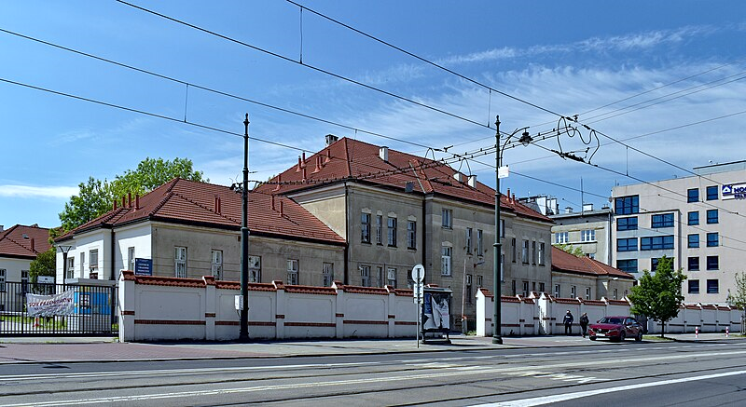
Cooperation with the Department of Internal Medicine and Geriatrics, CMUJ
In the framework of the project, a collaboration was established with Prof. Dr. Aleksandra Klimkowicz-Mrowiec, who works at the Department of Internal Medicine and Geriatrics at the Jagiellonian University Medical College.
The collaboration with Professor enabled obtaining the approval of the Bioethics Committee of the Jagiellonian University to conduct the study.
Fig 6.University Hospital-Neurology Clinic

Slide 13
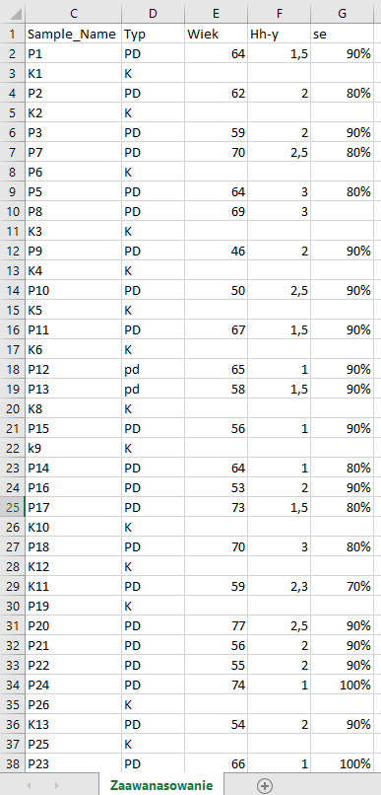
Collected materials for the research
Fig 6. A fragment of the set of related data needed in the study

Slide 14
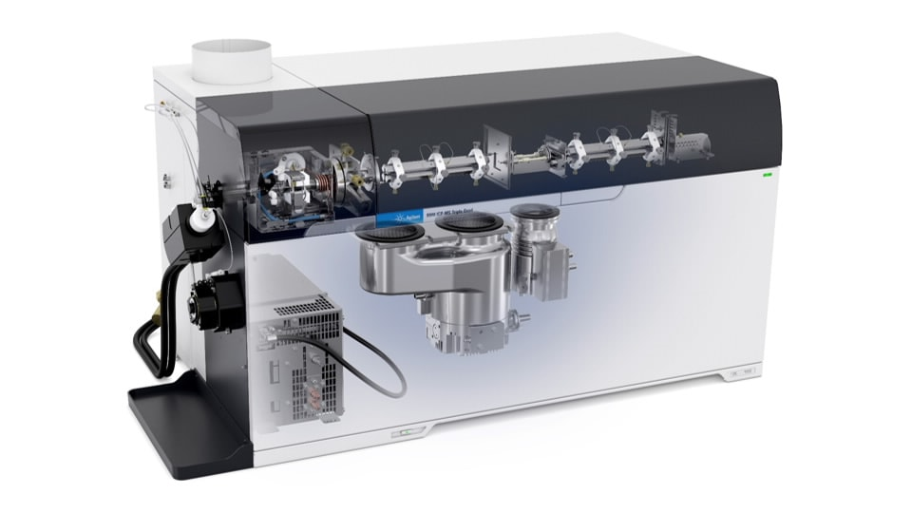
ICP-MS/MS: Mass Spectrometer for Elemental Concentration Analysis
Collision-reaction chamber
The first quadrupole
The second quadrupole
ICP burner
Electron multiplier
Fig 8. Construction of the Agilent 8900 ICP MS Mass Spectrometer

Slide 15
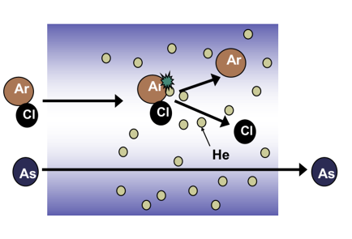
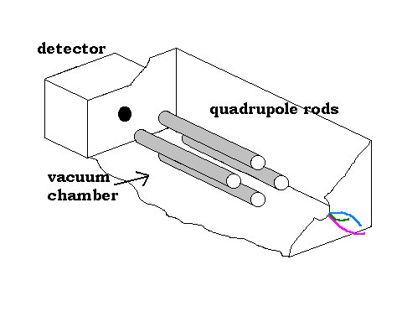
Ion Separation Process in ICP-QQQ
Principle of operation of the reaction-collision chamber using helium (collision mode)
Principle of operation of the quadrupole analyzer
Fig 9. Scheme of behavior of poly and monoatomic compounds in helium gas
Fig 10. Animation presenting the behavior of ions in a quadropole

Slide 16
Development of a procedure for carrying out measurements
To perform the measurement, in addition to the prepared sample, the following should be used:
Sensitivity [CPS/ ppb]
Blank sample – a solution composed only of the reagents used during sample preparation. It is used to determine the background level.
Calibration standards – used to establish a linear regression. The concentration of such materials is at the ppb level (10⁻⁹ g/g)
Reference sample – a hair or blood sample with known elemental concentrations, used to verify measurement accuracy.
Internal standards – enable monitoring of the sensitivity (stability) of the spectrometer.
Blank’s CPS
Fig 11. A chart presenting the determined linear regression

Slide 17
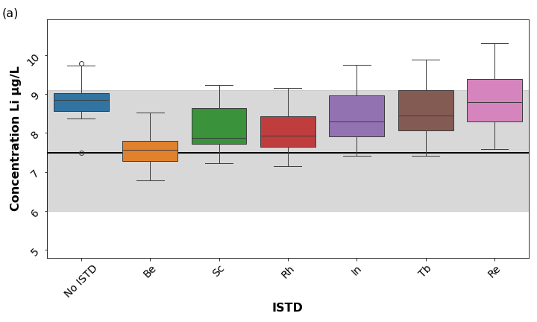
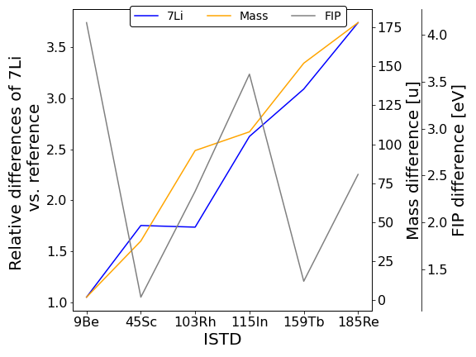
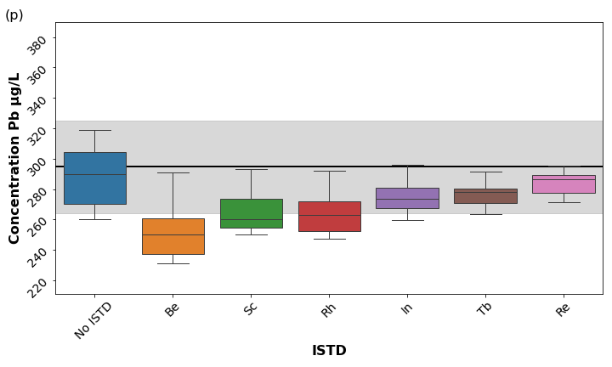
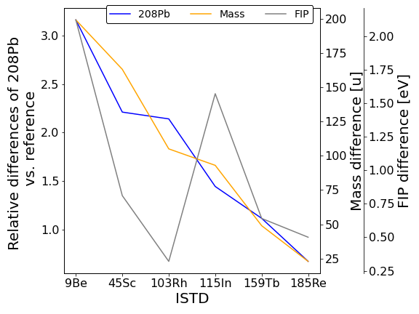
Influence of INTERNAL MARKERS ON THE MEASUREMENT RESULT
According to the recommendations of the ICP-MS manufacturer (Agilent) and numerous publications, the best approach to selecting an internal standard is to choose one with a mass as close as possible to the analyzed element.
Fig 12. A chart presenting the determined linear regression

Slide 18
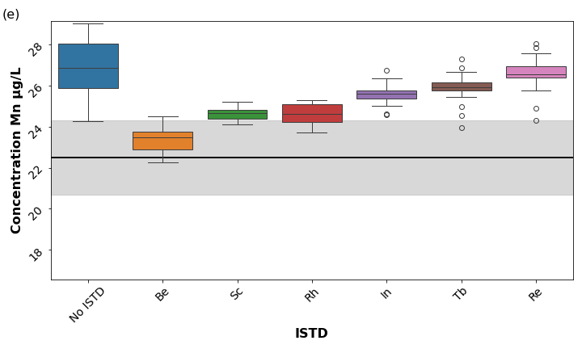
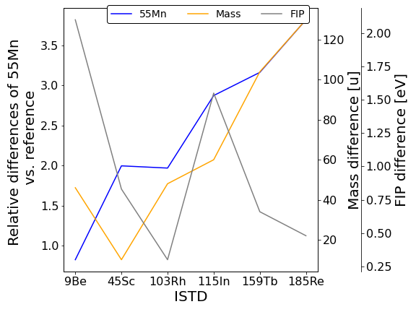
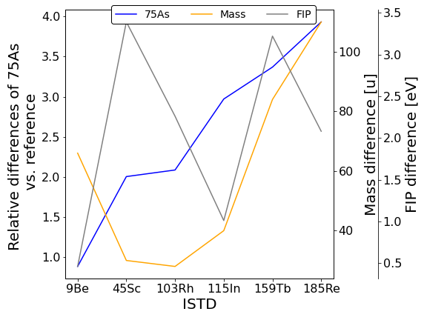
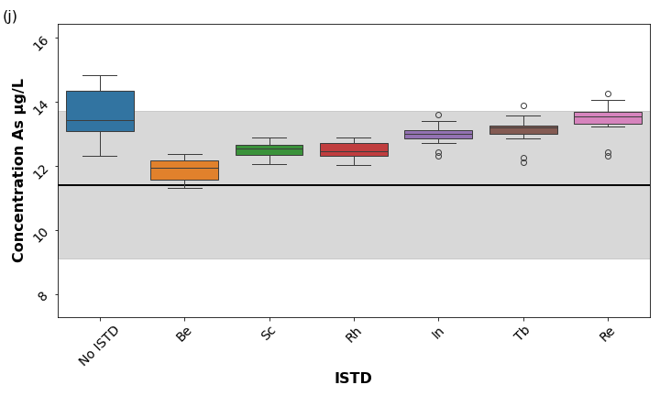
Influence of INTERNAL MARKERS ON THE MEASUREMENT RESULT
However, experimental observations indicated that the use of alternative internal standards allowed for more accurate measurement results. The accuracy of elements with intermediate atomic masses was influenced by their first ionization potential (FIP) and, in some cases, by an internal standard unrelated to these parameters
Fig 13. A chart presenting the determined linear regression

Slide 19
Influence of INTERNAL MARKERS ON THE MEASUREMENT RESULT
Elements | Best Marker | Alternative Markers | Selection Criteria
Li | ⁹Be | ⁴⁵Sc, ¹⁰³Rh | Mass
Mg | ⁴⁵Sc | ¹⁰³Rh | Mass
V | ⁴⁵Sc | ¹⁰³Rh | Mass
Cr | ⁴⁵Sc | ¹⁰³Rh | Mass
Mn | ⁹Be | -- | --
Co | ⁴⁵Sc | ¹⁰³Rh | Mass/FIP
Ni | ¹¹⁵In | ¹⁵⁹Tb | --
Cu | ¹¹⁵In | ¹⁵⁹Tb | --
Zn | ⁴⁵Sc | ⁹Be, ¹⁰³Rh | Mass/FIP
As | ⁹Be | ⁴⁵Sc, ¹⁰³Rh | FIP
Se | ⁹Be | ⁴⁵Sc, ¹⁰³Rh | FIP
Sr | ⁴⁵Sc | ¹⁰³Rh | FIP
Mo | ¹⁰³Rh | ⁴⁵Sc | Mass/FIP
Cd | ¹¹⁵In | ¹⁵⁹Tb | Mass/FIP
Tl | ¹⁸⁵Re | ¹⁵⁹Tb | Mass
Pb | ¹⁸⁵Re | ¹⁵⁹Tb | Mass
Statistical significance of the differences between the results was assessed using the Kruskal-Wallis test, with p-values << 0.05 confirming the differences. Dunn’s post-hoc test identified significant differences between most results(p-values << 0.05), except for the following pairs:
⁴⁵Sc and ¹⁰³Rh (and sometimes ⁹Be)
¹¹⁵In and ¹⁵⁹Tb
¹⁸⁵Re and ¹⁵⁹Tb
The results of these studies have been documented in the form of a publication and submitted for peer review to a specialized journal.

Slide 20
Comparison of metal concentrations in blood samples of people with Parkinson's disease and the control group
Metal | Typ | Mediana ng/ml | Mann-Whitney p-value
Ag | Control | 0.070 | 0.60
 | Study | 0.097
As | Control | 0.73 | 0.26
 | Study | 0.55
Bi | Control | 0.010 | 0.68
 | Study | 0.010
Cd | Control | 0.52 | 0.16
 | Study | 0.41
Co | Control | 0.123 | 0.36
 | Study | 0.095
Cr | Control | 1.2 | 0.62
 | Study | 1.1
Cu | Control | 747 | 0.21
 | Study | 846
Metal | Typ | Mediana ng/ml | Mann-Whitney p-value
Fe | Control | 499 | 0.72
 | Study | 487
K | Control | 1763 | 0.62
 | Study | 1739
Li | Control | 1.13 | 0.04
 | Study | 0.74
Li (No Gas) | Control | 0.96 | 0.04
 | Study | 0.65
Mg | Control | 33736 | 0.28
 | Study | 34940
Mn | Control | 7.1 | <<0.05
 | Study | 5.7
Mo | Control | 0.49 | 0.63
 | Study | 0.51
Metal | Typ | Mediana ng/ml | Mann-Whitney p-value
Na | Control | 1882 | 0.97
 | Study | 1900
Pb | Control | 11 | 0.50
 | Study | 12
Se | Control | 159 | 0.66
 | Study | 154
Sr | Control | 26 | 0.39
 | Study | 18
Tl | Control | 0.031 | 0.18
 | Study | 0.028
V | Control | 0.17 | 0.57
 | Study | 0.13
Zn | Control | 5773 | 0.09
 | Study | 6596

Slide 21
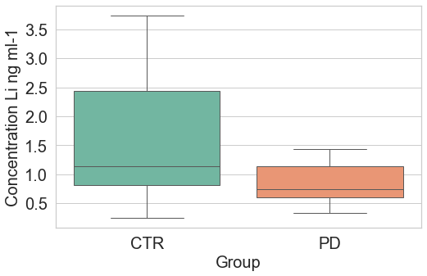
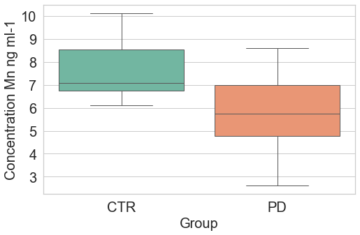
Elements showing significant differences between groups
Box plots illustrate the concentrations of elements for which the Mann-Whitney test identified statistically significant differences between individuals with Parkinson's disease (N = 40) and the control group (N = 20) (p < 0.05).
The observed discrepancies may suggest a potential role of these elements in the context of the disease; however, a comprehensive interpretation of the results requires further investigation
Fig 14. Box plots presenting differences in element concentrations between the control group (CTR) and the Test group (PD)

Slide 22
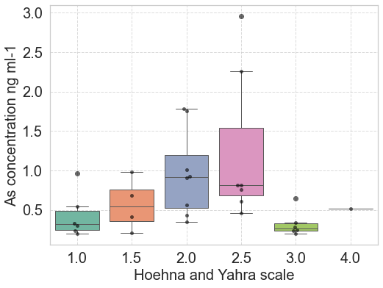
Dependence of the element concentration on the stage of disease advancement
The box plot shows the concentration of the tested element in groups of Parkinson's disease patients at various stages of advancement, determined according to the Hoehn and Yahr scale. The Kruskal-Wallis test showed statistically significant differences between groups (p < 0.05), suggesting that arsenic levels may change as the disease progresses.
Fig 15.Box plots showing differences in arsenic concentrations depending on the severity of the disease.

Slide 23
Results
Based on current research findings, differences have been observed in the concentrations of the following elements:
Manganese (Mn) and arsenic (As) – environmental exposure to these metals may increase the risk of developing Parkinson's disease.
Lithium (Li) – exhibits neuroprotective effects.
Although there is no data indicating disturbances in the concentrations of these metals in biological samples, several publications link them to the development of Parkinson's disease.

Slide 24
Summary
As the population ages, the prevalence of neurodegenerative diseases, such as Parkinson’s disease, continues to increase. Therefore, expanding knowledge about factors influencing its development, including metal homeostasis disorders, may be crucial for improving diagnostics and therapy.
ICP-MS/MS, due to its relatively simple sample preparation procedure and high detection sensitivity (limits at the ppt level, i.e., 10⁻¹² g/g), shows promise as a diagnostic tool.
Our research is based on the analysis of hair, which is less invasive and more comfortable to collect than cerebrospinal fluid, and whole blood, which does not require a separation process.
Further studies in this field may contribute to the development of non-invasive methods for the early diagnosis of Parkinson’s disease, increasing the chances of more effective treatment and slowing disease progression.
In our study, in addition to measuring element concentrations, we also optimized the analytical procedure, which improved the precision and accuracy of the obtained results.
The statistically significant results obtained concern elements that have documented associations with Parkinson’s disease in the scientific literature.
The ability to detect very low concentrations of elements opens new possibilities for studying the effects of trace amounts of these substances on human health

