Slide 1

Exploring the electronic structure of Zinc Selenide Quantum Dots
dr Rafał Fanselow
Supervisor: dr hab. Jakub Szlachetko (prof. UJ)
Assistant supervisor: dr hab. inż. Joanna Czapla-Masztafiak
Department of Applied Spectroscopy (NZ53)
Kraków, 19.12.2024

Slide 2
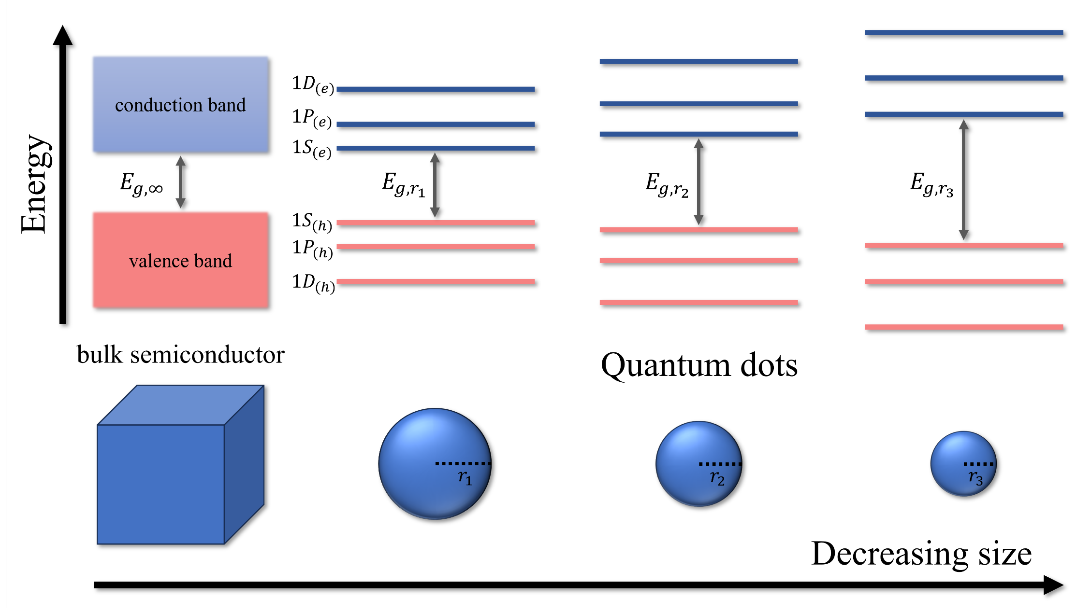
What are quantum dots?
Bulk semiconductors:
continuous conduction and valence bands;
charge carriers (conduction band electrons and valance band holes) move freely within the material.
Quantum dots (QDs):
nanometer size (typically 2-10 nm);
charge carriers spatially confined;
discreate (atom-like) energy structure;
size-dependent tunable properties!
Band-like structure of bulk semiconductors and discrete energy levels of QDs

Slide 3
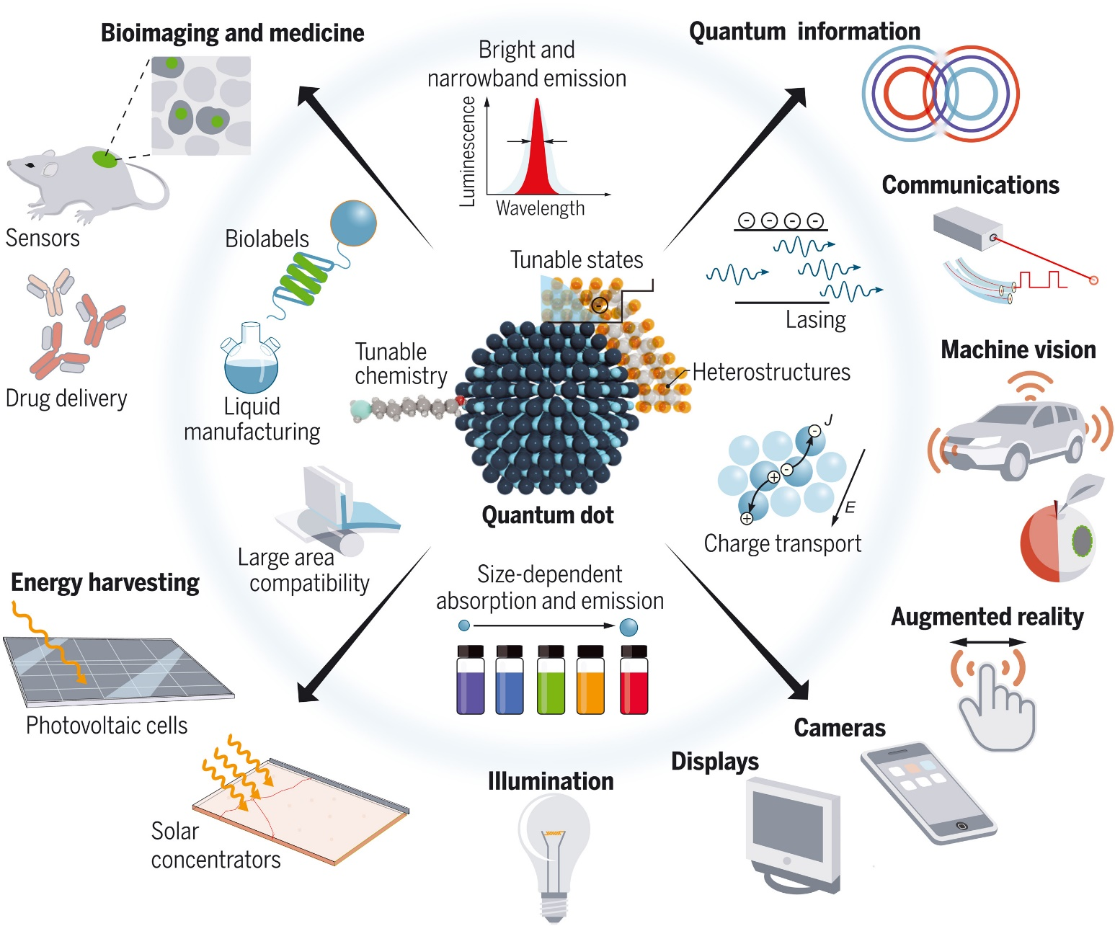
Motivation
2023 Nobel Prize in Chemistry to L. Brus, M. Bawendi, A. Ekimov and "for the discovery and synthesis of quantum dots„.
Quantum dots have potential applications in numerous fields of industry.
But:
Most QDs contain toxic heavy metal elements, primarily cadmium (Cd) and lead (Pb);
new directives/laws limit the use of Cd- and Pb- in commercial technologies;
there is an ongoing search for alternatives, currently much less explored.
QDs technologies
García de Arquer et al., Science 373, 640 (2021)
3

Slide 4
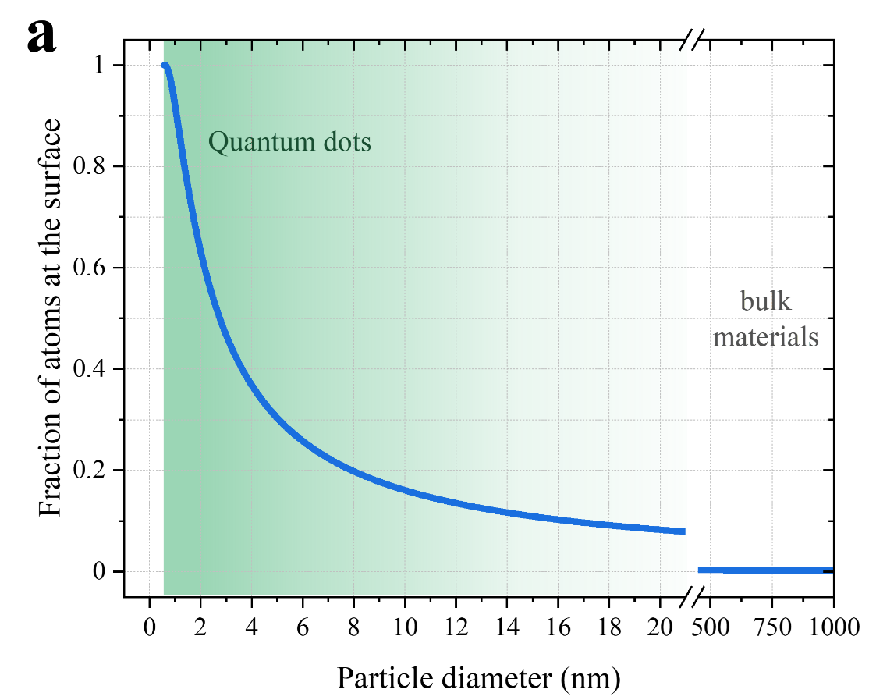
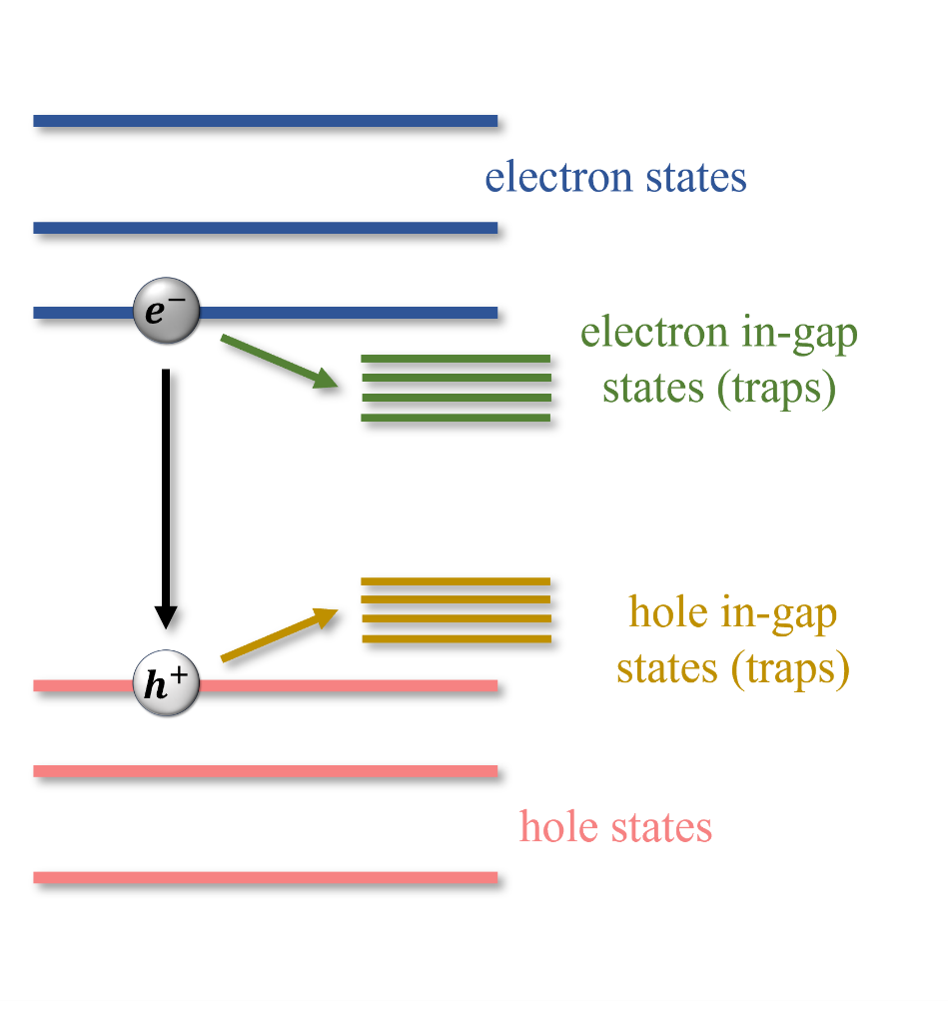
Aim
Zinc selenide quantum dots:
Wide bandgap of bulk semiconductor (2.65 eV);
analogous structure to Cd-based QDs, thus similar synthesis schemes, precursors, etc.;
more reactive, prone to undergo reactions affecting QDs properties.
Aim: Characterize the effects influencing the electronic structure of ZnSe QDs.
4

Slide 5
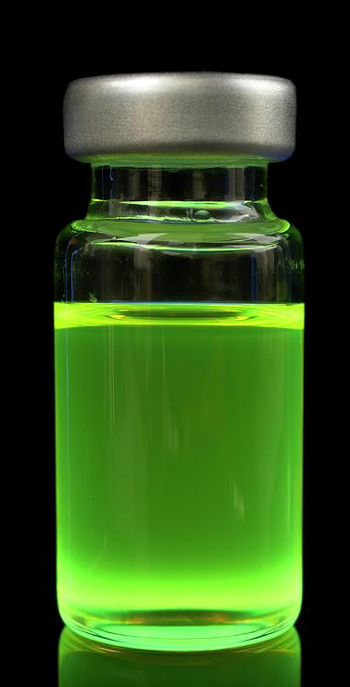


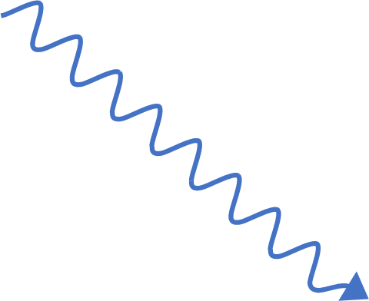
Conducted experiments
1. Material preparation & characterization
band gap size
outer-shell electron transitions
Steady-state optical spectroscopy
Determination of particle sizes
UV/Vis photons &
Optical spectroscopy
2. X-ray spectroscopy studies
Laboratory-based spectroscopy at IFJ PAN
Synchrotron measurements at SOLARIS
X-rays &
X-ray spectroscopy
3. Time-resolved studies of carrier dynamics
Optical transient absorption spectroscopy
X-ray Chronoscopy
inner-shell transitions
bulk sensitivity
element specific
chemical/structural sensitivity
5

Slide 6
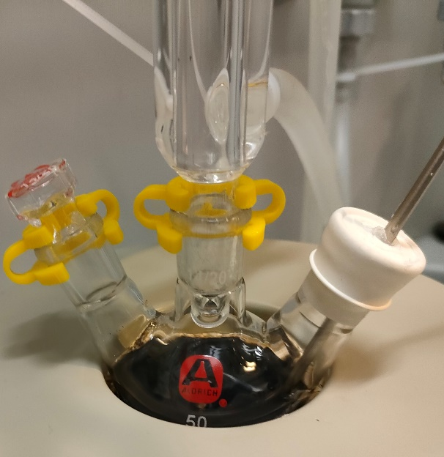
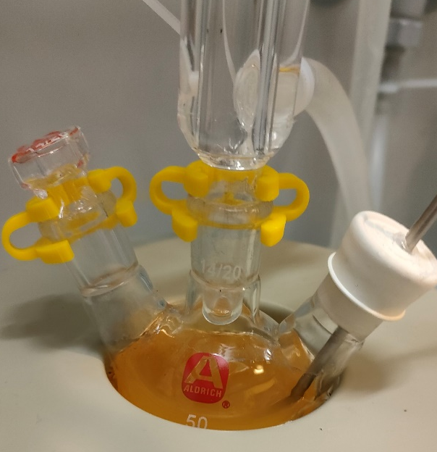
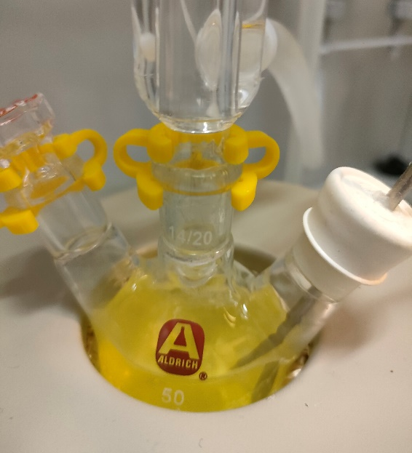
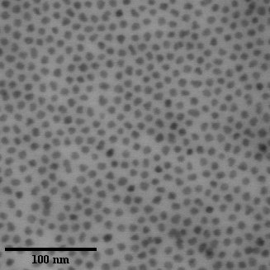
1. QDs preparation
Heat up wet chemical synthesis
STEM image
N₂ atmosphere
temperature-separated stages
protective capping agents
size control
Material characterization
Scanning transmission electron microscopy (TEM)
Steady-state UV-VIS absorption & emission spectroscopy
6

Slide 7
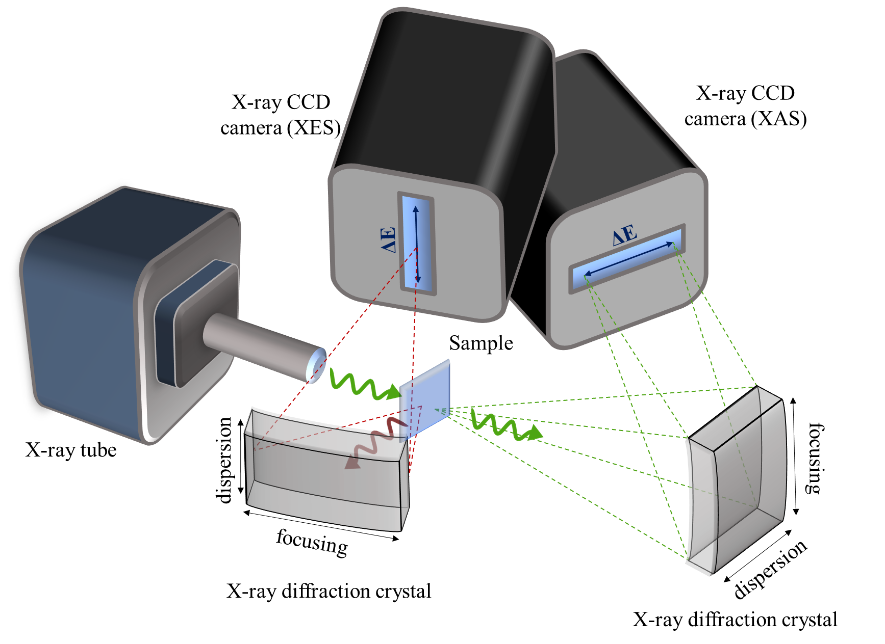
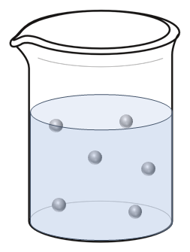
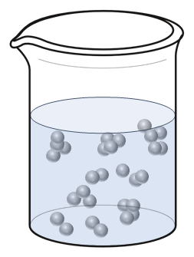
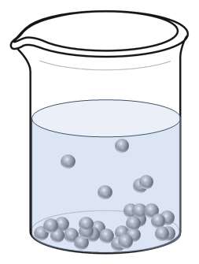
2a. Laboratory X-ray spectroscopy at IFJ PAN
Simultaneous X-ray absorption spectroscopy (XAS) and X-ray emission spectroscopy (XES);
ambient conditions, easy sample manipulation;
routine sample examination.
Challenges with nanomaterial suspension analysis:
Laboratory-based von Hámos type X-ray spectrometer
low concentration
agglomeration & sedimentation
[1] R. Fanselow, M. Sobstel, W. Błachucki, J. Szlachetko, „Performance of a laboratory von Hámos type x-ray spectrometer in x-ray absorption spectroscopy study on 3d group metals”, X-ray Spectrometry 52 (2023) 247-253. https://doi.org/10.1002/xrs.3317
7

Slide 8
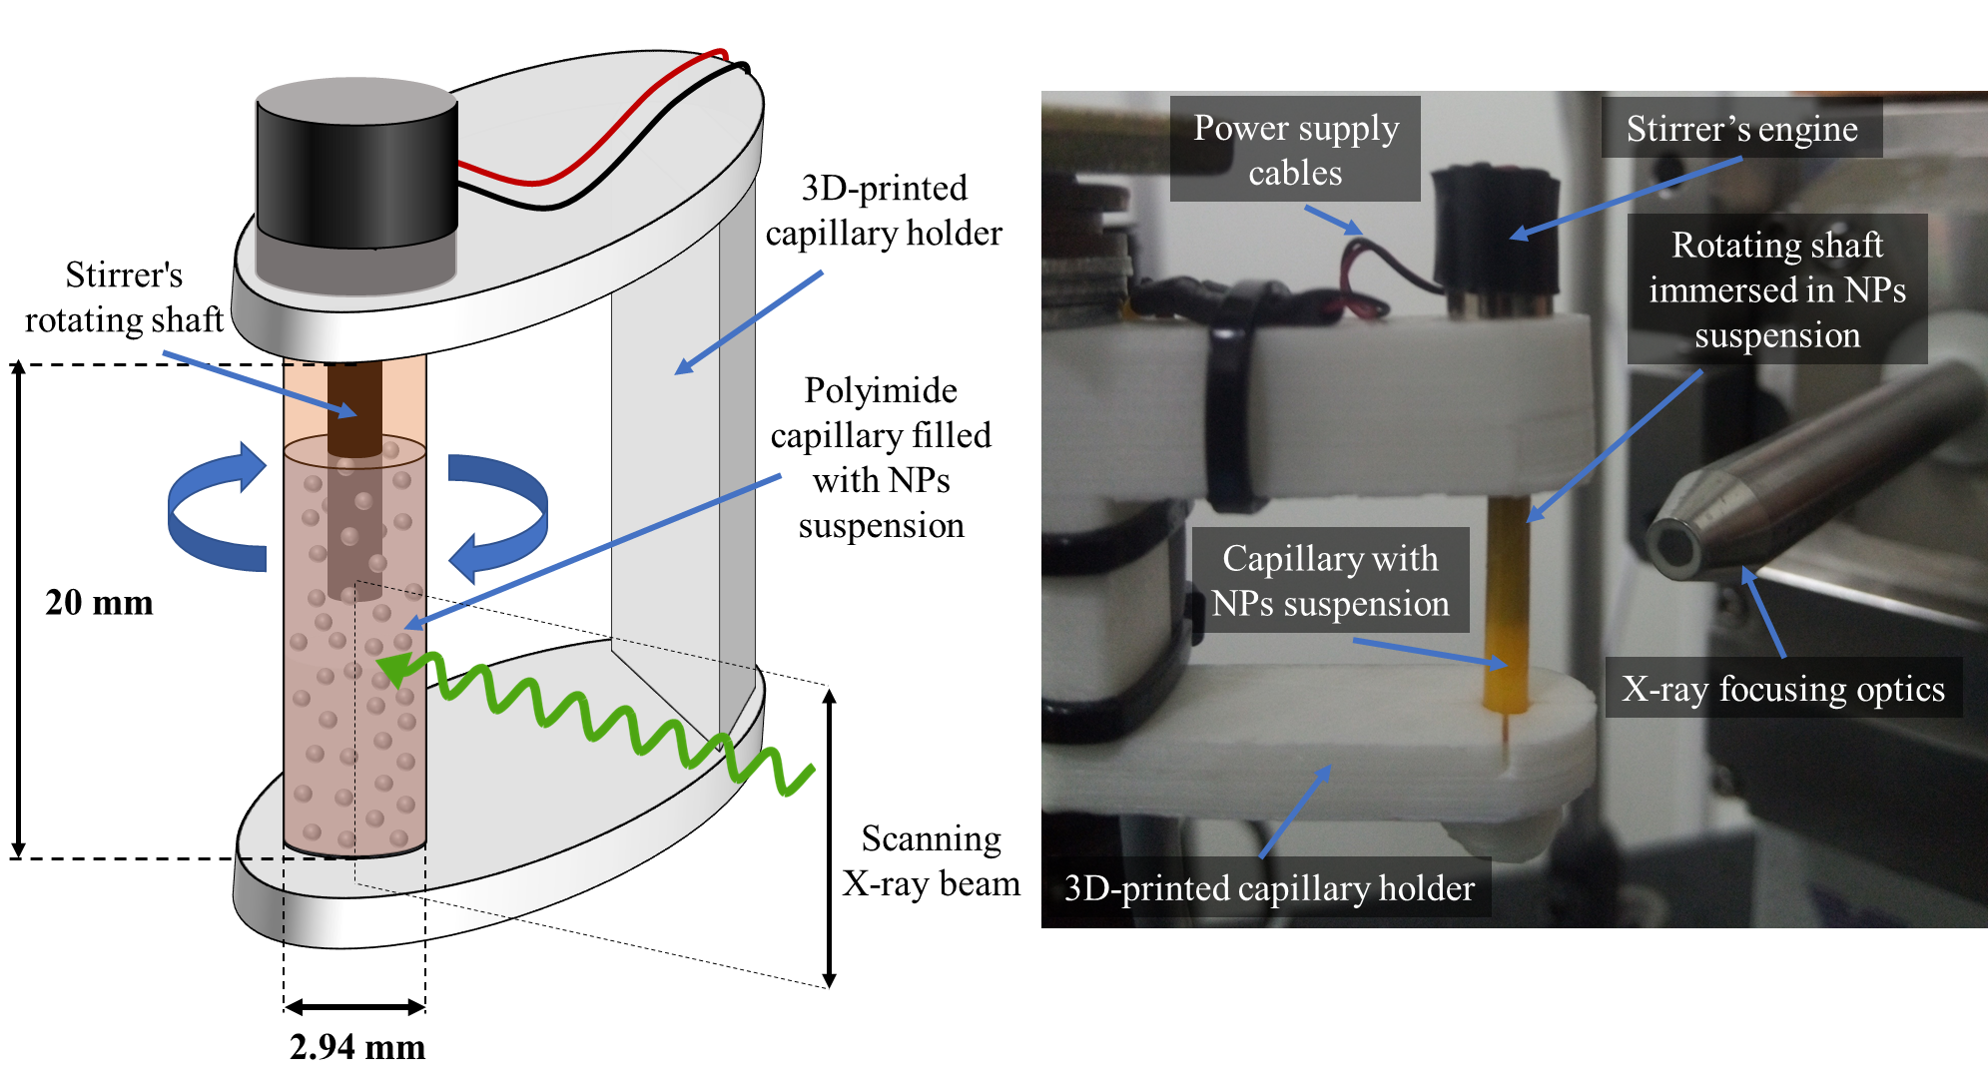

2a. Sample cell for laboratory X-ray spectroscopy
Commonly available & inexpensive components
Sample volumes down to 50 µL
Continuous sample mixing during the measurement
[2] R. Fanselow, A. Wach, W. Błachucki, J. Szlachetko, „Microliter-stirred sample setup for X-ray spectroscopy analysis of nanomaterials in suspension”, Spectrochim. Acta Part B At. Spectrosc. 189 (2022) 106367. https://doi.org/10.1016/j.sab.2022.106367
8

Slide 9
2a. Laboratory X-ray spectroscopy
Laboratory Zn K-edge XAS:
qualitative assessment of observable spectral changes;
intensity increase of 1s→4p transition has been attributed to presence of Zn vacancies in other
Zn nanostructures [3];
pronounced structural changes
in the photoelectron scattering region.
Absorption coefficient (a. u.)
Zn K-edge XAS
Photon energy (eV)
XAS
Continuum
4p
…
Difference (a. u.)
1s
Photon energy (eV)
[3] Rossi, T. et al. Characterizing the Structure and Defect Concentration of ZnO Nanoparticles in a Colloidal Solution. J. Phys. Chem. C 2014, 118 (33), 19422–19430. https://doi.org/10.1021/jp505559u
9

Slide 10

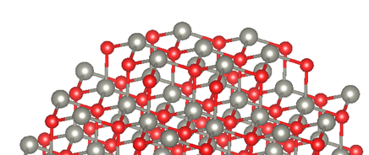
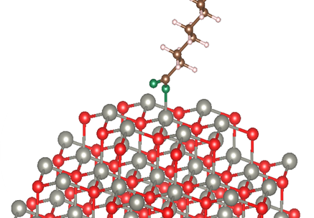
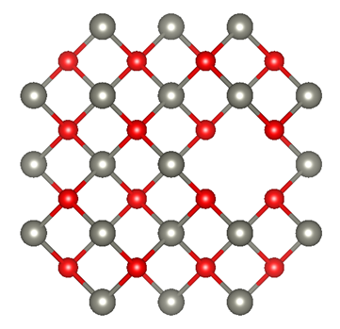
2b. Synchrotron studies
ASTRA beamline
More intense X-ray source & improved signal quality
Zn K-edge XAS
Calculations in FEFF 9.6 using several model structures with different coordination of central Zn atom
surface atom
Se vacancy
surface atom coordinated with ligand
Zn vacancy
10

Slide 11





3a. Ultrafast optical transient absorption
White beam
probe pulse
Ultrashort monochromatic pulse (pump) triggers the reaction/process in a studied sample.
Pump-probe
experiment
White probe pulse follows at a defined delay and captures the current state of the specimen.
Monochromatic pump pulse
The result is compared to the sample in the ground state (acquired without pump pulse).
Sample
The measurement is repeated for another pump-probe delay value.
Delay
Time
Transient signal:
$$ΔA=A_{pump on}−A_{pump off}$$
Temporal resolution of experiment: ~100fs
ELI Beamlines
Dolní Břežany
11

Slide 12
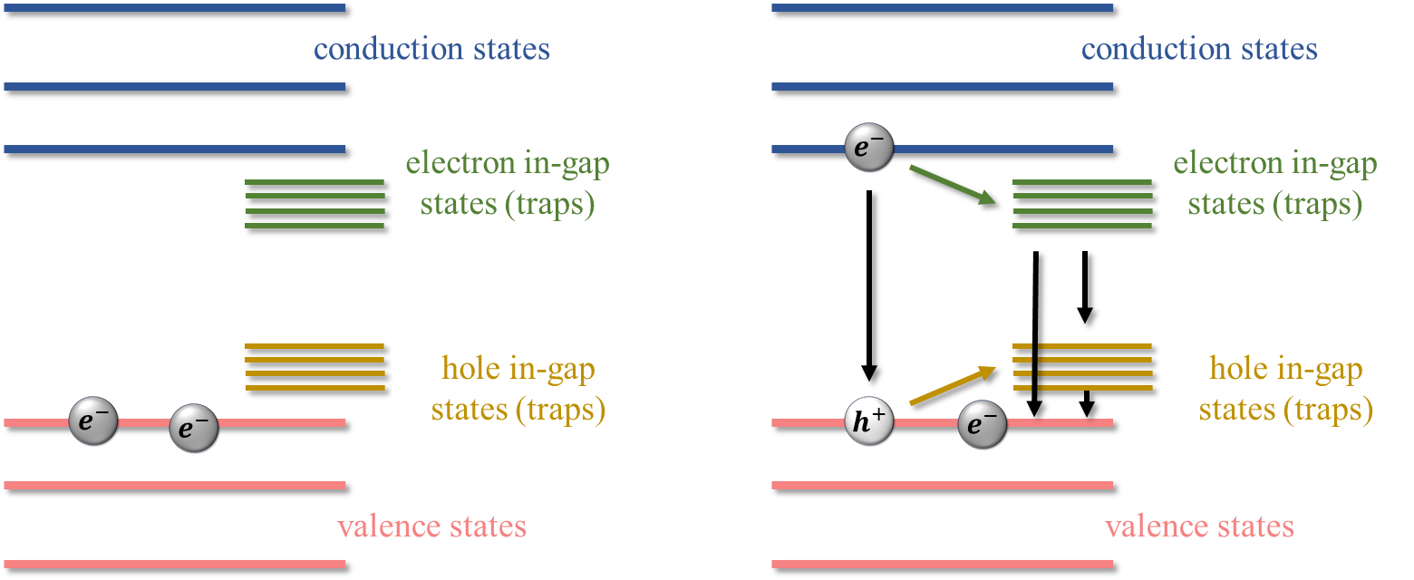
3a. Ultrafast optical transient absorption
Ground state bleach decay
Photoinduced absorption
Pump pulse
Probe
Absorbance
Photon Energy (eV)
Ground state
Excited state
Two main relaxation channels showing different dependence on quantum dot size:
τ₁ ~ 0.35-0.95 ps, 64-90%
τ₂ ~ 2-3 ps, 8-28%
Normalized ΔA (a. u.)
Excitation with pump pulse
Photoinduced absorption states
Photon Energy (eV)
TA spectra
12

Slide 13

3b. X-ray Chronoscopy
Proposal to expand time-resolved measurements of electron dynamics in QDs with the use of X-ray free electron lasers and X-ray chronoscopy method.
pump-probe experiment
X-ray pulse
Intensity (a. u.)
$$−ln{\frac{I_{1 pump on}(t)}{I_{0}(t)}}$$
Optical pump pulse
sample
time
13

Slide 14
3b. X-ray Chronoscopy
Proposal to expand time-resolved measurements of electron dynamics in QDs with the use of X-ray free electron lasers and X-ray chronoscopy method.
Incident X-ray pulse
pump-probe experiment
Intensity (a. u.)
$$−ln{\frac{I_{1 pump on}(t)}{I_{0}(t)}}$$
Optical pump pulse
sample
Transmitted X-ray pulse
time
14

Slide 15
3b. X-ray Chronoscopy
Numerical simulations of X-ray pulse propagation through a sample excited by an optical pulse were performed using the time-dependent Lambert–Beer law and a four-level sample model;
the impact of X-ray pulse duration and number of pump-probe cycles on the precision of the excited state lifetime determination was investigated;
results showcased that X-ray Chronoscopy can be utilized to track electron dynamics in matter, including ZnSe QDs.
15

Slide 16
Conclusions
Within my doctoral project:
I prepared a series of ZnSe quantum dot suspensions and determined their size-dependent optical properties.
I developed a special sample cell to enable X-ray measurements of QDs liquid suspensions.
I conducted X-ray spectroscopy measurements that indicated the presence of zinc defects in the examined quantum dots.
I determined the main carrier relaxation processes using ultrafast transient optical spectroscopy.
I proposed an X-ray Chronoscopy method as a complementary method for studying carrier dynamics in quantum dots.
16

Slide 17
Special thanks to all the members of the department of the Applied Spectroscopy at IFJ PAN:
Prof. W. M. Kwiatek Dr. hab. J. Czapla-Masztafiak Dr. W. Błachucki Dr. G. Imbir Dr. A. Yakovliev T. Pieprzyca
and to my supervisor Prof. J. Szlachetko.
This work was supported by the National Science Centre (Poland) under grants number 2020/37/B/ST3/00555 and 2017/27/B/ST2/01890
17

