Slide 1
EIC and the Odderon: exclusive productions of $χ_{cJ}$ charmonia
Tomasz Stebel
Institute of Theoretical Physics,
Jagiellonian University, Kraków
Project is supported by National Science Centre, grant no. 2021/43/D/ST2/03375.
with Sanjin Benić, Adrian Dumitru, Leszek Motyka
Based on:
Phys.Rev.D 110 (2024) 1, 014025 and 2407.04968
The 2024 Polish Particle and Nuclear Theory Summit
11.09.2024

Slide 2
Exclusive meson electroproduction in ep scattering
$$e+p→e^{′}+p^{′}+M$$
'
Meson $M$
$${\vec{K}}_{T}$$
p'
$$=−{\vec{K}}_{T}^{2}$$
$$γ^{∗}+p→p^{′}+M$$

Slide 3
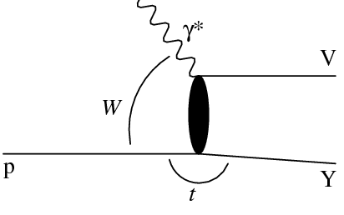
Exclusive meson production in $γ^{∗}−p$scattering
Consider $C$-parity of particles:
Meson with given $C$-parity:
$C_{M}=−1$, eg. $ρ,$ $φ$, $J/ψ$…
(pomeron exchange)
or
$C_{M}=+1$, eg. $π^{0}$, $η_{c}$, $χ_{c}$ …
(odderon exchange)
$$C_{γ}=−1$$
$$M$$
p'
For small $W$ other exchanges also possible.

Slide 4
Pomeron and Odderon
L. Lukaszuk and B. Nicolescu, Lett. Nuovo Cim. 8, 405 (1973)
J. Bartels, Nucl. Phys. B 175, 365 (1980)
J. Kwiecinski and M. Praszalowicz, Phys. Lett. 94B, 413 (1980)
R. A. Janik and J. Wosiek, Phys. Rev. Lett. 82, 1092 (1999)
J. Bartels, L. N. Lipatov and G. P. Vacca, Phys. Lett. B 477, 178 (2000)
Regge theory:
$$σ_{tot} \sim s^{α\left(0\right)−1}$$
Intercept of Regge trajectory: $α\left(t\right)=α\left(0\right)+α^{′}t$
POMERON
ODDERON
$C=1, P=1$
$C=−1, P=−1$
$α_{P}\left(0\right)>1$
$α_{O}\left(0\right)≾1$
Leading logarithms $α_{S}^{n}{(log{s})}^{n}$ resummed by Balitsky-Fadin-Kuraev-Lipatov (BFKL) equation
Leading logarithms $α_{S}^{n}{(log{s})}^{n}$ resummed by Bartels-Kwieciński-Praszałowicz (BKP) equation
Evidence for existence (comparison $pp$ vs. $p\overline{p}$) by TOTEM, G. Antchev et al. Eur.Phys.J.C 80 (2020) 2, 91)
Observed experimentally in many processes

Slide 5
Charmonia
Charmonia = $c\overline{c}$ states
$$∗$$
$$M$$
1) charm mass is a hard scale: $m_{c}\sim 1.3 GeV≫Λ_{QCD}$
2) relatively easy to measure
In this talk we consider :
$χ_{cJ}$: $J=0$ scalar, $J=1$ vector, $J=2$ tensor
$P$-wave meson with $C_{η_{c}}=+1$
Odderon-type exchange

Slide 6
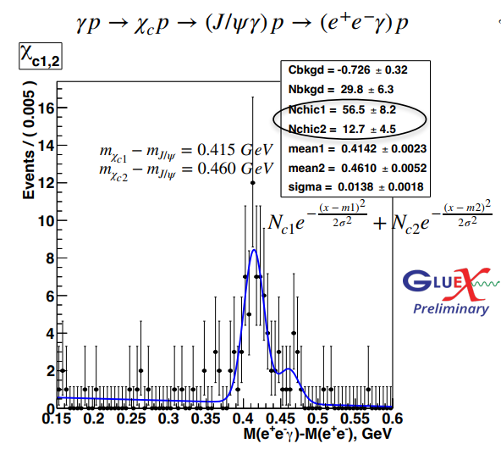
Why $χ_{cJ}$?
From late 90’s theorists focus on exclusive $η_{c}$ production as a evidence of odderon exchange.
J. Czyzewski, J. Kwiecinski, L. Motyka, and M. Sadzikowski, Phys. Lett. B 398, 400 (1997),
R. Engel, D. Y. Ivanov, R. Kirschner, and L. Szymanowski, Eur. Phys. J. C 4, 93 (1998)
At HERA no evidence for exclusive $η_{c}$ production was found. It is hard to measure:
small branching ratio Br$\left(η_{c}→γγ\right)\sim {10}^{−4}$ & feedown from $J/ψ$.
Last year results from GlueX
L. Pentchev et al. (GlueX), Exclusive threshold J/ψ photoproduction with GlueX (2023), presented at DIS2023.

Slide 7
Amplitude for $γ^{∗}+p→p^{′}+χ_{cJ}$
H. Kowalski, L. Motyka and G. Watt, Phys. Rev. D 74, 074016 (2006)
$$∗$$
$$χ_{cJ}$$
Odderon
exchange
Photon wave function
Meson wave function

Slide 8
Wave functions
Photon wave function:
Meson wave function (covariant):
where:
Final results for amplitudes (scalar quarkonium $χ_{c0})$:
Similar expressions for
axial $χ_{c1}$and tensor $χ_{c2}$

Slide 9
Boosted Gaussian
H. Kowalski, L. Motyka and G. Watt, Phys. Rev. D 74, 074016 (2006)
Scalar part of meson w.f. needs to be modeled. We use:
Free parameters, $ℛ_{H}$ and
we obtained from:
1) normalization condition:
2) decay into $γγ$ :
Exception:
$$χ_{c1}$$
Landau-Yung theorem: massive particle with spin 1 cannot decay into two real photons.
We assume

Slide 10
Dipole distribution evolution
Dipole distribution in terms of Wilson lines:
Small-x evolution is given by the Balitsky-Kovchegov (BK) equation:
We also have decomposition:
Pomeron
Odderon

Slide 11
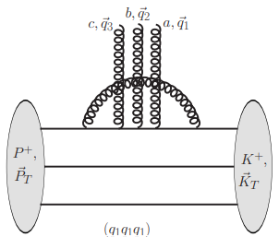
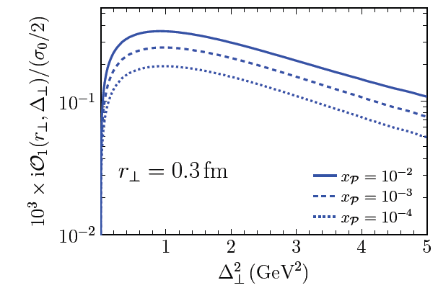
Odderon evolution
Benić, Horvatić, Kaushik, Vivoda, Phys. Rev. D 108, 074005 (2023),
At x=0.01 we use initial condition from 3-gluon exchange model & gluon emission.
Dumitru, H. Mantysaari, and R. Paatelainen, Phys. Rev. D 107, L011501 (2023),
Decrease with energy

Slide 12
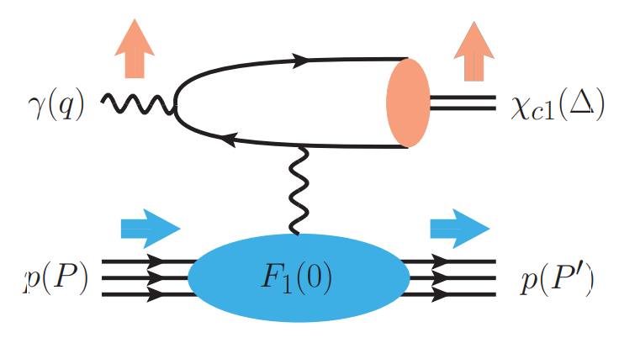
Backgroud
We have two main sources of background for this process:
Primakoff process
(photon exchange)
Feeddown from $ψ\left(2s\right)→χ_{cJ}+ γ$ (this is not covered in this talk).

Slide 13
Primakoff process
Just replace:
Dirac form factor.
Adding Pauli form factor:
Both form factors are very well constrained experimentally.

Slide 14
Numerical results for EIC

Slide 15
$γ^{∗}+p→p^{′}+χ_{cJ}:$momentum transfer dependence
Finite (Landau-Yung theorem)
Positive interference between odderon and Primakoff.

Slide 16
$γ^{∗}+p→p^{′}+χ_{cJ}$: energy dependence

Slide 17
Electroproduction

Slide 18
Electroproduction: number of events
Branching ratios for decays included.
Top EIC luminosity is assumed.

Slide 19
Summary
Searching for odderon is still interesting.
We calculated exclusive production of $χ_{cJ}$.
Interference between Primakoff and odderon is positive.
Finding odderon may be possible at EIC.
Thank you!

Slide 20
Backup

