Slide 1
Kink behavior in the sine-Gordon model under a variety of inhomogeneities Jacek Gatlik¹, Tomasz Dobrowolski², and Panayotis G. Kevrekidis³
¹ Faculty of Physics and Applied Computer Science, AGH University of Krakow, Krakow, Poland
² Department of Computer Physics and Quantum Computing, University of the National Education Commission in Krakow, Poland
³ Department of Mathematics and Statistics, University of Massachusetts Amherst, USA
12 September 2024

Slide 2
Introduction
We consider sine-Gordon equation in the form
In the presence of the electromagnetic fields in the junction the electric current has the form
Which leads to the phase gradient
And in curved coordinates simplifies to
For the selected contour we get
By the Stokes theorem we can find the relationship between the field $φ$ and the magnetic field $H_{ρ}$
Cross-section of the Josephson junction along the central line.
J. Gatlik and T. Dobrowolski, Physica D: Nonlinear Phenomena, 428, 133061 (2021)

Slide 3
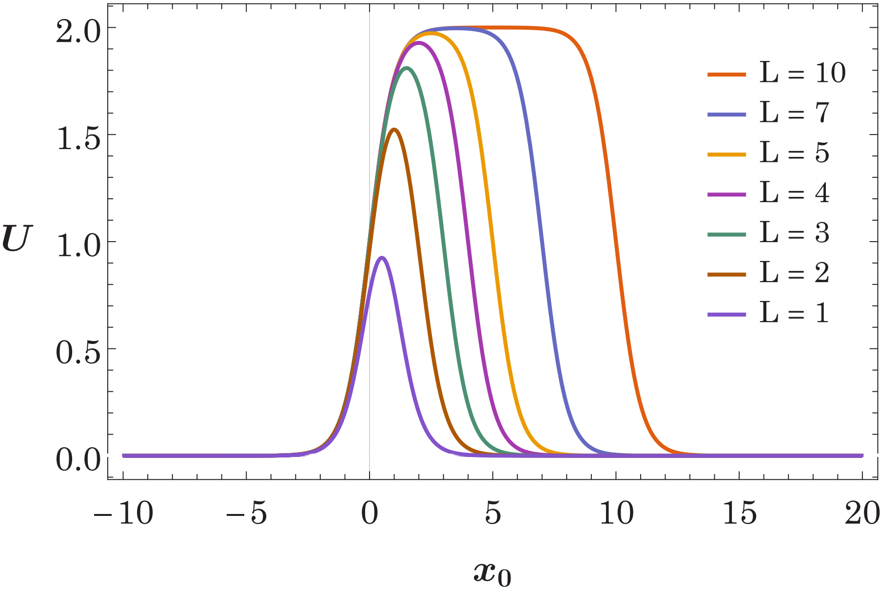
Introduction
On the other hand, the Ampere’s circular law with the Maxwell correction leads to
Adding the second Josephson law
Averaging this formula with respect to the normal variable also denoting $\overline{c}=\sqrt{\frac{a}{εd_{m}}}$ and $λ_{J}=\sqrt{\frac{ℏc^{2}}{8πed_{m}j_{0}}}$ we obtain
The effective potential for small velocities (i.e. $γ →1$).
Finally, we consider sine-Gordon equation in the form
J. Gatlik and T. Dobrowolski, Physica D: Nonlinear Phenomena, 428, 133061 (2021)

Slide 4
Nonconservative Lagrangian
We study the perturbed sine-Gordon model in the form
Due to the existence of dissipation in the studied system we used method based on a nonconservative Lagrangian [1] density
We consider a model with two degrees of freedom based on the following ansatz
Which leads to effective equations of motion
In the physical limit
[1] C. R. Galley, Classical mechanics of nonconservative systems, Phys. Rev. Lett. 110, 174301 (2013). C. R. Galley, D. Tsang, and L. C. Stein, The principle of stationary nonconservative action for classical mechanics and field theories, 2014.
J. Gatlik, T. Dobrowolski, and Panayotis G. Kevrekidis, Physical Review E, 108, 034203 (2023)

Slide 5
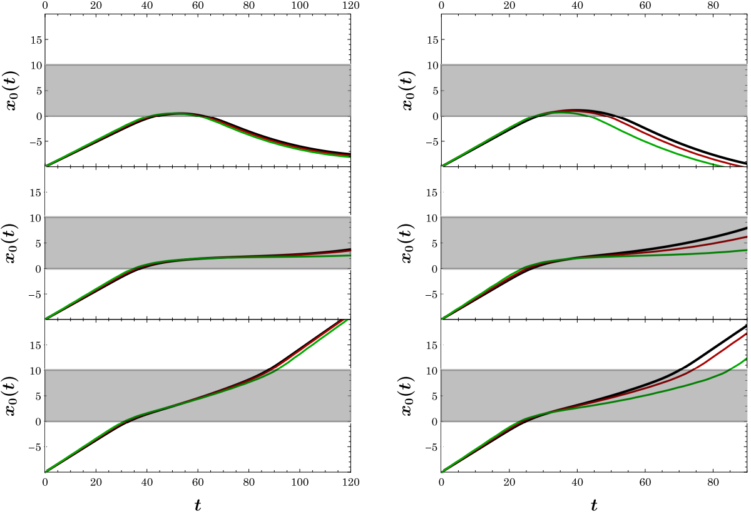
Nonconservative Lagrangian
Comparison of the position of the center of mass of the kink for the solution from the original field model (black line) and models with two degrees of freedom based on projecting onto the zero mode (green line) and on non-conservative Lagrangian (red line). On the right the phase diagrams corresponding to the same parameter values.
J. Gatlik, T. Dobrowolski, and Panayotis G. Kevrekidis, Physical Review E, 108, 034203 (2023)

Slide 6
The non-dissipative case
We insert the decomposition
into sine-Gordon equation obtaining
$φ_{0}(x)$ can be decomposed into static kink $φ_{K}$ of the sine-Gordon model and a time independent correction $χ$
On the left panel, the $χ(x)$value for different values of $ε$. On the right panel, the solid line shows the sum of the kink ansatz $φ_{K}(x)$ and $χ\left(x\right)$ value.
We can examine the spectral stability
Squared eigenfrequencies $λ=ω^{2}$ calculated for the quasi-static configuration
J. Gatlik, T. Dobrowolski, and Panayotis G. Kevrekidis, Physical Review E, 108, 034203 (2023)

Slide 7
The dissipative case
On the left panel, the $χ(x)$ value for different $ε$. On the right panel, the solid line shows the sum of the kink ansatz $φ_{K}(x)$ and $χ(x)$ value for different $ε$, while the dashed line is the corresponding static solution determined from original field model.
Squared eigenfrequencies $λ=ω^{2}$ calculated for the static configuration
J. Gatlik, T. Dobrowolski, and Panayotis G. Kevrekidis, Physical Review E, 108, 034203 (2023)

Slide 8
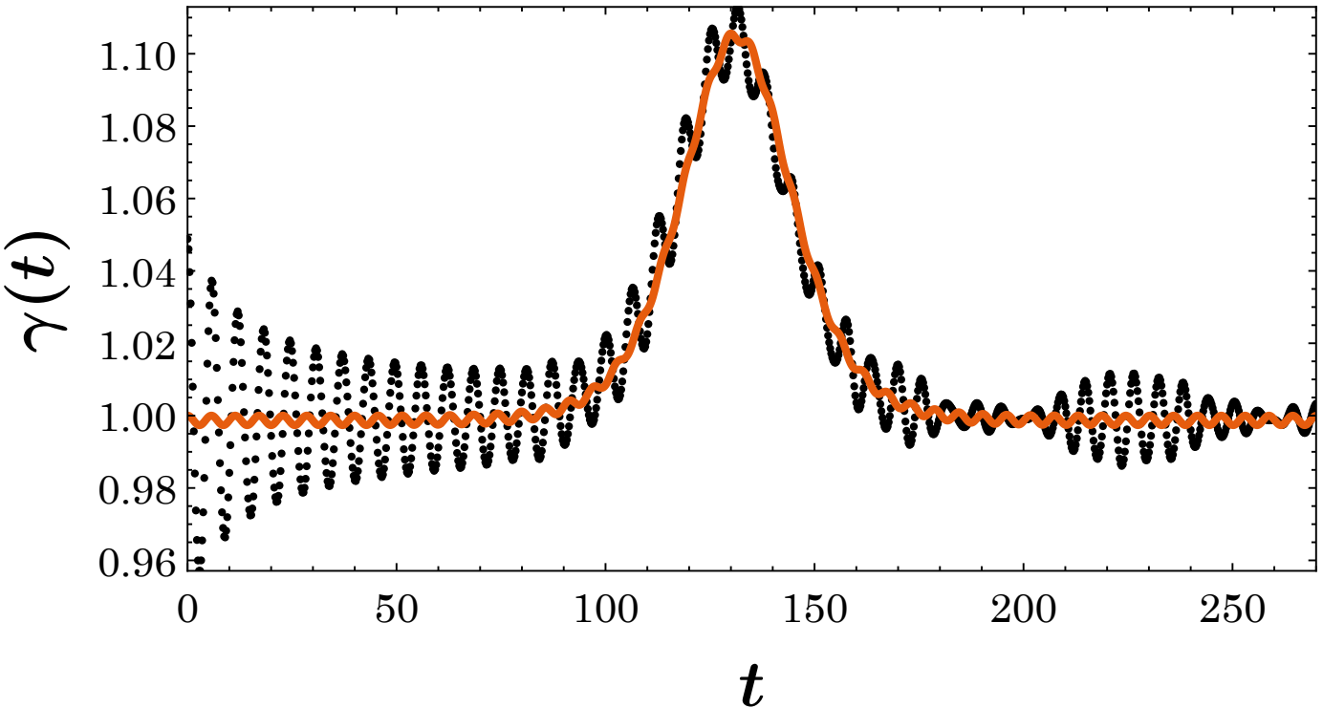
New ansatz
We study the perturbed sine-Gordon model in the form
As an initial condition, we propose a new form of ansatz
Where
Moduli space of the system
Ricci scalar for inhomogeneity in the form of a barrier (left panel) and periodic inhomogeneity (right panel).
The kink width obtained from the field equation (black dots) at standard initial conditions shows significant oscillations especially at the beginning of the evolution. The $γ(t)$ variable is compared with the result of the effective model.
T. Dobrowolski, J. Gatlik, and Panayotis G. Kevrekidis, arXiv:2409.05436 [nlin.PS] (2024)

Slide 9
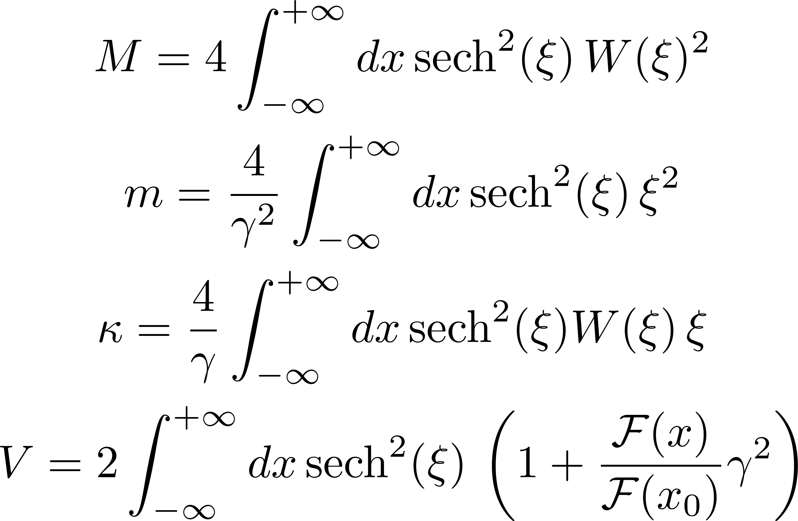
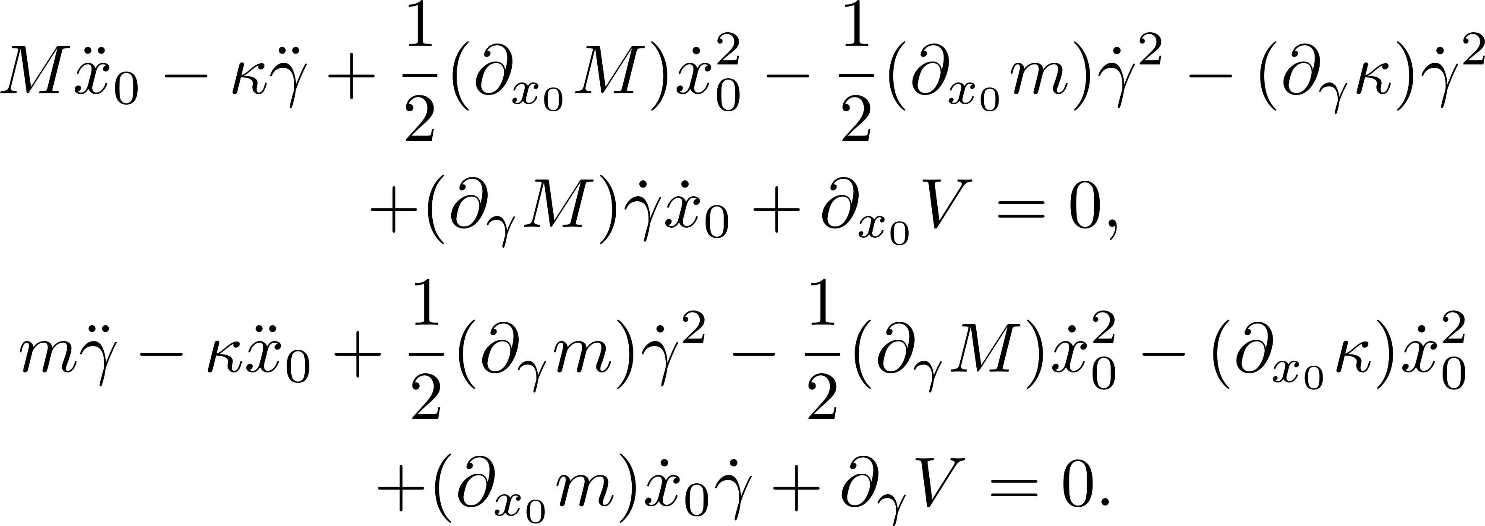
Hamiltonian Case
In the absence of dissipation and forcing, the equation of motion simplifies significantly
The Lagrangian for this system takes the form
By introducing
where
The Lagrangian can be equivalently transformed to the form
Effective Lagrangian is obtained by integrating over the spatial variable
The Euler-Lagrange equations obtained from the effective Lagrangian take the form of
T. Dobrowolski, J. Gatlik, and Panayotis G. Kevrekidis, arXiv:2409.05436 [nlin.PS] (2024)

Slide 10
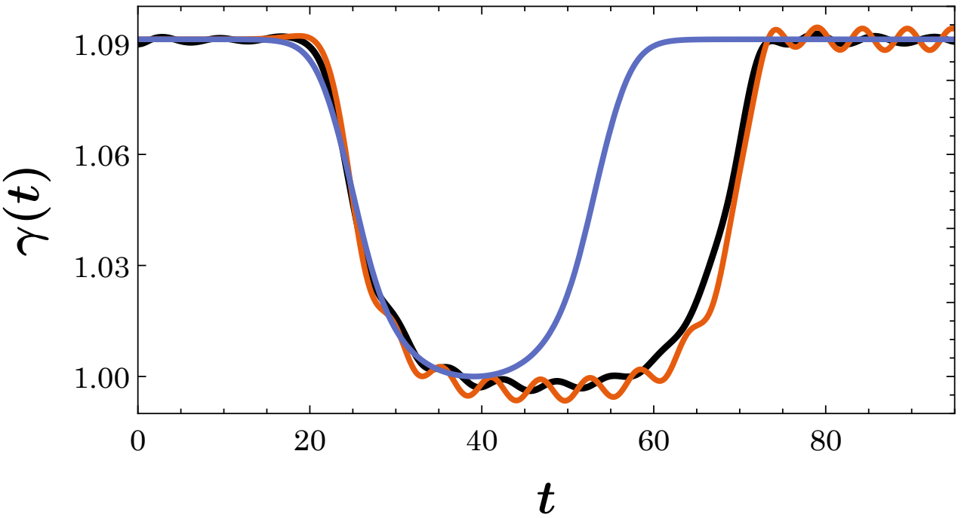
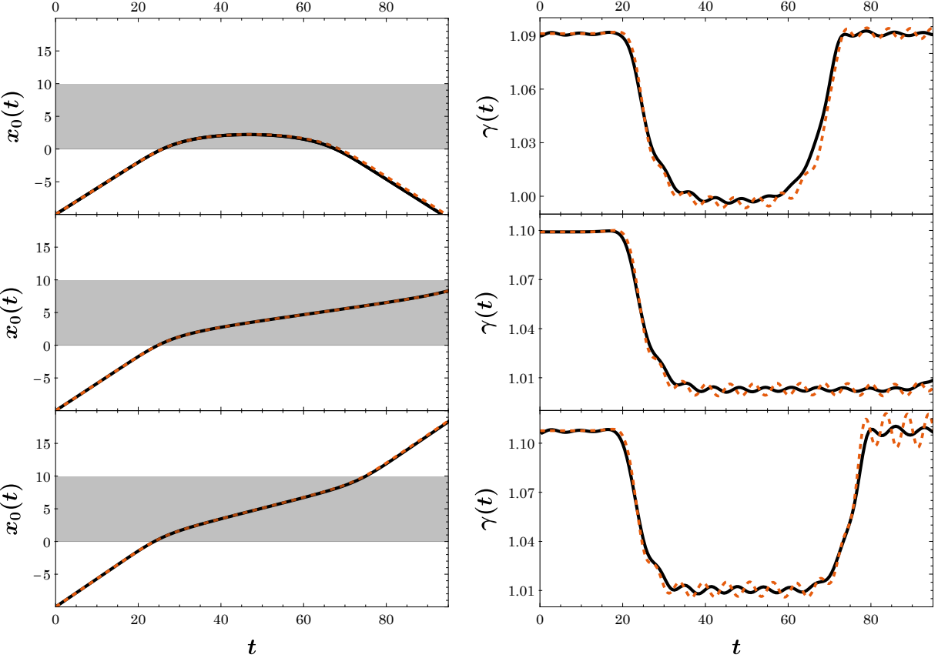
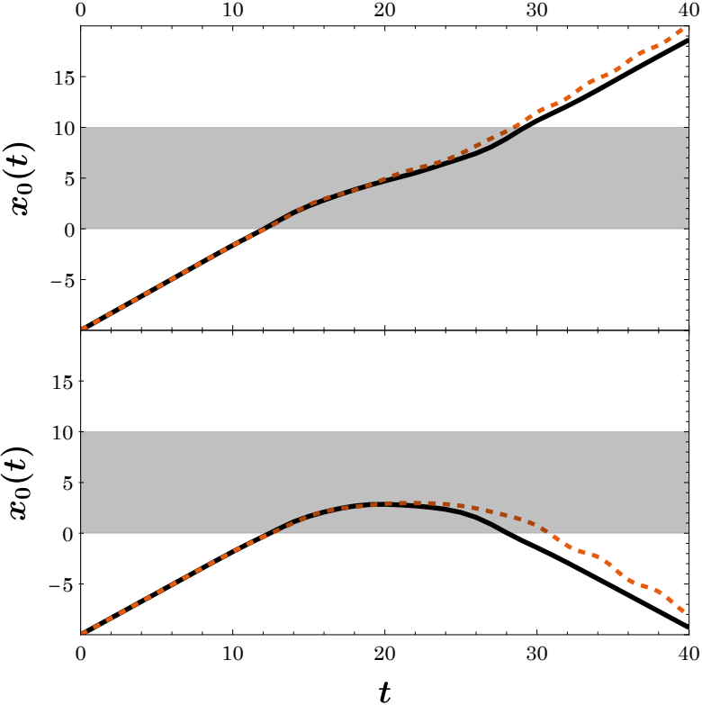
Hamiltonian Case
Comparison of the position of the center of mass and the $γ(t)$ variable of the kink for the solution from the original field model (black line) and the approximate model.
T. Dobrowolski, J. Gatlik, and Panayotis G. Kevrekidis, arXiv:2409.05436 [nlin.PS] (2024)

Slide 11
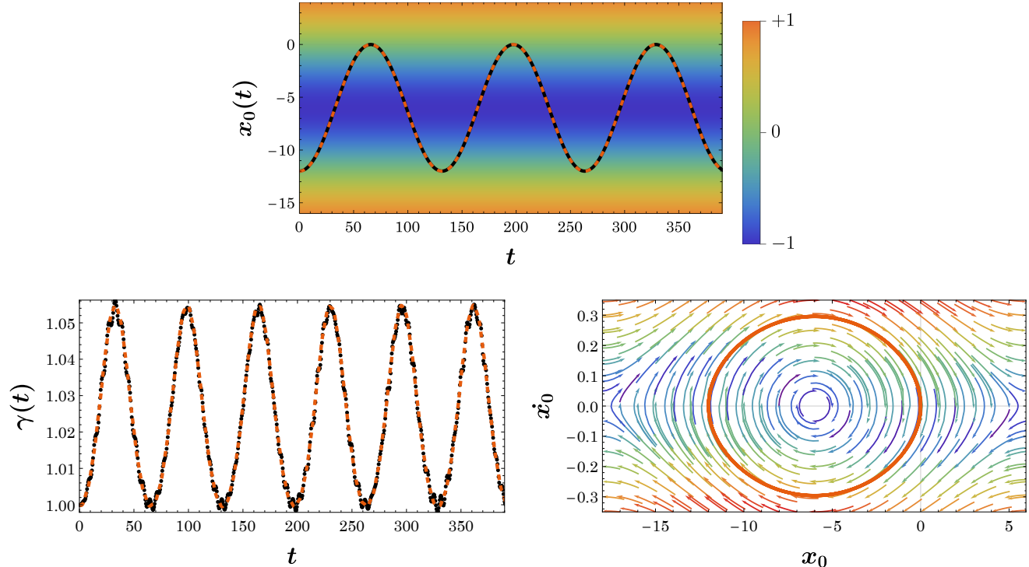
Hamiltonian Case
Comparison of the solution from the original field model (black line) and the approximate model (orange line).
T. Dobrowolski, J. Gatlik, and Panayotis G. Kevrekidis, arXiv:2409.05436 [nlin.PS] (2024)

Slide 12
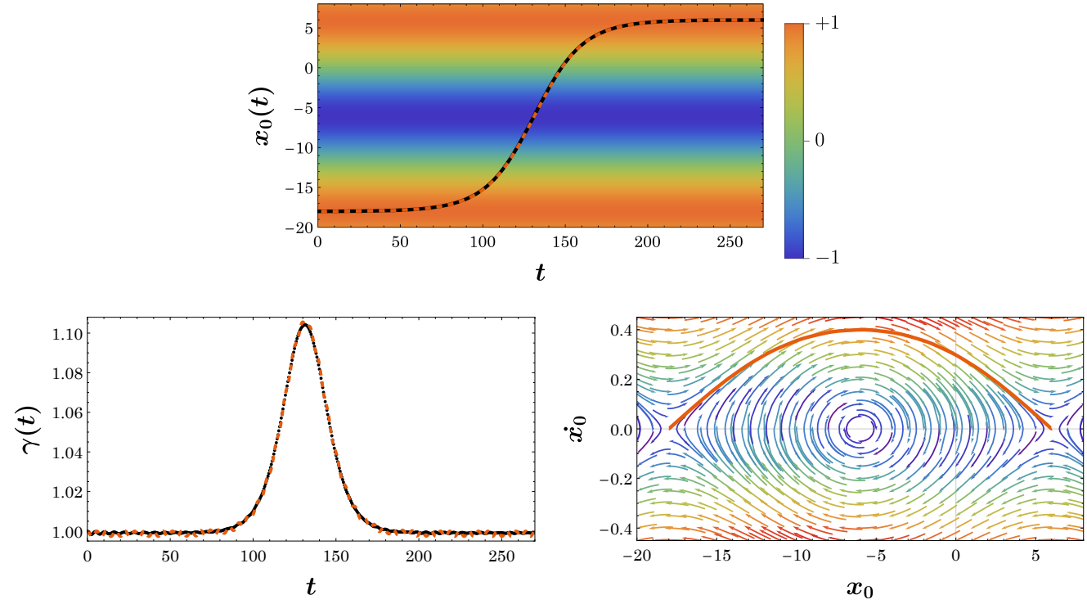
Hamiltonian Case
Comparison of the solution from the original field model (black line) and the approximate model (orange line).
T. Dobrowolski, J. Gatlik, and Panayotis G. Kevrekidis, arXiv:2409.05436 [nlin.PS] (2024)

Slide 13
Dynamics in the presence of dissipation
With dissipation and external forcing we used method based on a nonconservative Lagrangian density
In this notation, the equation of motion is of the form
Here, the left-hand side of this equation takes the form
We taking the following form of the non-conservative term
The equations of motion at the effective ODE level are then obtained as follows
T. Dobrowolski, J. Gatlik, and Panayotis G. Kevrekidis, arXiv:2409.05436 [nlin.PS] (2024)

Slide 14
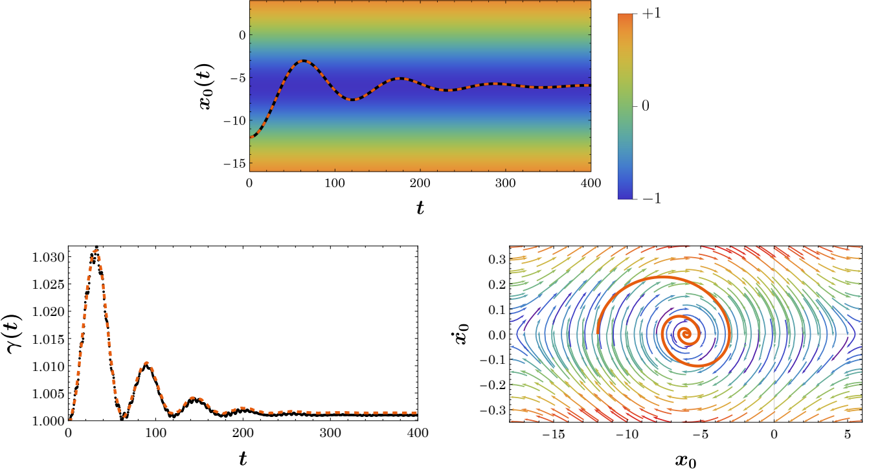
Dynamics in the presence of dissipation
A decelerating kink eventually stopping at a potential minimum through the effect of dissipation.
T. Dobrowolski, J. Gatlik, and Panayotis G. Kevrekidis, arXiv:2409.05436 [nlin.PS] (2024)

Slide 15
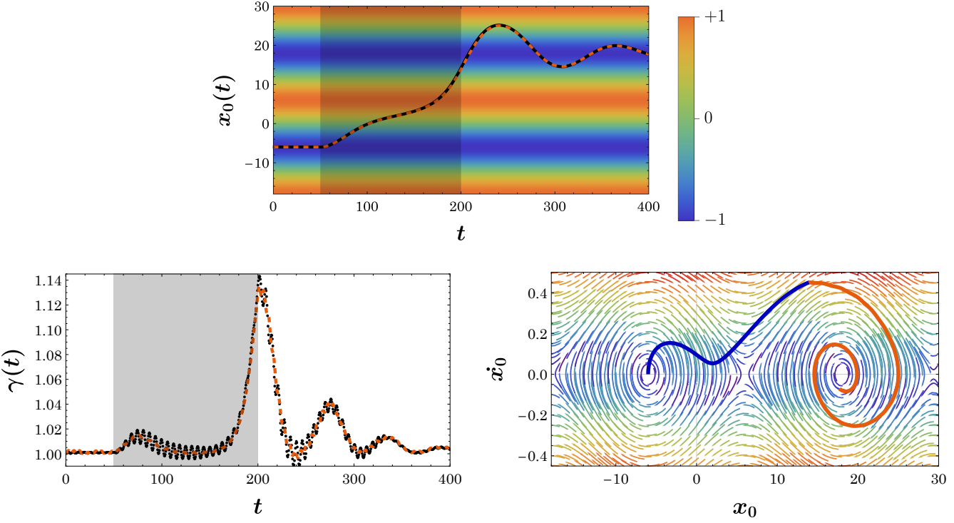
Dynamics in the presence of dissipation
A decelerating kink eventually stopping at a potential minimum through the effect of dissipation.
T. Dobrowolski, J. Gatlik, and Panayotis G. Kevrekidis, arXiv:2409.05436 [nlin.PS] (2024)

Slide 16
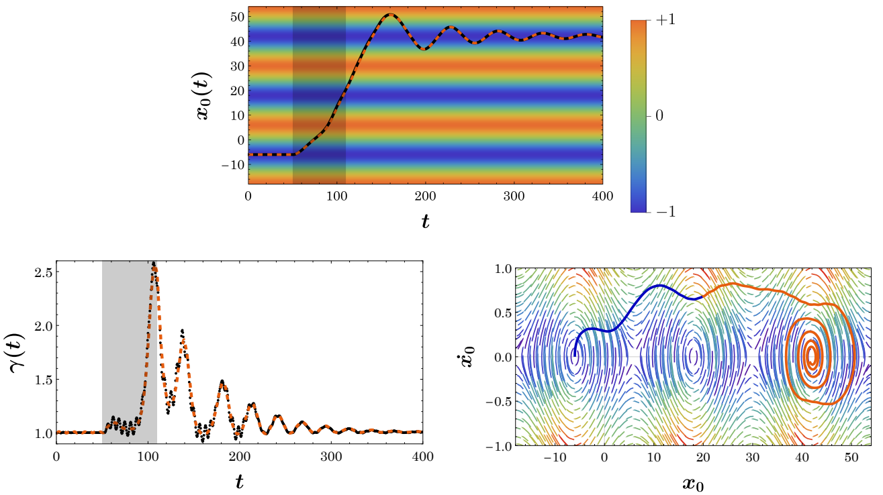
Dynamics in the presence of dissipation
Shifting the kink from a minimum to a minimum that is not directly adjacent to it.
T. Dobrowolski, J. Gatlik, and Panayotis G. Kevrekidis, arXiv:2409.05436 [nlin.PS] (2024)

Slide 17
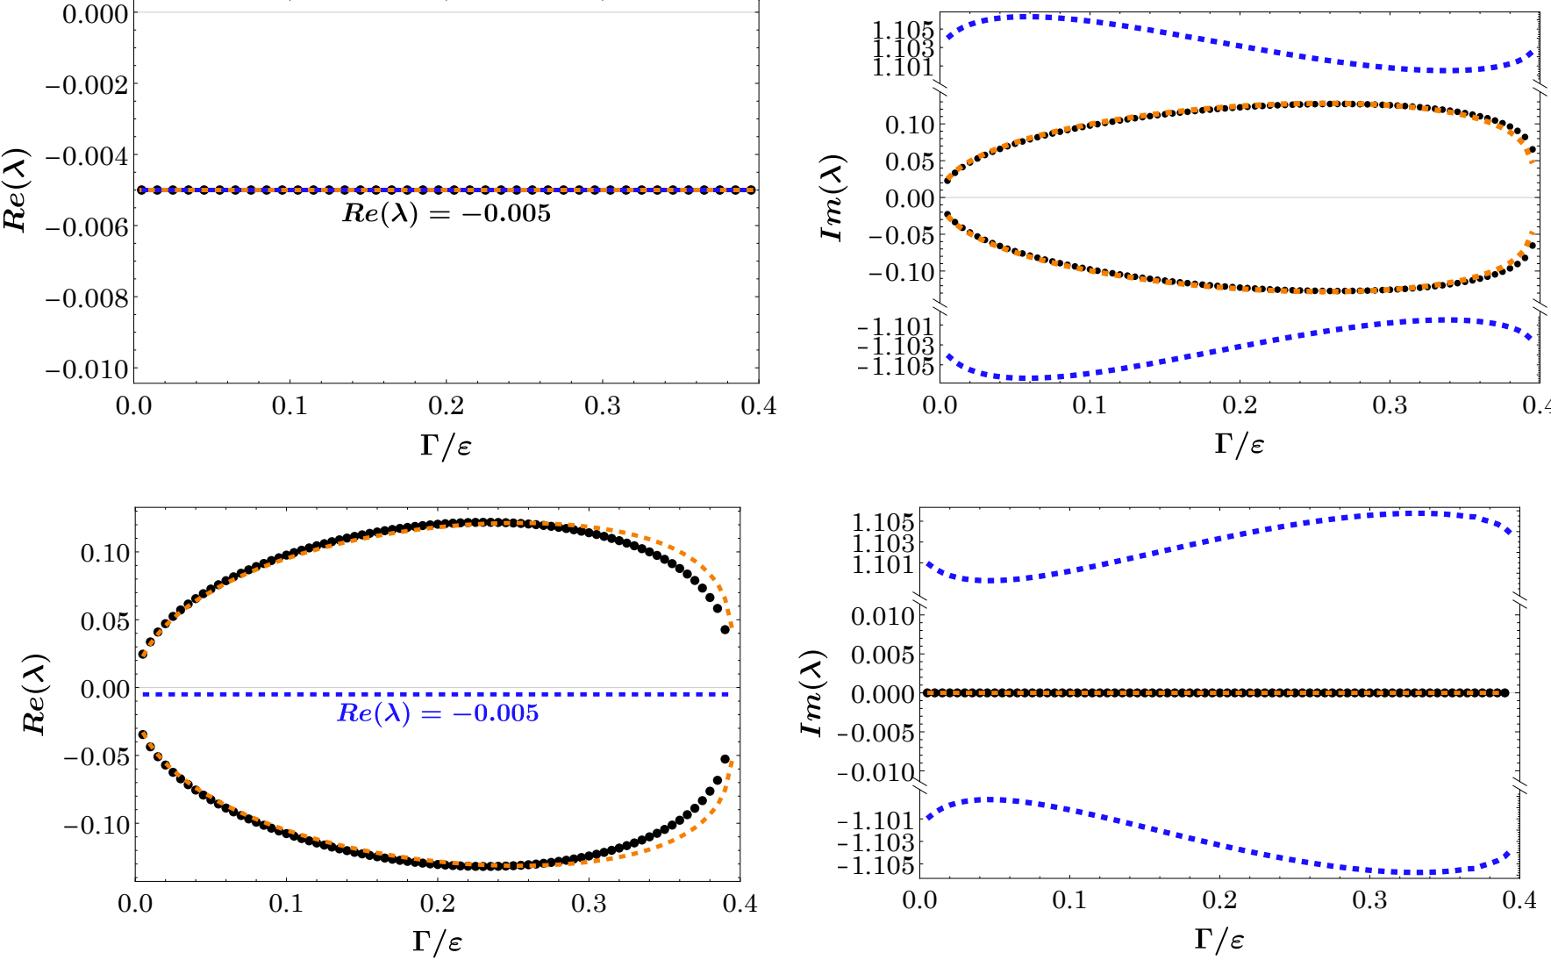
Kink-barrier interaction in the presence of bias current and dissipation
Linear approximation of the system
The exponents describing the time evolution of the trajectory in the linear approximation correspond to the solution of the following quartic equation
Analysis of the stability of the kink located in the minimum and maximum of the potential. The upper panels show the behavior of a kink located around the minimum potential, while the lower panels illustrate the instability of a kink located at the local maximum of the potential.
T. Dobrowolski, J. Gatlik, and Panayotis G. Kevrekidis, arXiv:2409.05436 [nlin.PS] (2024)

Slide 18
Thank you for your attention!

Slide 19
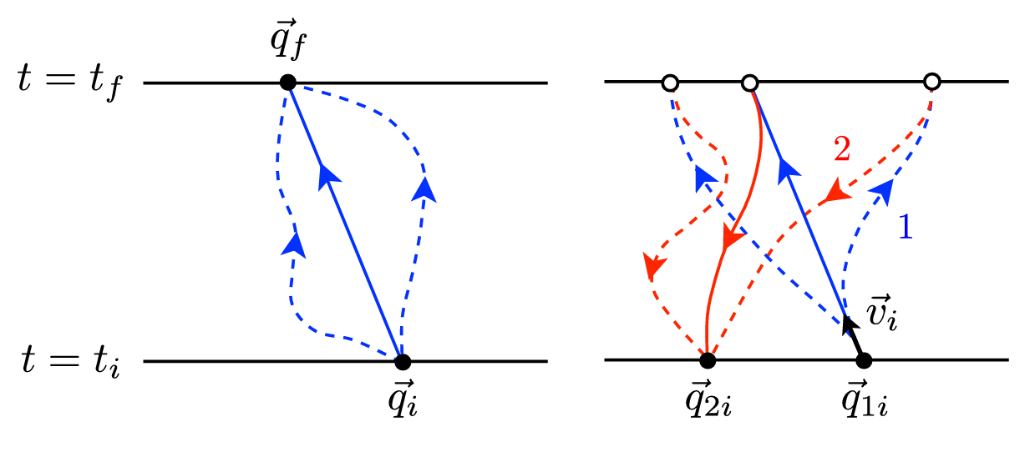
C. R. Galley, Classical mechanics of nonconservative systems, Phys. Rev. Lett. 110, 174301 (2013).

