Slide 1
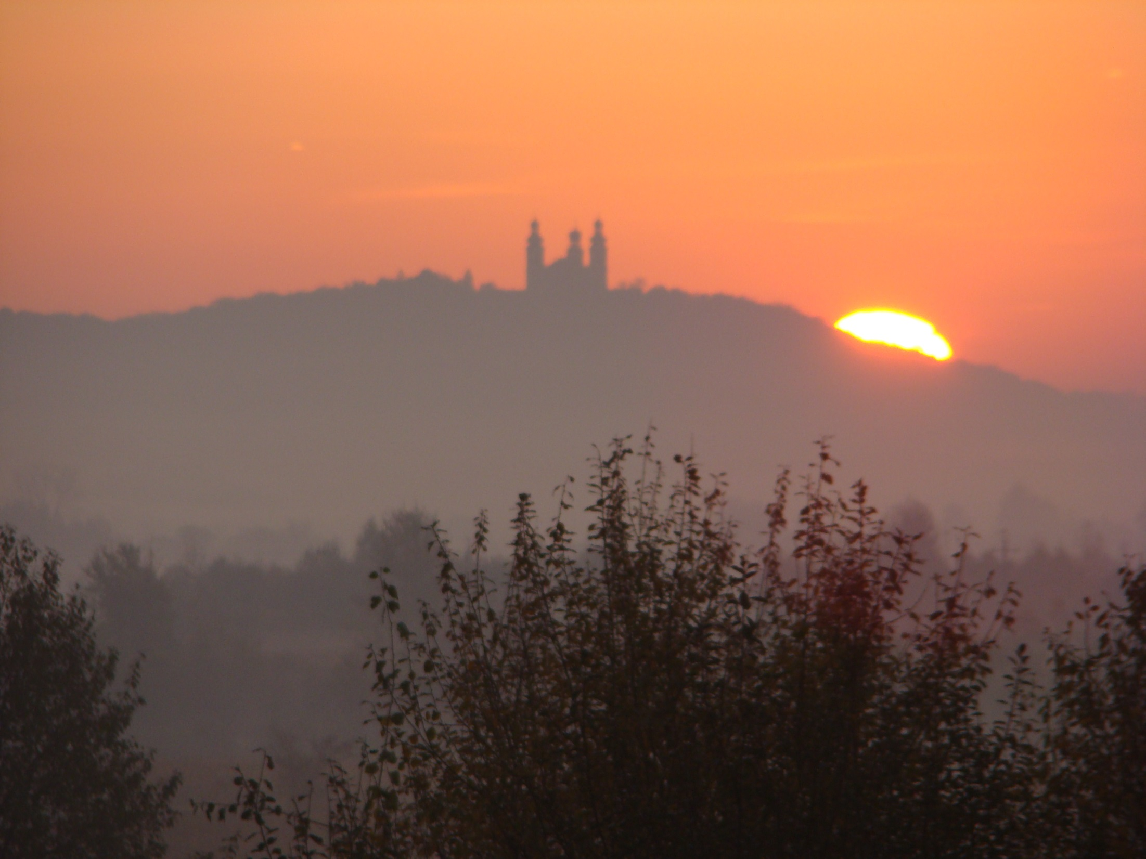
ENVIRA 2025
Krakow, Poland
Radisson Park-Inn Hotel
14-19.09. 2025

Slide 2
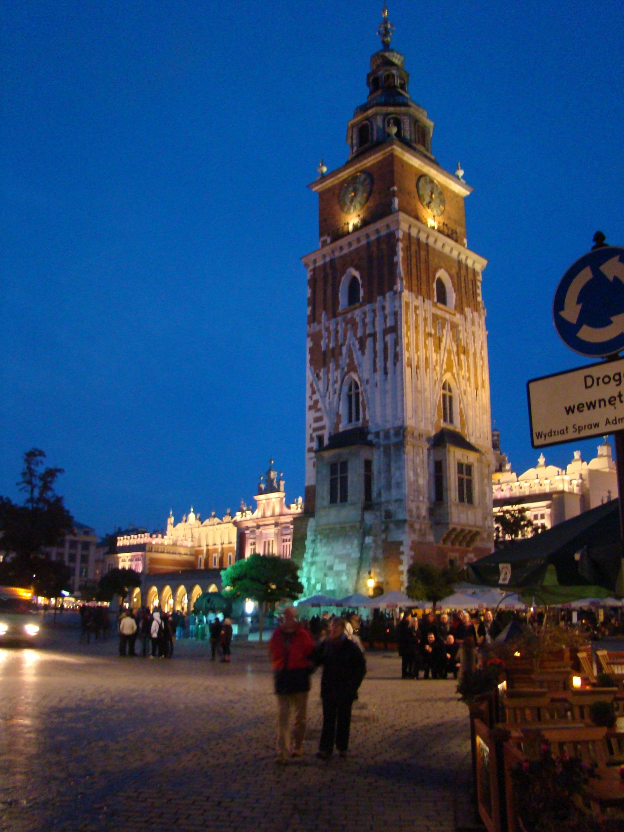
Kraków: Former capitol of Poland, ~800 000 inhabitants Academic center: The Jagiellonian University (659 years old university, Copenicus, …) + 22 other universities Mediveal old town, the center full of monuments – since 1978 on UNESCO world heritage list, the biggest european old town market place (~200x200 m), 107 churches (!)… ….

Slide 3
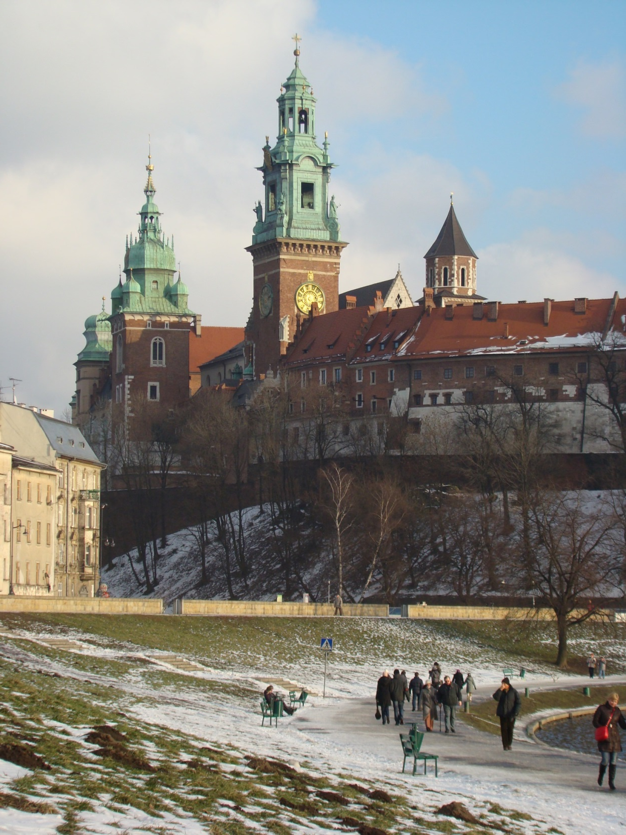
Royal Castle and
Royal Cathedra on Wawel hill,
Fameous Jewish district Kazimierz (since XIV century)
Mediveal salt mines around (Wieliczka, Bochnia)
….

Slide 4
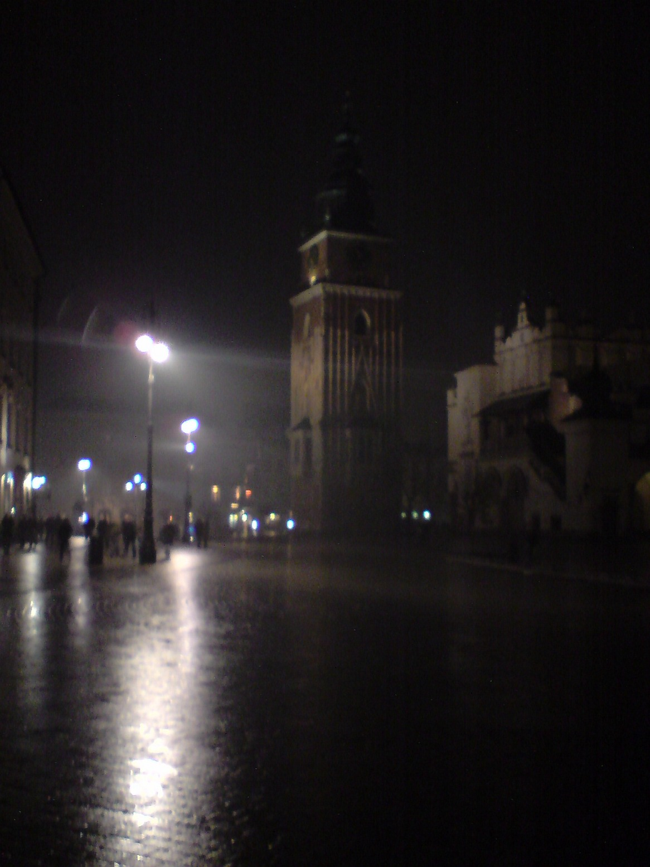
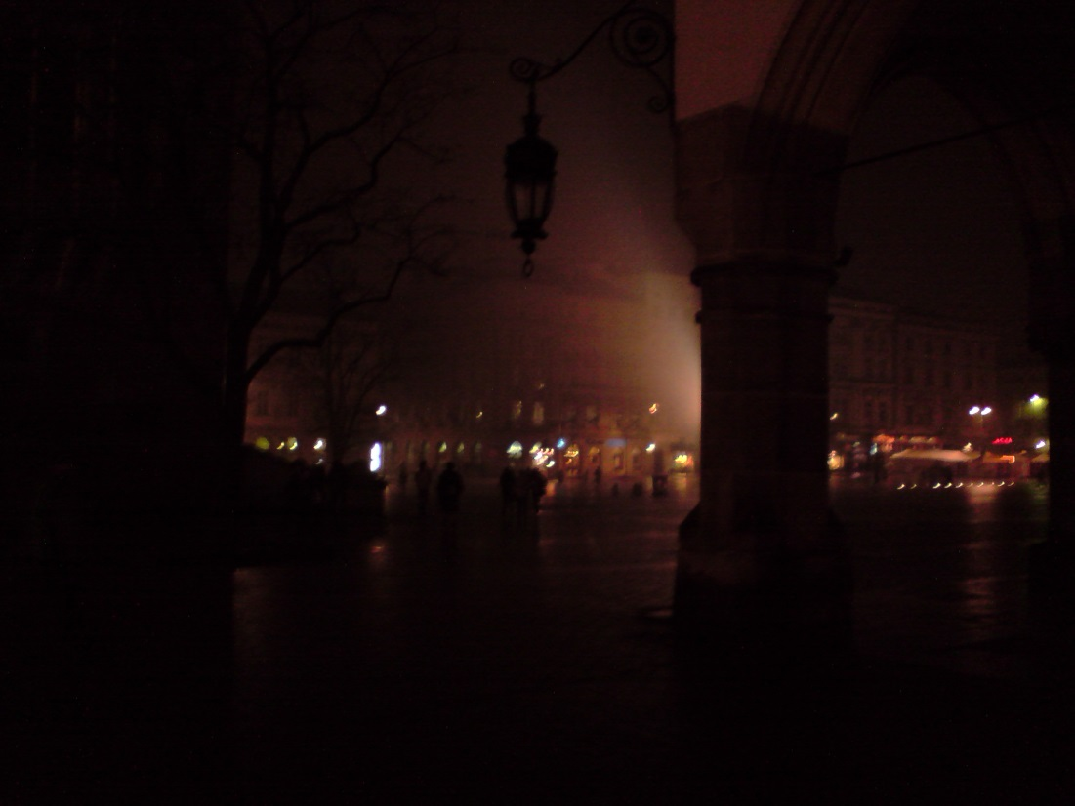
~ 5 Million tourists a year (Hotels, restaurants…)

Slide 5
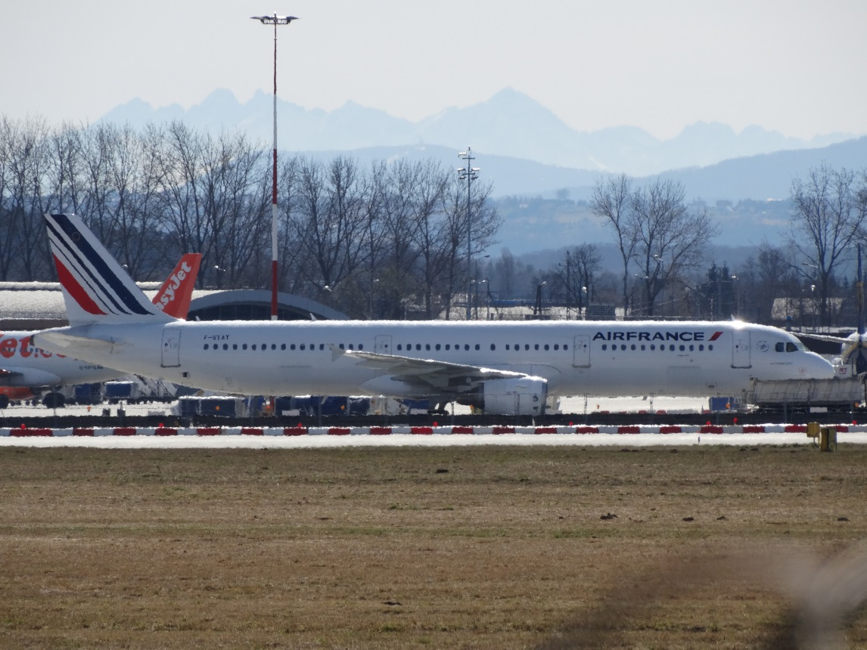
Kraków is not far away! The second biggest Polish airport (KRK)
More than 100 direct destinations
distances by air/road [km]:
Budapest 292/395
Bratislava 296/454 Vienna 331 /462 Prague 393/535 Berlin 529/595
Vilnius 629/739
Kiev 753/862
Copenhagen 795/1049 Stockholm 786/1383
Rome 1073/1577
Brussel 1104/1290 Oslo 1240/1604 Paris 1275/1583
Athens 1376/1866
London 1418/1652
Madrid 2126/2801
Lisbona 2609/3268
New Delhi 5313/6656
Beijing 7130/8970
Washington 7240
Seul 7944/10274
Pretoria 8469/12625
Tokyo 8815/11977
Brasilia 9851
Buenos Aires 12143
Canberra 15653
Wellington 17844

Slide 6
The Henryk Niewodniczański Institute of Nuclear Physics, Polish Academy of Sciences
(the host institution)
~600 employes
Two proton cyclotrones (230 MeV and 60 MeV)
From our web page:
„…The Institute conducts basic and applied research in the field of physics and related sciences. Using the latest technological and IT achievements at IFJ PAN, research is carried out on the structure of matter and the properties of fundamental interactions from the cosmic scale to that of the elementary particles. In the field of basic research, which is the main task of the Institute, theoretical and experimental research is carried out in four main directions:
particle physics and astrophysics
nuclear physics and strong interaction physics
condensed matter physics (including nano-materials)
interdisciplinary and applied research, which involves applications of physics in medicine, biology, dosimetry, environmental protection, nuclear geophysics, radiochemistry, high-temperature plasma diagnostics, the study of complex systems, such as the human brain, financial market or linguistics…”

Slide 7
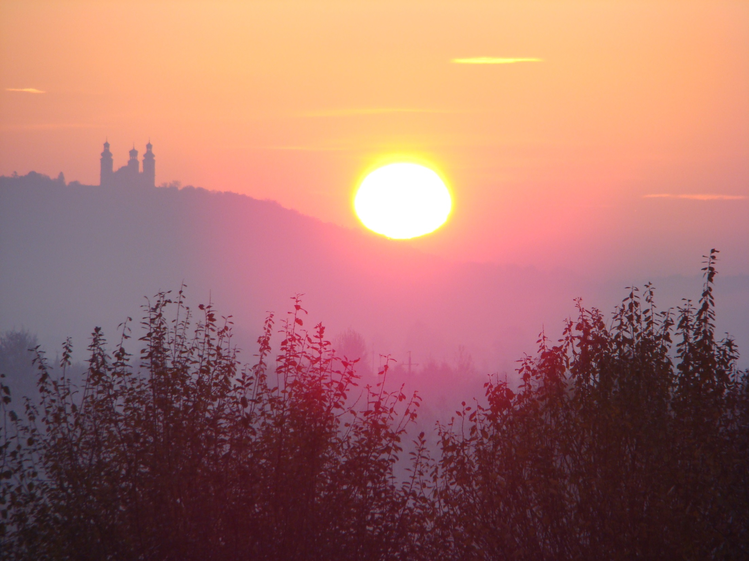
Welcome to Kraków in September 2025!
All phootos courtesy of my camera…

