Slide 1
Human Resources Strategy For Researchers in IFJ PAN

Slide 2
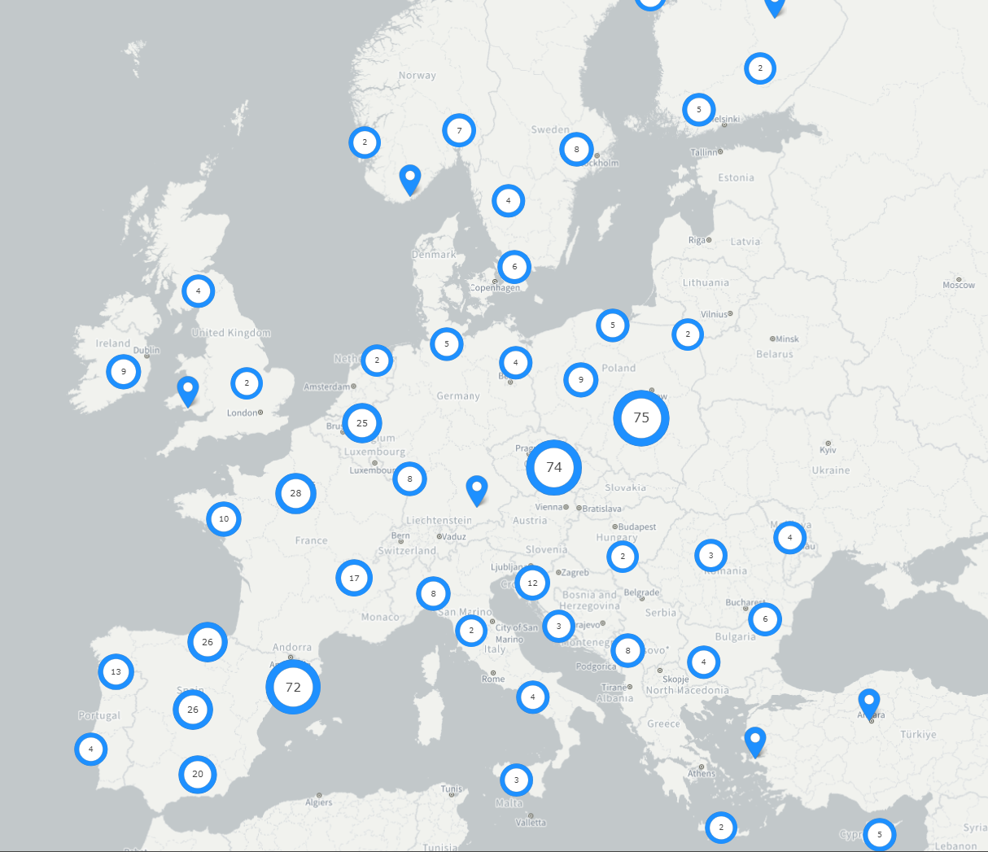
HR Excellence in Research
Etical & Proffesional Aspects
Recruitment
Working Conditions & Social Security
Training & Development
https://euraxess.ec.europa.eu/sites/default/files/brochures/kina21620b8c_pl.pdf

Slide 3
INITIAL PHASE
IMPLEMENTATION PHASE
AWARD RENEWAL PHASE
Endorsement of the C&C
Implementation
of the Action Plan
Implementation
of the Revised Action Plan
Implementation
of the Improved Action Plan
Implementation
of the Further Improved Action Plan
Application for the HR Award:
Gap Analysis
OTM-R Checklist
Initial Action Plan Design
INITIAL ASSESSMENT
RENEWAL WITH SITE VISIT
RENEWAL WITHOUT SITE VISIT
RENEWAL WITH SITE VISIT
INTERIM ASSESSMENT
12 months
24 months
36 months
HR AWARD GRANTING
HR AWARD GRANTING
36 months
36 months
HRS4R – from PROGRESS to QUALITY
Source: https://euraxess.ec.europa.eu/jobs/hrs4r
Institution
European Commission
External Experts

Slide 4
Site visit
Control is made by the foreign assessors. It takes one day.
Assessors check the progress of the action plan.
In the IFJ the AP realize five different aspects:
Development of the young scientists;
Developement of the experienced scinetists;
Comercialization of the research;
Equality and diversity;
Ethics and scientific freedom.
https://www.ifj.edu.pl/kariera/hrs4r/podjete-dzialania.php
Assesors require interviews with the representatives of the researchers.
13:00 – 14:00
PhD students and young researchers
14:15 – 15:15
Independent researchers and group liders

Slide 5
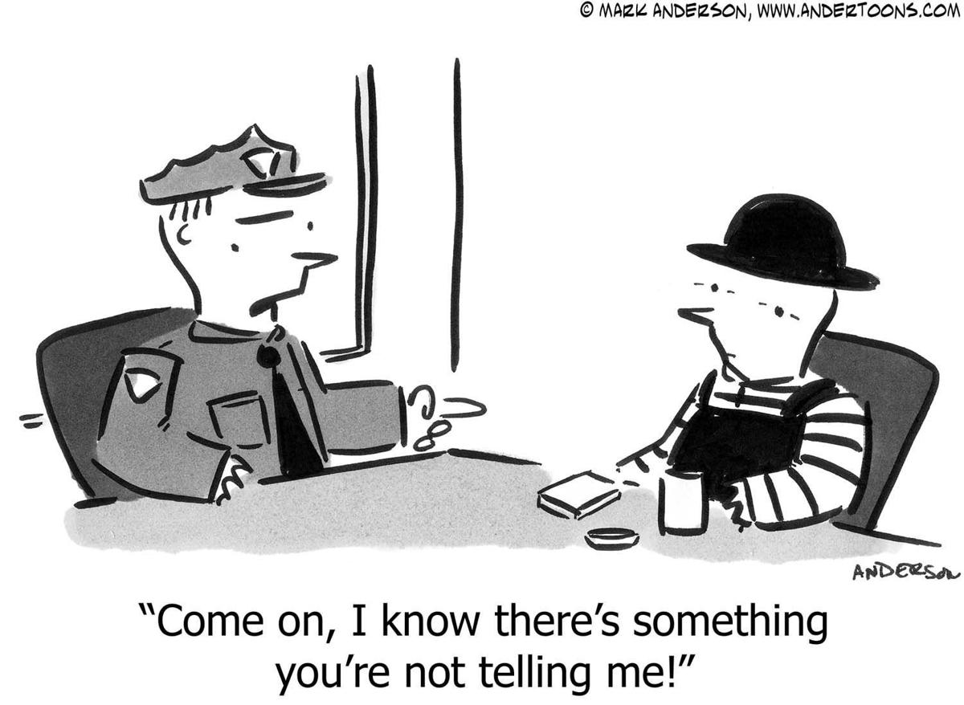
Interviews with assessors
Assesors don’t like:
Lack of commitment during talks;
Inconsistencies between the report and the accounts of individual groups of scientists;
Lack of the knowledge about Institute startegy related to HRS4R.
Friendly interogation
https://www.ifj.edu.pl/kariera/hrs4r/pdf/Strategia_HRS4R_w_IFJPAN.pdf

Slide 6
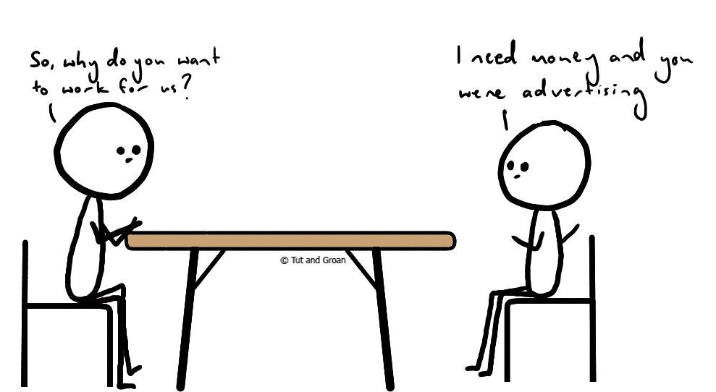
Selected aspects of the HRS4R strategy at IFJ PAN – OTM-R policy
Open, Transparent and Merit-based
Recruitment of Researchers
New policy and statute of hiring researchers (https://www.ifj.edu.pl/en/career/recruitment-procedures.php);
New recommendations for members of recruitment committees (www.ifj.edu.pl/dzialy/dsp/informatory/Zalecenie-dla-czlonkow-komisji-rekrutacyjnych-w-IFJ-PAN.pdf);
New Rules of Procedure for the Appeals Committee (www.ifj.edu.pl/dla-pracownikow/komisje/komisja-odwolawcza-rn/);
Feedback on strengths and weaknesses after the interview.

Slide 7
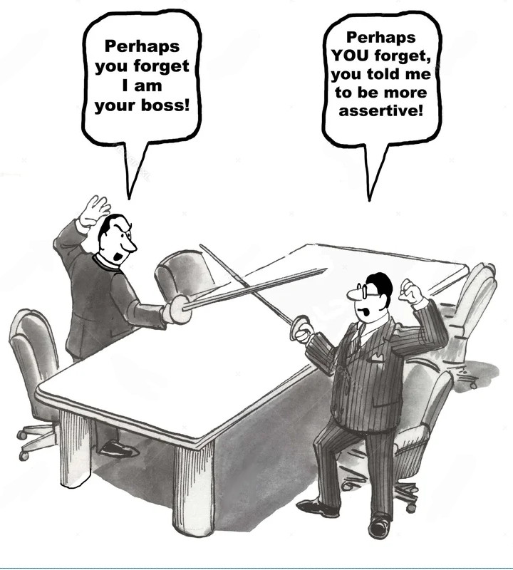
Selected aspects of the HRS4R strategy at IFJ PAN – conflicts and complains
Anti-mobbing Commission Prof. Mariusz Witek - Chair of the Committee komisja.antymobbingowa@ifj.edu.pl Permament duty: every first Monday of the month 11:00 – 12:00, room 108 – basement, bulding No. 0;
Ombudsman – an Advocate for the Rights and Ethical Values at IFJ PAN dr hab. Paweł Błasiak – ombudsman@ifj.edu.pl or mailbox next to the library https://www.ifj.edu.pl/en/institute/staff/Ombudsman_ENG.pdf;
Ombudsman for Doctoral Students mgr Michał Adamek – rzecznikdoktorantow@ifj.edu.pl or phdspokesman@ifj.edu.pl https://kisd.ifj.edu.pl/solving-problems/

Slide 8
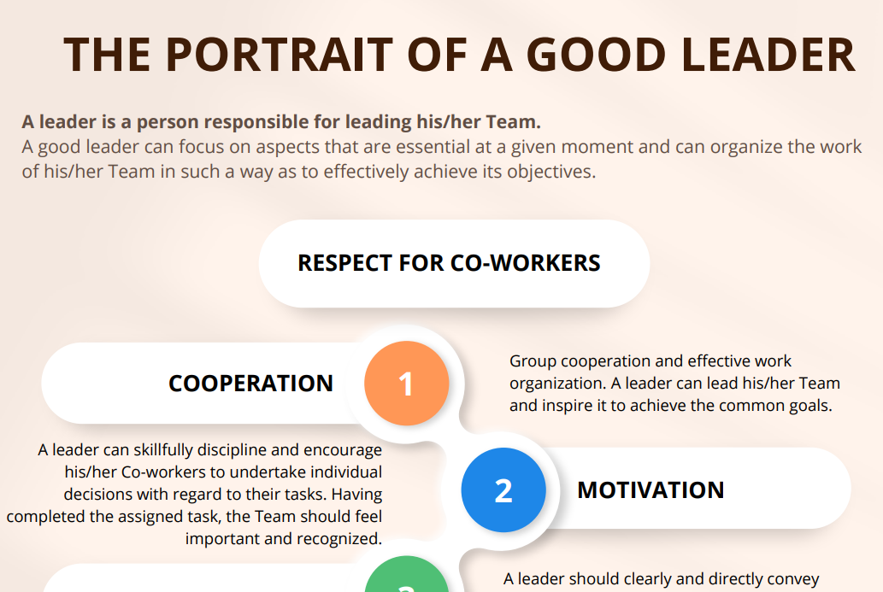
Selected aspects of the HRS4R strategy at IFJ PAN – management staff training
Mentoring in scientific institutions 8 May 2023 Resolving conflicts within and between teams 19,26,27 June 2023
Creation of the guide: The portrait of a good leader
www.ifj.edu.pl/dzialy/dsp/informatory/The-portrait-of-a-good-leader.pdf

Slide 9
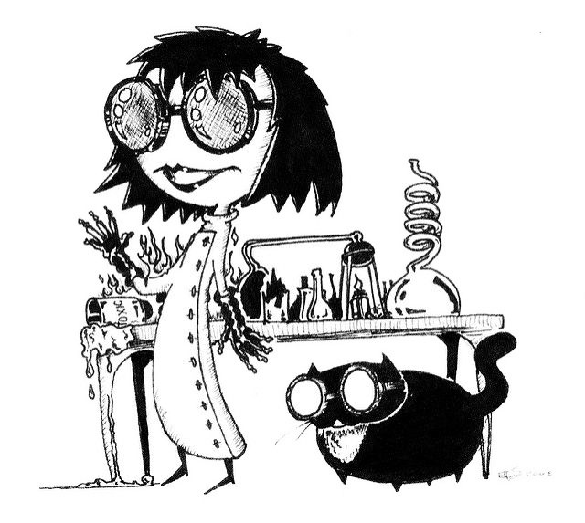
To make life better…
Open Access policy and guide: http://www.ifj.edu.pl/library/en/open-access/
http://www.ifj.edu.pl/library/open-access/materials/OTWARTY-DOSTEP-przewodnik-2023-eng.pdf
Development the recommendation about co-authorship:
http://www.ifj.edu.pl/dla-pracownikow/etyka/Recommendations-related-to-good-practices-in-determining-co-authorship-of-scientific-publications.pdf
Seminar: Thursdays for youth
Emergency psychological help:
http://www.kisd.ifj.edu.pl/psychological-help/
Appointment of an assistant for foreign employees:
Mgr Beata Murzyn - beata.murzyn@ifj.edu.pl
Creation of a website – welcome for newcomers
https://www.ifj.edu.pl/en/career/hrs4r/welcome-for-newcomers/
Bilingual forms and messages
Designated room for women in
pregnancy and parent with child:
building no. 5, floor 1
room no. 5320
BILINGUAL GUIDES
https://www.ifj.edu.pl/dzialy/dsp/informatory/

Slide 10
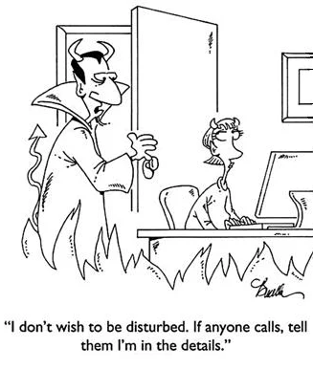
Details and proposals
https://www.ifj.edu.pl/en/career/hrs4r/
Proposals to undertake joint activities for the benefit of the institute community:
wg4@ifj.edu.pl
Thank You for attention!

