Slide 1
PTMA participation in the CREDO project
Marek Więckowski
Representative of the PTMA in the Project CREDO

Slide 2
The oldest and largest association of astronomy enthusiasts in Poland
Source: PTMA.pl
Marek Więckowski
Representative of the PTMA in the Project CREDO

Slide 3
9 thematic sections including: astronautical observing positions and occultation solar observations comet observations observers of variable stars
Source: PTMA.pl
Marek Więckowski
Representative of the PTMA in the Project CREDO

Slide 4
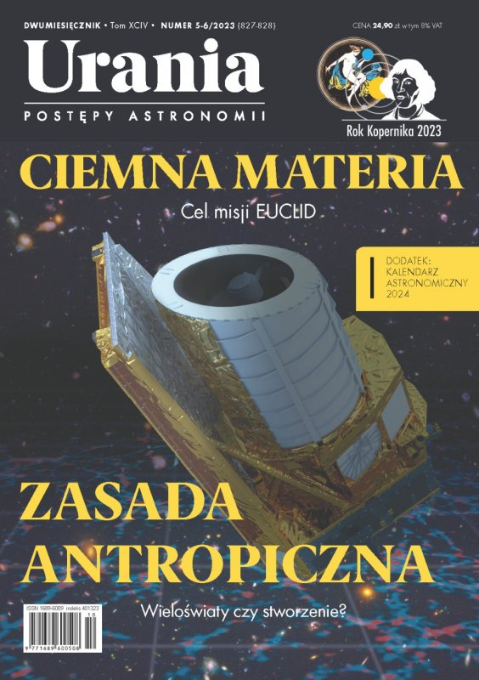
Source: Urania.edu.pl
Source: www.youtube.com/@Astronarium
Marek Więckowski
Representative of the PTMA in the Project CREDO

Slide 5
Source: FB/@Credo.science
Source: CREDO.science
Marek Więckowski
Representative of the PTMA in the Project CREDO

Slide 6
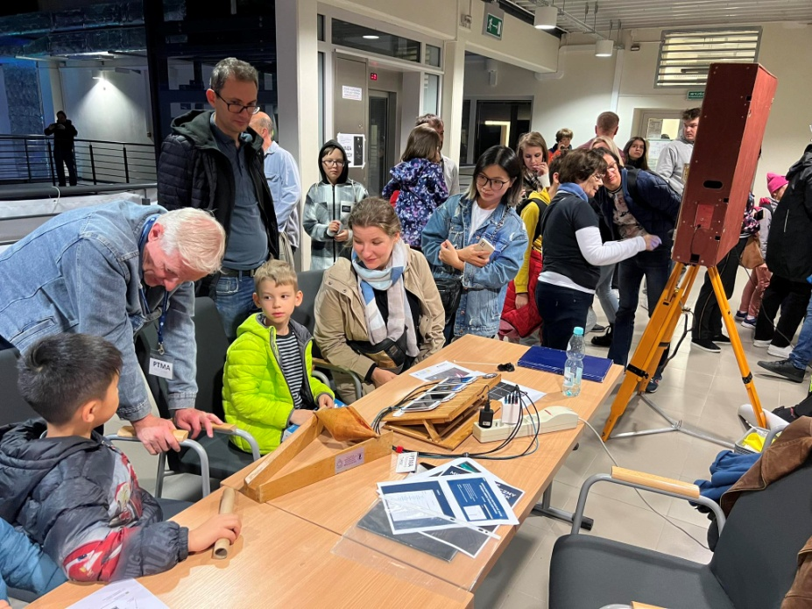
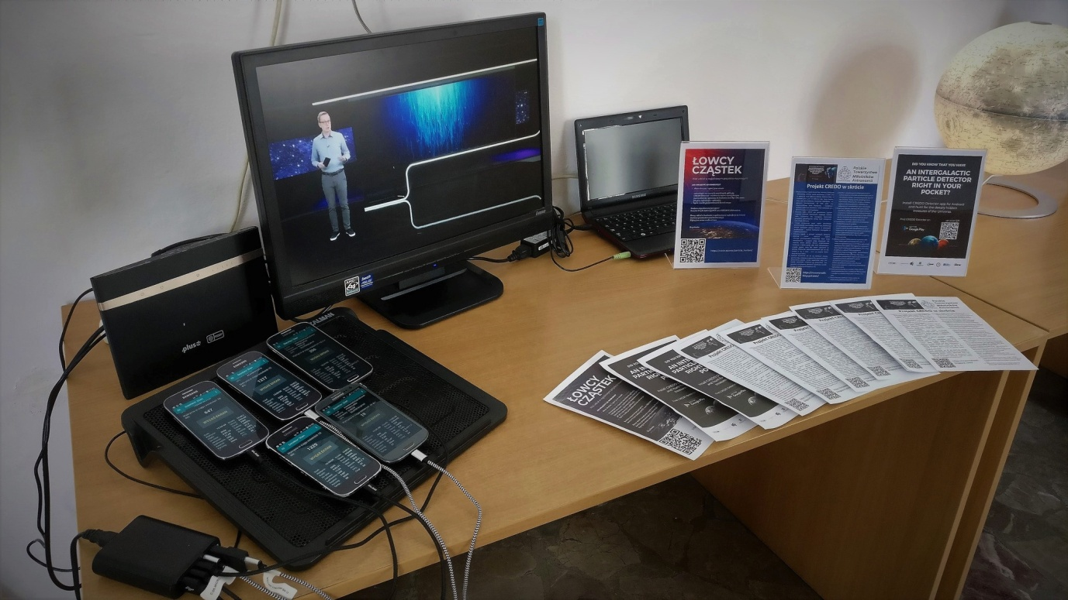
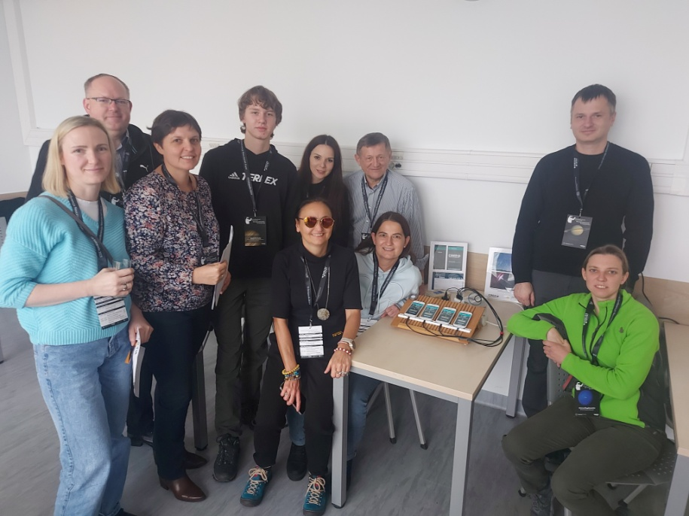
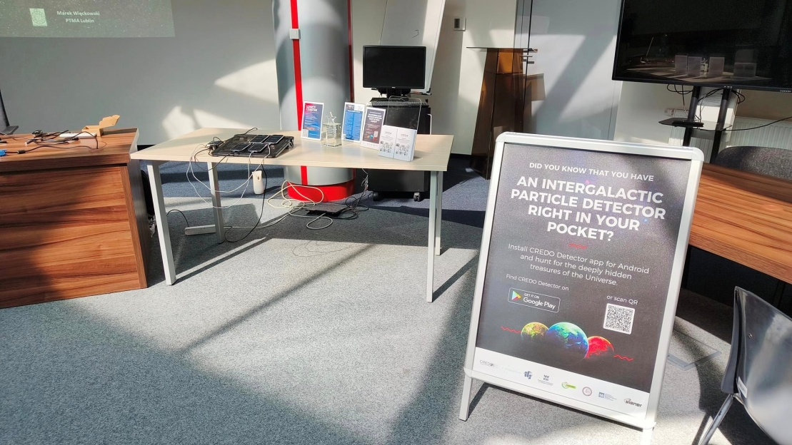
Source: fb/@PTMA Warszawa
Source: FB/@PTMA Warszawa
Marek Więckowski
Representative of the PTMA in the Project CREDO

Slide 7
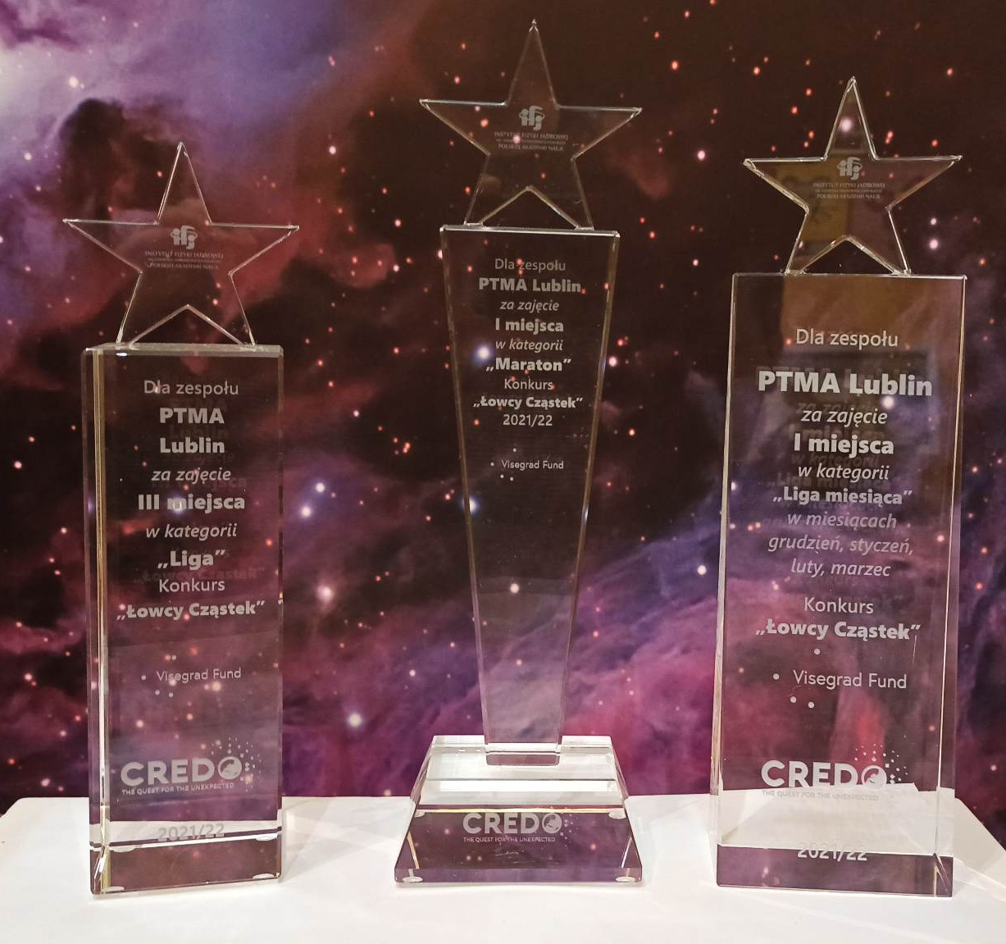
Source: FB/@Credo.science
Source: FB/@PTMA Lublin
Marek Więckowski
Representative of the PTMA in the Project CREDO

Slide 8
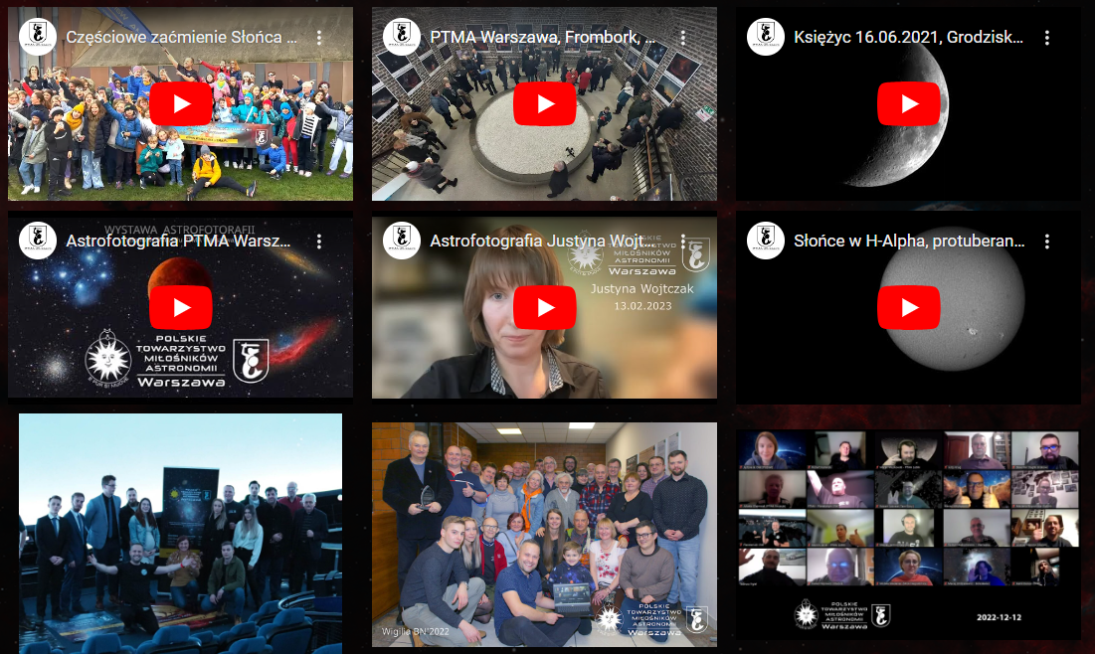
CREDO - PTMA #CopernicusHUB
International space education project

Slide 9
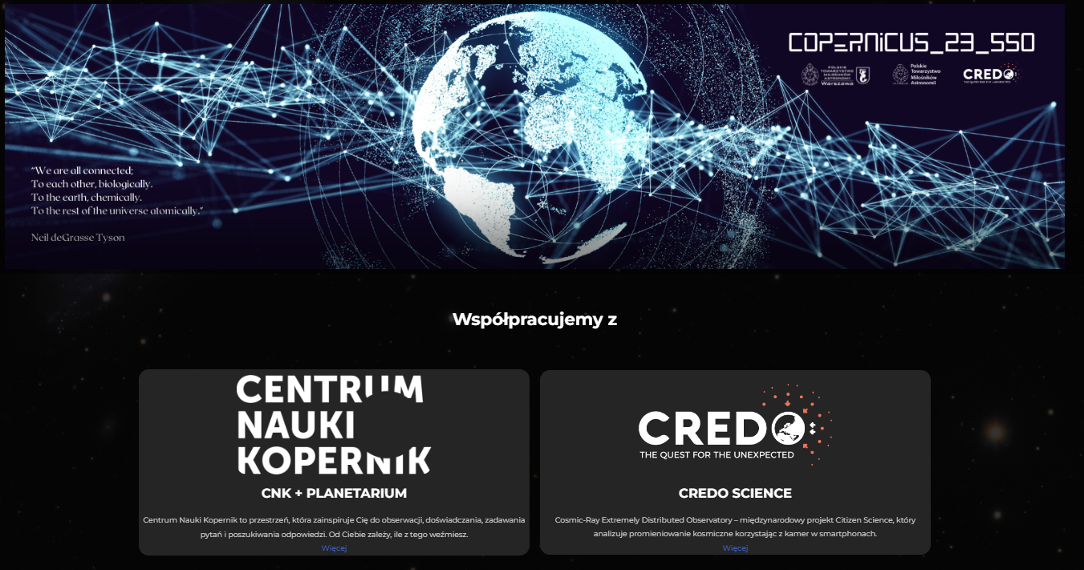
CREDO - PTMA #CopernicusHUB
International space education project

Slide 10
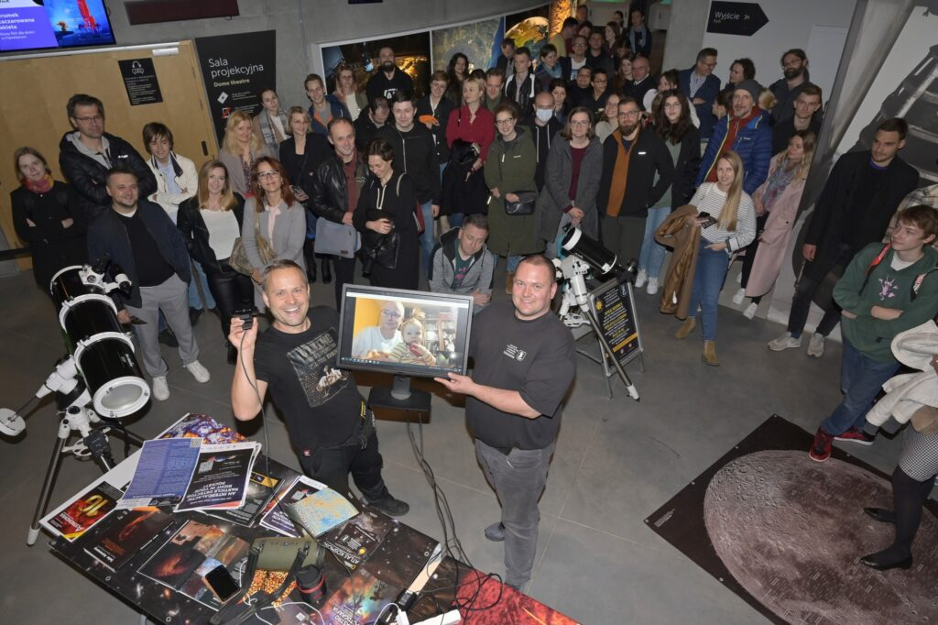
CREDO - PTMA #CopernicusHUB
International space education project

Slide 11
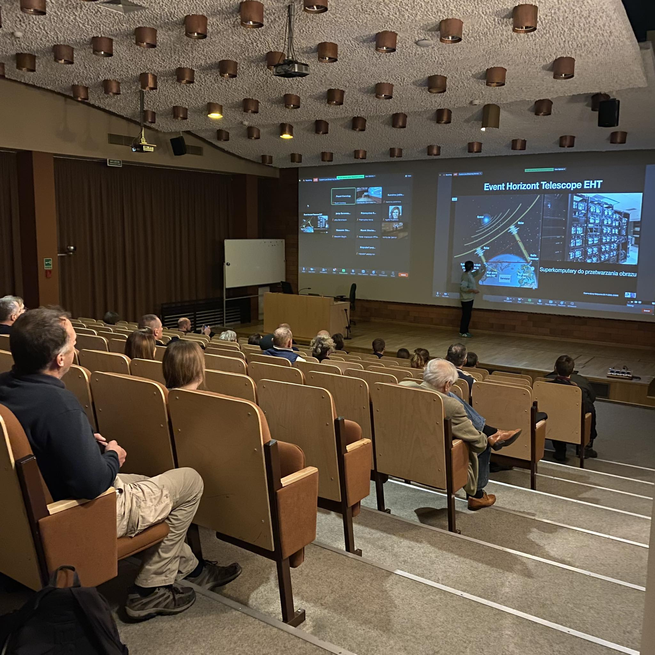
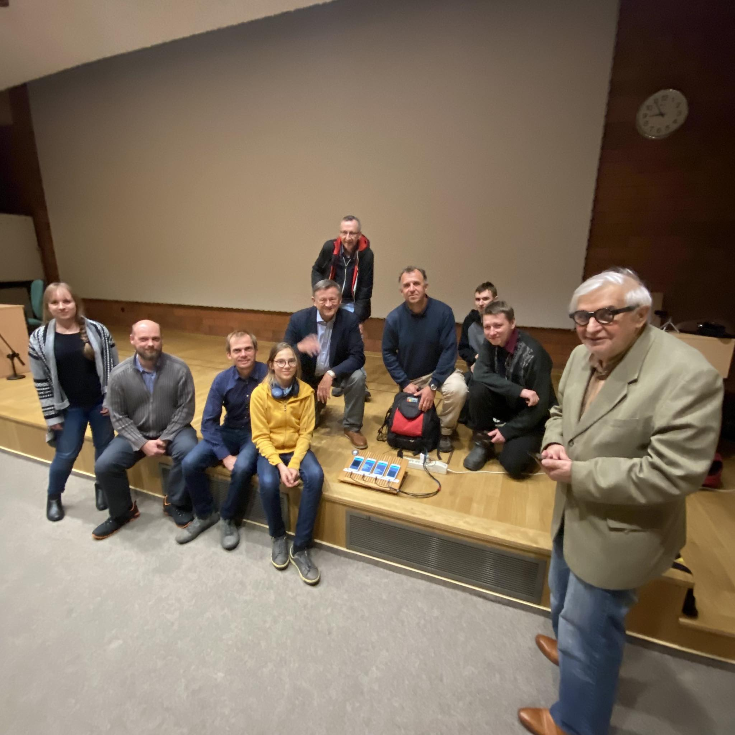
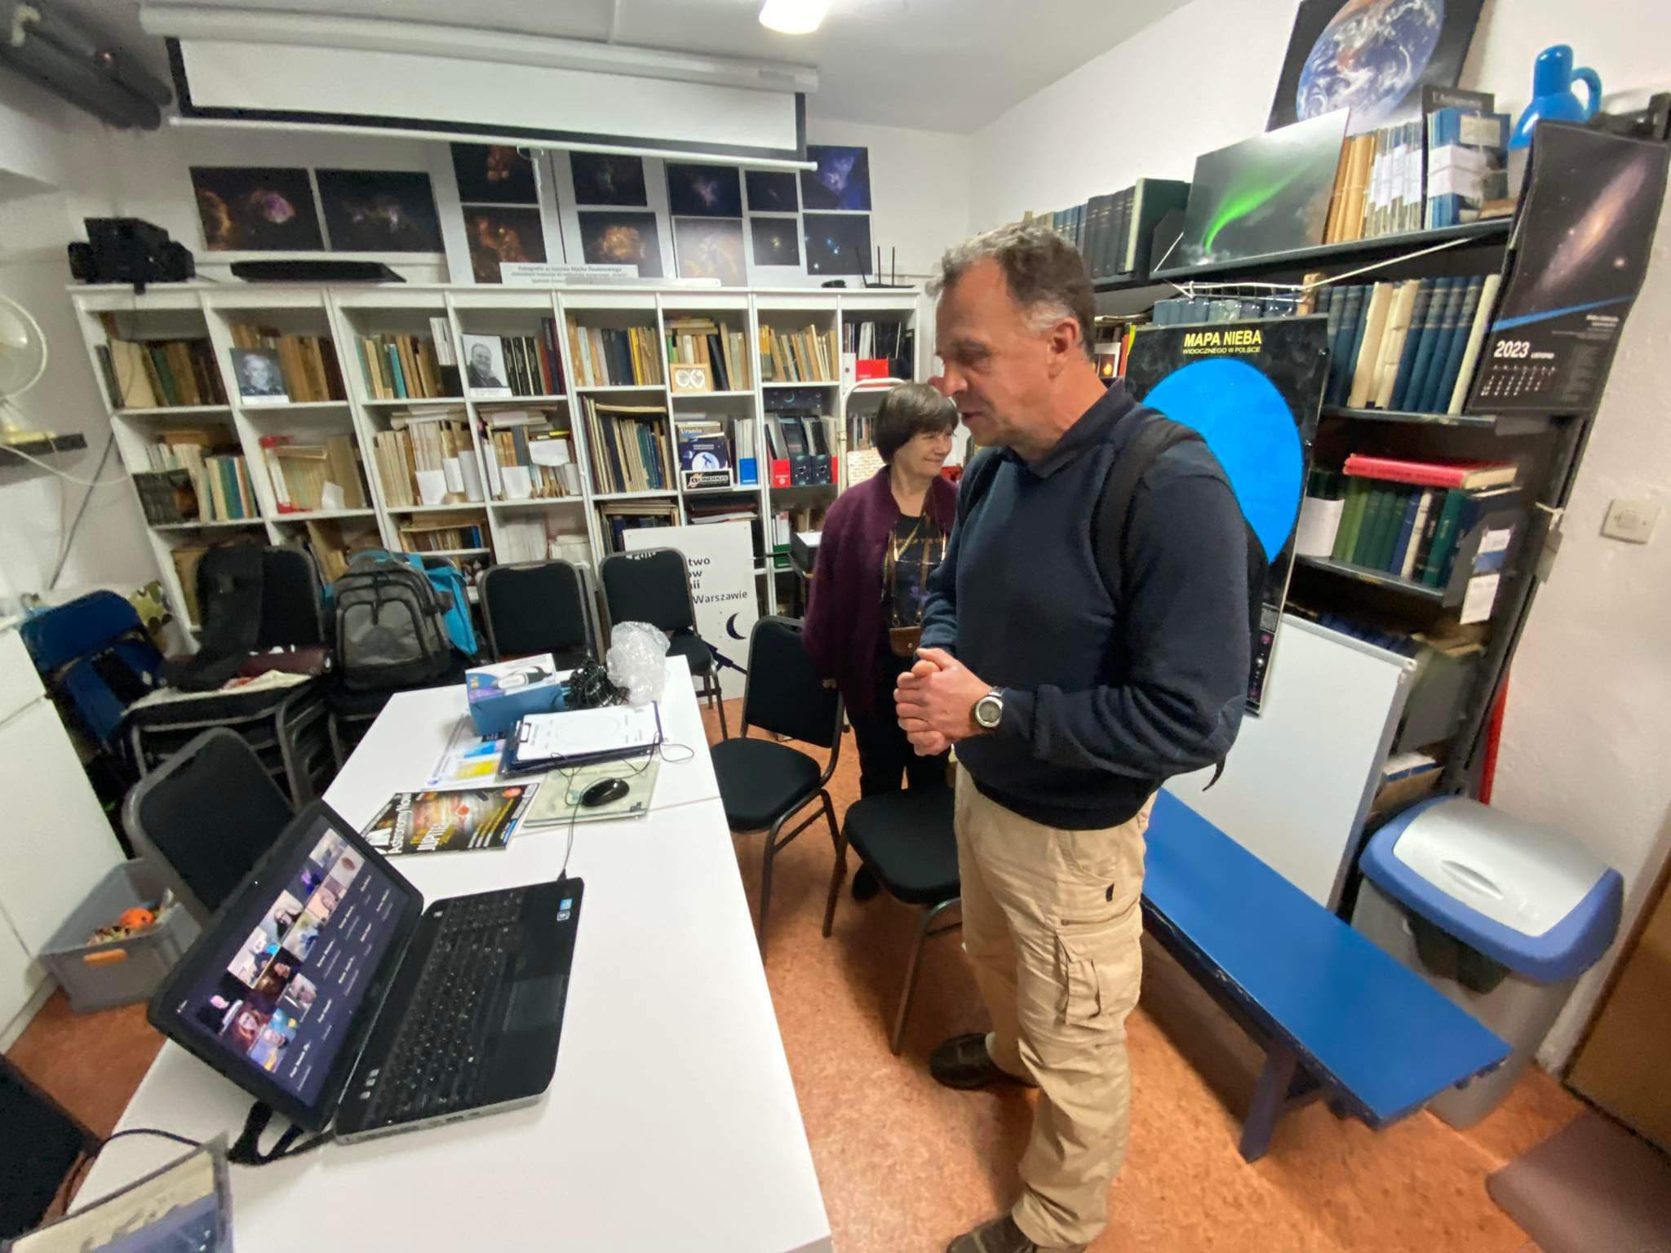
CREDO - PTMA #CopernicusHUB
International space education project

Slide 12
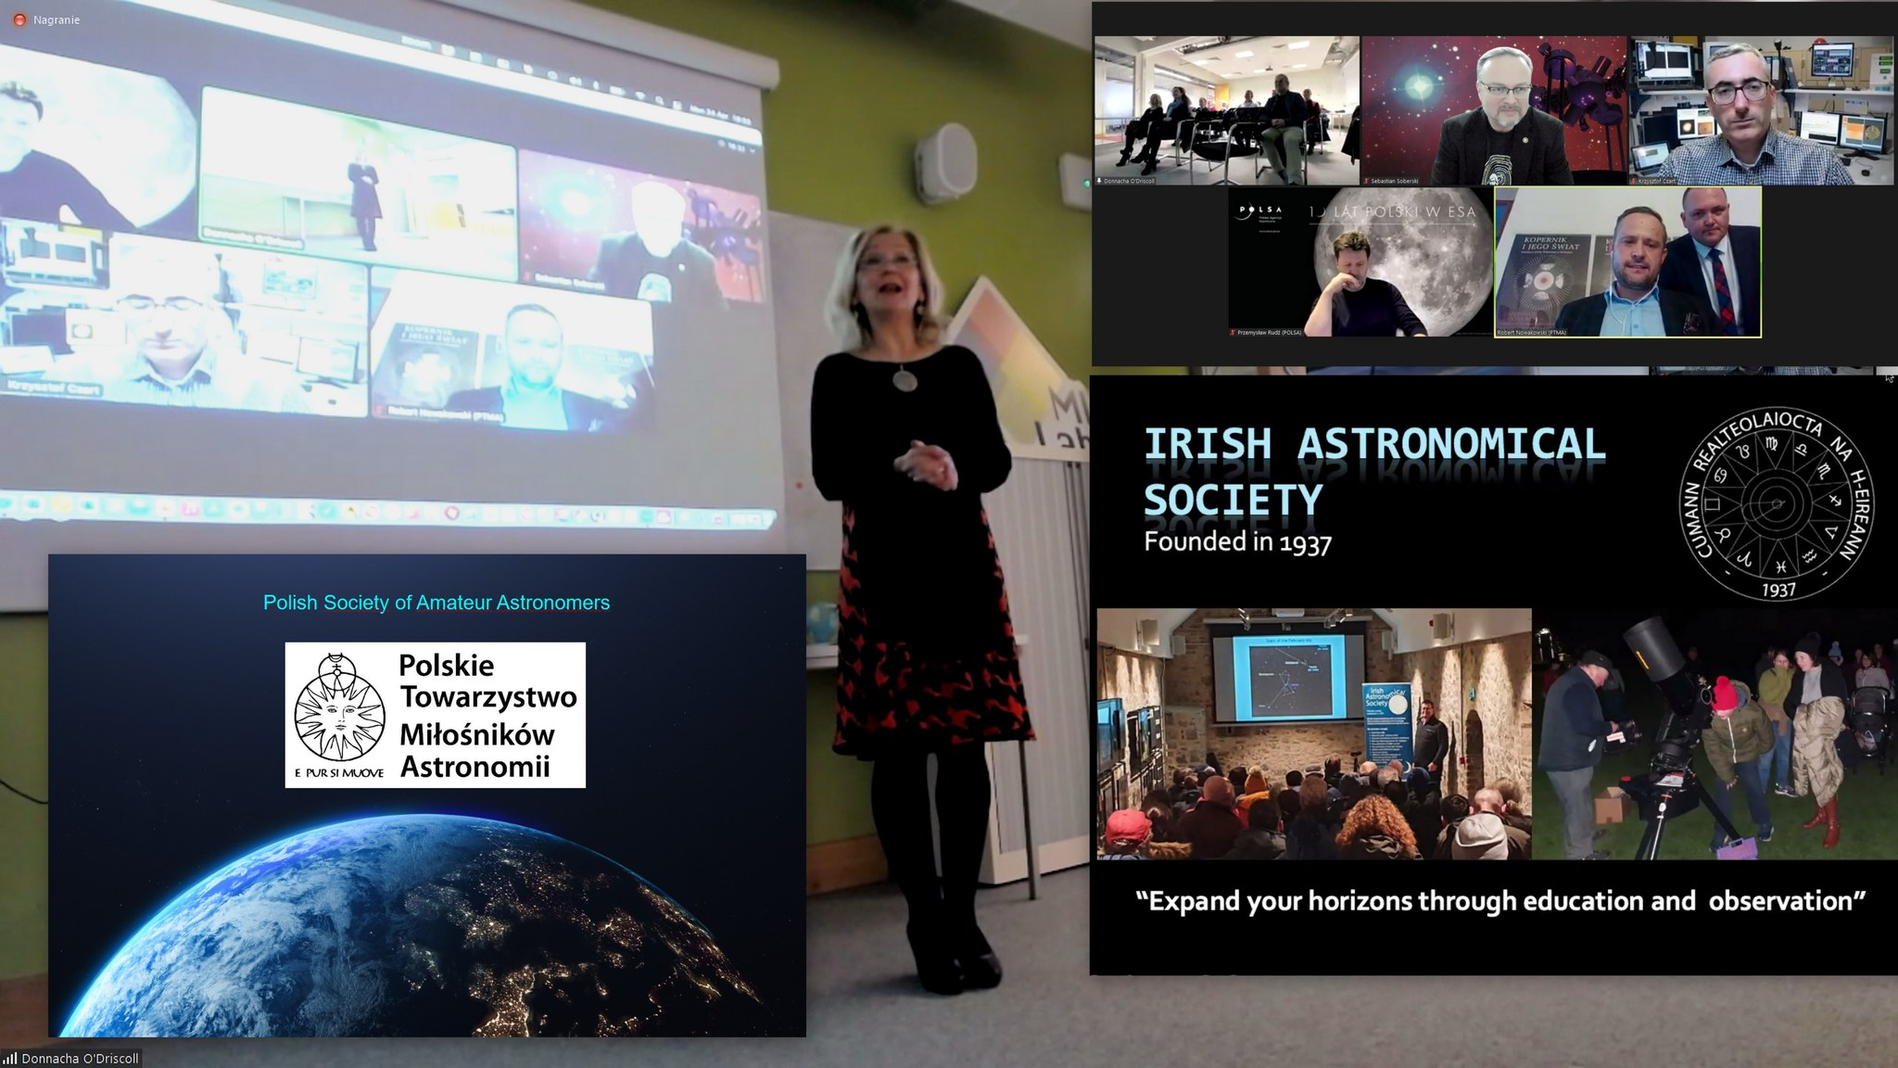
CREDO - PTMA #CopernicusHUB
Meeting with Irish Astronomical Society

Slide 13
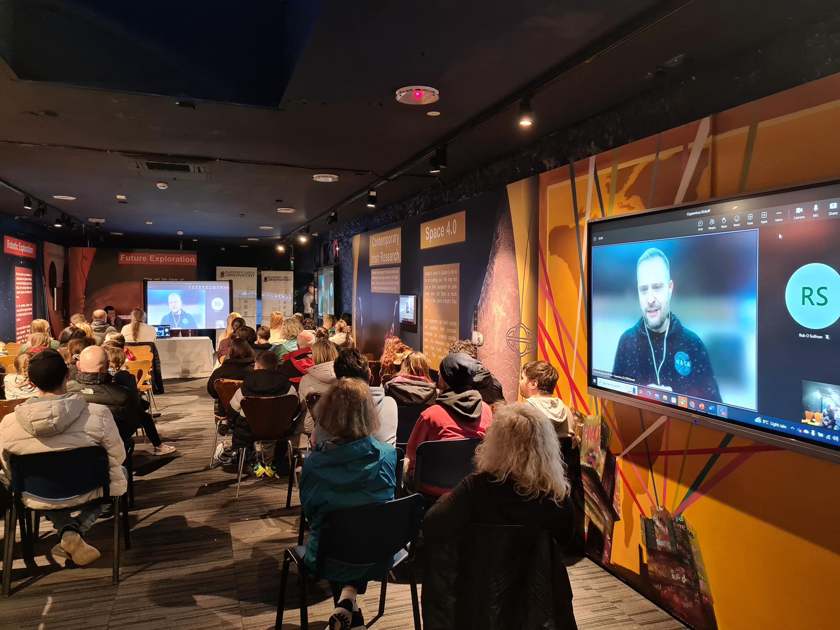
CREDO - PTMA #CopernicusHUB
Meeting with Blackrock Castle Observatory

Slide 14
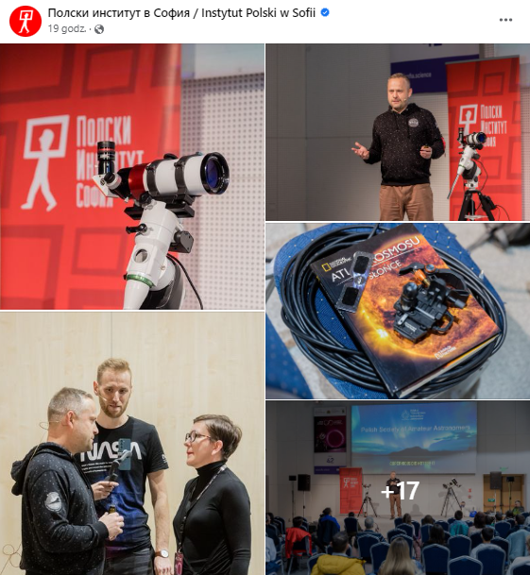
CREDO - PTMA #CopernicusHUB
Cooperation with Polish Institute in Sofia

Slide 15
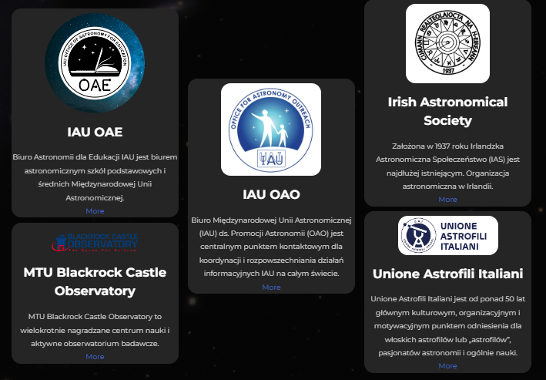
CREDO - PTMA #CopernicusHUB
International space education project

Slide 16
CREDO - PTMA #CopernicusHUB
International space education project
Thank you

