Slide 1
Machine Learning@CREDO
Łukasz Bibrzycki
AGH University of Krakow
on behalf of CREDO ML

Slide 2
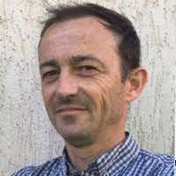
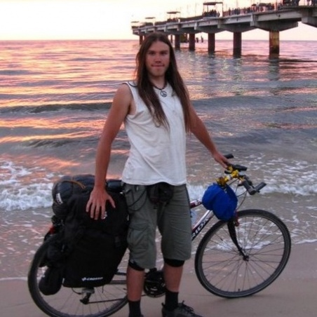
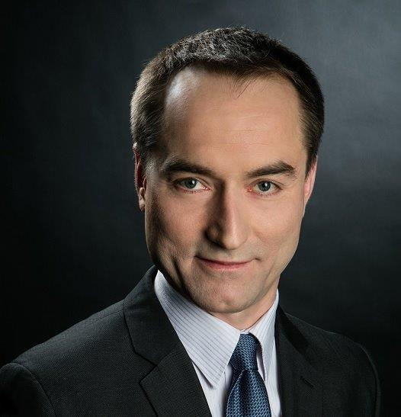
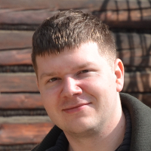
CREDO ML Members
ŁUKASZ BIBRZYCKI,
AGH Univ. of Krakow
KRZYSZTOF RZECKI,
AGH Univ. of Krakow
OLAF BAR,
Cracow Univ. Tech.
MICHAŁ FRONTCZAK,
Univ. of the National Education Commission
TOMASZ HACHAJ,
AGH Univ. of Krakow
MICHAŁ NIEDŹWIECKI,
Cracow Univ. Tech.
DARIUSZ PAŁKA,
AGH Univ. of Krakow
TOMASZ SOŚNICKI,
AGH Univ. of Krakow
MARCIN PIEKARCZYK,
AGH Univ. of Krakow
SŁAWOMIR STUGLIK,
Inst. of Nuclear Physics PAS

Slide 3
CREDO-ML research interests
Cosmic Ray observation with various devices: CMOS cameras of mobile devices, Cosmic Watches, other improvised detectors,
Recognition (background subtraction) and classification/interpretation of cosmic ray signals,
Detection of anomalies and novelties,
Simulation of Cosmic Ray distributions - application of generative ML models,
Search for collective Cosmic Ray phenomena - Extensive Air Showers, Cosmic Ray Ensembles.

Slide 4
CREDO ML timeline
Pre CREDO ML era:
2018-04-18 Cosmic-Ray Extremely Distributed Observatory: new opportunities in astroparticle physics and beyond -P. Homola talk at Pedagogical University of Krakow (UP)
2019-05-29 Signal observation and analysis at CREDO – UP group update - D. Burakowski, M. Piekarczyk, Ł. Bibrzyck - talk at UP
summer 2019 UP signs CREDO MoU
CREDO ML:
winter/spring 2020 CREDO ML was born !
2021-01-29 Classification of cosmic ray tracks with Machine Learning M. Piekarczyk - talk at UP
2021-02-26 Modelling cosmic ray classification uncertainty with deep neural network T. Hachaj - talk at UP
2021-03-05 The Cosmic Ray Observer on iOS - detection strategy Thomas Andersen - talk at UP
2021-03-19 Simulations of Cosmic Ray Ensembles originated nearby the Sun - D. E. Alvarez Castillo - talk at UP
2021-05-07 Muon distribution observation with CREDO smartphones - T. Wibig talk at UP
2021-11-24 MICRO-WORKSHOP ON MACHINE LEARNING AIDED SHOWER DETECTION
2021-11-24 CORSIKA below the knee Tadeusz Wibig talk at Microworkshop
2022-03-19 Start of CREDO detector for iOS (M. Frontczak UP, S. Stuglik INP, M. Niedźwiedzki C Uni. Tech.)
2022-05-25 Analysis of capability of detection of extensive air showers by simple scintillator detectors J. Pryga - talk at UP
2022-10-02 ECAI session at AGH talk by Tomasz Hachaj and Marcin Piekarczyk
2023-10-16 AGH signs CREDO MoU
2023-10-29 Latest CREDO Detector for Android Subversion

Slide 5
CREDO ML publication output
Core CREDO ML collaboration papers:
Towards A Global Cosmic Ray Sensor Network: CREDO Detector as the First Open-Source Mobile Application Enabling Detection of Penetrating Radiation Ł.Bibrzycki, D.Burakowski, P.Homola, M.Piekarczyk, M.Niedźwiecki, K.Rzecki, S.Stuglik, A.Tursunov, et al. (CREDO Collab.), Symmetry 2020,12(11), 1802, 2020.
CNN-Based Classifier as an Offline Trigger for the CREDO Experiment M. Piekarczyk, O. Bar, Ł. Bibrzycki, M. Niedźwiecki, K. Rzecki, S. Stuglik, et al. (CREDO Collab.), Sensors 2021,21, 4804, August 2021.
Zernike Moment Based Classification of Cosmic Ray Candidate Hits from CMOS Sensors O. Bar, Ł. Bibrzycki, M. Niedźwiecki, M. Piekarczyk, K. Rzecki, T. Sośnicki, S. Stuglik, M. Frontczak, et al. (CREDO Collab.), Sensors 2021,21 (22), 7718, November 2021.
Machine learning aided noise filtration and signal classification for CREDO experiment, Łukasz Bibrzycki, David Alvarez-Castillo, Olaf Bar, Dariusz Gora, Piotr Homola, Péter Kovács, Michał Niedźwiecki, Marcin Piekarczyk, Krzysztof Rzecki, Jaroslaw Stasielak, Sławomir Stuglik, Oleksandr Sushchov and Arman Tursunov, PoS, vol. ICRC2021, p. 227, 2021.

Slide 6
CREDO ML publication output
Papers with external collaborators:
Recognition of cosmic ray images obtained from CMOS sensors used in mobile phones by approximation of uncertain class assignment with Deep Convolutional Neural Network, T. Hachaj, Ł. Bibrzycki, and M. Piekarczyk, Sensors, vol. 21, no. 6, 2021.
Fast Training Data Generation for Machine Learning Analysis of Cosmic Ray Showers, T. Hachaj, Ł. Bibrzycki, M. Piekarczyk, IEEE Access, Vol 11, 7410-7419, 2023
Differentiating signal from artefacts in cosmic ray detection: applying siamese spiking neural networks to CREDO experimental data, M. Pabian, D. Rzepka, Ł. Bibrzycki, and M. Pawlak, Measurement, vol. 220, p. 113273, 2023.
Deep neural network architecture for low-dimensional embedding and classification of cosmic ray images obtained from CMOS cameras, T. Hachaj, M. Piekarczyk, and Ł. Bibrzycki, in Neural Information Processing, Cham: Springer International Publishing, 2021, pp. 307–316.
Searching of potentially anomalous signals in cosmic-ray particle tracks images using rough k-means clustering, T. Hachaj, M. Piekarczyk, and J. Wąs, in Rough Sets, International Joint Conference, IJCRS 2023, Krakow, Poland, October 5–8, 2023.
The practice of detecting potential cosmic rays using CMOS cameras: Hardware and algorithms, T. Hachaj and M. Piekarczyk, Sensors, vol. 23, no. 10, 2023.

Slide 7
CREDO ML conference presentations
WORKSHOP (24 Nov 2021) Micro-Workshop on Machine Learning aided shower detection
ICRC 2021 (14 Jun 2021) Machine learning aided noise filtration and signal classification for CREDO experiment
IJCRS 2023 (05 Oct 2023) Searching of potentially anomalous signals in cosmic-ray particle tracks images using rough k-means clustering combined with eigendecomposition-derived embedding.

Slide 8
Detectors

Slide 9
CREDO DETECTOR MOBILE APP
M. Niedźwiedzki,
Cracow Univ. Tech.
T. Andersen
NSCIR, Canada
&
Michał Frontczak,
Univ. of the National Education Commission

Slide 10
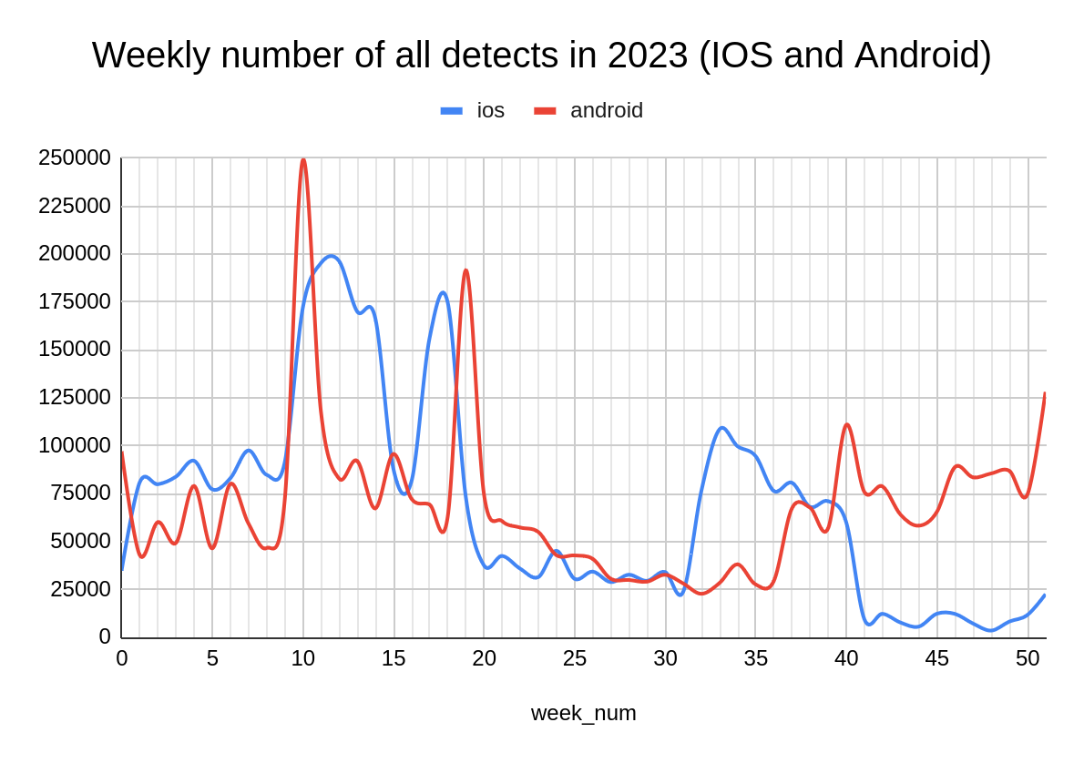
General statistics concerning the CREDO detection database
as of January 2024
Numerical Data
All detections | 52.7 M
Android detections | 46.8 M
IOS detections | 5.2 M
All devices (with img detects) | 14.6 K
Android devices (Api_V2 with detects) | ~12.8 K
IOS devices (with detects) | ~450
All users | 20.7 K
Total time of operation | ~1289 years
File Size
Raw Detections | 152 GB
Pings | 7.5 GB
Mappings | 6.2 MB

Slide 11
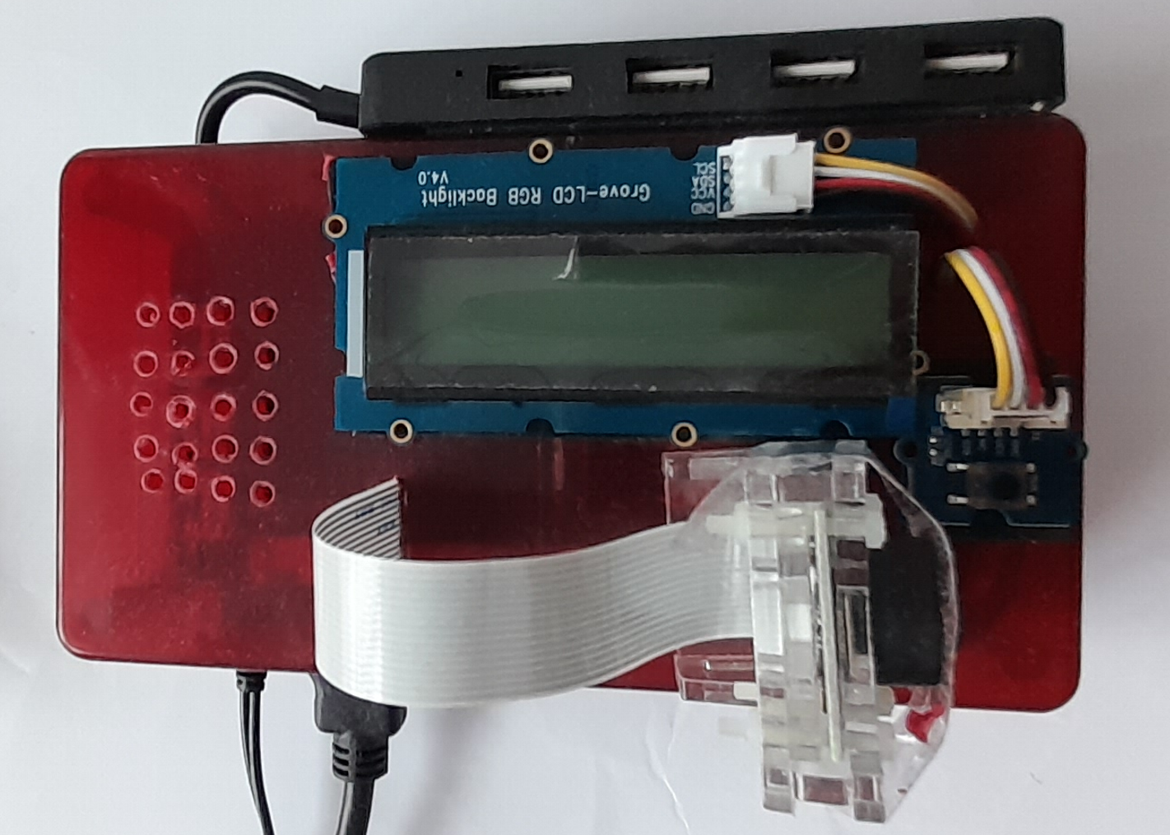
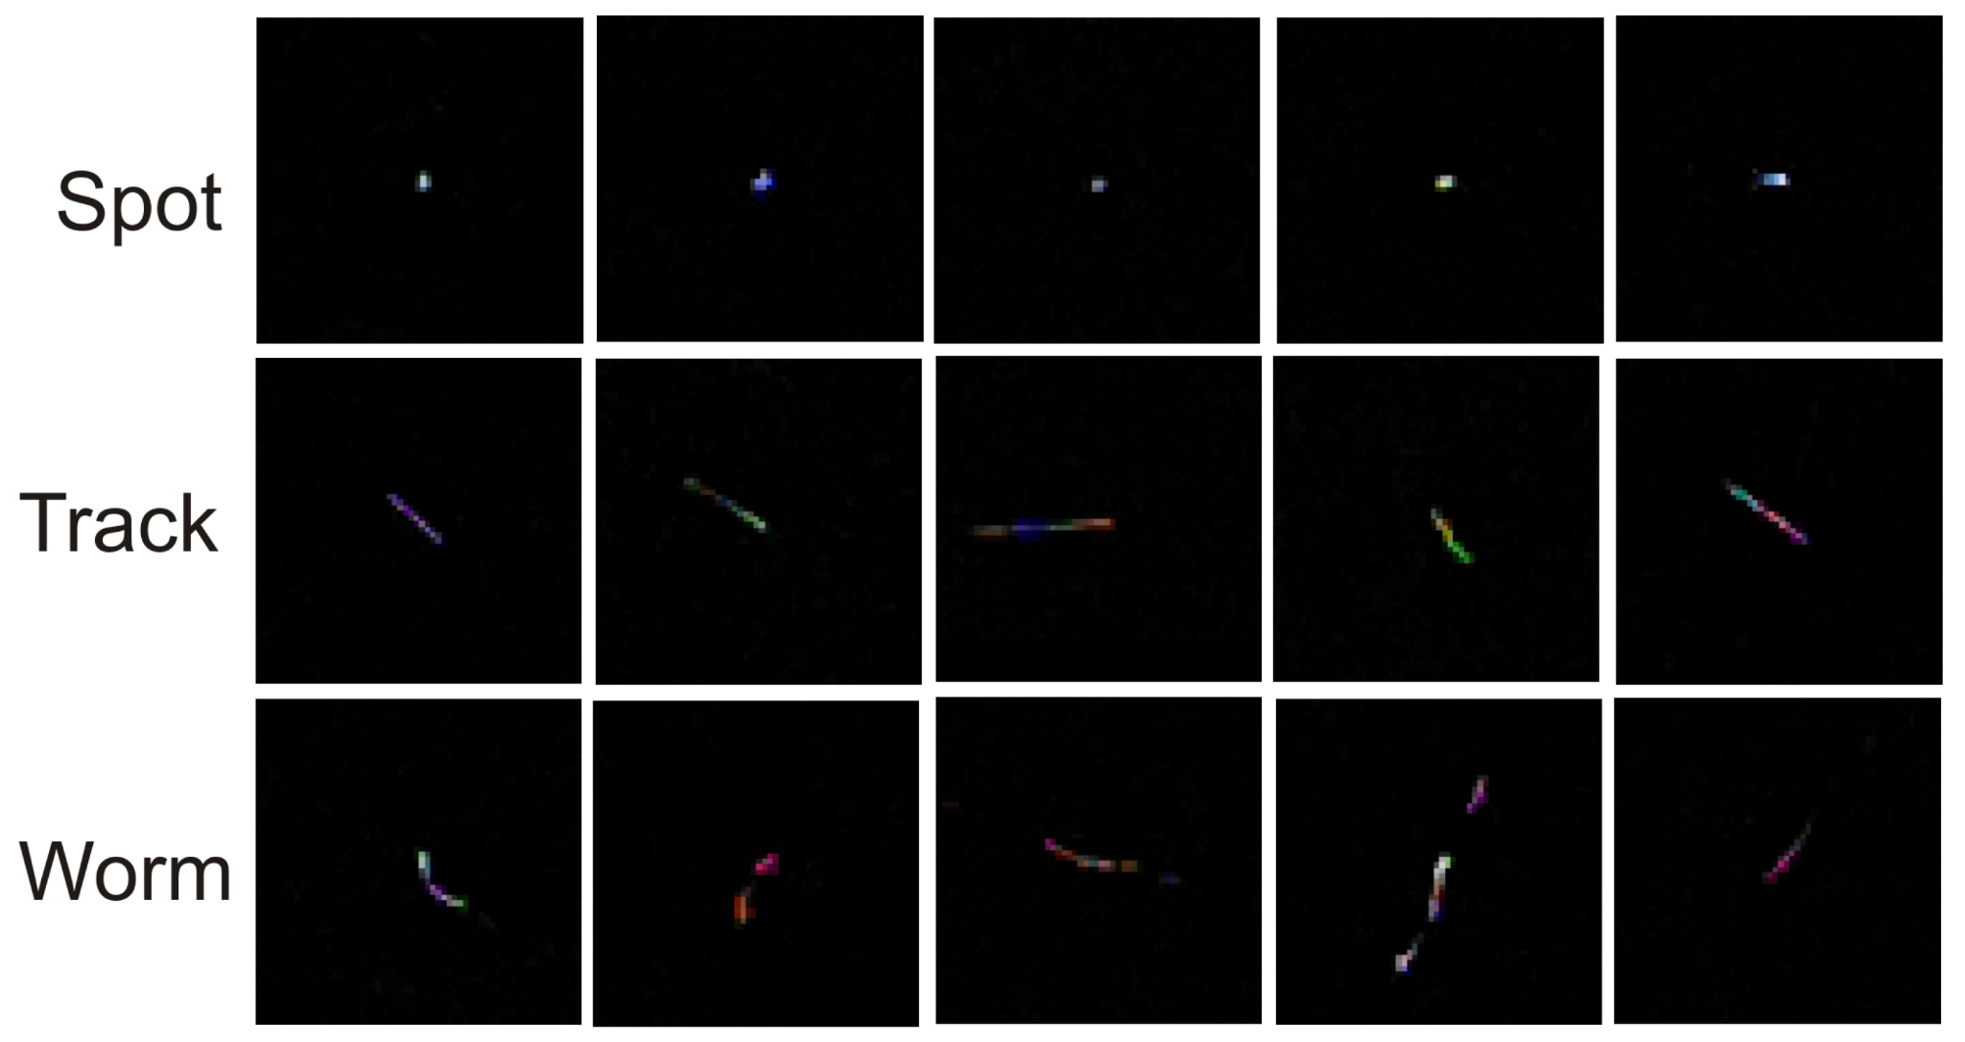
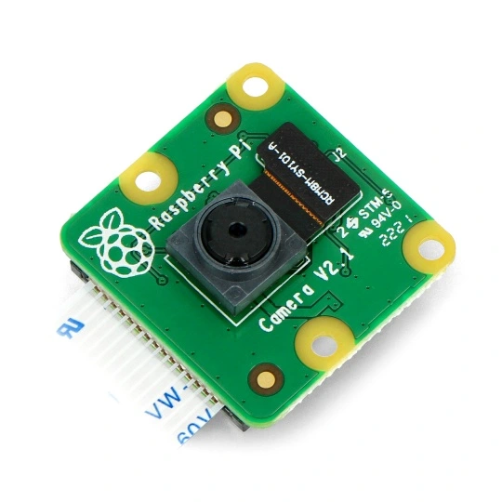
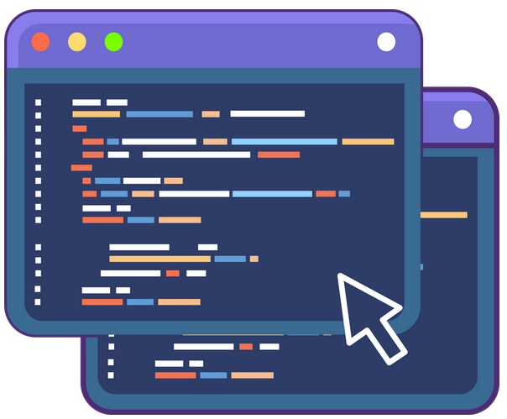
Detector based on raspberry pi
T. Hachaj and M. Piekarczyk, “The practice of detecting potential cosmic rays using cmos cameras: Hardware and algorithms,” Sensors, vol. 23, no. 10, 2023.
https://github.com/browarsoftware/cmosdetector

Slide 12
Hit images acquired with the Raspberry Pi

Slide 13
Data analysis

Slide 14
Image data analysis - challenges and methods
Research scope [CREDO-ML]:
signal recognition and filtration
Separating reliable observations from artefacts and noise,
comprehensive classification
Determination of signal classes based on morphology
Grouping according to the characteristics of the physical interpretation of signals (dots, tracks and worms)
Computational methods and algorithms: ML methods + AI techniques

Slide 15
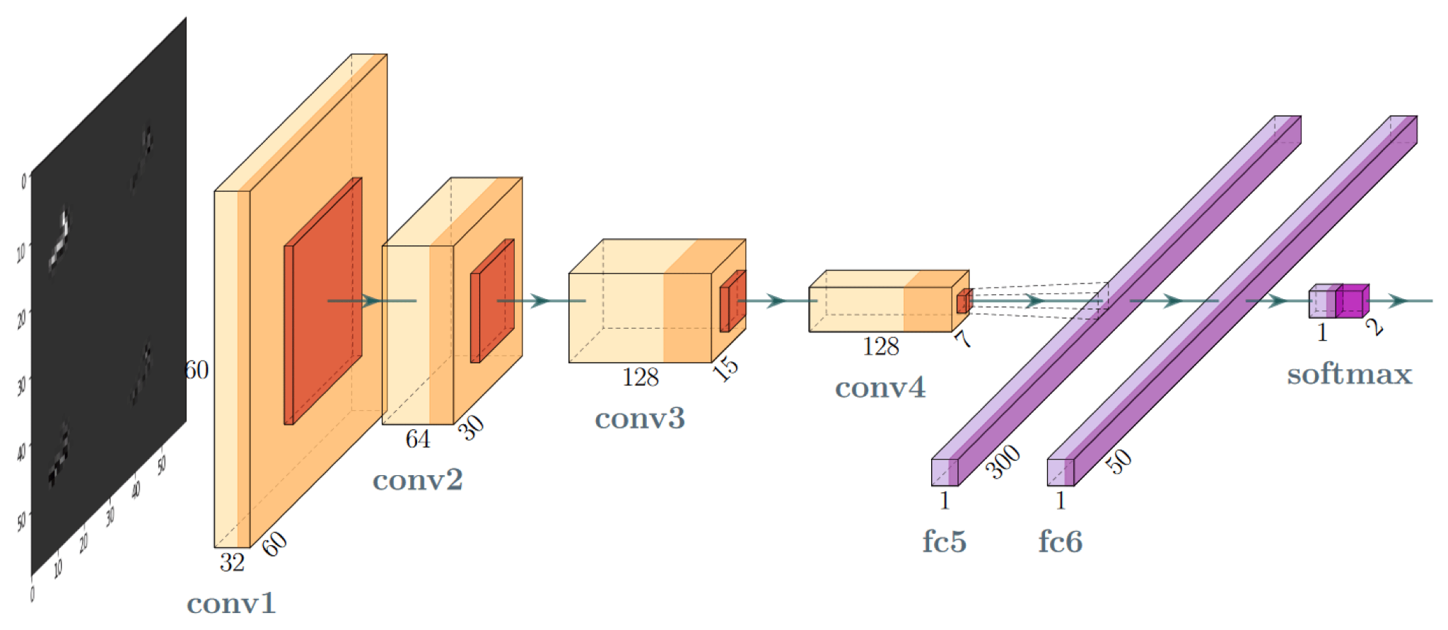
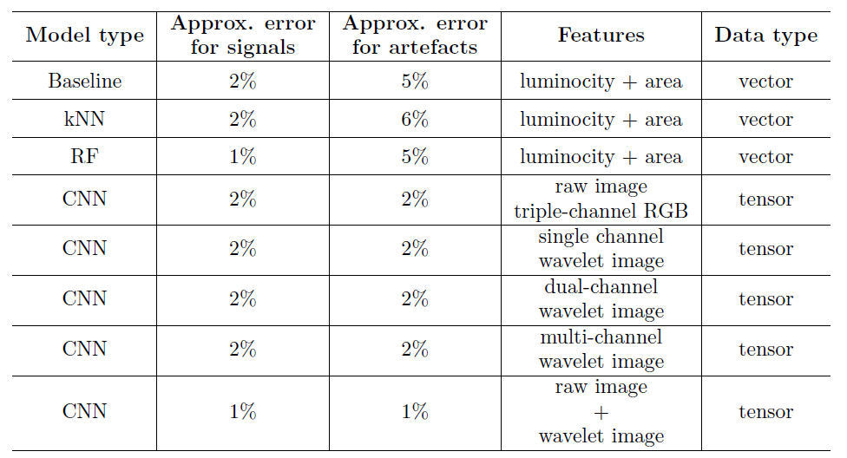
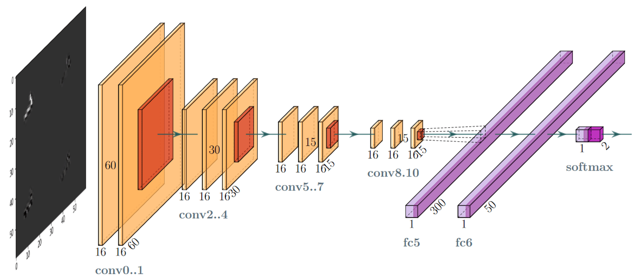
Artefact rejection
statistical models :: kNN, RF
neural models :: CNN, CNN + wavelets
M. Piekarczyk, et al., “CNN-based classifier as an offline trigger for the credo experiment,” Sensors, vol. 21, no. 14, 2021.
Ł. Bibrzycki, et al., “Machine learning aided noise filtration and signal classification for CREDO experiment,” PoS, vol. ICRC2021, p. 227, 2021.

Slide 16
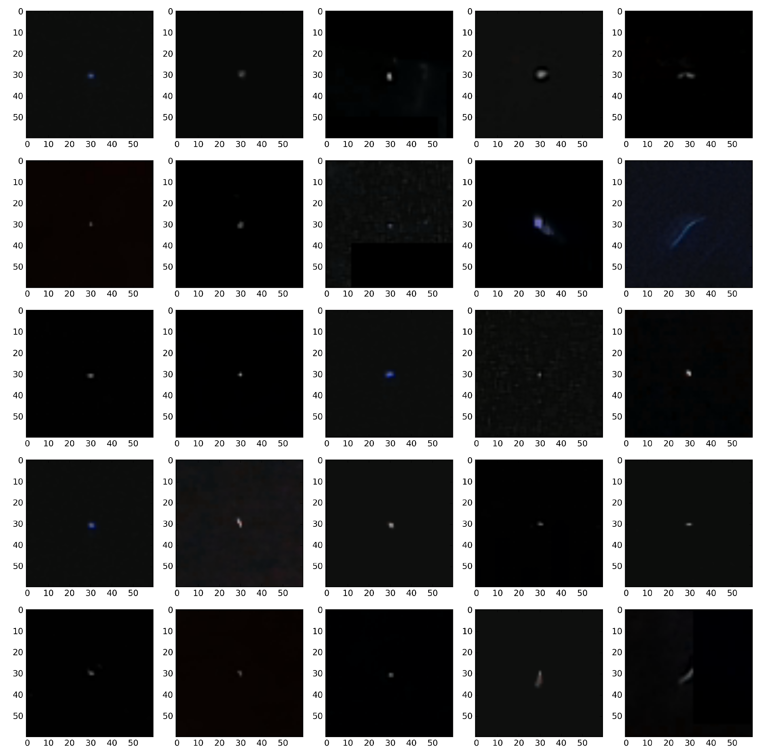
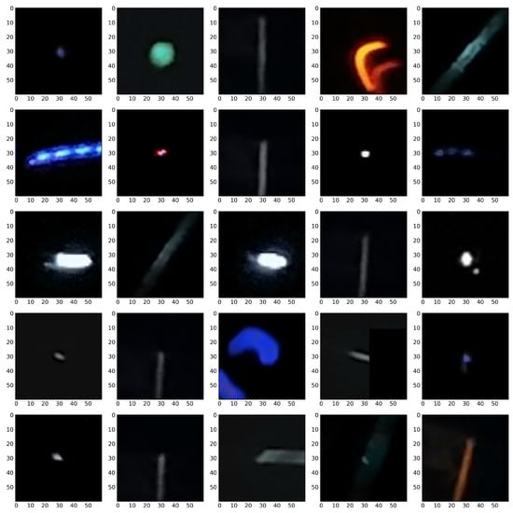
Artefact rejection
Classification results: signals (left), artefacts (right)
M. Piekarczyk, et al., “CNN-based classifier as an offline trigger for the credo experiment,” Sensors, vol. 21, no. 14, 2021.
Ł. Bibrzycki, et al., “Machine learning aided noise filtration and signal classification for CREDO experiment,” PoS, vol. ICRC2021, p. 227, 2021.

Slide 17
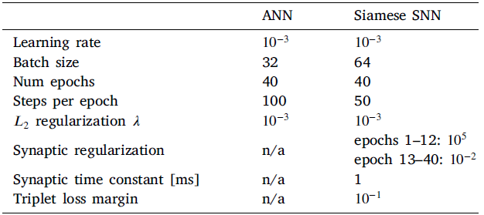
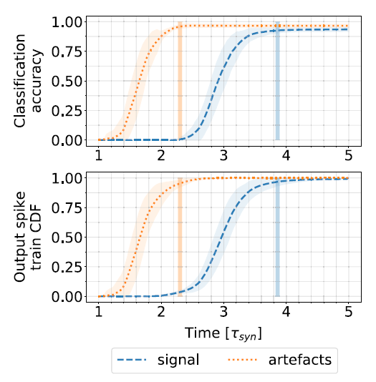
Artefact rejection
Architecture | Performance [%]
SNN | 96.35
Siamese Spiking Neural Network (SNN)
trained by optimizing Earth Mover’s Distance (EMD)
M. Pabian, D. Rzepka, Ł. Bibrzycki, and M. Pawlak, “Differentiating signal from artefacts in cosmic ray detection: applying siamese spiking neural networks to CREDO experimental data,” Measurement, vol. 220, p. 113273, 2023.

Slide 18
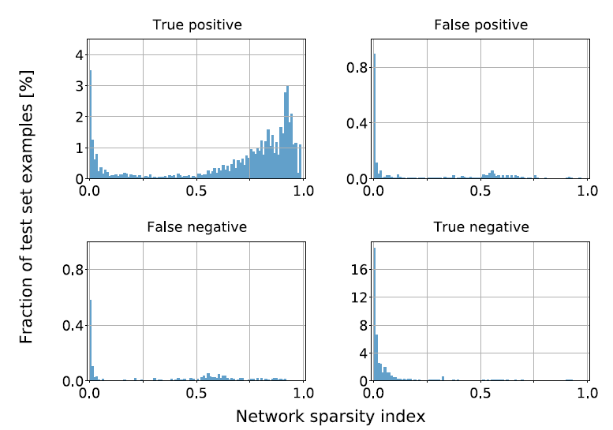
Artefact rejection
Performance: Network Sparsity Index (left) and similarity matching (right)
Accuracy: 96.35% (average over classes)
M. Pabian, D. Rzepka, Ł. Bibrzycki, and M. Pawlak, “Differentiating signal from artefacts in cosmic ray detection: applying siamese spiking neural networks to CREDO experimental data,” Measurement, vol. 220, p. 113273, 2023.

Slide 19
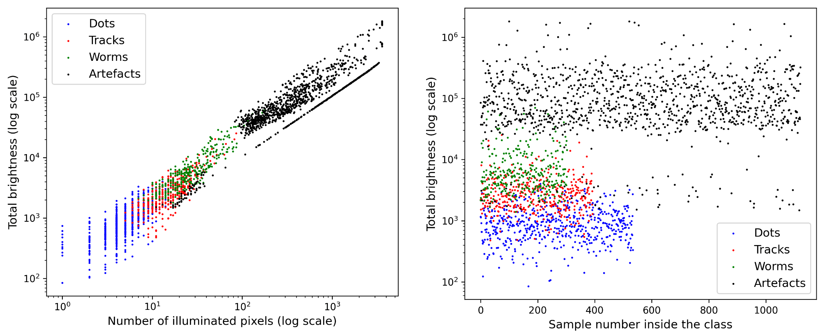
Shape analysis :: dots, tracks, worms and artefacts
Feature space:
Zernike moments up to 8th degree (24 values) + Total brightess (1 value)
25 parameters as input feature vector
O. Bar, et al., “Zernike moment based classification of cosmic ray candidate hits from CMOS sensors,” Sensors, vol. 21, no. 22, 2021.

Slide 20
Shape analysis :: dots, tracks, worms and artefacts
Base models:
kNN (Neasest Neighbour), LDA (Linear Discriminant Analysis), QDA (Quadrative Discriminant Analysis), GNB (Gaussian Naive Bayes), DT (Decision Tree), MLP (Feed-Forward Neural Network), SVM (Support Vector Machine)
ensemble (homogeneous):
ETC (Extremely Randomized Trees),
GBC (Gradient Boosting),
RFC (Random Forest)
BAG (bagging)
ensemble (heterogeneous):
VOT (Voting)
OVO/OVR strategies
Class | MLP / OVR | MLP | SVM | SVM / OVO
Dots | 98.13% | 96.26% | 93.46% | 97.20%
Tracks | 93.67% | 96.20% | 92.41% | 94.94%
Worms | 88.52% | 85.25% | 80.33% | 81.97%
Artefacts | 91.96% | 93.75% | 89.73% | 92.86%
O. Bar, et al., “Zernike moment based classification of cosmic ray candidate hits from CMOS sensors,” Sensors, vol. 21, no. 22, 2021.

Slide 21
Uncertain class assignment by annotators
Deep CNN models
pretrained deep neural architectures
modelling an uncertainty of class assignment
ambiguous image labelling / human annotators
Architecture | Performance [%]
VGG16 | 85.79 ±2.24
NASNetLarge | 81.66 ±2.53
MobileNetV2 | 78.43 ±2.06
Xception | 81.49 ±2.94
DenseNet201 | 84.68 ±1.77
T. Hachaj, Ł. Bibrzycki, and M. Piekarczyk, “Recognition of cosmic ray images obtained from CMOS sensors used in mobile phones by approximation of uncertain class assignment with Deep Convolutional Neural Network,” Sensors, vol. 21, no. 6, 2021.

Slide 22
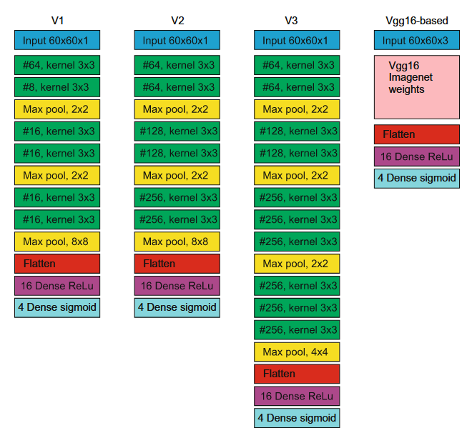
Classification in dimensionally reduced feature space
Deep NN architectures
generate low-dimensional embedding of CR images
evaluated on 3.5 million images / subset of CREDO data
Metric / Model | V1 | V2 | V3 | VGG16
Accuracy [%] | 88.60 | 89.41 | 90.48 | 90.52
Performance [IPS] (Images per Second) | 136.24 | 127.55 | 117.05 | 95.51
T. Hachaj, M. Piekarczyk, and Ł. Bibrzycki, “Deep neural network architecture for low-dimensional embedding and classification of cosmic ray images obtained from CMOS cameras,” in Neural Information Processing, Cham: Springer International Publishing, 2021, pp. 307–316.

Slide 23
Search for anomalous phenomena

Slide 24
Anomaly detection
Problem:
Clusterization is inherently stochastic procedure - various algorithms indicate various outliers
Objective:
Designing a quasi-deterministic method to indicate new phenomena
Procedure:
Image embedding - non-linear analysis of variance using convolutional autoencoder,
Feature vectors are recovered from the bottleneck (latent space),
Reducing the problem to outlier detection to unsupervised clustering,
Maximizing the common set of outliers resulting from various clusterization methods.

Slide 25
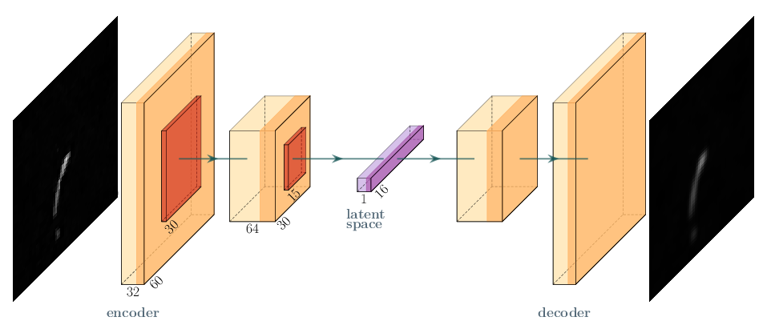
Anomaly detection
Autoencoder network was used for feature extraction
Two CNN layers :
60x60 (32 filters), strides=2, LeakyReLU activation function
30x30 (64 filters), strides=2, LeakyReLU activation function
Agglomerative Clustering: One element cluster treated as anomaly
DBSCAN method: Treat noise (outlier points) as anomalies.

Slide 26
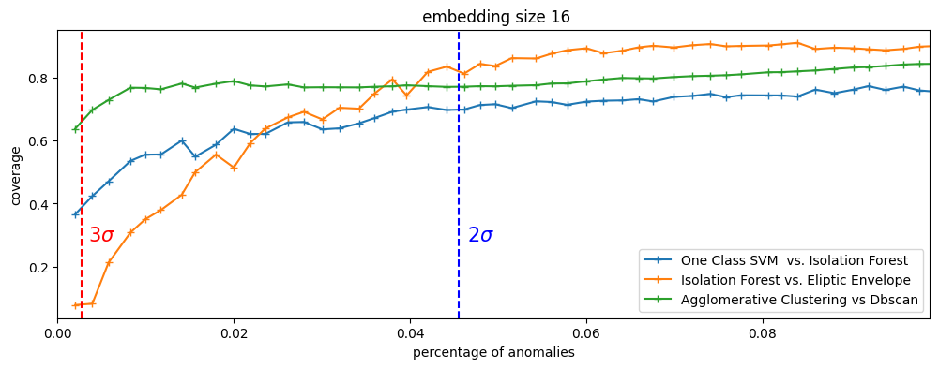
DBSCAN and Agglomerative Clustering compared to other methods:

Slide 27
Example DBSCAN and Agglomerative Clustering anomaly detections
signal
anomaly

Slide 28
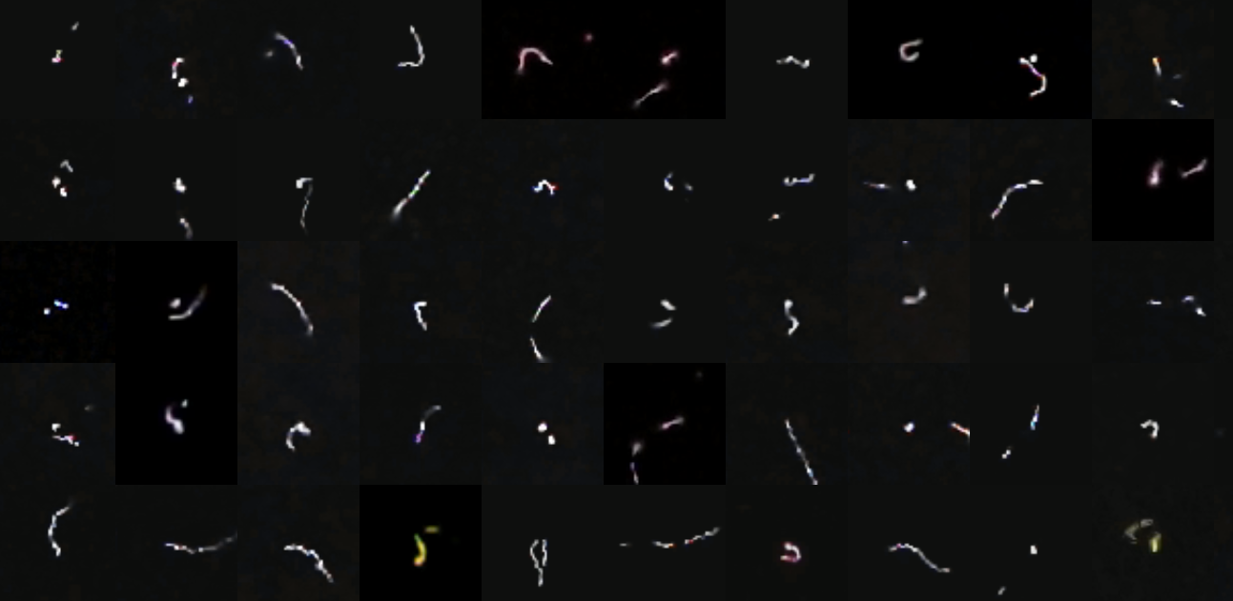
EigenHits :: anomaly detection
Inspiration
Eigenfaces
Features
Image-driven
PCA-based embedding
clustering methods:
DBSCAN,
OPTICS,
Agglomerative
T. Hachaj, et al. Towards detection of anomalous cosmic ray signals for observations acquired from Cosmic Ray Extremely Distributed Observatory mobile detectors, Engineering Applications of Artificial Intelligence , 2024 [UNDER REVIEW]

Slide 29
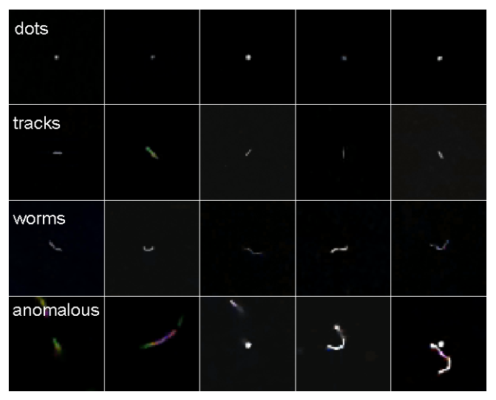
Rough sets approach:: anomaly detection
feature space
PCA embedding using SVD
method: rough k-means algorithm
k-means based on rough sets (RS)
salient features of the solution
uncertainty to cluster assignment is modelled by upper approximation (RS)
object can be assigned to more than one cluster
T. Hachaj, M. Piekarczyk, and J. Was, “Searching of potentially anomalous signals in cosmic-ray particle tracks images using rough k-means clustering,” in Rough Sets, International Joint Conference, IJCRS 2023, Krakow, Poland, October 5–8, 2023, Proceedings, C. Andrea, U. L.Oliver, X. Shuyin, S. Dominik, W. Jaroslaw, and Y. JingTao, Eds. Springer Cham, 2024.

Slide 30
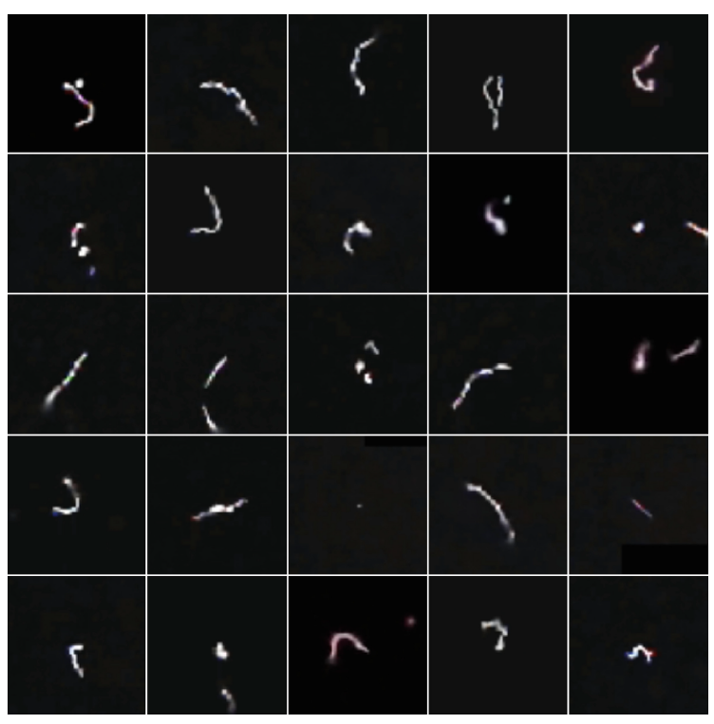
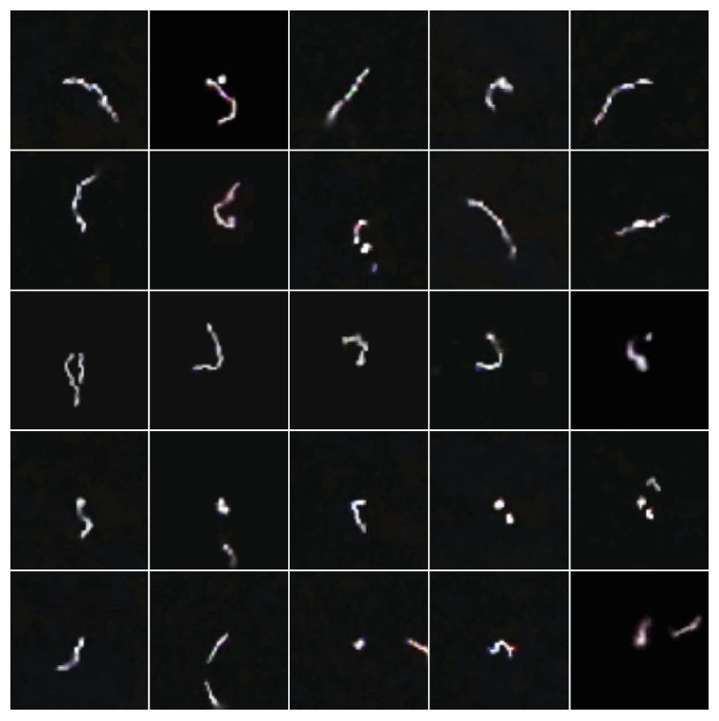
Rough sets approach:: anomaly detection
performance comparison: k-means vs rough k-means in left and right panel
clusters: 4, threshold: 1.25, lower/upper approx: 0.9/0.1
T. Hachaj, M. Piekarczyk, and J. Was, “Searching of potentially anomalous signals in cosmic-ray particle tracks images using rough k-means clustering,” in Rough Sets, International Joint Conference, IJCRS 2023, Krakow, Poland, October 5–8, 2023, Proceedings, C. Andrea, U. L. Oliver, X. Shuyin, S. Dominik, W. Jaroslaw, and Y. JingTao, Eds. Springer Cham, 2024.

Slide 31
Future perspectives

Slide 32
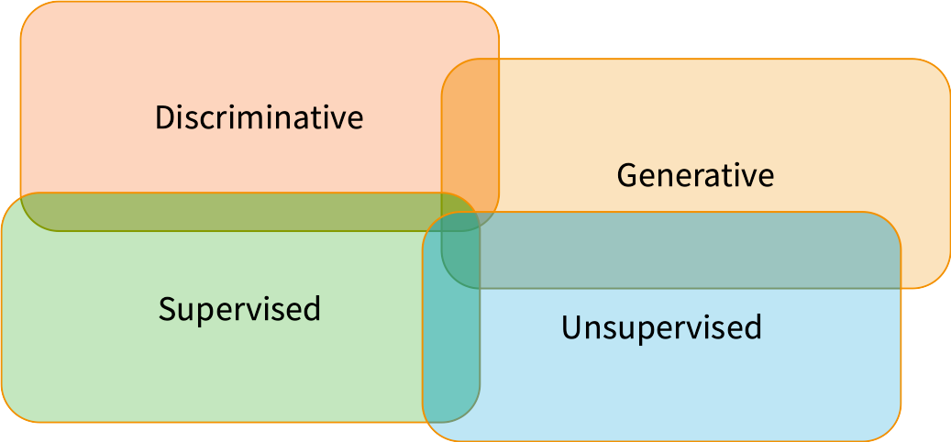
Future perspectives
Taxonomy of ML models

Slide 33
Future perspectives
So far CREDO ML analyses focused on:
Supervised and discriminative models: signal classification, background and artefact rejection: 8 papers,
and unsupervised approaches: feature extraction, dimensional reduction, anomaly and novelty detection 1 paper + 1 paper under review+1 work in progress.
preliminary study towards application of generative models: 1 paper.

Slide 34
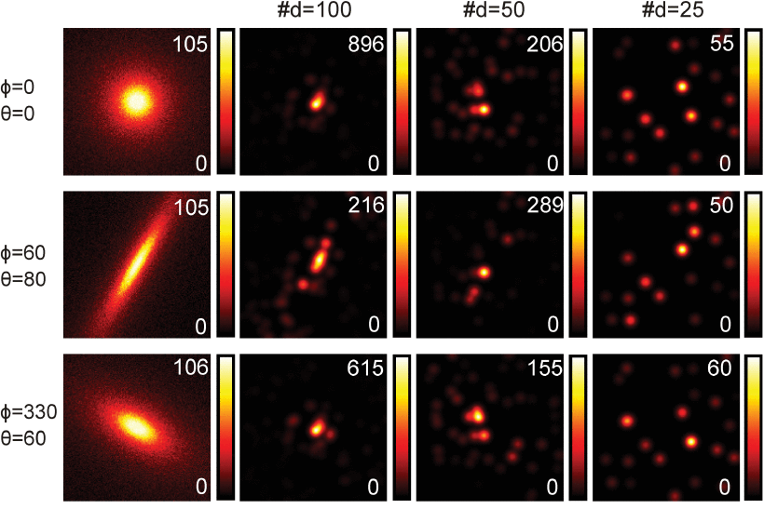
Future perspectives
Now it’s time to unleash the potential of generative models.
They can be used for:
Efficient EAS distribution generation,
Unfolding detector effects,
Data compression and restoration,
Numerical tools for fast training data generation are already developed and discussed in
T. Hachaj, Ł. Bibrzycki, M. Piekarczyk, “Fast Training Data Generation for Machine Learning Analysis of Cosmic Ray Showers”, IEEE Access, Vol 11, 7410-7419, 2023

Slide 35
Summary and outlook
Done:
Efficient signal classification is already implemented
CREDO ML classifiers fully operational and analyse CREDO data
To do:
Online event classification - classification working at smartphones
Online outlier detection - outlier alarms at smartphones
Optimal detector layout for EAS identification - MC and generative ML simulation
Unfolding detector effects

Slide 36
Thank you for your attention

Slide 37
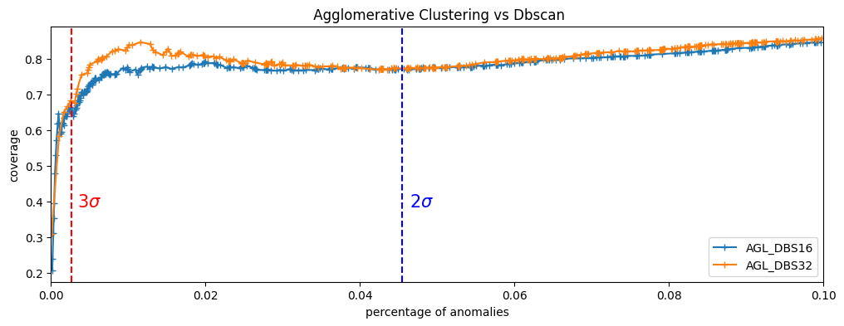
The problem of compatibility of anomaly classifiers

Slide 38
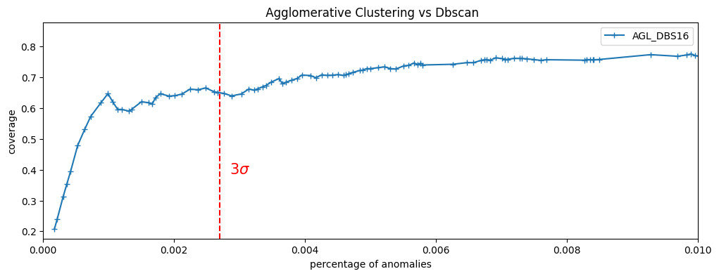
The problem of consistency of anomaly classifiers

Slide 39
Plan
WAŻNE - Kiedy CREDO ML rozpoczęło działalność ? Jakieś kalendarium.
CREDO-ML research interests (section 1 EPJ paper) Łukasz
Radiation registration / mobile detectors (EPJ: [4,5, 8-10]) Sławek
Cosmic ray tracks / recognition and classification (EPJ: [11-16]) Marcin,Tomasz
Detection of anomalies / image data (EPJ: [17] + nie wydane jeszcze prace) Olaf, Michał
Future perspectives / EAS identification (EPJ: [20,21]) Łukasz

