Slide 1
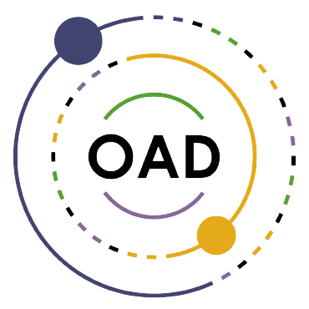
The LightSound Project Observing Solar Eclipses with Sound
Allyson Bieryla
January 15, 2024

Slide 2
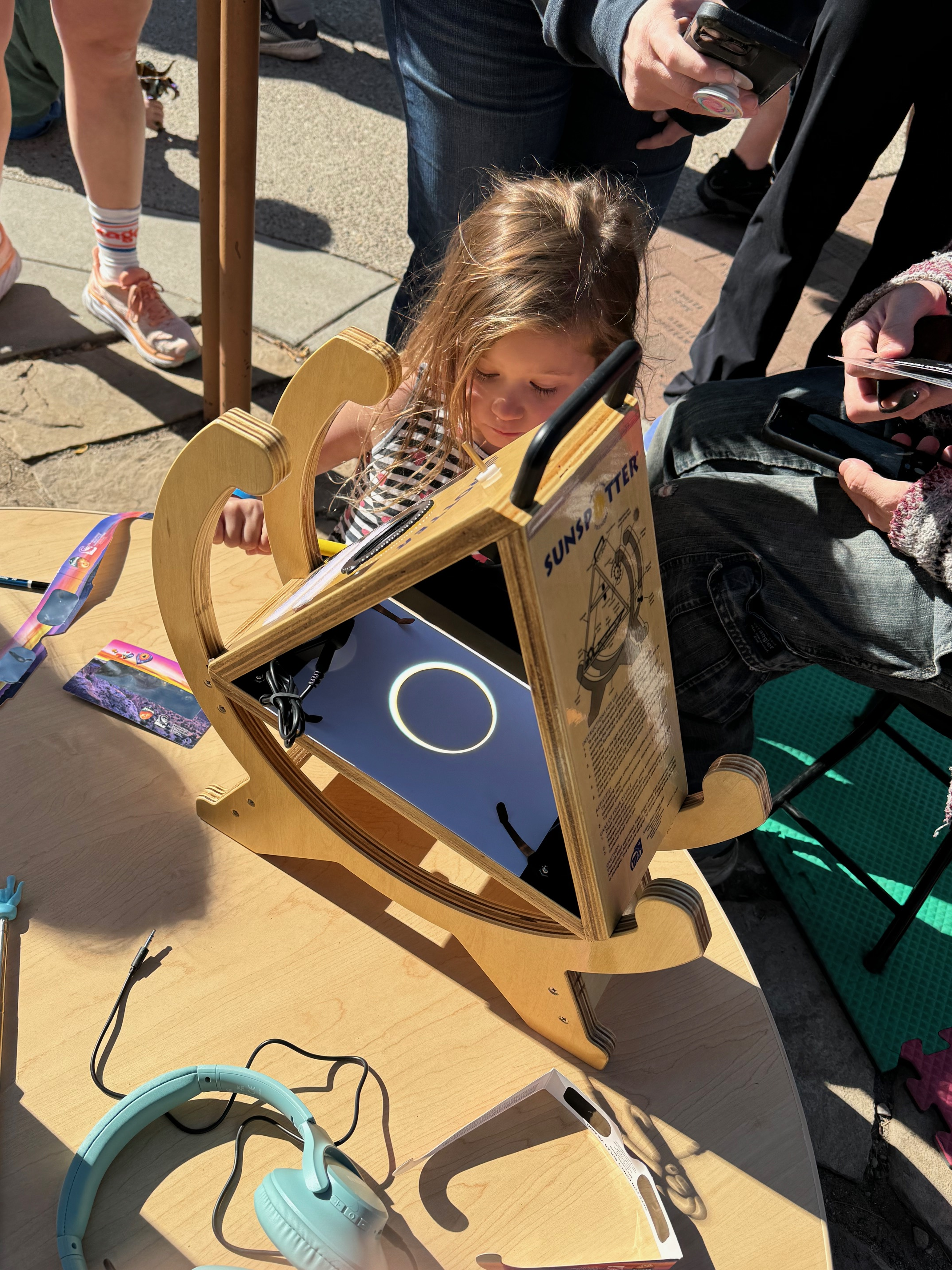

Slide 3
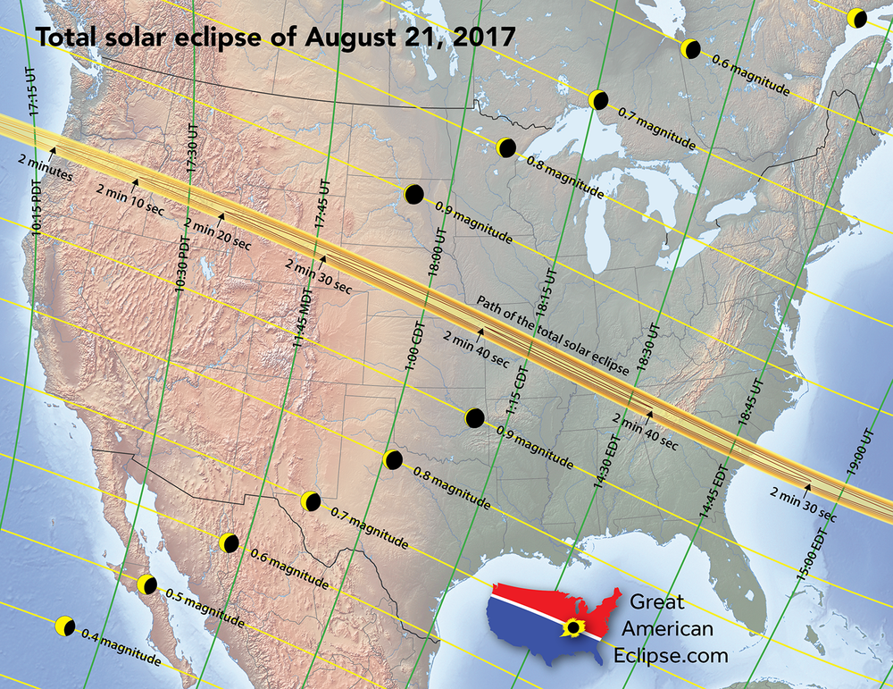

Slide 4
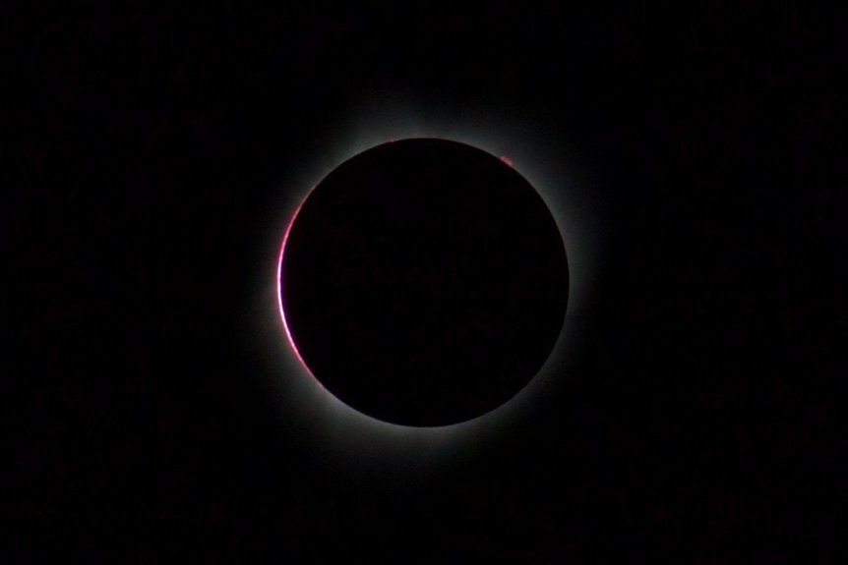
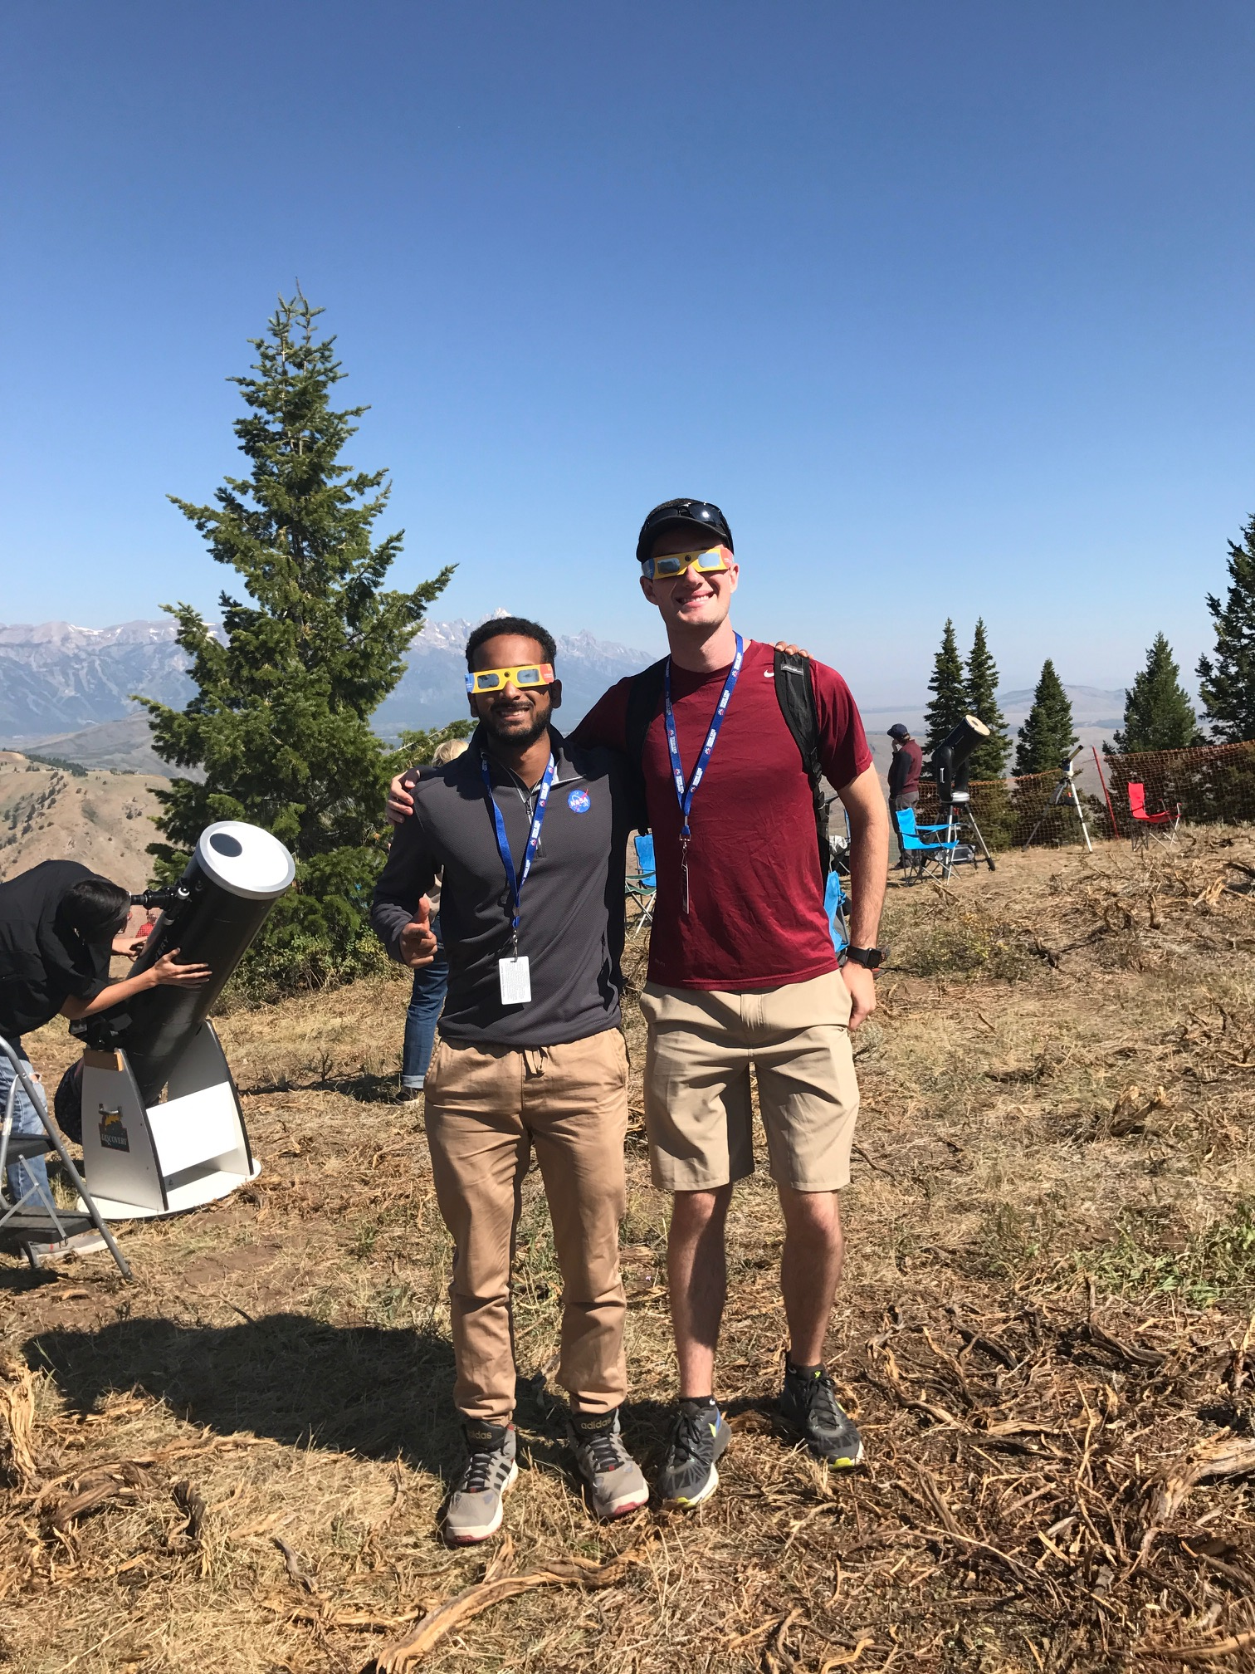
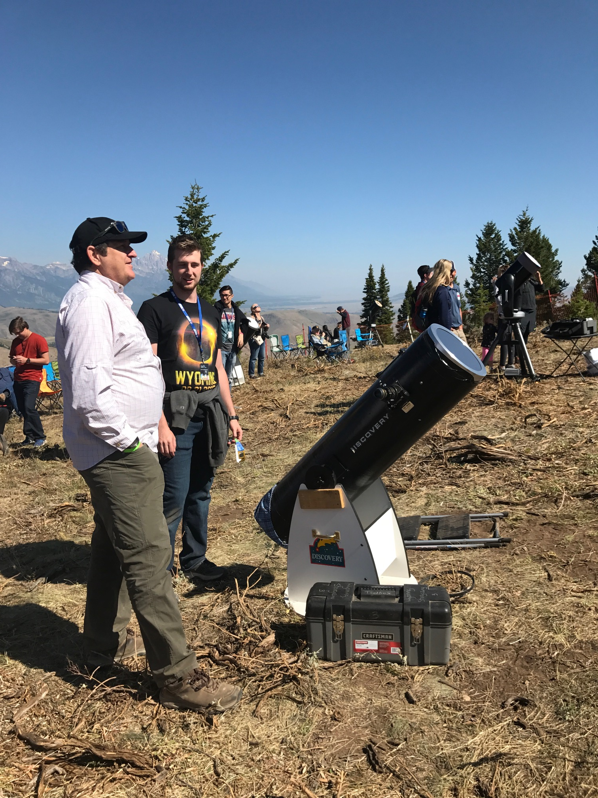
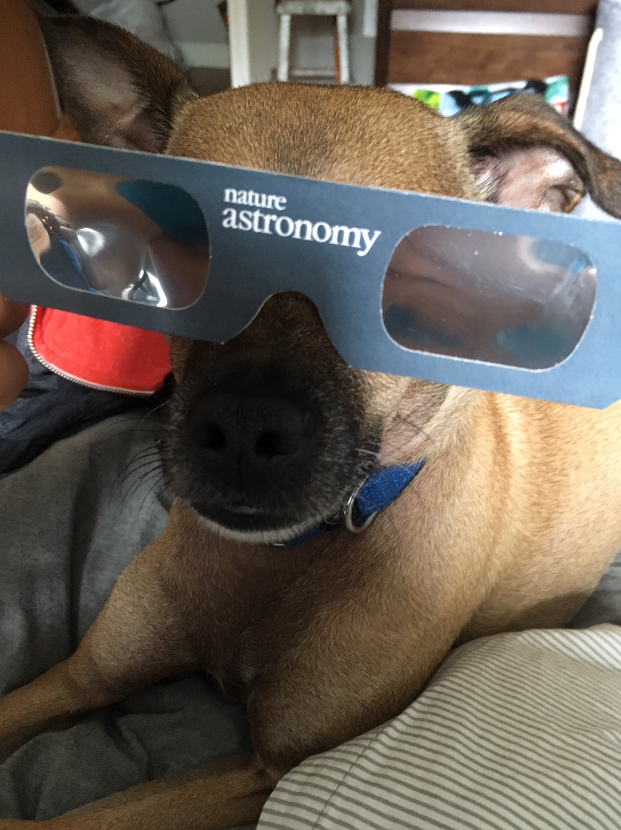
Jackson Hole, Wyoming

Slide 5
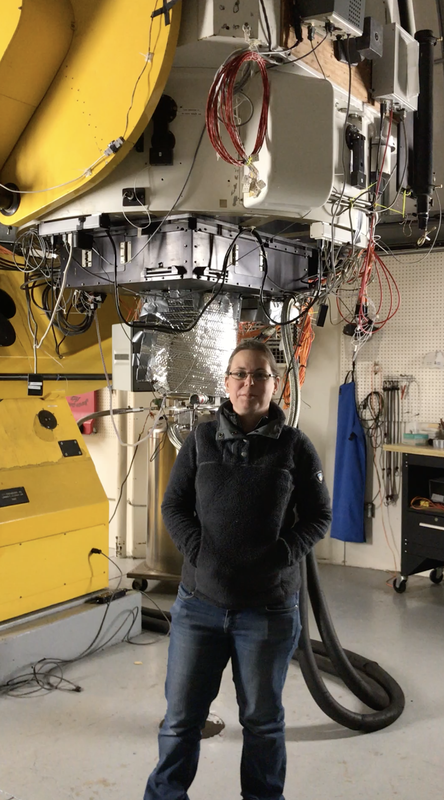
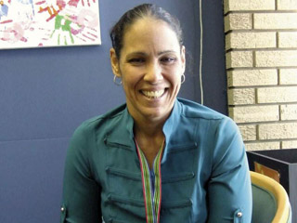
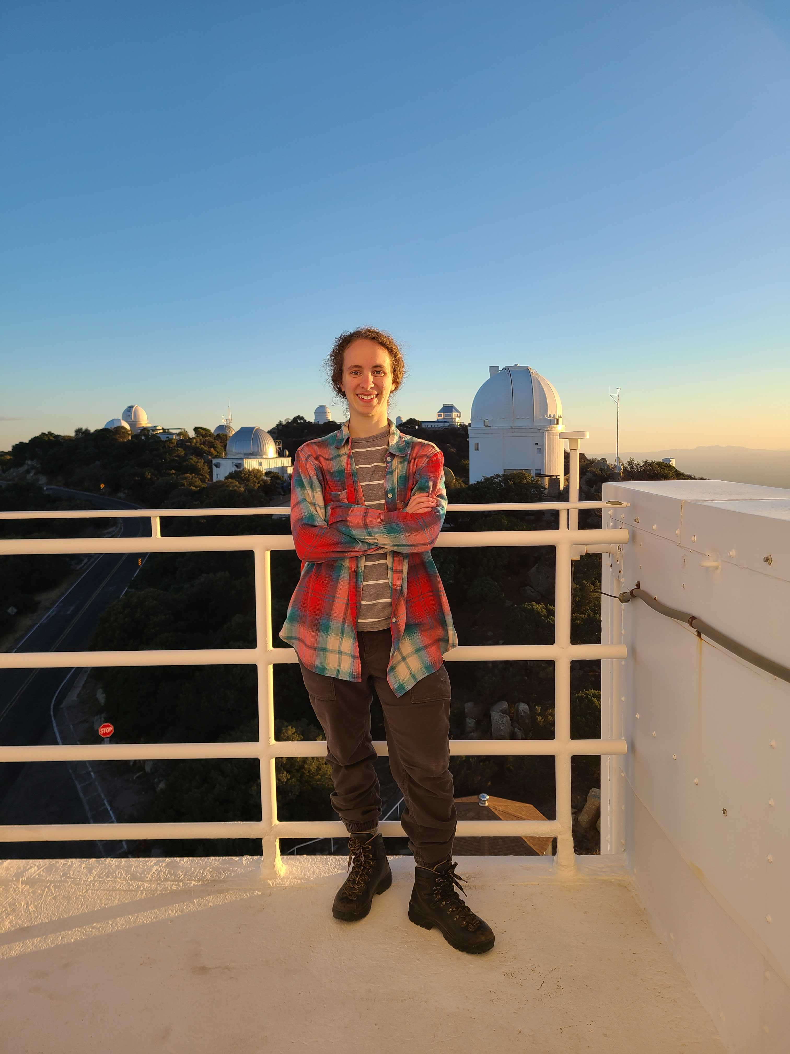
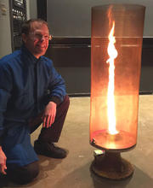
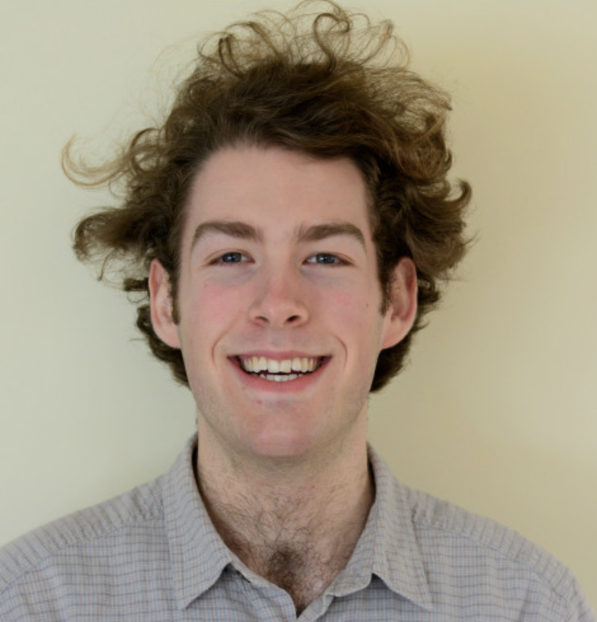
Team members
Wanda Diaz Merced
Elliot Richards
Engineer
Center for Astrophysics |
Harvard & Smithsonian
Allyson Bieryla
Center for Astrophysics |
Harvard & Smithsonian
Sóley Hyman
Harvard ’19
U of AZ grad student
Daniel Davis
Director of Harvard Natural Sciences Lecture Demonstrations

Slide 6
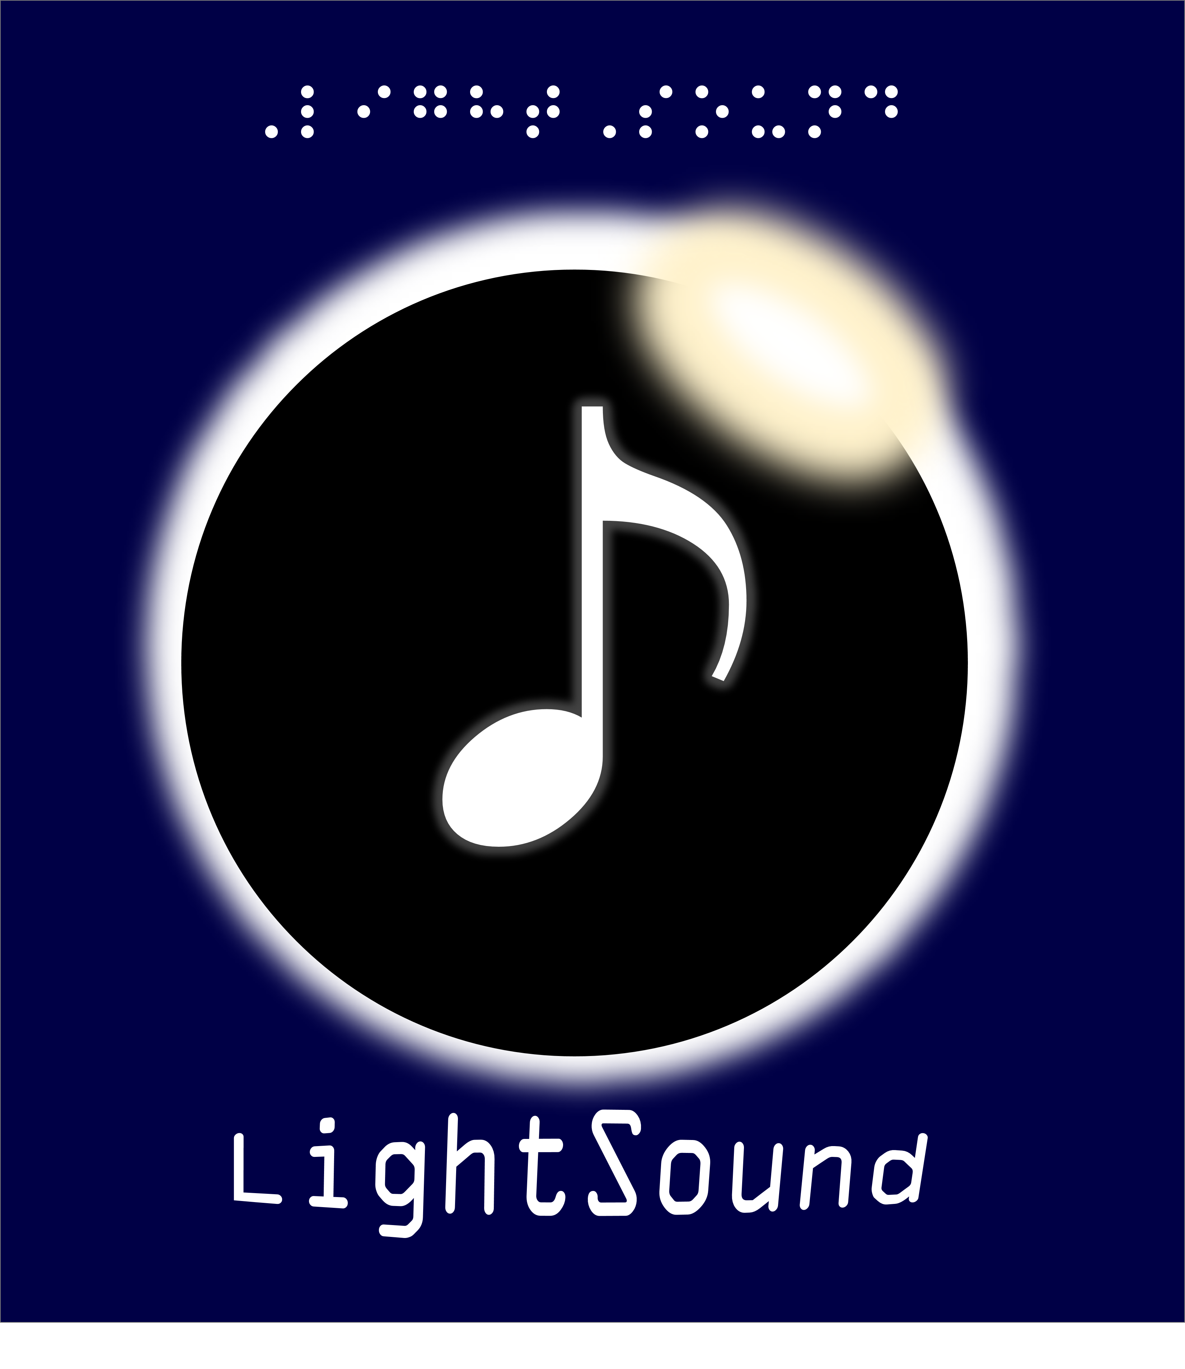
What is LightSound?
A solar eclipse sonification device for the blind and low-vision
Open Source
Instructions to build your own (English, Spanish, and French)
Software to collect and plot data
3D case designs

Slide 7
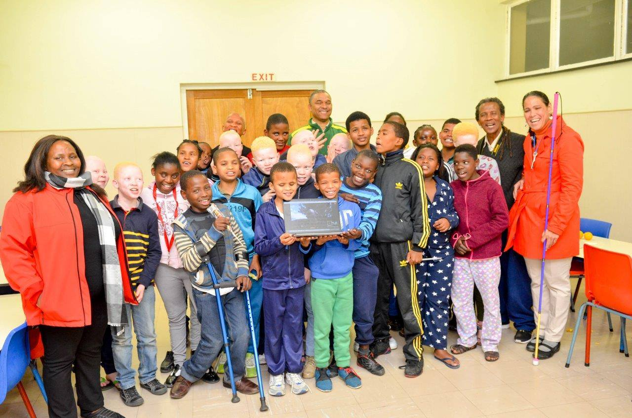
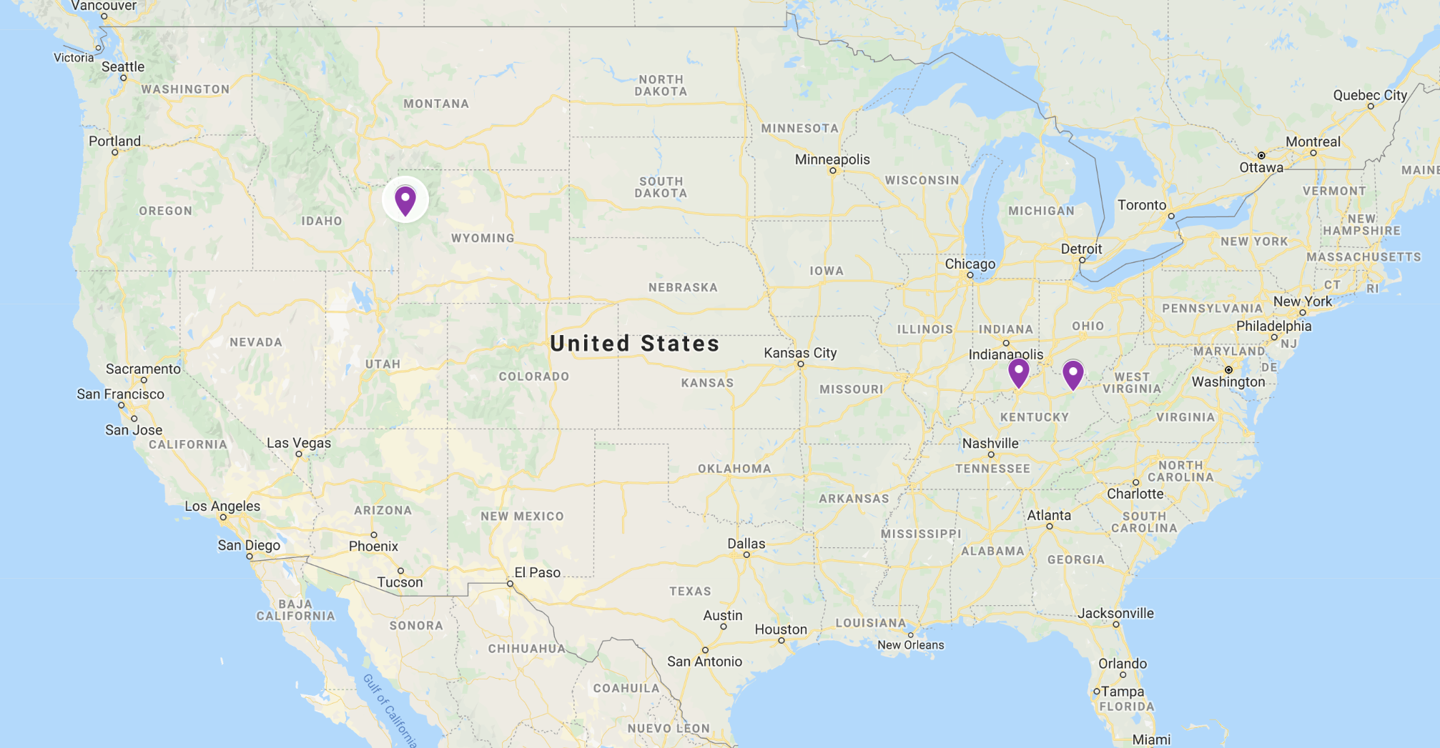
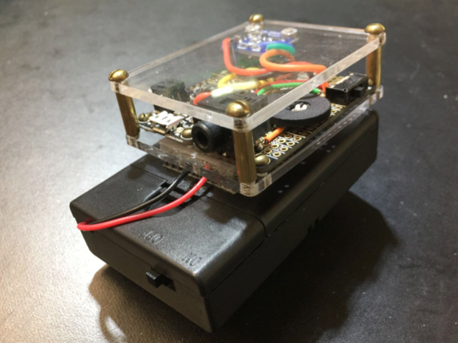
Great American Solar Eclipse August 21, 2017

Slide 8
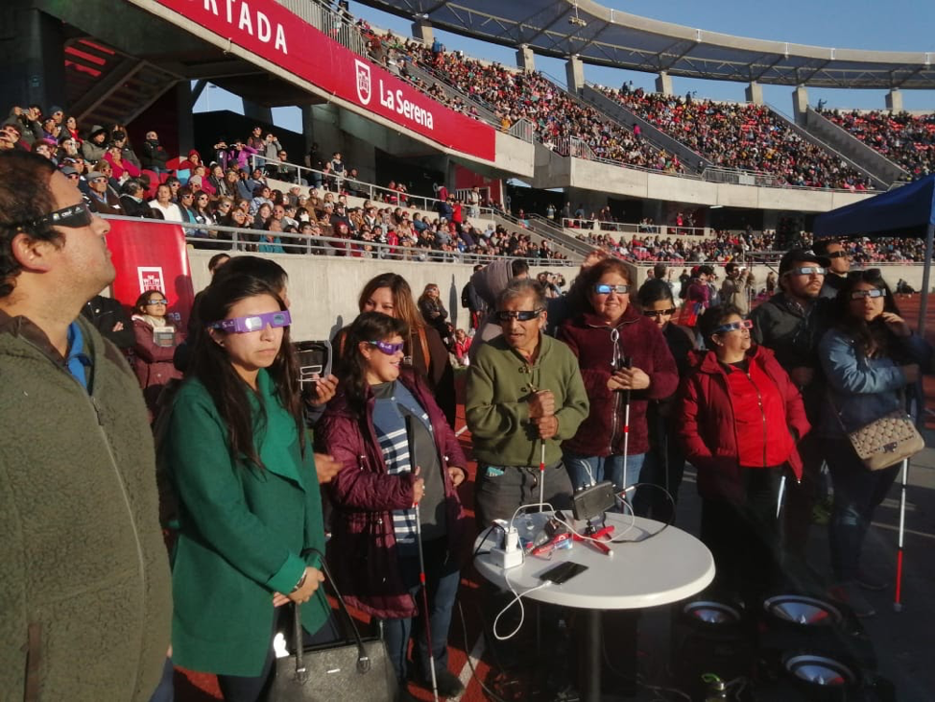
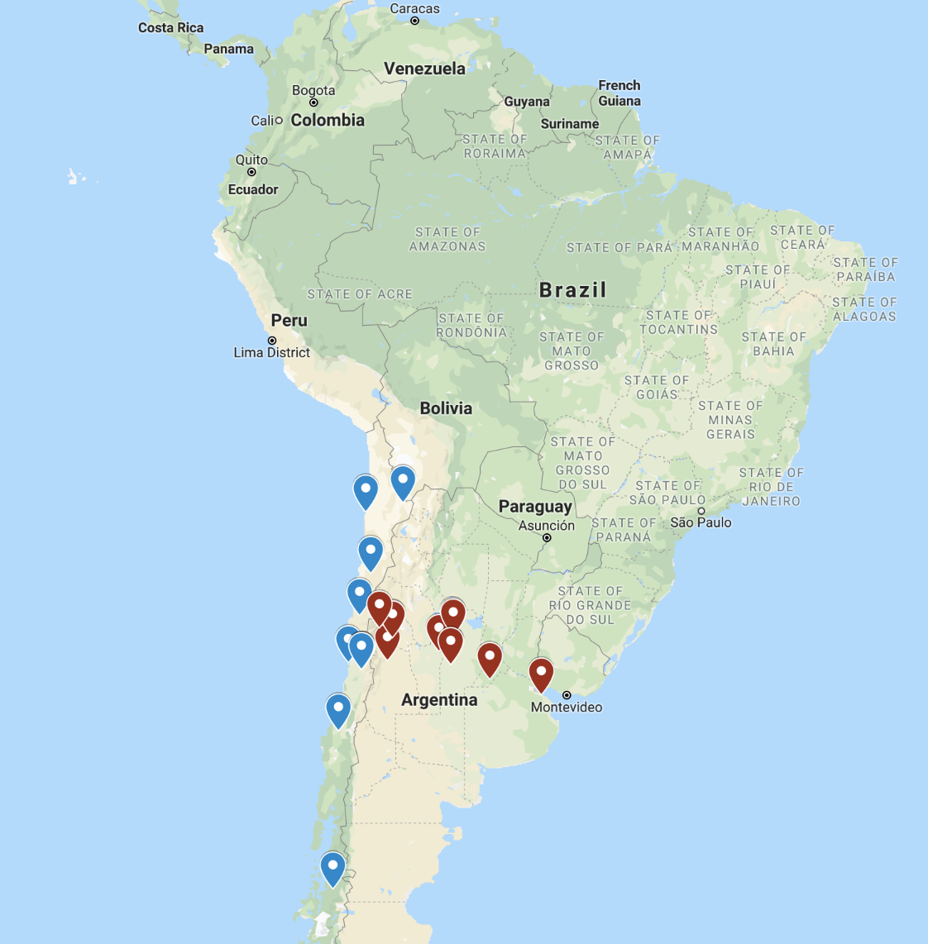
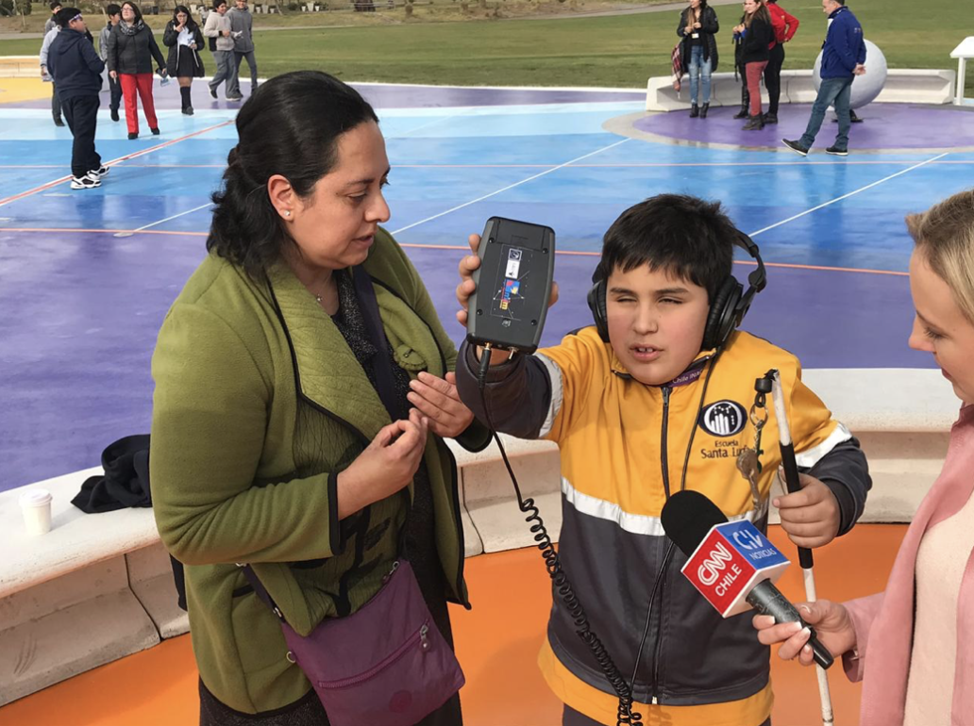
July 2, 2019
South America

Slide 9
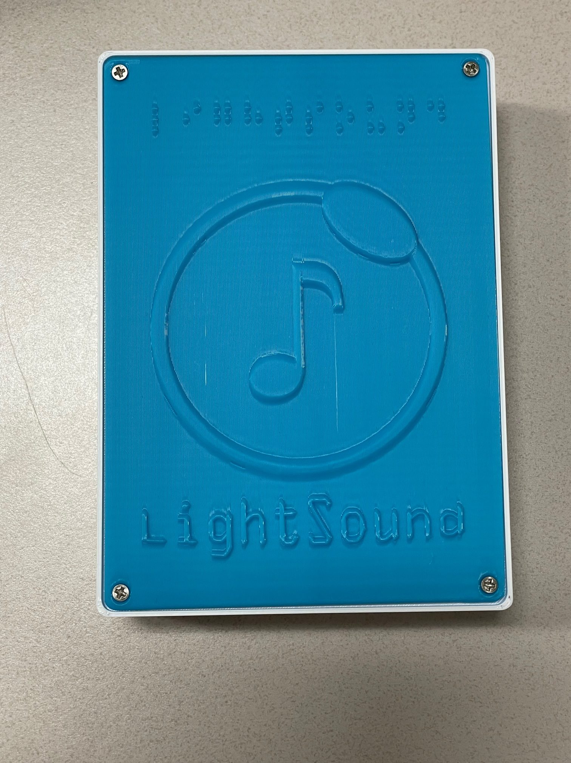
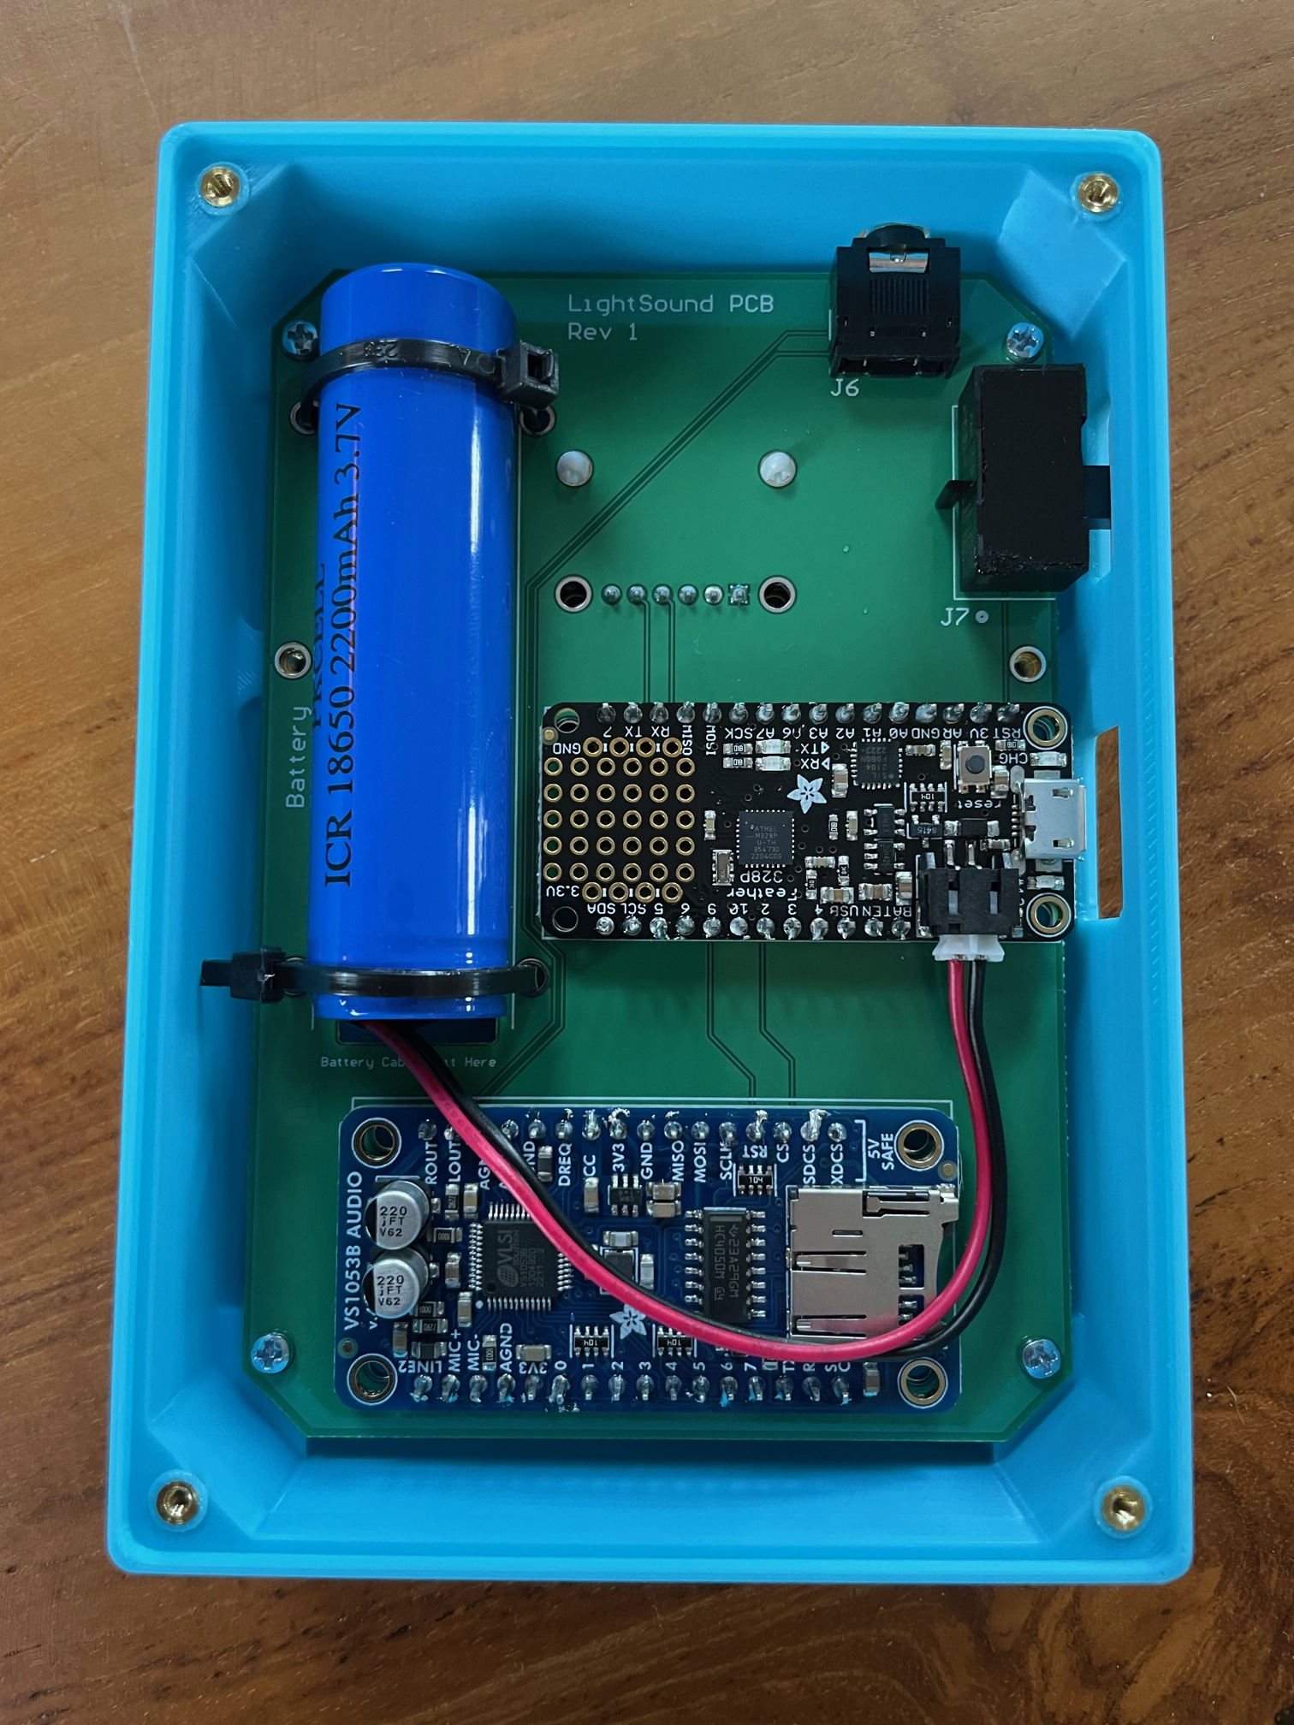
The LightSound designs
Wired
Case Design
PCB

Slide 10
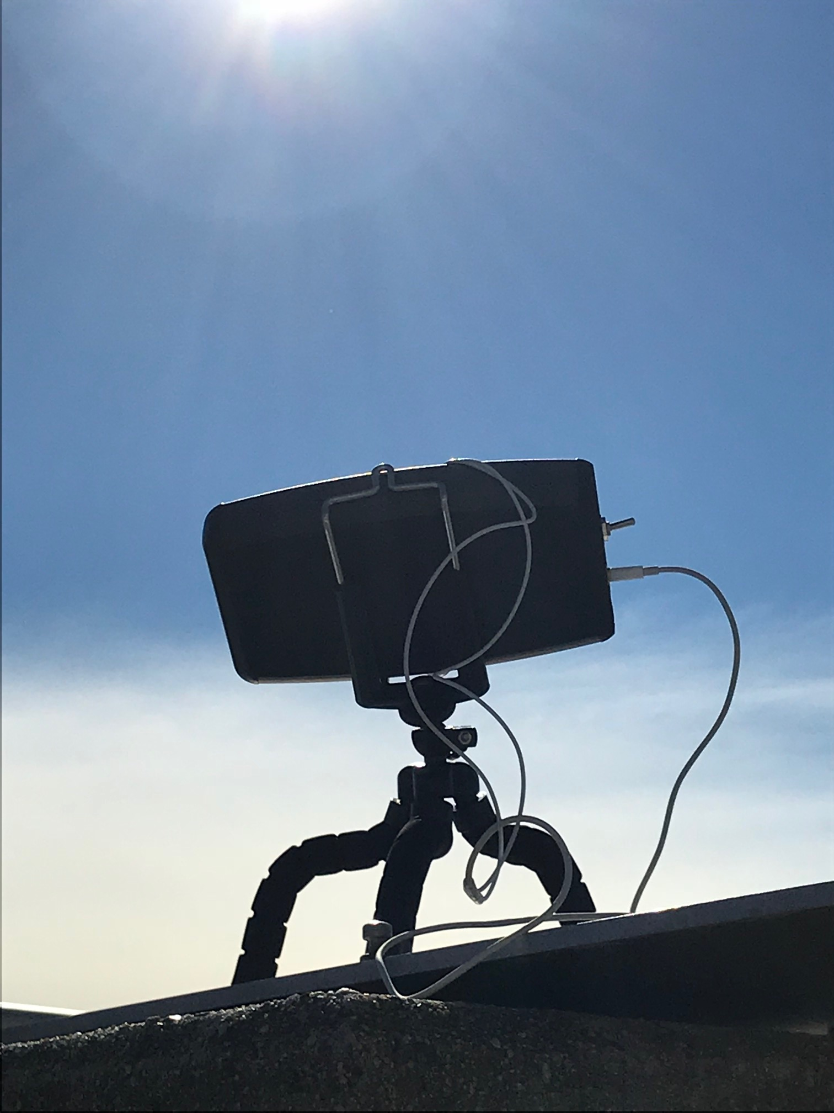
LightSound sound clip
Video demonstration of simulated eclipse
The sound starts as a high flute tone in the bright sunlight, and as the circle covers the sensor, the sound drops to a low clarinet before becoming clicks as the circle completely covers the opening. As it continues passing over, the low clarinet sound returns and the pitch rises until the flute sound returns.

Slide 11
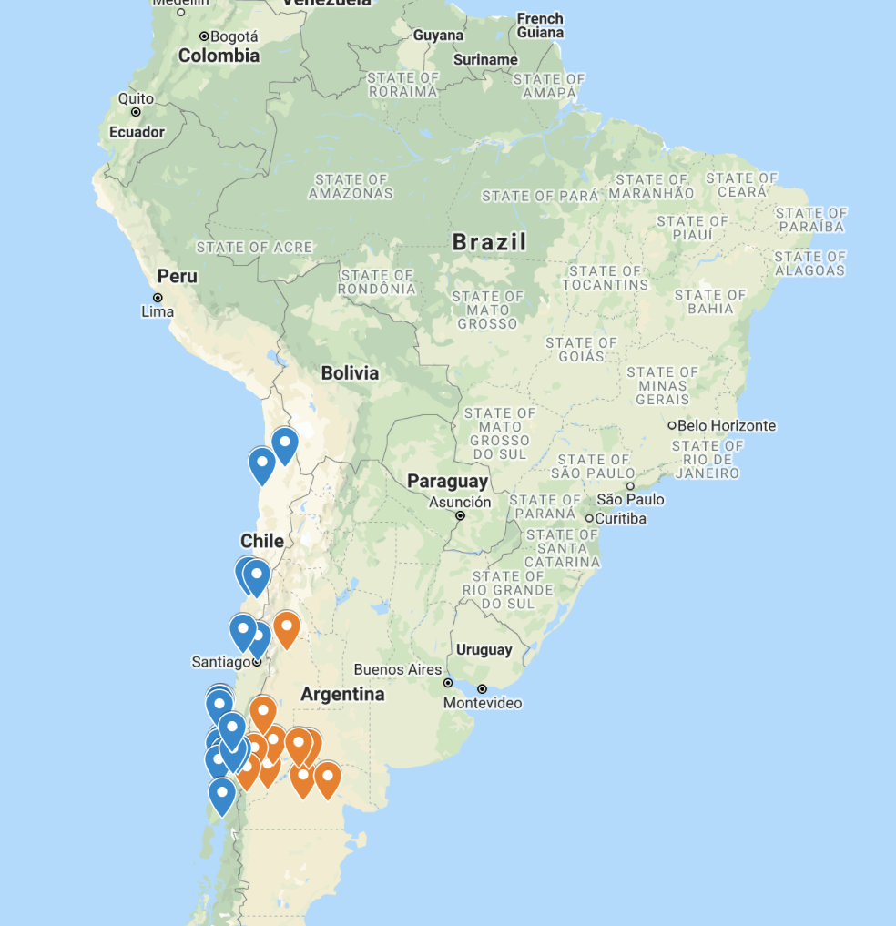
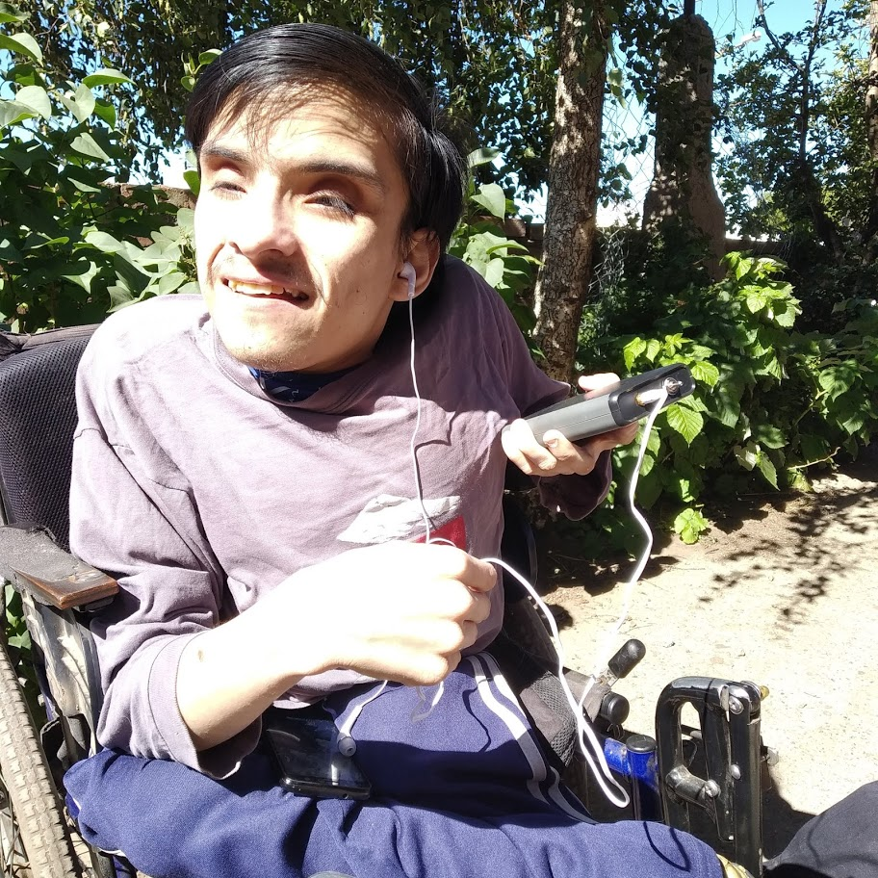
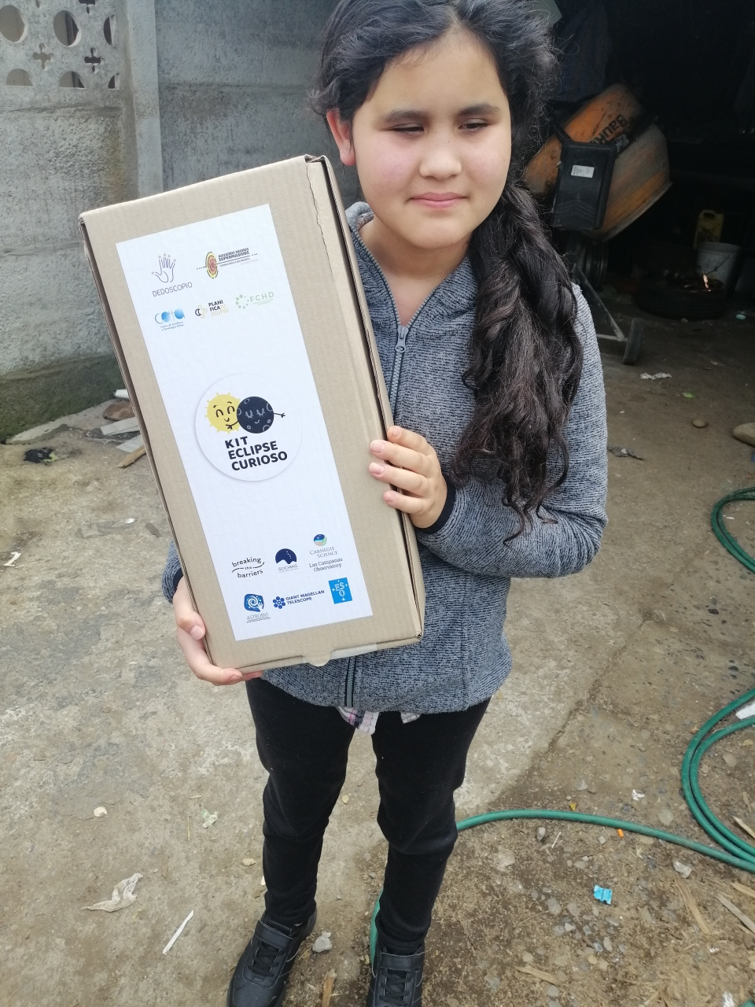
One LightSound device can impact thousands!!!

Slide 12
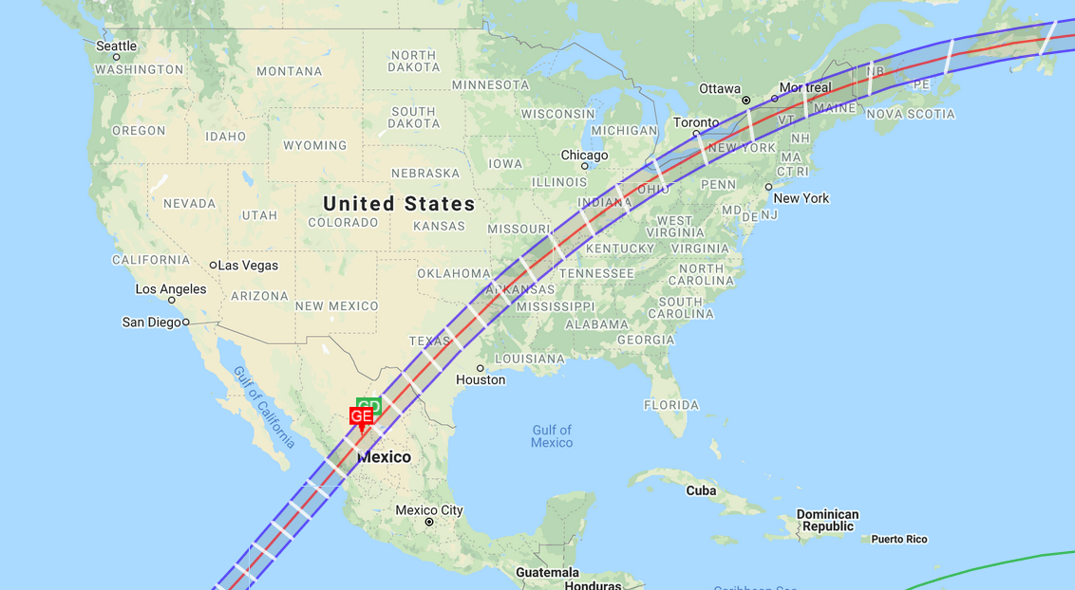
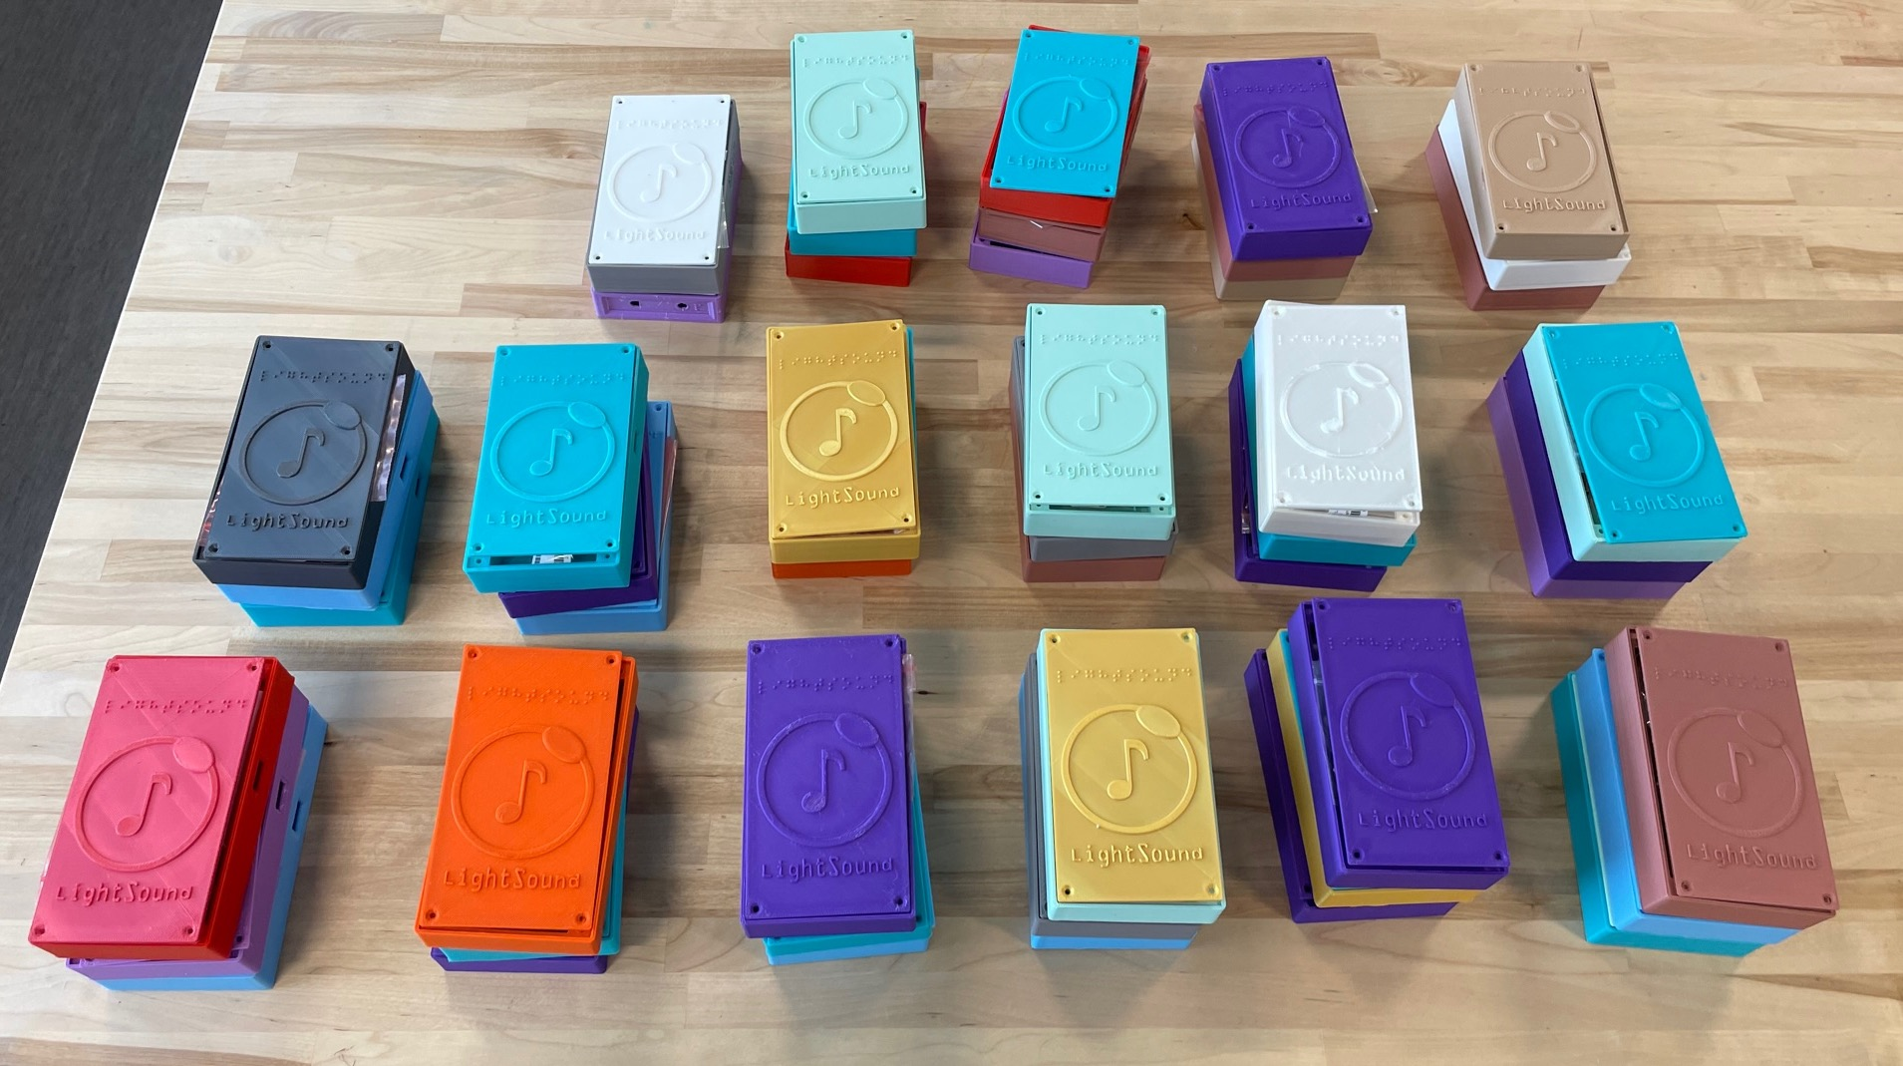
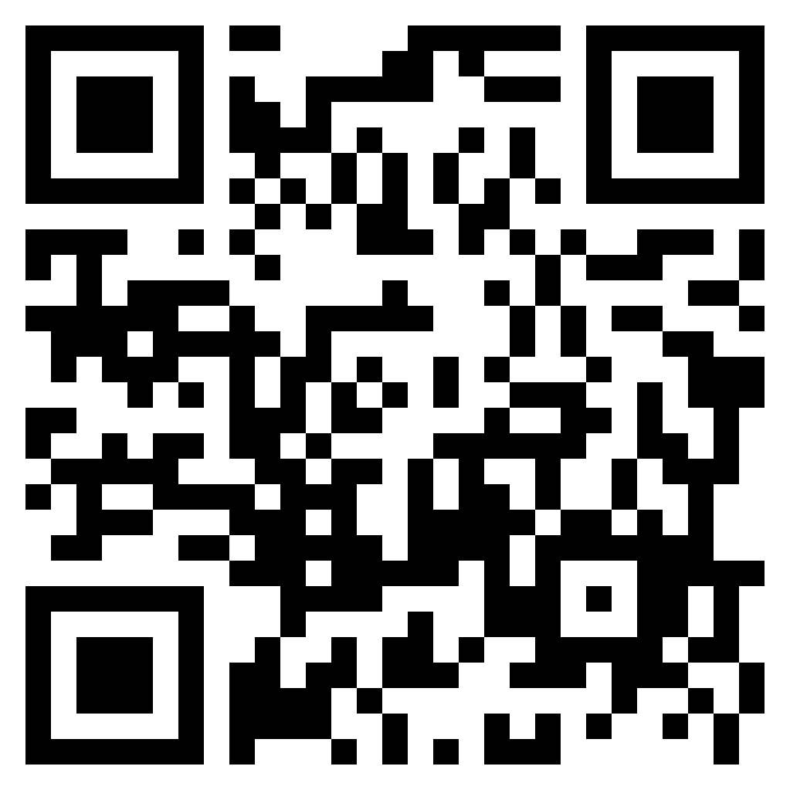
North American Annular Eclipse
October 14, 2023
North American Total Eclipse
April 8, 2024
In Progress
Goal:
750+ devices!!
We are ….
Building LightSound devices
Running Workshops
Donating LightSound devices
Scan to request a device!
Notes:
Less than two years away!

Slide 13
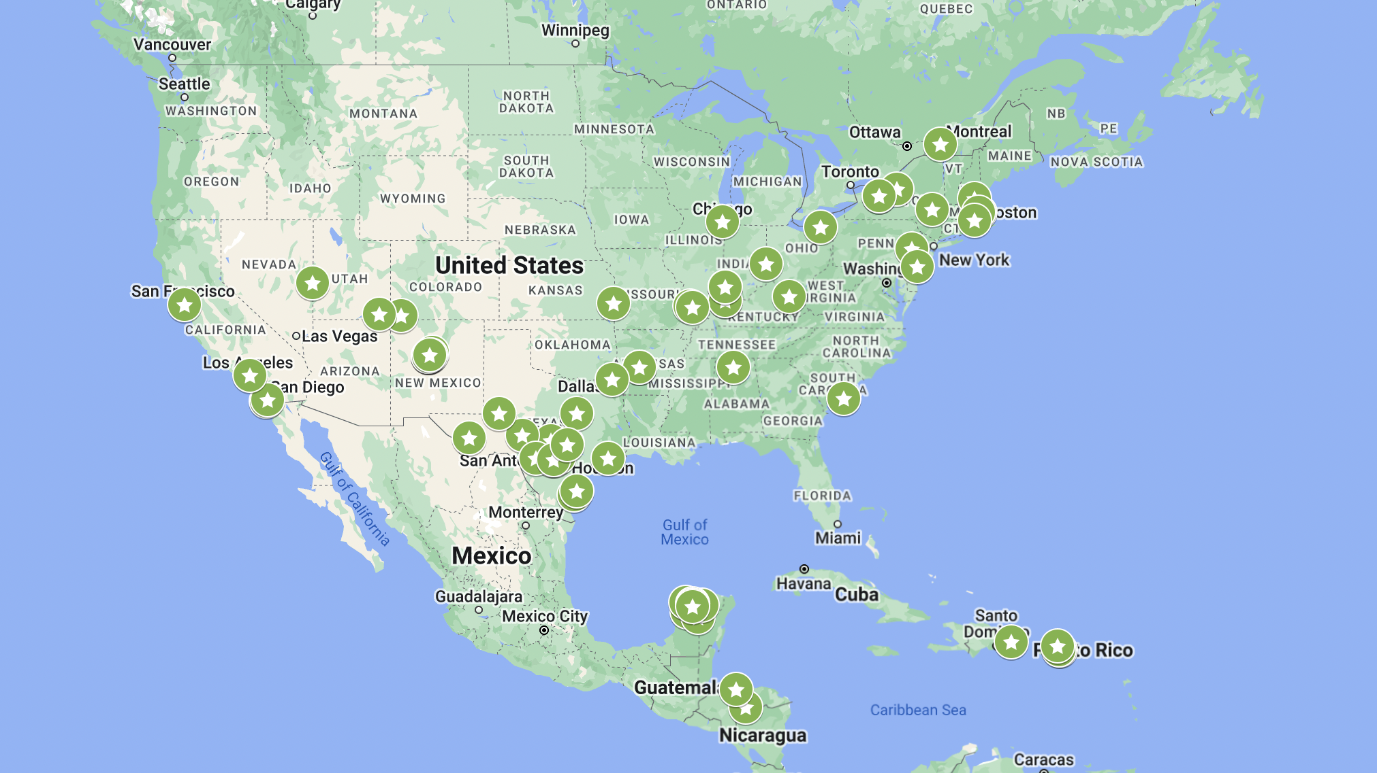

Slide 14
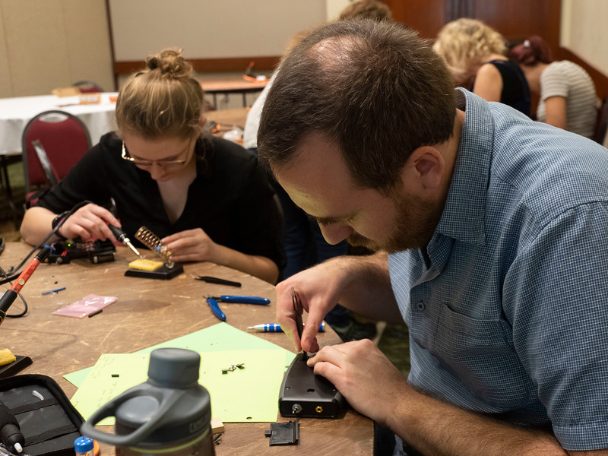
Workshops
Teach
Teach soldering and circuitry skills
Build
Build devices to be donated
Transfer
Transfer the knowledge
AAS 235 Workshop
Photo credit: Todd Buchanan 2020

Slide 15
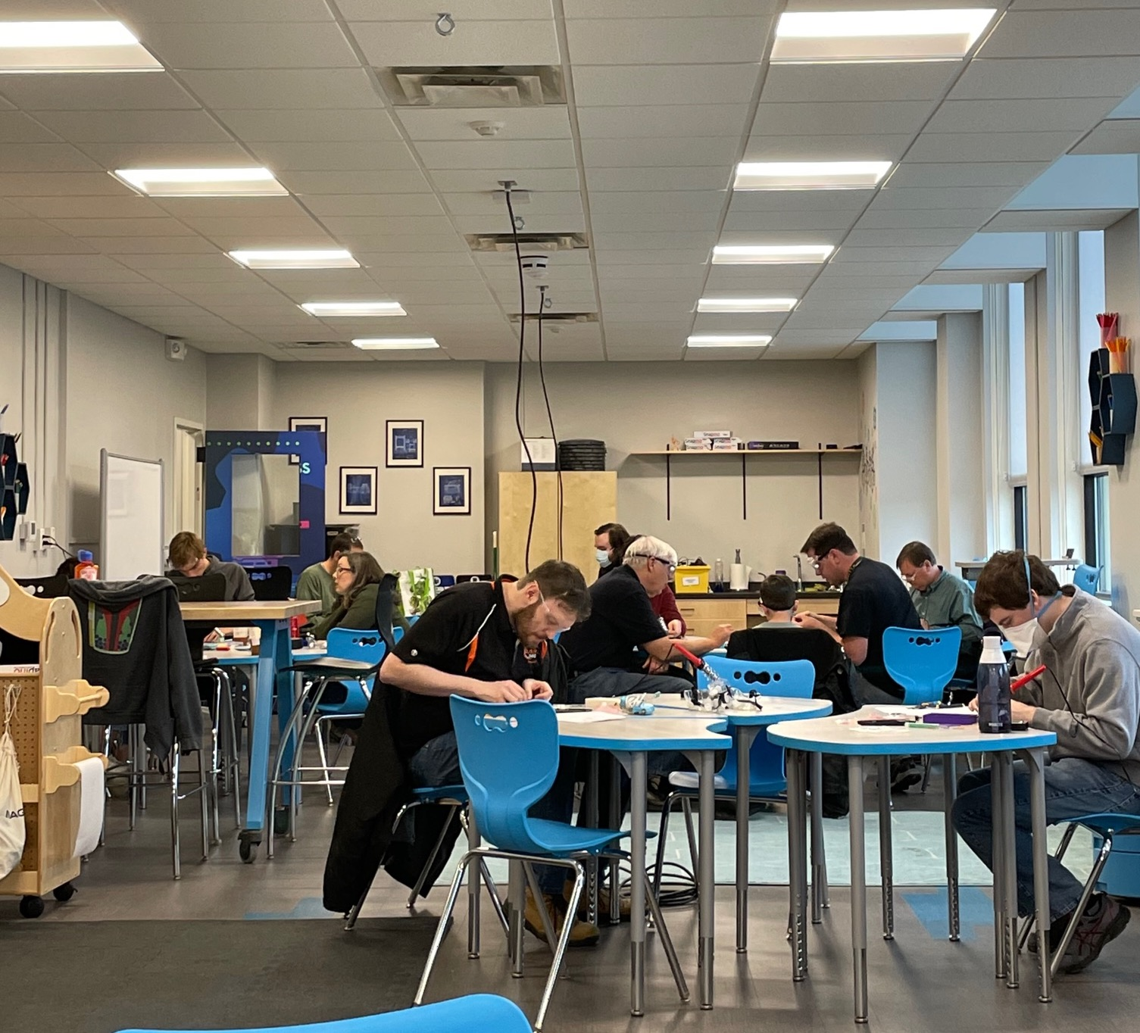
Rochester Museum SC
October 2022

Slide 16
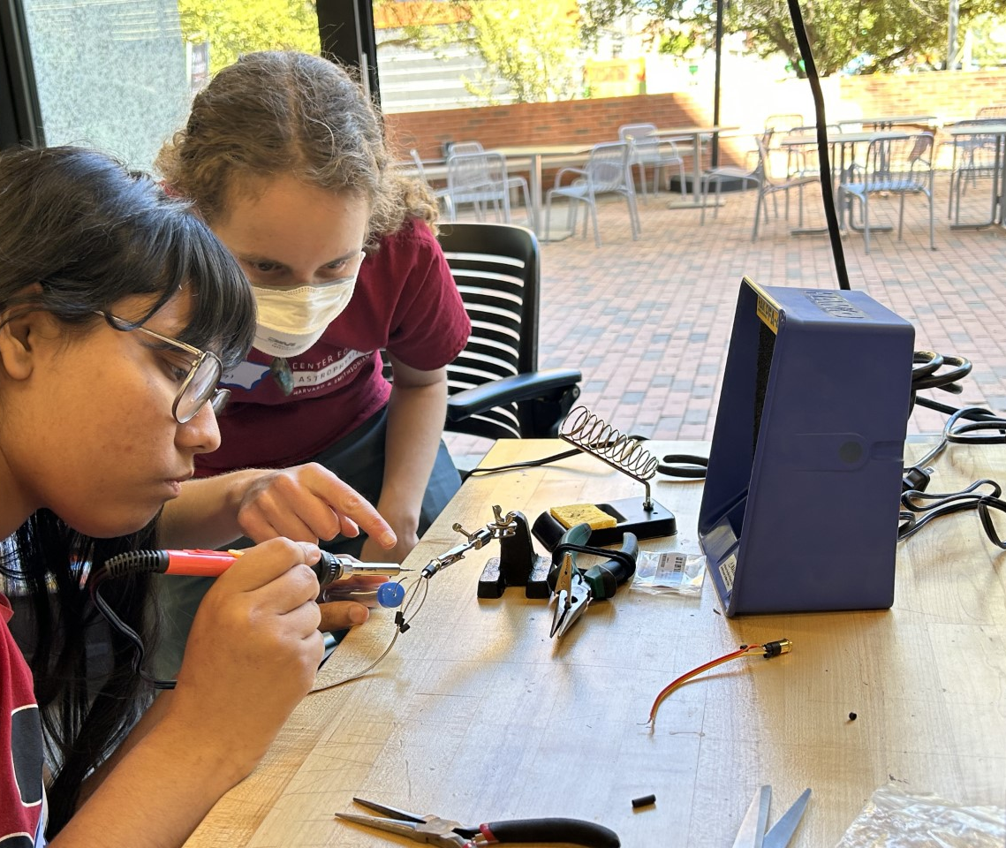
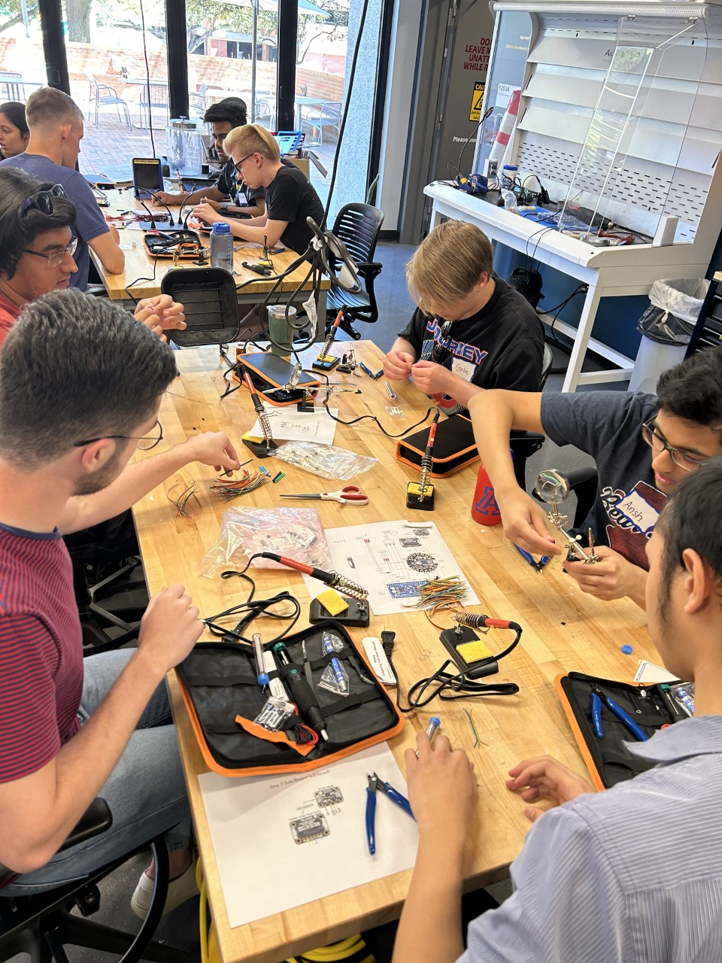
Tucson Initiative for Minoritized student Engagement in Science and TEchnology Program
April 2023

Slide 17
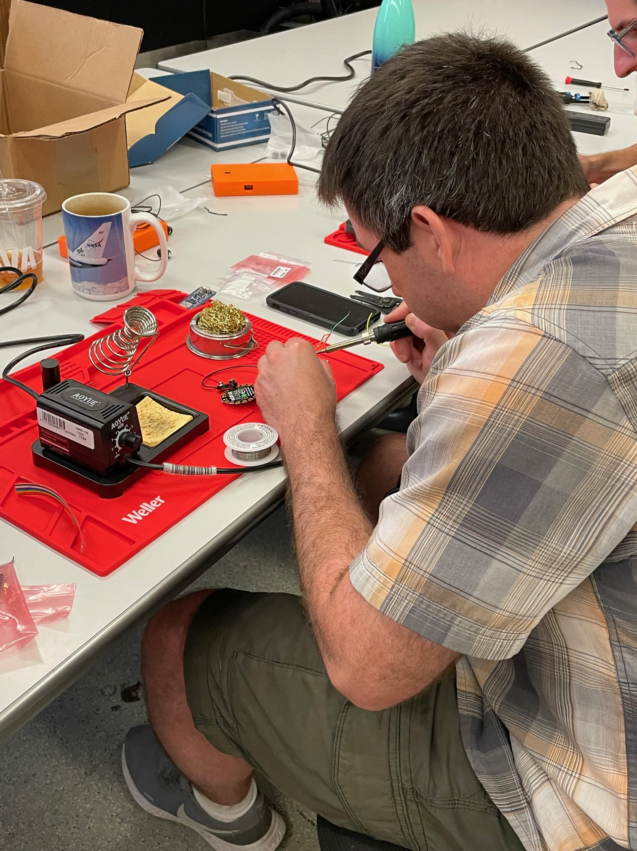
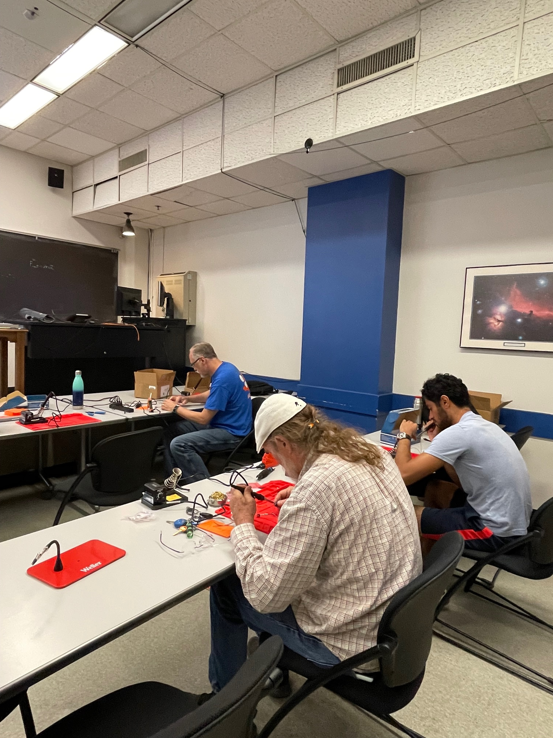
UT Austin
June 2023

Slide 18
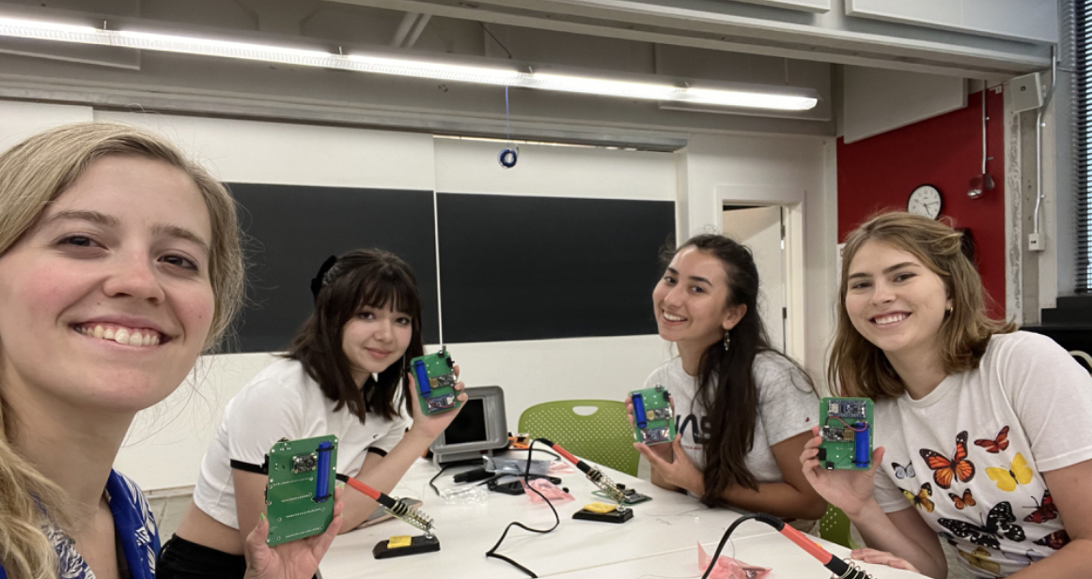
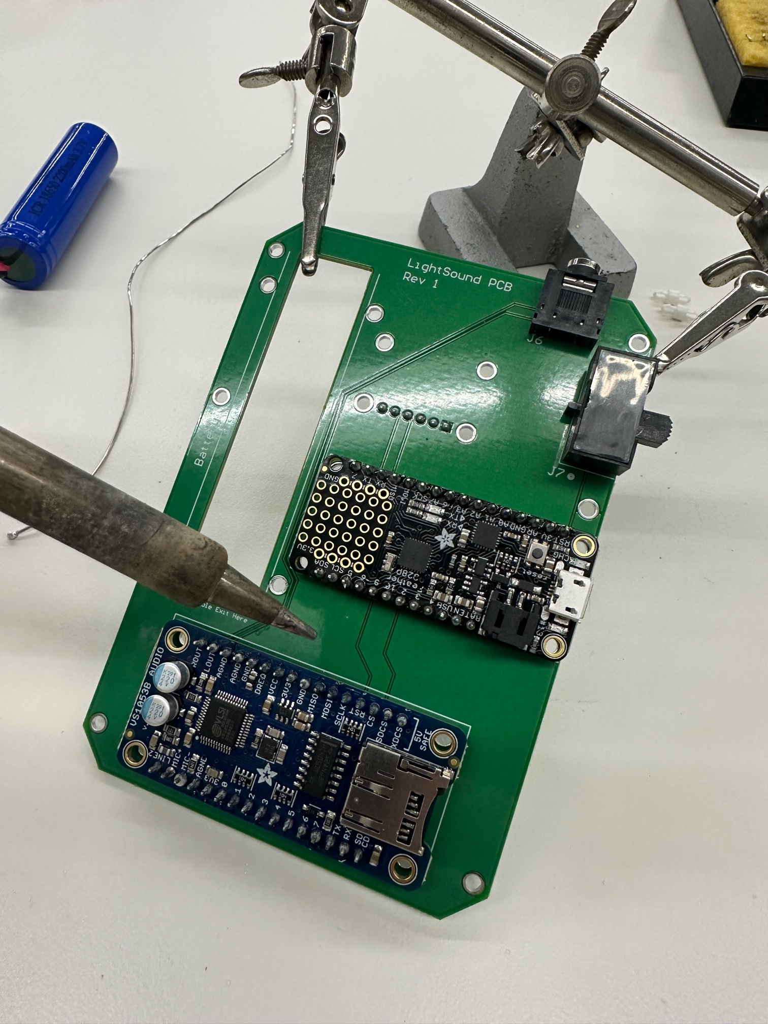
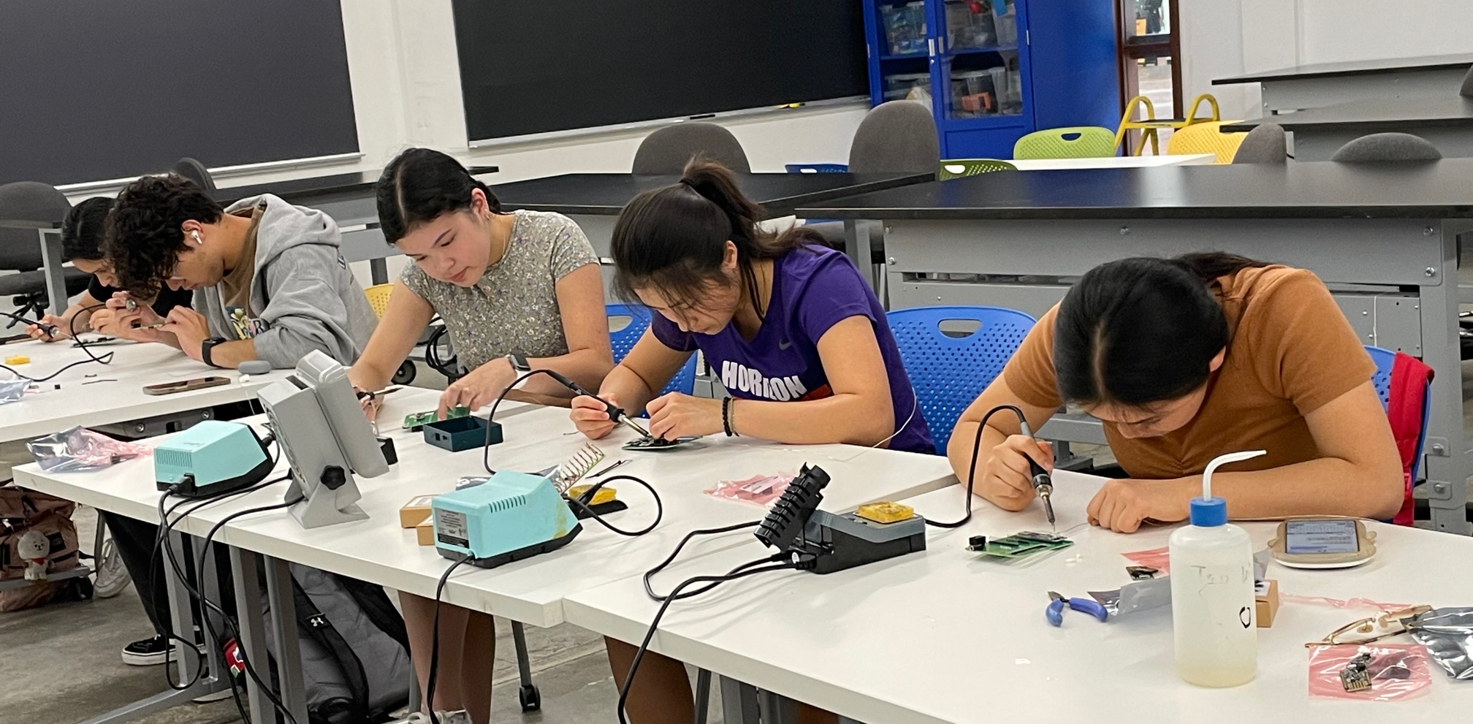
Harvard University July 2023

Slide 19
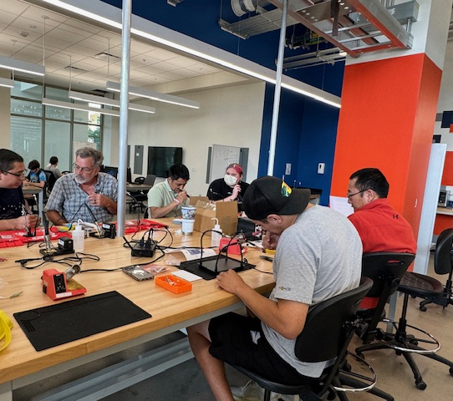
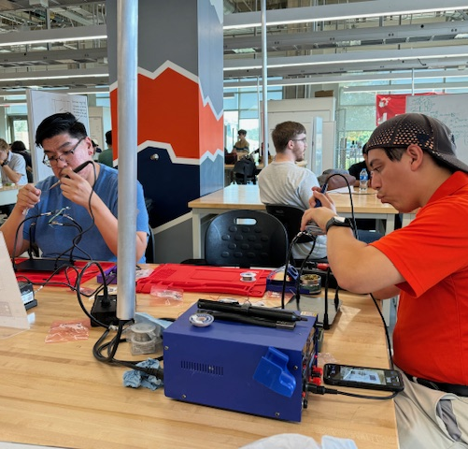
UT San Antonio
September 2023

Slide 20
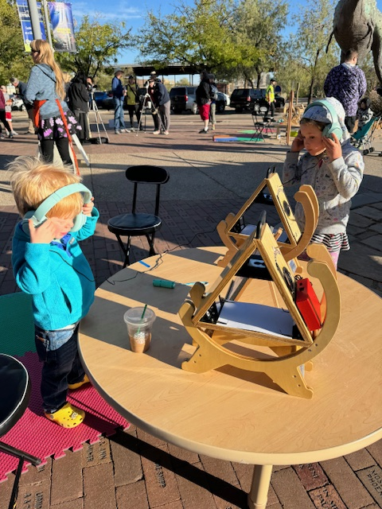
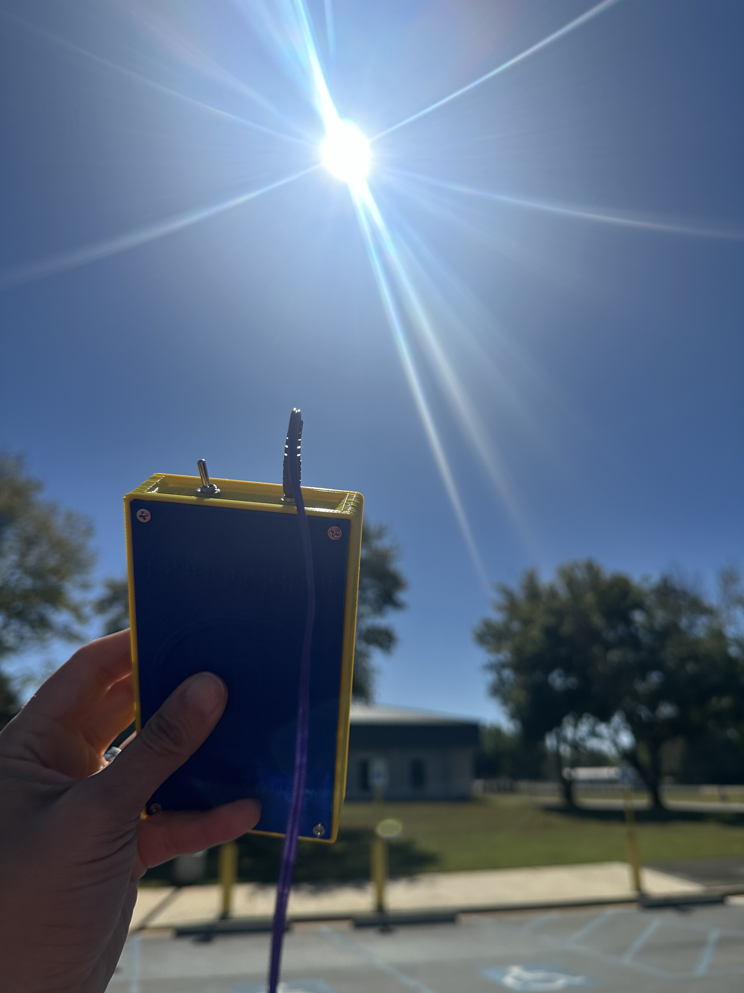
Annular Solar Eclipse Oct 14, 2023

Slide 21
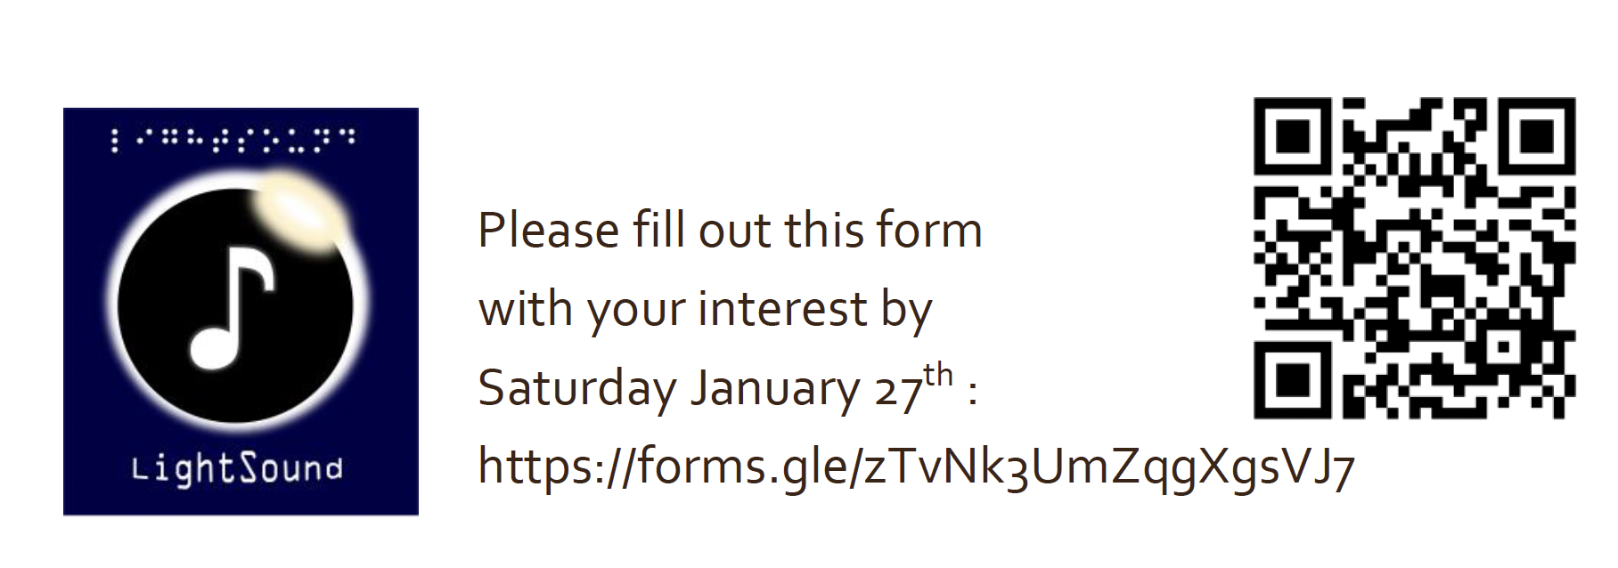
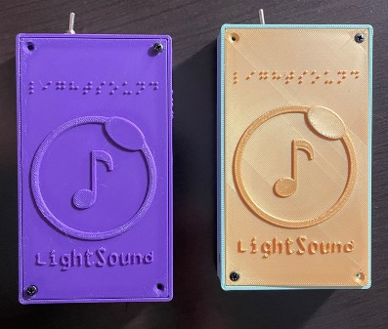
Upcoming Workshops
January 28-29, 2024
UT Austin (Texas)
Feb 3, 2024
New England Sci-tech (Massachusetts)

Slide 22
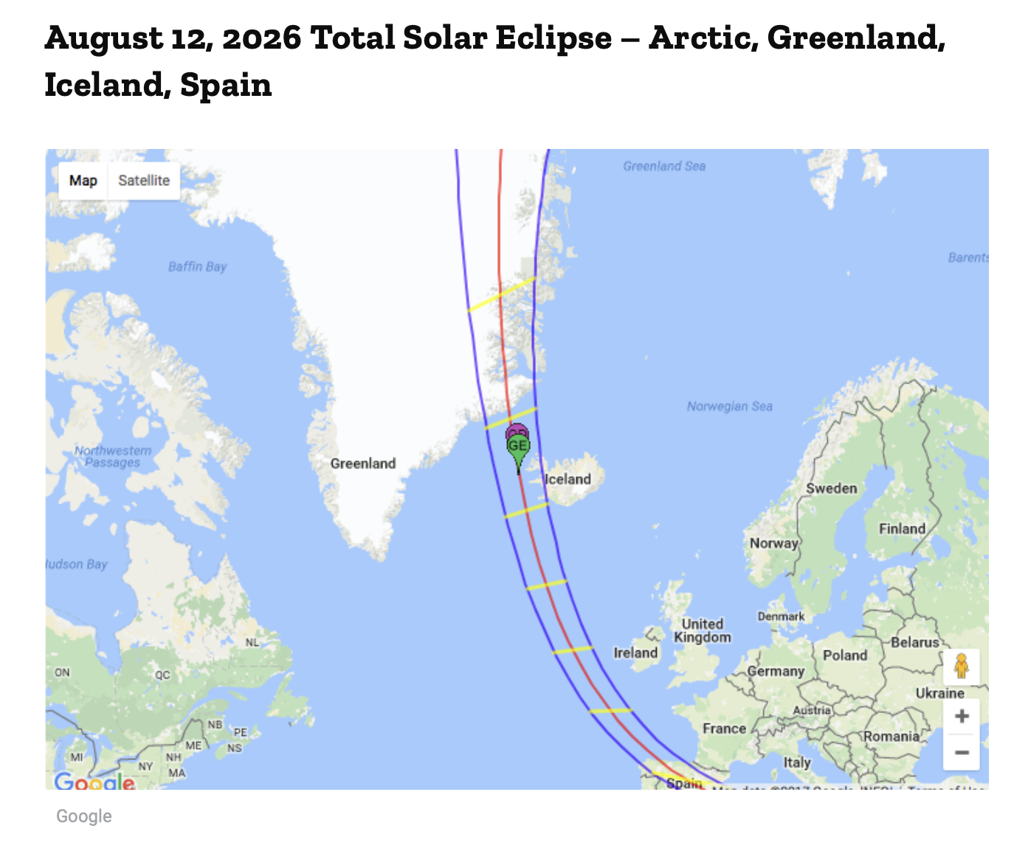
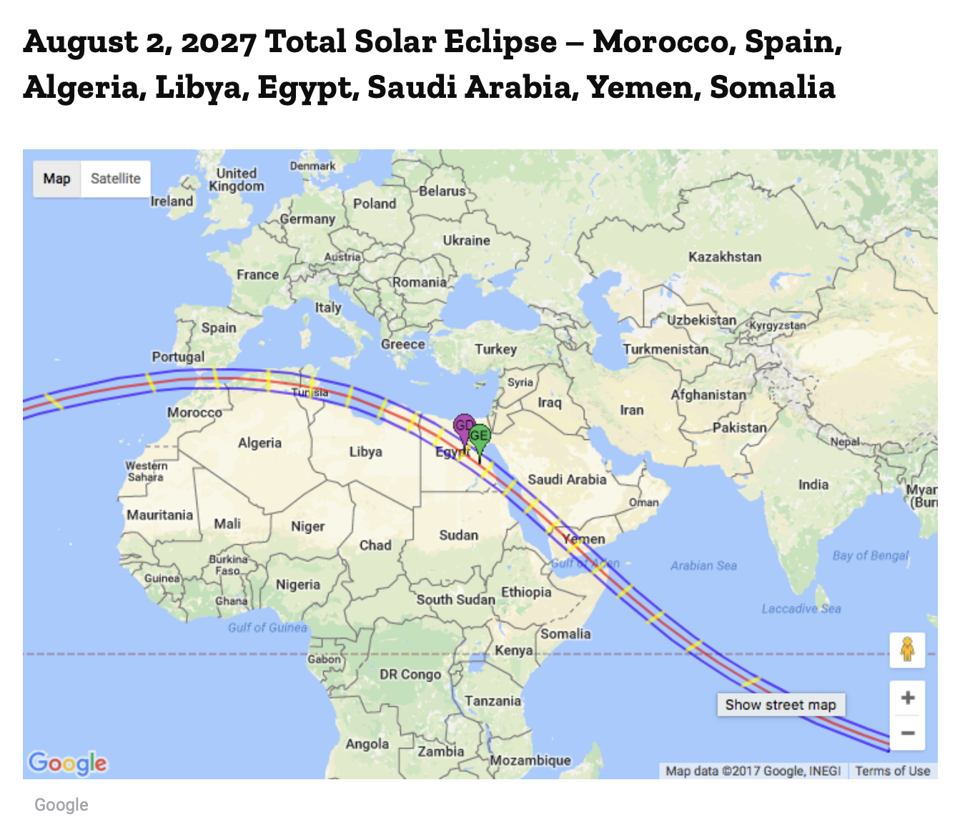

Slide 23
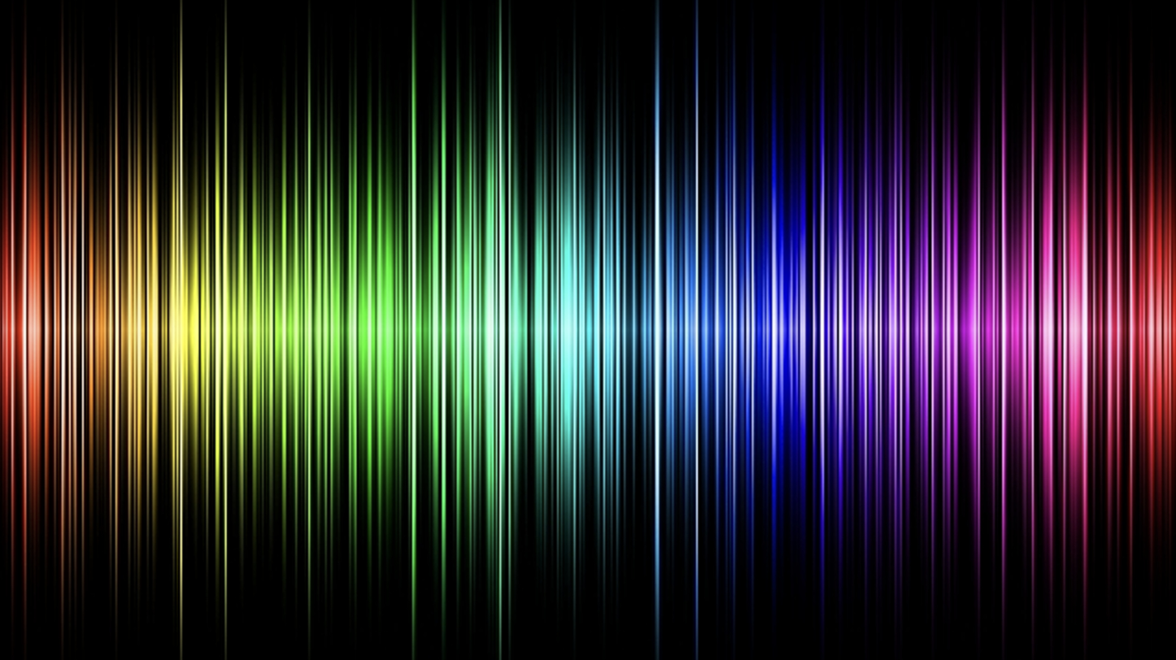

Slide 24
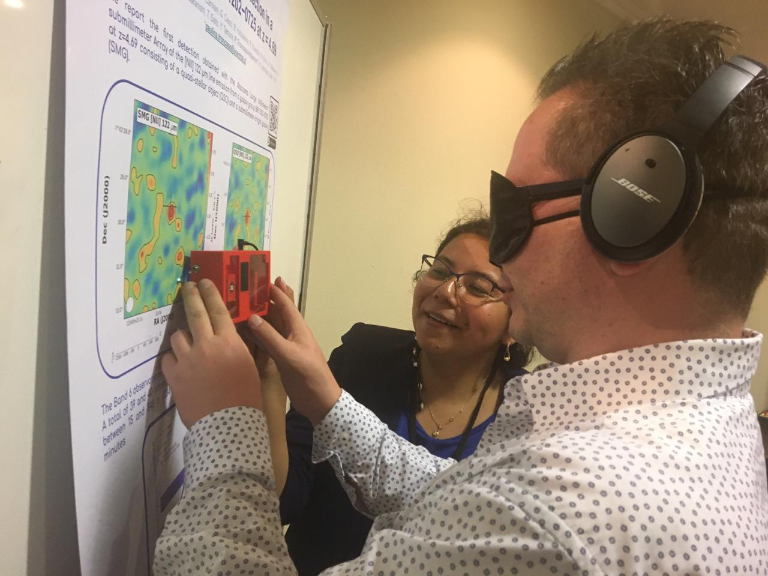

Slide 25
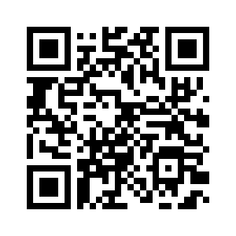
LightSound
(eclipse sonification device)
http://astrolab.fas.harvard.edu/LightSound.html
Scan to request a device!
Allyson Bieryla (abieryla@cfa.harvard.edu)

