Slide 1
NASA/CHANDRA EXAMPLE SONIFICATION (TYCHO SNR COMPIILATION)
Notes:
Beginning in the center, the sonification of the Tycho supernova remnant expands outward in a circle. The image contains X-ray data from Chandra where the various colors represent small bands of frequency that are associated with different elements that are moving both toward and away from Earth. For example, red shows iron, green is silicon, and blue represents sulfur. The sonification aligns with those colors as the redder light produces the lowest notes and blue and violet create the higher-pitched notes. Color varies over the remnant, but the lowest and highest notes (red and blue) dominate near the center and are joined by other colors (mid-range notes) towards the edge of the remnant. White corresponds to the full range of frequencies of light observable by Chandra, which is strongest toward the edge of the remnant. This light is converted to sound in a more direct way as well, by interpreting frequencies of light as frequencies of sound and then shifting them lower by 50 octaves so that they fall within the human hearing range. The different proportions of iron, silicon, and sulfur across the remnant can be heard in the changing amounts of the low-, mid-, and high-frequency peaks in the sound. The field of stars in the image as observed by Hubble is played as notes on a harp with the pitch determined by their color.

Slide 2
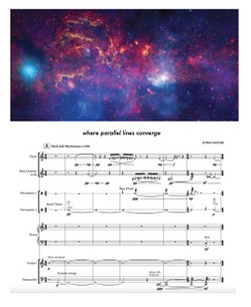
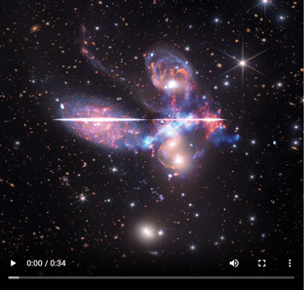
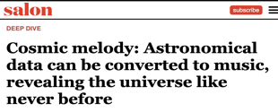
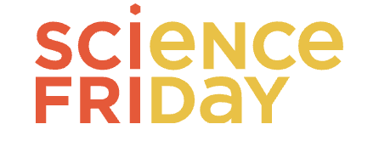
NASA/CHANDRA SONIFICATIONS METRICS
Chandra sonifications continued to attract very high interest levels:
• Released 4 sonifications w/data from Chandra, Webb, Hubble, IXPE in 2023. 1M listens to Stephan’s quintet in 1 month
• BBC radio ”top science stories of 2023,” WaPo, LA Times, Salon, multiple NPR shows, podcasts, artist usage (e.g., Royal Museums Greenwich Prize for artist derivation), etc.
>Jan-Dec 2023: 650 articles in the media, potential reach of 2.9B.
• Created w/BVI SMEs; sustained accessibility/inclusion program
•Sonification composition/sheet music released Nov 2023: WaPo, SI magazine, CBC, Weather channel trending video, etc.
• Sonification coding app updated for Hour of Code, #1 app, drove heavy traffic to Chandra server (>60M hits from Nov-Dec, 2023)
• New NASA sonification documentary to be released on NASA+ in Jan 2024

Slide 3
TAKEAWAYS OF CHANDRA FUNDED PAPER/RESEARCH:
Both sighted & BLV audiences enjoy astronomical sonifications.
Both report wanting to listen to more: continue including sonification in comms & engagement.
Both sighted & BLV reported learning more about the astronomical object from the sonifications, but BLV sometimes reported learning more.
Both wanted to learn more about Universe after listening to sonifications, but BLV reported being more motivated than sighted.
Indication: sonification increases accessibility of astro. engagement.

Slide 4
CREDITS/ACKNOWLEDGEMENTS
Kimberly Arcand, PhD
kkowal@cfa.harvard.edu
@kimberlykowal
Chandra X-ray Center funding from NASA under contract NAS8-03060
Additional support from NASA's Universe of Learning under award# NNX16AC65A to STScI, with Caltech/IPAC, JPL, SAO.
Paper authors: Dr. Kimberly Arcand, Jessica Schonhut-Stasik, Sarah Kane, Dr. Gwynn Sturdevant, Dr. Matt Russo, Megan Watzke, Brian Hsu, Dr. Lisa F. Smith
http://chandra.si.edu/sound

