Slide 1
Gamma Factory
multidisciplinary research tools based on LHC
WIESŁAW PŁACZEK
Jagiellonian University in Krakow
Poland
Representing the Gamma Factory Study Group
Polish Particle and Nuclear Theory Summit (2PiNTS)
Institute of Nuclear Physics, Polish Academy of Sciences, Krakow, Poland, 22–24 November 2023

Slide 2
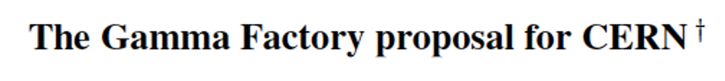
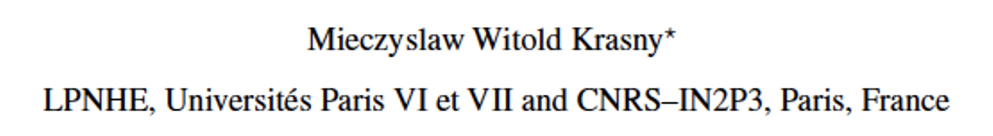

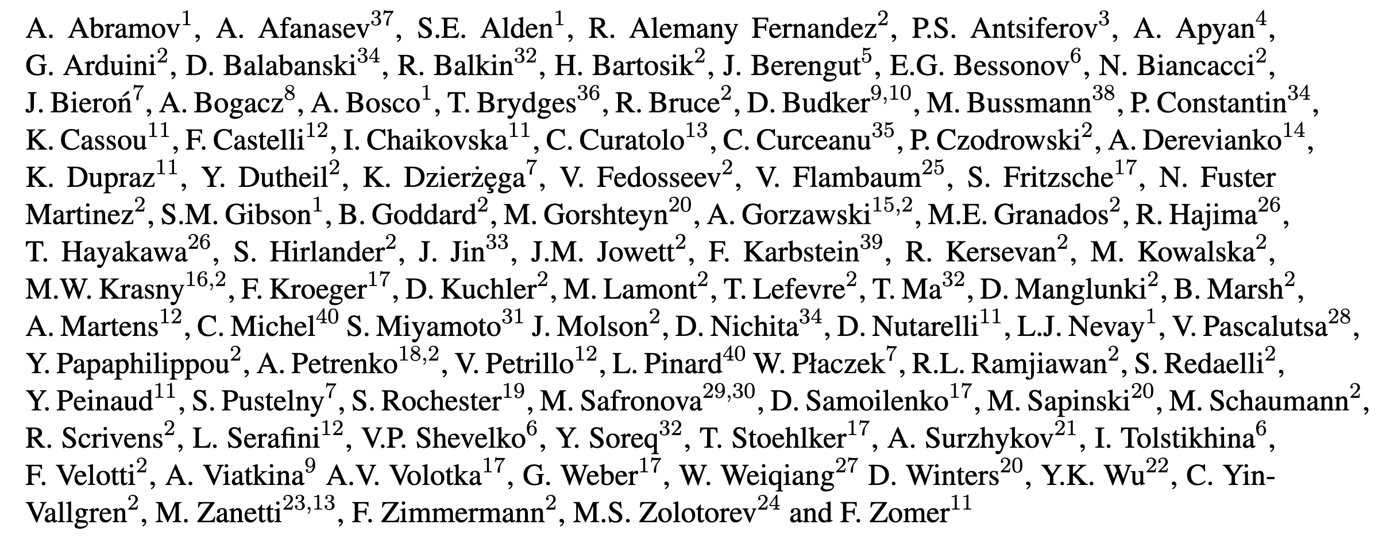
Gamma Factory studies
Gamma Factory studies are anchored and supported by the CERN Physics Beyond Colliders (PBC) framework.
More info on all the GF group activities:
https://indico.cern.ch/category/10874
We acknowledge the crucial role of the CERN PBC framework in bringing our accelerator tests, GF-PoP experiment design, software development and physics studies to their present stage!
~100 physicists from ~40 institutions have contributed so far to the Gamma Factory studies

Slide 3
Principles

Slide 4
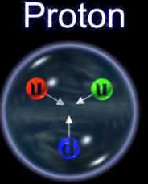
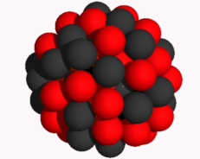
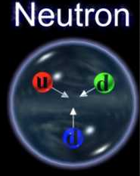
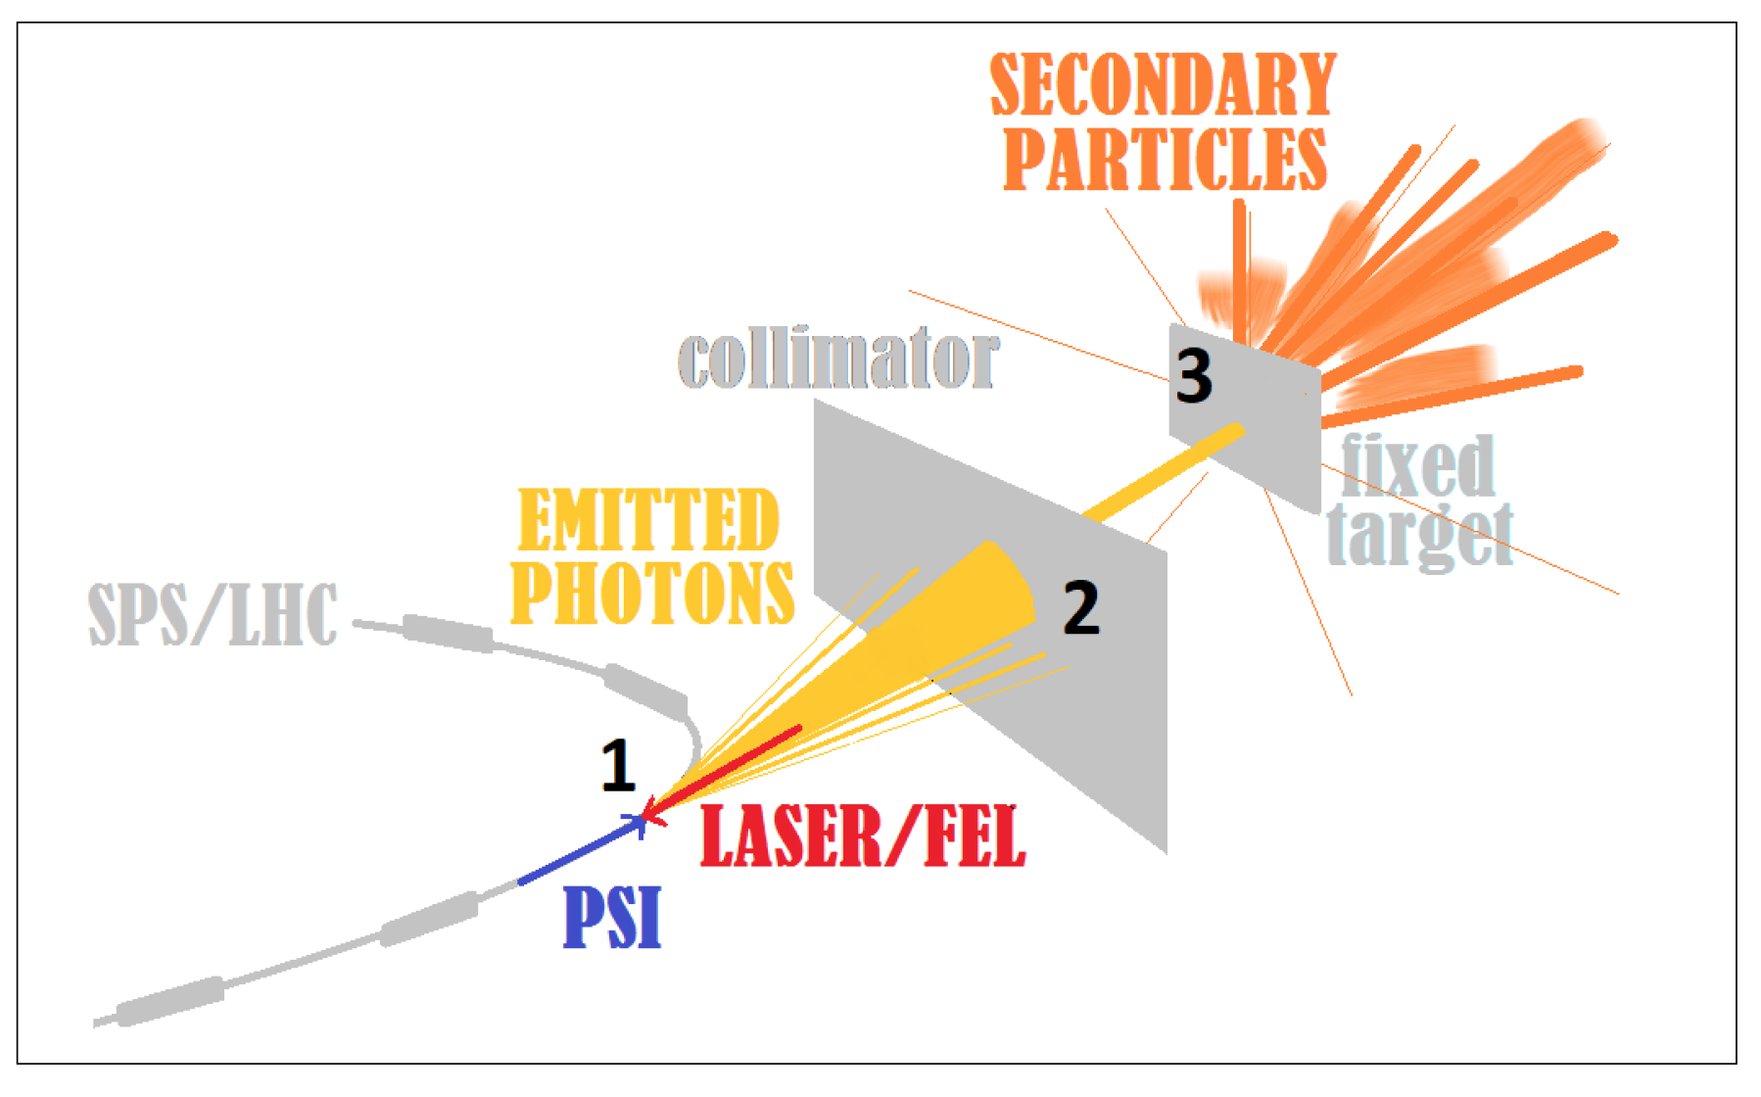
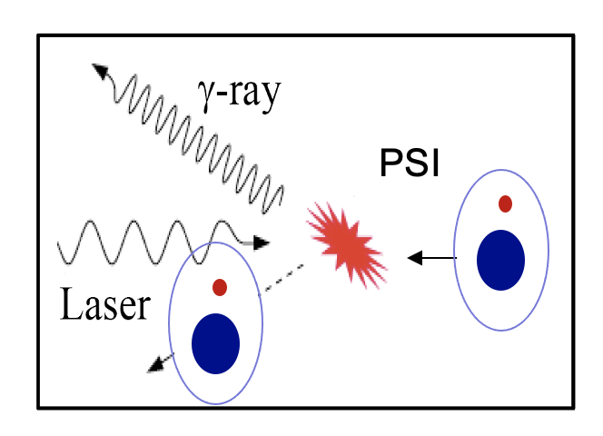

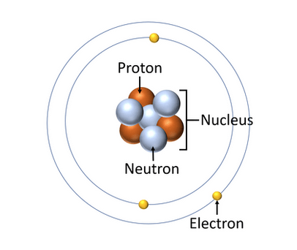
Gamma Factory beams
LHC beams
Include atomic beams of partially stripped ions in the LHC menu.
Collide them with laser pulses (circulating in Fabry-Pérot resonators)
to produce beams of polarised photons and secondary beams
of polarised electrons/positrons/muons, neutrons and radioactive ions.
PSI – atomic beams of Partially Stripped Ions

Slide 5
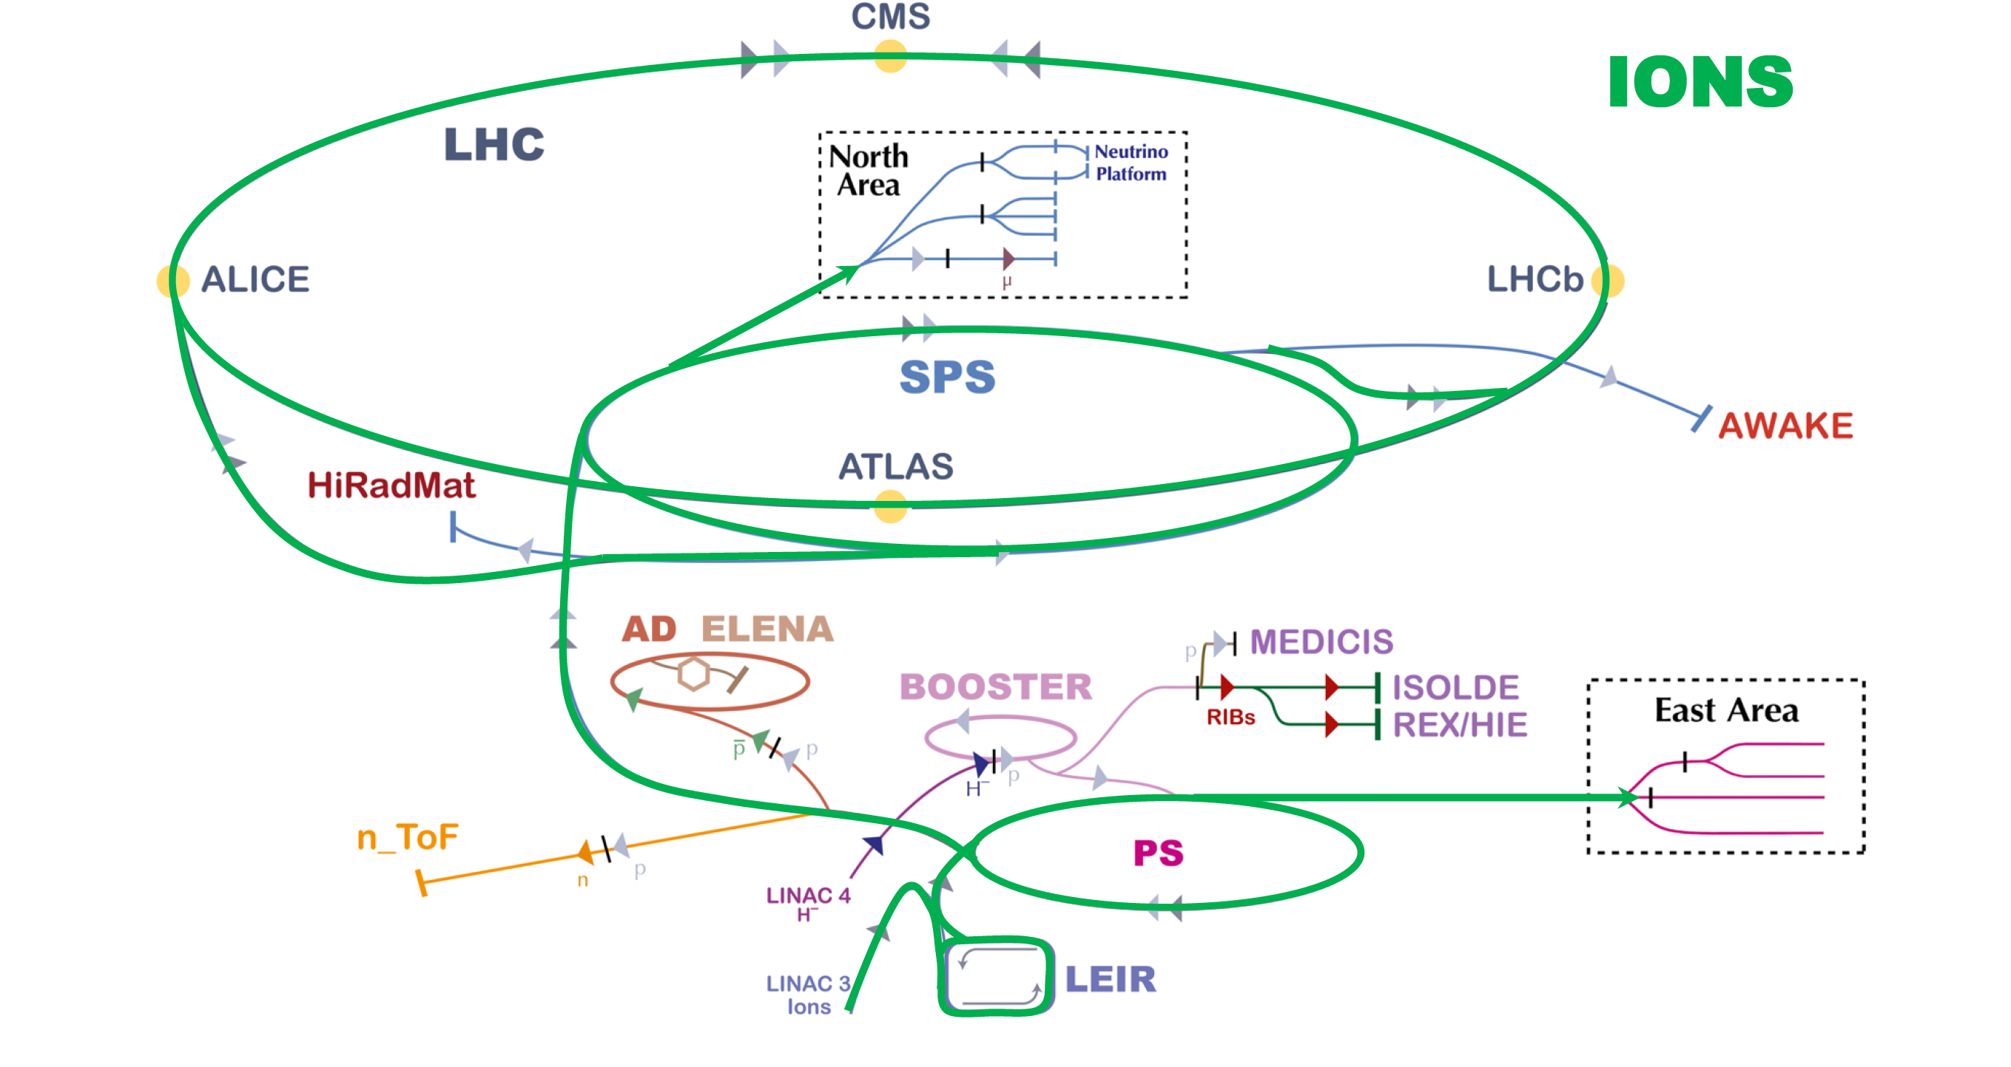
CERN accelerator infrastructure
Gamma Factory (additional) requirements:
modification of the ion stripping scheme
storage of atomic beams in the LHC

Slide 6
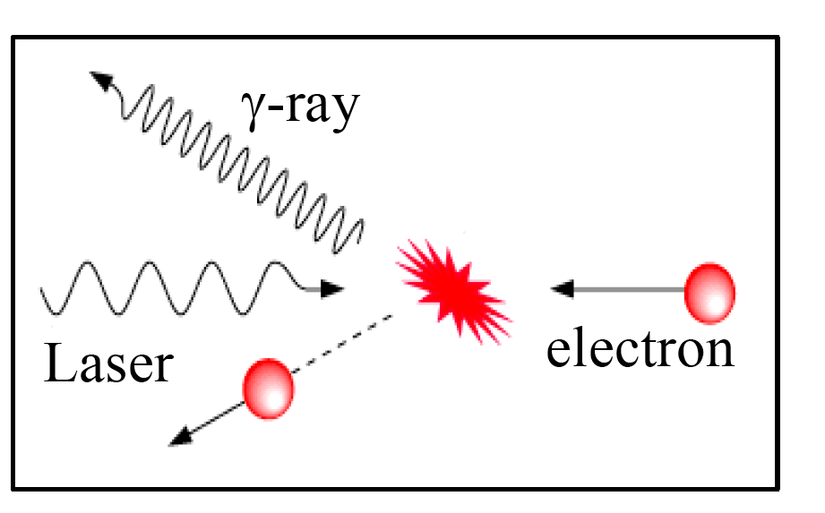
The idea:
Replace an electron beam (Inverse Compton Scattering) by a beam of Partially Stripped Ions (PSI)
PSI

Slide 7

High energy atomic beams play a role of passive light-frequency converters:
Laser photon
γ−ray
E=0
E=0
E=0
n=2
n=2
n=2
n=1
n=1
n=1
ν^{max} (4γ_{L}²) ν_{Laser}
γ_{L} = E/M – relativistic Lorentz factor of a PSI beam
(~100 at SPS, ~3000 at LHC)
Notes:
7

Slide 8
Performance of electron-beam and PSI-beam driven photon sources: cross sections and beam rigidity
Electrons:
σ_{max} = (8π/3) r_{e}²
r_{e} – classical electron radius
Partially Stripped Ions (PSIs):
σ_{peak} = λ_{res}² /2π
λ_{res} – photon wavelength in the ion rest frame
Electrons:
σ_{e} = 6.65 ✕ 10⁻²⁵ cm²
PSIs:
σ_{peak} = 1.7 ✕ 10⁻¹⁵ cm²
Numerical example: λ_{laser} = 1034 nm, γ_{L}^{PSI} = 1000
PSI beams:
Highly efficient (~100%) conversion of the RF power into the power of the photon beam!
(PSI looses only a tiny fraction, < 10⁻⁶, of its energy in the process of photon emission)

Slide 9
Extraordinary properties GF photon source
1. Point-like, small divergence:
Δz ~ l_{PSI-bunch} < 7 cm; Δx, Δy ~ σ^{PSI}_{x}, σ ^{PSI}_{y} < 50 μm; Δ(θ_{x}), Δ(θ_{y}) ~ 1/γ_{L} < 1 mrad
2. Huge jump in intensity:
More than 7 orders of magnitude w.r.t. existing (being constructed) γ-sources: up to 10¹⁸ γ/s
3. Very wide range of tuneable energy photon beam:
10 keV – 400 MeV – extending by a factor of ~1000 the energy range of FEL photon sources
4. Tuneable polarisation:
Polarisation transmission from laser photons to γ-beams of up to 99%
5. Unprecedented plug power efficiency (energy footprint):
LHC RF power can be converted to the photon beam power. Wall-plug power efficiency of the GF photon source is by a factor of ~300 better than that of DESY-XFEL!
(assuming power consumption: 200 MW – CERN, 19 MW – DESY)
Notes:
9

Slide 10
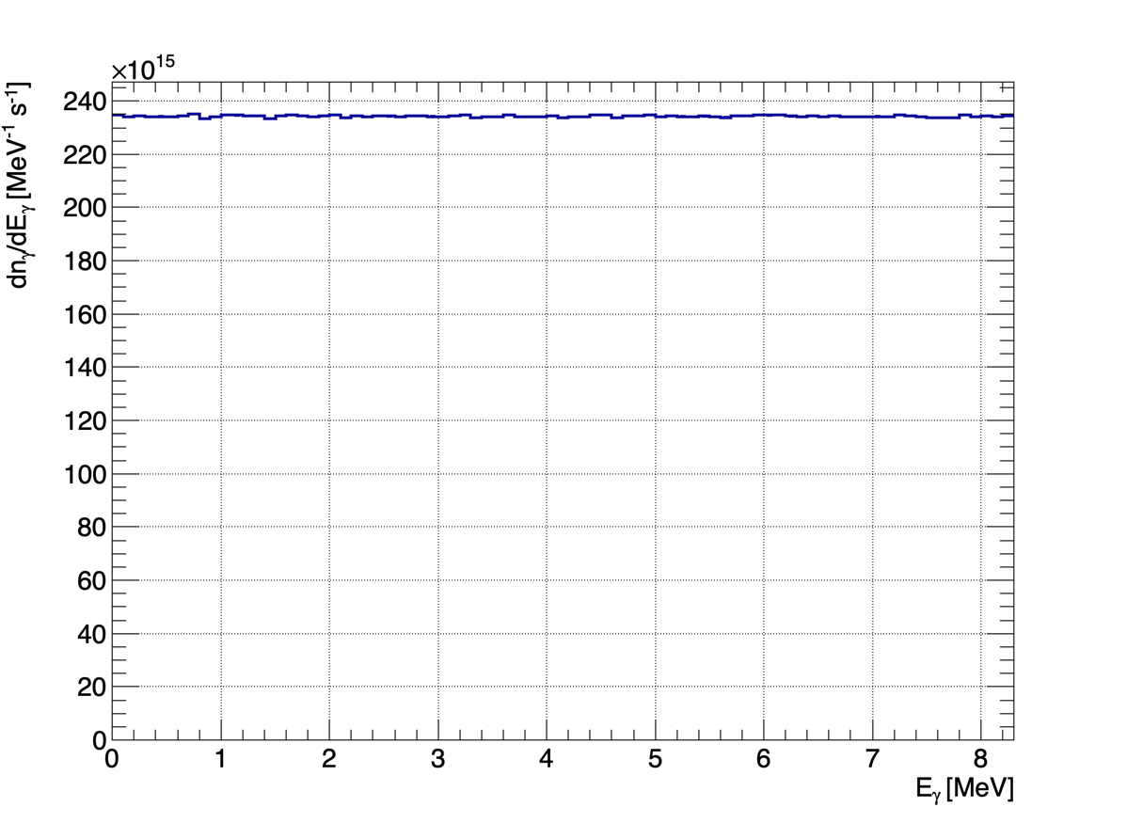
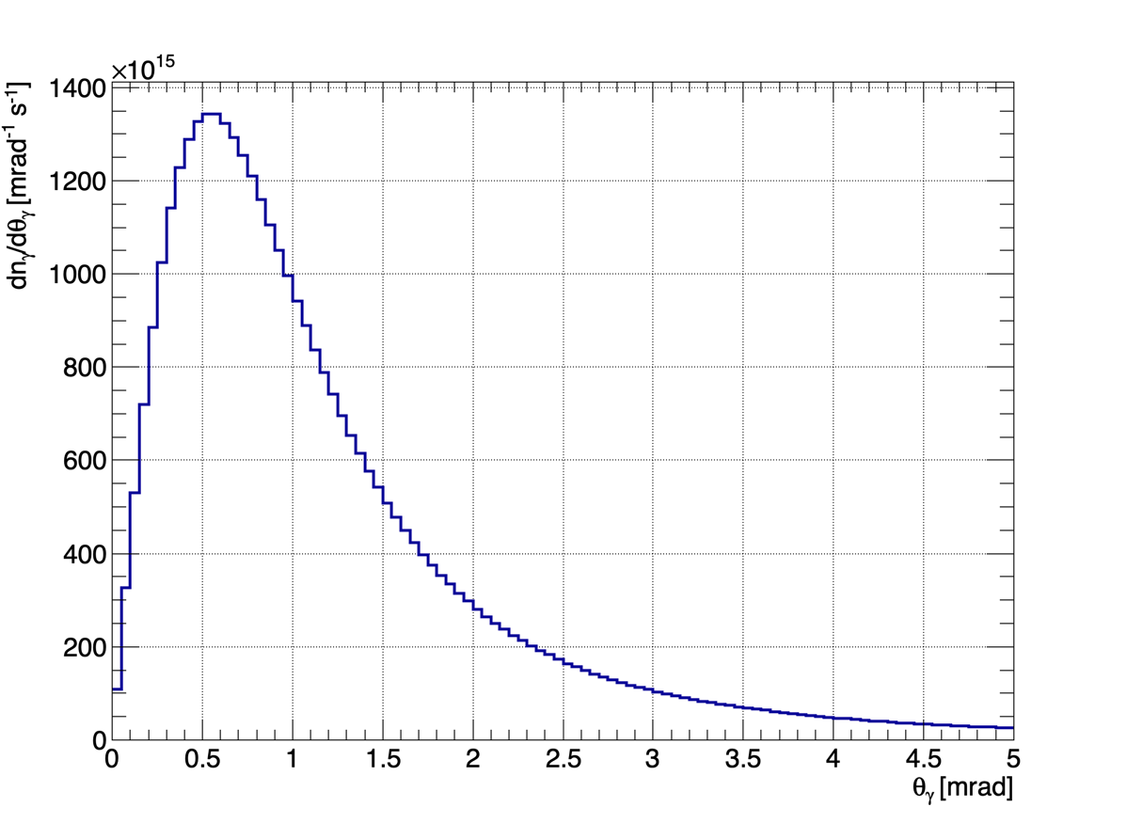
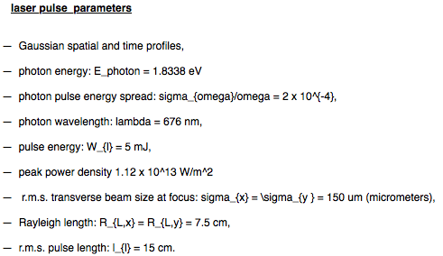
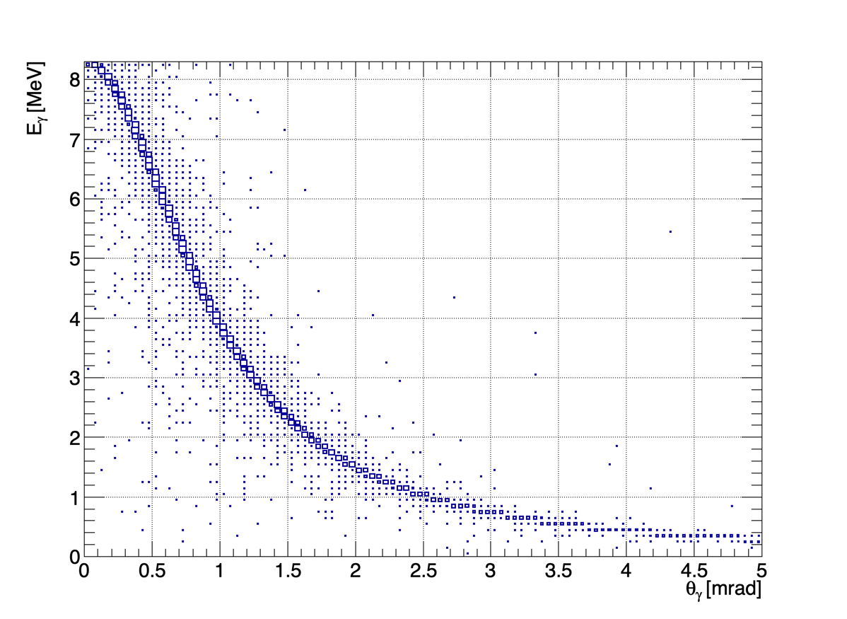
A concrete example: Nuclear physics application
He-like, LHC Calcium beam, (1s→2p)_{1/2} transition, Ti:Sa laser
Photon fluxes
6. Highly-collimated monochromatic γ−beams:
beam power is concentrated in a narrow angular region (facilitates beam extraction)
(E_{γ},Θ_{γ}) correlation can be used (collimation) to “monochromatise” the beam
GF@CERN:
dn_{γ}/dE_{γ} = 0.4–2.4 ✕ 10¹⁷ γ/MeV/s
Highest fluxes achieved so far – HIγS, Duke
HiγS: dn_{γ}/dE_{γ} = 2–5 ✕ 10⁸ γ/MeV/s
Beam divergence ~1/γ_{L}
Expected improvement – ELINP (2024?)
ELI-NP: dn_{γ}/dE_{γ} = 1–4 ✕ 10¹⁰ γ/MeV/s

Slide 11
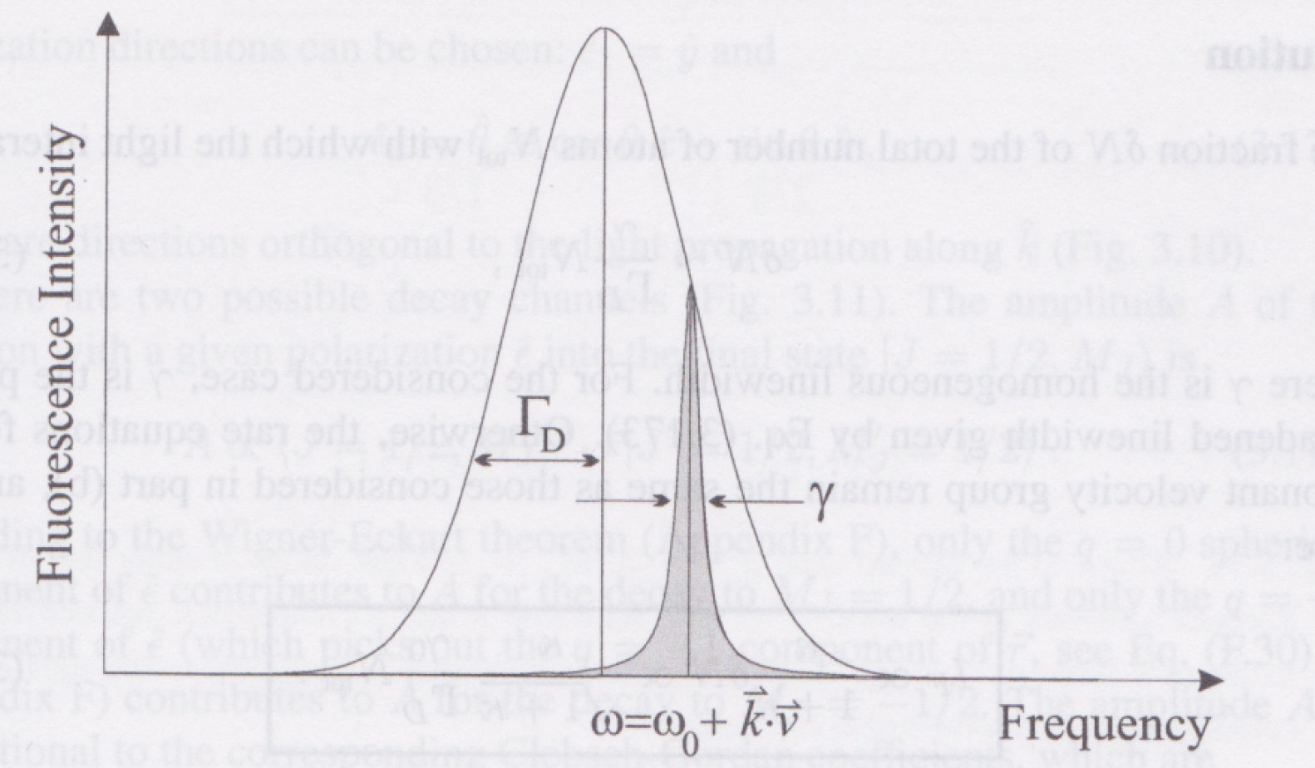



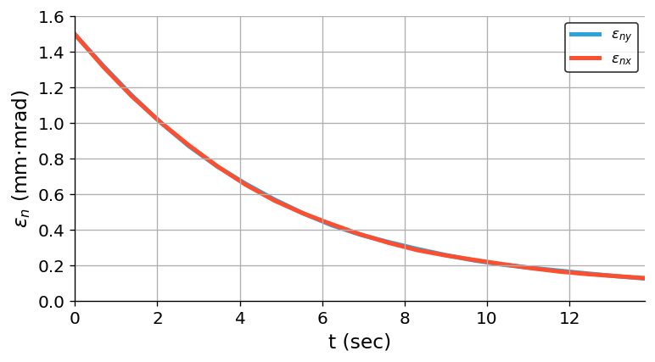
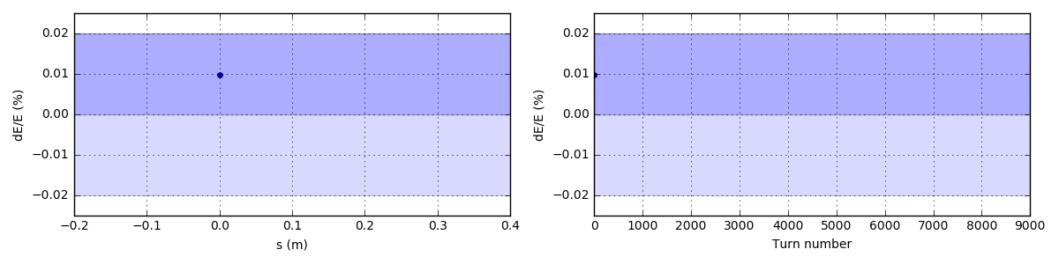
Laser cooling of atomic beams
γ = Δλ/λ (laser bandwidth)
Opens a possibility of forming at CERN high-energy hadronic bunches of the required longitudinal and transverse emittances and population (bunch merge + cooling) within a seconds-long time scale.
Two regimes:
γ > Γ_{D} – photon source
γ < Γ_{D} – laser cooling
ions absorbing laser photons
Bunch
σ_{x} = 0.8 mm, σ_{y} = 0.57 mm
σ_{z} = 10 cm, t_{pulse} = 2 ps
Θ_{coll} = 1.3 deg, Dx = 2.44 m
W = 2 mJ Ti:Sa laser pulses
Ion momentum profile, Δp/p (Γ_{D} ~ 10⁻⁴ at the LHC)
4.0 scatterings
per ion per turn
A. Petrenko
A. Petrenko
Beam cooling
The laser wavelength band is chosen such that only the ions moving in the laser-pulse direction (in the bunch-rest frame) can resonantly absorb photons.
Simulation of laser cooling of the lithium-like Ca¹⁷⁺ bunches in the SPS: transverse emittance evolution.

Slide 12
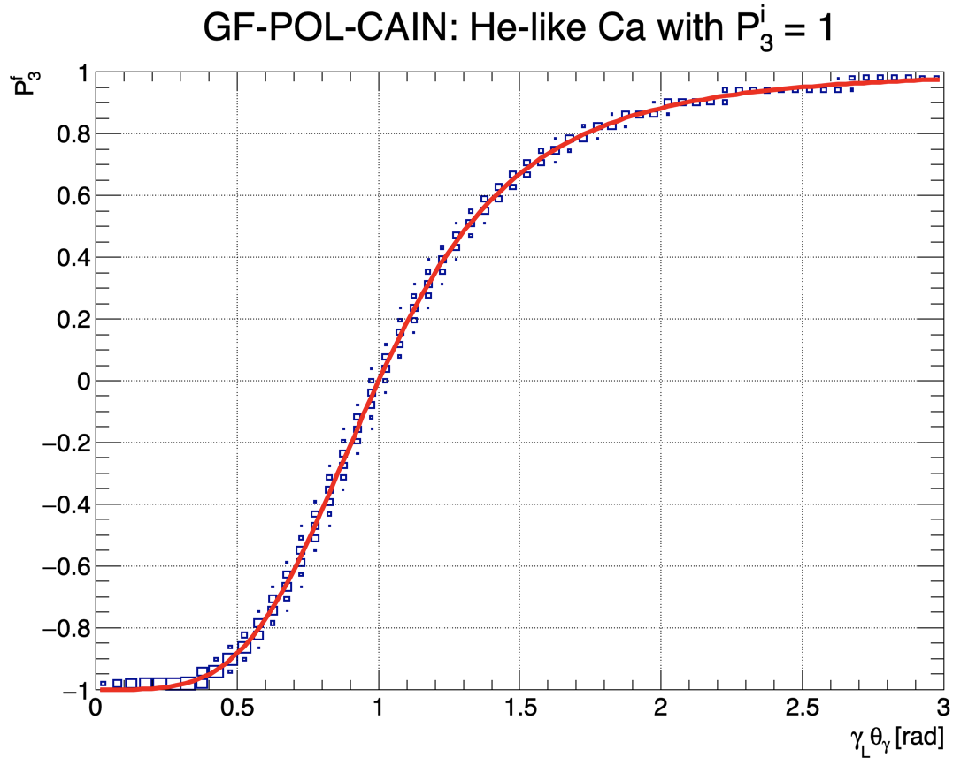
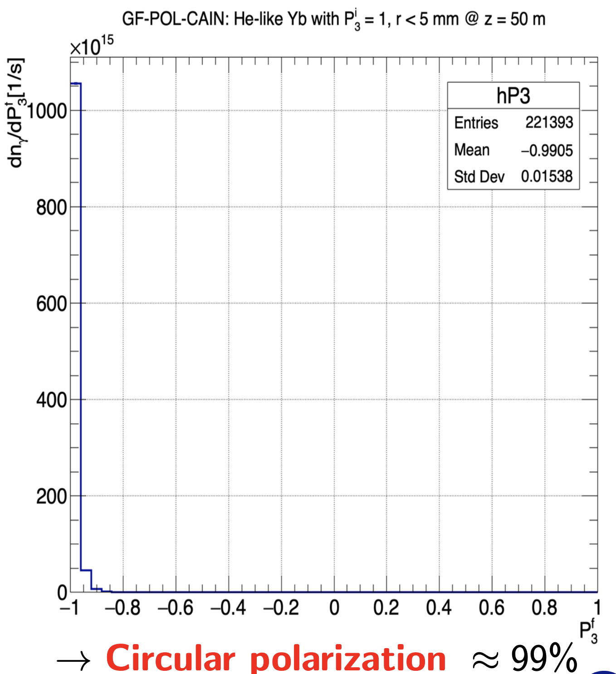
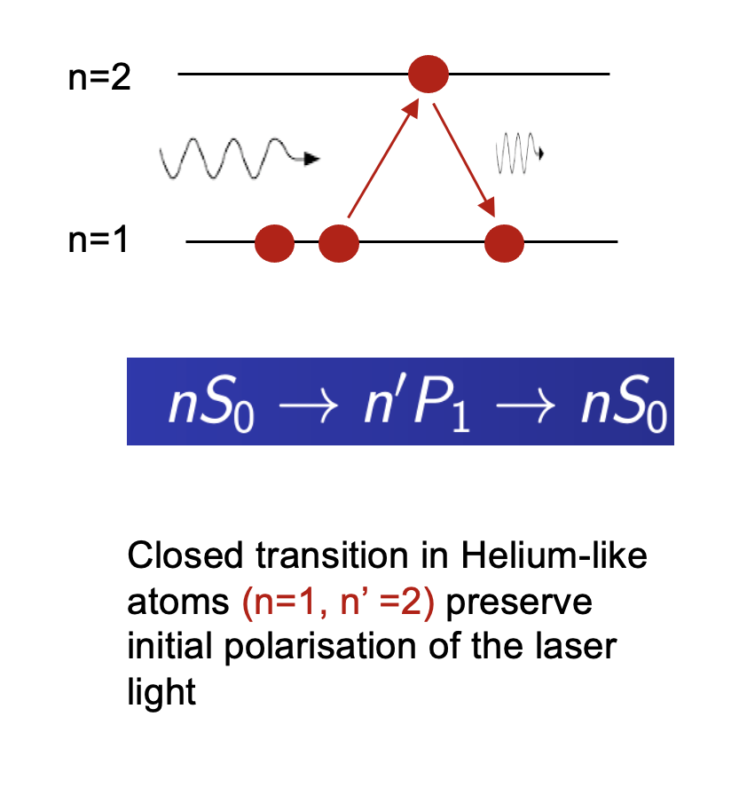
Polarised beams in GF – example:
He-like Calcium beam, Er:glass laser (1522 nm)
A trick: 1s² ¹S₀ → 1s¹2p¹ ¹P₁ transition in He-like atoms
Radial collimation:
R < 5 mm @ z = 50 m
For more details see presentations at Gamma Factory workshop: https://indico.cern.ch/event/1076086/

Slide 13
Tertiary beams’ sources – intensity/quality targets
Polarised positrons – potential gain of up to a factor of 10⁴ in intensity w.r.t. the KEK positron source, satisfying both the LEMMA (for muon collider) and the LHeC requirements; → Phys. Rev. Accel. Beams 26, 083401 (2023).
Pions – potential, gain by a factor of 10³, gain in the spectral density (d²N/dpdp_{T}) with respect to proton-beam-driven sources at KEK and FNAL → PRAB 26, 083401 (2023).
Muons – potential gain by a factor of 10³ in intensity w.r.t. the PSI (Villigen, Switzerland) muon source, charge symmetry (Nμ⁺ ~ Nμ⁻), polarisation control → PRAB 26, 083401 (2023).
Neutrinos – fluxes comparable to the proposed NuMAX (FNAL) but: (1) Very Narrow-Band Beam, driven by the small spectral density pion beam and (2) unique possibility of creating flavour and CP-tuned beams driven by the beams of polarised muons.
Neutrons – potential gain of up to a factor of 10⁴ in intensity of primary MeV-energy neutrons per 1 MW of the driver beam power.
Radioactive ions – potential gain of up to a factor of 10⁴ in intensity w.r.t. e.g. ALTO (Orsay).

Slide 14
Challenges

Slide 15
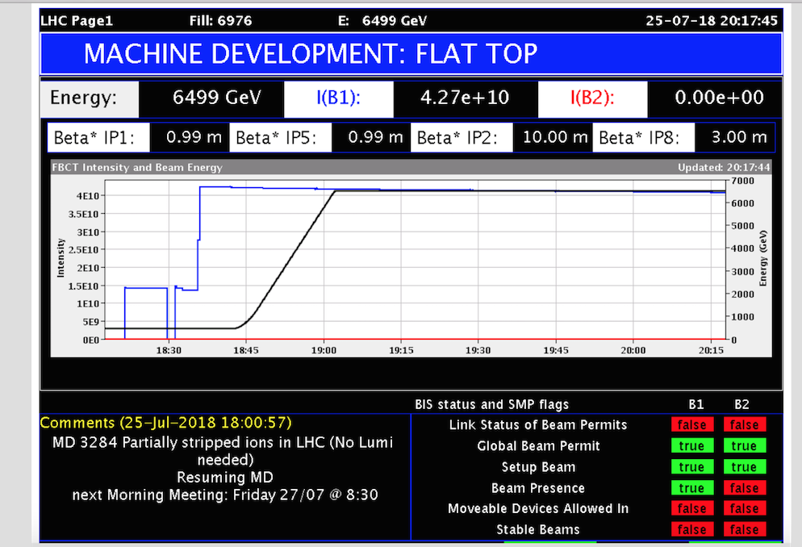
25 July 2018: successful production, injection, ramp and storage of the hydrogen-like lead beam in LHC!
M. Schaumann
Beam lifetime ~ 50 hours
Intensity/bunch (~ 7 x 10⁹), 6 bunches circulating.

Slide 16
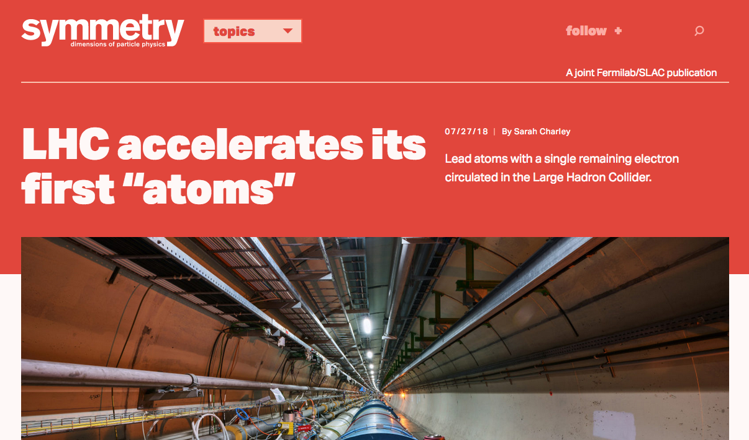

July 2018: Birth of Atomic Physics research at CERN
https://home.cern/about/updates/2018/07/lhc-accelerates-its-first-atoms
https://www.sciencealert.com/the-large-hadron-collider-just-successfully-accelerated-its-first-atoms
https://www.forbes.com/sites/meriameberboucha/2018/07/31/lhc-at-cern-accelerates-atoms-for-the-first-time/#36db60ae5cb4
https://www.livescience.com/63211-lhc-atoms-with-electrons-light-speed.html
https://interestingengineering.com/cerns-large-hadron-collider-accelerates-its-first-atoms
https://www.sciencenews.org/article/physicists-accelerate-atoms-large-hadron-collider-first-time
https://insights.globalspec.com/article/9461/the-lhc-successfully-accelerated-its-first-atoms
https://www.maxisciences.com/lhc/le-grand-collisionneur-de-hadrons-lhc-accomplit-une-grande-premiere_art41268.html
https://www.symmetrymagazine.org/article/lhc-accelerates-its-first-atoms
LHC po raz pierwszy przyspiesza „atomy”: https://www.ifj.edu.pl/aktualnosci/2018/18-07-31/

Slide 17
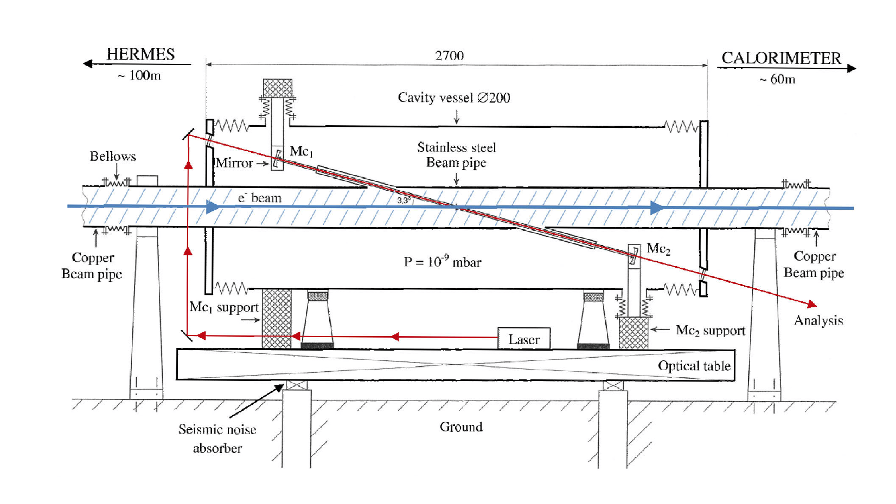
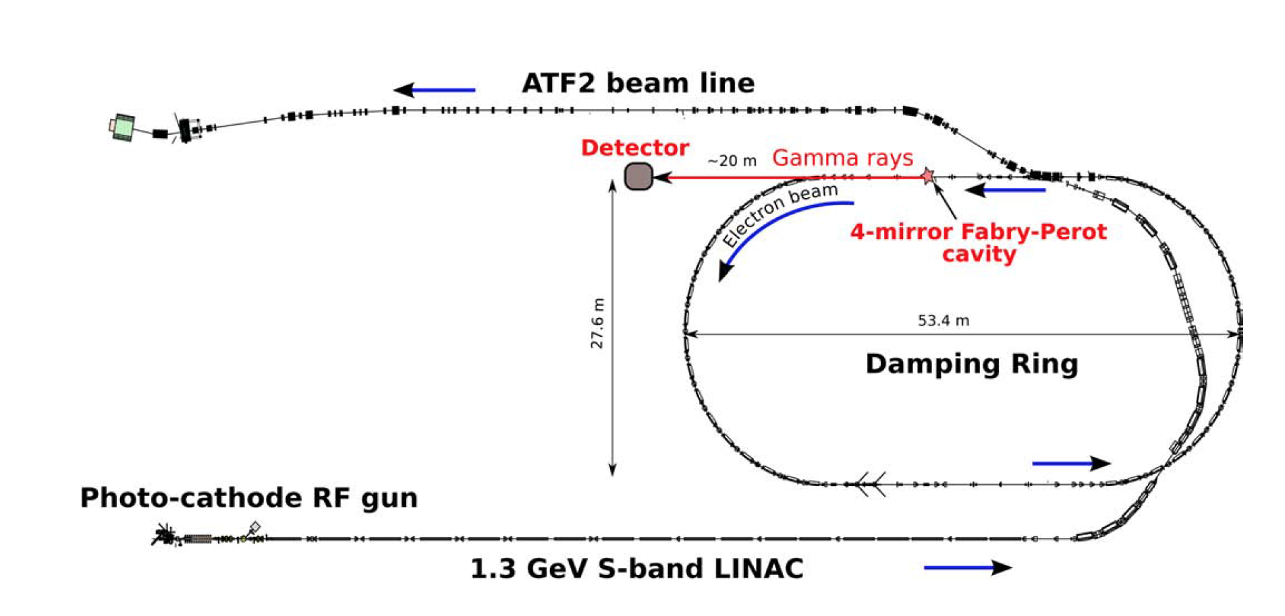
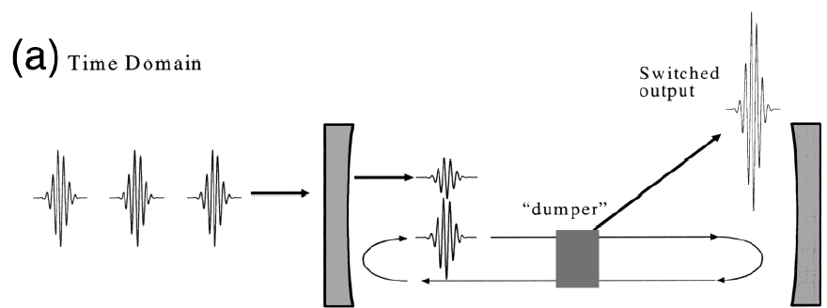
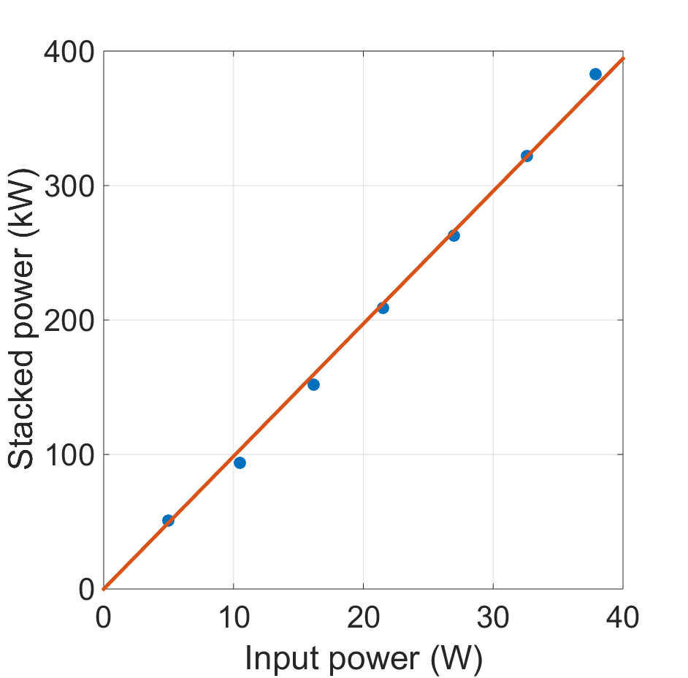
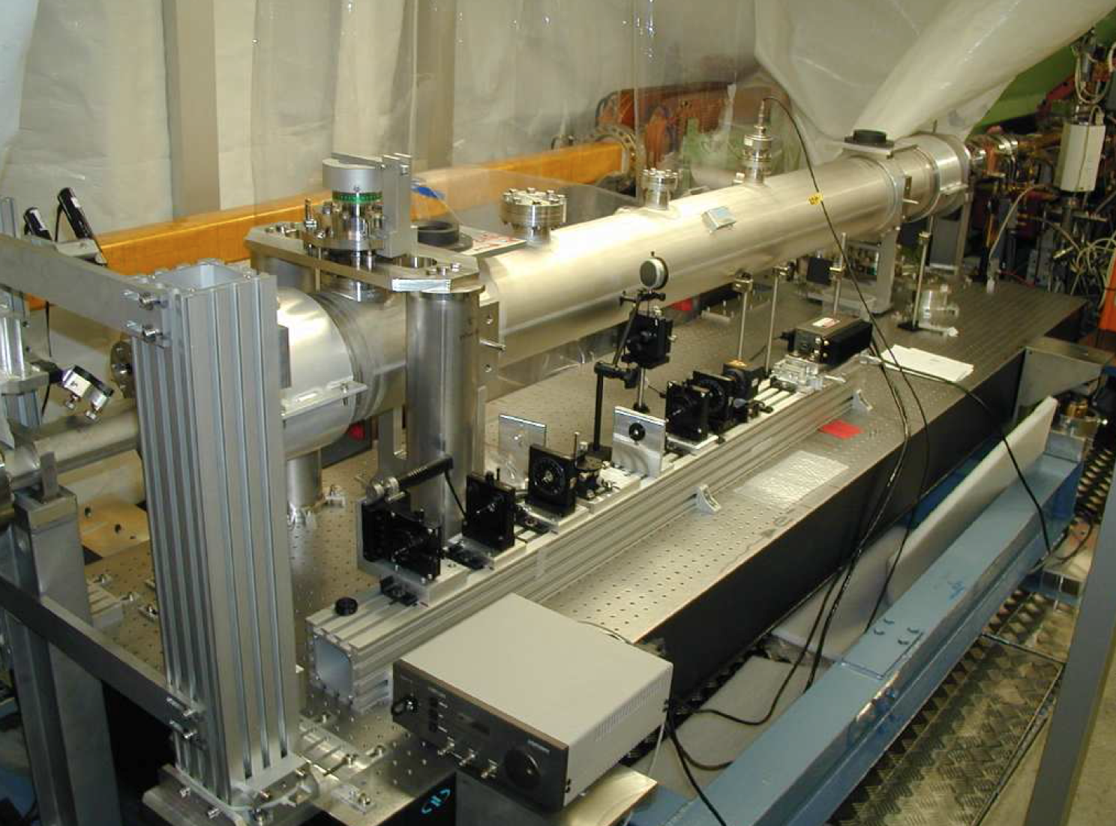
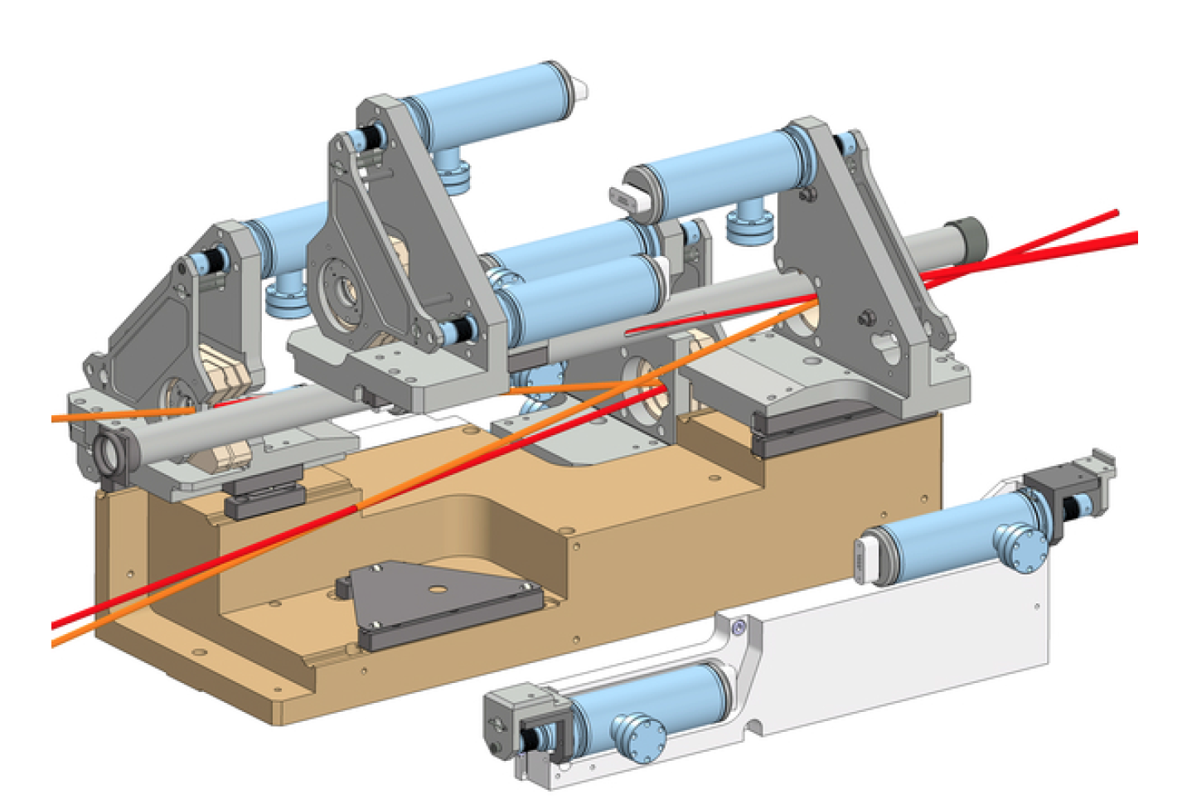
Fabry-Pérot resonator
Fabry-Pérot (FP) resonators
and their integration in the electron storage rings
HERA storage ring
KEK – ATF ring
mirror
mirror
~10¹⁶ ph/bunch
Laser pulses
Amoudry L. et al., Applied Optics 59(2020)116
100 W amplifiers are
commercial systems
GF requirement:
~ 5 mJ pulses @ 40 MHz, (200 kW photon beam)
Towards the first integration of the FP resonator in the hadron storage ring →

Slide 18
Proof of Principle

Slide 19
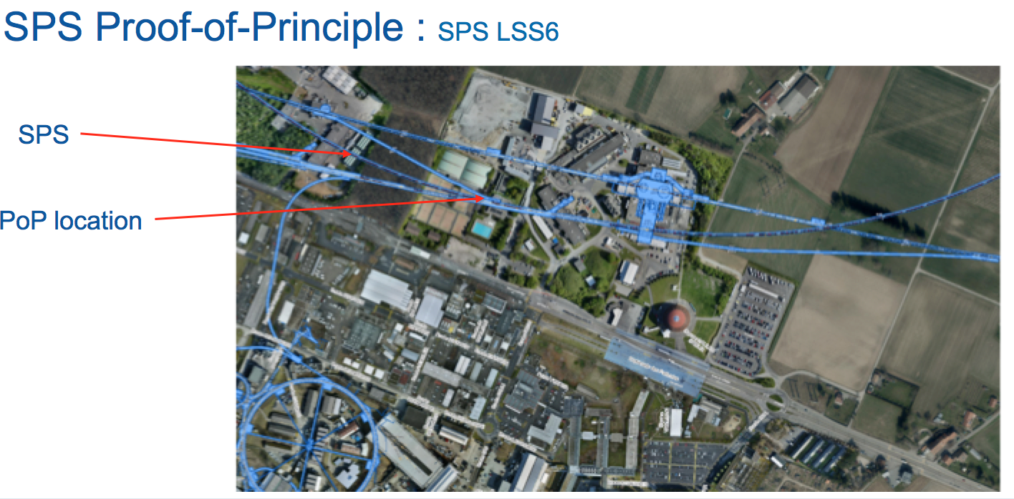
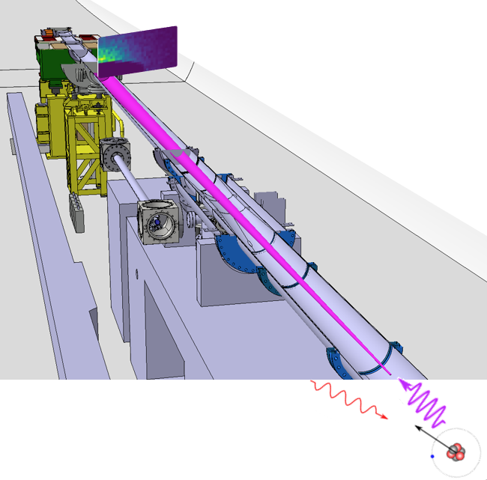
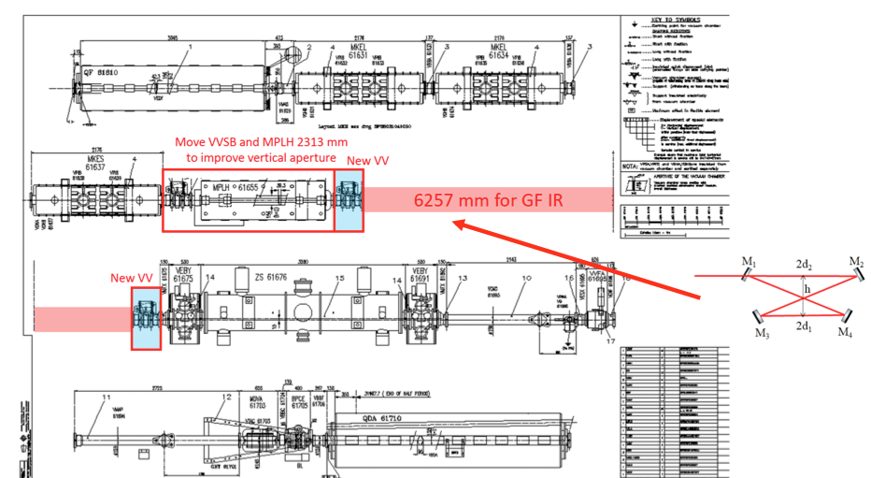
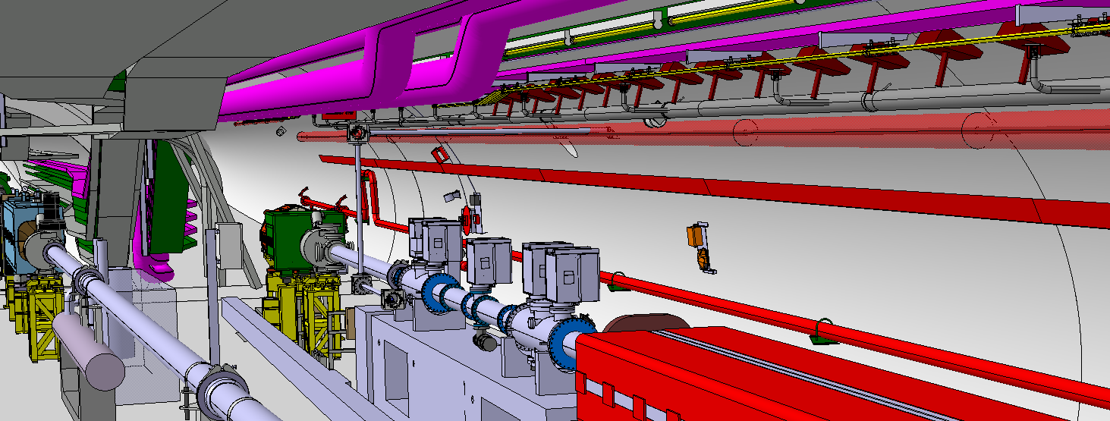
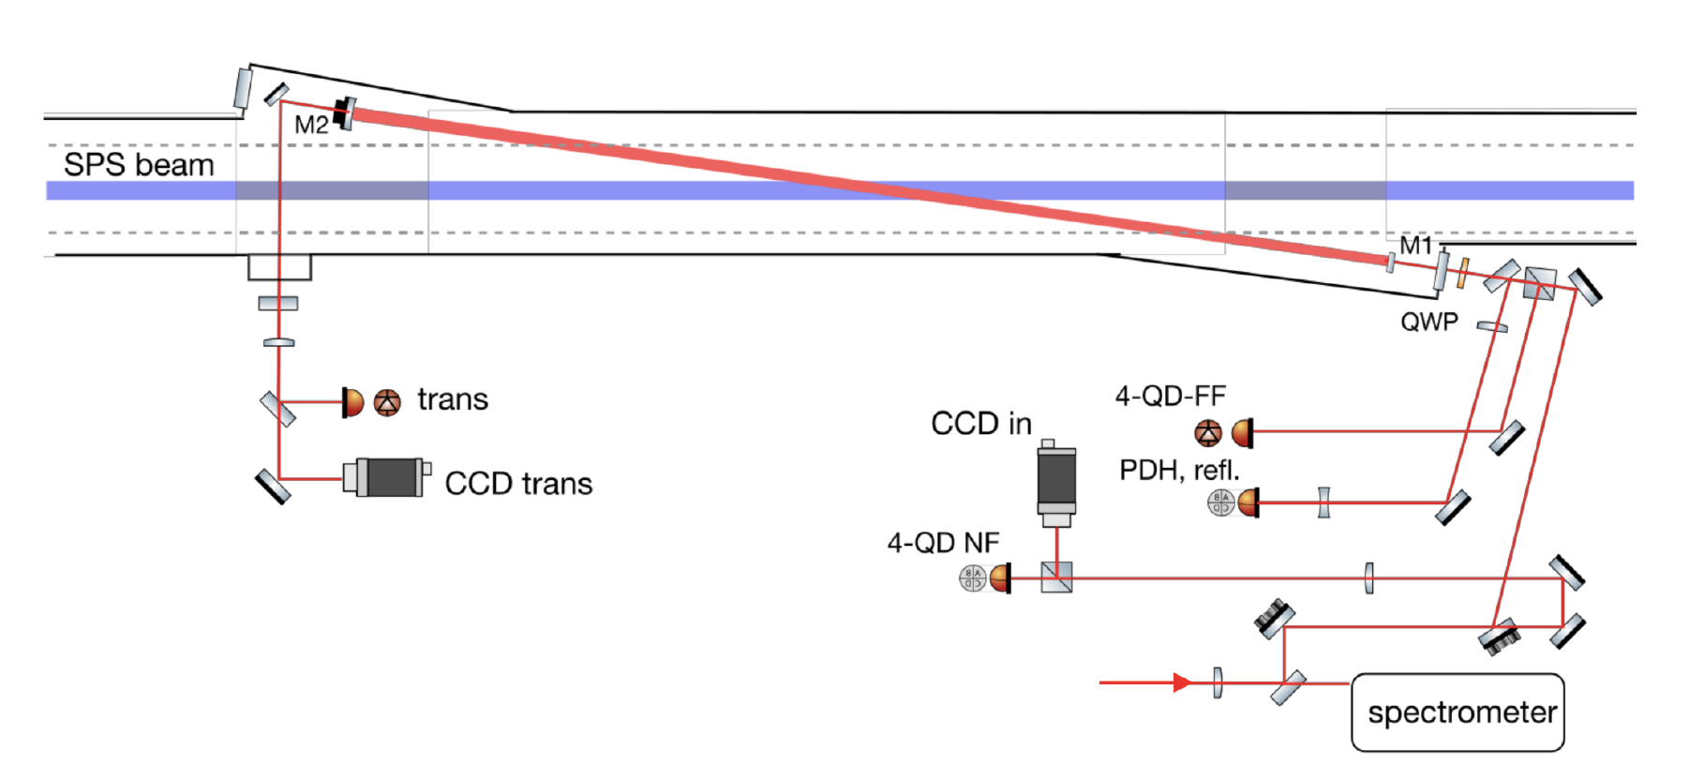
Gamma Factory Proof-of-Principle (PoP) SPS experiment
Detection of produced
X-rays in resonant
excitation of the
(2s → 2p)_{1/2}
transition
Lithium-like lead ion bunches in the SPS
SPS half-cell 621 with side tunnel TI18
LSS6 zone
F-P cavity – “in beam” position
F-P cavity
F-P cavity length: 3.75 m – vertically tilted by 2.6 deg

Slide 20
Purpose of GF SPS PoP experiment
1
5
Demonstrate ion beam cooling: longitudinal, and then transverse.
6
New atomic physics measurements.
4
2
3
Demonstrate stable and repeatable operation.
Confront data and simulations.
Demonstrate that an adequate laser system (5 mJ @ 40 MHz) can be (remotely) operated in the high-radiation field of the SPS.
Demonstrate that very high rates of photons are produced: almost all ions are excited in a single collision of a PSI bunch with a laser pulse.
Estimated cost of the experiment: 2.5 MCHF

Slide 21

PoP experiment status
As received from the SPSC referees on Oct. 20th, 2020:
«The SPSC recognizes the Gamma Factory's potential to create a novel research tool, which may open the prospects for new research opportunities in a broad domain of basic and applied science at the LHC.»
«The SPSC recognizes the GF-PoP experiment as a path finder in the GF R&D process. The SPSC … looks forward to further details of how the GF proto-collaboration intends to deliver this programme.»
We are in the process of signing the GF-PoP MoU by collaborating institutes.
In parallel, we are finalising a detailed estimation of the CERN (BE, SY and EN departments) and participating labs resources needed to construct and operate the PoP experiment in the SPS tunnel.
Target installation time: LS3 (2026–2027).

Slide 22
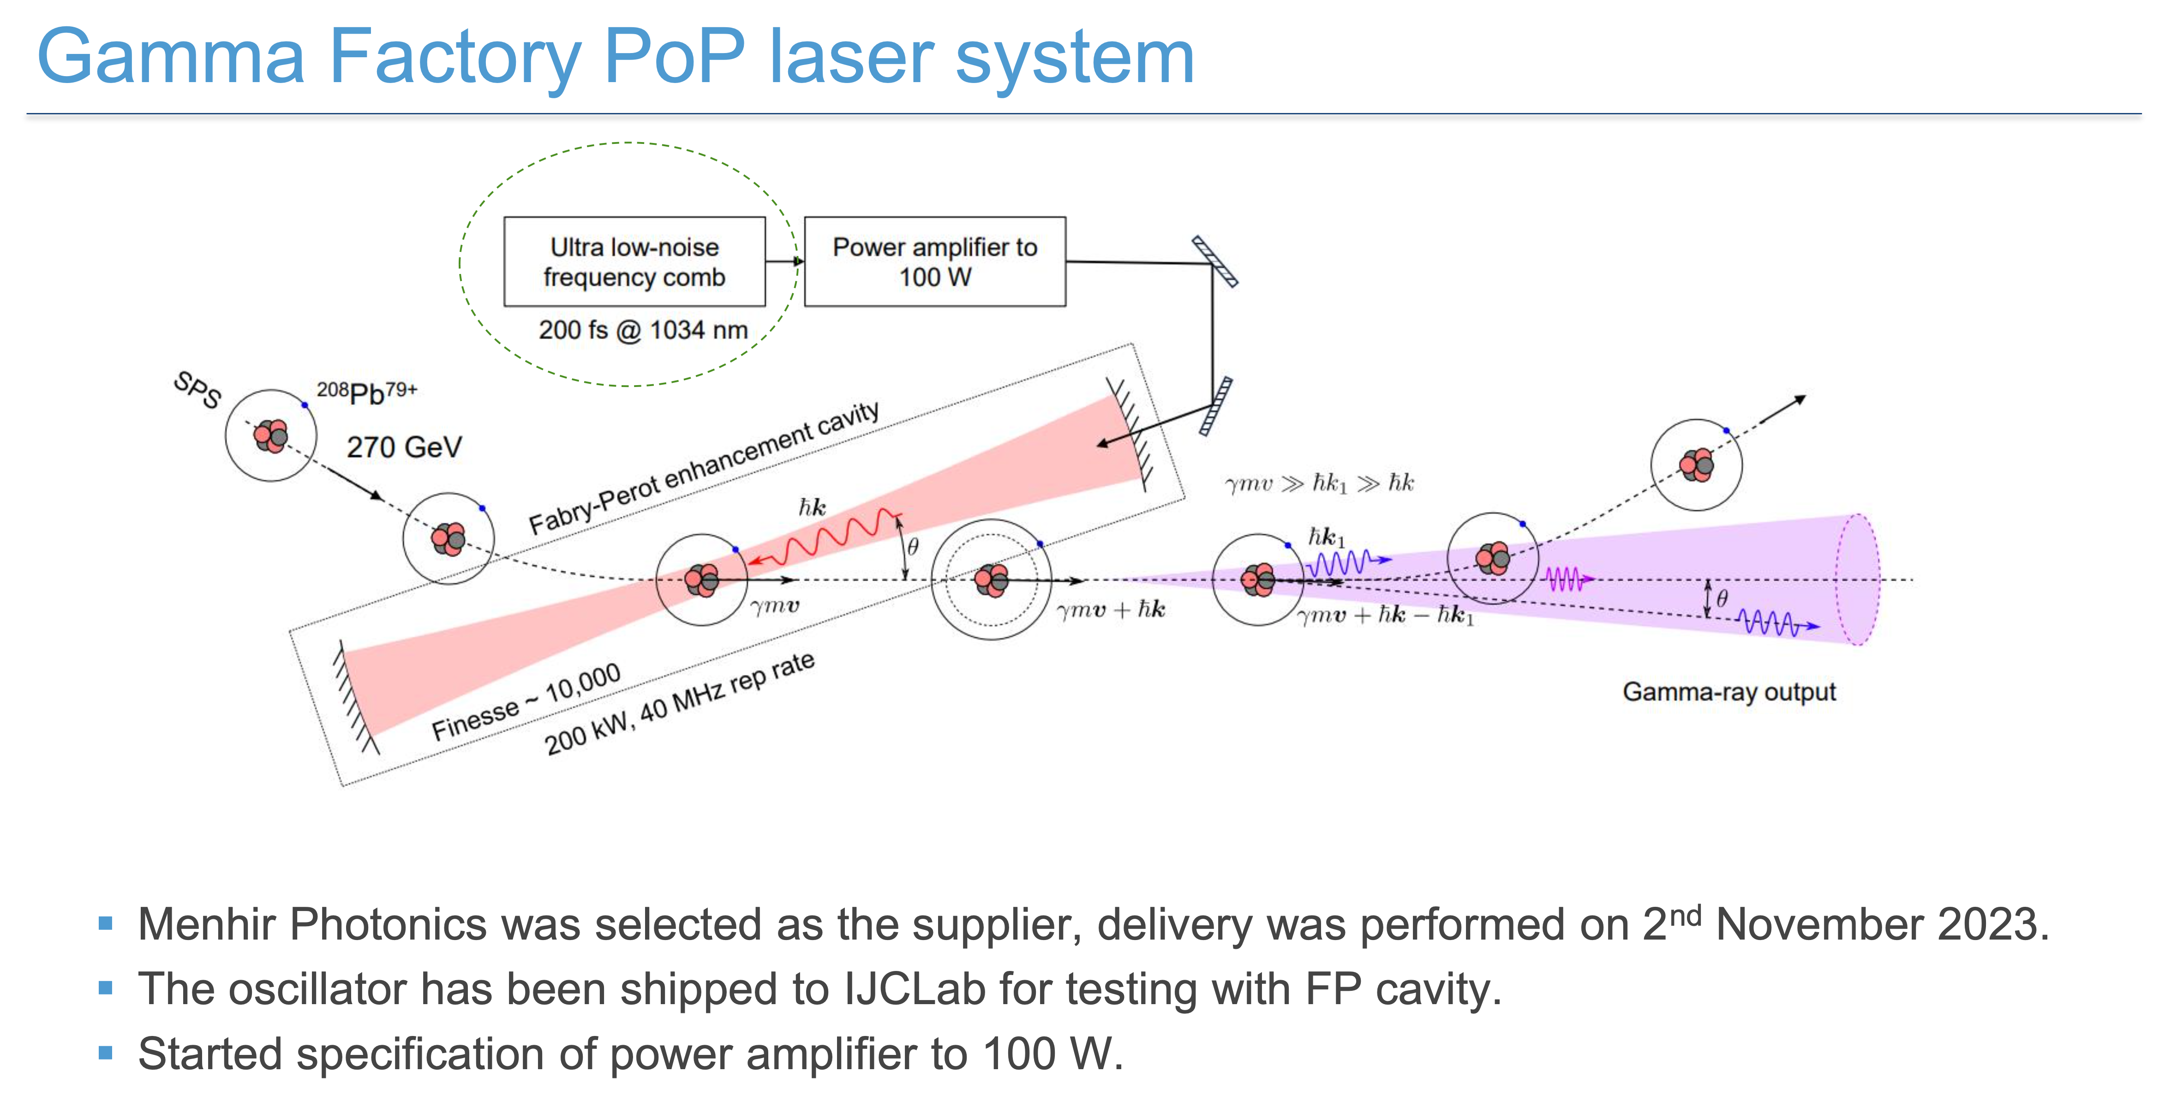
Recent news
E. Granados, GF PoP meeting, 14 Nov. 2023

Slide 23
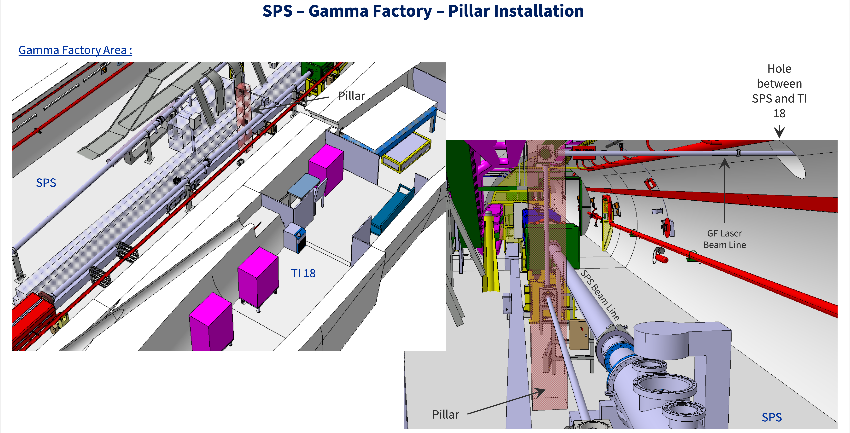
Plans for YETS 2023-2024

Slide 24
Possibilities

Slide 25
Examples of potential applications domains of
the Gamma Factory research tools
Particle physics: precision QED and EW studies, vacuum birefringence, Higgs physics in γγ collision mode with laser-cooled ion beams, rare muon decays, precision neutrino physics, QCD-confinement studies, …
Nuclear physics: nuclear spectroscopy, cross-talk of nuclear and atomic processes, GDR, nuclear photo-physics, photo-fission research, gamma polarimetry, physics of rare radioactive nuclides,…
Atomic physics: highly charged atoms, electronic, muonic, pionic and kaonic atoms, …
Astrophysics: dark matter searches, gravitational waves detection, gravitational effects of cold particle beams, ¹⁶O(γ,α)¹²C reaction and S-factors …
Fundamental physics: studies of the basic symmetries of the universe, atomic interferometry, …
Accelerator physics: beam cooling techniques, low-emittance hadronic beams, plasma wake field acceleration, high-intensity polarised positron and muon sources, beams of radioactive ions and neutrons, very narrow band and flavour-tagged neutrino beams, neutron sources, …;
Applied physics: accelerator driven energy sources, nuclear fusion research, medical isotope and isomer production, …

Slide 26
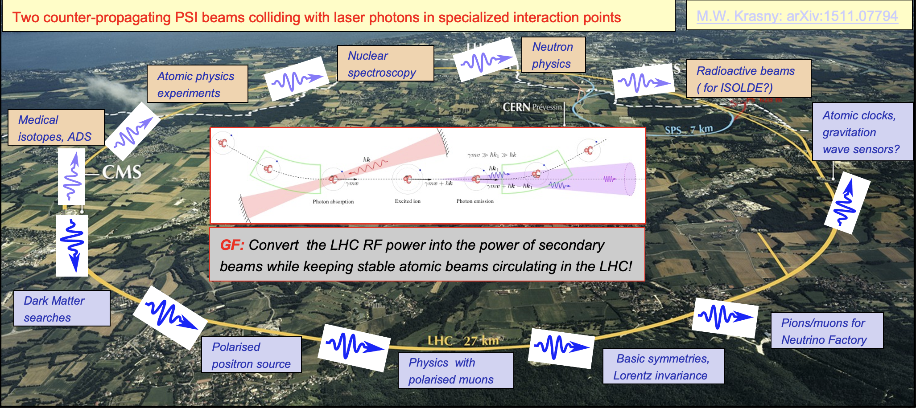
  “A dream” vision of the LHC operation in post-HL-LHC phase (in ~20 years?)

Slide 27

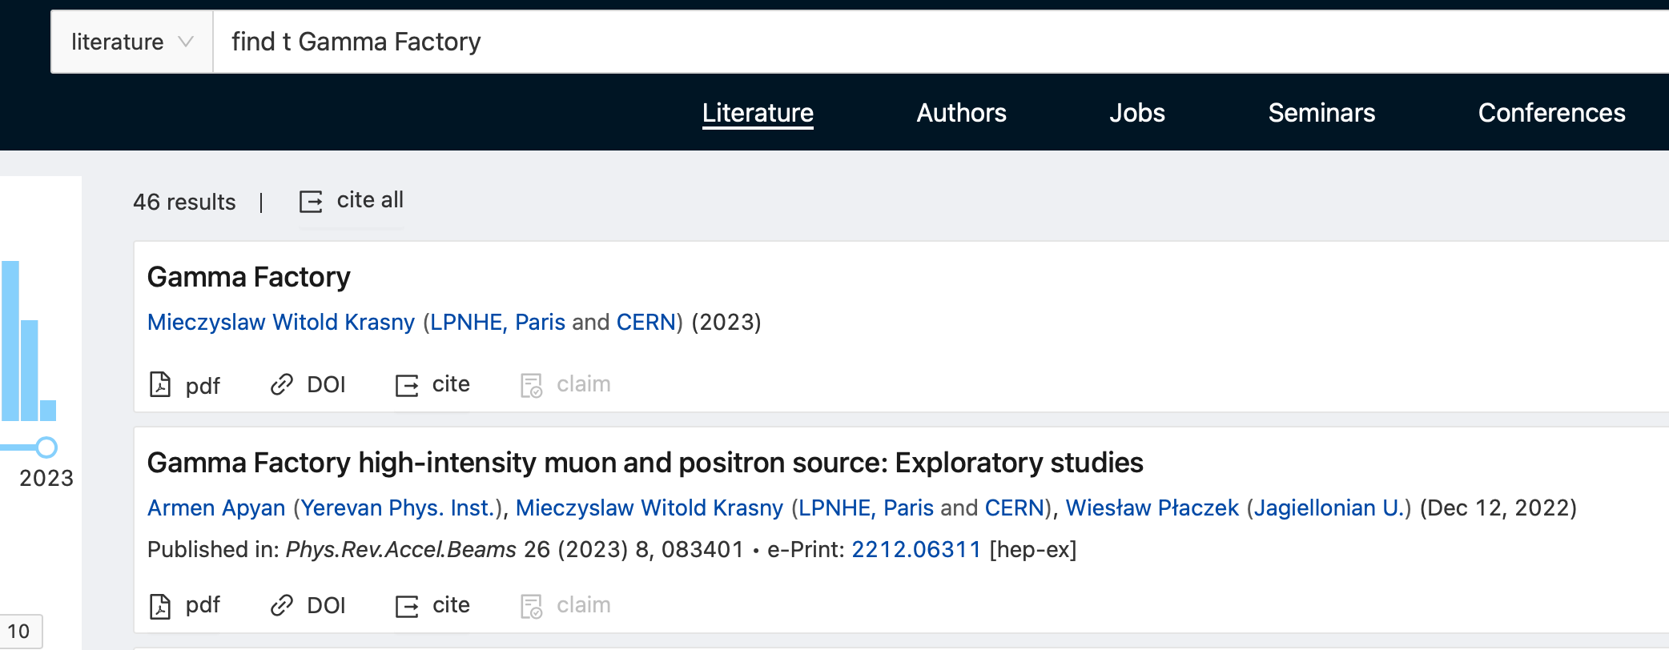


GF studies: recently published papers

Slide 28
Conclusions

Slide 29
A potential place of the Gamma Factory (GF) in the future CERN research programme
The next CERN high-energy frontier project may take long time to be approved, built and become operational (if ever), … unlikely before 2050?.
The present LHC research programme will probably reach earlier (late 2030’s?) its discovery saturation (little physics gain by simple extending its pp/pA/AA running time).
A strong need will certainly arise for a novel multidisciplinary programme which could re-use (“co-use”) the existing CERN facilities (including LHC) in ways and at levels that were not necessarily thought of when the machines were designed.
The Gamma Factory research programme (2035-????) could fulfil such a role. It can exploit the existing world unique opportunities offered by the CERN accelerator complex and CERN’s scientific infrastructure (not available elsewhere) to conduct new, diverse and vibrant research in particle, nuclear, atomic, fundamental and applied physics with novel research tools and methods.

Slide 30

Potential Gamma Factory role in the incremental, sustainable and multi-disciplinary development of the research infrastructure at CERN
M.W. Krasny, CERN-PBC workshop, November 2022
SPS injectors
GF-photon beam driven
200–300 MW
energy source
Dark matter
search
Multidisciplinary
Gamma Factory
research programme
μ-collider
p,A
SPS fixed target programme
SPS
tunnel
PSI = Partially Stripped Ions
μ⁻
μ⁺
Muon programme
Laser
cooling
LHC
tunnel
μ –based ν-factory
e⁻
e⁺
40(60) GeV ERL?
5 GeV Linac
e⁺
μ⁻
μ⁺
μ⁻
Gamma Factory could provide:
Cold, low-emittance hadronic beam for the ultimate luminosity hadron collider.
High-intensity muon source (> 10¹³ μ/s).
Polarised positron source (> 10¹⁶ e⁺/s) for the LEMMA-scheme muon collider.
~ 10 MW driver beam for the ADS energy source (under study).
LEMMA
target
μ⁺
e⁻
e⁺
“cold” PSI beam
Stripper
FCC-ee
FCC
tunnel
FCC-hh
Low-emittance
“cold” hadron beam

Slide 31
BACKUP SLIDES

Slide 32
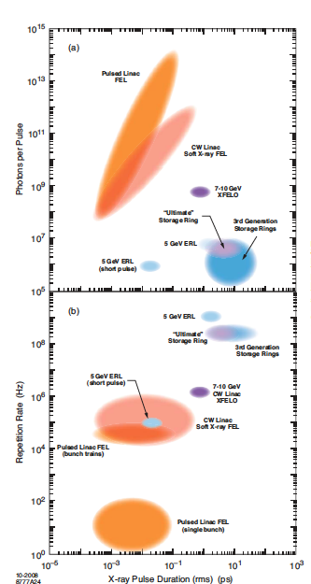
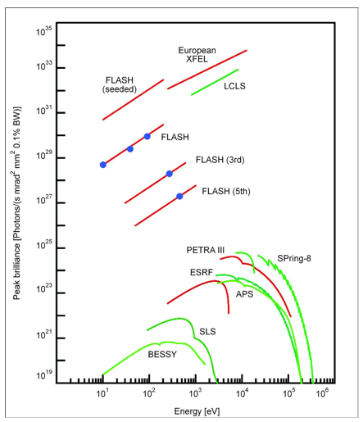
Photon sources: X-rays
100 keV
Energies up to ~ 100 keV
Intensities up to ~ 10¹⁶ photons/s

Slide 33
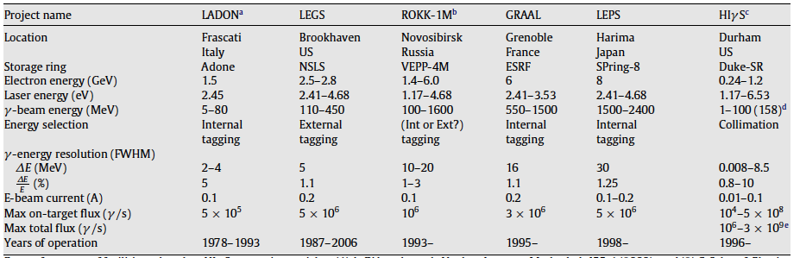
Photon sources: γ-rays
Intensities up to ~ 10⁹ photons/s

Slide 34
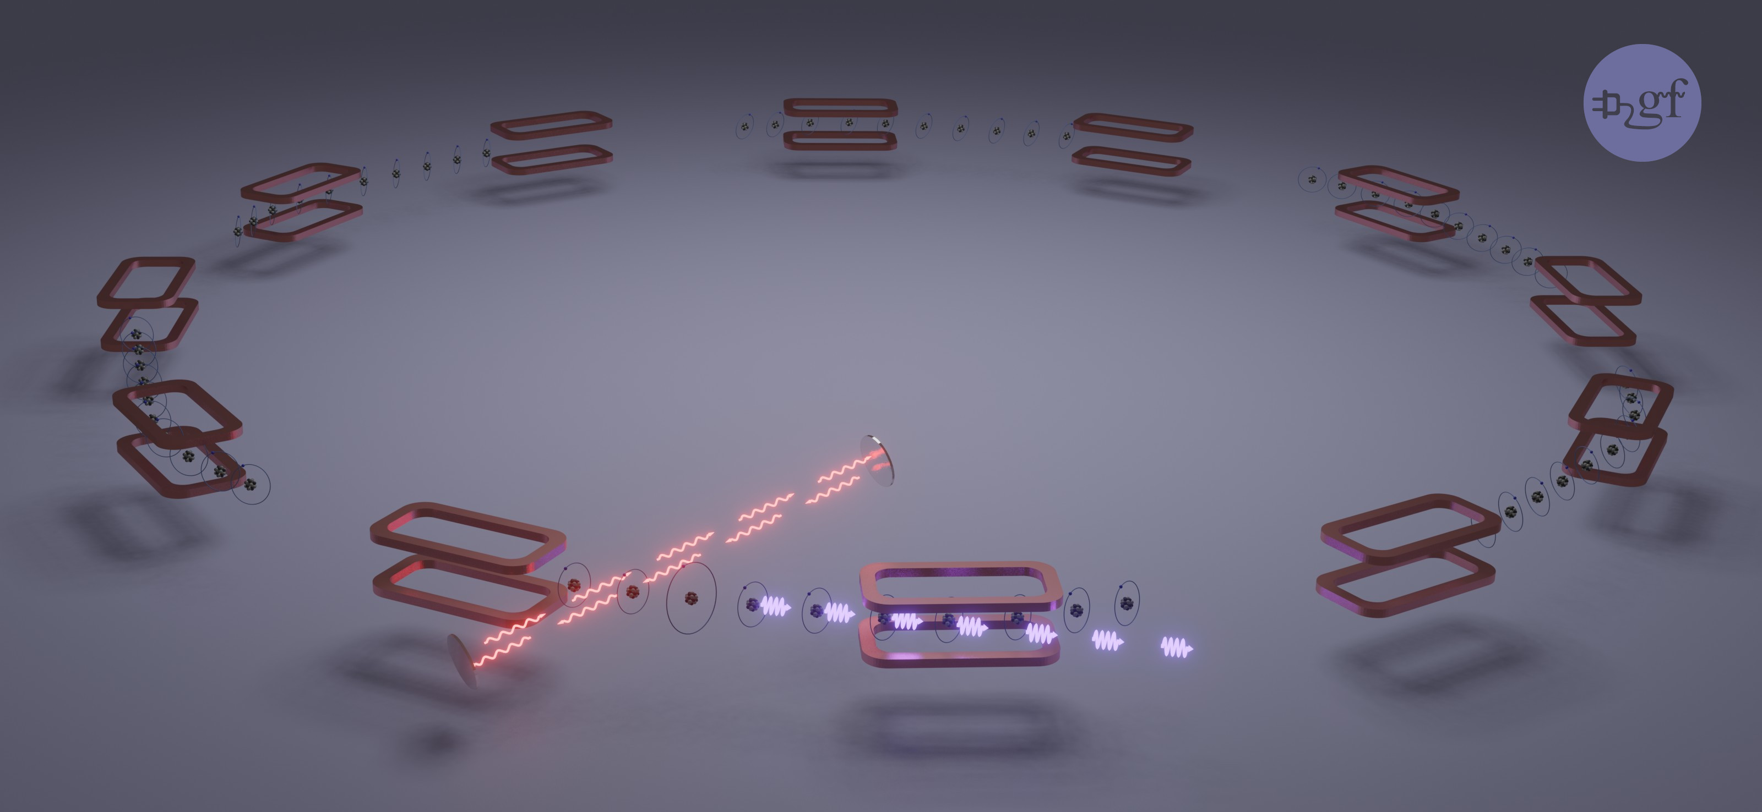
Gamma Factory photon source: intensity leap
Requirements: Accelerated bunches of ~10⁸–10⁹ partially stripped atoms, delivered with ~20 MHz frequency, ~5 mJ laser photon pulses stacked in 20 MHz, Fabry-Perot resonator
Stored atomic
beams
FP resonator
Laser photons
Gamma Factory photons
Novel technology:
Resonant scattering of laser photons on ultra-relativistic atomic beam

Slide 35
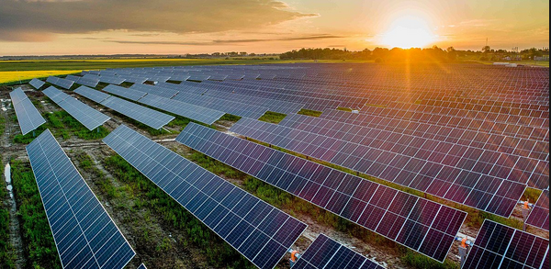
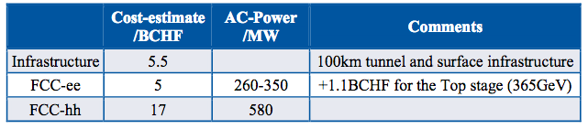
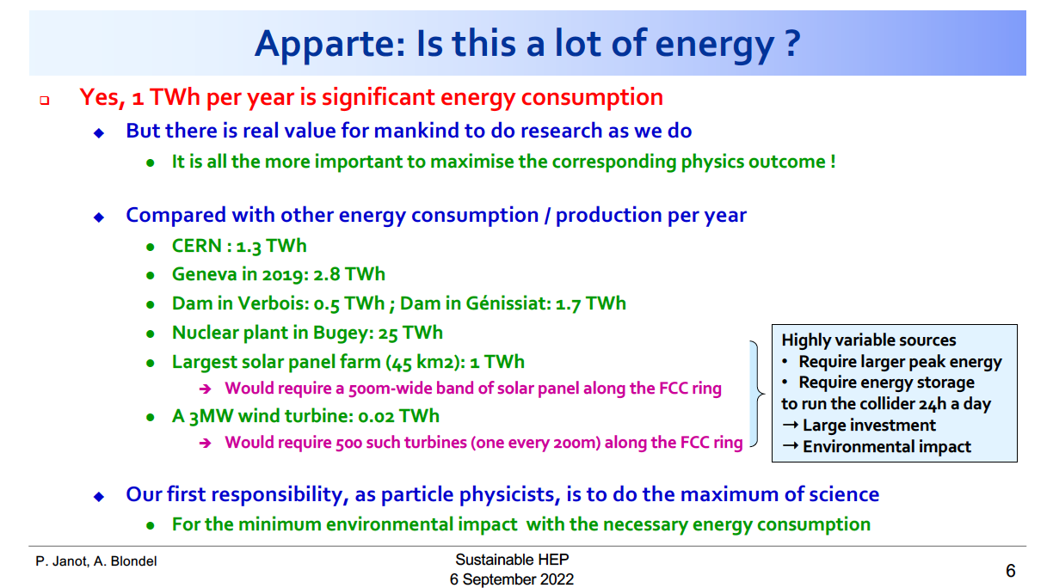
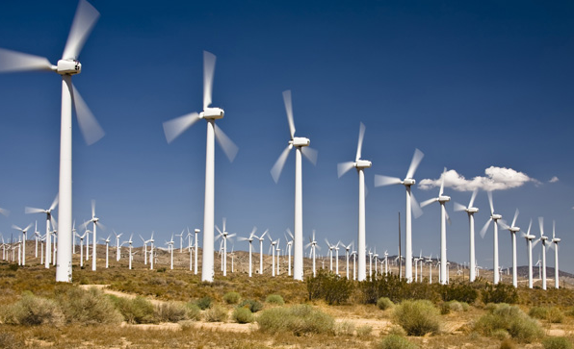
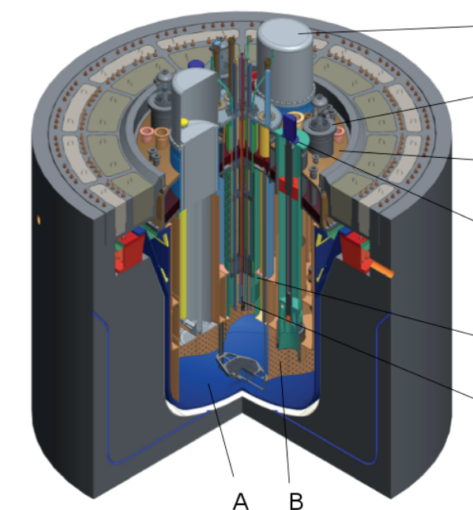

High intensity (MW) photon beams
Best use of the CERN expertise to produce rather than buy the plug-power:
GF photon-beam-driven energy source (ADS)
Satisfying three conditions;
requisite power for the present and future CERN scientific programme
operation safety (a subcritical reactor)
efficient transmutation of the nuclear waste (very important societal impact if demonstrated at CERN – given its reputation )
P. JANOT
P. JANOT

Slide 36
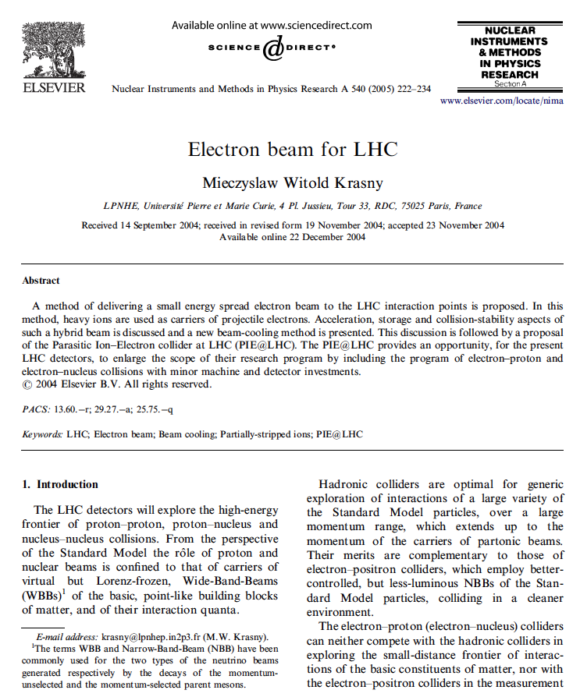
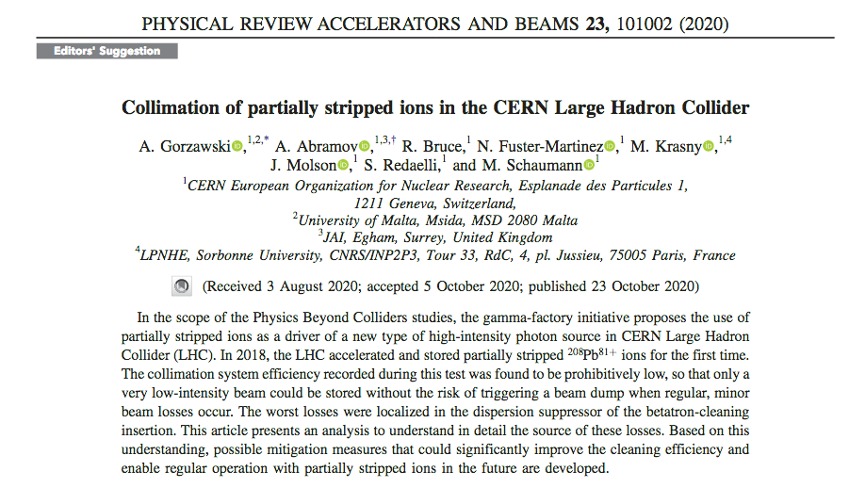
Electron beam for ep collisions at LHC
(in the ATLAS, CMS, ALICE and LHCb interaction points)
Hydrogen-like lead
Opens the possibility of collecting by each of the LHC detectors over one day of the Pb⁸¹⁺–p operation the effective ep-collision luminosity comparable to the HERA integrated luminosity in the first year of its operation (1992) – in-situ diagnostic of the emittance of partonic beams at the LHC!
E_{CM} ~ 200 GeV
p
e
average distance of the
electron to the lead nucleus
d ~ 600 fm
(sizeably higher than the range
of strong interactions)
…or
Z
E_{CM} ~ 8.8 TeV
Initial studies:
p
Recent development:
Atomic beams can be considered as independent electron
and nuclear beams as long as the incoming proton scatters
with the momentum transfer q >> 300 KeV!

Slide 37
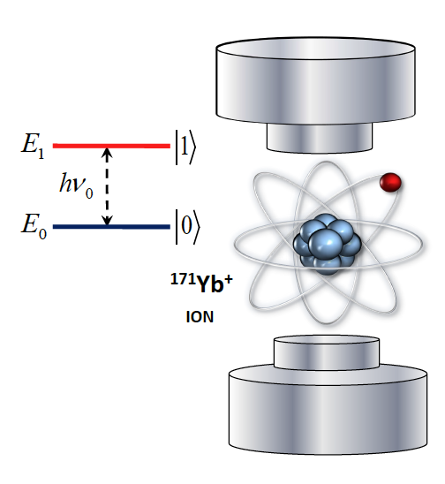



Atomic traps of highly-charged “small-size” atoms
Opening new research opportunities in atomic physics:
Highly-charged atoms – very strong (~10¹⁶ V/cm) electric field (QED-vacuum effects)
Small size atoms (electroweak effects)
Hydrogen-like and helium-like atomic structure
(calculation precision and simplicity)
Atomic degrees of freedom of trapped highly-charged ions can be resonantly excited by lasers
Atomic rest-frame
Trapped stationary atoms
exposed to pulsed magnetic
and electric fields of the storage
ring
Crystalline beams?

Slide 38


Gamma Factory twisted photons

