Slide 1
Precision calculation of dark matter relic abundance produced out-of-kinetic equilibrium Shiuli Chatterjee NCBJ, Warszawa
based on ongoing work with Andrzej Hryczuk
Polish Particle And Nuclear Theory Summit (2pints) Meeting November 23rd, 2023

Slide 2
Outline
Recap of the standard calculation of Dark Matter (DM) abundance in a freeze-out process, starting from the Boltzmann equation
How does one calculate the freeze-out relic abundance of DM out of kinetic equilibrium
Solution of the Boltzmann equation at phase space level: challenges and existing solutions
Fokker Planck approximation: domain of applicability
Discussion of and results for when Fokker Planck approximation fails
highlight underlying assumption: DM temperature = SM temperature (ie. kinetic equilibrium)
No kinetic equilibrium at freeze-out
DM is not self-thermalized around freeze-out
expanding in small momentum transfer, more tractable form of Boltzmann equation

Slide 3
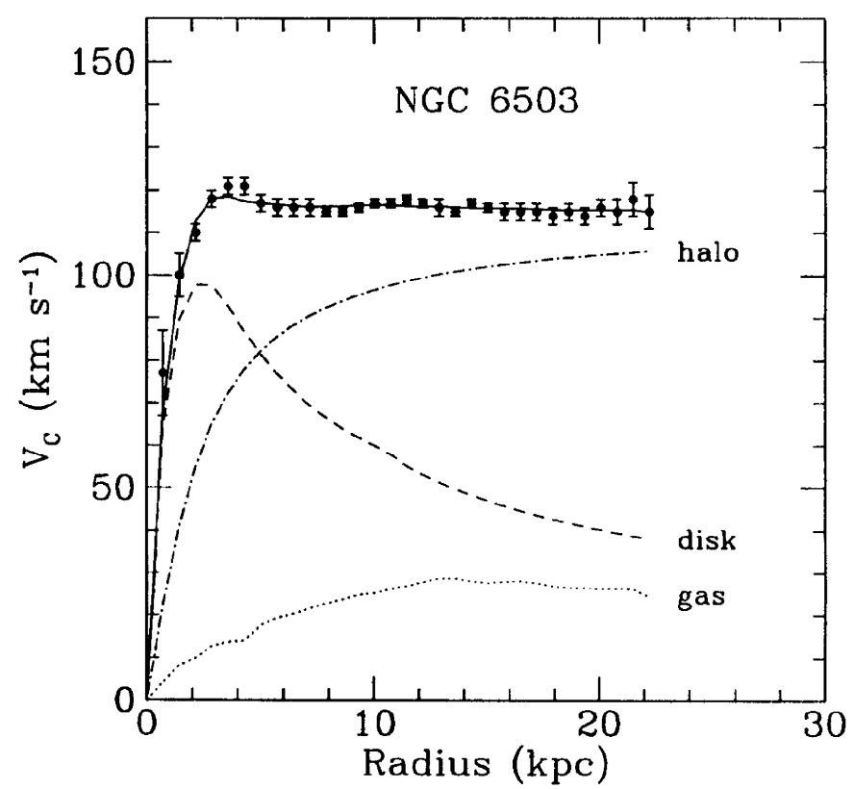
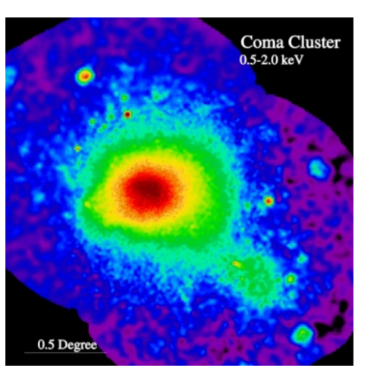
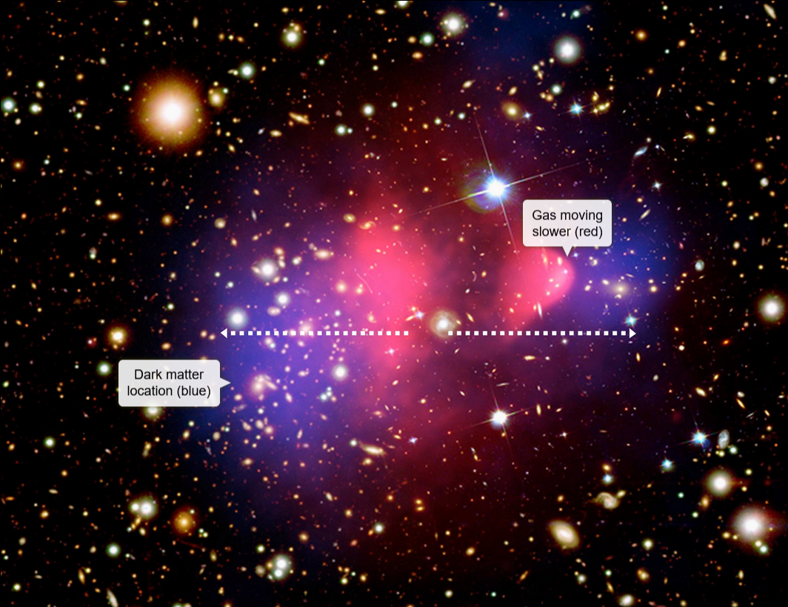
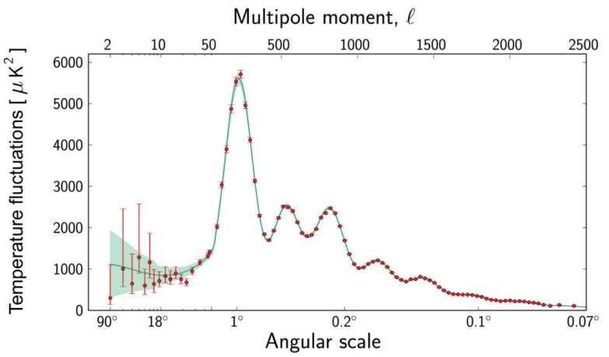
Dark Matter IS
Begeman et al 1991
STSI, Bullet cluster
$O(10)$ kpc
$O(100)$ kpc
$O(10)$ Mpc
$Ω_{c}h^{2}=0.1198±0.0012$
cosmological scale
Freese 2017; Planck 2015

Slide 4
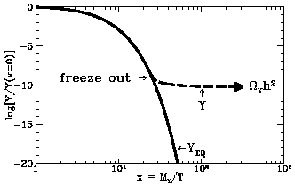
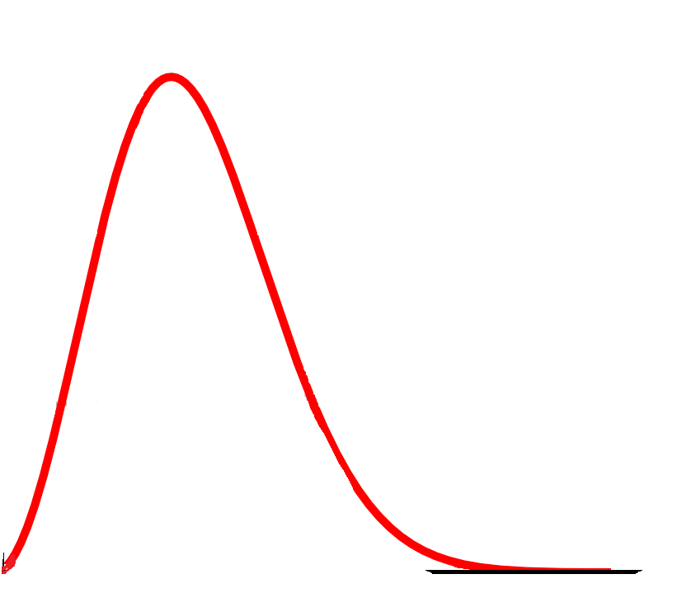
Production of DM by freeze-out
Dark matter relic density measurement from the CMB is a well-measured quantity
$Ω_{c}h^{2}=0.1198±0.0012$ PLANCK 2018
Canonical WIMP: production of observed DM abundance from freeze-out
and is essentially an exercise in solving the Boltzmann equation
$$L\left[f_{DM}\right]=C\left[f_{DM}\right]$$
$∂_{t}f_{DM}−Hp∂_{p}f_{DM}=C_{el}\left[f_{DM}\right]+C_{ann}[f_{DM}]$
$$\dot{n}+3Hn=−⟨σv⟩(n^{2}−n_{eq}^{2})$$
Kinetic equilibrium
$$f_{DM}(T)∝f_{eq}(T)$$
Bernstein, Brown, Feinberg 1985
Typically a good assumption for $m_{DM}≫m_{SM}$ so # elastic scatterings >> # annihilation events
DM
DM
DM
SM
$$f_{DM}(p)$$
$$∝Exp\left[−\frac{m_{DM}}{T}\right]$$
$$m_{DM}≳T$$
changing
normalization
$$∝Exp\left[−\frac{E}{T}\right]$$
$$E\sim T$$
SM
SM
DM
SM
changing shape
changes shape
changes normalisation
$$p$$
Bringmann, Hoffman 2006
Binder, Bringmann, Gustafsson, Hryczuk 2017
Ala-Mattinen, Kaunilainen 2019
Gondolo, Hisano, Kadota 2012
Abe 2004
$$∝Exp\left[−\frac{m_{DM}}{T}\right]$$
$$m_{DM}≳T$$
But there exist scenarios where kinetic decoupling PRECEEDES freeze-out
Notes:
L is the Liouville operator which gives net rate of change in time of the particle phase-space density f, C is the collision operator which gives the change in number of particles per phase-space volume that are lost or gained per unit time under collisions. And integrating over the DM momenta p, then results inthe traditional number density equation

Slide 5
Dark Matter Freeze-out production
out of Kinetic Equilibrium
Annihilation
typical
Freeze-out (FO) occurs in Kinetic Equilibrium in typical WIMP models when:
Same coupling fully controls annihilation and elastic scattering
# scattering partners ($n_{SM}$) >> # annihilating partners ($n_{DM}$) at FO
Literature of solving for abundance of DM out of Kinetic equilibrium:
Solve for DM temperature along with abundance (coupled BE)
(assume: DM distribution still has an equilibrium shape, only at a temperature $T_{DM}≠T_{SM}$) (Binder, Bringmann, Gustafsson, Hryczuk 2017)
2. A generalized relaxation approximation
(assume: $f_{DM}\left(p,t\right)=g\left(t\right)f_{eq}\left(p,t\right)+δf(p,t)$ and that the the integrated difference between the exact collision term and this momentum dependent approximation is small) (Ala-Mattinen, Kainulainen 2019)
3. Solving the DM distribution function at the full phase space level:
$∂_{t}f_{DM}−Hp∂_{p}f_{DM}=C_{el}\left[f_{DM}\right]+C_{ann}[f_{DM}]$
DM
DM
eg.: Resonant annihilation, Sommerfeld enhanced annihilation
SM
SM
eg.: $m_{DM}\sim m_{SM}$
Scattering

Slide 6
Boltzmann equation at the phase space level
Solving the DM distribution function at the full phase space level:
$∂_{t}f_{DM}−Hp∂_{p}f_{DM}=C_{el}\left[f_{DM}\right]+C_{ann}\left[f_{DM}\right]$ where, $f_{DM}≡f_{DM}\left(p,T\right)$.
CAN proceed fully numerically but it is time and CPU costly, due to the multidimensional integrations in the collision operators:
$$C_{el}\left[f_{DM}\right]=\int{dΠ}{\left|M\right|}_{DM,SM→DM,SM }^{2}(f_{DM}\left(p_{1}\right)f_{eq}\left(p_{3}\right)−f_{DM}\left(p_{2}\right)f_{eq}\left(p_{4}\right))$$
$$C_{ann}\left[f_{DM}\right]=\int{dΠ}{\left|M\right|}_{DM,DM→SM,SM}^{2}(f_{DM}\left(p_{1}\right)f_{DM}\left(p_{2}\right)−f_{eq}\left(p_{3}\right)f_{eq}\left(p_{4}\right))$$
Typically the average momentum transferred during the scattering events is small
$δ^{\left(3\right)}\left(\vec{p_{3}}+\vec{p_{4}}−\vec{p_{1}}−\vec{p_{2}}\right)≈\sum_{n}{\left(\frac{1}{n!}{\left(\vec{q}.{\vec{∇}}_{p_{3}}\right)}^{n}δ^{\left(3\right)}\left(\vec{p_{3}}−\vec{p_{1}}\right)\right)}$
$C_{el}\left[f_{DM}\right]=C_{2}+C_{4}+C_{6}+C_{8}+…$
$$C_{el}\left[f_{DM}\right]≃C_{FP}=\frac{1}{2E_{1}}γ\left(f_{eq}\right) \hat{FP}\left(p_{1}\right).f_{DM}(p_{1})$$
easier
harder
harder
easier
no integration on $f_{DM}$
Bringmann, Hoffman 2006
Fokker Planck approximation
----code for solving at this full phase space level:
(as well as for coupled Boltzmann equation)
Gondolo, Hisano, Kadota 2012
Binder, Bringmann, Gustafsson, Hryczuk 2017
Binder, Bringmann, Gustafsson, Hryczuk 2019
$$\frac{Δ\vec{p}}{\vec{p}}<1,\frac{p_{1}}{E_{1}}<1$$
$dΠ≡dπ_{p_{2}}dπ_{p_{3}}dπ_{p_{4}}$ $δ^{\left(4\right)}\left(p_{1}+p_{3}−p_{2}−p_{4}\right)$

Slide 7
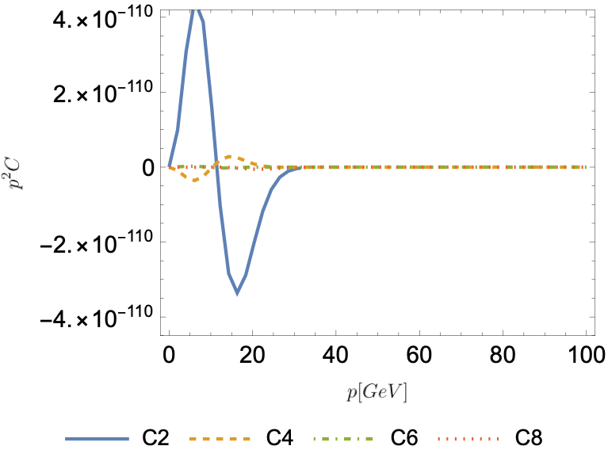
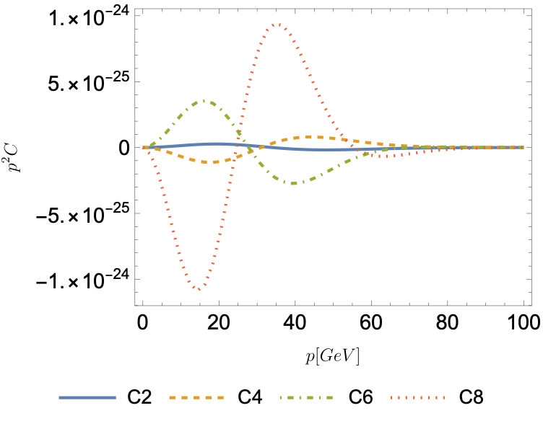
The Fokker Planck approximation
$$C_{el}\left[f_{DM}\right]=C_{2}+C_{4}+C_{6}+C_{8}+…$$
$$C_{FP}=\frac{1}{2E_{1}}γ\left(f_{eq}\right) \hat{FP}\left(p_{1}\right).f_{DM}(p_{1})$$
Has all the nice features:
no integration on $f_{DM}$
number conserving
0 on equilibrium distribution
$$x≡\frac{m_{DM}}{T}=\frac{m_{χ}}{T}$$
$$\frac{Δ\vec{p}}{\vec{p}}<1,\frac{p_{1}}{E_{1}}<1$$
$m_{χ}=100$ GeV, $m=1$ GeV, $x=250$
$m_{χ}=100$ GeV, $m=100$ GeV, $x=25$

Slide 8
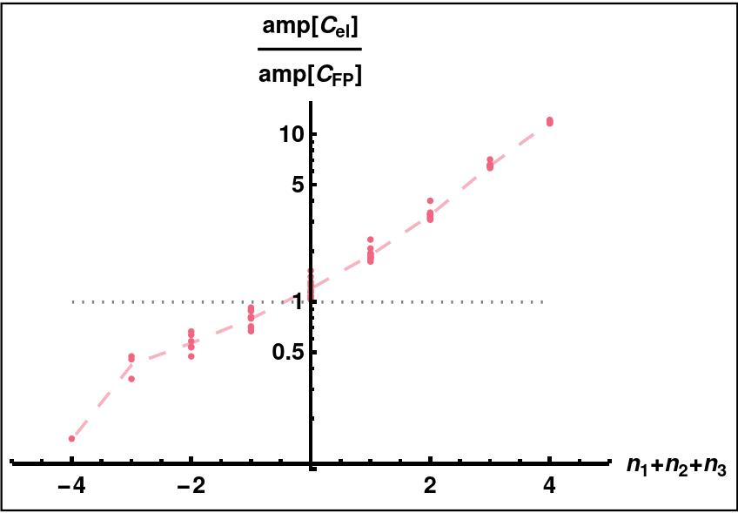
When does the Fokker Planck approx. work?
Arrived at by dropping higher order terms in $Δ\vec{p}/\vec{p}$ and $p_{1}/E_{1}$.
Very good “approximation” (O(1%)) while the conditions of the expansion hold true.
Q: How to know when the FP approximation works?
$${\left|M\right|}^{2}⟶t^{n_{1}}{\left(s−{\left(m_{DM}+m_{SM}\right)}^{2}\right)}^{n_{2}}{\left(u−{\left(m_{DM}−m_{SM}\right)}^{2}\right)}^{n_{3}})$$
$∝$ transfer momentum
$∝$ relative velocity
$∝$ velocities
1
With an efficiently implemented fully numerical solver for the Boltzmann equation into DRAKE, we find that
The Fokker Planck approximation works well for:
Scattering particle with masses significantly smaller than DM mass (small reduced mass$⇒$small momentum transfer
&
DM temperatures close to the SM temperature (eg.: near kinetic decoupling)
&
Scattering amplitudes that aren’t strongly dependent on momentum transfer (the dropped higher order terms are more relevant for an amplitude sensitive to said dropped quantity)
eg.:
${\left|M\right|}^{2}∝$ $constt.$
eg.: ${\left|M\right|}^{2}∝t^{2}$
$$\frac{m_{DM}}{m_{SM}}=1.1,\frac{T_{DM}}{T_{SM}}=0.95$$
1
Ala-Mattinen, Kainulainen 2019
Hryczuk, Laletin 2020
Aboubrahim, Klasen, Wiggering 2023

Slide 9
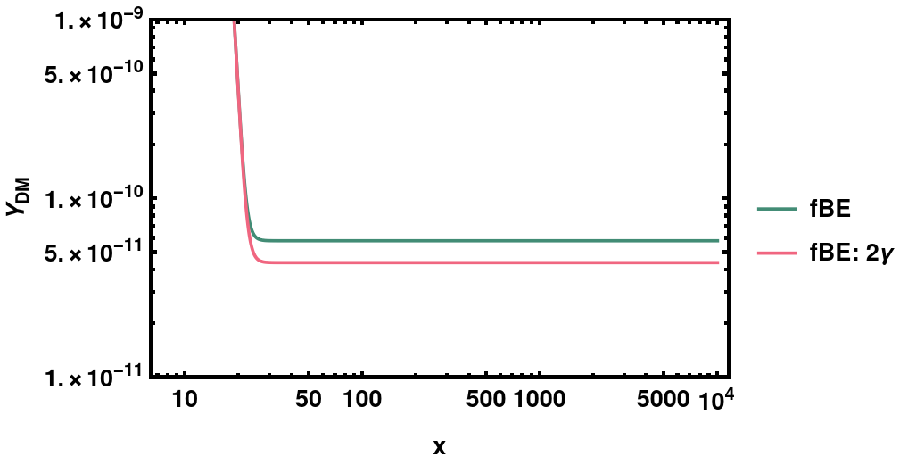
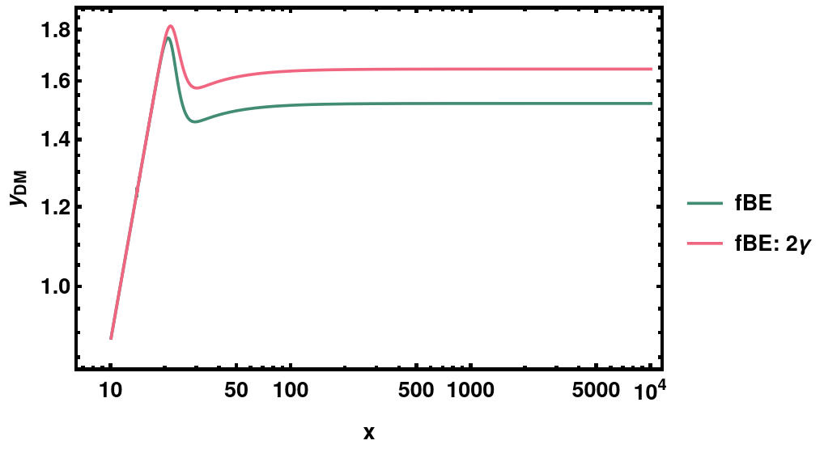
Improvement on Fokker Planck: Relic density
$$∂_{t}f_{DM}−Hp∂_{p}f_{DM}=C_{el}\left[f_{DM}\right]+C_{ann}[f_{DM}]$$
$$C_{el}\left[f_{DM}\right]≃C_{FP}=\frac{1}{2E_{1}}γ\left(f_{eq}\right) \hat{FP}\left(p_{1}\right).f_{DM}(p_{1})$$
An overall factor 2 at the level of collision operator $⟹$ 25% change in DM relic density
$$Y_{DM}≡\frac{n_{DM}}{s}$$
$$y_{DM}≡\frac{T_{DM}}{s^{3/2}}$$
sub-threshold DM
sub-threshold DM

Slide 10
Conclusions
We further the precision calculation of DM production from freeze-out out-of-kinetic-equilibrium.
In doing so, we find that the whether the Fokker Planck approximation works, depends, in addition to kinematics, also on the (model-dependent) specifics of DM interaction with SM.
For a given a DM model, we thus give a prescription to check whether the Fokker Planck approximation works.
A code to solve the Boltzmann equation at phase space level for precision calculation and/or when the Fokker Planck approximation fails, with a time scale that can enable large parameter scans. (to be included in a future version of the publicly available code DRAKE)
The discussion of the domain over which Fokker Planck approximation works, is relevant for all early Universe scenarios that entail an interaction between two semi-relativistic fluids of different temperatures,
eg. Baryogenesis, extended dark sectors
Thank you!

Slide 11
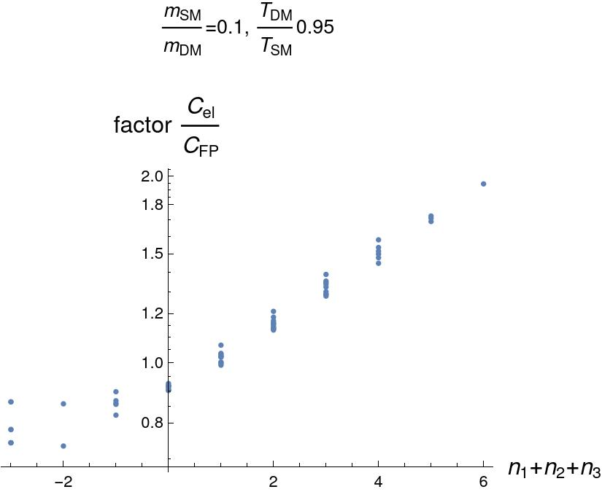
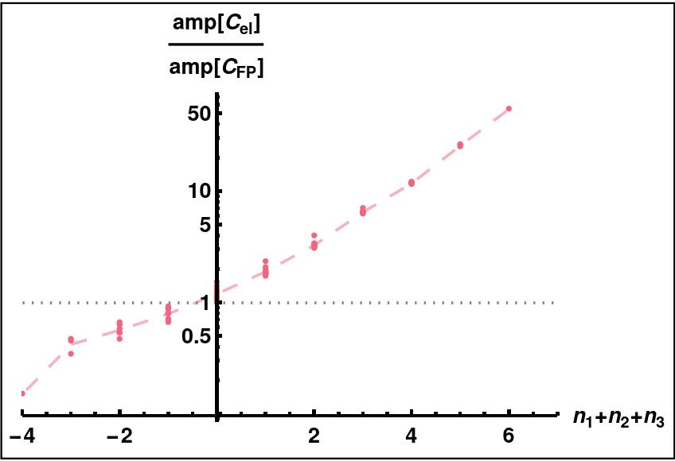

Slide 12
Sommerfeld enhanced

Slide 13
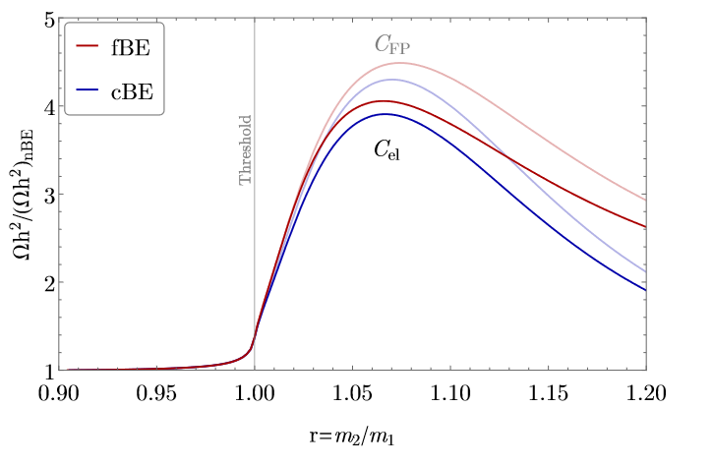
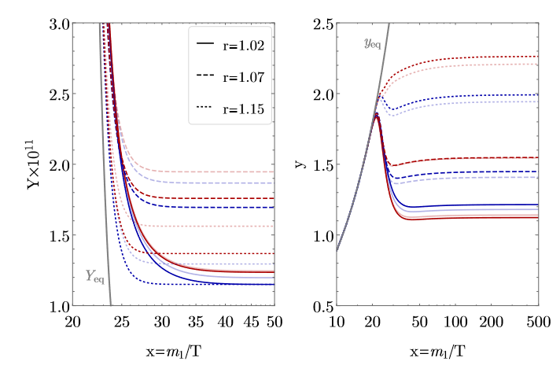
Sub-threshold model

