Slide 1
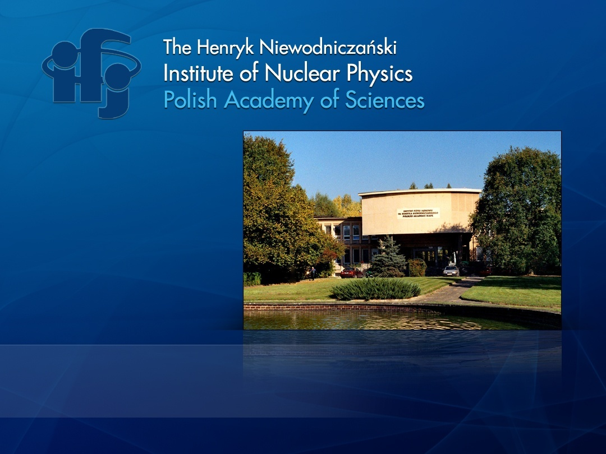
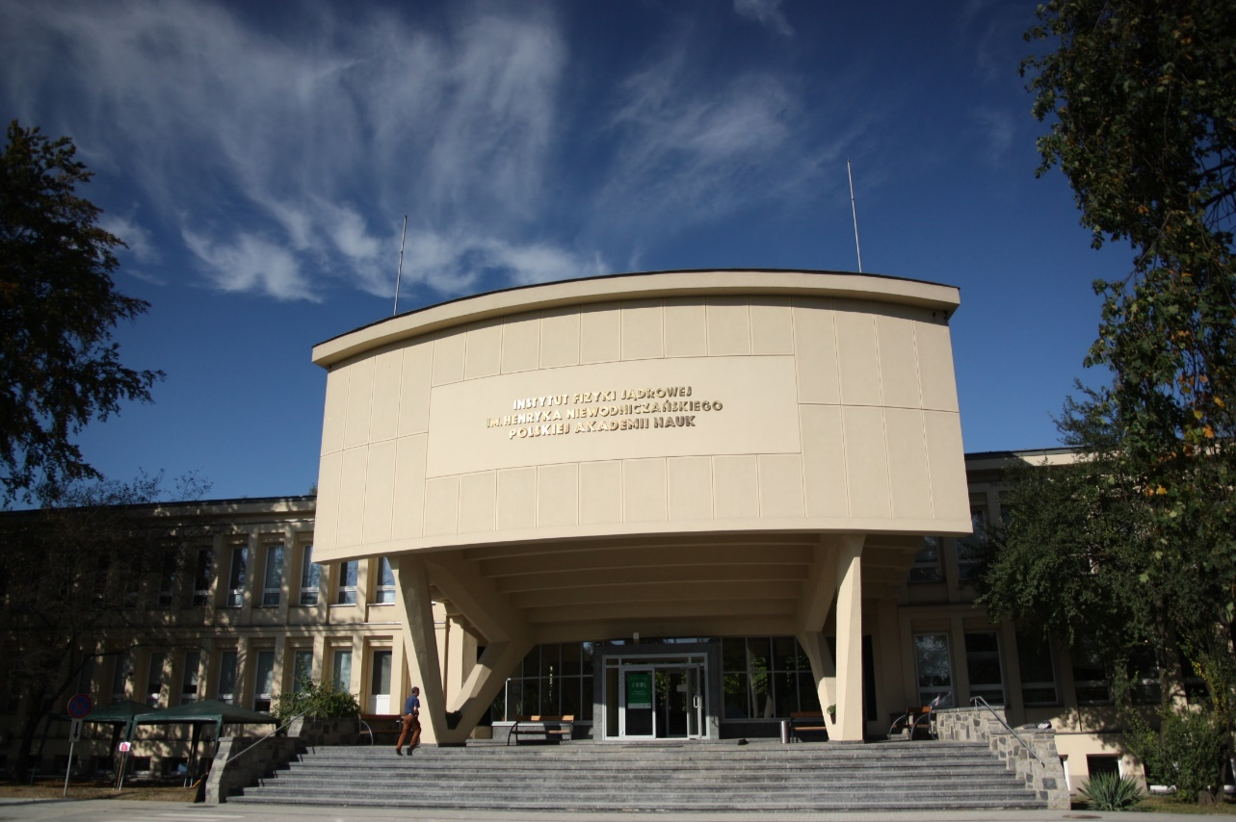




www.ifj.edu.pl
Kraków, April 4, 2023
Dariusz Bocian
Scientific & Technical Director
Place 670 (3.3%)

Slide 2

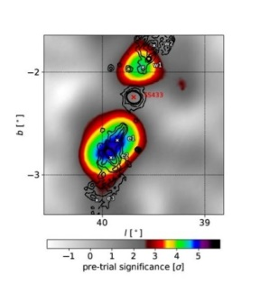
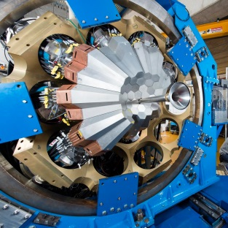
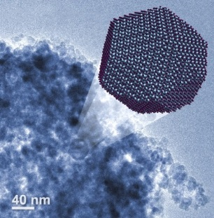
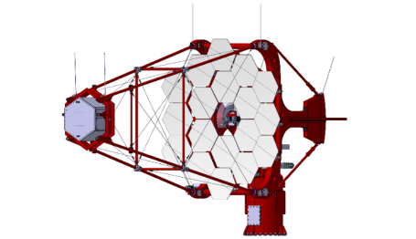
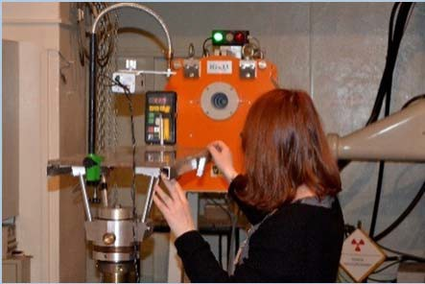
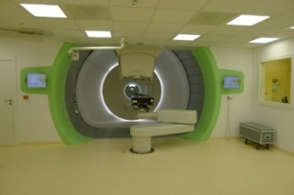
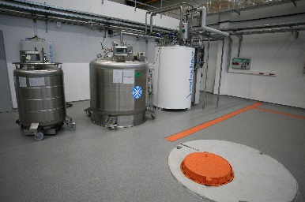


General Information about IFJ PAN
Personnel: 561; Prof. 30, Assoc. Prof. 61, Ph.D. 101, engineers 117
Scientific Divisions:
Division of Particle and Astroparticle Physics
Division of Nuclear Physics and Strong Interactions
Division of Condensed Matter Physics
Division of Theoretical Physics
Division of Interdisciplinary Research
Division of Applications of Physics
Researcher Departments:
Cyclotron Centre Bronowice
Division of Scientific Equipment and Infrastructure Construction
Four accredited laboratories
Education:
International Ph.D. Studies
Interdisciplinary Doctoral Studies
Kraków Interdisciplinary Doctoral School
Scientific output: > 650 publications annually

Slide 3
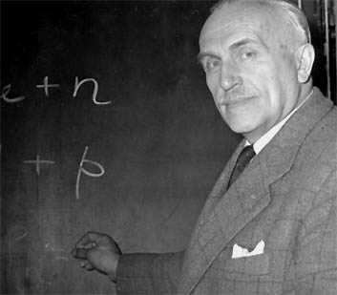
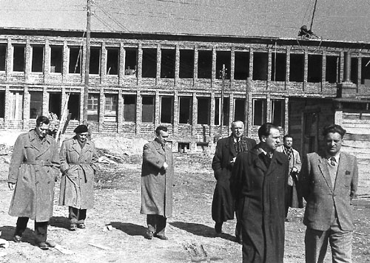
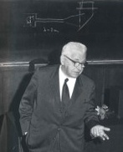
Genesis and History
1955 – foundation of the IFJ – as a branch of the Institute of Nuclear Research – Prof. Henryk Niewodniczański
(1900-1968)
1960 – IFJ as a standalone unit
1970 – Particle physics enters – Prof. Marian Mięsowicz
(1907-1992)
1988 – IFJ gets the name of its patron – Henryk Niewodniczański
2003 – IFJ gets the status of a Research Institute of Polish Academy of Sciences
(Fot. Archiwum of the IFJ PAN)

Slide 4
Scientific Activity (2017-2022)

Slide 5



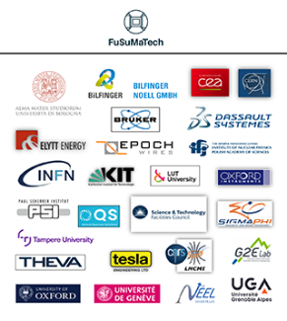
Integration of European Accelerator Research Infrastructures
Participation of IFJ PAN in projects aimed at the Development of Innovation
and Cooperation of European Technological Infrastructures for Accelerators and Magnets
TIARA – Test Infrastructure and Accelerator Research Area (2 lata, 2011-2013)
In Poland, the project was carried out by a consortium of 7 scientific institutions: the Henryk Niewodniczański Institute of Nuclear Physics of the Polish Academy of Sciences,
the AGH University of Science and Technology, the Cracow University of Technology, the Andrzej Sołtan Institute of Nuclear Problems, the Warsaw University of Technology, the Lodz University of Technology, the Wrocław University of Technology.
AMICI – Accelerator and Magnet Infrastructure for Cooperation and Innovation (2017-2019)
In Poland, the project was carried out by the Henryk Niewodniczański Institute of Nuclear Physics of the Polish Academy of Sciences
i.FAST – Innovation Fostering in Accelerator Science and Technology (2021-2025)
In Poland, the project is executed by the Henryk Niewodniczański Institute of Nuclear Physics of the Polish Academy of Sciences
FuSuMaTech - Future Superconducting Magnet Technology (2017-2019, 2021-2025)
In Poland, the project is executed by the Henryk Niewodniczański Institute of Nuclear Physics of the Polish Academy of Sciences

Slide 6
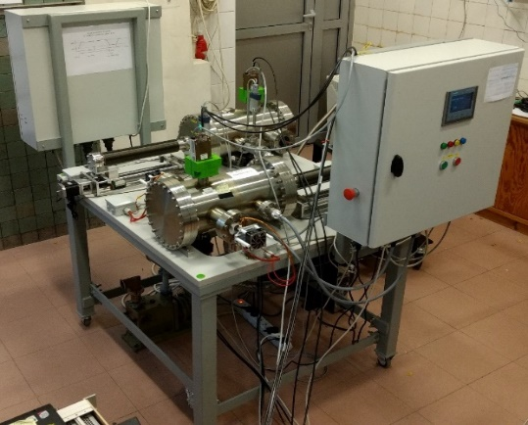
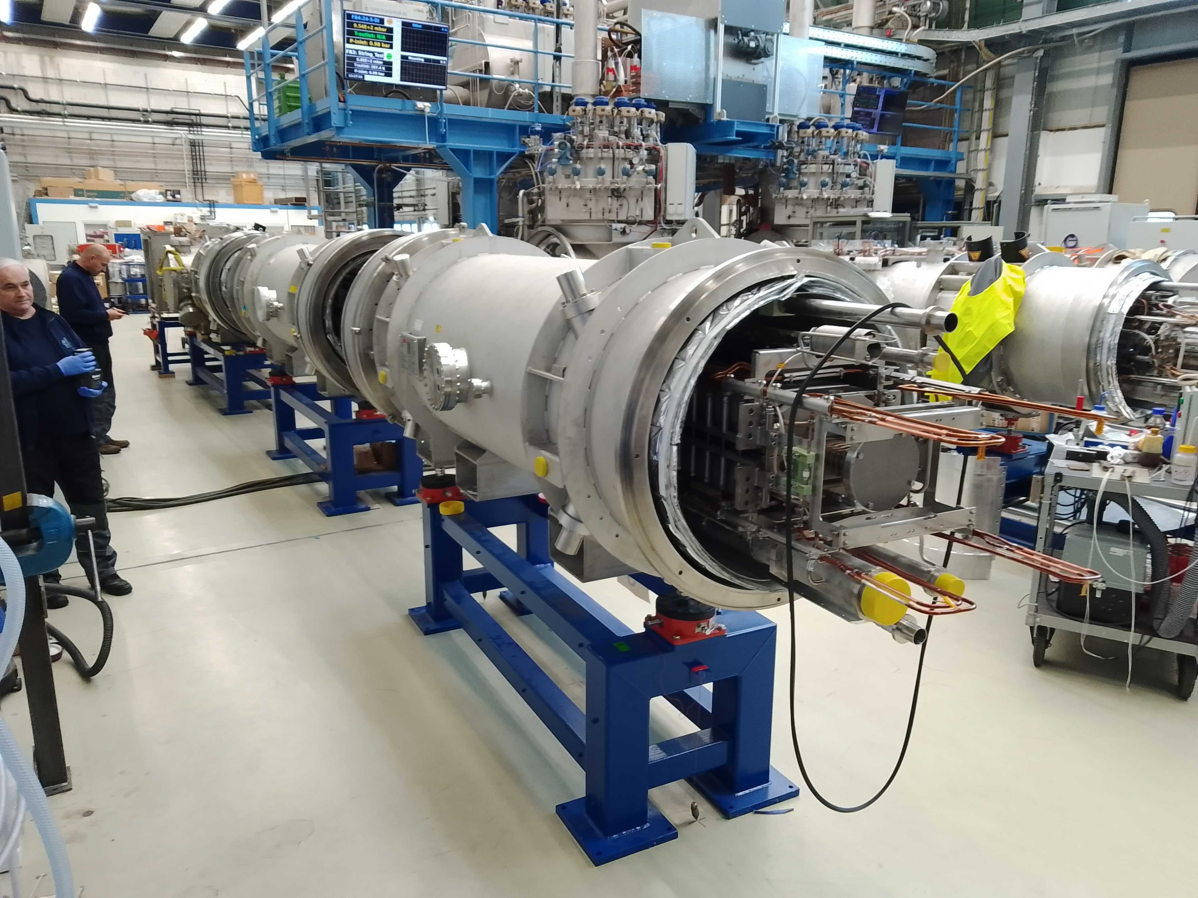
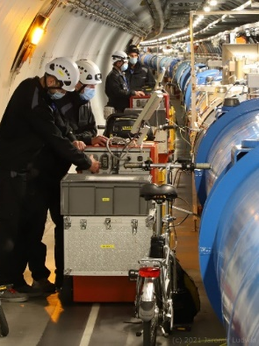
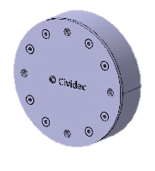
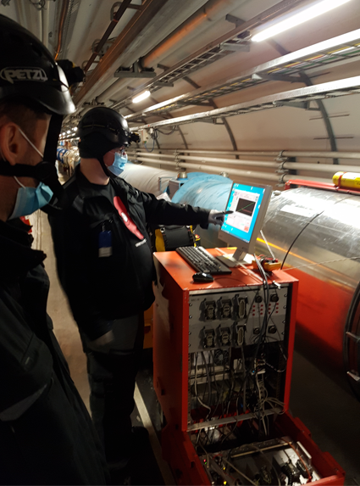
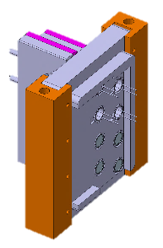
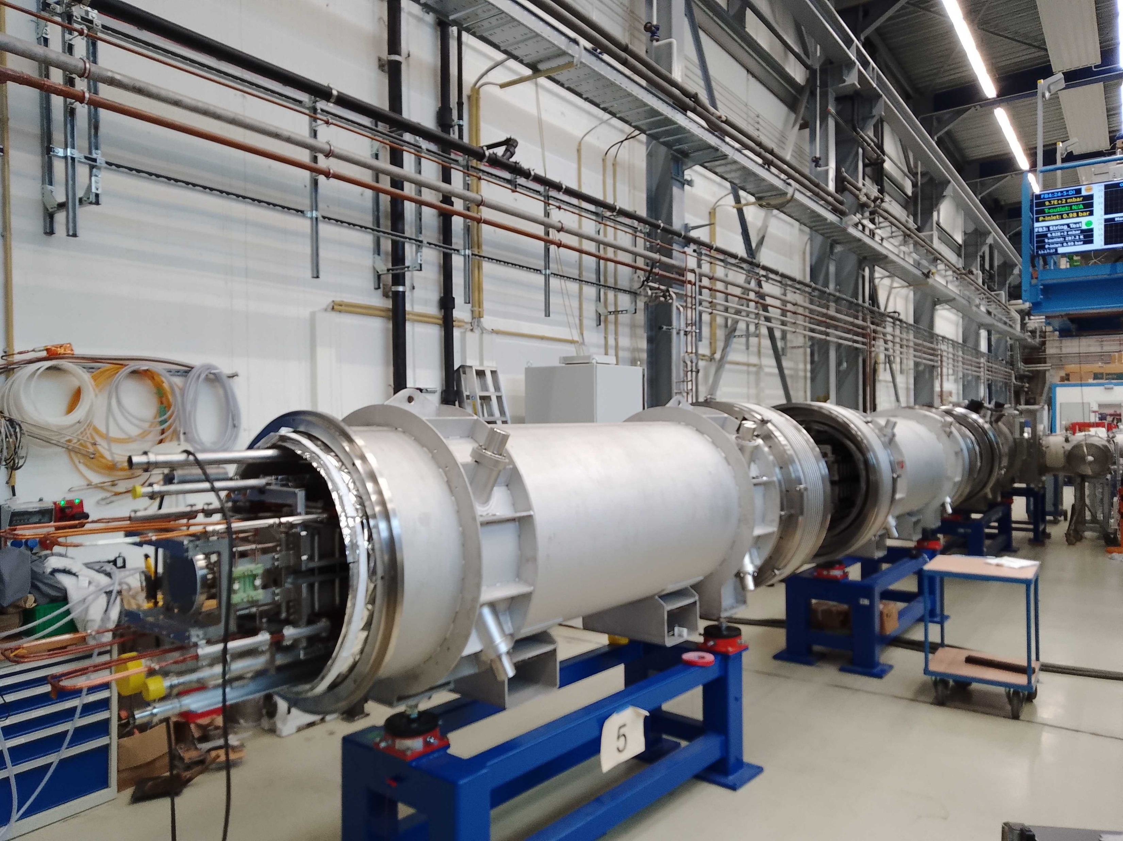
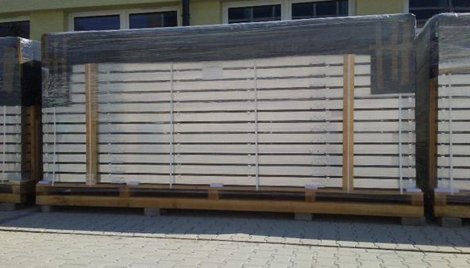
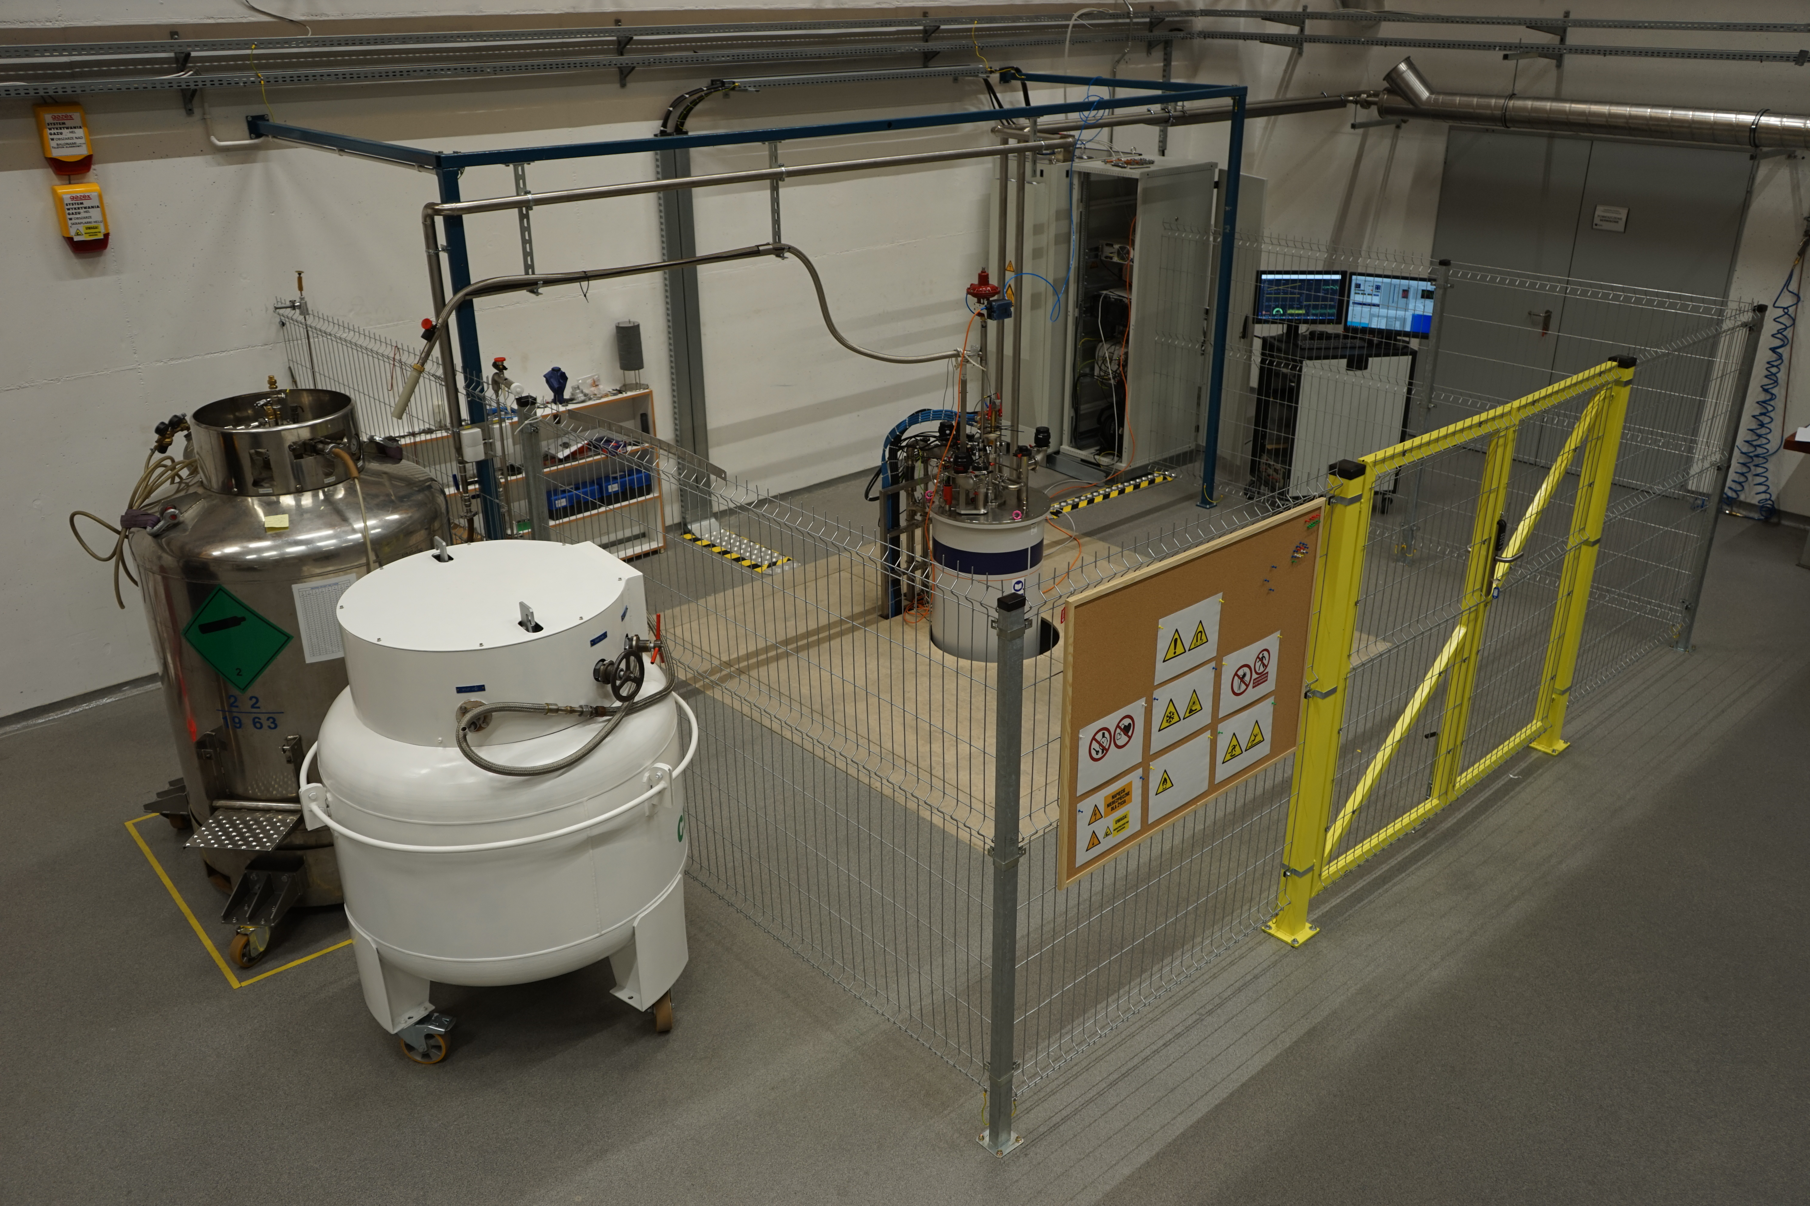
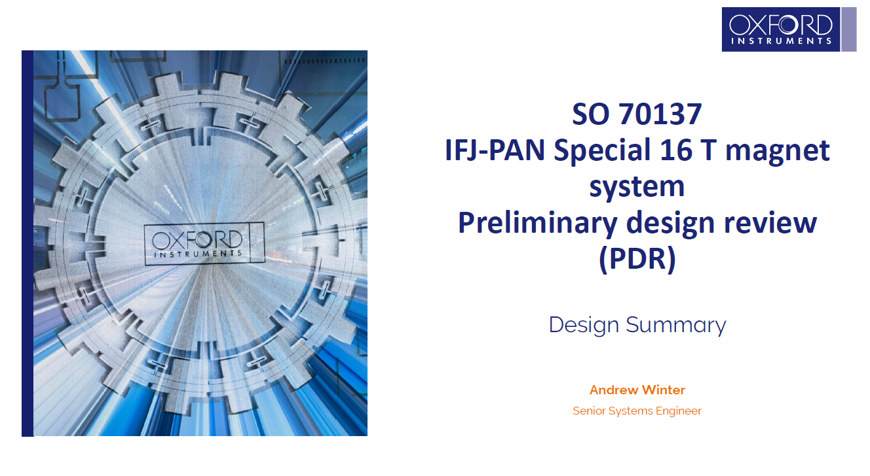
Scientific & Engineering Activity
Tests for ITER
Installation of SIS100 (GSI)
Contribution to LHC
(feedthrough, diamod detectors)
QC for interconnections of LHC magnets
Test stand built at the IFJ PAN
Surface Scintillator Detector (SSD) for Pierre Auger
Dedicated measuring apparatus built at the IFJ PAN
225 pieces
Local infrastructure: test stand for S.C. wires and magnets
Batch of 15 SSDs ready to move to Argentina
Under commissioning

Slide 7

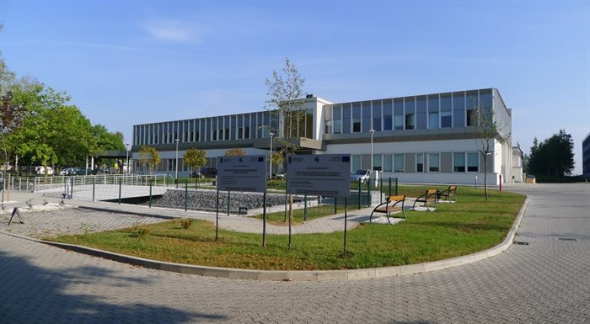
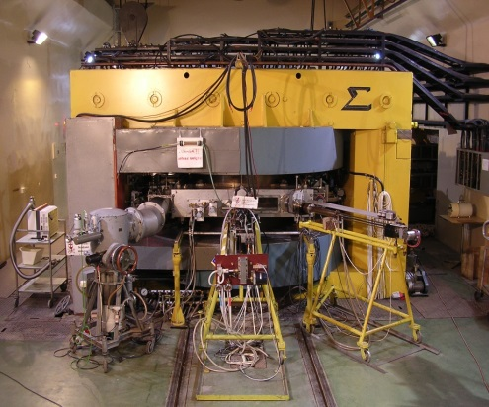
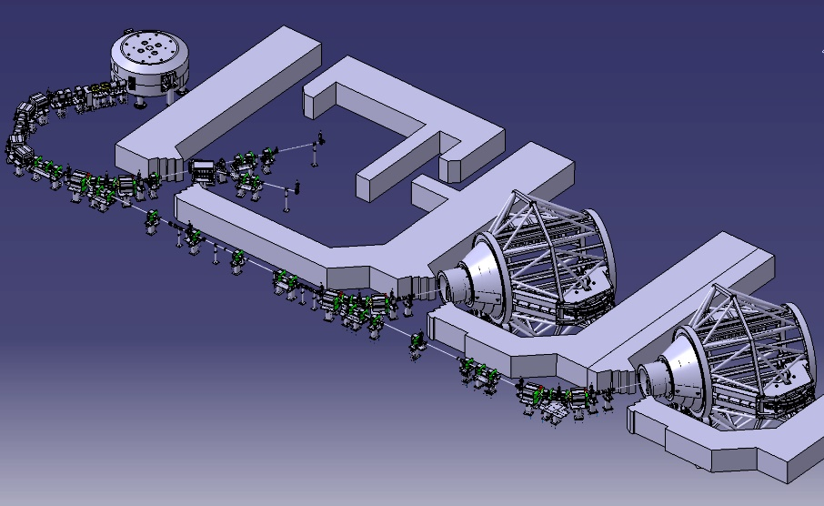
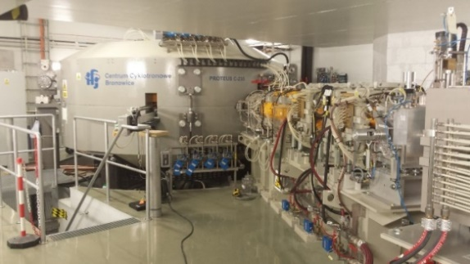
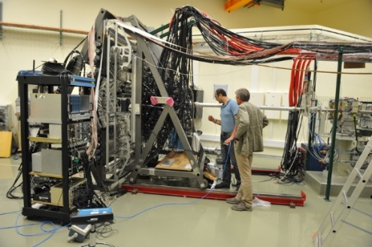
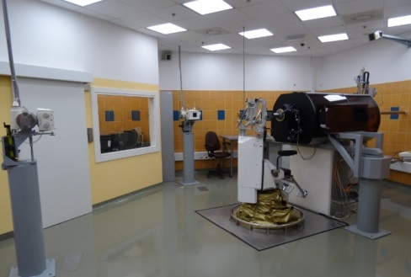

Cyclotron Centre Bronowice (CCB)
Construction 2010-2015; the 1st patient: Oct. 2016
918 patients finished irradiation in gantries
348 occular patients with eye melanoma
(by August 2023)
AIC-144 cyclotron
Start of operation : 2005-2010
Treatment of first patient with eye melanoma
Staff: about 50 people
Proteus-235 cyclotron IBA
Two dedicated scanning gantries
Experimental Hall
Eye treatment
70-230 MeV, I_{beam} = 1-500 nA

Slide 8
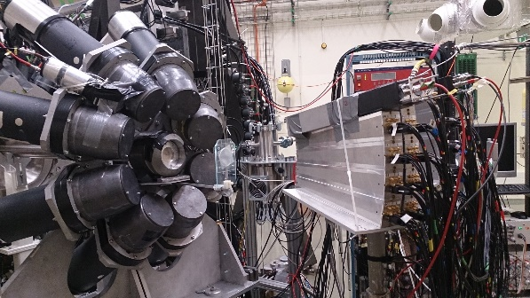
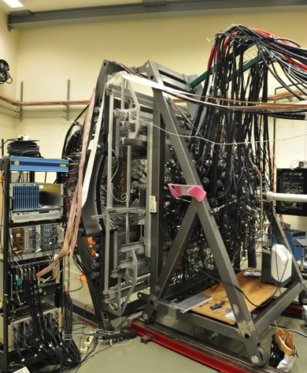
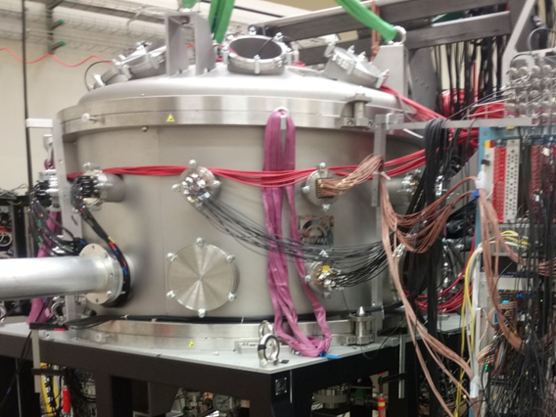
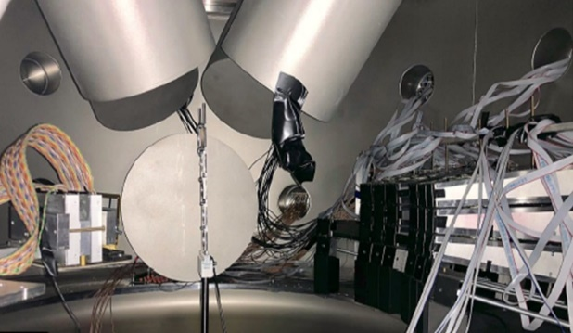
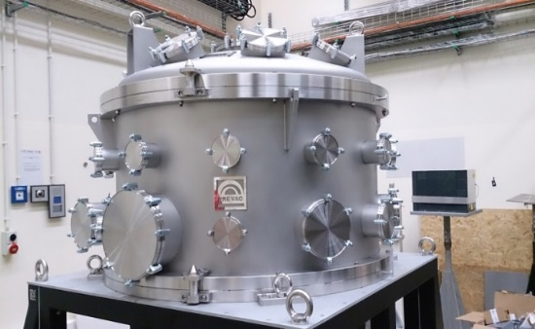
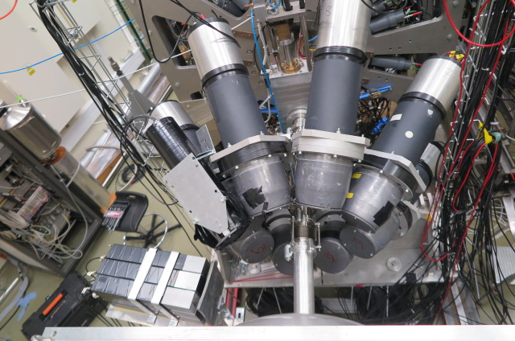
Fundamental Research at the Cyclotron Center Bronowice
Proton beam (230 MeV) from the Proteus-235 Cyclotron at the Cyclotron Centre Bronowice
Studies of resonance excitations of nuclei
Studies of triple nucleon dynamics
Detector KRATTA
Measurement of proton’s inelastic scattering
Detector BINA
Measurement of p, d, t
detector HECTOR
Measurements of gammas)
LABR
LABR
„Big” scattering chamber
PARIS
DSSD
KRATTA
Detectors inside the scattering chamber
PARIS and LaBr3 high-energy γ-ray array

Slide 9
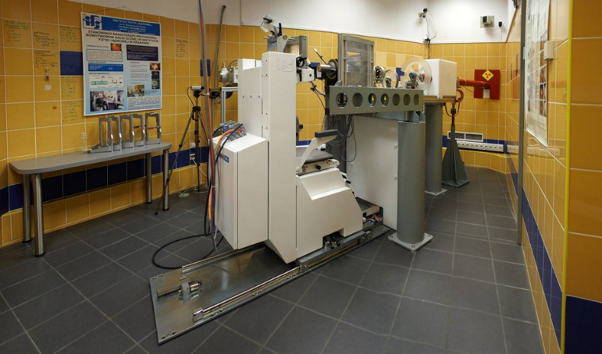
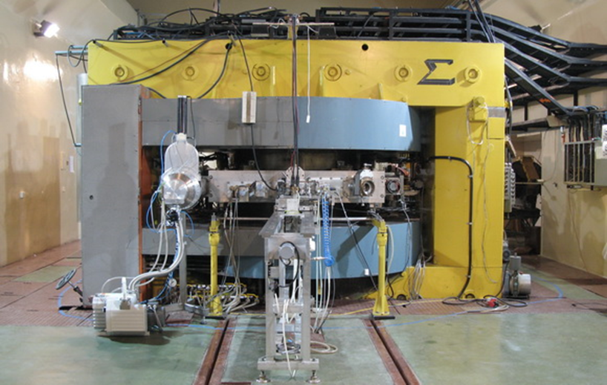
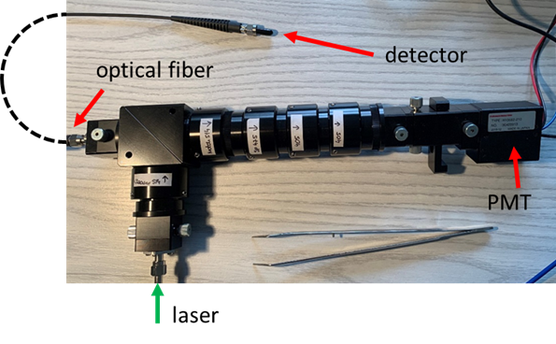
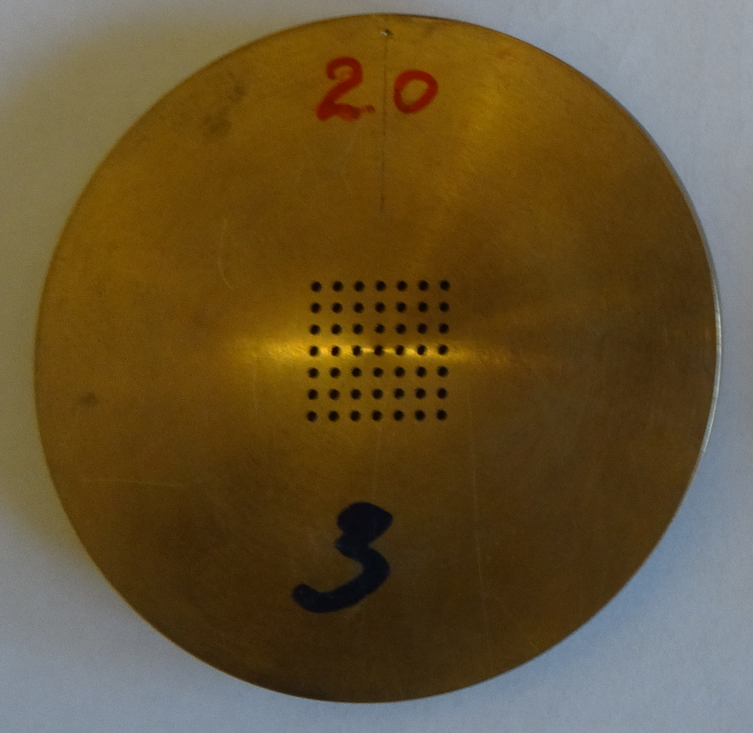
Applied research at the AIC-144 60 MeV proton cyclotron
Line for isotope production
proton current: < 100nA;
Eye line for precise irradiation
dose rate: 0.001 – 1 Gy/min
beam field size: ≤ 40 mm;
Typical flux: 10e8 – 10e9 p/cm2·s;
Experimental room: high beam intensity
proton current: 2nA – 100nA;
Dose rate up to 50 Gy/s
irradiation field d < 12 cm;
AIC-144 Cyclotron
energy 60 MeV; RF 26,26 MHz;
beam current 80 nA
Proton grid therapy – to reduce side effect sof treatment
Testing of electronics for space flights
Staff: 10 people
Testing of detectors and dosimeters

Slide 10
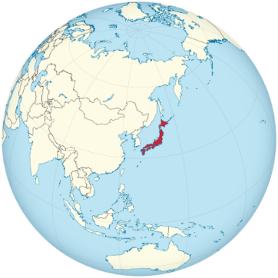

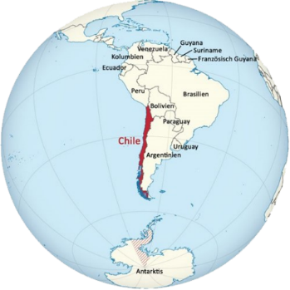
Scientific and Engineering Experience
Scientific & Engineering Activity
Major partners in the world
ESS
LUND
E-XFEL
DESY
W7X
IPP GREIFSWALD
SPIRAL 2
GANIL, CAEN
T2K, J-PARC
BELLE 2, KEK
CTA
Pierre Auger
IFJ PAN
KRAKÓW
FAIR
GSI DARMSTADT
LHC, ATLAS
CERN
ITER
CADARACHE
F4E
BARCELONA

