Slide 1


Feasibility study and validation of PEEK gasket for DONES STUMM module
Urszula Wiącek¹, Santiago Becerril², Jesus Castellanos³, Jerzy Kotuła¹, Wojciech Królas¹, Arkadiusz Kurowski¹, Agnieszka Kulińska¹, Jacek Świerblewski¹
1 Institute of Nuclear Physics Polish Academy of Sciences (IFJ PAN), Kraków, Poland
2 IFMIF-DONES España, Granada, Spain
3 Universidad Castilla La Mancha (UCLM), Toledo, Spain
This work has been carried out within the framework of the EUROfusion Consortium, funded by the European Union via the Euratom Research and Training Programme (Grant Agreement No 101052200 — EUROfusion). Views and opinions expressed are however those of the author(s) only and do not necessarily reflect those of the European Union or the European Commission. Neither the European Union nor the European Commission can be held responsible for them.
February 2005

Slide 2
IFMIF-DONES Laboratory
IFMIF-DONES - International Fusion Materials Irradiation Facility DEMO Oriented Neutron Source
EUROfusion Consortium WPENS Project
(Work Package Early Neutron Source)
Department of Radiation Transport Physics (NZ61)
Jan Dankowski
Barbara Gabańska
Andrzej Igielski
Wojciech Królas
Agnieszka Kulińska
Arkadiusz Kurowski
Urszula Wiącek
Division of Scientific Equipment and Infrastructure Construction (DAI)
Dariusz Bocian
Marcin Curyło
Jerzy Kotuła
Rafał Ortwein
Przemysław Wąchal
Jacek Świerblewski
Wojciech Marek

Slide 3
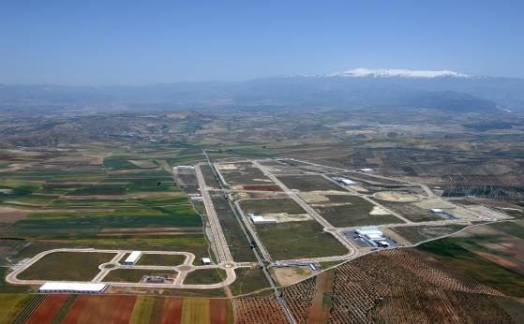
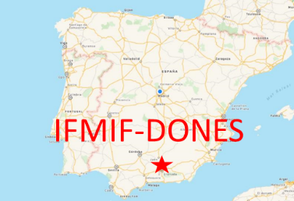
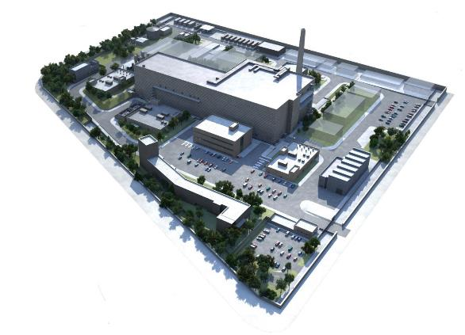
IFMIF-DONES Laboratory
IFMIF-DONES - International Fusion Materials Irradiation Facility DEMO Oriented Neutron Source
EUROfusion Consortium WPENS Project
(Work Package Early Neutron Source)
Escúzar site (ca. 10 ha),
18 km southwest from Granada, Spain

Slide 4
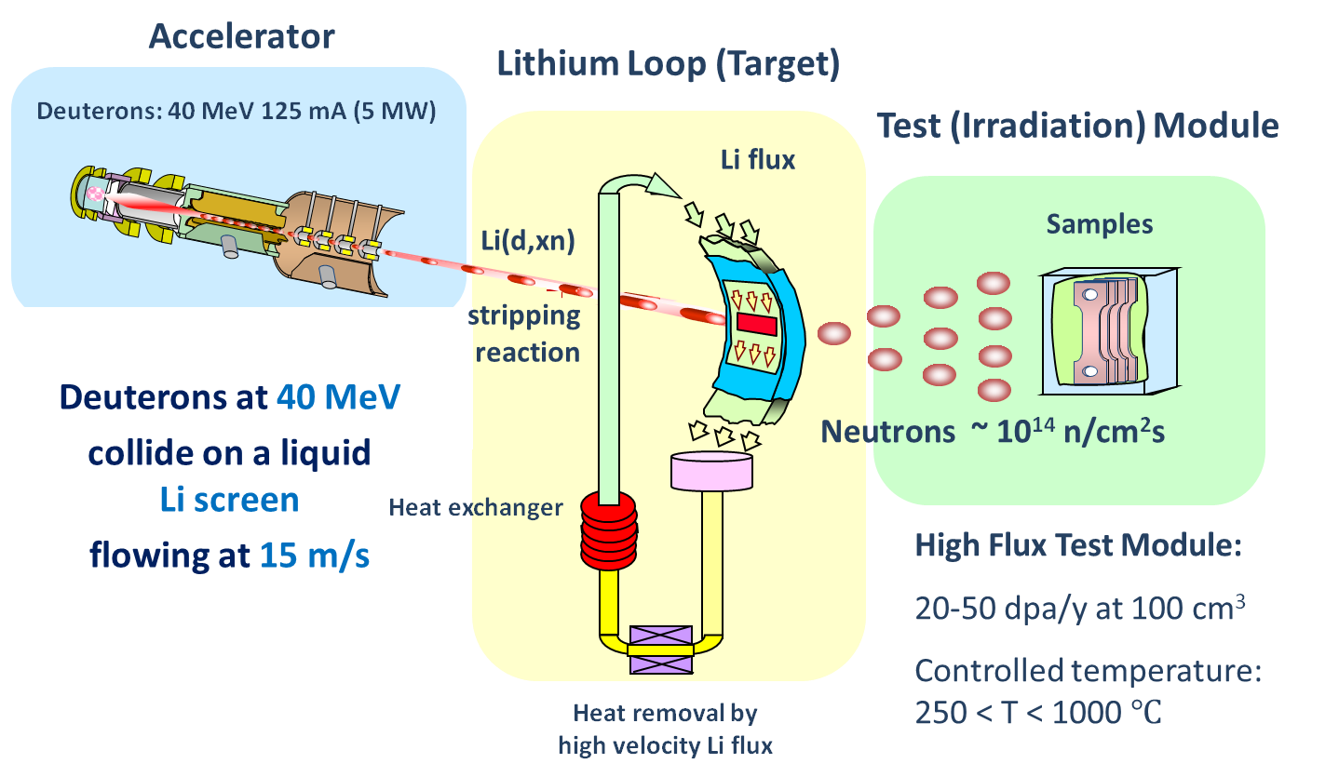
IFMIF-DONES Laboratory
IFMIF-DONES - International Fusion Materials Irradiation Facility DEMO Oriented Neutron Source
EUROfusion Consortium WPENS Project
(Work Package Early Neutron Source)
Escúzar site (ca. 10 ha),
18 km southwest from Granada, Spain

Slide 5
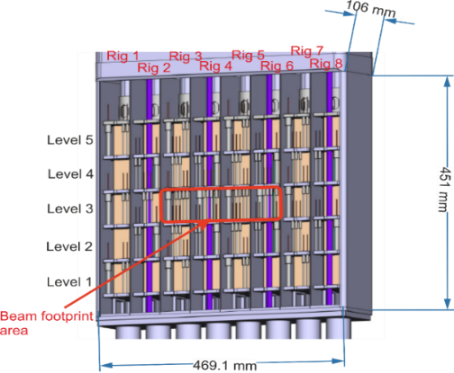
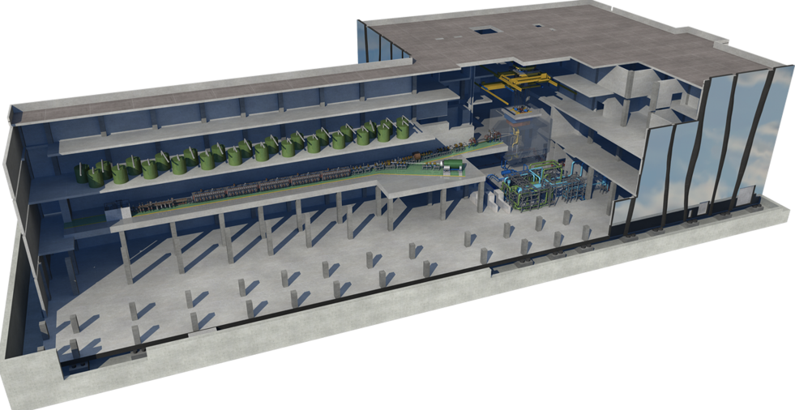
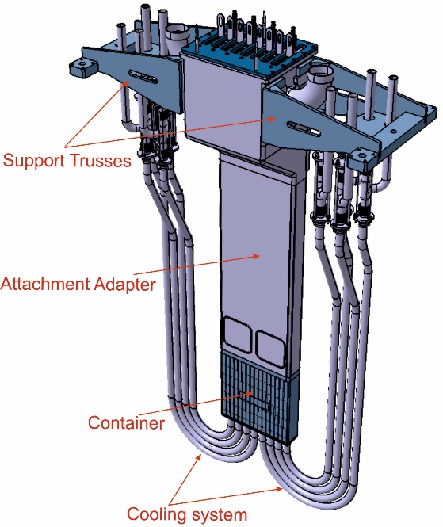
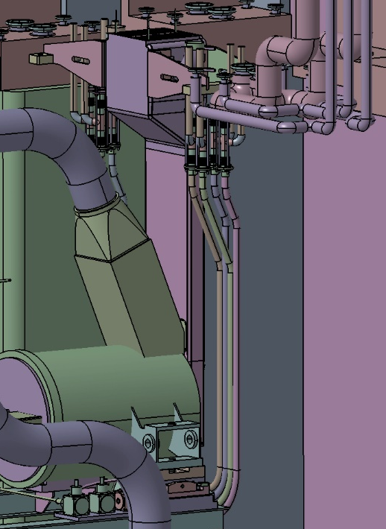
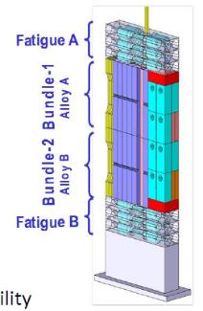
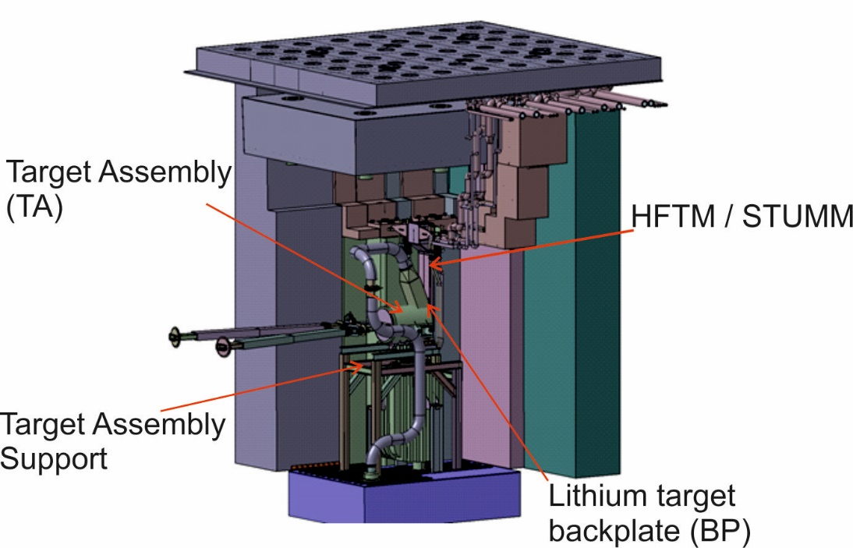
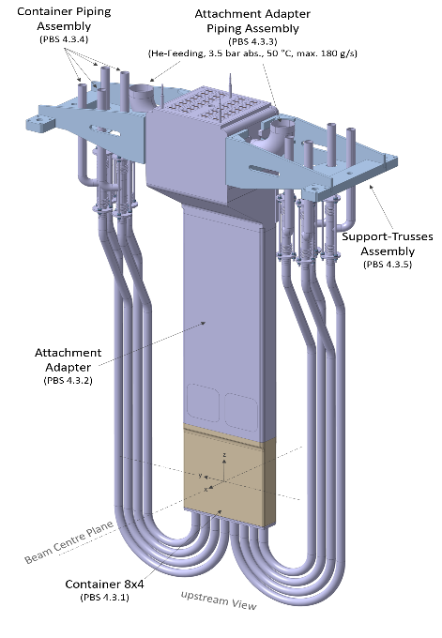
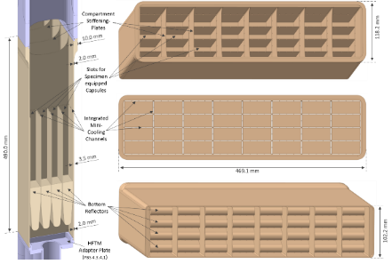
IFMIF-DONES Laboratory
STUMM –
Start Up Monitoring Module
A. Ibarra et al., Nuclear Fusion 58, 105002 (2018)
W. Królas et al., Nuclear Fusion 61, 125002 (2021)
Test Cell (TC) - the space dedicated to irradiations.
HFTM – High Flux Test Module
F. Arbeiter et al., Nuclear Materials and Energy (2016)

Slide 6
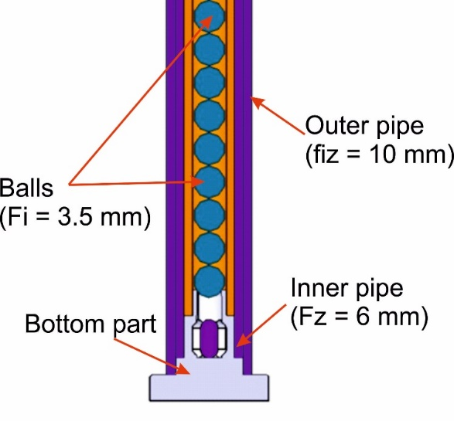
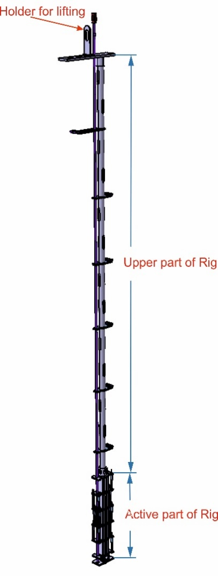
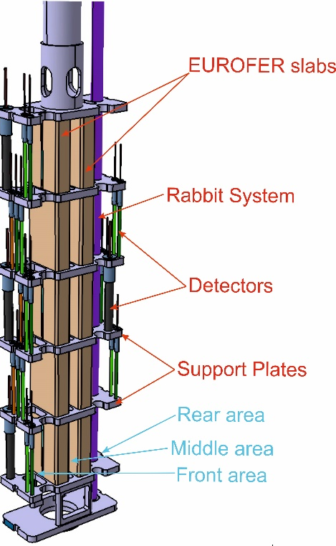
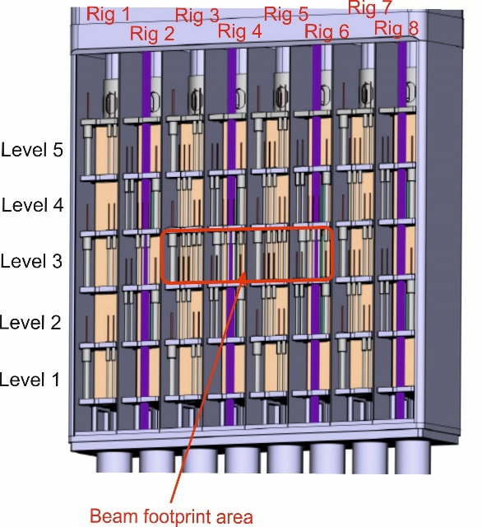
STUMM – Start Up Monitoring Module
Rabbit System
Container
Reaction | Threshold [MeV]
In-115 (n,n’) In-115m | 0.4
Ni-58 (n,p) Co-58 | 1.0
Ti-47 (n,p) Sc-47 | 1.5
Ti-46 (n,p) Sc-46 | 3.5
Ti-48 (n,p) Sc-48 | 7.0
Nb-93 (n,2n) Nb-92m | 8.9
Ni-58 (n,2n) Ni-57 | 12.4
Cu-63 (n,3n) Cu-61 | 20.0
Y-89 (n,3n) Y-87m | 21.5
Bi-209 (n,4n) Bi-206 | 22.6
Tm-169 (n,4n) Tm-166 | 23.7
Active part of rig
Detection systems for STUMM:
Rabbit system (RS) (x8) (1 per rig) – thermal, epithermal and fast neutrons
MFC (U238) & IC (max 140) - fast neutrons
MFC (U235) or SPND detectors (max 40) – thermal and epithermal neutrons
Gamma thermometers (max 40) – nuclear heating
Thermocouples ( max 40) – temperature
Single Rig

Slide 7
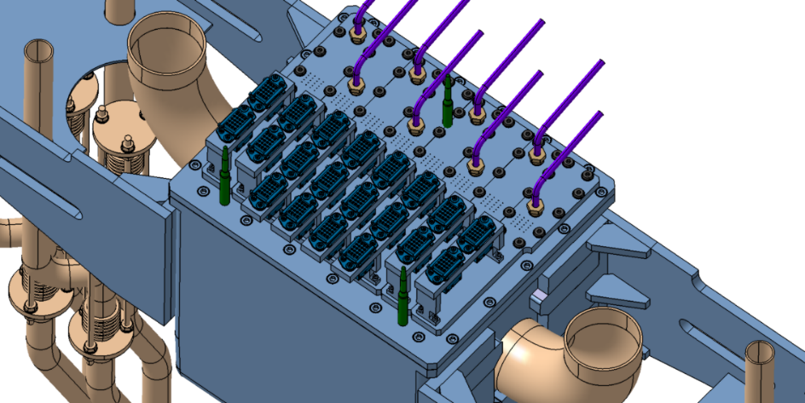
STUMM – Start Up Monitoring Module
Initial Conditions
Gas pressure in Test Cell | 0.2 bar
Gas pressure in STUMM (Helium gas) | 3 – 3.5 bar
Maximum drop pressure in STUMM | 0.6 – 0.8 kPa
The maximum mass flow rate of the cooling medium | 0.18 kg/s
Cooling gas temperature at the inlet | max to 60°C
Maximum temperature of the cooling gas at the outlet | 150°C
Maximum temperature inside Container | 200°C - 250°C
Heat generation | from MCNP calculations
Neutron flux density | up to 10¹⁴ - 10¹⁵ n/cm²/s
Gamma-ray dose | ~GGy per year
Heat exchange (radiation, conduction in He-gas) with the Target Assembly at 300 °C
The tolerated leakage for each flange shall be equal to 2 ⋅ 10⁻⁴ Pa ⋅ m³/s based on a total tolerated leakage from HFTM to TC of 10⁻² Pa ⋅ m³/s
Rabbit system
Rigs
Electrical conectors
STUMM Ver. 2022

Slide 8
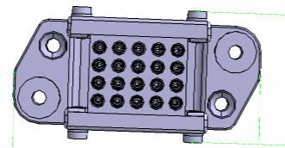
STUMM – Start Up Monitoring Module
Rabbit system
Requirements:
STUMM shall be able work in more than one irradiation cycle - replaceable rigs
STUMM shall be a system tightness
Rigs
Electrical conectors
STUMM Ver. 2022
General issues:
Each rig must be sealed.
Large amount of detectors in the current design (240).
2 or 3 multi-pin (20 pins) connectors per rig for the most instrumented rigs.
Limited space for access via RH.
It is very difficult to ensure both

Slide 9
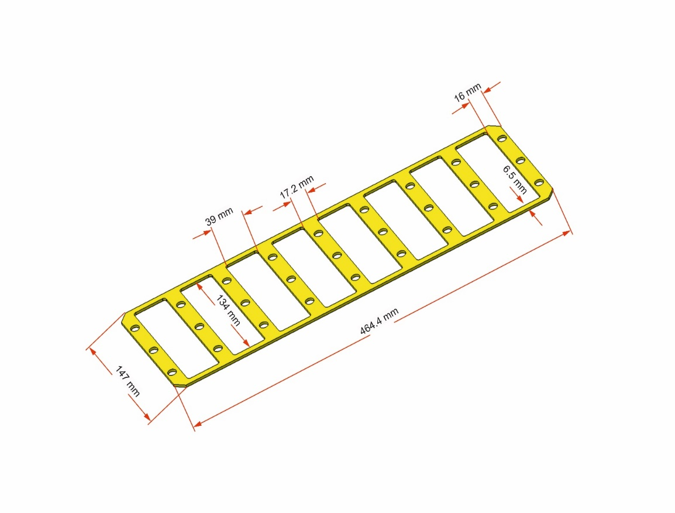
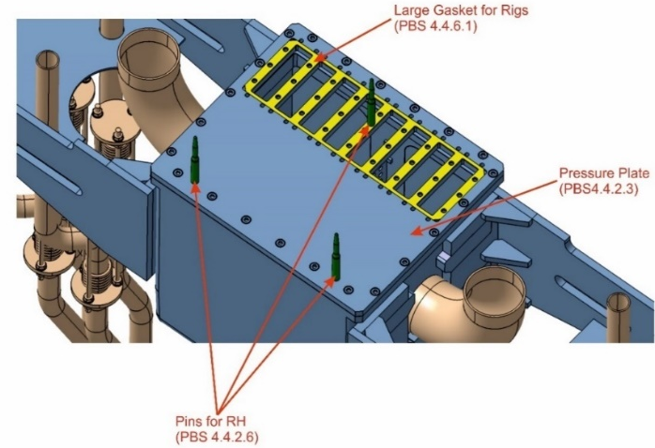
PEEK as a gasket for STUMM
Rabbit system
The general assumptions:
Propose material for the rigs gasket –
PEEK (Polyether ether ketone)
  One gasket for all rigs
Rigs
Electrical conectors
STUMM Ver. 2022

Slide 10
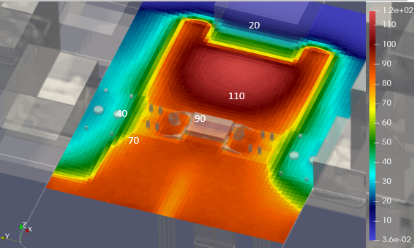
PEEK as a gasket for STUMM
Radiation resistance of PEEK:
Based on ITER Report (RHYTUK):
Radiation damage properties of Polyether ether ketone (PEEK)
Good radiation resistance and keep its mechanical properties up to 10 – 20 MGy
Is recommended to use for the radiation dose up to 1.5 MGy
Most of the presented tests for gamma ray (or electron beam)
For combined radiation fields (neutrons and gamma) PEEK degrades faster
The parameters of PEEK are improved while the dose is increased
MGy/fpy
There is a risk that the PEEK seal will lose its properties and will not be reusable.
The absorbed dose (MGy/fpy) of PEEK (Rep EFDA 2NF525 v.1.4).
At the upper part of HFTM/STUMM is foreseen above 50 MGy / fpy.

Slide 11
PEEK as a gasket for STUMM
The general questions are:
Is this solution feasible?
Is it possible to reuse the same gasket (PEEK) after rig replacemant?
Experimental validation of the PEEK gasket reusing
A simple system consisting of following elements:
The vacuum chamber
PEEK o-ring seals
He leak detector
A set of pipes
The vacuum pumping station

Slide 12
Experimental validation of the PEEK gasket reusing
Results of the tightness test of the seal made of PEEK
  Mechanical test
Positive
Negative
  Radiation hardness test
  Revision of the design & requiremants
  Other materials for rig gasket
Positive
Negative
OK!

Slide 13
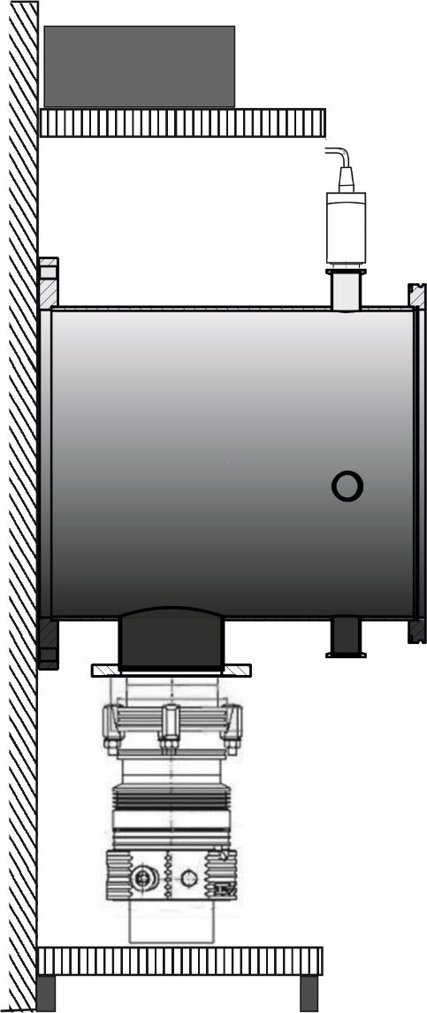

Experimental validation of the PEEK gasket reusing
Pressure control
Set-up for test experiments:
High vacuum chamber
(Pressure during typical experiments
up to ~3x10⁻⁶ mbar)
The front flange DN 210 ISO-K
(uses clamp fasteners)
The rear flange DN 210 ISO-F
(uses bolt fasteners).
Pumping system – the set of the rotary and turbo pump
Pressure measurement - IONIVAC gauge (Cold Cathode/Pirani Combination Gauge) can measure ~10⁻¹⁰ mbar
Pressure control - COMBIVAC gauge controller
PEEK gaskets
Pressure measurement
DN 210 ISO-F
High vacuum chamber
DN 210 ISO-K
Air Valves
Pumping system

Slide 14
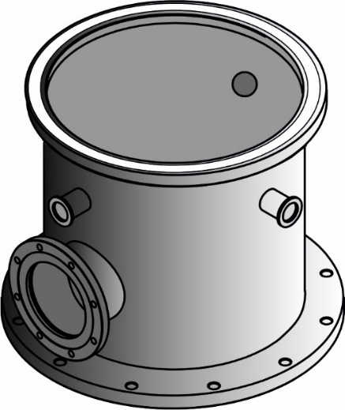
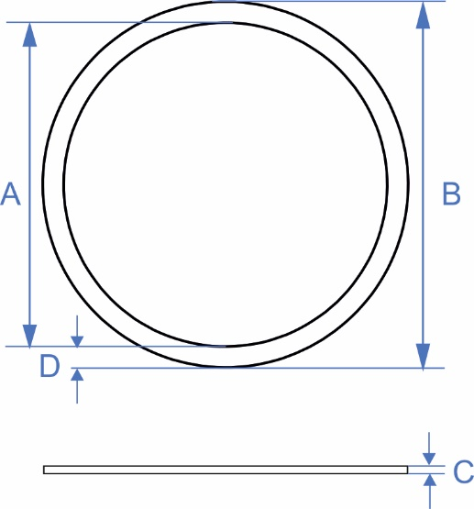
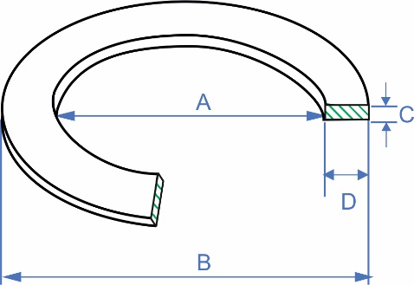
Experimental validation of the PEEK gasket reusing
PEEK gaskets
Pressure control
Pressure measurement
DN 210 ISO-F
High vacuum chamber
DN 210 ISO-K
Air Valves
PEEK gasket dimensions:
A (mm) B (mm) C (mm) D (mm)
I 210 223 3 6.5
II 210 223 4 6.5
III 210 238 3 14
IV 210 238 4 14
Pumping system

Slide 15
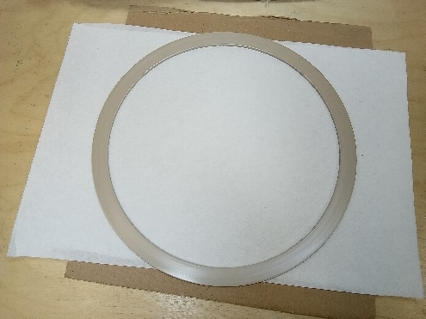
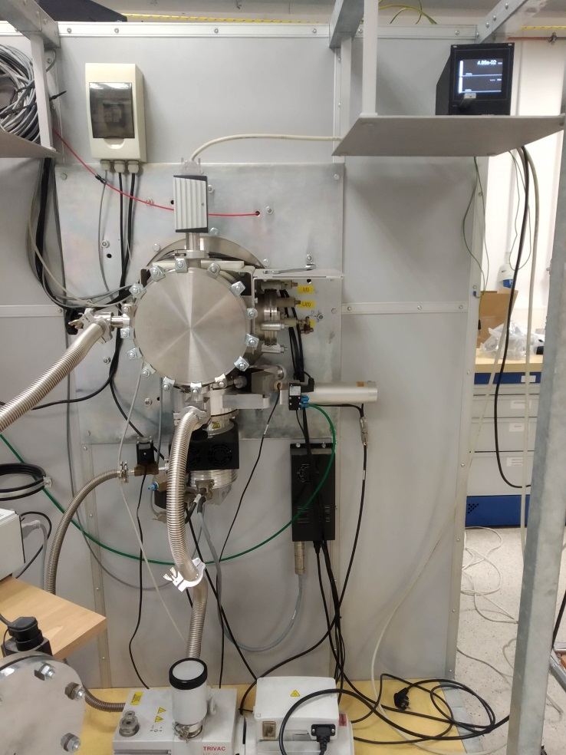
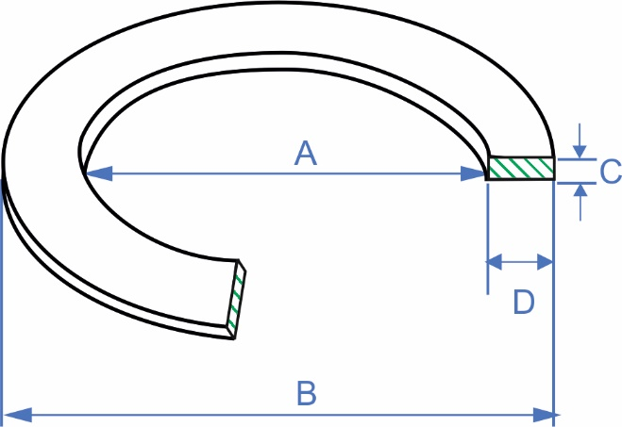
Experimental validation of the PEEK gasket reusing
Pressure control (GRAPHIX)
PEEK gasket dimensions:
A (mm) B (mm) C (mm) D (mm)
I 210 223 3 6.5
II 210 223 4 6.5
III 210 238 3 14
IV 210 238 4 14
High vaccum chamber
Main experimental steps:
PEEK gasket placed under the front flanche of the HV chamber.
Closing and evacuating the HV chamber (~10⁻⁴ mbar).
Pressure control continously ~24 hours.
Opening of the chamber, visual check of the PEEK gasket, thickness control.
PEEK gasket placed again under the front flanche.
Steps repeated five times.
Pumping system
Set-up for test experiments

Slide 16
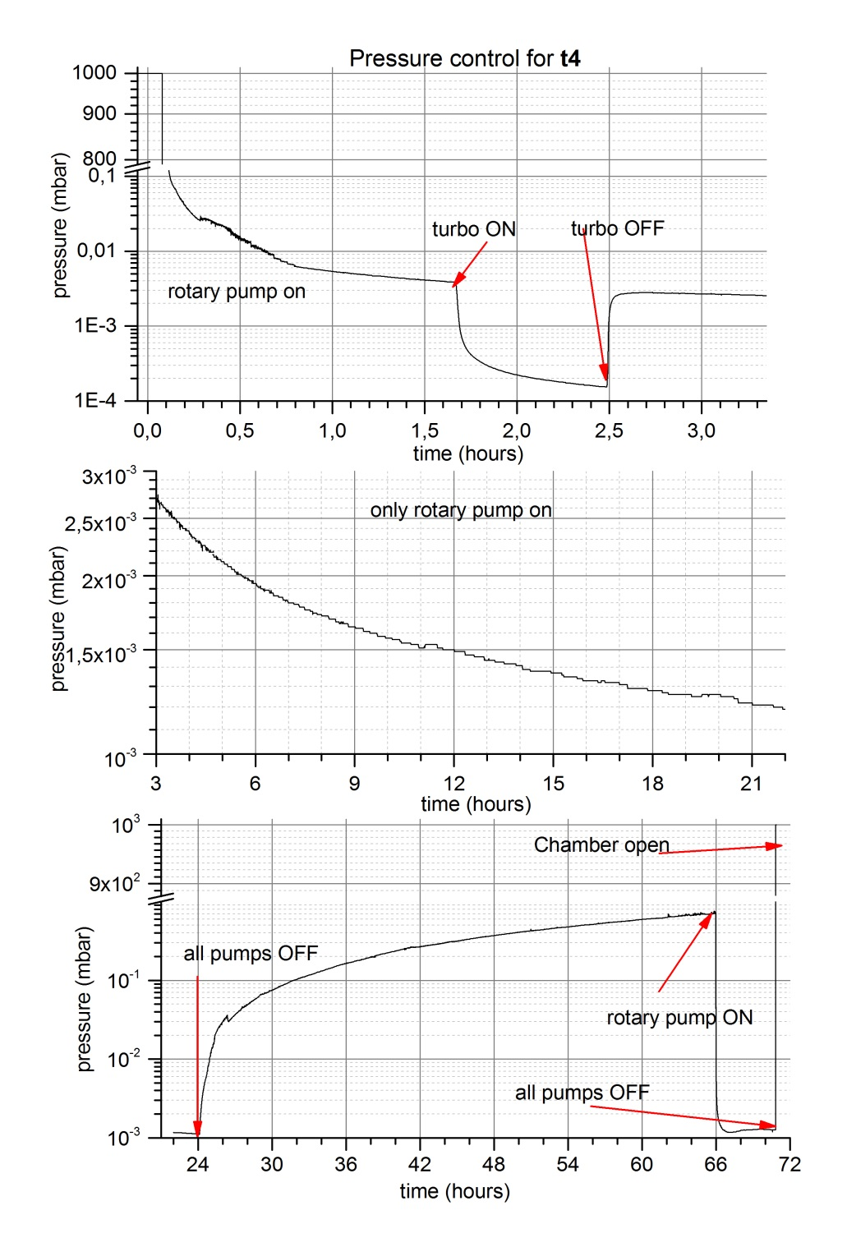
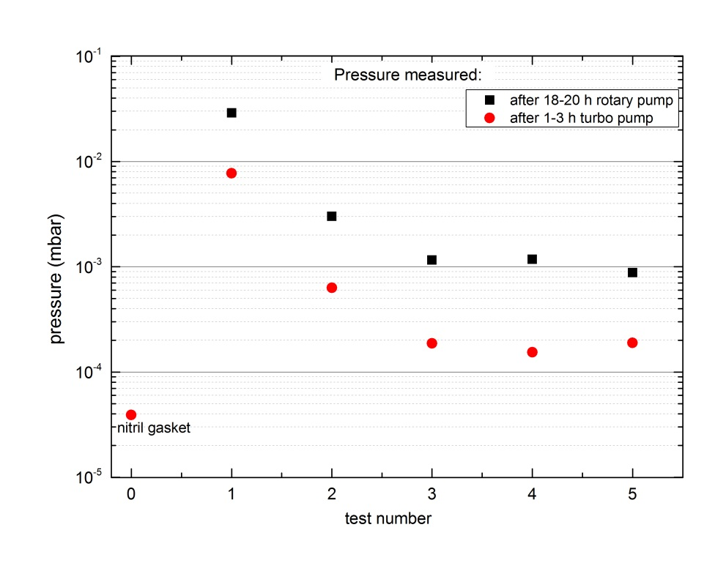
Experimental validation of the PEEK gasket reusing
Preliminary experimental results

Slide 17
Experimental validation of the PEEK gasket reusing
Results of the tightness test of the seal made of PEEK
  Mechanical test
Positive
Negative
  Radiation hardness test
  Revision of the design & requiremants
  Other materials for rig gasket
Positive
Negative
OK!

Slide 18
Summary
The first results look promising!
The next step will be a test of the PEEK gasket after irradiation
But the question is:
  Where this gasket can be irriadiated?
- MARIA Reactor
- TR24 at NPI-Rez in Czech Republic
- LIPAc

Slide 19
References:
U. Wiącek, A. Kurowski, J. Kotuła, R. Ortwein. System Design Description Document for the IFMIF-DONES Start-Up Monitoring Module (STUMM); Technical Report - EFDA_D_2MNBDB (2023)
U. Wiącek, J. Kotuła, A. Kurowski, R. Ortwein “2022 Update of the STUMM Engineering Design”; Report EFDA_D_2PWFB8 (2023)
3D CAD model of STUMM; EFDA_D_2N5PTM v.2.9 (2023)
R. Ortwein, U. Wiącek; Conjugated heat transfer analysis of the Start-Up Monitoring Module (STUMM) for IFMIM-DONES including heat generation mapping ; Fusion Eng. Des. 188 (2023) 113451; DOI: https://doi.org/10.1016/j.fusengdes.2023.113451
C. Torregrosa-Martin and all, Overview of IFMIF-DONES diagnostics: Requirements and techniques; Fusion Eng. Des 191 (2023) 113556
U. Wiącek, and all, New approach to the conceptual design of STUMM: a module dedicated to the monitoring of neutron and gamma radiation fields generated in IFMIF-DONES, Fusion Eng. and Design 172, 112866 (2021).
W. Królas, A. Ibarra and all, The IFMIF-DONES fusion oriented neutron source: evolution of the design, Nucl. Fusion 61, 125002 (2021).
R. Ortwein, J. Kotuła, U. Wiącek, J. Świerblewski, D. Bocian, Hydraulic analysis of the start-up monitoring module (STUMM) for IFMIF-DONES,
Fusion Eng. Des., 171 (2021) 112601, doi: 10.1016/j.fusengdes.2021.112601,

Slide 20
Thank you for your attention

Slide 21
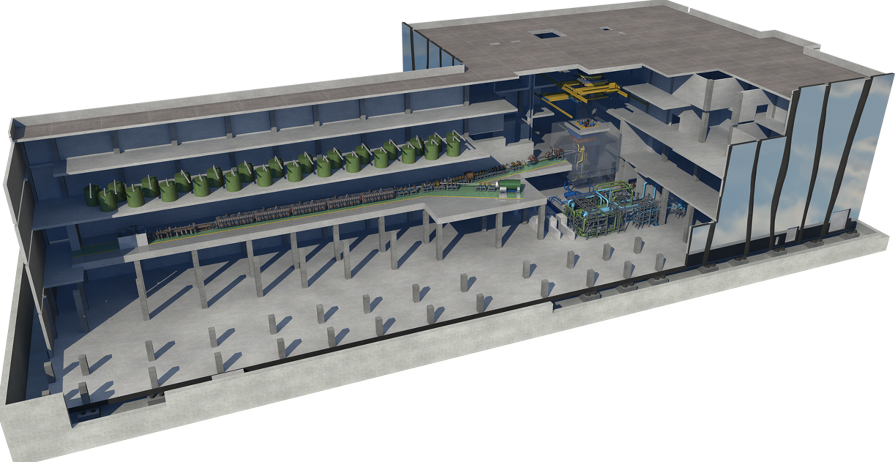
IFMIF-DONES principal system
70% Availability
30 years Operation
Access Cell
TIR
Test Cell
(Target + Test Systems)
RF area
Accelerator Vault
Lithium Systems
Complementary experiments area
System engineering approach
Poster D. Sánchez-Herranz, TUPM019
A. Ibarra et al., Nuclear Fusion 58, 105002 (2018)
W. Królas et al., Nuclear Fusion 61, 125002 (2021)

Slide 22
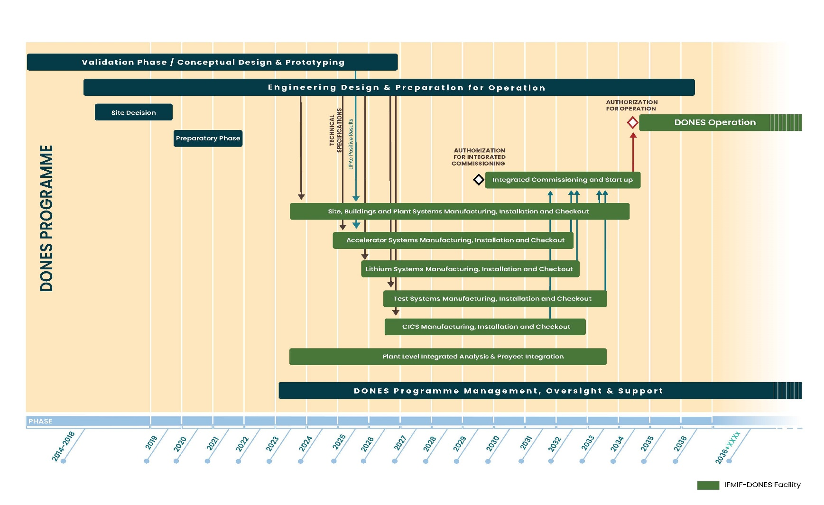
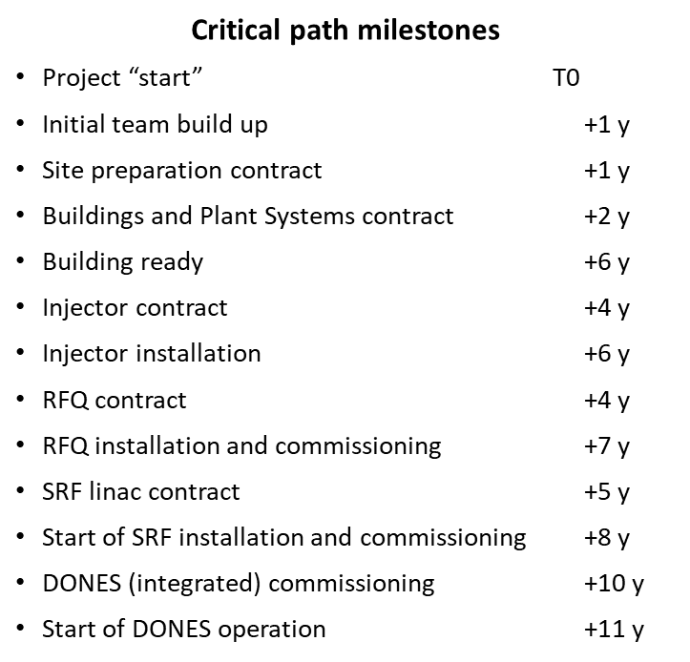
DONES Programme Schedule
+1-2 years of irradiation and +1-2 years of PIE
First materials data around T0+(13-15)y
Some acceleration could be possible, but not very relevant

