Slide 1
LNL accelerator facilities
Luca Bellan
on the behalf of INFN-LNL

Slide 2
Index
Overview of the National Laboratories of Legnaro accelerators
  Existing accelerators, stable ion production and acceleration for user
Light ions facilities
  CN
  AN2000
Heavy Ions Facility
  TANDEM ALPI PIAVE
General accelerator operation overview
Upgrades
Contacts

Slide 3
Accelerators
The LNL accelerators for users supply light and heavy stable ions in the order of 10 MeV/u.
under development
for users
High intensity linac (RFQ IFMIF, DTL ESS, Anthem)
Irradiation lines for material tests for industries and users.
Cyclotron and new normal conductive RFQ
SPES: Radioactive Ion Beams
Electrostatic type accelerators
RF (superconductive) type linac accelerators
Nuclear Physics experiments
Applied Physics: neutron experiments, medical and industrial applications, accelerator developments

Slide 4
Light ions facilities
Electrostatic type

Slide 5
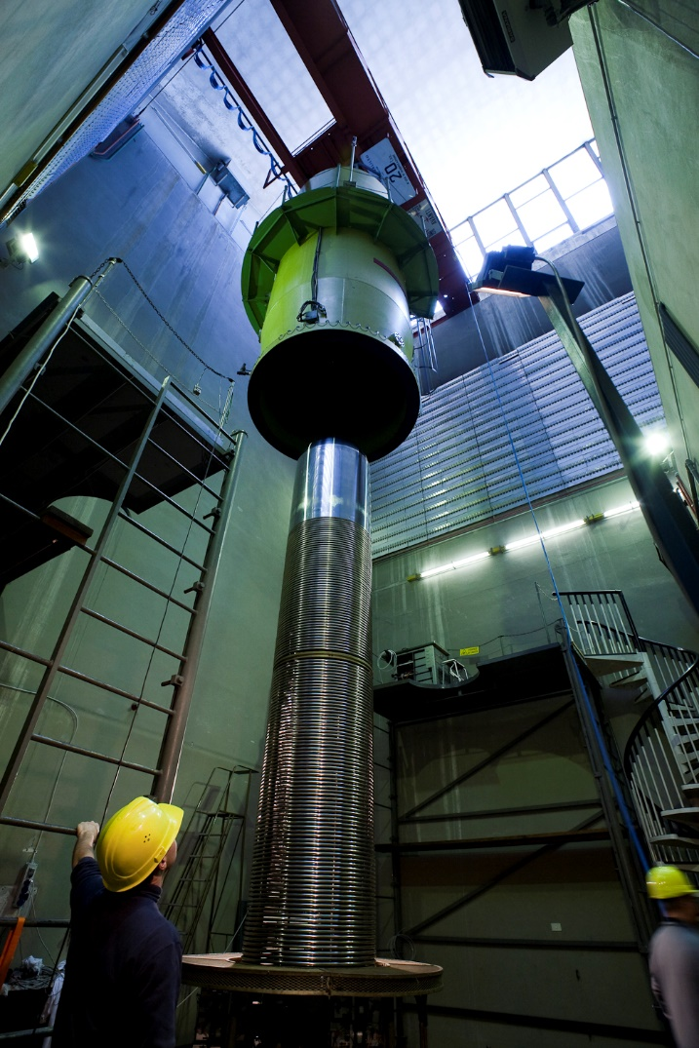
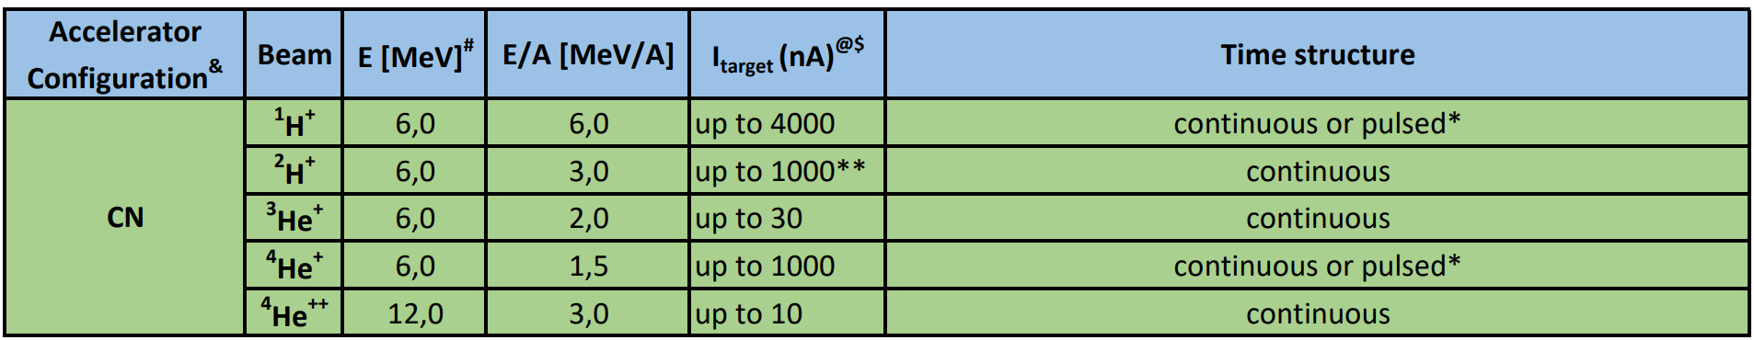
CN
Van der Graaf accelerator type. Light ions up to 6 MV terminal voltage.
Used for applied physics and nuclear physics experiment
Neutron irradiation experiments.
Pulsing system at 3 MHz is available

Slide 6
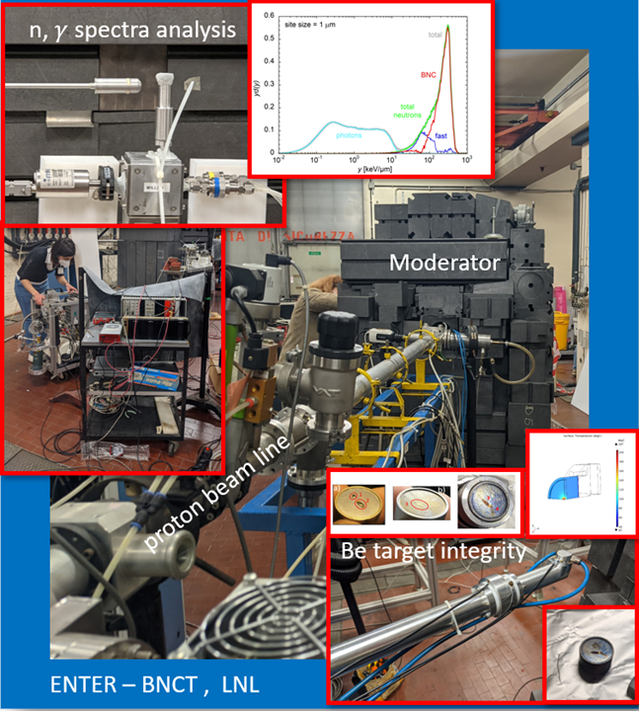
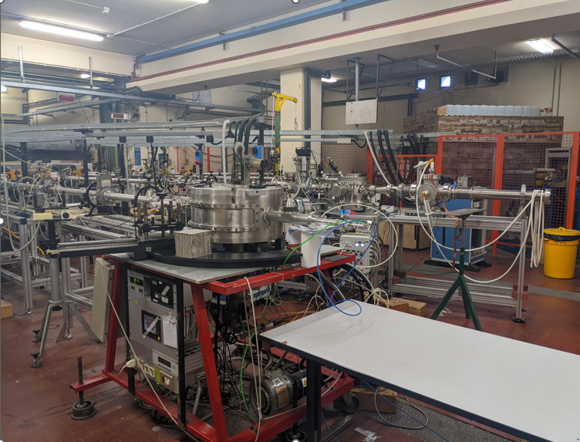
Neutron flux irradiation
MUNES line
  The line is equipped with a graphite heavy water thermal neutron moderator that generates a neutron flux of 4.5×10⁵ n/(s·cm2), 96% fraction [0,1]
  Test of the composite target material: blistering, resistance to power deposition (up to 3 kW/cm², beam spot 1 mm radius)
0 Line: can be equipped with Li target or Be target.
  In the latter case, we can reach a neutron flux (5 MeV protons, 3 uA) of 4.5×10⁹ s peaked at 1.2 MeV, with maximum 3.2 MeV.
  Can be equipped with different moderators.
Test of neutron converter for accelerators, materials
Courtesy of Anna Selva. anna.selva@lnl.infn.it
[0] Selva et al, 2022, “Microdosimetry of an accelerator based thermal neutron field for Boron Neutron Capture Therapy” Appl. Radiat. Isot. 182, 110144”
[1] Agosteo et al, 2011, “Characterization of the energy distribution of neutrons generated by 5 MeV protons on a thick beryllium target at different emission angles.”, Appl. Radiat. Isot. 69, 1664”

Slide 7
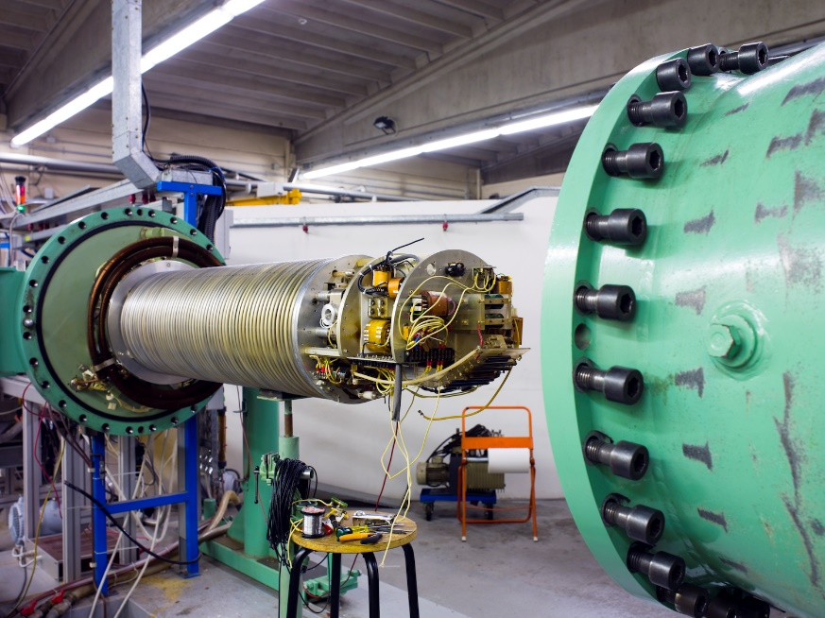
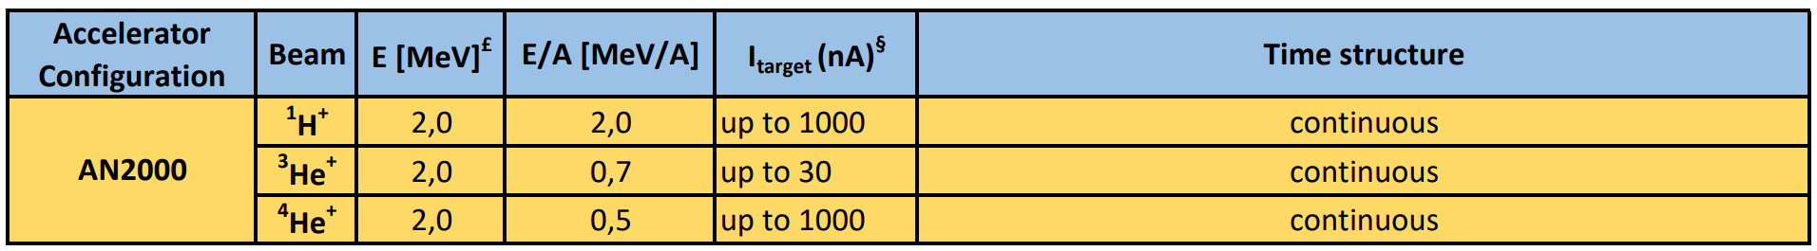
AN2000
Van der Graaf accelerator type. Light ions with 2 MV terminal voltage
Used for applied physics and nuclear physics experiment
Microbeam experiments

Slide 8
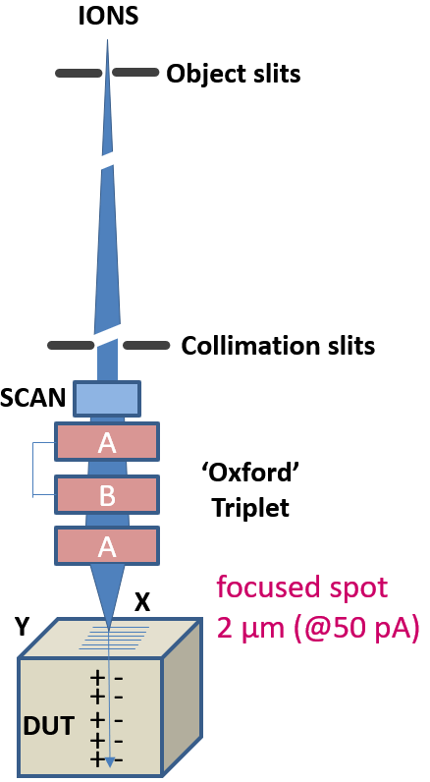
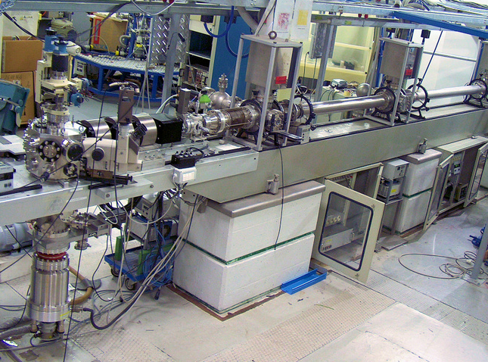
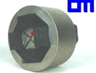
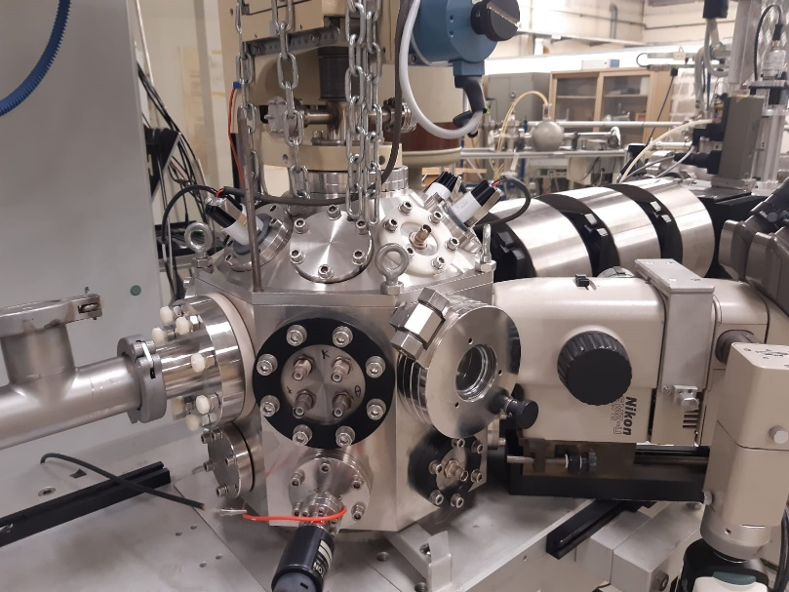
AN2000 - microbeam
Ultra low intensity (100-1000 p/s) ion beams rastered on the DUT
APPLICATIONS
► 2D detectors efficiency maps
► localised irradiations
Iron yoke cut from single piece, accuracy <2µm
Accurate hyperbolic pole tips
Undetectable 6-pole field contamination
Nucl. Instrum. Meth. B54 (1991) 52-63
Courtesy of Valentino Rigato and Matteo Campostrini – valentino.rigato@lnl.infn.it

Slide 9
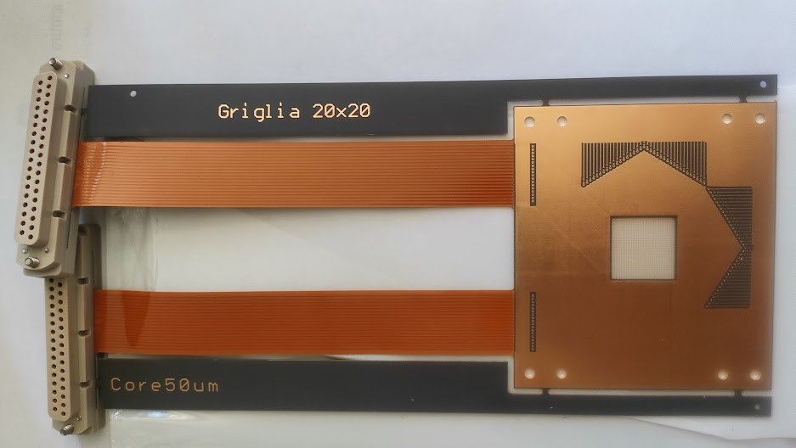
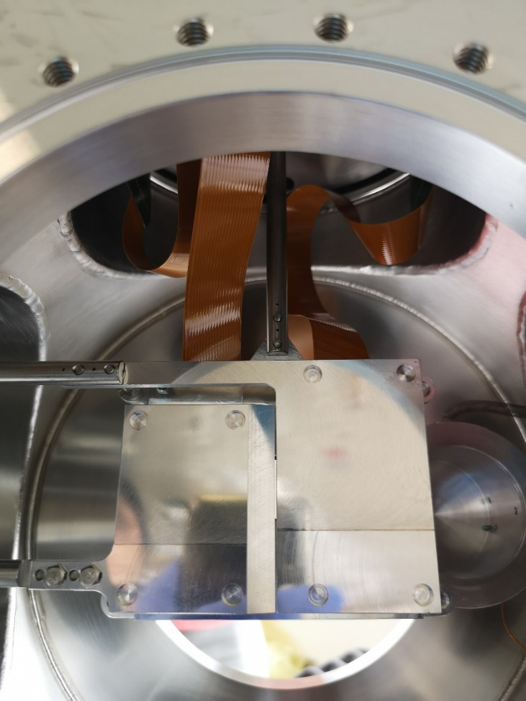
Accelerator components tests AN2000
Courtesy of Pierfrancesco Mastinu
Beam based alignment of the new SPES diagnostics
Relation between the centre of the wire and the actual position of the beam
collimator
AN2000 beam
Detector and readout

Slide 10
Heavy ion facility
RF type*
*Tandem type accelerator also

Slide 11
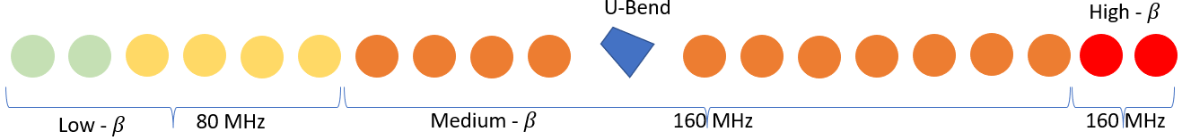
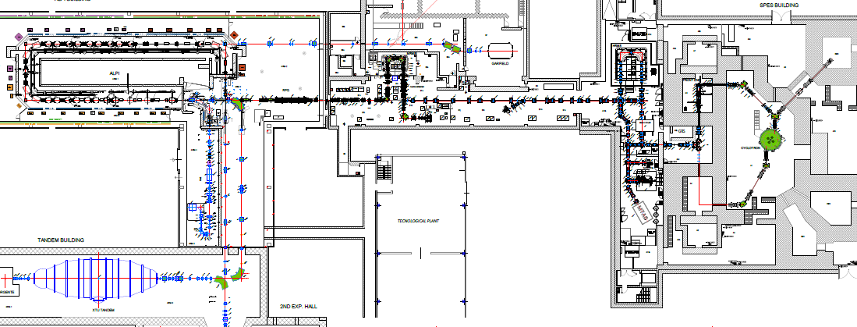
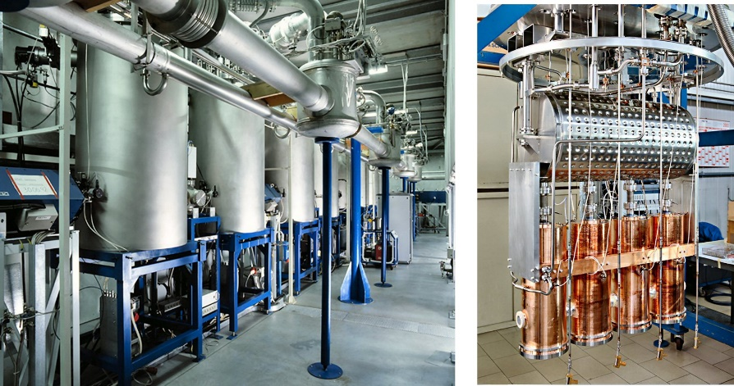
Tandem-ALPI-PIAVE facility
CW Folded independent cavity linac
Design and built 80’-90’
One of the first prototypes in Europe.
82 QW cavities at 4 K
  80 MHz low beta (0.047, 0.055)
  160 MHz medium beta (0.11)
  160 MHz high beta (0.13)
Output energy ions of about 10 MeV/amu
ALPI

Slide 12
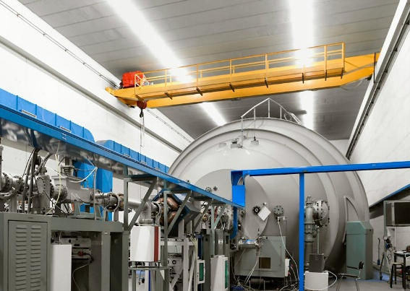
Tandem-ALPI-PIAVE facility
Tandem XTU accelerator
14 MV terminal voltage
Negative ion source
Up to light-medium A (around 50) for ALPI injection
Highest energies output for light ions, 22 MeV/u
ALPI
TANDEM

Slide 13
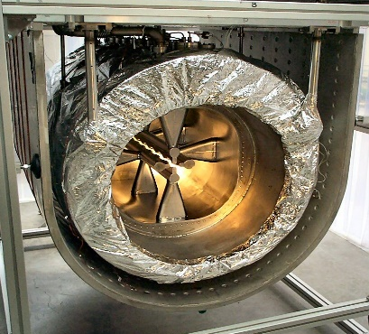
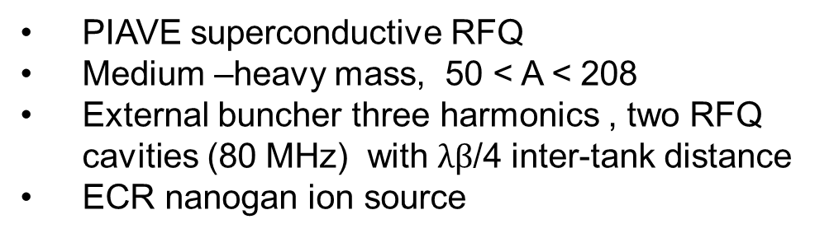
Tandem-ALPI-PIAVE facility
PIAVE superconductive RFQ
Medium –heavy mass, 50 < A < 208
External buncher three harmonics , two RFQ cavities (80 MHz) with $λβ$/4 inter-tank distance
ECR nanogan ion source
ALPI
PIAVE
TANDEM

Slide 14
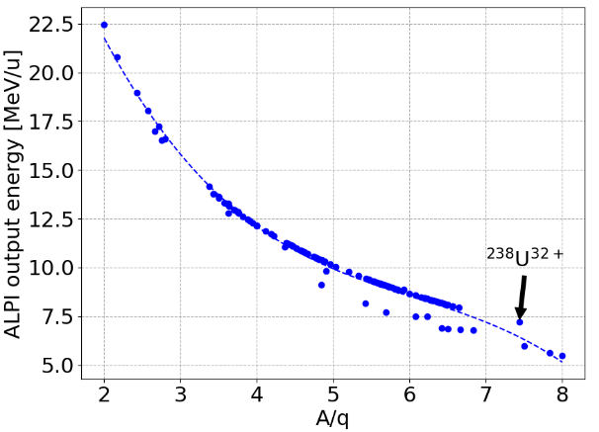
Tandem-ALPI-PIAVE facility
Up to hundreds nA, max A/q = 8 (NO SC issue whatsoever, problem on the applied fields)
From C to Pb (to U) and stable isotopes.
ALPI
PIAVE
TANDEM

Slide 15
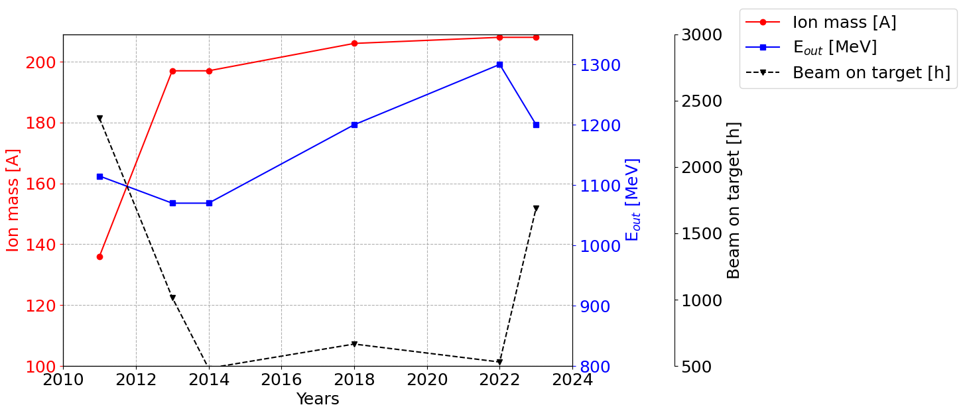

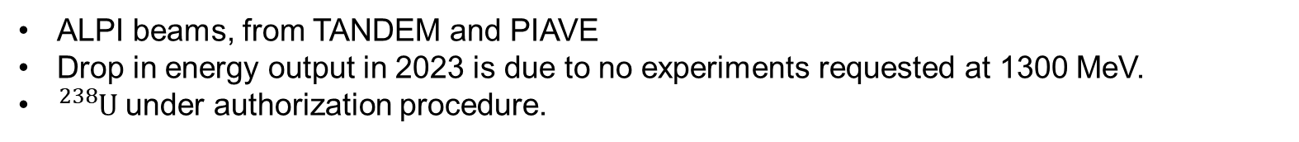



A decades of upgrades to accelerate heavy ions at higher energies
${}_{ }^{136}{Xe}$ - 2010-11
${}_{ }^{197}{Au}$ - 2013
${}_{ }^{206}{Pb}$ - 2018
${}_{ }^{208}{Pb}$ - 2022
ALPI beams, from TANDEM and PIAVE
Drop in energy output in 2023 is due to no experiments requested at 1300 MeV.
${}_{ }^{238}U$ under authorization procedure.

Slide 16
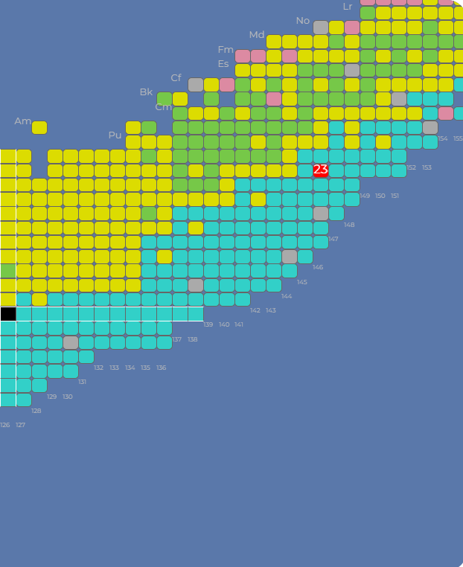
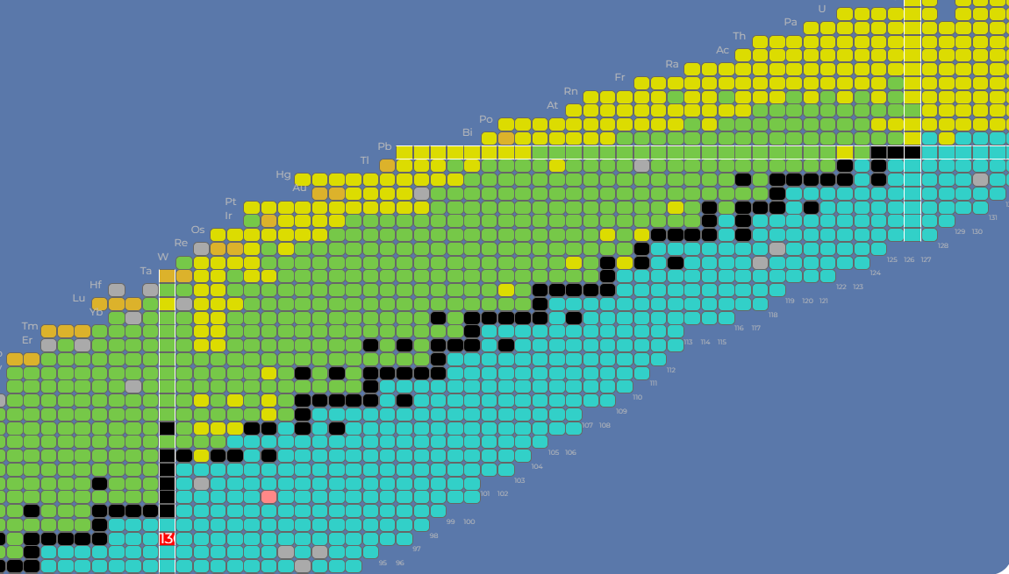


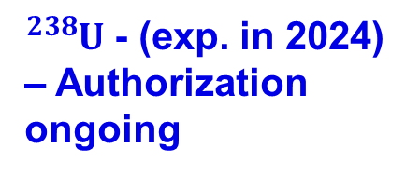


Towards heavy ions
${}_{ }^{208}{Pb}$ - 2022
${}_{ }^{206}{Pb}$ - 2018
${}_{ }^{238}U$ - (exp. in 2024) – Authorization ongoing
${}_{ }^{197}{Au}$ - 2013
${}_{ }^{136}{Xe}$ - 2010

Slide 17
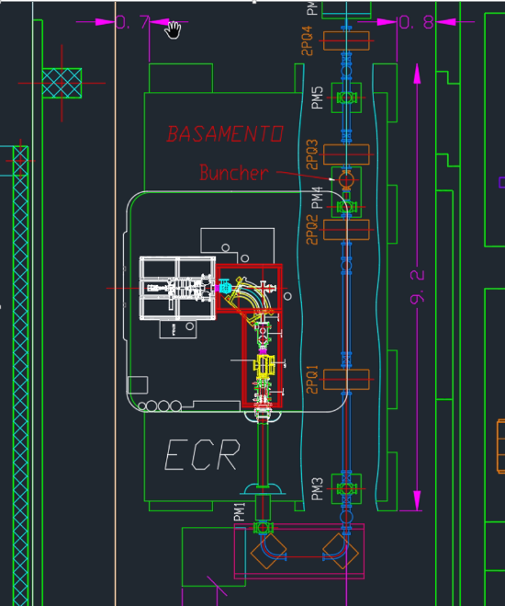
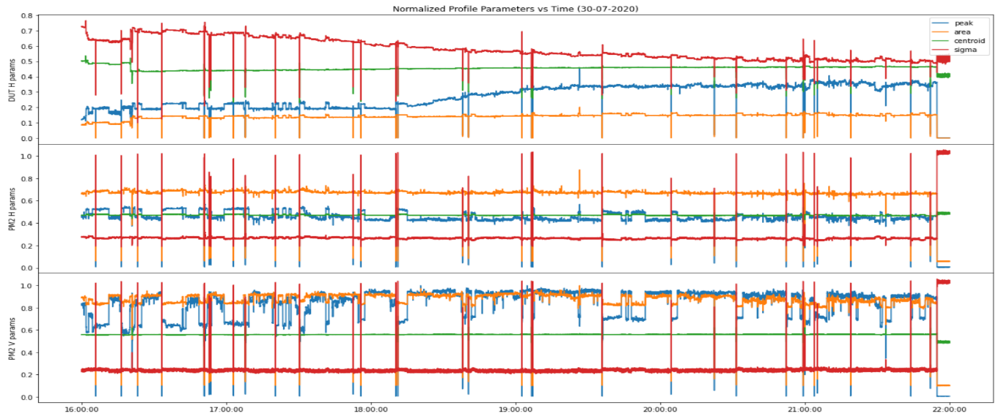
Accelerator components tests TAP - 2
Test on PIAVE LEBT of new beam profiler
Test of RIB profiler signal and RIB robustness
¹³⁶Xe¹⁸⁺ @ 2.23 MeV, I = 1.3 uA, 3 W
Possible to ramp up to 8 MeV, 2 uA, 16 W.
0.98-1.1 mW (interceped power on the central wire)
Installed new diagnostic box for testing accelerator components:

Slide 18
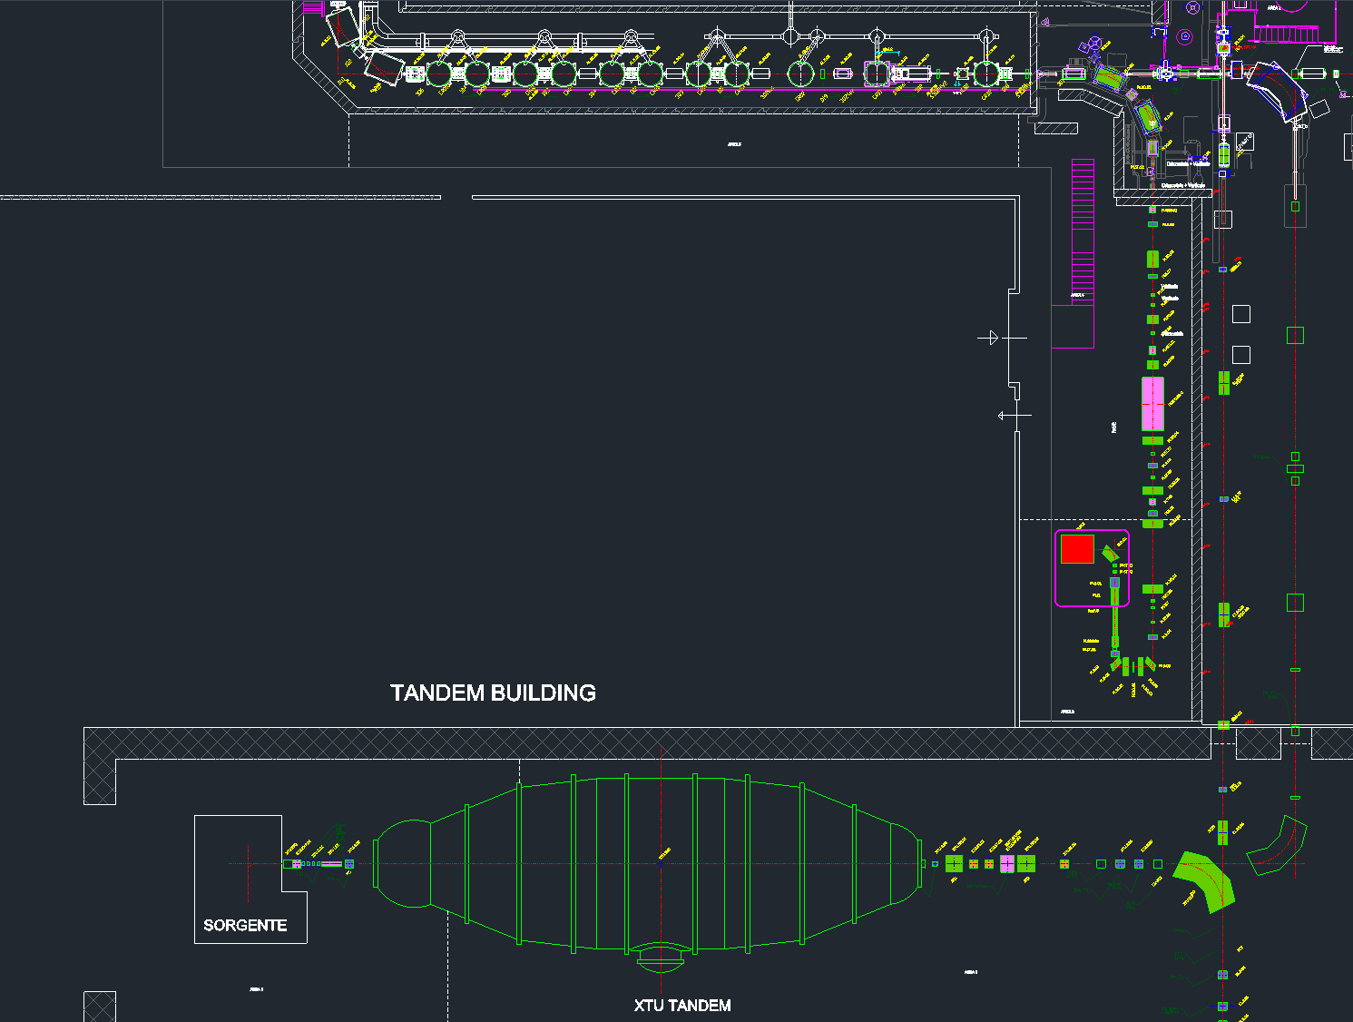
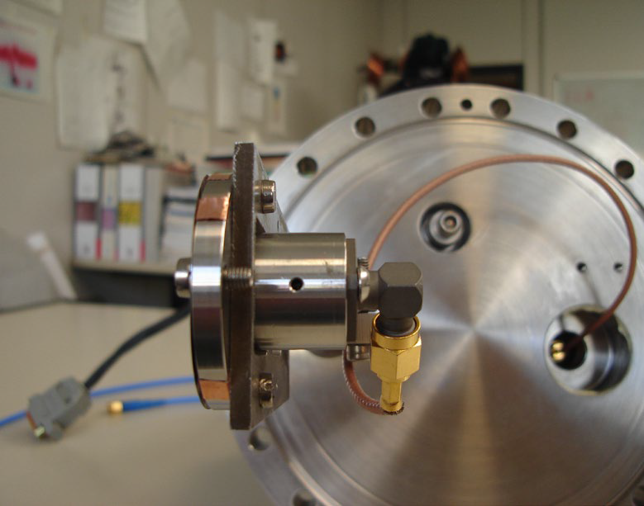
Accelerator components tests TAP - 3
Test on ALPI of FFC for longitudinal beam measurements
Test box
FFC
Buncher 80 MHz
The beam was ¹⁸O⁶⁺ at 100.26 MeV, 100 nA from TANDEM.
The 80 MHz buncher AL.HEB.01 was used in order to focus the beam longitudinally at test BOX diagnostics (which contains the FFC)

Slide 19
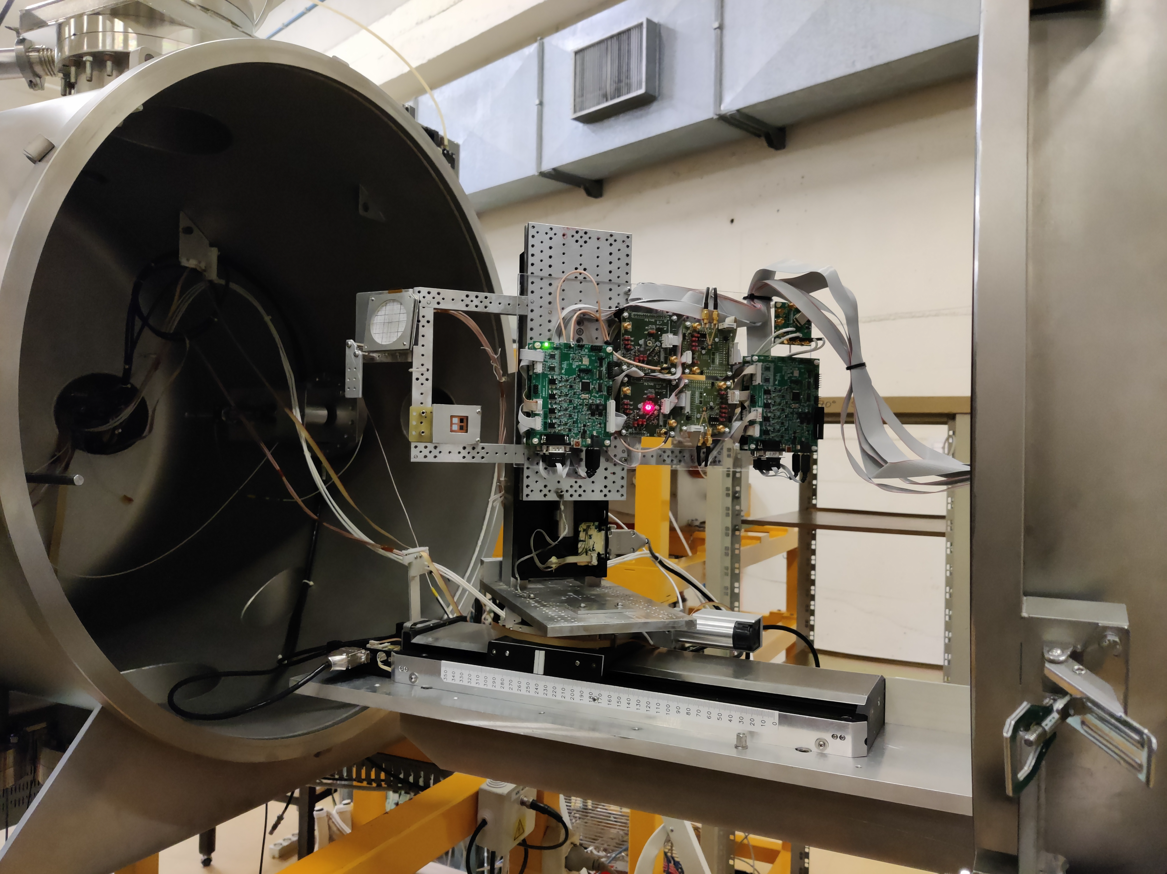
Irradiation for industries
First irradiation service for private company successfully tested before summer 2023.
A ¹³⁶Xe beam was accelerated with PIAVE-ALPI complex up to 1 GeV energy and sent to SIRAD irradiation chamber.
Flux dosimeter and uniformity calibration was performed by 2 boards hosting 4 silicon diodes each.
Average beam flux was about 2 x 10³ ions/cm²/sec and total accumulated flux was 1 x 10⁷ ions/cm² in 8.3 min exposure.
LET = 89.5 MeV cm²/mg
Courtesy of Jeff Wyss, wyss@unicas.it

Slide 20
General overview

Slide 21
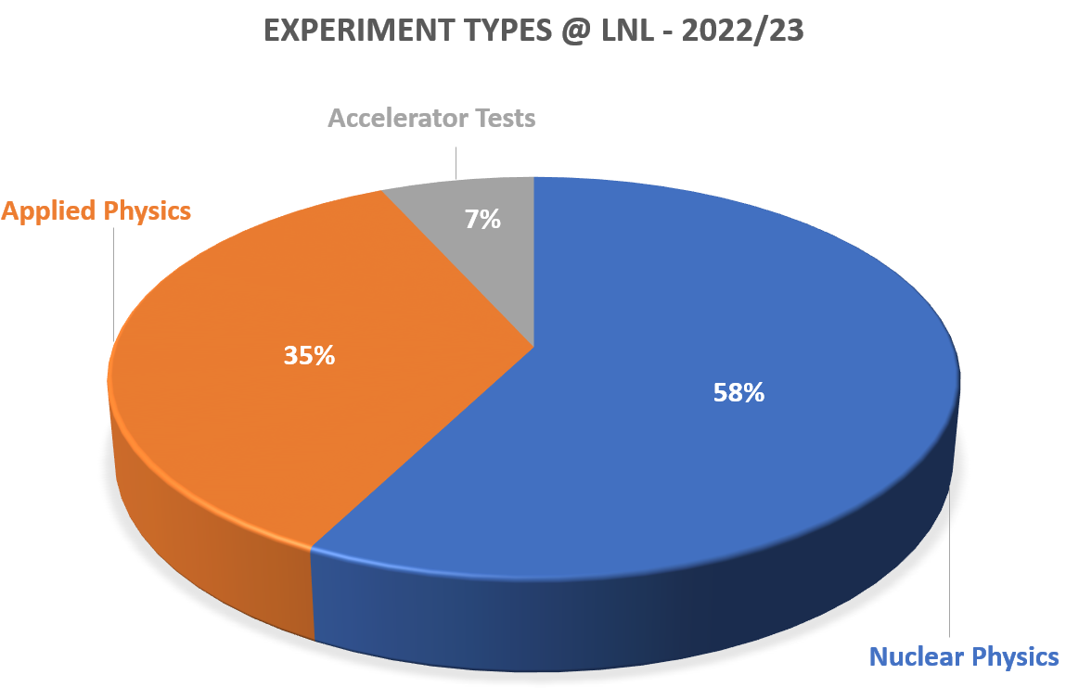
Experiments - overview
Applied physics:
Surface studies (sputtering characteristics)
Irradiation for material/components testing
Medical physics
Radiological studies
Accelerator tests:
Accelerator improvement studies
Experimental run feasibility studies
Diagnostics and accelerators components tests
High level application tests.

Slide 22
Accelerators overview

Slide 23
Upgrades

Slide 24
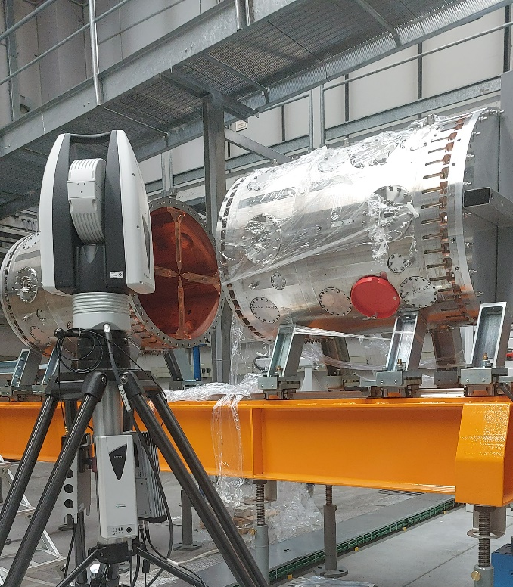
Tandem-ALPI-PIAVE – Normal conductive RFQ
ALPI
SPES RFQ
PIAVE
SPES RFQ: normal conductive 4-vane internal bunching RFQ
coupled with SPES Charge-Breeder (ECRIS type) and MRMS
Higher energy injection to ALPI, 727 keV/u VS 587.5 keV/u (PIAVE)
Optimized longitudinal emittance output
Higher RFQ transmission: 93% SPES vs 55% PIAVE
TANDEM

Slide 25
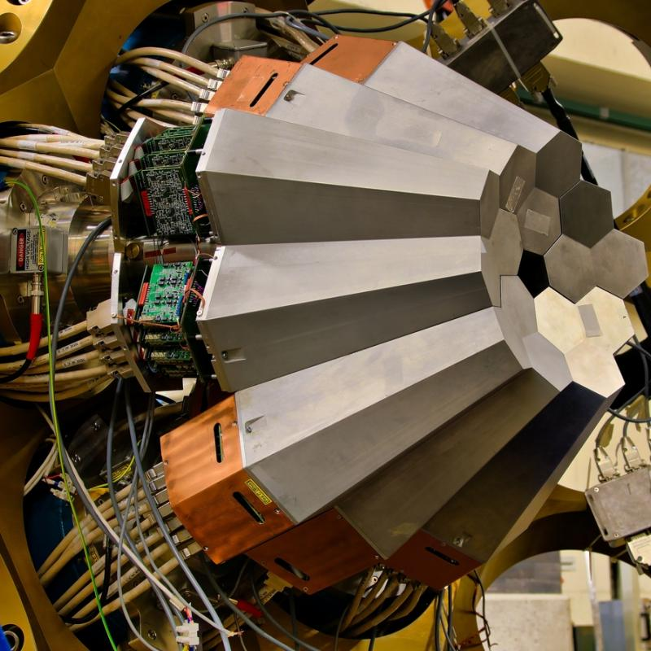
SPES upgrade
Radioactive ion beams input through the SPES RFQ
Use of existing superconductive linac ALPI to post accelerate the RIBs
AGATA
AGATA: HPGe detector array

Slide 26
SPES upgrade
ISOL target
ADIGE
Cyclotron
Cyclotron: 30-70 MeV H⁺, 800 uA
Target: UCx target ISOL type
ADIGE: post acceleration and charge breeding line
AGATA: HPGe detector array
AGATA

Slide 27
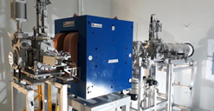
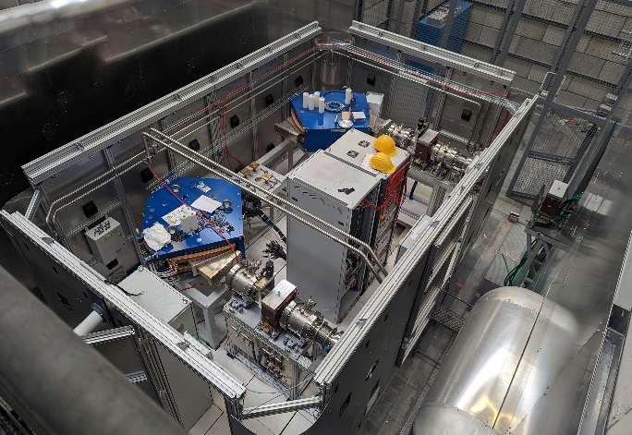
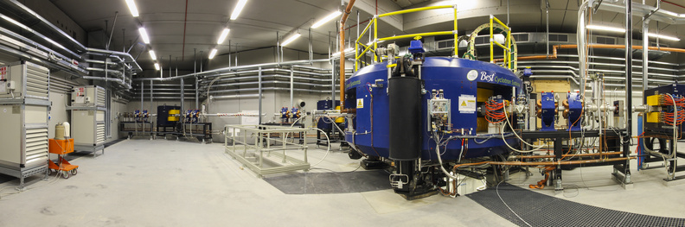
SPES upgrade
ISOL target
ADIGE
Cyclotron
Cyclotron: 30-70 MeV H⁺, 800 uA
Target: UCx target ISOL type
ADIGE: post acceleration, medium mass sepration and charge breeding line
AGATA: HPGe detector array
AGATA

Slide 28
Cyclotron
Normal conductive cyclotron with double extraction lines (70 MeV protons at 800 uA). It is under commissioning, and it will be equipped with eight target stations. Main stations here
LARAMED: research on medical radionucleotides
ISOL 1 & 2 : SPES and other activities

Slide 29
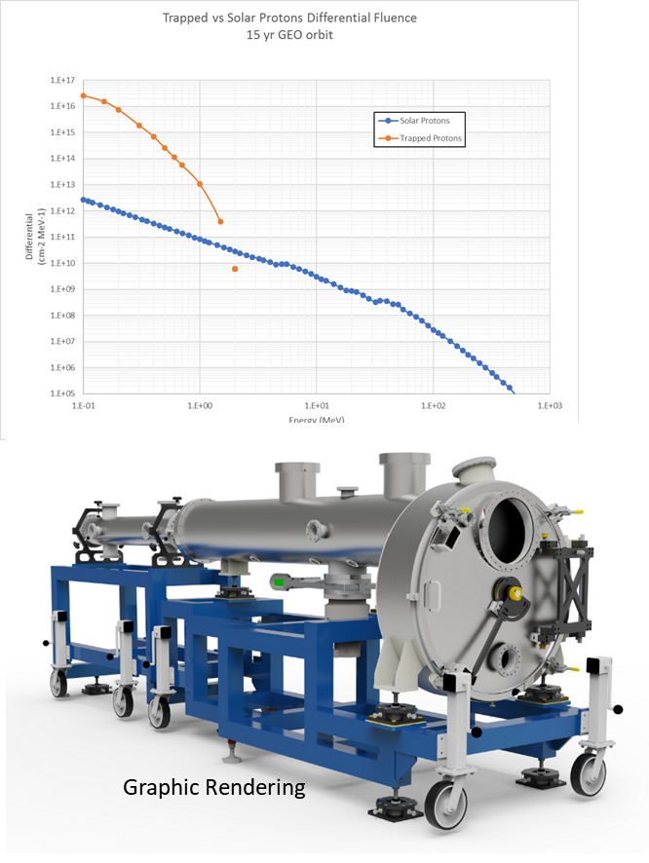
CN – irradiation upgrade
BEAM FEATURES:
  Monochromatic Beams: ¹H+, ⁴He+
  Energy: 0.2÷5.5 MeV
  Standard Beam Size: 2÷8 mm (FWHM)
  Beam Current: 1-400nA (typical)- (400nA - 2μA energy dependent)
IRRADIATION SPECIFICATIONS OF THE NEW FACILITY
  Large area uniform irradiation of spacecraft materials and components in a wide range of energies and fluences
    Fluence: 1x10⁹ ÷ 10¹⁶ cm⁻²
    Energy: 0.2÷5.5 MeV
  Large area
    ΔX·ΔY=20x20cm² @ 2 MeV, ΔX·ΔY=8·8cm² a 5.5 MeV
    XY beam scanning
  Uniformity
    Spatial uniformity: target ≤ ±1%
  Accuracy
    Accuracy: base ≤ ±5% - target to ≤ ±3% (multiple Faraday cups)
  No Carbon build-up (cryogenic LN2 trap)
  Time for full irradiation
    From 30s to several hours
  Certification of irradiation: ESA/ASI ongoing
Courtesy of Valentino Rigato and Matteo Campostrini – valentino.rigato@lnl.infn.it

Slide 30
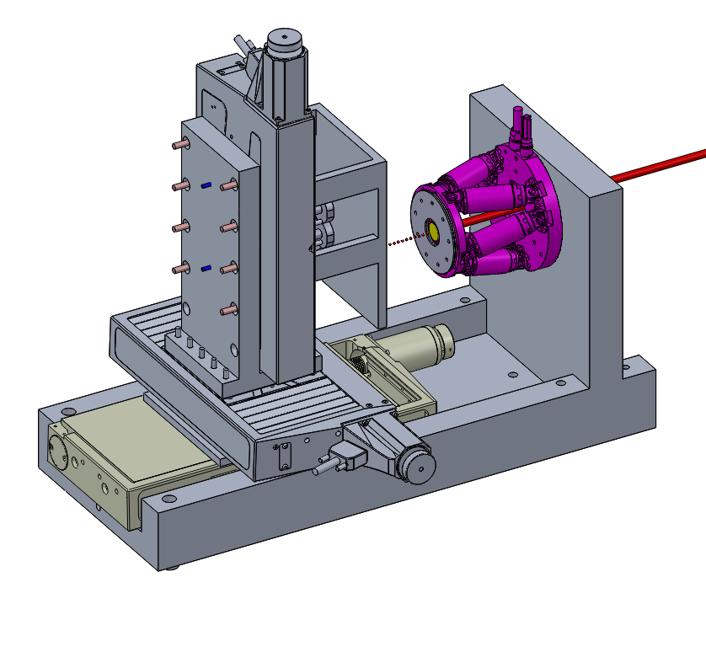
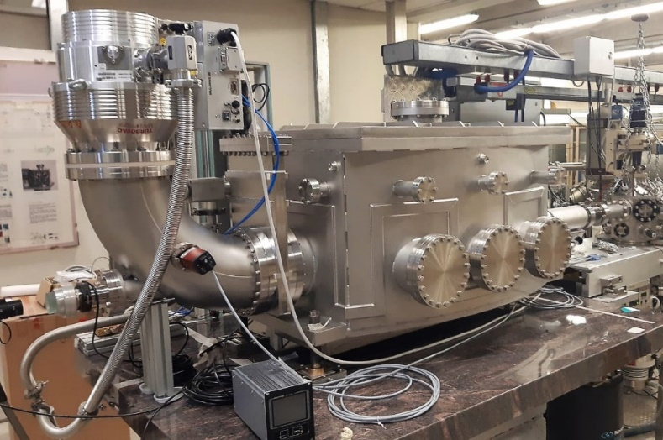
AN2000 – line upgrades
DUT holder
ΔY travel: 100mm, bi-direct. repeatability ±50 nm
ΔZ travel: 50mm, bi-direct. repeatability ±50 nm
ΔX travel: 150mm, bi-direct. repeatability ±2 µm
Collimator holder
Parallel-kinematic design for six degrees of freedom (X, Y, Z, θ_{X}, θ_{Y}, θ_{Z}) for collimator precise alignment with ion beams
beam
APPLICATIONS
► Shoot single ions in precise position (Z_{i},Y_{i}) in ΔZ, ΔY steps
  2D array of individual defects
  Single photon sources (eg.: QUANTEP)
► Vary the energy keeping the DUT-collimator relative position fixed
  Individual centers in 3D (Z_{i}, Y_{i}, X_{i})
► Vary ion specie at same (Z_{i},Y_{i}) position: creation of totally new color centers / defects with multiple single ion implantation in semi and super conductors
► Localized irradiation of nano-wires and band engineered low-D materials(IV, III-V) (QUANTUM SENSING and METROLOGY, PHOTONICS)
Chamber at 0° beam-line at AN2000
Low divergence ion beams
Vibration free pumping system
Water with temperature control (±0.5°C)
Vacuum: ≤1x10⁻⁷ mbar
Courtesy of Valentino Rigato and Matteo Campostrini – valentino.rigato@lnl.infn.it

Slide 31
Contact information:
Accelerator Division (beam requests and questions)
enrico.fagotti@lnl.infn.it – Accelerator division head
giovanni.bisoffi@lnl.infn.it
luca.bellan@lnl.infn.it
PACbeams@lnl.infn.it (information about beams, species energies)

