Slide 1


The Henryk Niewodniczański Institute of Nuclear Physics
Polish Academy of Sciences, (IFJ PAN)
IFJ PAN accelerator facilities
Jan Swakoń
Department of Radiation Research
and Proton Radiotherapy

Slide 2
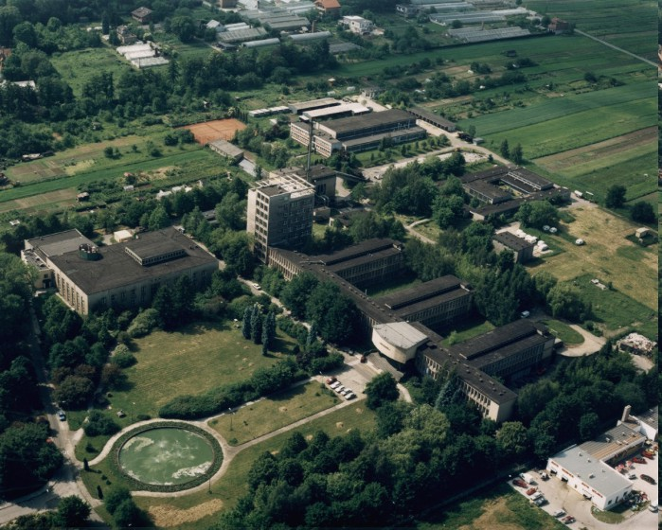
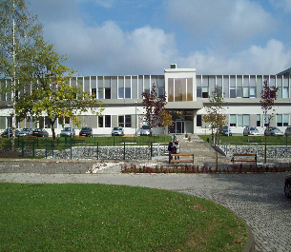
The Henryk Niewodniczański Institute of Nuclear Physics
Polish Academy of Sciences, IFJ PAN
- established 1955
550 employees (220 with Ph.D. degree)+70 Ph.D. students, over 120 highly qualified engineers and technicians.
main interest:
particle physics (CERN)
nuclear physics
applied research:
60 MeV proton cyclotron
230 MeV Proteus IBA
-proton radiotherapy
Cyclotron Centre Bronowice
AIC-144
Cyclotron building
Proteus C-235

Slide 3
The Henryk Niewodniczański Institute of Nuclear Physics
Polish Academy of Sciences, IFJ PAN
CCB
Cyclotrone Centre Bronowice
Proteus C-235

Slide 4
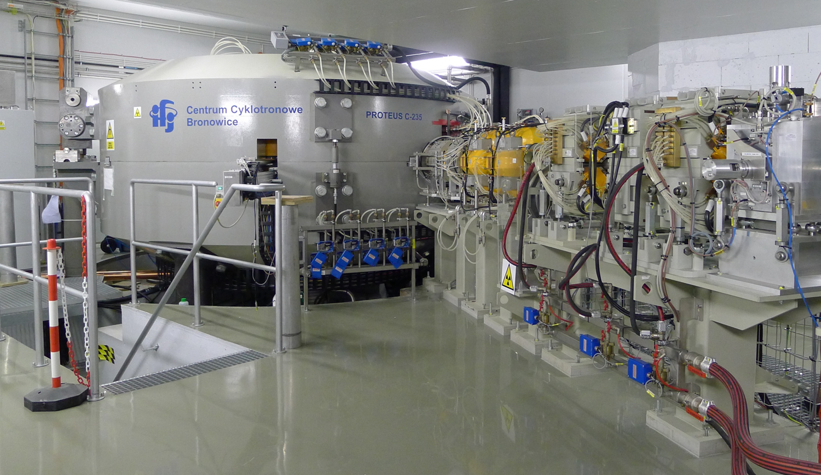
Proteus C-235
BEAM PARAMETERS:
Energy 230 MeV; RF 106 MHz;
quasi continuous beam; beam current 500 nA (for 230 MeV);

Slide 5
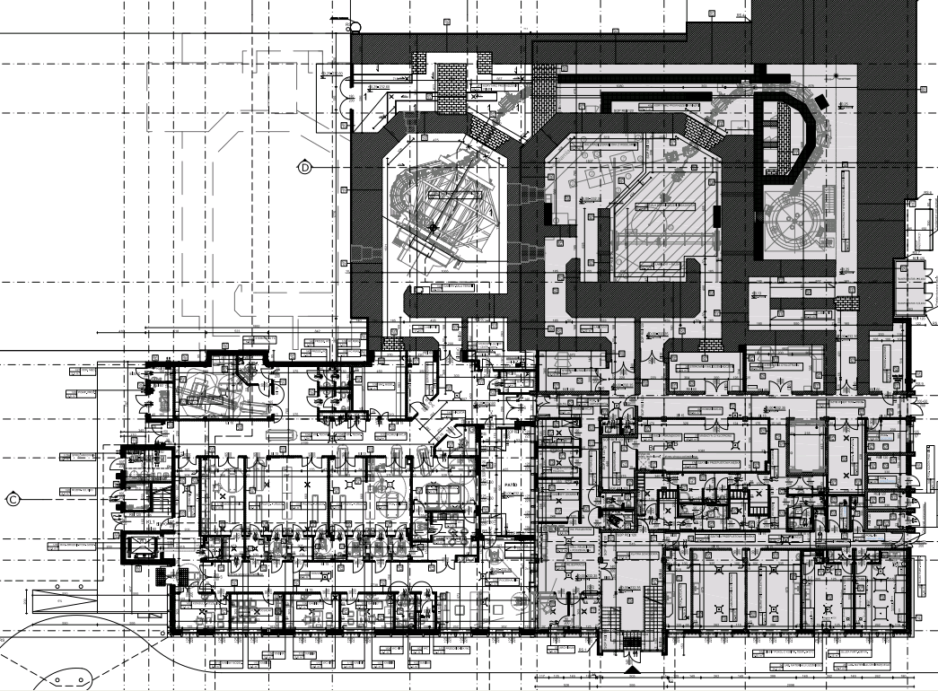
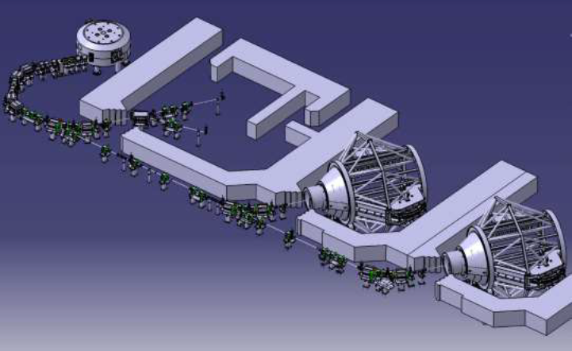
CCB infastructure
Energy selector
Eye Therapy
room
Cyclotron
Proteus C-235
Experimental
room
eye treatment room
Gantry 2
Gantry 1
experimental room
Utility rooms
gantry
Medical building
230 MeV cyclotron
Laboratories
P. Olko M. Jezabek NCRH

Slide 6
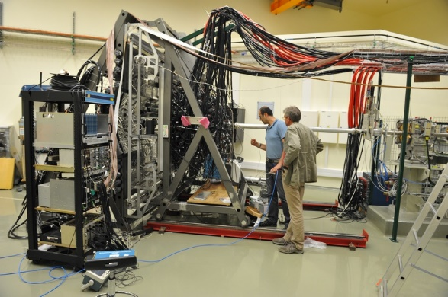
Experimental room (CCB Proteus C-235 building)
Proton beam energy:
70MeV – 230MeV;
Beam current: 1nA - 100nA for 230MeV;
2nA for 70MeV;
Spot size: 5.5 mm (1σ);
Energy less than 70MeV after degradation;

Slide 7
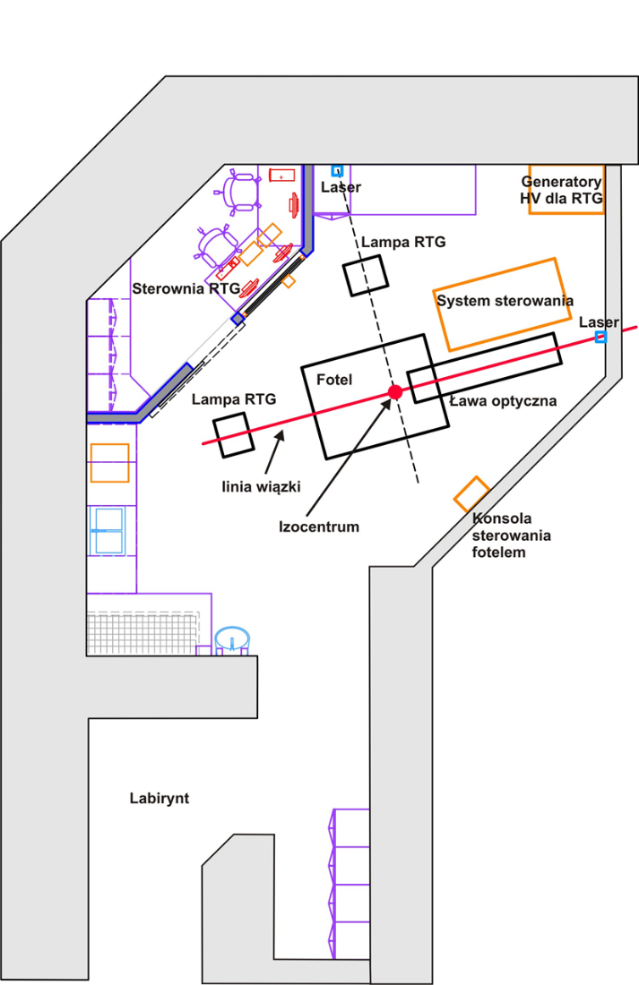
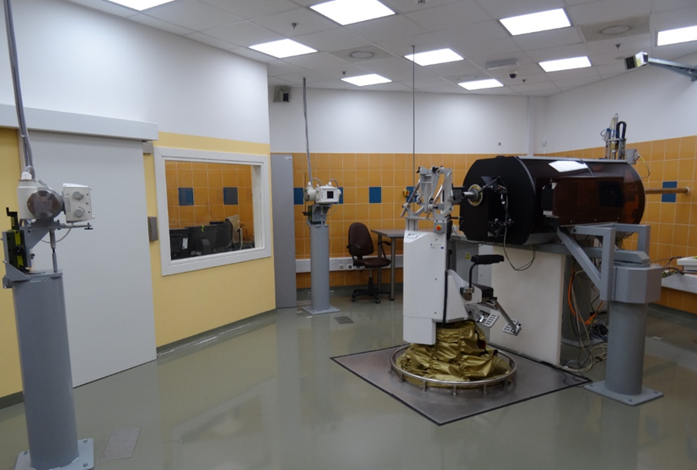
Proton eye therapy room ELTR in CCB
(proton beam from Proteus C-235)
Energy : 0 - 60 MeV;
Precise Energy regulation in range 10 MeV – 60 MeV
Dose rate: 0.001 – 0.3 Gy/s (measured in water);
Single scattering;
Field size: ≤ 40 mm;
Beam field homogeneity≥ 5%;
Irradiation in SOBP available;
Sample positioning precision(> 0.1 mm);
It is not possible to deposit high doses (>1 kGy);
Eye therapy room
Limited access to the room due to medical applications

Slide 8
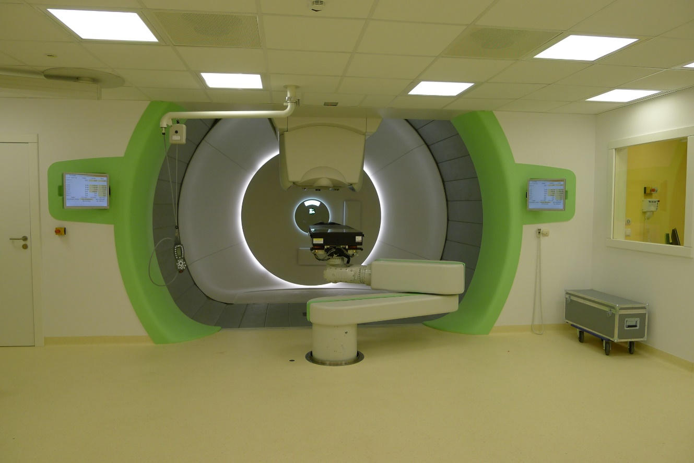
Gantry (GTR3, GTR4)
Energy range: 70 MeV – 230 MeV;
Spot size: 3 – 7 mm (1σ);
Field size(scanning beam): 30cm x 40cm;
Field homogeneity: ≤ 2%;
Dose rate: 2Gy delivered into 1 litre volume in 90 s;
Irradiation in SOBP available;
Sample positioning precision(> 0.1 mm);
It is not possible to deposit high doses (>1 kGy);
Limited access to the room due to medical applications

Slide 9
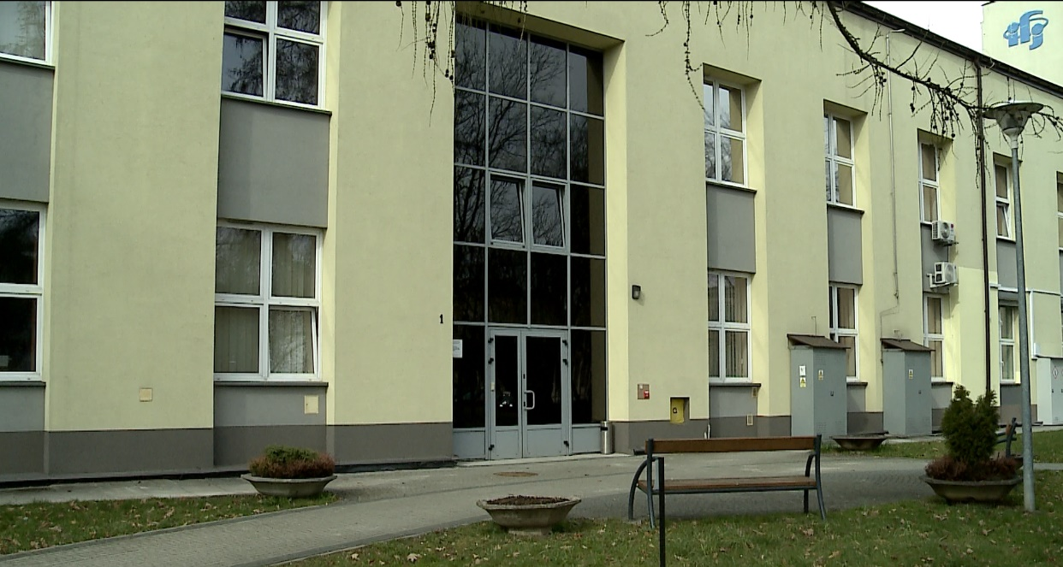
The Henryk Niewodniczański Institute of Nuclear Physics
Polish Academy of Sciences, IFJ PAN
AIC-144 Facility
AIC-144
Cyclotron building

Slide 10
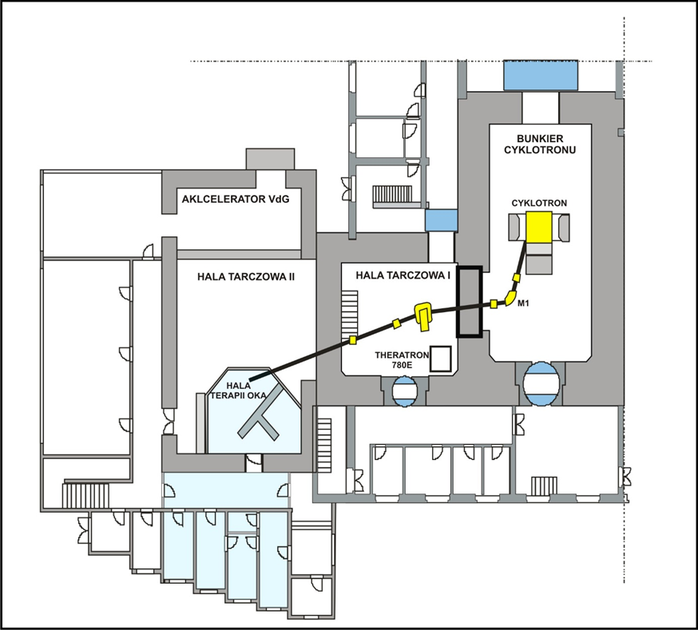
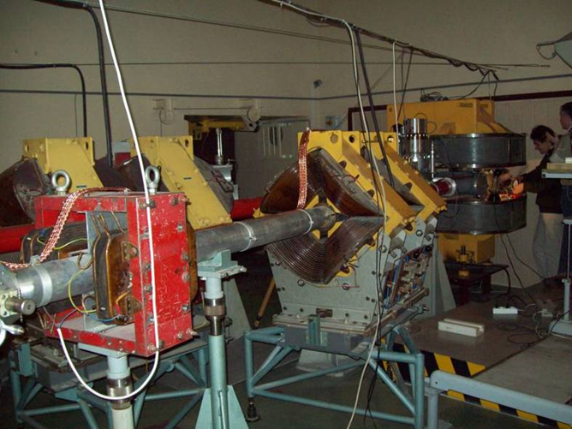
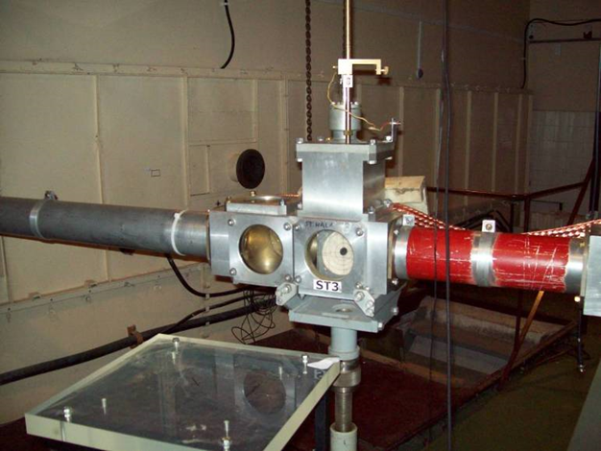
AIC-144 cyclotron facility
Beam lines
Scattering foil (tantalum 25um)

Slide 11
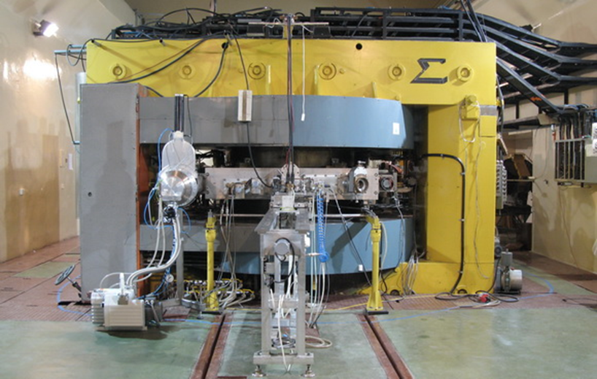
AIC-144 isochronous cyclotron
BEAM PARAMETERS:
Energy 60 MeV; RF 26,26 MHz;
Beam macro structure 50 Hz, macro pulse length 0.5 ms, beam current 80 nA (110nA);

Slide 12
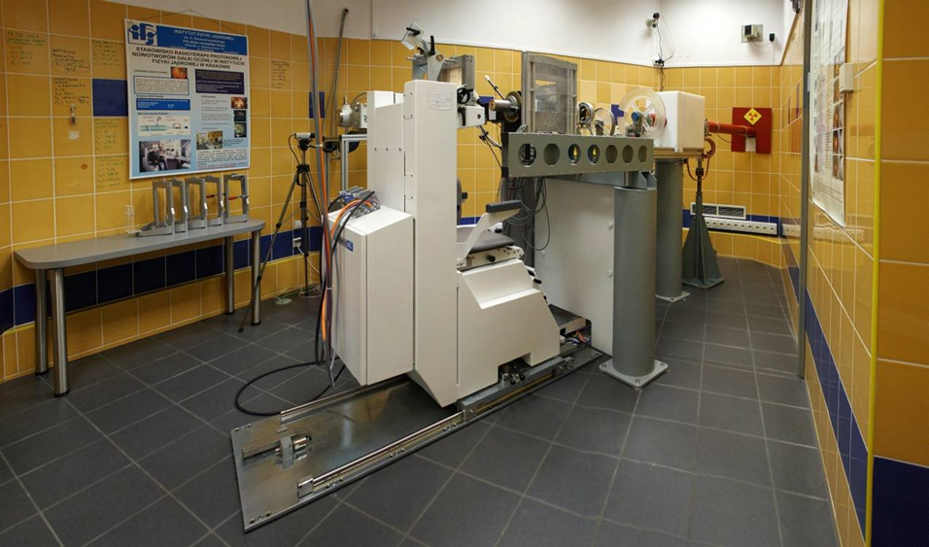
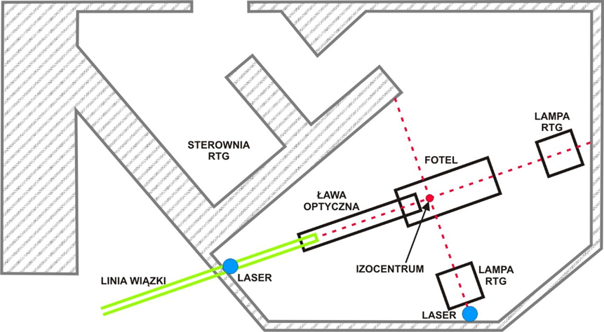
Irradiation facility with horizontal beam line
(AIC-144 cyclotron)
Eye therapy room
Energy: 0-58 MeV;
Dose rate: 0.001 – 1 Gy/s (measured in water);
Single scattering;
Beam field size: ≤ 40 mm;
Field homogeneity ≥ 5%;
Min flux of protons: 5e5 p/cm2·s (50MeV);
Typical flux: 10e8 – 10e9 p/cm2·s;
Irradiation in SOBP available;
Sample positioning precision(> 0.1 mm);
It is not possible to deposit high doses (>1 kGy);
It is possible to apply for beam time

Slide 13
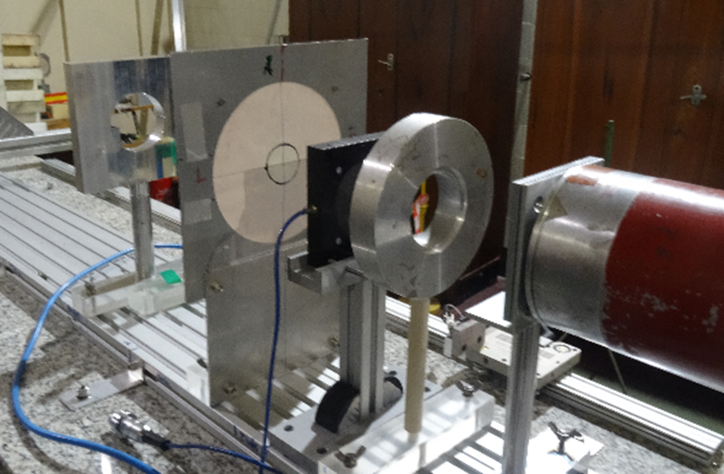
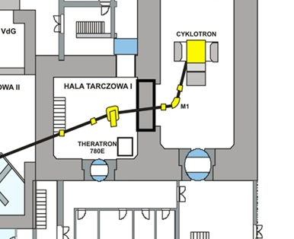
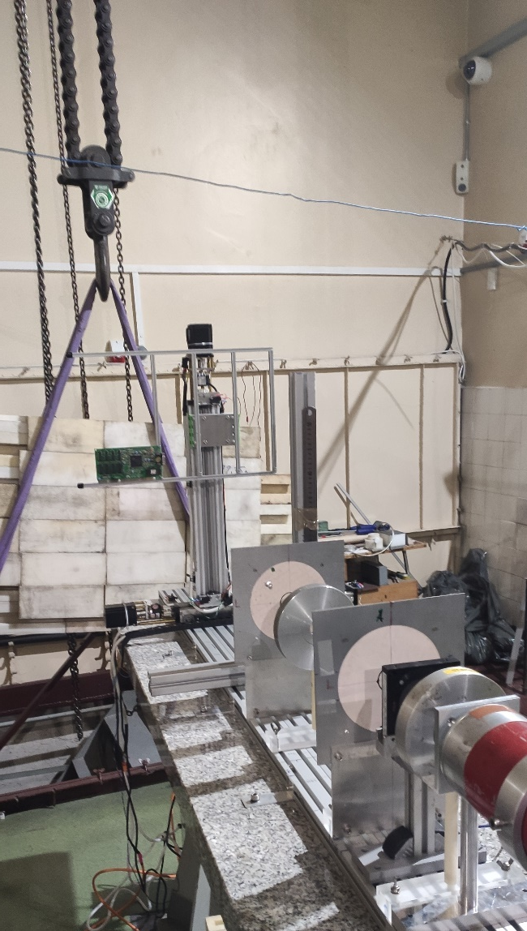
Optical line at the experimental room at the AIC-144 cyclotron building
Energy: 60 MeV (10MeV-60MeV);
Proton beam current: 2nA – 100nA;
Spot size: ~ 10mm (1σ, estimated);
Possible Energy degradation to the 10 MeV;
Irradiation field diameter < 12 cm;
Flatness ≥ 15% (±10%);
High beam and irradiation field configuration flexibility
Facility dedicated to low energy protons (10-60MeV)
and high beam intensity (10-20 (80)Gy /s);
Possibility to deposit very high doses (> 120kGy in H2O);
It is possible to apply for beam time

Slide 14
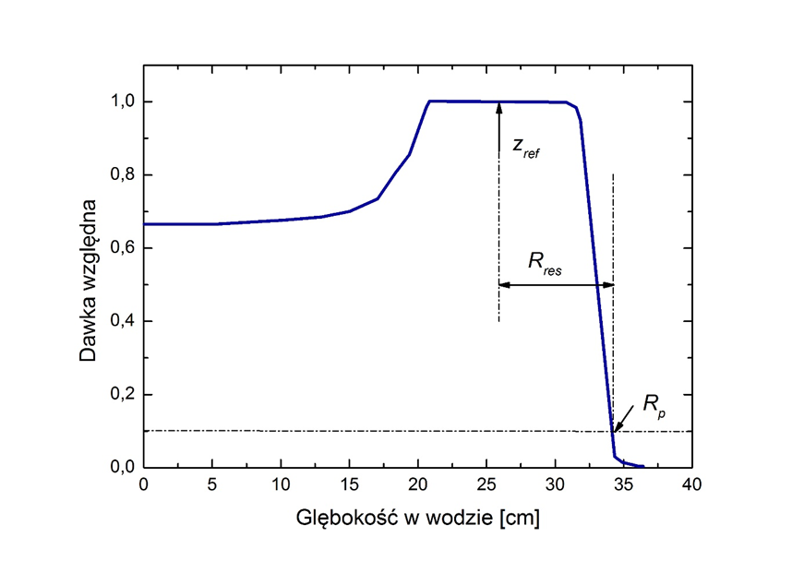
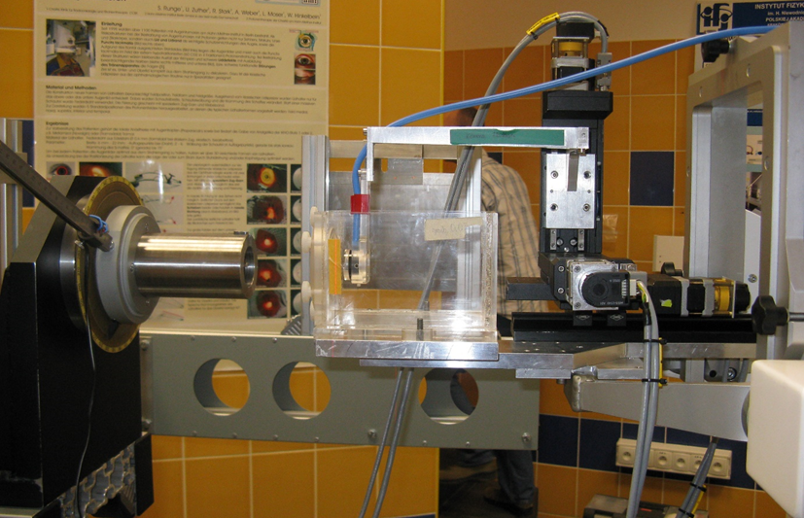

Beam dosimetry for electronics radiation hardness tests
Proton beam reference dosimetry based on the recommendations of the IAEA TRS-398 Code of Practice protocol
dose measurement with ionization chambers calibrated in the Co-60 radiation field, dose measurement performed in a water phantom
$$D_{w,Q}= M_{Q}∙N_{D,wQ_{O}}∙k_{Q,Q_{O}}$$

Slide 15
Dosimetry methods
Dose and proton beam current measurements:
Ionisation chambers: semiflex IC, Pinpoint IC Markus IC, transition parallel IC;
Diamond detectors semiconductor diodes;
Reference class electrometers: PTW UNODOS, PTW UNIDOS Webline;
Water phantoms, solid state phantoms, (PMMA, RW3), anthropomorphic phantoms,
Beam current measurements:
Faraday cup, Keithley electrometers;
Measurement of transverse profiles and imaging of beam transverse distributions
(scintillator +CCD camera):
ProBimS:
Lynx;
Passive:
Gafchromic EBT3;
TLD, 2DTLD dosimeters;
Alanine pellets
Beam current measurement with Faraday cup
LynX beam profile measurements

Slide 16
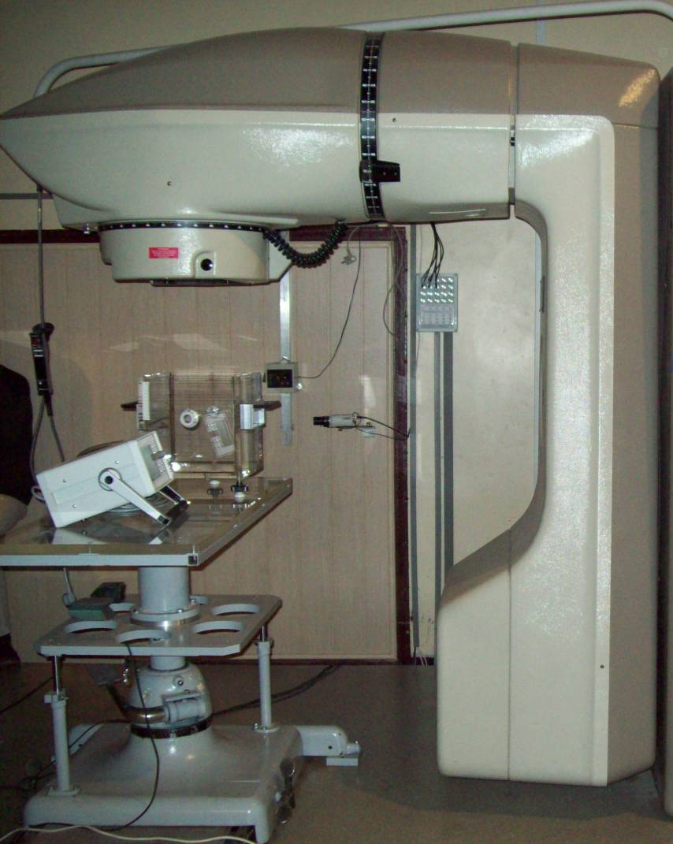
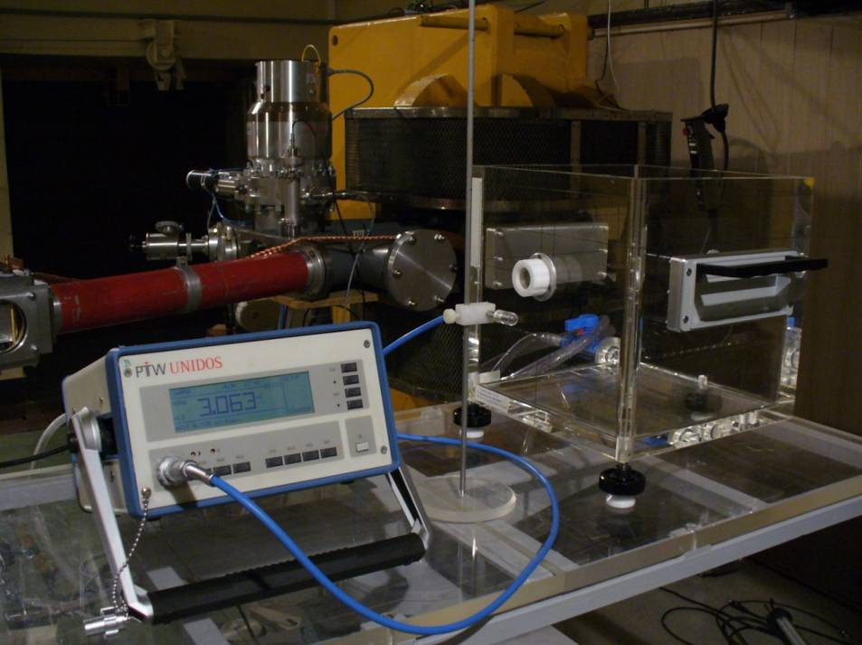
THERATRON 780E
⁶⁰Co γ-rays 237 TBq
Dose rate 0.5 -2 Gy/min
Field size 20 cm x 20 cm;
Traceability: Secondary Standard Laboratory, Centre of Oncology Warszawa (->IAEA)

Slide 17
Thank you for your attention

