Slide 1
The use of modern spectroscopic methods for evaluation of the effects of ketogenic diet used in pregnancy on the nervous system development in offspring
May 19, 2023
Speaker: Marzena Rugieł
Supervisor: Prof. Joanna Chwiej and Prof. Zuzanna Setkowicz-Janeczko
Department: Faculty of Physics and Applied Computer Science, AGH University of Science and Technology

Slide 2
Purpose of the research work
The treatment of pregnant epilepsy patients is particularly difficult as most anticonvulsants strongly affect the developing nervous system of the fetus.
There is a great need to investigate the alternative therapies and one of the approaches may be the use of the ketogenic diet, which was successfully used as a treatment of drug-resistant epilepsy in children and adults.
What is the effect of the maternal ketogenic diet on the fetus?

Slide 3
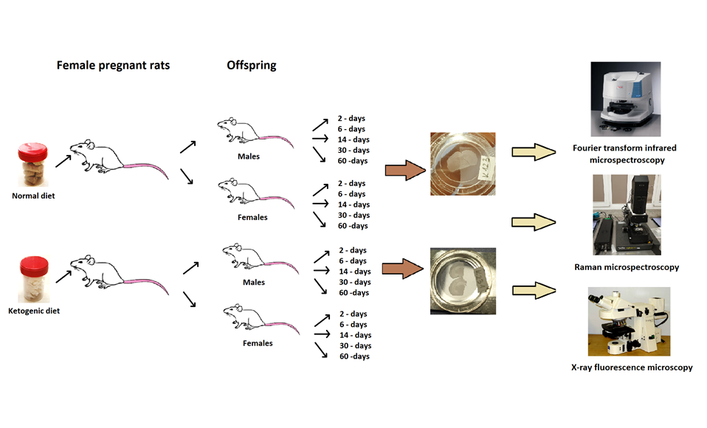
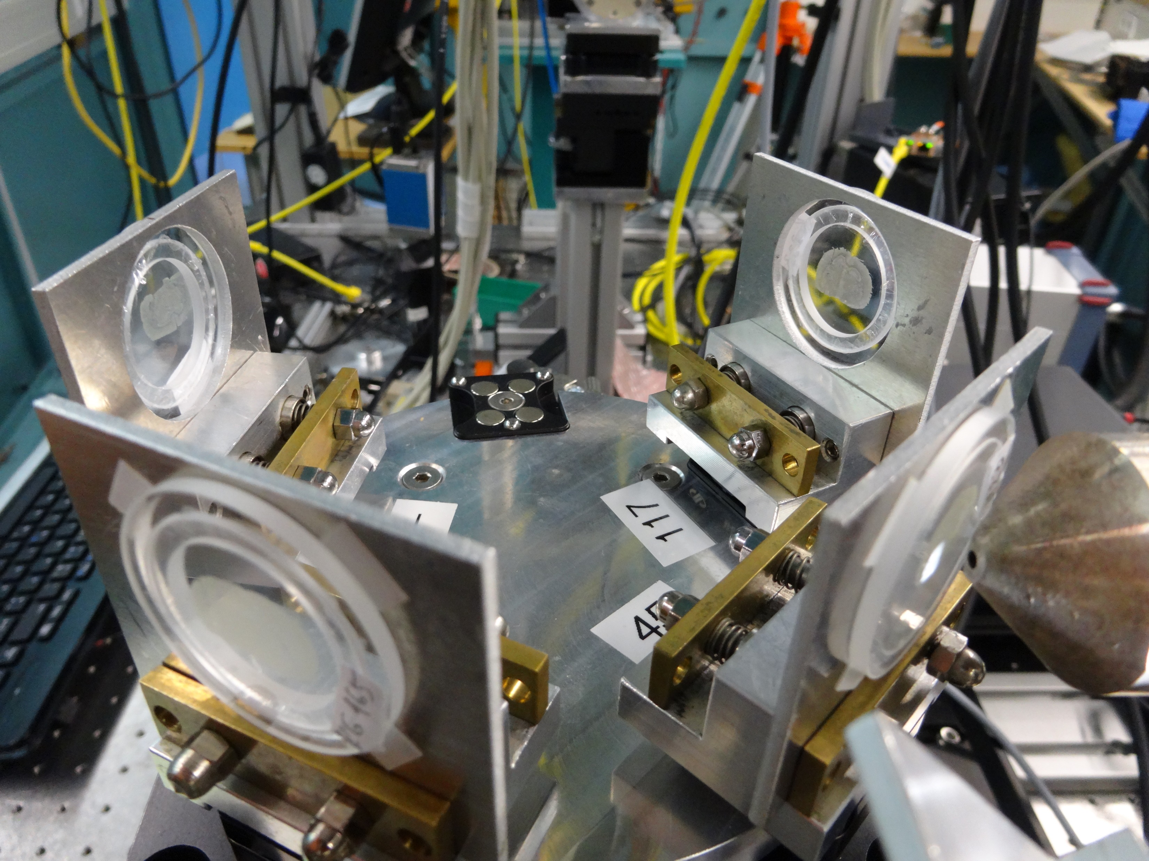
Purpose of the research work

Slide 4
Ketogenic diet: quick reminder
A ketogenic diet (KD) is defined as a high-fat, low-carbohydrate diet that induces ketone body production in the liver through fat metabolism.
Fatty acids produce the ketone bodies acetoacetate (which spontaneously converts to acetone) and β-hydroxybutyrate, which enter the bloodstream and are utilized by organs where they are further metabolized in mitochondria to generate energy.
Ketone bodies become the major fuel source for the central nervous system, replacing glucose.

Slide 5
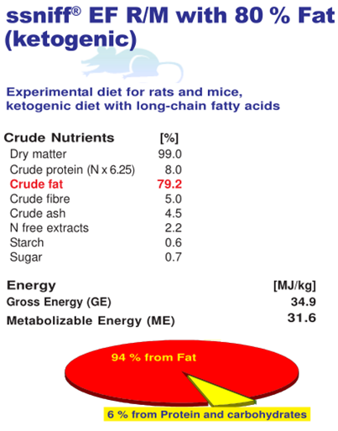
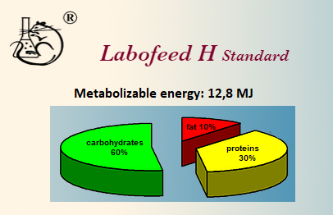
Ketogenic and normal diets

Slide 6
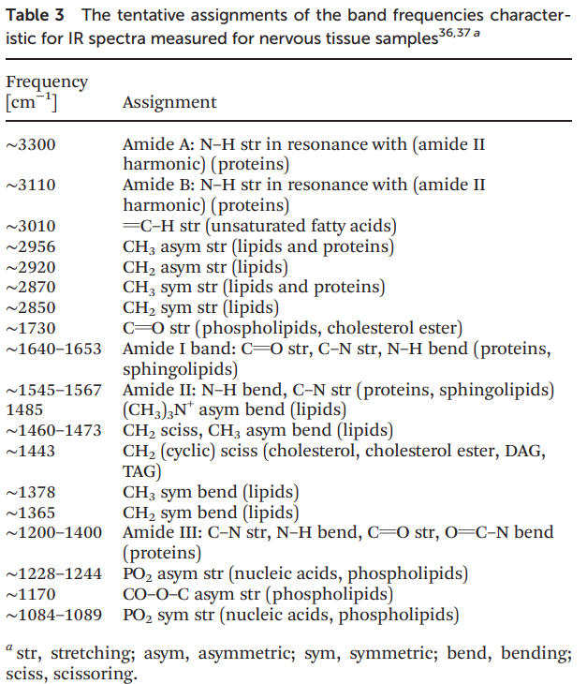
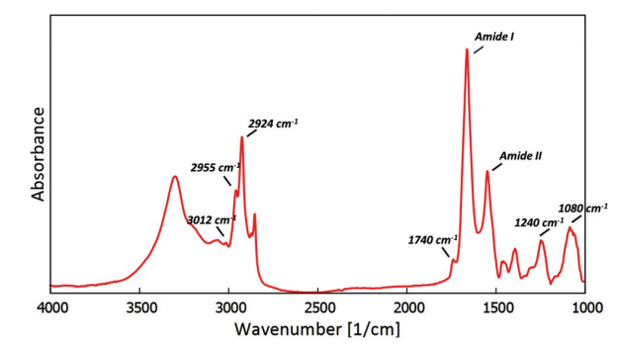
Fourier transform infrared microspectroscopy: quick reminder
The tentative assignments of the band frequencies characteristic of IR spectra measured for nervous tissue
The typical spectrum (baseline corrected) recorded for the hippocampal formation tissue
Chwiej et al.(2015). The biochemical changes in hippocampal formation occurring in normal and seizure experiencing rats as a result of a ketogenic diet. The Analyst, 140(7), 2190–2204.

Slide 7
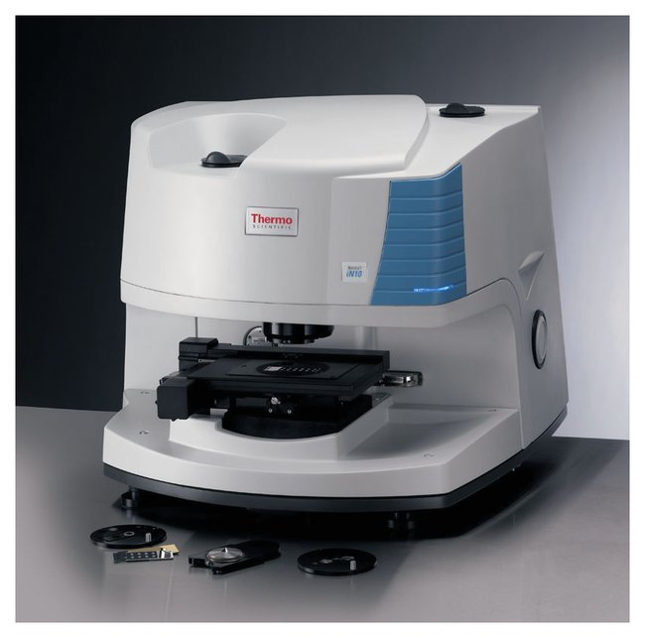
Spectroscopic methods: Fourier transform infrared microspectroscopy
Spectrometer: Nicolet iN10 MX
IR source: ceramic radiation source
Detector: MCT IN10 Array, Point MCT
Measurement mode: transmission
Number of scans averaged per spectrum: 32
Spectral resolution: 8 cm ⁻¹
Spatial resolution: 25 µm
Sample carrier: CaF₂ slides
Spectral analysis: chemical mapping of the main absorption bands or their ratios

Slide 8
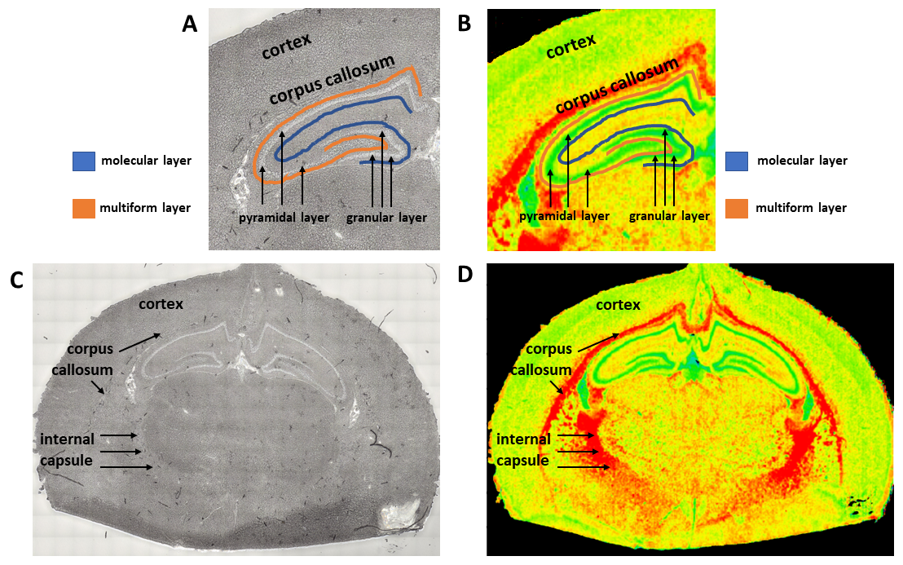
Chemical mapping: areas of interest
Figure 1. The localization of the areas (two structures of white matter, namely corpus callosum and internal capsule, and cortex) and cellular layers (granular, pyramidal molecular and multiform layer) of interest, presented in the microscopic images (A and C) and chemical maps (B and D) showing the distribution of lipids for selected sample of the brain.

Slide 9
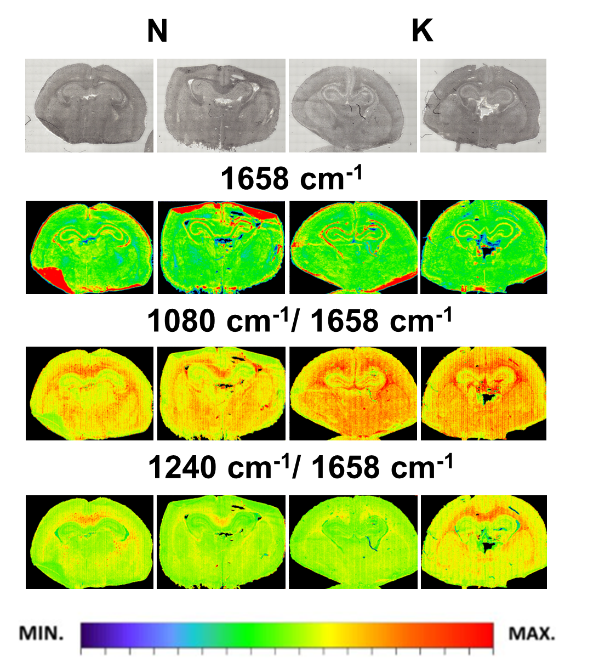
Chemical mapping: 2-days old rats
Figure 2. Chemical maps presenting intensity of the main absorption bands, which were obtained for the brain tissue taken from the 2-days old rats exposed in prenatal life to the ketogenic diet (K) or to the standard diet (N).

Slide 10
Mann Whitney U test: 2-days old rats
corpus callosum
cortex
1080 cm⁻¹/1658 cm⁻¹
1240 cm⁻¹/1658 cm⁻¹
*
*
Figure 3. Box-and-whisker plots presenting the spread of the biochemical parameters values (integrated band areas or their ratios) in corpus callosum and cortex for experimental and control rats (K and N groups, respectively) at examined stages of postnatal development (2, 6 and 14 days of life). Statistically significant differences (Mann-Whitney U test, 95% confidence level) between experimental groups and appropriate controls were marked with *.

Slide 11
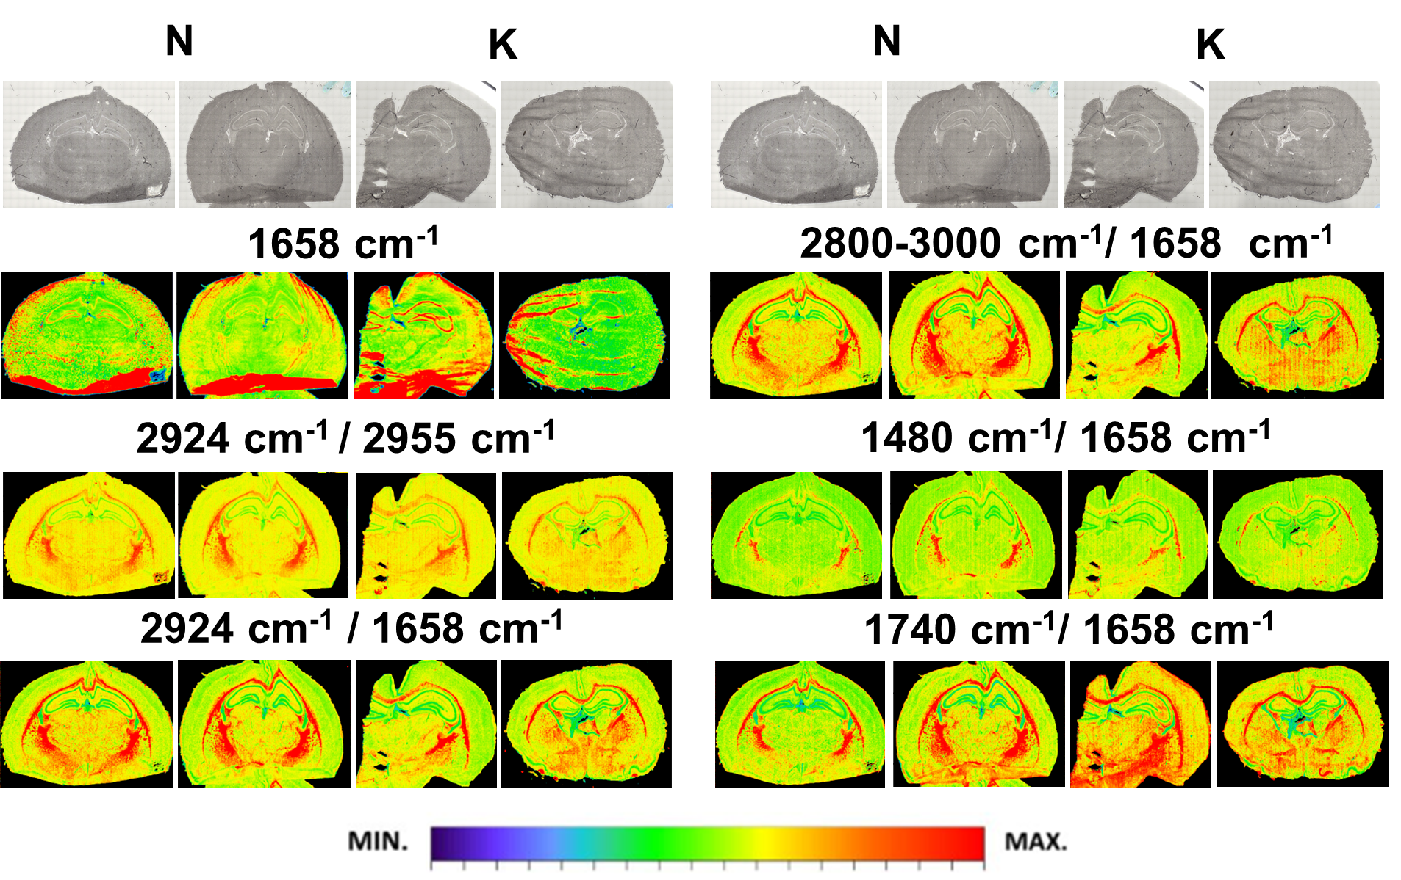
Chemical mapping: 14-days old rats
Figure 4. Chemical maps presenting intensity of the main absorption bands, which were obtained for the brain tissue taken from the 14-days old rats exposed in prenatal life to the ketogenic diet (K) or to the standard diet (N).

Slide 12
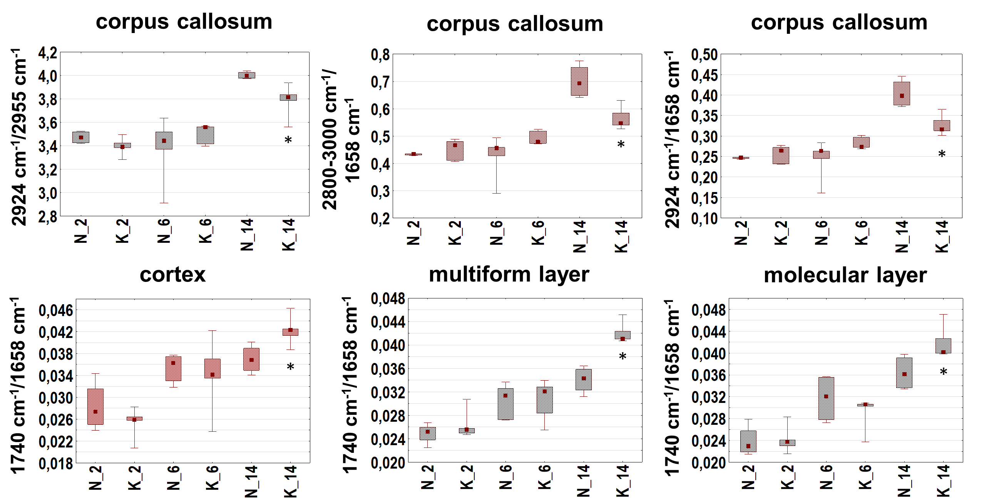
Mann Whitney U test: 14-days old rats
Figure 5. Box-and-whisker plots presenting the spread of the biochemical parameters values (integrated band areas or their ratios) in corpus callosum, cortex, multiform and molecular layers for experimental and control rats (K and N groups, respectively) at examined stages of postnatal development (2, 6 and 14 days of life). Statistically significant differences (Mann-Whitney U test, 95% confidence level) between experimental groups and appropriate controls were marked with *.

Slide 13
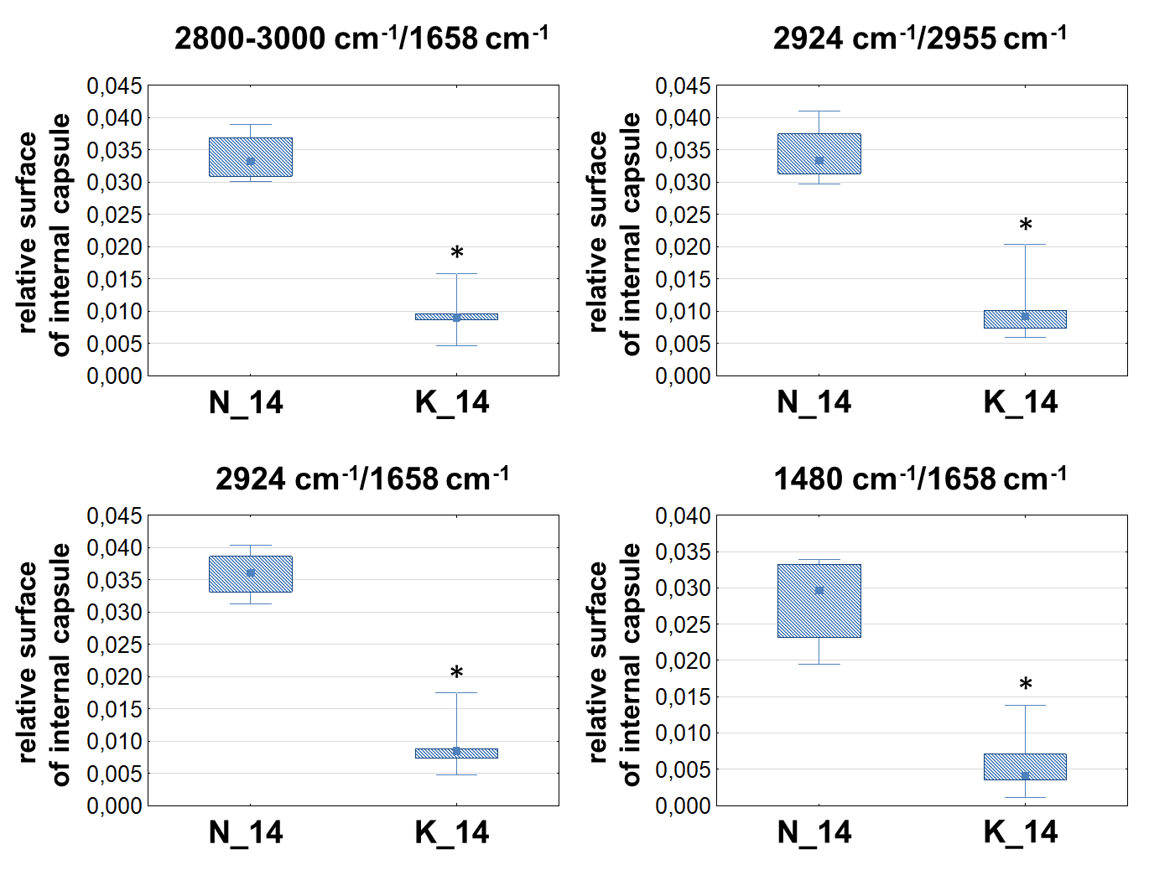
Relative surfaces of the internal capsule region: 14-days old rats
Figure 6. . Box-and-whisker plots presenting the spread of the relative surface of the internal capsule for 14-days old experimental and control rats (K and N groups, respectively). Statistically significant differences (Mann-Whitney U test, 95% confidence level) between groups were marked with *.

Slide 14
Discussion and conclusions
Chemical mapping and statistical analysis showed that the use of the KD during pregnancy, in general, does not lead to the brain biochemical anomalies in 2- and 6-days old rats.
Exeption: increased relative (comparing to proteins) content of compounds containing phosphate groups in white matter and cortex of 2-days old rats exposed prenatally to KD.
The processes of compensation of mother organism, which slowly began to make up for the deficiencies in carbohydrates postpartum?
Greater number of abnormalities in brains of 14-day old offspring of KD fed mothers:
* the increase of the relative level of compounds containing carbonyl groups (in cortex as well as multiform and molecular cells of the hippocampal formation)
* the decrease of the relative content of lipids and their structural changes (in white matter)
* smaller size of the surfaces of internal capsule determined for chemical maps prepared for absorption bands associated with lipids and their structural changes
Elevated exposition to ketone bodies during a fetus life and the disturbance of lipid metabolism after prenatal exposure to the KD.

Slide 15
Thank you for your attention !

