Slide 1
Diffractive Physics and Beam Optics at LHC
Pragati Patel
Supervisor: Prof. dr. hab. Janusz Chwastowski
Co-Supervisor : Maciej Trzebiński
Department of Diffractive Processes IFJ PAN (NZ13)

Slide 2
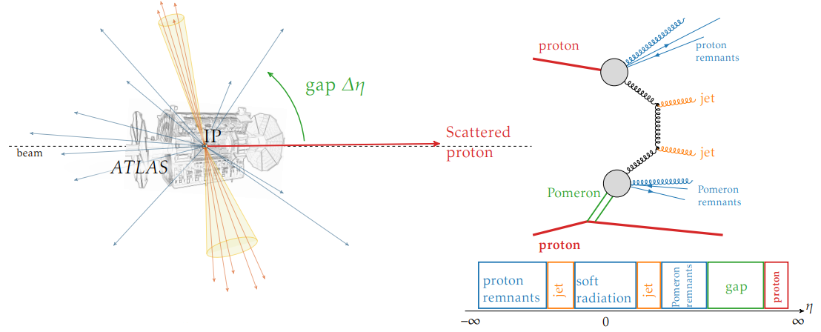
Diffractive Physics: a quick introduction
Diffraction ≡ colour singlet exchange:
Photon
Pomeron (two gluons + ...)
Measurements of diffractive processes--discrimination tool for models:
QCD – hard and non-perturbative,
Probing electroweak scale,
physics beyond SM.
Natural ways to seek for diffraction:
rapidity gaps
forward protons

Slide 3
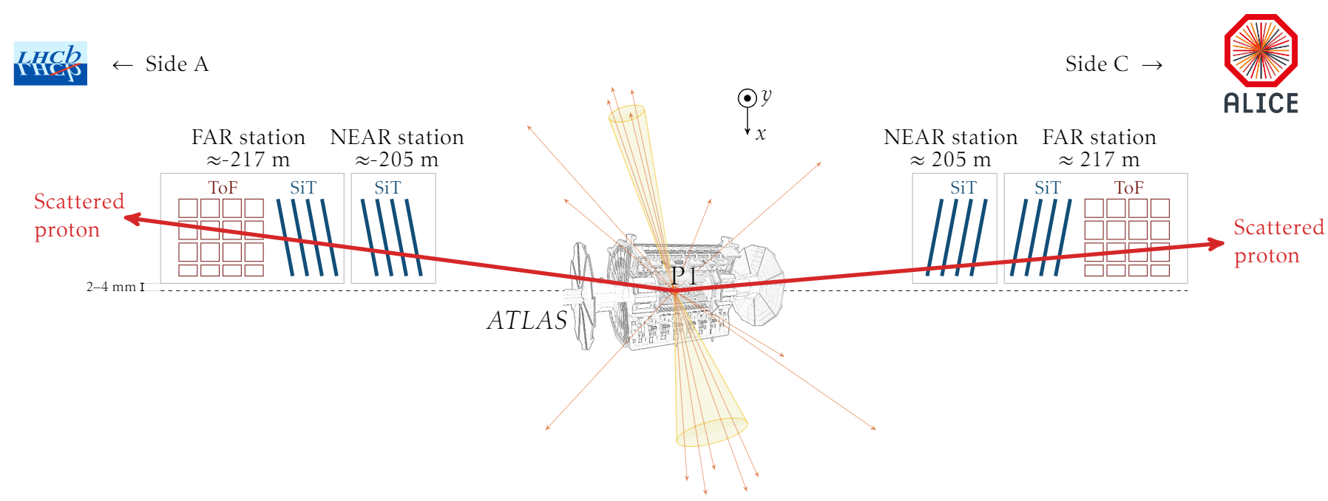
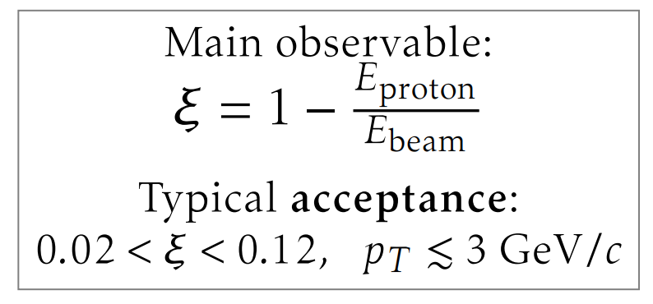
ATLAS Roman Pots

Slide 4
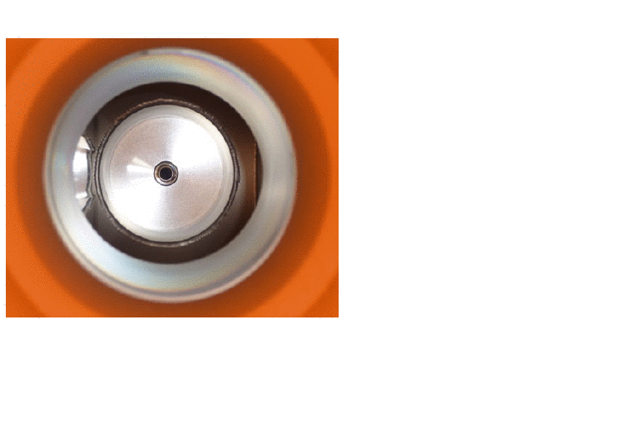
ATLAS Roman Pots

Slide 5
Digression: Geometric acceptance in RUN 4
Defined as ratio of number of protons of interest detected at our pots to the number of protons of interest produced at the collision point.
Starting point for whole physics program.
LHC will go through major upgrades to be HL-LHC (starting 2030+)
Not much acceptance according to planned machine design for AFP.
NO AFP in RUN 4 :( ...planning for RUN 5

Slide 6
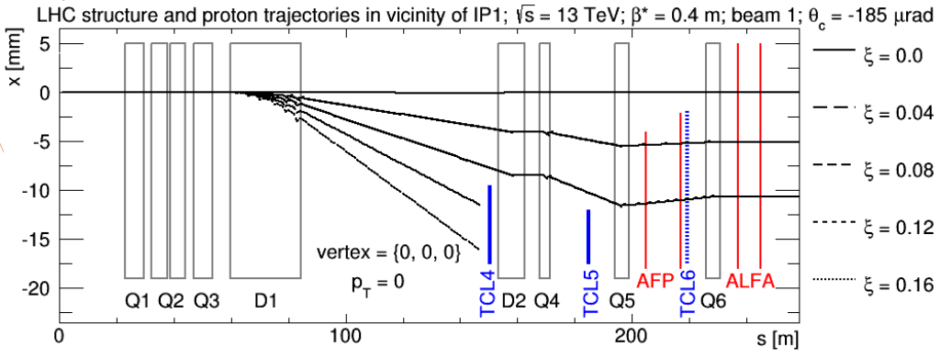
Forward Proton Trajectories

Slide 7
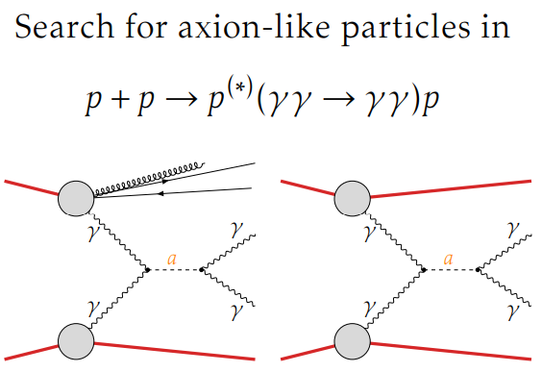
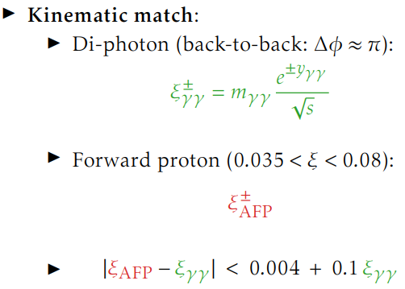
What’s the point ?
Main idea: production of objects in which background can be extremely reduced by kinematic constraints coming from forward proton measurements.
arXiv:2304.10953

Slide 8
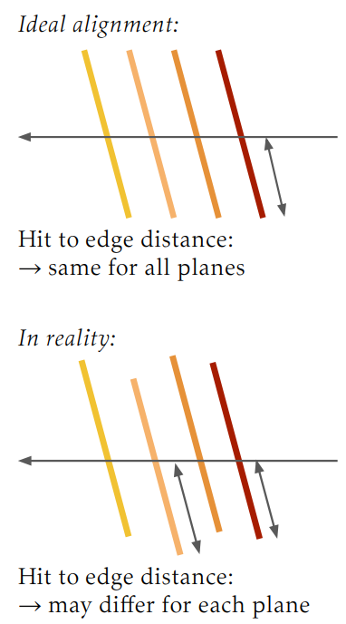
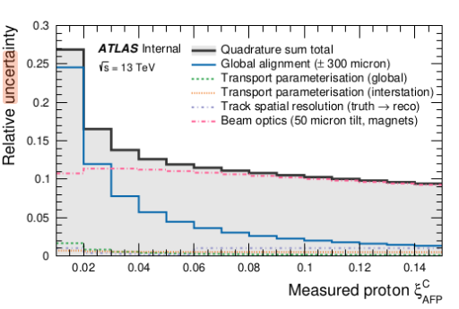
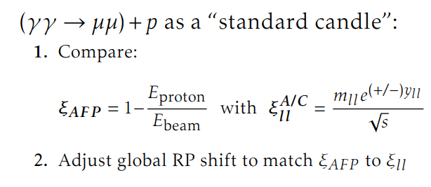
Issues with ongoing analyses
Uncertainty in calculating ξ_{AFP} :
Local Alignment of planes
Global alignment of pots
Wrong parametrization
Beam optics
spatial resolution of detectors

Slide 9
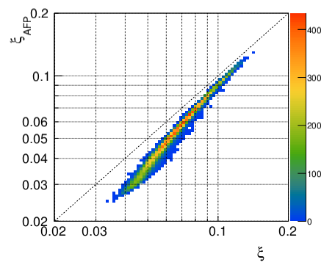
Search for “True Optics”
Even after all such corrections we see this:
Largest contributor to uncertainty is “beam optics”- never corrected before.
Standard magnetic lattice considered between collision point and pots is not optimal.
LHC built in 2008, since then magnets are shifted and/or titled from their initial position.

Slide 10
Search for “True Optics”
Aim: Define a modified magnetic lattice between IP1 and pots to reduce uncertainty in ξ_{AFP}
Information about shifts, change in strength of magnets available in LHC databases.
To precisely track the position of the beam within the LHC, beam position monitors (BPM) are strategically placed at various locations throughout the ring, providing accurate coordinates of the beam at those specific points.

Slide 11
Binding Everything together
Once “true optics” is found successfully:
Enhanced parametrization and global alignment can be implemented, leading to a notable reduction in uncertainty associated with ξ_{AFP}.
Improved kinematic matching techniques can be employed to select signals with forward proton tags.
Overall, a substantial enhancement in the results of various ongoing analyses can be anticipated.

Slide 12
Thank you for your attention !
This work was partially supported by the Polish National Science Centre grant: 2019/34/E/ST2/00393

