Slide 1
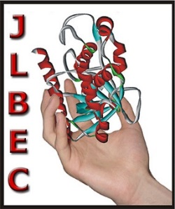
Fumarate adding enzymes
Gabriela Oleksy^{1,2}
Supervisors: prof. Maciej Szaleniec¹ and prof. Johann Heider²
1 - Jerzy Haber Institute of Catalysis and Surface Chemistry Polish Academy of Sciences
2 - Department of Biology, Laboratory for Microbial Biochemistry, Philipps University Marburg
1

Slide 2
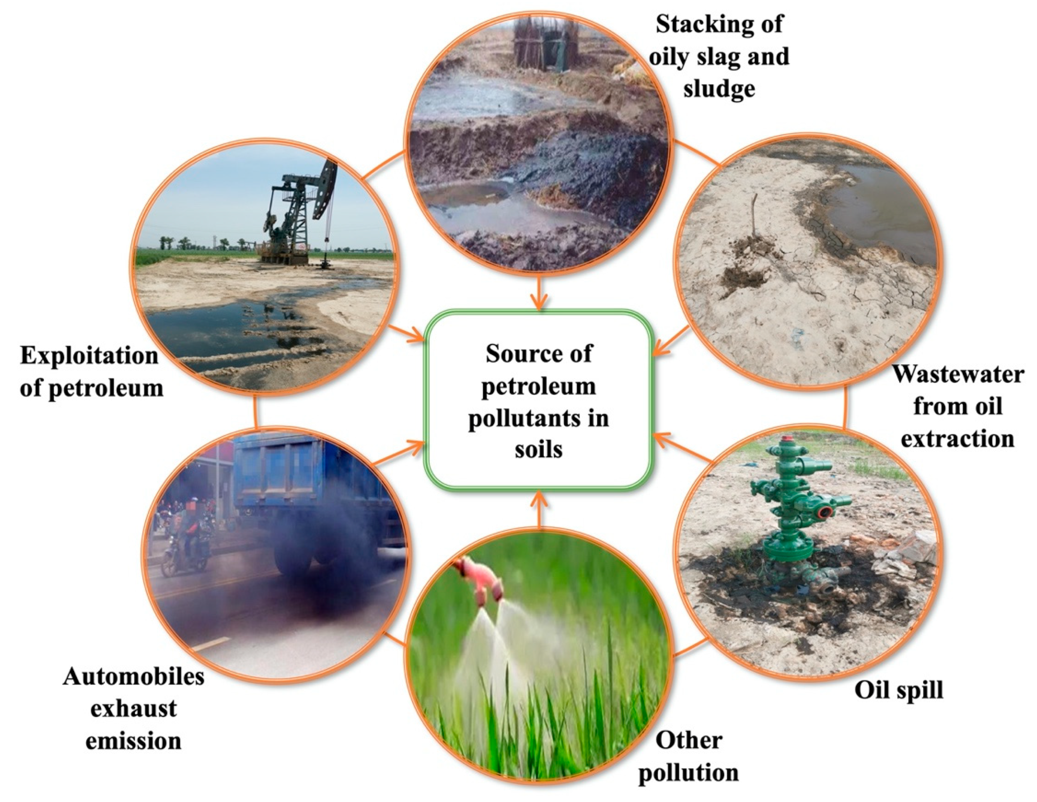
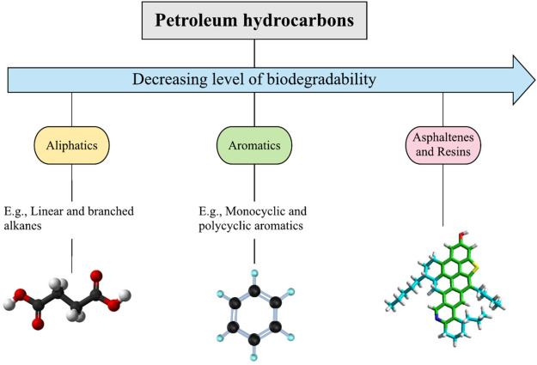
Hydrocarbons contamination
Global leakage of petroleum: ~ 600,000 metric tons each year
Consequences:
Soil fertility decrease
Crop-germination delay
Health threat for humans and animals
Sui et al. 2021
Tran et al. 2021
Notes:
Crop germination is delayed, the chlorophyll content is poor, and some crops perish when grown in high petroleum-contaminated soil [5]. Furthermore, pollutants can enter the human body by Sustainability 2021, 13, 9267. https://doi.org/10.3390/su13169267 https://www.mdpi.com/journal/sustainability Sustainability 2021, 13, 9267 2 of 28 breathing, skin contact, or eating petroleum-contaminated food, causing contact dermatitis, visual and auditory hallucinations, and gastrointestinal disorders, as well as substantially raising the risk of leukemia in children. Although certain low-molecular-weight hydrocarbon pollutants will weather and decay over time, high-molecular-weight hydrocarbon pollutants will remain in the soil for a long period due to their hydrophobicity, causing secondary contamination in the ecosystem [6

Slide 3
Anaerobic biodegradation of hydrocarbons
Biodegradation – process in which an organic substance is broken down by microorganisms using it as a carbon and energy source
Notes:
Crop germination is delayed, the chlorophyll content is poor, and some crops perish when grown in high petroleum-contaminated soil [5]. Furthermore, pollutants can enter the human body by Sustainability 2021, 13, 9267. https://doi.org/10.3390/su13169267 https://www.mdpi.com/journal/sustainability Sustainability 2021, 13, 9267 2 of 28 breathing, skin contact, or eating petroleum-contaminated food, causing contact dermatitis, visual and auditory hallucinations, and gastrointestinal disorders, as well as substantially raising the risk of leukemia in children. Although certain low-molecular-weight hydrocarbon pollutants will weather and decay over time, high-molecular-weight hydrocarbon pollutants will remain in the soil for a long period due to their hydrophobicity, causing secondary contamination in the ecosystem [6

Slide 4
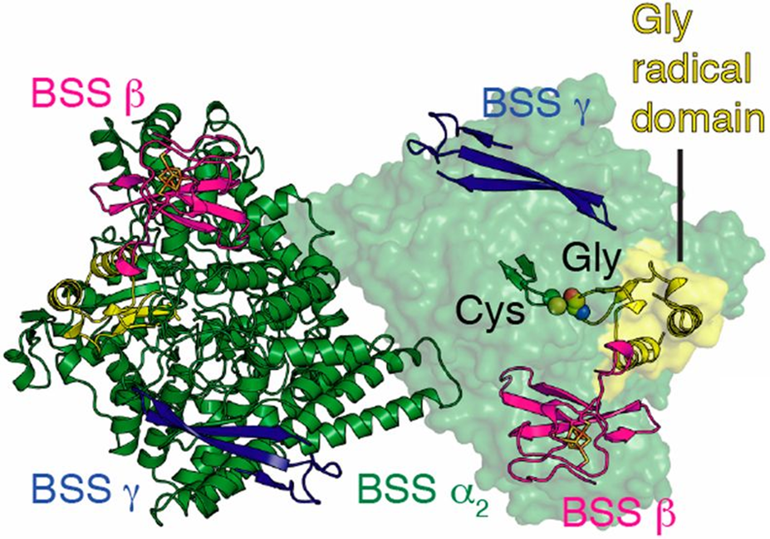
Benzylsuccinate synthase (BSS): a model FAE
Glycyl-radical in an active centre
→
High fragility!
Natural role:
toluene activation
(αβγ)₂ heterohexamer
Activating-enzyme
is required for BSS
glycyl radical formation
Product enantioselectivity
Funk et al. 2014

Slide 5
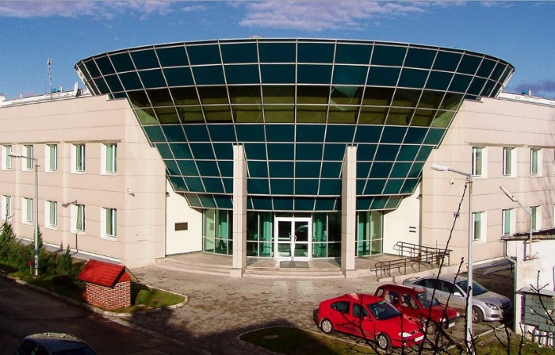
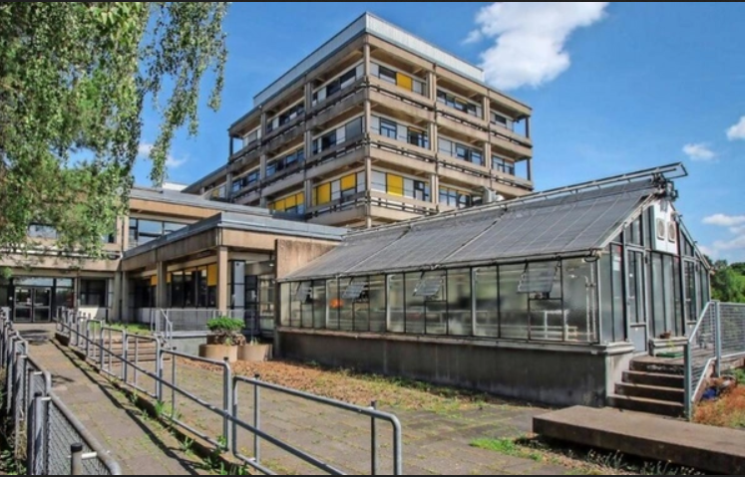
PhD objectives
Explanation of BSS catalytic properties (in silico vs lab-scale results)
Structure characterisation ->Cryo-EM, HDX
BSS mutants enzymatic characterisation
methodology optimization
Know-how transfer between the research groups in Cracow and Marburg
FAE recombinant production in A. evansii
Author: Marian Satała
mar.prod.image.rndtech.de
Institute of Catalysis and Surface Chemistry, Poland
University of Marburg, Faculty of Biology, Germany
5

Slide 6
Methodology
Reaction products detection and quantification: LC-DAD, LCMS/MS
Enzyme assays: ANAEROBIC CONDITIONS (Glove-Box chambers)
+ in silico results as suport data
Protein detection: FPLC, SDS-PAGE, Western Blot
Genetics: Recombinant A. evansii strains are obtained via conjugation and electroporation

Slide 7
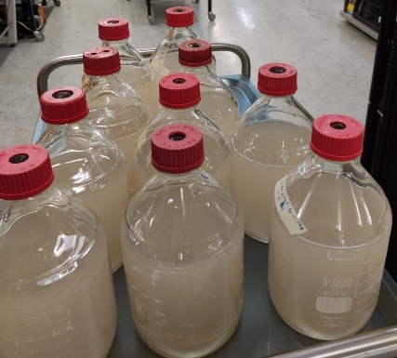
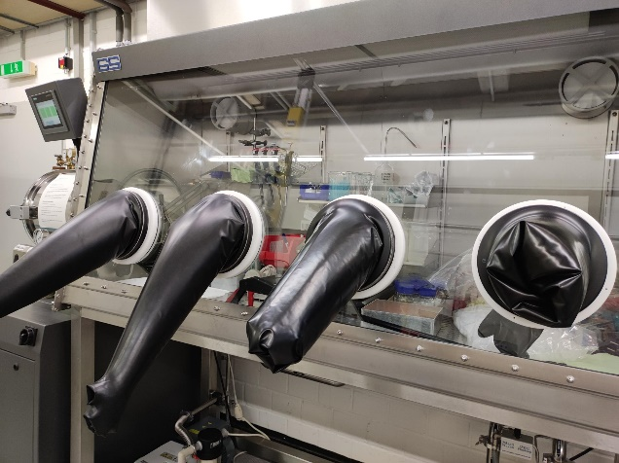
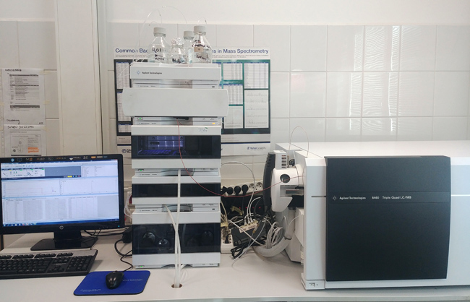
Methodology – anaerobic work
Bacteria growth
Bacteria harvest and
enzyme assay on cell extract
Reaction products analysis:
LC-MS/MS

Slide 8
FAE production optimization in new strains
blog.edvotek.com
Conjugation:
time: ~14 days
High contamination risk
low efficiency
complicated protocol
Electroporation:
time: ~3 days
Low contamination risk
high efficiency
simplified protocol

Slide 9
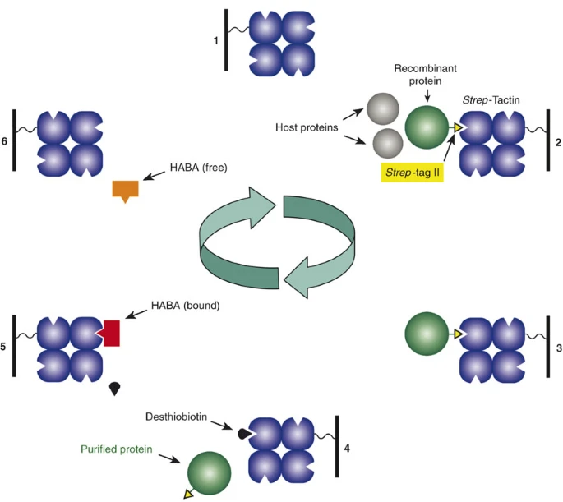
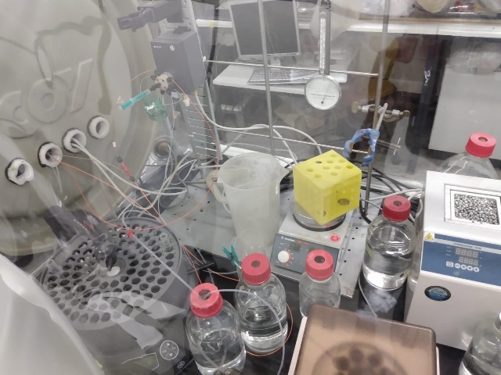
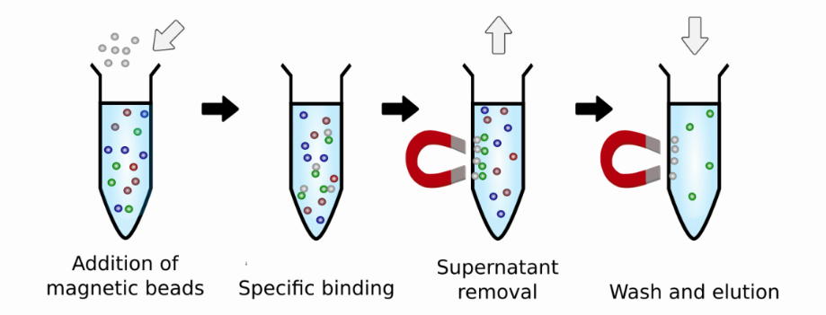
FAE purification optimization
FPLC
acrobiosystems.com.cn
Schmidt & Skerra 2007
Strep-tag purification strain
Magnetic beads

Slide 10
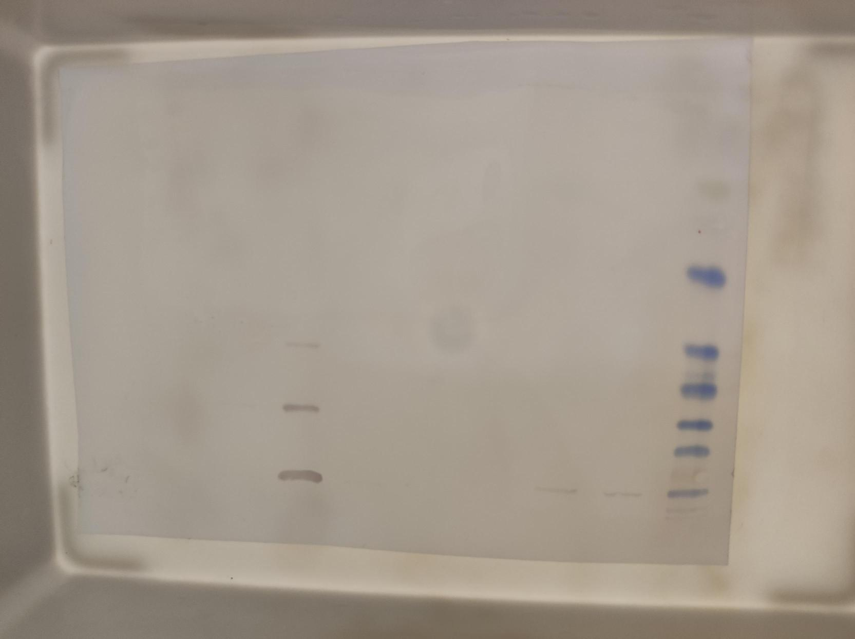
FPLC purification:
More unspecific bindings
Higher risk of protein degradation
Extremely demanding in anaerobic conditions
Magnetic beads:
Less unspecific bindings
Fast method
Protocol more suitable for anaerobic conditions

Slide 11
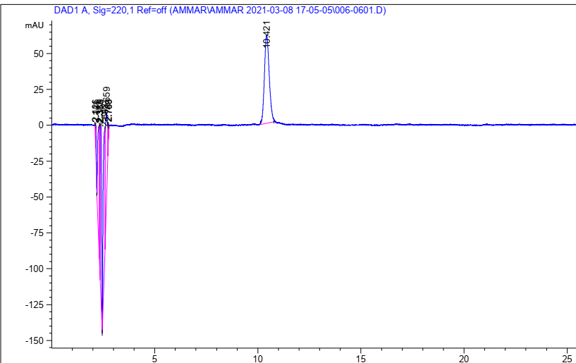
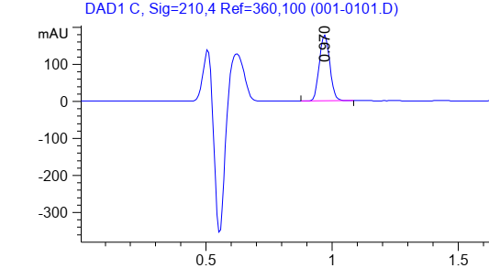
Product detection optimization
RT=10.421 min
bs
RT=0.970 min
bs
Traditional C18 column:
Maximal pressure=400 bar
30 cm
30 min analysis
UHPLC C18 column:
Maximal pressure=1100 bar
10 cm
2 min analysis
10x higher resolution (detection limit: 10 uM vs 100 uM)

Slide 12
Other finished tasks
Substrate range for BSS-WT protein vs Tyr193 and Arg504 mutants
Enantioselectivity analysis – Gln703 and Trp609 mutants
BSS inhibition kinetics – benzyl alcohol and benzaldehyde
BSS purification in an inactivated form
MASS production confirmed in A. evansii

Slide 13
Summary
Environment pollution with hydrocarbons poses a serious threat to human and animal health
Understanding the mechanisms of anaerobic enzymes involved in hydrocarbon degradation can help the bioremediation attempts
Due to the FAEs high sensitivity to oxygen, methodology choice and optimization were crucial for enabling the further investigation

Slide 14
Acknowledgments
Beethoven-Life project participants:
Ivana Aleksić, PhD; Ammar Alhaj Zein, Anna Sekuła, Kai Krämer,
Professor Maciej Szaleniec and Professor Johann Heider
University of Marburg,
Faculty of Biology
NAWA STER
NCN Beethoven Life
2018/31/N/HS2/02453
14

