Slide 1
Inhalable polymeric drug delivery system: Azithromycin-loaded poly(ethylene-glycol)/poly(sebacic anhydride) microparticles
Konrad Kwiecień
AGH University of Science and Technology, Al. A. Mickiewicza 30 30-059 Kraków, Poland
kkwiecien@agh.edu.pl

Slide 2
Motivation: Chronic Obstructive Pulmonary Disease (COPD)
Progressive life­threatening lung disease
251 million cases of COPD globally in 2016.
3.23 million deaths in 2019 (60,000 more than in 2015)
Moderate or severe lung obstruction –acute exacerbations 1.5-2 times a year, mostly due to recurrent bacterial inflammations (ca. 50% of such events)
Most of the events require hospitalization
https://www.who.int/news-room/fact-sheets/detail/chronic-obstructive-pulmonary-disease-(copd)

Slide 3
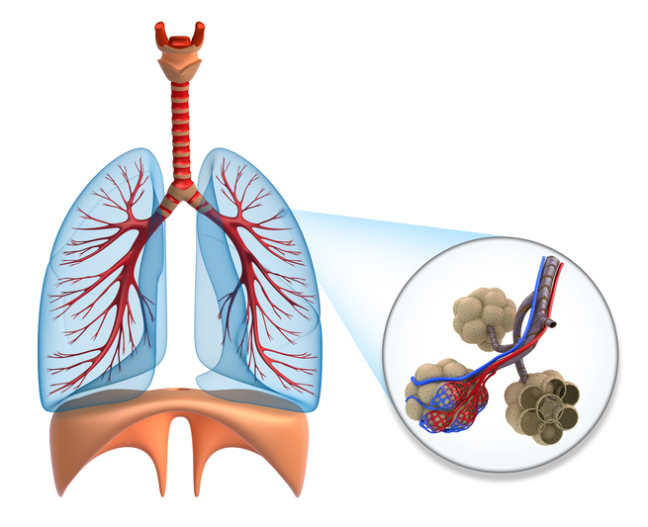
Motivation II: Conventional therapy is not enough
Only a small portion of drugs administered orally or intravenously delivered to alveolar region of the lungs
Remaining antibiotics spread around the whole body causing severe side effects
https://toxtutor.nlm.nih.gov/10-003.html
Small concentration of antibiotic in infected area $→$ gaining resistance to antibiotics
$→$number of potent antibiotics dimishing with each subsequent infection.
https://www.medlife.com/blog/infectious-diseases-antibiotic-resistance-growing-global-threat/

Slide 4
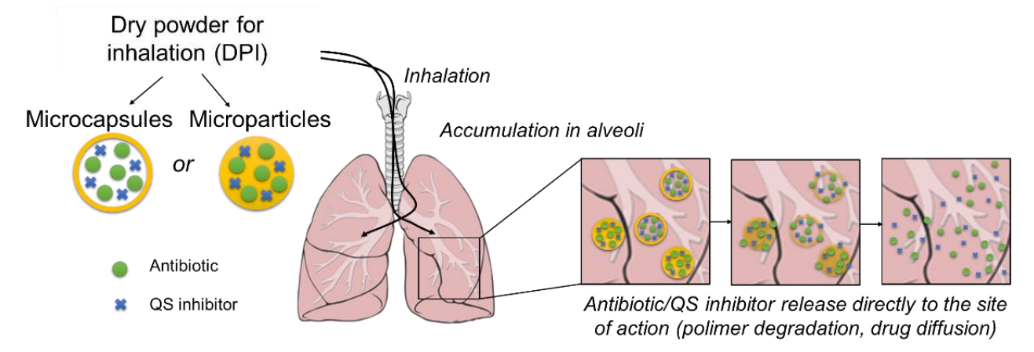
Our idea
Smaller doses
Reduced side effects of systemic administration
Controlled drug release
Reduced risk of developing antibiotic resistance
Convenient form of administration
”Inhalable polymeric delivery systems of antibiotics and quorum sensing inhibitors for the treatment of respiratory infections”

Slide 5
Project stages
I
Selection of materials with appropriate degradation kinetics and physicochemical characteristics
II
Obtaining microparticles with appropriate size distribution and encapsulation of antibiotics and QS inhibitors, testing their properties (DLS, SEM) and degradation, aerodynamic properties
III
In vitro cytocompatibility study of microparticles with pulmonary epithelial cells (A549, BEAS / 2B, and Calu-3) and ex vivo - tissue slices
IV
Determining the effectiveness of the antibacterial action
V
In vitro cytocompatibility and efficacy studies on 2.5 / 3D cell models

Slide 6
The chosen material
Poly(sebacic anhydride) (PSA)
Quick degradation rate
No excessive accumulation in lungs
Mostly Surface degradation
Better drug release kientics
PSA modified with poly(ethylene glycol) Mw = 250 or 600 10% w/w
Various copolymers
Open way for manipulating the properties

Slide 7
Powder manufacturing
W: poly(vinyl alcohol) (PVA) solution in UHQ-water
O: Polymer in dichloromethane (DCM)
HPLC - drug encapsulation
Microscopic observation – morphology
Zeta potential, DLS

Slide 8
Microparticles requirements
Size: 1-5 µm
Homogeneous size distribution
Sufficient drug encapsulation capacity
Non-toxic
Bacteria eradiction in cytocompatible concentration

Slide 9
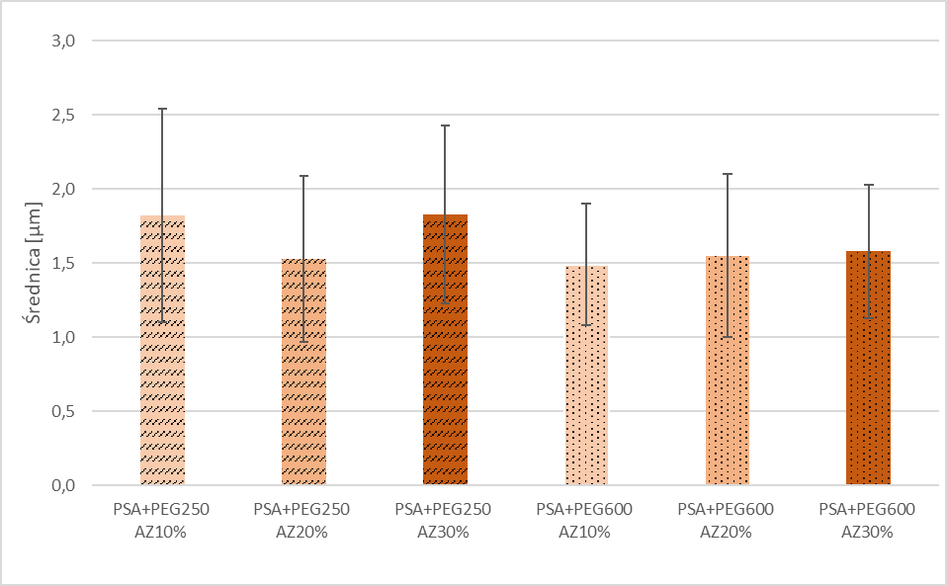
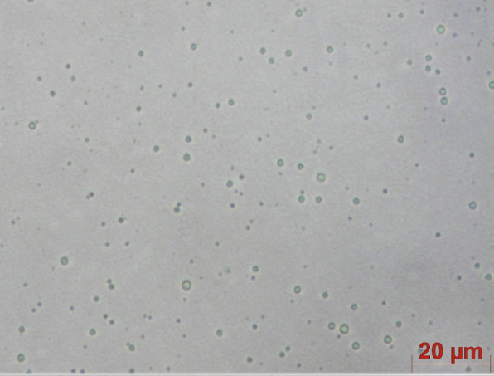
Optical microscopy – seems perfect
Average diameter ± SD

Slide 10
Laser diffraction size distribution, however
Peak 1 – similar to initial observation – correct sizes
Peak 2 – undetected before – incorrect sizes
Air humidity
Initial degradation
Stuck together

Slide 11
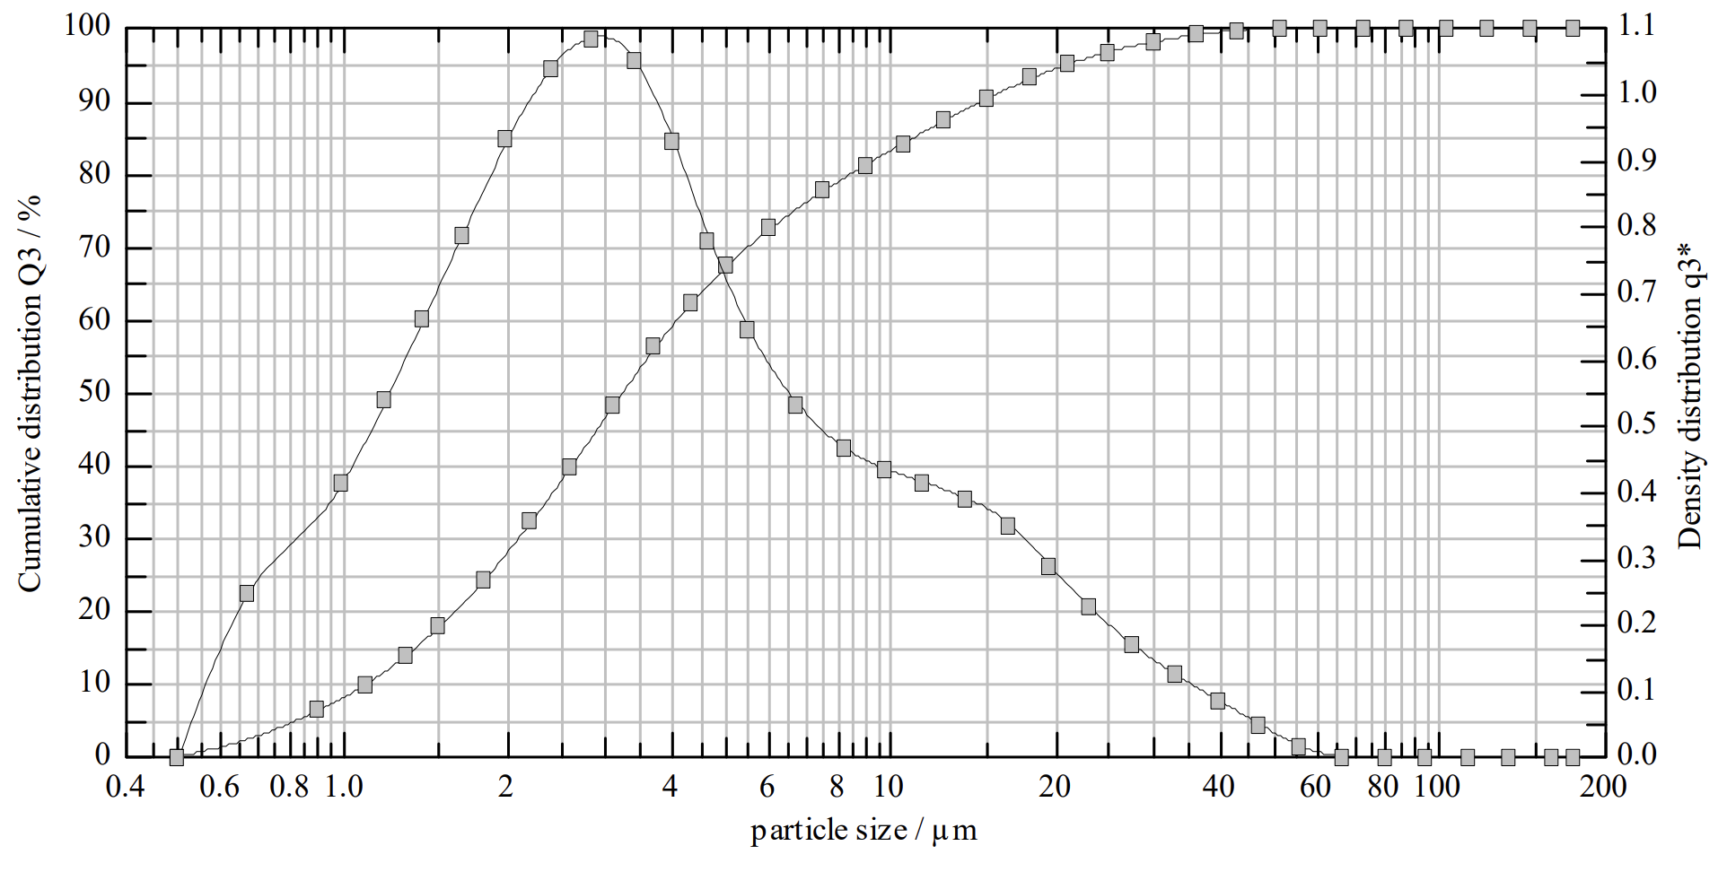
But with PEG…
PSA-PEG 250

Slide 12
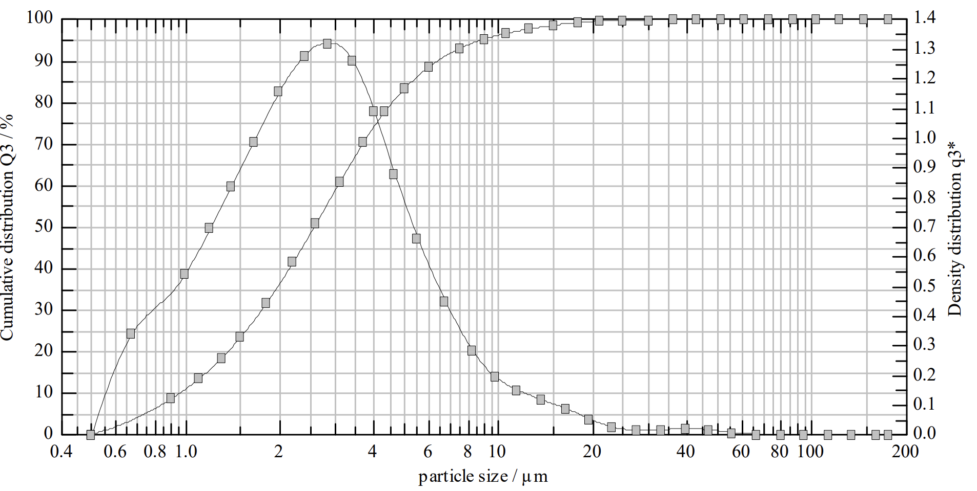
Or with a heavier PEG
PSA-PEG 600

Slide 13
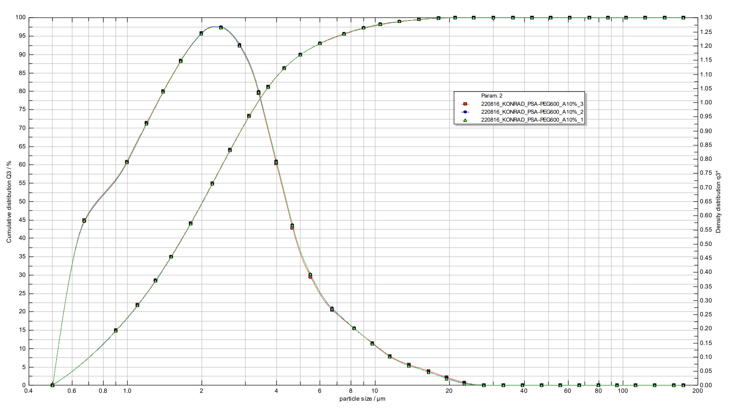
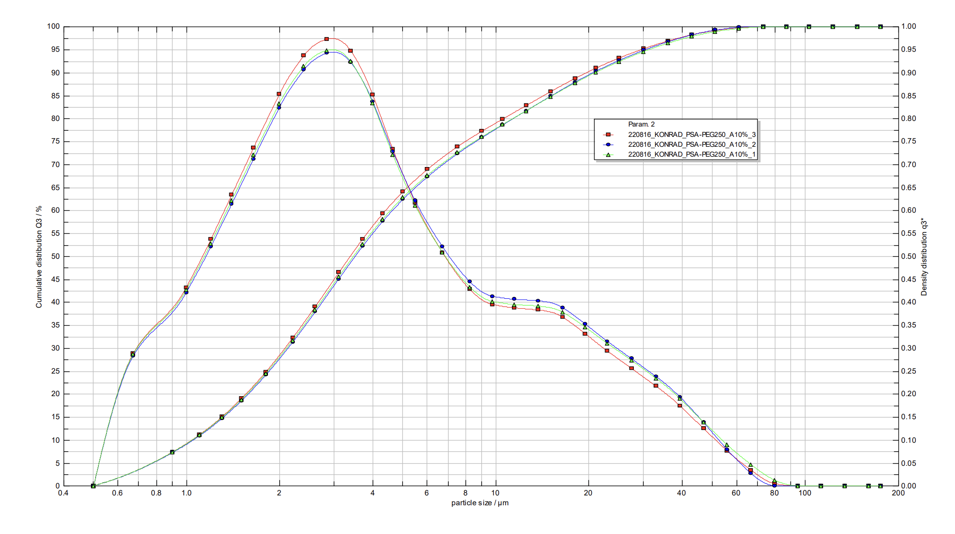
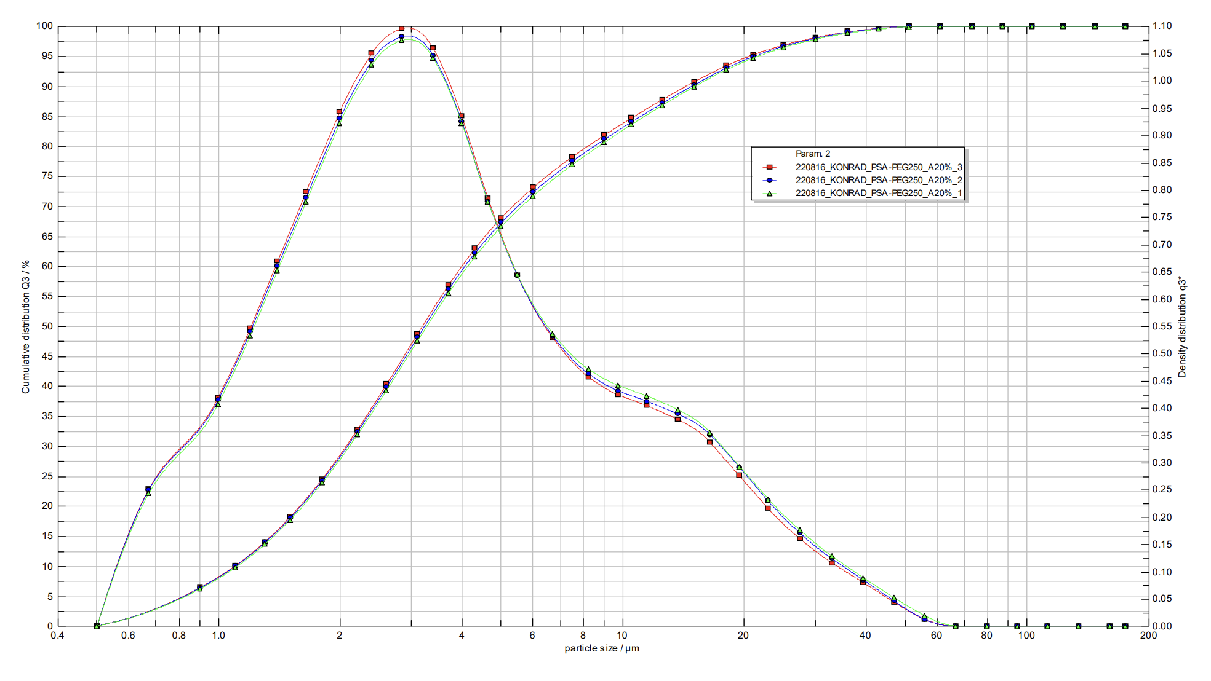
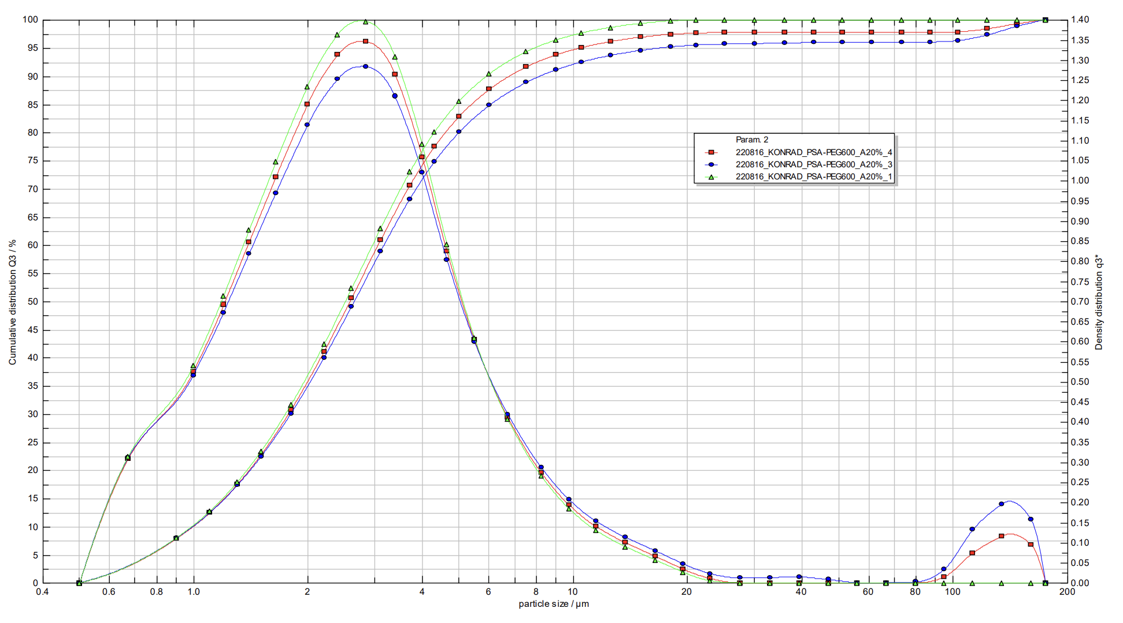
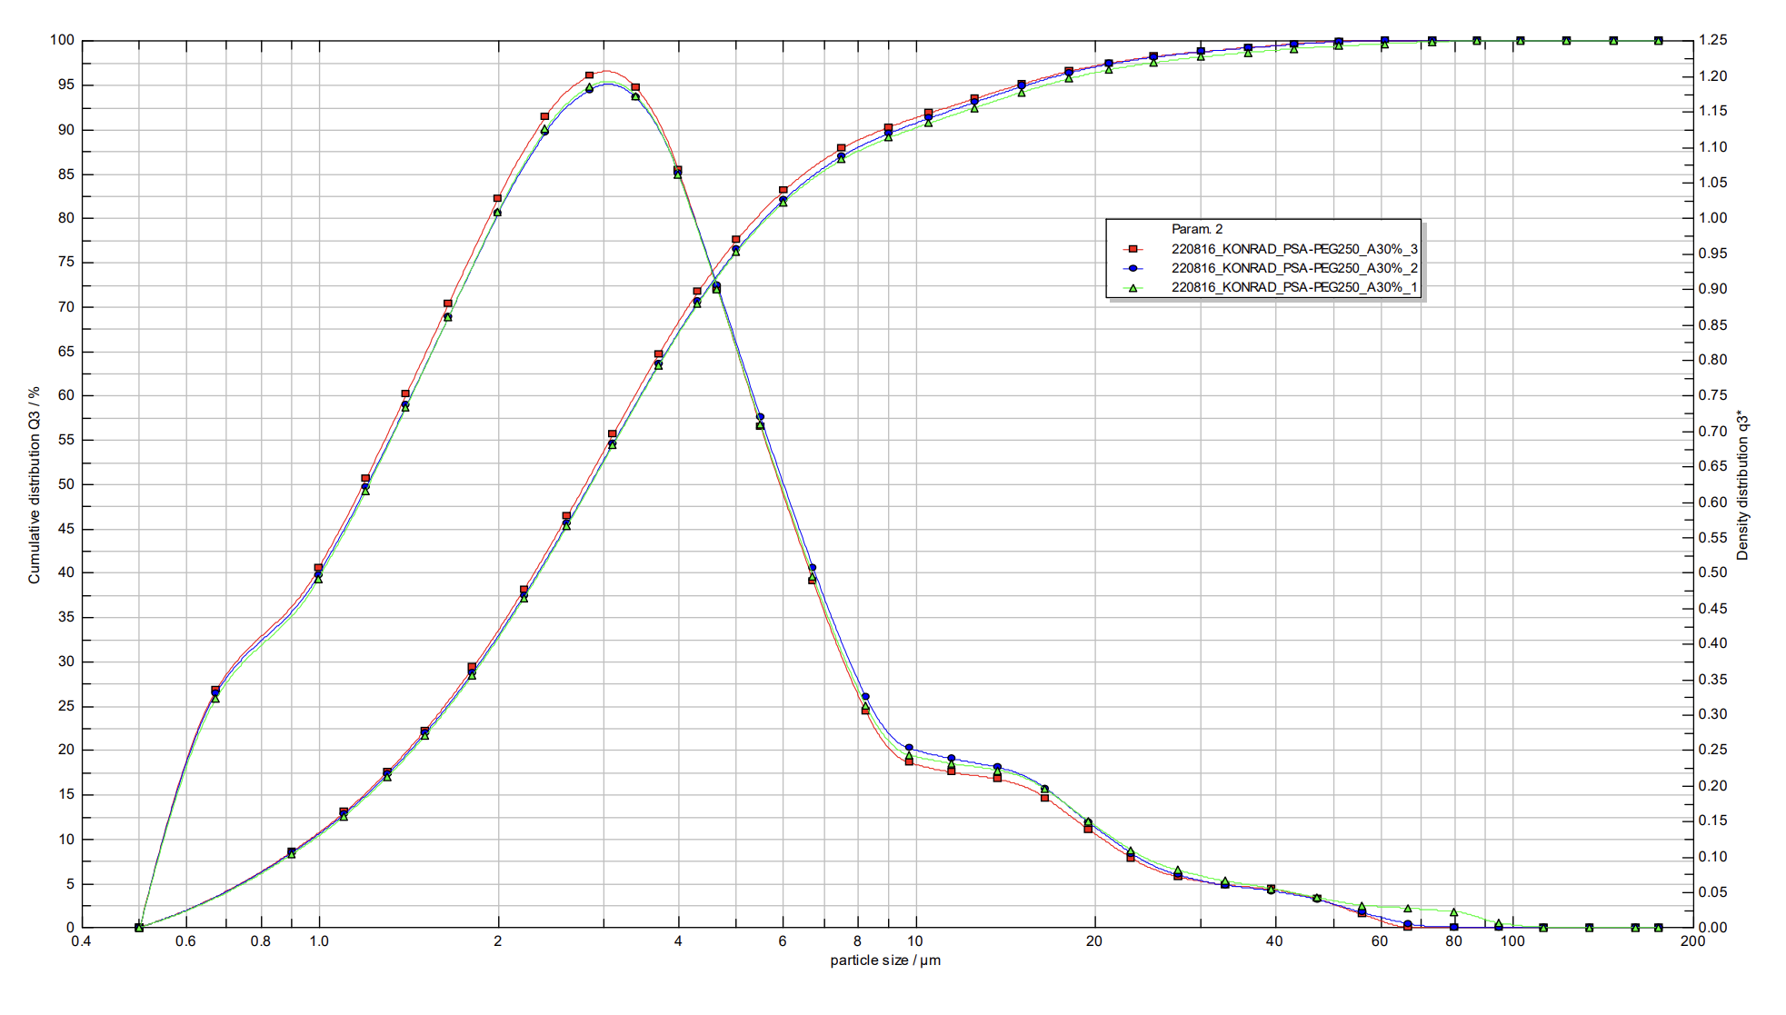
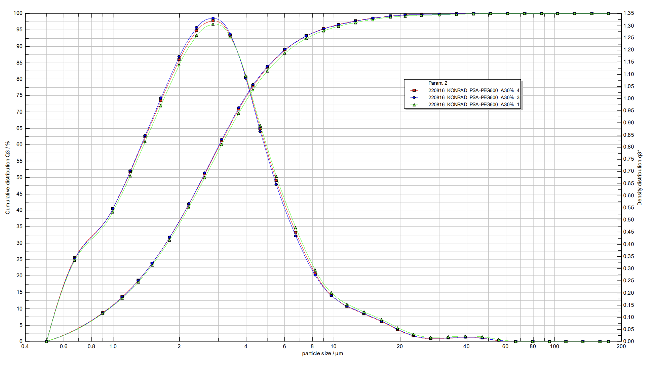
Homogenious powders loaded with AZM
PSA-PEG250
AZM 10%
PSA-PEG600
AZM 10%
PSA-PEG250
AZM 20%
PSA-PEG600
AZM 20%
PSA-PEG250
AZM 30%
PSA-PEG600
AZM 30%

Slide 14
And some size numbers
Batch/ feature ± SD | PSA-PEG250 AZM10% | PSA-PEG250 AZM20% | PSA-PEG250 AZM30% | PSA-PEG600 AZM10% | PSA-PEG600 AZM20% | PSA-PEG600 AZM30%
X < 5 µm | 63.05 +/- 0.87 % | 67.28 +/- 0.70 % | 76.65 +/- 0.72 % | 89.88 +/- 0.01 % | 82.82 +/- 2.76 % | 83.24 +/- 0.70 %
x₅₀ | 3.47 +/- 0.06 µm | 3.24 +/- 0.04 µm | 2.84 +/- 0.03 µm | 2.02 +/- 0.00 µm | 2.58 +/- 0.07 µm | 2.57 +/- 0.03 µm
Span | 5.61 +/- 0.11 µm | 4.22 +/- 0.05 µm | 2.97 +/- 0.15 µm | 2.11 +/- 0.01 µm | 2.33 +/- 0.39 µm | 2.17 +/- 0.04 µm

Slide 15
Encapsulation efficiency by HPLC – promising but not convincing
Drug: | AZM
EE | ~100%
DL | Up to 17%
$$EE=\frac{Drug in the MPs}{Initial drug}∗100\%$$
Retention time of AZM = 5.5 min
$$DL=\frac{Drug in MPs}{MPs^{′}mass}∗100\%$$

Slide 16
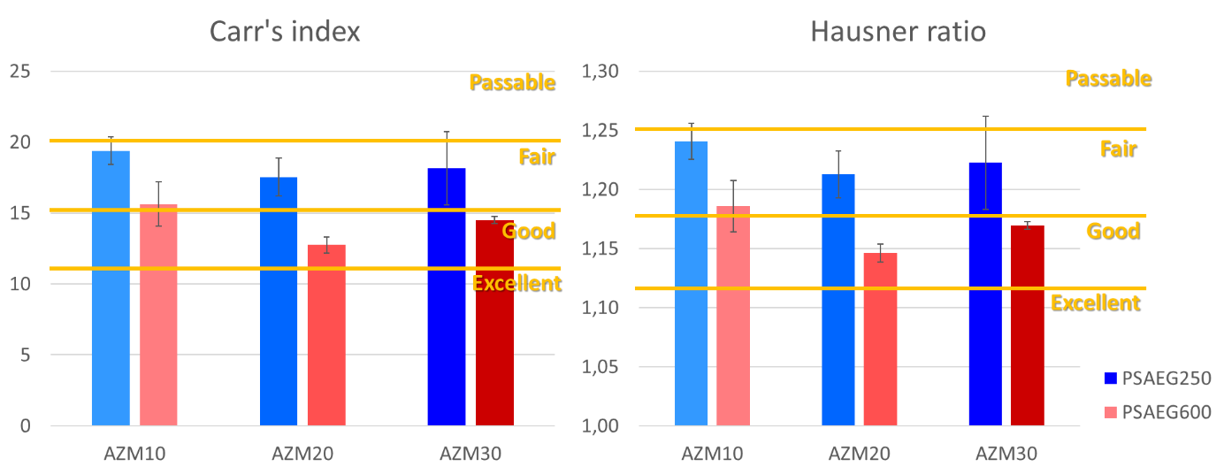
Flowability – fair to good, which is good!

Slide 17
Cytotoxicity in vitro AlamarBlue

Slide 18
Cytotoxicity in vitro Live/dead staining

Slide 19
Cytotoxicity ex vivo rat lung tissue slices
https://www.sciencedirect.com/science/article/pii/S0939641118308993
ATP/protein test
Medium LDH
Medium ELISA IL-6
H-E staining (pending)

Slide 20
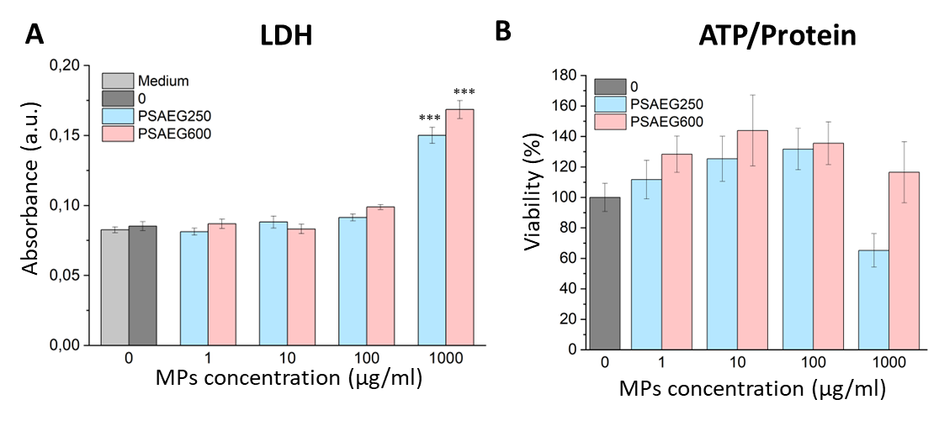
Cytotoxicity ex vivo rat lung tissue slices

Slide 21
Cytotoxicity ex vivo rat lung tissue slices
IL-6
 | 1 | 2 | 3 | 4 | 5 | 6 | 7 | 8 | 9 | 10 | 11 | 12
A | 0,083 | 0,084 | 0,074 | 0,07 | 0,066 | 0,075 | 0,069 | 0,074 | 3,5 | 3,5
B | 0,07 | 0,068 | 0,066 | 0,058 | 0,061 | 0,082 | 0,081 | 0,079 | 2,36 | 2,161
C | 0,068 | 0,066 | 0,066 | 0,055 | 0,07 | 0,057 | 0,06 | 0,067 | 1,116 | 1,15
D | 0,064 | 0,063 | 0,056 | 0,052 | 0,082 | 0,069 | 2,594 | 0,063 | 0,553 | 0,544
E | 0,064 | 0,071 | 0,053 | 0,056 | 0,077 | 0,058 | 0,051 | 0,053 | 0,217 | 0,253
F | 0,074 | 0,064 | 0,07 | 0,062 | 0,065 | 0,065 | 0,05 | 0,058 | 0,117 | 0,165
G | 0,069 | 0,066 | 0,067 | 0,06 | 0,07 | 0,065 |  |  | 0,101 | 0,134
H | 0,055 | 0,079 | 0,081 | 0,073 | 0,064 | 0,07 |  |  | 0,065 | 0,074

Slide 22
Antibacterial properties – Kirby-Bauer test with Staphylococcus aureus

Slide 23
Antibacterial properties – Kirby-Bauer test with Staphylococcus aureus

Slide 24
Conclusions
• Successful microparticles manufacturing efficiently loaded with azithromycin
• Inhibition of S. aureus at the cytocompatible concentrations
• Hypothetically possible encapsulation of more azithromycin
• Suitable size distributions by 3 bar dispersion. What if lower?
• Bigger than under the microscope? Agglomeration…
• Future studies: the use of inhaler and lower pressures with other steps to increase the flowability and decrease agglomeration:
o Addition extra amount of free PEG as Surface modification
o Using porosity generating agents
In general, the solution is promising and PSAEG600 seems to be a better materials for this purpose than PSAEG250, but more has to be done in terms of aerodynamic properties in the next steps

Slide 25
Thank you for your attention!

