Slide 1

Functional steel/ceramic layer systems as interconnects for electrochemical energy conversion devices.
Supervisors:
prof. dr hab. inż. Tomasz Brylewski
prof. dr hab. Mieczysław Jurczyk
12.05.2023, Kraków
Kamil Domaradzki
AGH, WIMiC

Slide 2
Motivation
Hydrogen can be used as a fuel
Global energy demand continues to grow
Why hydrogen technologies are important?
Moving away from environmentally harmful fossil fuels
The growing importance of renewable energy sources

Slide 3
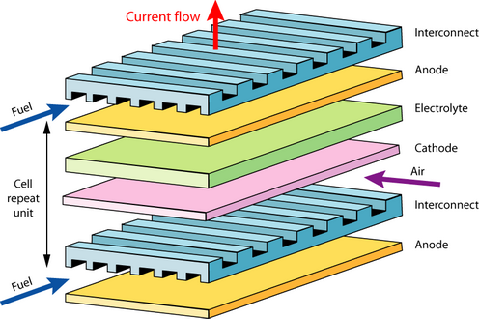
Solid Oxide Fuel Cell (SOFC)

Slide 4
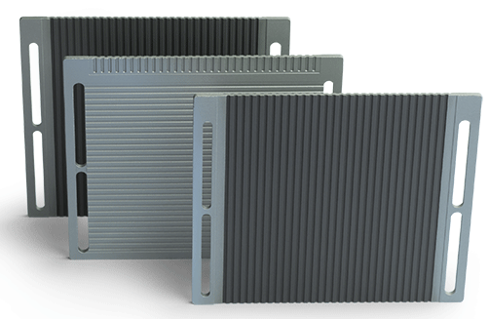
Coatings for interconnects
Advantages of metallic interconnects:
Similar coefficient of thermal expansion with other components of the fuel cell
Easy forming process
Problem with metallic interconnects:
Evaporation of volatile chromium compounds
Formation of poorly conductive Cr₂O₃ scale

Slide 5
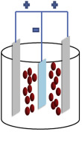
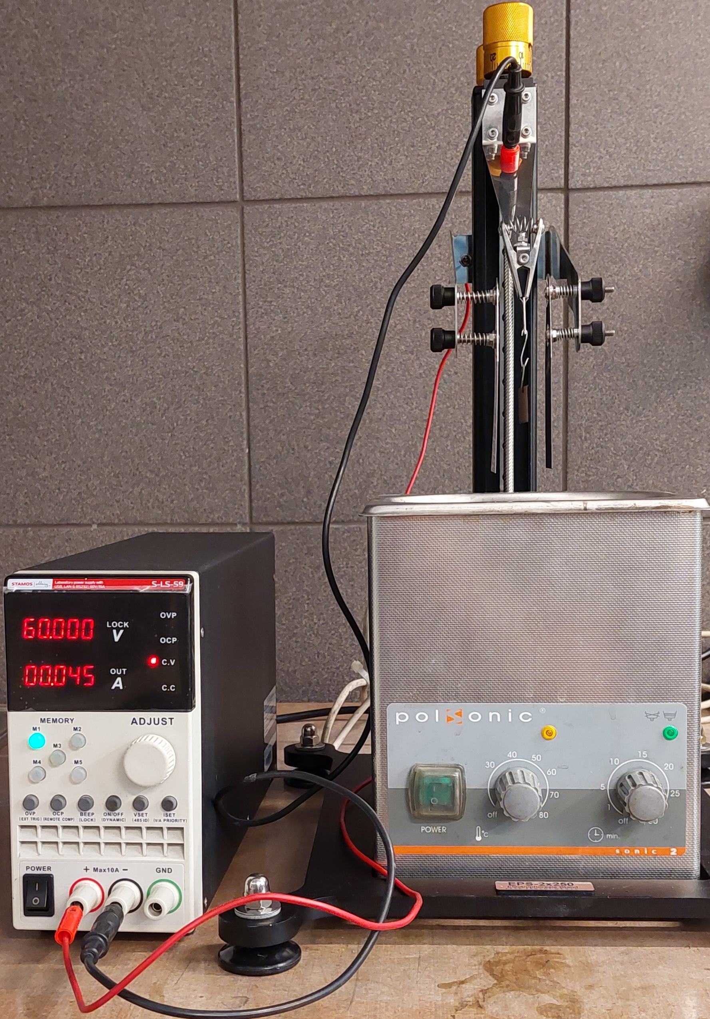
Electrophoretic deposition
Parameters of EDP
Suspesion
deposition
type of solvent
amount of dispersant (I₂)
amount of powder
powder grain size
current
voltage
time

Slide 6
Electroforetic deposition
parameters tested
12 types of solvent
8 concentrations of I₂
3 voltages
4 times
Acetone
2-propanol
Ethanol
Acetone + 2-prpanol
(1:3; 1:1; 3:1)
Acetone + Ethanol
(1:3; 1:1; 3:1)
Ethanol + 2-prpanol
(1:3; 1:1; 3:1)
0.5 g/L
1.0 g/L
1.5 g/L
2.0 g/L
2.5 g/L
3.0 g/L
3.5 g/L
4.0 g/L
20 V
40 V
60 V
60 s
120 s
180 s
240 s

Slide 7
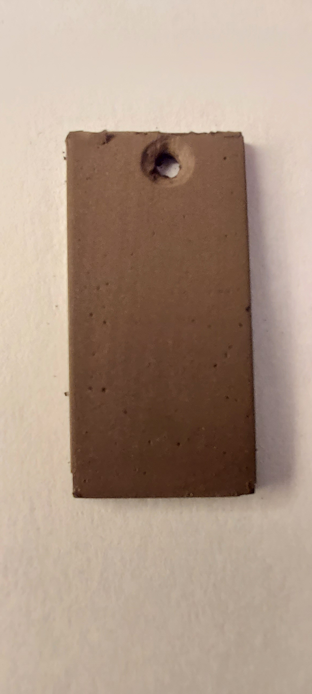
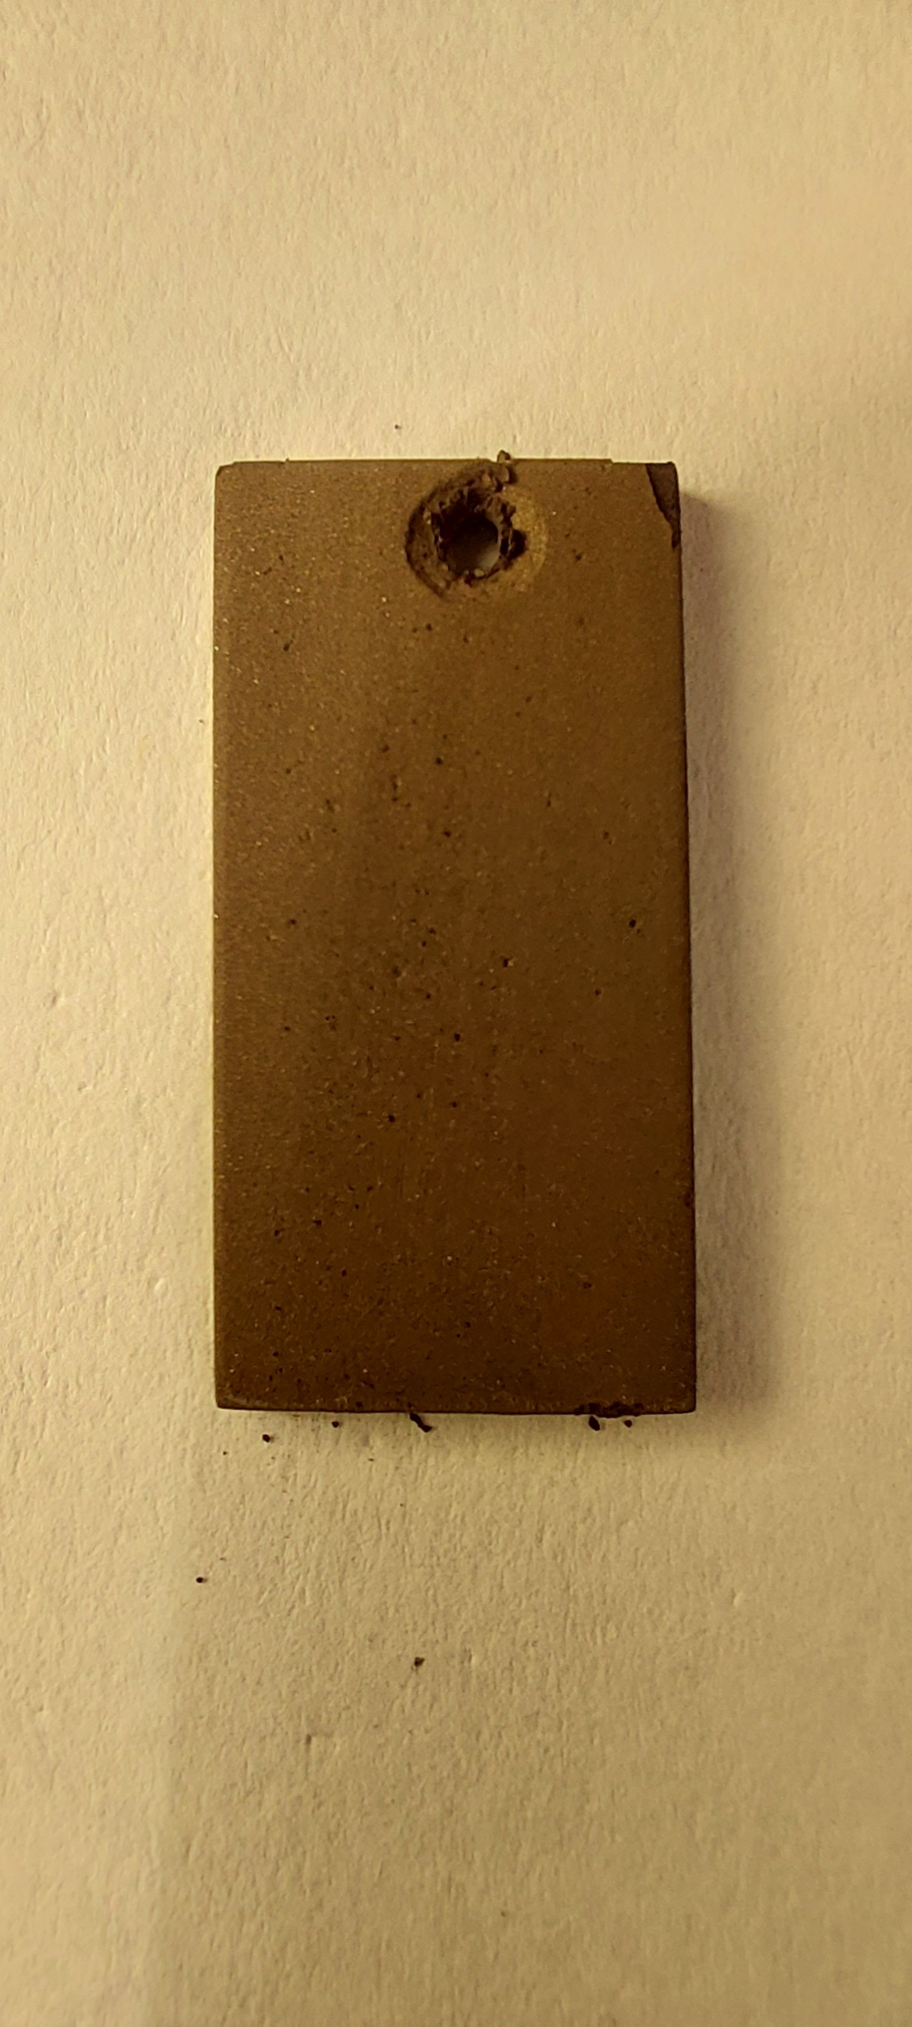
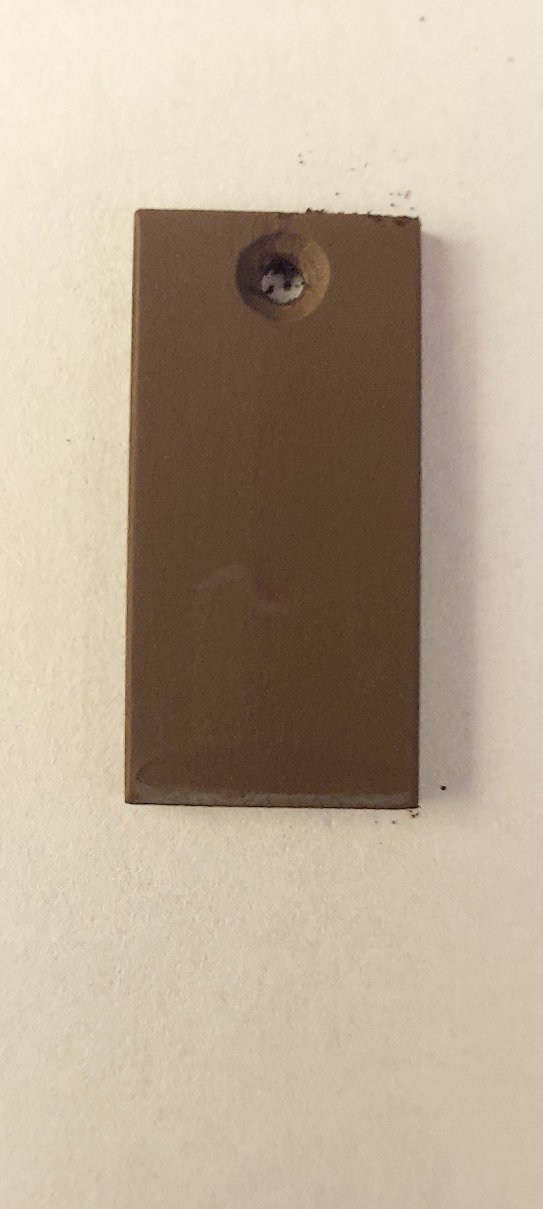
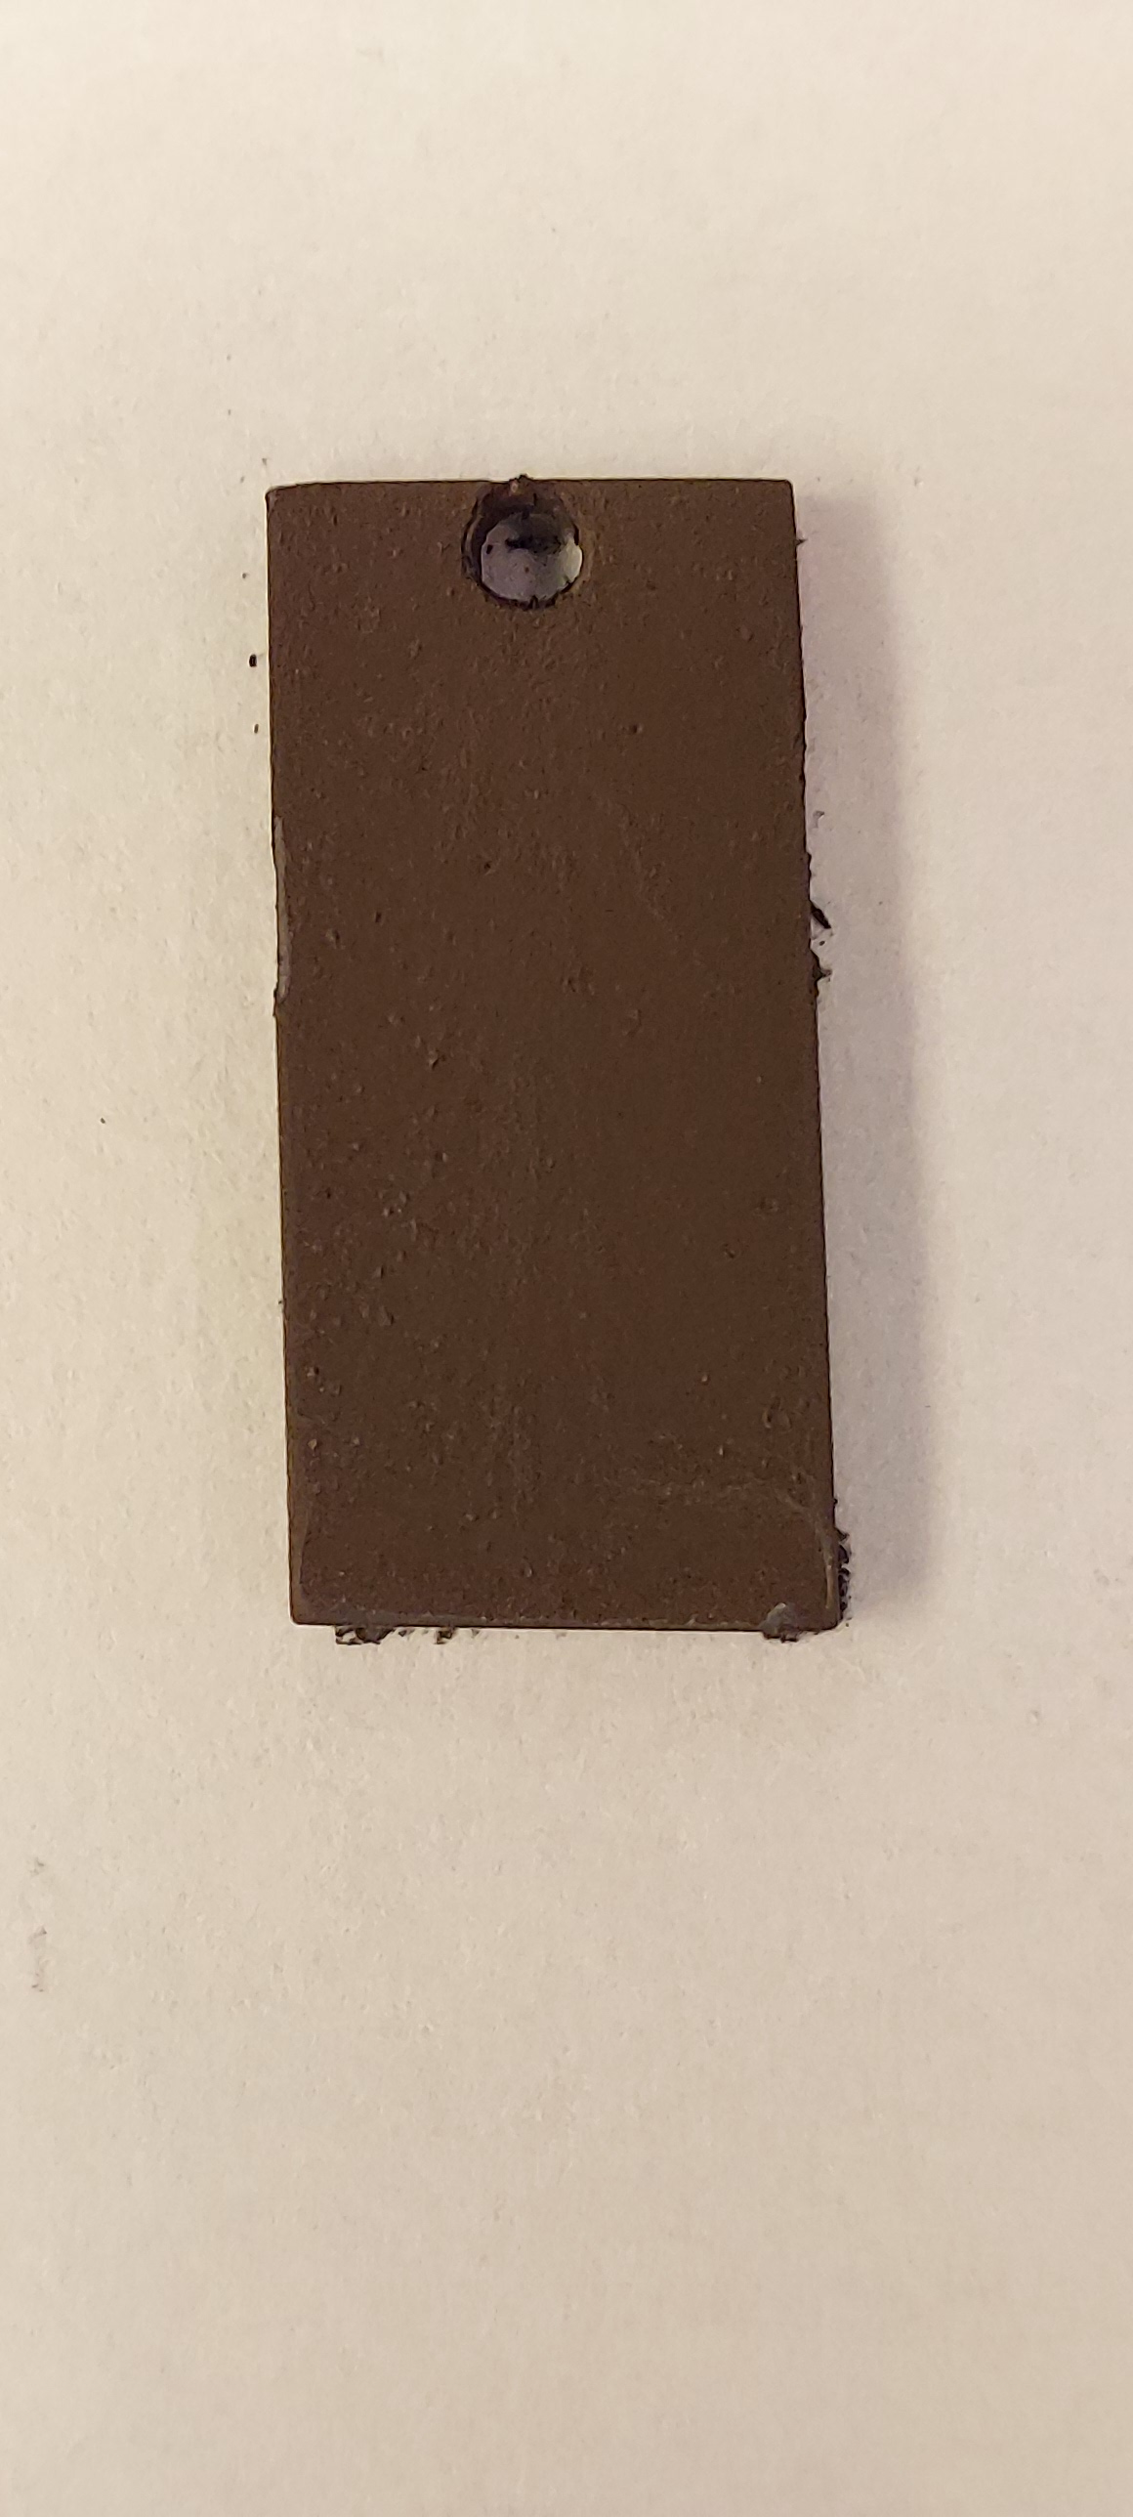
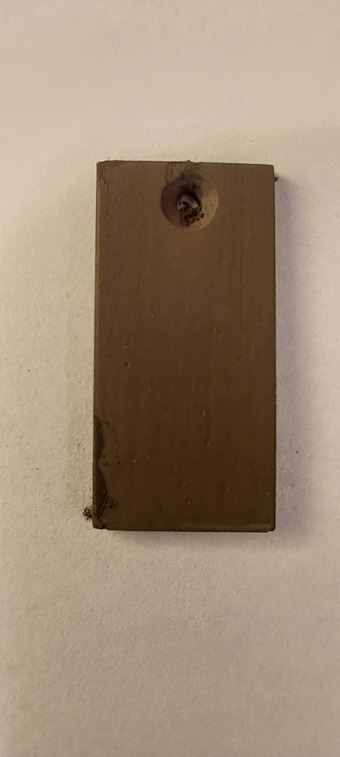
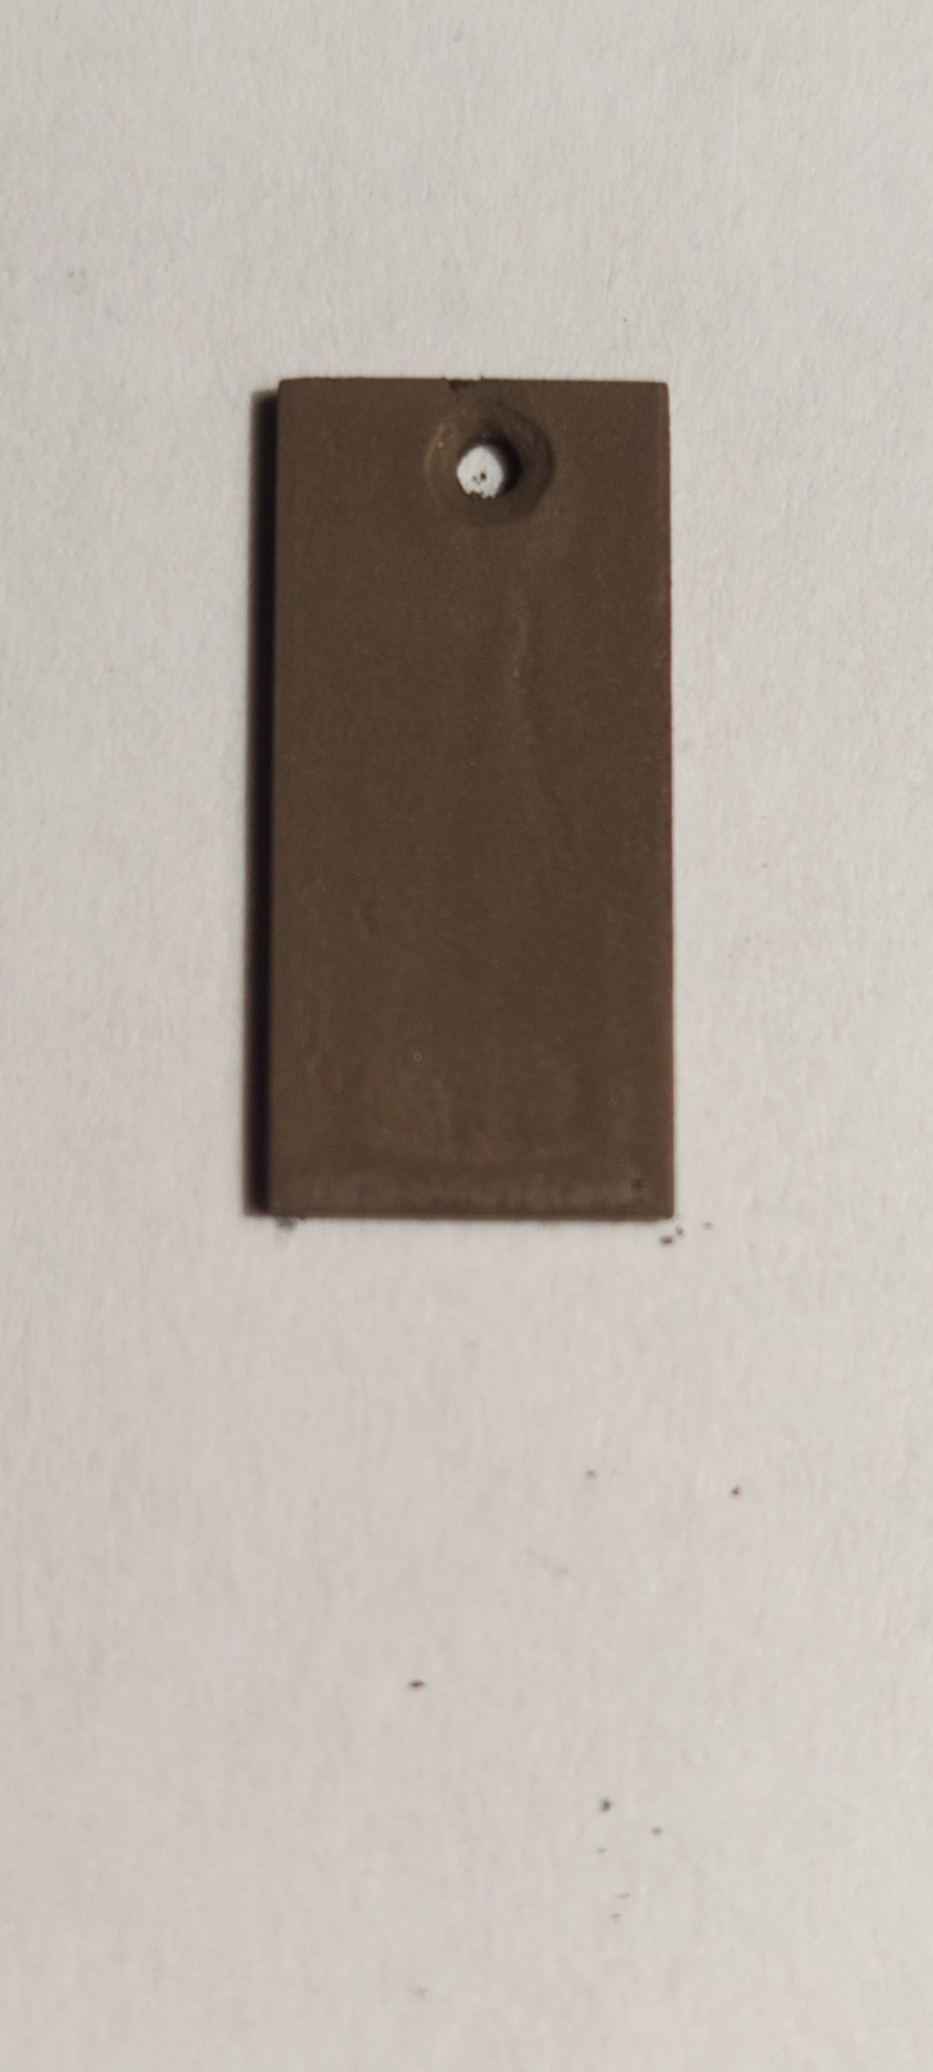
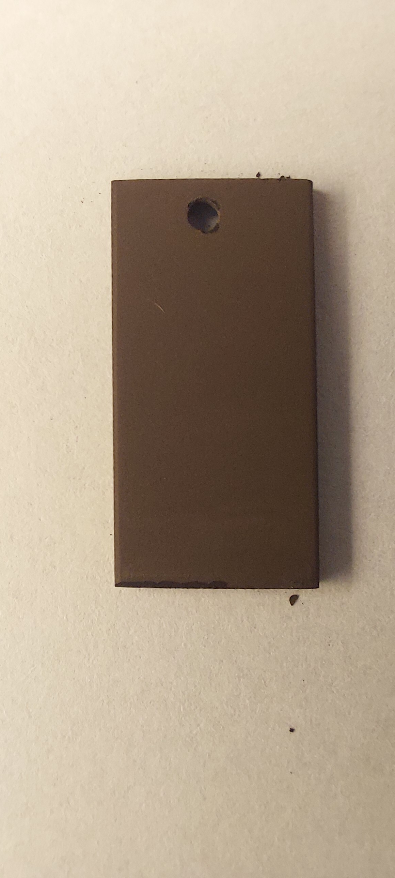
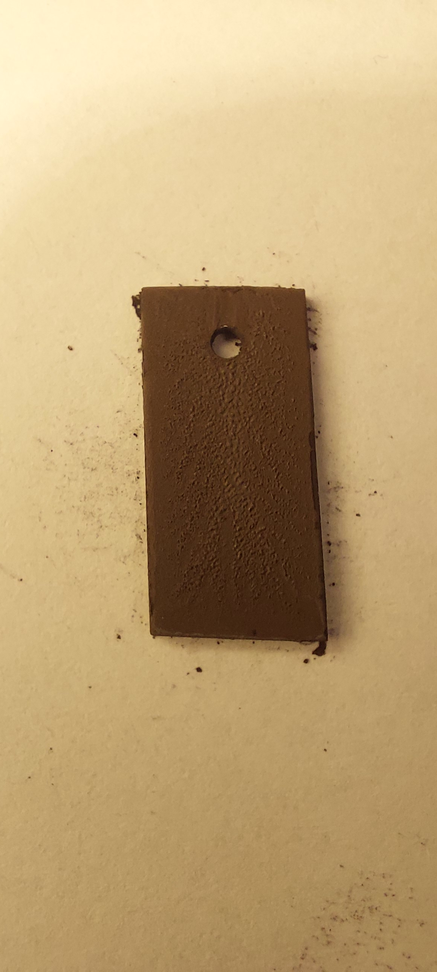
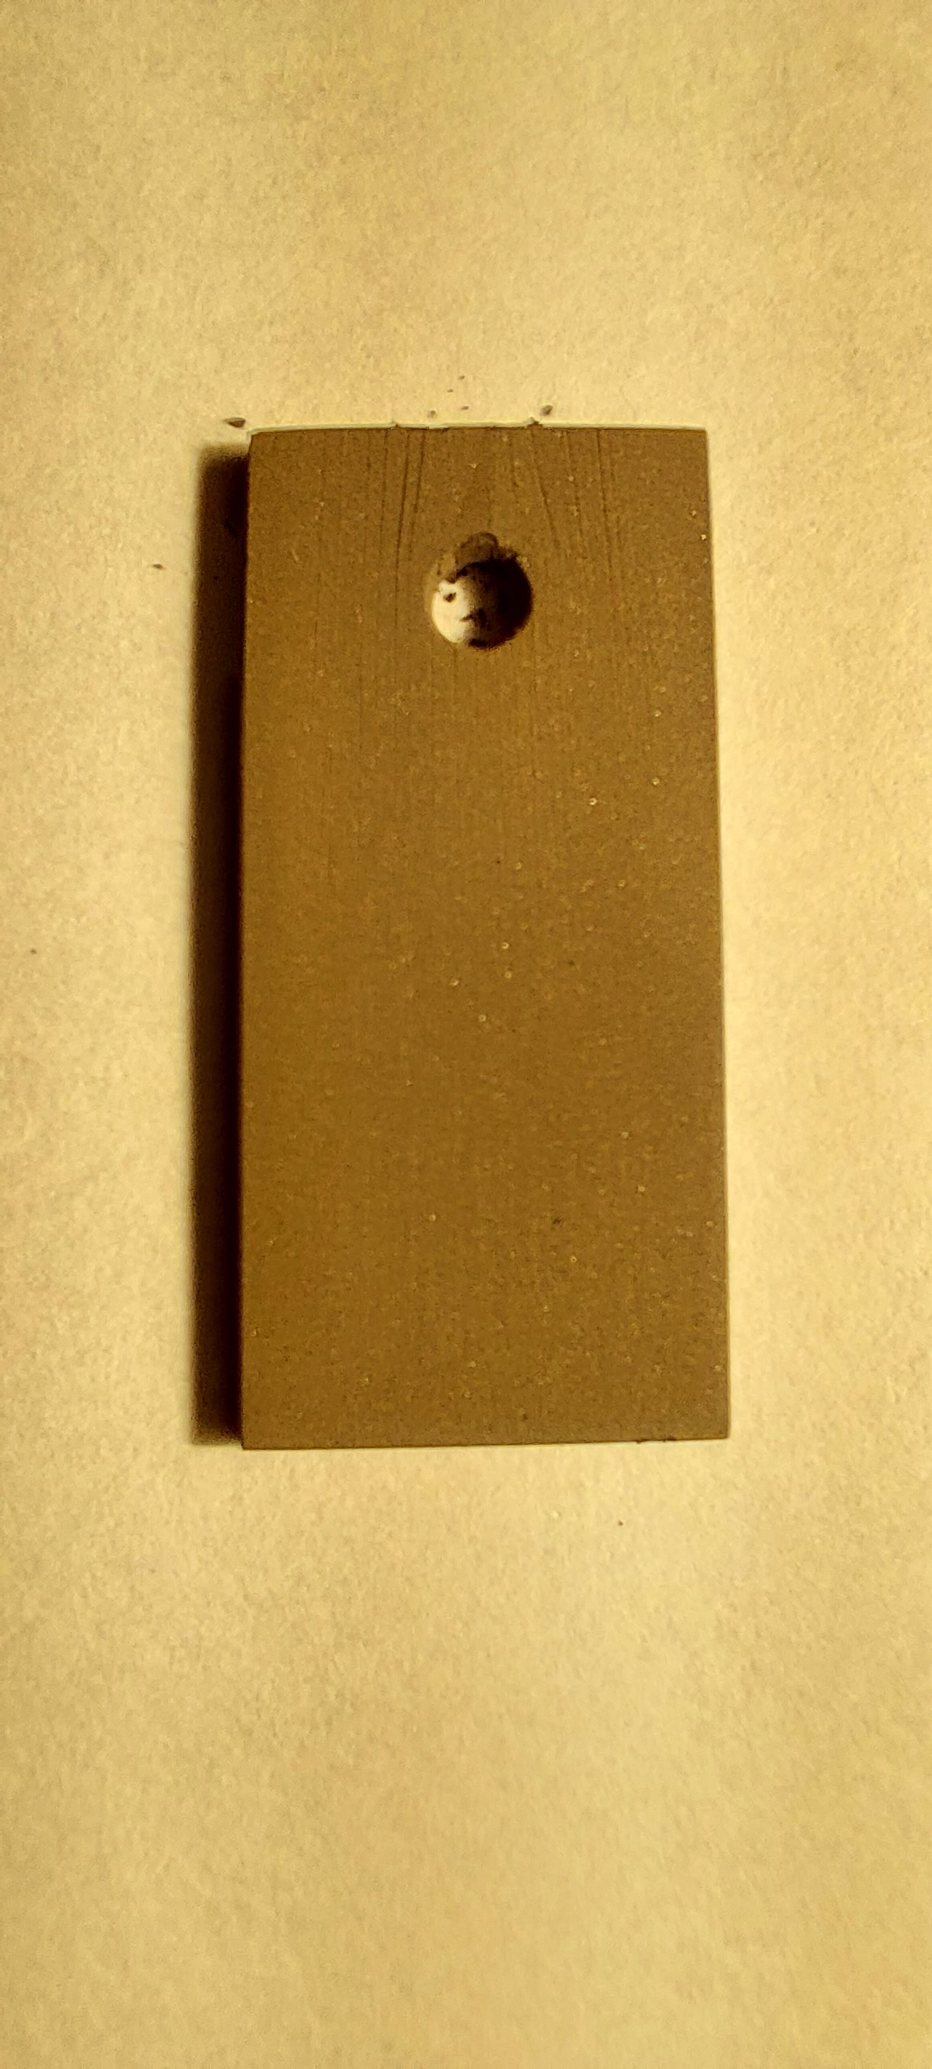
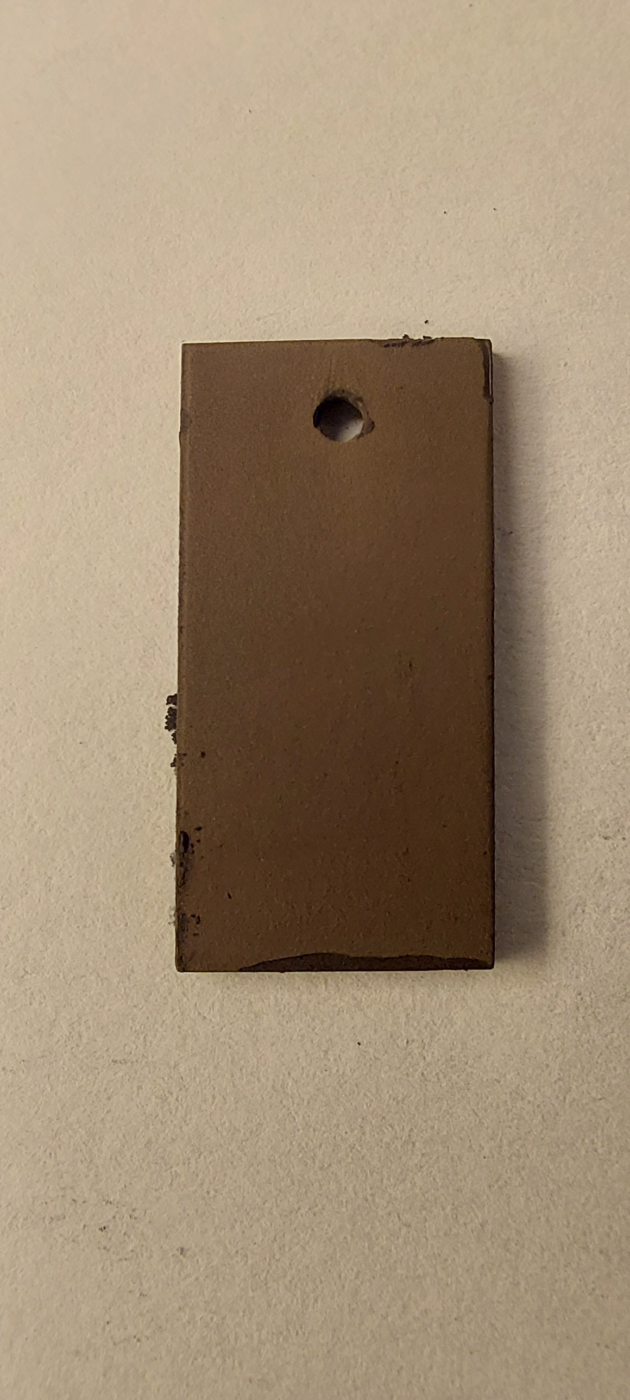
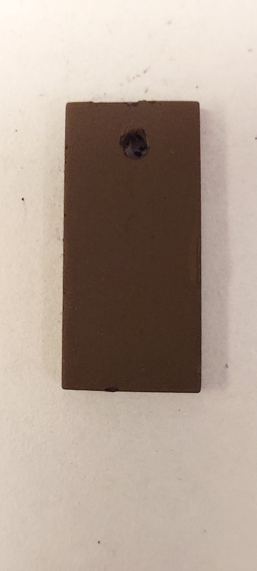
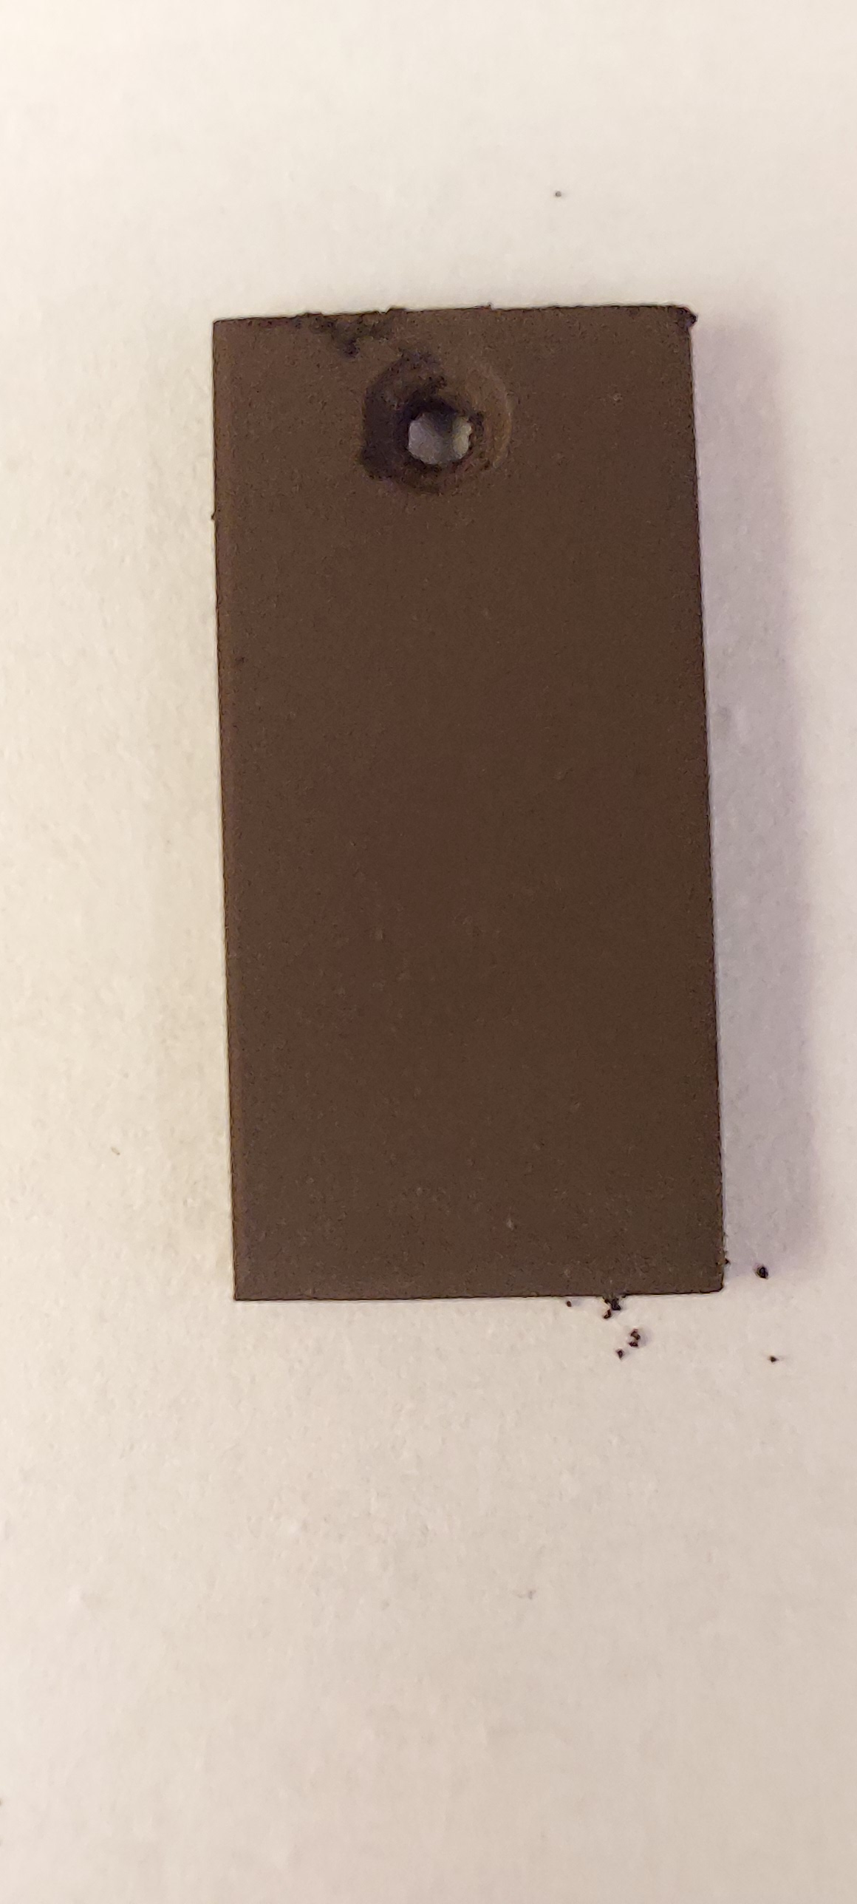
Electroforetic deposition
EOH
ACT+EOH
ACT+IPA
EOH+IPA
✗
✗
✗
✗
25/75
IPA
✗
✗
✗
✓
50/50
ACT
✓
✓
✓
✓
75/25

Slide 8
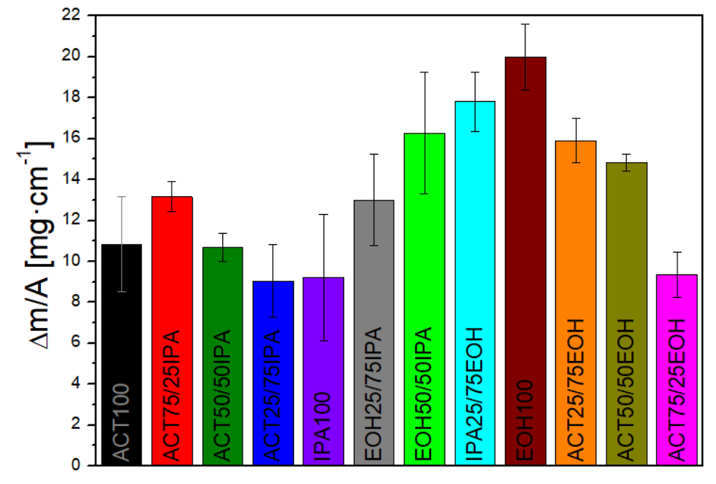
Electroforetic deposition

Slide 9
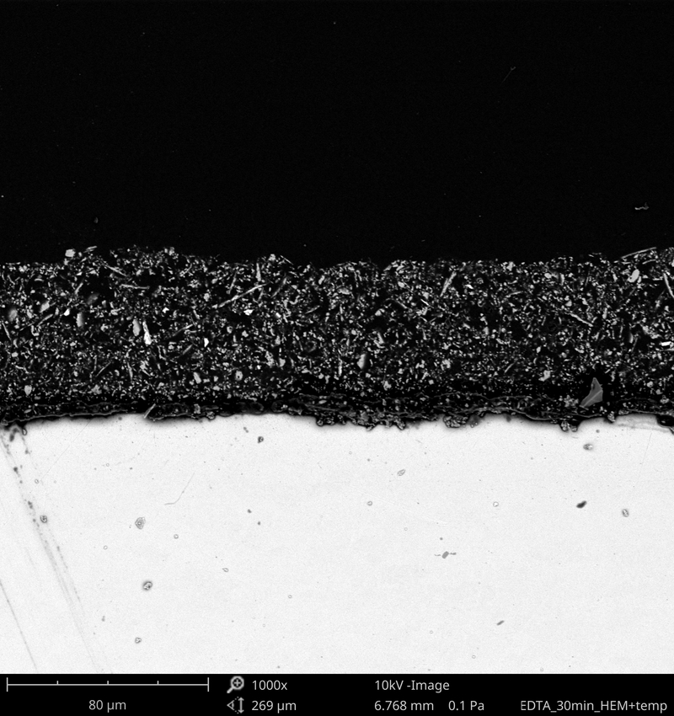
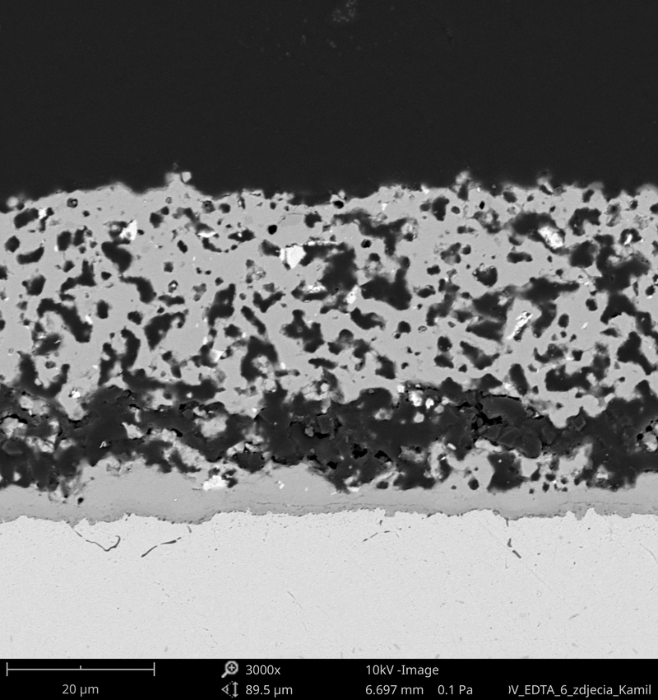
Coatings after heat treatment
As deposited
69 μm
80 μm
Heat treatment
32.5 μm
1000 °C for 5 h
20 μm

Slide 10
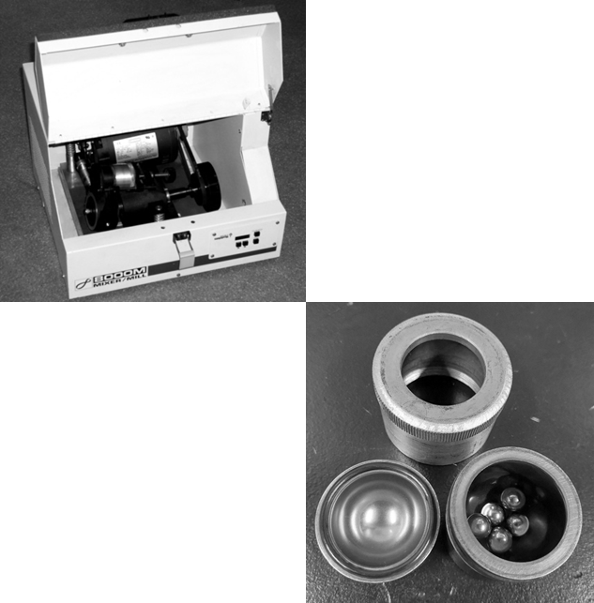
Composite CM/LNF
composition of the composite:
powder CM + powder LNF
wt% of LNF in composite | Sample name
5 | CM5LNF
10 | CM10LNF
15 | CM15LNF
20 | CM20LNF
30 | CM30LNF
40 | CM40LNF
50 | CM50LNF

Slide 11
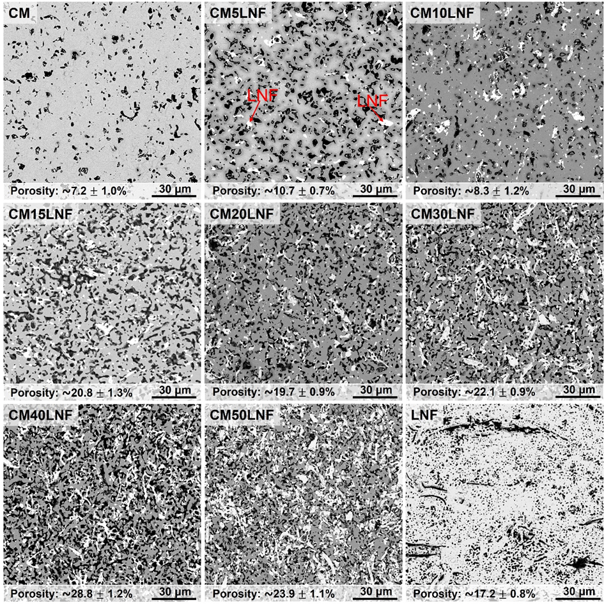
Composite CM/LNF

Slide 12
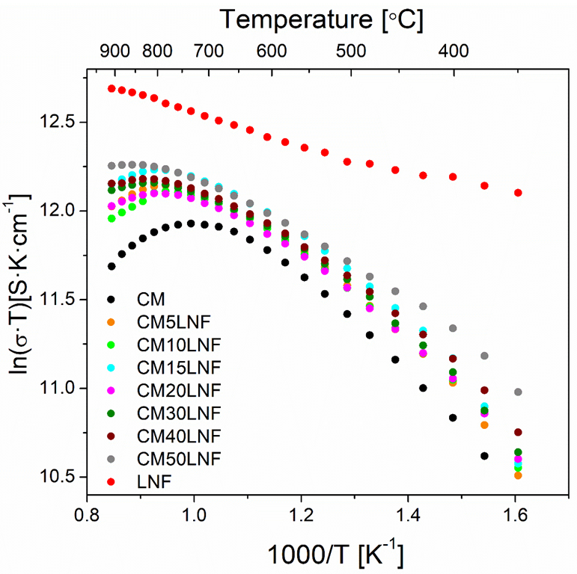
Electrical properties

Slide 13
Summary
To obtain nice coatings by electrophoretic deposition, it is necessary to select the appropriate deposition parameters: supspesion, dispersant concentration, voltage, current and time.
The coatings with a smooth, uniform surface were obtained from solutions containing the majority of acetone.
Analyzing the electrical conductivity and porosity of composites, the most promising coating materials are compositions with 5 and 10 wt% of LNF.

Slide 14
Thank you!

