Slide 1




The influence of micro-alloying elements on the microstructure of extruded Al-Mg alloy containing 7 wt.% of Mg
Krakow School of Interdisciplinary PhD Studies
Institute of Metallurgy and Materials Science
Polish Akademy of Sciences
Łukasiewicz
Institute of Non- Ferrous Metals
Kamila Limanówka^{1,2}, Sonia Boczkal¹, Monika Mitka¹, Anna Góral²
¹ Łukasiewicz Research Network – Institute of Non- Ferrous Metals, Skawina, Poland
² Institute of Metallurgy and Materials Science of the Polish Academy of Sciences, Cracow, Poland
Researches conducted as a part of the Ministry of Education and Science program "Implementation Doctorate„ project no DWD/4/42/2020
Notes:
Good morning Ladies and Gentelman, My name is Kamila Limanówka, I would like to present you results of researches as part of the implementation doctorate, which is carried out in the cooperation with the Institute of Metallurgy and Materials Science Polish Academy of Sciences and the Institute of Non- Ferrous Metals Skawina Division, belongs to the Łukasiewicz Research Network. The topic of the work was

Slide 2

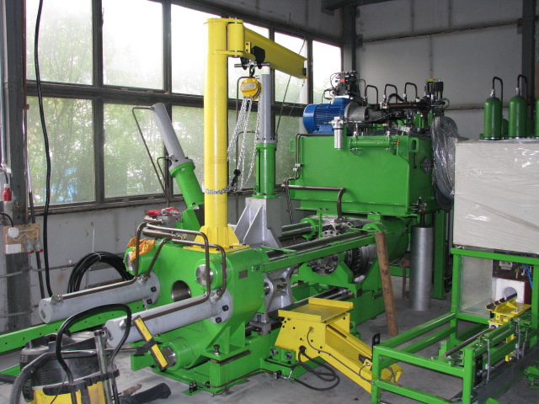
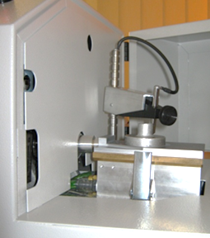
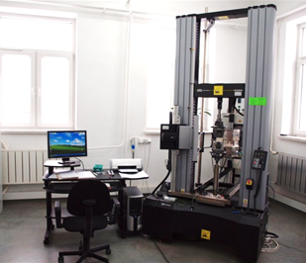
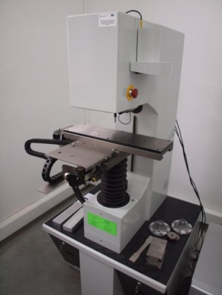
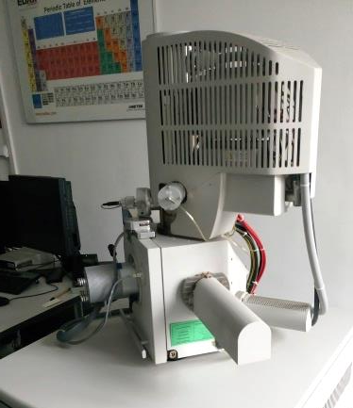
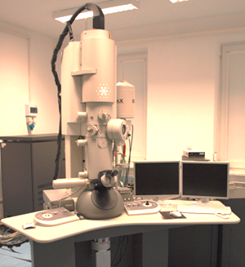
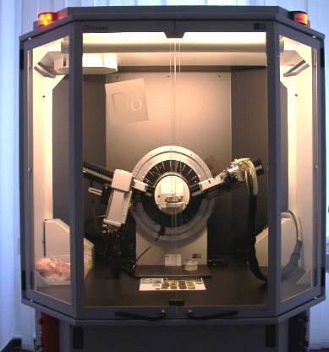
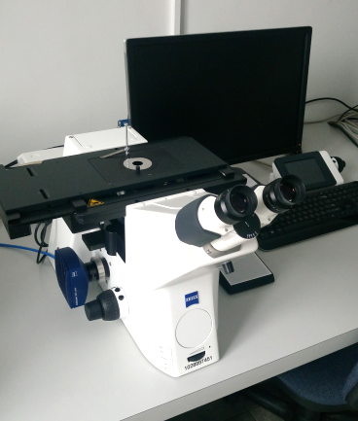

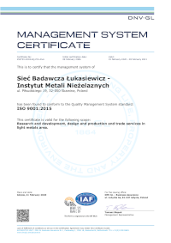

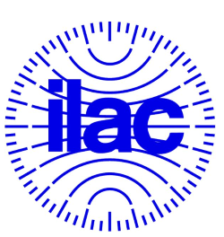
Łukasiewicz – Research Network, Division in Skawina
Crucible furnace Manometer 300 kg
hydraulic press max. 500 T
Optical Emission Spectrometer ARL 4400
Testing machine Instron DX 600
Hardness tester Duramin 2500
Light microscope Olympus GX 71
SEM Inspect F50
TEM Tecnai G2
X-ray diffractometer Bruker D8 Advance

Slide 3
Outline
1. Motivation
4. Hot extrusion process of the alloys
5. Analysis of the microstructure and mechanical properties of the rods after extrusion
6. Conclusions
2. Casting of the ingots and experiment plan
3. Analysis of the microstructure of the ingots
Notes:
At today's presentation, I would like to present to you the motivation to undertake research, the process of producing the material and its subsequent plastic processing processes as well as the material investigatrions. At the end, I will present the conclusions of the conducted experiments

Slide 4
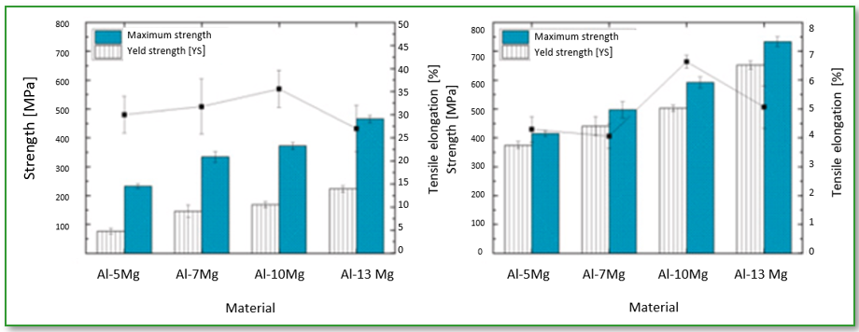
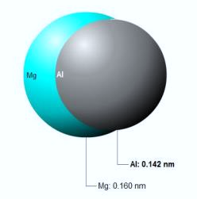
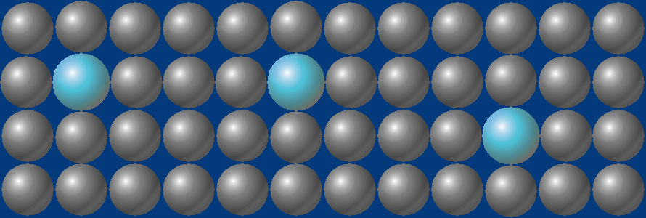
1. Motivation
Mechanical properties of Al-Mg alloys [1]:
Solid solution hardening
Solid solution hardening + work hardening
References:
[1] D. H. Jang, Y. B Park, W. J. Kim,, Mater. Sci. and Eng., 744(2019)
Properties of Al-Mg alloys:
High durability
Susceptibility to mechanical processing
Welding susceptibility
Corrosion resistance
Mg:
Has a high solubility in Al
The atomic misfit of Mg is quite high
Al: 0.142 nm
Mg: 0.160 nm
Application of extruded products from Al-Mg alloys:
Construction elements in the automotive, rail and marine industries
Welding wires
Notes:
Al-Mg alloys with high Mg content may be a cheaper alternative to the strongest Al-alloys of the 7000 series. This is because the theory shows that Al-Mg alloys have permanent solid solution hardening and can be additionally work hardened. The amount of magnesium has a major influence on the mechanical properties of these alloys. . An example is given in the slide, where Jang and others showed that with increasing Mg content, the yield strength is higher in yhe alloys with solid solution hardening and more effective in the alloys with solid solution hardening and work hardening. According to the standard, these alloys have a maximum content of approx. 5.5% Mg.
The need to develop extrusion technology for new Al-Mg alloys due to the growing interest of the railway and automotive industries as a construction material, because of a significant reduction in the weight of the vehicle, as well as the corrosion resistance of the construction. Also for welding, because to obtain a weld with the same magnesium content as the parts to be welded, a welding wire with the same or higher magnesium content should be used for welding. And this is the reason why is necessary to develop a technology for the production of welding wires with an increased magnesium content.

Slide 5
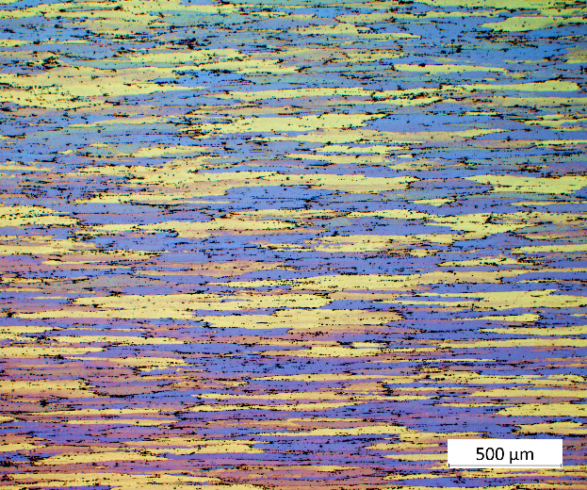
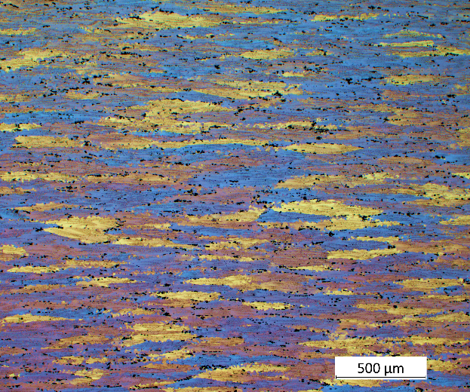
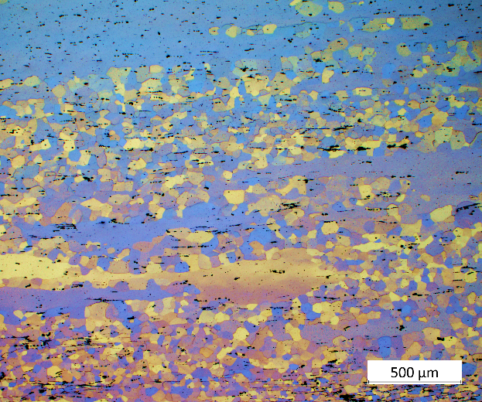
1. Motivation
Er, Zr
Fine- dispersion Al₃(Er,Zr) phases inhibit recrystallization and improve the mechanical properties of Al-Mg alloys. The final recrystallization temperature of the Al-Mg alloy with Er and Zr is at least 200 °C higher than for alloys without Er and Zr.
Extruded Al-Mg alloys
Al-3 wt.% Mg
Al-6 wt.% Mg
Sc, Zr
Fine- dispersoids Al₃(Sc,Zr) significantly improve the microstructure and mechanical properties of Al-Mg alloys. Those particles have good thermal stability, and the grain boundaries can be strongly pinned by Al₃(Sc,Zr) particles, which contribute to inhibit the recrystallization.
Ag, Cu
simultaneous addition of Ag and Cu is effective in strengthening Al alloys but also results in the formation of fine precipitates leading to an increase in the thermal stability of Al-based alloys.
Al-7 wt.% Mg
Scientific goal:
Inhibition of the recovery and recrystallization processes in Al-Mg alloys after the hot extrusion by introducing the micro-alloying elements.
Notes:
Unfortunately, based on the work carried out at the IMN, it has been shown that the Al-Mg alloys with increased Mg content undergo recrystallization processes immediately after plastic processing. The photos show the microstructure of extruded at 400 stC Al-Mg alloys with Mg content 3, 6 and 7 %. as we can see the alloy with 3 and 6% of magnesium content showed deformed structures with elongated grains, typical for extruded products while AlMg7 alloy was characterized by a partially recrystallized structure immediately after the extrusion process. So, the main aim of the work Is
Based on the data available in the literature, microadditives were selected. Those additions should form precipitates modifying the structure of the alloys, limiting the mobility of dislocations, and causing its strengthening. Three Al-Mg alloys containing Sc, Zr, Ag, Cu, Er Zr were prepared.

Slide 6
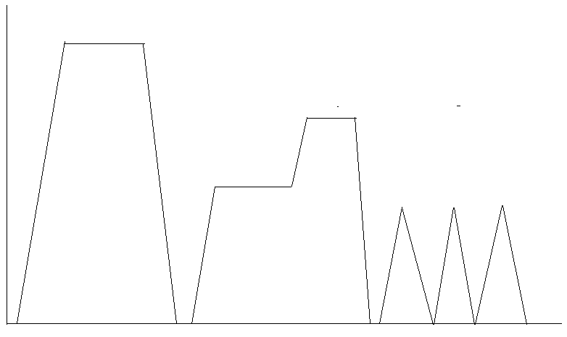
2. Casting of the ingots and experiment plan
2.1. Scheme of conducted researches
Microstructure
Approx. 720 °C
Temperature [°C]
480 °C / 5 h
420 °C / 12 h
400 °C
Casting
Homogenization
Hot extrusion
Time [h]
Notes:
With the aim of inhibit the recovery and recrystallization processes of these alloys, it was planned to produce AlMg 7 alloys with a different combination of micro-additives which could limiting the mobility of dislocations in aluminum alloys. The research scheme was developed on the basis of the technology used in industry. First, alloys with selected micro-additives were cast. Then, two-stage homogenization was performed. In the first stage at the temperature of 420 ° C for 12 hours, in the second stage at the temperature of 480 ° C for 5 hours. Homogenization was performer in order to even out the magnesium concentration, especially in the border area of the grain, and to dissolve losing Al3Mg2 phase forming at grain boundaries and causing cracking of this alloy during plastic working.
Then, extrusion process was carried out. After each step, the microstructure of the alloys were analysed.

Slide 7
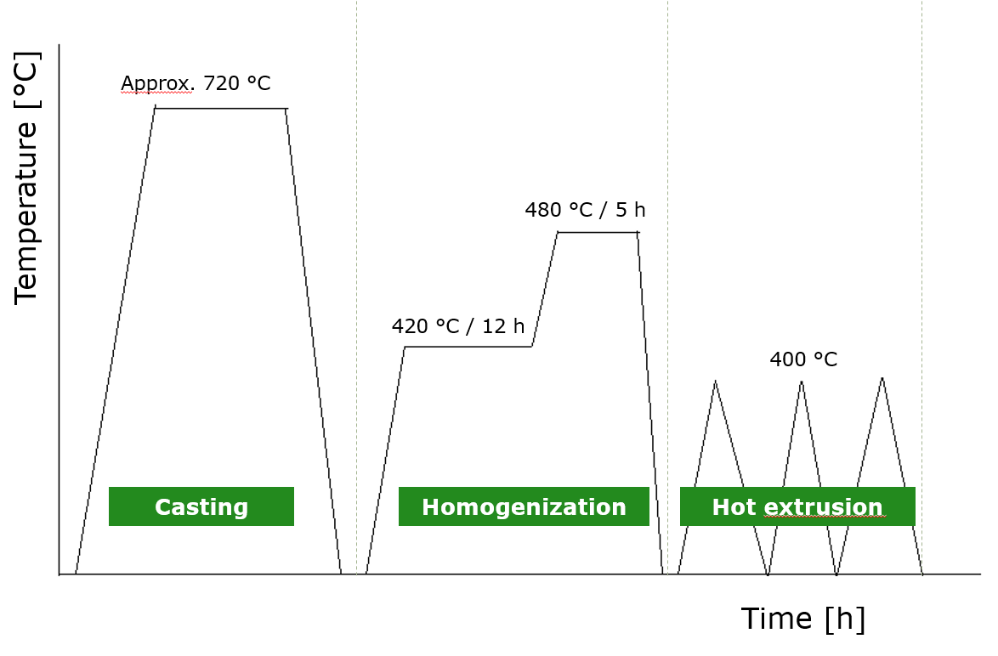
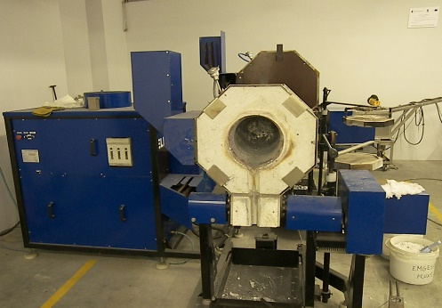
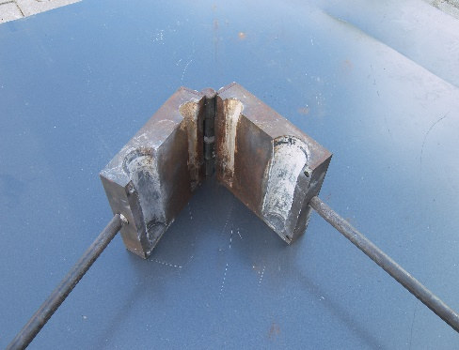
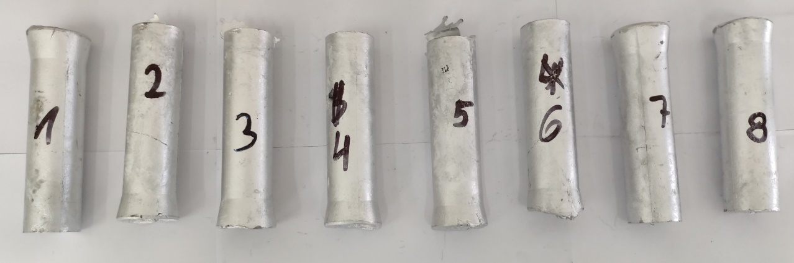
2 Casting of the ingots and experiment plan
2.3. Casting of the ingots
Composition | Abbrevation
Al- 7 wt.% Mg (base alloy) | AlMg7
Al- 7 wt.% Mg + 0.25 wt.% Sc + 0.2 wt.% Zr | AlMgScZr
Al- 7 wt.% Mg + 0.5 wt.% Cu + 0.5 wt.% Ag | AlMgCuAg
Al- 7 wt.% Mg + 0.25 wt.% Er + 0.2 wt.% Zr | AlMgErZr
Induction furnace
Target rods
Casting mould Ø 40 mm
Cast ingots Ø 40 mm
Notes:
Four alloys were produced which the basic chemical composition is shown in the table. The charge material in the form of aluminum ingots was melted in an induction furnace. During the cast process, it was important to maintain the appropriate temperature and the order of adding alloying elements in the form of technically pure metals or mortars. The photos show the cast furnace, casting moulds and ingots. Each alloy was cast into a metal cast mould with a diameter of 40 mm.

Slide 8
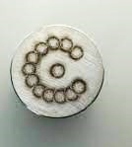
3. Analysis of the microstructure of the ingots
3.1. Chemical analysis of the ingots
Chemical composition analysis by optical emission spectrometry
Alloy | Chemical composition [wt.%]
 | Al | Fe | Si | Mg | Mn | Cr | V | Zr | Be | Sc | Er | Ag | Cu
AlMg7 | 92.97 | 0.055 | 0.091 | 7.011 | 0.006 | > 0.01 | 0.003 |  | 0.002
AlMgScZr | 92.28 | 0.058 | 0.065 | 6.981 | 0.451 | > 0.01 | 0.006 | 0.203 | 0.001 | 0.221
AlMgCuAg | 92.28 | 0.111 | 0.058 | 7.143 | 0.009 | > 0.01 | 0.001 |  | 0.001 |  |  | 0.492 | 0.511
AlMgErZr | 92.47 | 0.054 | 0.062 | 6.979 | 0.391 | > 0.01 | 0.004 | 0.204 | 0.001 |  | 0.271
[3] PN EN 573-3 Aluminium and aluminium alloys - Chemical composition and form of wrought products, part 3 (portion)
Alloy | Si | Fe | Cu | Mn | Mg | Cr | Ni | Zn | Ti
EN-AW 5058 | 0.40 | 0.50 | 0.10 | 0.20 | 4.5-5.6 | 0.10 | - | 0.20 | 0.20
Notes:
The chemical composition of the ingots were analyzed by optical emission spectrometry. They show that the concentration of magnesium and selected micro-additives corresponded to the assumed chemical compositions of the alloys.
The chemical composition based on the standard, containing up to 5.6% Mg, is also shown in red frame, representing the alloy with the highest Mg content.

Slide 9
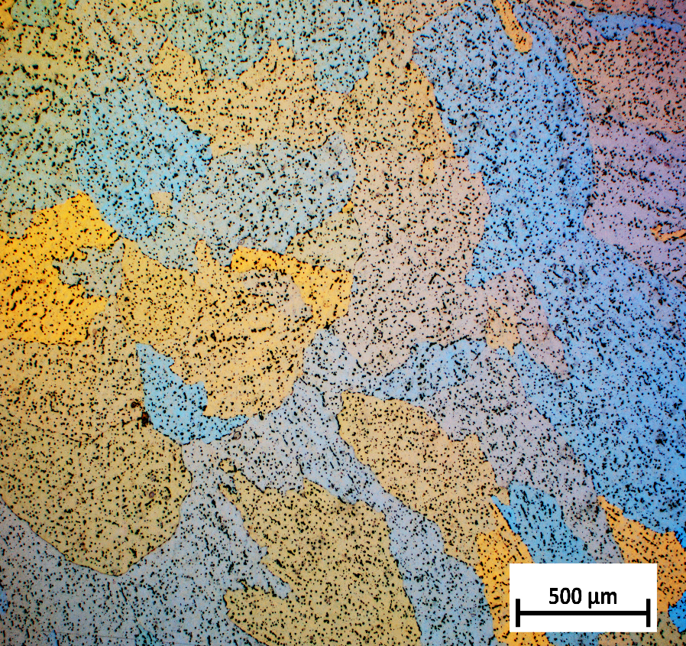
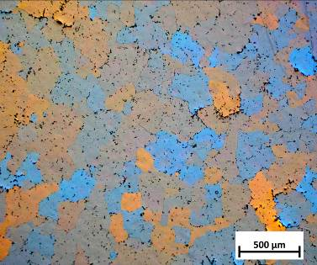
3. Analysis of the microstructure of the ingots
3.2. Microstructure of the ingots
AlMg7
AlMgScZr
d= 270 µm
d= 36 µm
d= 230 µm
AlMgCuAg
AlMgErZr
d= 330 µm
d= 68 µm
d= 116 µm
d= 361 µm
d= 384 µm
Notes:
The microstructure of the ingots were determined. while the Sc, Er, and Zr alloying additives reduced the average grain size, the average grain size is shown in white in the photos of microstructures. The smallest grain size was observed in the sample with additions of Sc and Zr. All samples had equiaxed (ekłiagzd) grain except the sample with the addition of Ag and Cu, which was characterized by a semi-dendritic structure.

Slide 10
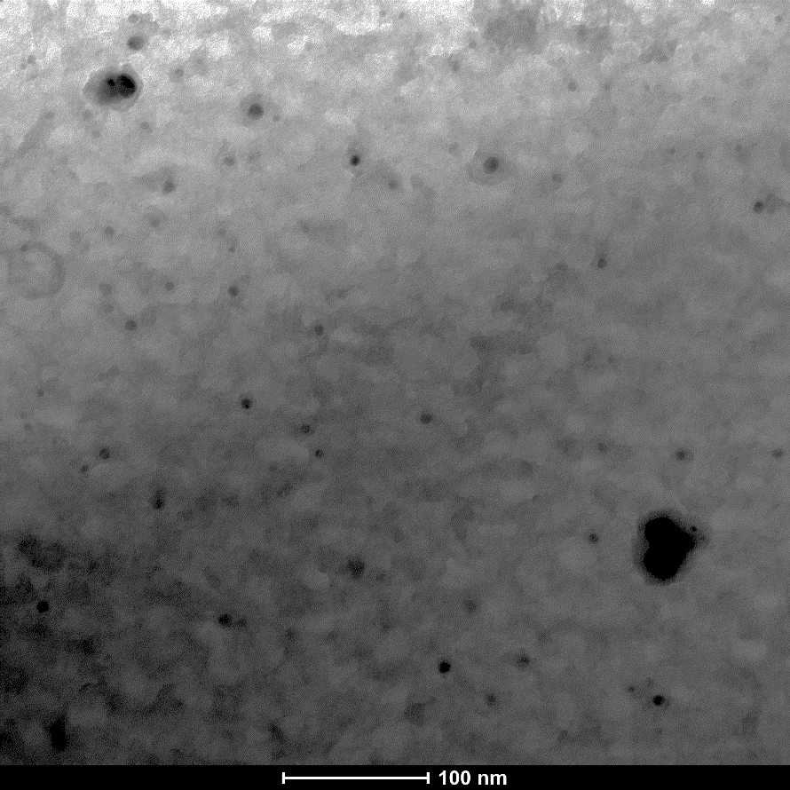
3. Analysis of the microstructure of the ingots
3.3. Microstructure of the ingots
AlMg7
AlMgScZr
Al, Mn, Fe,Si
Fine dispersoids
Mg, Si
Al, Sc, Zr
100 nm
AlMgCuAg
AlMgErZr
Al, Mg, Cu, Ag
Al, Er, Zr
100 nm
100 nm
Notes:
The analysis of the chemical composition in micro-areas was performed using a transmission electron microscope. the base alloy had standard precipitations (Mg2Si and iron phases) occurring in this alloys. TEM investigations allowed showing the fine dispersoids in the AlMg7 alloys with micro-alloying elements. The phases were identified by analysis of the chemical composition, and diffractions will be the subject of further studies The alloy containing Sc and Zr possessed (pozezd) the smallest and the most densely and evenly distributed dispersoids in the Al matrix . Meanwhile, the fine dispersoids were also observed in the alloy with Ag and Cu. This alloy also had evenly distributed precipitates in the Al matrix, but significantly less than was observed in the AlMg7 alloy containing Sc and Zr . AlMg7 alloy with Er and Zr was characterized by an accidentally distribution of precipitates in the Al matrix
Basis on the data in literaturę I expect three-component phases in alloys with ER and SC and 4 component phases in the alloy
This will be verified on the basis of electron diffraction

Slide 11
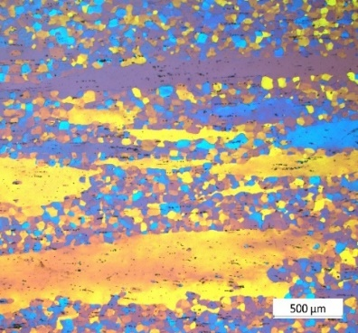
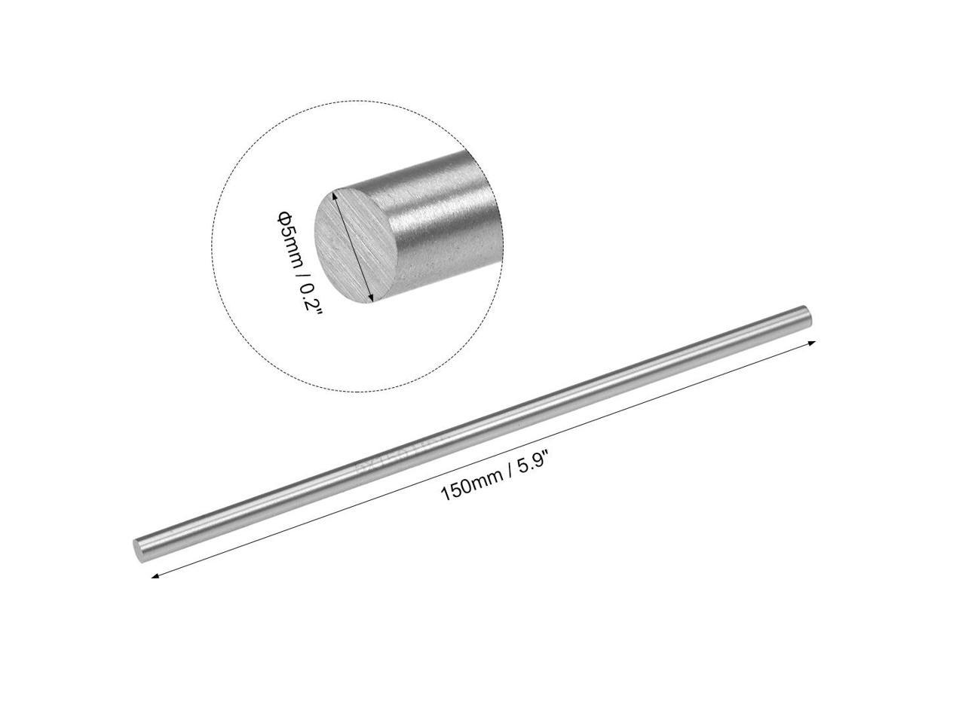
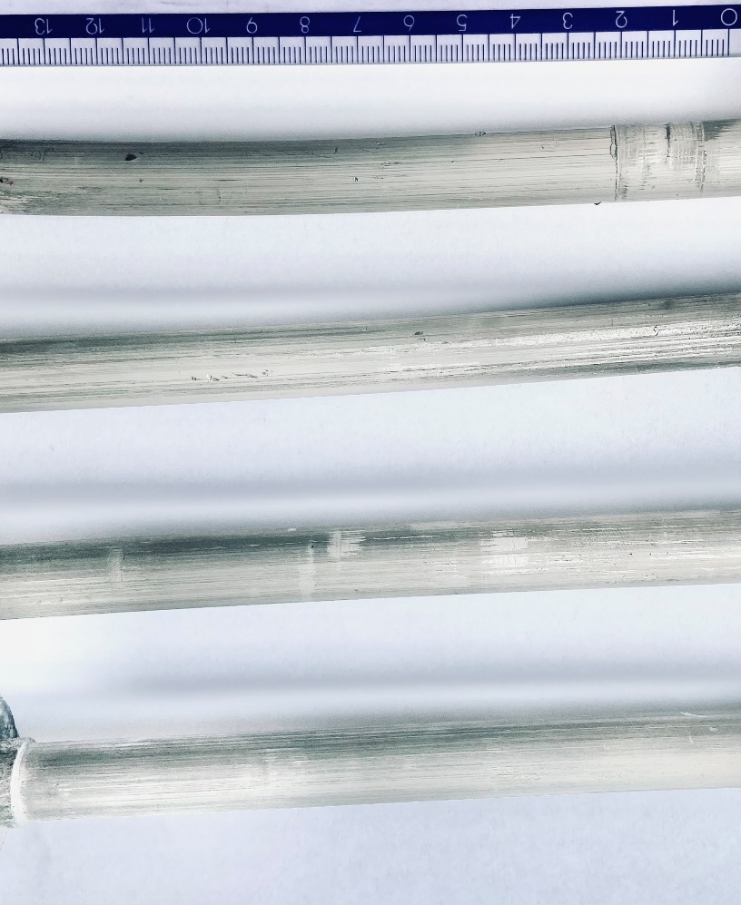
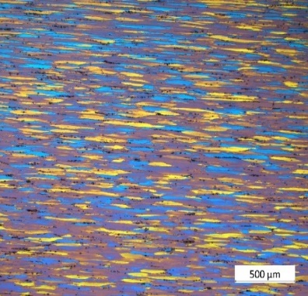
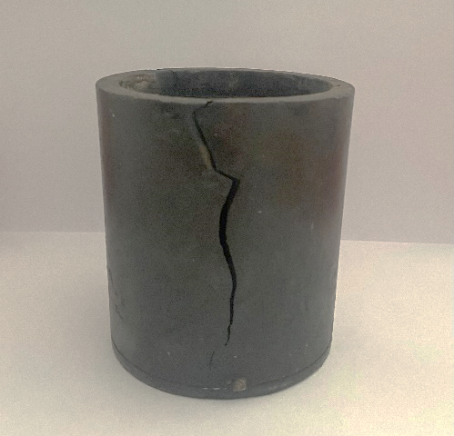
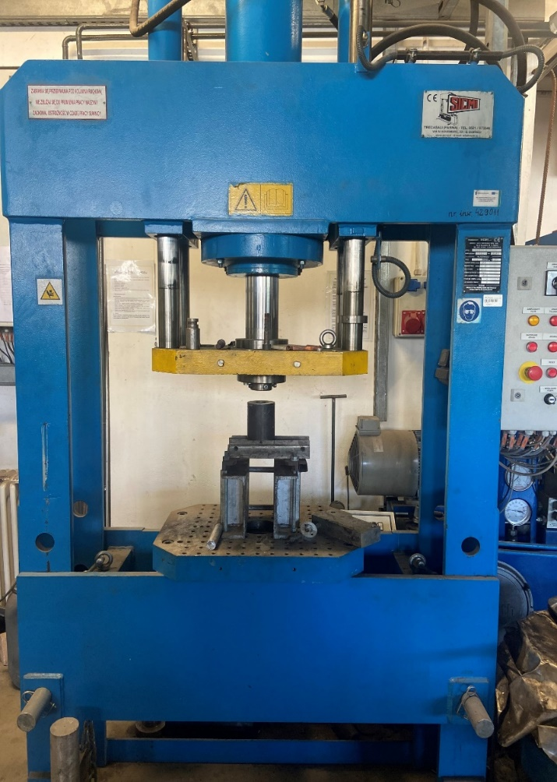
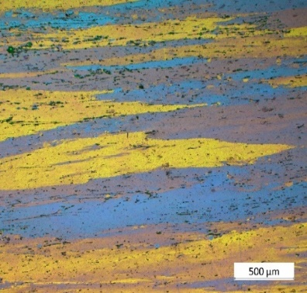
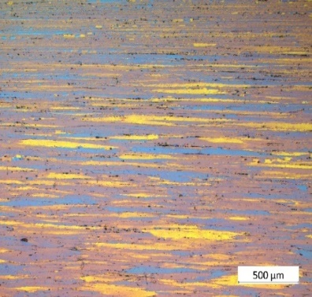
4. Hot extrusion process of the alloys
Vertical press: 100 t
Temperature: 400 °C
Strain force: 48 t
Speed: 0.5 mm/s
Ø 8 mm
AlMg7
Ø 8 mm
Extrusion press
AlMgScZr
AlMgCuAg
AlMgErZr
Notes:
The development of the technology of extrusion of Al-Mg alloys with above-standard Mg content requires complex research experiments, as well as extensive knowledge about the deformability of Al-Mg alloys at various extrusion possibilities. An increase in the magnesium content is associated with a compound in the deformability of the material due to the high plastic resistance of the material during extrusion. The extrusion conditions were selected on the basis of extrusion tests at various temperatures, starting from of 500°C. In subsequent steps, the temperature was reduced by 50 °C. At 400 °C, pressures of 50 T were achieved, which is close to the max. allowable force that can be transferred by the container. During the tests at the temperature of 350 °C, the pressure value of 55 T was exceeded, which caused the compression of the tip of the piston and crakc the container. Therefore, the prepared ingots were extruded at a temperature of 400 ° C, with a piston speed of 0.5 mm/s and a force of 48t.
Obtained rods with diameter 8 mm

Slide 12





5. Analysis of the microstructure and mechanical properties of the rods after extrusion
5.1. Microstructure of the rods after hot extrusion
AlMg7
AlMgScZr
Extrusion direction
AlMgCuAg
AlMgErZr
Notes:
The microstructure after the extrusion process was characterized along the direction of extrusion. The alloys with micro-alloying elements had deformed and elongated grains while the base alloys had mostly equiaxed grain and only partly elongated

Slide 13
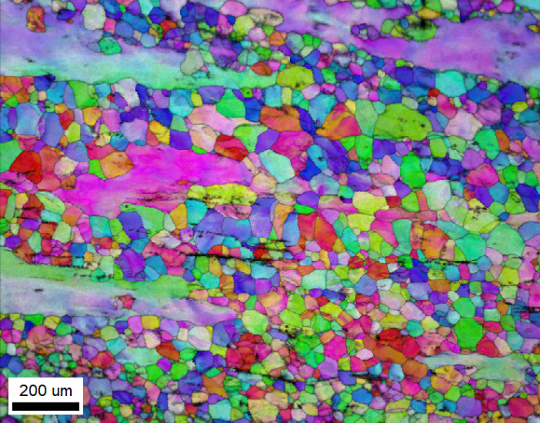
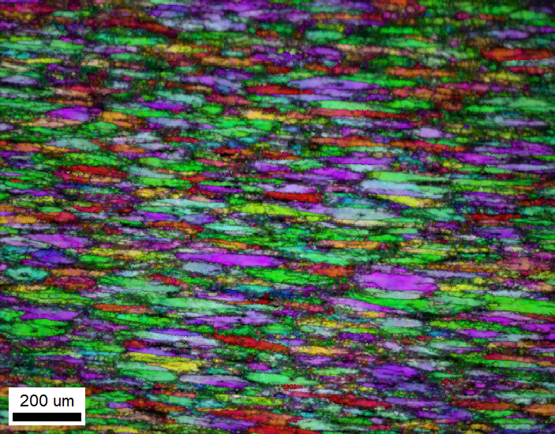
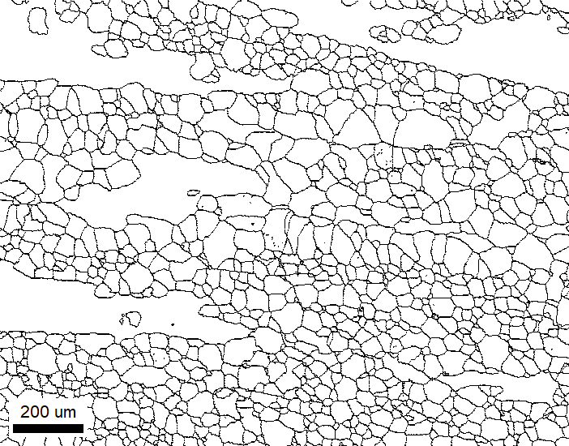
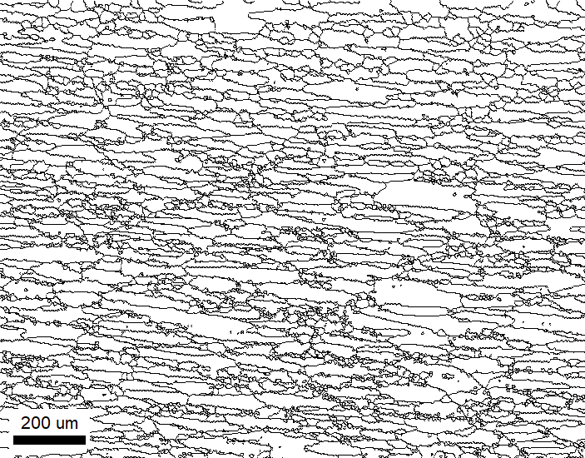
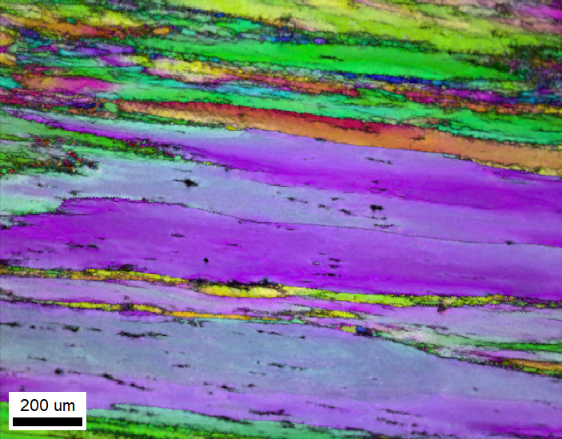
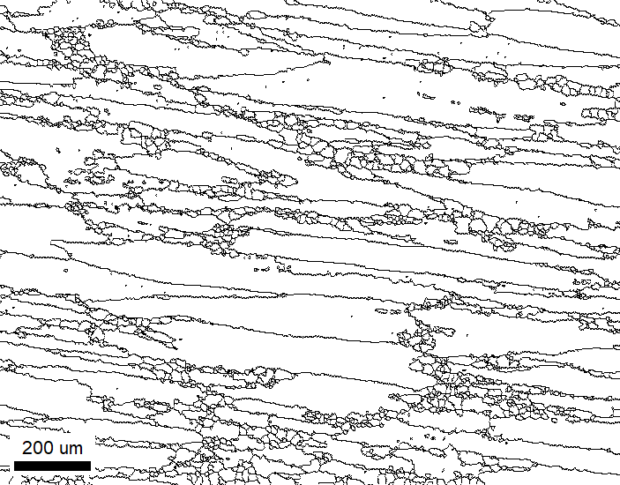
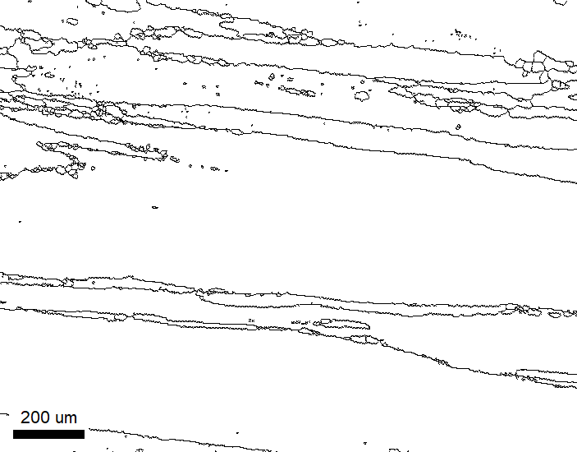
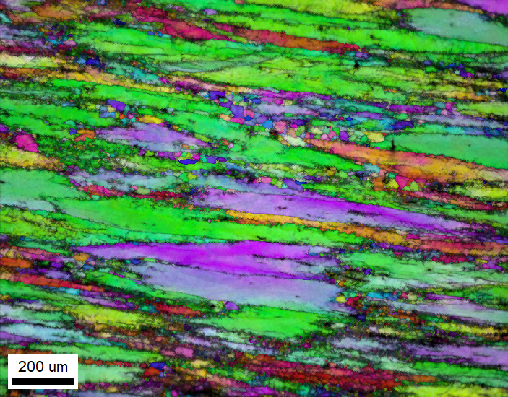


5. Analysis of the microstructure and mechanical properties of the rods after extrusion
5.2. Microstructure of the rods after hot extrusion
AlMg7
AlMgScZr
Extrusion direction
AlMgCuAg
AlMgErZr
Notes:
The microstructure was characterized by the EBSD method. In the base alloy the partically recrystallized structure was observed. In case of the alloys with micro-alloying elements It was showed that all aalloys had deformed structure with elongated grains after hot extrusion. In alloys with micro alloying elements the grain size is comparable as after casting, only the grains has been elongated during extrusion process. The smallest grain size was analyzed for the sample with addition of Sc and Zr and the greastest for the sample with addition of Ag and Cu. Whereby, no recrystallized fraction observed in both samples. To anallize the structure of the alloy with the addition of Er and Zr, we can see that slight processes of structure renewal. As a confirm of this process are grain boundaries map extracted from the original microstructure as we can see in the slide. We can see not only the elongated grains but albo a small amount of equiaxial grains, which may indicate the beginning of recrystallization. in this alloy fine precipitates were not evenly distributed in the matrix, therefore recrystallization probably began in places free of precipitates. In alloys with addition of Sc and Zr and Cu ang Ag the recryslallization fraction was not observed because the fine dispersoids were densely and evenly distributed in Al matrix.

Slide 14
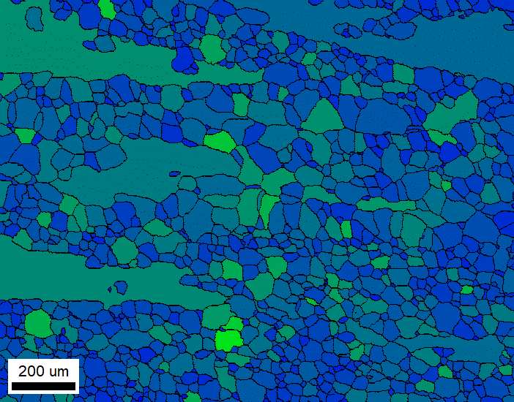
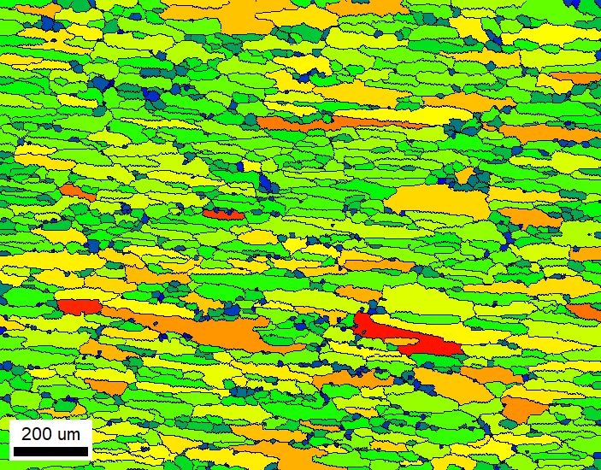

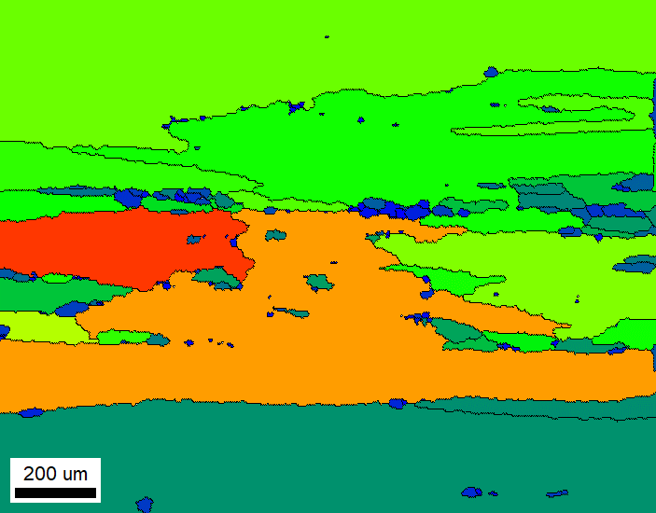
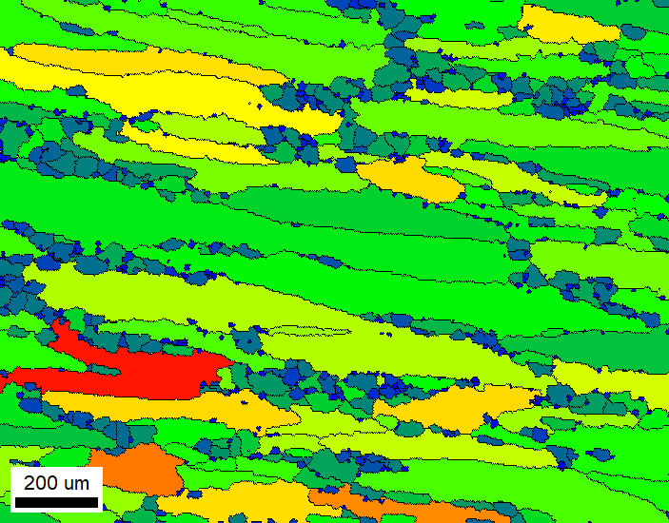
5. Analysis of the microstructure and mechanical properties of the rods after extrusion
5.2. Microstructure of the rods after hot extrusion
AlMg7
AlMgScZr
Extrusion direction
AlMgCuAg
AlMgErZr

Slide 15
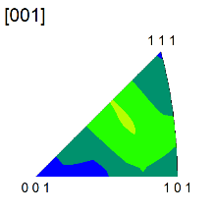
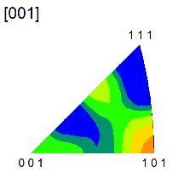
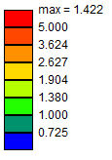
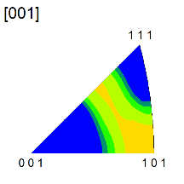
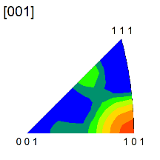
5. Analysis of the microstructure and mechanical properties of the rods after extrusion
5.3. Inverse pole figures
AlMg7
AlMgScZr
AlMgCuAg
AlMgErZr
Notes:
Texture analysis is the analysis of the privileged crystallographic orientation of grains. The slide shows the result of texture analysis in the form of inverse pole figures where The alloys with micro-alloying elements had the most axial texture in the direction [101]. in contrast the base alloy was characterized by random texture.

Slide 16
5. Analysis of the microstructure and mechanical properties of the rods after extrusion
5.4. Brinell hardness after hot extrusion
Brinell hardness after casting and extrusion
Notes:
The Brinell hardness after casting and extrusion were measured. Micro-alloying elements caused an increase the Brinell hardness from approx 10 to 15 % in AlMg7 alloy after hot extrusion. the Brinell hardness of the base alloy had not change.

Slide 17
6. Conclusions
The Al-7 wt.% Mg alloy with addition of Sc and Zr, Ag and Cu, Er and Zr were casted.
The addition of Sc and Zr as well as Er and Zr reduced the average grain size in AlMg7 alloy, however, micro-alloying of Ag and Cu did not change the grain size after casting and homogenization.
The base AlMg7 alloy was characterized by a partially recrystallized structure after the hot extrusion process.
The alloys with micro-alloying elements showed deformed structures with elongated grains after the hot extrusion process:
  the alloy with the additions of Sc and Zr had the smallest grain size, the recrystallization was inappreciable
  the alloy with additions of Ag and Cu was characterized by large grains the recrystallization phenomenon was appreciable,
  the alloy with additions of Er and Zr showed the beginning of the recrystallization process.
The AlMg7 alloys with micro-alloying elements revealed an axial texture in the direction of <101>. The base alloy was characterized by a weak texture.
Micro-alloying elements caused an increase in the Brinell hardness by approx. 15% in AlMg7 alloy after the hot extrusion, while the Brinell hardness of the base alloy did not change.

Slide 18

Krakow School of Interdisciplinary PhD Studies
Institute of Metallurgy and Materials Science
Polish Akademy of Sciences
Łukasiewicz
Institute of Non- Ferrous Metals
Thank you for your attention!
Researches conducted as a part of the Ministry of Education and Science program "Implementation Doctorate„ project no DWD/4/42/2020

