Slide 1
MARIA
The Nuclear Research Reactor
Michał Gryziński, PhD
Nuclear Facility Operation Department
National Centre for Nuclear Research
Świerk, Poland

Slide 2
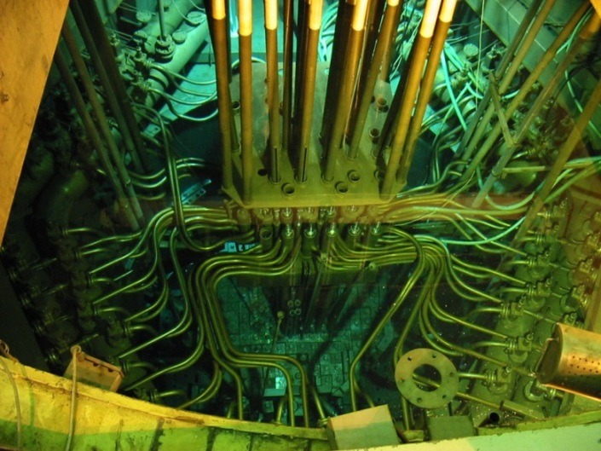
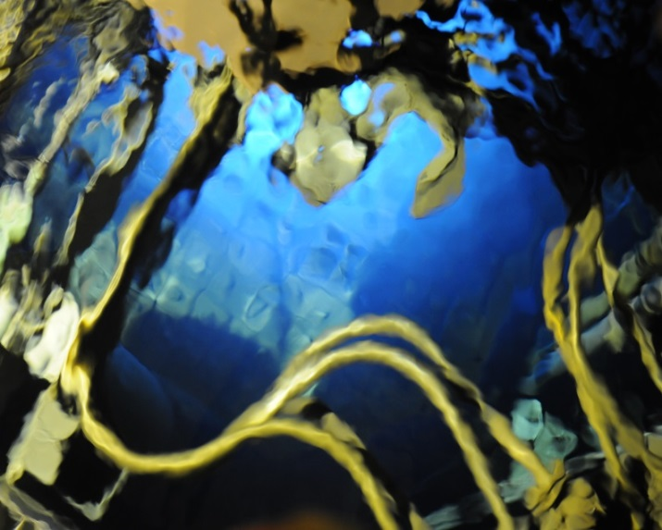
The MARIA Research Reactor
high neutron flux density research reactor
water and beryllium moderated
pool-type reactor with pressurized fuel channels
concentric tube assemblies of fuel elements
fuel channels in conical matrix of beryllium blocks
surrounded by graphite reflector
30 MW of nominal thermal power
thermal neutron flux density up to 2·10¹⁴ cm⁻² s⁻¹
fast neutron flux density up to 1·10¹⁴ cm⁻² s⁻¹
over 4500 hours operation per year
radioisotope production 600 TBq/year
Mo-99 production 6000 TBq/year

Slide 3
The MARIA Research Reactor
HOT CELL
SPENT FUELS IN
CONTROL RODS DRIVE MECHANISM
TECHNOLOGY
CHANNELS
FLOWGATE
+.6.33
TECHNOLOGY POOL
R 3250
+4.1
12250
SPENT FUEL
+2.25
REACTOR
+1.1
HORIZONTAL CHANNEL
R 2250
-2.85
-2.85

Slide 4
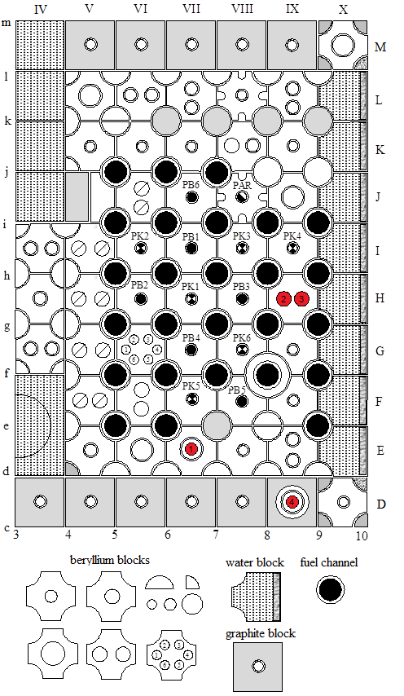
Hydraulic ‘rabbit’ system
4 ‘rabbit’ systems
precise neutron irradiation
thermal neutron flux density up to 1.8·10¹⁴ cm⁻² s⁻¹
fast neutron (Watt spc.) flux density up to 3·10¹³ cm⁻² s⁻¹
containers Ø24 mm
irradiation time accuracy 1 sec.

Slide 5
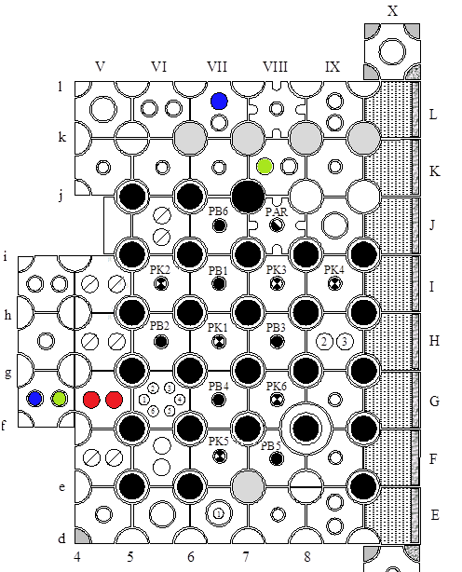
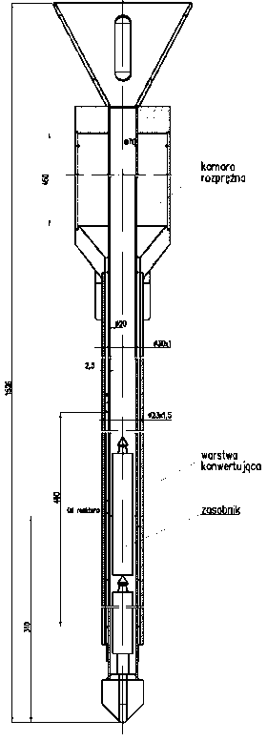
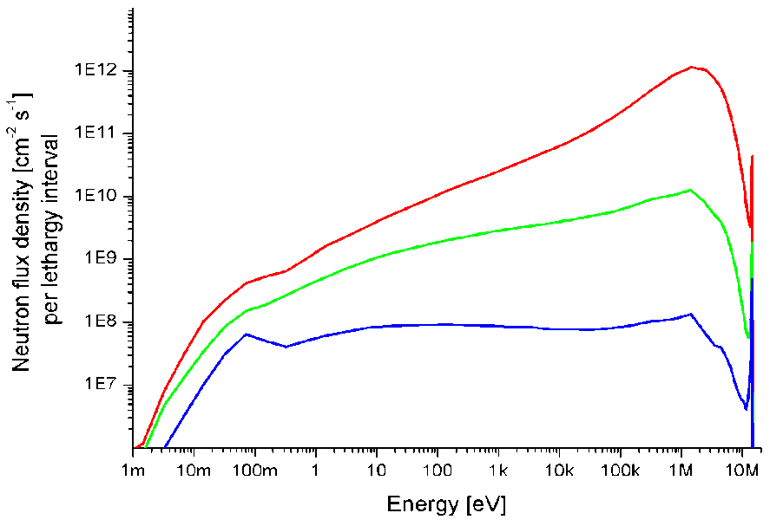
Thermal to 14 MeV neutron converter
inside converter
thermal neutron flux density > 1·10⁹ cm⁻² s⁻¹
fast fission neutron flux density > 1·10¹² cm⁻² s⁻¹
14 MeV neutron flux density > 1·10⁹ cm⁻² s⁻¹
channel Ø20 mm
convert. ⁶LiD (10g), ⁶LiOD·D₂O (55g)
outside thermal neutr. 9·10¹³ cm⁻² s⁻¹
conversion efficiency < 10⁻⁴
core centre
core periphery
reflector

Slide 6
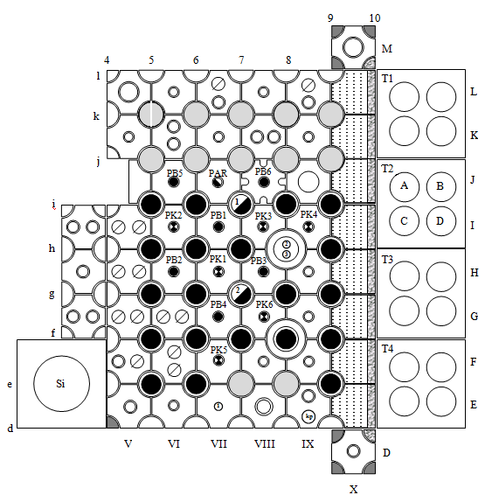
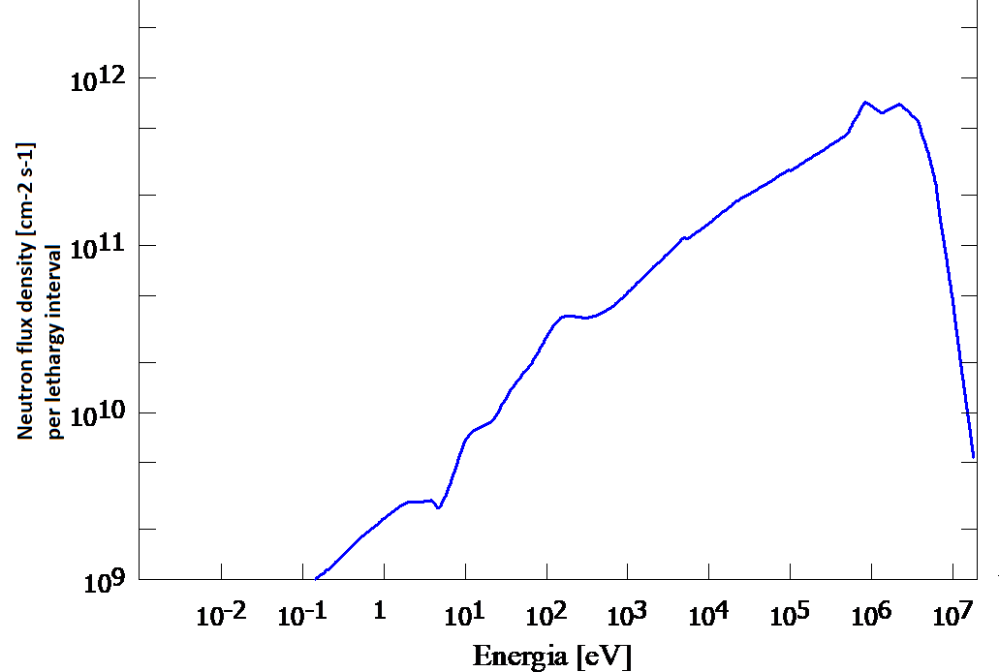
Fast neutron irradiation channels
fast neutron (Watt spc.) flux density 1·10¹¹ ÷ 3·10¹² cm⁻² s⁻¹
thermal neutron flux reduced down to 3·10¹⁰ cm⁻² s⁻¹
irradiation channels 8 x Ø90 mm, 8 x Ø80 mm, h=900 mm
possible irradiation of large samples, apparatus, etc.

Slide 7
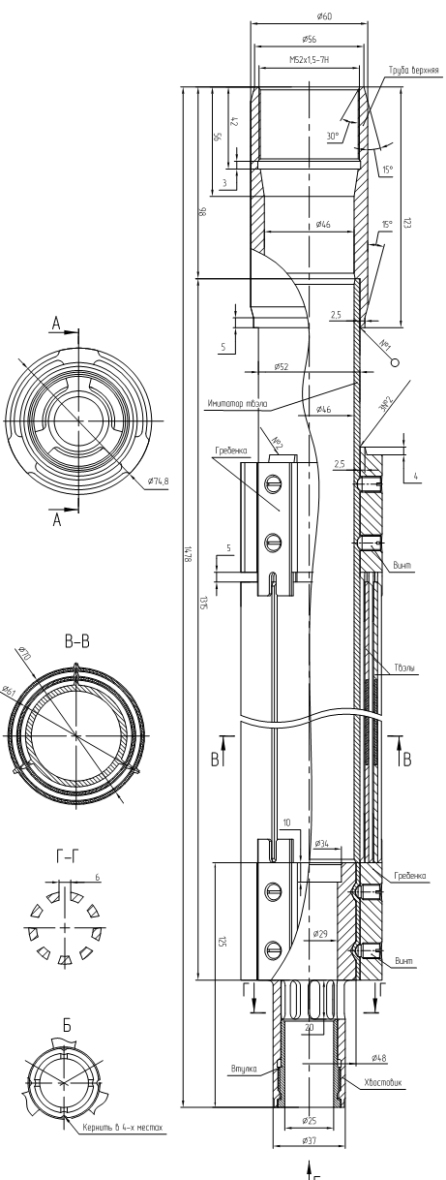
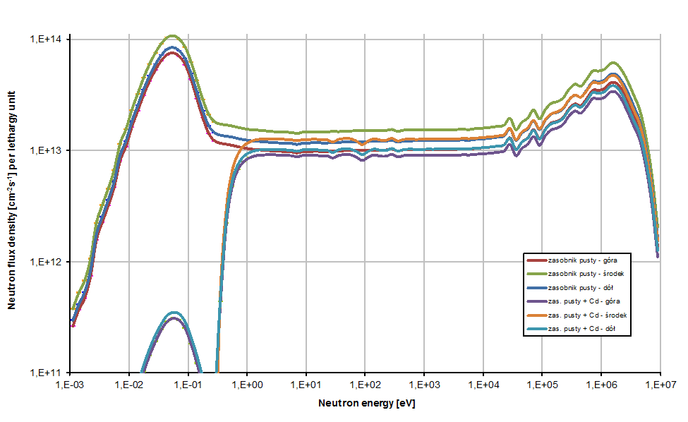
In-fuel irradaition
fast neutron irradiation inside purpose-build fuel element (2019)
fast neutron (Watt spc.) flux density ca. 1·10¹⁴ cm⁻² s⁻¹
thermal neutron flux density 3·10¹² ÷2·10¹⁴ cm⁻² s⁻¹
container Ø34 mm

Slide 8
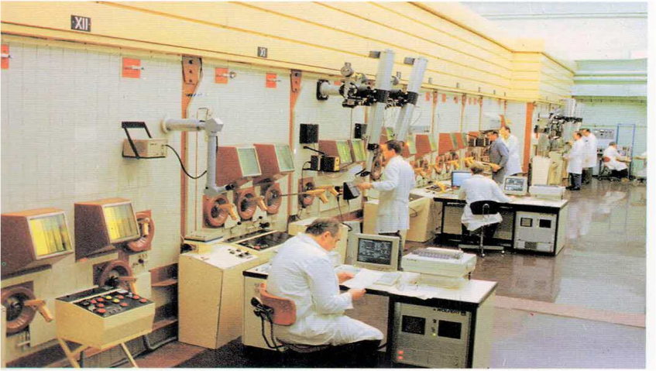
Post-irradiation examination
3 reactor hot cells (10¹²÷10¹⁵ Bq) with instrumentation
12 NCBJ Material Research Laboratory hot cells (10¹² Bq) with instrumentation
transport system of radioactive materials form reactor

Slide 9
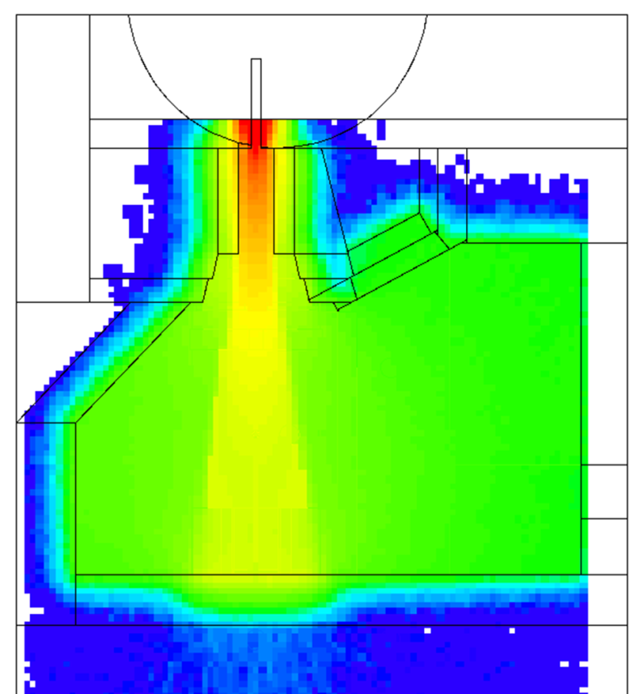
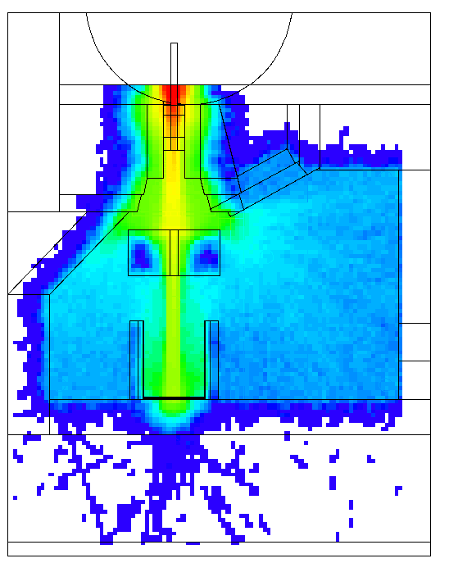
Shielding material testing
Concrete composition
Concrete production for longterm utilistation
Neutron and gamma „consumption”

