Slide 1
IFJ & Thermonuclear Fusion

Slide 2
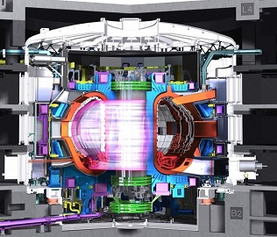
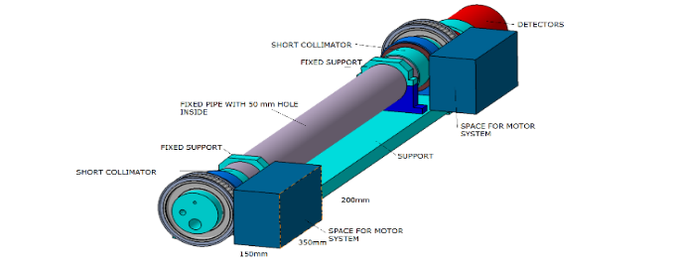
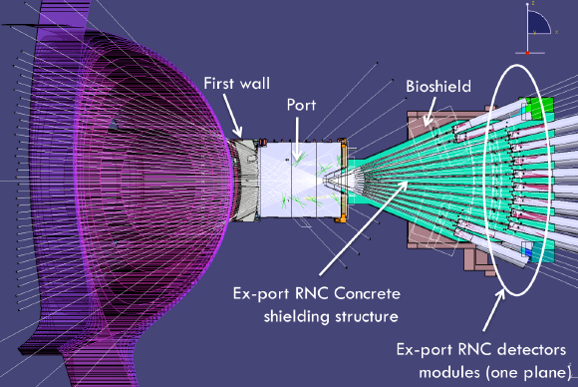
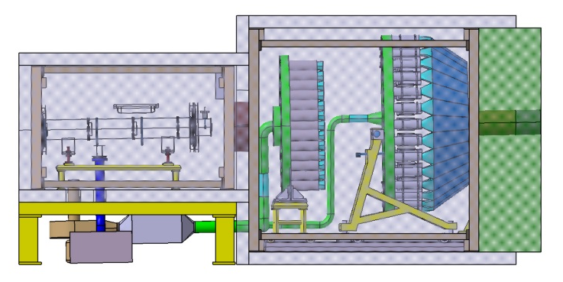
ITER – R&D activities
2014-2018: Radial Nautron Camera (RNC)
Thermo-hydraulic: cooling system design and optimization
Electromagnetic: dynamic loads and elecromagnetic shielding
Design of RNC components (rotating collimators and rotating detectors)
Design of system for diamond detectors temperature fatique tests
CAD support
2014-2017: High Resolution Neutron Spectrometer (HRNS)
Engineering activities coordination
Thermo-hydraulic: cooling system design and optimization
Electromagnetic: dynamic loads and elecromagnetic shielding
CAD support
ITER – R&D activities
RNC
RNC
HRNS

Slide 3
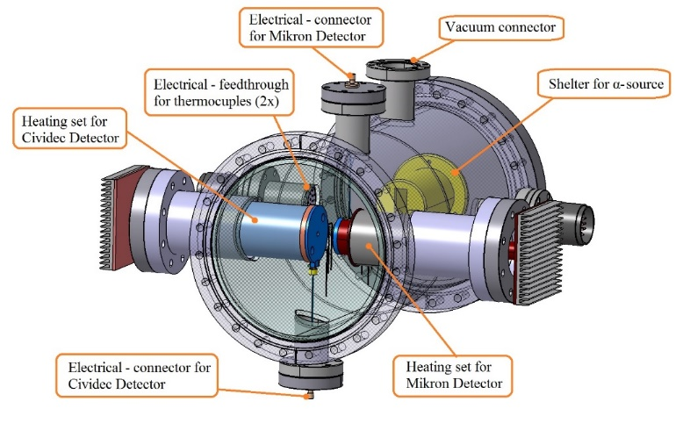
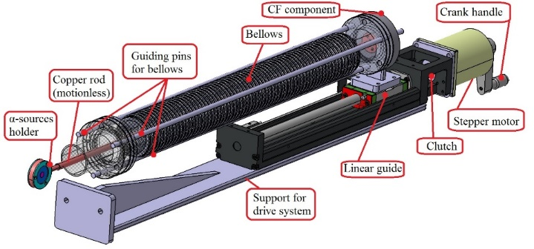
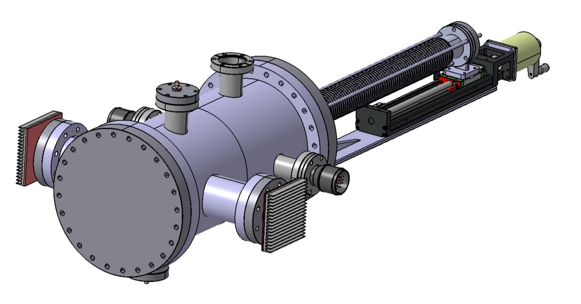
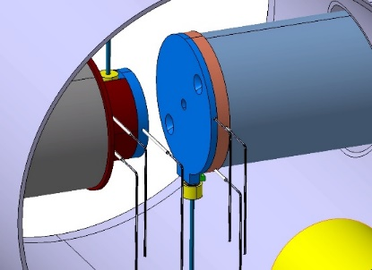
ITER: RNC – diamond detectors tests
Final design of testing system (26.04.2017)
Fig. 1: Isometric views of main components in testing system

Slide 4
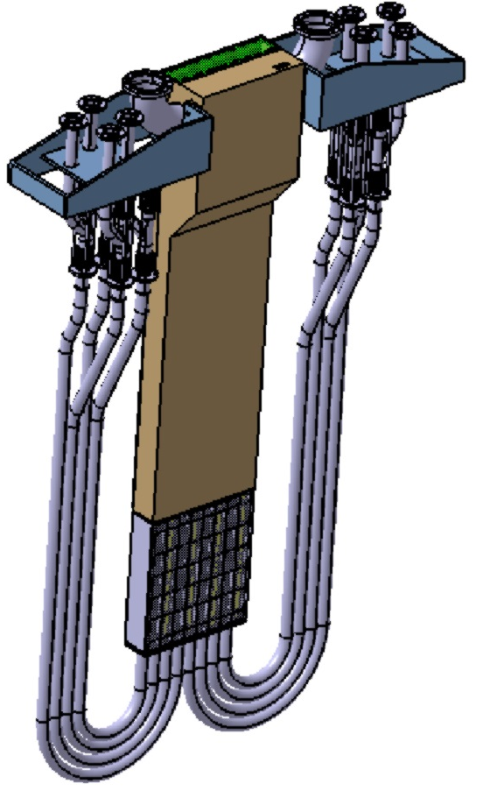
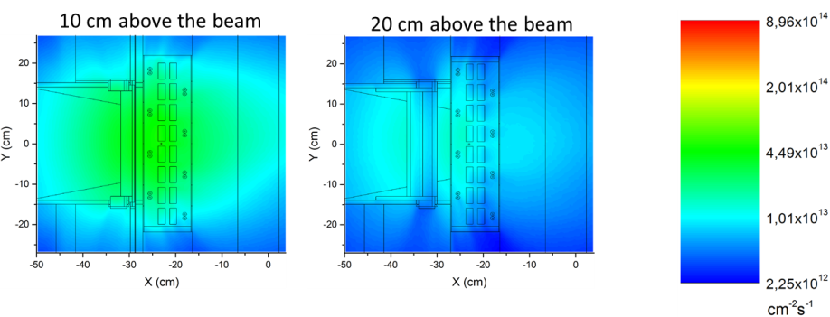
Start-up and Monitoring Module
The STUMM module will be used to:
Characterize the neutron flux at the irradiation position (measure its position, intensity, energy spectrum)
Verify and validate neutronics modelling
Measure the gamma radiation field
Określenie pola promieniowania gamma
It will be used during beam commissioning and each time after a change in the configuration is made
The STUMM module will contain an array of neutron and gamma sensors, e.g. micro-fission chambers, a rabbit system, gamma thermometers, SPND detectors. This module is designed in Poland by IFJ PAN, NCBJ, IPPLM
W. Królas | SPAS 2018 | 27.11.2018 | Page 4

Slide 5
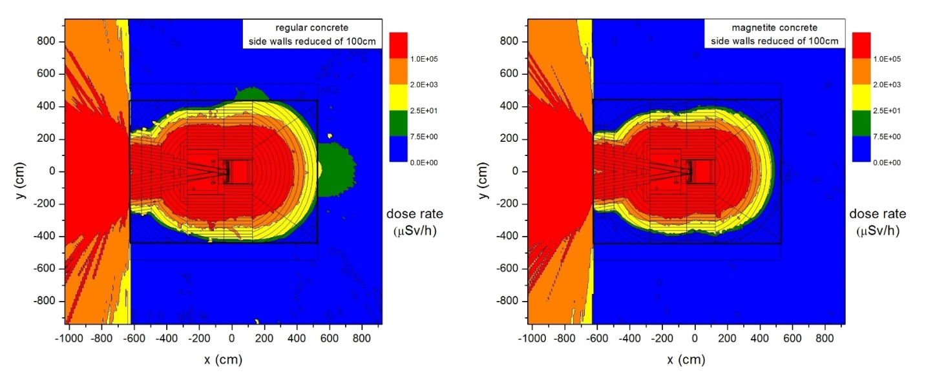
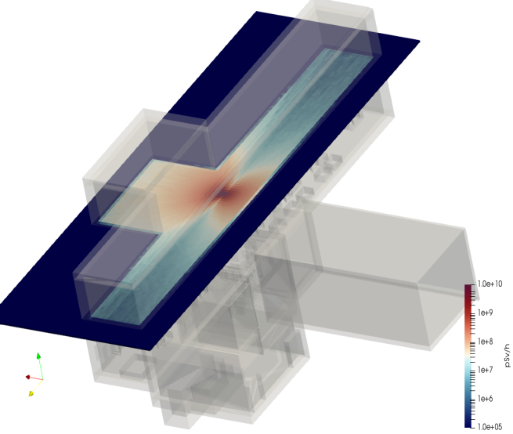
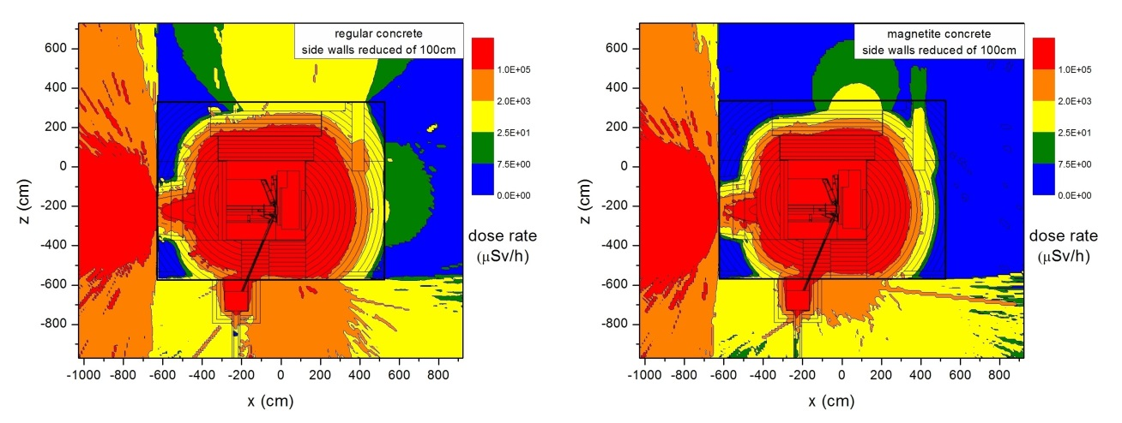
DONES – Neutronics modelling
Dawki
„beam-on target” / aktywacja
W IFJ PAN grupa prof. K. Drozdowicza, G. Tracz, D. Dworak,
obliczenia przy użyciu oprogramowania MCNP
na komputerach clustra McRadiat (NZ61) oraz w Cyfronecie na clustrze Prometheus
Rozkład dawek promieniowania 5h po zakończeniu naświetlania w Access Cell – pomieszczeniu ponad tarczą, w którym odbywać się będzie obsługa techniczna elementów tarczy i modułu naświetlania G. Stankunas, LEI
20.09.2018 | W. Królas | IFJ PAN Kraków | DONES - laboratorium prędkich neutronów dla europejskiego programu fuzji termojądrowej i nie tylko…

