Slide 1
Potential WUST’s scope in the DTT Cryogenic System
Jaroslaw Polinski
Big Science: Thermonuclear Fusion Projects Workshop
Institute of Nuclear Physics PAN,
26th of Nov 2018, Krakow, POLAND

Slide 2
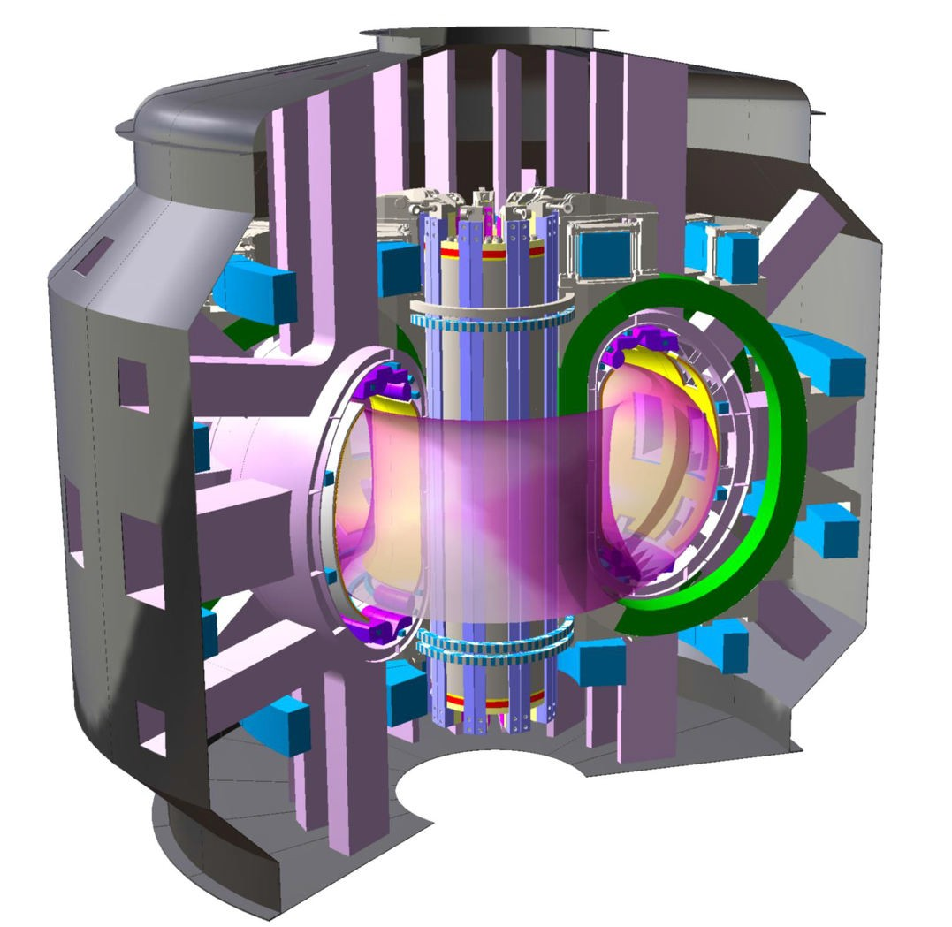
Requirements and
Conceptual design of the
DTT Cryogenic System
A. Frattolillo (FSN-FUSTEC-TES)
Poland-Italy Meeting, Frascati, 28-29 September, 2018
Agenzia nazionale per le nuove tecnologie, l'energia e lo sviluppo economico sostenibile

Slide 3
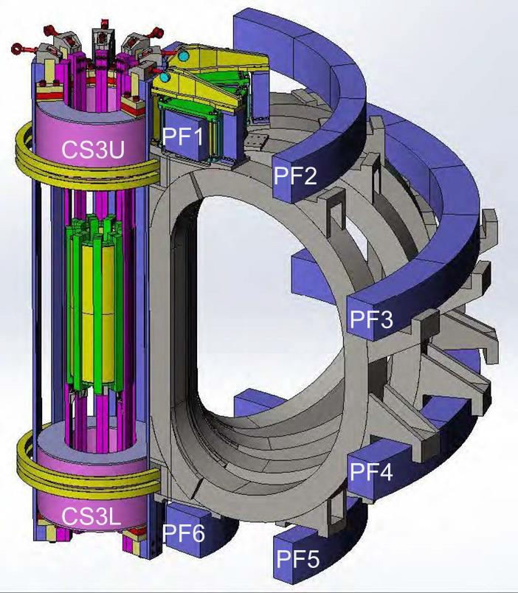
Main duties of the DTT Cryogenic System
The Cryogenic System of the DTT has to provide adequate cooling of the following components:
› 18 TF coils (Nb₃Sn CIC) + 6 current leads + Feeders;
› 6 CS module coils (Nb₃Sn CIC) + 6 current leads + Feeders;
› 6 PF coils (NiTi CIC) + 6 current leads + Feeders;
› Thermal shields (TS);
› Cryo-lines:
› Cryogenic pumps (other options, such as combined NEG
and Hg diffusion pumps, are also being considered)
100 s plasma pulses, with 60 s of full nuclear heating, repeated every
3600 s (dwell periods ∼ 3540 s)

Slide 4
Conceptual design of the DTT Cryogenic System

Slide 5
Potential WUST’s scope in the DTT Cryogenic System
DTT cryogenic system elements:
Valve Box (at connection to the Cryo Plant)
Cryogenic Transfer Lines
Auxiliary Valve Boxes
Safety system for the cryogenic system

Slide 6
Potential WUST’s scope in the DTT Cryogenic System
DTT cryogenic system elements:
Valve Box (at connection to the Cryo Plant)
Cryogenic Transfer Lines
Auxiliary Valve Boxes
Safety system for the cryogenic system
Potential scope of works
Preliminary design, detail requirements, P&ID development, system sizing,
Detail design under PED regulations,
Production, delivery and installation,
Commissioning,
ODH risk analysis.

