Slide 1
Opole University
Plasma Spectroscopy Group:
dr hab. A. Bacławski
dr A. Bartecka
dr I. Książek
dr hab. W. Olchawa
dr hab. E. Pawelec

Slide 2
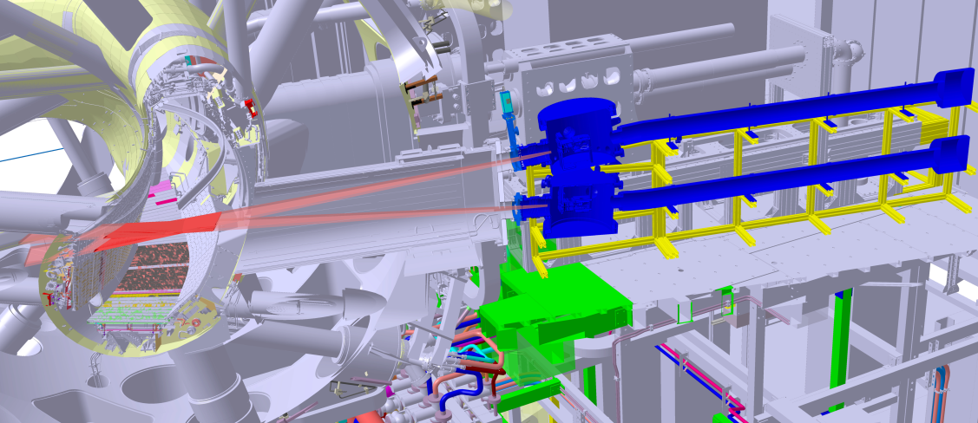
„C/O monitor for W7-X”
Dedicated spectrometer for fast monitoring of light impurities of W7-X plasma, by registering intensity of Lyman-α line of:
O VIII (1.9 nm)
N VIII (2.5 nm)
C VI (3.4 nm)
B V (4.9 nm)
‘C/O monitor for W7-X’ at AEK 30 port (under construction)

Slide 3
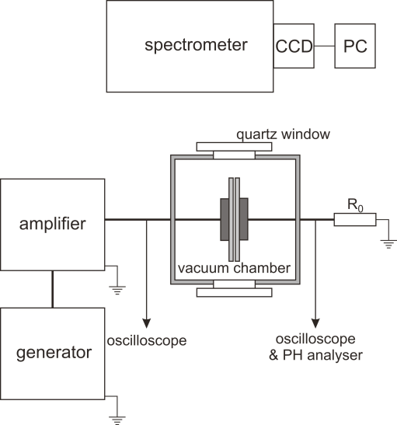
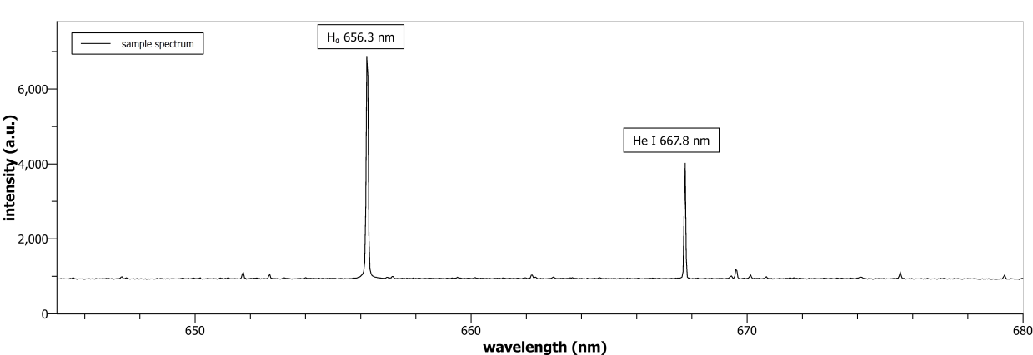
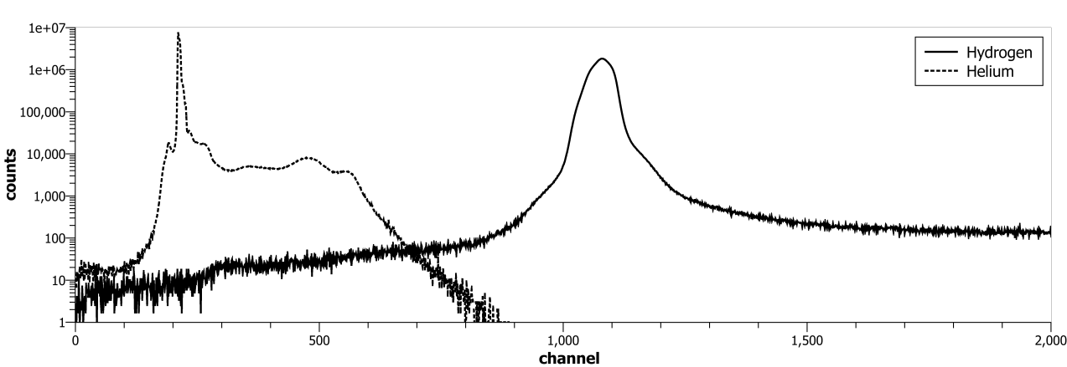
Barrier discharge as a method for monitoring of H/He ratio
The ratio of H/He in the exhaust of fusion machine will be an indicator of the efficiency of the fusion processes.
The simple and robust method for determining this ratio can be study of the parameters of a barrier discharge.
The principle of operation of this concept has been proved (I. Książek, A. Brosławski, H. Janus, E. Pawelec, Applicability of the dielectric barrier discharge for helium ash measurements in the divertor region, Nukleonika 61(2), 99-102 (2016))
sample of optical spectrum
sample of pulse-height spectrum

Slide 4
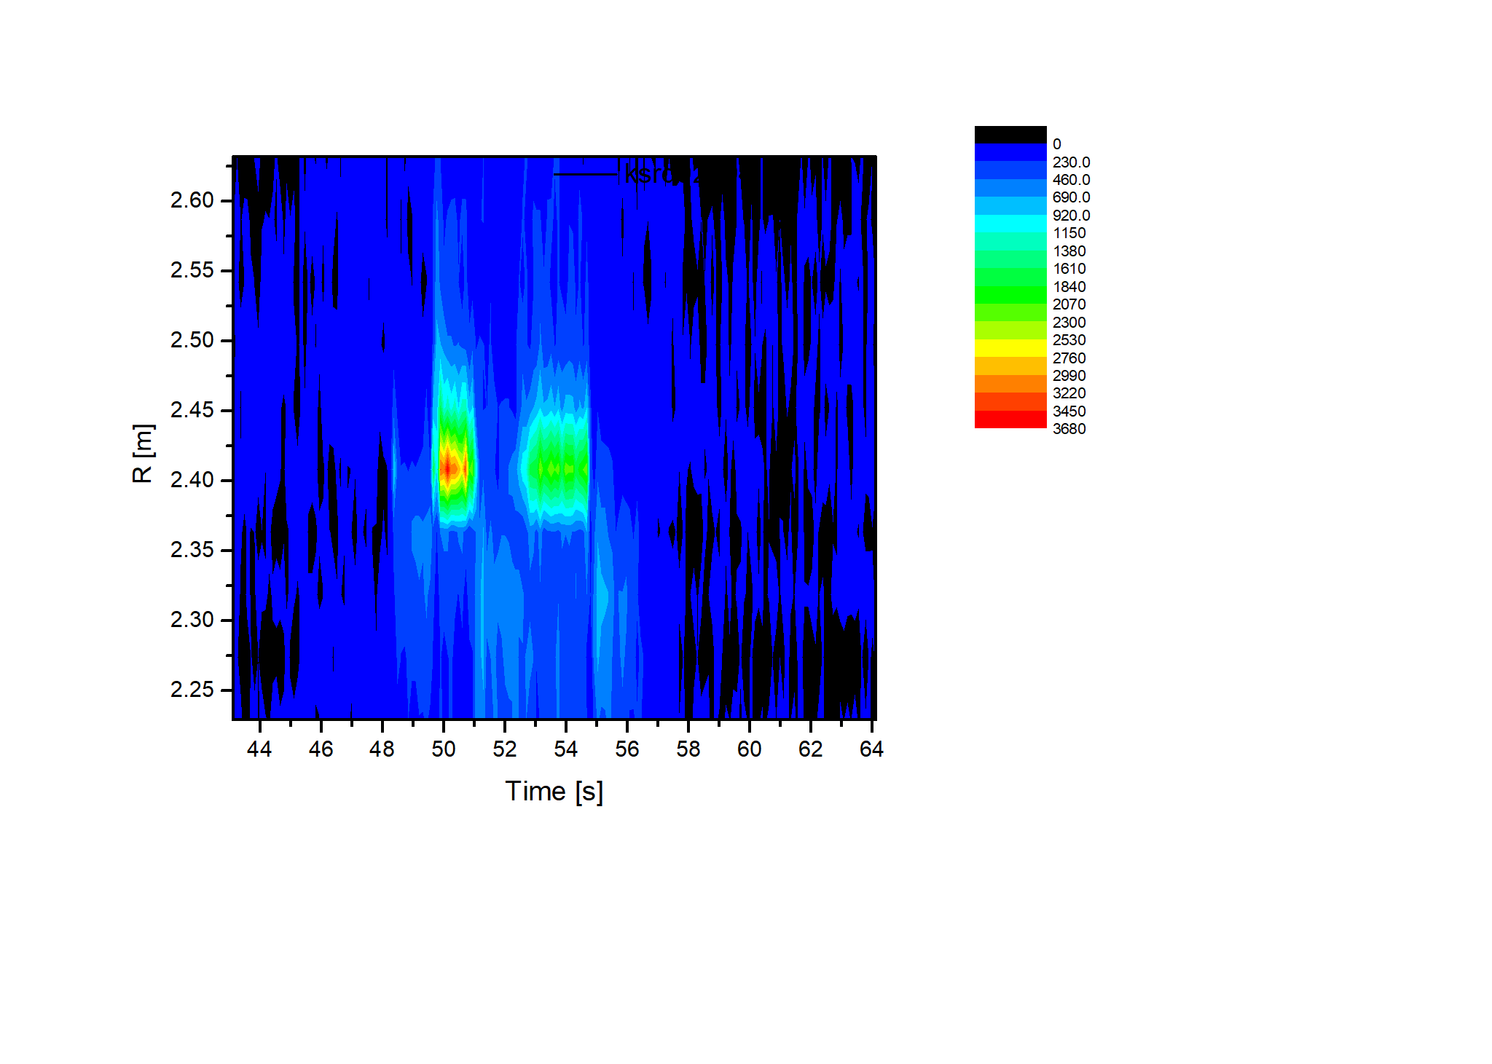
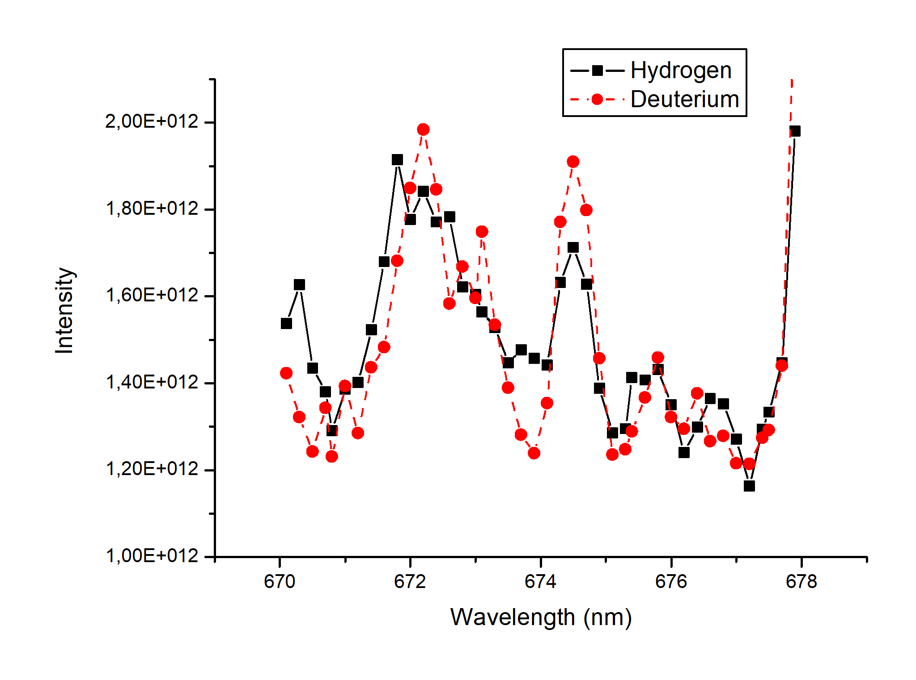
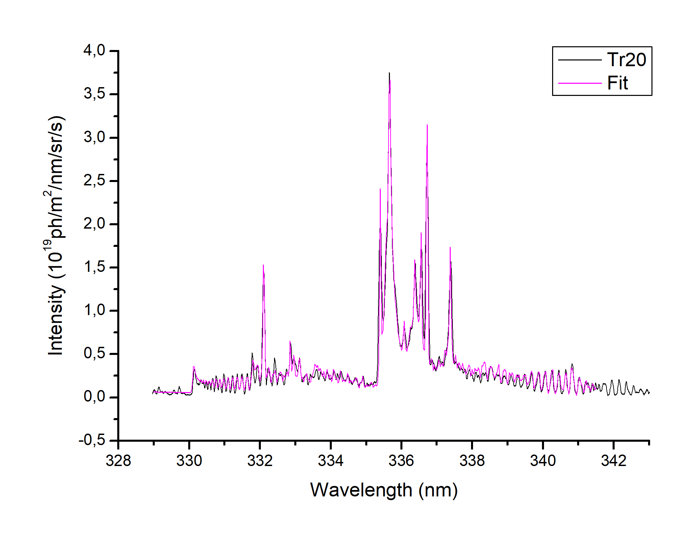
Molecular radiation in MCF
N seeding
Different molecules (e.g. D₂, N-D, B-D) are observed in the SOL region of an MCF machine;
analysis of its radiation can be important e.g. for analysis of seeding or fuel retention.
NH: observations in outer divertor and comparison with ammonia production (Pawelec et al, JoP Conf. Series 959 (2018) 012009, Drenik et al, PSI 2018)
WH: detection in JET, planned more study (Brezinsek et al, paper EX/9-4, IAEA conference, 2018)

Slide 5
Modelling and measurements of Stark broadening (and shift) of the spectral lines
Electric microfields in the plasma can cause the broadening of the spectral line as well its wavelength shift.
This effect can be applied for determining of the electron density in the plasma.

