Slide 1
The status of the ITER project
Marek Scholz
Instytut Fizyki Jądrowej PAN

Slide 2
Outline
Introduction
Controlled thermonuclear fusion
Ways of implementing controlled thermonuclear fusion.
The European fusion reactor program
Status of the ITER project
Summary
The seminar used materials presented by D. Campbell during ITPA Diagnostic Topical Group Meeting, ITER HQ, 11/2016 & 10/2017
The views and opinions expressed herein do not necessarily reflect those of the ITER Organization.
18/03/2015
IFJ Kraków

Slide 3
Introduction
Figure 1.1: World primary energy consumption from 1991 to 2016 in milion tons oil
equivalent (Mtoe). Source: [BP. British Petroleum Statistical Review of World Energy, 2017. (Cited in sections 1.1.1, 1.1, and 2.4.2.2.)]

Slide 4
Introduction
Fossil fuels:
Petroleum
Natural gas
Carbon
Alternative sources (not affecting the thermal balance of the planet)
Biomass;
Hydro;
Sun;
Wind;
Other (geothermal, tides, ...)
Alternative sources (affecting the thermal balance of the planet)
Nuclear energy (based on nuclear fission)
Solar energy from space
Nuclear energy (based on nuclear fusion) - thermonuclear energy
Remark
Large-scale (global) energy requires:
Continuity of energy supply;
Network parameters guarantee

Slide 5
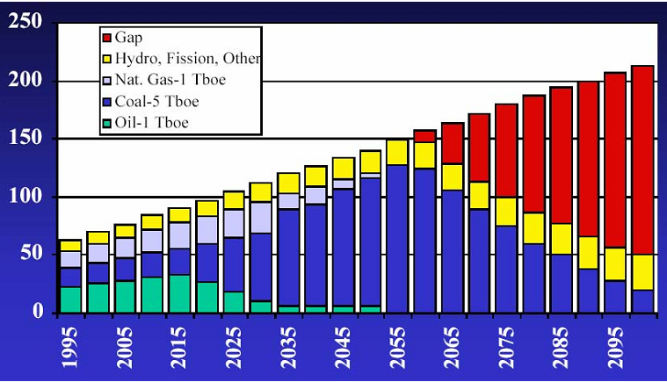
Introduction
The difference between the demand for energy and the possibilities of energy based on conventional energy sources
Bilion barrel of oil energy equivalent/y
This can be the basis for the development of thermonuclear energetics
IFJ Kraków

Slide 6
Thermonuclear reactor fuel
Isotopes of hydrogen
hydrogen - ¹H
Deuterim - ²H (0,016% in hydrogen)
Trytium - ³H (radioactive T_{1/2} = 12.262 lat, (1 – 150)·10⁻¹⁸ in hydrogen)
The problem of fuel for a thermonuclear reactor: very little tritium in nature (world stock of 20 kg) - a reactor using a mixture of deuterium and tritium will have to produce tritium from lithium
Helium
In nature 5 – 10%
⁴He – 99.999862 %, residual ³He
Large amounts on the moon
Lithium
In the Earth's cortex 6.5·10⁻³ %
~10% ⁶Li, ~90% ⁷Li
Fuel consumption for all of today's energy
D ~ 300 t/rok (5·10¹³ t in water);
Li ~ 10000 t/rok (5·10¹³ t )
18/03/2015
IFJ Kraków

Slide 7
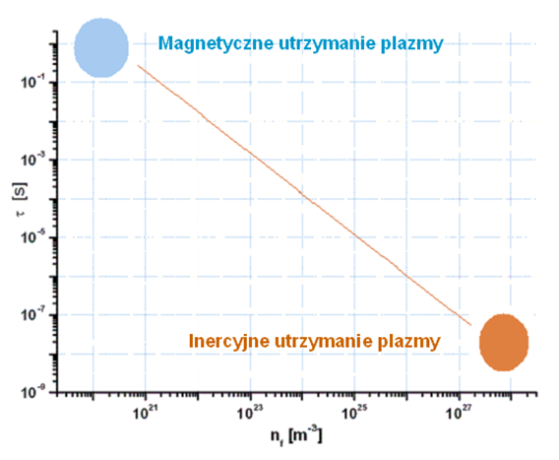
Methods of a plasma confinement
T ~ 28 keV; (n_{f0}t)_{min} ≥ 3⋅10¹⁹ m⁻³s
Status of projects
(1 keV = 1.1606⋅10⁷ ºK ~ 10⁷ ºK)
(D,T)
Two main ways - two methodologies :
Inertial Confinement Fusion (ICF):
  NIF (USA)
  Laser Megajoule (Francja)
Magnetic Confinement Fusion (MCF):
  ITER (Chiny, Indie, Japonia, Korea Pd, Rosja, UE, USA)
7

Slide 8
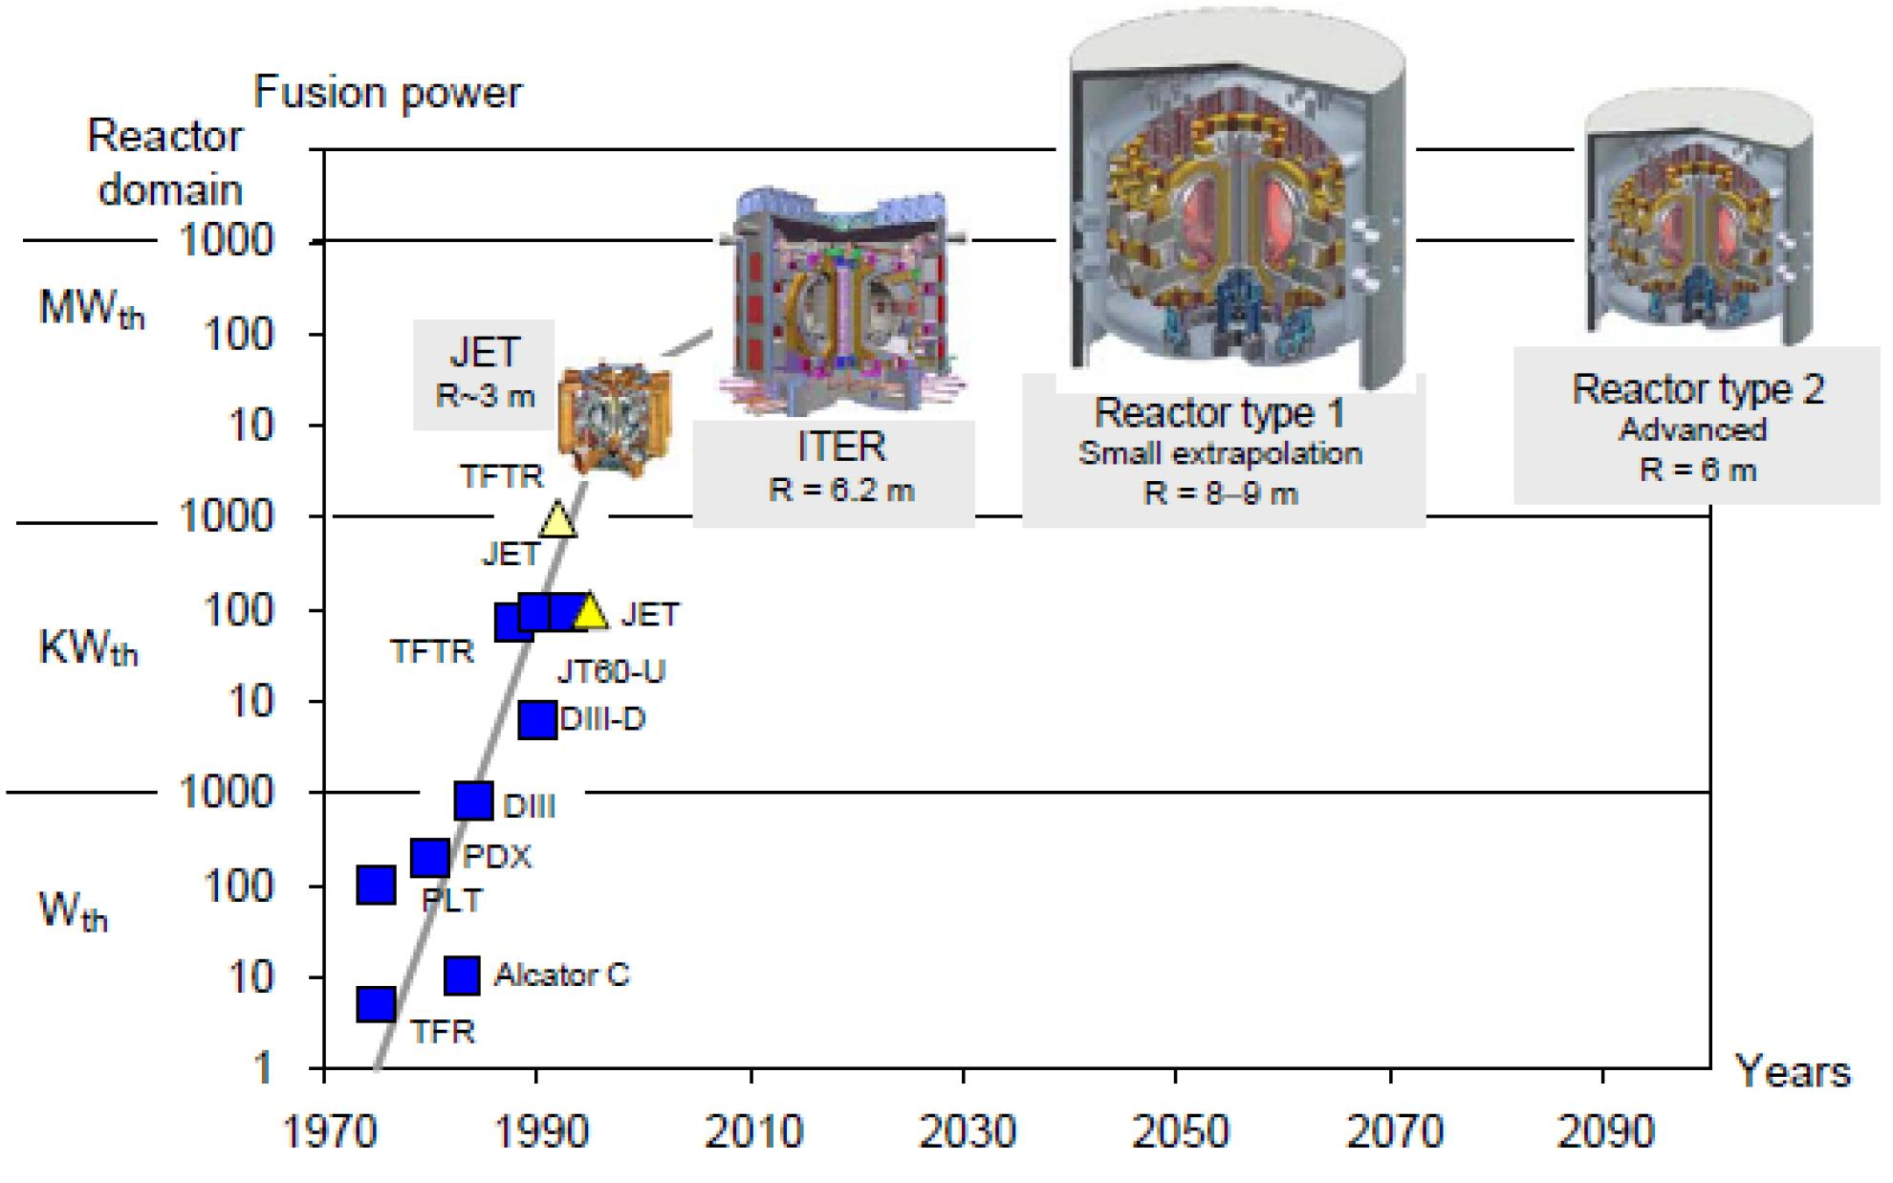
Scaling
International
Thermonuclear
Experimental
Reactor
Power: 0,5GW
Time: 1000s
DEMO
DEMOnstration
Power Plant
Power: 2GW
Time: con.
Energy Production
Notes:
8

Slide 9
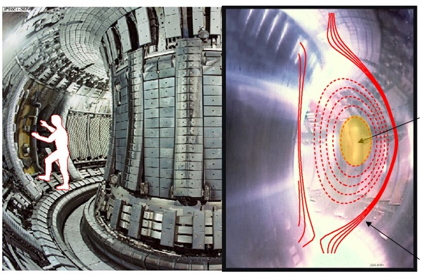
Joint European Torus (JET)
Basic parameters:
- Torus radius:…..3.1 m
- Chamber:H=3.96 m x S=2.4 m
- Plasma volume:…80 m³
- Plasma current:…..up to 5 MA
- Magnetic field: up to 4 T
The most important JET results :
1991:
The first controlled fusion with
D+T ~ 2MW during 1s was obtained
1997:
16MW fusion power was obtained 75% efficiency
10 keV
Line of magnetic field
1973 – decision about construction
1983 – getting started
Notes:
9

Slide 10
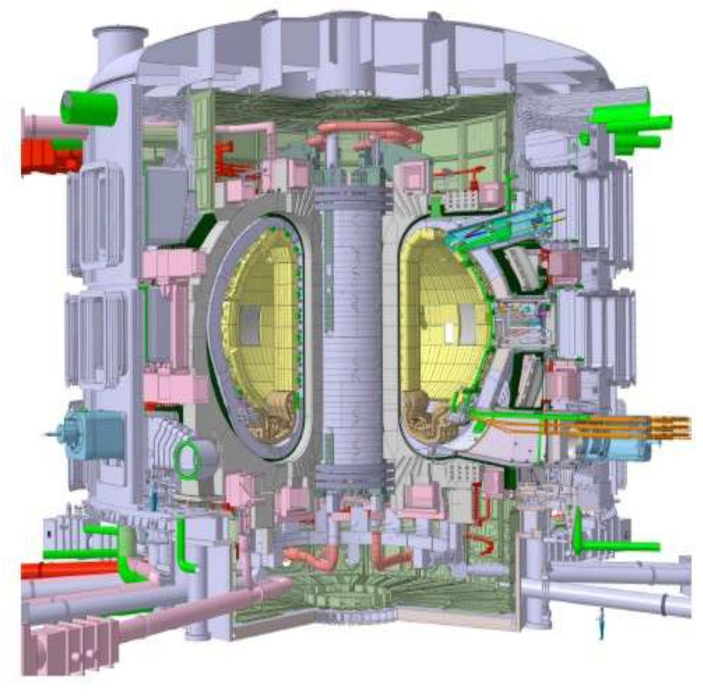
ITER
Test of the necessary technology;
Test of materials for thermal and radiation load;
Demonstration of the possibilities of energy production from thermonuclear fusion
Basic Parameters:
- Torus radius:…..6.2 m
- Plasma volume:…300 m³
- Plasma current:…..do 15 MA
- Magnetic field: up to 5,3 T
- Pulse:………..up to 1000 s
- Power:…do 0,5 GW
- Efficiency:.………..up to 10
Notes:
10

Slide 11
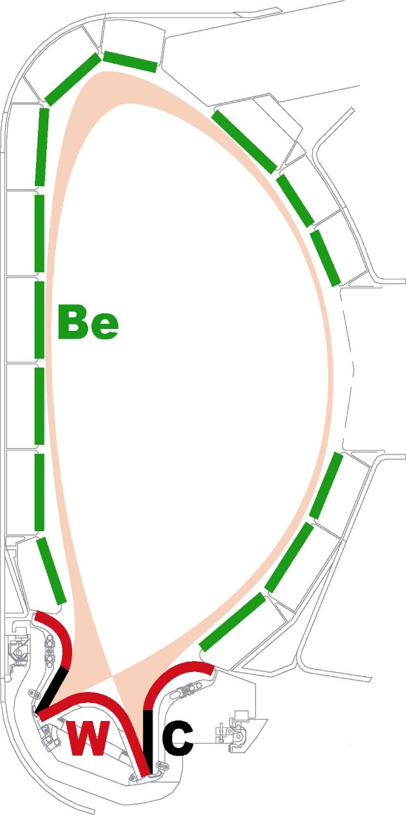

JET and ITER
P_{f}
Y_{n}
- (50% neutron branch)
Be first wall
700 m²
- (50% neutron branch)
500 MW
16 MW
JET
Tungsten
100 m²
- (55% neutron branch)
ITER
- (4% neutron branch)
Graphite CFC
50 m²
11

Slide 12
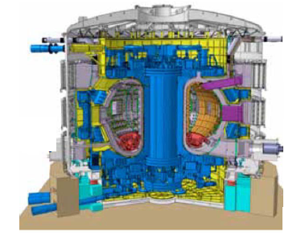
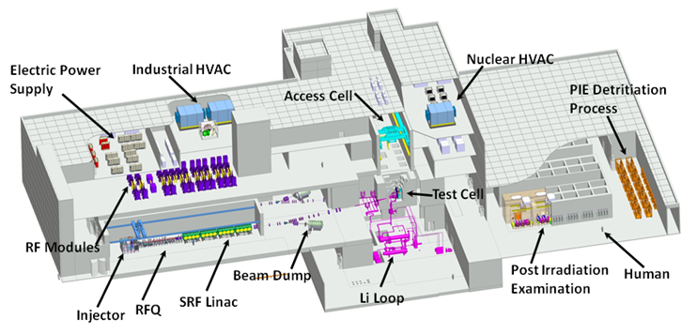
Major Project
Major projects related to thermonuclear power engineering
ITER
International Thermonuclear Experimental Reactor
In Europie
IFMIF/EVEDA:
International Fusion Materials Irradiation Facility/
Engineering Validation & Engineering Design Activity
In Japan
Published with permission of IFMIF-EVEDA
STP – satellit program associated with JT60SA
IFEREC – computer center, cooridnation center for DEMO R&D

Slide 13

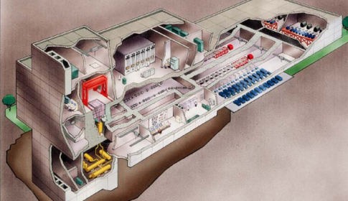
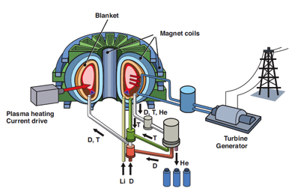
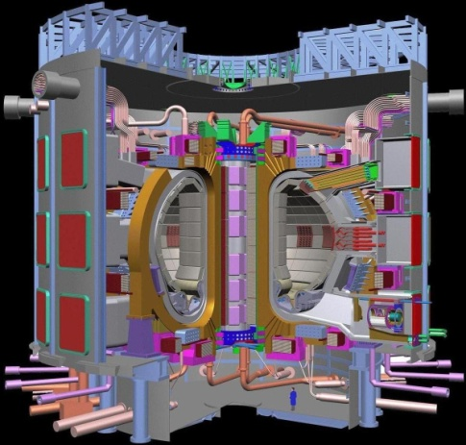
Main projects R & D
Technology (R & D)
IFMIF
Thermonuclear power plant
Construction materials
Reactor blanket test
Component test
superconducting magnets
tritium delivery systems
PFC
remote maintenance
heating systems
security
Blanket tests at
ITER
Plasma Physics (R & D)
Maintaining plasma
Control of admixtures
stability
Fuel and ash control
etc
DEMO
ITER
Notes:
13

Slide 14
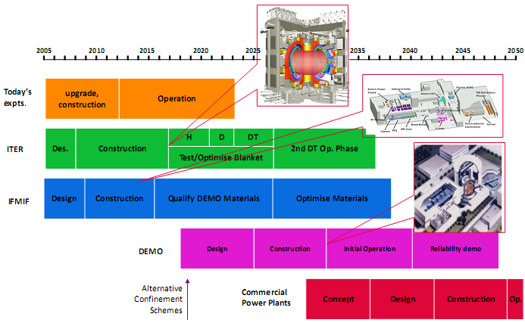
Plans and reality

Slide 15
Research Plan: An Important Note
ITER differs in an important way from other devices:
  the experimental programme is determined by the need to reach high current and to demonstrate baseline fusion power as soon as possible
  Disruptions must be absolutely be mastered to reach high I_{p}
  to a large extent the whole of PFPO and a large fraction of the first part of FPO is ‘commissioning with plasma’ of all tokamak and plant systems for to prepare the reliable operation required to reach high Q
  nevertheless, we anticipate that even during the ‘commissioning with plasma’ phase in PFPO, that ITER will give access to many new aspects of fusion plasma research as the programme develops plasmas with parameters well beyond those which can be attained in present experiments

Slide 16
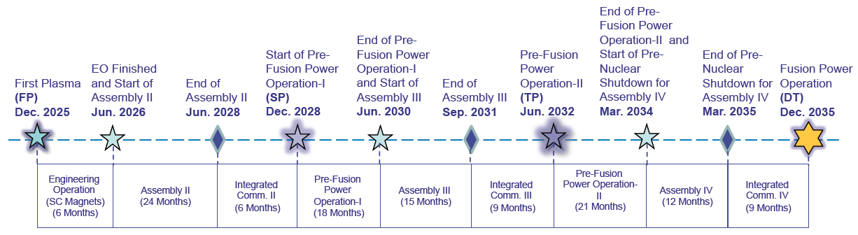
Baseline Schedule - ‘Staged Approach’
During 2015 – 2016, the project has performed a ‘bottom-up’ analysis of the construction and operations schedule to develop a fully consistent programme towards plasma operation and fusion power production:
Schedule and IO-CT resource estimate to First Plasma consistent with Members’ budget constraints
4-stage operations programme developed towards fusion power production in DT, starting in late-2035
DT
Operation
Stage I
Stage II
Stage III
Stage IV

Slide 17
Research Plan Structure and Activities I
Pre-Fusion Power Operation (PFPO):
  First Plasma: nominal 100 kA/100 ms
  plasma operation to ~3.5 MA to establish initial divertor operation
  disruption loads, disruption detection, avoidance and mitigation
  extensive control and protection system commissioning
  development of plasma operation to ~7.5 MA/ 2.65 T (possibly ~10 MA/5.3 T)
  possible option for operation at 5 MA/1.8 T (early H-mode access) with ECRH and ICRF heating systems
  H-mode operation and ELM Control (helium/ hydrogen?)
  options for long pulse operation in L- and H-mode
  demonstration of 15 MA/ 5.3 T operation
  PWI programme: eg, fuel retention/removal, dust, limiter/divertor heat loads

Slide 18
Research Plan Structure and Activities II
Fusion Power Operation (FPO):
  development of deuterium H-modes and preparation of DT scenarios
  trace tritium experiments to initiate transition to full DT operation
  development of 15 MA/5.3 T DT scenario
  initial DT operation to short-pulse (few×10s) several 100 MW fusion power
  optimize Q with target of Q ≥ 10 to few×10s
  develop scenarios for long-pulse operation:
    Inductive: Q ≥ 10 towards ~500 s
    Hybrid: Q ~ 5 (up to 10, if possible) towards ~1000 s
    Non-inductive: Q ~ 5 towards ~3000 s
  PWI programme: Fuel retention/ removal, material migration,
  heat loads/ detachment control

Slide 19
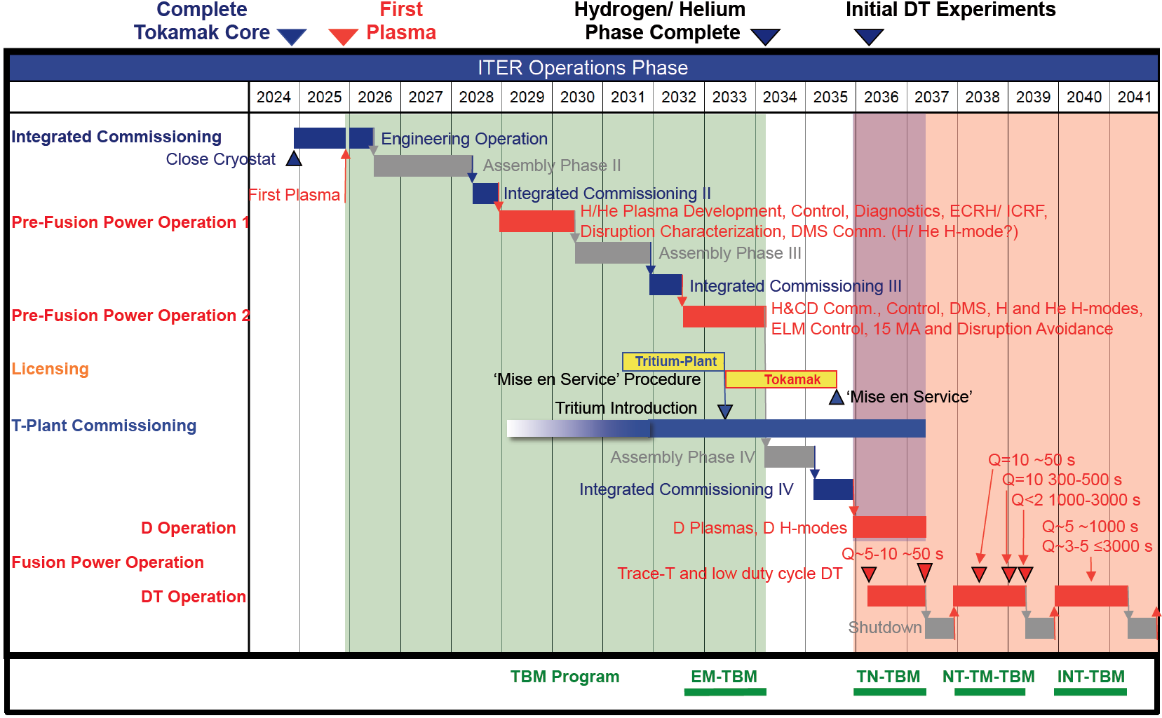
Overview of ITER Experimental Plan

Slide 20
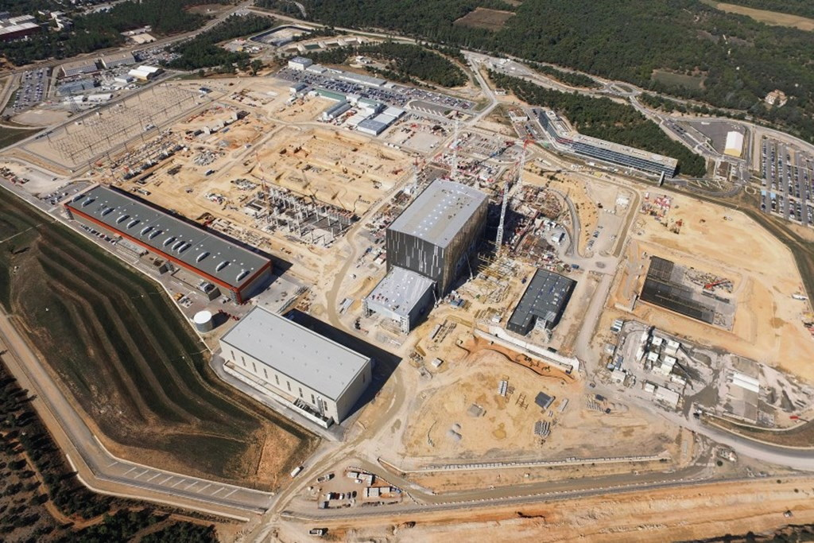
Worksite progress
(Aerial Photo October 2016)
400 kV switchyard
Transformers
Cryoplant
Construction underway
Storage area 1
Tokamak Complex
Construction underway
IO Headquarters
Cooling Systems
Construction underway
PF Coil Facility
Cryostat Workshop
Assembly Hall
Being equipped
Service Building
Cleaning facility
Construction underway
Radiofrequency Bdg
Construction underway
Batching plant

Slide 21
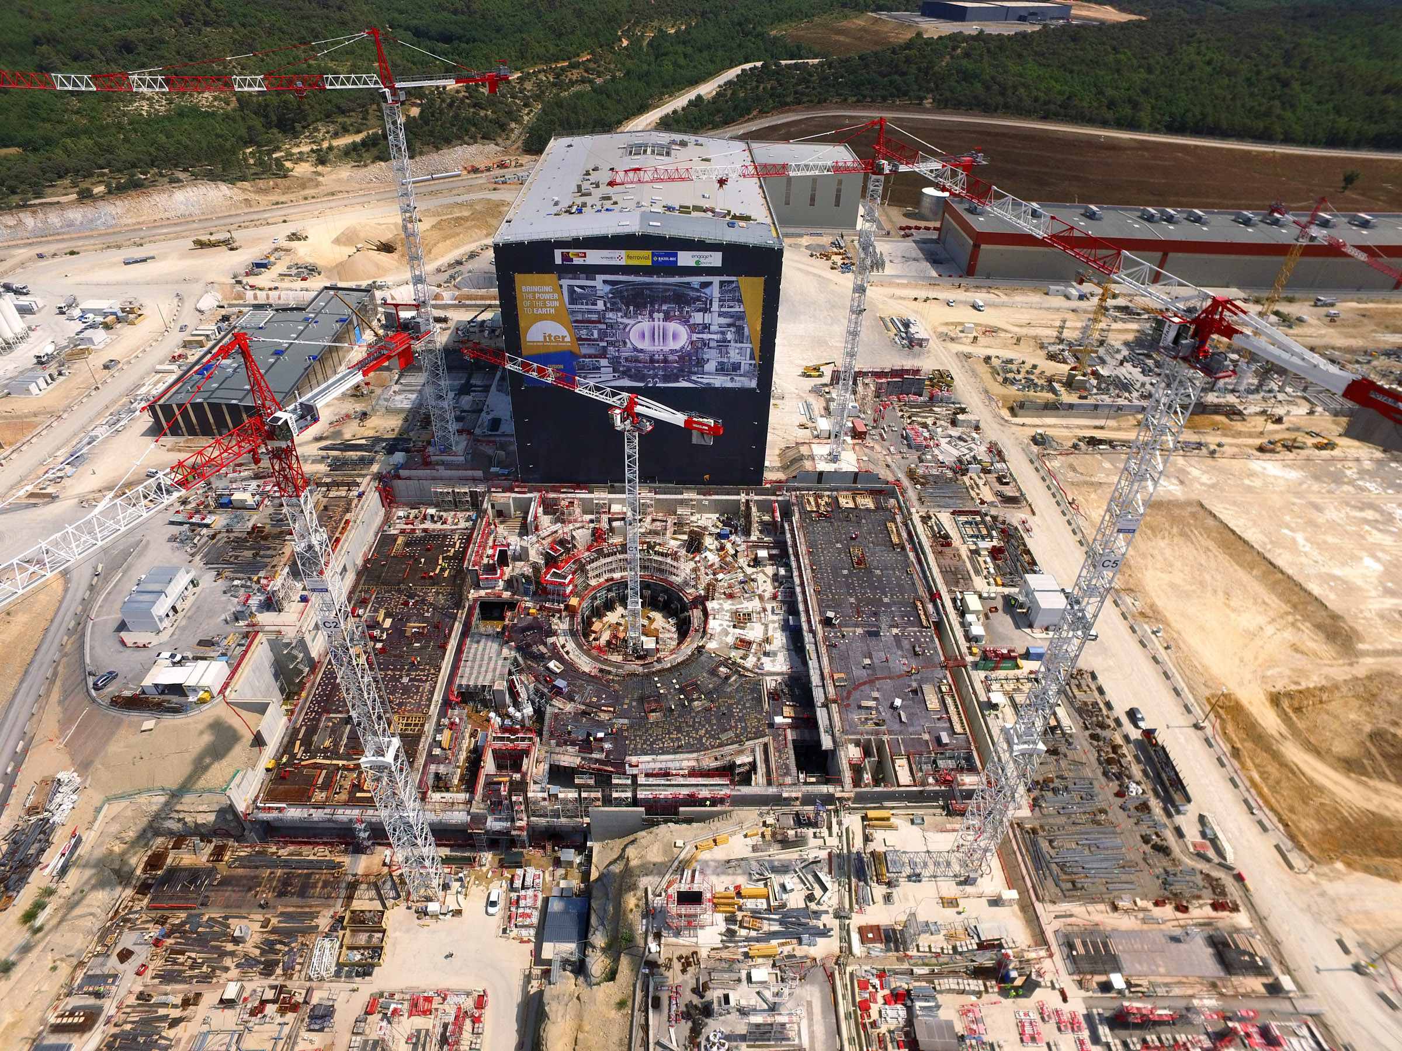
Tokamak Complex

Slide 22
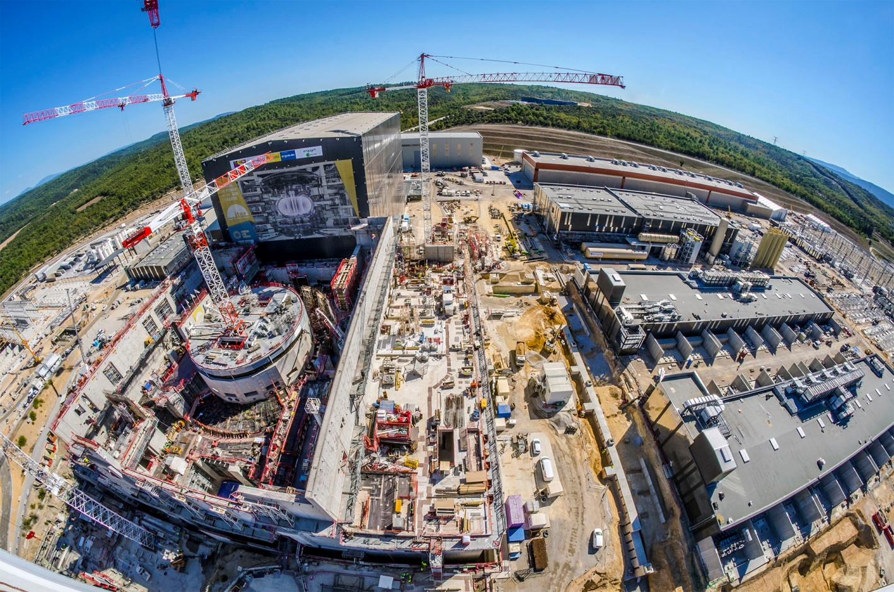
Tokamak Complex
Oct 2018

Slide 23
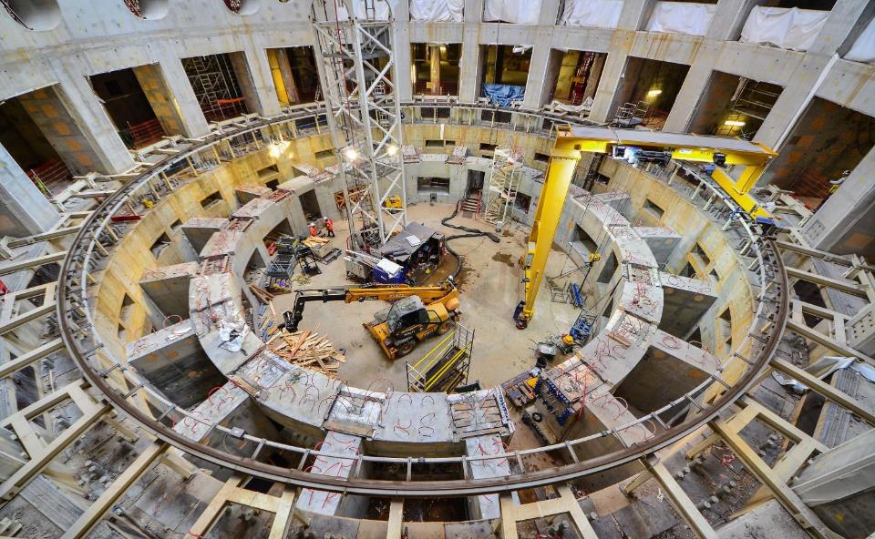
Tokamak Complex

Slide 24
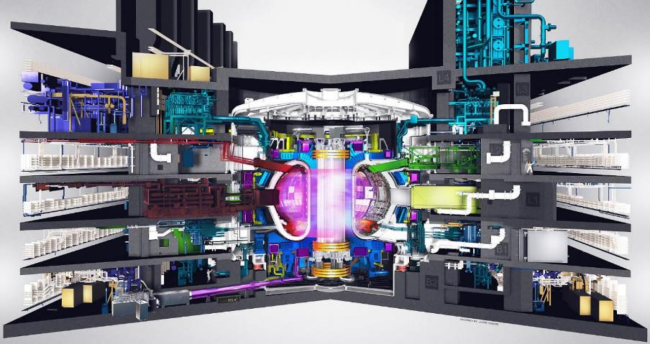
Plant Systems provided by F4E
12 Diagnostic
Systems
ECRH Launchers & Components
ICRH Antenna & Components
Neutral Beam Heating
Test Blanket Modules
Remote Handling Systems
Cryogenic Systems

Slide 25
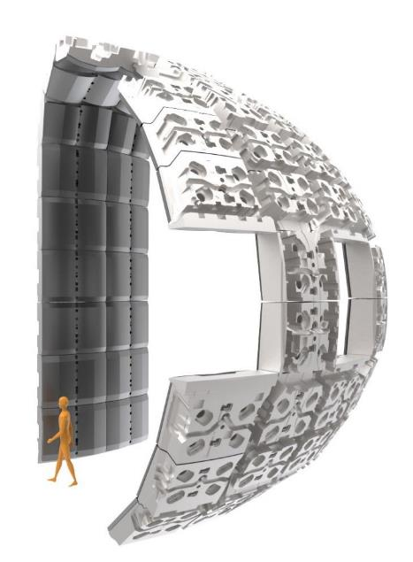
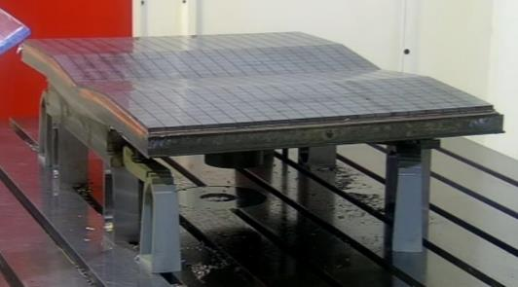
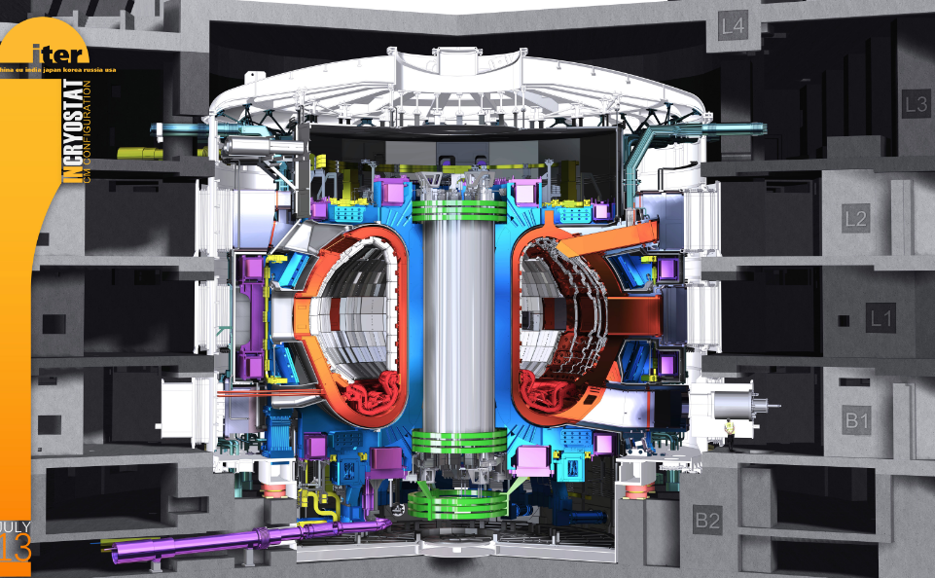
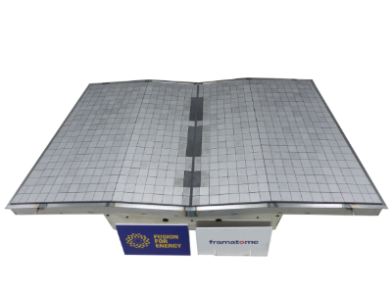
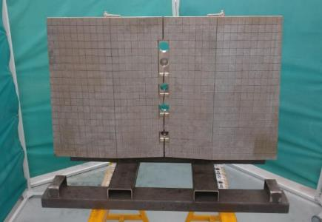
F4E Contributions to ITER: First Wall
  IBERDROLA-LEADING-WOOD
  FRAMATOME
  ATMOSTAT
215 First Wall Panels

