Slide 1


Model-independent analysis of nearly Lévy source
T. Csörgő^{1,2} , W. Metzger^{1,3}, T. Novák¹ and A. Ster²
¹ EKU KRC, Gyöngyös, Hungary
² Wigner RCP, Budapest, Hungary
³ Radboud University, Nijmegen, The Netherlands
OUTLINE
Model-independent shape analysis:
General introduction
Edgeworth, Laguerre
Lévy expansions
Applications
Summary

Slide 2
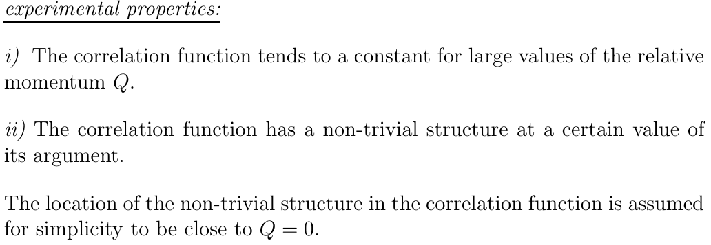
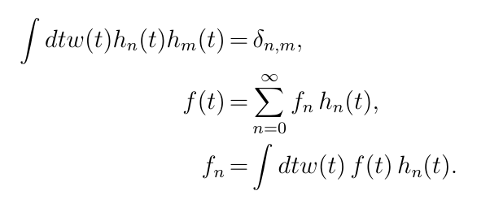

MODEL - INDEPENDENT SHAPE ANALYIS I.
Model-independent method, proposed to analyze Bose-Einstein correlations IF experimental data satisfy
The measured data tend to a constant for large values of the observable Q.
There is a non-trivial structure at some definite value of Q, shift it to Q = 0.
Model-independent, but experimentally testable:
t = Q R
dimensionless scaling variable
approximate form of the correlations w(t)
Identify w(t) with a measure in an abstract Hilbert-space
T. Csörgő and S: Hegyi, hep-ph/9912220, T. Csörgő, hep-ph/001233

Slide 3
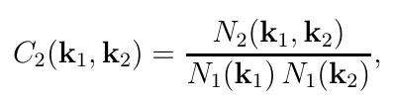

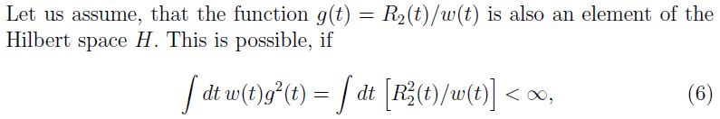
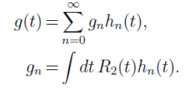

MODEL - INDEPENDENT SHAPE ANALYIS II.
Then the function g can be expanded as
From the completeness of the Hilbert space,
if g(t) is also in the Hilbert space:

Slide 4




MODEL - INDEPENDENT SHAPE ANALYIS III.
Model-independent AND experimentally testable:
method for any approximate shape w(t)
the core-halo intercept parameter of the CF is
coefficients by numerical integration (fits to data)
condition for applicability: experimentally
testable

Slide 5
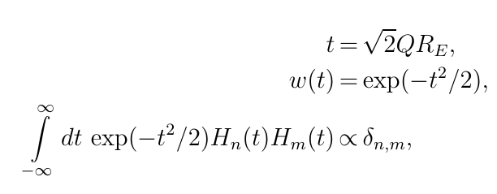
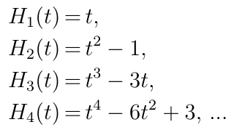
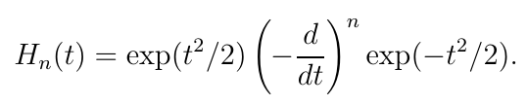
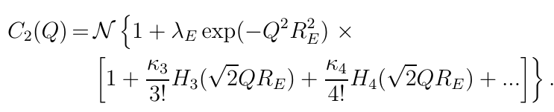
GAUSSIAN w(t): EDGEWORTH EXPANSION
3d generalization straightforward
Applied by NA22, L3, STAR, PHENIX, ALICE, CMS (LHCb)

Slide 6
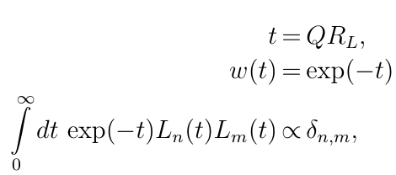


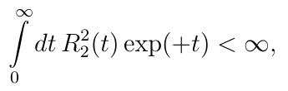
EXPONENTIAL w(t): LAGUERRE EXPANSIONS
Model-independent but experimentally tested:
  w(t) exponential
  t: dimensionless
  Laguerre polynomials
First successful tests
  NA22, UA1 data
  convergence criteria satisfied

Slide 7
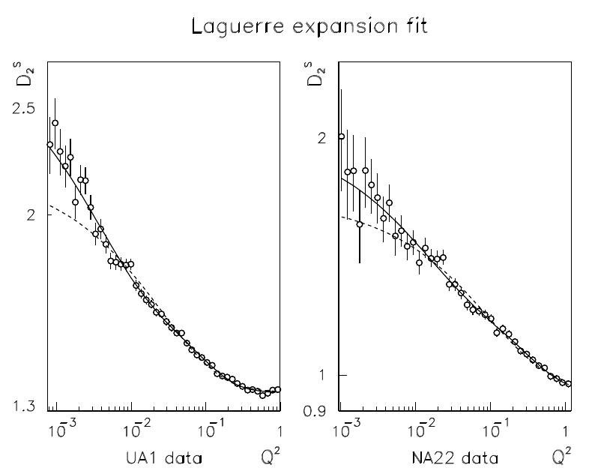
EXAMPLE, LAGUERRE EXPANSIONS
T. Csörgő and S: Hegyi, hep-ph/9912220, T. Csörgő, hep-ph/001233

Slide 8


STRETCHED w(t): LÉVY EXPANSIONS
Model-independent but:
  Lévy: stretched exponential
  generalizes exponentials and Gaussians
  ubiquitous in nature
  How far from a Lévy?
  Need new set of polynomials orthonormal to a Lévy weight

Slide 9

STRETCHED w(t) = exp(-t^{α}): LÉVY EXPANSIONS
In case of $α$= 1,
in 1 dimension Laguerre expansion is recovered
These reduce to the
Laguerre expansions and
Laguerre polynomials.

Slide 10

STRETCHED w(t)=exp(-t^{α}): LEVY EXPANSIONS
In case of $α$ = 2 ,
a new formulae for one-sided Gaussians:
Provides a new expansion around a Gaussian shape
that is defined for the non-negative values of t only.
Edgeworth expansion different, its around two-sided Gaussian, includes non-negative values of t also.
arXiv:1604.05513 [physics.data-an]

Slide 11
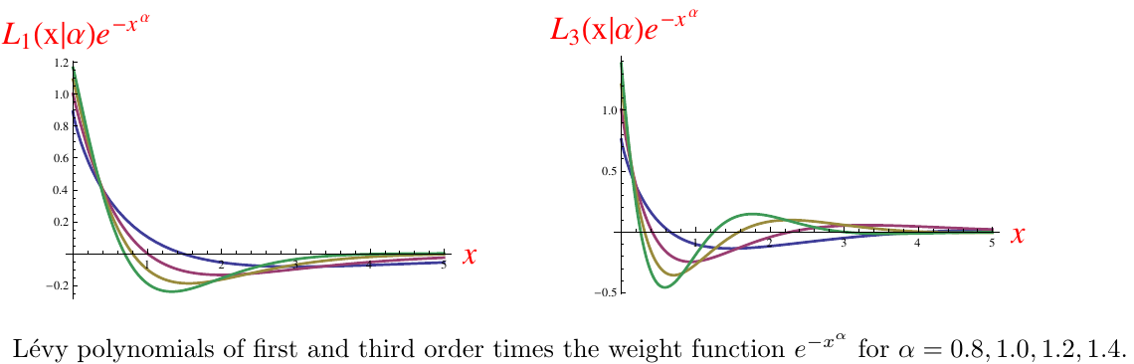

EXAMPLE, LÉVY EXPANSIONS
Model-independent but:
  Levy generalizes exponentials and Gaussians
  ubiquitous in nature
  How far from a Lévy?
  Not necessarily positive definit !
M. de Kock, H. C. Eggers, T. Cs: arXiv:1206.1680v1 [nucl-th]

Slide 12
Example, L₃ BE correlation function

Slide 13
HB et al. observed oscillations

Slide 14
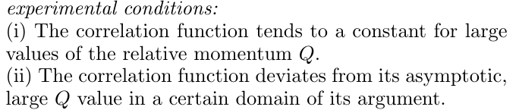




LÉVY EXPANSIONS for POSITIVE DEFINIT FORMS
Model-independent but:
  Assumes that Coulomb can be corrected
  No assumptions about analyticity yet
  For simplicity, consider 1d case first
  For simplicity, consider factorizable x k
  Normalizations :
    density
    multiplicity
    single-particle spectra
T. Cs, S. Hegyi, W.A. Zajc, EPJ C36, 67 (2004)

Slide 15



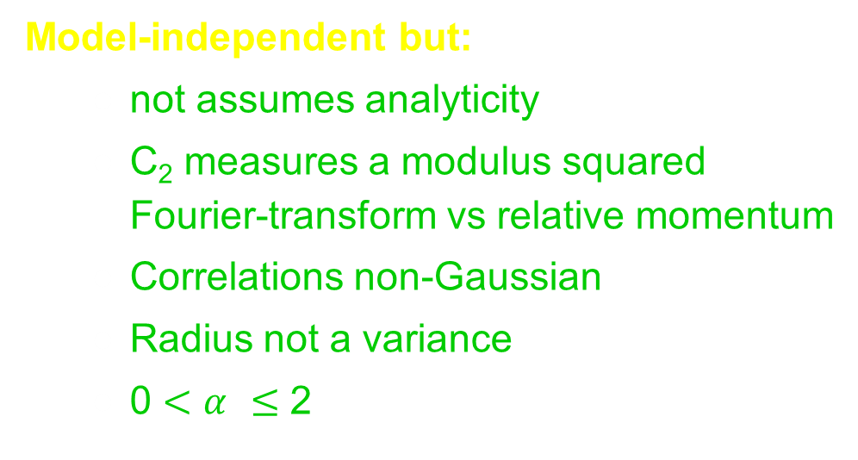
MINIMAL MODEL ASSUMPTION: LÉVY
Model-independent but:
  not assumes analyticity
  C₂ measures a modulus squared Fourier-transform vs relative momentum
  Correlations non-Gaussian
  Radius not a variance
  0 $<$ $α$ $≤$ 2
T. Cs, S. Hegyi, W.A. Zajc, EPJ C36, 67 (2004)

Slide 16


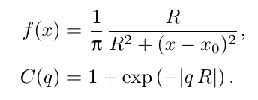
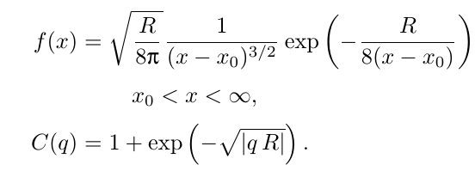
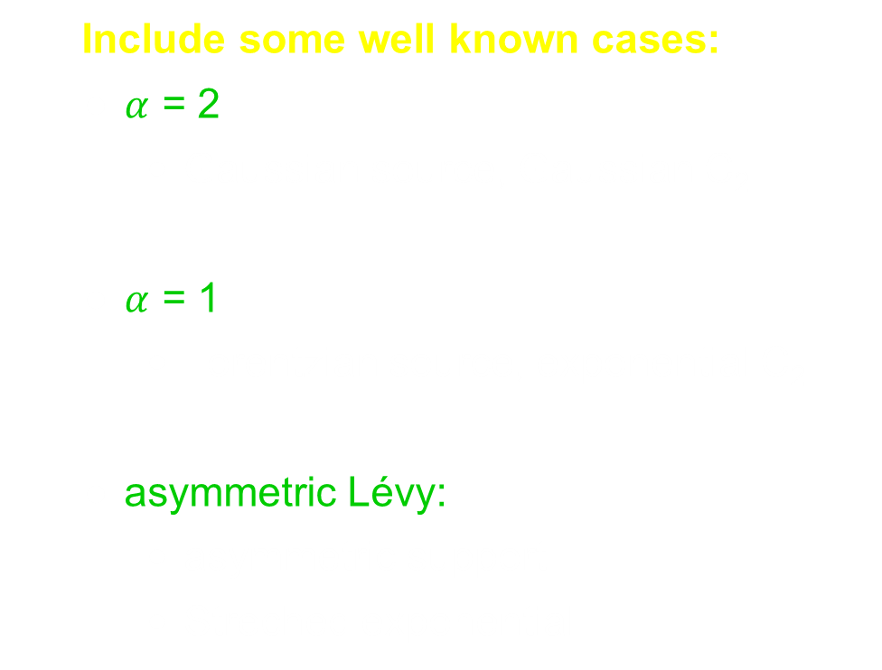
UNIVARIATE LEVY EXAMPLES
Include some well known cases:
  $α$ = 2
    Gaussian source, Gaussian C₂
  $α$ = 1
    Lorentzian source, exponential C₂
  asymmetric Lévy:
    asymmetric support
    Streched exponential
T. Cs, hep-ph/0001233, T. Cs, S. Hegyi, W.A. Zajc, EPJ C36, 67 (2004)

Slide 17
Multivariate, nearly Lévy correlations
If the BE correlation function is
then

Slide 18
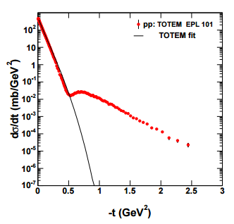
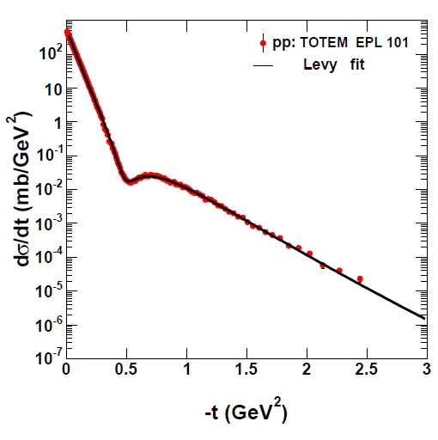

Lévy expansion fit to pp elastic scattering at sqrt(s) = 7 TeV
Data: TOTEM Collaboration,
EPL 101 (2013) no.2, 21002
TOTEM fit
Data: TOTEM Collaboration,
EPL 101 (2013) no.2, 21002
Lévy expansion
$a_{1}=0.559±0.008;b_{1}=−0.030±0.0$67
$$a_{2}=−0.264±0.009;b_{2}=−0.025±0.024$$

Slide 19
Towards imaging

Slide 20
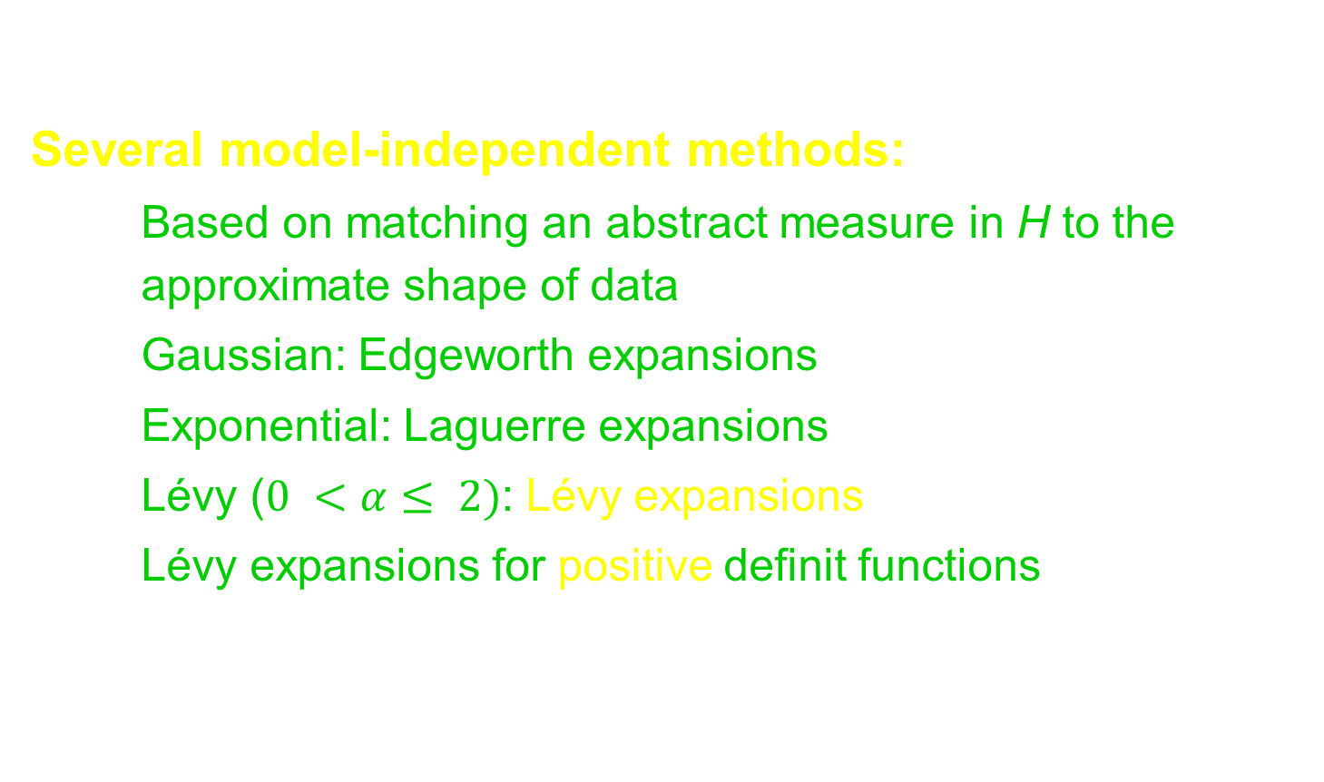
SUMMARY AND CONCLUSIONS
Several model-independent methods:
  Based on matching an abstract measure in H to the approximate shape of data
  Gaussian: Edgeworth expansions
  Exponential: Laguerre expansions
  Lévy ($0 <α≤ 2)$: Lévy expansions
  Lévy expansions for positive definit functions
Thank you for your attention!

